Slide 1







Future Colliders, Siting and Civil Engineering at CERN
6th July 2025
John Osborne , Edward MacTavish, Tamara Bud, Liam Bromiley
SCE-SAM-FS

Slide 2
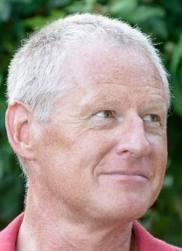
My Background
Graduated from Liverpool University 1988 in UK with Civil Engineering Degree
Worked for 10 years for UK Contractor, Carillion (formally Tarmac) on :
  Conwy tunnel
  Design Secondment in Glasgow with Sir Alexander Gibb & Partners (now Jacobs)
  Medway tunnel
  Jubilee Line Extension, Canary Wharf Station
Joined CERN in 1998 for Large Hadron Collider Works (CMS)
Fellow of Institution of Civil Engineers (UK) in 2017
Now working on CERN’s Future Accelerator Projects and Tunnel Asset Management
Switzerland country representative for ICE
Judge on the UK’s New Civil Engineer annual tunnel awards event
Member of ITA Client Forum

Slide 3
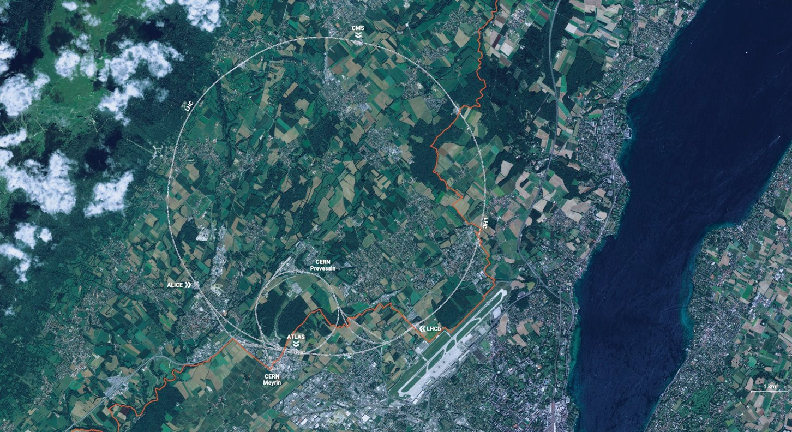
CERN is the world's biggest laboratory for particle physics.
Our goal is to understand the most fundamental particles and laws of the universe.

Slide 4
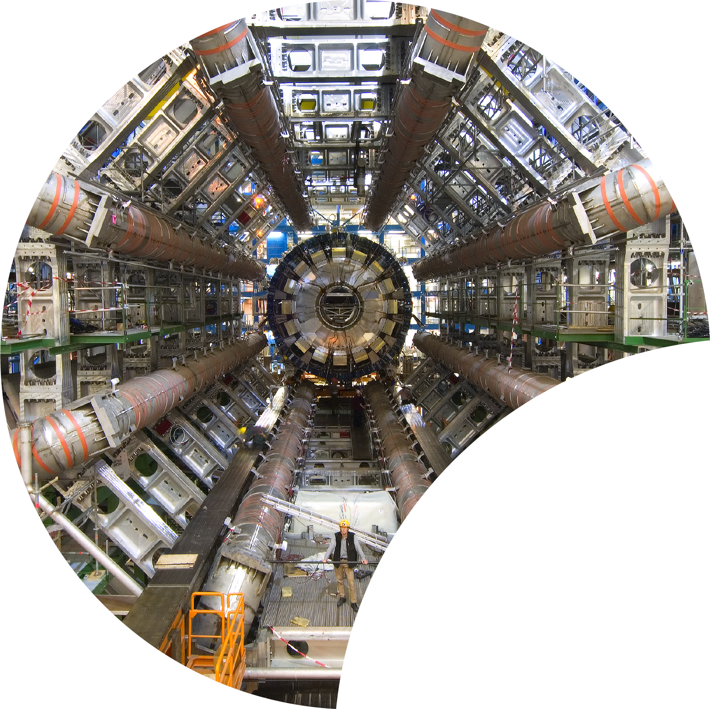
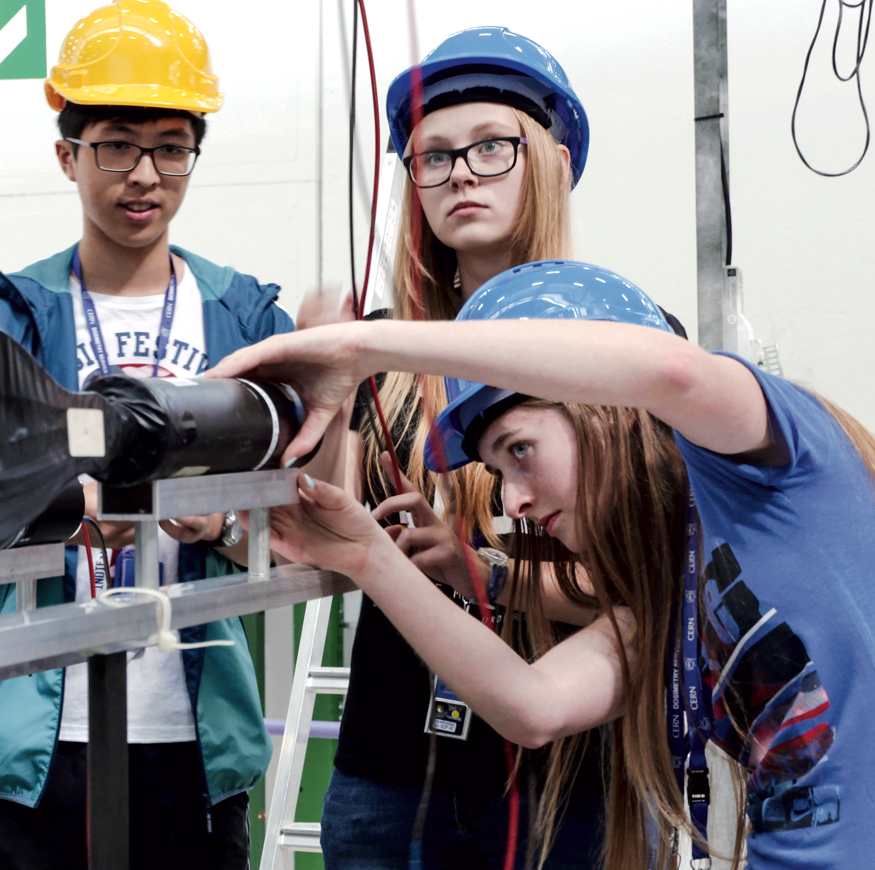
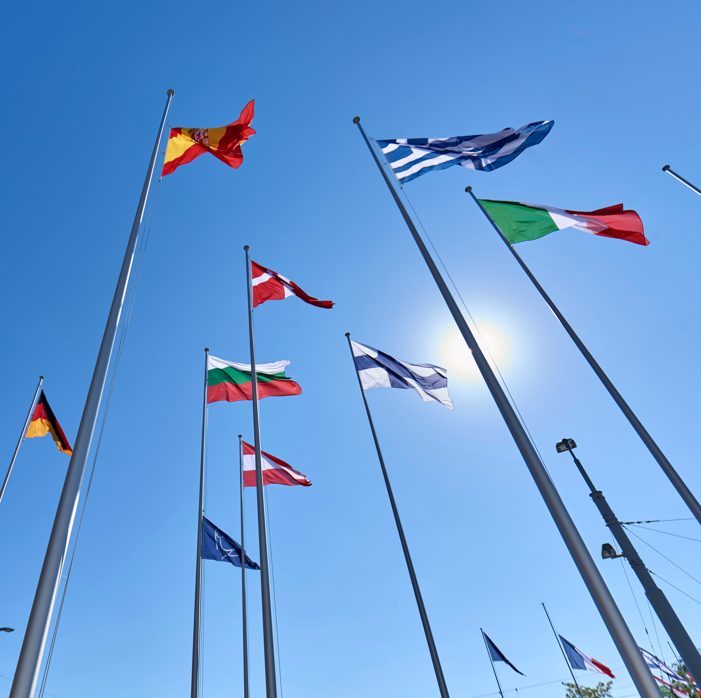
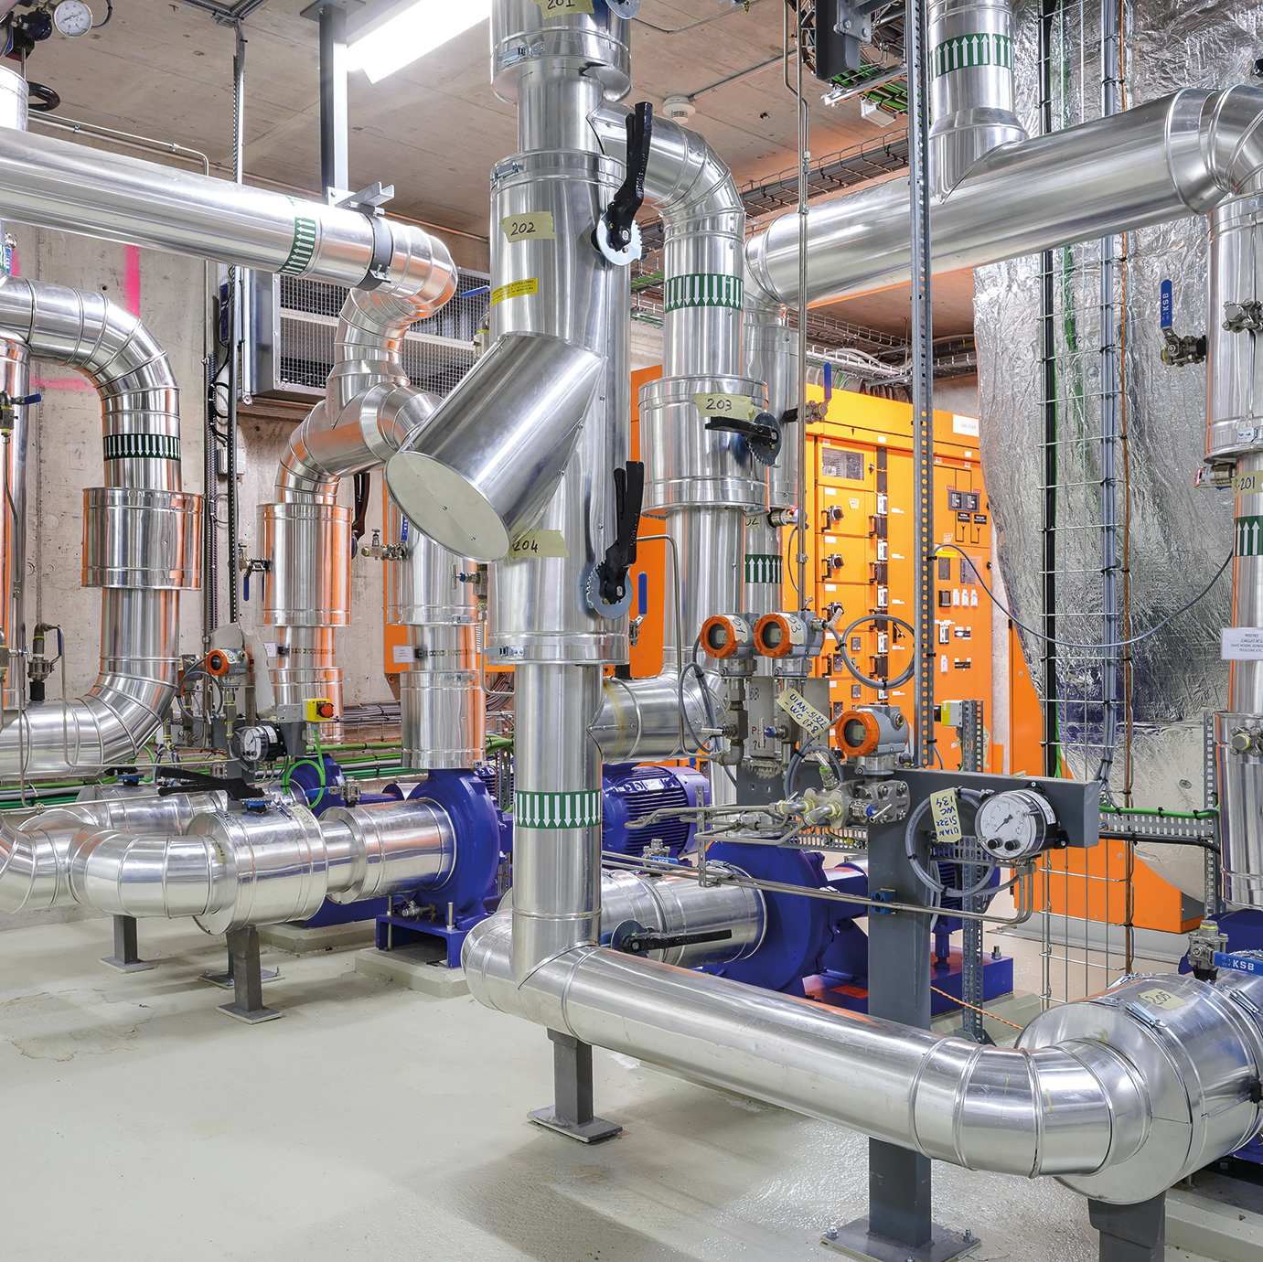
Four pillars underpin CERN's mission
RESEARCH
EDUCATION
& TRAINING
COLLABORATION
TECHNOLOGY
& INNOVATION

Slide 5
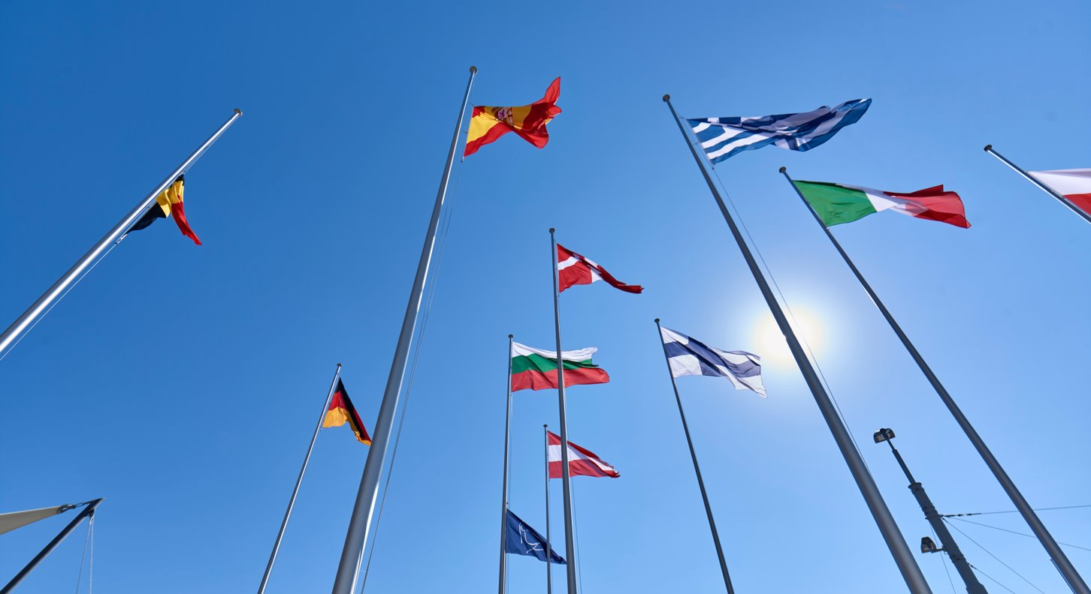
COLLABORATION

Slide 6

Science for peace
CERN was founded in 1954 with 12 European Member States
25 Member States
Austria – Belgium – Bulgaria – Czech Republic – Denmark – Finland – France – Germany – Greece Hungary – Israel – Italy – Netherlands – Norway – Poland – Portugal – Romania – Serbia – Slovakia Spain – Sweden – Switzerland – United Kingdom
CERN's annual budget is 1200 MCHF (equivalent to a medium-sized European university)
Employees:
2676 staff, 783 fellows
Associates:
11 175 users, 1556 others
3 Associate Member States in the pre-stage to membership
Cyprus – Estonia – Slovenia
7 Associate Member States
Croatia – India – Latvia – Lithuania – Pakistan
Türkiye – Ukraine
6 Observers
Japan – Russia (suspended) – USA
European Union – JINR (suspended) – UNESCO
Around 50 Cooperation Agreements with non-Member States and Territories
Albania – Algeria – Argentina – Armenia – Australia – Azerbaijan – Bangladesh – Belarus – Bolivia – Bosnia and Herzegovina – Brazil – Canada – Chile – Colombia – Costa Rica – Ecuador – Egypt – Georgia – Honduras – Iceland – Iran – Jordan – Kazakhstan – Lebanon – Malta – Mexico – Mongolia – Montenegro – Morocco – Nepal – New Zealand – North Macedonia – Palestine – Paraguay – People's Republic of China – Peru – Philippines – Qatar – Republic of Korea – Saudi Arabia – Sri Lanka – South Africa – Thailand – Tunisia – United Arab Emirates – Vietnam

Slide 7
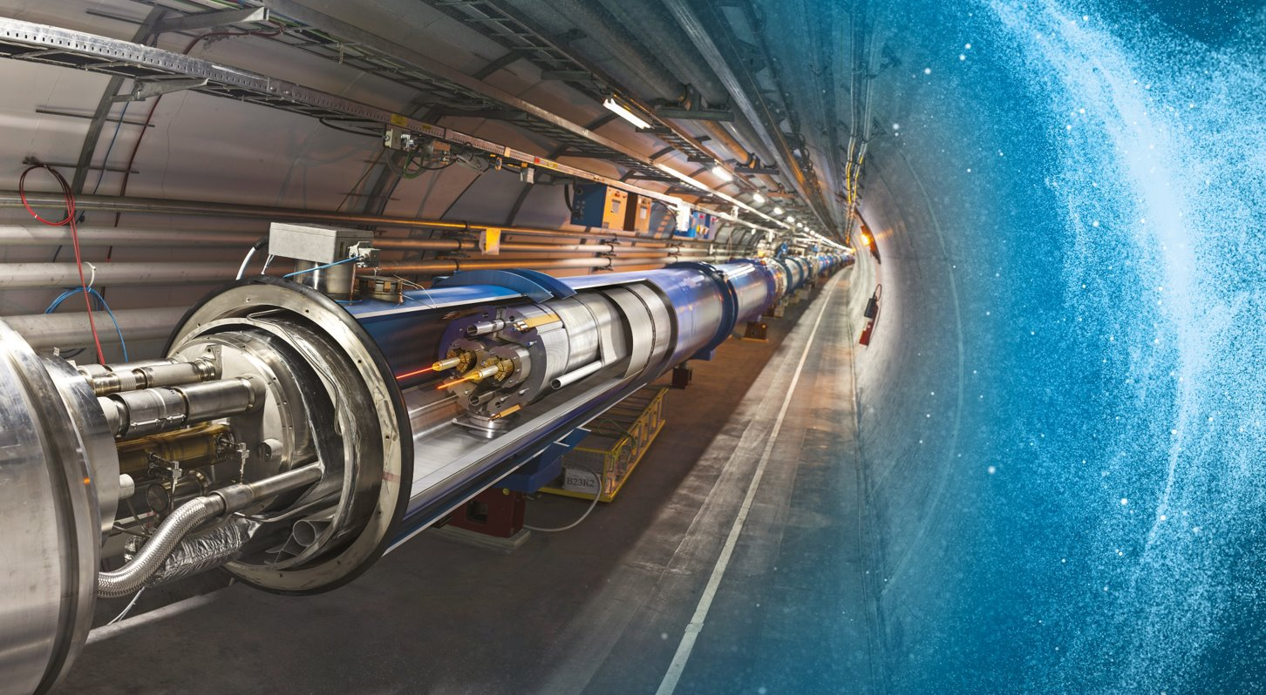
Large Hadron Collider (LHC)
27 km in circumference
About 100 m underground
Superconducting magnets steer the particles around the ring
Particles are accelerated to close to the speed of light

Slide 8
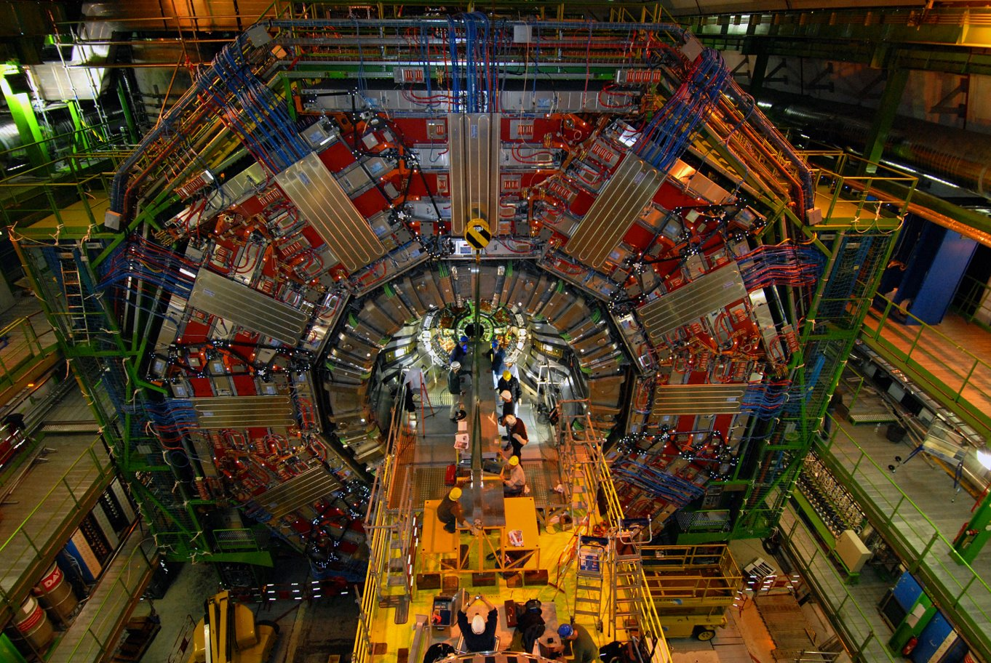
CERN – European Centre for Nuclear Research
Higgs Boson Discovery

Slide 9
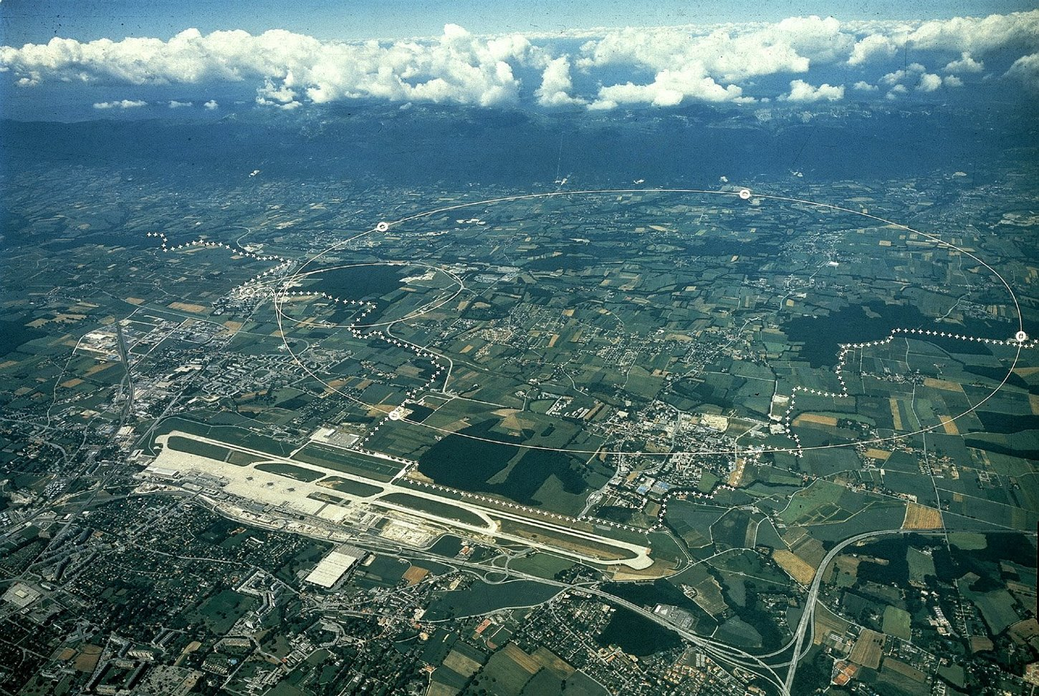


CERN Civil Engineering Works: Past and Future Projects
ALICE
CMS
ATLAS
LHCb

Slide 10
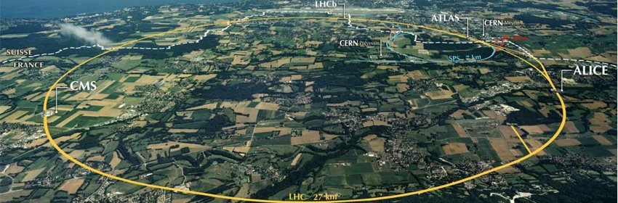
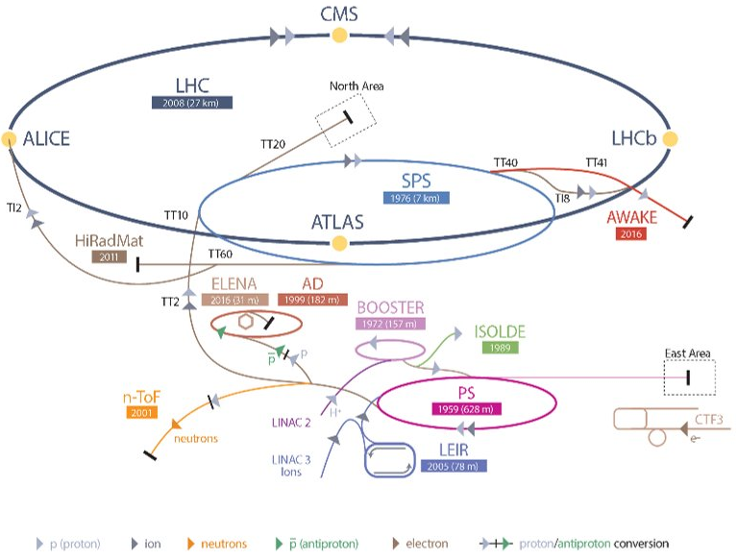
CERN tunnels and geology
Large Hadron Collider :
- 27km long
- 50-175m depth
- 4.5m ø TBM tunnels
- Molasse and limestone
Total underground tunnels >70km
More that 80 Caverns

Slide 11
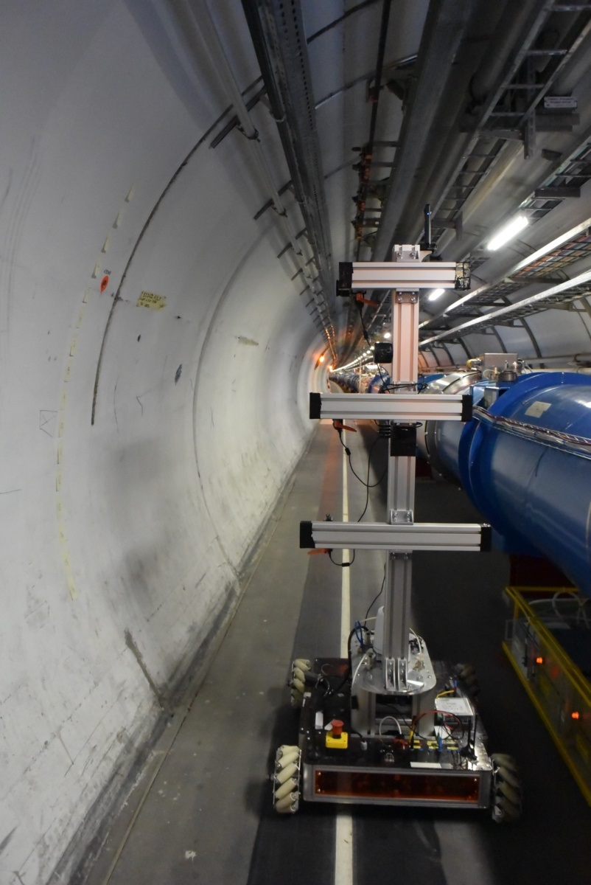
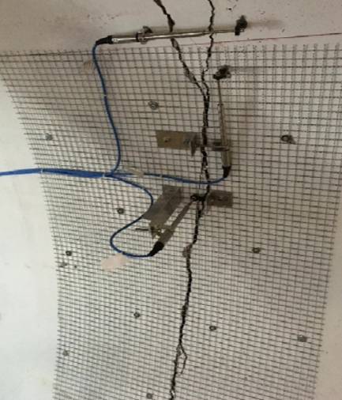
Tunnel Asset Management
The TAM team is responsible for the coordination and research & development of tools that enables to assess the status of our underground infrastructure in order to operate it safely and efficiently. The use of Smart monitoring technologies will help to predict where maintenance is required and, hence, optimize future tunnel constructions.
Main Objectives
Measurements, inspection and monitoring
Reduce inspection time
Increase objectivity of inspection
Increase quantitative data
Reduce personnel presence in tunnels by using remote monitoring technologies
Develop a technology for future inspection to be implemented in new underground infrastructures (eg. FCC, Linear Colliders)
Advanced robotics
solutions
Extensometer in RB26 (Point 2)

Slide 12
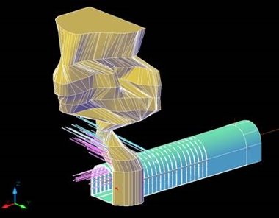
'CERN' Geology
Rock properties
Moraines
Glacial deposits comprising gravel, sands, silt and clay
Water bearing unit
Low strength
Molasse
Mixture of sandstones, marls and formations of intermediate composition
Considered good excavation rock
Relatively dry and stable
Relatively soft rock
However, some risk involved
Weak marl horizons between stronger layers are zones of weakness
Faulting due to the redistribution of ground stresses
Structural instability (swelling, creep, squeezing)
Rock type​ | Average σc (Mpa)​
Sandstone weak​ | 10.6​
strong​ | 22.8​
very strong​ | 48.4​
Sandy marl​ | 13.4​
Marl​ | 5.7​
Molasse Compression Strengths
Model of tunnel collapse caused by Karsts
Limestone
Hard rock
Normally considered as sound tunneling rock
In this region fractures and karsts are encountered
Risk of tunnel collapse
High inflow rates measured during LEP construction (600L/sec)
Clay-silt sediments in water
Rockmass instabilities

Slide 13
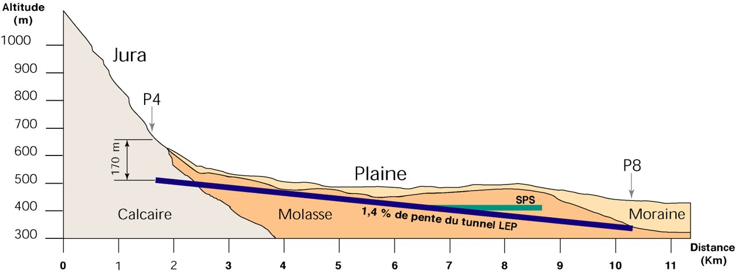
LHC tunnel alignment

Slide 14
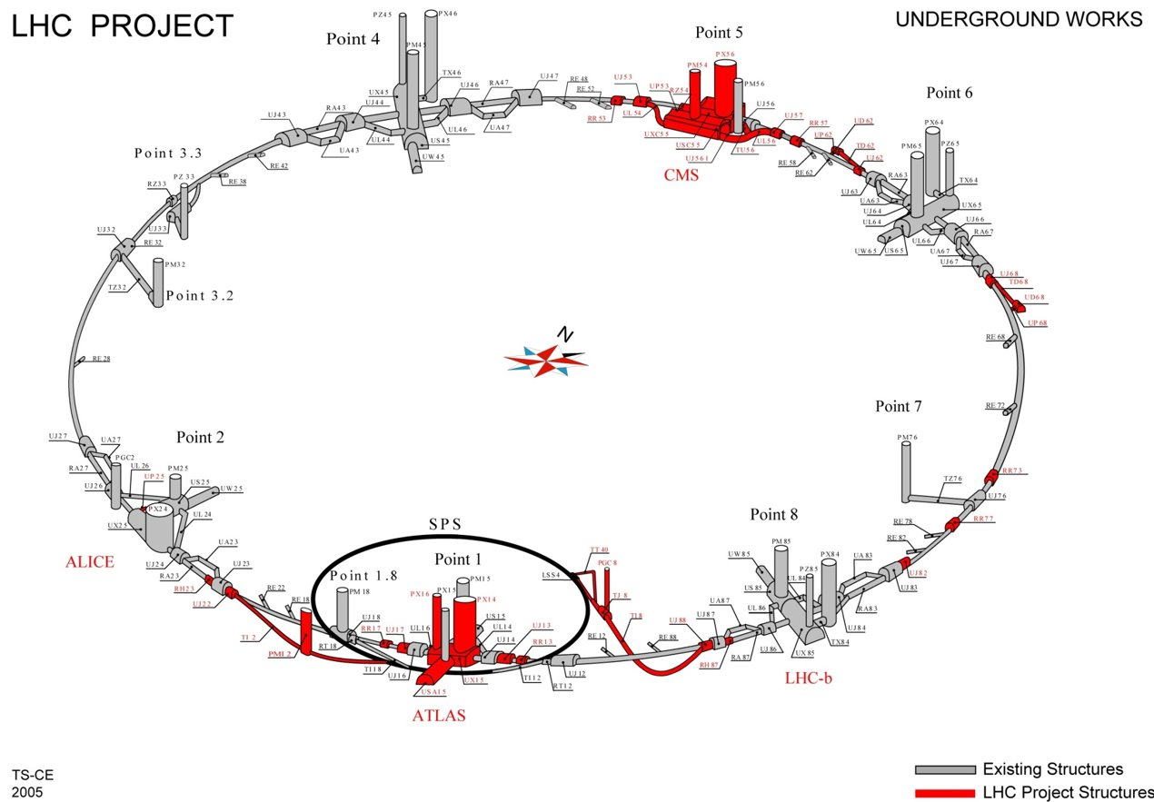
LHC Civil Engineering 1998-2005

Slide 15
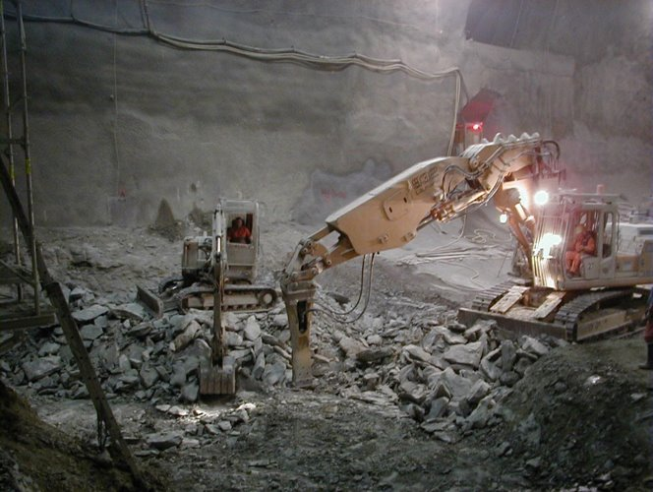
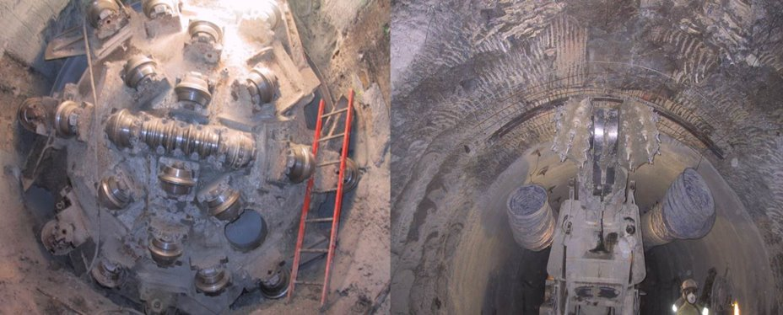
Tunnel excavation options
Rock breakers
Roadheader
Roadheader
TBM

Slide 16
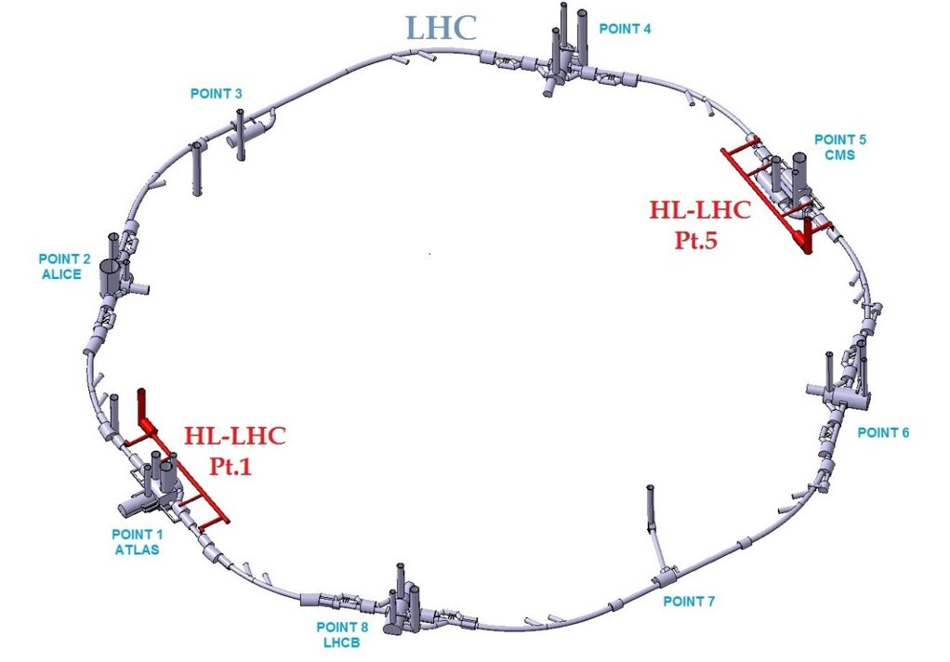
High Luminosity LHC Project (HL-LHC)
FIDIC CONTRACTS
Packages 1:
1a: Architect contract for building permit submission (CH)
1b: Consultants for design of underground and surface
1c: Contractor for underground and surface works
Packages 2:
2a: Architect contract for building permit submission (F)
2b: Consultants for design of underground and surface
2c: Contractor for underground and surface works

Slide 17
FCC Civil Engineering Summary - July 2025
FCC Civil Engineering
Summary

Slide 18
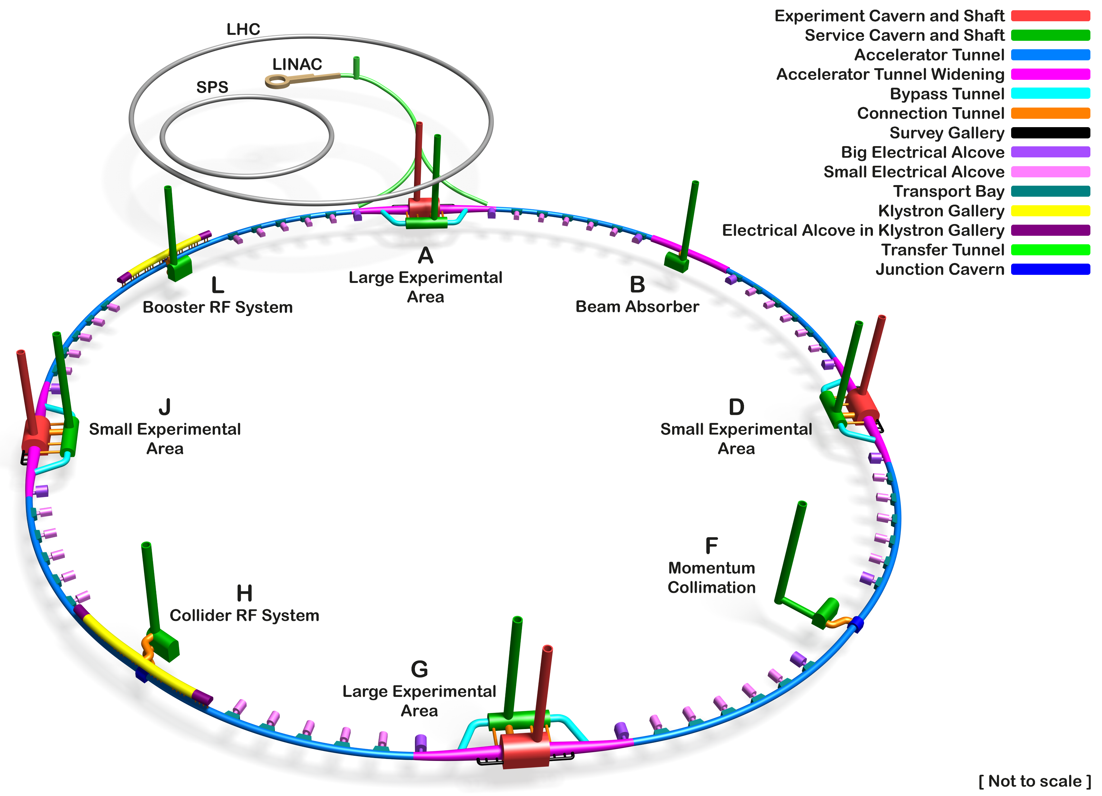
Overview of Underground Civil Engineering
Tunnel Circumference: 90.7 km
Excavated vol: 6.25M m³ (in-situ volume)
Access shafts: 12
Construction shafts: 1
Large experiment sites: 2
Small experiment sites: 2
Technical sites: 4
Deepest shaft: 400m
Average shaft depth: 243m
Total concrete volume: 1.9 M m³
FCC Civil Engineering 3D Schematic

Slide 19
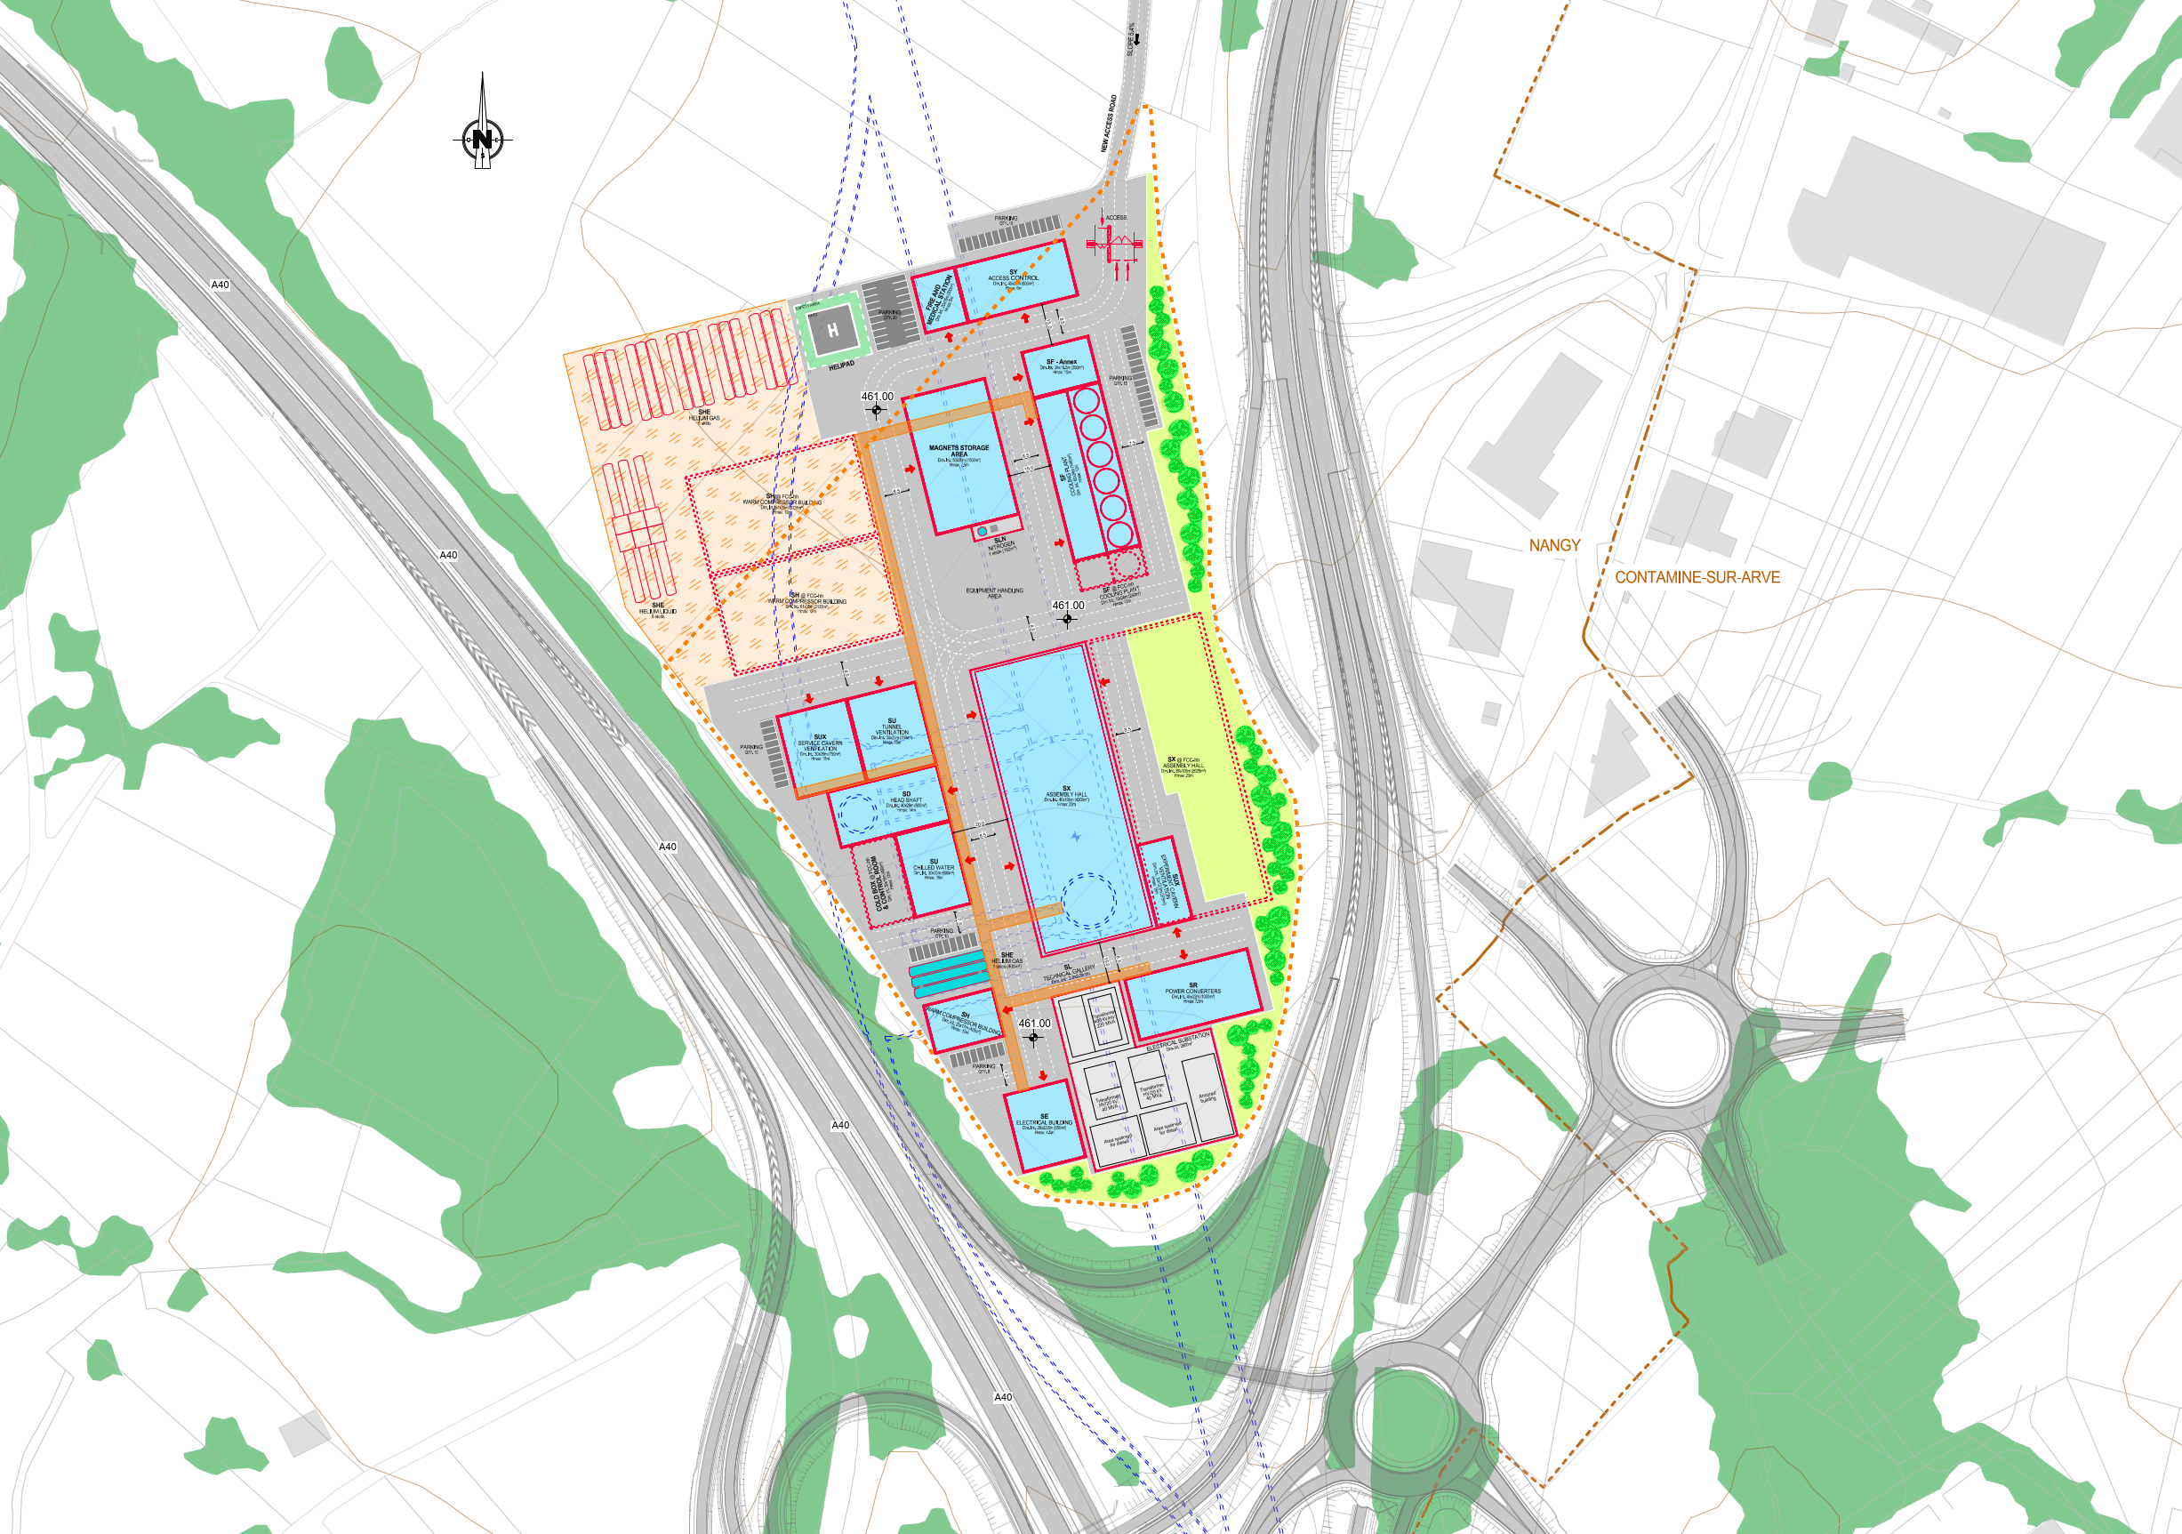
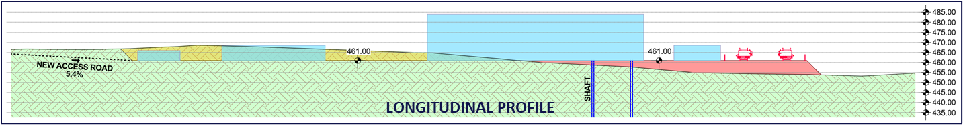
Surface Civil Engineering Baseline
Preliminary plan views and sections of all eight surface sites have been prepared at CERN based on the requirements study led by the integration team and target land plots identified by the territorial implementation team.
The dimensions and function of the buildings are based on CERNs previous experience as detailed engineering studies for most interfacing systems have not yet been carried out.
The plans, drawings and specifications have been prepared primarily for the purpose of cost estimation, this being done by an external contractor.
PLAN VIEW

Slide 20
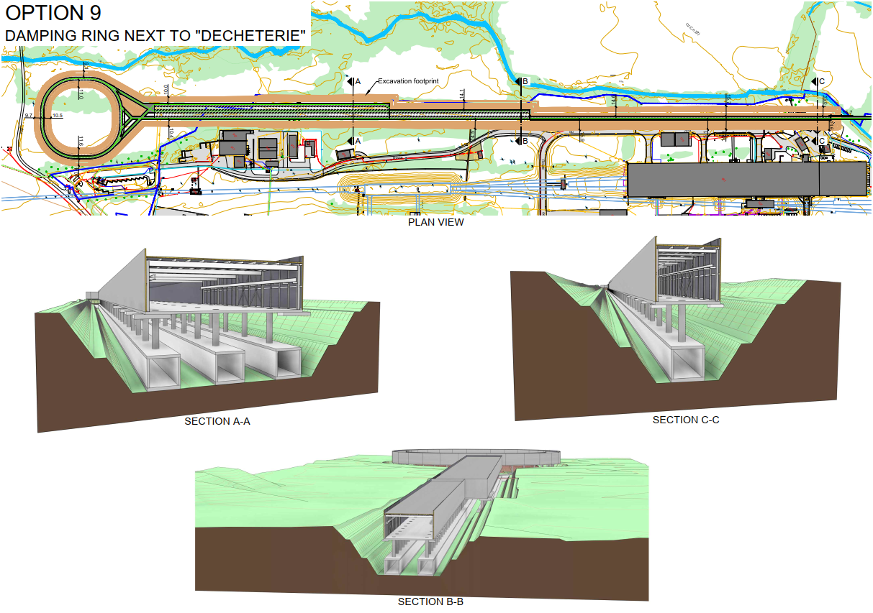
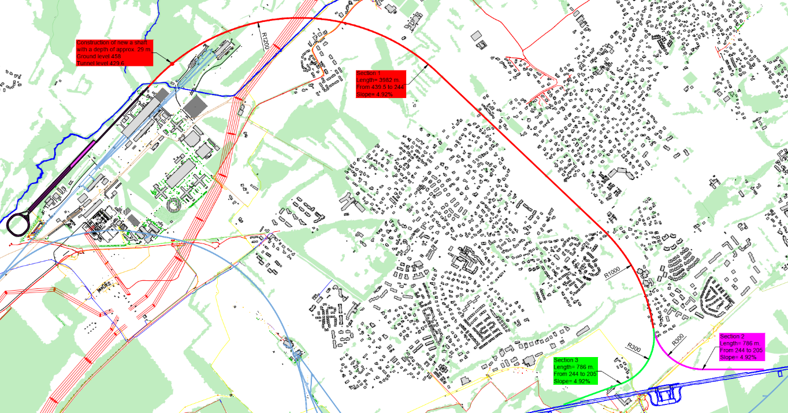
Injection Complex Baseline
Preliminary layout that fits within current CERN Prevessin fence line.
Contracts for hydrological and geological assessments are about to be launched
Initial state analysis to be undertaken (ATS with HSE).
Studies ongoing to confirm overall footprint and main CE requirements (SY-ABT/PSI/CHART)

Slide 21
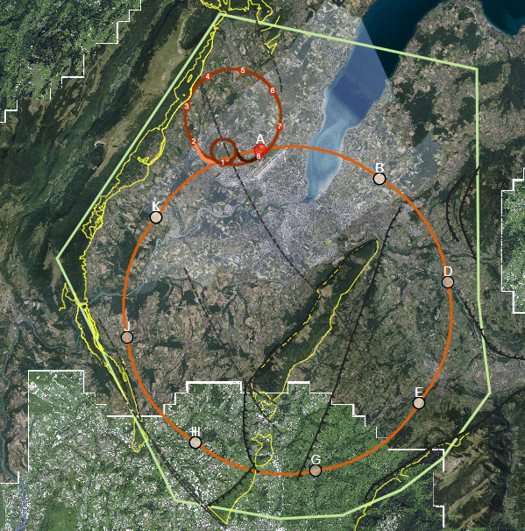
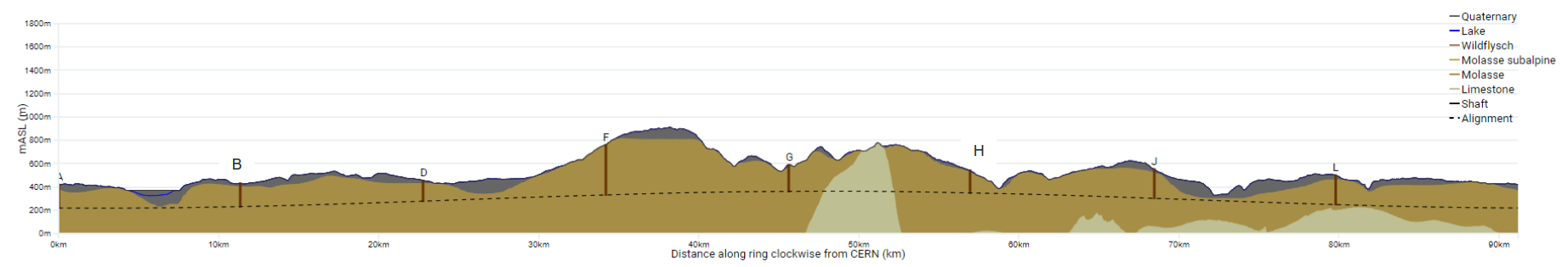
Areas of Geological Uncertainty
Good knowledge of the ground (e.g. information near to CERN from LEP/LHC projects)
Lac Léman
Moraine/molasse interface uncertain
Soils and rock properties uncertain
High uncertainty in the hydrogeological conditions
Jura
Limestone/molasse interface uncertain.
Risk of karts and high-water pressures
A
B
Vallée de l‘Arve
Moraine/molasse interface uncertain.
Lack of reliable borehole information
L
Le Rhône
Moraine/molasse interface uncertain.
D
Bornes
Insufficient deep borehole information
Complex faulted region
Quality of molasse is uncertain.
J
Vuache
Limestone/molasse interface not certain.
Proximity to active fault
J
F
H
Mandallaz
Fractured limestone formations, characteristics and locations of karsts unknown.
Potentially high-water pressures
Les Usses
Moraine/molasse interface uncertain.
Low tunnel rock cover
G
Bornes
Mandallaz
Usses
Lake
Arve
Rhône
Jura

Slide 22
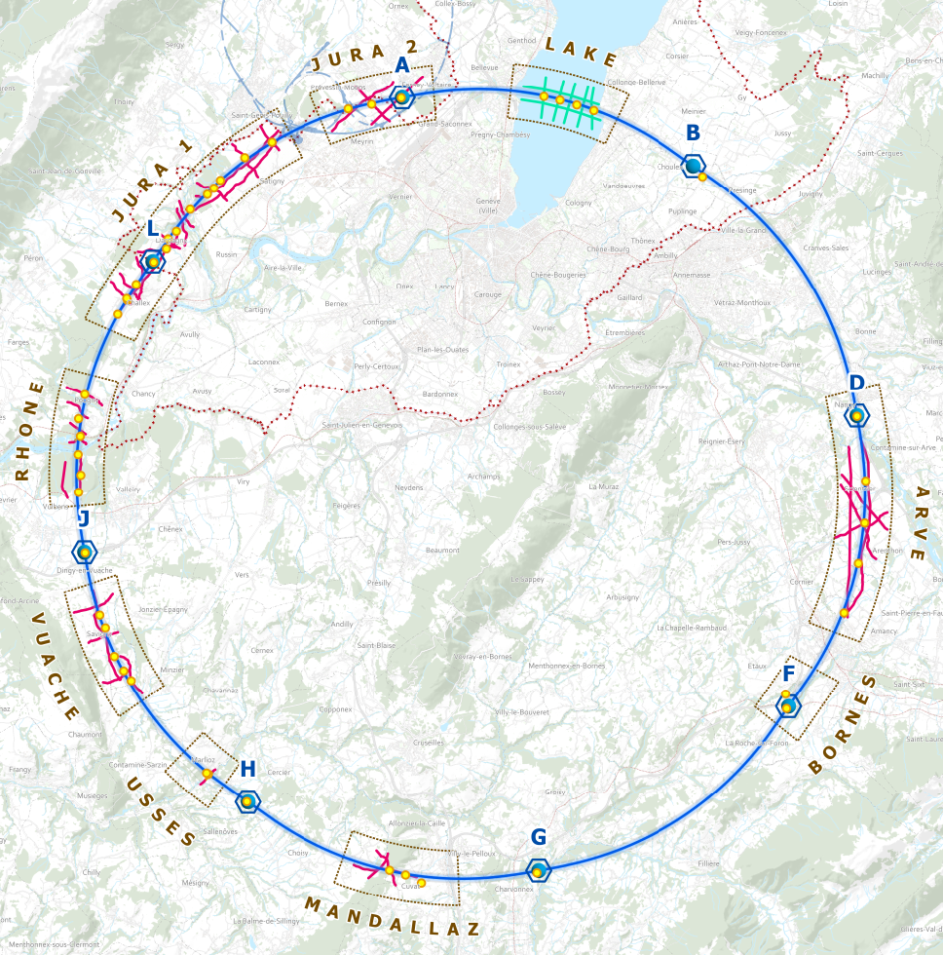
SSI Programme
Overview
  29 boreholes in total between Oct 2024 and summer 2026
  80km of geophysics between Oct 2024 and Oct 2025
Bids received from contractors
(10/23)
Geophysics permits received FR
(20/09/2024)
Borehole works begin FR
(14/10/2024)
Geophysics works begin FR
(30/09/24)
Borehole permits received FR
(11/10/2024 )
Works complete summer 2026
Geophysics and borehole permits CH expected and works begin
(07/25)

Slide 23
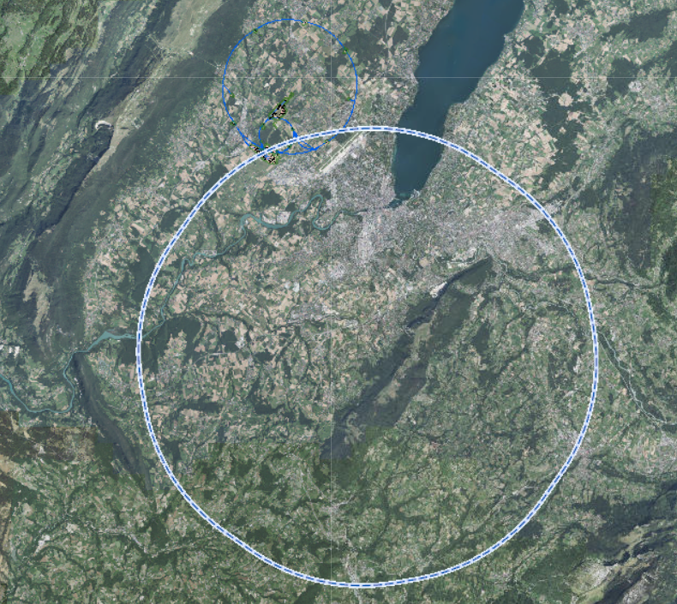
Overview of Works
South-western work package SGS3
Works began in October 2024
Geophysics acquisition complete and interpretation ongoing
Drilling activities complete on 8 of 10 boreholes
Testing and reporting being finalised
North-eastern work package GEOTEC-IOI
Works began in France in April 2025
Drilling activities ongoing on 3 boreholes
Geophysics in Sept 2025 due to environmental constraints
Still awaiting permits for drilling and geophysics in Switzerland
Geotec SPA (IT) and Structural Soils (UK)
JURA 2
LAKE
JURA 1
RHONE
ARVE
VUACHE
BORNES
Complete
USSES
Ongoing
Starting shortly
MANDALLAZ
Awaiting permits

Slide 24
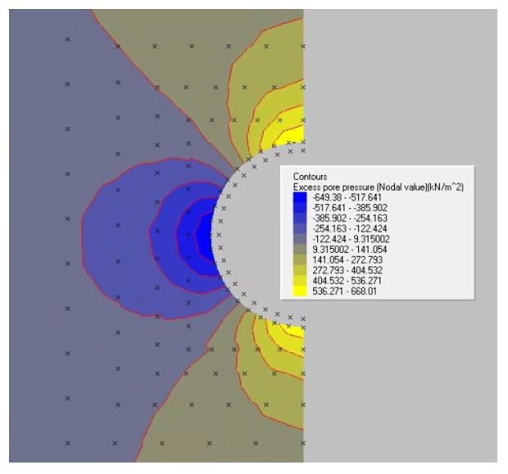
Future Civil Engineering Studies
Market survey to be issued this summer for the next phase of civil engineering consultant studies.
Tender process end of 2025
Activities include:
Numerical structural analysis
Risk mitigation,
Tunnelling through limestone,
TBM specifications
Construction scheduling
Cost estimation
Contract to be awarded Q1 2026

Slide 25
Pre-TDR Work Scope
For underground civil engineering works to start in early 2033 there are a number of critical tasks that CERN must complete during the Pre-TDR phase ie between now and early 2028.
These tasks cover five main areas:
Complete the current site investigation campaign
Prepare for the second site investigation campaign (Market Survey for design firms now ‘closed’).
Develop the surface sites in conjunction with professional architects and engage with stakeholders to develop acceptable solutions
Continue to improve the maturity of the underground designs and study some specific technical topics with the aim to reduce overall cost, schedule and technical risks.
Advance on the design maturity for the injection complex including impact assessments for the existing structures and infrastructure.

Slide 26
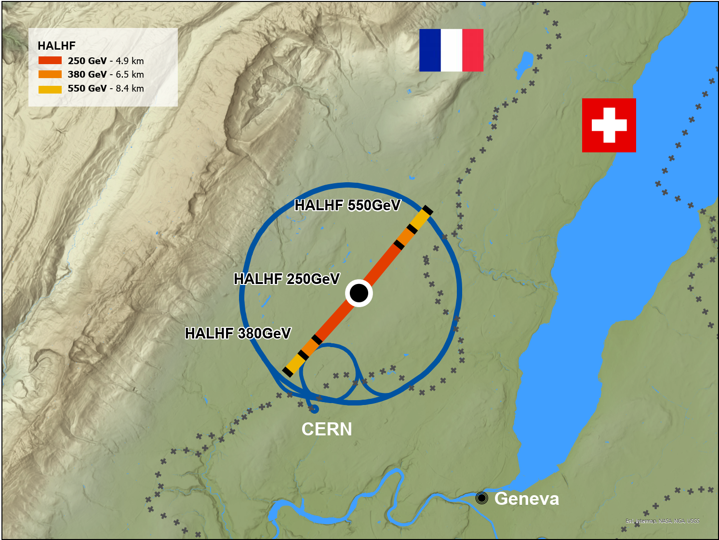
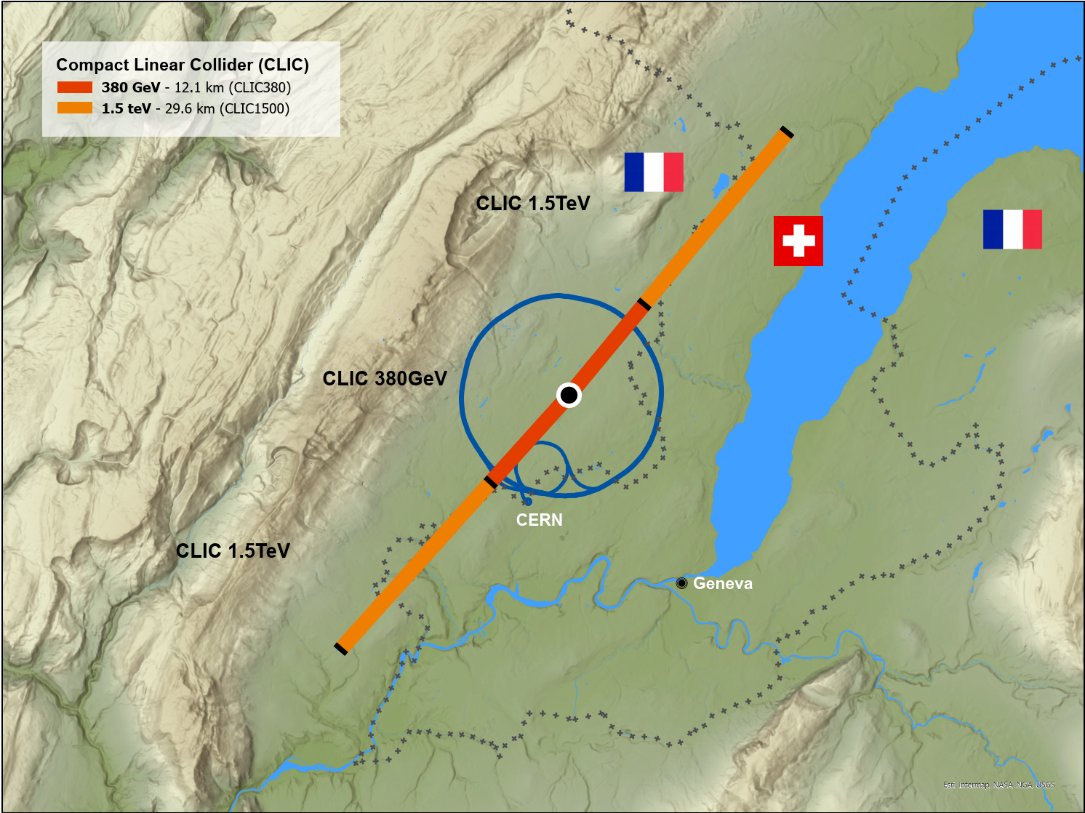
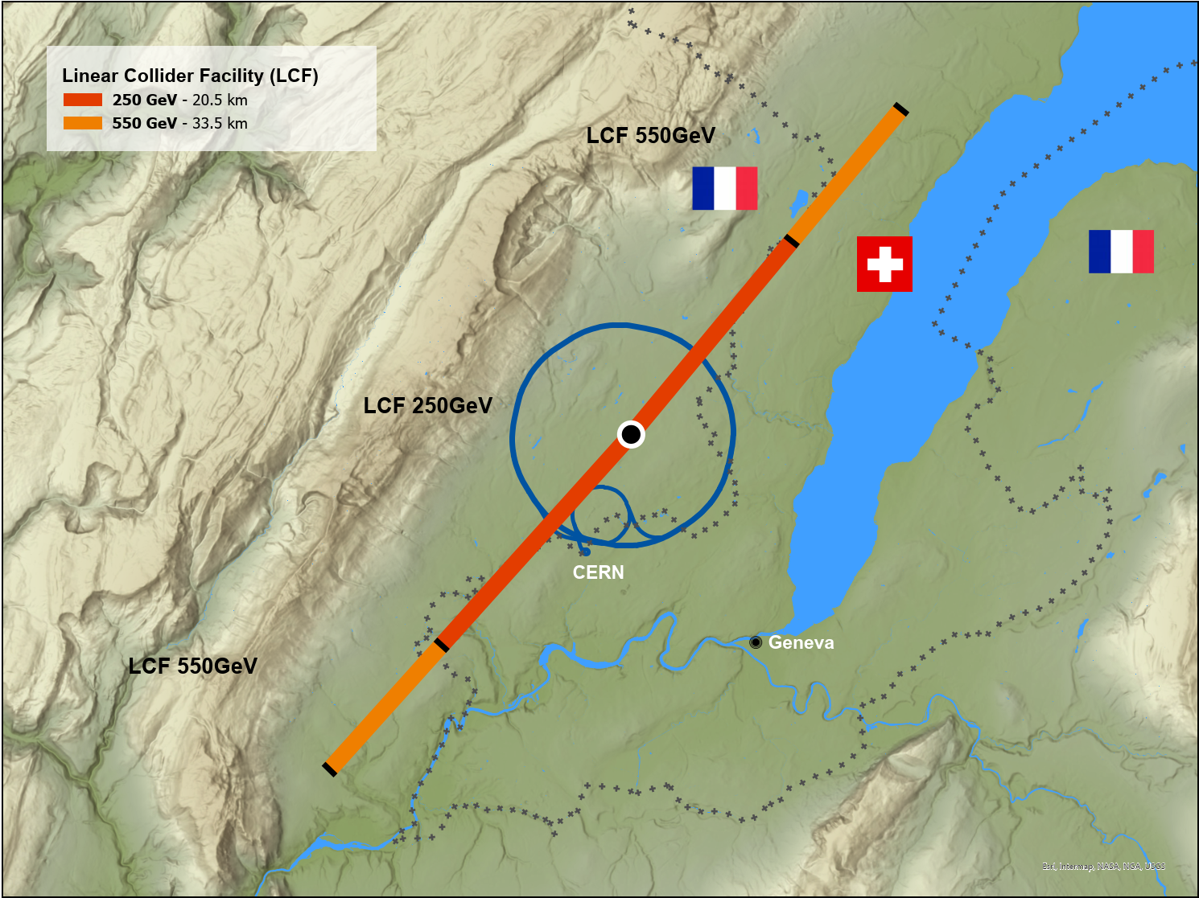
CERN Linear Collider Studies
HALHF
CLIC
LCF
The Hybrid Asymmetric Linear Higgs Factory (HALHF).
Compact Linear Collider (CLIC).
Linear Collider Facility (LCF) based off the ILC Japan.

Slide 27
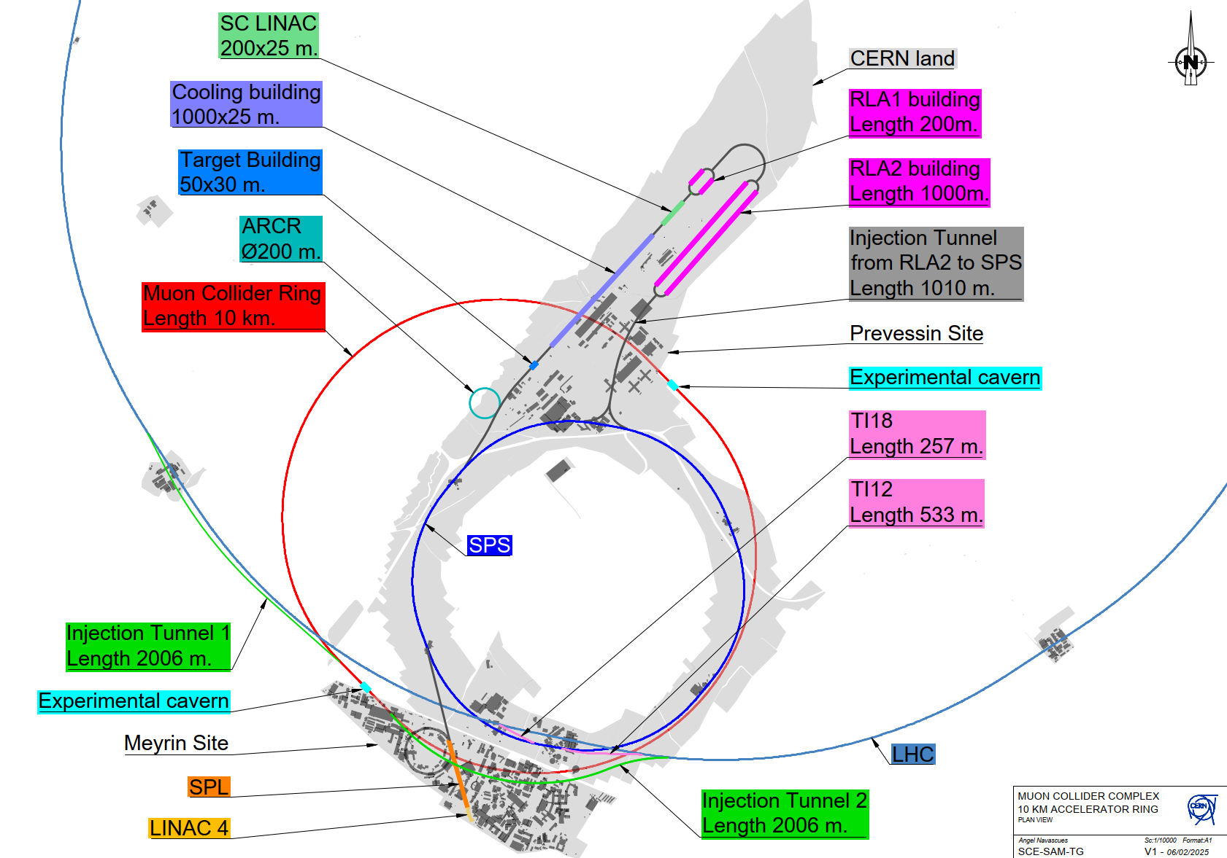
Muon Collider
Initiates at LINAC 4
Integrates existing SPL design
Transfer to Prévessin via SPS
Series of Cut & Cover LINACs on the Prévessin Site
Injection to SPS beneath existing buildings on Prévessin Site
Transfer via existing TI12 & TI18 tunnels into the LHC
Injection occurs from straight sections of the LHC into the Collider Ring at equidistant points from the Experimental Cavern

Slide 28
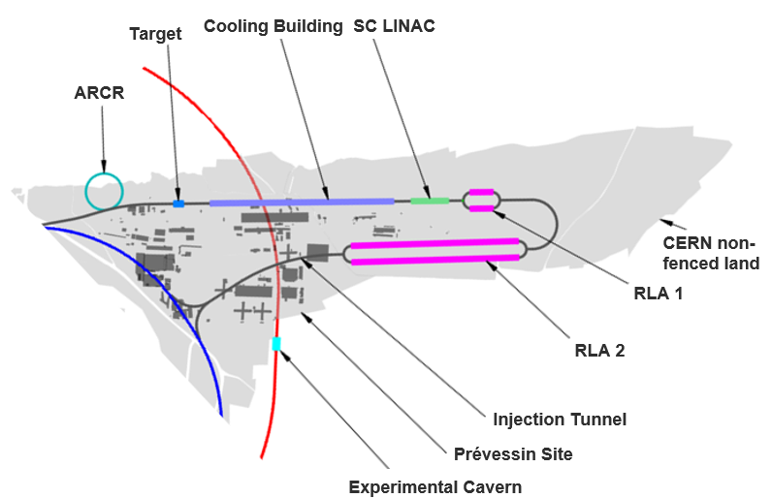
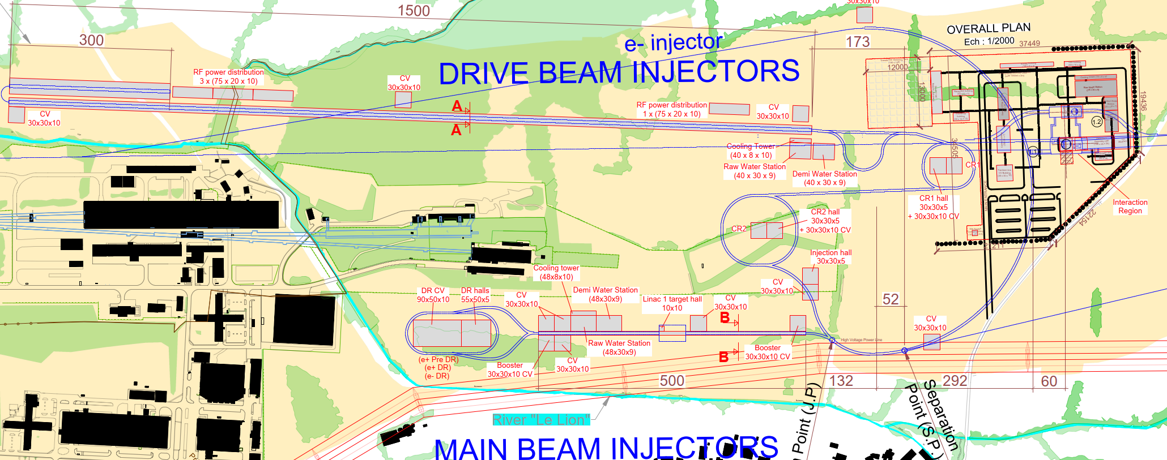
Prévessin Siting Overview Between Studies
Muon Collider
CLIC
The Surface Injection complexes between both the Muon Collider and CLIC occupy the same available CERN owned land on and adjacent to the CERN Prévessin site.
Site investigation studies and results can be shared between projects.
Notes:
Cooling, SC LINAC, RLA1 in place of the Drive Beam Injectors
RLA2 in place of Main Beam Injectors

Slide 29
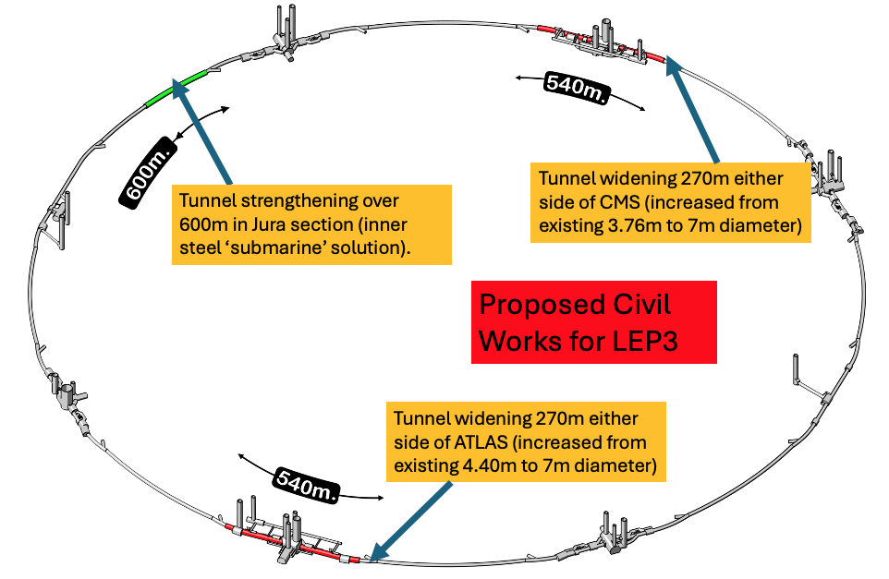
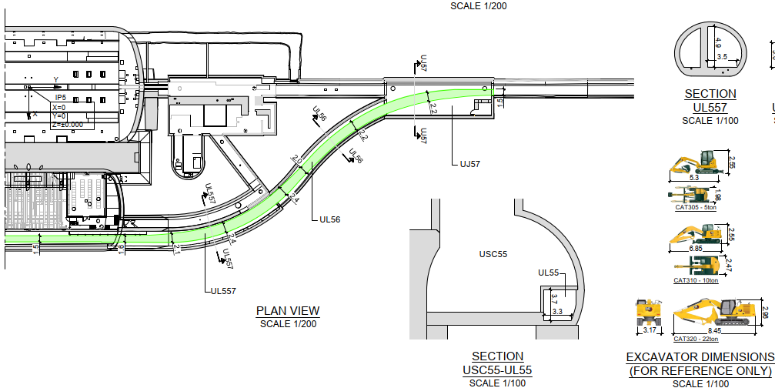
LEP3 Civil Engineering
  40 years old infrastructure, some parts need maintenance
  Widen tunnels at two LHC points
  Booster by-pass (possibly not needed)
  Overall civil engineering cost estimated: 100-200 MCHF
Access constraints

Slide 30
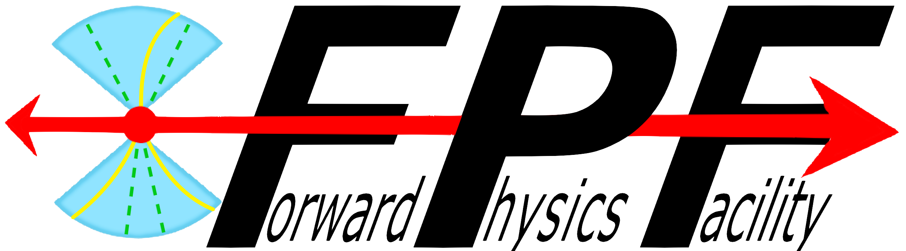

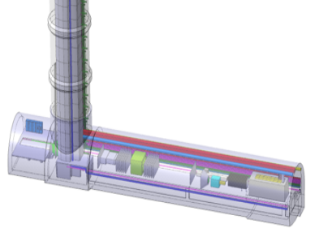
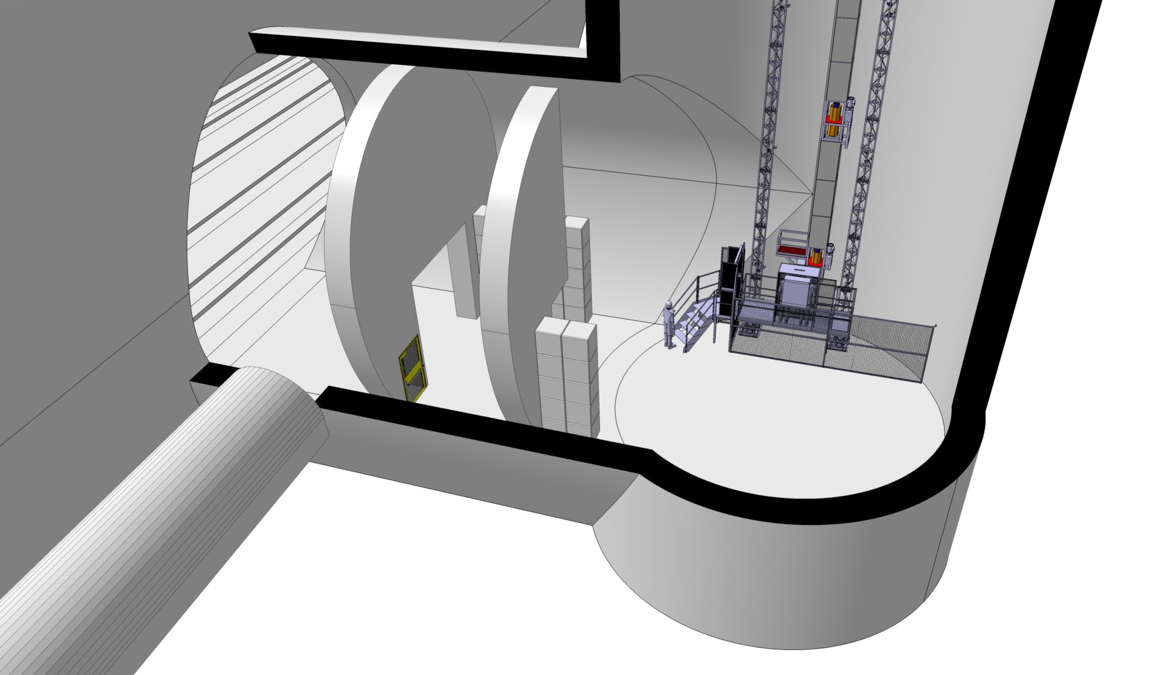
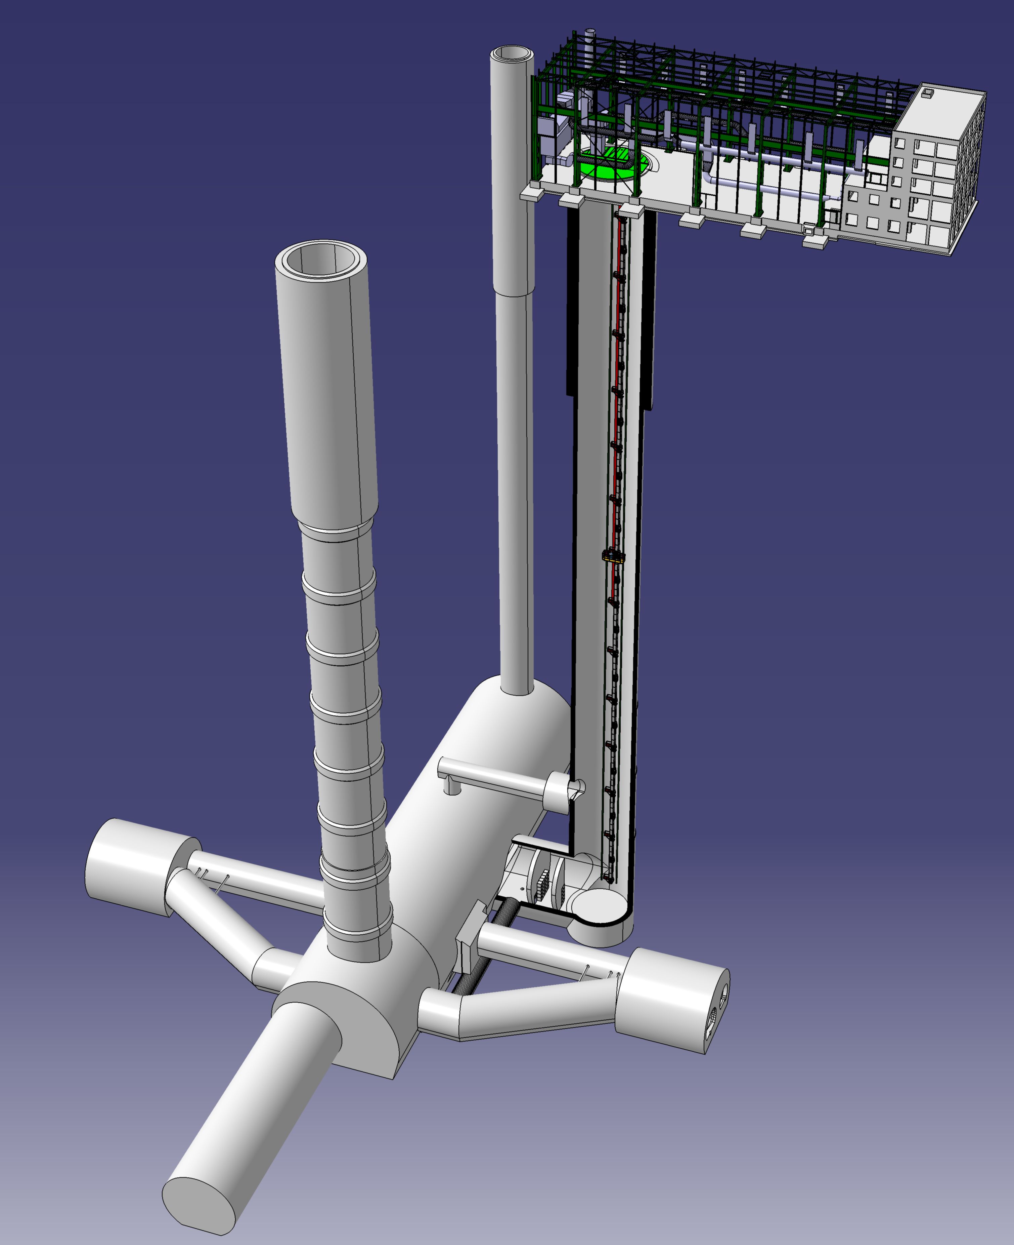
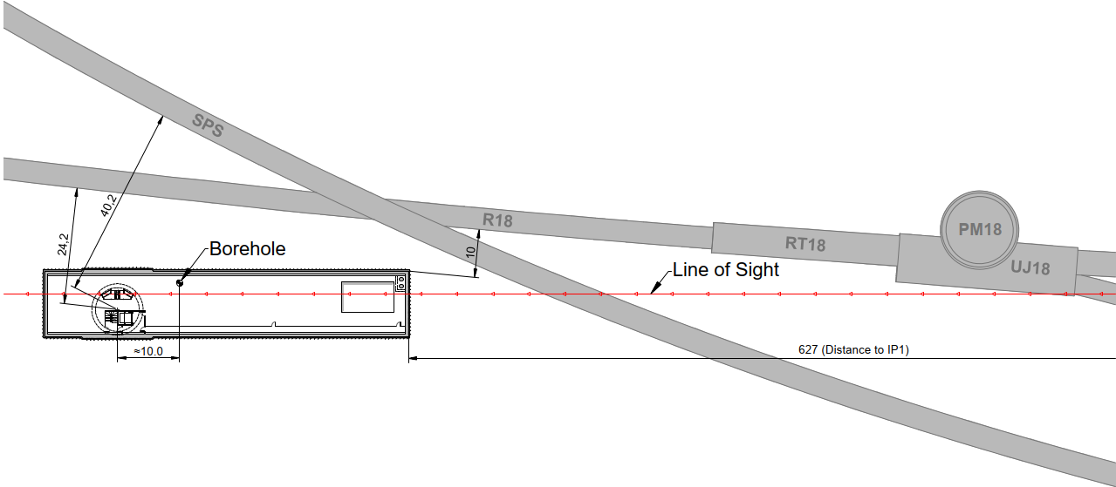

Physics Beyond Colliders
Forward Physics Facility
AION100 @ CERN
Undergound:
A 75m x 11.8m experimental cavern
An 84m deep access shaft
Safety corridor inside the cavern
Overview
Proposed use of existing 100m deep shaft to house the latest Atom Interferometer at CERN
Proposed civil works include a surface structure and shielding wall + blocks at the base of the shaft
Above ground:
  Access building
  Electrical building
  Cooling & Ventilation building
Project Stage
  Awaiting budget approval before detailed design stage
These projects are yet to be decided on at the ESPP

Slide 31

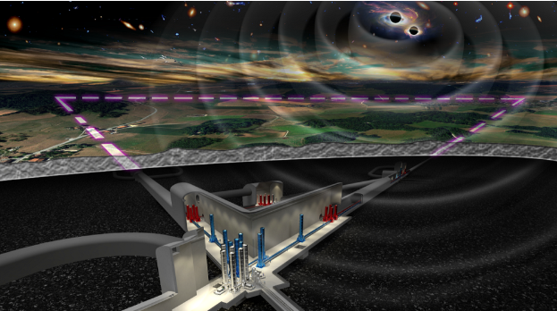
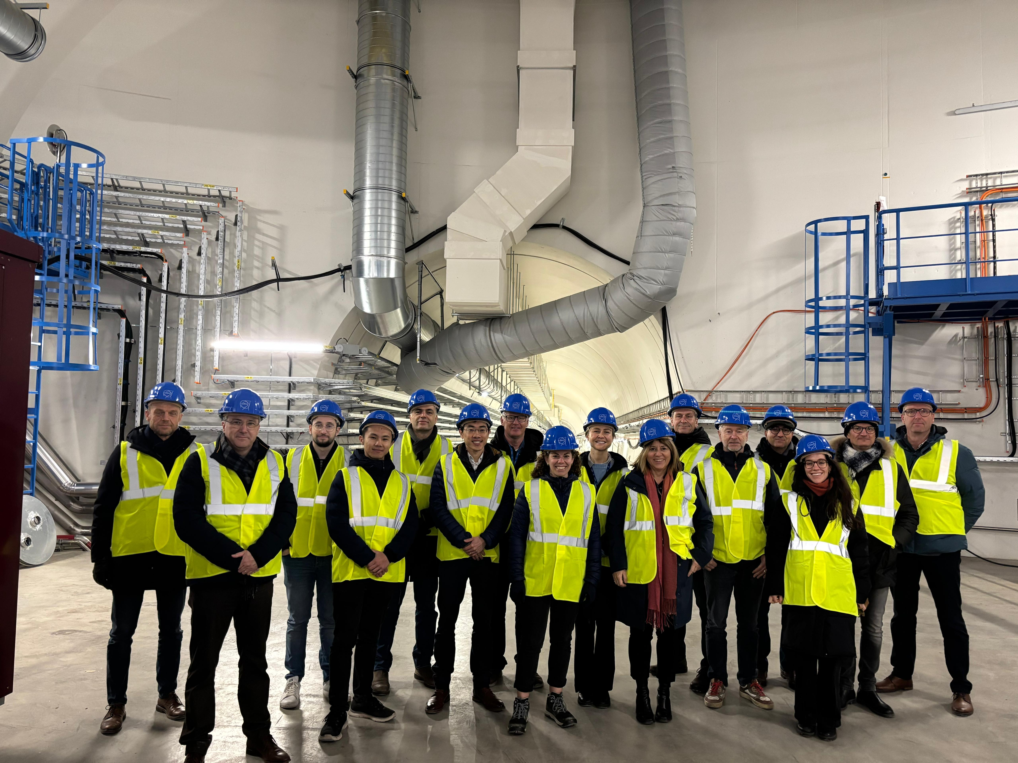
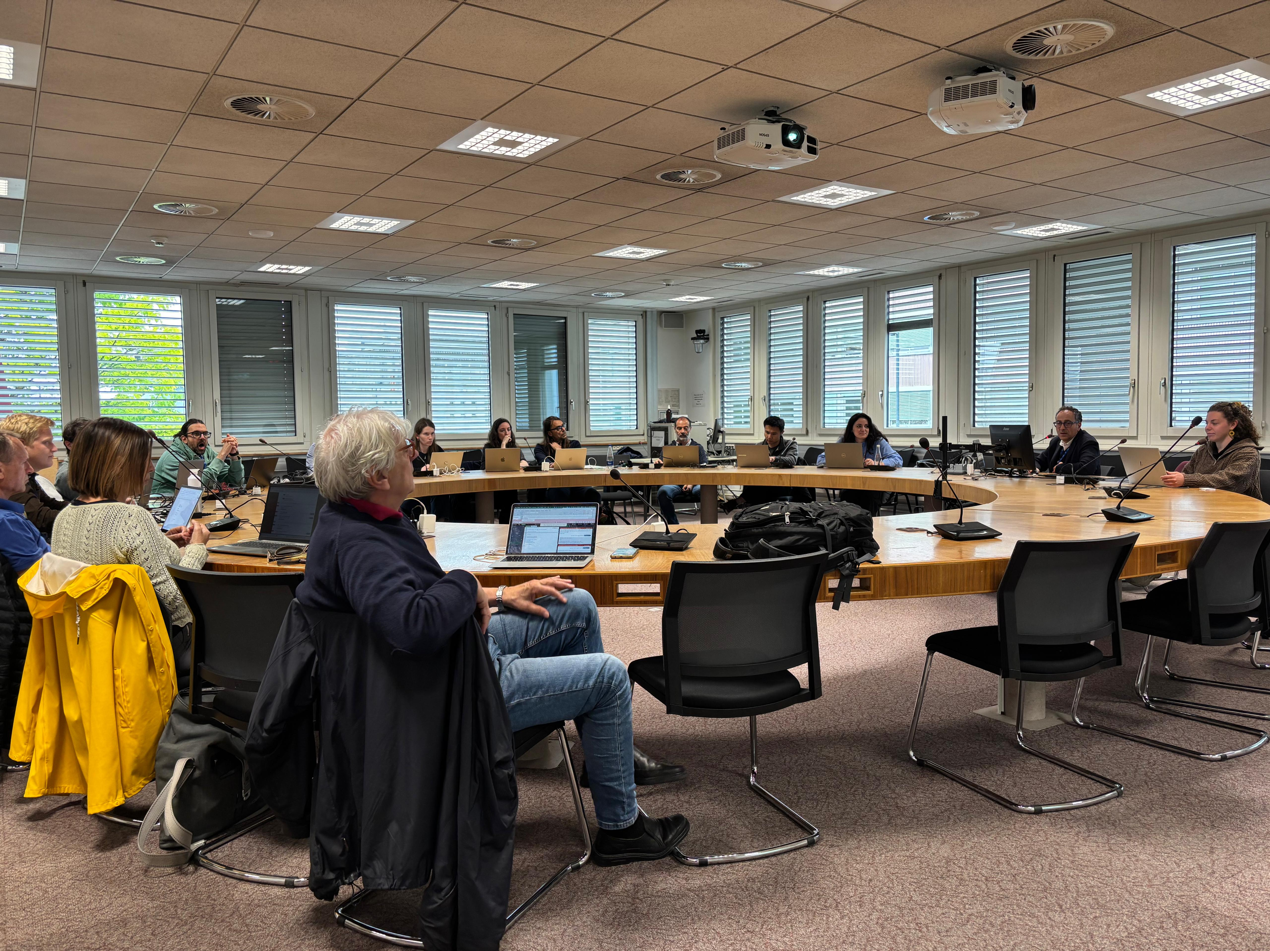
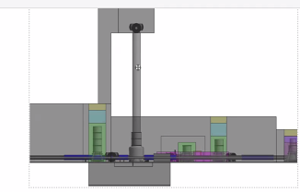
Einstein Telescope
Collaboration between CERN and ETO involves:
  Ongoing collaboration agreement ongoing until 31st December 2026
  Future Studies Section will provide support in the civil engineering activities required for the delivery of a TDR
  Site independent
  Support for the ET Engineering Department
  Advice on shared design platforms
  Technical reviews of civil engineering reports
  Technical input where appropriate
Collaboration Achievements…
Successful workshops at CERN, hosting colleagues from ETO, INFN, Nikhef, IFAE, Local Teams, Comments from local teams’ on roadmap document addressed
Identified challenges and considered next steps together
Decision to start a taskforce involving local teams and ETO and CERN together

Slide 33
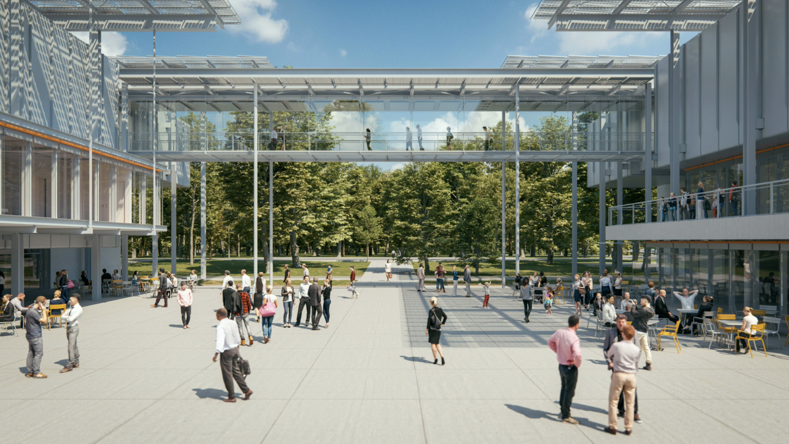
Science Gateway
A constelation of aligning stars
Fred Magnin – 3.09.2024

Slide 34
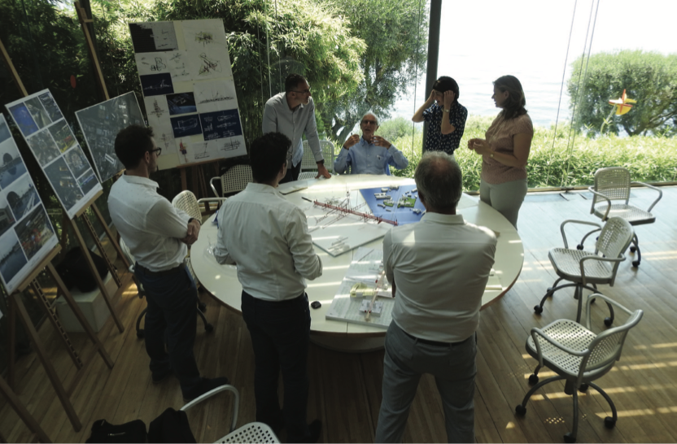
June 2018

Slide 35
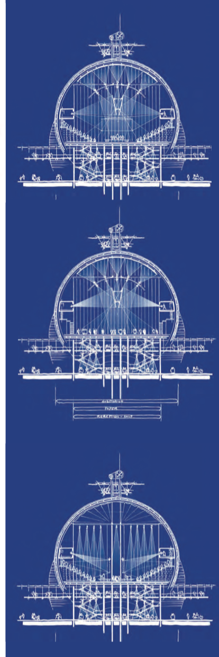




Slide 36

Dinner party…
June 2014
WASHINGTON — President Barack Obama had just disembarked from Air Force One and was still on the tarmac in Rome when he turned to his host, John R. Phillips, the U.S. ambassador to Italy, with an unexpected request:
How about a dinner party tomorrow night?
Over the next 24 hours, the startled Phillips and his wife, the former Obama aide Linda Douglass, scrambled to gather some of Italy’s intellettuali.
The architect Renzo Piano flew in from Genoa. The particle physicist Fabiola Gianotti arrived from Geneva. John Elkann, the chairman of Fiat and the owner of the Italian soccer club Juventus, came too, as did his sister, Ginevra, a film director.
Geneva, Rolex, Lego, Spotify…..

Slide 37

Three weeks later…
Gone the perfect symmetry
Embracing asymmetry!
Shuttle landing, birth of universe
Forest
Bridge

Slide 38

Gateway

