Slide 1
GSM POINT 1
PICTURES EXTRACT FROM REFERENCE
ST1120748_01 | UR15_1102_INTEGRATION
ST1120290_01 | US17_1102_INTEGRATION
ST1120286_01 | UL13_1102_INTEGRATION
ST1120287_01 | UL17_1102_INTEGRATION
ST1173628_01 | UA17_1102_INTEGRATION
ST1173629_01 | UA13_1102_INTEGRATION
Stephane Maridor
23/05/2025

Slide 2
UA13

Slide 3
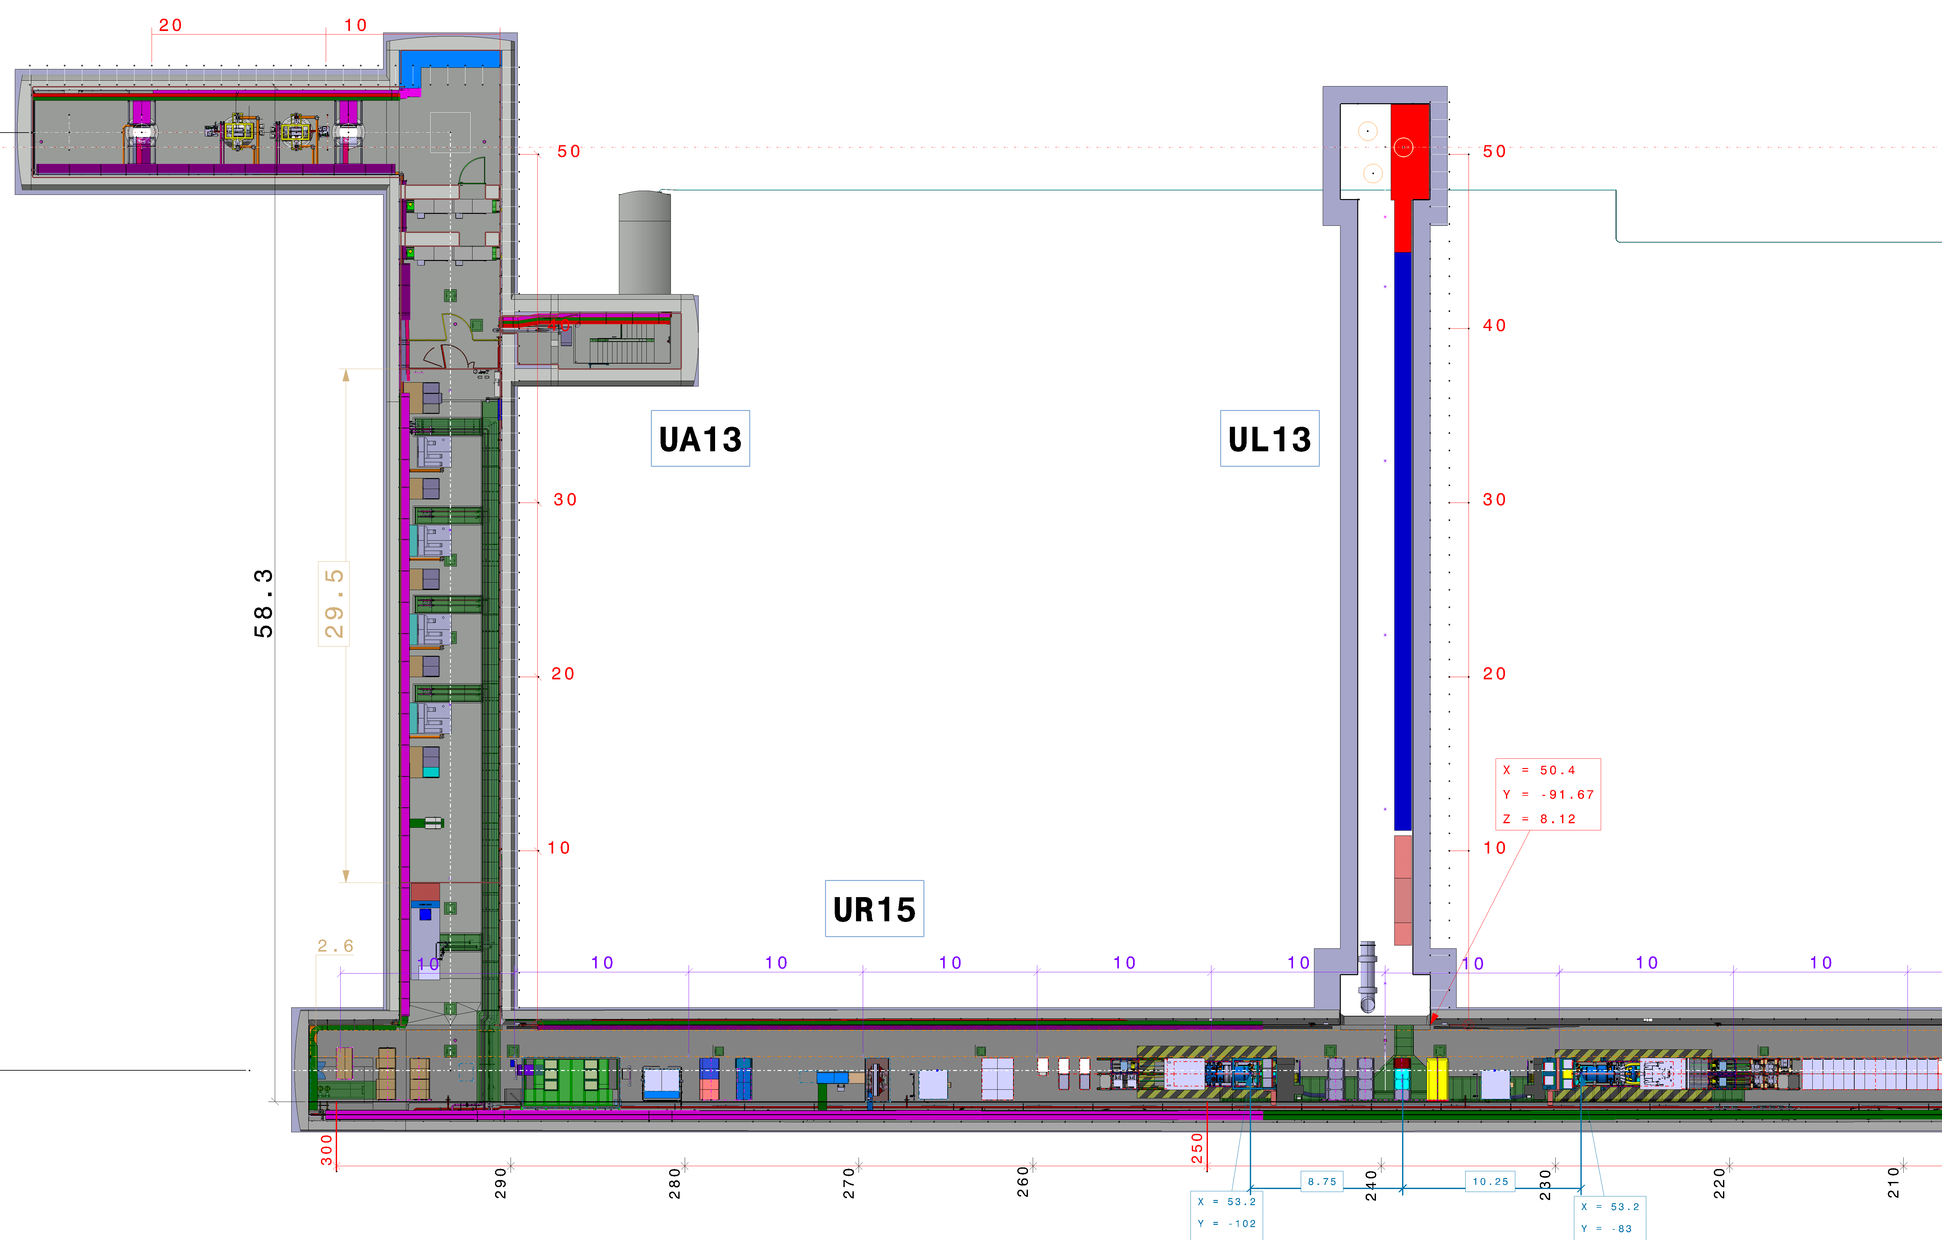

Slide 4
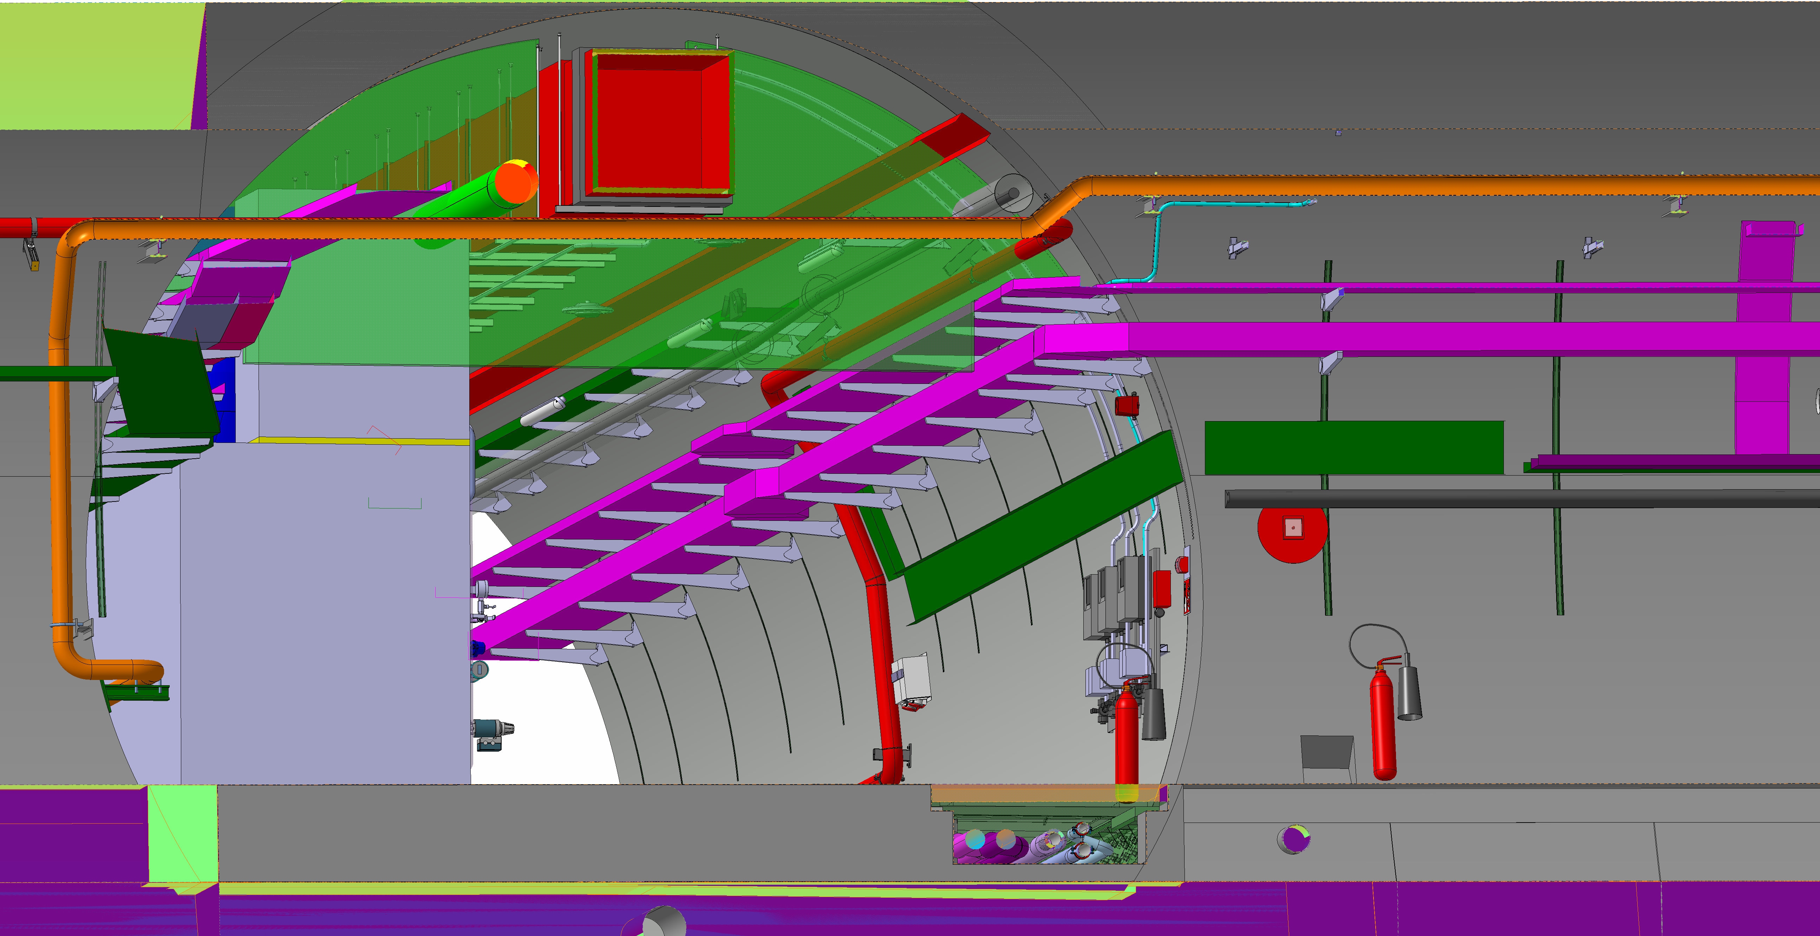

Slide 5
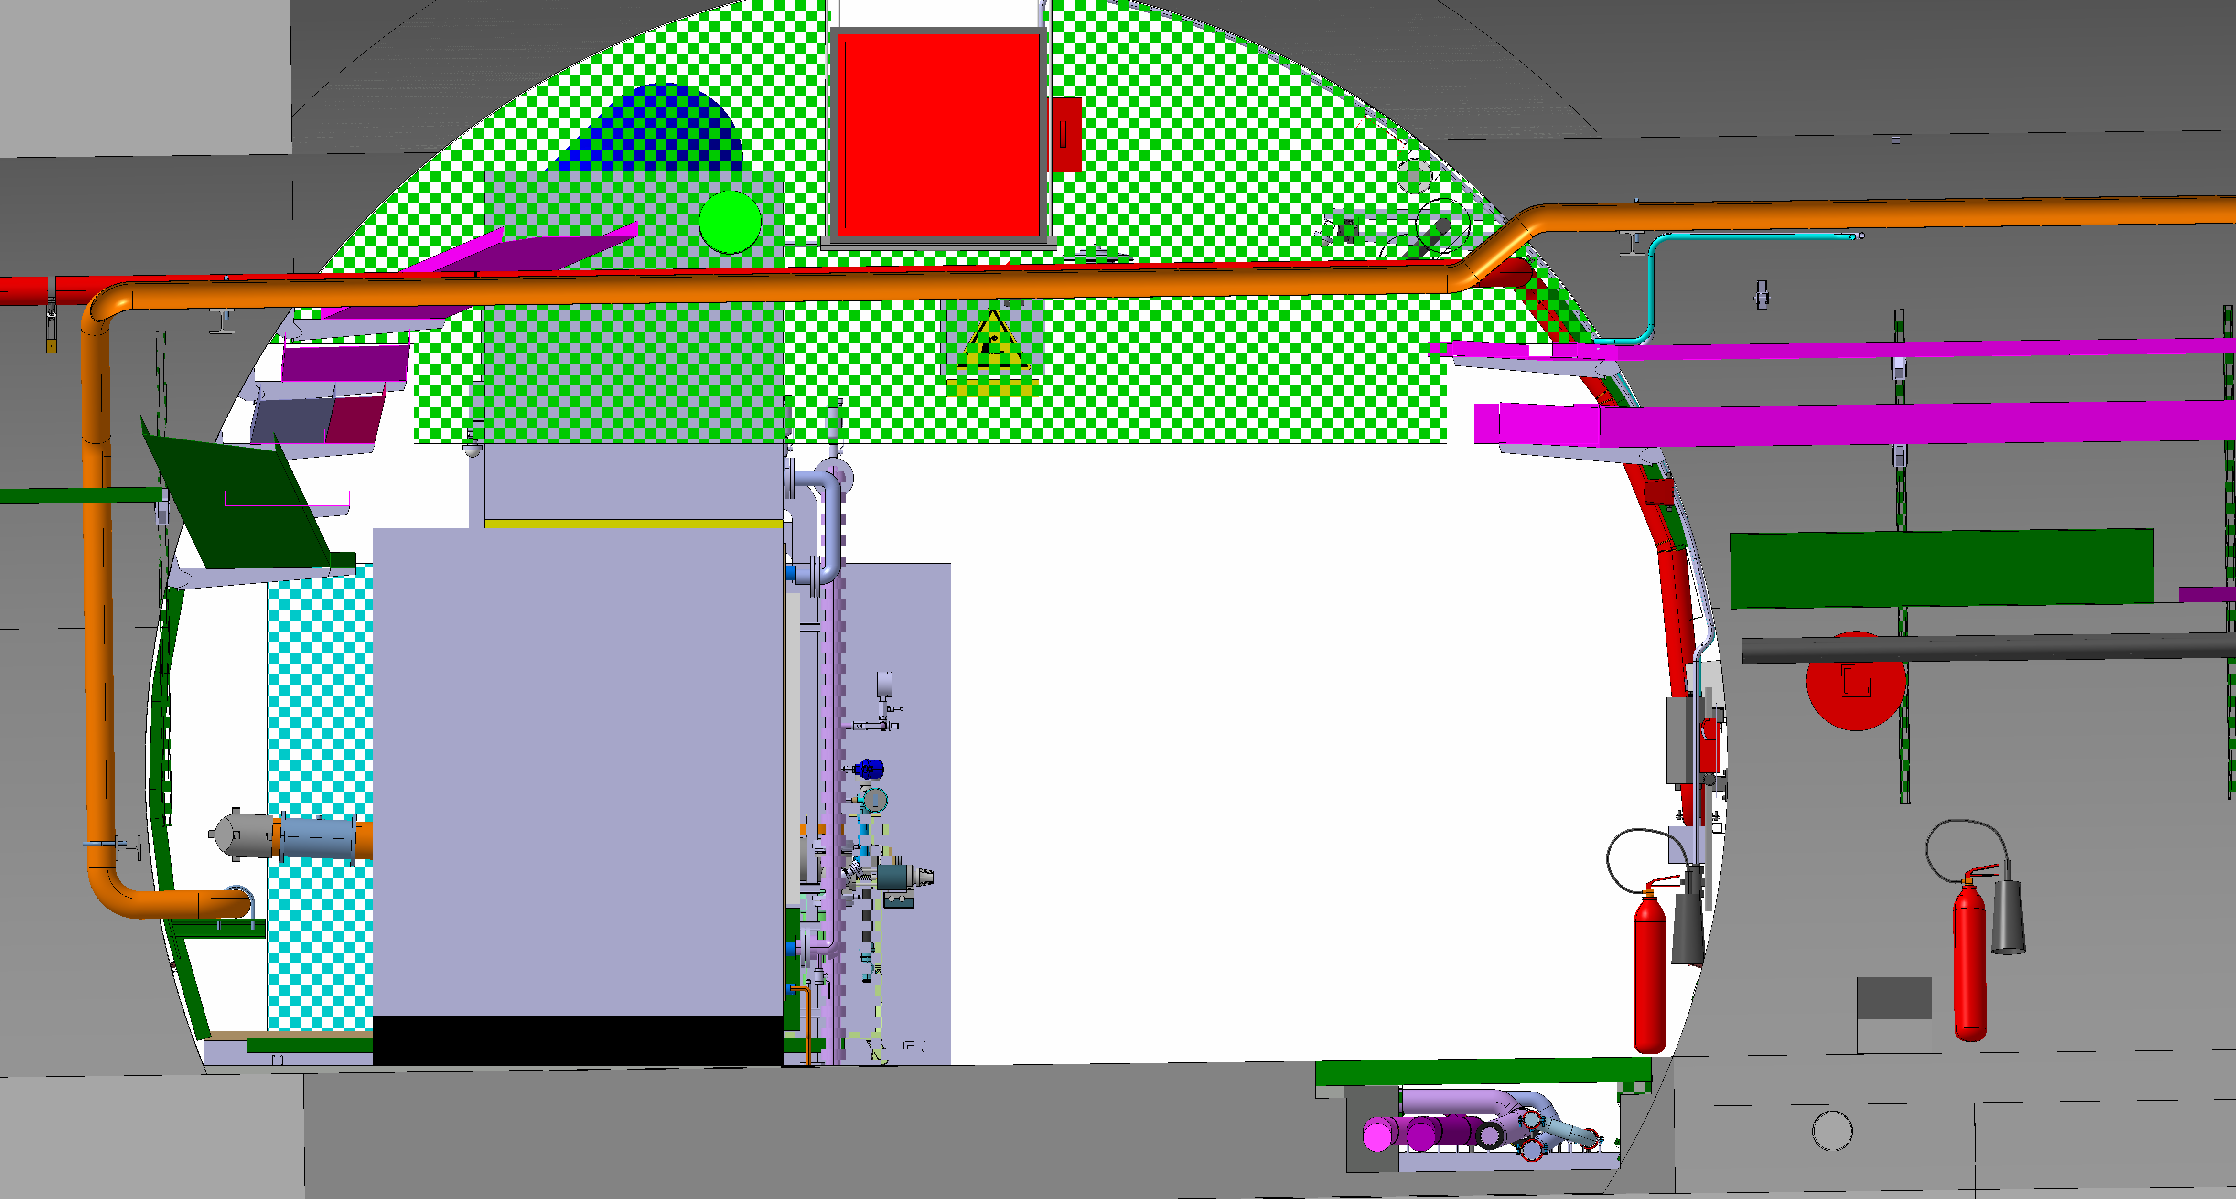

Slide 6
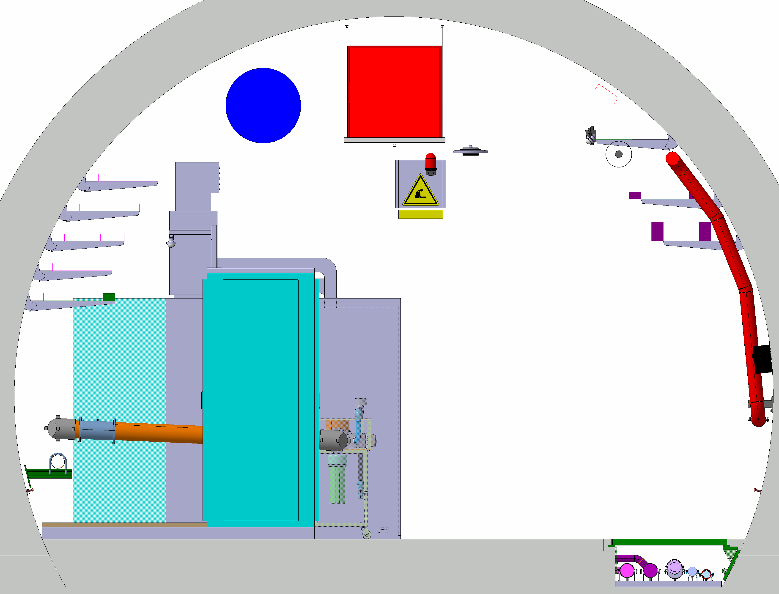

Slide 7
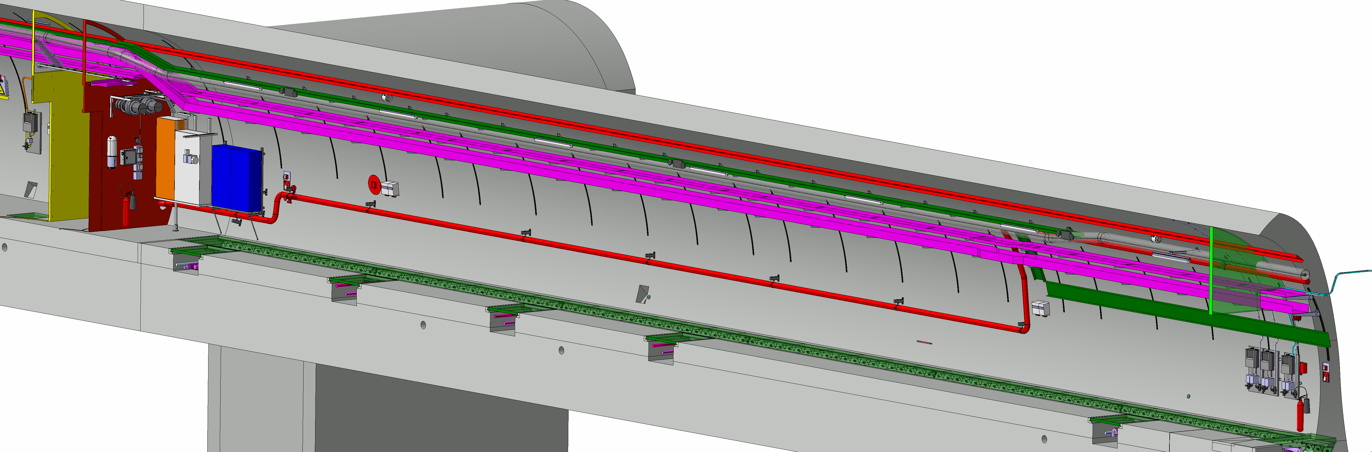

Slide 8
UA17
par Stephane Maridor

Slide 9
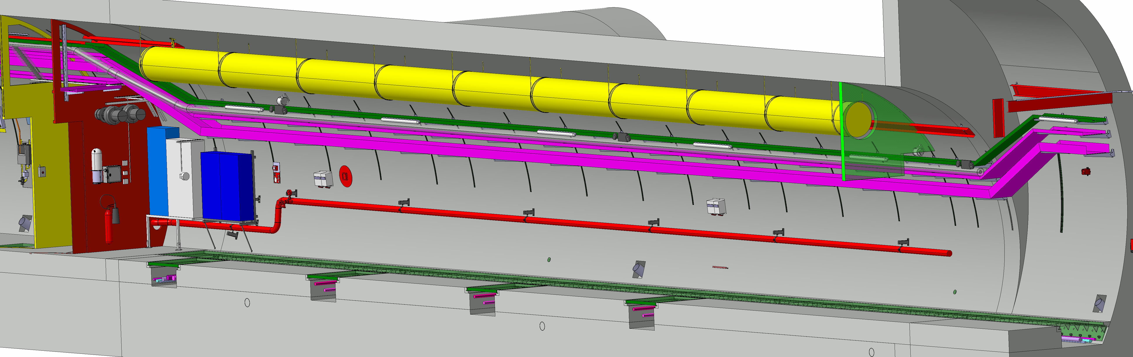

Slide 10
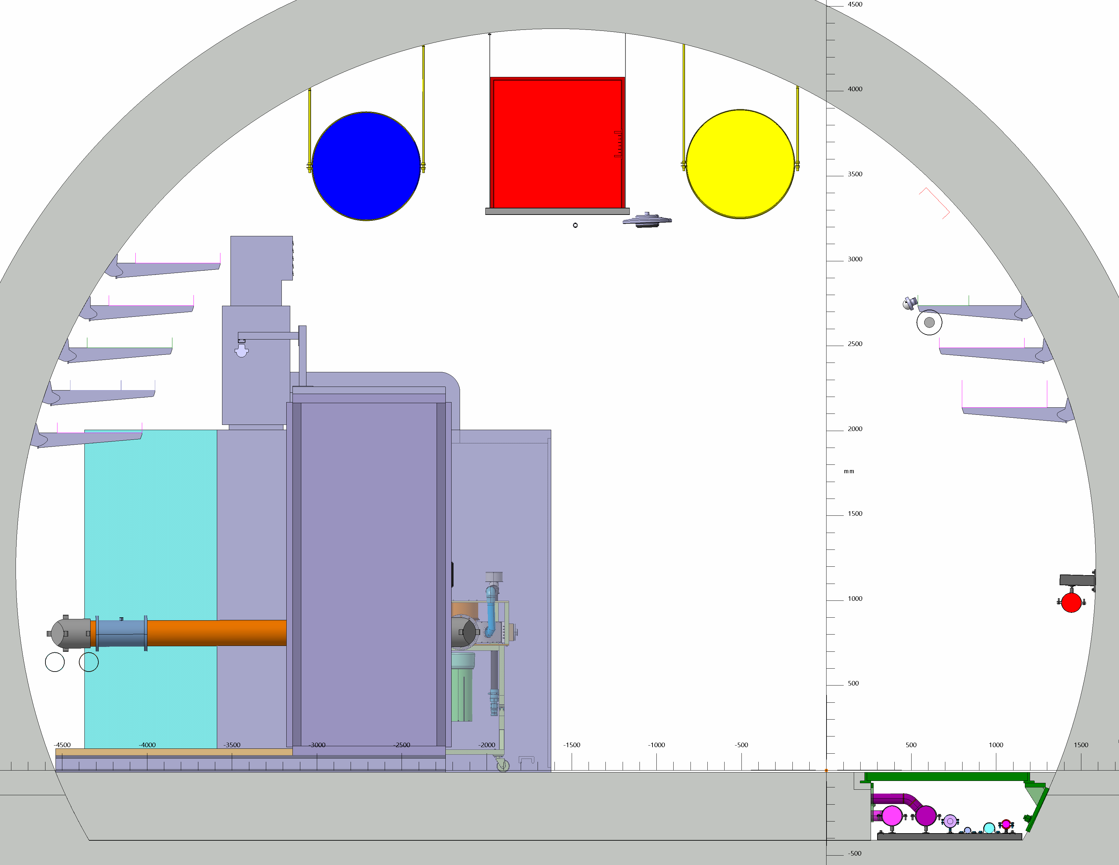

Slide 11
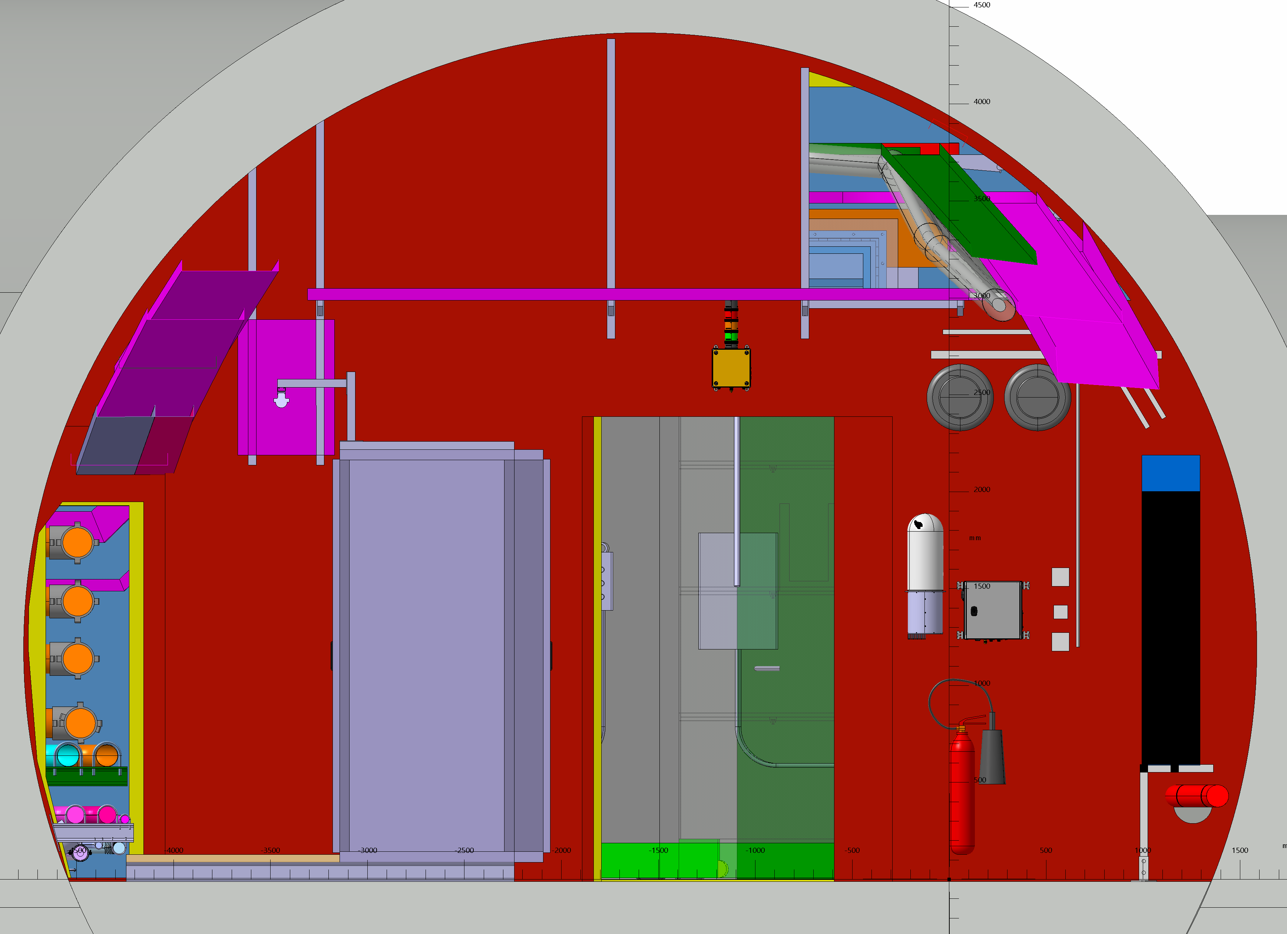

Slide 12
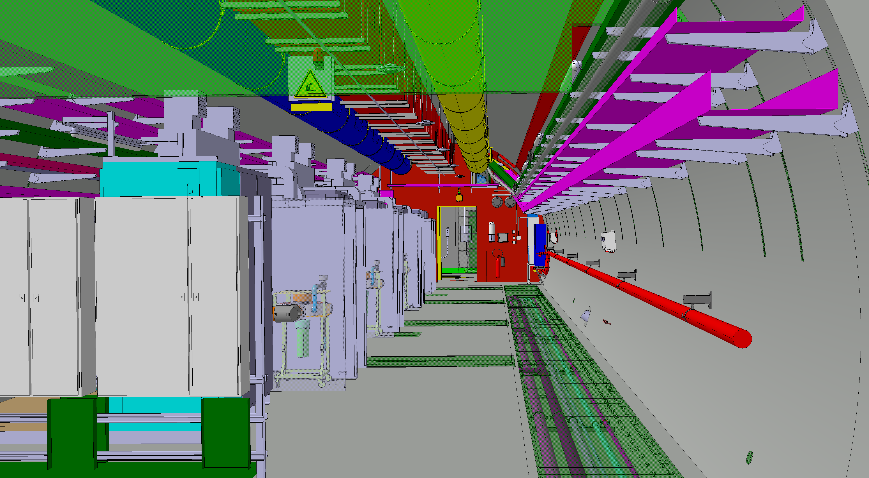

Slide 13
UL13

Slide 14
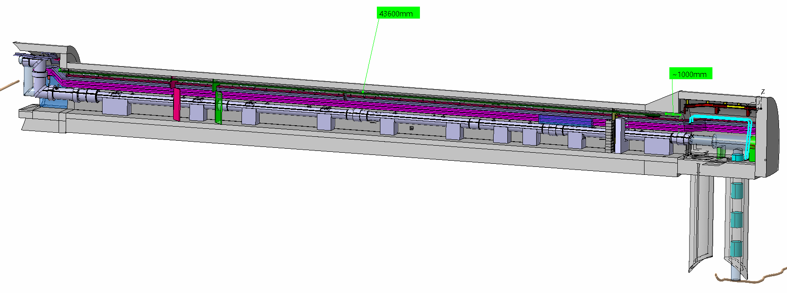

Slide 15
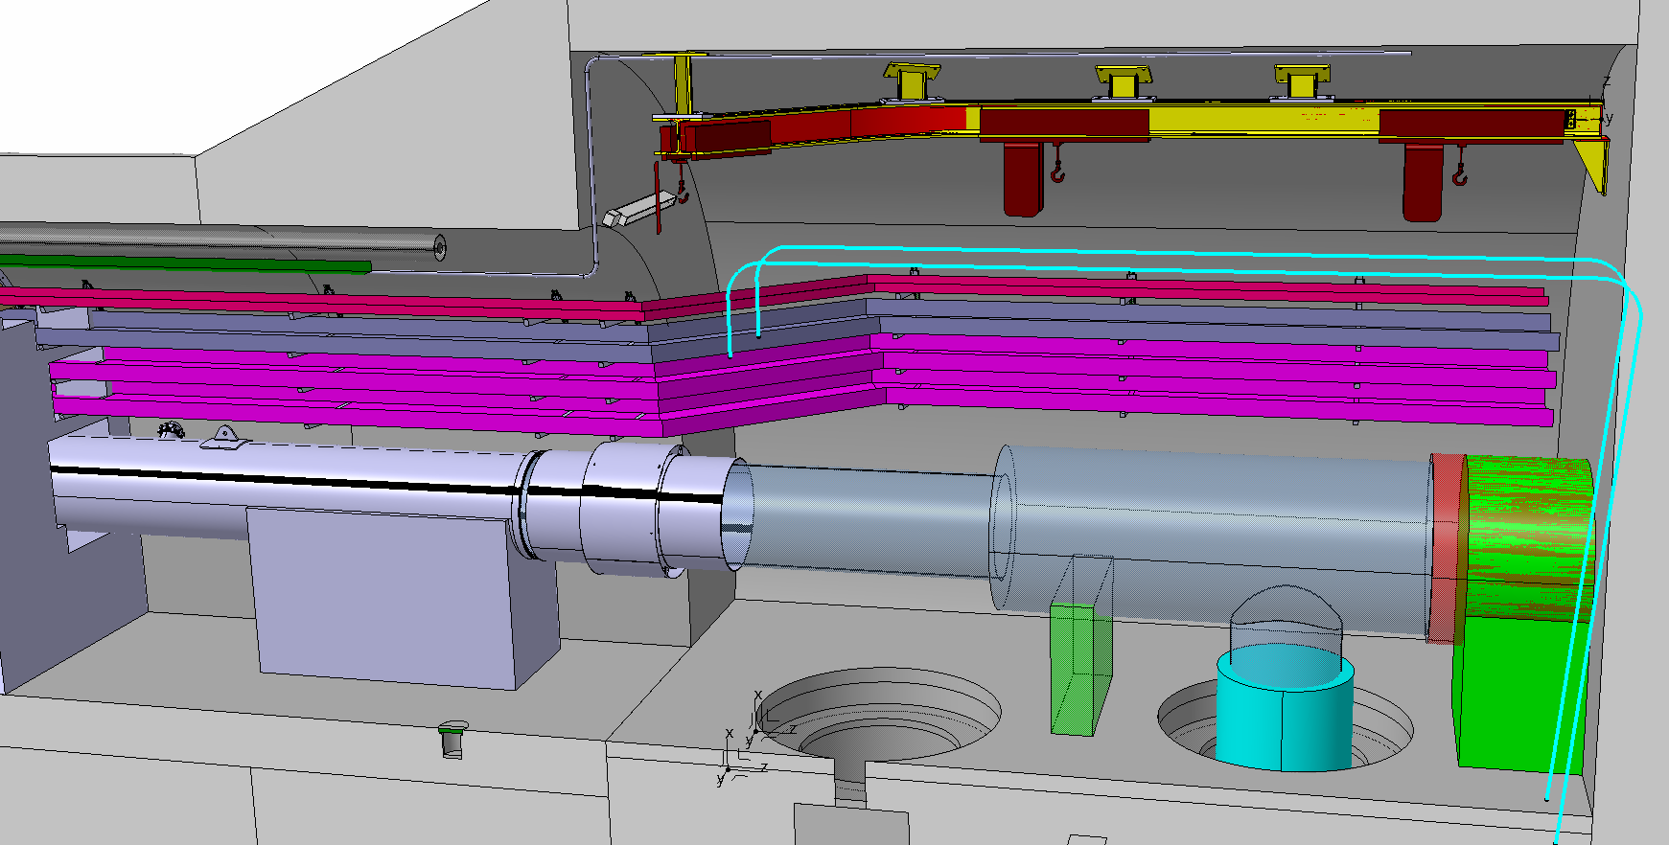

Slide 16
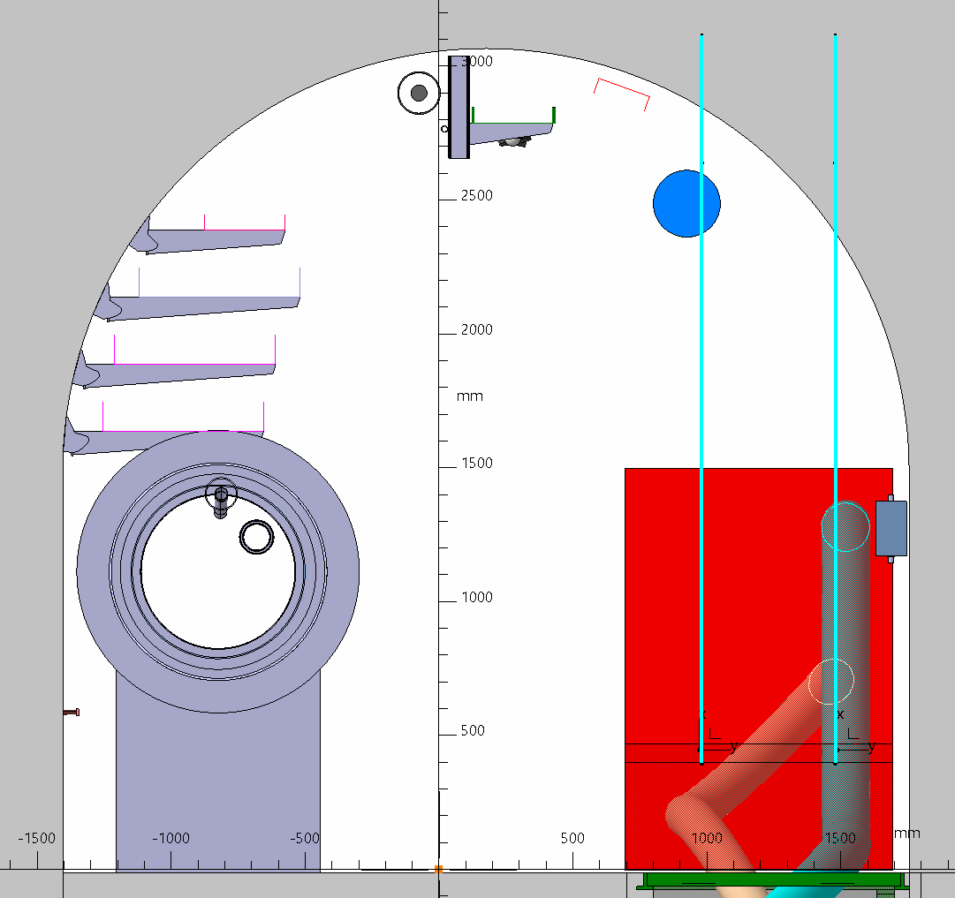
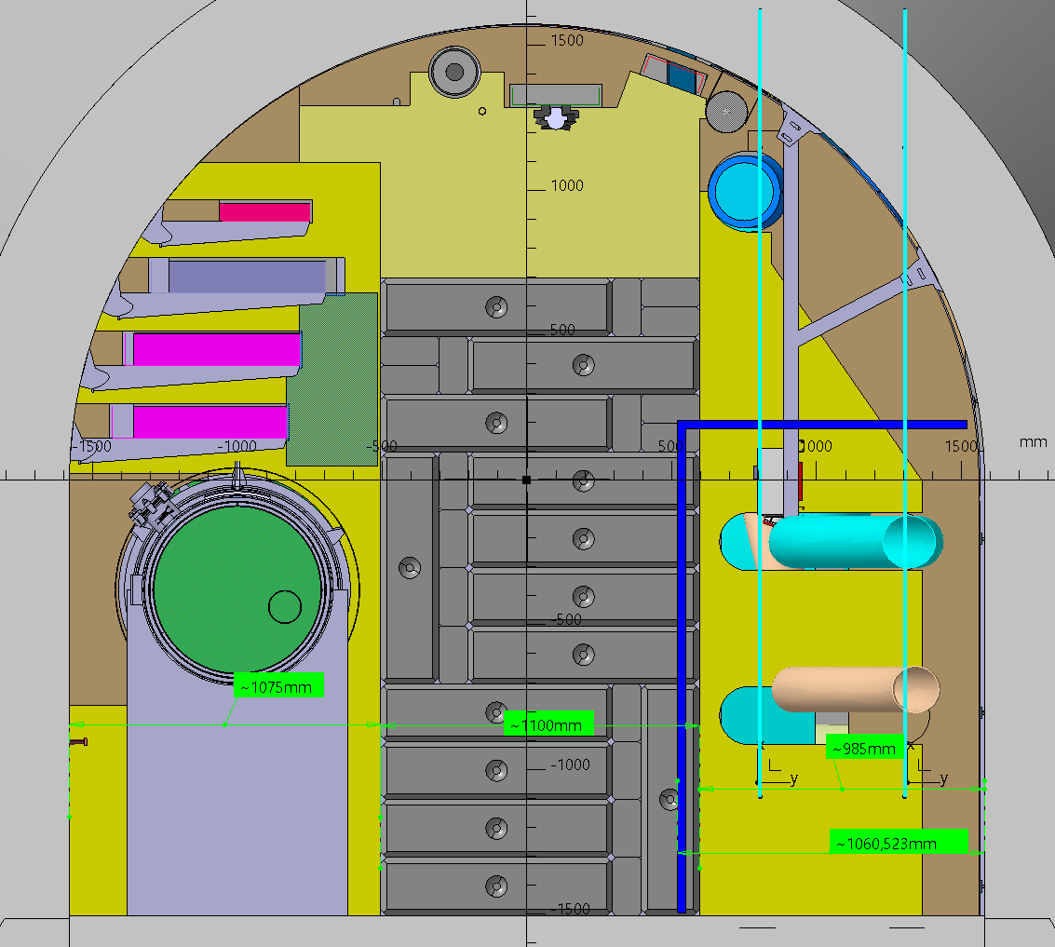

Slide 17
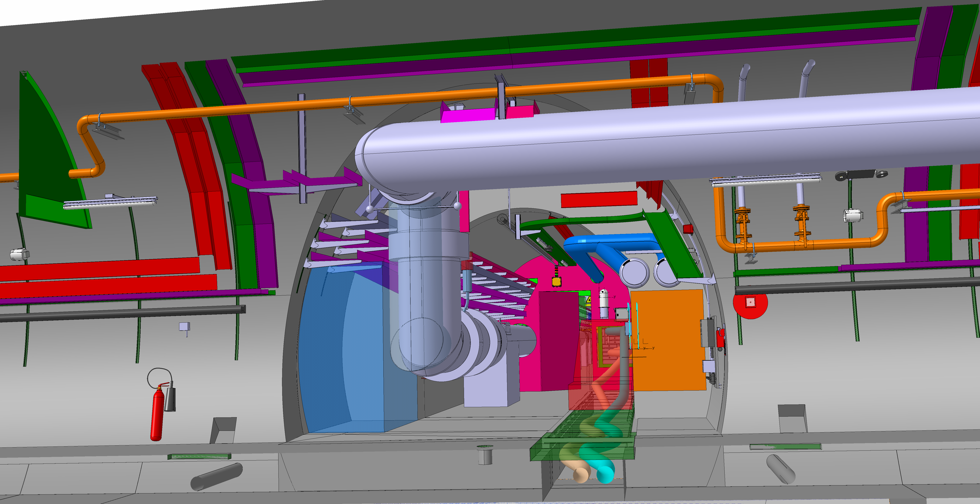

Slide 18
UL17

Slide 19
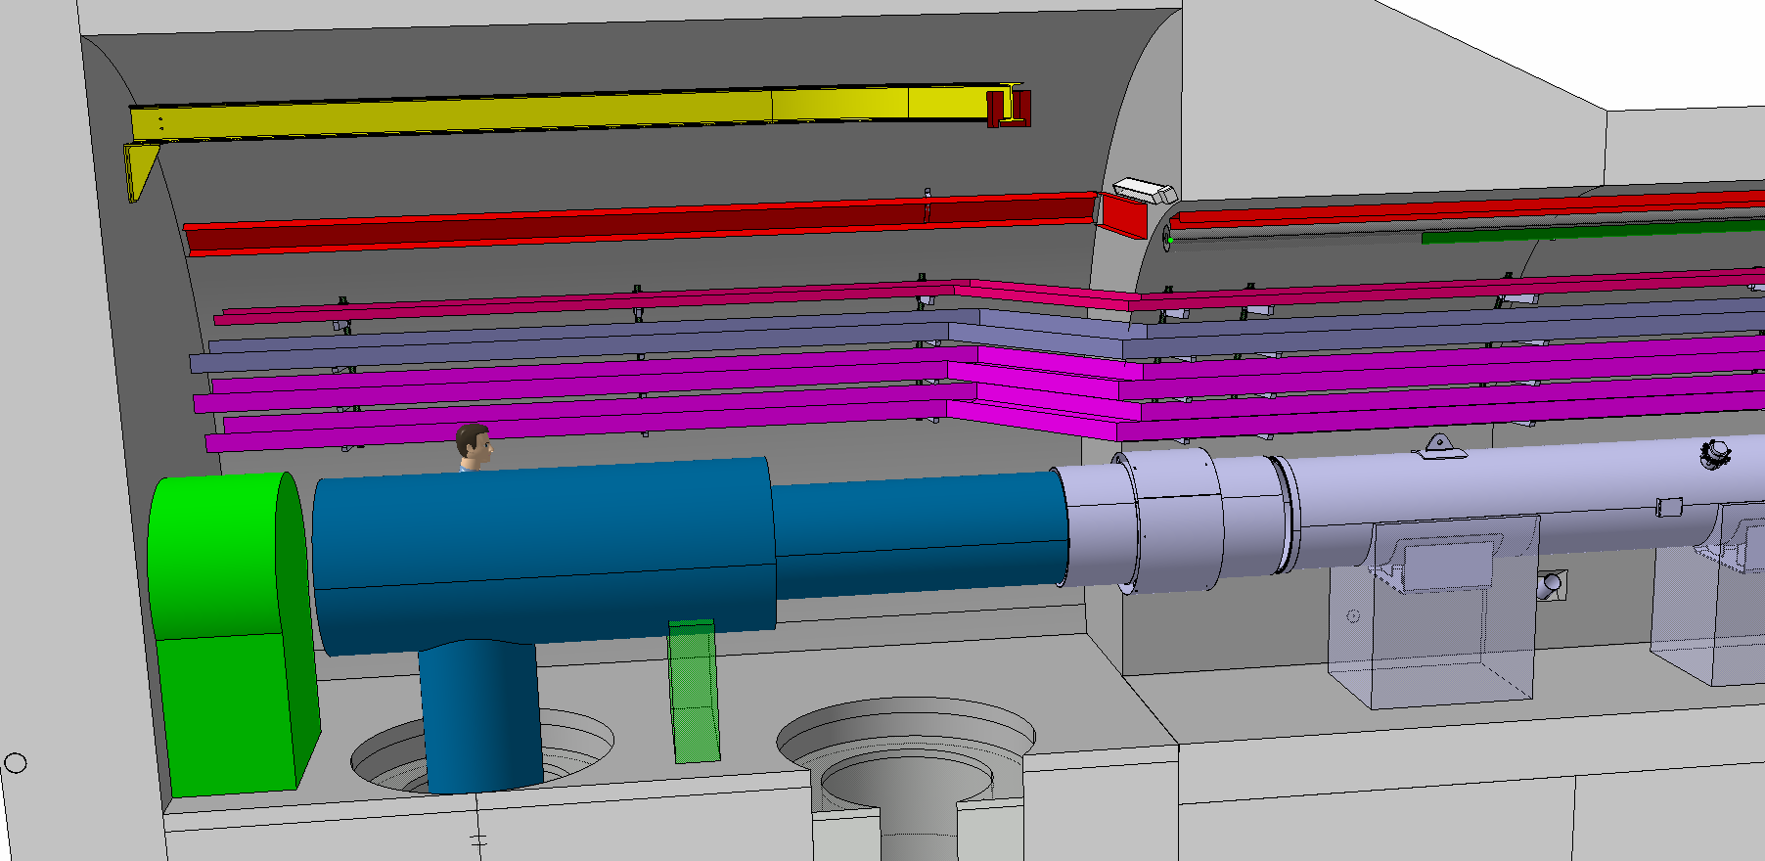

Slide 20
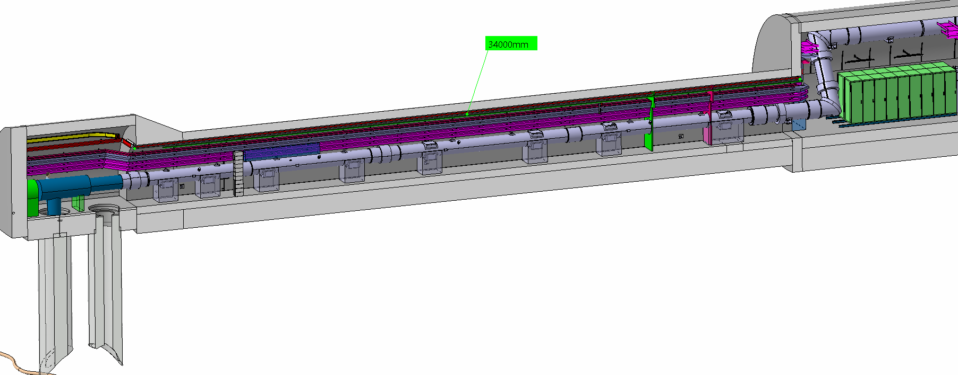

Slide 21
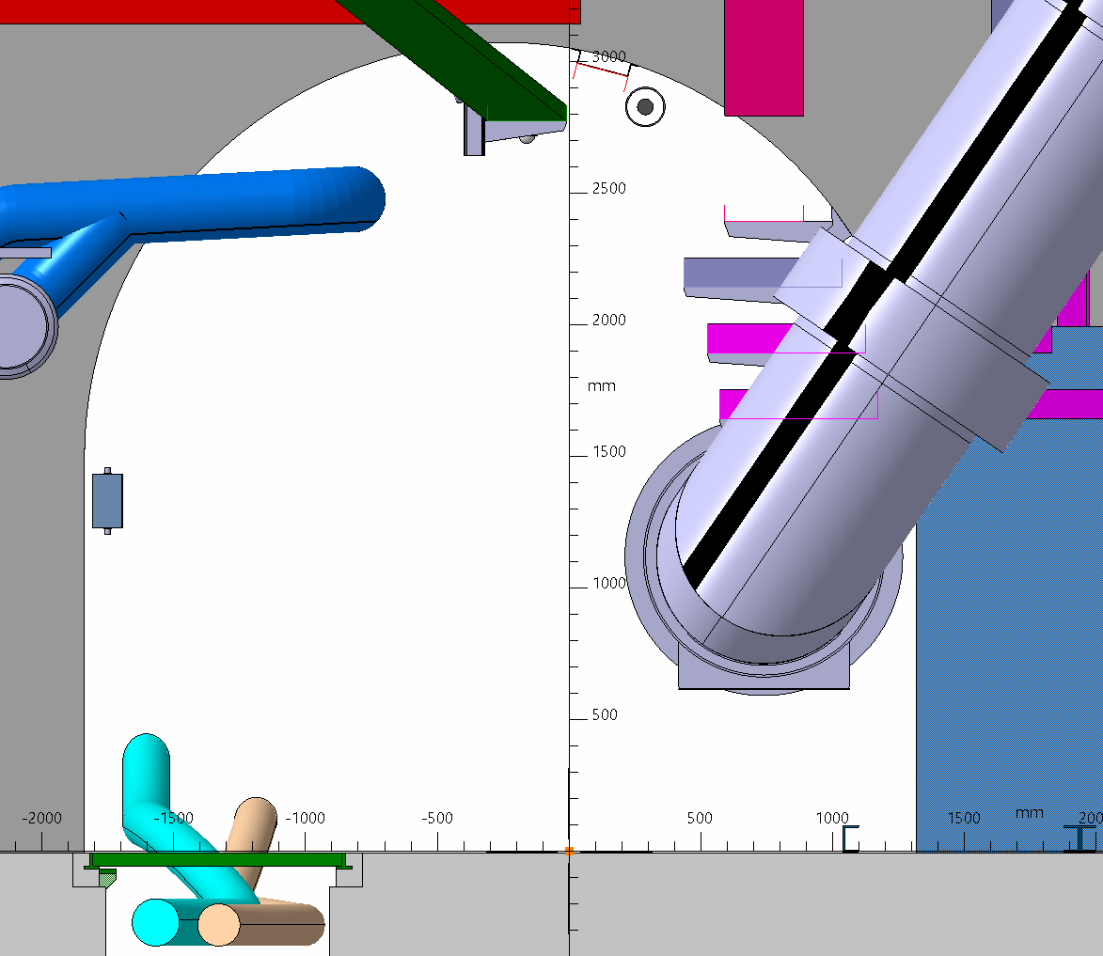

Slide 22
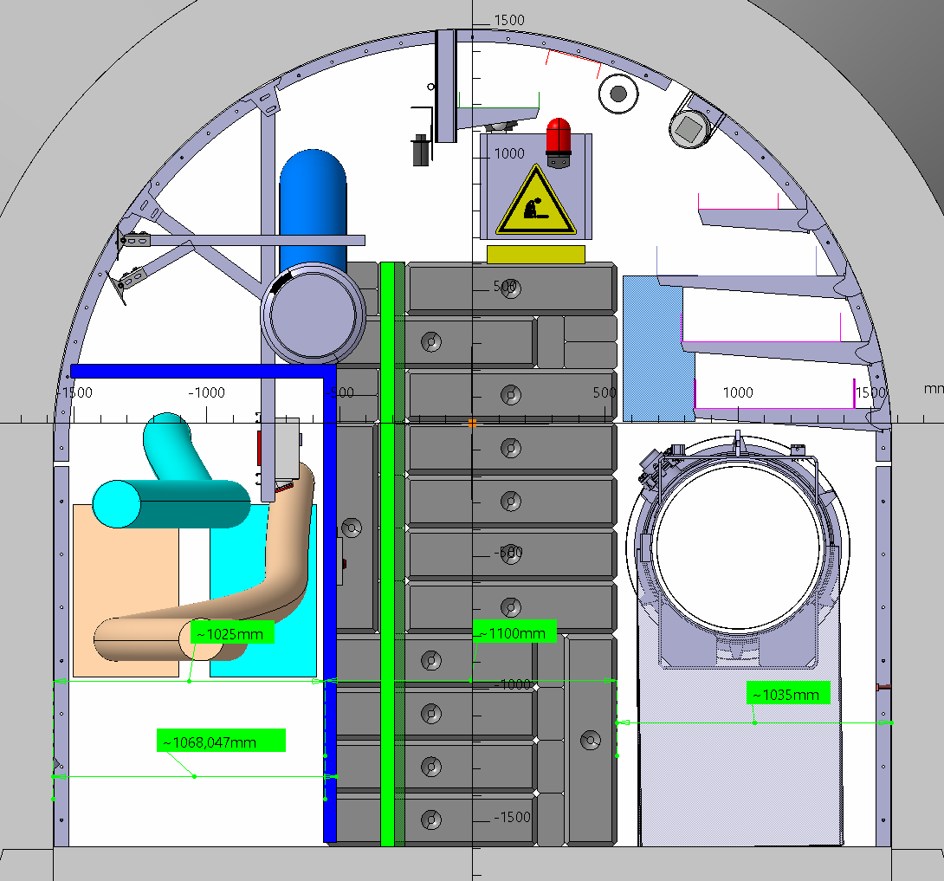

Slide 23
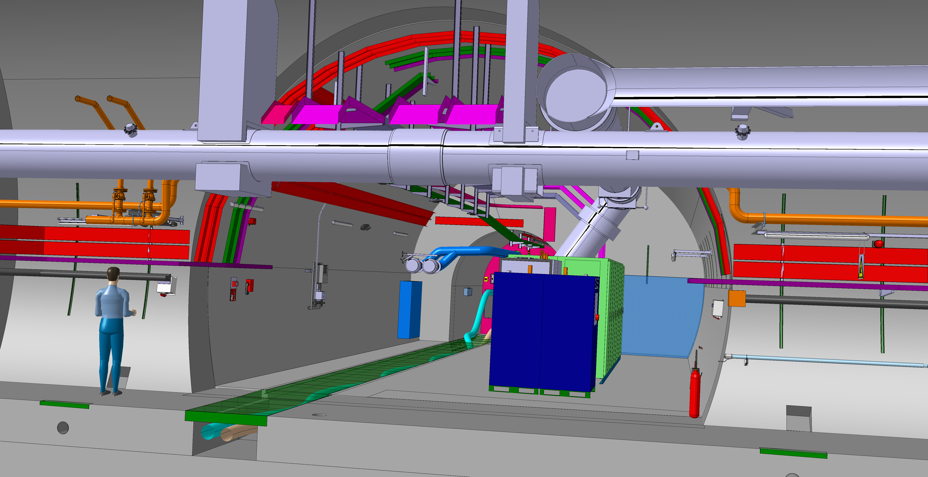

Slide 24
UR15

Slide 25
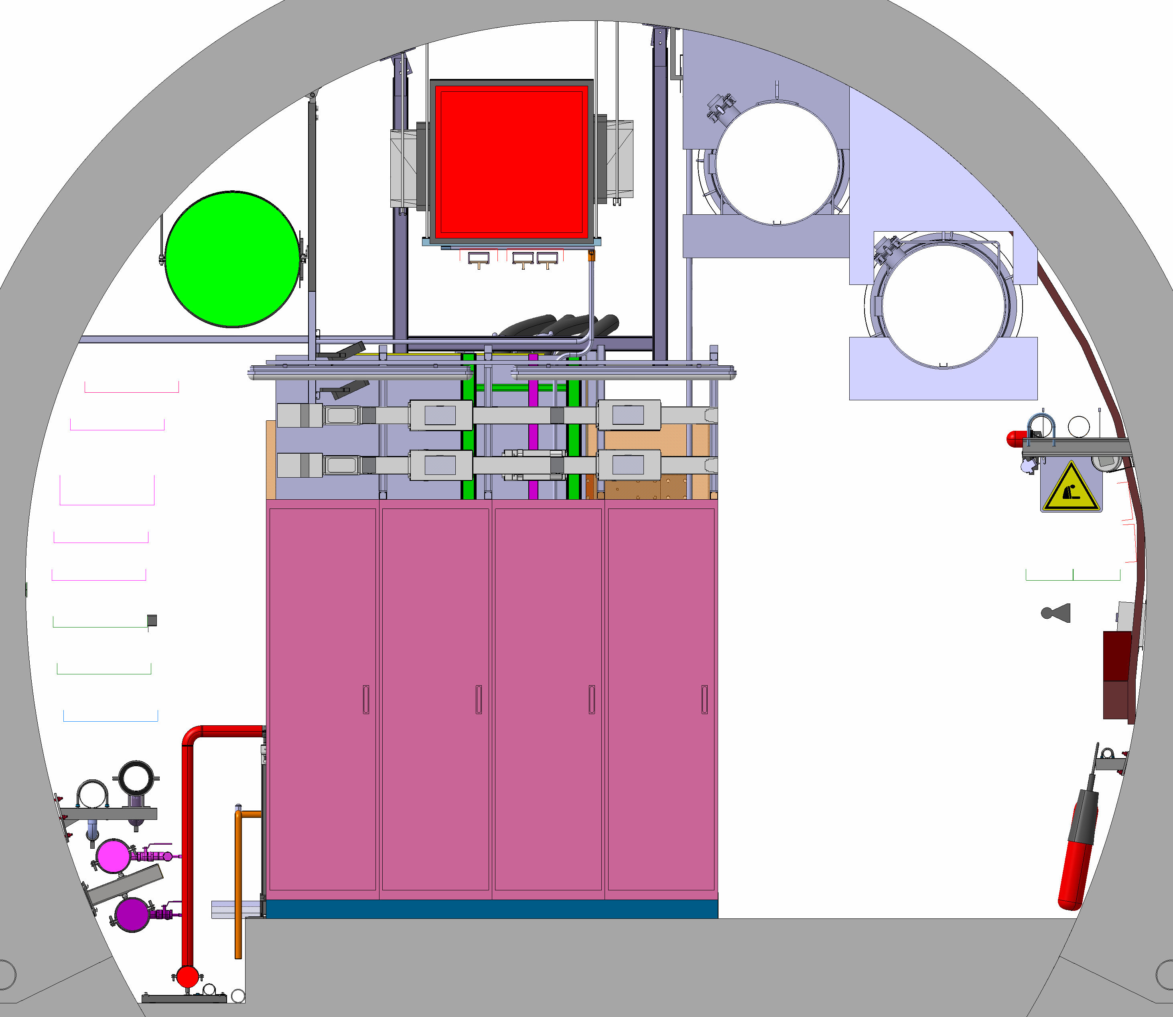

Slide 26
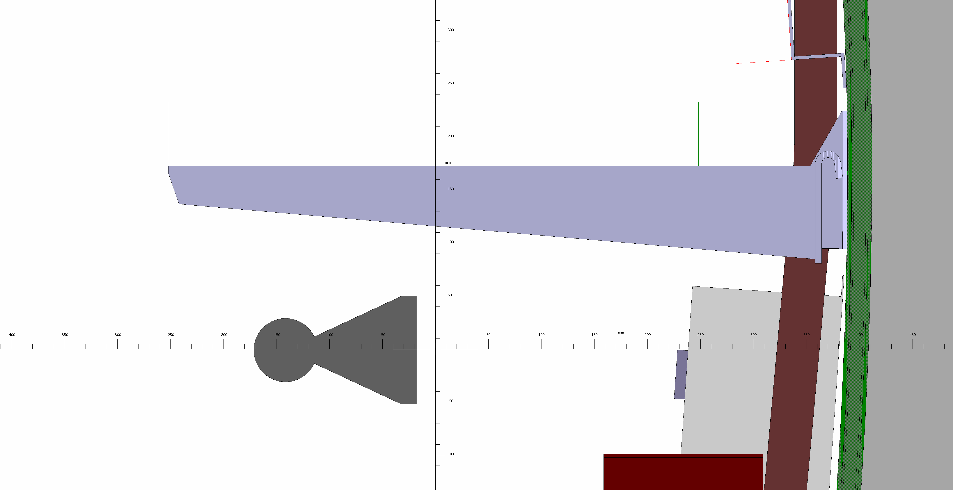

Slide 27
US17 /UW17

Slide 28
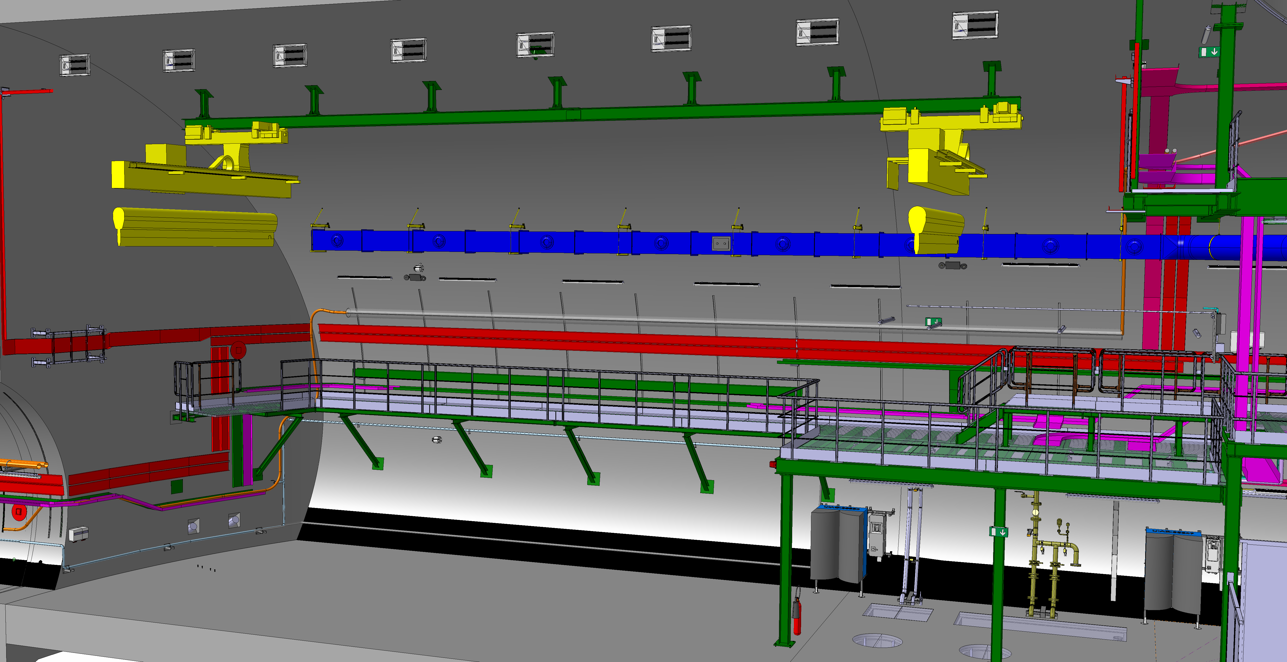

Slide 29
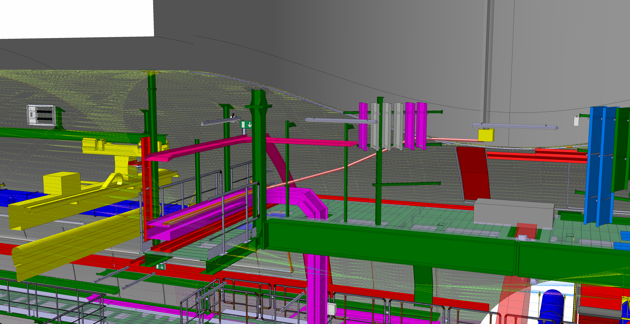

Slide 30
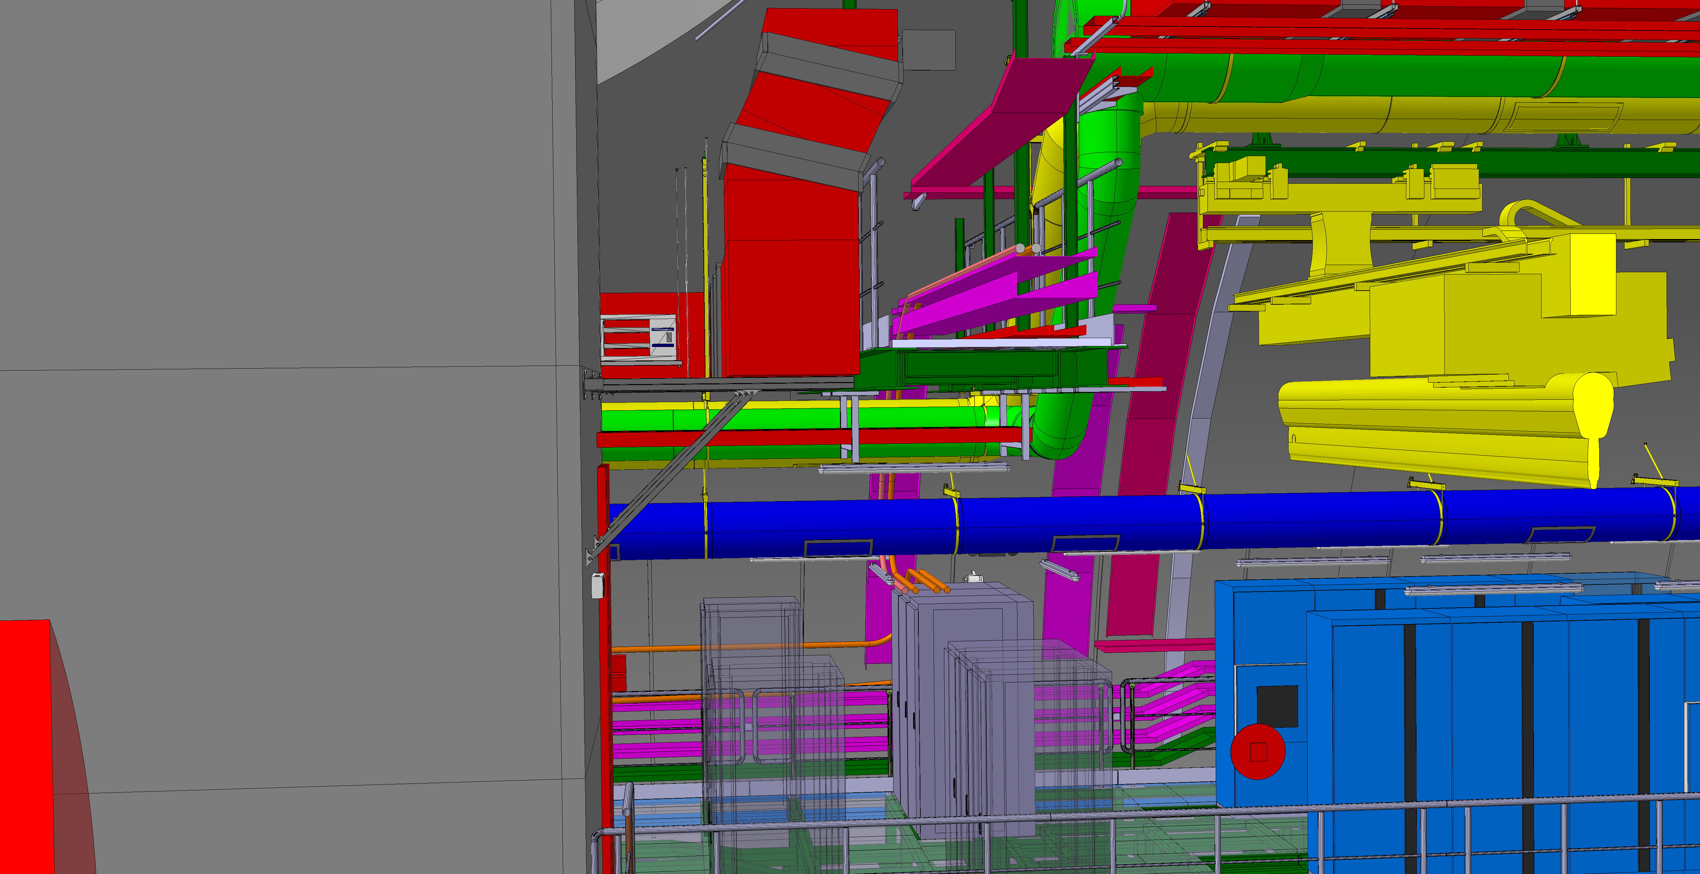

Slide 31
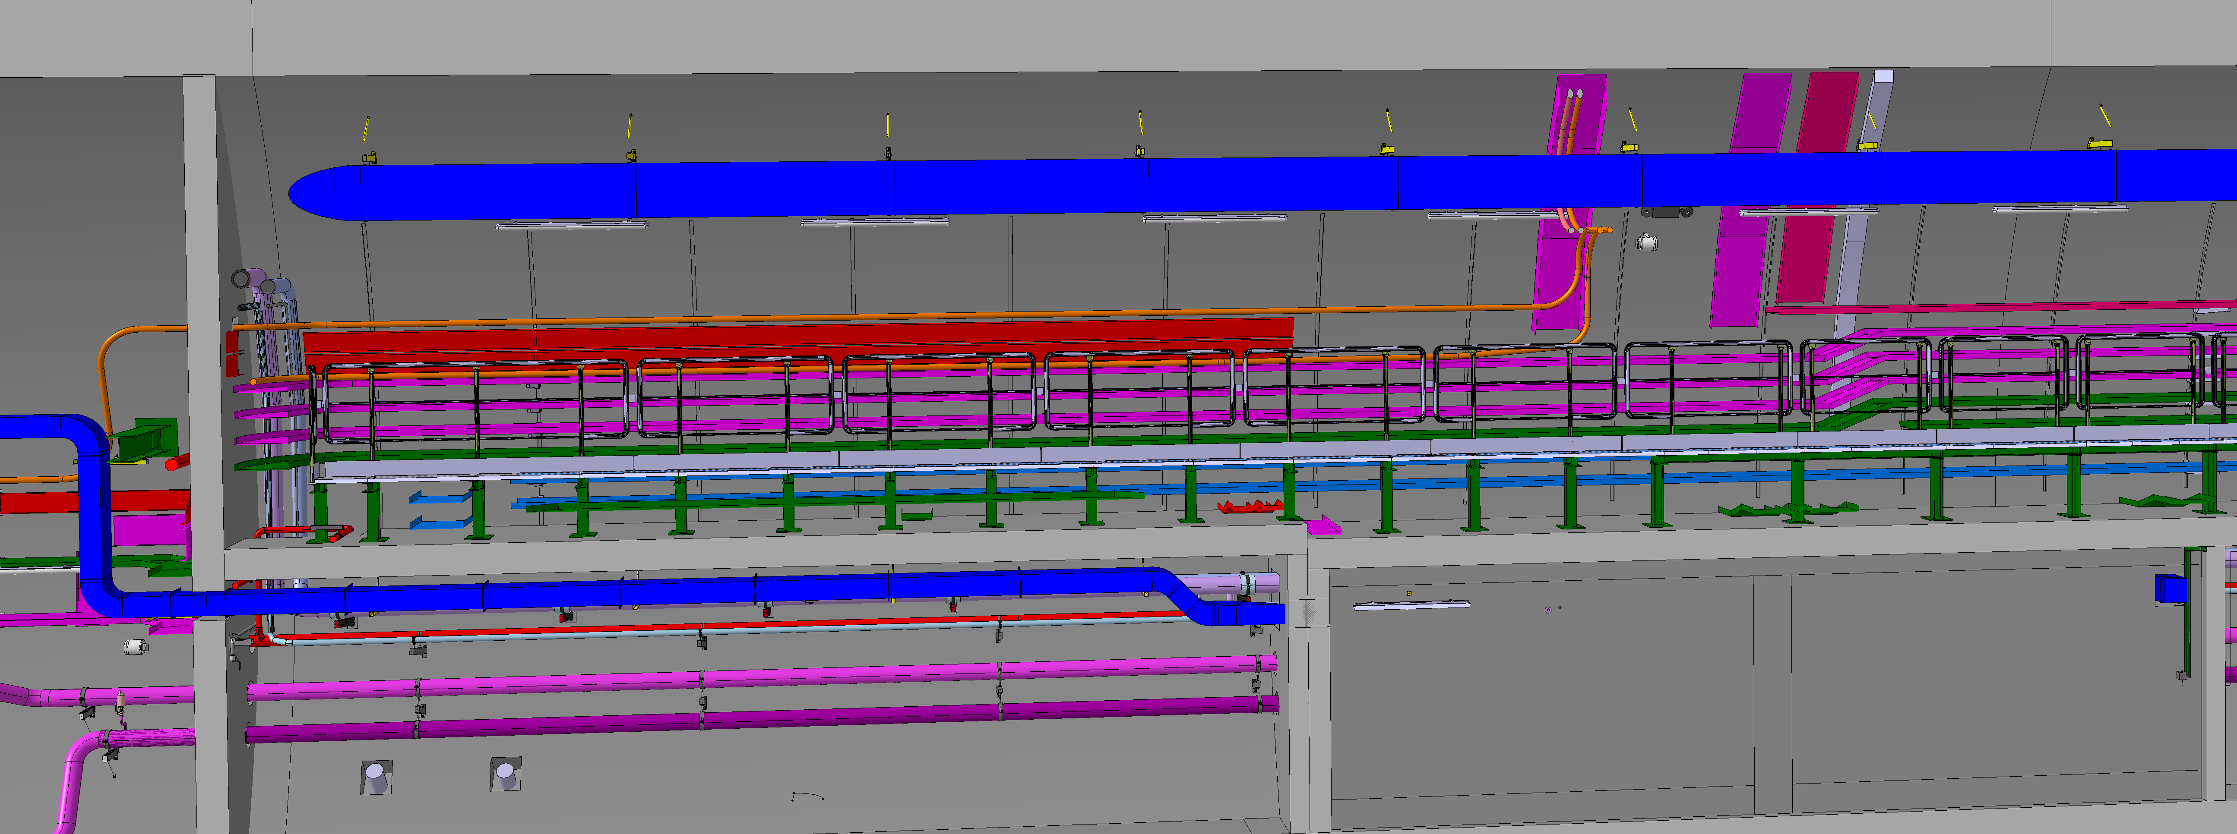

Slide 32
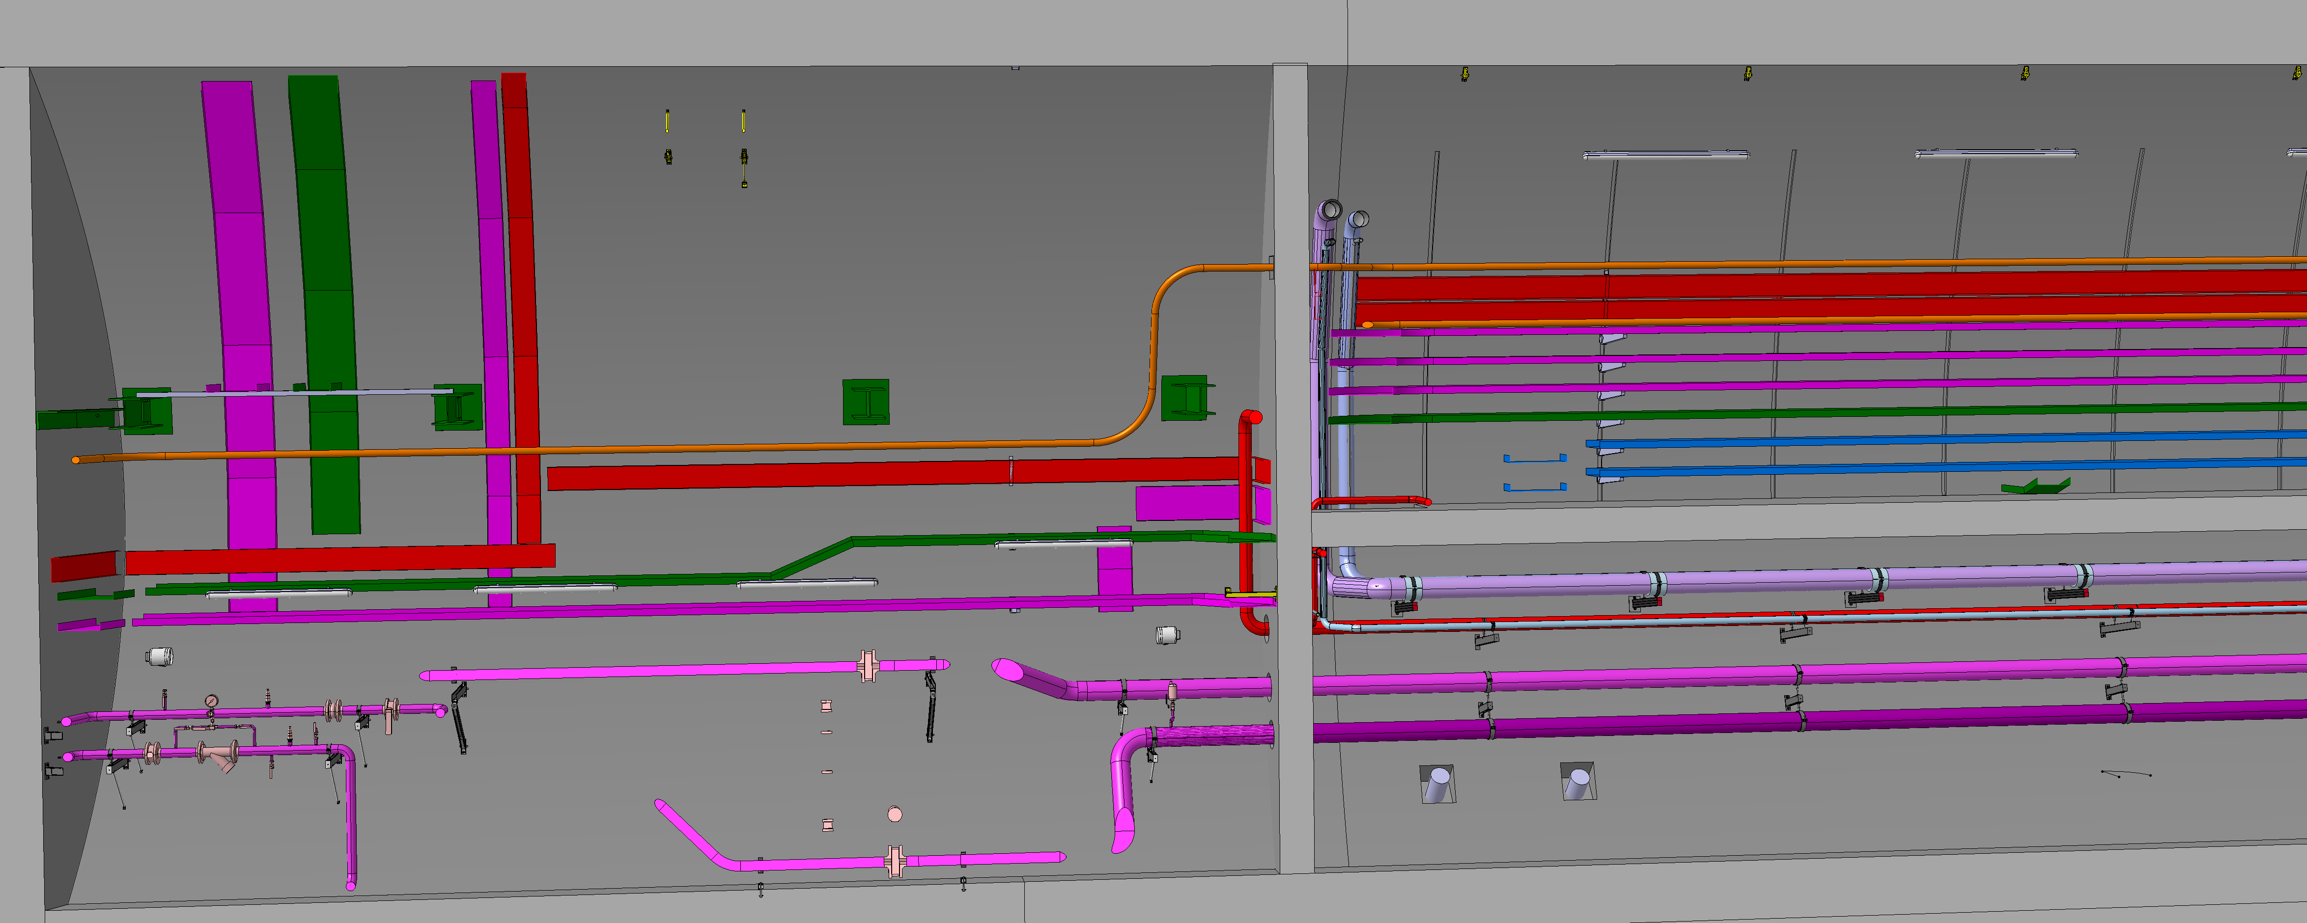

Slide 33
