Slide 1
Beam pipe rope support from YE1
Mockup 1:1 design
Ali Karaki - CMS Engineering and Integration Office
28/04/2025

Slide 2
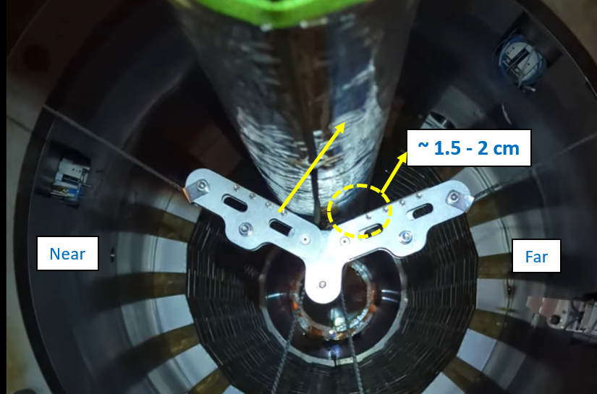
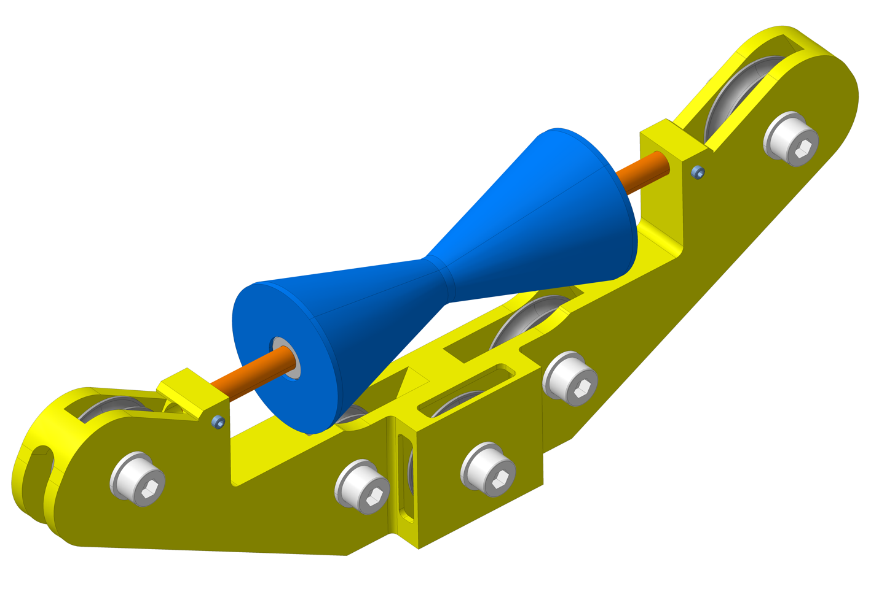
Aim and scope
During the recent test of the support in the cavern, a horizontal displacement of the beam pipe was observed when the support got in contact, indicating a force transfer from the support to the beam pipe due to a constrained degree of freedom.
To address this issue, a new interface design was proposed to add the missing degree of freedom.
Additionally, it was agreed to construct a full-scale (1:1) mock-up. This will allow for testing the new solution and provide an opportunity to manipulate the support and identify any other potential issues.

Slide 3
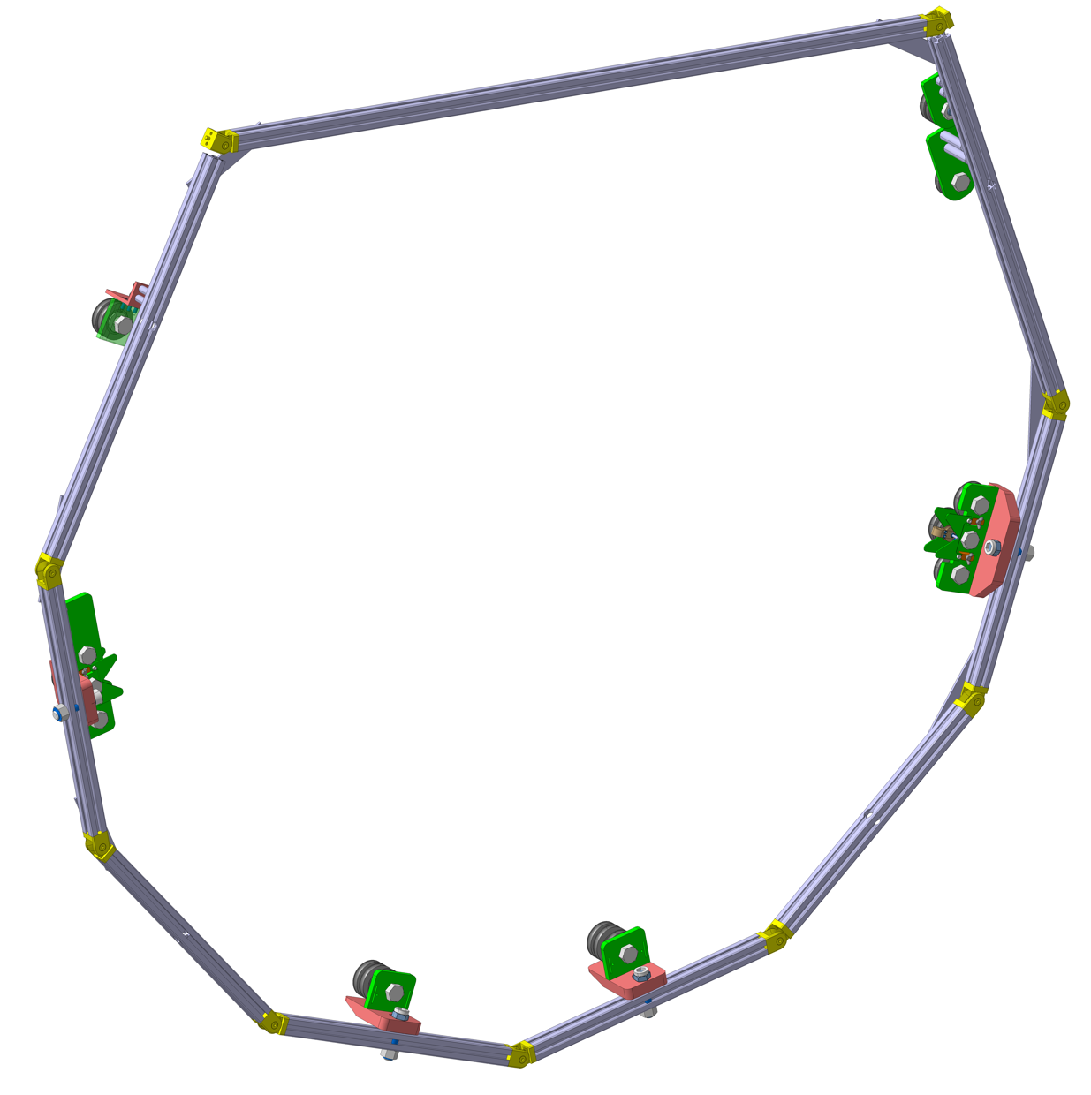
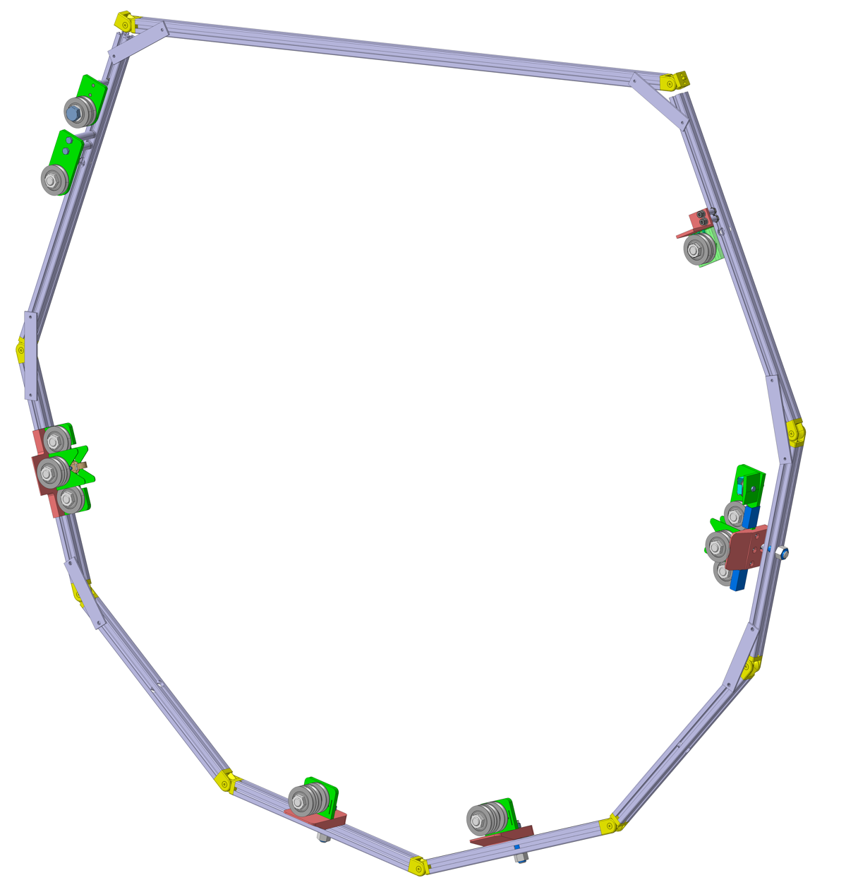
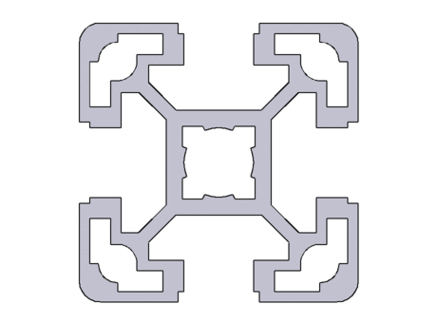
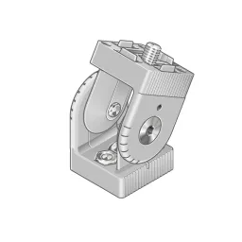
Main frame
Front
Back
Bosch profile 30x30
Reinforcement plates
Articulation 30x30
Pulleys blocks

Slide 4
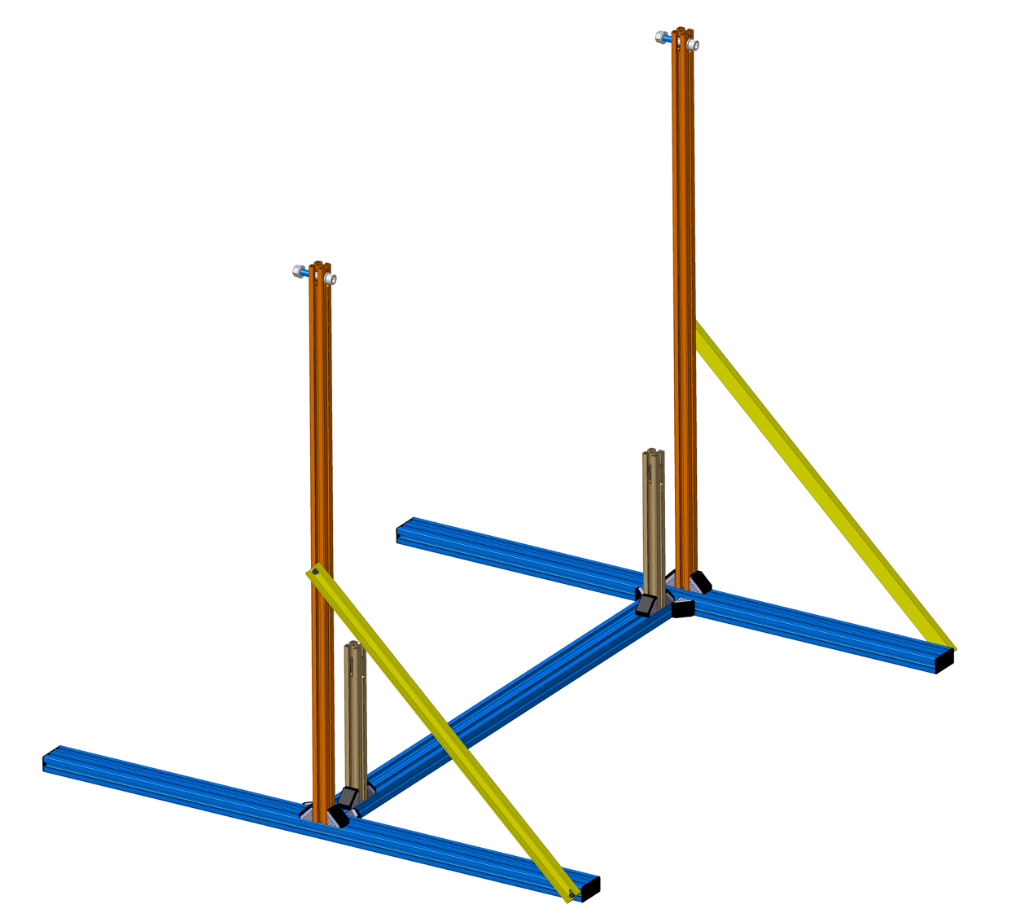

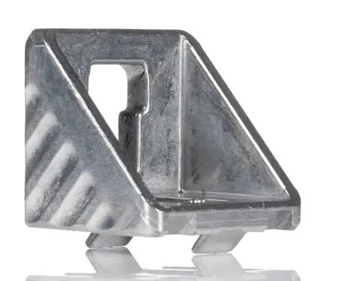
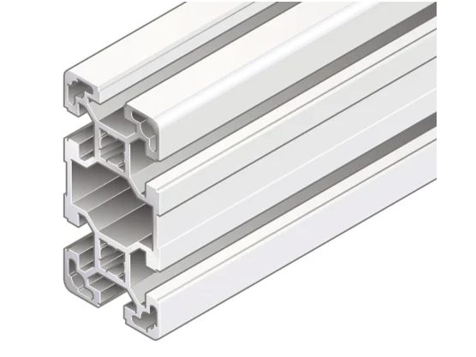
Support frame
Bosch profile 40x40
Chanel section
1750
Angle bracket
Bosch profile 40x80
1600
1500

Slide 5
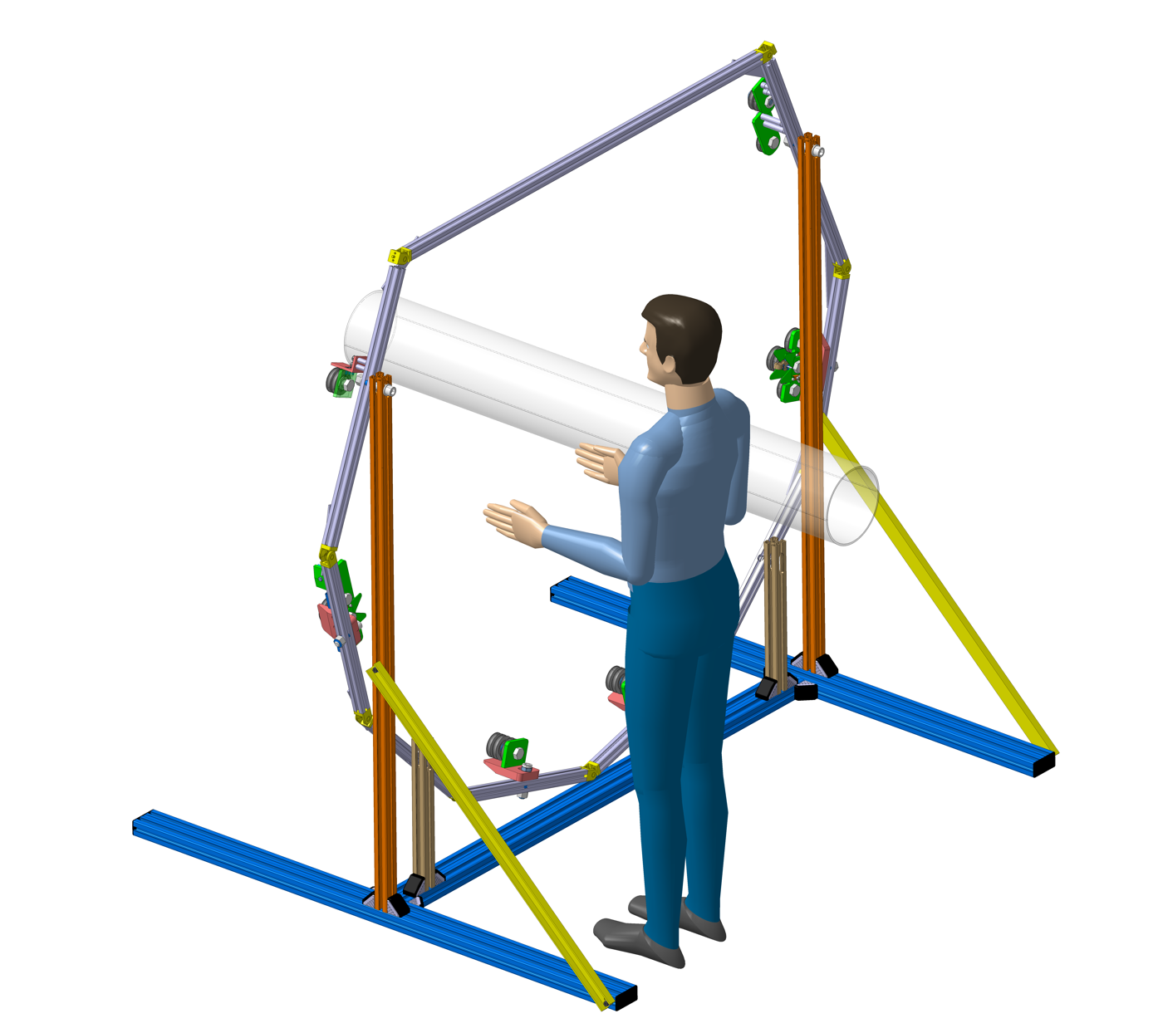
Full Mockup
Plexiglass tube D200
5.5 Kg
The two frames are joined together with 4 screws.
A plexiglass tube installed at the centre to represent the beam pipe and attached with wire ropes to the frame.
The machining can be done at P5.
The final assembly can be placed either in b.904 or b. 113
Connection
screws

