Slide 1
TCDS – ECR 3294522
Presenter Name
Date

Slide 2
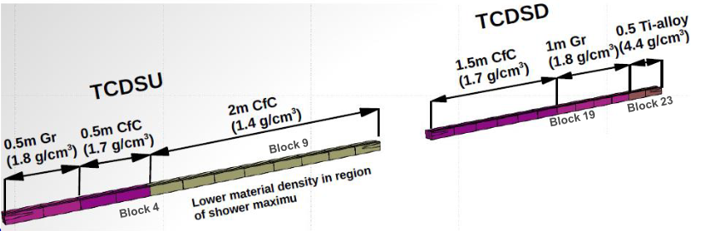

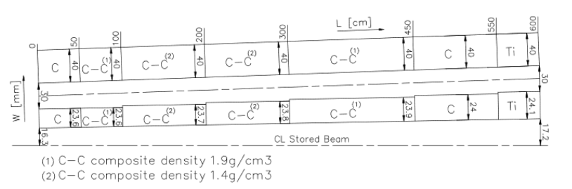
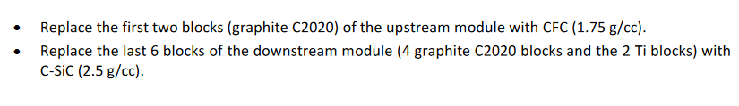
TCDS
1.5 m of C-SiC @ 17 – 17.3 mm from beam axis

Slide 3
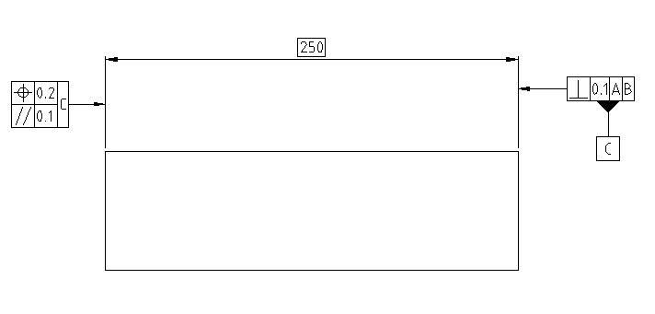
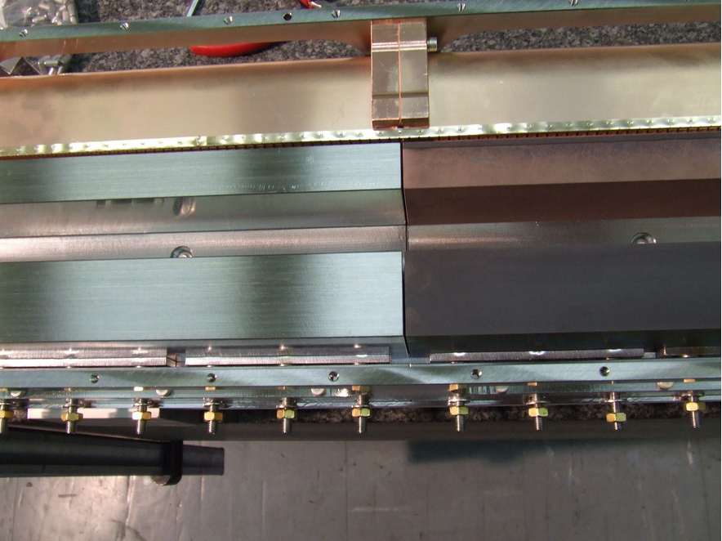
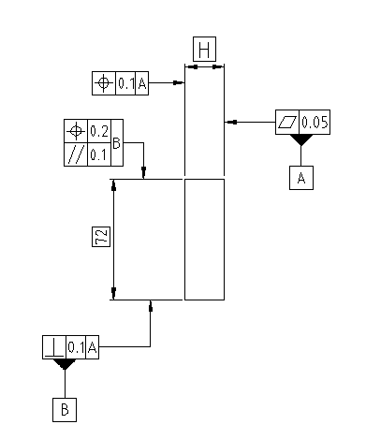
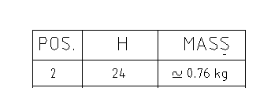
C blocks geometry
4 blocks
Cu coated?

Slide 4
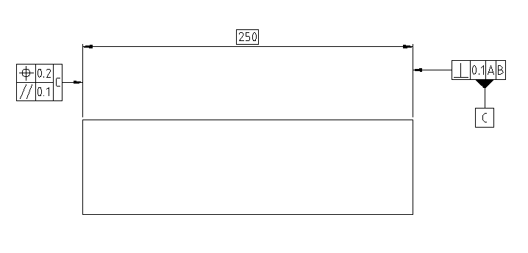
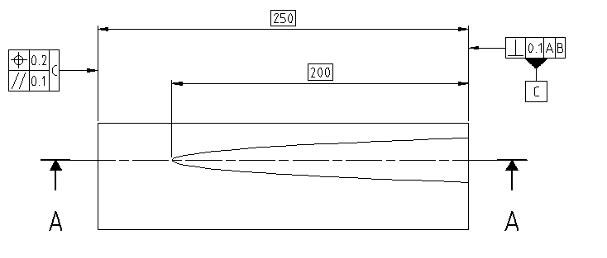
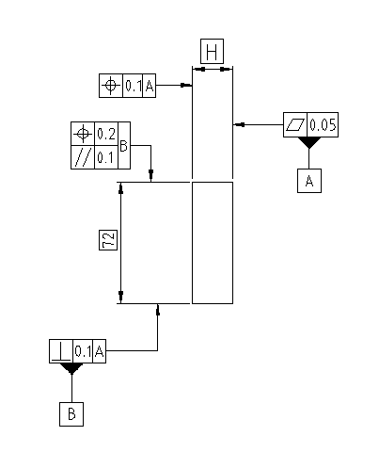
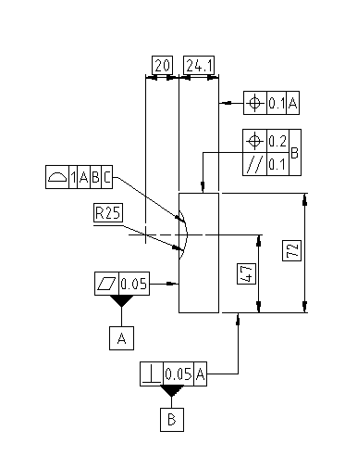
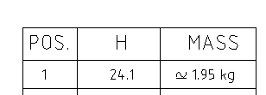
Ti blocks geometry

Slide 5
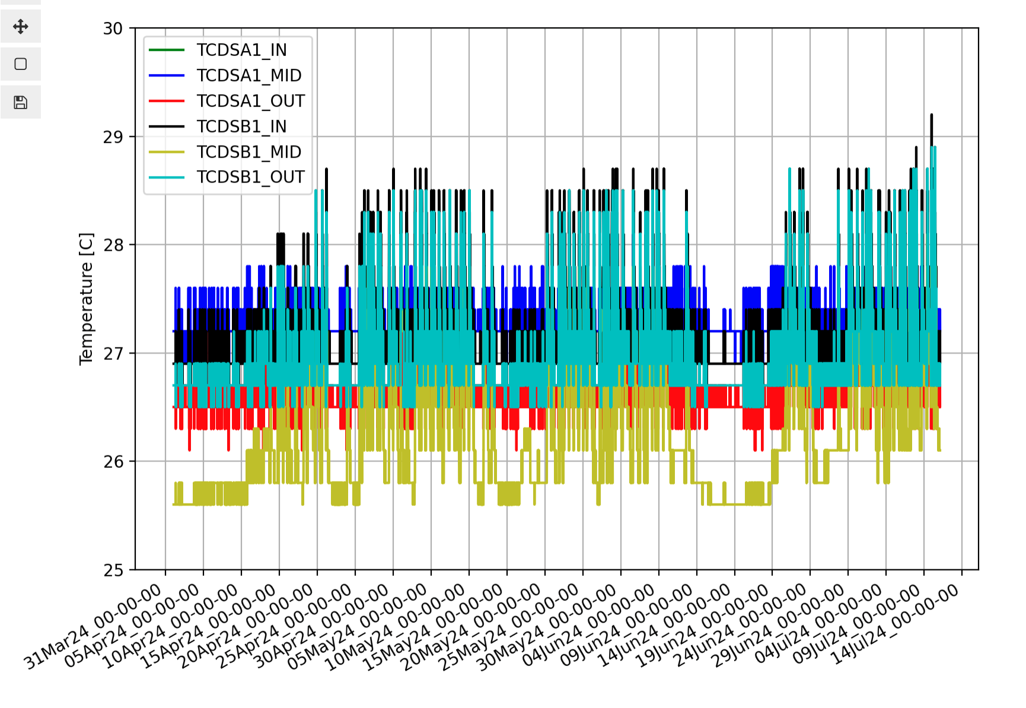
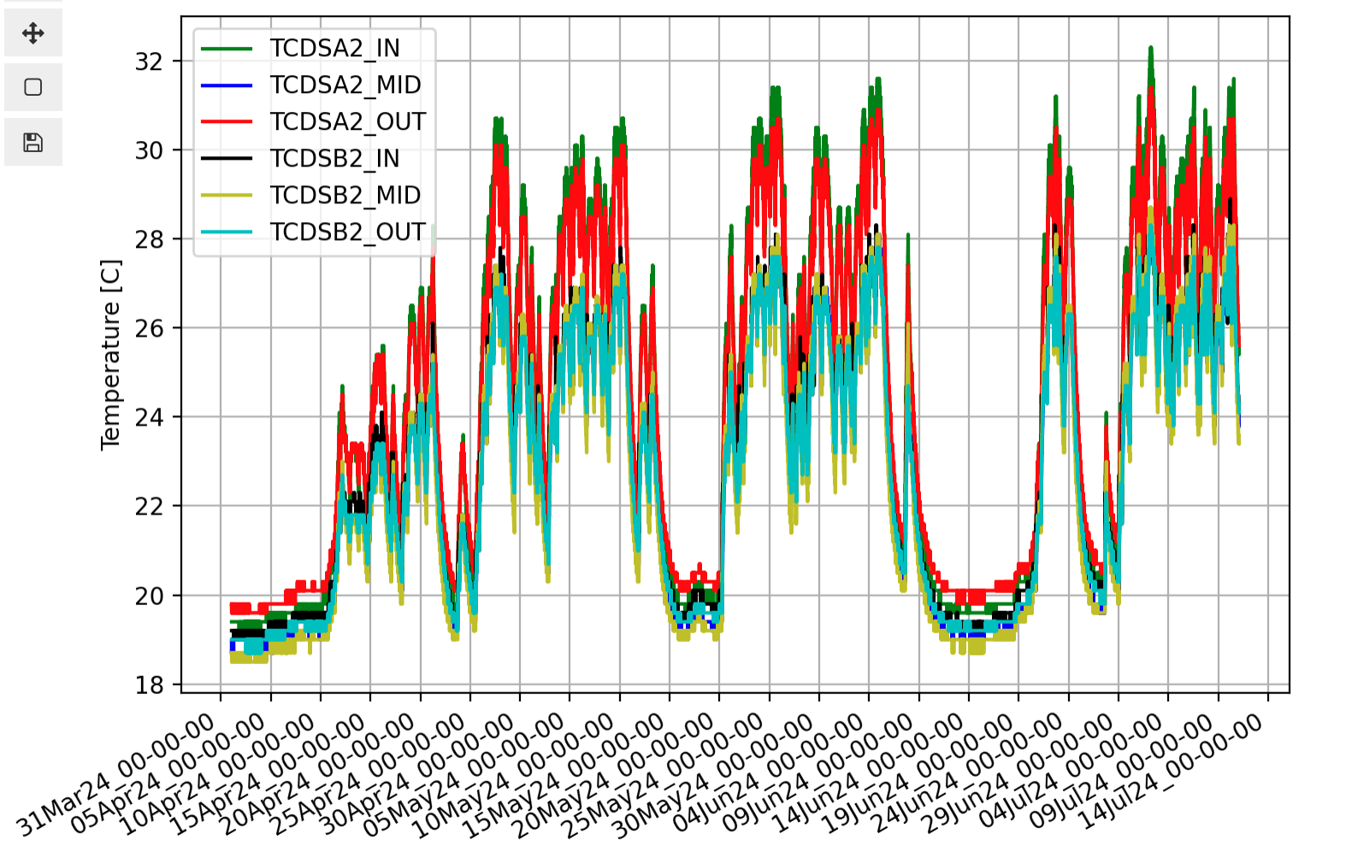
Operational Temperature (up to 4E14 p+)
With cooling
Without cooling
~ 2 ∘C temperature increase
Resistive wall?
~ 13 ∘C temperature increase

Slide 6
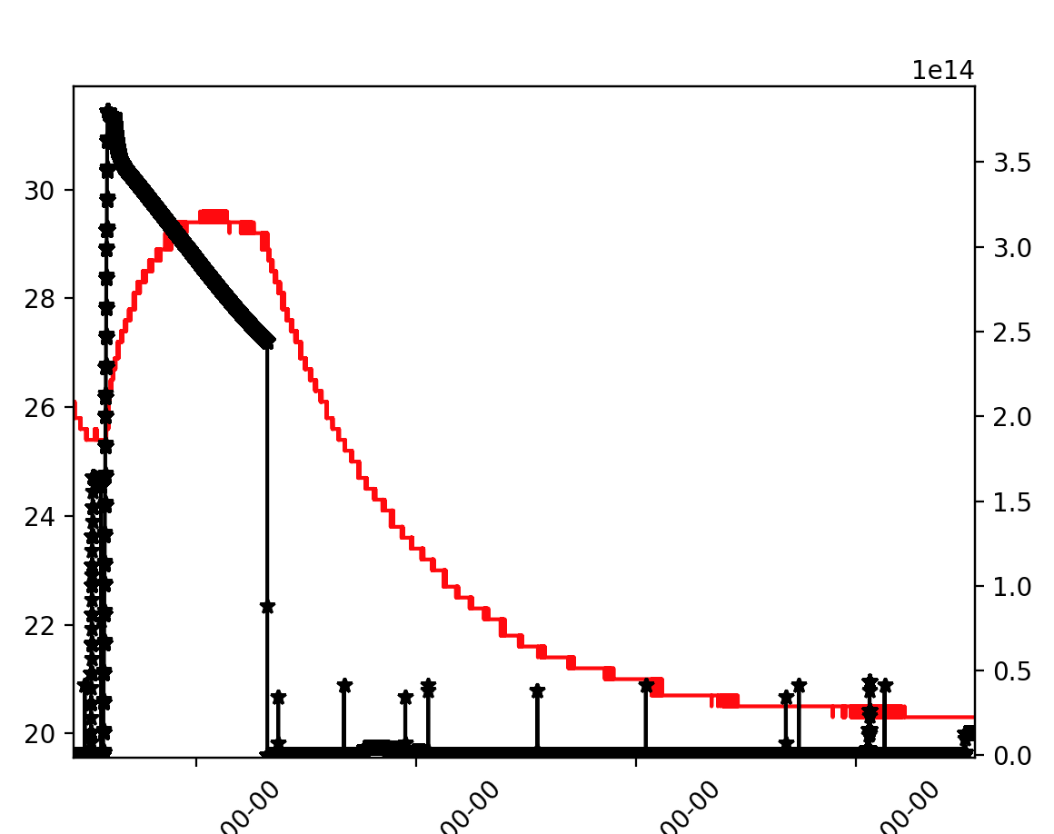
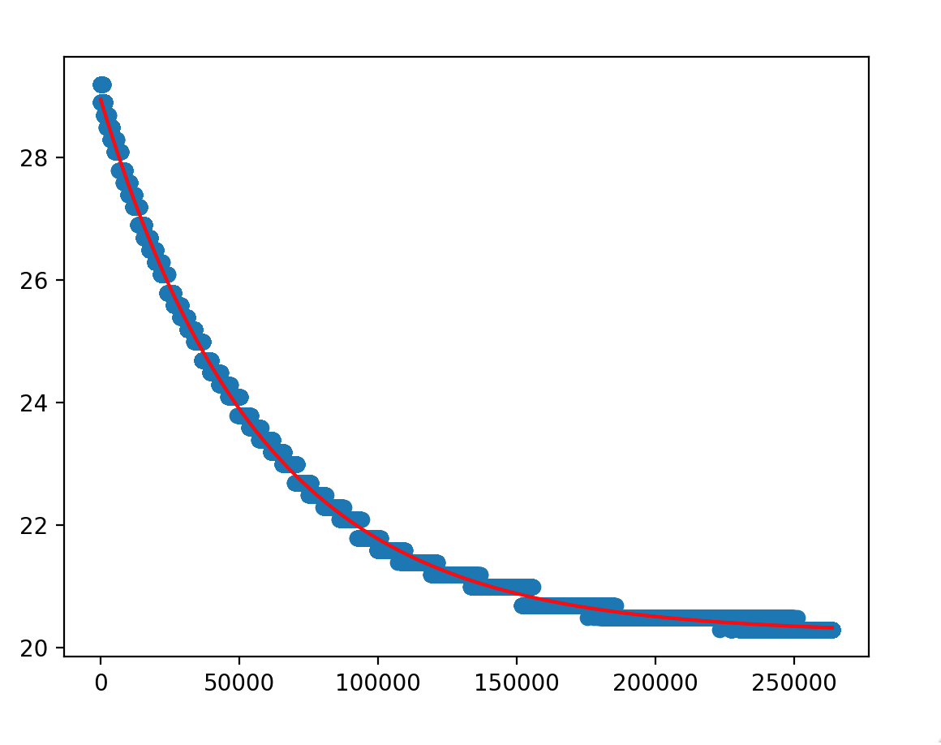
Cooling time
Tau ~ 16 h

Slide 7
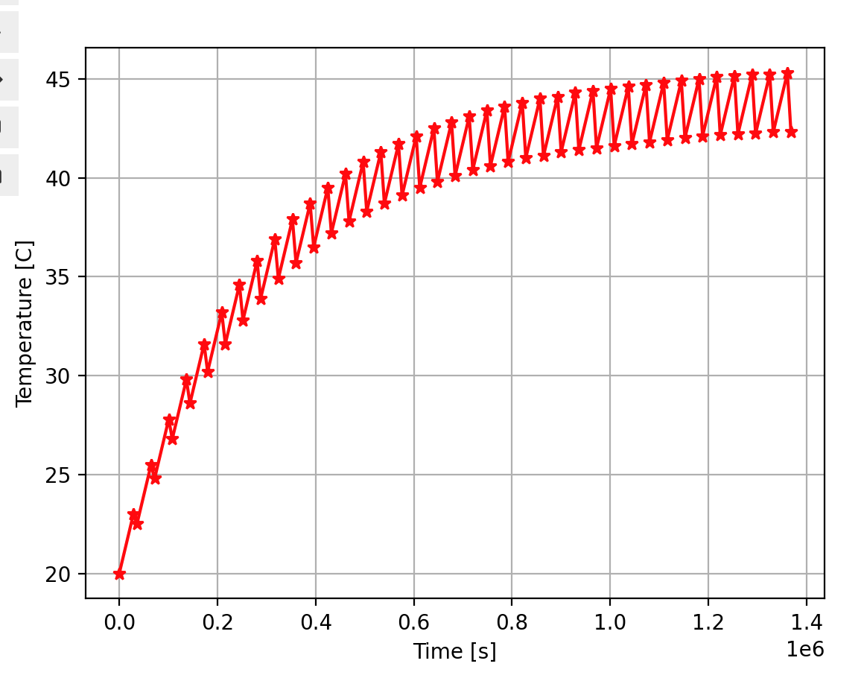
Temperature evolution
Assumptions: consecutive 8 h fills with 2 h between consecutive fills and burn-off due to collisions
Max T ~45 C assuming present material
Max DT = 25 C for 3.7e14 p+
Assuming twice intensity ➔ Max DT ~ 100 C
Heating depends also on bunch length, burn-off rate etc.

Slide 8
Feedback on C-SiC properties
G. Banks

Slide 9
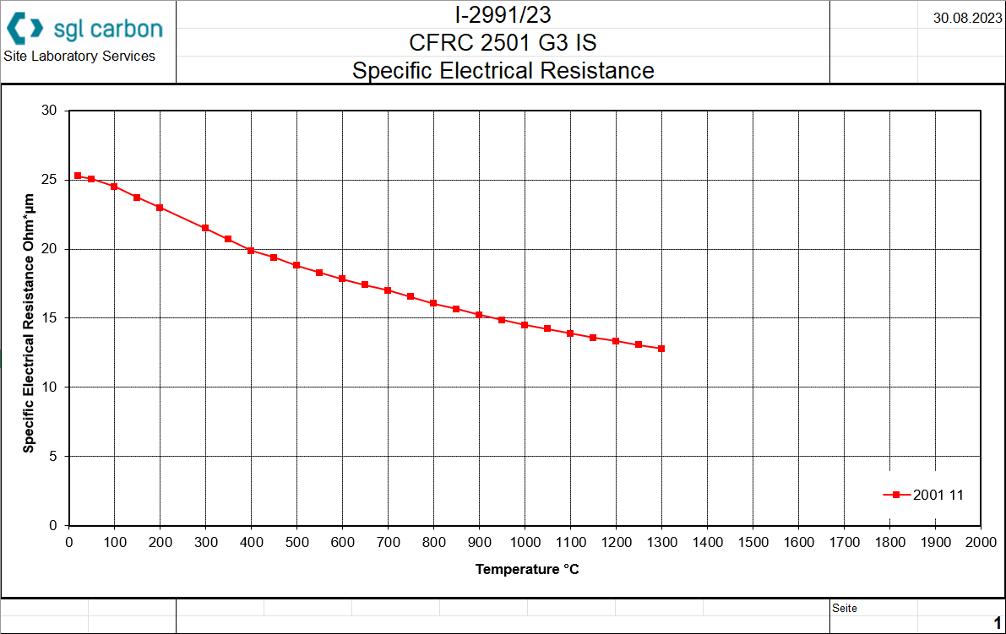
Data sent by Supplier
NOT the same grade as expected to be used in the TCDS
The properties shown here are for:
Long fibres
Low density (1.8 g/cm3)
Whereas the grade assumed for the TCDS is:
Short fibres
Medium matrix density
(2.5 g/cm3)

Slide 10
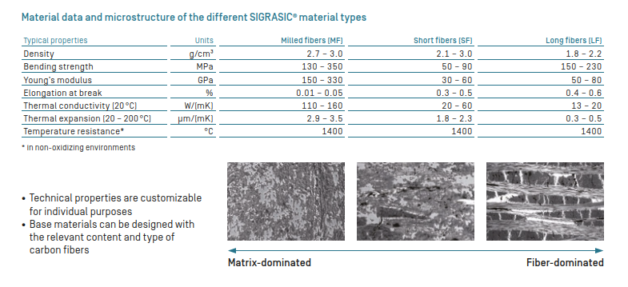
Material properties
Grade studied in HiRadMat and assumed for TCDS design
Electrical conductivity curve given for this grade

Slide 11
Conclusions/recommendations
Electrical conductivity of the TCDS material could be lower than the one given here
  Carbon fibres dominate electrical conductivity – shorter fibres lead to lower conductivity
  Higher density ceramic matrix unlikely to have large contribution to electrical conductivity
Clear that characterisation must be done on actual material
  Tests are simple and can be performed by MME
Properties given likely for in-plane (orientated with fibres) direction
  Through-plane (normal to fibres) direction should have much lower conductivity
This study: https://www.degruyterbrill.com/document/doi/10.1515/ijmr-2003-0165/html?lang=en indicates that electrical conductivity can reduce significantly if damaged
  TCDS should not nominally experience damage during operation, but this should be considered in the failure effects + possible impact assessed

Slide 12
Open Questions and next steps
Effect of impedance: beam induced heating and/or instabilities
Expected heating wrt today with/without coating
Do we need Cu coating for the last 6 blocks at least?
Need electrical characterization of actual material (effect of damage on electrical conductivity)
Long-fiber lower density instead of short-fiber medium density good from potin of view of energy deposition (@ TCDS and MSD), mechanical properties, etc.
More tests?

