Slide 1
Feedback on C-SiC properties
G. Banks

Slide 2
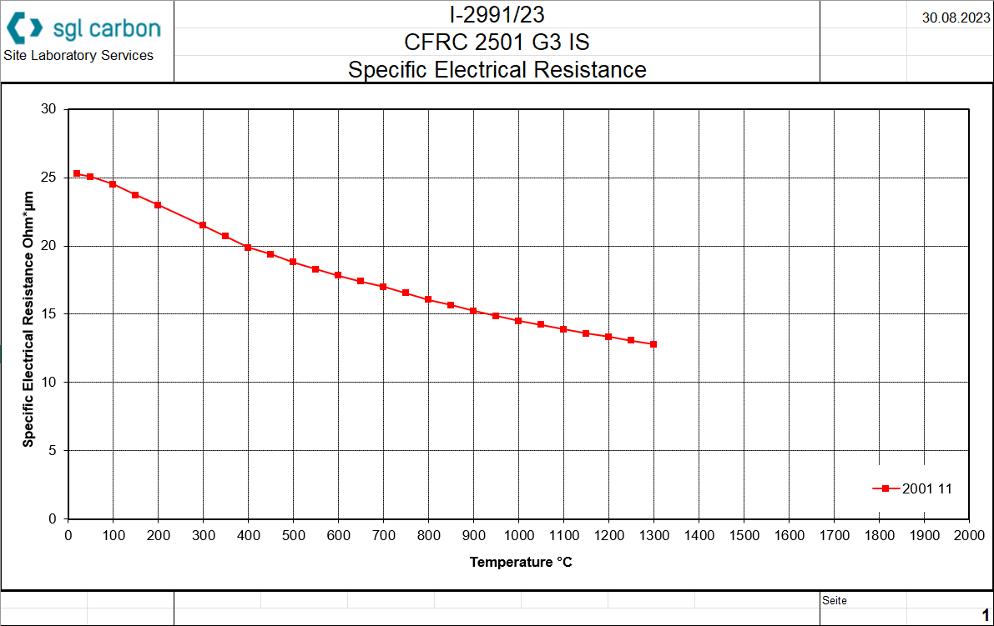
Data sent by Supplier
NOT the same grade as expected to be used in the TCDS
The properties shown here are for:
Long fibres
Low density (1.8 g/cm3)
Whereas the grade assumed for the TCDS is:
Short fibres
Medium matrix density
(2.5 g/cm3)

Slide 3
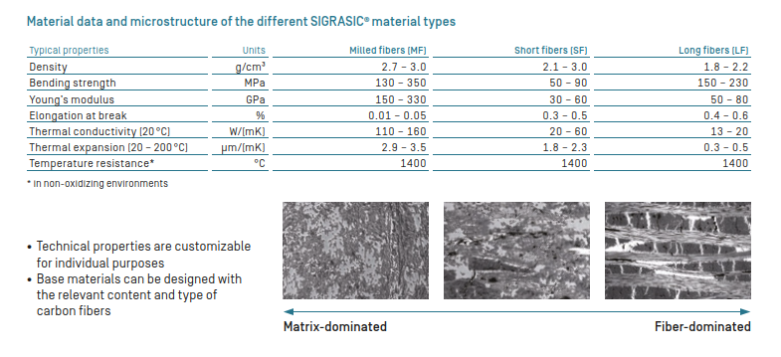
Material properties
Grade studied in HiRadMat and assumed for TCDS design
Electrical conductivity curve given for this grade

Slide 4
Conclusions/recommendations
Electrical conductivity of the TCDS material could be lower than the one given here
  Carbon fibres dominate electrical conductivity – shorter fibres lead to lower conductivity
  Higher density ceramic matrix unlikely to have large contribution to electrical conductivity
Clear that characterisation must be done on actual material
  Tests are simple and can be performed by MME
Properties given likely for in-plane (orientated with fibres) direction
  Through-plane (normal to fibres) direction should have much lower conductivity
This study: https://www.degruyterbrill.com/document/doi/10.1515/ijmr-2003-0165/html?lang=en indicates that electrical conductivity can reduce significantly if damaged
  TCDS should not nominally experience damage during operation, but this should be considered in the failure effects + possible impact assessed

