Slide 1
Metallurgical investigation and analysis needed for ET beampipe
Prepared by: M. Dakshinamurthy
Contributions from: A. T. Pérez, S. Sgobba, P. Chiggiato, R. Misler, G. Favre,

Slide 2
Corrosion testing
Material | Ferritic stainless steel 441 & 444 |  | Austenitic stainless steel 304 L |  | Austenitic filler 317L
Electro chemical test | Base material |  |  |  | With weld bead
Chemical test | Weld (with 317L and without filler) |  | Without filler weld |  | -
 | TIG | Laser | TIG | Laser
Corrosion testing campaigning with CETIM (FR)
  Standardised quantitative tests
  Inc. characterization (microscopy, chemical analysis, etc..)
  Electro chemical test, chemical test,
  Sample extraction based on standards
Other tests: samples for installation sites
  20 cm X 20 cm base & welded material
  AISI 441, 444, 304L
Water analysis from different sites
  Evaluate chemical composition
  Determine elements/compounds detrimental for each material
  Provide direction for material selection
  Define further tests based on installation site water sampling
**All material will be with 3 mm thickness

Slide 3
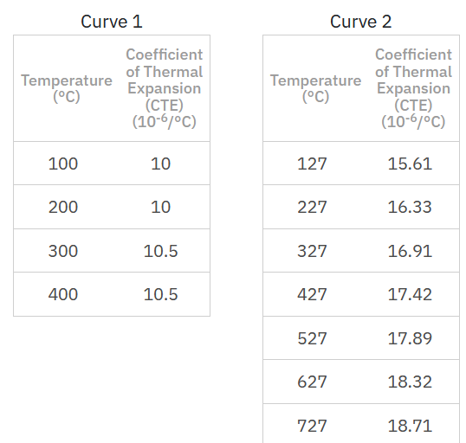
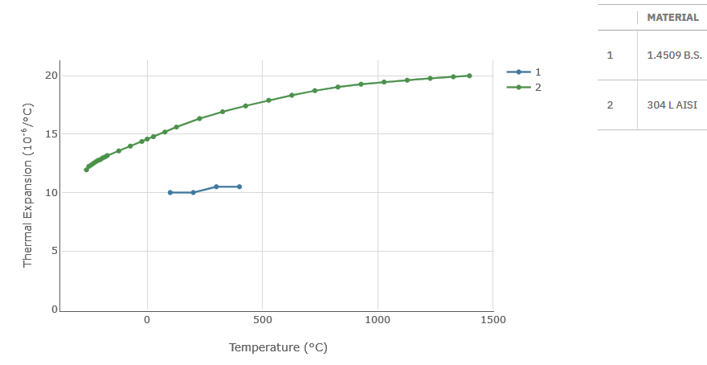
Metallurgical and mechanical studies
Residual stress analysis of the welded component
  Evaluation of the internal stress induced during welding and heat treatment for PS ferritic components welded with austenitic filler material
  Influence of different thermal expansion coefficient.
  Simulate different heating and cooling cycles (i. e. bake out)
  Evaluation methods → XRD, SEM-EBSD
Microstructure and mechanical analysis
  Effect of forming, welding approach and heat treatment on microstructure and mechanical properties
  Impact test → effect of heat treatment on impact toughness of welded samples
Ductile to Brittle transition in ferritic SS
  Effect of operation temperature on mechanical properties (e.g. in CE conditions)
Further optimization of welding parameters
  To limit grain coarsening and improve corrosion resistance
Source Total materia

Slide 4
Metallurgical and mechanical studies
Microstructure and mechanical analysis
  Effect of forming, welding approach and heat treatment on microstructure and mechanical properties
  Impact test → effect of heat treatment on impact toughness of welded samples
  Proposed tests→ Charpy test on welded and heat-treated samples @ room temperature, tensile tests.
Ductile to Brittle transition in ferritic SS
  Effect of operation temperature on mechanical properties (e.g. in CE conditions)
  Proposed test → Charpy test on base material and welded samples @ different temperatures
Further optimization of welding parameters
  To limit grain coarsening and improve corrosion resistance
Source Total materia

