Slide 1
My activities - the ET pilot sector
Purnalingam Revathi
Working with Carlo Scarcia, Jan Hansen, Ivo Wevers, Sophie Meunier, Manjunath Dakshinamurthy, Paolo Chiggiato
05/06/2025

Slide 2
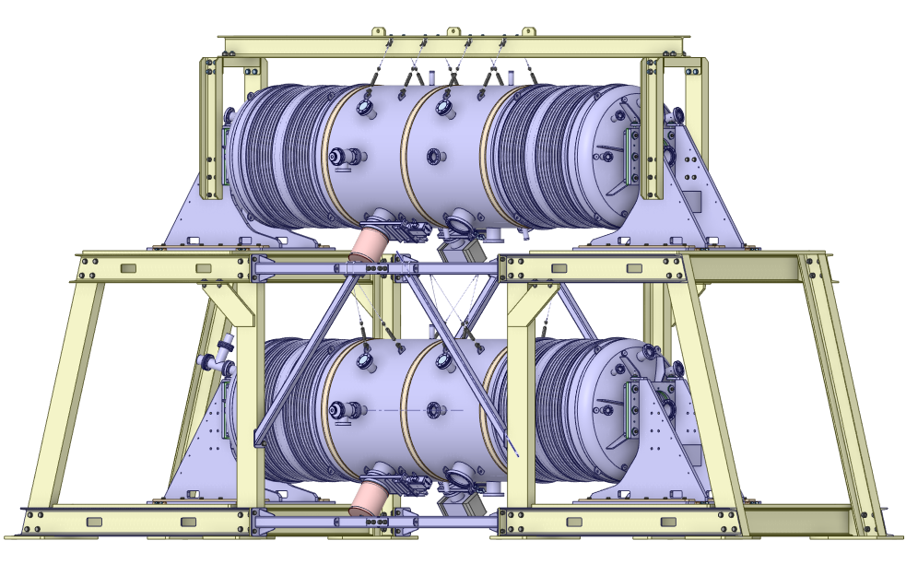
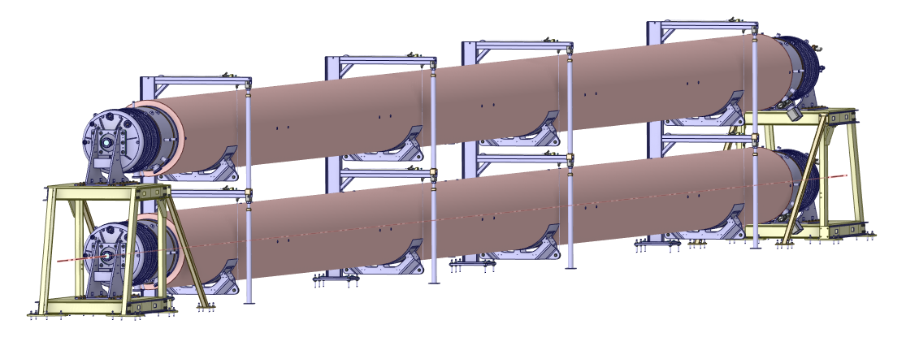
Introduction: ET pilot sector components
The ET pilot sector will be assembled and tested in two phases.
Pumping module
Bellows
End cap with Instrumentation
Phase 2 / ET Pilot Sector
Phase 1 / Background

Slide 3
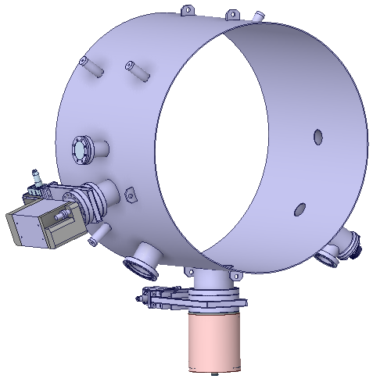
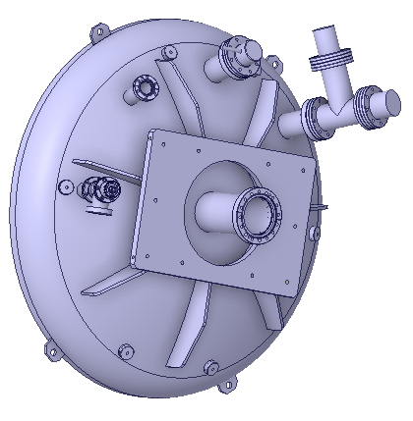
Introduction: Impact of valves and instrumentation
The ET pilot sector (also in ET) will be equipped with instrumentation (RGA, BA gauges) and isolating valves.
The isolating valves are essential to replace any defective instrumentation and pumps without the
need for additional bakeouts.
In the ET pilot sector, we have FKM (viton) sealed gate valves (x 2) and all-metal right-angle valves for isolation (x 2)
along with an RGA and a BA gauge.
It is necessary to know the impact of these components on the pilot sector outgassing rate budget.
Pumping module
BA gauge
RGA
Angle valve
Angle valve
Gate valves

Slide 4
Outgassing rate and calibration Inventory [08/04/2024 – 23/04/2025]
Objectives:
Conditioning and outgassing rate measurements of all the valves and non-ferritic StS components.
Outgassing rate measurements and calibration of the instrumentation (RGA, BA gauges).
Element | Type | Degassing treatment | Measurement
 |  |  | Total (Open/Closed) | Background
DN40 AV | All metal | 250°C for a week | ✓ | ✓
DN63 AV |  |  | ✓ | ✓
DN100 GV | FKM seal | Valve flange at 200°C and valve body at 140 °C for a week | ✓ | ✓
DN150 GV |  |  | ✓ | ✓
AV: Angle Valve; GV: Gate Valve; RGA: Residual Gas Analyzer; BA gauge: Bayard-Alpert gauge

Slide 5
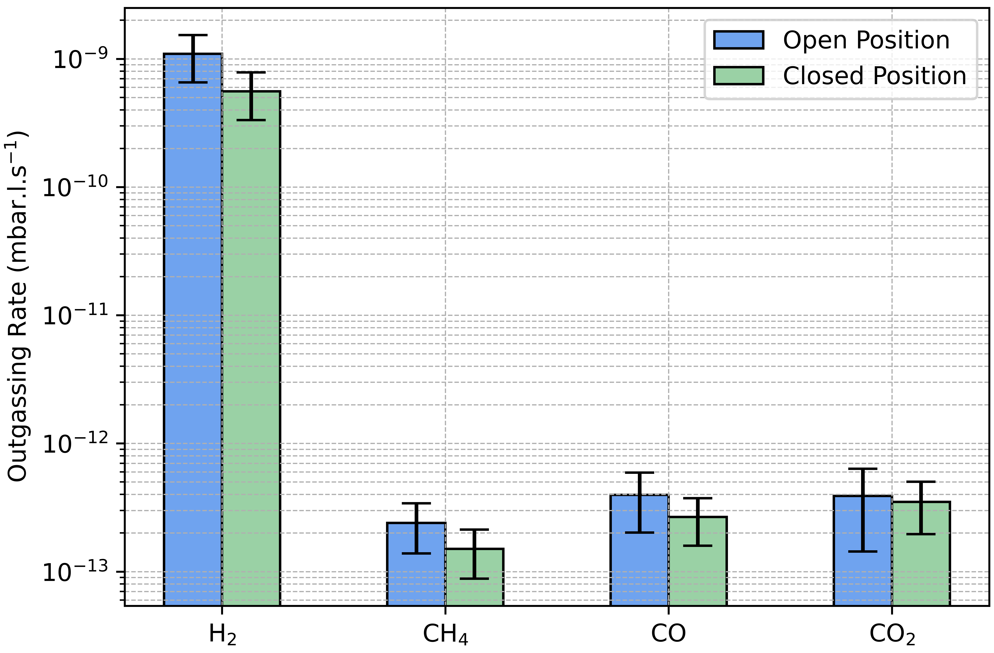
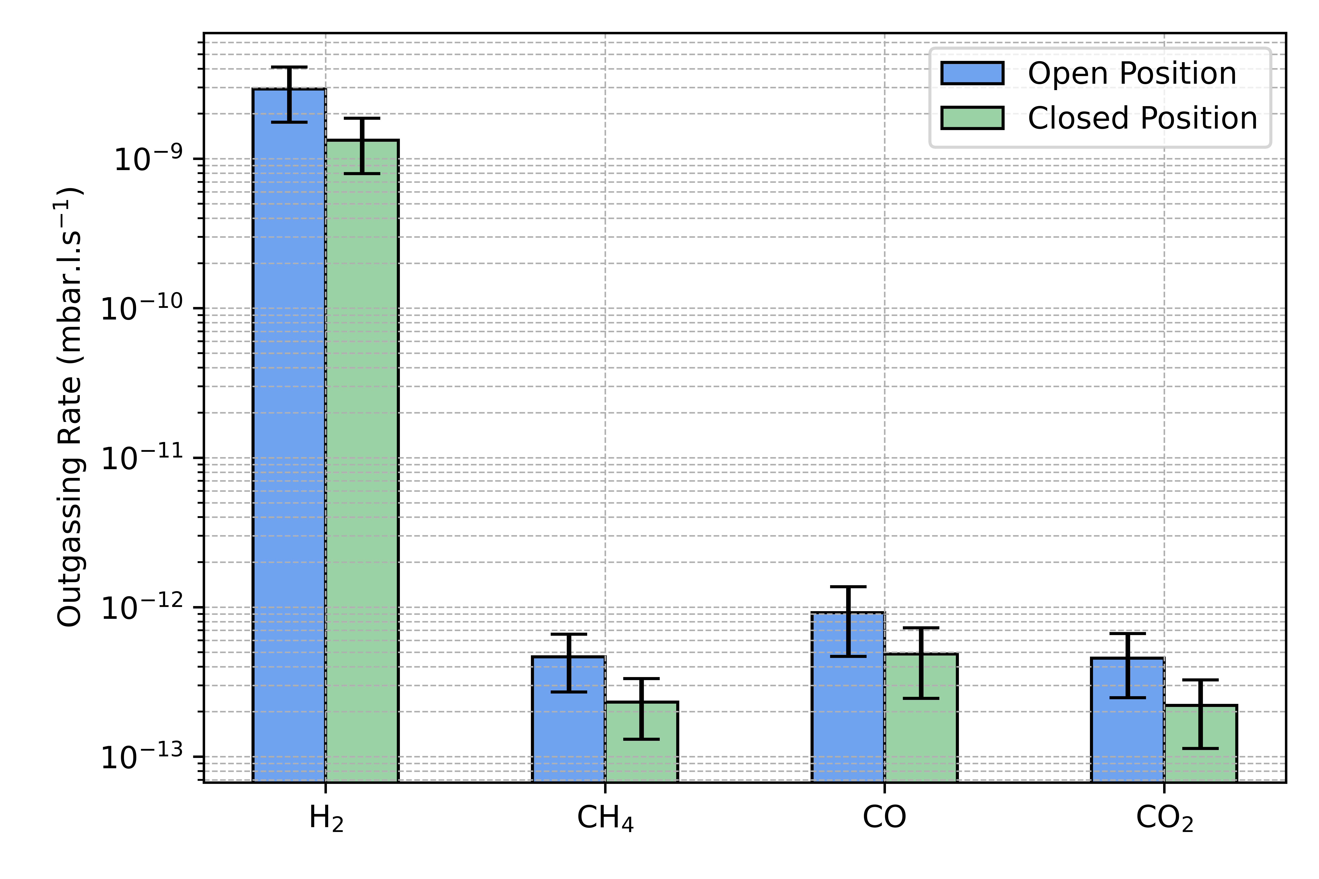
Outgassing rate – Angle valves
The results shown are for a single valve.
DN40 angle valve
DN63 angle valve

Slide 6
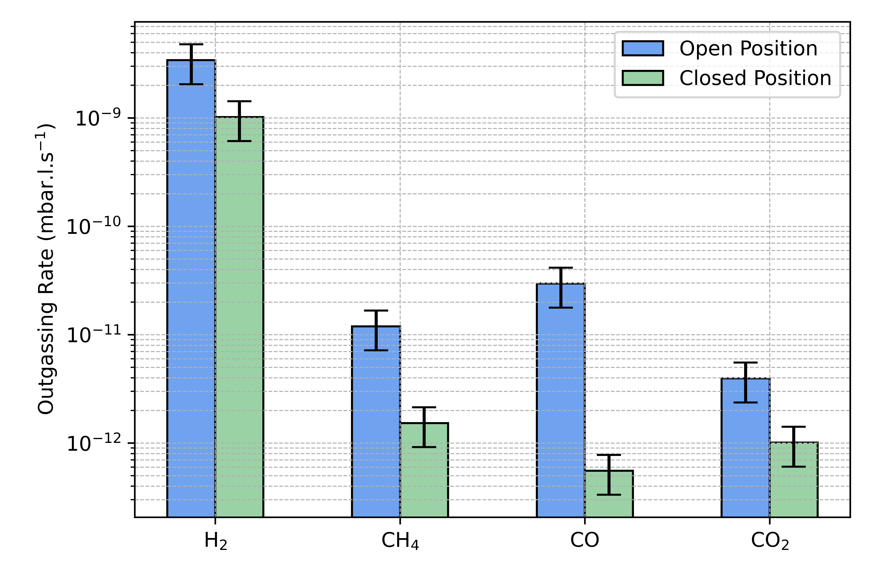
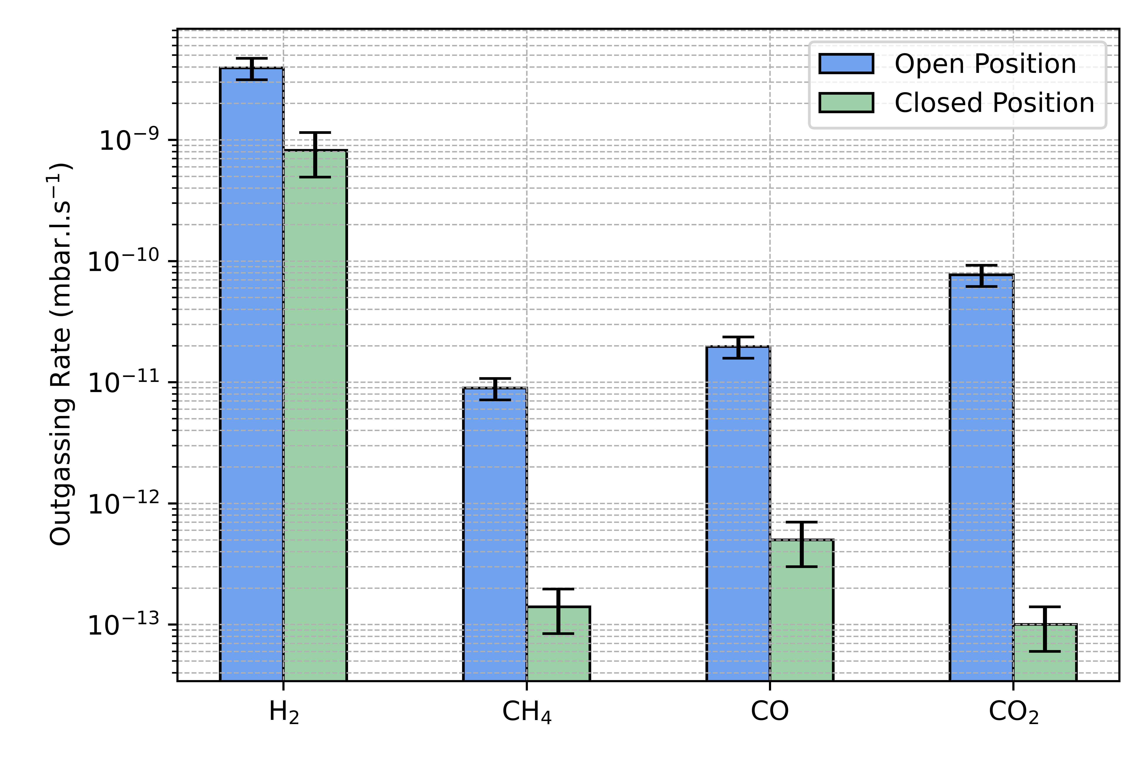
Outgassing rate – Gate valves
The results shown are for a single valve.
DN100 gate valve
DN150 gate valve*
*CO₂ outgassing rate in open position measured using the throughput method.

Slide 7
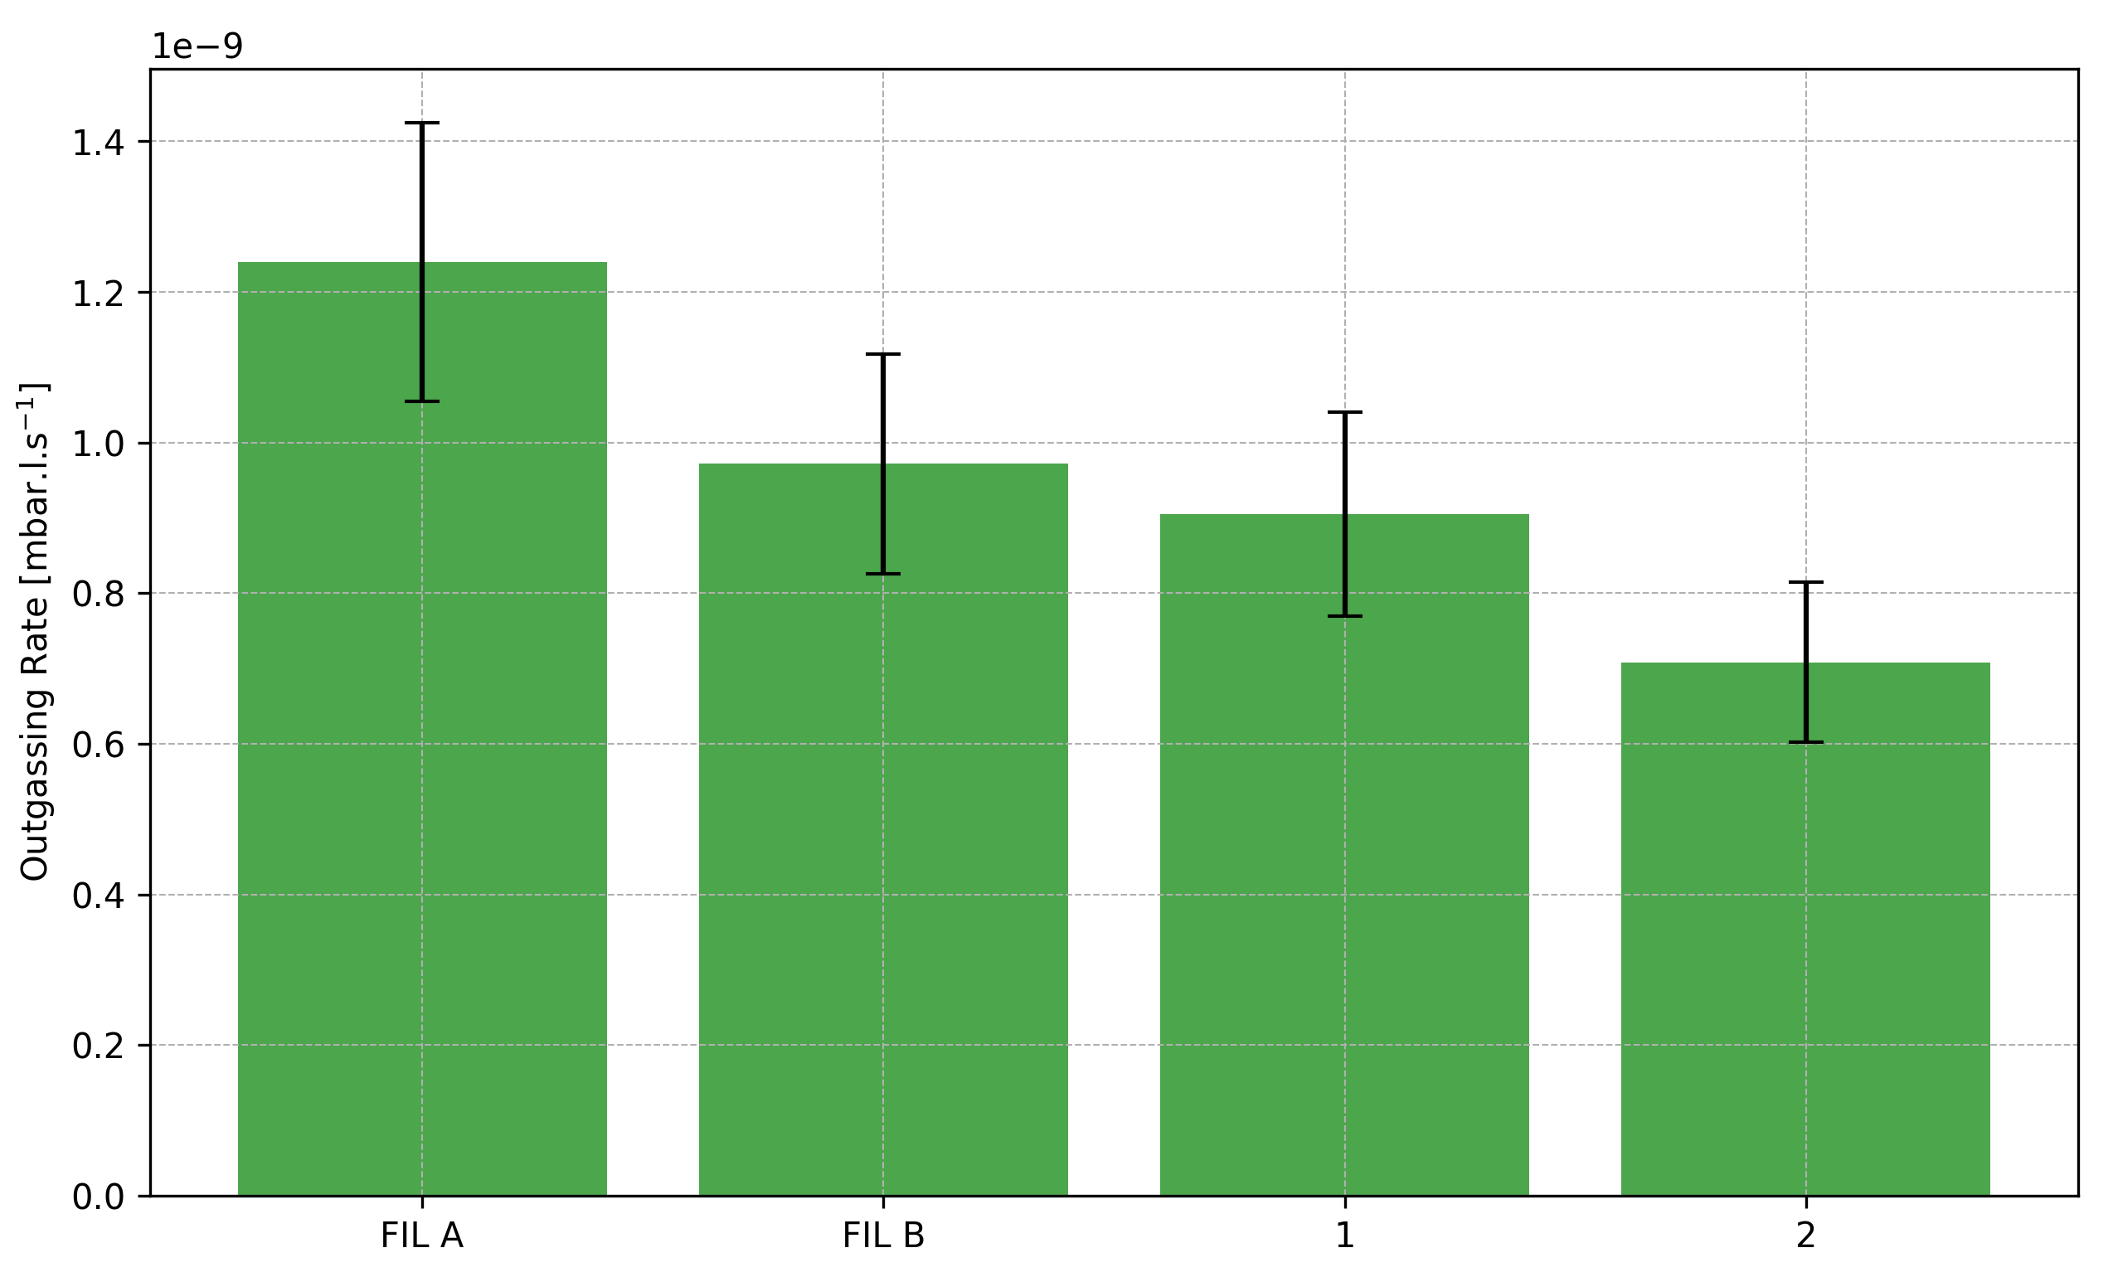
Instrumentation – Outgassing Rates
RGA: QMA125
B-A gauge: SVT

Slide 8
Outgassing Rates - Equivalence
Outgassing rate of RGA, BA gauge (SVT), and DN40 angle valve equivalent to the total length of the pilot sector tube made of AISI 441.
The outgassing rate of AISI 441 is considered here: 1E-15 mbar.l.s⁻¹.cm⁻²

Slide 9
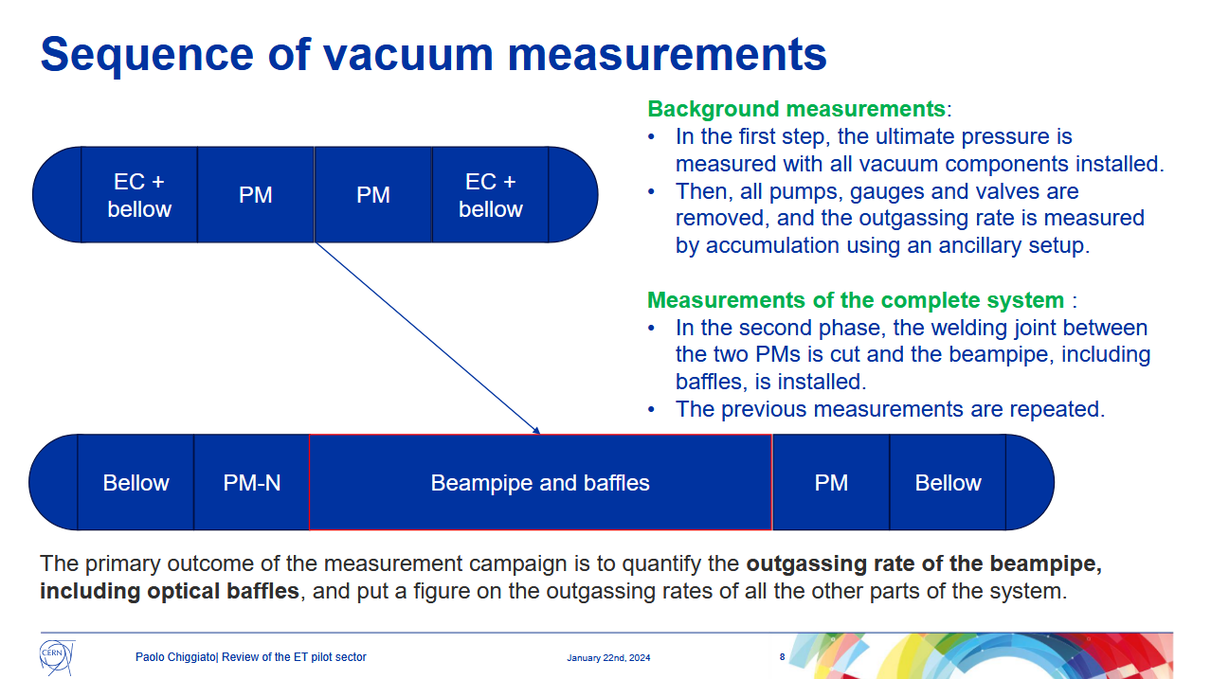
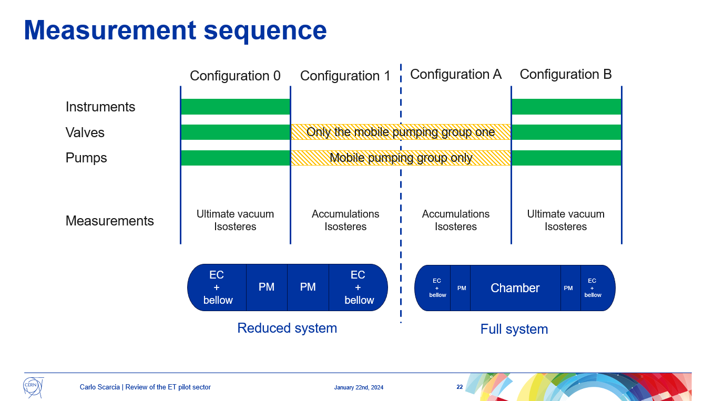
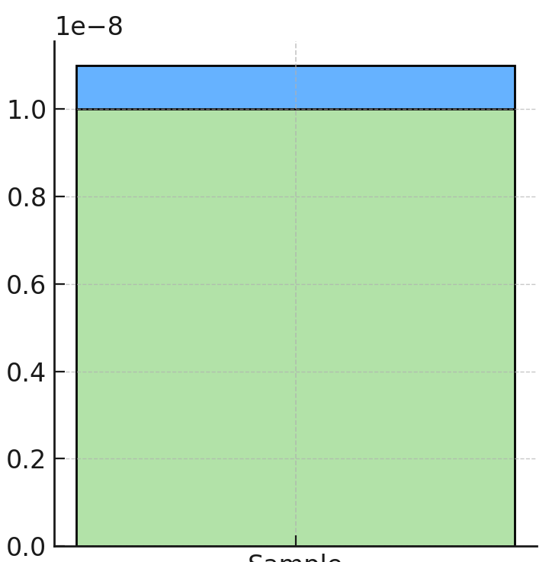
Partial Conclusions (1)
The measurement campaign for the outgassing rate of the valves and instrumentation has been concluded.
The total outgassing rate from the RGA, SVT and the isolation valves (in open position) of the pilot sector is ~ 1E-8 mbar.l.s⁻¹ which is equivalent to 360 m of the beampipe (10 x the pilot sector).
The ultimate pressure (with the components) will be determined not by the tube but by instrumentation and valves, so the planned accumulation measurements (without the components) are necessary.
Credits: Paolo Chiggiato, Peer Review of the ET pilot sector, Jan 2024
36 m beampipe
Instrumentation and valves
Credits: Carlo Scarcia, Peer Review of the ET pilot sector, Jan 2024

Slide 10
Instrumentation Calibration: B-A gauges
Calibration factor of B-A gauges
Calibration factor or Sensitivity [1/mbar]
Performed with Thomas Tillier
Gas species
* Results shown for filament 1 of B-A gauges | Electron energy: 100 eV.

Slide 11
Instrumentation Calibration: B-A gauges
CO₂
CH₄
Relative Ionization Cross Section (w.r.t N₂)
CO
Ar
N₂
H₂
He
Relative Sensitivity (w.r.t N₂)
* Results shown for filament 1 of the B-A gauges | Electron energy: 100 eV | Cross section data: NIST Standard Reference Database 107

Slide 12
Instrumentation Calibration: RGA
He Sensitivity – Faraday mode
RGA | Calibration Factor [A/mbar]
Species | Faraday | SEM
H₂ | 1.03E-04 | 19.65
He | 3.11E-05 | 3.46
N₂ | 7.34E-05 | 6.48
CH₄ | 6.97E-05 | 6.93
CO | 7.52E-05 | 6.48
CO₂ | 5.51E-05 | 3.95
Ion Current [A]
Pressure [mbar] (He eq.)
* Results shown for filament A of the RGAs | Type: QMA 125 | Electron energy: 100 eV.

Slide 13
Partial Conclusions (2)
The measurement campaign for the outgassing rate of the valves and instrumentation has been concluded.
The total outgassing rate from the RGA, SVT and the isolation valves (in open position) of the pilot sector is ~ 1E-8 mbar.l.s-1 which is equivalent to 360 m of the beampipe (10 x the pilot sector).
The ultimate pressure will be determined not by the tube but by instrumentation and valves, so the planned accumulation measurements are necessary.
The calibration of the instrumentation has been completed and it is important to have a sensitive and at the same time, stable instrumentation for precise measurements in the pilot sector.

Slide 14
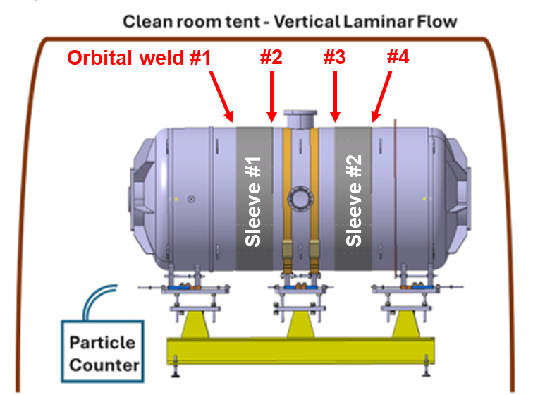

Mock-up Installation procedure document [15/10/2024 – 06/01/2025]
The mock-up is the Φ 850 mm chamber to test the sleeve welding process and to assess the dust generated during the welding.
The document includes procedure for handling during the drying phase after cleaning, packing, unpacking, assembling, and welding the components.
Performed with Manjunath Dakshinamurthy
https://edms.cern.ch/document/3205259/1
mock-up

Slide 15
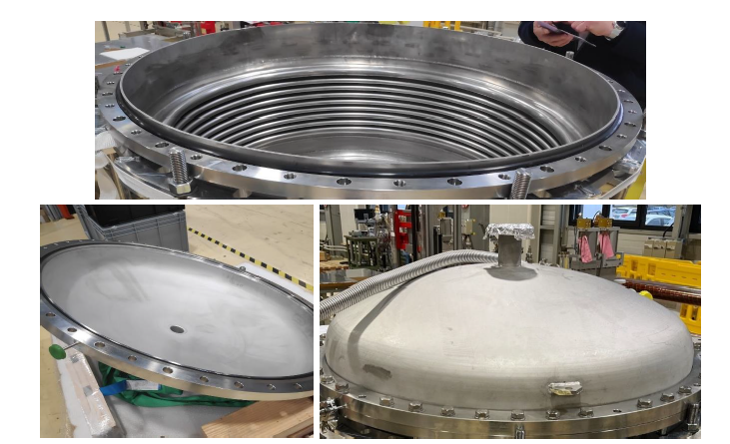
Leak detection tooling test [12/02/2025 – 24/02/2025]
The tooling is required to leak test components of the pilot sector.
It was tested on one of the ET pilot sector bellows.
Top: The counter flange and the O-ring on top of the bellow.
Bottom Left: Housing with the flat rubber seal.
Bottom Right: The housing and supporting ring are bolted together.
Performed with Jan Hansen, Carlo Scarcia

Slide 16
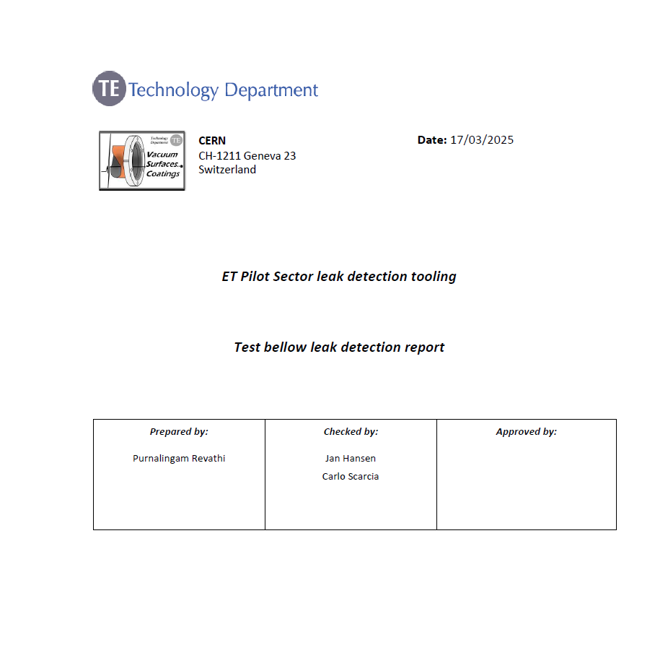
Leak detection tooling test
The tooling can be used for leak detection of 1E-10 mbar l s⁻¹ for the components of the pilot sector.
Performed with Jan Hansen, Carlo Scarcia
Pump down and leak detection

Slide 17
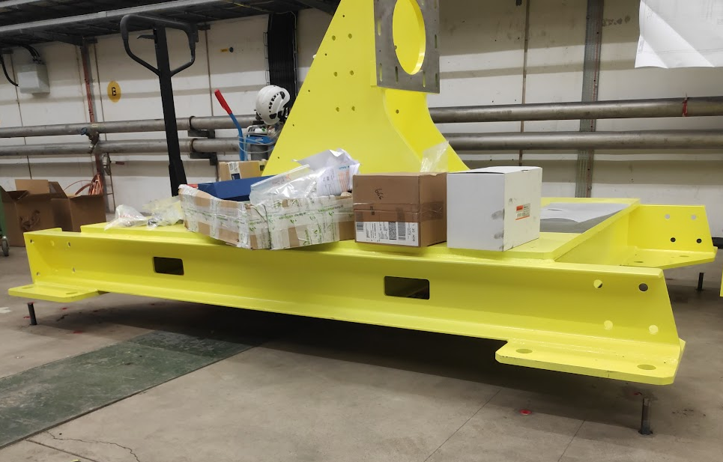
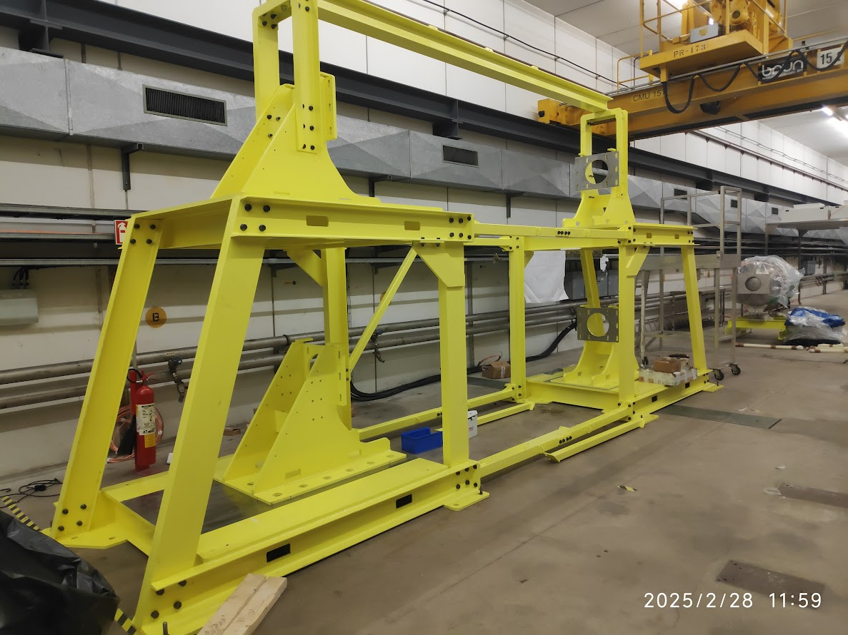
ET Pilot sector Phase1 support installation [27/02/2025 - 29/04/2025]
The phase1 support installation test was performed with the help of handling team.
Performed with Jan Hansen, Carlo Scarcia
End frame preparation
Installation test

Slide 18
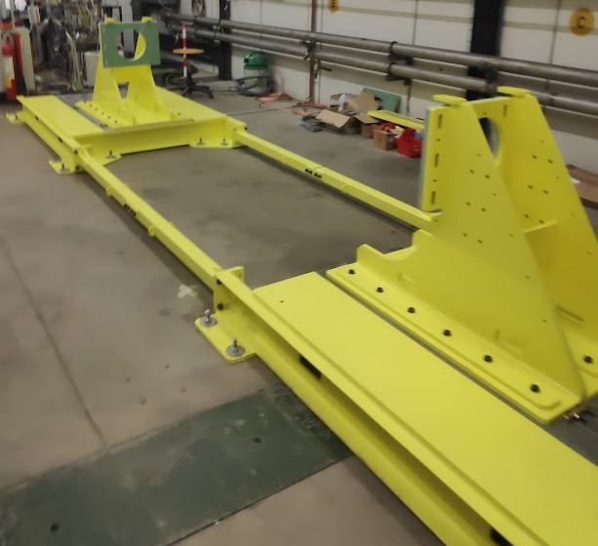
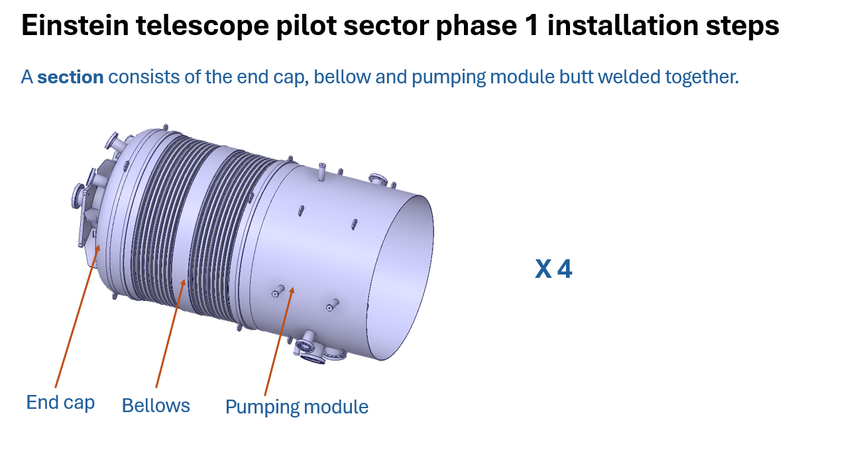
ET Pilot sector Phase1 support installation
It has been reassembled to facilitate the bottom line first and the topline next sequentially.
Current Status
Installation procedure document

Slide 19
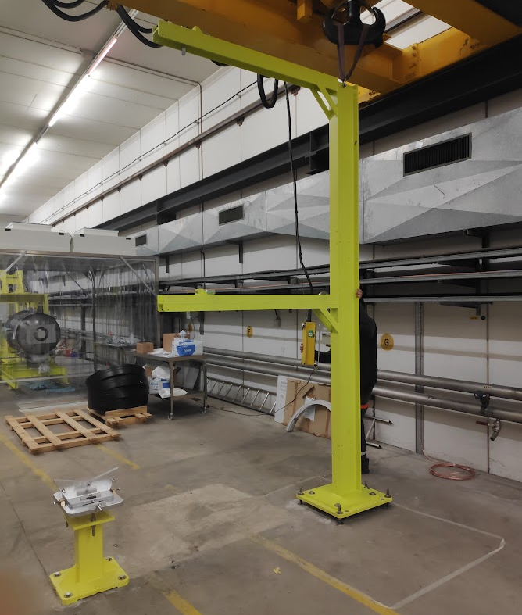
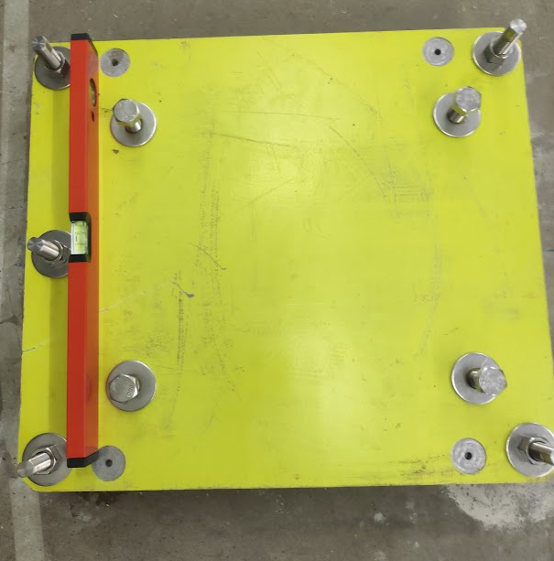
ET Pilot sector Phase2 support installation [28/03/2025 - 01/04/2025]
The phase2 support installation test was performed with the help of handling team.
Performed with Jan Hansen, Carlo Scarcia
Ground plates preparation
Support installation

Slide 20
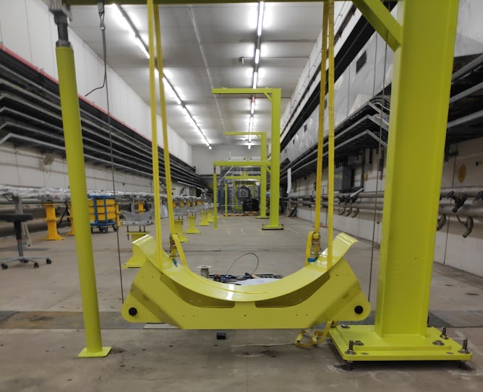
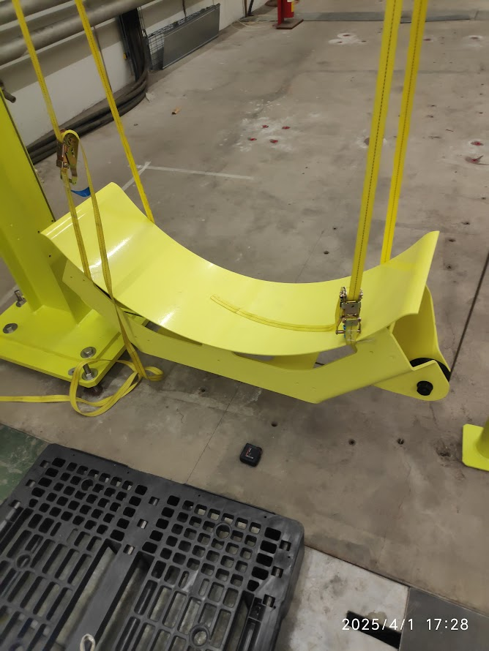
ET Pilot sector Phase2 support installation
Cradle supports installation and testing

Slide 21
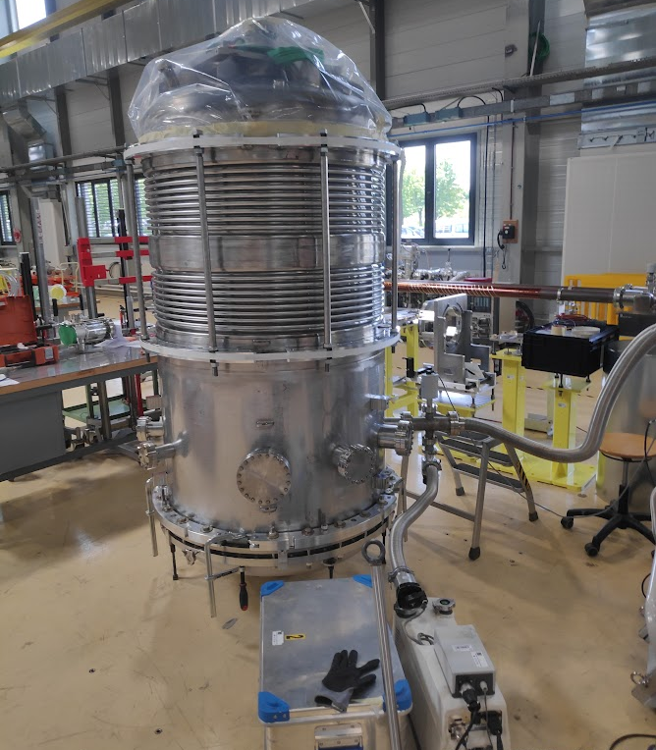
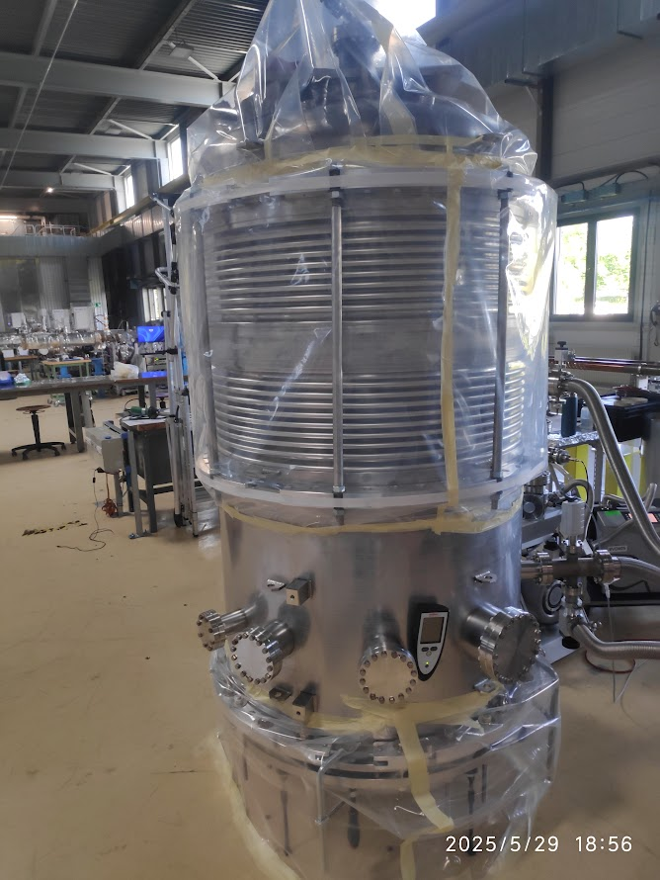
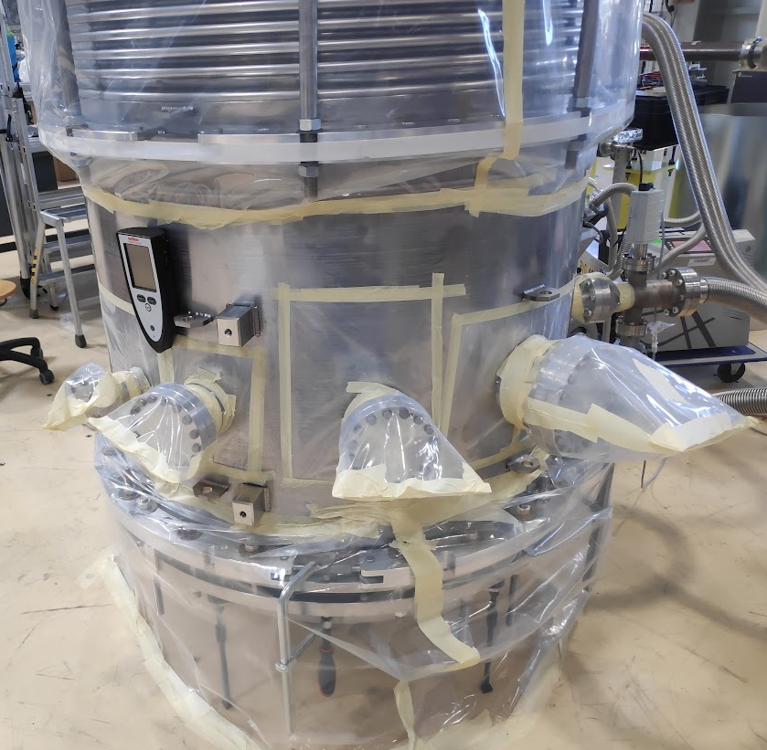
ET Phase1 extremity leak detection [21/05/2025 - 02/06/2025]
The leak detection of the two extremities of phase1 has been completed and is tested leak-tight (≤ 1 x 10⁻¹⁰ mbar l s⁻¹).
The report writing is underway.
Performed with Jan Hansen, Carlo Scarcia
Leak detection of the end cap
Leak detection of the bellows
Leak detection of the pumping module

Slide 22
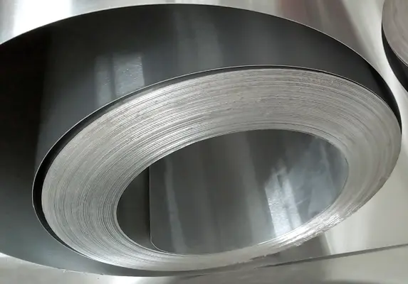
Plan B for beampipe materials [28/03/2025 - present ] ​
Question: If ferritic alloys are not chosen as the material of choice for the ET beampipe for reasons such as corrosion,
can we follow the LIGO solution of doing an air bake of the AISI 304L coils to reduce the H₂ Outgassing?
Potential Issue: Does the tightly packed coil structure prevent the depletion to the required level (1E-15 mbar.l.s⁻¹.cm⁻²) because of the increase in H₂ partial pressure (1E-4 mbar in air) in the gap between stainless steel layers in the coil is very small (~ 1 -10 μm)?
In LIGO :
Material: AISI 304L 3 mm thick as coils
Degassing treatment: Air bake at 454 °C for 36h +
21 days of bakeout at 168 °C
Measured H₂ specific outgassing rate: 5.2E-14 mbar.l.s⁻¹.cm⁻²
Small gap between coil layers

Slide 23
Analysis
P_{H2}= 1E-4 mbar
The most important parameter that affects hydrogen depletion is the concentration (equilibrium pressure P_{H2}) of hydrogen around the layers.
Questions to be answered:
What is the contact force between the layers so there is no increase in H₂ equilibrium pressure between the layers?
How does the outgassing rate of hydrogen at room temperature change as a function of the contact force between the layers?
How is the gap affected because of?
Clamping force,
Weight of other layers above,
Expansion during the air bake,
Cleanliness between the layers.
g
Q_{H2}
P_{H2}= ?
Q_{pump}
Coil

Slide 24
Basic considerations
Roughness Ra [3]:
Finish 1D/HRAP: 3.5 – 7.5 µm
Finish 2B: 0.1 - 0.5 µm
Initial hydrogen concentration in the bulk c₀ = 1 wt. ppm = 0.097 mbar. l/cm³ at 20 °C
Initial hydrogen concentration in the surroundings is 1E-4 mbar equivalent to c_{w} = 1E-4 wt. ppm = 9.9E-6 mbar. l/cm³ at 20 °C
Air bake temperature: 450 °C
Hydrogen equilibrium pressure at 450 °C: 40 mbar
The design of the stacked flat sheets experiment requires two parameters
Contact pressure between the layers: determined by the pulling force.
Dimensions of the sheet: determined by the conductance.
https://www.worldstainless.org/files/issf/non-image-files/pdf/euro_inox/roughnessmeasurement_en.pdf
[3]

Slide 25
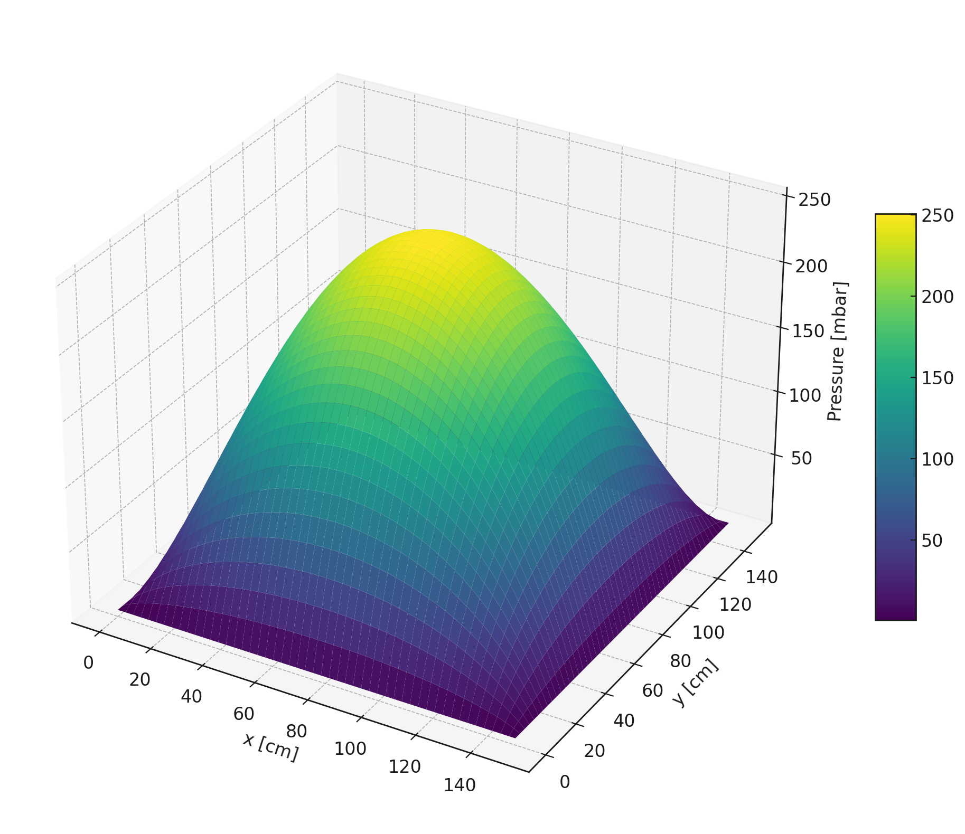
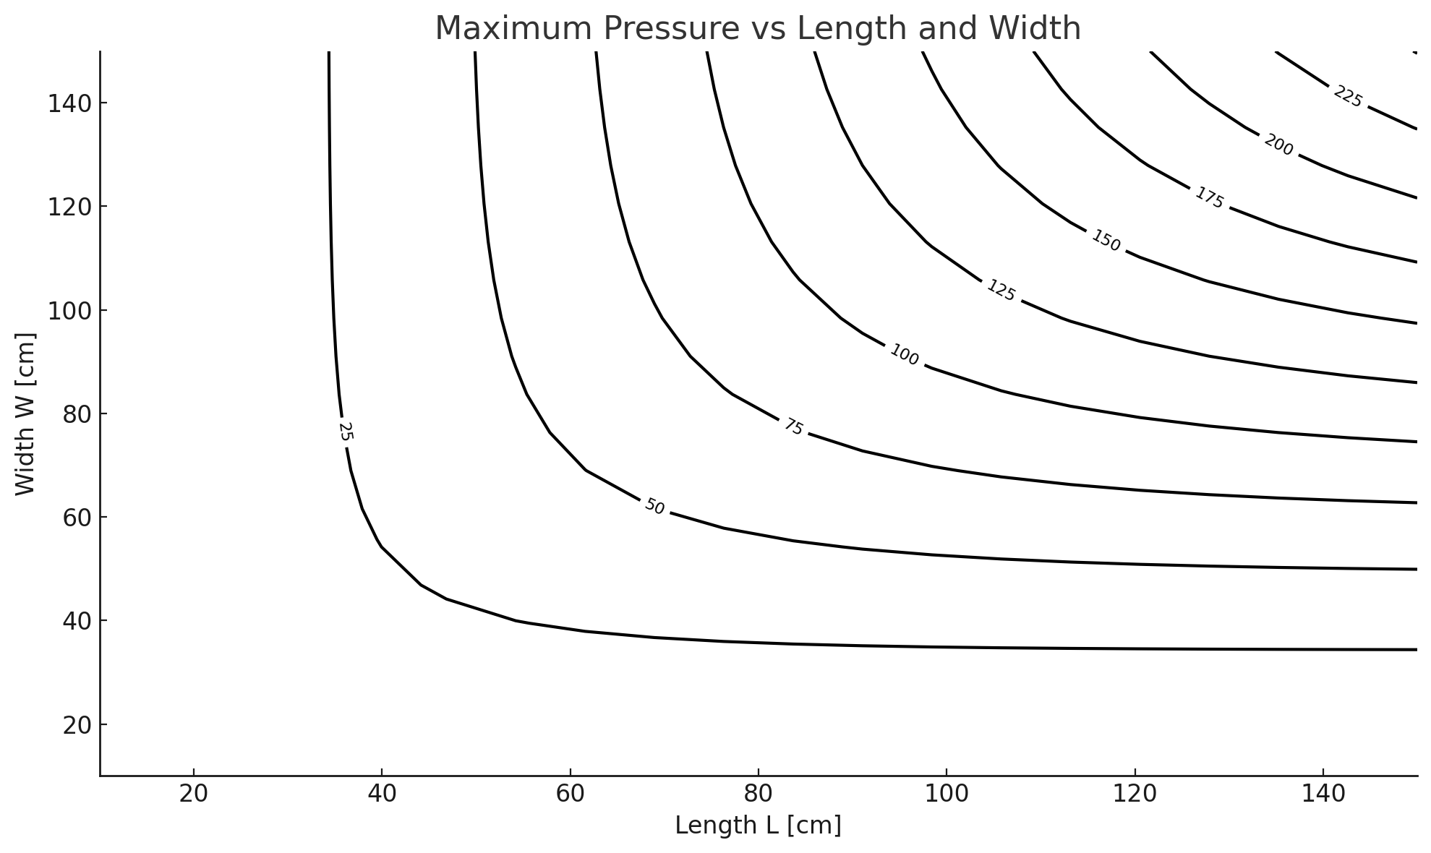
2D Steady state analysis
h [cm]
Allowing flow in both directions:
1. Boundary conditions: P₀ = 10⁻⁴ mbar at all four edges.
2. Initial conditions: q_{H2}(T = 450 °C) = 7.5E-7 mbar.l/s.cm² and constant
w [cm]
l [cm]

Slide 26
Conclusions and Outlook
I will continue my work on pilot sector installation and measurements.
For the Plan B for beampipe materials, time dependent analysis and contact force modelling are the next steps.

Slide 27
Thank you for your attention!

Slide 28
Appendix

Slide 29
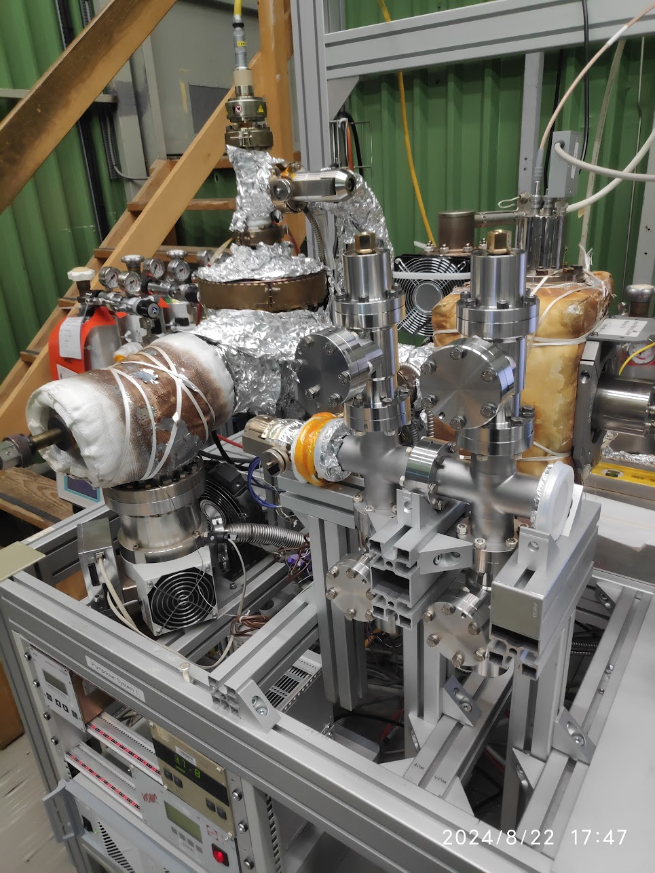
DN40 angle valve assembly
DN40 Angle Valves (open/closed)
Throughput system
Crosses
Blank Flange
VLV
Assembly: 4 angle valves + 2 DN40 crosses + 5 DN40 blank flanges + VLV
Throughput system
Crosses
Blank Flange
VLV
Background measurement
Background: 2 DN40 crosses + 5 DN40 blank flanges + VLV

Slide 30
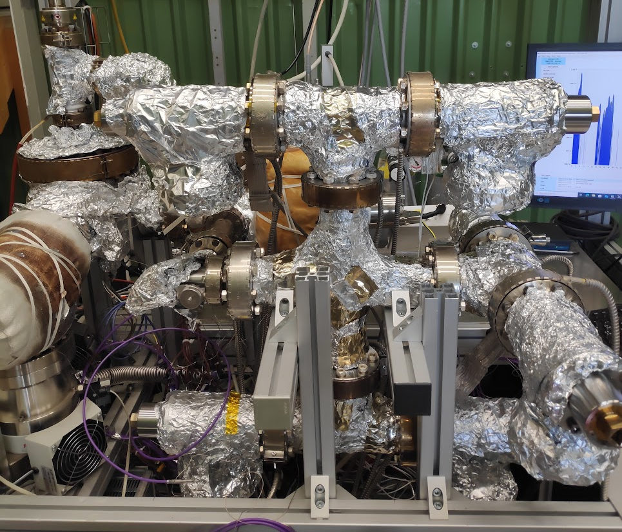
DN63 angle valve assembly
Conditioning: Degassing valve flange at 200°C and valve body at 140 °C for a week.
DN63 Angle Valves (open/closed)
Throughput system
Cross
VLV
Assembly: 6 DN63 angle valves + 1 DN63 cross + 3 DN63 tees + 6 DN63 blank flanges + DN63/DN35 transition + VLV
Throughput system
Cross
VLV
Background: 1 DN63 cross + 3 DN63 tees + 6 DN63 blank flanges + DN63/DN35 transition + VLV

Slide 31
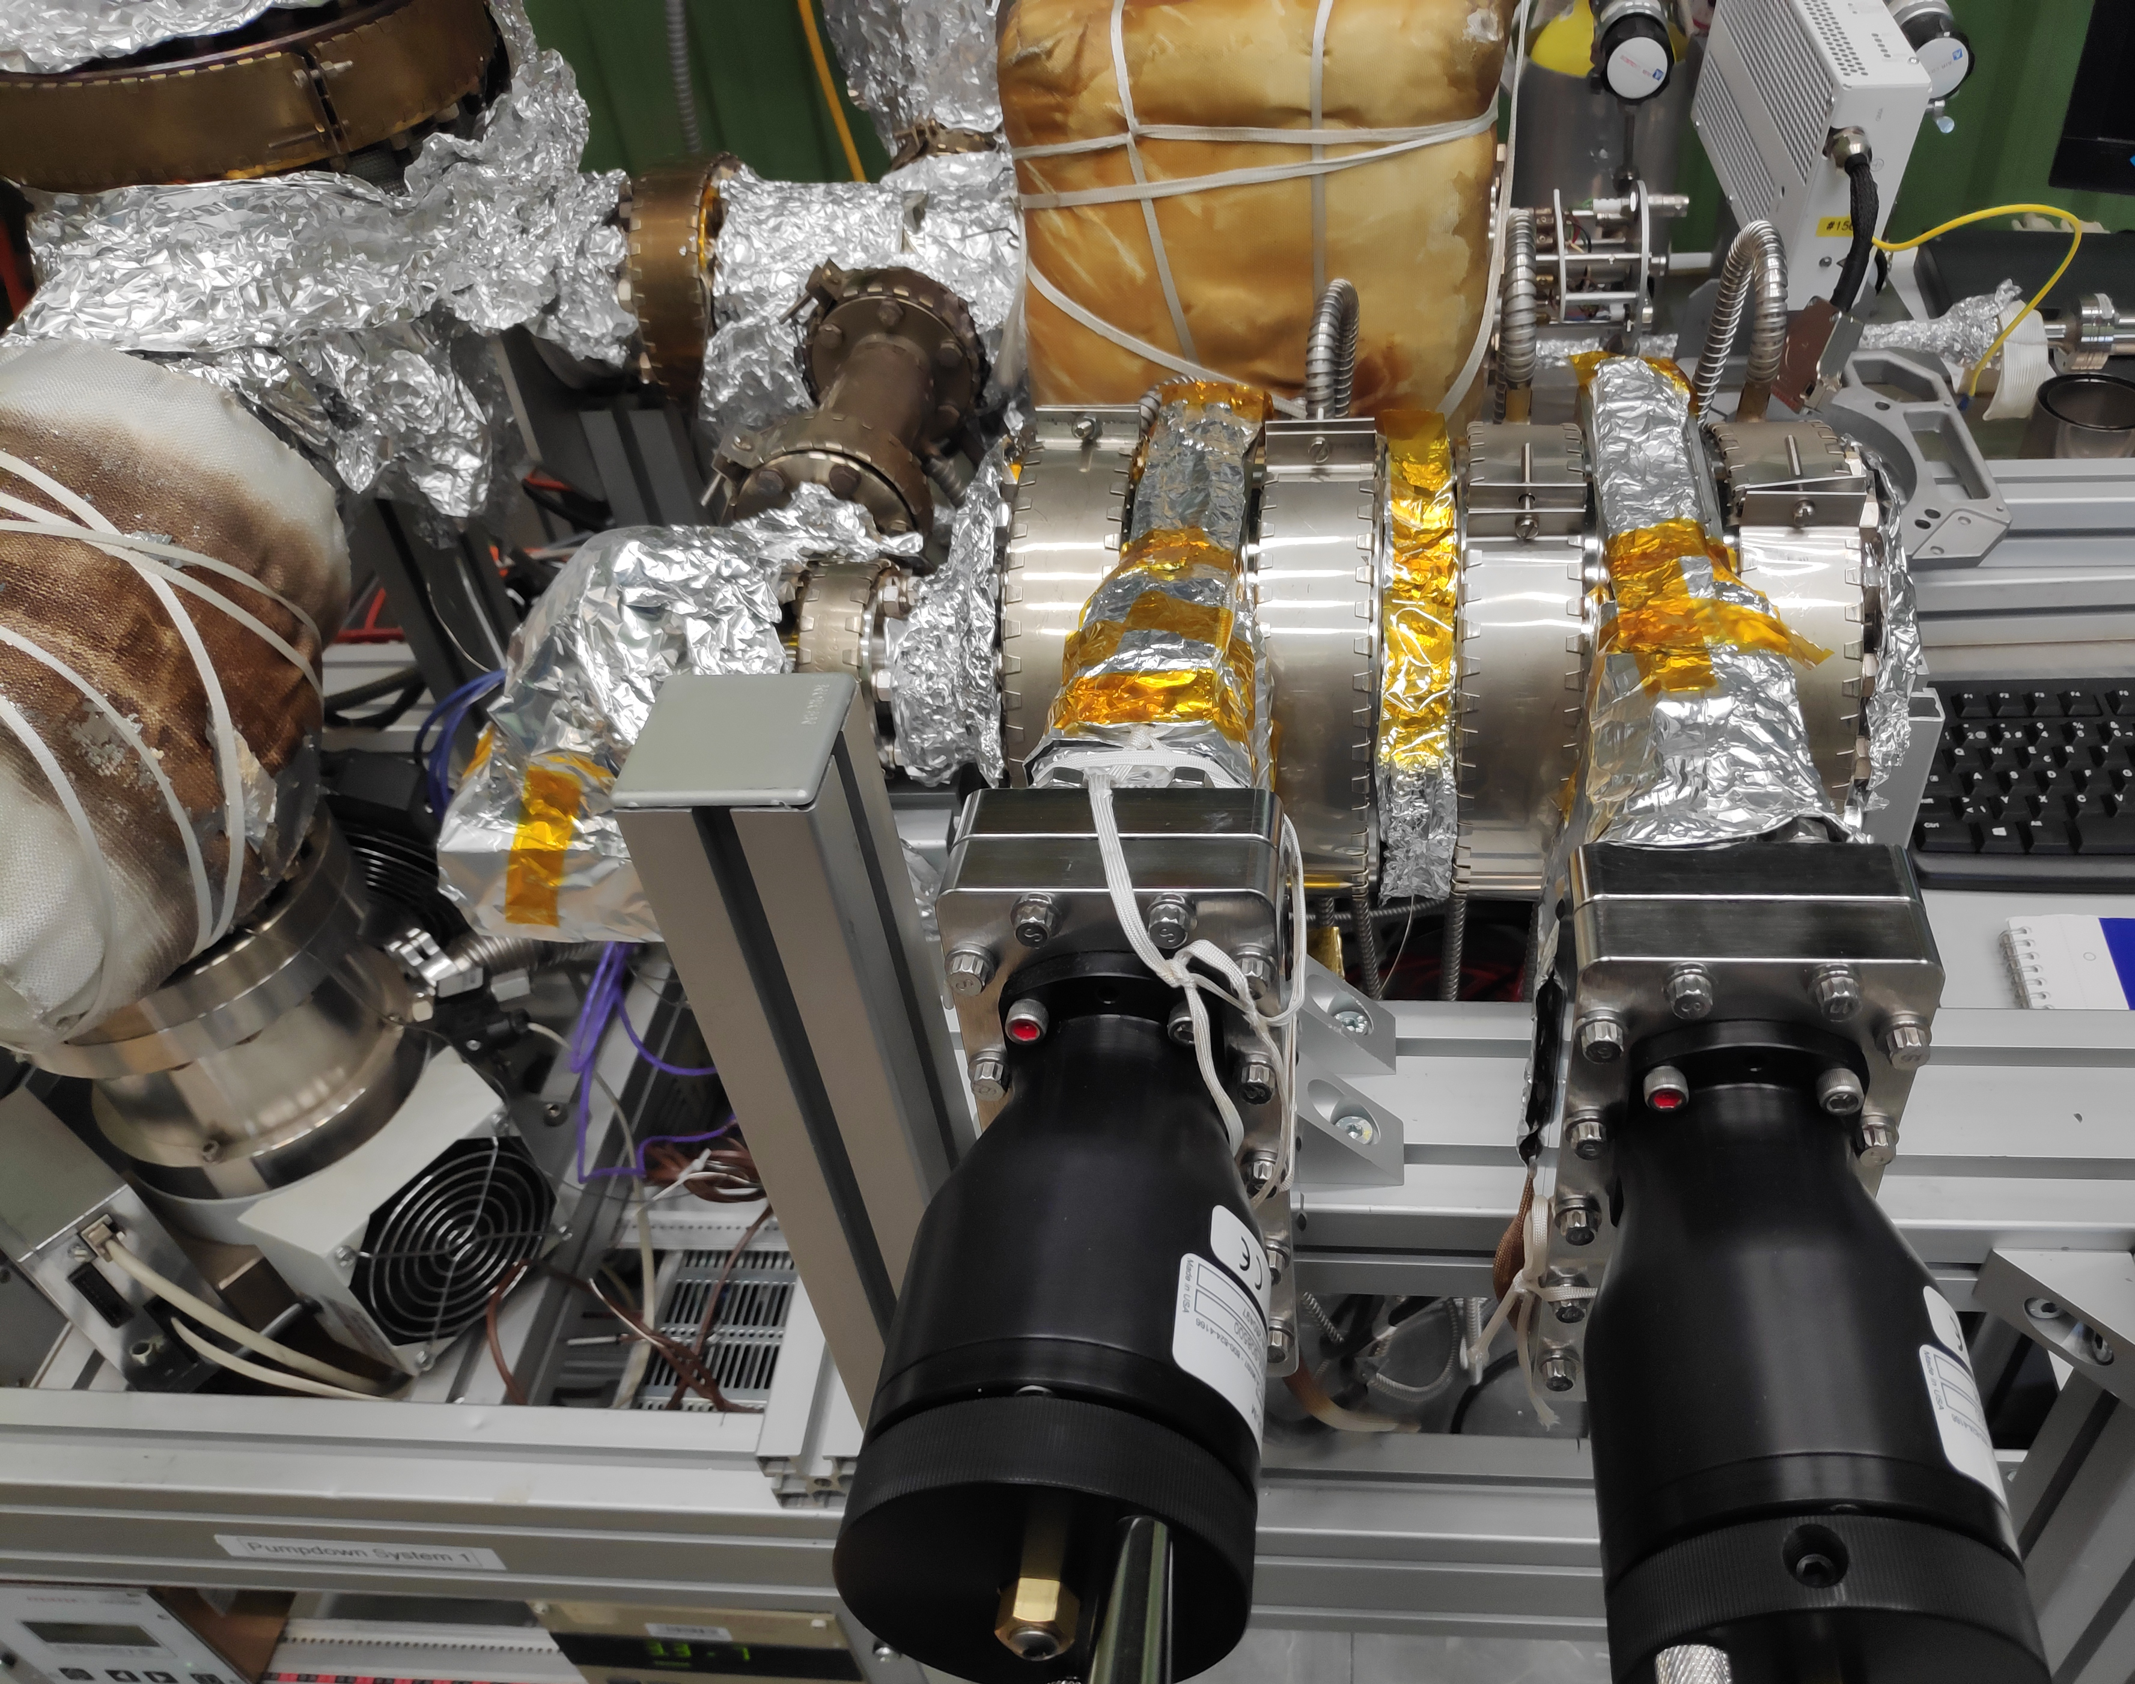
DN100 gate valve assembly
Conditioning: Degassing valve flange at 200°C and valve body at 140 °C for a week.
DN100 Gate Valves (open/closed)
Throughput system
Blank Flange
VLV
Transitions
Assembly: 2 gate valves + 1 DN100/DN100 transition + DN100/DN35 transition + 1 blank flange + VLV
Throughput system
Blank Flange
VLV
Transitions
Background: 1 DN100/DN100 transition + DN100/DN35 transition + 1 blank flange + VLV

