Slide 1
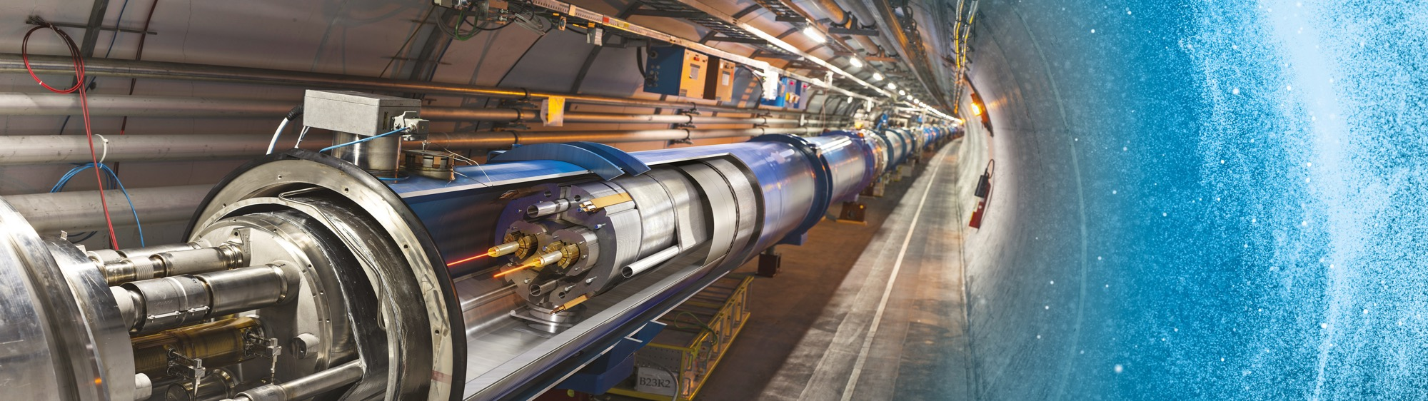
Upcoming Tenders at CERN
Industry Webinar
Nordine Azizi / Charles Carayon
IPT-PI 24 June 2025

Slide 2
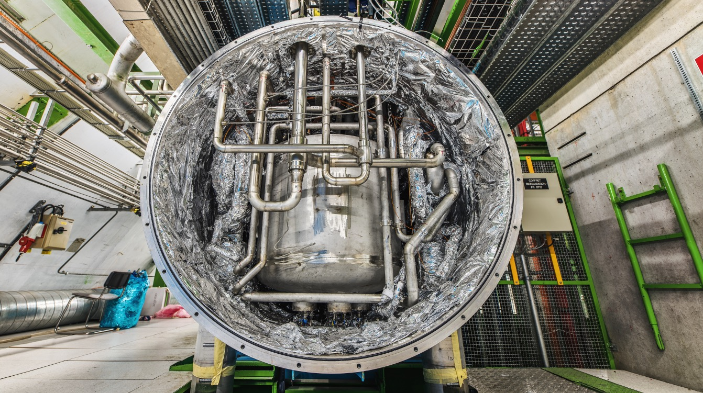
Cooling & Ventilation,
Cryogenics

Slide 3
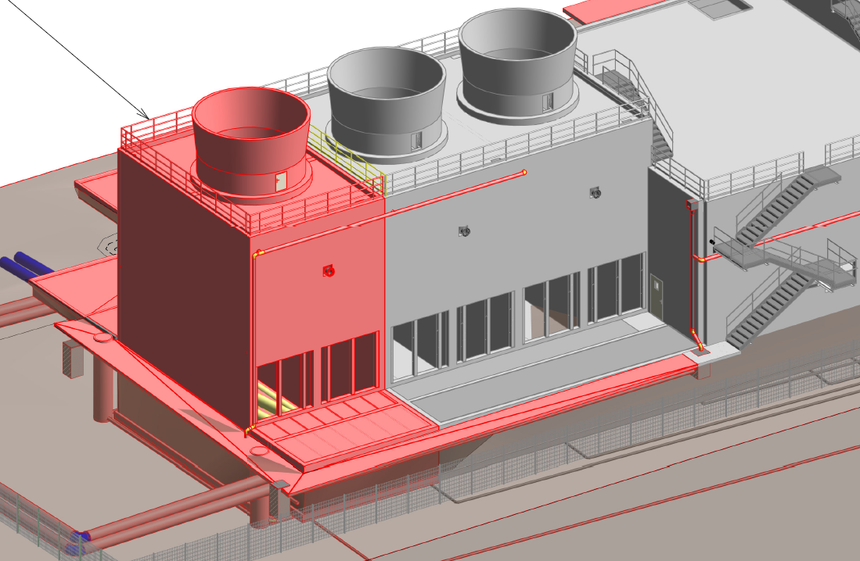
NA-CONS: CT2 cooling upgrade and consolidation
Description & Specific Condition :
Design, supply, installation, testing and commissioning of the 5th cooling tower cell in CT2.
To meet the requirements of the additional load required by the new users that will be installed as part of the NA-CONS project, a 5th cooling tower cell will be added to CT2. This Invitation to Tender will cover the equipment to be installed in the cell, as well as consolidation works to the pumping station.
Start of the Contract: Q2 2027
Procurement Code: 01 03 03 00
Cost Range : 400k - 1.5M CHF
Planning: MS: Q4 2026
IT: Q1 2027
Contact: laurentiu.vlasceanu@cern.ch

Slide 4
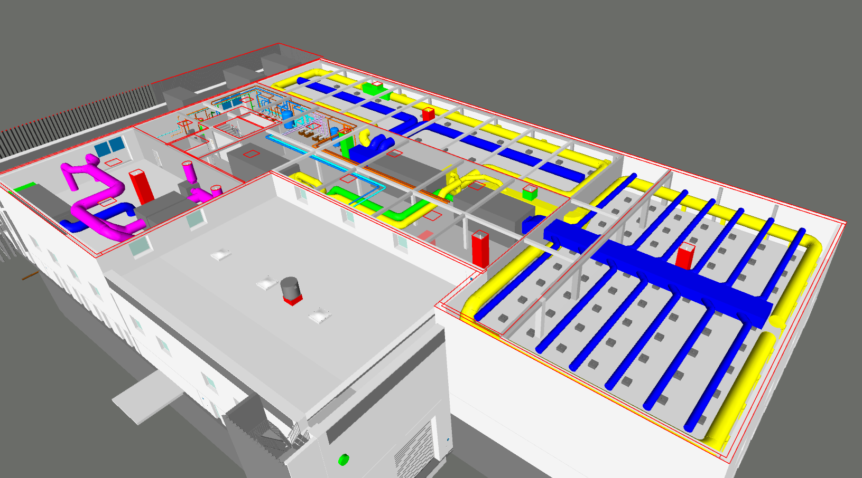
SRF/SA18 Cooling and ventilation systems
Description & Specific Condition :
Design, supply, installation, test and commissioning of all the HVAC systems and the air treatment system in the new building SA18 at Point 1.8 of the LHC.
Key conditions:
Experience in the installation of HVAC systems of similar size and complexity.
Experience in the installation of air treatment systems with wet scrubbers.
Experience in the execution of similar projects in accordance with applicable regulations.
Start of the Contract: Q2 2026
Procurement Code: 01 03 00 00
Cost Range : 5 MCHF ⬄ 10 MCHF
Planning: MS: Q3 2025
IT: Q4 2025
Contact: theodoros.aivaliotis@cern.ch

Slide 5
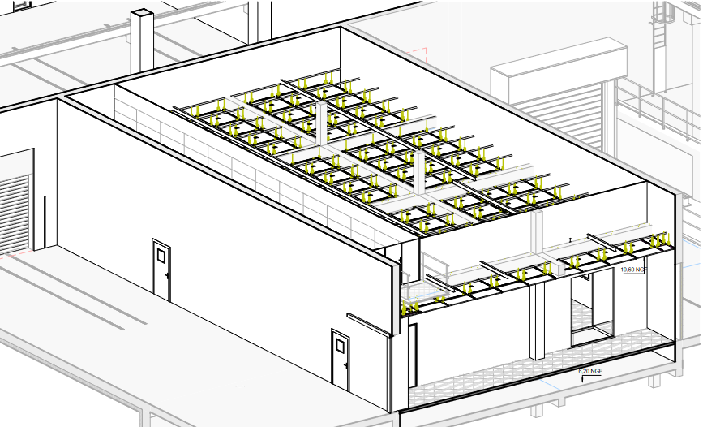
SRF/SA18 Cleanrooms construction
Description & Specific Condition :
Design, supply, construction, test and commissioning of all the cleanrooms and their associated HVAC systems in the new building SA18 at Point 1.8 of the LHC.
Key conditions:
Experience in the construction of laminar flow ISO Class 4 cleanrooms and mixed flow ISO 8 cleanrooms of similar size and complexity.
Experience in the execution of similar projects in accordance with the applicable regulations.
Start of the Contract: Q3 2026
Procurement Code: 01 03 00 00
Cost Range : 5 MCHF ⬄ 10 MCHF
Planning: MS: Q3 2025
IT: Q1 2026
Contact: theodoros.aivaliotis@cern.ch

Slide 6
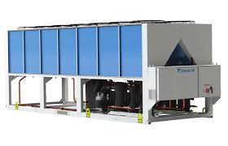
SRF/SA18 Natural refrigerant heat pumps/chillers
Description & Specific Condition :
Supply of the Air Source Heat Pumps (ASHPs), which will generate heating and cooling water for the new building SA18 at Point 1.8 of the LHC.
Key conditions:
Experience in the supply of units of similar cooling and heating capacities.
Utilisation of a natural refrigerant with very low GWP.
Energy performance validated in accordance to EN14511.
Start of the Contract: Q3 2026
Procurement Code: 01 03 01 03
Cost Range : 400k - 1.5M CHF
Planning: MS: Q3 2025
IT: Q1 2026
Contact: theodoros.aivaliotis@cern.ch

Slide 7
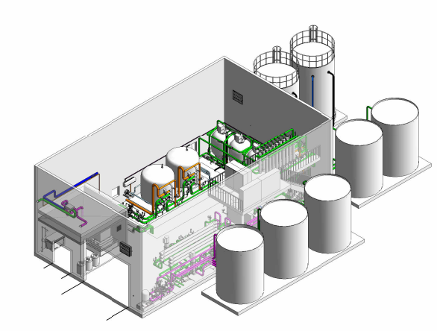
Water treatment plant in point 1
Description & Specific Condition :
Design, supply, installation, test and commissioning of a water treatment plant including :
Filtration: multimedia filters, ultrafiltration.
Softeners.
Reverse osmosis.
Tanks and piping.
Power and control cubicles.
Cost Range : 1.5 MCHF ⬄ 5 MCHF
Planning: MS: Q1 2027 IT: Q3 2027
Contact: serge.deleval@cern.ch
7

Slide 8
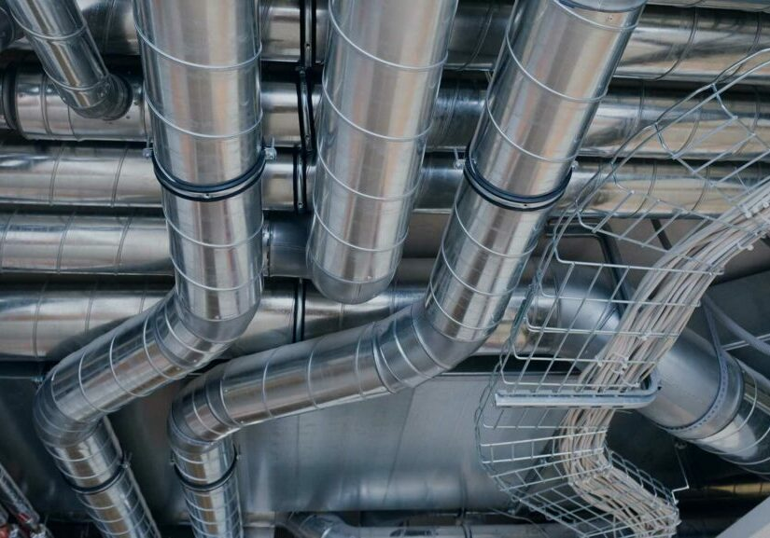
Ventilation systems (MS-5113/EN)
Description & Specific Condition :
Two blanket purchase contracts (5+1+1 years).
Design, supply, installation, testing and commissioning of ventilation systems on the CERN Site.
Projects will range from small to medium and large sizes
Key conditions:
Proven experience and competence in large-size industrial ventilations systems;
Yearly turnover of at least 6 M CHF in the field;
Have at least 20 technical employees and four engineers specialised in the field.
Start of the Contract: Q3 2026
Procurement Code: 01 03 01 03
Cost Range : > 10 MCHF
Planning: MS: Q3 2025
IT: Q1 2026
Contact: Francesco.Dragoni@cern.ch

Slide 9
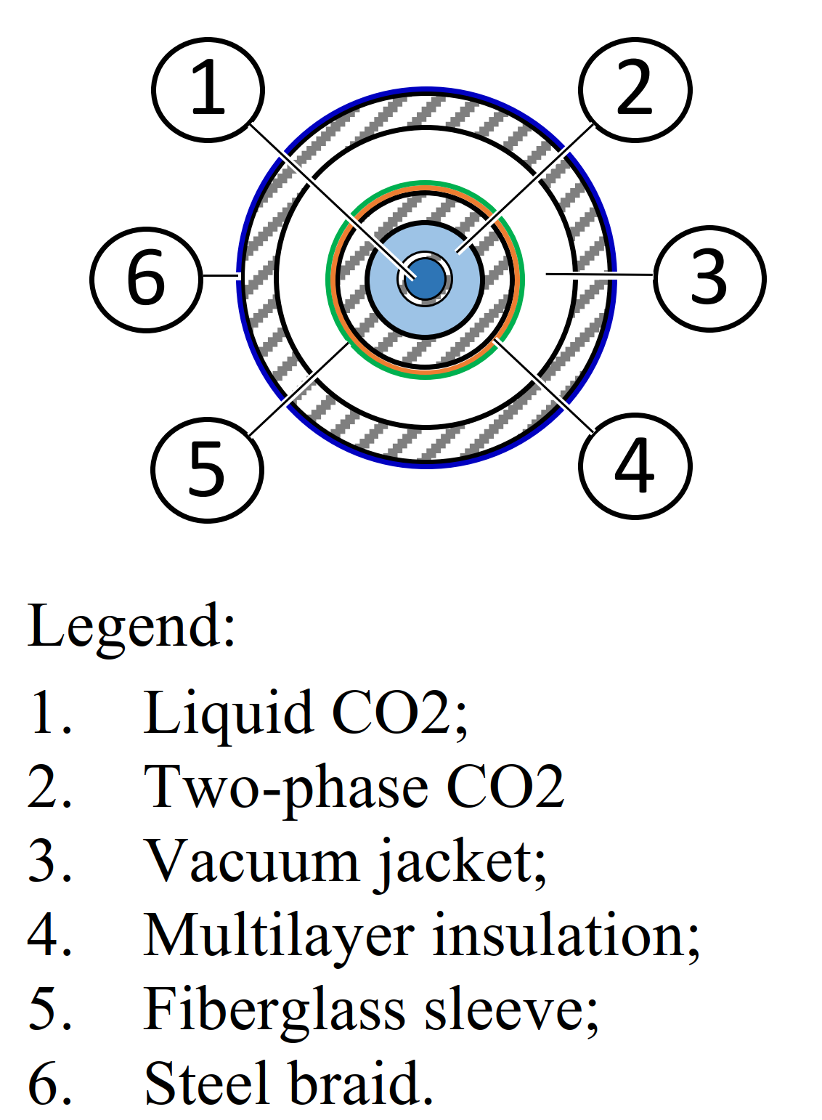
CO₂ Cooling Flexible Lines (DO-34782/EP/ATLAS)
Procurement Code: 01 03 03 01 (Cooling equipment, related pipework and accessories)
05 01 02 00 (Metallic pipes, tubes, rods, bars and profiles)
Cost Range : 200k – 400k CHF
Planning: DO : Q3 2025
Contract start: Q4 2025
Scope:
CO2 Cooling Flexible Lines, commonly designated as Flexline
To transfer the liquid and two-phase CO2 in counterflow configuration between its end connections
Length between 5 and 13m
Eligible Firm Profile
Interested firms shall have competence and experience in design, assembly, welding and testing for high pressure applications.
They shall have as well the necessary equipment to perform the Contract, as well as a 500m² or bigger assembly hall.
Contact: joao.noite@cern.ch

Slide 10
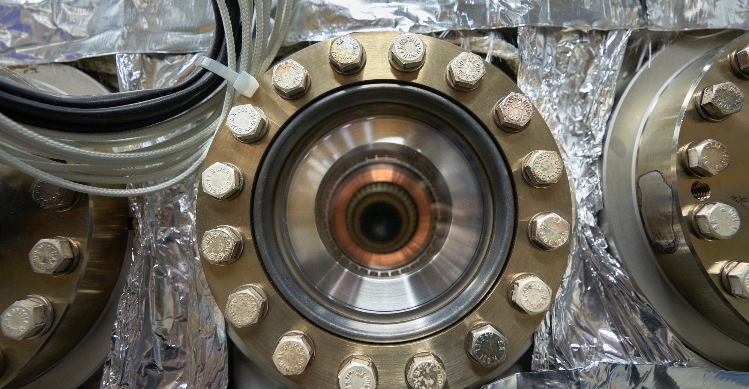
Electrical Engineering, Magnets

Slide 11
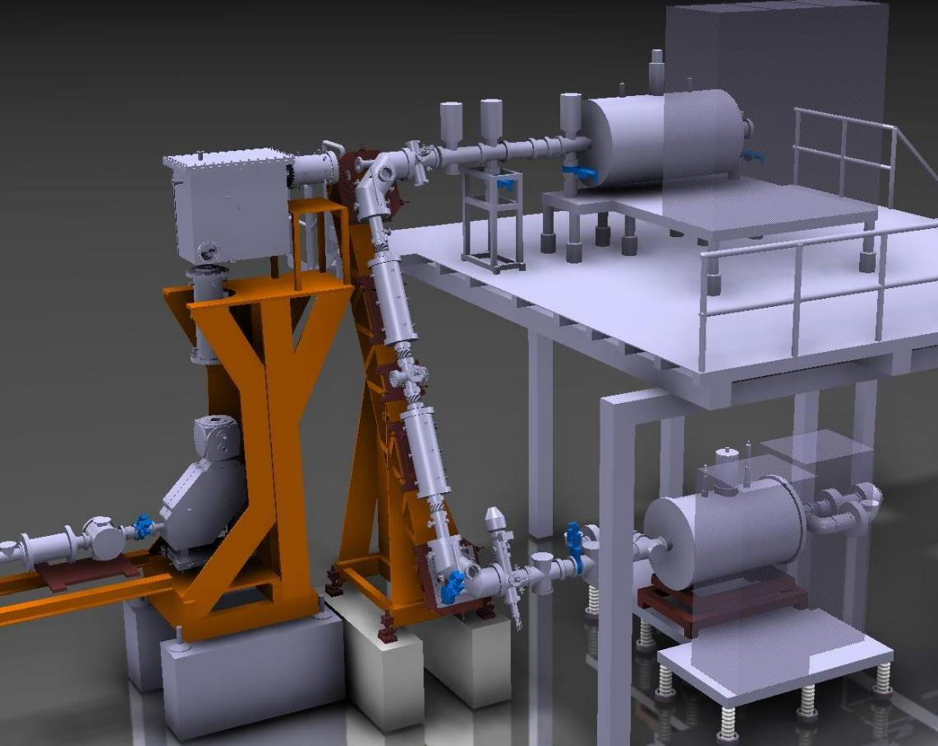
Superconducting solenoid system, including cryostat and ancillaries (MS-5102/TE)
Description & Specific Condition :
Supply of a superconducting solenoid system to be operated at 4.3K and at 3T, including cryostat and ancillaries.
Firms must have a proven experience and competence in the design, manufacturing and integration of a 3T solenoid system.
The Supply is expected to be delivered to CERN within 18 months after the entry into force of the Contract.
Procurement Code: 02 25 03 03
Cost Range : 400k - 1.5M CHF
Planning: MS: June 2025 IT: Q3-Q4 2025
Contact: susana.izquierdo.bermudez@cern.ch
Beamline
REXTRAP solenoid
30 kV HV platform

Slide 12
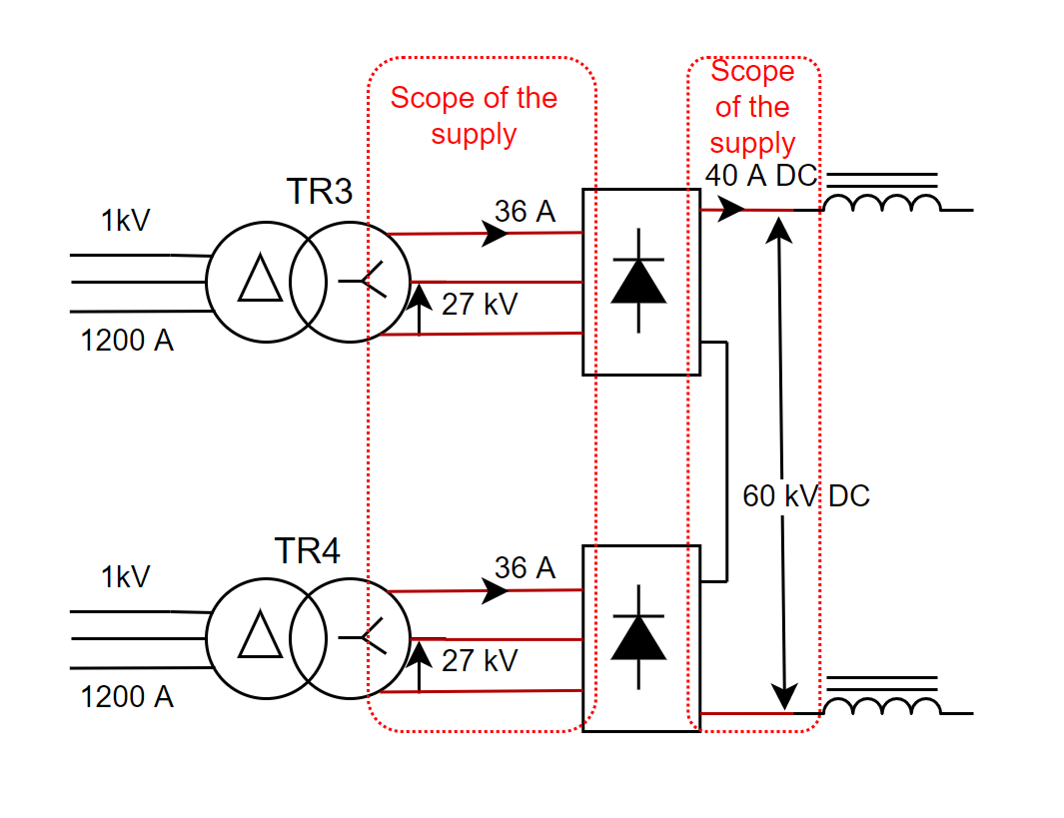
Supply of 3.5 km of coaxial high voltage cable (MS-5068/EN)
Description & Specific Condition :
Supply of 3.5 km of coaxial high voltage cable of 72.5kV, including cable drum, packing, shipping and documentation.
The High Voltage cable will be used for the connection between a transformer and a diode bridge rectifier and between a bridge rectifier and a choke as shown in the Figure.
Firms must have a proven experience and competence in manufacturing coaxial high voltage cables with CPR certification.
The Supply shall be delivered to CERN within six months of notification of the Contract by CERN.
Procurement Code: 02 05 01 00
Cost Range : 400k - 1.5M CHF
Planning: MS: dispatch IT: Q3 2025
Contact: stephane.joffe@cern.ch

Slide 13
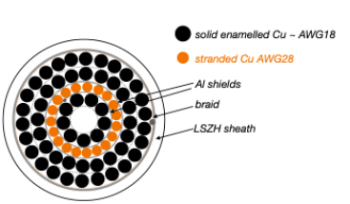
Special Power Cables with Enamelled Copper Conductors
(MS-5098/EP)
Description & Specific Condition :
Supply of 80 km of power cable with solid enameled copper conductors and the provision of the connectorisation of the cables, including the testing of the isolation and resistivity, the packaging, the documentation, the storage and the shipping.
Contract might be split between two companies.
Firms must have a proven experience and competence, for the production of power cables in:
Design, production and testing of special power cables with enamelled copper conductors;
Producing 80km of power cables in several production batches.
Firms must have a proven experience and competence, for the connecterisation in:
The field of special cable work and termination;
Wire soldering on PCB boards;
Potting and molding;
Cable testing.
Procurement Code: 02 05 05 00
Cost Range : 400k - 1.5M CHF
Planning: MS: Q3 2025 IT: Q4 2025
Contact: simone.paoletti@cern.ch

Slide 14
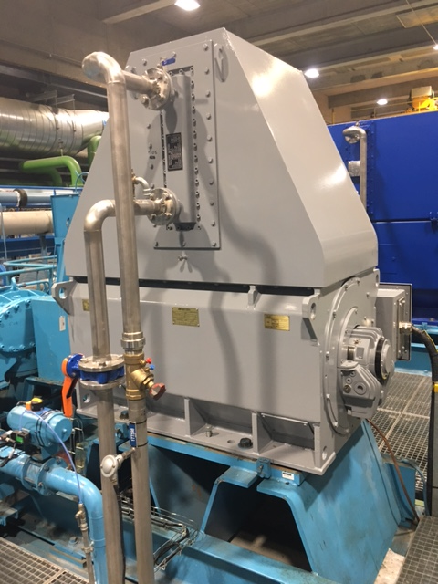
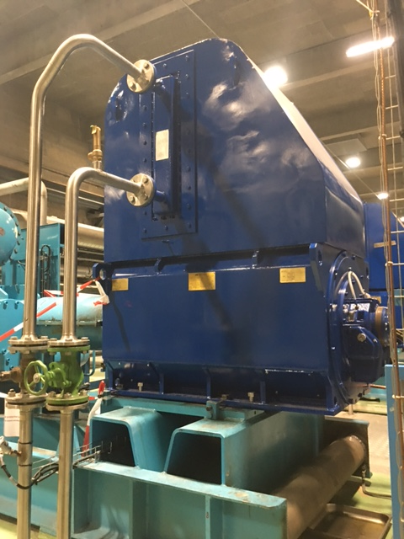
Electrical motor overhaul (DO-34739/TE/CRG)
Procurement Code: 02 09 01 00 (Alternating current motors)
Cost Range : 200k – 400k CHF
Planning: DO : Q4 2025
Contract start: Q1 2026
Scope:
Overhaul of 75 low-voltage (400 V) and 70 medium-voltage (3.3 kV) electrical motors
In accordance with IEC 60034 standards.
Eligible Firm Profile
Interested firms shall have proven experience and competence in overhauling in accordance with IEC 60034 standards. They shall be certified and equipped with proper electrical testing tools and benches, a painting facility, an oven, a balancing system, etc.
Contact: Nicolas.Bonetti@cern.ch

Slide 15
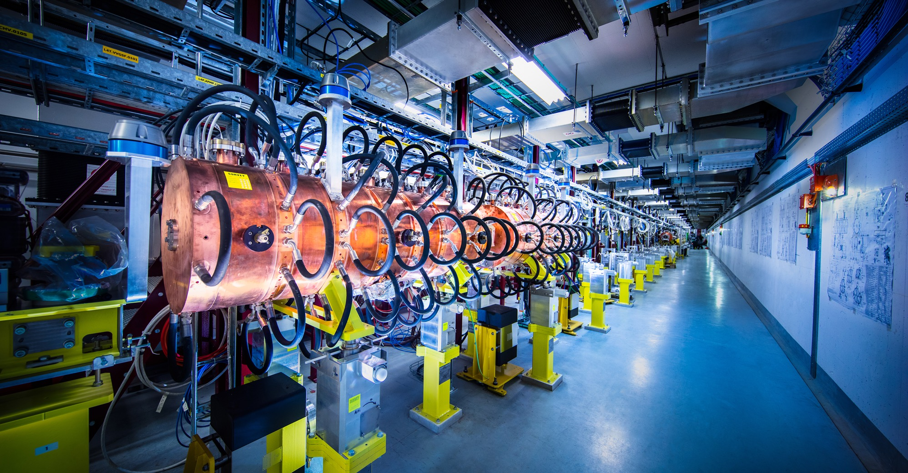
Electronics, Radiofrequency

Slide 16
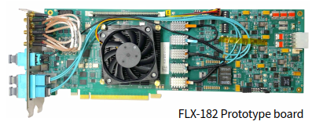
Custom designed PCIe based fibre optics I/O cards (MS-5040/EP)
Procurement Code: 03 04 09 00 (PCI, PCIe modular electronic boards)
Cost Range : 400 K – 1.5 M CHF
Planning: MS : Q4 2024 - published
IT: Q3 2025
Scope:
Assembly and testing of approx. 800 PCBs
Versal Prime VP1552 FPGA
PCIe Gen5 x16
Up to 52 optical links, link speed up to 25 Gb/s
Overall PCB dimensions: 311.99 x 106.65 m
24 layers and a thickness of (3.00 ± 0.28) mm
PCB material is EM980K
Duration: Production over 12 months
Eligible Firm Profile: Interested firms shall have proven experience and competence in assembly and test of PCBs of the complexity required. At least 50% shall originate in FR, DE, IL, IT, NL, RO, CH, US.
© CERN
Contact: Carlo.Alberto.Gottardo@cern.ch

Slide 17
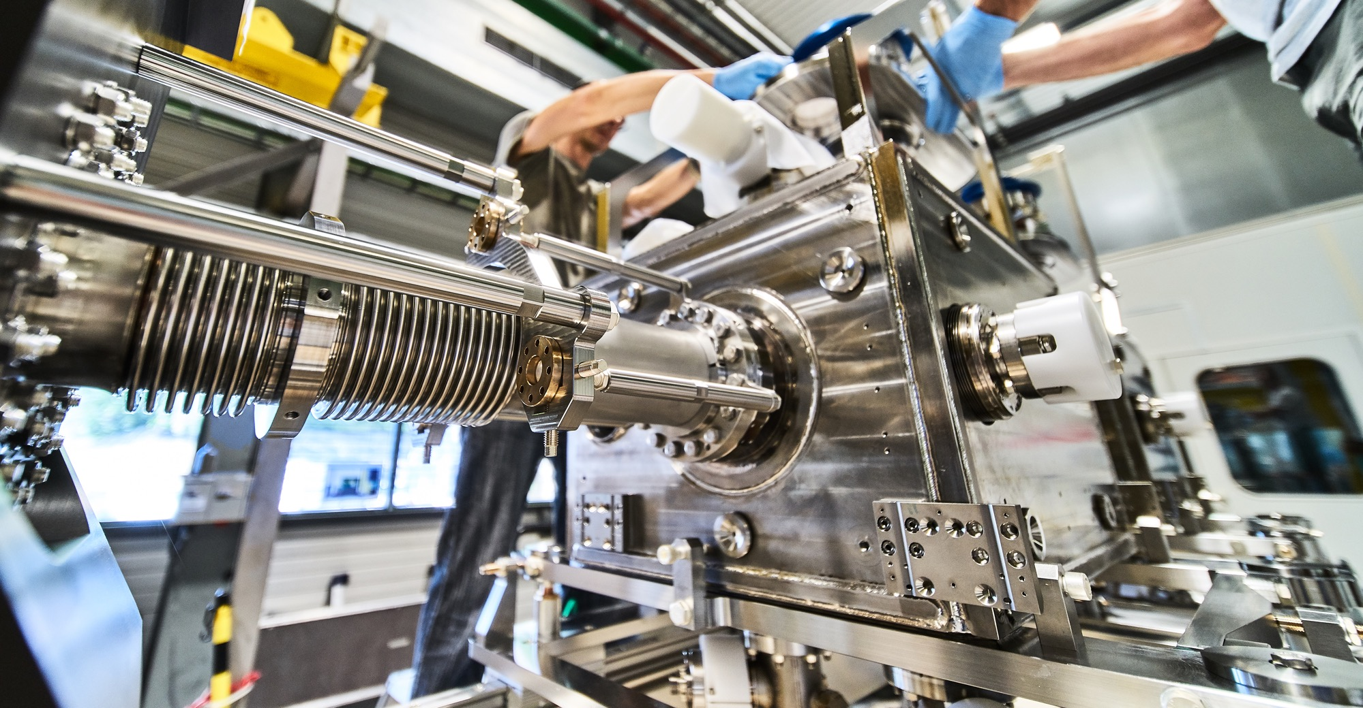
Mechanical Engineering, Raw Materials

Slide 18
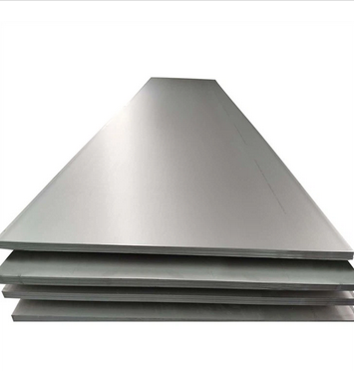
Stainless-steel sheets and plates EN 1.4429 AISI 316LN for Ultra-High Vacuum applications (MS-5056/SCE)
Procurement Code: 05 01 01 02 (Stainless Steel)
Cost Range : 1,5M – 5M CHF
Planning: MS : published
IT: Q3 2025
Contract start: Q3/Q4 2025
Scope:
Supply of 80T stainless steel sheets and plates;
EN 1.4429 AISI 316LN (Electroslag Remelting ESR)
Duration: 5 years
Eligible Firm Profile: Interested firms shall have proven experience and competence in metallurgy, manufacturing, forging and testing of the above-mentioned material.
Contact: Leila.akhouay@cern.ch

Slide 19
Stainless-steel sheets and plates EN 1.4306 AISI 304L for High Vacuum applications (MS-5054/SCE)
Procurement Code: 05 01 01 02 (Stainless Steel)
Cost Range : 400K – 1,5M CHF
Planning: MS : Q2 2025
IT: Q3 2025
Contract start: Q3/Q4 2025
Scope:
Supply of 70T stainless steel sheets and plates;
EN 1.4306 AISI 304L
Duration: 5 years
Eligible Firm Profile: Interested firms shall have proven experience and competence in metallurgy, manufacturing, forging and testing of the above-mentioned material.
Contact: Leila.akhouay@cern.ch

Slide 20
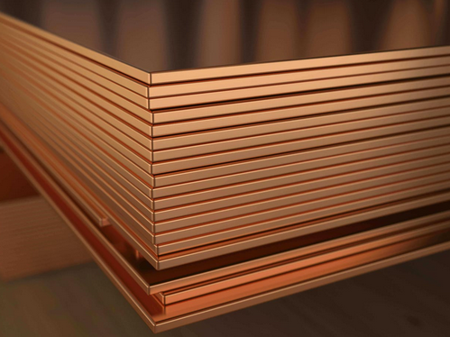
Cu-OFE (Oxygen-Free Copper) sheets and plates for Ultra-High Vacuum applications (MS-5057/SCE)
Procurement Code: 05 01 01 03 (Copper)
Cost Range : 400K – 1,5M CHF
Planning: MS : Q2 2025
IT: Q3 2025
Contract start: 1 October 2025
Scope:
Supply of 50T Oxygen- Free Electronic copper (UNS C10100) Grade 1, according to ASTM B224 with a maximum oxygen content of 5ppm
Duration: 5 years
Eligible Firm Profile: Interested firms shall have proven experience and competence in metallurgy, manufacturing, forging and testing of the above-mentioned material.
Contact: Leila.akhouay@cern.ch

Slide 21
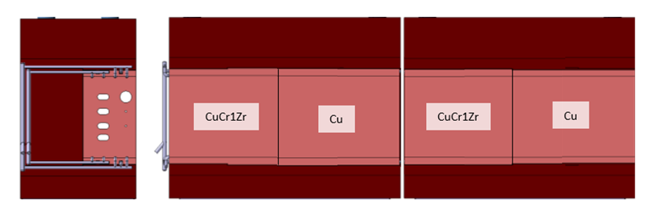
CuCr1Zr blanks for XTAX (MS-5074/BE)
Procurement Code: 05 01 03 03 (Copper, copper alloys)
Cost Range : 400K – 1,5M CHF
Planning: MS : Q2 2025
IT: Q3 2025
Contract start: Q4 2025
Scope:
Supply of forged CuCr1Zr blanks in various shapes and sizes
Material: CuCr1Zr CW106C according to EN 12420, multi-directional forged, solution annealed, and precipitation hardened. Delivered in temper H120 (according to EN 12167).
Overall tolerances: ISO2768 – cL
Delivery by July 2026
Eligible Firm Profile:
Interested firms shall have proven experience and competence in forging, machining, and material testing and certification.
6x DIMENSIONS : 300x810x420 mm³
2x DIMENSIONS : 800x810x420mm³
1x DIMENSIONS : 300x800x170mm³
Contact: miguel.lino@cern.ch

Slide 22
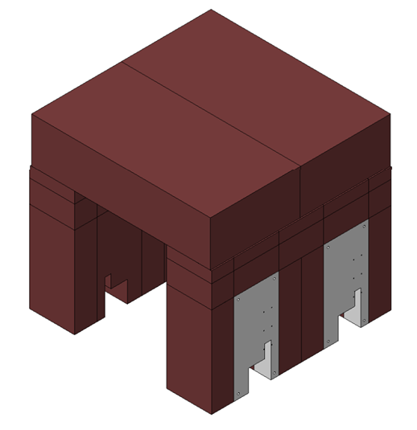
Cast Iron for XTAX (MS-5075/BE)
Procurement Code: 05 01 04 01 (Cast iron, steel)
Cost Range : 1,5M CHF – 5M CHF
Planning: MS : Q3 2025
IT: Q1 2026
Contract start: Q3 2026
Delivery by end 2027
Scope:
Supply of 410 T of Cast Iron Blocks machined in various shapes and sizes.
Main materials: Nodular Iron GJS – 400-18U-RT, acc. to EN 1563
Paint: Primer anti-radiation: Inorganic zinc silicate; 2nd layer epoxy coat; (3rd layer red 3005)
Overall tolerances: ISO2768 - cL
Eligible Firm Profile:
Interested firms shall have proven experience and competence in casting, machining, and material testing and certification.
20x DIMENSIONS : 500x380x2100 mm³
20x DIMENSIONS : 500x820x2100 mm³
14x DIMENSIONS : 500x785x2100 mm³
7x DIMENSIONS : 3200x1600x800 mm
1x DIMENSIONS : 490x3230x657 mm³
1x DIMENSIONS : 300x3230x440 mm³
Contact: miguel.lino@cern.ch

Slide 23
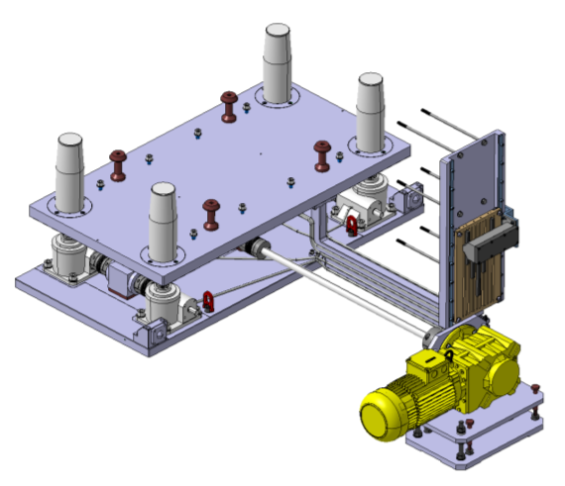
Tables for XTAX (MS-5076/BE)
Procurement Code: 05 01 01 04 (Aluminium, aluminium alloys)
05 01 01 02 (Stainless steel)
Cost Range : 400K – 1,5M CHF
Planning: MS : Q1 2026
IT: Q2 2026
Contract start: Q3 2026, delivery by May 2027
QTY: 8; DIMENSIONS: 1616 x 780 x 832 mm³
QTY: 1; DIMENSIONS: 3200 x 780 x 832 mm³ (non motorized)
Scope:
Supply of alignment tables which are a Z displacement (300 mm) device, designed to support and lift 15T of operational load with all controls and driving systems placed outside the table footprint.
Stroke: +/-150 mm; Operational Load 12 T; Speed: 100 mm/min
Each table is equipped with a manual alignment system on its base providing 5 DOF with the following specifications:
Resolution: 0.1mm; Stroke: y: +/- 5 mm; Z: +/- 3mm; Rx: +/- 7 mrad; Ry: +/- 7 mrad; Rz: +/- 7 mrad
Main materials: AL EN AW6082, Stainless Steel A4, Stainless Steel 304
General machining tolerances ISO2768 – mk
All commercial components must be radiation hard > 100kGy in 20 Yrs.
Eligible Firm Profile
Interested firms shall have proven experience and competence in machining, precision assembly, and metrology and material testing and certification.
Contact: miguel.lino@cern.ch

Slide 24
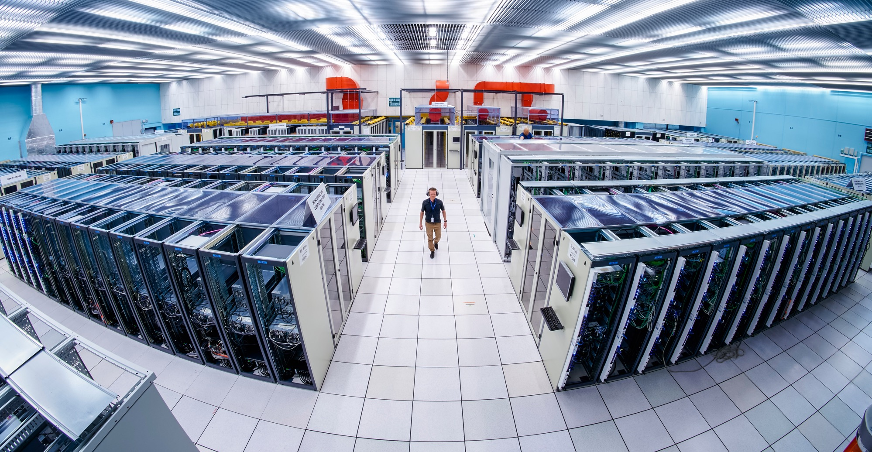
Information Technology

Slide 25
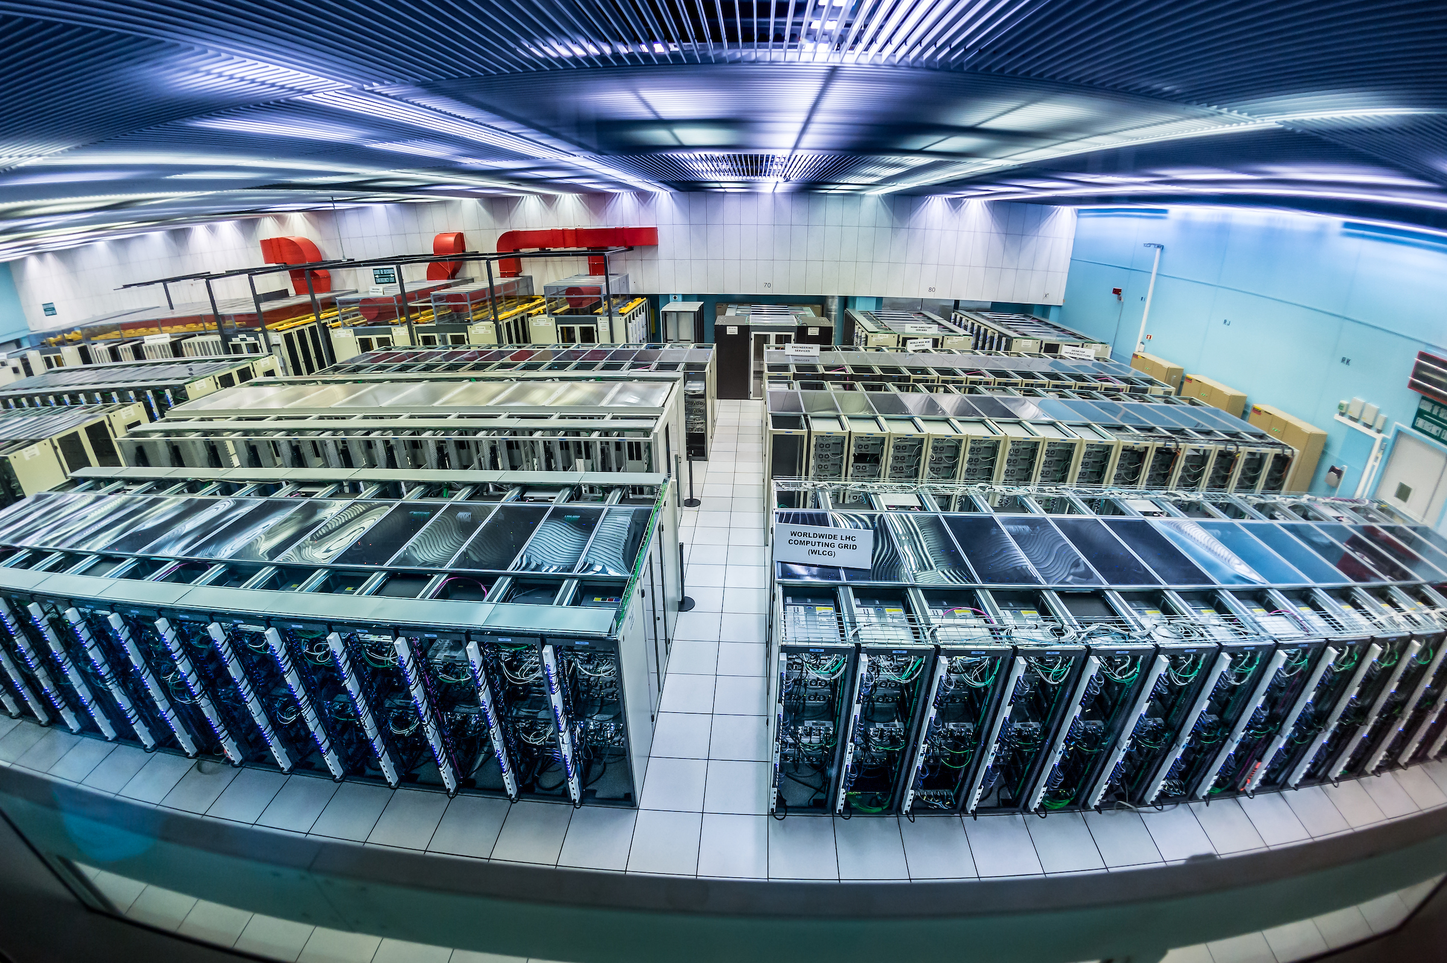
Supply of Water-Cooled Server Racks and Cooling Doors (MS-5108/EP)
Procurement Code: 03040100 (Other components for racks)
Cost Range : 1.5M – 5M CHF
Planning: MS : Q3 2025
IT: Q3/Q4 2025
Contract start: Q1 2026
Scope:
Supply and commissioning of 54 complete water-cooled racks as well as approximately 40 additional cooling doors for existing racks to house computing servers for the ATLAS experiment.
Eligible Firm Profile:
Interested firms shall have a proven experience and competence in designing and manufacturing computing racks and cooling doors.
Contact: Markus.Joos@cern.ch

Slide 26
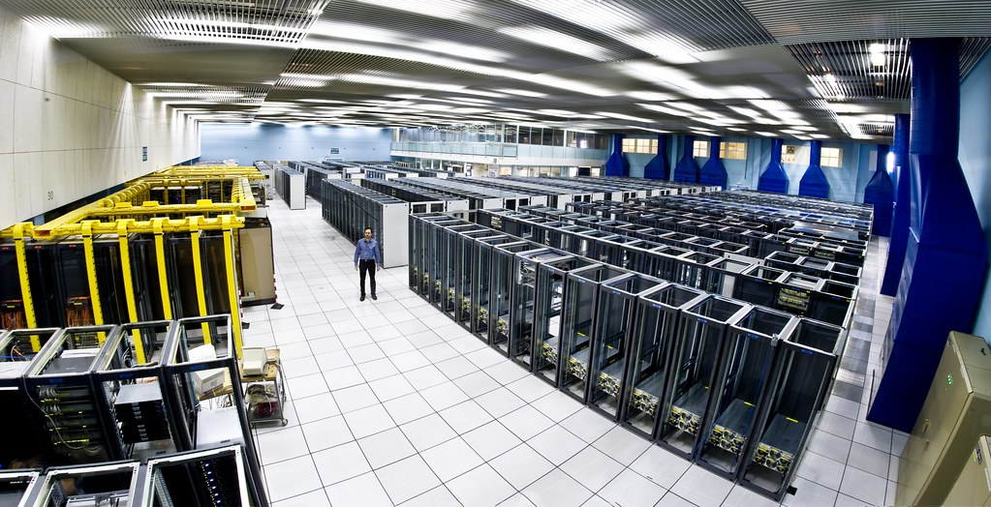
Supply of 20 servers for CMS (DO-34769/EP)
Procurement Code: 04010300 (Servers)
Cost Range : 200-400K CHF
Planning: DO: Q3 2025
Contract start: Q1 2026
Scope:
Supply of 10 servers for general purpose workloads and 10 servers optimised for high performance I/O including on-site warranty of 5 years. The main technical features include, rack mounted form factor, dual CPU multicore motherboards, two or more PCIe Gen 5 slots, and NVMe disk capabilities.
Eligible Firm Profile:
Interested firms shall have a proven experience and competence in the world of high-performance computing servers either as designer/manufacturer or as integrator/reseller along with on-site maintenance.
Contact: Marc.Dobson@cern.ch

Slide 27
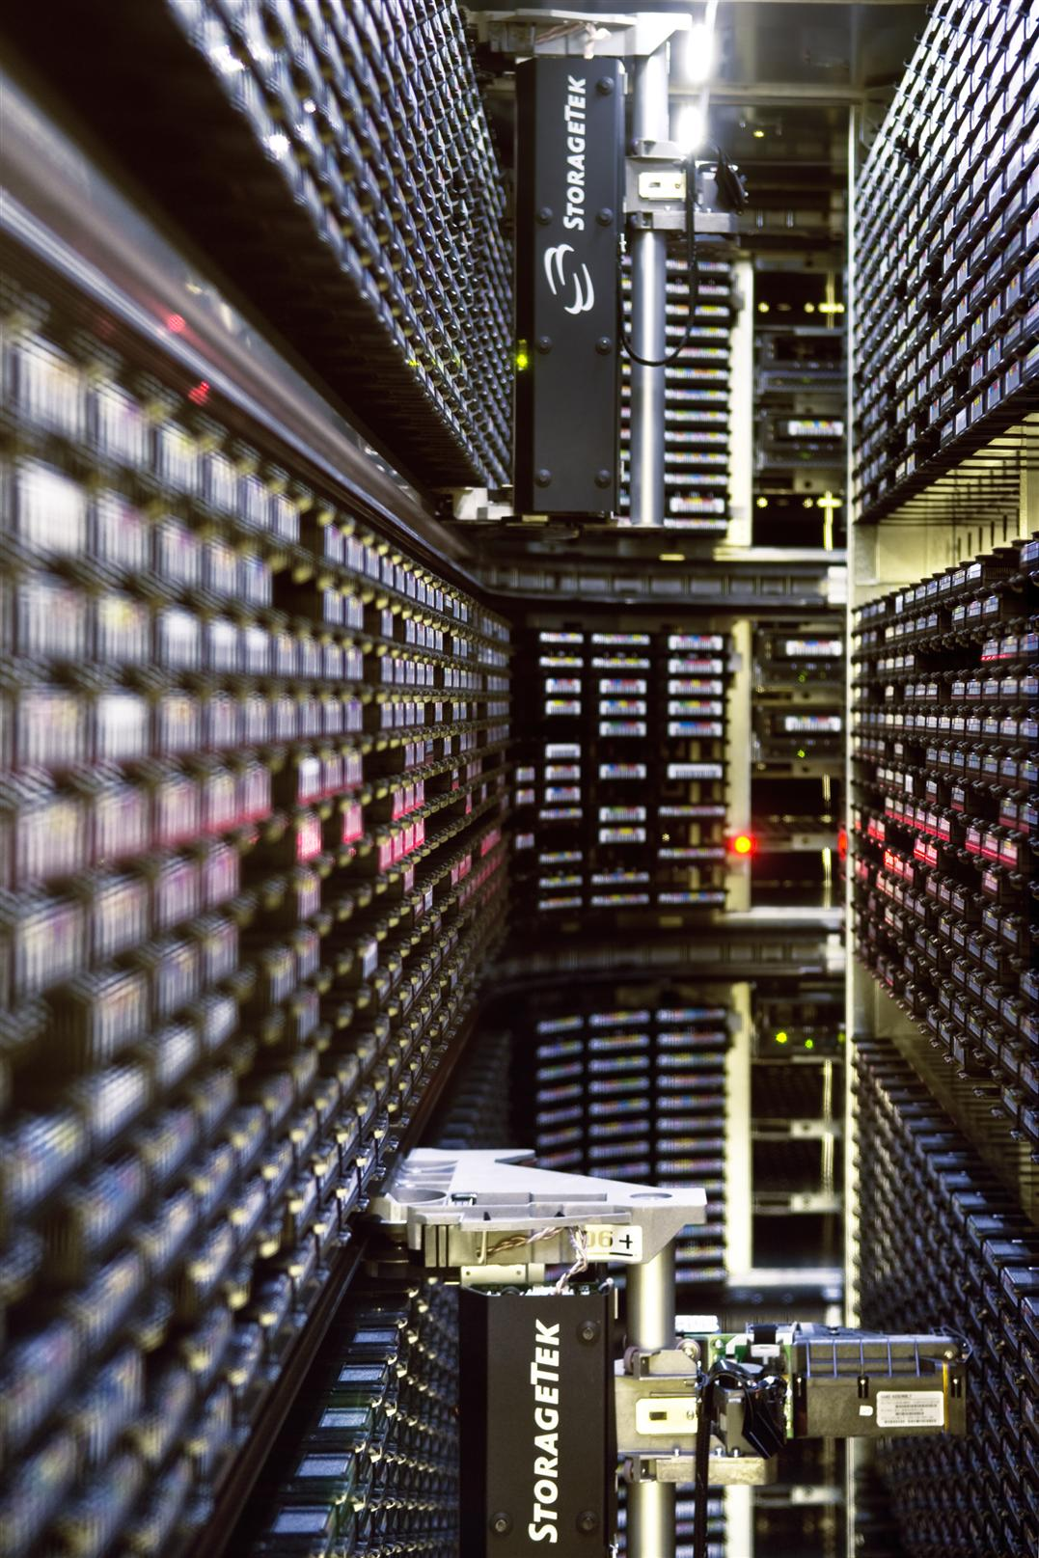
Supply of LTO 10 tape cartridges
Procurement Code: 04060100 (Magnetic tapes and cassettes)
Cost Range : 200-400K CHF
Planning: DO: Q3 2025
Contract start: Q4 2026
Scope:
The Supply shall include:
LTO Ultrium 10 Tape Cartridges: Quantity: 2500.
LTO Ultrium Universal Cleaning Cartridges: Quantity : 100.
CERN may, order additional quantities of LTO Ultrium 10 Tape Cartridges and LTO Ultrium Universal Cleaning Cartridges
Duration: 3-5 years, blanket purchase contract
Eligible Firm Profile:
Interested firms shall have a proven experience and competence in the supply of LTO 10 tape cartridges and LTO Ultrium Universal Cleaning Cartridges
Contact: vladimir.bahyl@cern.ch

Slide 28
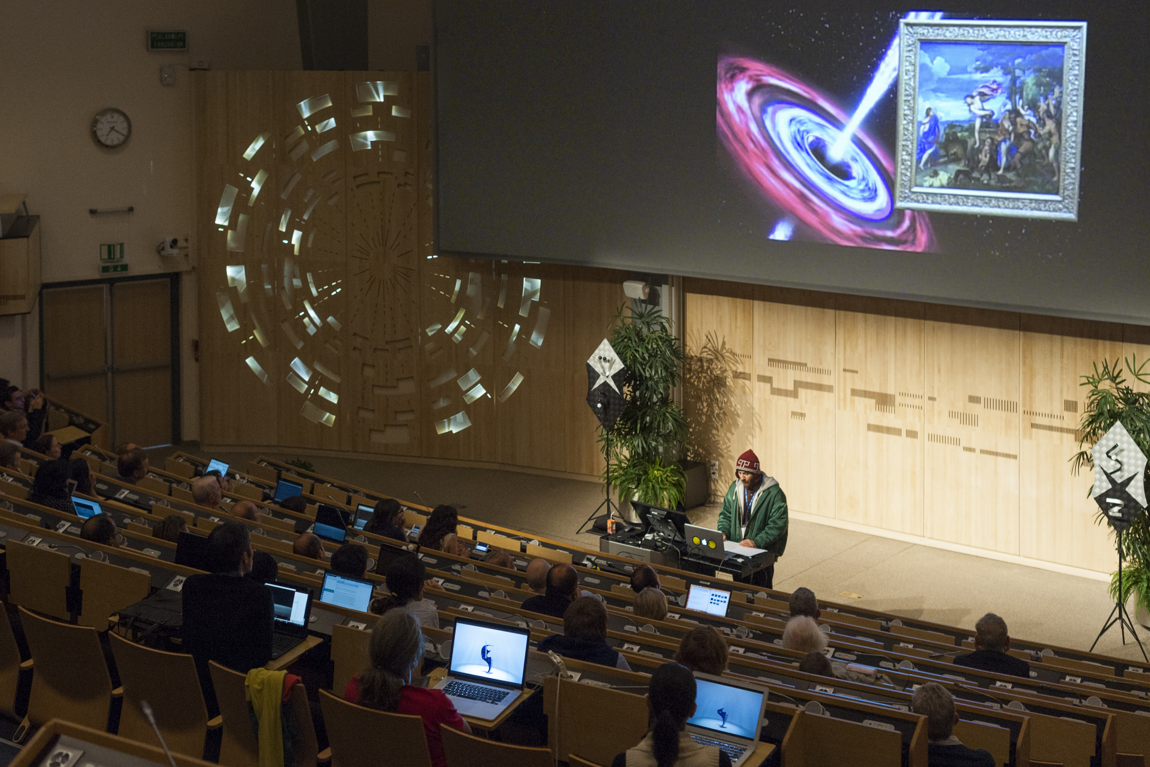
Supply and Installation of Audio-Visual Equipment (IT-5090/IT)
Procurement Code: 04040700 (Audio-visual control systems)
Cost Range : 1.5M – 5M CHF
Planning: MS : Q2 2025
IT: Q3 2025
Contract start: 1 January 2026
Scope:
Supply and installation of equipment for around 75 conference rooms including three auditoriums
Includes system schematics, rack layouts, cabling schedules, room layouts
Duration: 3 years, blanket purchase contract renewable for up to two further periods on one year each.
Eligible Firm Profile:
Interested firms shall have proven competence and experience in supplying AV and videoconferencing equipment
Contact: Olof.Barring@cern.ch

Slide 29
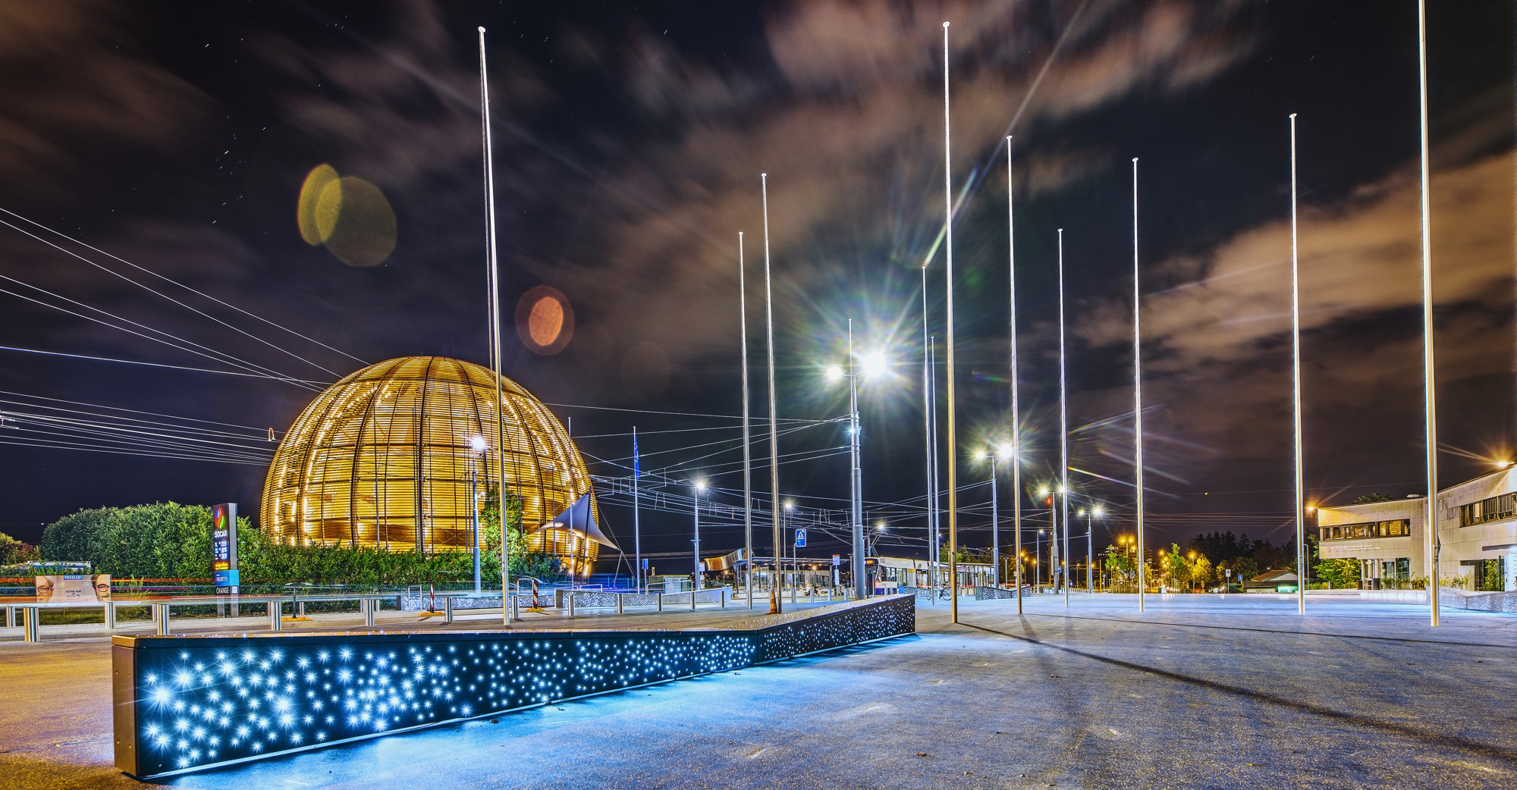
Health & Safety

Slide 30
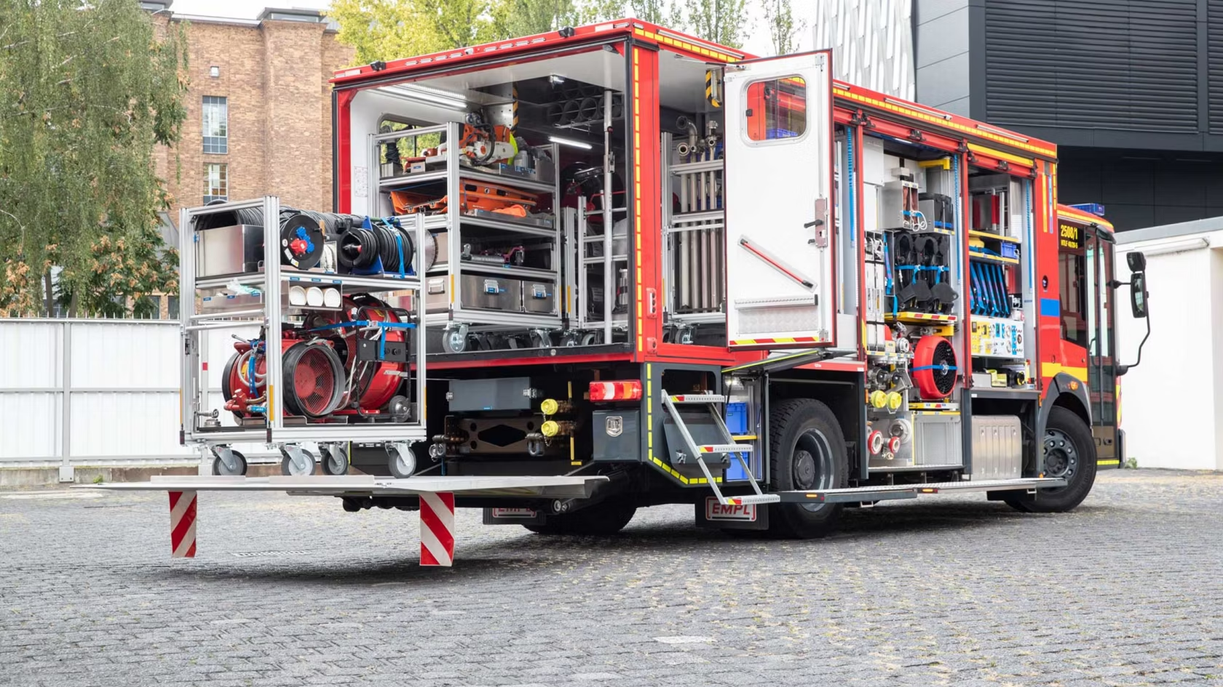
Supply of three utility vehicles (MS-5083/HSE)
Description & Specific Condition :
Three utility vehicles to be delivered over a three- year period (2026-2028)
  1x Flexi Unit in 2026
  1x Officer unit in 2027
  1x Flexi unit in 2028
Vehicles must be suited to transport fire and rescue equipment
Be equipped with an automatic gearbox
Procurement Code: 11 01 04 01 (Fire engines)
Cost Range : 400 kCHF - 1.5 MCHF
Planning: MS: Q2 2025 IT: Q3/4 2024
Contact: Miikka.Leinonen@cern.ch

Slide 31
Construction,
Onsite & Offsite Services

Slide 32
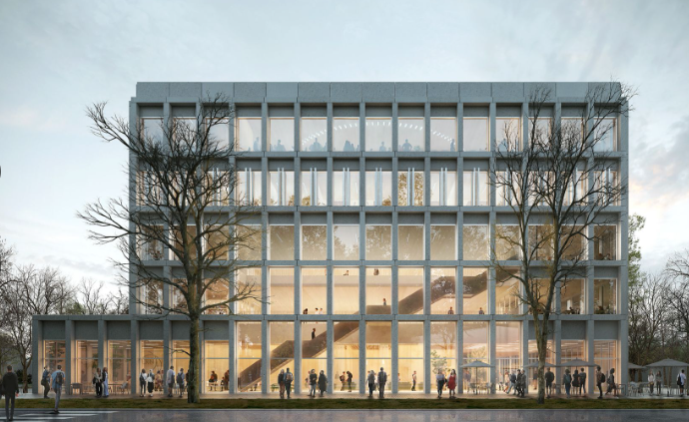
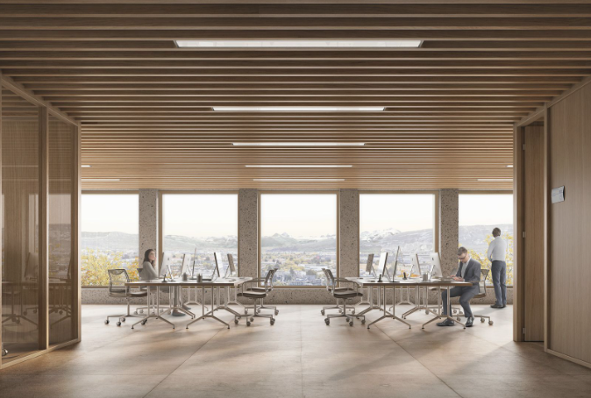
Construction of new Building 140
Description & Specific Conditions :
General contractor to construct new Building 140 on CERN’s Meyrin site in Switzerland.
Highly-performing mechanical, electrical, plumbing (MEP) and façade system to achieve recognised sustainability accreditation.
The building will provide a new council chamber, EP workshops, a learning centre and media facilities and will be constructed in two phases
Procurement code: 01 02 01 00/ 01/ 02
Cost Range : > 10M CHF
Planning: MS Published (MS-5104) / IT Q1 2026
Contact: baptiste.mercier@cern.ch

Slide 33
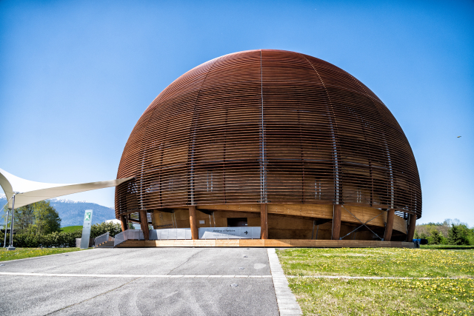
Insurance brokerage services (MS-4864/FAP)
Procurement Code: 14 01 02 00 (Transport and Property Insurance)
Cost Range : 400k - 1.5M CHF
Planning: MS : Q1 2025
IT: Q3 2025
Contract start: 1 January 2026
Scope:
Provision of insurance broking services;
Support, advice and monitoring of CERNs insurance contract portfolio (around twenty contracts).
Duration: 5 years (+ optional 2-y extension)
Eligible Firm Profile: Interested firms shall have proven competence and experience in providing insurance broking services for large science infrastructures and international organizations
© CERN
Contact: Carmelo.Saitta@cern.ch
Notes:
© CERN Some rights reserved. This image is freely available for non-commercial use.

Slide 34
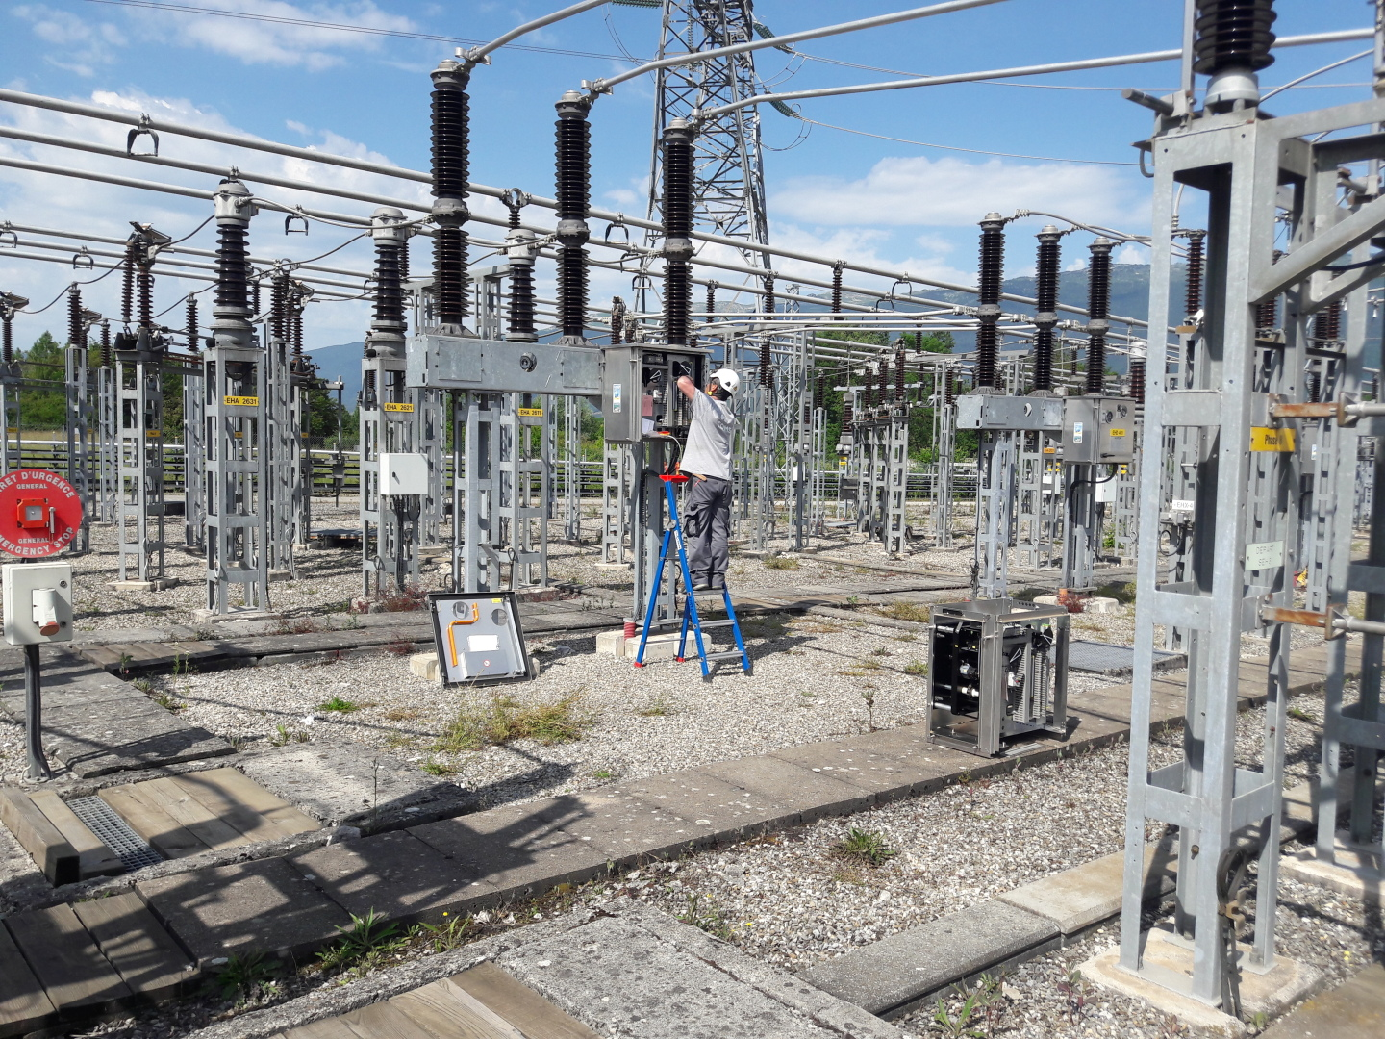
Maintenance services for high voltage (HTB) power electrical equipment at CERN (MS-4819/EN)
Procurement Code: 02010100, 13030200, 13030600 (Electrical Services)
Cost Range : 1.5 – 5 M CHF
Planning: MS : published
IT: Q3 2025
Contract start: Q1 2026
Scope:
Preventive and corrective maintenance for high voltage (HTB) power electrical equipment rated 400 kV and 66 kV at CERN.
The equipment to be maintained will include power transformers, circuit breakers, switches, measurements instruments and busbar systems.
Duration: 5 years (+ optional 2-y extension)
Eligible Firm Profile: Interested firms shall have proven experience and competence in maintenance of similar high voltage (HTB) power electrical equipment rated 400 kV and 66 kV.
© CERN
Contact: Giuseppe.Cappai@cern.ch

Slide 35
Maintenance services of low voltage switchboards at CERN
(MS-5072/EN)
Procurement Code: 02020400 (Electrical Services)
Cost Range : 1.5 – 5 M CHF
Planning: MS : Published
IT: Q3 2025
Contract start: 1 April 2026
Scope:
Preventive and corrective maintenance services of low voltage switchboards at CERN. including management of parts and consumables, revamping of drawers, supply of drawers and switching, modification of fixed parts and installation of drawers
Duration: 3 years (+ 2 optional 2-y extension)
Eligible Firm Profile: Interested firms shall have a proven experience in similar activities, with particular emphasis on technical expertise, project scale, and financial scope. Firms shall also demonstrate the capability to collaborate with switchboard manufacturers to procure spare parts or perform complex maintenance interventions.
© CERN
Contact: Stefano.Bertolasi@cern.ch

Slide 36
Supply and installation of HV cable accessories at CERN
(MS-5082/EN)
Procurement Code: 13030601 , 02059000 (Electrical Services)
Cost Range : 0.4 – 1.5 M CHF
Planning: MS : Published
IT: Q3 2025
Contract start: 1 January 2026
Scope:
Supply and installation of HV cable accessories compatible with existing and new power cables, including: the supply, the installation, the connection to electrical equipment and qualification after mounting of the accessories.
Duration: 3 years (+ 4 optional 1-y extension)
Eligible Firm Profile: Interested firms shall be specialized and qualified in the field of HV cable accessories (up to 66 kV) with skilled and experienced technicians
© CERN
Contact: mathieu.rigollet@cern.ch

Slide 37
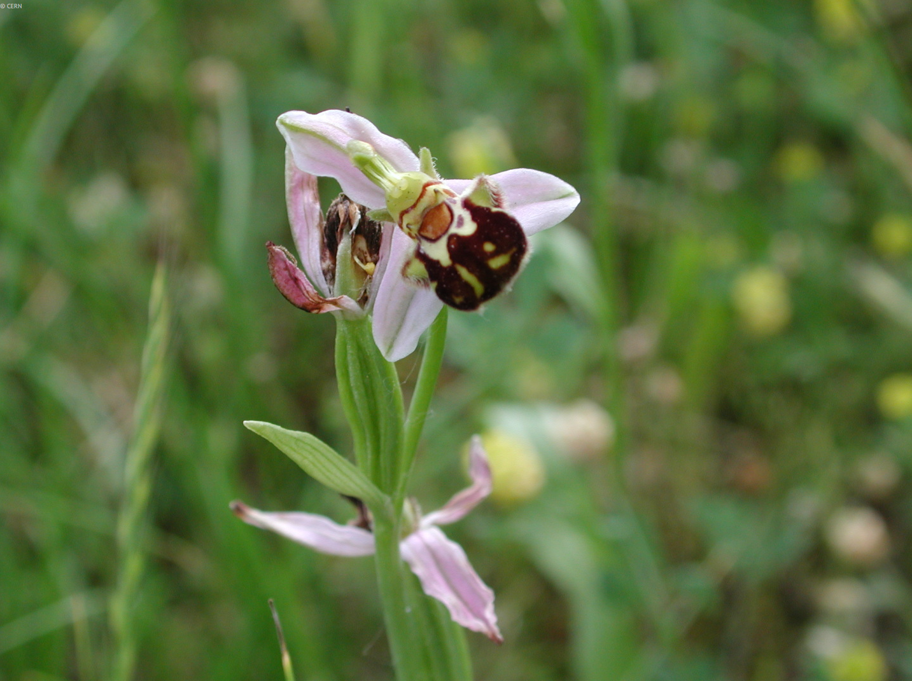
Maintenance of CERN’s green spaces (MS-5071/SCE)
Procurement Code: 13 01 02 00 (Green spaces)
Cost Range : 1.5M – 5M CHF
Planning: MS-5071/SCE : Q1 2025
IT-5071/SCE: Q3 2025
Contract start: 1 January 2026
Scope: maintenance of all the green spaces with the CERN domain, including lawn, trees, terraces and pedestrian paths, roads, and parking lots.
Duration: 3 years (+ optional 2 x 2-y extensions)
CERN intends to place two contracts, one for the French part and one for the Swiss part of CERN.
Eligible Firm Profile: Interested firms shall have proven experience and competence in maintenance of green spaces
Rare wild Orchids at CERN Meyrin
© CERN
Contact: Mathieu.fontaine@cern.ch
Notes:
© CERN Some rights reserved. This image is freely available for non-commercial use.

Slide 38

Small works for CERN’s green spaces
Procurement Code: 13 01 02 00 (Green spaces)
Cost Range : 200k – 400 KCHF for each PE (three in total)
Planning: PE : Q3 2025
Contract start: 1 January 2026
Scope: Small works for CERN’s green spaces including tree and agricultural work as well as landscaping work.
Duration: 3 years (+ optional 2 x 2-y extensions)
CERN intends to place three contracts:
- One for tree and agricultural work
- One for the French part and one for the Swiss part of CERN for landscaping work.
Eligible Firm Profile: Interested firms shall have proven experience and competence in maintenance of green spaces
Contact: Mathieu.fontaine@cern.ch
Notes:
© CERN Some rights reserved. This image is freely available for non-commercial use.

Slide 39

Wooden joinery works on the CERN Site
(MS-5045/SCE)
Procurement Code: 01 02 04 21 (Timber joinery)
Cost Range : 1.5M – 5M CHF
Planning: MS : Q4 2024
IT: Q3 2025
Contract start: 1 July 2025
Scope: wooden joinery works for CERN’s buildings: custom installations, maintenance and modification of windows, doors, partitions, cupboards, furniture and glazing.
Duration: 3 years (+ optional 2 x 2-y extensions)
Eligible Firm Profile: Interested firms shall have proven experience and competence in timber joinery works (Maintenance and works)
Contact: samuel.adam@cern.ch
Notes:
© CERN Some rights reserved. This image is freely available for non-commercial use.

Slide 40
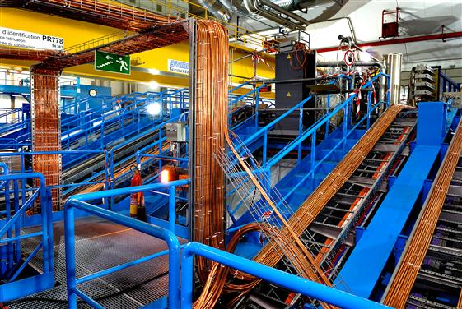
Electrical installation services at CERN
Procurement Code: 13 03 06 00 (Electrical installation works)
Cost Range : > 10M CHF
Planning: MS : Q3 2025
IT: Q4 2025
Contract start: Q2 2026
Scope:
Modifications to the electrical power distribution network
Cabling work
Minor electrical works
IT cabling
Work supervision
...
Duration: 5 years (+ optional 2-y extension)
Eligible Firm Profile: Interested firms shall have proven experience and competence in large electrical installation service contracts.
© CERN
Contact: Jan.Devoght@cern.ch
Notes:
© CERN Some rights reserved. This image is freely available for non-commercial use.

Slide 41

Consultancy Services (MS-5066/FAP) – several tenders
Procurement Code: 04900200, 04900100, 04900300, 04900400, 04900100, 12900100, 12900200, 12900300, 12900400, 12900500 (Consulting Services)
Cost Range : widely varying, depending on the opportunity
Planning: MS : Closed but still open to applications
DO/IT: from now till 2027
Contract start: as per needs
Scope:
Consultancy Services to assist CERN in Corporate Services, Technical and Business Computing and Associated Transverse Domains.
Service consists of the provision of domain experts to give advice, document templates, submit related reports and presentations with recommendations, research articles.
Duration: project based
Eligible Firm Profile: Interested firms shall have a proven experience and competence in technical and business computing, in associated transverse domains as well as in management and corporate consultancy.
Contact: Derek.Mathieson@cern.ch

Slide 42
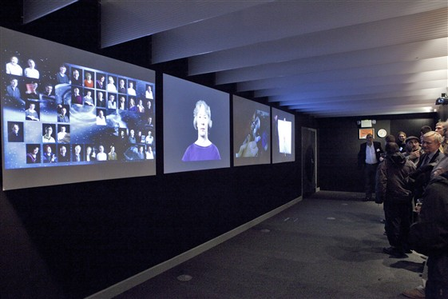
Multimedia content production
Procurement Code: 04 04 00 00 Audio-visual Equipment
Cost Range : 50k – 100k CHF
Planning: - DO launch Q3 2025
- Contract start: Q4 2025
Scope:
Provision of multimedia material (videos, animations) foreseen by the design of a new exhibition at CERN
© CERN
Contact: Antonella.Del.Rosso@cern.ch
Notes:
© CERN Some rights reserved. This image is freely available for non-commercial use.

Slide 43
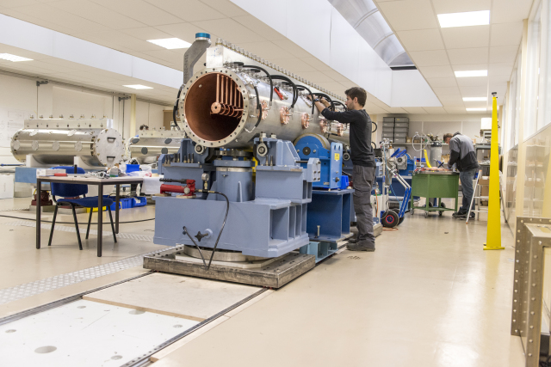
Vacuum vessel design study
Procurement Code: 05 90 01 00 Mechanical engineering design and consultancy
Cost Range : 50k - 100 CHF
Planning: - DO launch Q3 2025
- Contract start: Q4 2025
Scope:
Provision of a preliminary design study of a 40m3 vacuum vessel housing the target for the Beam Dump Facility target complex
© CERN
Contact: Jean-Louis.Grenard@cern.ch
Notes:
© CERN Some rights reserved. This image is freely available for non-commercial use.

Slide 44

Human Capital Management (HCM) Implementation Services
(MS-5061/FAP)
Procurement Code: 04900200 (Software Development Consultants)
Cost Range : 400k – 1.5M CHF
Planning: MS : Q3 2025
IT: Q4 2025
Contract start: 1 May 2026
Scope:
Provision of agile HCM Suite implementation services (tool vendor to be determined in preceding tendering procedure).
Duration: 3 years
Eligible Firm Profile:
Interested firms shall have proven competence and experience in implementing HCM/ERP solutions in replacement of an existing system.
They shall be certified implementation partners for the HCM solutions they wish to be considered for.
Contact: Oana.Liteanu@cern.ch, Jan.Janke@cern.ch

Slide 45
Human Capital Management (HCM)
Implementation Quality Assurance Services (MS-5060/FAP)
Procurement Code: 04900200 (Software Development Consultants)
Cost Range : 100k – 400K CHF
Planning: MS : Q4 2025
IT: Q1 2026
Contract start: 1 May 2026
Scope:
Provision of Quality Assurance services during the HCM Suite implementation period. As part of the HCM implementation Steering Committee act as intermediate between CERN’s implementation partner and CERN.
Duration: 3 years
Eligible Firm Profile:
Interested firms shall have proven competence and experience in providing quality assurance for HCM/ERP implementation projects.
Firm has to be fully independent from the chosen HCM implementation provider.
Contact: Oana.Liteanu@cern.ch, Jan.Janke@cern.ch
Notes:
© CERN Some rights reserved. This image is freely available for non-commercial use.

Slide 46
Thank you

