Slide 1
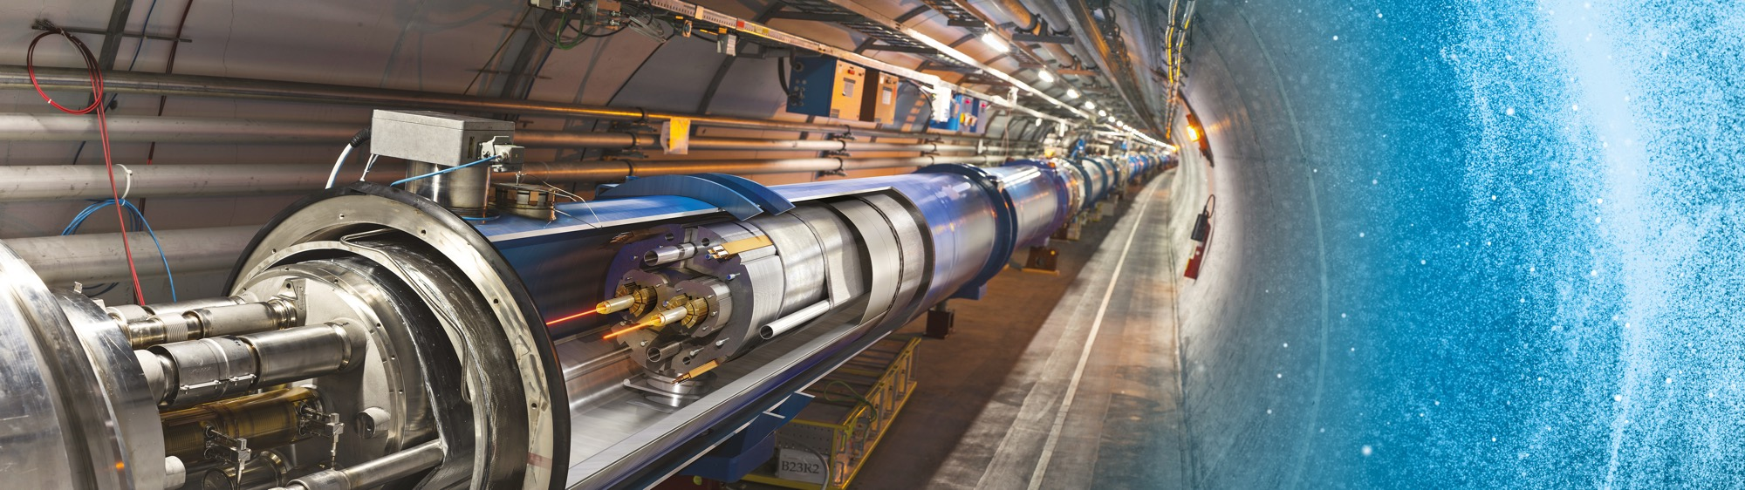
A Typical Tender Package
Industry Webinar
Adam Horridge
24 June 2025

Slide 2

Tendering at CERN – A Quick Recap
“Price enquiry” (Demande d’Offre - DO)
A single-step tendering process for requirements up to 400k CHF
“Market Survey” (MS) >400k CHF
CERN’s prequalification phase to qualify and select suitable companies for tendering requirements above 400k CHF
“Invitation to Tender” (IT)
Bidding phase for requirements above 400k CHF issued to firms

Slide 3

Whether your company…
Expressly asked to be consulted based on CERN’s published:
“Business Opportunities”
Is selected from CERN’s Suppliers Data Base
Is added by your ILO
… It all starts with an email
Either from the Procurement Officer (up to 50k CHF)
Or from Procurement.service@cern.ch (>50k CHF and Market Surveys)

Slide 4
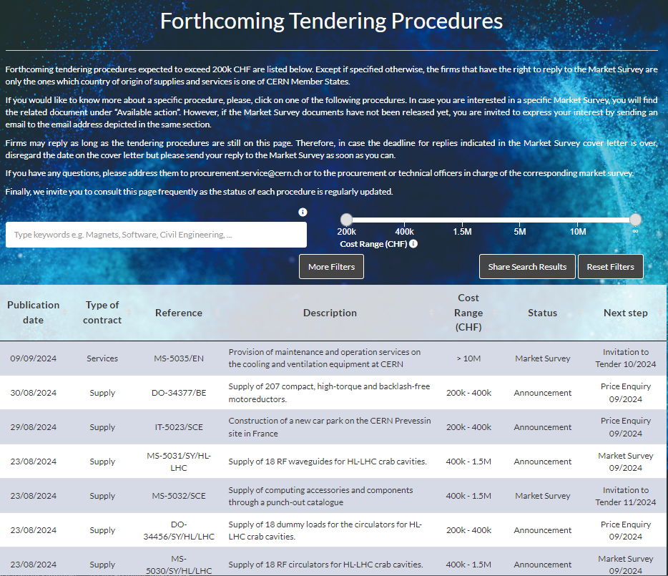
Forthcoming Opportunities Page
Step 1 : Announcement
CERN’s Shopping List https://forthcoming-ms.app.cern.ch/#!/
For more info, click here

Slide 5
Requirements between 10’000 and 400’000 CHF
“Price enquiry” (Demande d’Offre - DO)
Submission deadline: 4-6 weeks from date of dispatch;
All price enquiries above 50’000 CHF are also sent to the
Industrial Liaison Officers (ILOs) for information;
All price enquiries above 200’000 CHF are advertised on our Business Opportunities page
Price enquiries consist of:
  Technical specification and annexes;
  Tender form (and a technical annex - optional);
  CERN’s General Conditions (contracts, invitations to tender, safety, etc.)
  CERN’s Supplier Code of Conduct

Slide 6
Requirements exceeding 400’000 CHF
Phase 1 : “Market Survey” (MS) (Prequalification stage)
1 - E-mail Cover letter
2 – CERN e-survey Interface
4 - Qualification Questionnaire
5 - Selection and Adjudication Criteria
3 - Technical Description

Slide 7

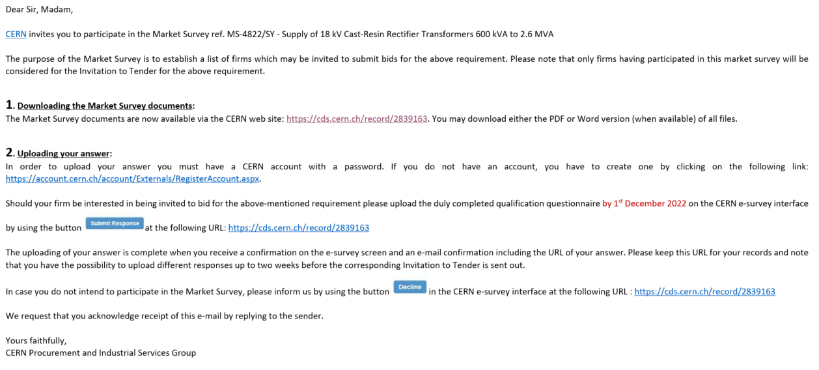
Requirements exceeding 400’000 CHF - Phase 1 : “Market Survey” (MS)
Submission deadline: 4 weeks, or more if the MS is still online on the business opportunities table

Slide 8

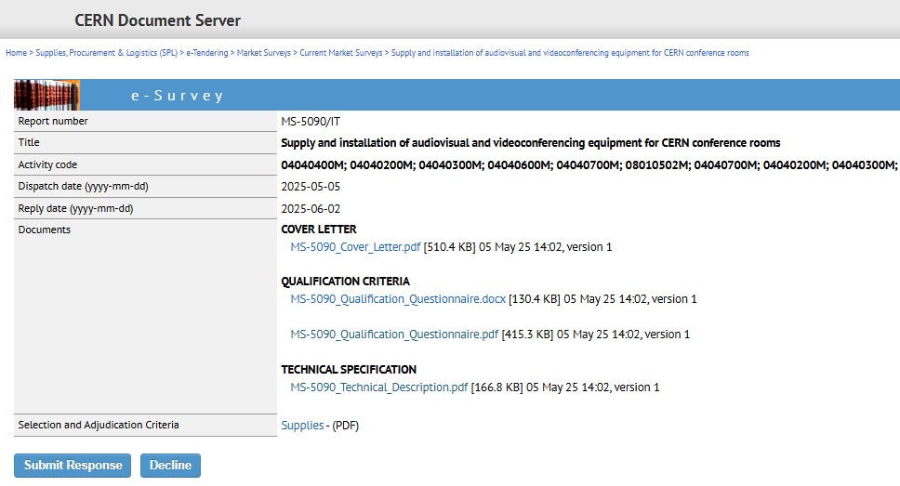
Requirements exceeding 400’000 CHF - Phase 1 : “Market Survey” (MS)

Slide 9


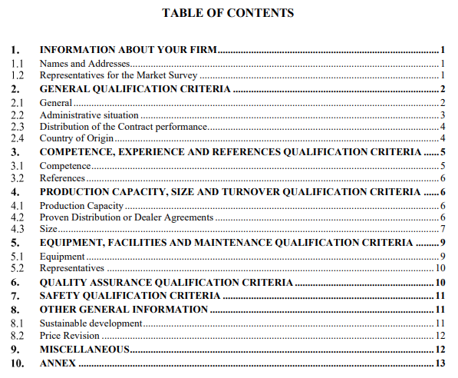
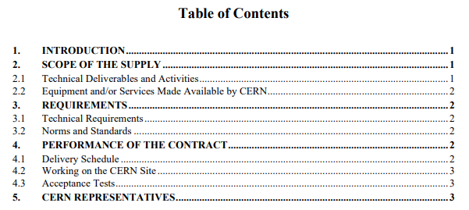
Requirements exceeding 400’000 CHF - Phase 1 “Market Survey” (MS-5090/IT)

Slide 10


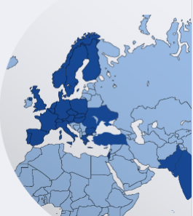
Requirements exceeding 400’000 CHF - Phase 1 : “Market Survey” (MS)
Only firms fullfilling the Qualification Criteria
and having been Selected by CERN on the basis of the Market Survey will be invited to participate in the forthcoming Invitation to Tender.
technical and financial qualifications of the firm;
CERN's previous experience with the firm, if any;
the number of firms selected from each Member State (MS's contribution, the relevant industrial return coefficient and the estimated amount of the contract)

Slide 11
Requirements exceeding 400’000 CHF
Phase 2 : “Invitation to Tender” (IT) (Tendering stage)
Sent to qualified and selected firms only
Submission deadline: 4 weeks from date of dispatch (with a longer period for more complex requirements)
1 - E-mail - Cover letter
2 – CERN e-tendering Interface
5 – Tender Form
3 – General Documents
4 - Technical Specification

Slide 12

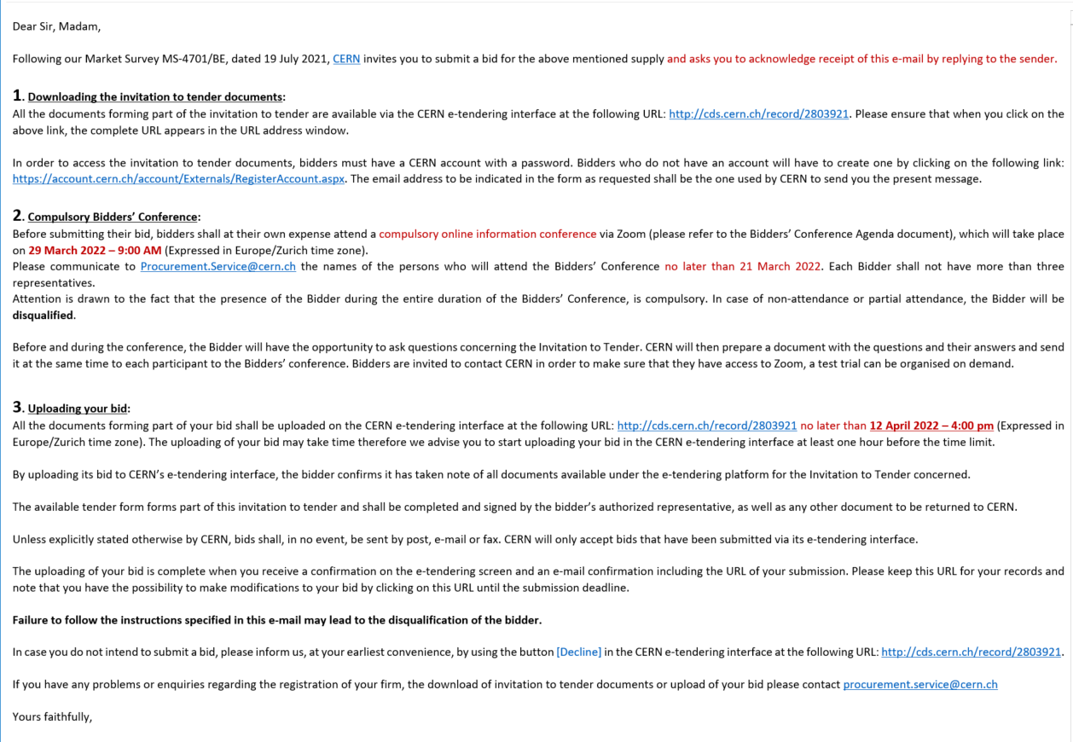
Requirements exceeding 400’000 CHF - Phase 2 : “Invitation to tender” (IT)
Sets out key timing and procedural steps

Slide 13
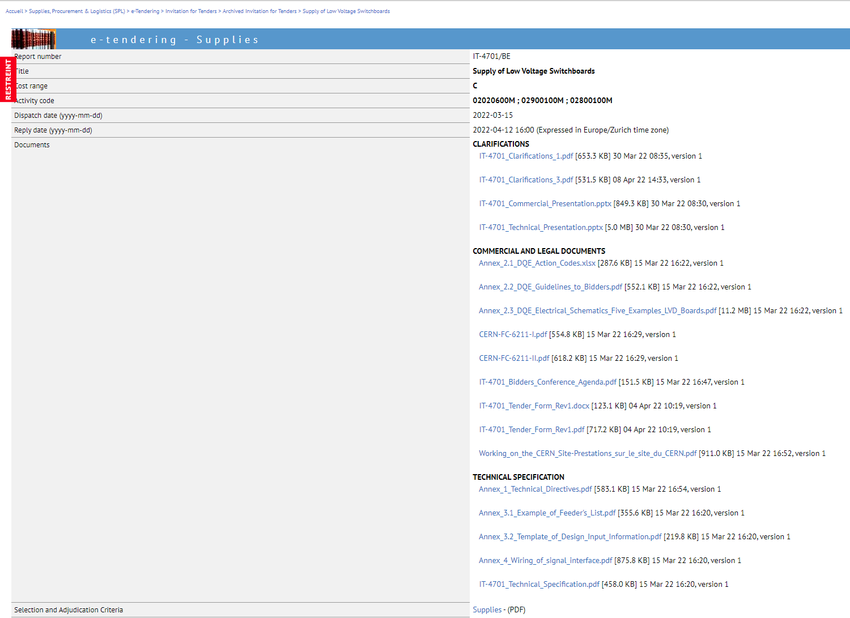

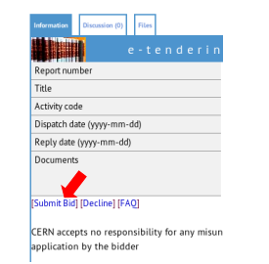
Requirements exceeding 400’000 CHF - Phase 2 : “Invitation to tender” (IT)
On a case-by-case basis:
  Mandatory Bidders Conference
  Mandatory/Optional technical visits
Firms may ask any necessary questions in writing to:
  Ensure full understanding of all requirements
  Prepare a bid that best matches CERN’s needs
  Pay close attention to adjudication basis i.e. lowest compliant bid vs best-value-for-money (technical/commercial submission envelopes)
  Bids shall be submitted on the CERN e-tendering platform

Slide 14



Requirements exceeding 400’000 CHF - Phase 2 : “Invitation to tender” (IT)
  General Conditions for Invitations to Tender by CERN (CERN-FC – 6674-I)
  General Conditions of CERN Contracts (CERN-FC – 6674-II)
  Selection and Adjudication criteria – Supplies or Services
  CERN Supplier Code of Conduct
  All these documents are publicly available here:
  Key Reference Documents

Slide 15

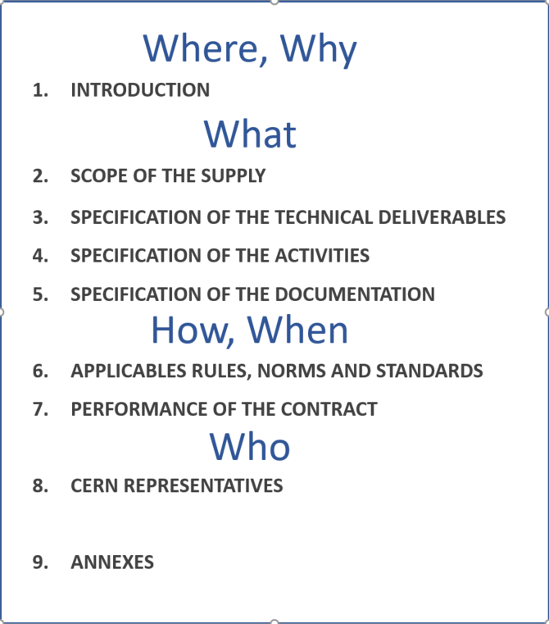
Requirements exceeding 400’000 CHF - Phase 2 : “Invitation to tender” (IT)
The Technical Specification is structured in order to explain

Slide 16

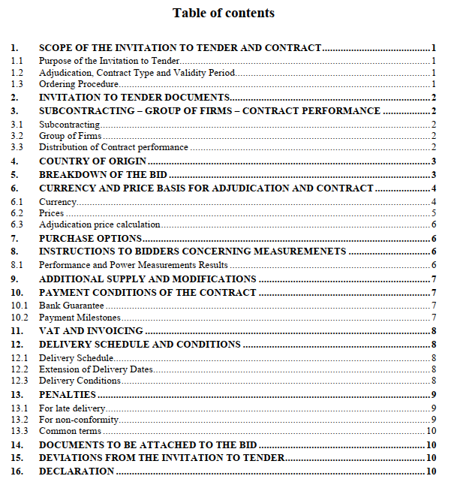
Requirements exceeding 400’000 CHF - Phase 2 : “Invitation to tender” (IT)
Your Tender Form shall be:
Duly completed and signed by the bidder (single firm or all member firms in case the bidder is a group of firms)
UPLOADED on the CERN e-tendering Interface with all documents to be attached to the bid (§12)
In your chosen currency. CERN converts all bids into CHF using SNB rate on the closing date of the DO/IT
Comments and/or Deviations from the IT documents shall be listed in the closing section
In case you cannot meet the required delivery schedule, do not decline, Please mention your best achievable delivery schedule as CERN may have some flexibility
Bidders are always encouraged to ask any questions during the tender period

Slide 17

Conclusion: Success Factors
Register your company on the CERN Suppliers Portal.
  https://procurement.web.cern.ch/
Look out for forthcoming opportunities, large and small:
  https://forthcoming-ms.app.cern.ch/#!/
  Our LinkedIn page
Gain a full understanding of CERN’s requirements and ask questions if needed
Submit bid documentation in full and on time
Be mindful of adjudication methods…..lowest compliant bid or best-value-for-money
Readiness to adapt production techniques and meet demanding tolerances

Slide 18
Thank you

