Slide 1
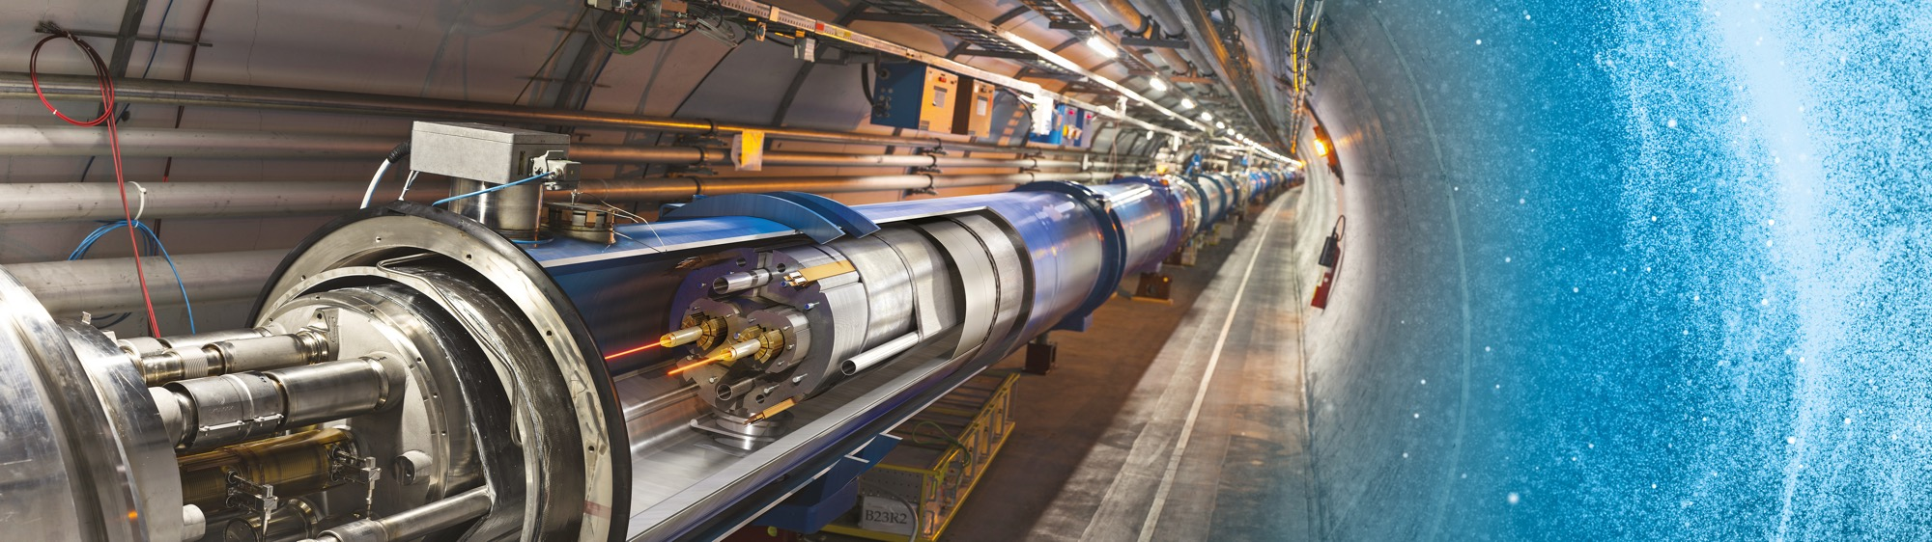
Doing Business with CERN
Industry Webinar
Adam Horridge
24 June 2025

Slide 2
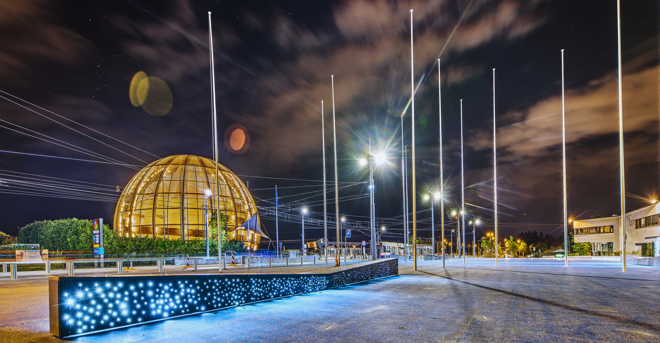
EVENT AGENDA
14:00 –14:05
Welcome, agenda (A.Horridge)
14:05 –14:20
Introduction to CERN (Video)
14:20 – 14:50
Doing business with CERN (A.Horridge)
14:50 – 15:20
Procurement forthcoming needs (N. Azizi, C. Carayon)
15:20 – 15:35
Typical tender process (A.Horridge)
15:35 – 15:55
Questions – Answers (C.Carayon; A.Horridge; N. Azizi; C. Lara)
15:55 Close

Slide 3

SOME HOUSEKEEPING
The event will be recorded and made available to participants
All slides will be available to you on the event page
Webinar mode – Questions can be submitted via the Q&A button

Slide 4
AGENDA
Introduction
Statistics and What We Buy
Procurement @ CERN - the rules
Impact of Doing Business With CERN
Procurement Website and Info Resources

Slide 5

Introduction

Slide 6
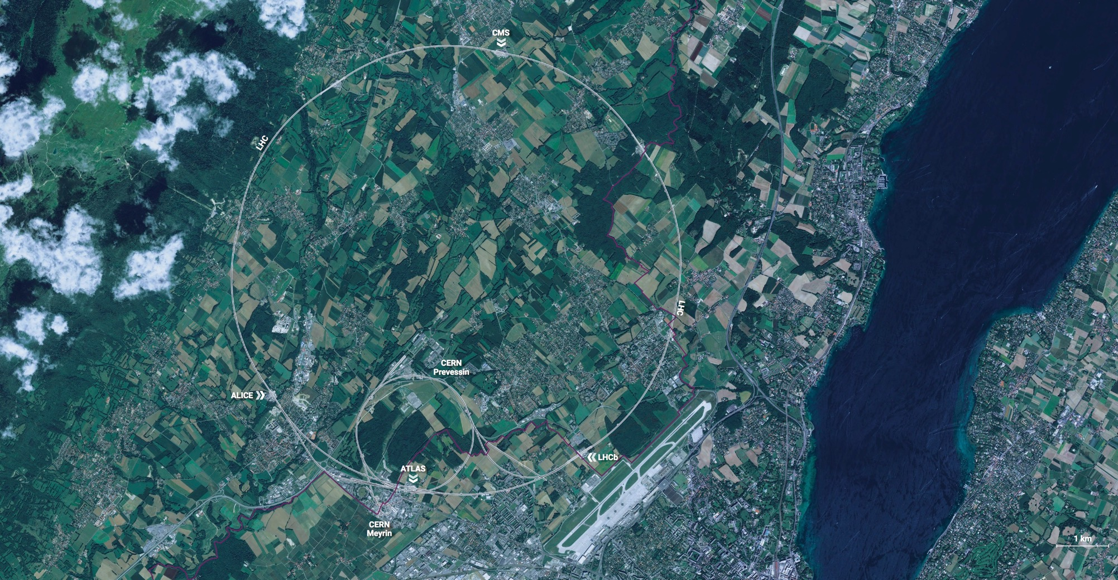
CERN - the world’s biggest laboratory for particle physics.
International Organization
established on 1 July 1953 -
“Science for Peace”.
Immunity of jurisdiction
and execution.
Notes:
This slide addresses two questions:
“Where are we?”
Use the map to indicate the location of CERN, headquartered in Geneva, straddling the Franco-Swiss border
“What is CERN?”
CERN is one of the world’s leading laboratories for particle physics
CERN’s vision (long-term goal) is to understand the fundamental particles and laws of the Universe (This is the Vision statement that features in CERN’s communication strategy)
Thus, CERN is first and foremost a research laboratory

Slide 7

CERN is entitled to establish its own internal rules necessary for its proper functioning, including:
Procurement Rules
Safety Rules
Staff Regulation of its own personnel

Slide 8

In 1954 CERN had 12 Member States
Today CERN has 25 Member States
25 Member States
1 Associate Member States in the pre-stage to membership
8 Associate Member States
4 Observers
Geographical & cultural diversity
110 nationalities,
from 77 countries
~ 2,676 Staff members
~ 2,000 contractors’ employees
~ 13,000 physicists /users
Yearly budget ~ 1300 MCHF
Notes:
The speaker can highlight CERN’s second mission as stated when it was established: to foster peaceful collaborations between nations that had recently been at war.
This slide will have information on the country of the visiting delegation:
Location on the world map
Date of accession (if Member State or Associate Member State)
For information:
Member States – Austria, Belgium, Bulgaria, Czech Republic, Denmark, Estonia, Finland, France, Germany, Greece, Hungary, Israel, Italy, Netherlands, Norway, Poland, Portugal, Romania, Serbia, Slovak Republic, Spain, Sweden, Switzerland, United Kingdom
Associate Member States in the pre-stage to membership – Cyprus, Slovenia
Associate Member States – Croatia, India, Latvia, Lithuania, Pakistan, Turkey, Ukraine
Observers – USA, Russia (SUSPENDED), Japan, (EU, JINR, UNESCO)

Slide 9


































Yearly Budget (contributions 2025)
Country | Percentage | Amount (CHF)
Germany | 20.10% | 254 713 750
United Kingdom | 14.63% | 185 443 700
France | 12.38% | 156 880 600
Italy | 9.43% | 119 487 150
Spain | 6.62% | 83 864 950
Netherlands | 4.72% | 59 771 700
Switzerland | 3.72% | 47 108 400
Poland | 3.09% | 39 196 050
Belgium | .2.71% | 34 355 300
Sweden | 2.61% | 33 069 950
Norway | 2.43% | 30 748 450
Israel | 2.28% | 28 901 850
Austria | 2.15% | 27 217 900
Denmark | 1.87% | 23 653 250
India | 1.45% | 18 348 250
Romania | 1.32% | 16 710 000
Finland | 1.29% | 16 346 850
Country | Percentage | Amount (CHF)
Czech Republic | 1.17% | 14 807 450
Portugal | 1.06% | 13 424 700
Greece | 0.97% | 12 225 600
Brazil | 0.81% | 10 232 950
Hungary | 0.71% | 8 982 550
Slovak Republic | 0.52% | 6 552 450
Türkiye | 0.39% | 4 955 250
Bulgaria | 0.39% | 4 888 400
Serbia | 0.28% | 3 596 450
Slovenia | 0.21% | 2 654 050
Pakistan | 0.16% | 2 053 850
Estonia | 0.16% | 2 045 150
Cyprus | 0.09% | 1 119 450
Latvia | 0.08% | 1 066 250
Ukraine | 0.08% | 1 034 000
Croatia | 0.08% | 1 000 000
Lithuania | 0.08% | 1 000 000

Slide 10

Statistics

Slide 11
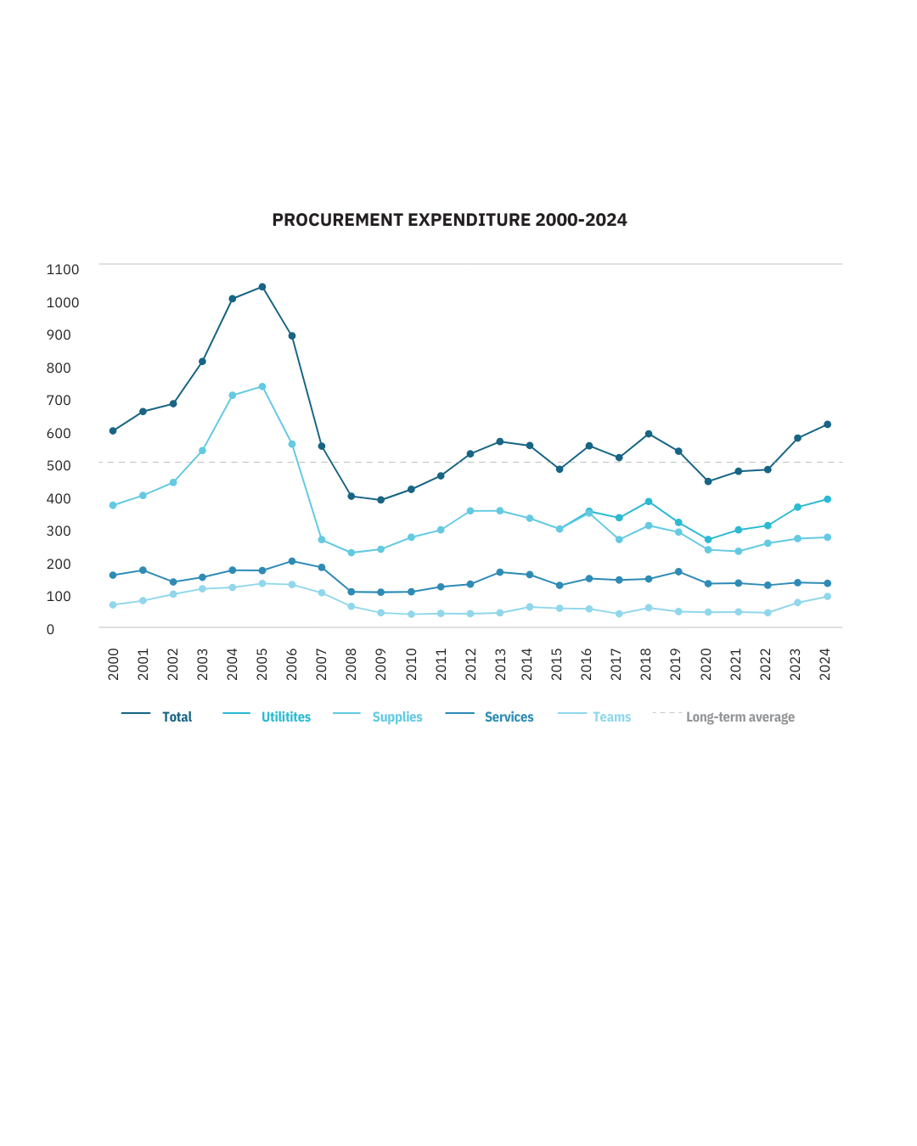
Procurement Expenditure
613MCHF

Slide 12
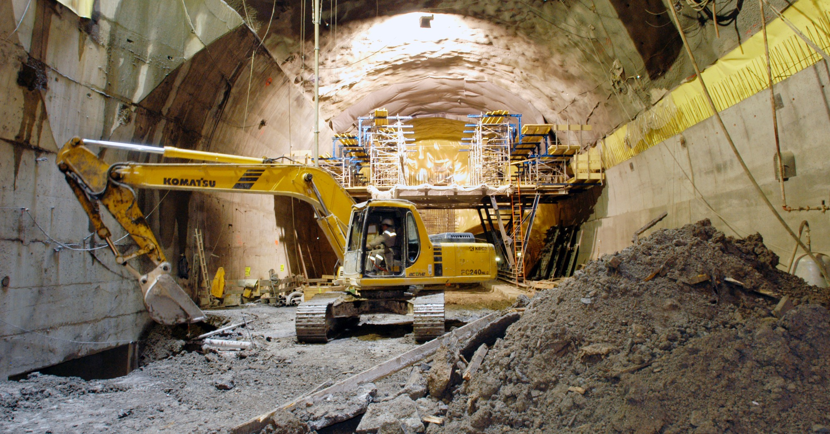
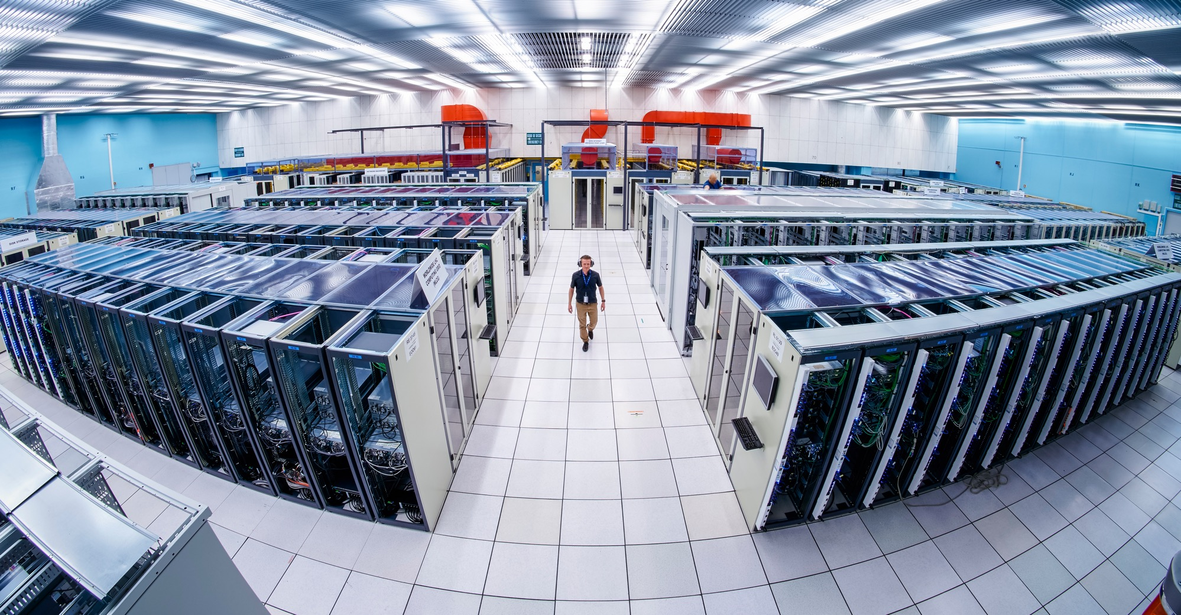
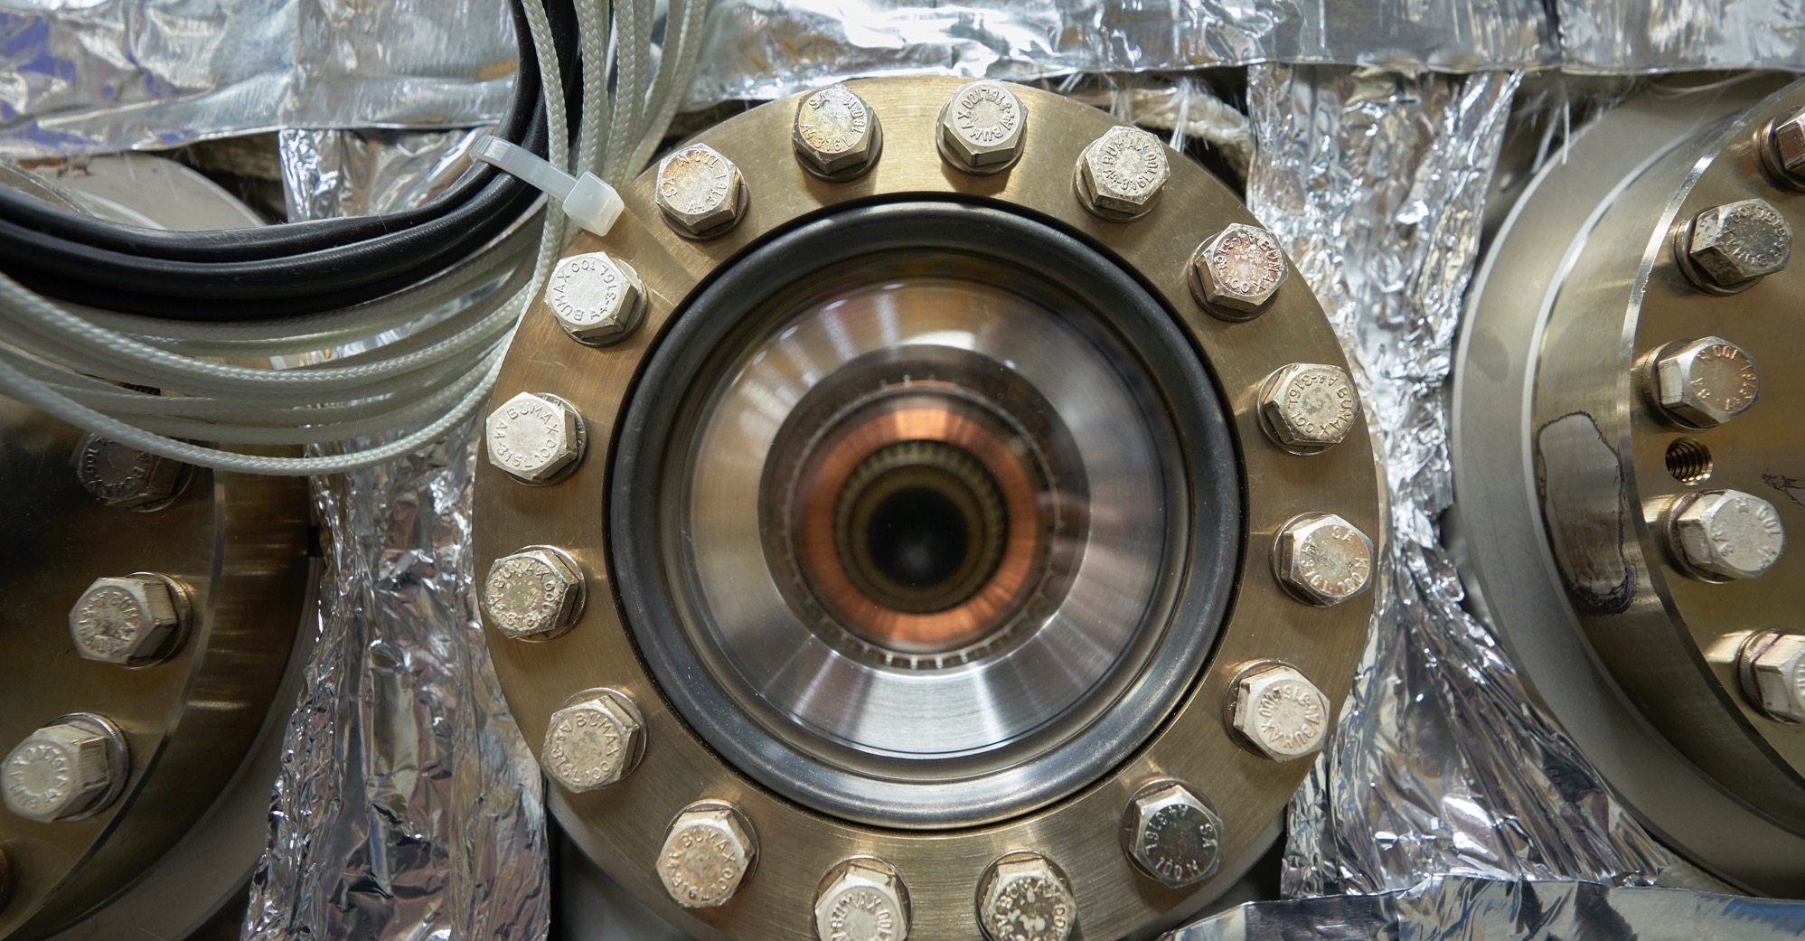
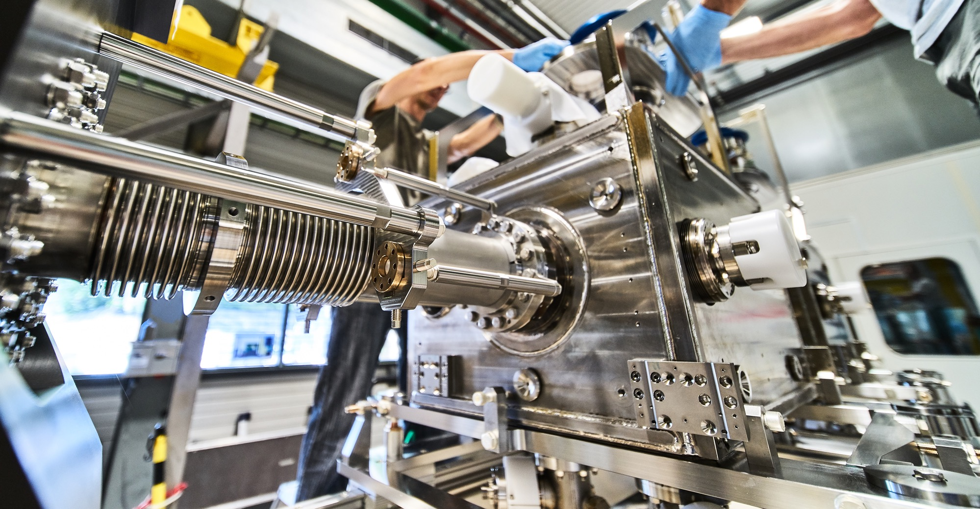
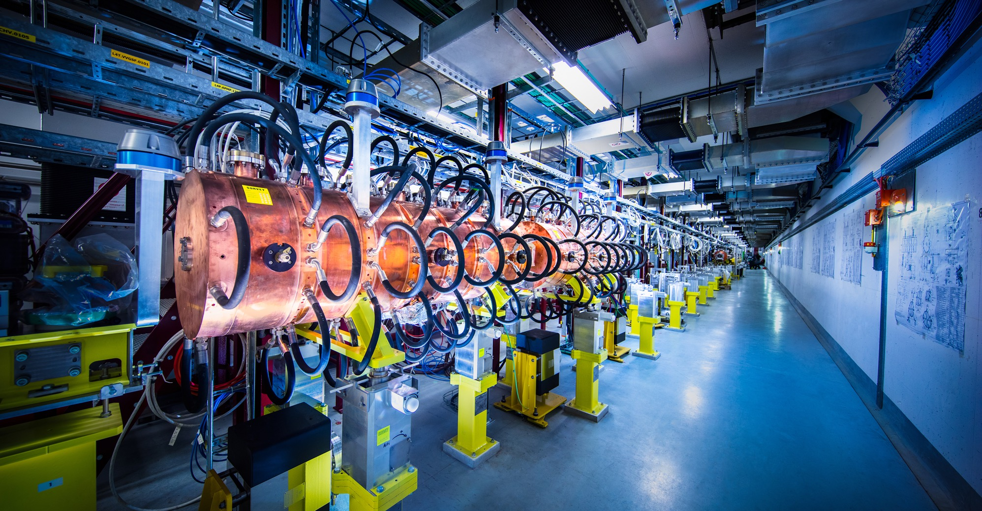
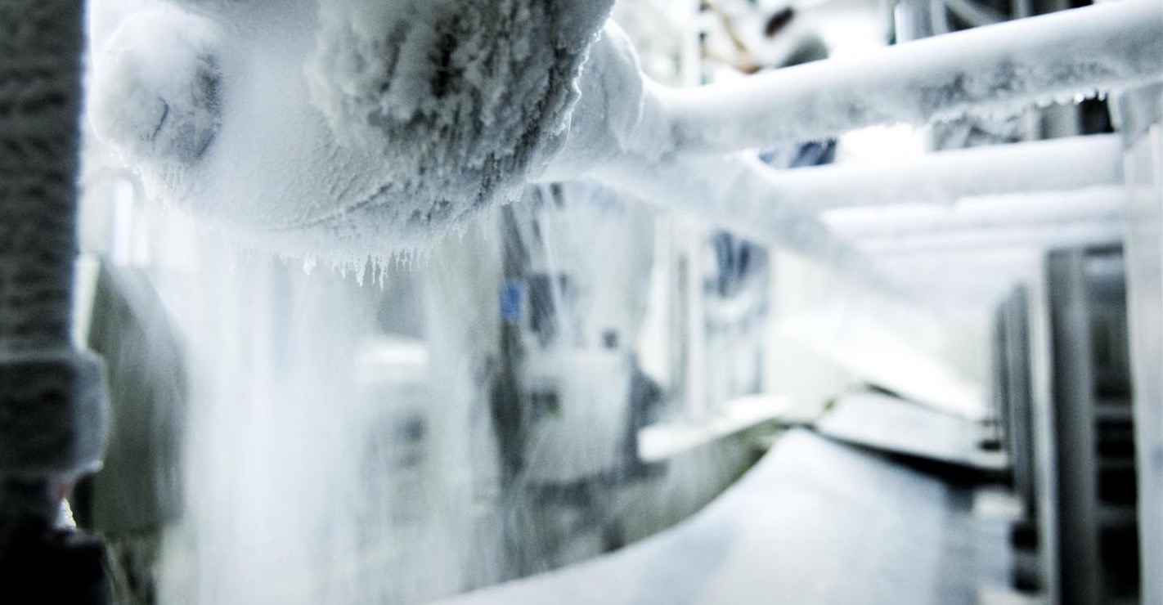
What do we buy?
Civil engineering
Cooling and ventilation
Electrical engineering and magnets
Information Technology
Mechanical engineering and raw materials
Electronics and radiofrequency
  Cryogenic and vacuum equipment
  Health and safety equipment,
  Transport and handling equipment
  Office supply, furniture
  Industrial services on the CERN site

Slide 13
Supplies (279MCHF spent in 2024 – CERN budget only*)
*Excluding visiting research teams and collaborations

Slide 14
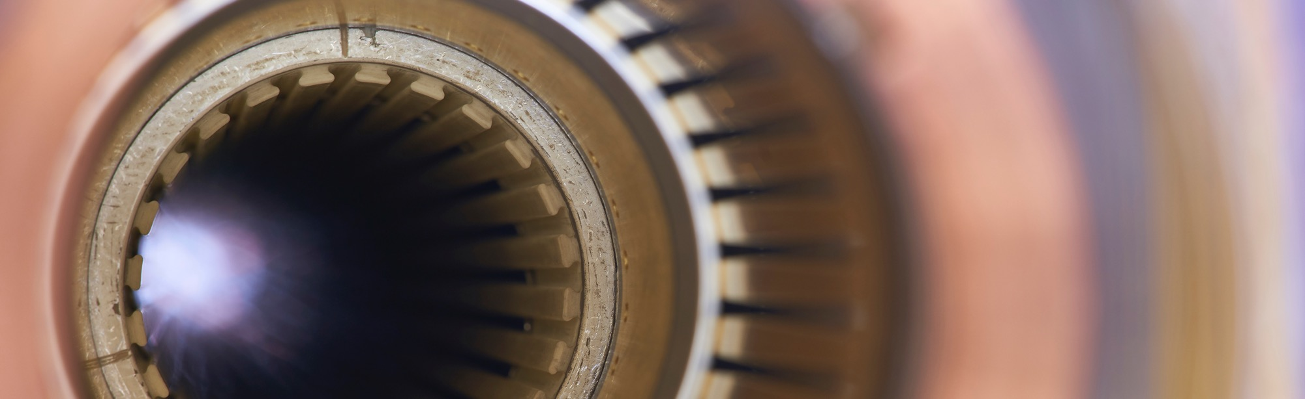
Current project - upgrade of the LHC to High Luminosity
Hi-Lumi will provide greater precision and discovery potential
Hi-Lumi will start operating in 2030, and run until 2041
CERN is already looking beyond 2041, with several projects in R&D or study stages

Slide 15
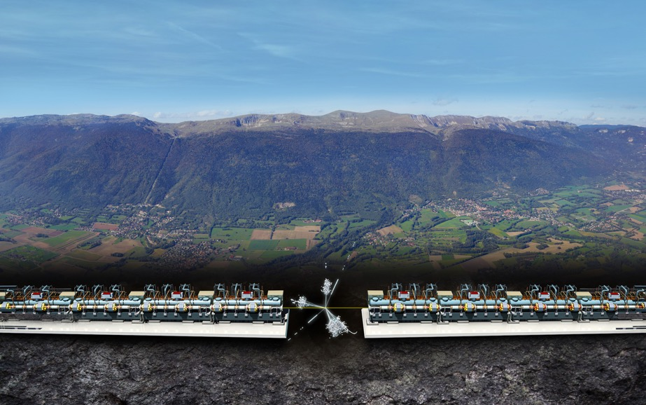
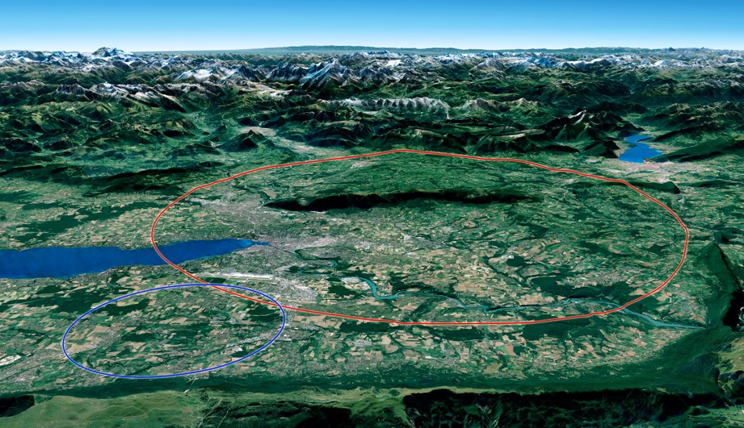

Two biggest projects for future of particle physics
Future Circular Collider (FCC)
New technology magnets 100 TeV pp collisions in 91km ring
e⁺e⁻ collider (FCC-ee) as 1st step?
FCC
Compact Linear Collider (CLIC)
Linear e⁺e⁻ collider √s up to 3 TeV
LHC

Slide 16
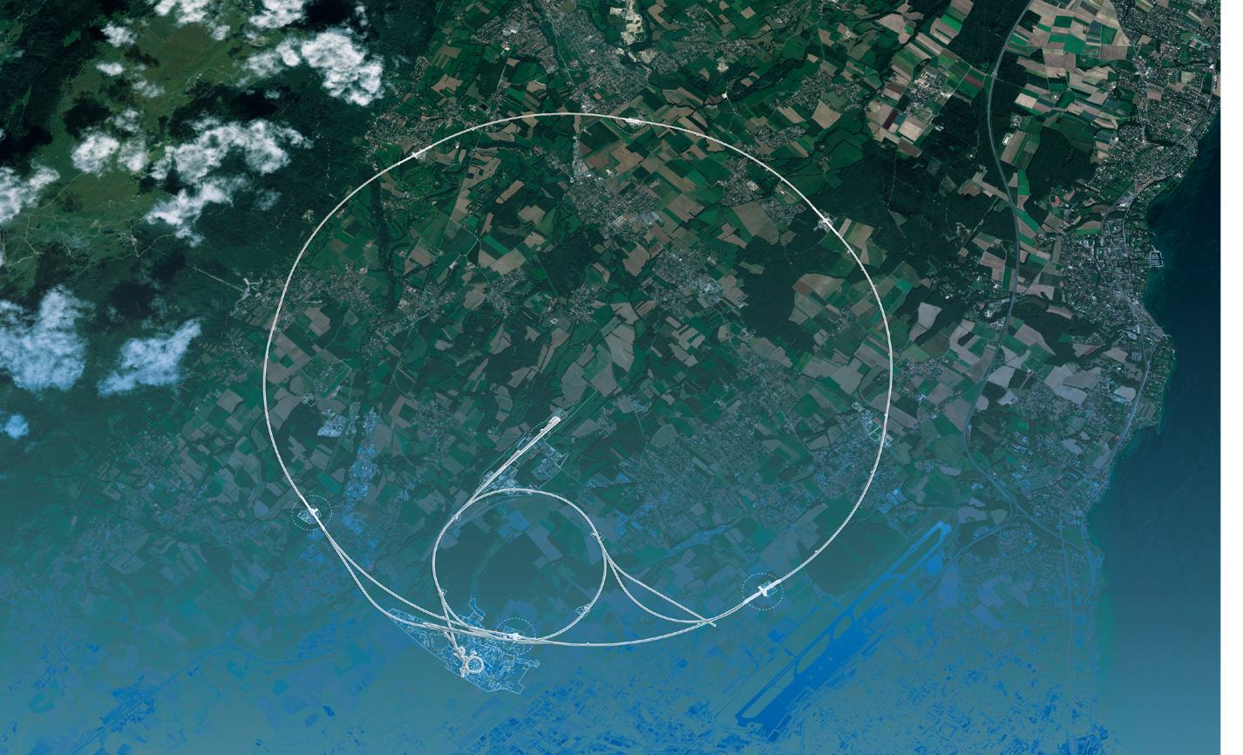
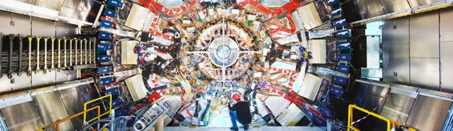
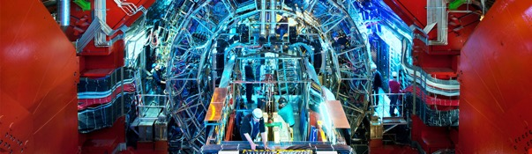
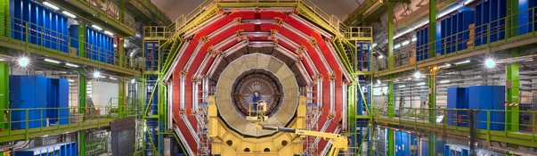
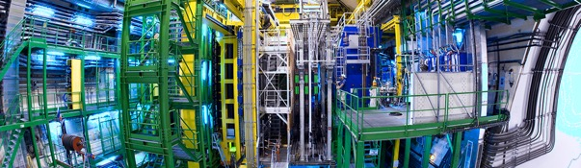
We also buy for the LHC experiments
CMS
ALICE
ATLAS
LHCb

Slide 17
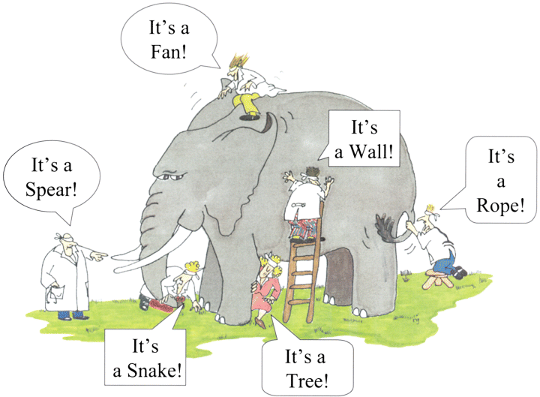

How do we buy?
  Off-the shelf or non-standard products which can be produced with existing manufacturing techniques or technologies:
  Functional specification
  Non-standard products where industry has neither the required know-how nor the interest to develop and design the products:
  Build-to-Print specification
Prototypes and or Pre-series might be required.

Slide 18


Procurement @CERN - Rules

Slide 19
The Procurement Service
Mission
The Procurement Service (PS) procures all supplies and services for CERN
Meeting the specified and financial, technical, environmental and delivery requirements
Keep overall costs for CERN as low as possible and to ensure the most advantageous use of CERN’s resources
While achieving balanced industrial return for CERN Member States
Respecting CERN
Procurement Rules

Slide 20
Principles of the Procurement Rules (1/4)
1
Transparency and Impartiality
2
Tenders open to Member States only
3
Objectivity and equal treatment: tendering packages are objective and impartial

Slide 21
Principles of the Procurement Rules (2/4)
Selective tendering procedures: CERN’s tendering procedures are not open to any interested firms
Confidentiality: Opening and evaluation of bids as well as negotiations are not public

Slide 22
Principles of the Procurement Rules (3/4)
Award for on Lowest compliant bid basis
Most commonly for Supply contracts
Technical
Financial
2
Delivery

Slide 23
Principles of the Procurement Rules (4/4)
Award on Best Value For Money basis
Most commonly used for industrial service contracts
2

Slide 24

Enquiries between 10,000 and 400,000 CHF
“Price enquiry” (Demande d’Offre - DO)
Submission deadline: 4-6 weeks from date of dispatch;
All price enquiries above 50,000 CHF are also sent to the
Industrial Liaison Officers (ILOs) for information;
Price enquiries consist of:
  Technical specification and annexes;
  Tender form (and a technical annex - optional);
  CERN’s General Conditions (contracts, invitations to tender, safety, etc.)
Price enquiries between 200,000 – 400,000 CHF announced on CERN’s procurement website, see
“Business Opportunities”

Slide 25

Enquiries exceeding 400’000 CHF (1/2)
“Market Survey” (MS)
Prior announcement on CERN’s procurement website, see
“Business Opportunities”
  At this stage, interested firms are encouraged to contact CERN in
  order to have a clear understanding of the requirement, allowing
  them to begin their organization ahead of the tendering process.
Market surveys consist of:
  “Technical Description” and;
  “Qualification Questionnaire” (financial and technical).
Submission deadline: 4 weeks, or more if the MS is still online.

Slide 26

Enquiries exceeding 400’000 CHF (2/2)
“Invitation to tender” (IT)
Sent to qualified and selected firms only;
Submission deadline: 4 weeks from date of dispatch (with a longer period for more complex requirements);
Firms shall ask all necessary questions in writing to understand all requirements and prepare a bid that best matches CERN’s needs;
All invitations to tender are sent to the Industrial Liaison Officers (ILOs) for information;
Bids shall be submitted via CERN’s e-tendering application.
Notes:
Invitations to tender consist of:
Technical specification and annexes;
Tender form (and a technical annex - optional);
General Conditions of CERN (contracts, invitations to tender, Safety, etc.)

Slide 27

Country of origin – Why do we need to know?
Industrial Return to our Member States and Associate Member States is a key organisational objective and therefore we need to record this in order to better manage our efforts to achieve our goals in this respect

Slide 28
Country of origin
SUPPLIES
“Country(ies) where the supplies (including their components and sub-assemblies) are manufactured or undergo the last major transformation by the contractor or its sub-contractor”
SERVICES
“Country(ies) in which the bidder is established.”

Slide 29

Industrial return coefficient
Industrial return
coefficient
Over a 4-year period:
Poorly balanced (PB) : < 1
Well balanced (WB): ≥ 1
For Supply contracts and for a
12-month period starting on
1st March, defined as:
“The ratio between a Member State's percentage share of the value of all Supply contracts and that Member State's percentage contribution to the CERN Budget over the same period”.
Status definition
% expenditure in the MS
Return Coef.=
% contribution to CERN budget for this MS

Slide 30
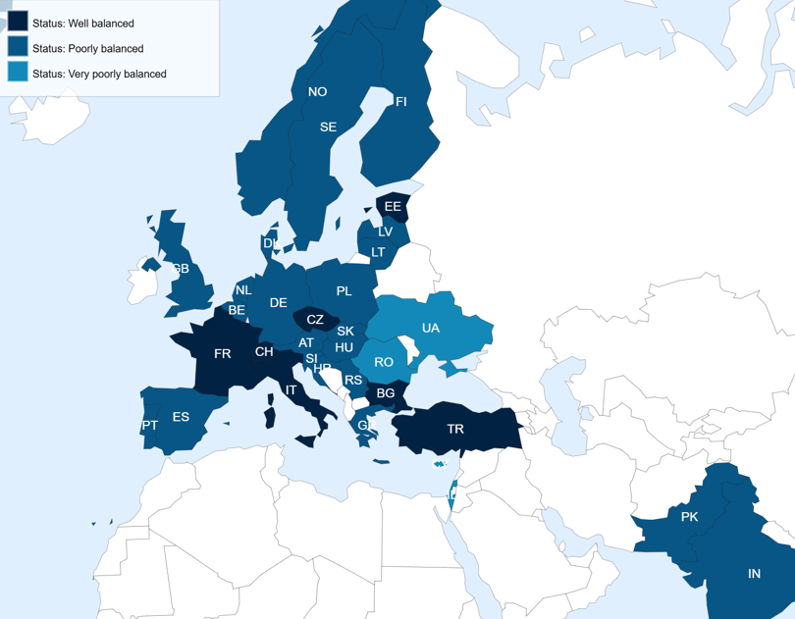
Poorly balanced Member States (Supplies)
(1st March 2025 – 28 February 2026, based on the previous 4 calendar years):
Well Balanced (≥1) | Poorly Balanced (< 1)
Bulgaria Croatia* Czech Republic Estonia France Italy Pakistan* Switzerland Türkiye* Ukraine* | Austria Belgium Brazil* Cyprus* Denmark Finland Germany Greece Hungary India Israel Latvia* Lithuania* Netherlands Norway Poland Portugal Romania Serbia* Slovak Republic | Slovenia Spain Sweden United Kingdom
*Associate Member States

Slide 31
Alignment rule
Applicable for:
1
Contracts awarded on the lowest
compliant basis (mainly supply contracts)
2
With a total amount exceeding
100’000 CHF.
Under certain conditions as defined in CERN Procurement Rules, a bidder offering goods originating* in poorly balanced Member States is allowed to align his price to that of the
lowest bidder and thereby be awarded the contract.
RULE
* At least 60% for supply contracts or; at least 40% for service contracts awarded on the lowest compliant basis.

Slide 32
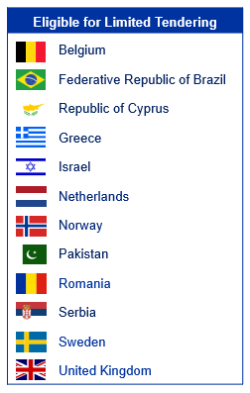
Limited Tendering
«Limited tendering is foreseen by the CERN Procurement Rules to improve the industrial return of the 12 most poorly balanced Member States»
Conditions
Twelve Member States with the lowest industrial Return Coefficient for Supply Contracts
Used in case where there is sufficient competition;
ILO can ask to add firms, provided they are established in one of the eligible countries.
Bids shall only be considered where a minimum of 60% of their value originates in any combination of the twelve Member States communicated by CERN

Slide 33

Impact of Doing Business with CERN

Slide 34
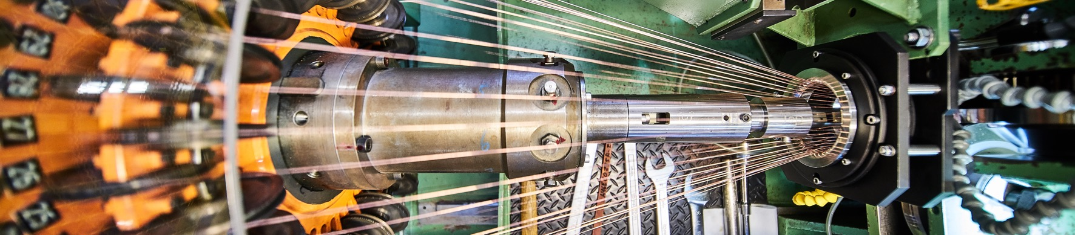
Doing business with CERN: the facts
Supplier Survey (500+ respondents in 34 countries, 2024)
4.53/5
average rating
98%
of suppliers would recommend CERN as a client
1 out of 4
hired new personnel
71%
had positive impact on their sales
63%
used CERN as a marketing reference
66%
improved products or services
47%
developed new products
70%
improved technical knowledge in their field
52%
found or opened a new market to address
Notes:
The key message here is that CERN is an open institution: open to its neighbours, and open to citizens from across the globe. We welcome them to CERN and go out to meet them
This slides summarises the outreach activities carried out by CERN.
It also includes a mention of CERN’s fundraising activities, for projects that are not part of CERN’s core activity. These fall into three categories: education & outreach, culture and creativity, innovation and knowledge exchange

Slide 35
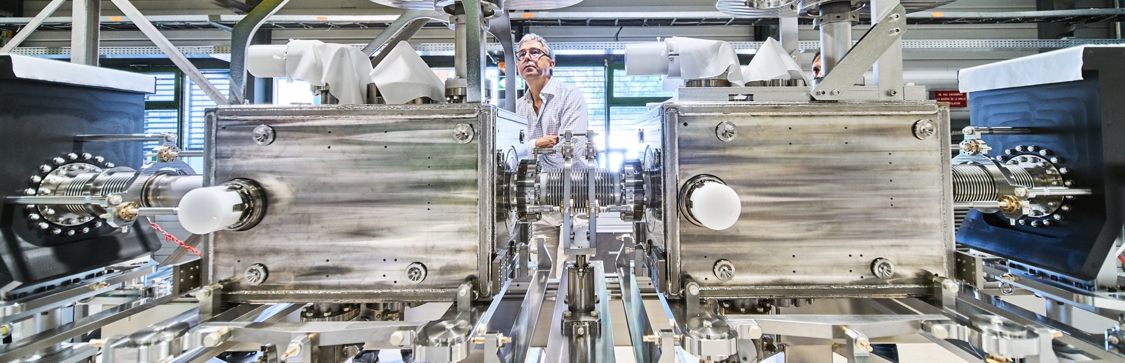
Doing business with CERN: the facts
Using CERN as a marketing reference has a positive
reputational effect for our suppliers

Slide 36

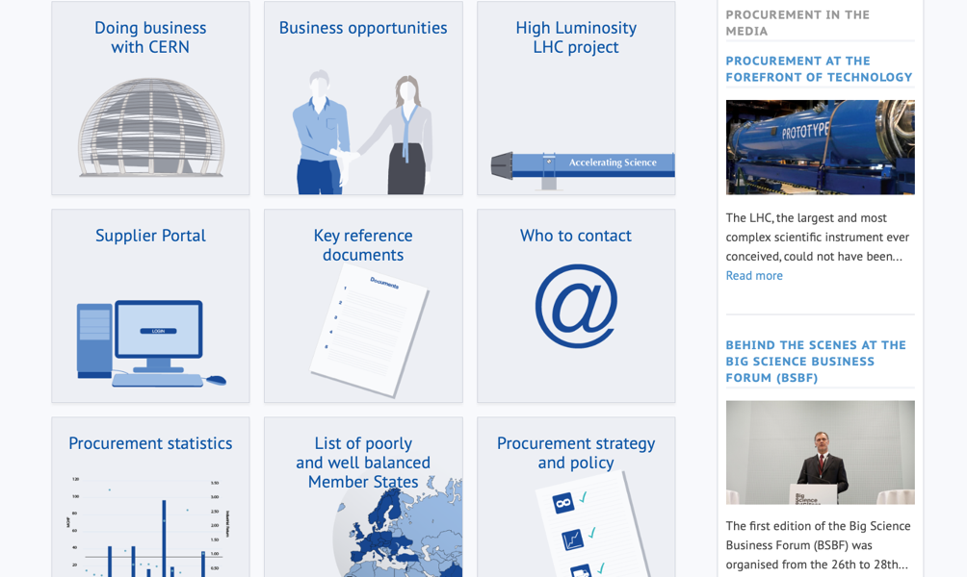
Procurement
website

Slide 37
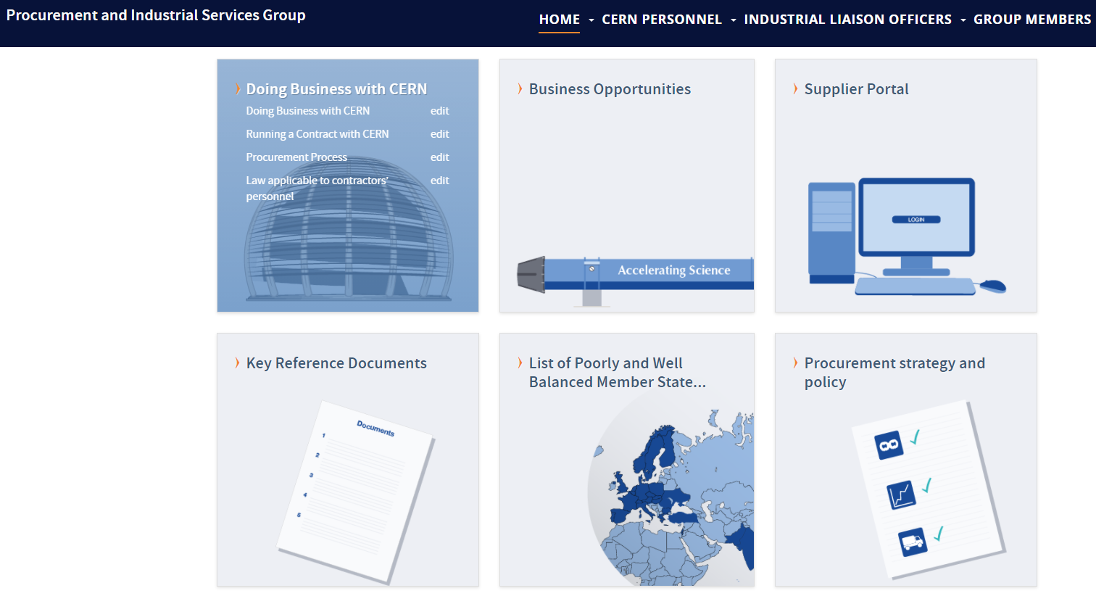
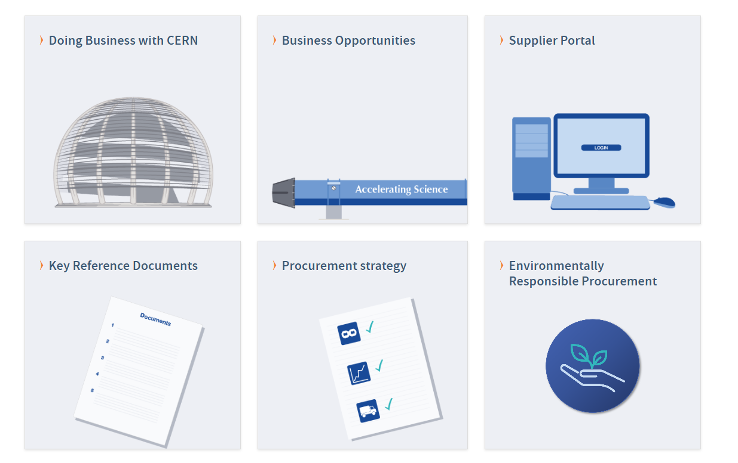
Website of the Procurement Service
http://procurement.web.cern.ch

Slide 38
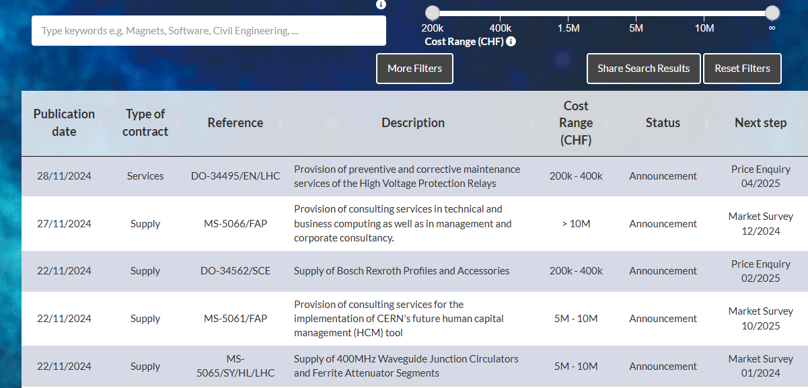
CERN Shopping List
https://forthcoming-ms.app.cern.ch/#!/

Slide 39
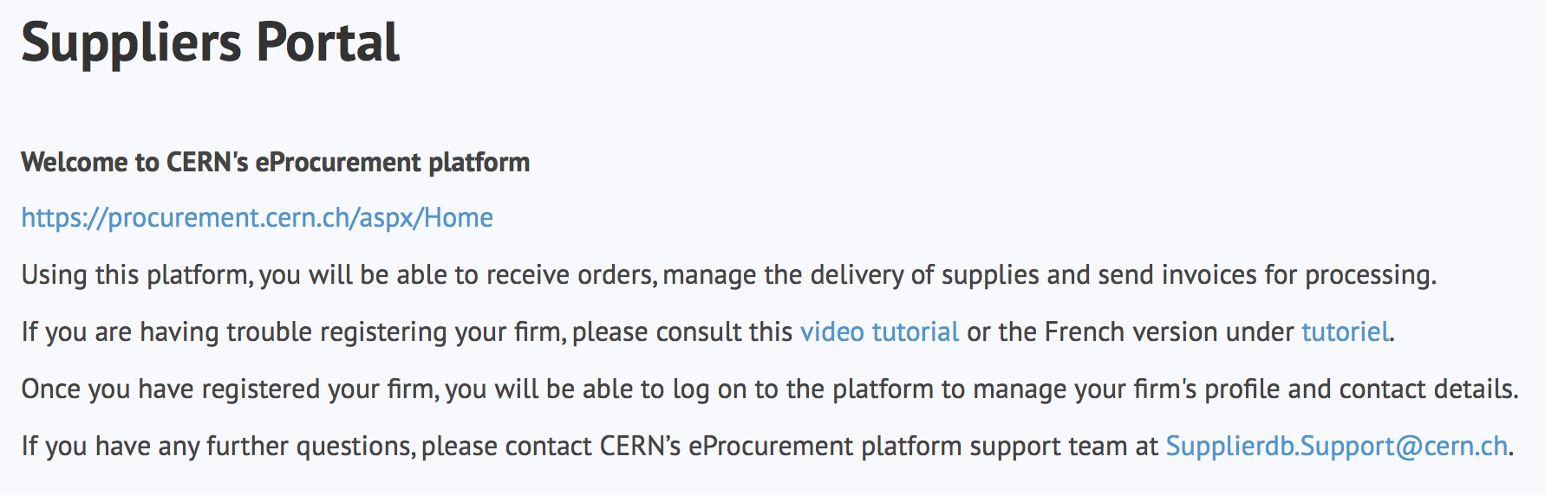
Register in the Suppliers Portal
for all exchanges with CERN, in particular to:
Be visible for future opportunities
(with the procurement codes you have indicated),
Receive and follow-up orders,
Send invoices.
MANDATORY

Slide 40
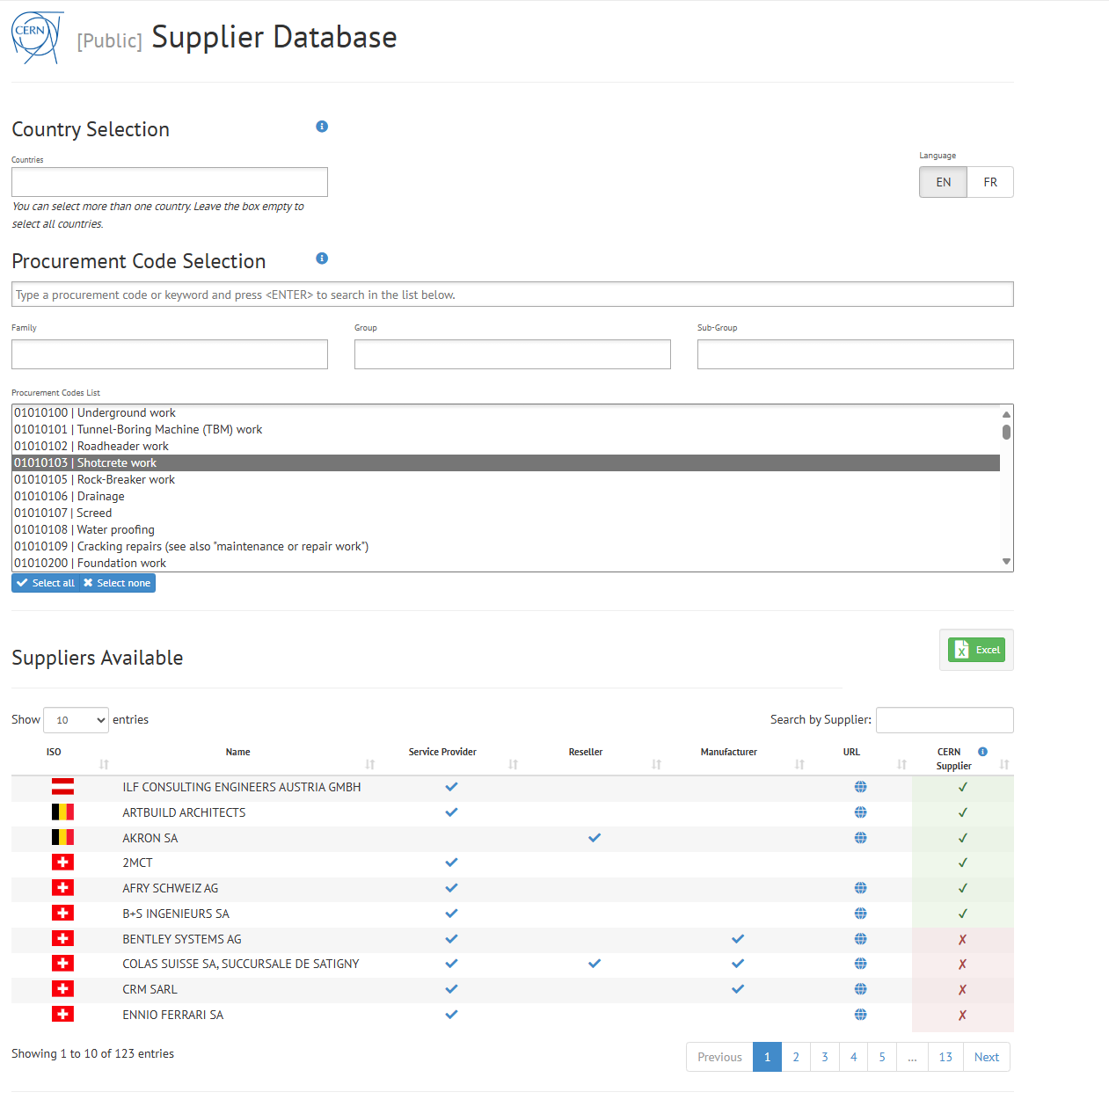
Look for potential partners
https://dir-ext-prod.cern.ch/pentaho/api/repos/%3Apublic%3ASupplier%20Database%3ADashboard.wcdf/generatedContent

Slide 41
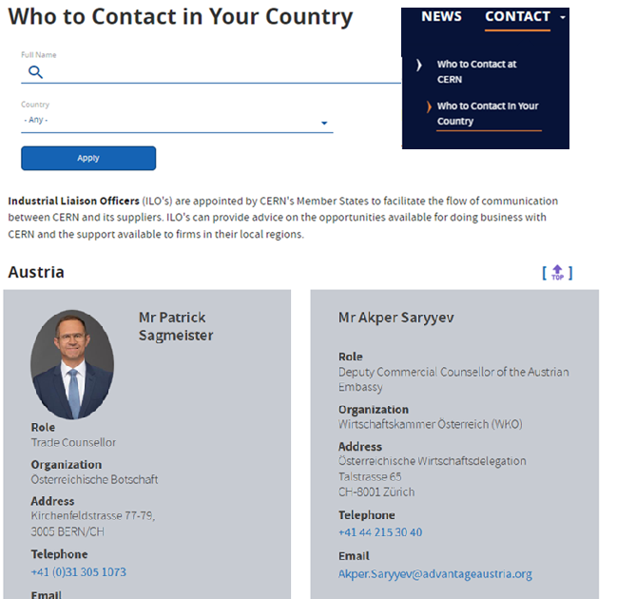
Contact in your country
ILO: Industrial Liaison Officer
Who to contact in your Country
    Industrial Liaison Officers (ILO's) are appointed by CERN's Member States to facilitate the flow of communication between CERN and its suppliers. ILO's can provide advice on the opportunities available for doing business with CERN and the support available to firms
    in their local regions.

Slide 42

Follow us on LinkedIn – ‘Business with CERN’
Selected forthcoming opportunities
News on events and webinars
Tips on how to engage with CERN
Success stories

Slide 43

Thank you
Thank you

