Slide 1
HL-LHC Task 2.2 news
R. De Maria, K. Skoufaris, Y. Angelis

Slide 2
Optics Tasks
On going:
2025-Q4 Full round optics cycle (Yannis) and Flat optics cycles (Kyriacos)
2026-Q2 Operational cycles for testing in IT String (Riccardo)
2025/9 Contribution to String day (Riccardo)
Urgent but not started yet:
Reduction aperture analysis LHCb upgrade (MBW 42 mm and D1 70mm)
Verify implication in Q11R8 reduction of current + MQ refurbishment
ECRs on aperture models (see later)
Other items:
Optics optimization for CLIQ suspended waiting on models from WP7.

Slide 3
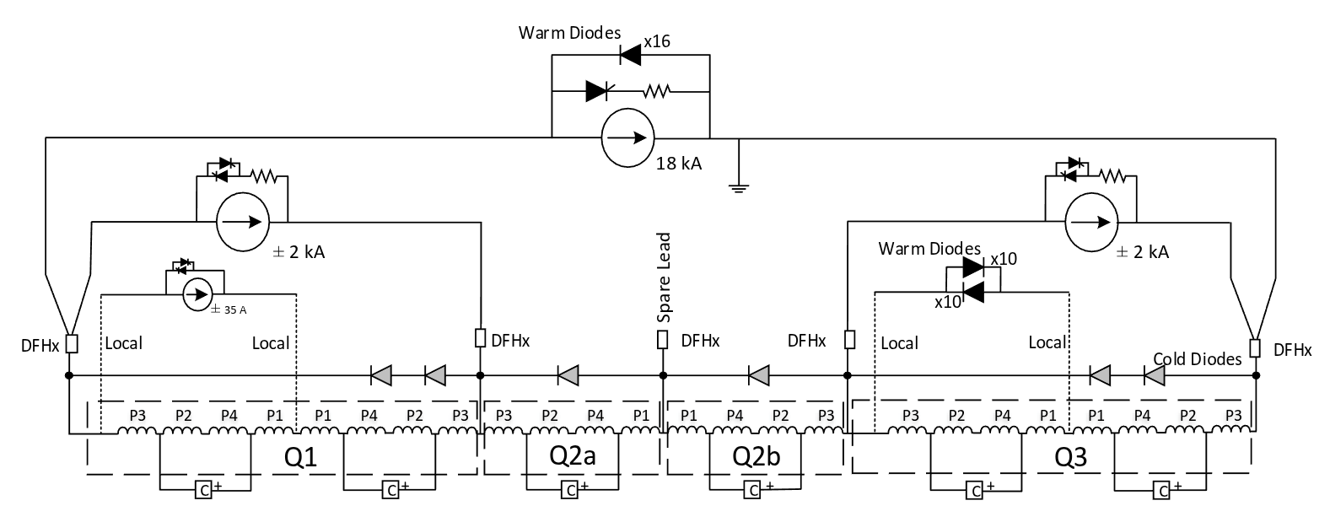
Xsuite-LSA implementation of triplet circuits
LSA needs a energy independent variables to control the circuits
Differently from LHC, operational optics will be matched using measured transfer functions (speed up convergence of OMC iterations)
Xsuite model
LSA Parameters
iqx.r1 = "RQX.R1/I" = b_to_i_q2ar1("MQXFB.2AR1/K"*BRHO)
itqx3.r1 = "RTQX3.R1/I" = b_to_i_q3ar1("MQXFA.3AR1/K"*BRHO) - "RQX.R1/I"
itqx1.r1 = "RTQX1.R1/I" = b_to_i_q1br1("MQXFA.1BR1/K"*BRHO) - "RQX.R1/I"
itqx1a.r1 = "RTQX1A.R1/I" = b_to_i_q1ar1("MQXFA.1AR1/K"*BRHO) - "RQX.R1/I" - "RTQX1.R1/I"
where
i = b_to_i_q2ar1( i_to_bl_q2ar1(i)/ lqx2a.r1)
i = b_to_i_q3ar1( i_to_bl_q3ar1(i)/ lqx3a.r1)
i = b_to_i_q1br1( i_to_bl_q1br1(i)/ lqx1b.r1)
i = b_to_i_q1ar1( i_to_bl_q1ar1(i)/ lqx1a.r1)
mqxfa.a1r1: k1:= kqx1a.r1/lqx1a.r1, l:=lqx1a.r1, fringe=...
mqxfa.b1r1: k1:= kqx1b.r1/lqx1b.r1, l:=lqx1b.r1, fringe=...
mqxfb.a2r1: k1:=-kqx2a.r1/lqx2a.r1, l:=lqx2a.r1, fringe=...
mqxfb.b2r1: k1:=-kqx2b.r1/lqx2b.r1, l:=lqx2b.r1, fringe=...
mqxfa.a3r1: k1:= kqx3a.r1/lqx3a.r1, l:=lqx3a.r1, fringe=...
mqxfa.b3r1: k1:= kqx3b.r1/lqx3b.r1, l:=lqx3b.r1, fringe=...
#Using individual magnet transfer functions of the integrated gradient
klqx1a.r1:=i_to_bl_q1ar1(iqx.r1+itqx1.r1+itqx1a.r1)/brho
klqx1b.r1:=i_to_bl_q1br1(iqx.r1+itqx1.r1)/brho
klqx2a.r1:=i_to_bl_q2ar1(iqx.r1)/brho
klqx2b.r1:=i_to_bl_q2br1(iqx.r1)/brho
klqx3a.r1:=i_to_bl_q3ar1(iqx.r1+itqx3.r1)/brho
klqx3b.r1:=i_to_bl_q3ar1(iqx.r1+itqx3.r1)/brho
L. Fiscarelli (WP3) to provide the transfer functions from current to integrated gradient and magnetic length for individual magnets in the form of parameters of the Fidel model and/or tabulated functions. R. De Maria (WP2) provide scaled gradients for the HL-LHC cycle. M. Hostletter (OP) uploads transfer functions and scaled gradients in LSA. To be tested in Q2/2026 in the String OP test.
R. De Maria, L. Fiscarelli, M. Hostletter, S. Yammine

Slide 4
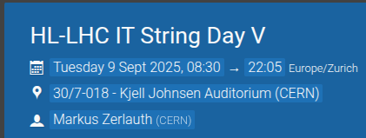

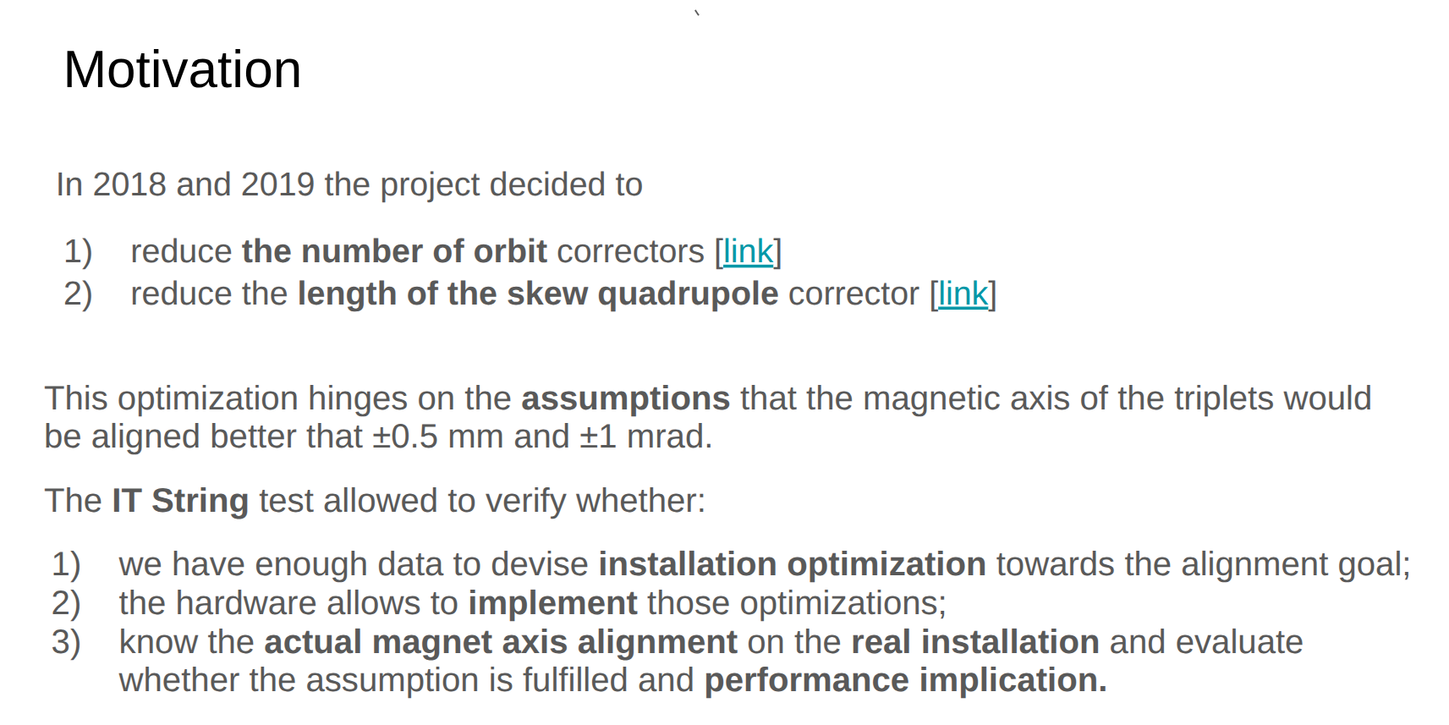
IT String Day

Slide 5
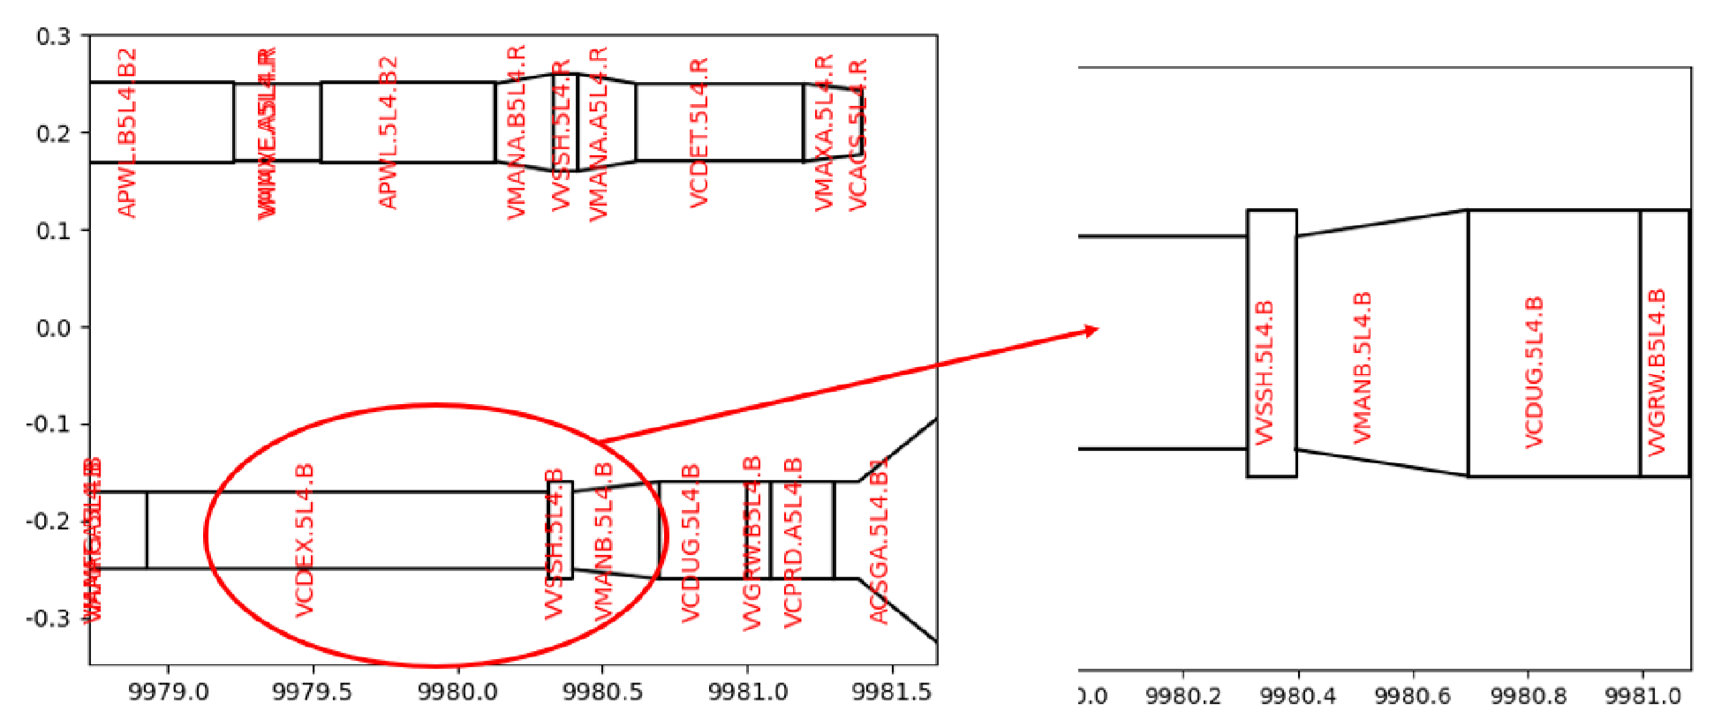
ECR - on aperture
Title | Deadline | Actions
Vacuum Layout LSS5 LS3 1.8 | 2025-07-22 EC | Validate new aperture models in LDB/optics
ATLAS experimental beam vacuum layout configuration for RUN 4 | EC expired | Validate new aperture models in LDB/optics
B5L4.B Layout change | 2025-07-18 APP | Followed-up with impedance, e-cloud

