Slide 1
Update on TF of MQXFB (Q2) and MQXFA (Q1/3)
Lucio Fiscarelli
17.06.2025

Slide 2
Introduction
Sorting of the triplet magnets based on the TF is desirable
The possibility of an effective sorting are based on the early knowledge of the TF of all units
Measurements at ambient temperature is available 9 months before measurements at cryogenic temperature
An accurate cold-warm correlation would allow an estimation of the field at 1.9 K and nominal current from a measurement at ambient temperature
Given the schedule for the magnet production, and magnet preparation for the tunnel, this time is crucial

Slide 3
MQXFB

Slide 4
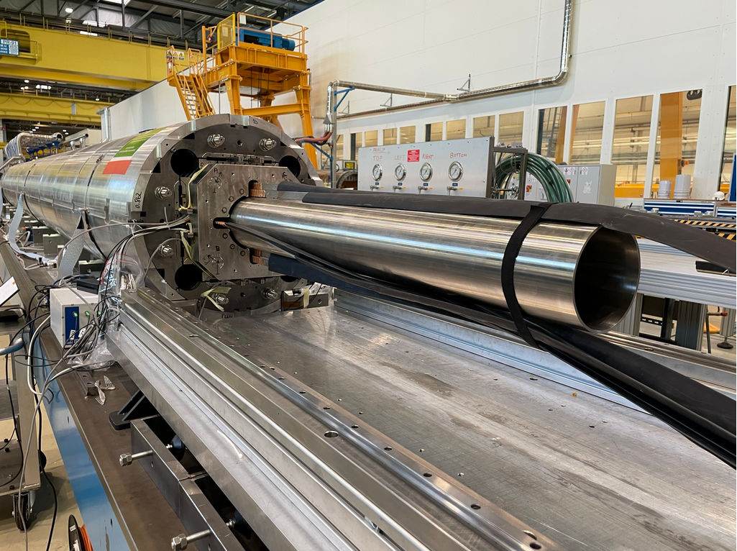
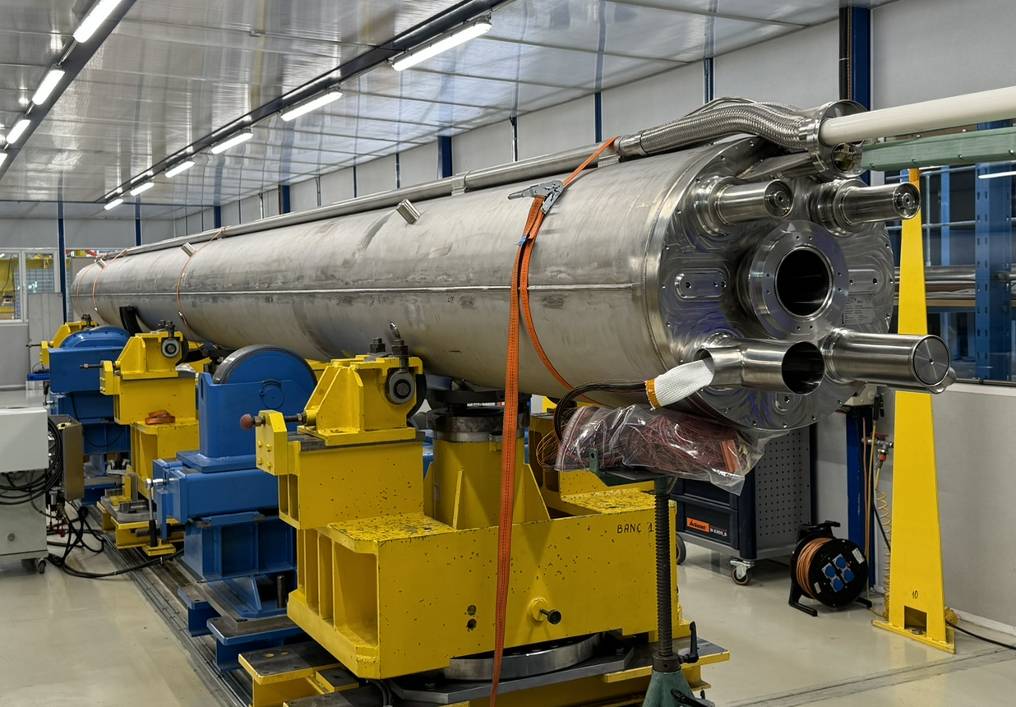
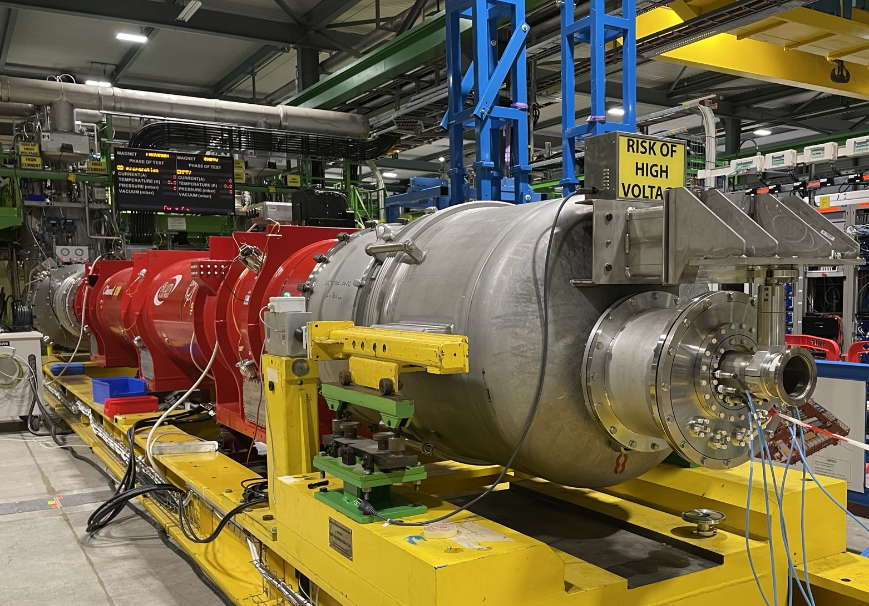
Magnetic tests on MQXFB
  Magnet
  Coil-pack
  Centering
  Loading
  Cold-mass
  Alignment wrt reference points
  Cryo-assembly (1 MQXFB + MCBXFB)
  TF calibration and alignment at nominal
  Reference measurement at warm
  Ambient temperature
  3 months after the loading procedure
  1.9 K
  Final measurement, 9 months after the loading procedure

Slide 5
Available measurement data (June 2025)
Cold mass |  | LMQXFB01 | LMQXFB02 | LMQXFB03 | LMQXFB05 | LMQXFB04 | LMQXFB06 | LMQXFB07 | LMQXFB08 | LMQXFB09 | LMQXFB10 | LMQXFB11
Magnet |  | MQXFBP2 | MQXFBP3 | MQXFB02 | MQXFB03 | MQXFB04 | MQXFB05 | MQXFB06 | MQXFB07 | MQXFB08 | MQXFB09 | MQXFB10
Used for |  | String | String | Withdrawn | Machine | Machine | Machine | Machine | Machine | Machine | Machine | Machine
Slot |  | Q2B | Q2A | - | Q2A-R1 | Q2B-L5 | Q2A-L5 | Q2B-R1
Warm
TF central | T m⁻¹ kA⁻¹ | 8.8342 | 8.8298 | 8.8458 | 8.8288 | 8.8384 | 8.8416 | 8.8367 | 8.8427 | 8.8473 | 8.8540 | Under assemblying
Magnetic length | m | 7.1720 | 7.1721 | 7.1680 | 7.1876 | 7.1762 | 7.1745 | 7.1742 | 7.1748 | 7.1739 | 7.1771
Cold (16230 A)
TF central | T m⁻¹ kA⁻¹ | - | 8.1712 | 8.1804 | 8.1556 | 8.1691 | 8.1772 | 8.1559 | Under test | Nov 2025 | Apr 2026 | Jun 2026
Magnetic length | m | - | 7.1720 | 7.1696 | 7.1816 | 7.1801 | 7.1785 | 7.1755
TF integral | T kA⁻¹ | - | 58.603 | 58.650 | 58.571 | 58.655 | 58.700 | 58.523
Max | Min | Average | Max-Min (units)
58.700 | 58.523 | 58.617 | 30

Slide 6
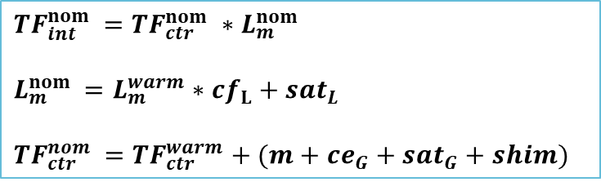
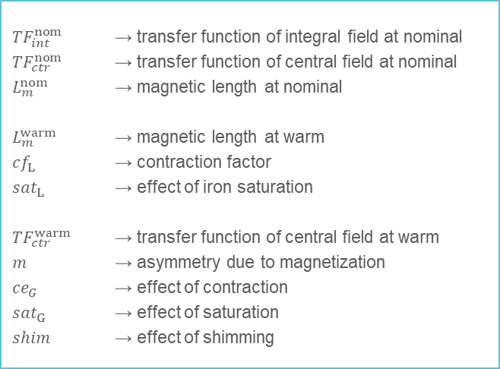
Model for the warm-to-cold extrapolation
$${TF}_{int}^{nom }={TF}_{ctr}^{nom} ∗L_{m}^{nom }$$
$$L_{m}^{nom }=L_{m}^{warm}{∗cf}_{L}{+ sat}_{L}$$
${TF}_{ctr}^{nom }={TF}_{ctr}^{warm}{+ (m+ce}_{G}{+ sat}_{G}+shim)$
${TF}_{int}^{nom }$ → transfer function of integral field at nominal
${TF}_{ctr}^{nom}$ → transfer function of central field at nominal
$L_{m}^{nom }$ → magnetic length at nominal
$L_{m}^{warm}$ → magnetic length at warm
${cf}_{L}$ → contraction factor
${sat}_{L}$ → effect of iron saturation
${TF}_{ctr}^{warm}$ → transfer function of central field at warm
$m$ → asymmetry due to magnetization
${ce}_{G}$ → effect of contraction
${sat}_{G}$ → effect of saturation
$shim$ → effect of shimming

Slide 7
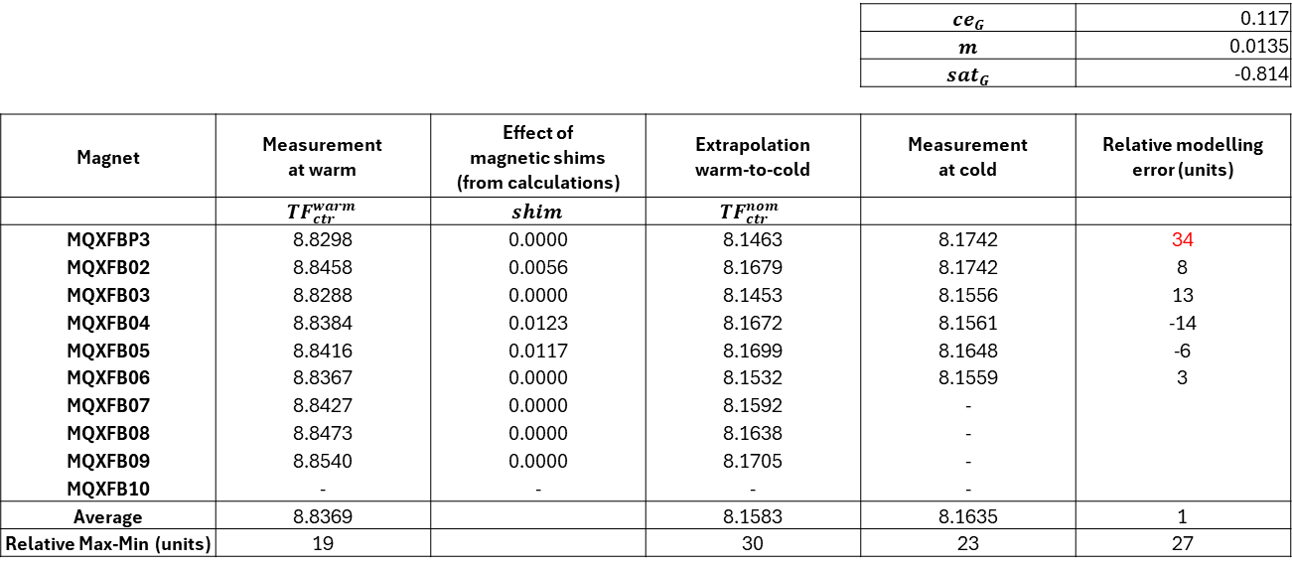
Modeling parameters and error – Central TF
 |  |  |  | $${ce}_{G}$$ | 0.117
 |  |  |  | $$m$$ | 0.0135
 |  |  |  | $${sat}_{G}$$ | -0.814
Magnet | Measurement at warm | Effect of magnetic shims (from calculations) | Extrapolation warm-to-cold | Measurement at cold | Relative modelling error (units)
 | $${TF}_{ctr}^{warm}$$ | $$shim$$ | $${TF}_{ctr}^{nom }$$
MQXFBP3 | 8.8298 | 0.0000 | 8.1463 | 8.1742 | 34
MQXFB02 | 8.8458 | 0.0056 | 8.1679 | 8.1742 | 8
MQXFB03 | 8.8288 | 0.0000 | 8.1453 | 8.1556 | 13
MQXFB04 | 8.8384 | 0.0123 | 8.1672 | 8.1561 | -14
MQXFB05 | 8.8416 | 0.0117 | 8.1699 | 8.1648 | -6
MQXFB06 | 8.8367 | 0.0000 | 8.1532 | 8.1559 | 3
MQXFB07 | 8.8427 | 0.0000 | 8.1592 | -
MQXFB08 | 8.8473 | 0.0000 | 8.1638 | -
MQXFB09 | 8.8540 | 0.0000 | 8.1705 | -
MQXFB10 | - | - | - | -
Average | 8.8369 |  | 8.1583 | 8.1635 | 1
Relative Max-Min (units) | 19 |  | 30 | 23 | 27
${TF}_{ctr}^{nom }={TF}_{ctr}^{warm}{+ (m+ce}_{G}{+ sat}_{G}+shim)$
The measurement units of the central TF are T m⁻¹ kA⁻¹

Slide 8
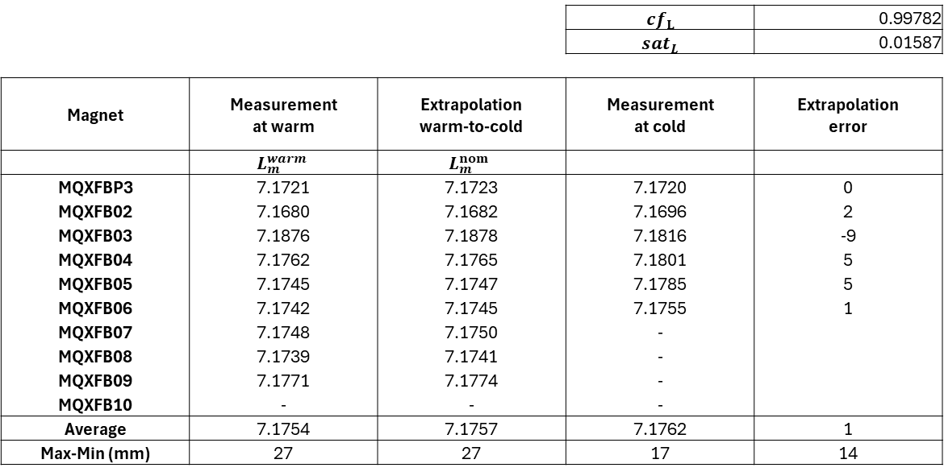
Modeling parameters and error – Magnetic L
 |  |  | $${cf}_{L}$$ | 0.99782
 |  |  | $${sat}_{L}$$ | 0.01587
Magnet | Measurement at warm | Extrapolation warm-to-cold | Measurement at cold | Extrapolation error
 | $$L_{m}^{warm}$$ | $$L_{m}^{nom }$$
MQXFBP3 | 7.1721 | 7.1723 | 7.1720 | 0
MQXFB02 | 7.1680 | 7.1682 | 7.1696 | 2
MQXFB03 | 7.1876 | 7.1878 | 7.1816 | -9
MQXFB04 | 7.1762 | 7.1765 | 7.1801 | 5
MQXFB05 | 7.1745 | 7.1747 | 7.1785 | 5
MQXFB06 | 7.1742 | 7.1745 | 7.1755 | 1
MQXFB07 | 7.1748 | 7.1750 | -
MQXFB08 | 7.1739 | 7.1741 | -
MQXFB09 | 7.1771 | 7.1774 | -
MQXFB10 | - | - | -
Average | 7.1754 | 7.1757 | 7.1762 | 1
Max-Min (mm) | 27 | 27 | 17 | 14
$$L_{m}^{nom }=L_{m}^{warm}{∗cf}_{L}{+ sat}_{L}$$
The measurement unit of the magnetic length is m

Slide 9
Available data and extrapolation at nominal for magnets under construction
Cold mass |  | LMQXFB01 | LMQXFB02 | LMQXFB03 | LMQXFB05 | LMQXFB04 | LMQXFB06 | LMQXFB07 | LMQXFB08 | LMQXFB09 | LMQXFB10 | LMQXFB11 | LMQXFB12 | LMQXFB13
Magnet |  | MQXFBP2 | MQXFBP3 | MQXFB02 | MQXFB03 | MQXFB04 | MQXFB05 | MQXFB06 | MQXFB07 | MQXFB08 | MQXFB09 | MQXFB10 | MQXFB11 | MQXFB12
Used for |  | String | String | Withdrawn | Machine | Machine | Machine | Machine | Machine | Machine | Machine | Machine | Spare | Spare
Central TF | T m⁻¹ kA⁻¹ | - | 8.1712 | 8.1804 | 8.1556 | 8.1691 | 8.1772 | 8.1532 | 8.1592 | 8.1638 | 8.1705
Magnetic length | m | - | 7.1720 | 7.1696 | 7.1816 | 7.1801 | 7.1785 | 7.1745 | 7.1750 | 7.1741 | 7.1774
Integral TF | T kA⁻¹ | - | 58.603 | 58.65 | 58.571 | 58.655 | 58.700 | 58.523 | 58.542 | 58.568 | 58.643
 |  |  |  |  |  |  |  | 58.495
Measured - Extrapolated
MQXFB06 was tested at cold recently (extrapolation shows an error of -5 units )
MQXFB07 is now under test at cold
MQXFB10 is under assembly

Slide 10
MQXFA

Slide 11
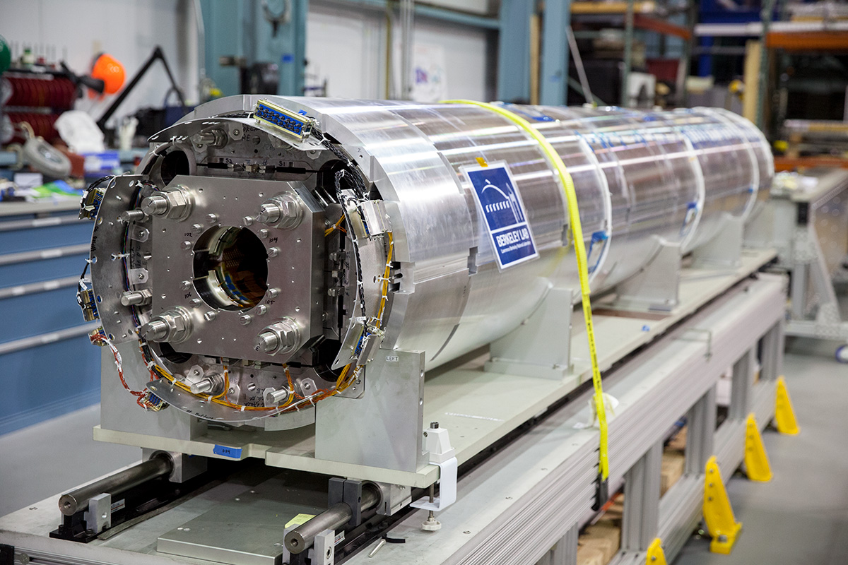
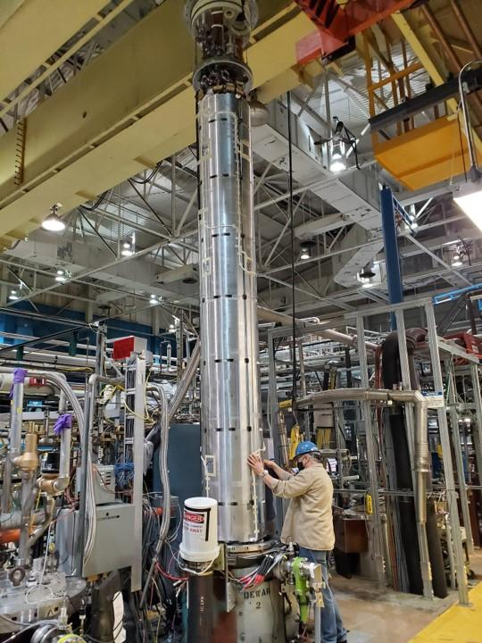
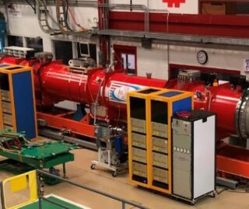
Magnetic tests on MQXFB
  Magnet
  Coil-pack
  Centering
  Loading
  Magnet
  Test in vertical
  Cryo-assembly (2 MQXFA magnets)
  TF calibration and alignment at nominal
  Reference measurement at warm
  Ambient temperature
  Limited absolute accuracy
  but they can be used to improve the TF prediction
  1.9 K
  Final measurement

Slide 12
Available measurement data
Coil FNAL
Coil BNL
Magnet | 3 |  | 4 |  | 5 |  | 6 |  | 10 |  | 11 |  | 14b |  | 8b |  | 7b |  | 15 |  | 13b |  | 18 |  | 12b |  | 17b |  | 19 |  | 20 |  | 21 |  | 22 |  | 23 |  | 24 |  | 16b
Vertical test (BNL)
Cold mass | LQXFA01 |  |  |  | LQXFA02 |  |  |  | LQXFA03 |  |  |  | LQXFA04 |  |  |  | LQXFA05 |  |  |  | LQXFA06 |  |  |  | LQXFA07 |  |  |  | LQXFA08 |  |  |  | LQXFA09 |  |  |  | LQXFA10
H test (FNAL) |  |  |  |  |  |  |  |  |  |  |  |  | test at CERN |  |  |  | test at CERN |  |  |  |  |  |  |  | test at CERN
Accepted |  |  |  |  |  |  |  |  |  | On-going |  |  |  |  |  |  |  |  |  | To do

Slide 13
Available data
Cold mass | Magnet | Warm |  |  |  | Cold
 |  | Integrated TF | Central TF | Magnetic length | ∆ same cold mass | Integrated TF | Central TF | Magnetic length
 |  | (T kA-1 ) | (T m-1 kA-1 ) | (m) | (units) | (T kA-1 ) | (T m-1 kA-1 ) | (m)
LQXFA01 | 3 | 37.198 | 8.831 | 4.213 | 5 | 34.486 | 8.180 | 4.216
 | 4 | 37.178 | 8.828 | 4.211 |  | 34.501 | 8.189 | 4.213
LQXFA02 | 5 | 37.350 | 8.870 | 4.211 | 15 | 34.644 | 8.219 | 4.215
 | 6 | 37.293 | 8.857 | 4.210 |  | 34.619 | 8.213 | 4.215
LQXFA03 | 10 | 37.394 | 8.877 | 4.213 | 19 | Tested at FNAL (results not released yet)
 | 11 | 37.322 | 8.865 | 4.210
LQXFA04 | 14b | 37.287 | 8.856 | 4.210 | 30 | Test at CERN Oct-Dec 2025
 | 08b | 37.398 | 8.875 | 4.214
LQXFA05 | 07b | 37.364 | 8.868 | 4.213 | 20 | Test at CERN Feb-Mar 2026
 | 15R | 37.288 | 8.855 | 4.211
LQXFA06 | 13b | 37.287 | 8.855 | 4.211 | 11
 | 18 | 37.246 | 8.846 | 4.211
LQXFA07 | 12b | 37.295 | 8.859 | 4.210 | 8 | Test at CERN May-Jun 2026
 | 17b | 37.265 | 8.843 | 4.214
LQXFA08 | 19 | 37.216 | 8.837 | 4.211 | 9
 | 20 | 37.249 | 8.844 | 4.211
LQXFA09 | 21 | 37.226 | 8.841 | 4.210
 | 22
LQXFA10 | 23
 | 24
Max-Min |  | units |  | mm
 |  | 59 | 55 | 9

Slide 14
Modeling parameters and error
Magnet | Model for magnetic length |  |  |  |  |  |  |  |  |  |  | Measurement (mm) | Modelling error (mm)
 | Lwl |  | tc |  | sat |  |  |  |  |  | Ln | Ln
3 | 4.213 |  | 0.9971 |  | 0.01587 |  |  |  |  |  | 4.2166 | 4.216 | -2
4 | 4.211 |  |  |  |  |  |  |  |  |  | 4.2147 | 4.213 | -4
5 | 4.211 |  |  |  |  |  |  |  |  |  | 4.2147 | 4.215 | 1
6 | 4.210 |  |  |  |  |  |  |  |  |  | 4.2137 | 4.215 | 3
Average | 4.2113 |  |  |  |  |  |  |  |  |  | 4.2149 | 4.2148 | 0
std | 3 |  |  |  |  |  |  |  |  |  | 3 | 3
 | Model for central gradient |  |  |  |  |  |  |  |  |  |  | Measurement (T/m/kA) | Modelling error (units)
 | TFwl |  | tc |  | M |  | sat |  | shims |  | TFn | TFn
3 | 8.831 |  | 0.1480 |  | 0.0135 |  | 0.8140 |  | 0.0000 |  | 8.1785 | 8.1797 | 1
4 | 8.828 |  |  |  |  |  |  |  | 0.0000 |  | 8.1755 | 8.1892 | 17
5 | 8.870 |  |  |  |  |  |  |  | 0.0123 |  | 8.2298 | 8.2193 | -13
6 | 8.857 |  |  |  |  |  |  |  | 0.0123 |  | 8.2168 | 8.2133 | -4
Average | 8.8465 |  |  |  |  |  |  |  |  |  | 8.2002 | 8.2004 | 0
std | 23 |  |  |  |  |  |  |  |  |  | 33 | 23

Slide 15
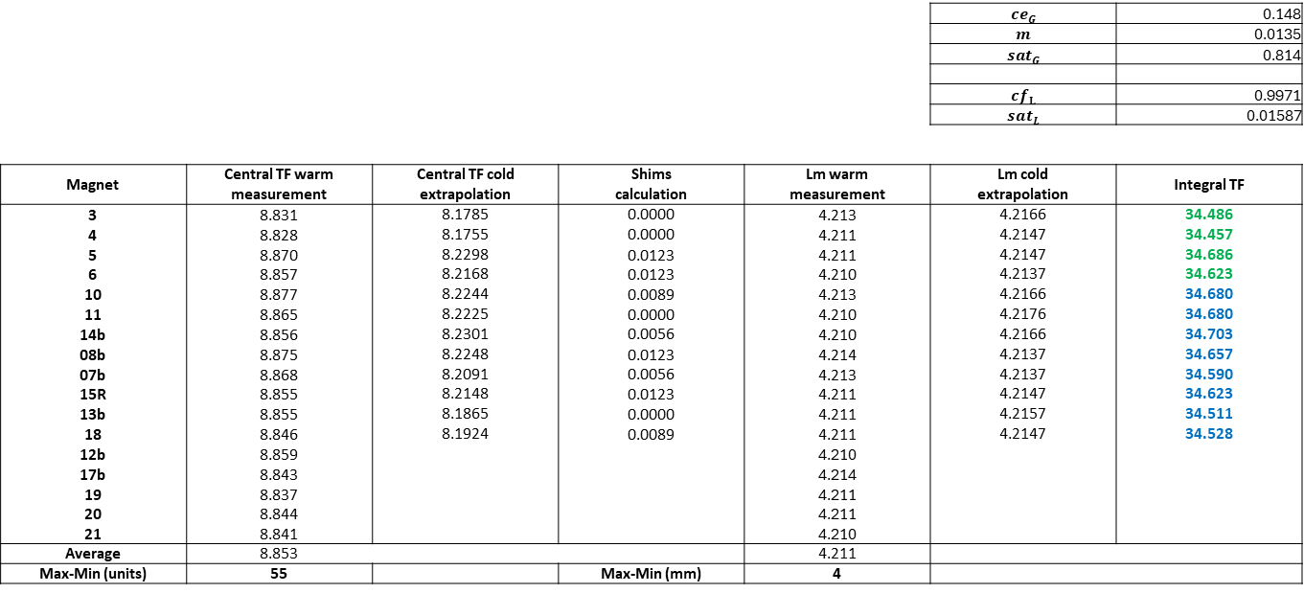
Available data and extrapolation at nominal for magnets under construction
 |  |  |  |  | $${ce}_{G}$$ | 0.148
 |  |  |  |  | $$m$$ | 0.0135
 |  |  |  |  | $${sat}_{G}$$ | 0.814
 |  |  |  |  | $${cf}_{L}$$ | 0.9971
 |  |  |  |  | $${sat}_{L}$$ | 0.01587
Magnet | Central TF warm | Central TF cold | Shims | Lm warm | Lm cold | Integral TF
 | measurement | extrapolation | calculation | measurement | extrapolation
3 | 8.831 | 8.1785 | 0.0000 | 4.213 | 4.2166 | 34.486
4 | 8.828 | 8.1755 | 0.0000 | 4.211 | 4.2147 | 34.457
5 | 8.870 | 8.2298 | 0.0123 | 4.211 | 4.2147 | 34.686
6 | 8.857 | 8.2168 | 0.0123 | 4.210 | 4.2137 | 34.623
10 | 8.877 | 8.2244 | 0.0089 | 4.213 | 4.2166 | 34.680
11 | 8.865 | 8.2225 | 0.0000 | 4.210 | 4.2176 | 34.680
14b | 8.856 | 8.2301 | 0.0056 | 4.210 | 4.2166 | 34.703
08b | 8.875 | 8.2248 | 0.0123 | 4.214 | 4.2137 | 34.657
07b | 8.868 | 8.2091 | 0.0056 | 4.213 | 4.2137 | 34.590
15R | 8.855 | 8.2148 | 0.0123 | 4.211 | 4.2147 | 34.623
13b | 8.855 | 8.1865 | 0.0000 | 4.211 | 4.2157 | 34.511
18 | 8.846 | 8.1924 | 0.0089 | 4.211 | 4.2147 | 34.528
12b | 8.859 |  |  | 4.210
17b | 8.843 |  |  | 4.214
19 | 8.837 |  |  | 4.211
20 | 8.844 |  |  | 4.211
21 | 8.841 |  |  | 4.210
Average | 8.853 |  |  | 4.211
Max-Min (units) | 55 |  | Max-Min (mm) | 4
${TF}_{ctr}^{nom }={TF}_{ctr}^{warm}{+ (m+ce}_{G}{+ sat}_{G}+shim)$
$$L_{m}^{nom }=L_{m}^{warm}{∗cf}_{L}{+ sat}_{L}$$
Measured - Extrapolated

Slide 16
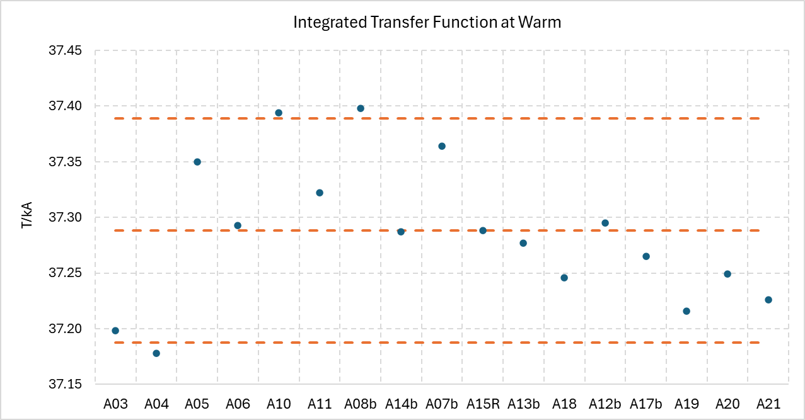
TF spread on MQXFA
+0.27%
Mid-range
-0.27%
Accepted magnets plus A20, A21.
Mid-range is the average of the MAX and MIN value of the series.
Range ± 0.27% corresponds to the ±1.5 T range at nominal

Slide 17
Conclusions
For MQXFB:
  Warm-to-cold extrapolation is based on the data available so far: 1 prototype + 5 series magnets
  The extrapolation error on MQXFB06 is -5 units
For MQXFA:
  The spread of TF at warm is at the limits of the required range (+/- 1.5 Tm)
  The measurement in vertical at cold could be used to improve the prediction (ongoing analysis)

