Slide 1
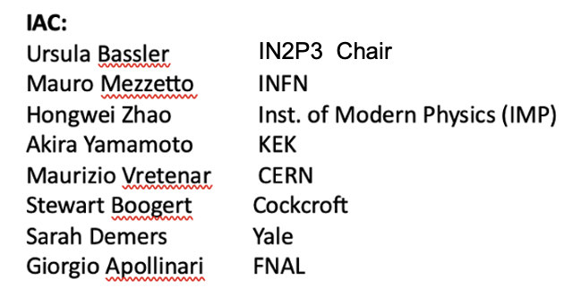
IAC review in June
The Lab Director Group will update the plans for accelerator R&D during this year, among them the muon collider R&D planning. The IAC review is an important preparation for the LDG accelerator R&D roadmap update.
The draft mandate (below) for the review reflects this:
The review will cover R&D planned for the IMCC over the next decade.
Key questions to be answered are:
Is the overall programme complete or are there important missing topics ?
Is the R&D proposed for the various parts and challenges appropriate, and if not, how can the plans be improved ?
How should the programme be prioritised in case of resource shortage ?
Are there clear intermediate evaluation and decision points within the 10 year programme ?
Identify opportunities for common work with other projects or R&D initiatives (e.g. for HFM and RF), or industry (e.g. HTS magnets) ?
In general the IAC shall consider how the muon collider R&D is presented and pursued in the landscape of other studies, e.g. for Higgs factories, hadron machines and high energy e+e- machines, and if appropriate, provide advice for common or complementary studies.
The committee is invited to give suggestions on any aspect of the IMCC R&D plans beyond the above points.

