Slide 1
Injection losses and protection
Evian, 12-Dec-11
W. Bartmann
R. Appleby, P. Baudrenghien, C. Bracco, B. Dehning, A. Di Mauro, L. Drosdal, J. Emery, E. Gianfelice-Wendt, B. Goddard, E.B. Holzer, W. Höfle, V. Kain, M. Meddahi, S. Redaelli, J. Uythoven, D. Valuch, J. Wenninger, C. Zamantzas, M. Zerlauth

Slide 2
Outline
Comparison of 2010/2011 performance
Mitigations in 2011
Potential future injection loss reduction
Issues in operation
Performance reach for 2012

Slide 3
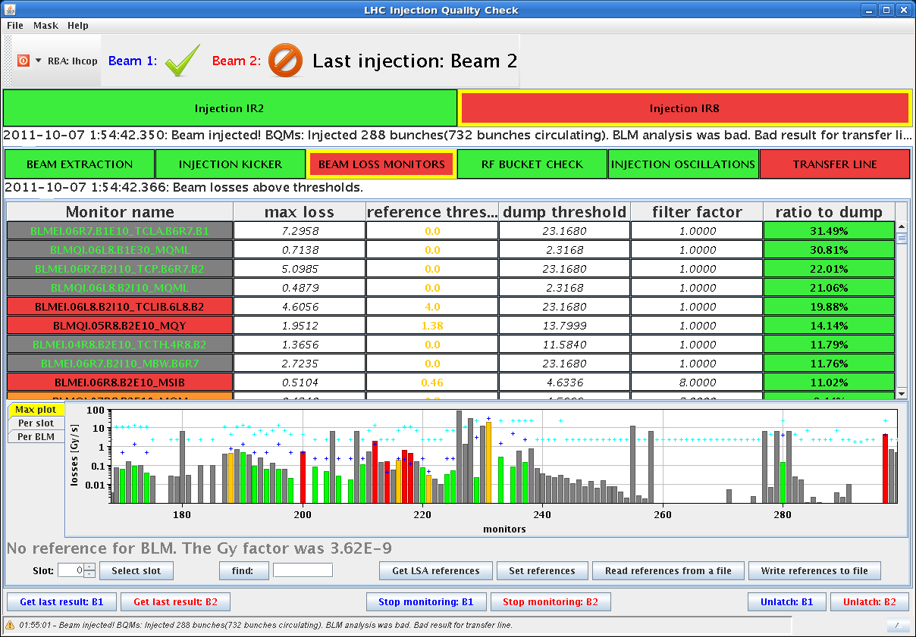
2010 vs 2011
Loss type | Losses in % of dump threshold B1/B2
 | 8b | 16b | 24b | 48b | 96b | 144b
TCDI shower | 1/2 | 3/5 | 4/6 | 23/24 | <50? | <75?
Uncaptured beam | 4/2 | 12/3 | 12/5 | 20/8 | <40? | <60?
not optimised
Now we have:
144 b injections (~1.5e11, ~2 um) in normal operation
288 b (1.05e11, 2.5-2.7 um) injected with 30 % of dump threshold

Slide 4
Mitigation techniques
Overinjection and MKI failure
  Interlocking and good procedure (covered by Chiara)
TL showers:
  Local shielding between TCDIs and LHC
  Beam scraping in SPS (covered by Karel)
  Opening TCDIs
  BLM sunglasses
  Moving/adding TCDIs
  Improve stability of MSE (covered by Lene)
Uncaptured beam
  Local shielding at TDI
  Minimisation of capture losses
  Injection and abort gap cleaning
  Carefully monitoring beam quality in injectors (transv. beam size and shape, bunch length, satellites)
  BLM sunglasses

Slide 5
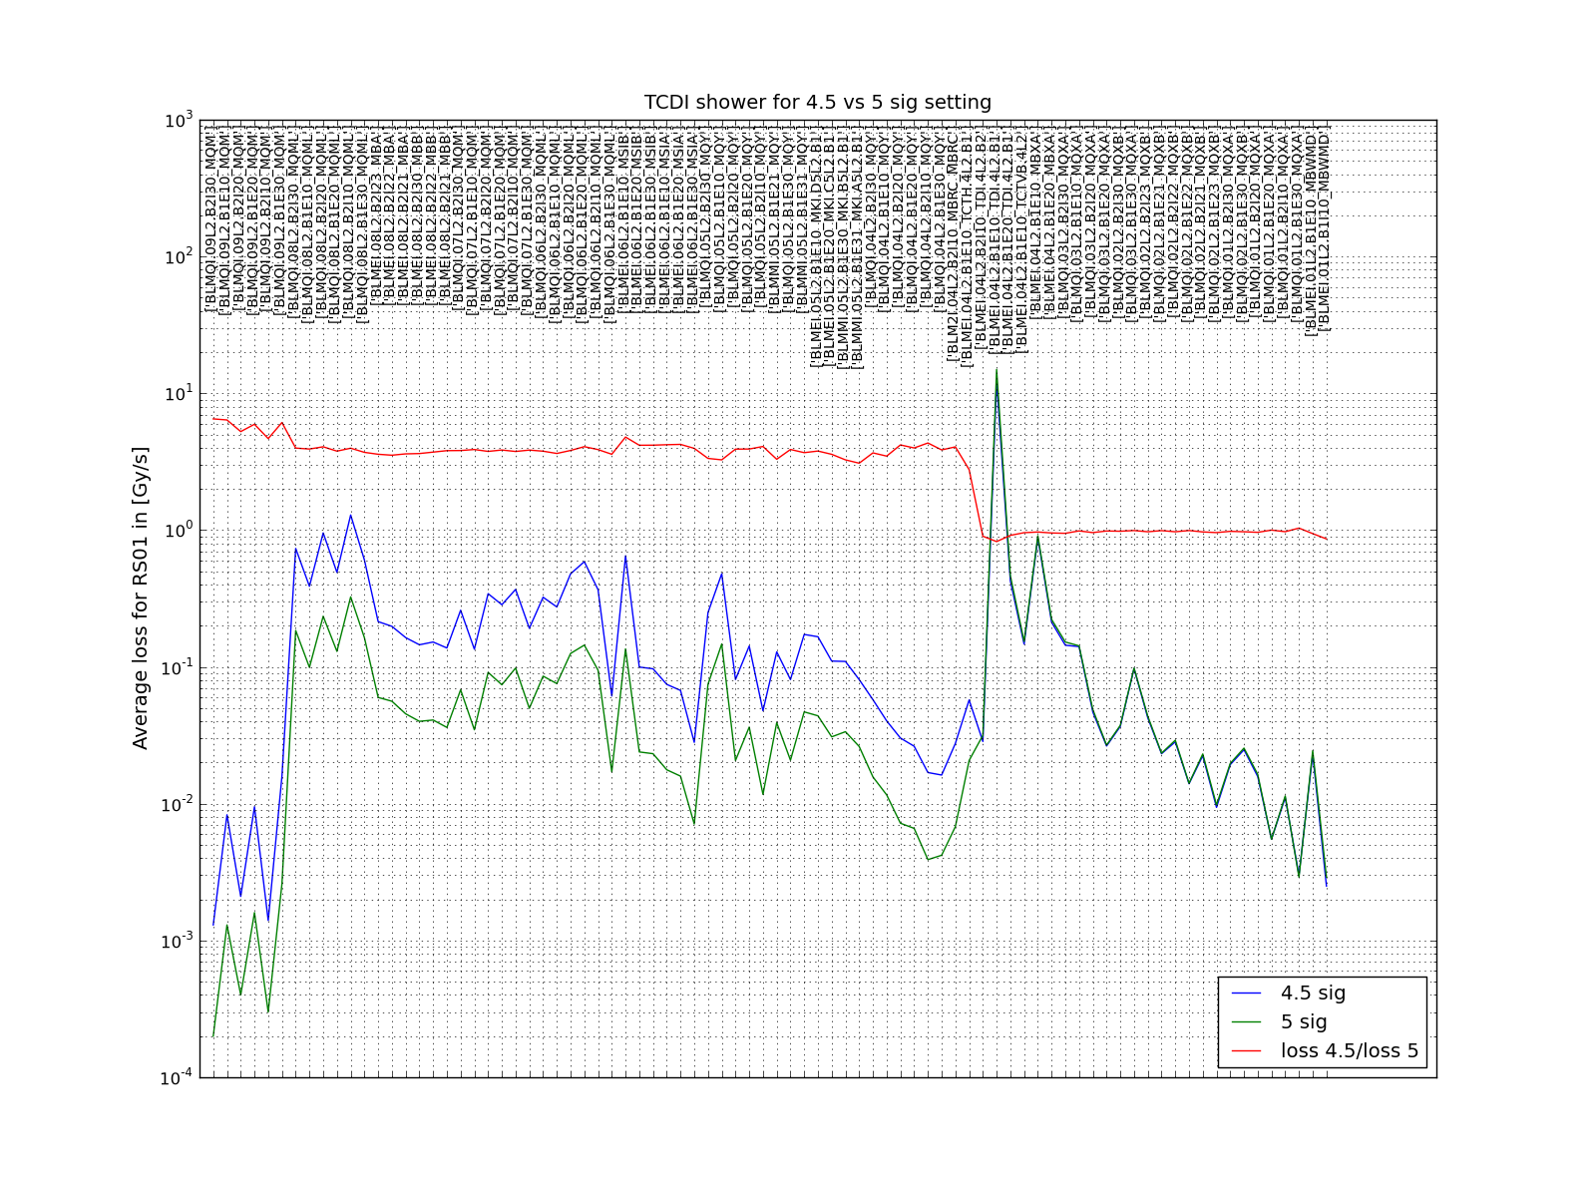
Open TCDI gap: loss shower on LHC BLMs for B1
factor 4
Q8
MKI
Triplet
TDI
B1

Slide 6
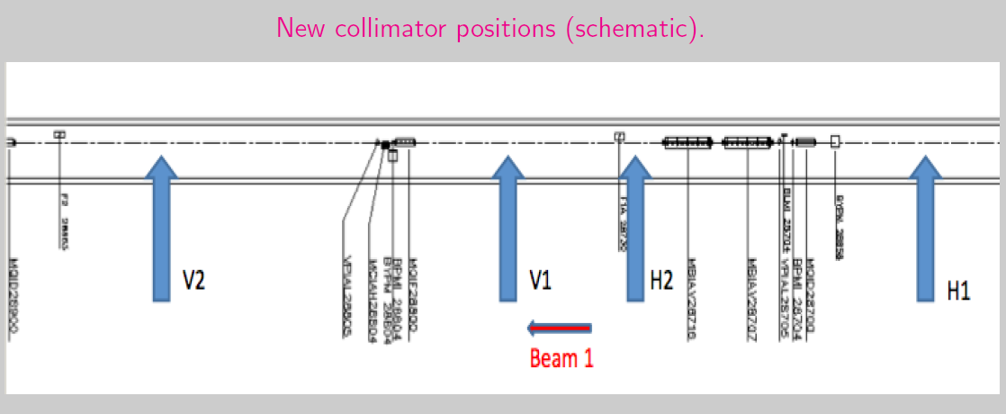
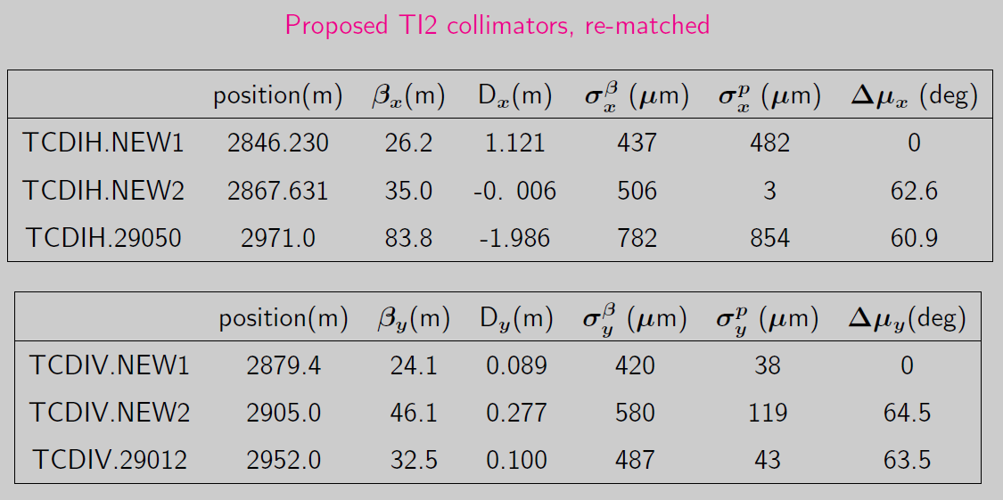
Move/add TCDIs
Results of studies by Eliana Gianfelice:
  New locations for TCDIs in TI 2 and TI 8
  FLUKA simulations started
  impact of Q20 optics to be checked

Slide 7
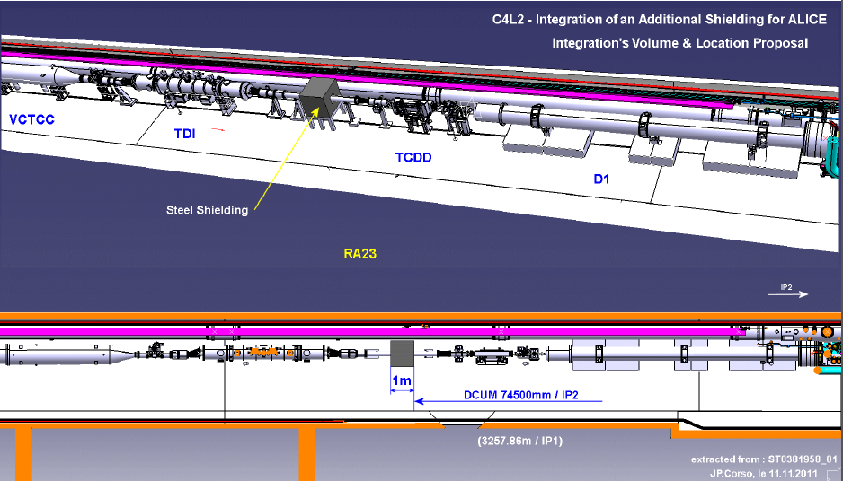
Local TDI shielding - ALICE
A. Di Mauro, A.L. Perrot, JP. Corso

Slide 8
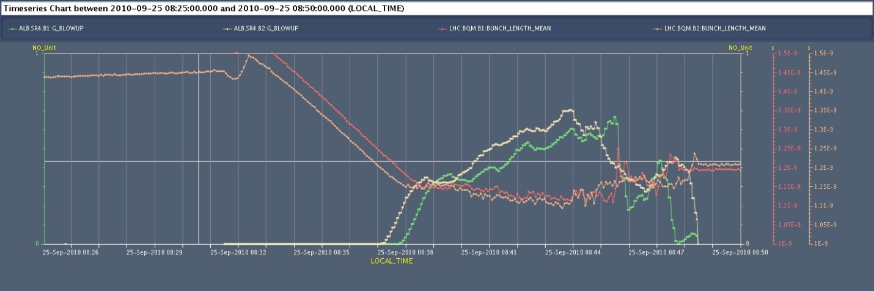
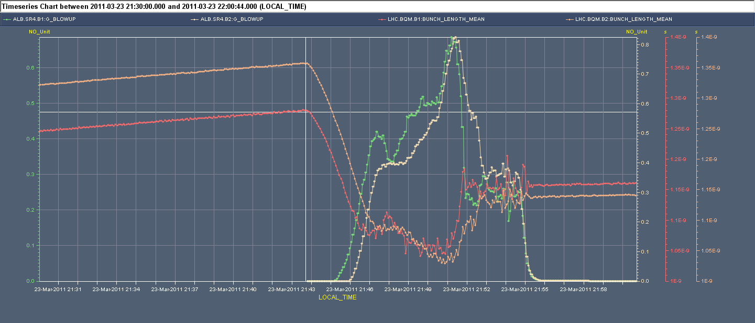
Capture
P. Baudrenghien for the RF team:
SPS bucket length is double of LHC bucket due to RF frequency ratio 200/400 MHz
MD on reducing injection losses by increasing nominal matched voltage of 3.5 MV to 6 MV (currently in operation)
Running with mismatched voltage causes bunch length shrinking after capture → long. emittance blow up needed to reach the aim of 1.2 ns long bunches
Bunch Length Mean and Noise Amplitude during Ramp
P. Baudrenghien for RF team

Slide 9
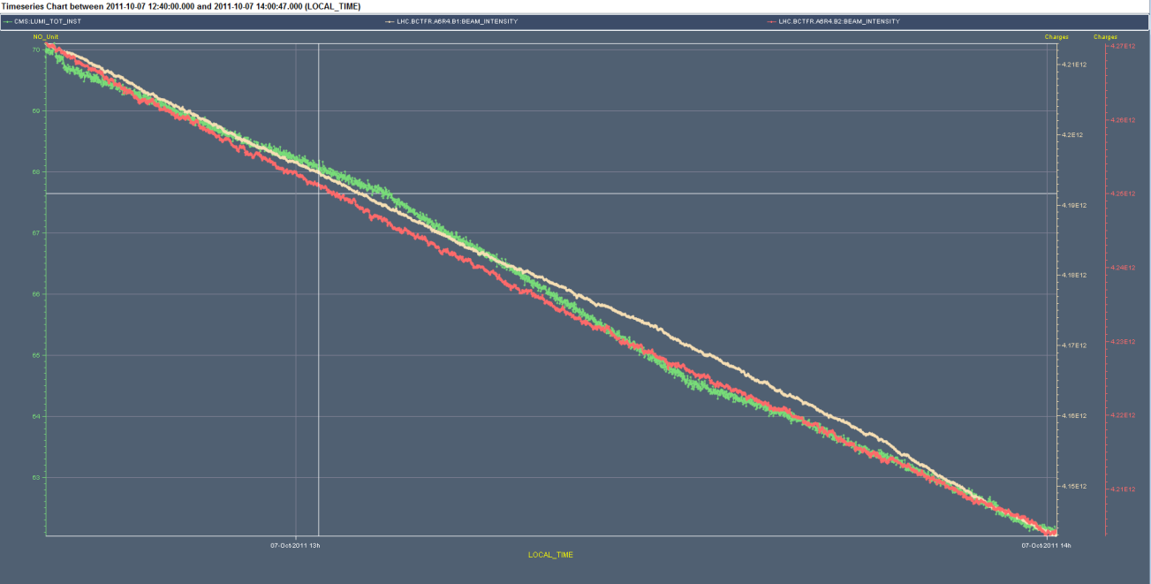
Abort gap and injection cleaning
AGC already in 2010 but became more automatised
Inj cleaning introduced in 2011, now operational and automatised
Main difference wrt safety: injection cleaning has to be calculated on the fly – can be less controlled by MCS
Fixed display for abort gap population
Effect on luminosity
Application to improve handling of AGC and IC

Slide 10
BLM sunglasses - background
Why sunglasses:
Unnecessary beam dumps due to TCDI and unbunched beam shower from outside
Aim of sunglasses:
Factor 5 margin between injection losses and BLM thresholds for comfortable operation
Many options discussed (C. Zamantzas and J. Emery, MPP, 30-Sept-11):
  replace certain monitors by LICs and relax thresholds at 450 GeV
  → no HW modification, certain thresholds constantly higher for 450 GeV
  blind out BIS input from certain BLMs while injection via deploying additional energy level, regrouping crates, new monitor flag
  → need external signal, threshold change only at injection, severe changes to SIS or BLM system

Slide 11
BLM sunglasses – LIC solution
Potential to increase thresholds of ICs by factor 60 with replacing present ICs by LICs
No change to BIS system nor BLM firmware needed
List of monitors to be replaced for B1 and B2 identified
Procedere:
  Replace certain monitors (over Christmas stop)
  Start with present thresholds (be sure to be aware of any bad injection)
  Define maximum thresholds for LICs
  Apply increase of thresholds via monitor factor in case unnecessary dumps limit operation

Slide 12
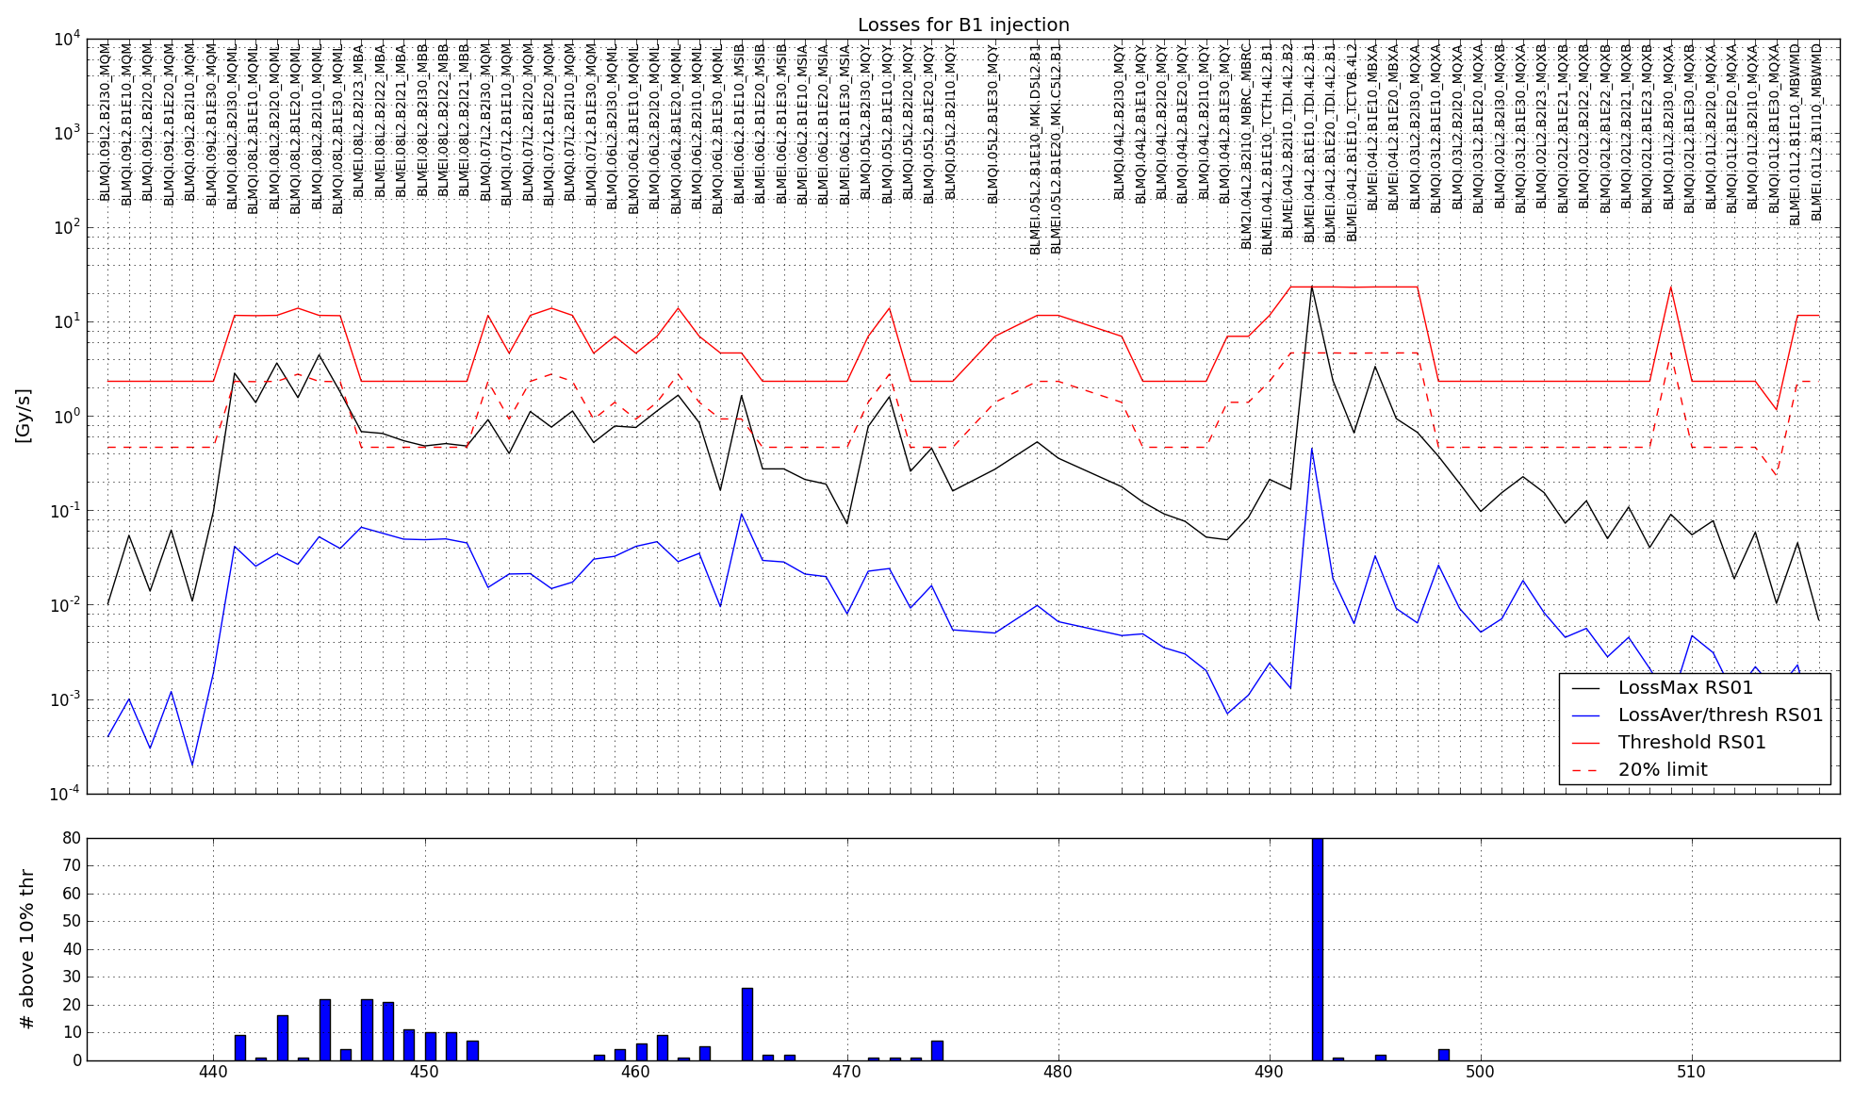
BLM sunglasses B1

Slide 13
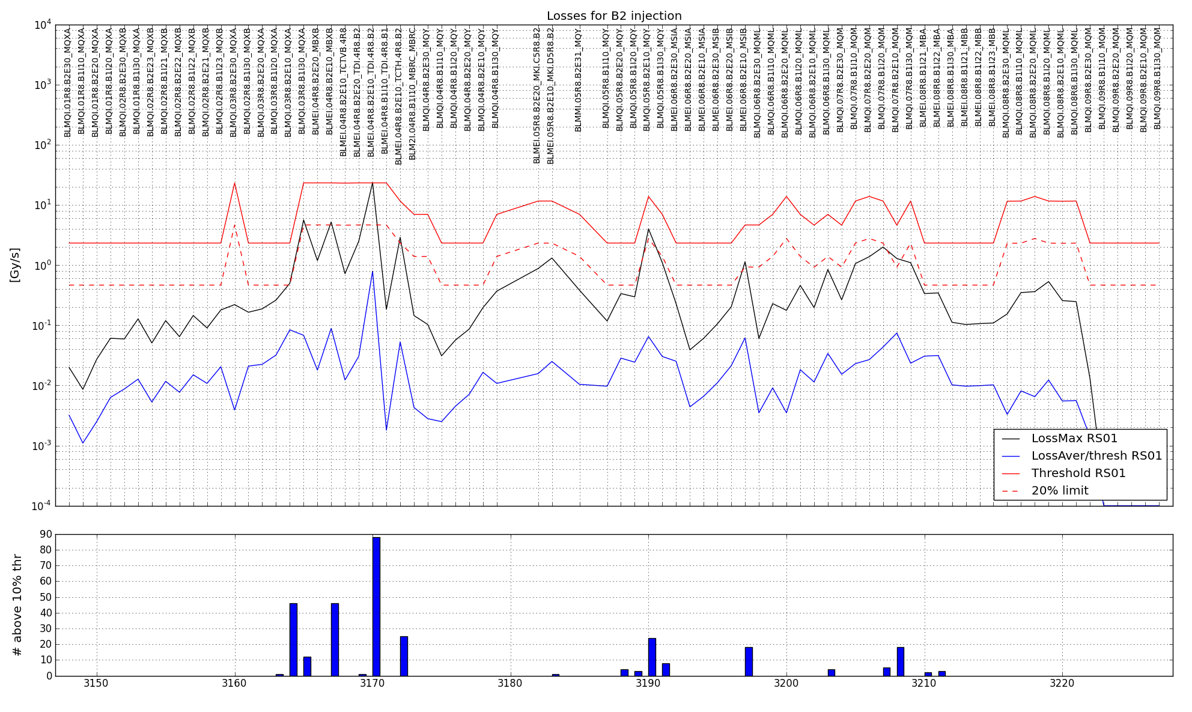
BLM sunglasses B2

Slide 14
Mitigation techniques with expected future gain
MITIGATION | POTENTIAL FUTURE GAIN
Local shielding between TCDIs and LHC | Presently less gain than expected from simulations; difficult to increase shielding, in particular for TI 8
Beam scraping in SPS | No gain with present emittances, for future bigger emittances probably worse;
Opening TCDIs | No gain for TI 2 (already at 5 sig), but possible gain for TI 8 (at 4.5 sig), Machine Protection!
BLM sunglasses | With LICs at certain positions and removed filters factor 5 margin possible, Machine Protection!
Moving/adding TCDIs | Potentially significant gain, under study
Improve stability of MSE | Ripple improvement and phase stabilisation in place since 3 days, effect to be checked
Local shielding after TDI | No gain for inj losses, but ALICE interested to reduce background
Minimisation of capture losses | No gain: trade-off with mismatch and resulting bunch length reduction
Injection and abort gap cleaning | No gain: trade off with luminosity
Carefully monitoring beam quality in injectors | No gain in losses but better detection of bad beam quality early in the chain; Longitudinally already well covered by BQM, transv. can be improved
BLM sunglasses | With LICs at certain positions and removed filters factor 5 margin possible, Machine Protection!
TL Shower
Uncaptured beam

Slide 15
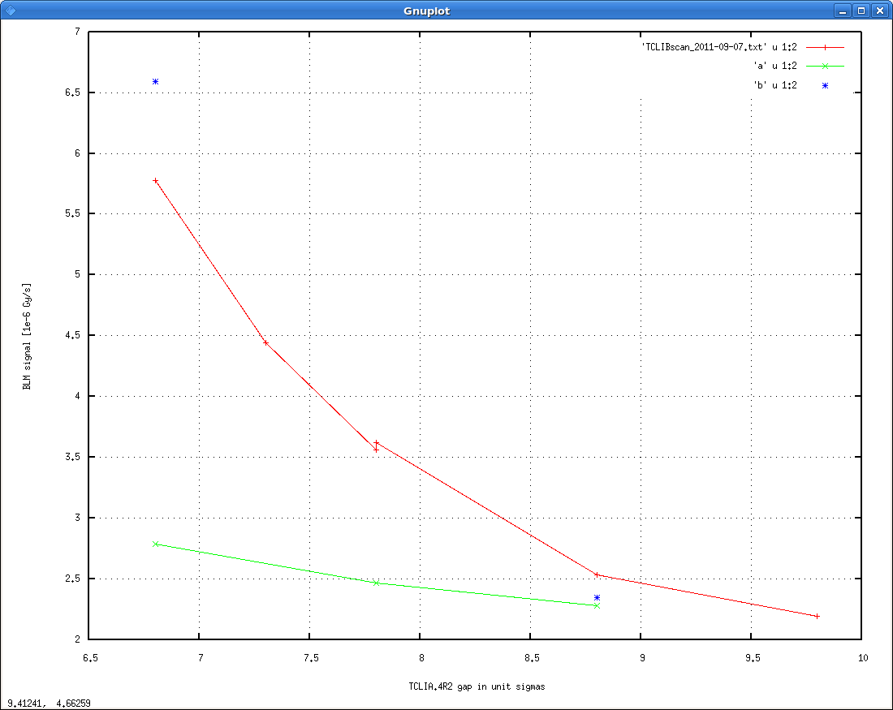
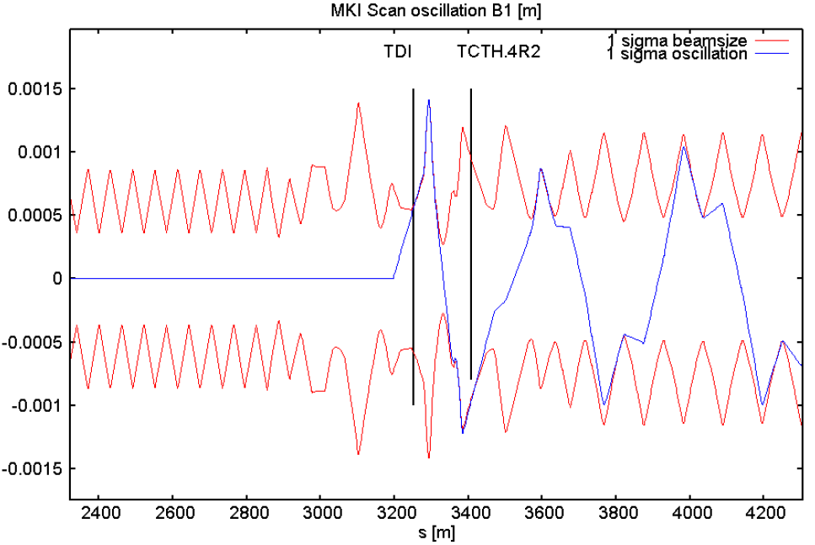
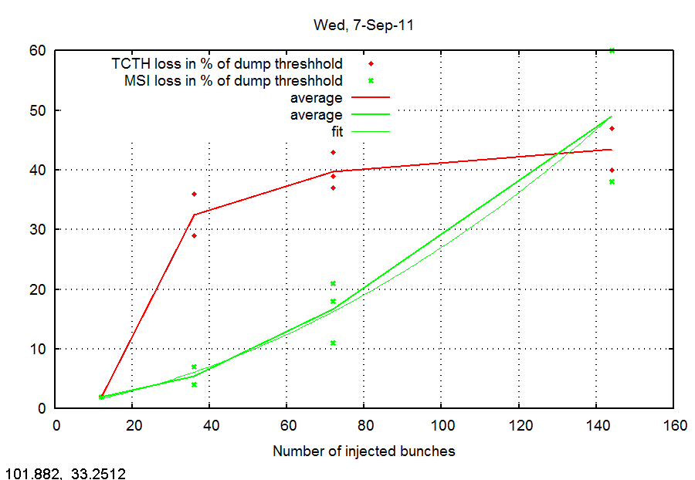
Operational issues
Lower jaw losses
Steering, MKI failure
RF loops, monitoring of phase
  To be automatised
TCLIA losses – not fully understood
Upper jaw losses
TCTH losses rather constant for 36 -144 b injections
Asymmetry of grazing losses (+4/-6 sig) seems to be correlated to injection losses on the lower TCTH jaw

Slide 16
Performance reach 2012
288 bunches (1.05e11 ppb, 2.5-2.7 um) injected at 30% of thresholds
→ promising for full SPS batch injection with higher bunch intensities
Limit is the time spent for injection - sometimes already difficult for 36, 72 or 144 b
How to reduce time spent at injection:
  Improve trajectory stability hardware wise
  Make steering straight-forward by more sophisticated info in IQC (trajectory at collimators, envelopes for monitors and correctors, intensity dependent and thus easy colour code)
  Improve transverse diagnostics of SPS-LHC transfer
  Don’t change supercycles in injectors while LHC filling

Slide 17
Summary
Since 2010 many mitigations put in place which allowed injecting up to 288 bunches this year
Ongoing improvements:
  MSE stability improvement by EPC
  BLM sunglasses
  IQC
  Transverse diagnostics for SPS-LHC transfer
Improvements under study
  Moving/adding TCDIs
in 2011 there was a lot of work on reducing losses at injection –
in 2012 focus on reducing the time spent at injection
2012 set-up time for injection: 4 shifts
Thank you!

