Slide 1
EAM, AFT and PMU events data integration
Isabel AMUNDARAIN ARGUELLO (EN-EL-EPM), Patricia PENADES HUESCA (EN-EL-MO)
2025-06-04

Slide 2

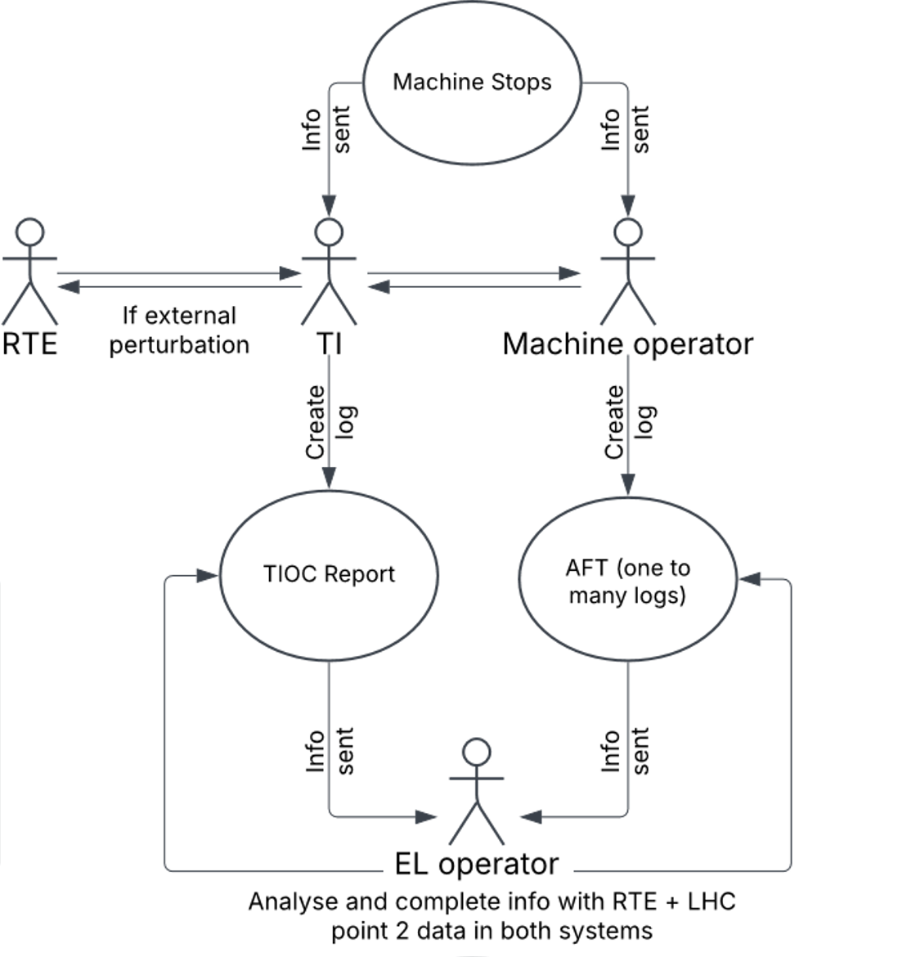
Current status
ELECTRICAL PERTURBATION
IMPACT ON BEAM
NO IMPACT ON BEAM
EAM/AFT Integration (in test)
AFT link
Notes:
Less time-consuming thank to the aft link. Still need human intervention (with the time window etc)
New entity created that is called ‘nature’: ‘event’, to be recorded in the logbook. This is to adapt the logbook to us and not mess with other natures. Step toward organization of this data.
We still have the same data, nothing has changed. Point 2 because of historical reasons, they realized it was always the lowest voltage
Even if there is a tool to facilitate, the correlation is still manual

Slide 3
EAM Additional Requirement
ELECTRICAL PERTURBATION
IMPACT ON BEAM
NO IMPACT ON BEAM
Need to capture events not affecting the machine in EN-EL EAM.
Additional efforts required from TI and EL operator within the logbook required.
This is a functional activity to equipment resilience analysis.
Perturbation affecting the grid
Notes:
Once you have the nature event, there is a new need/requirement which is not fulfilled with the previous scheme (which only explains the events that affect the machine). In EN-EL EAM we want to have also the events that don’t affect the machine. There is an additional effort to be made by the EL operator and the Technical Infrastructure to capture those extra cases.

Slide 4
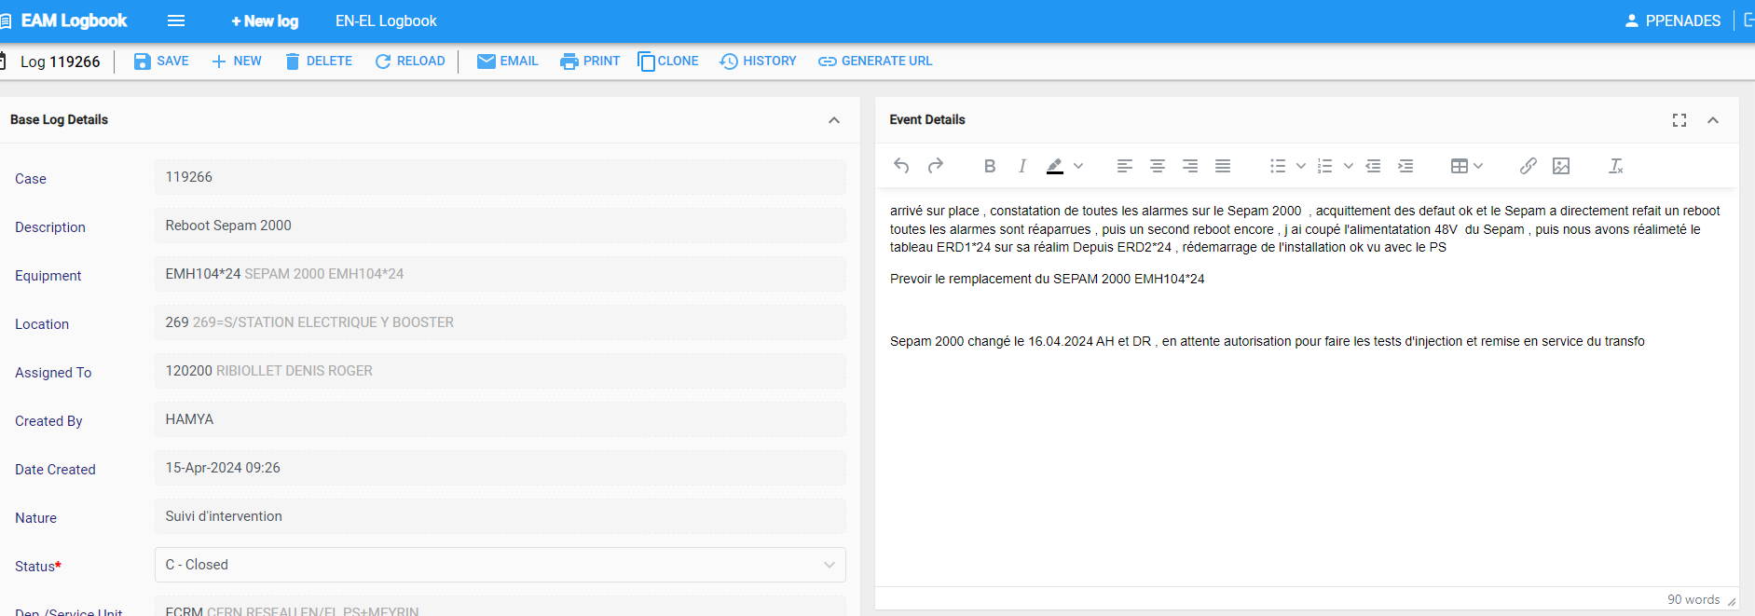
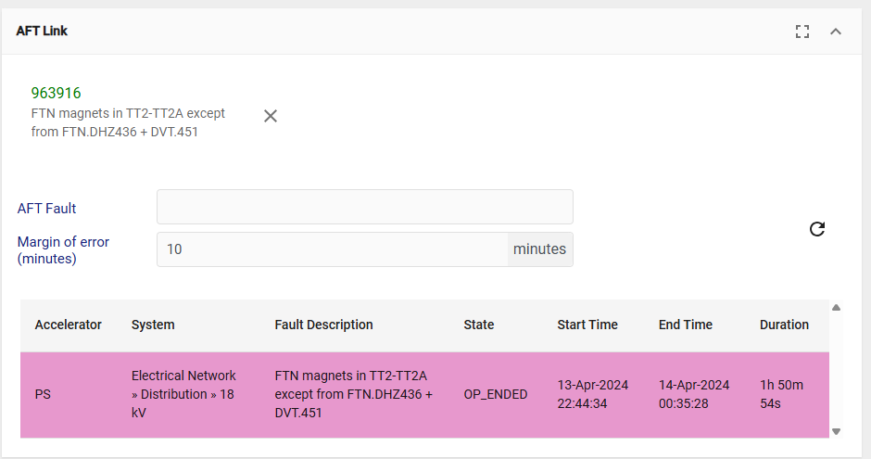


New EN-EL Logbook View - Nature “Event”
Already presented in previous AFT meetings. Not yet integrated
Link Test EAM Logbook
Base Log Details
Description*
Equipment
Location Site
Nature* Status*
Created By Date Created
Updated By Date Updated
Event Start Date Event End Date
Assigned to
(FP)
(Building)
(LCH1)
Event
13-Apr-2024 22:40
Fault Type
Impact Fault Type
System Cause
TI Mayor Event Id
Network Perturbation
Duration (ms)
Voltage Dip (%)
Origin Location External Internal
CERN
RTE
Future EAM data automatically sent to AFT
Notes:
Location: building
Site: Machine place, for example LH1

Slide 5
EAM/AFT and Phasor Measurement Units (PMU) Event Data Integration
Notes:
Now we introduce the new tool, the PMUs and want to show how impactful is the use of this system and what different way of processing the data requires this technology

Slide 6
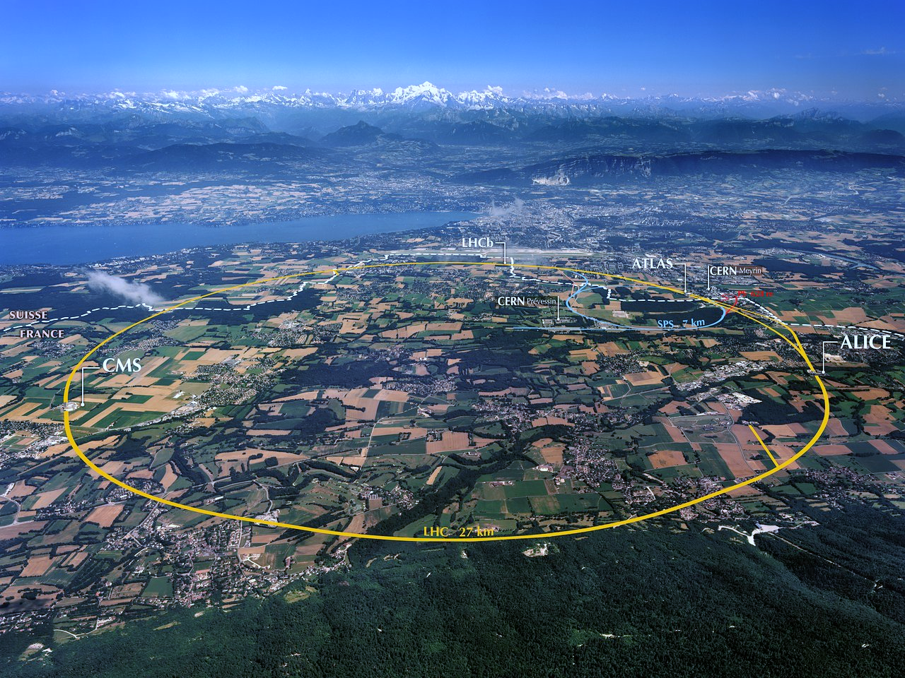
PMU Locations
400 kV network
2 substations (BE1 and BE2)
1 PMU/substation
P6
66 kV network
1 substation (SEH9)
2 PMUs
SEH9
BE1
BE2
P4
18 kV network
LHC loop + PCC
20 PMUs
6
Notes:
It basically measures I and V.
it provides phasors data (magnitude and phase data synchronized with timestamped data)

Slide 7
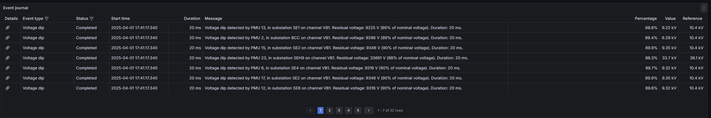
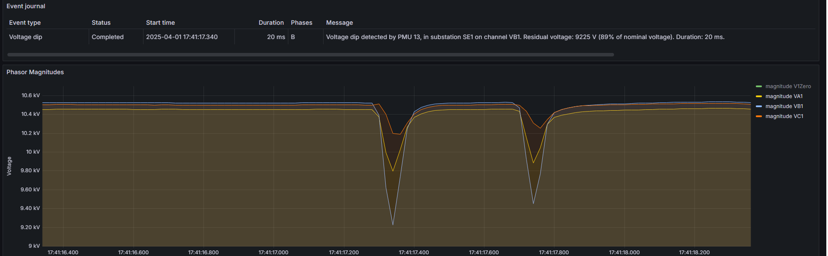
PMU Events in Dashboard
7
Notes:
This is what a typical representation of an event looks like in the dashboard provided by the supplier of the system, still in commissioning, list of events recorded from different PMUs. We see phasors data, already postprocessed data compared to the waves we typically receive from the relays. It is RMS data, postprocessed.
It is measured in multiple locations. There are many records for the same perturbation.
It is possible to extrapolate magnitude and duration. It is already prepocessed. The manual process that was made by EN-EL doing this manually, it is already done and in multiple locations.

Slide 8
EAM/AFT and PMU Data Integration
The alarm logic used in SCADA would have to be reproduced again to retrieve data from NXCALS to EAM (flag status, duration, dip).
How to extract data from EAM and AFT to another app? Via an API? Need collaboration from AFT and EAM to extract and query that info.
Completed log
AFT link
AFT logs references in EAM logs
Analysis system
EL expert eq. resilience
Notes:
Same process as before, while before explaining the intervention of the EL operator, we explain the parallel process.
There is a perturbation, data sent to SCADA and then to repository NXCALs. For the moment, we will automatically create a log in EAM with the nature ‘perturbation’.
Up to 2026, there will be a validation process and we need to be sure that all events are grouped as necessary and identified properly.
Next step after validation and the automatic generation of the logs, we can get rid of the nature event.
- The line between systems includes the aft link. Once it is linked, we need to send back what is easy for correlation because we need information on the effects, for analysis for the equipment resilience.
- Differences are the improved correlation and analysis tools in nxcals. Also, more reliable fault data
- Why we want to use the data by EL expert? We aim to link and analyse the causes with the consequences of the perturbations. To eventually be able to perform an immunity of the system or a specific subsystem of the grid. The specifics we don’t know yet and may depend also on the kind of information we start retrieving.

Slide 9
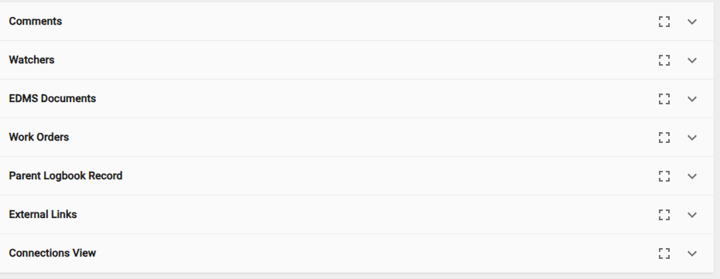
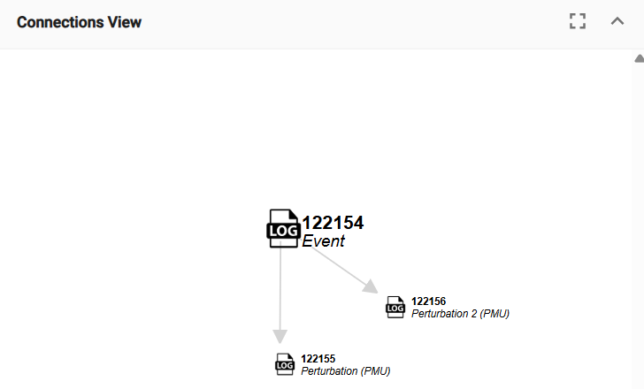
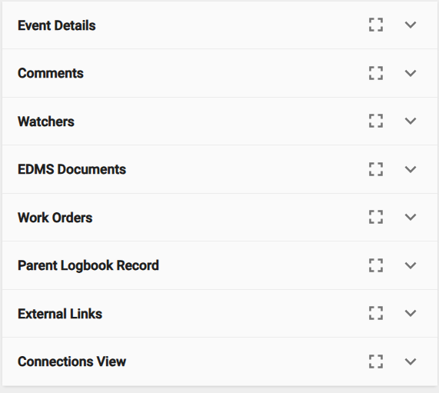
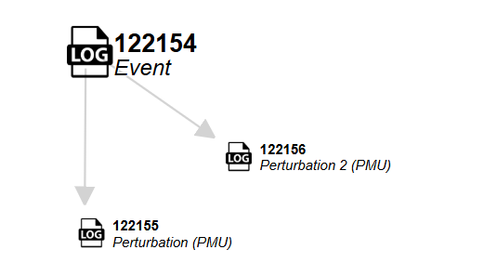
New EN-EL Logbook View - Nature “Event”
Link Test EAM Logbook
Base Log Details
Description*
Equipment
Location Site
Nature* Status*
Created By Date Created
Updated By Date Updated
Event Start Date Event End Date
Assigned to
(FP)
Event
13-Apr-2024 22:40
Fault Type
Impact Fault Type
System Cause
TI Mayor Event Id
Future EAM data automatically sent to AFT
Notes:
Right down is the info of the event data. Within the event nature log, no need for the network perturbation information naymore, because it will be shown and included in the perturbation nature log now (populated automatically by the pmus).
The idea is not only to linkt he aft but to send the data from eam to aft too. The event nature still requires manual intervention.

Slide 10
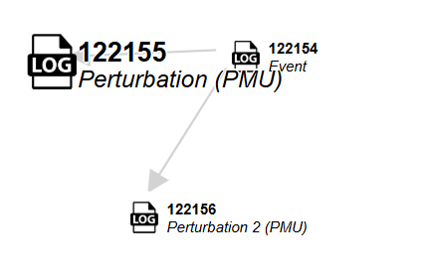
New EN-EL Logbook View - Nature “Perturbation”
Base Log Details
Description*
Equipment
Location Site
Nature* Status*
Created By Date Created
Updated By Date Updated
Event Start Date Event End Date
Assigned to Intervention
(PMU FP)
Perturbation
13-Apr-2024 22:40
Network Perturbation
Duration (ms) Type
Voltage Dip (%)
Origin Location External Internal
CERN
RTE
Fields are auto-populated from PMU
Notes:
Whereas this is all autopopulated by the pmus

Slide 12


Introduction
ELECTRICAL PERTURBATION
IMPACT ON BEAM
NO IMPACT ON BEAM
CURRENT STATE
FUTURE STATE
Integration
AFT
AFT
TIOC REPORT
EL EAM LOGBOOK
Manual process
TIOC REPORT
EVENT
“Automation”
EVENT
↓ Precision
↑ Precision
EL EAM LOGBOOK
Notes:
Current state: SCADA data goes to the operators and they fill manually info in AFT and TIOC report.
Future state: an event, there is some automation, more precision and integration of the systems

Slide 13


Final EAM/AFT and PMU Data Integration
Advantages
Less Time-Consuming: Requires less time (AFT event association is simple). Everything automatized.
Data Accuracy: More reliable fault data.
Improved Correlation: Possible link between perturbations and their effect on the machine.
Recorded in the EN-EL EAM Logbook.
Disadvantages
Still Requires Minimum Manual Effort: Some manual work is needed.
EAM logbook
nature ‘event’
Completed log
AFT logs references in EAM logs
Analysis system
EL expert eq. resilience
Notes:
For the complex cases, there will always be possibility to go through the EL operator.
Once everything is validated, we will have fully automatized process, we don’t need the nature event log anymore

Slide 14
Final EAM/AFT and PMU Data Integration 2.0
Advantages
Less Time-Consuming: Requires less time (AFT event association is simple). Everything automatized.
Data Accuracy: More reliable fault data.
Improved Correlation: Possible link between perturbations and their effect on the machine.
Recorded in the EN-EL EAM Logbook.
EAM logbook
nature ‘event’
Completed log
AFT logs references in EAM logs
Analysis system
EL expert eq. resilience
Notes:
For the complex cases, there will always be possibility to go through the EL operator.
Once everything is validated, we will have fully automatized process, this is the tendency. The necessary data is generated by the flow in the left.
From NXCALs, we would be doing all the smart automatization. There is possibility to link to other tools. We can run things over nxcals.

Slide 15
PMU Data SCADA Integration – Feasibility Study
Installation of SCADA prototype
Successfully tested interface between Zaphiro’s SCADA gateway and CERN’s SCADA gateway
Clarified expected behavior during events
Defined
  IEC 60879-5-104 parameters
  Address range for each device (discrete and measurement range)
  Datatype for each address
PMU number | Event | Feature1 | Feature 2 | Feature 3
n | Voltage dip | Detection | Duration | Depth
n | Interruption | Detection | Duration | Depth
n | Swell | Detection | Duration | Depth
n | Rapid voltage change | Detection | Depth
15

Slide 16

PMU Data SCADA Integration
Status of developments at Q1/2025:
  Feasibility study: Data communication, architectural and cyber-sec requirements → Completed
  SCADA integration: Implementation of communication protocol, gateway configuration, and metadata management → In progress, Q3 2025
Next steps
  Develop a plugin to extract the values of interest for CERN and structure the message as expected → In progress, Q1 2025
  Internal testing → Q2 2025
  Commissioning → Q3 2025
Notes
Approach for alarm handling in SCADA:
  Event start: event detection Boolean variable ON (with timestamp equal to event start)
  Event stop: event detection Boolean variable OFF (with timestamp equal to event stop).
  Analogs: Duration, depth, are sent at the end of the event.
SCADA integration
via IEC-104 protocol
Context: Full SCADA integration of PMU measurements and events (power quality faults, etc.) via protocol 104
Actions:
  Feasibility study: Data communication, architectural and cyber-sec requirements
  SCADA integration: Implementation of communication protocol, gateway configuration, and metadata management.
Effort: HIGH (feasibility study + implementation)
Roadmap : N/A (est. depends on feasibility study results )
16

