Slide 1
WP5 status
SiPM task
- Development and production of the optimised BSI SiPMs – High segmentation
- ASIC prototype design, floorplan and layout – Based on FastIC – CMOS
- Integration Validation of the photo detection module
MCP-PMT task
Two proposals have emerged, which have synergies, and were originally put forward as 350k joint
project. However, if reduced to 250k things become too diluted. Therefore, we must decide
between the two separate tasks (DRD4 is not prepared to make the decision for us!).
Diamond transmission dynode to overcome rate / lifetime limitations of MCP-PMTs
or
New generation of highly granular MCP-PMT
RICH task
Next-generation eco-friendly dual-radiator RICH Cell
with high-density cooled SiPM Photodetector Module

Slide 2
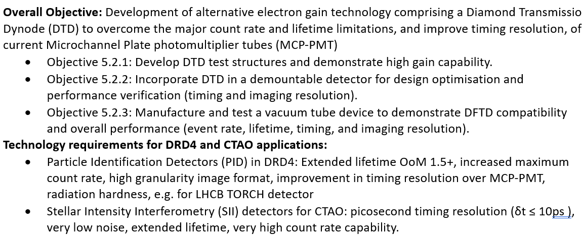
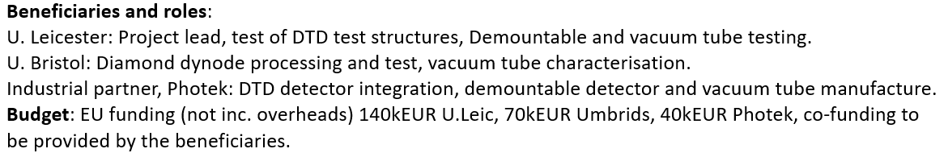
Transmission dynodes: enhancing vacuum photodetectors

Slide 3
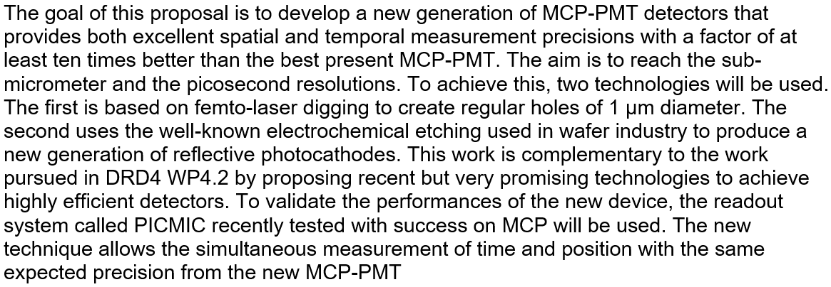
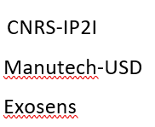
New generation of highly granular MCP-PMT

Slide 4
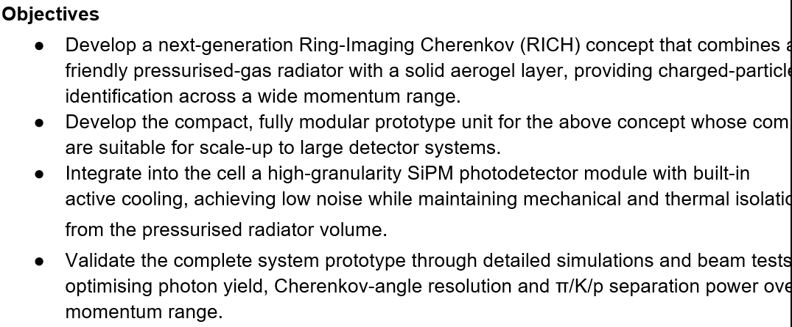
Next-generation eco-friendly dual-radiator RICH Cell
with high-density cooled SiPM Photodetector Module
Participants: INFN Trieste, Genova, Bologna, Ferrara, Oxford, Leicester (possibly), RAL, Liberec,
and Fraunhofer ITKS
Likely beneficiaries: INFN, Oxford

