Slide 1
Experiment Resource Usage 2025 Q2

Slide 2
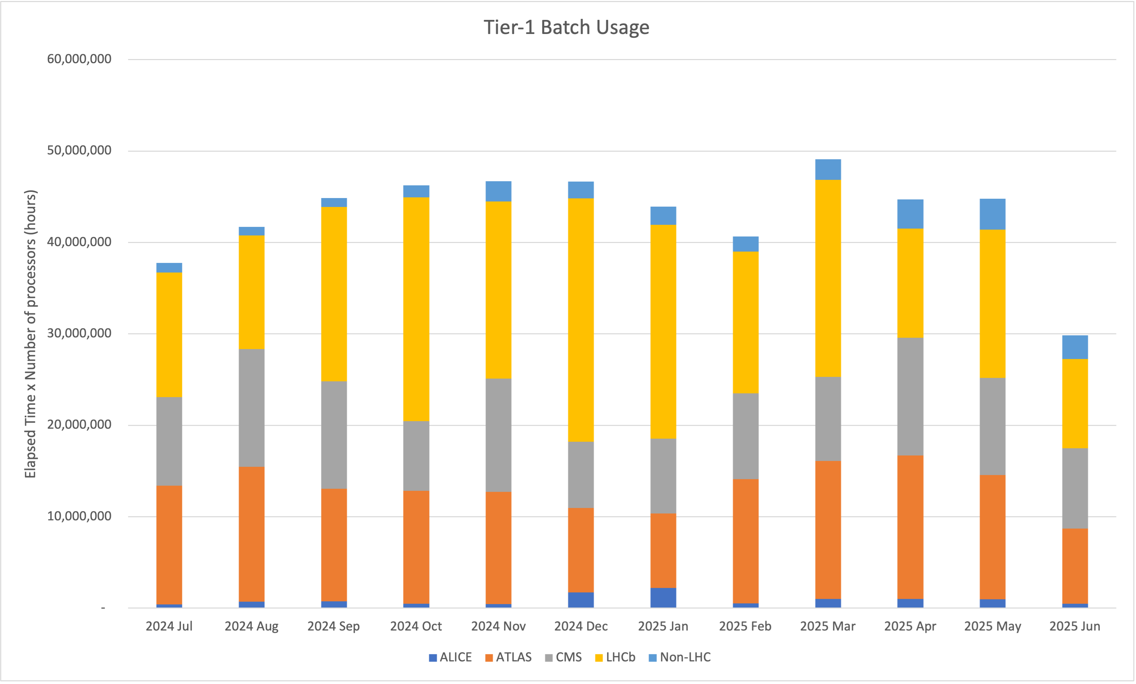
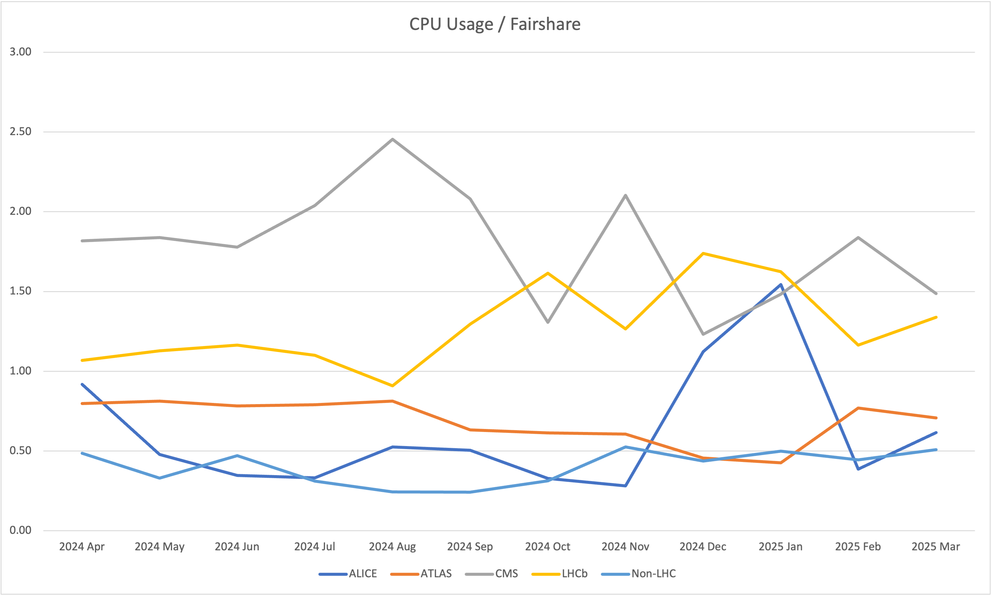
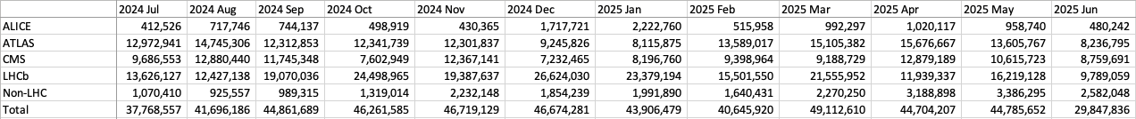
CPU usage
New Accounting Bug with all ARC instances
Since June 24th Accounting has broken for all ARC instances due to a bug, developers are working on it

Slide 3
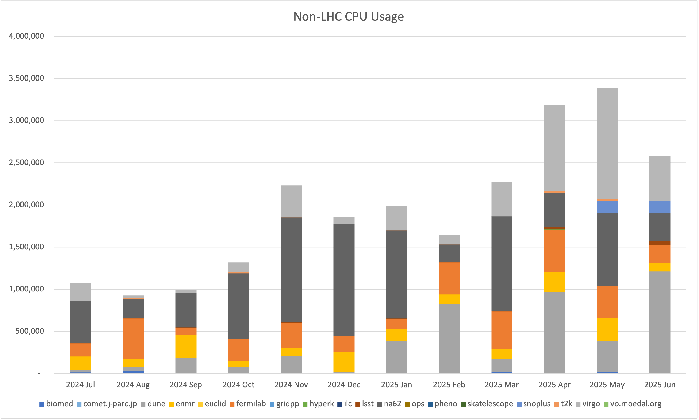
Non-LHC CPU Usage

Slide 4
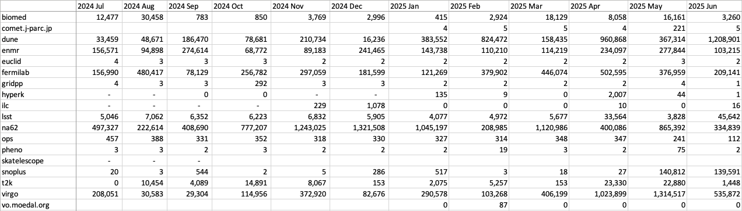
Non-LHC CPU Usage (2)
Two new VOs are submitting jobs:
  Comet
  Moedal

Slide 5
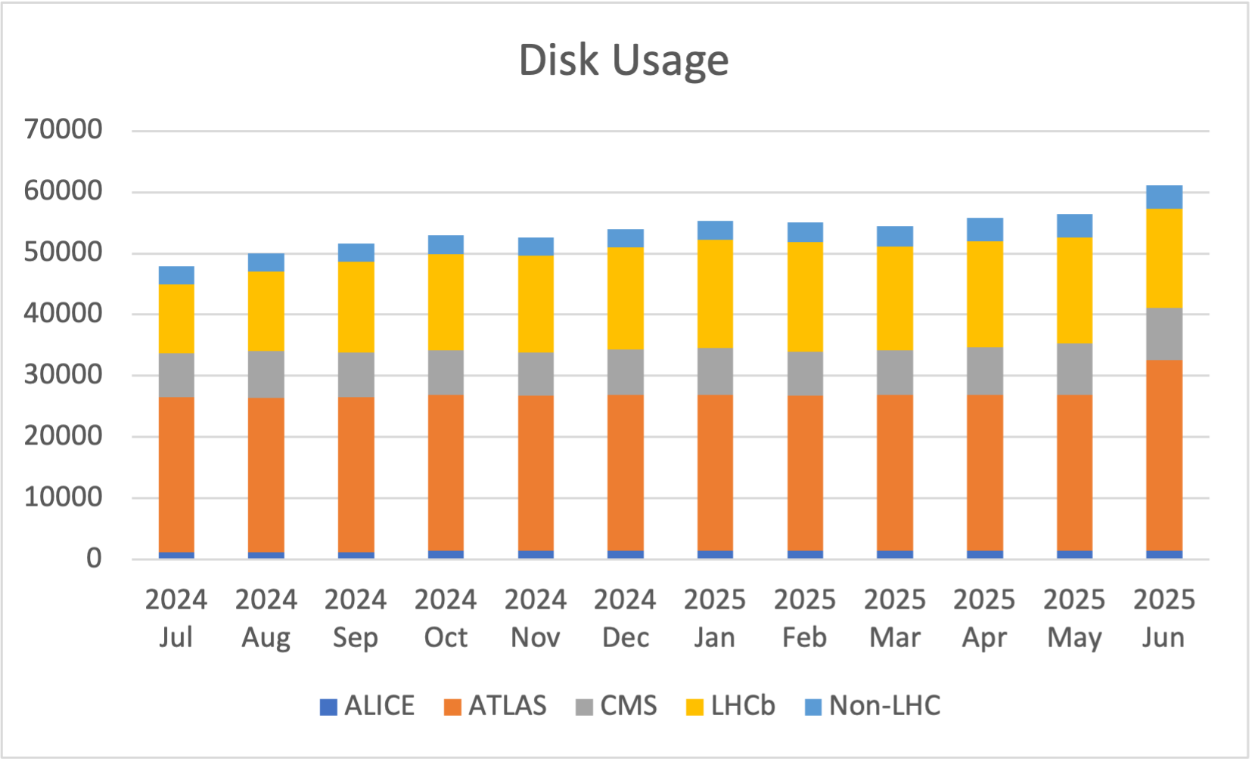
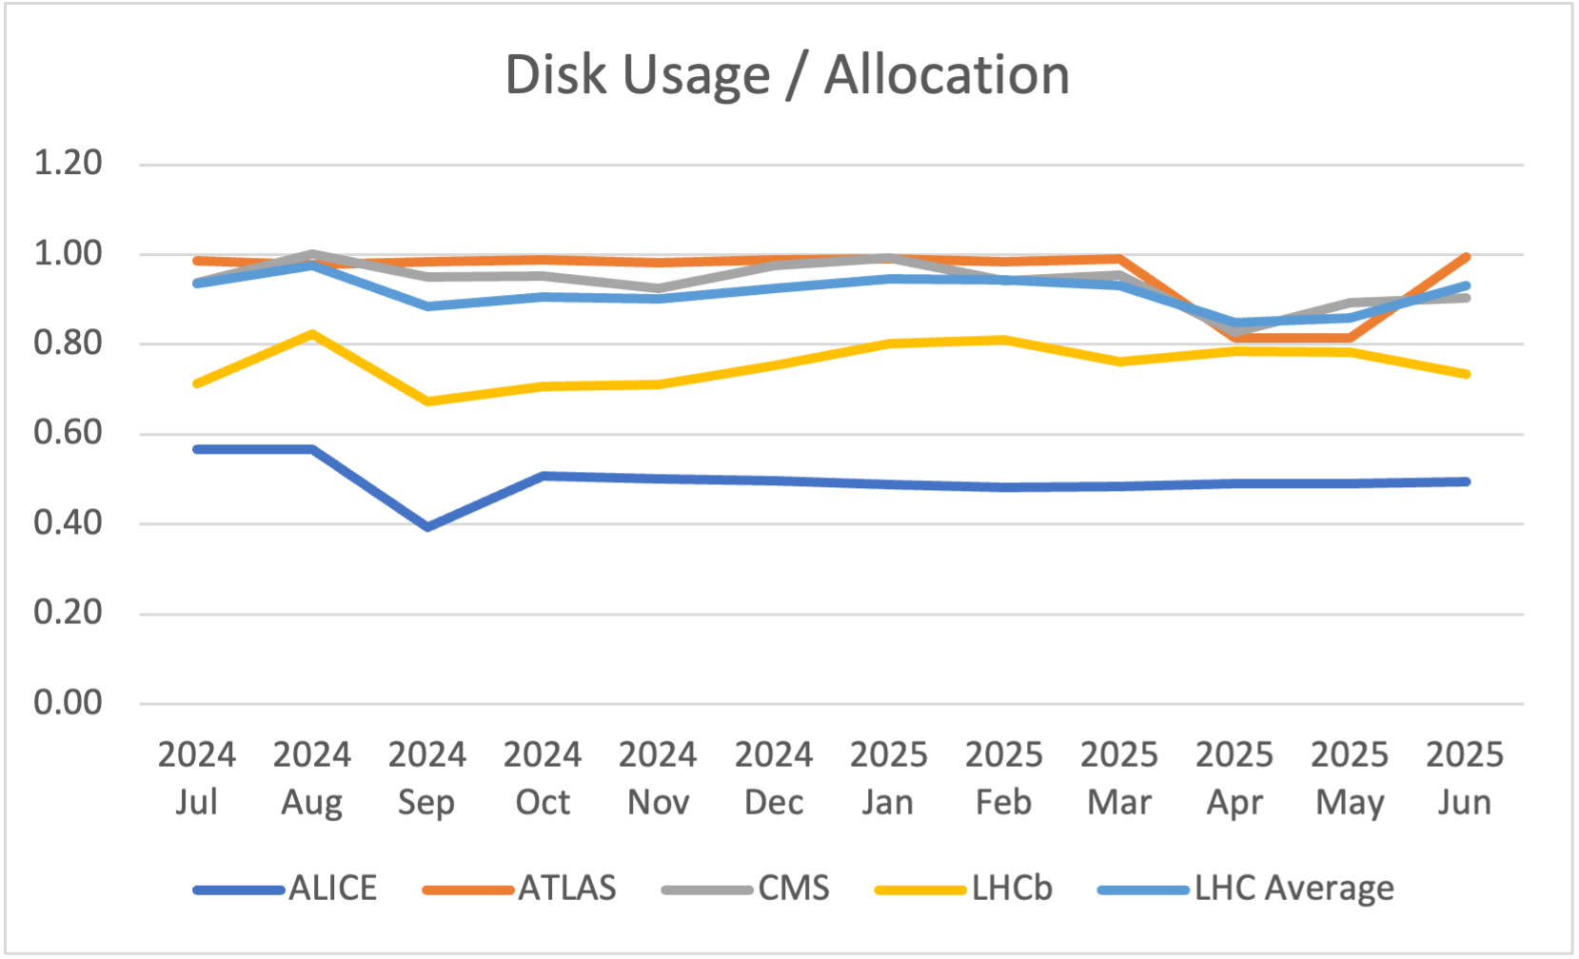
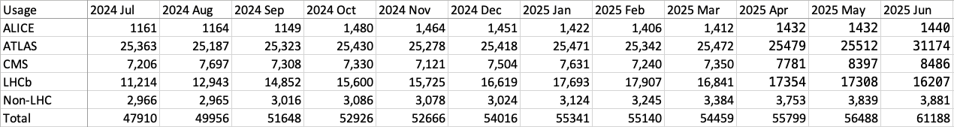
Disk usage

Slide 6
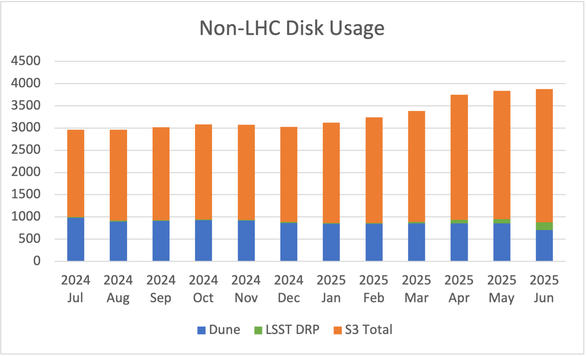
Non-LHC Disk Usage

Slide 7
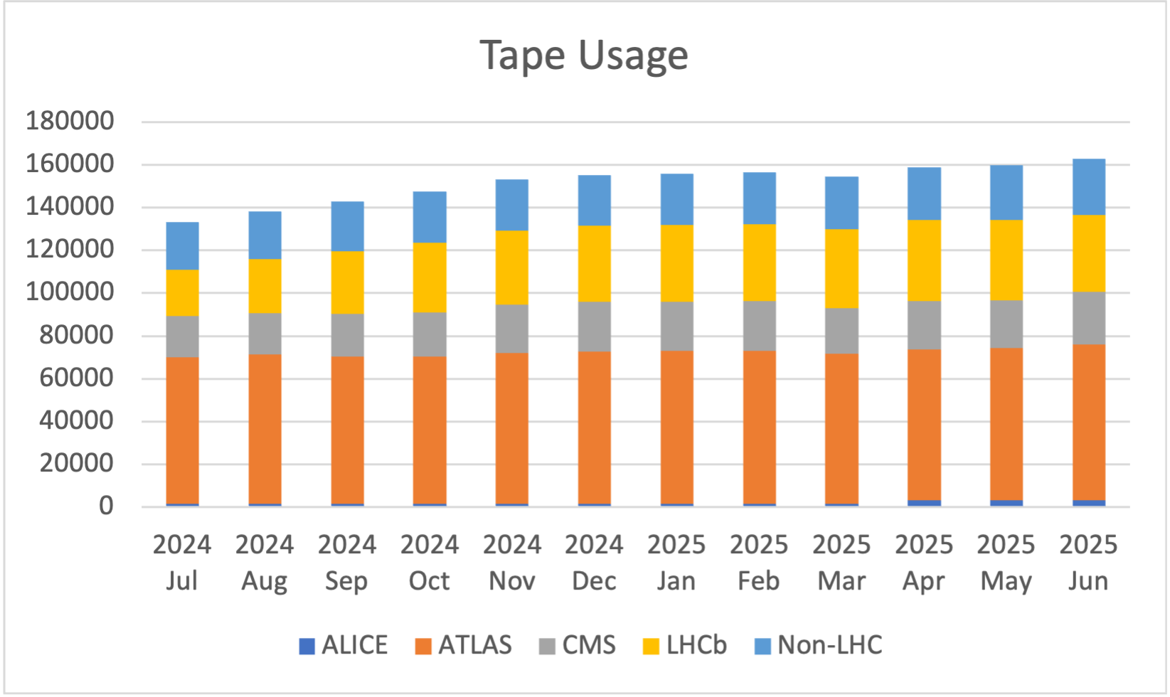
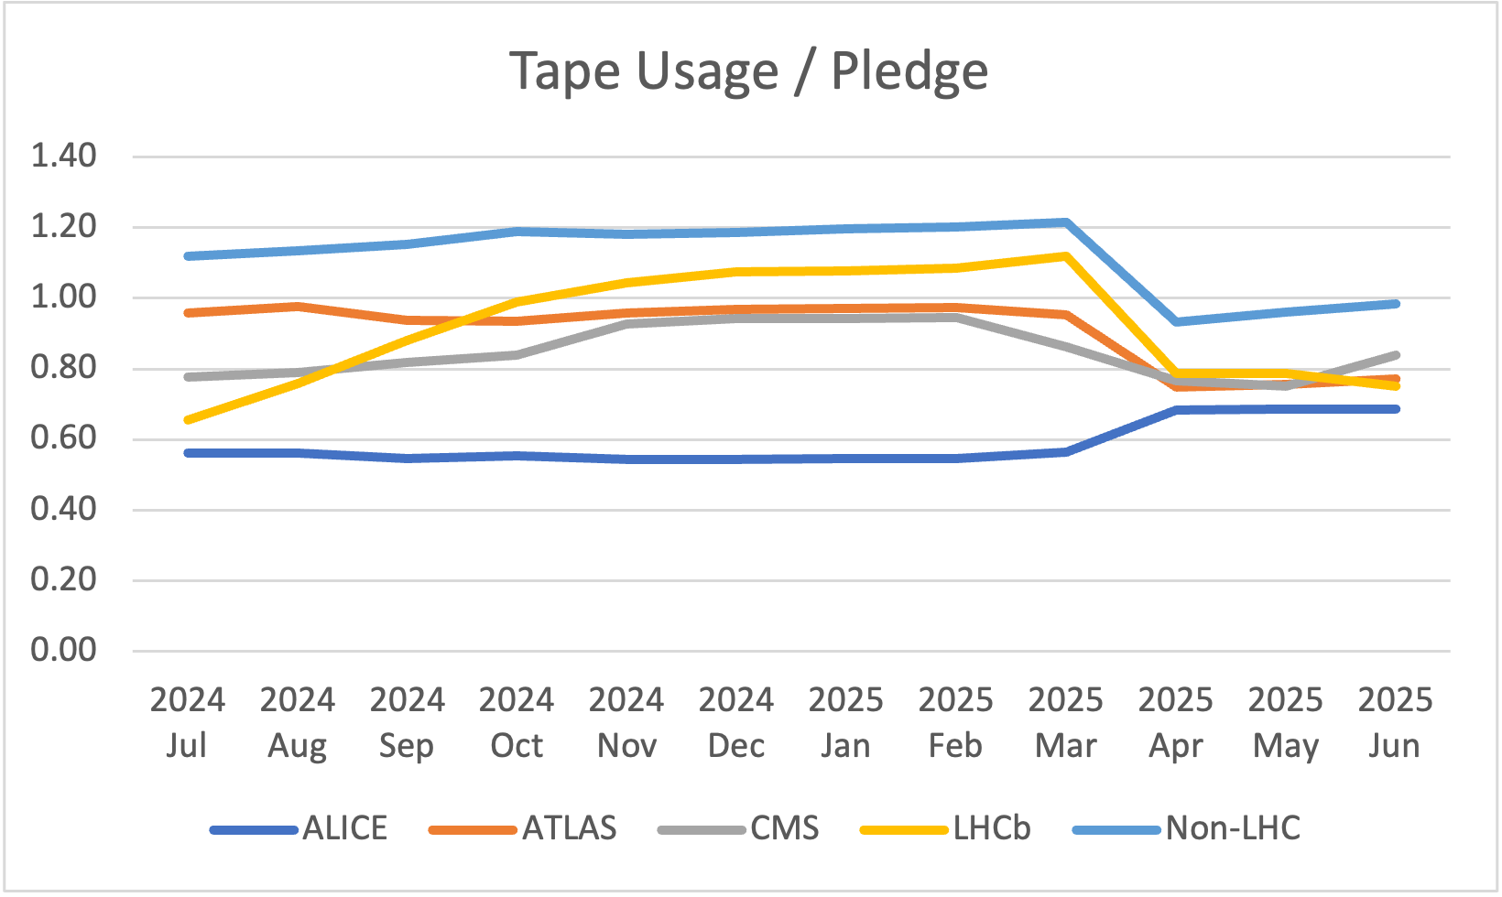
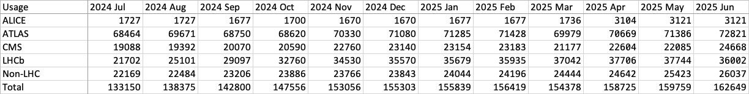
Tape usage

Slide 8
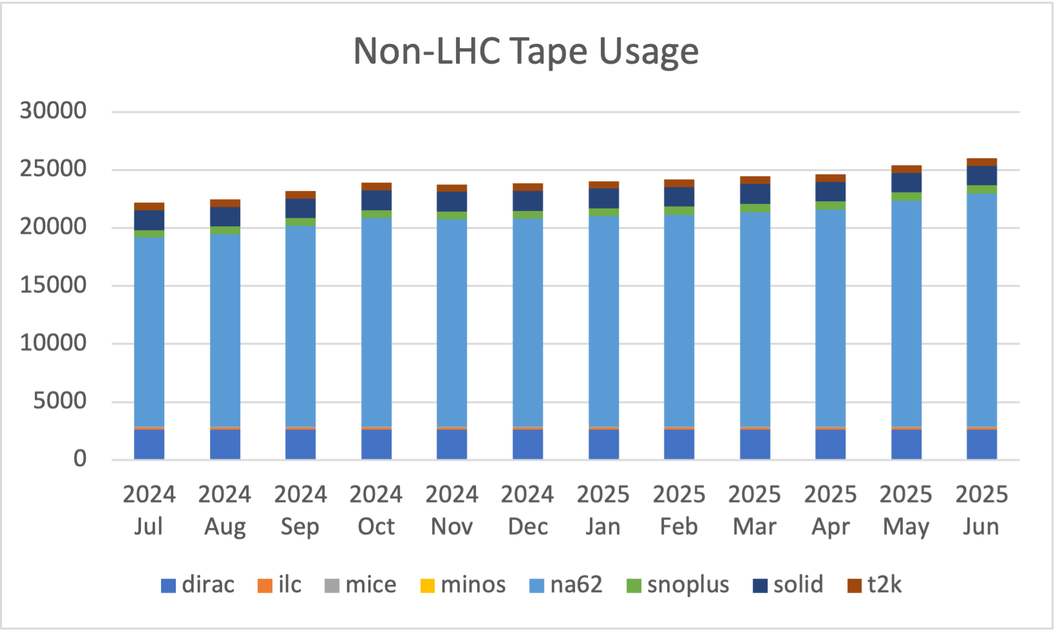
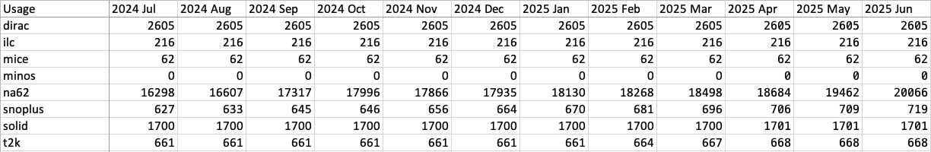
Non-LHC Tape usage

