Slide 1
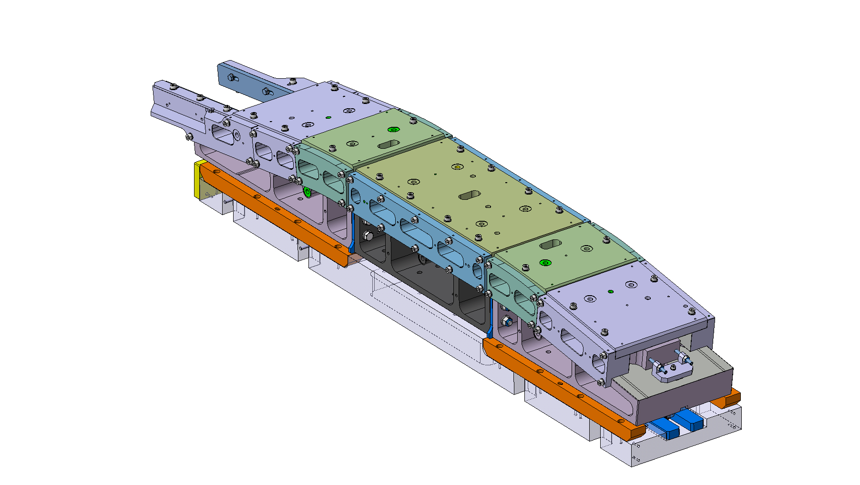
BOND
Reaction Toolings Assy.

Slide 2
Summary:
Bearings Reaction Tooling Assy.
Idea n°1
Idea n°2
Idea n°3
Sarcophagus Reaction Assy.
Idea n°1
Idea n°2
Idea n°3

Slide 3
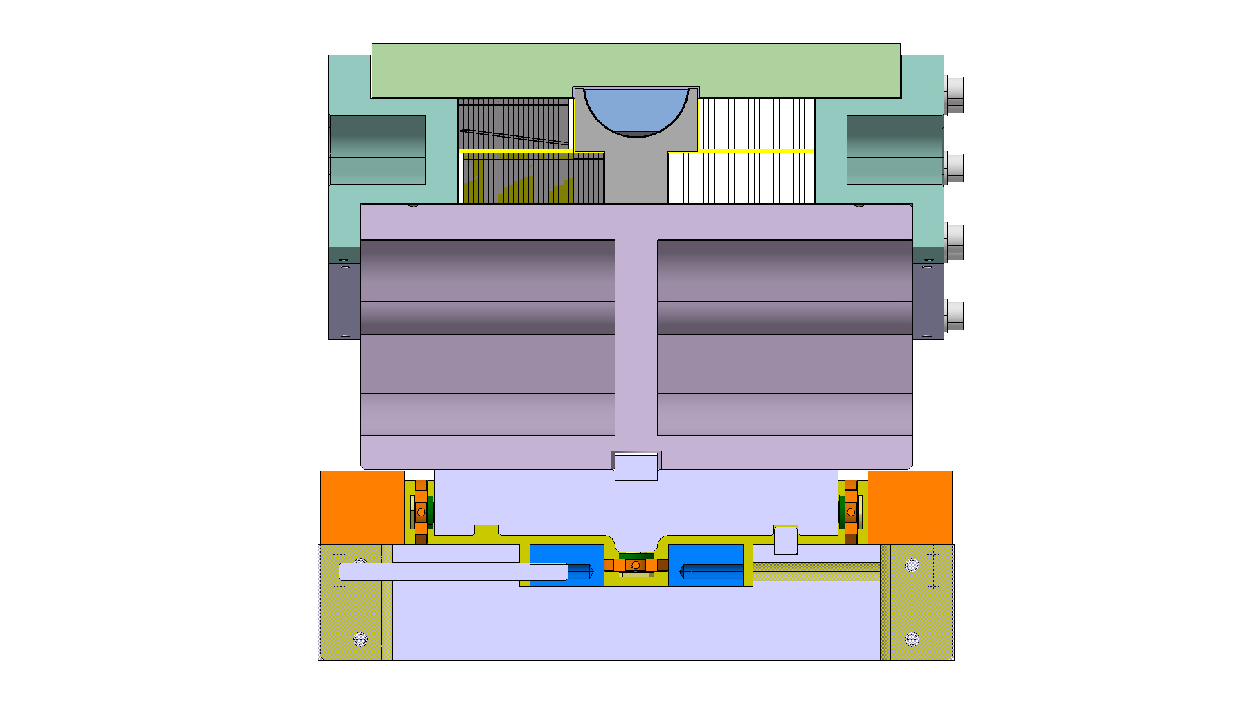
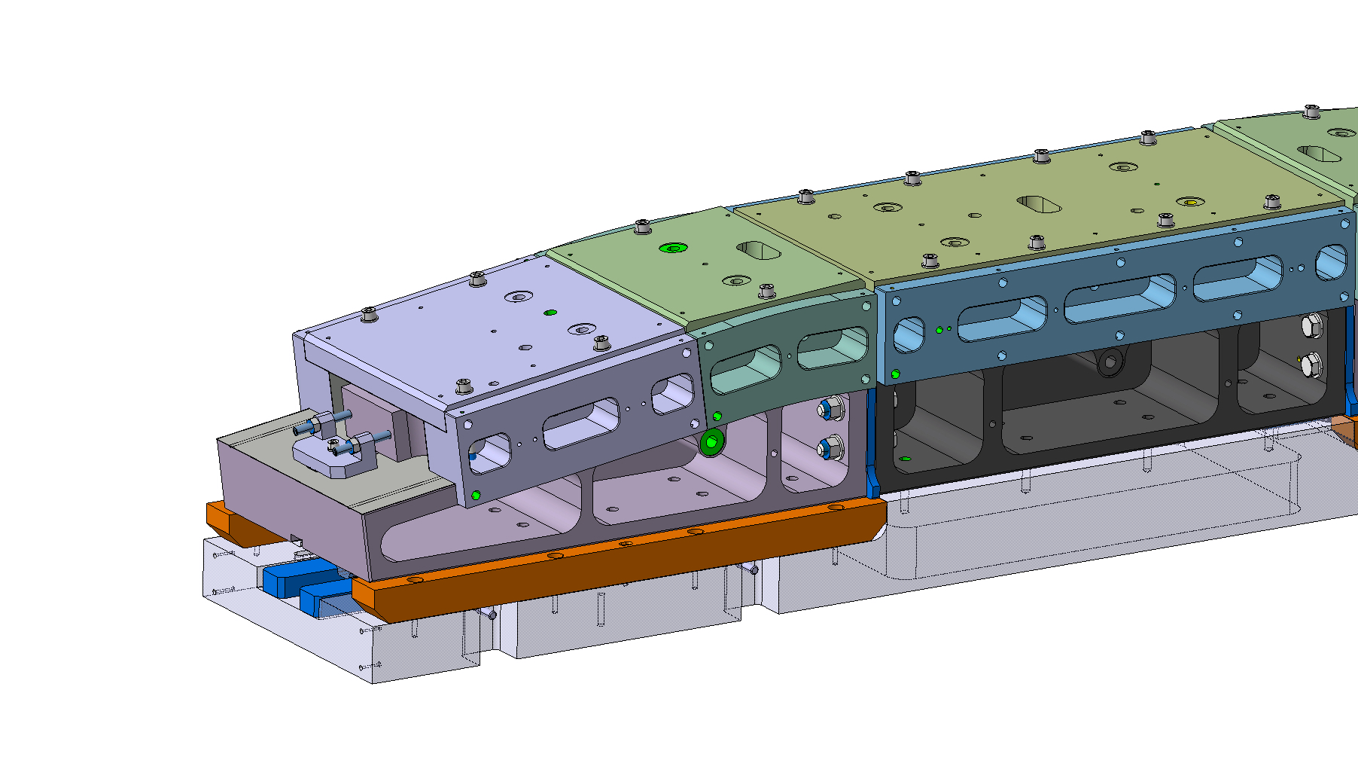
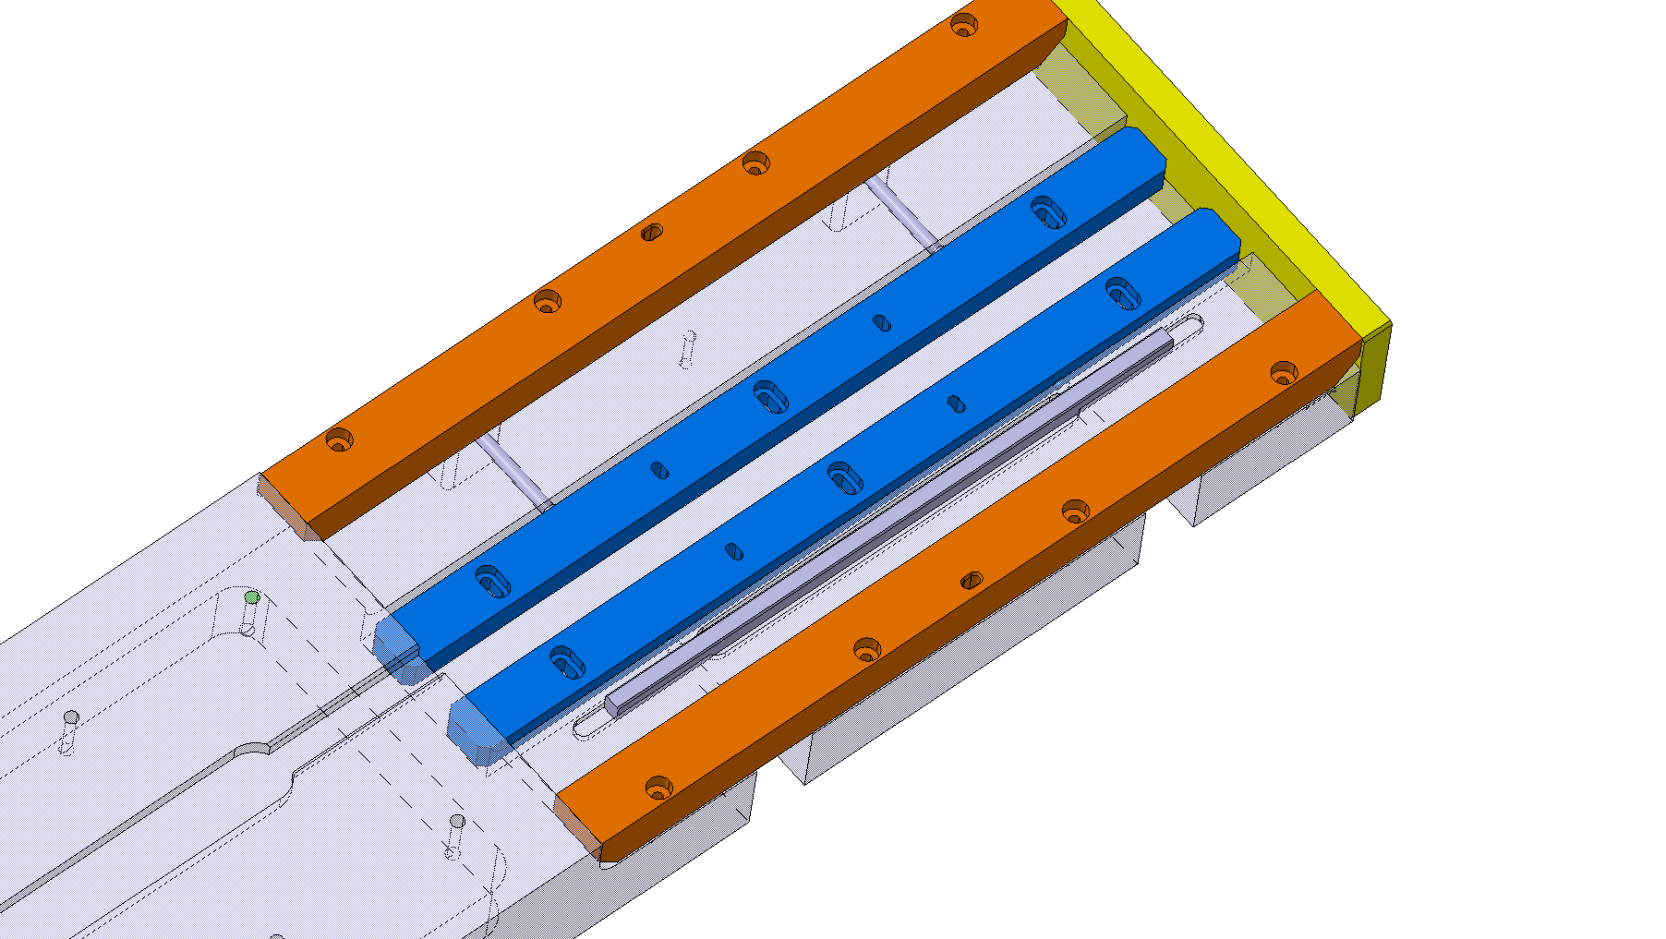
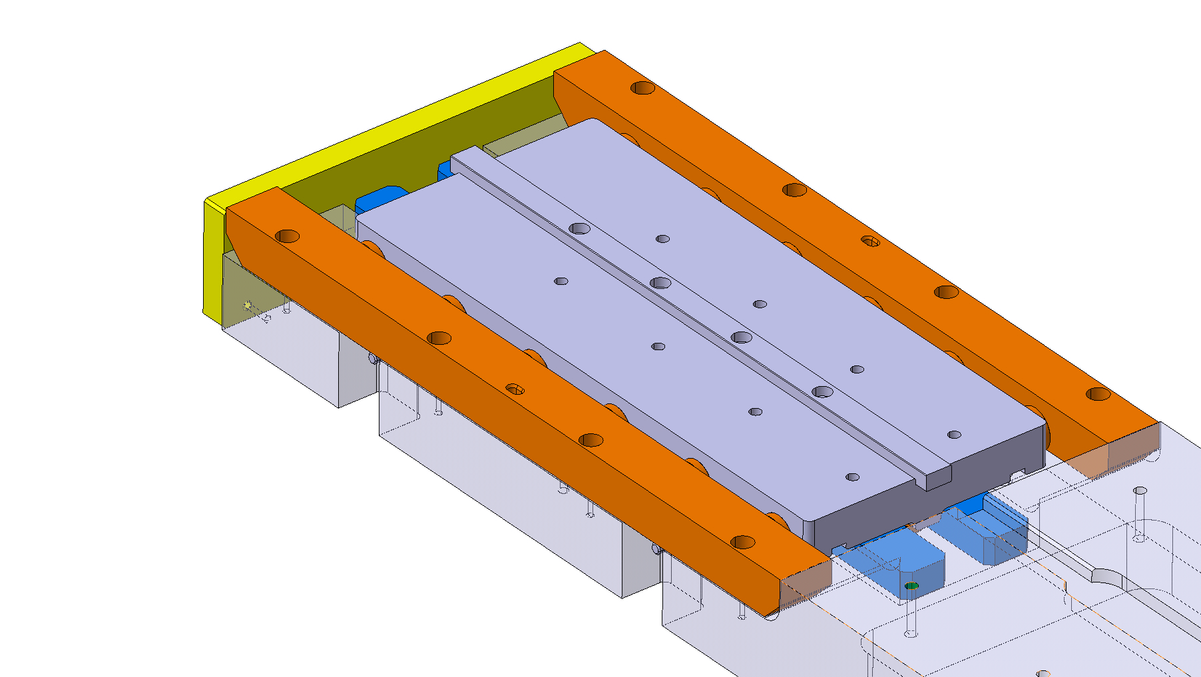
Bearings Reaction Tooling Assy :
Idea n°1:

Slide 4
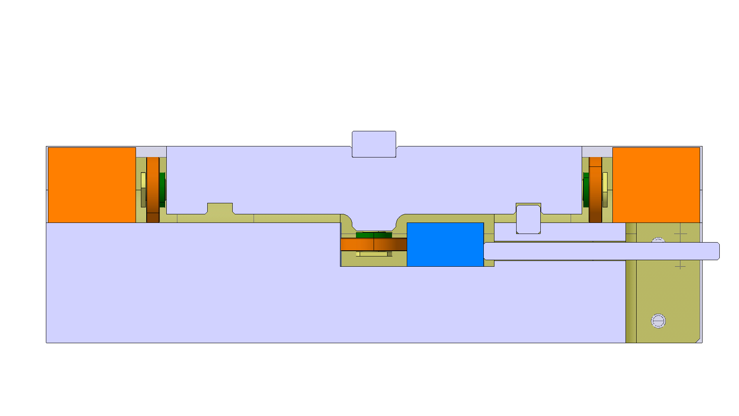
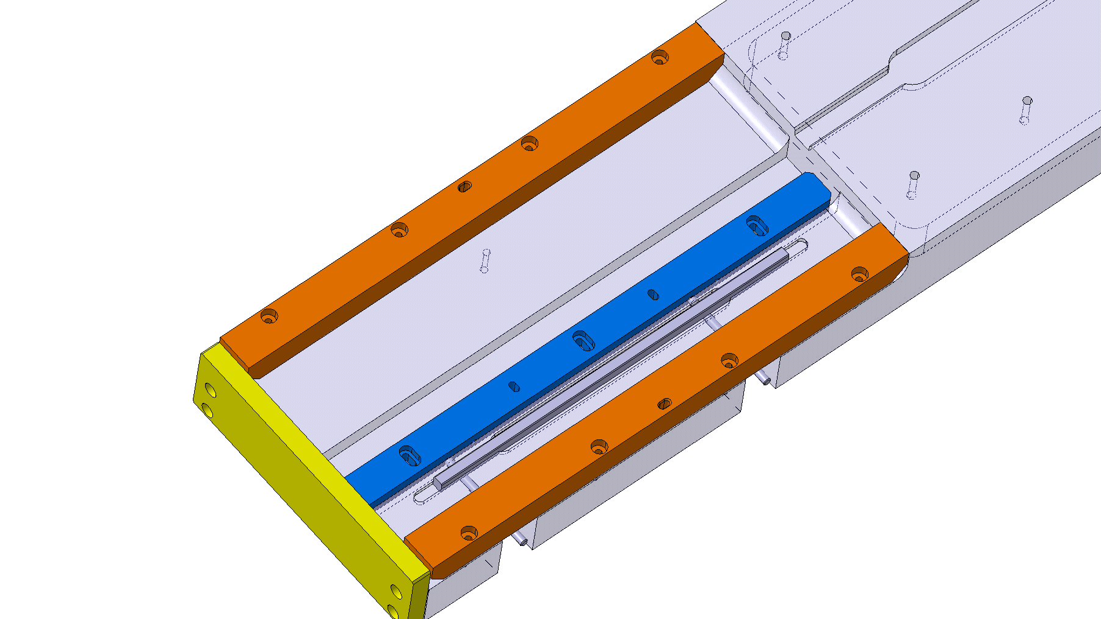
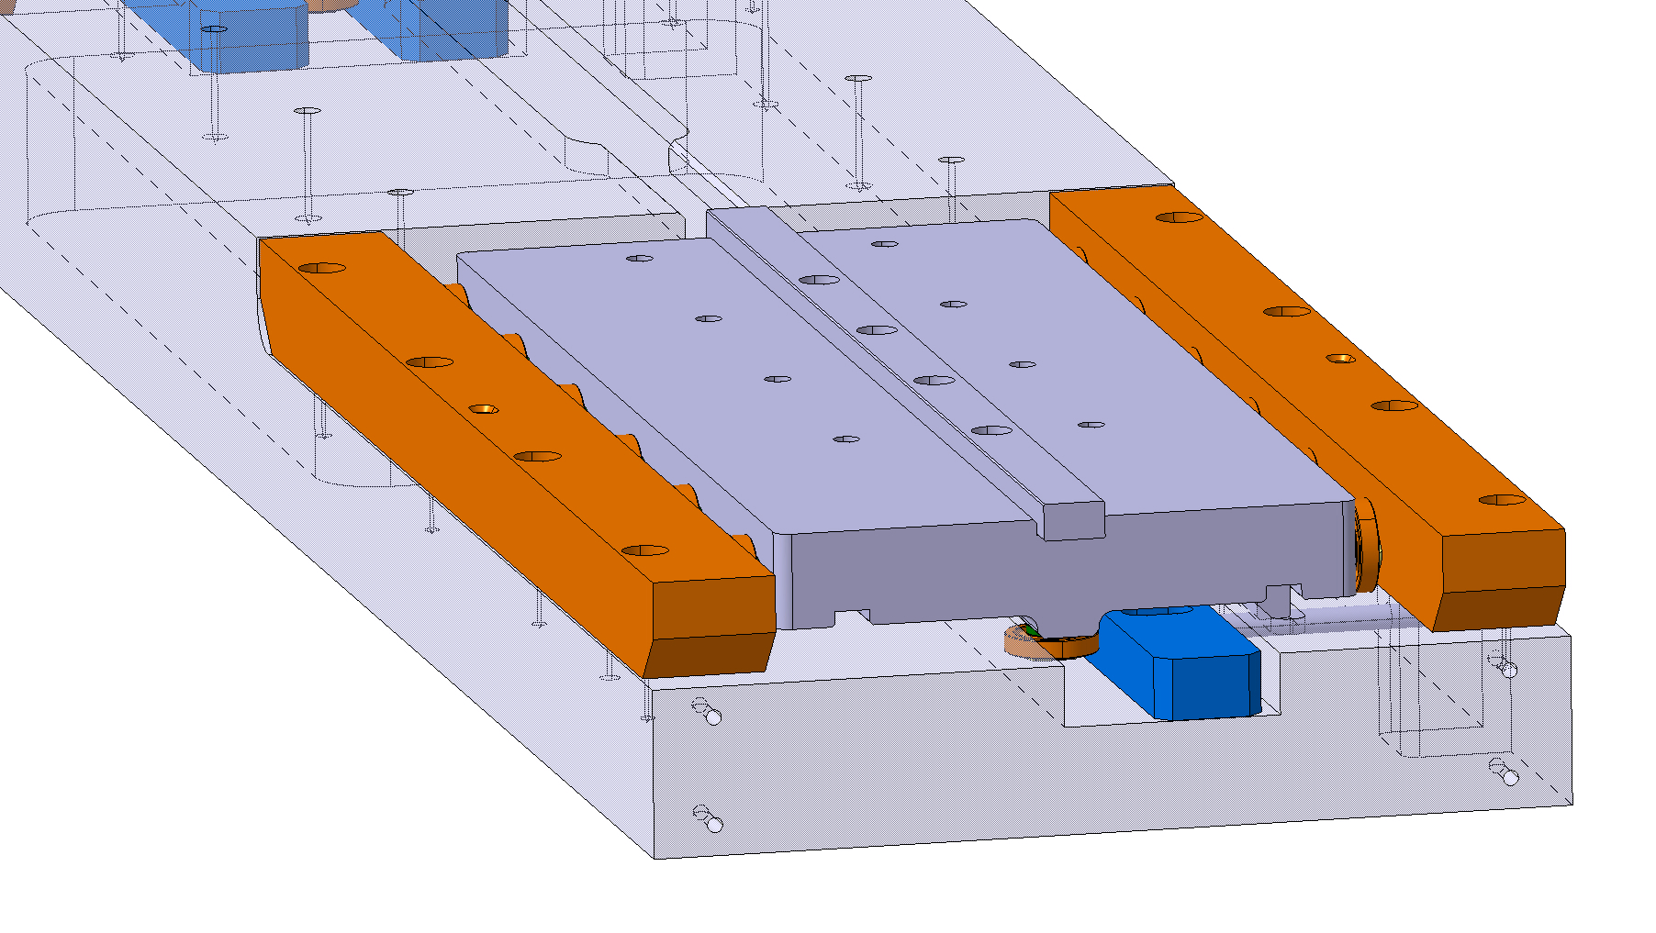
Bearings Reaction Tooling Assy :
Idea n°2:

Slide 5
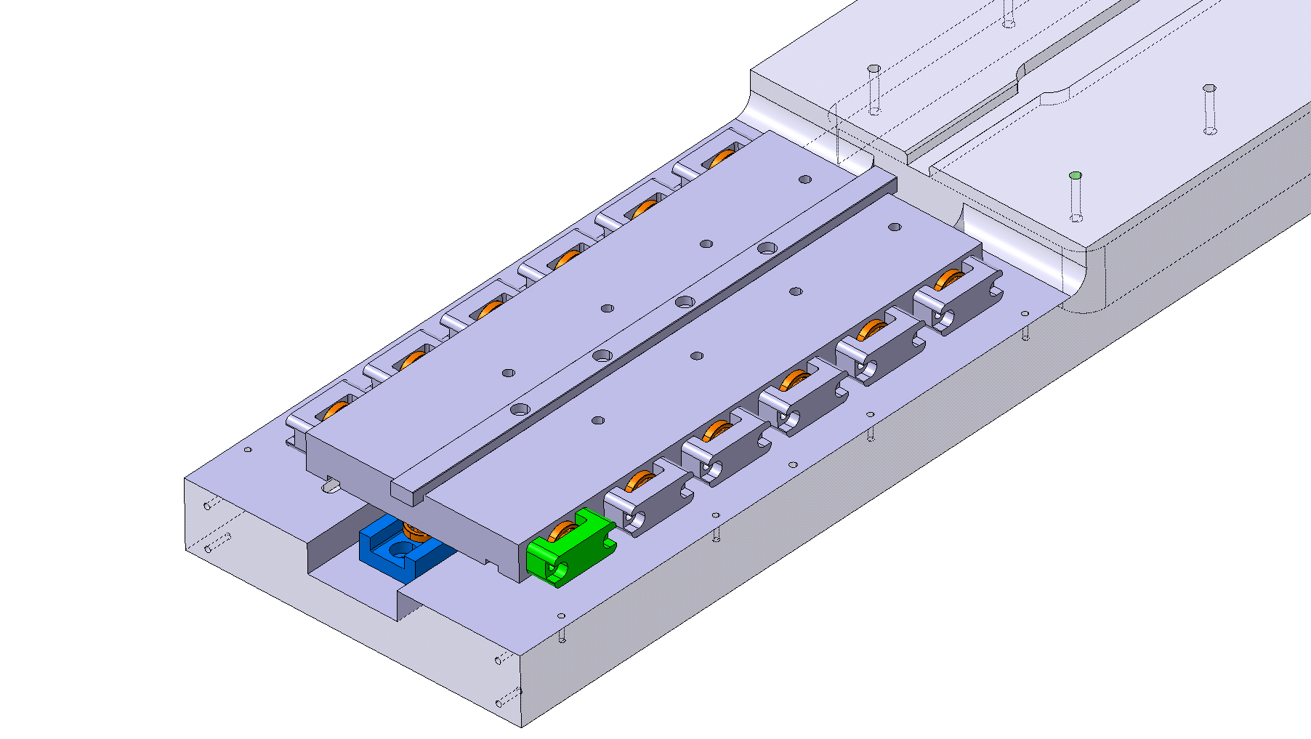
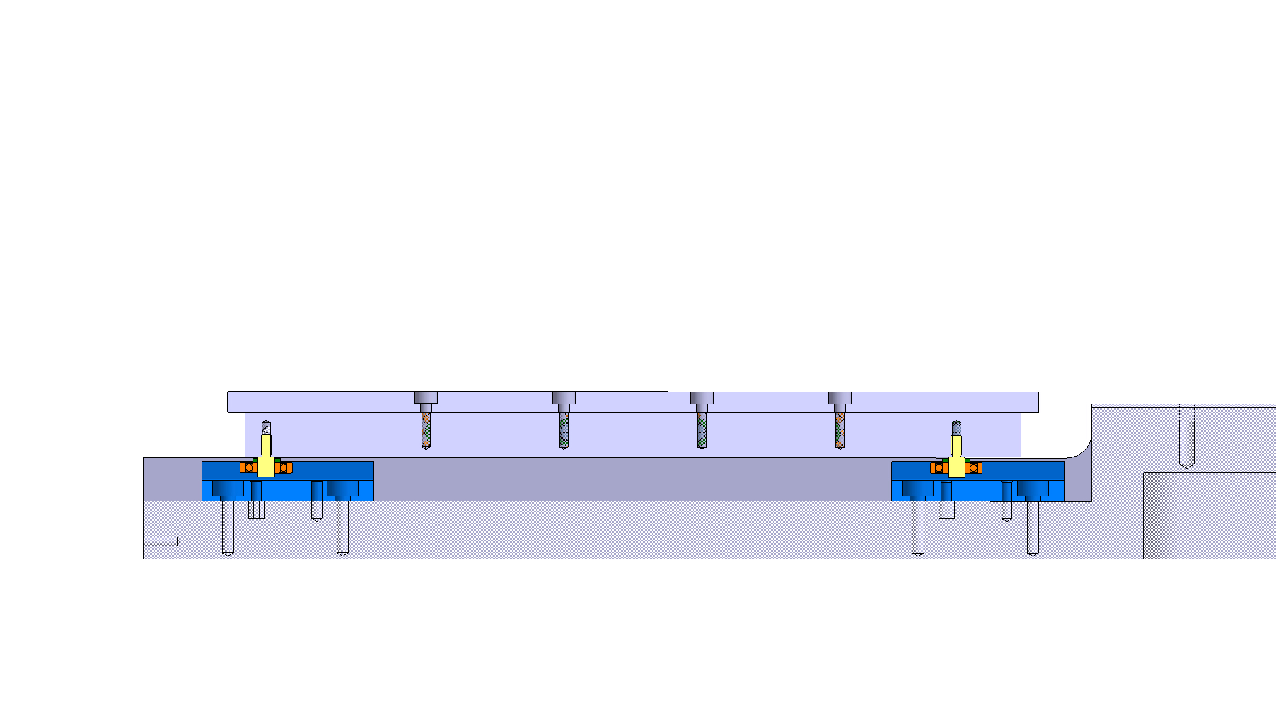
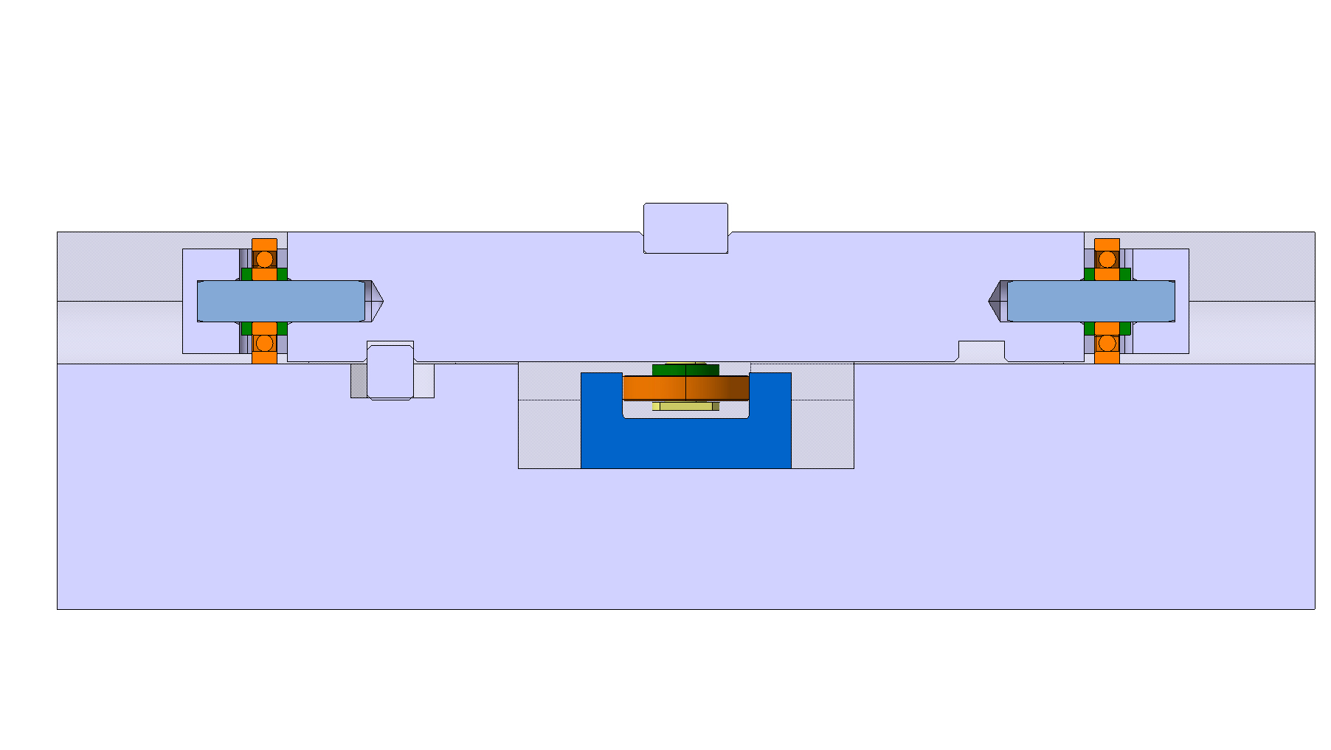
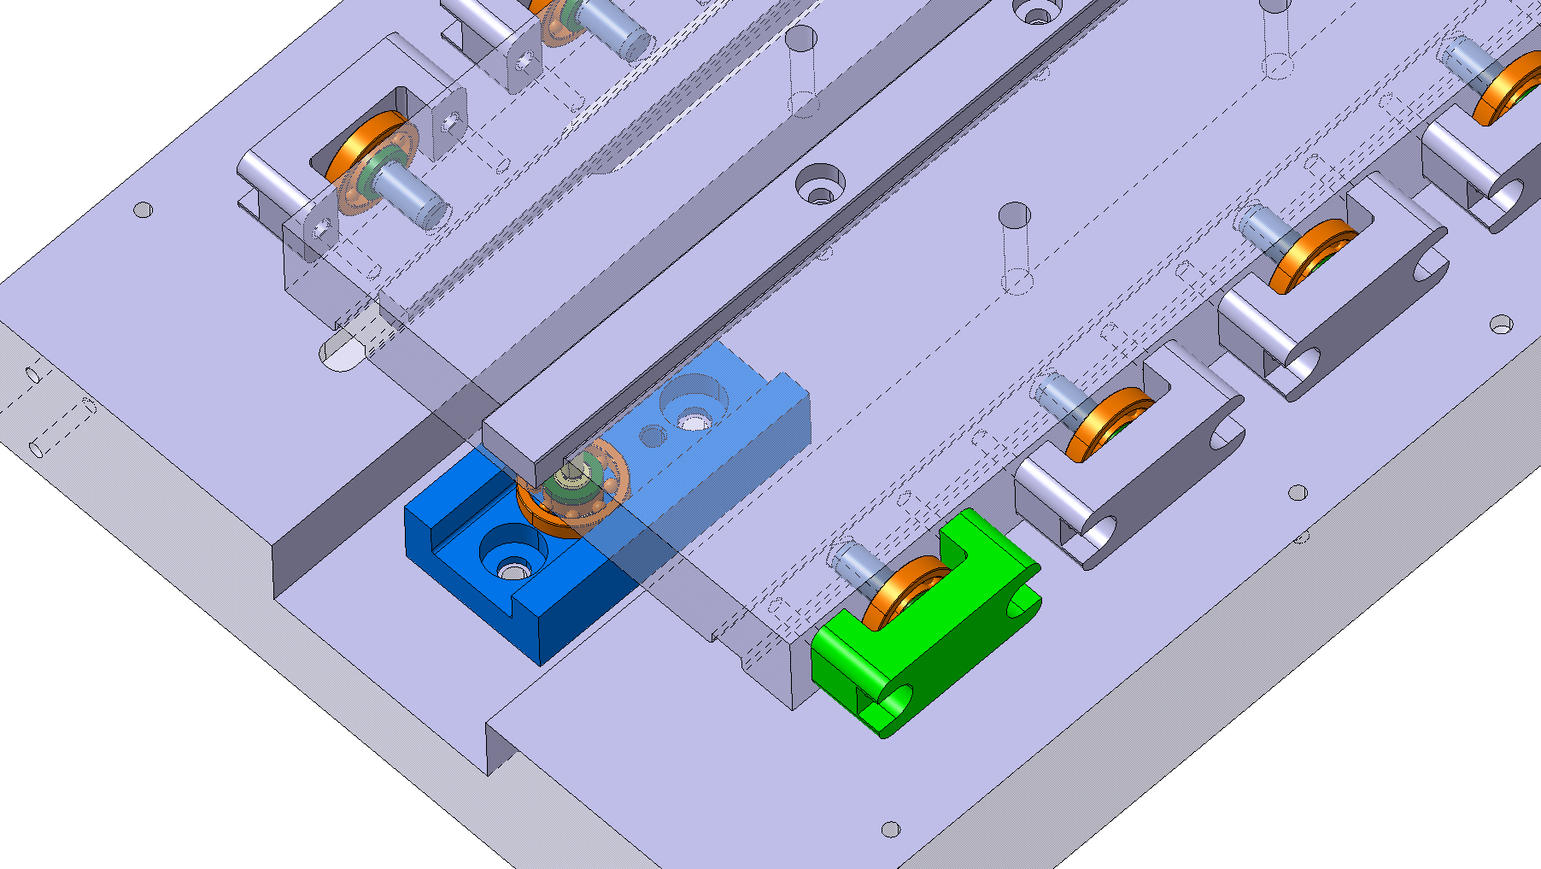
Bearings Reaction Tooling Assy :
Idea n°3:

Slide 6
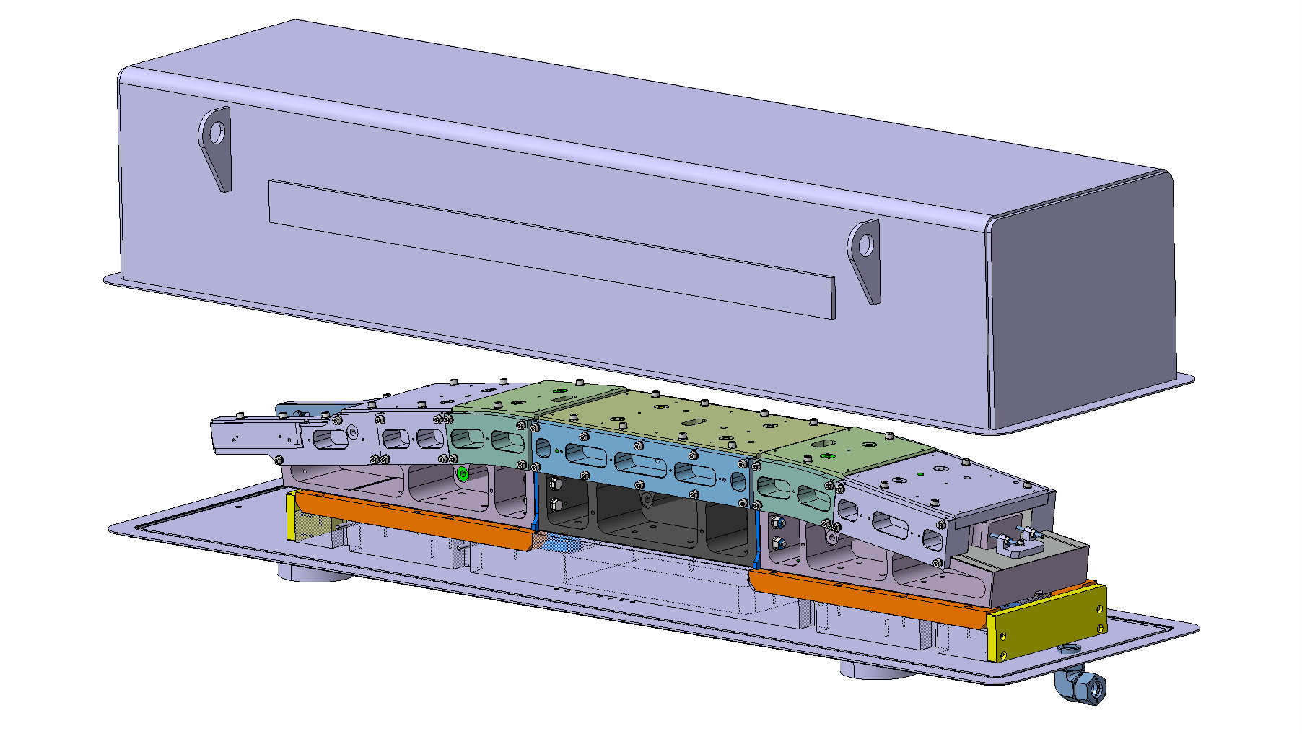
Sarcophagus Reaction Assy :
Idea n°1:

Slide 7
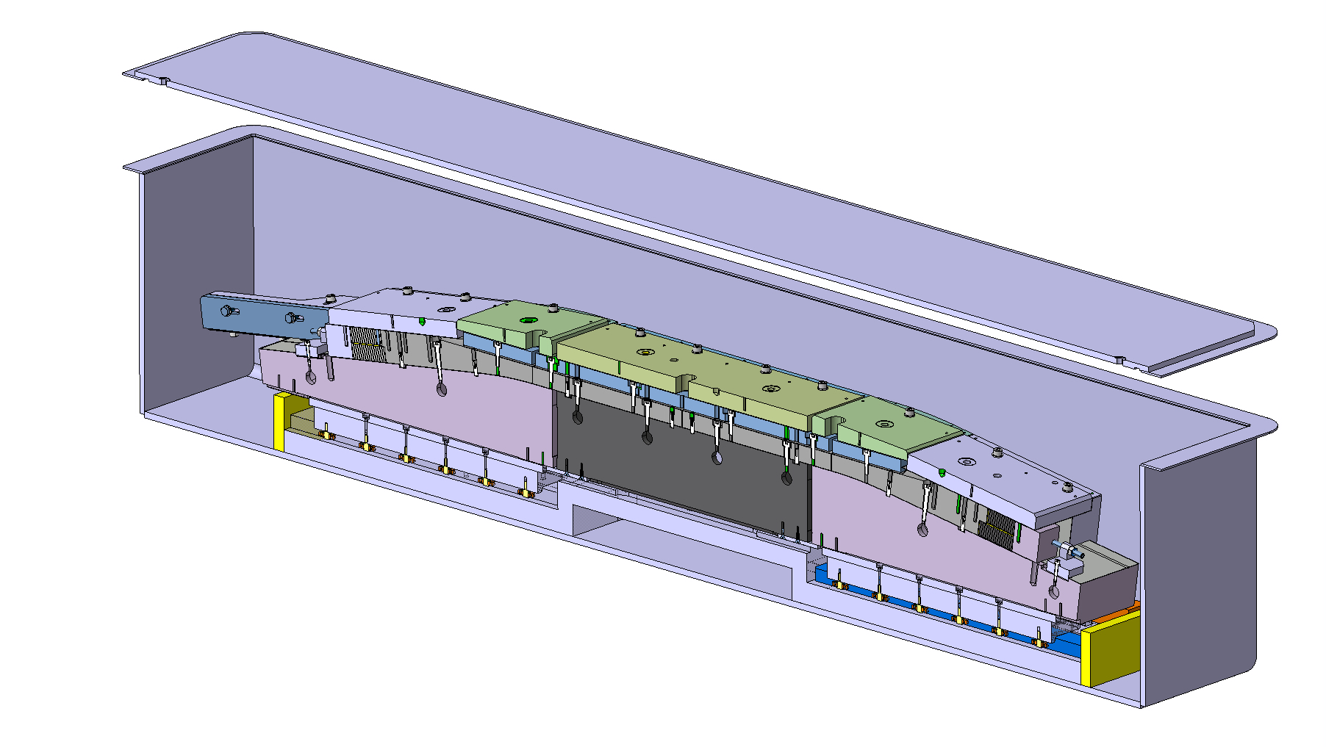
Sarcophagus Reaction Assy :
Idea n°2:

Slide 8
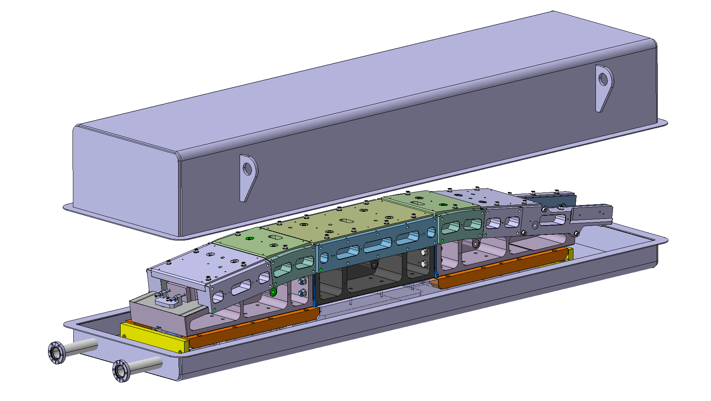
Sarcophagus Reaction Assy :
Idea n°3:

