Slide 1
New Tier-1 EOS node benchmarking and tuning
Geroge Patargias, Tom Byrne

Slide 2
antares-eos26 has been installed with EOS and had its SSD partitioned as EOS FS
Deployed in the default space of the Antares Tier-1 preprod instance
Network tuning has been applied (as per https://fasterdata.es.net/host-tuning/linux/100g-tuning/)
net.core.rmem_max=2147483647
net.core.wmem_max=2147483647
net.ipv4.tcp_rmem='4096 131072 1073741824'
net.ipv4.tcp_wmem='4096 16384 1073741824'
net.core.optmem_max=1048576
net.ipv4.tcp_sack=1
ethtool -G eth0 rx 8192 tx 8192
ethtool -C eth0 adaptive-rx on adaptive-tx on
ethtool -A eth0 rx on tx on
/sys/block/nvme*n1/queue/read_ahead_kb to 8192

Slide 3
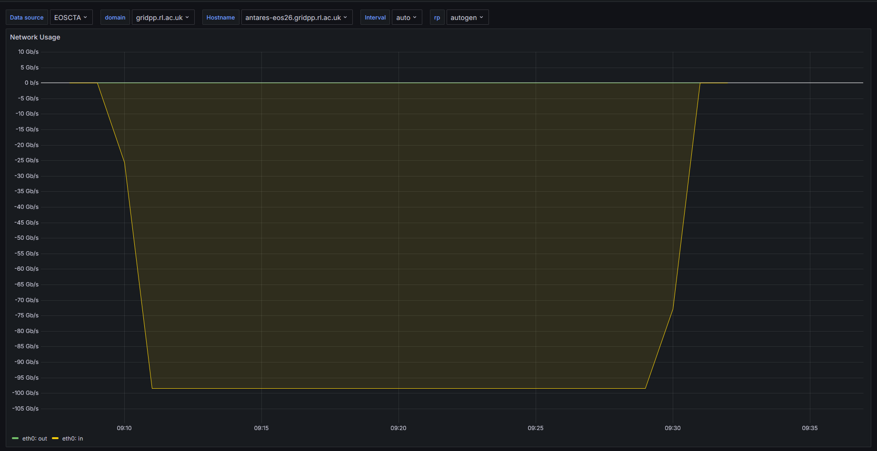
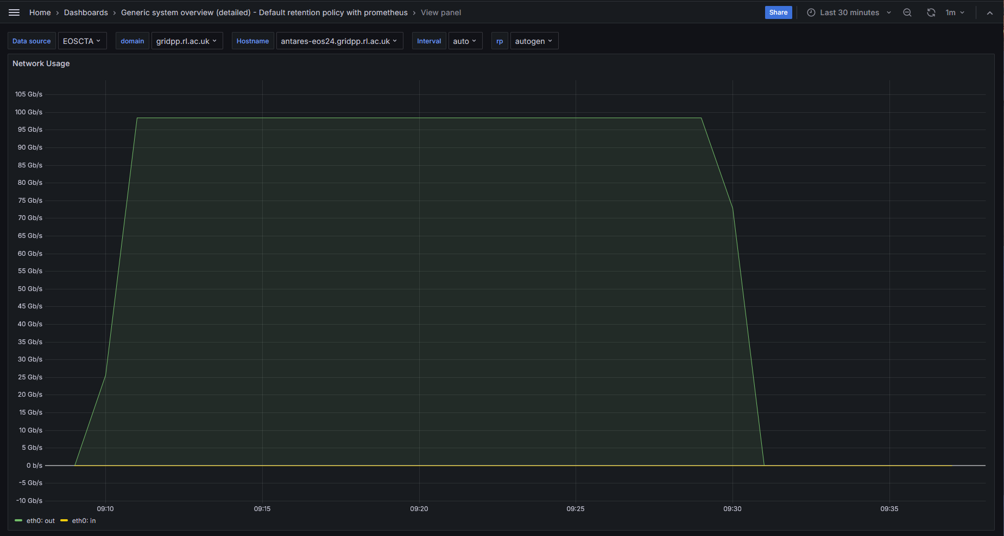
Pure NIC testing
8 x iperf3 transfers from another of the new EOS nodes (antares-eos24) can saturate the100G NIC card of antares-eos26
antares-eos26 (server)
antares-eos24 (client)

Slide 4
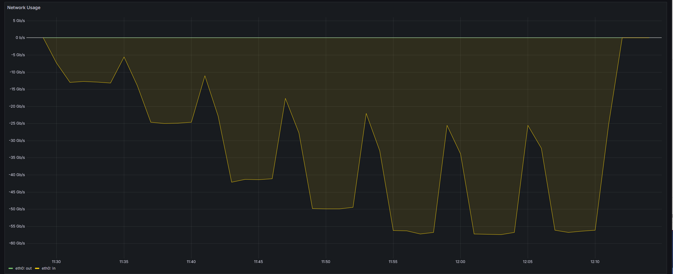
Multiple XRootD transfers
A sweep of 2, 4, 8, 16, 32, 64, 128 XrootD transfers of 10G files initiated from antares-eos24,25 to antares-eos26

Slide 5
Multiple XRootD transfers (writes)
Aggregate performance and individual file rates start degrading after 8 transfers

Slide 6
Multiple XRootD transfers (reads)
Aggregate performance plateaus after 8 transfers to ~98Gb/s

Slide 7
Mixed (50:50) transfers

Slide 8
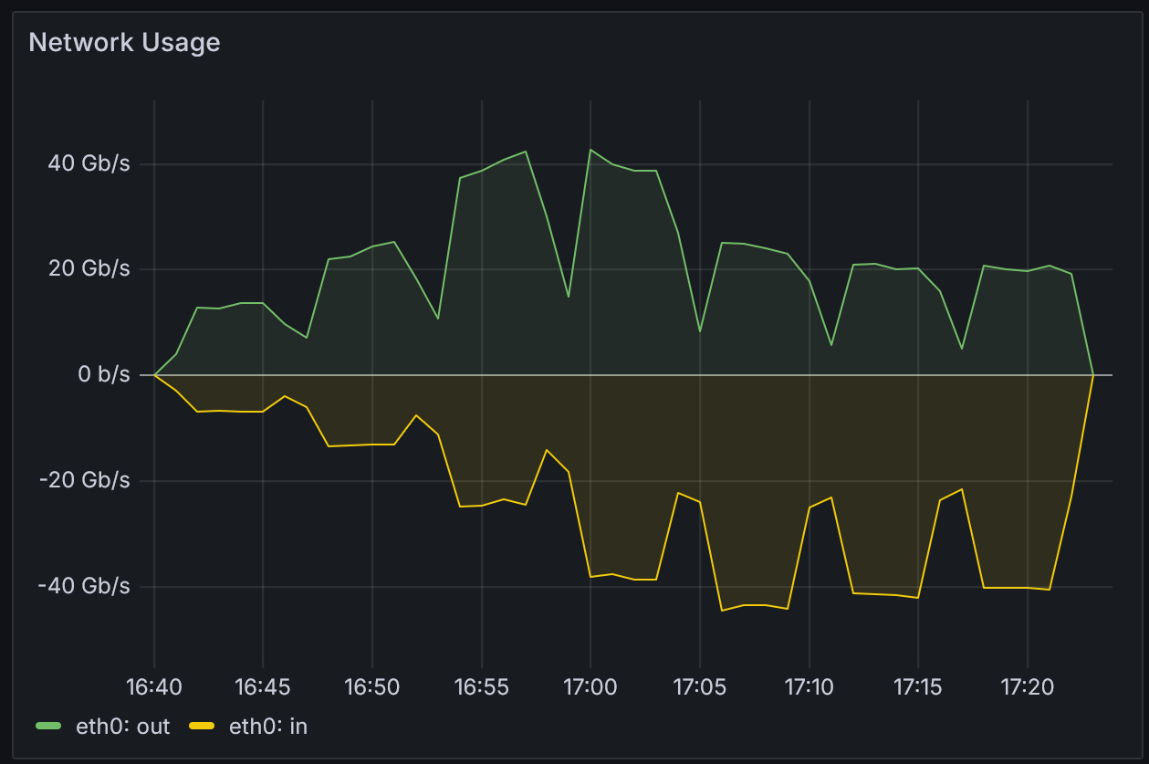
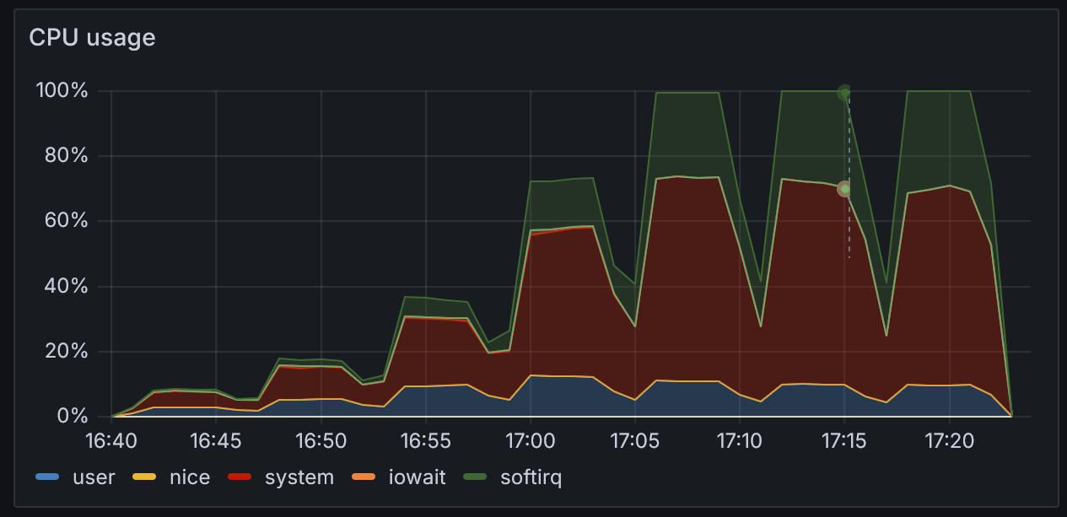
Mixed workload observations
CPU usage maxing out during test from 16 r/w pairs upwards
Minimal IOwait backs up observation of low NVMe utilisation – not a block device limit
A single Epyc 9124 CPU specified for these nodes
  Possibly too few CPU cycles available to achieve 100Gb/s to the NVMes
We can limit the number of transfers to each filesystem (NVMe)
  To ensure maximum throughput, the limit would need to be around 2 open files per NVMe – or ~50 files per space

Slide 9
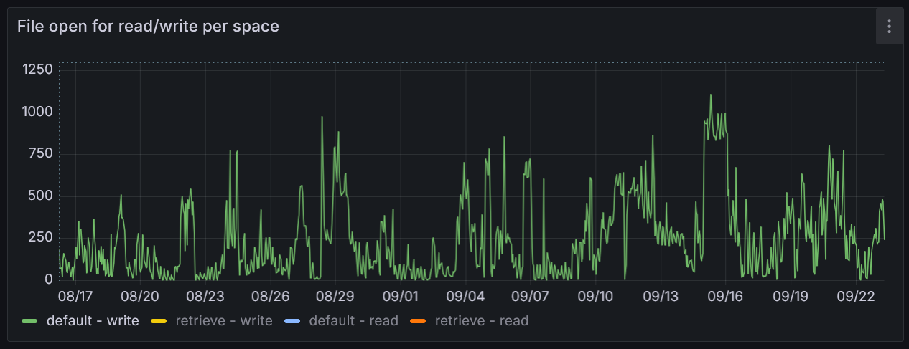
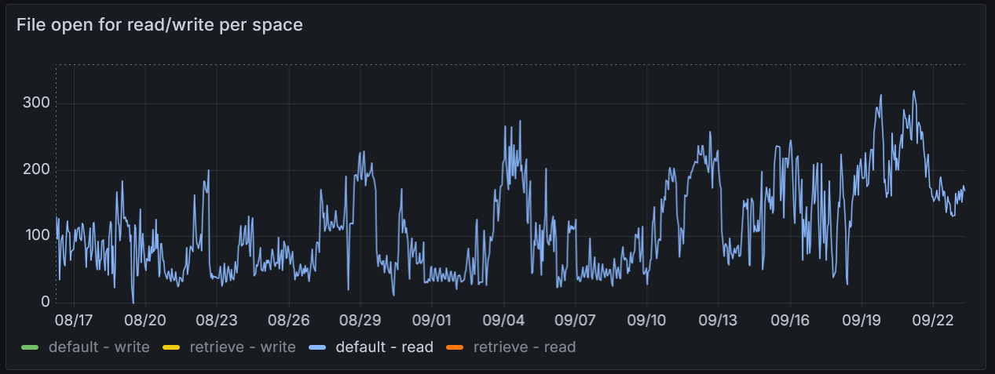
Archive buffer historical open files
Historical data of number of open files in the archival buffer indicates that an open file limit will impact VO write patterns
  and not applying a limit will result in performance drop-off
Data taken from a period of intense archival in summer 2024
Writes (from CERN)
Reads (from tape servers)

Slide 10
(Current) conclusion
The EOS nodes do not have enough CPU to saturate the NIC with mixed reads and writes from the NVMe devices
  It would be useful to be able to test an EOS node with a beefier CPU to confirm this
Complete replacement of Tier-1 EOS buffer with the new hardware is likely to compromise peak archival ingest rates
  Sustained archive rate limits may be <10GB/s
The new EOS nodes have demonstrated enough performance to be added to the existing buffer

