Slide 1
Incoherent effects for FCC-ee

Slide 2
Overview of activities
3 main topics to cover in the following months:
Orbit feedbacks
Noise & power converter ripple
Beam performance & optimizations mainly focusing on LCC optics

Slide 3
Overview of activities
3 main topics to cover in the following months:
Orbit feedbacks
Noise & power converter ripple
Beam performance & optimizations mainly focusing on LCC optics
Global: Sofia, J. Wenninger, D. Alves, A. Calia
IP: Jack
A. Kastrinellis TECH starting in July
Sofia, +?

Slide 4
Orbit feedback

Slide 5
Motivation
Target vertical emittance for FCC-ee in the order of ~1pm, extremely sensitive to:
  Misalignments (static & dynamic)
  Mechanical vibrations
  Technical noise
  Ground motion (spatially correlated or uncorrelated, specific frequency, velocity)
If not mitigated, these effects can result in:
  Reduction of DA, MA → low beam lifetime
  Significant loss of luminosity
  Emittance growth
  Poor injection efficiency
  Beam dumps & reduced machine availability
  ..and many other detrimental effects.
Strategy for orbit correction is essential!

Slide 6
Strategy for orbit correction
Orbit correction needs to combine:
  Global orbit feedback to maintain RMS orbit deviations at ~μm level around the ring
  Local IP feedback to preserve ~nm beam overlap at the IP
  These two systems should operate in parallel but on different timescales
Global orbit feedback must address both static & dynamic perturbations:
  Static random (uncorrelated) misalignments: typically well corrected
  Time varying perturbations (e.g. technical noise, ground motion):
    Frequency sensitivity: Feedback performance strongly depends on its bandwidth. Bandwidth of ≤10 Hz is already ambitious (LHC ~1 Hz).
    Amplitude sensitivity: Even with small perturbations, orbit response can be resonantly amplified due to beam properties e.g. when perturbation wavelength ≈ betatron wavelength (or its harmonics). Large residual orbit even after correction.
    → Realistic time-varying perturbations based on measurements (ground motion, girders contribution) and accurate modeling are essential!

Slide 7
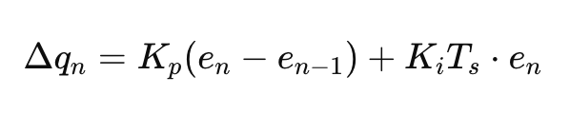
Feedback modeling: Starting from the LHC
A realistic simulation tool is essential: accurately reproduce feedback behavior under realistic scenarios & validate against measurements before deploying to FCC
  LHC is the ideal case as it has a state-of-the-art feedback system that is currenty operational.
Steps are:
  Inject orbit perturbations in the lattice
  Simulate PI feedback loop including delays:
    BPM sampling → orbit reconstruction → SVD inversion→
    apply proportional & integral gain → correction ramp
  Assess correction efficiency across various scenarios
  Scan perturbation characteristics (frequency, amplitude, wavelength..) to quantify feedback performance & identify limits
  Benchmark model against LHC data

Slide 8
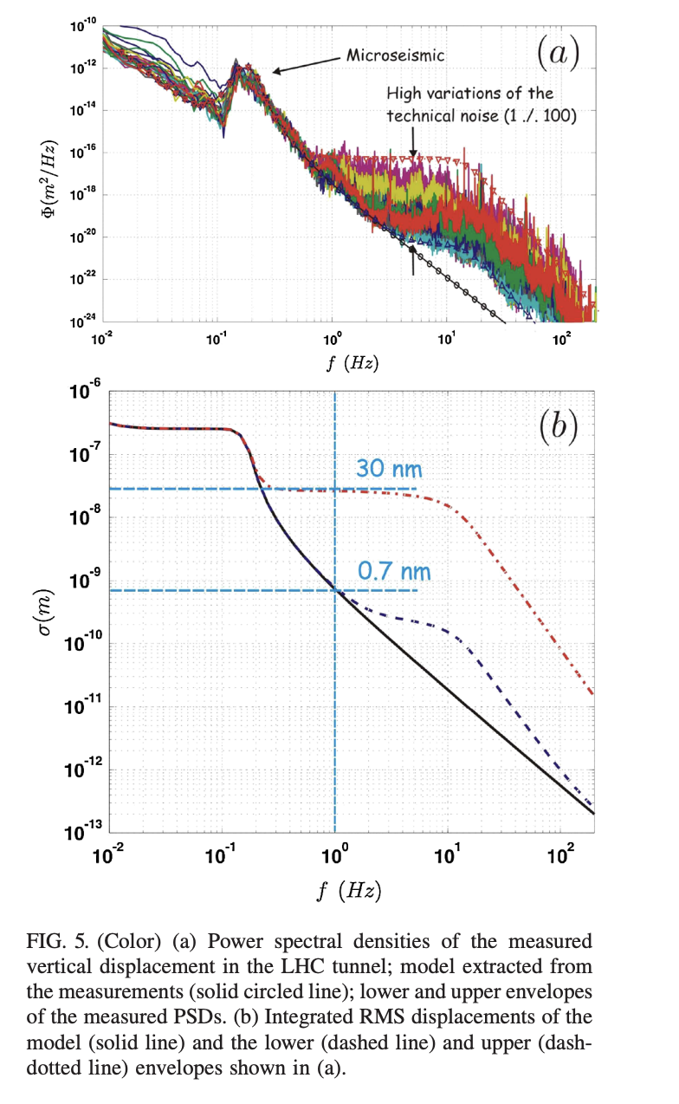
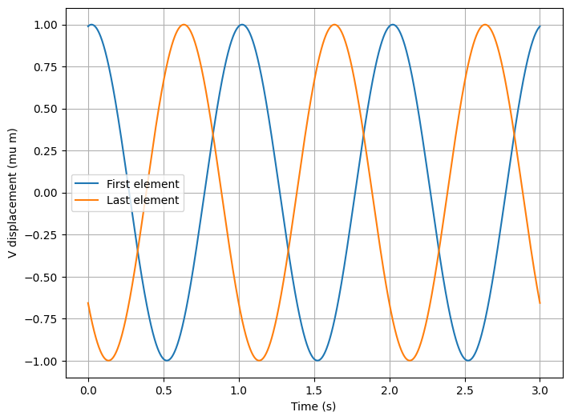
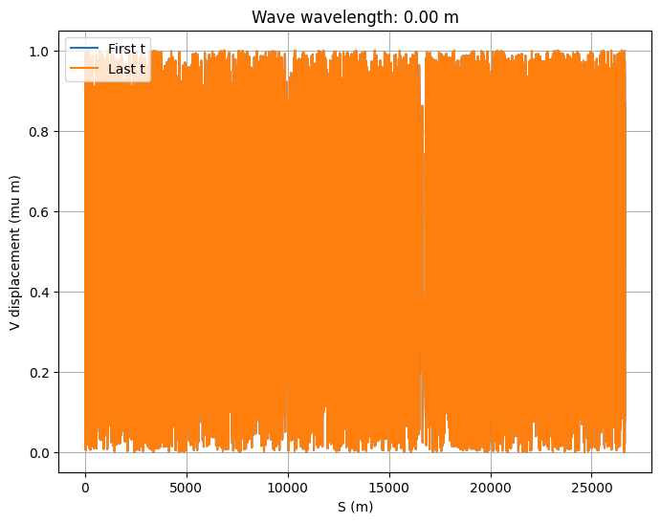
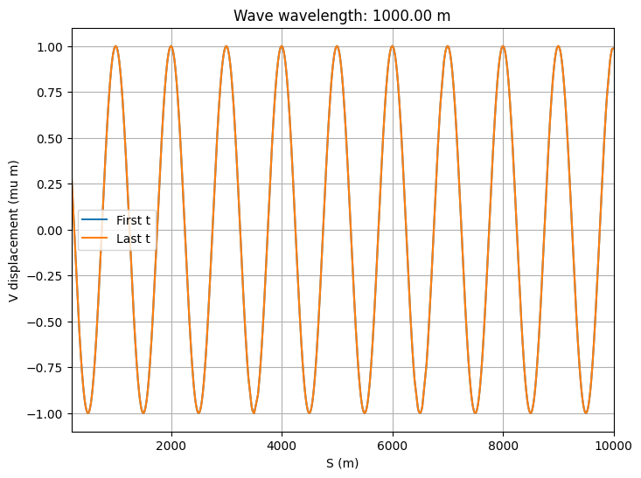
Feedback modeling: Starting from the LHC
Inject orbit perturbations in the lattice
  Random static misalignments along the ring
  Correlated/uncorrelated ground motion with specific frequency
  Orbit perturbations extracted by measured PSD in LHC tunnel
Correlated ground wave
with specific f and propagation velocity
Random static misalignments distributed in the ring
Measurements show coherence mainly in microseismic range (~0.17 Hz), uncorrelated for higher frequencies
LHC tunnel measurements of ground motion

Slide 9
Feedback modeling: Starting from the LHC
Simulate feedback loop including delays:
  Closed orbit reconstruction (~2ms minimum time):
    From ~560 BPMs.
    In operation, averaging turn-by-turn data over a 50 Hz period.
  Correction calculation (~20ms):
    Precompute transfer linear response matrix.
    SVD inversion and compute correction using ~500 correctors to minimize RMS orbit deviations from reference.
    Number of eigenvalues varies depending on beam mode (larger number → better correction but increased sensitivity to BPM noise).
    Correction is scaled by gain factor to avoid feedback becoming unstable. Correction converted from angle (kick) to current. Corrections are clipped if they exceed maximum PC current.
  PC regulation (~20ms):
    Correction is sent to the corrector power converters
    Ramp current based on regulation parameters (~0.5 A/s).
→ Total LHC feedback cycle: ~42ms feedback cycle in total (~24 Hz).

Slide 10
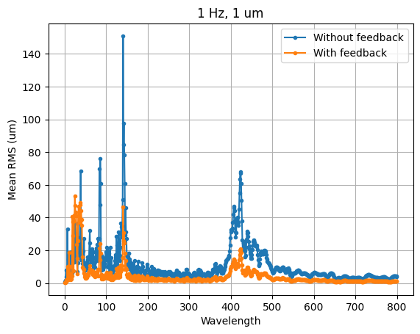
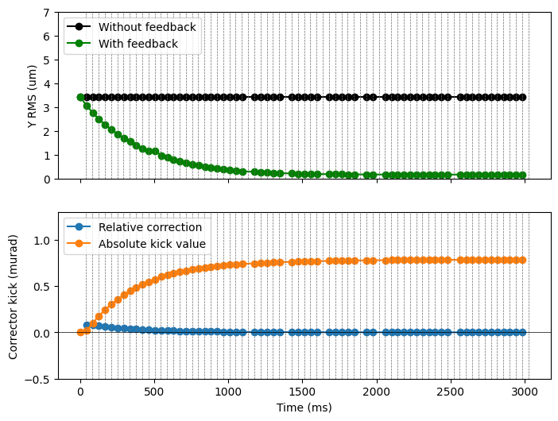
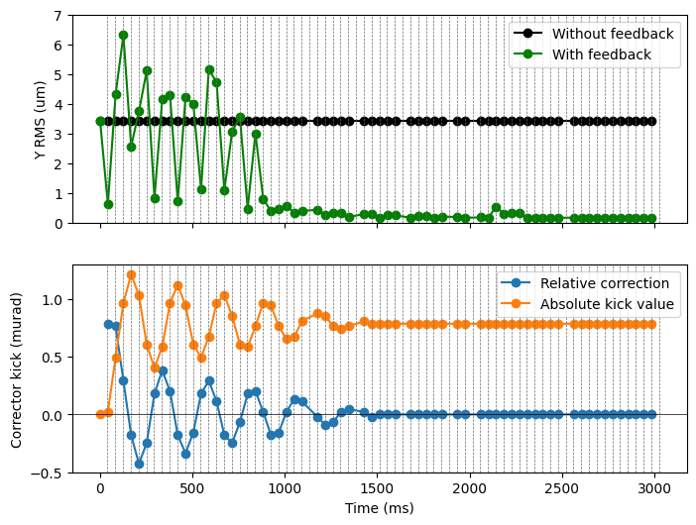
Feedback modeling: Starting from the LHC
Assess correction efficiency across various scenarios
Ground motion,
sensitivity to wavelength
Correction of static misalignments
Gain = 0.1
Ramping PC
Gain = 1
Ramping PC

Slide 11
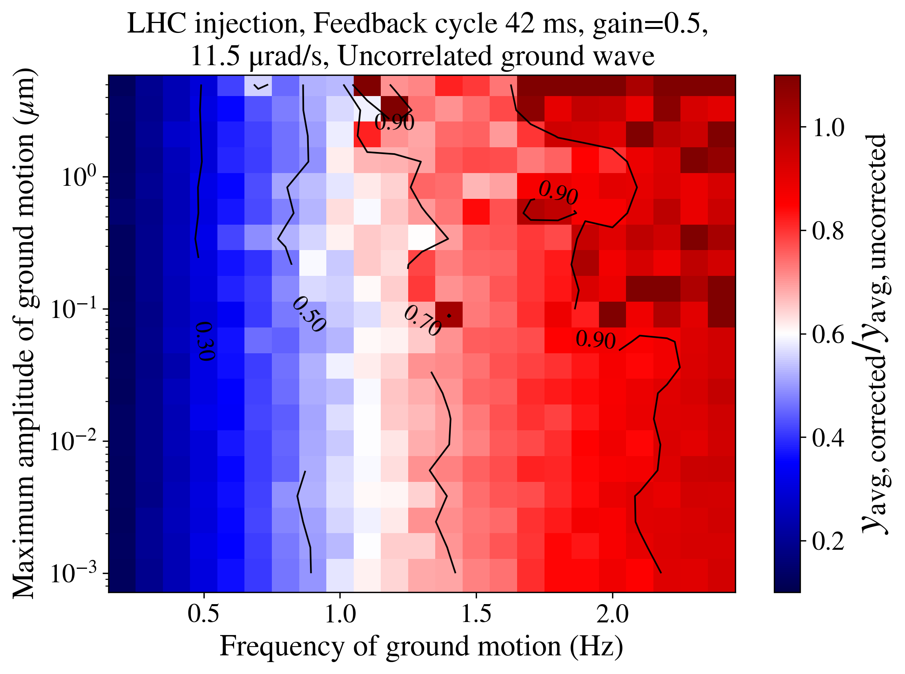
Feedback modeling: Starting from the LHC
Scan perturbation characteristics (frequency, amplitude, wavelength..) to quantify feedback performance & identify limits
Feedback bandwidth

Slide 12
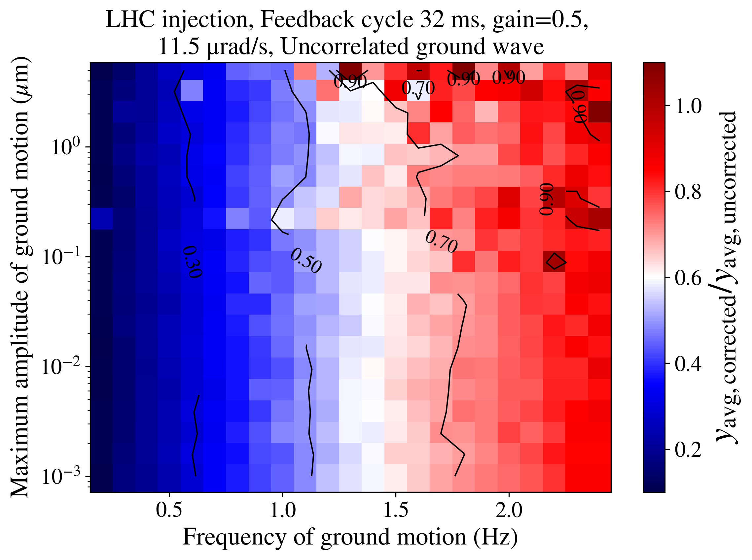
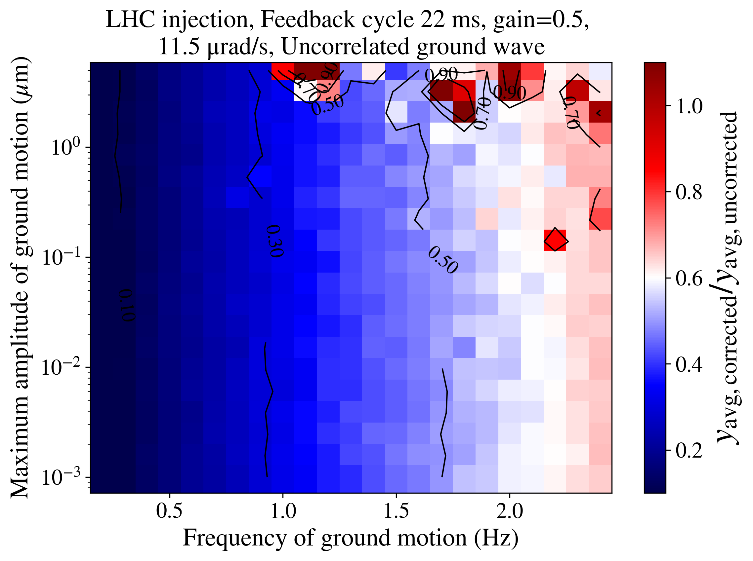
Feedback modeling: Starting from the LHC
Scan perturbation characteristics (frequency, amplitude, wavelength..) to quantify feedback performance & identify limits
Extending bandwidth to higher frequencies
22 ms cycle
10 ms faster correction computation
10 ms faster PC regulation
32 ms cycle
10 ms faster correction computation
42 ms cycle

Slide 13
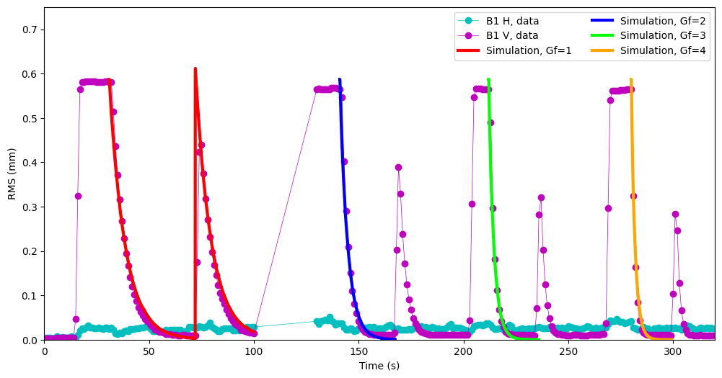
Benchmark model against LHC measurements

Slide 14
Lessons learned for FCC-ee
Defining required bandwidth for global orbit feedback: Extending beyond ~1 Hz will require minimizing the total feedback cycle time:
  Fast orbit reconstruction.
  Reduce correction computation time.
  Minimize communication time between feedback and power converters.
  Faster corrector response through higher ramp rate.
A large machine such as FCC-ee might require a distributed feedback architecture instead of centralized, which would add additional complexities.
For correlated ground motion, orbit response & feedback performance will strongly depend on wavelength and betatron motion.
Need to optimize feedback parameters (gain, trade-off between number of eigenvalues and BPM noise, feedback correction algorithm).

Slide 15
Noise & power converter ripple

Slide 16
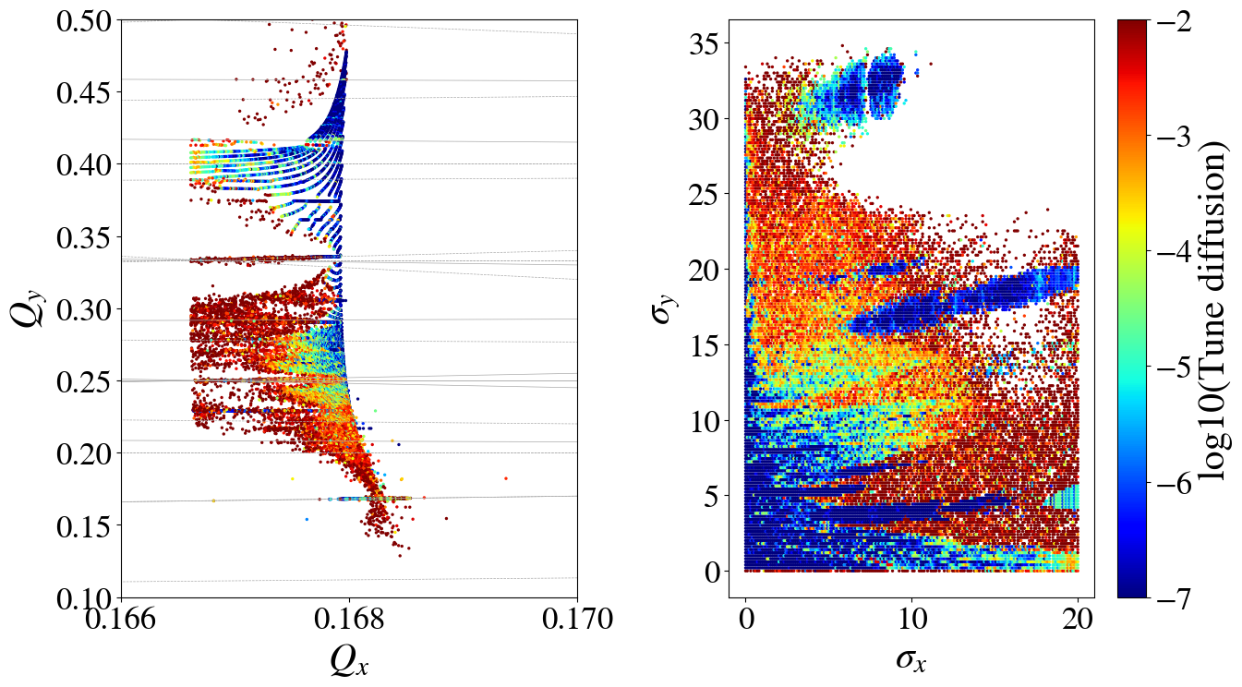
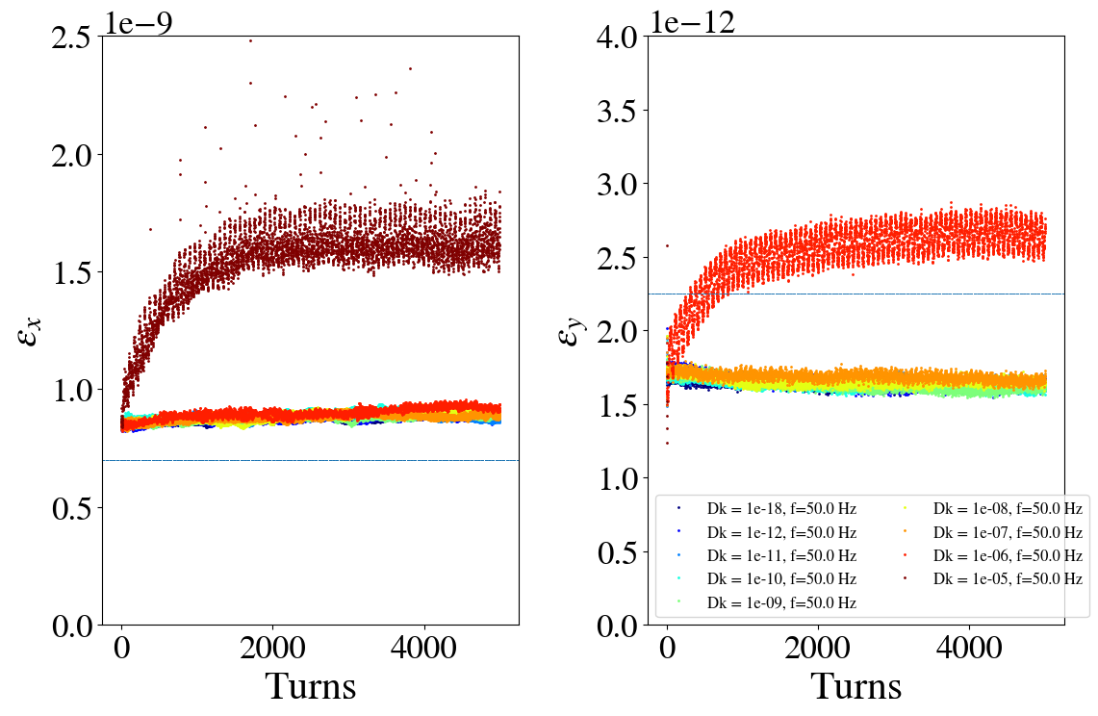
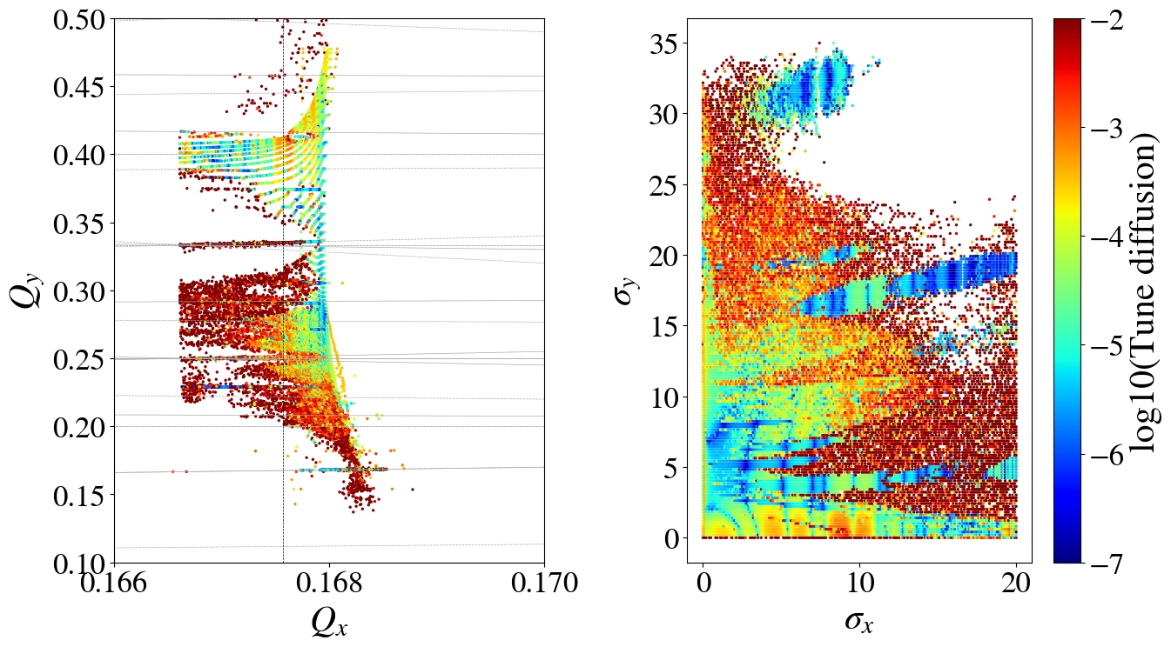
Noise studies
Noise studies include:
  Power supply ripple
  White noise (e.g. transverse feedback)
Noise impacts beam performance by introducing additional resonances and increasing tune diffusion: emittance blowup, losses, loss of luminosity etc.
Goal: determine maximum tolerated magnetic field ripple from beam quality requirements (ABP) and derive corresponding current/voltage ripple specifications from that (EPC). Outcome should be frequency dependent ripple specifications for various PC and make sure that all ripple remains inside this envelope.

Slide 17
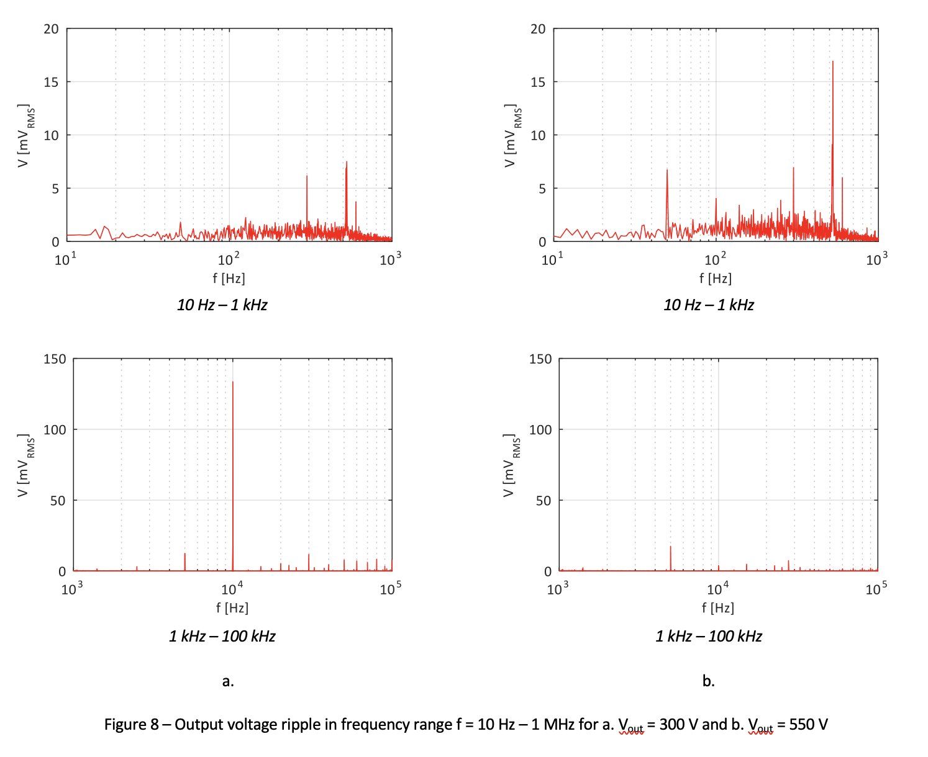
Noise studies
Switch mode power supplies: some components at 50, 100, 150, 300, 600 Hz & switching frequency (note that betatron tune is around 500-600 Hz). Switching frequency can be increased if needed to avoid perturbing beam spectrum (at the expense of higher cost).
At the moment, all power converters are considered class 4 for cost estimations and there is no redundancy.
To be noted that 700/2300 power supplies at SuperKEKB are class 0.
300 V
550 V
Up to ~130 mV 1-10 kHz
Up to ~20 mV 10-1 kHz

Slide 18
Noise studies
Switch mode power supplies: some components at 50, 100, 150, 300, 600 Hz & switching frequency (note that betatron tune is around 500-600 Hz). Switching frequency can be increased if needed to avoid perturbing beam spectrum (at the expense of higher cost).
At the moment, all power converters are considered class 4 for cost estimations and there is no redundancy.
To be noted that 700/2300 power supplies at SuperKEKB are class 0.
FCC-ee is not a ramping machine, heavy filtering can be applied in the output of the power supplies.
Need to define sensitivity of beam to power supply ripple:
  Which circuits are more critical.
  If specific powering and circuit organization can mitigate the problem
  Focusing first on doublet (no specifications for power converters yet, most critical due to large beta-functions), dipole circuits and sextupoles (largest cost in terms of powering for GHC lattice).
  Define which power converters are more critical for redundancy.

Slide 19
Beam performance optimizations with LCC lattice

Slide 20
Beam performance optimizations for LCC lattice
Most studies including important non-linearities such as beam-beam have focused on GHC lattice.
Evaluate DA, MA, lifetime, emittance for LCC lattice
Will help with the comparison between the two optics.
Connects well with studies for other machines (e.g. HL-LHC), tutorial for LCC lattice in the following months by P. Raimondi in Ghislain’s meetings, developments of LCC optics in Xsuite.

