Slide 1
Beam coupling impedance studies

Slide 2
Beam coupling impedance studies
Analytical models
EM simulations
Main challenges for impedance:
Build a complete model with limited design info
Optimization of collimators impedance
Definition of impedance budget
  Multi-bunch studies (tune shift, working point and filling scheme considerations)
Bench or beam
measurements
IW2D, TLwall
CST, ABCI, ECHO3D,
Wakis (GitHub link)
Impedances: wall, collimators, cavities, BPMs, bellows, tapers
IMPEDANCE/WAKE MODEL
Update of the model to reflect improvements and design evolution
Beam dynamics simulations (Xsuite-PyHEADTAIL)
Single bunch TMCI threshold
Figure of merit for impedance assessment
Multi-bunch feedback system
Simulations with Beam-Beam
X. Buffat and team

Slide 3
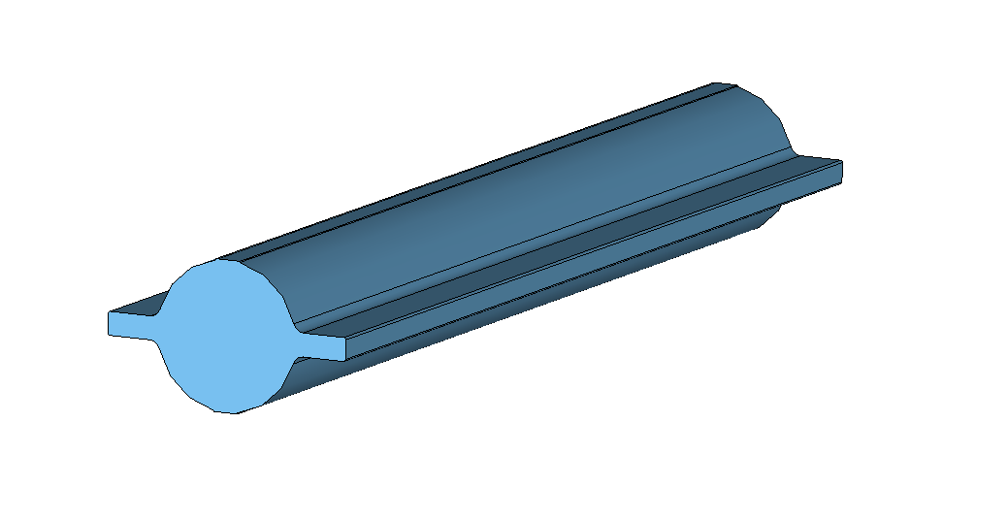
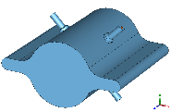
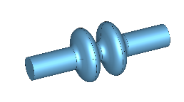
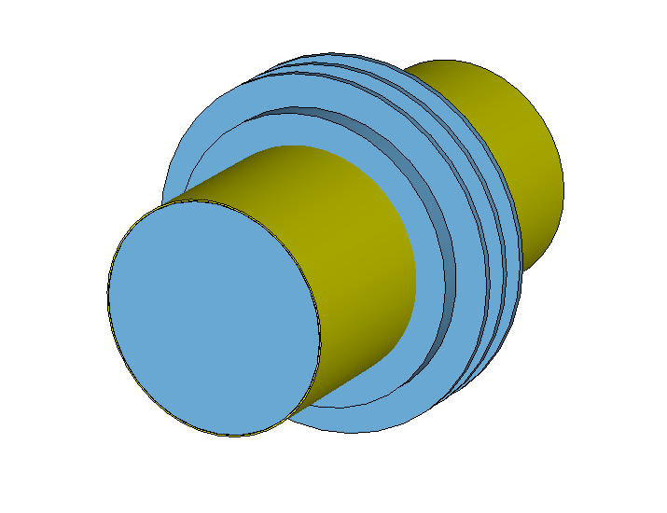
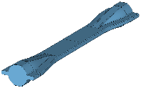
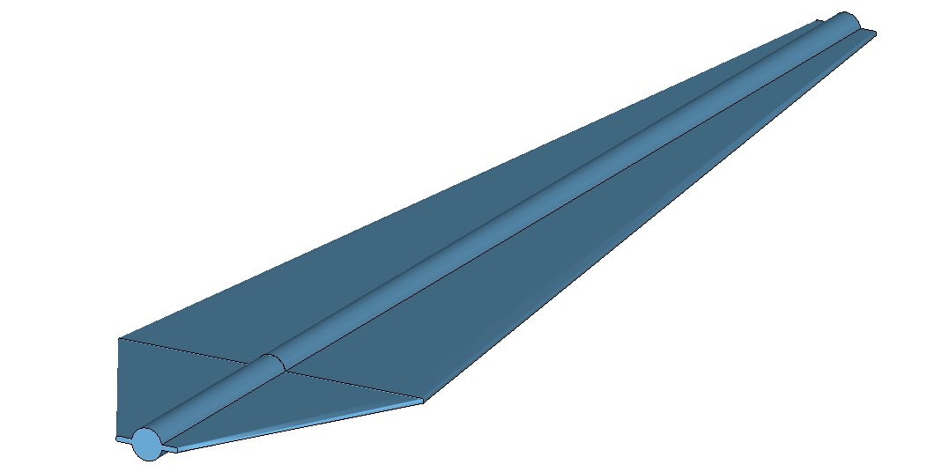
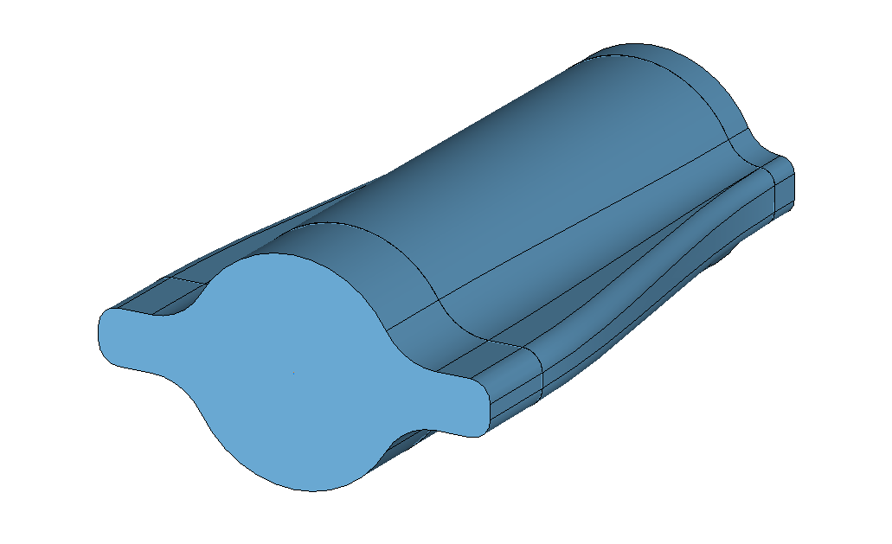
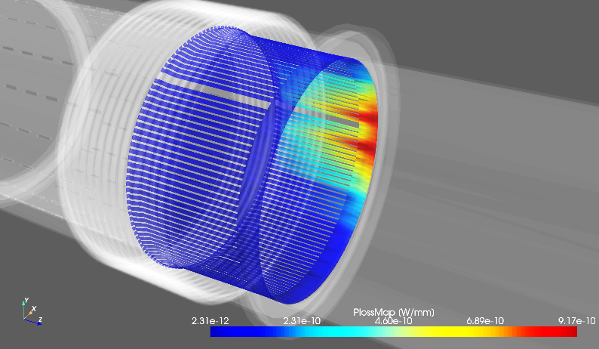
Impedance optimization
Impedance optimization of accelerator elements is crucial to avoid
  Beam instabilities
    Machine impedance
  Equipment degradation and damage
    Beam induced heating
    Beam induced sparking

Slide 4
Impedance optimization
Impedance optimization requires the knowledge of the knobs to manipulate the impedance
Having simplified formulas to master the main dependencies
Step by step simulation to have a deep understanding of the impedance mechanism
Impedance evaluation
Beam induced power
Power loss map
Combining 3D simulations and BIHC results
Simulations, analytical models, measurements
Established calculation tool BIHC https://github.com/ImpedanCEI/BIHC
Impedances are included in the global impedance model
for beam dynamics assessments and energy loss budget considerations
Design optimization

Slide 5


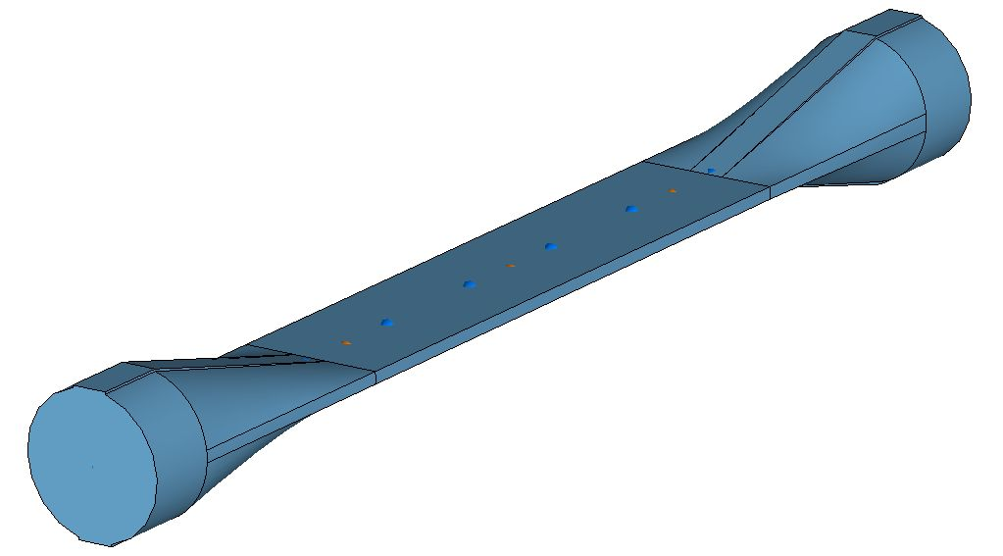

FCC-ee impedance challenges
Challenging simulation regime
  Combination of large beam pipe dimensions and short bunch lengths
    Very high number of mesh cells.
~3000 bilion mesh cells
~3 bilion mesh cells
~15 bilion mesh cells
Ad-hoc developments in the open source wakefield solver Wakis are ongoing to address this simulation challenge efficiently https://github.com/ImpedanCEI/wakis/

Slide 6
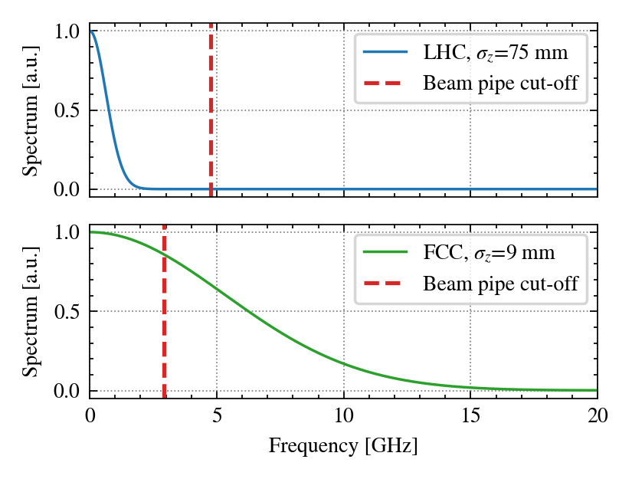
FCC-ee impedance challenges
Normalized spectrum envelope
The beam pipe cut-off lies well within the relevant frequency spectrum.
  Several modes above cut-off are strongly excited, leading to significant crosstalk between different accelerator elements.
    Particularly relevant for long range wakefield and beam induced power assessment
  Multiple modes can propagate along the accelerator. Should we consider implementing ad-hoc devices to absorb the propagating power?
Courtesy of L. Sito

Slide 7

Beam induced power
Power loss map
Impedance evaluation
Beam induced power
Combining 3D simulations and BIHC results
Simulations, analytical models, measurements
Established calculation tool BIHC https://github.com/ImpedanCEI/BIHC
Total number of particles in the beam
Longitudinal impedance
Revolution frequency of particles
Normalized beam spectrum
Input for equipment owner to assess risks due to beam induced power level

Slide 8
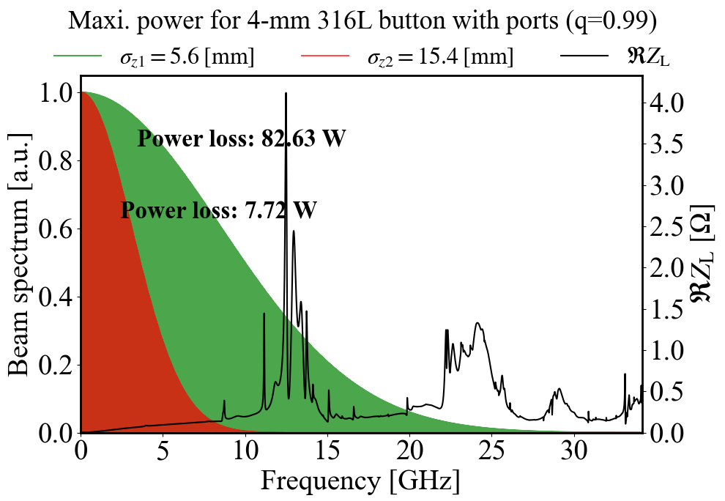
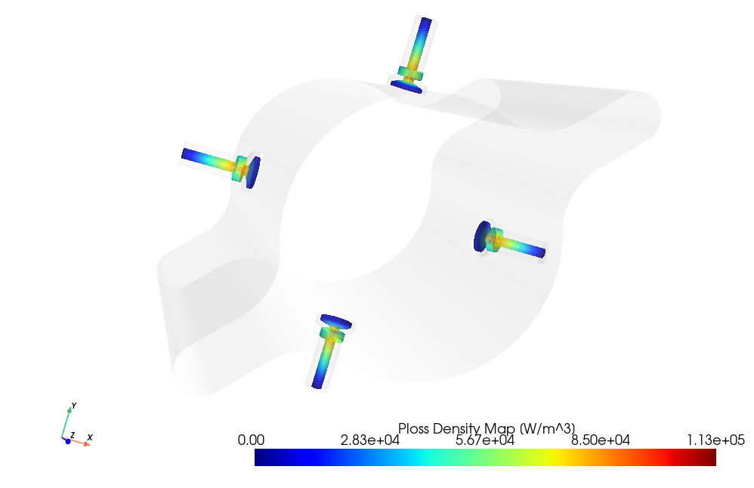
Beam induced power: the FCC-ee BPM example
Beam induced power loss map obtained combining the effect from all modes is provided to equipment owner for thermo-mechanical assessment
Courtesy of J. Li and E. De la Fuente

Slide 9
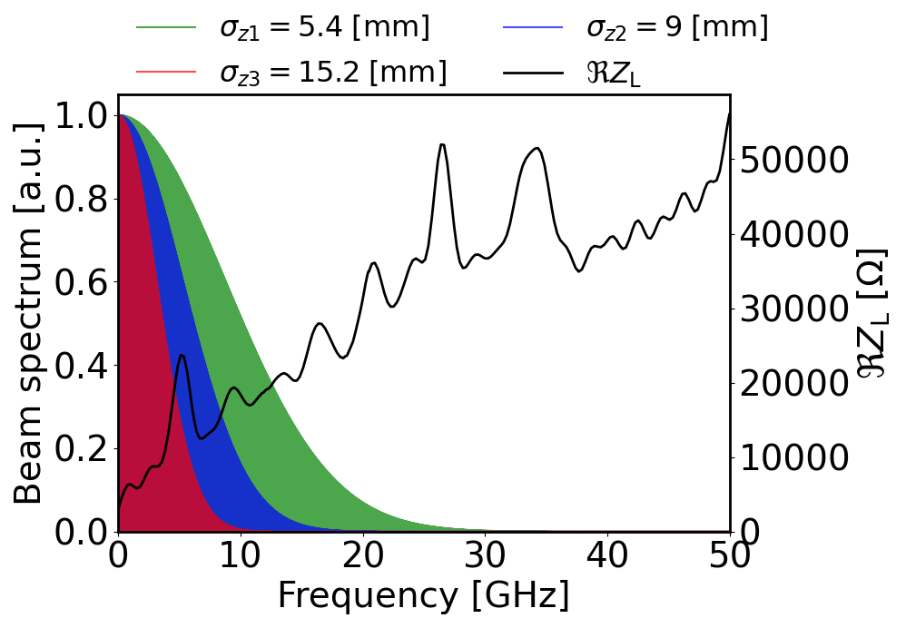
Total beam induced power from impedance
Z configuration
Beam induced power from impedance
with the latest impedance model
1.8 MW at 15.2 mm bunch length
4.2 MW at 9 mm bunch length
9 MW at 5.4 mm bunch length
Courtesy of J. Li
Energy loss per turn from SR 0.039 GeV
SR power for the full beam ~50 MW
Impedance beam induced power from ~4% to ~20% of SR power depending on bunch length

Slide 10
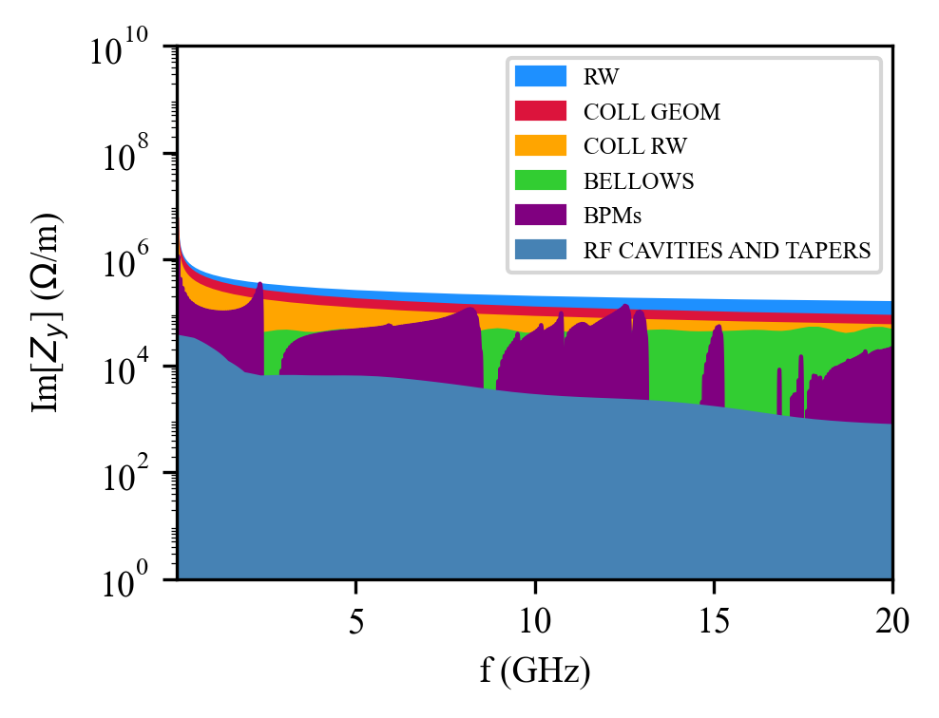
FCC-ee impedance budget
Status of the impedance/wake model
Accelerator element | Model status | Evaluation method
Beam pipe (RW) | Advanced | Analytical (IW2D)
Collimator RW | Initial | Analytical (IW2D)
Collimator geom. | Initial | 3D simulations
Bellows | Initial | 3D simulations
BPMs | Initial | 3D simulations
RF cavities+tapers | Initial | 3D simulations
Polarimeter | Initial | 3D simulations
Stripline kickers | Initial | 3D simulations
Chamber transitions | Initial | 3D simulations
Courtesy of D. Gibellieri
Follow-up design evolution ensuring impedance optimization and update models accordingly
Inclusion of additional elements (e.g. injection and extraction devices)

Slide 11
Overview on collective effects for the main rings
With the current impedance model, the vertical plane shows an instability threshold close to the nominal beam intensity.
Feedback system and chromaticity help, but vertical instability remains critical.
Still some missing impedance sources and several devices in the initial design phase.
Interplay with beam-beam and beamstrahlung must be considered in the future.
x-plane
y-plane
Courtesy of M. Migliorati
Wake with reduced collimators’ geometric contribution.
Chromaticity = 5
Feedback system on 4 turns

Slide 12
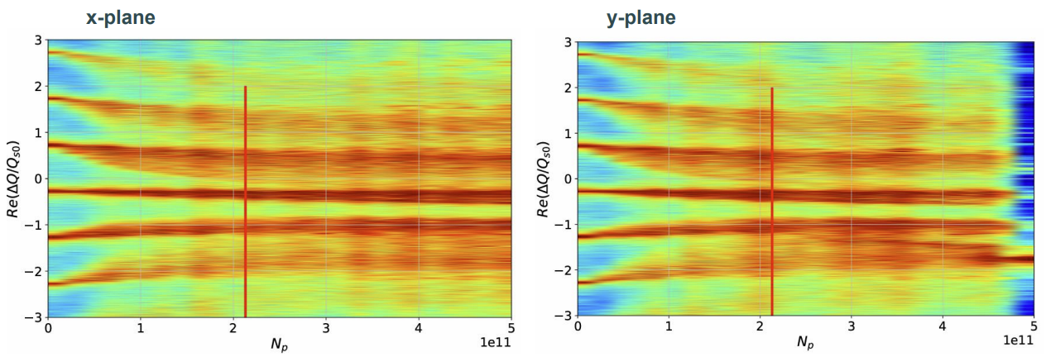
Overview on collective effects for the main rings
With the current impedance model, the vertical plane shows an instability threshold close to the nominal beam intensity.
Feedback system and chromaticity help, but vertical instability remains critical.
Still some missing impedance sources and several devices in the initial design phase.
Interplay with beam-beam and beamstrahlung must be considered in the future.
Courtesy of M. Migliorati
Wake with reduced collimators’ geometric contribution.
Chromaticity = 20
Feedback system on 4 turns

Slide 13
Overview on collective effects for the main rings
With the current impedance model, the vertical plane shows an instability threshold close to the nominal beam intensity.
Feedback system and chromaticity help, but vertical instability remains critical.
Still some missing impedance sources and several devices in the initial design phase.
Interplay with beam-beam and beamstrahlung must be considered in the future.
x-plane
y-plane
Courtesy of M. Migliorati
Wake with non optmized collimators’ geometric contribution.
Chromaticity = 20
Feedback system on 4 turns

Slide 14
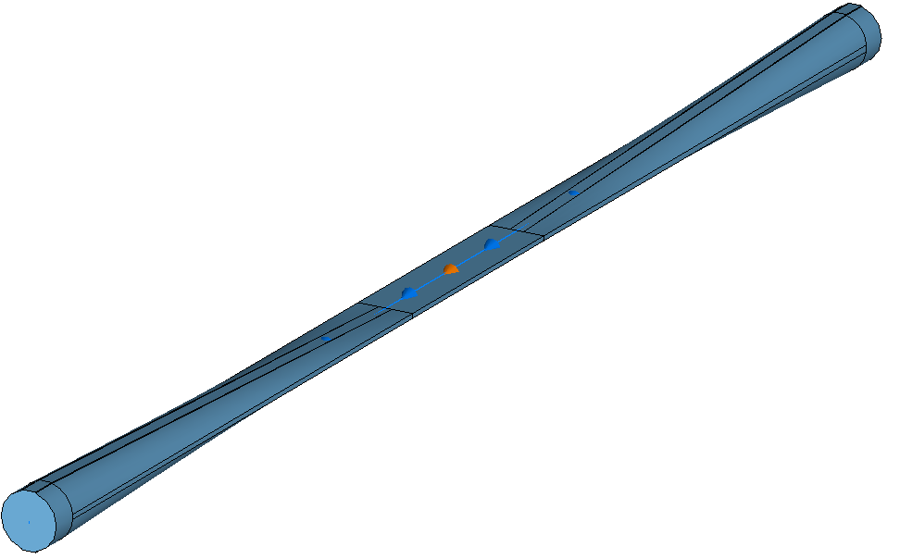
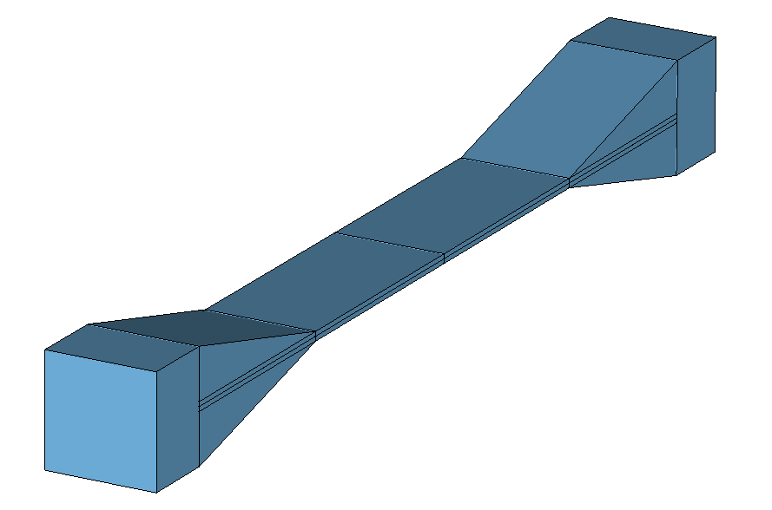
Impact of Collimator Geometric Impedance
Since the geometrical contribution of the collimators has been identified as the primary source of impedance, an optimization of the taper angle for all vertical collimators has been proposed, reducing it from 15 degrees to 2.5 degrees. The most recent optimization refers to latest collimators design.
Courtesy of D. Gibellieri
tcp.v.b1
Coll. length = 250 mm
Taper length = 110mm
Taper angle = 15 degrees
tcp.v.b1
Coll. length = 250 mm
Taper length = 630 mm
Taper angle = 2.5 degrees
It is worth noting that the achievable taper angle could be limited by spatial and mechanical constraints

Slide 15
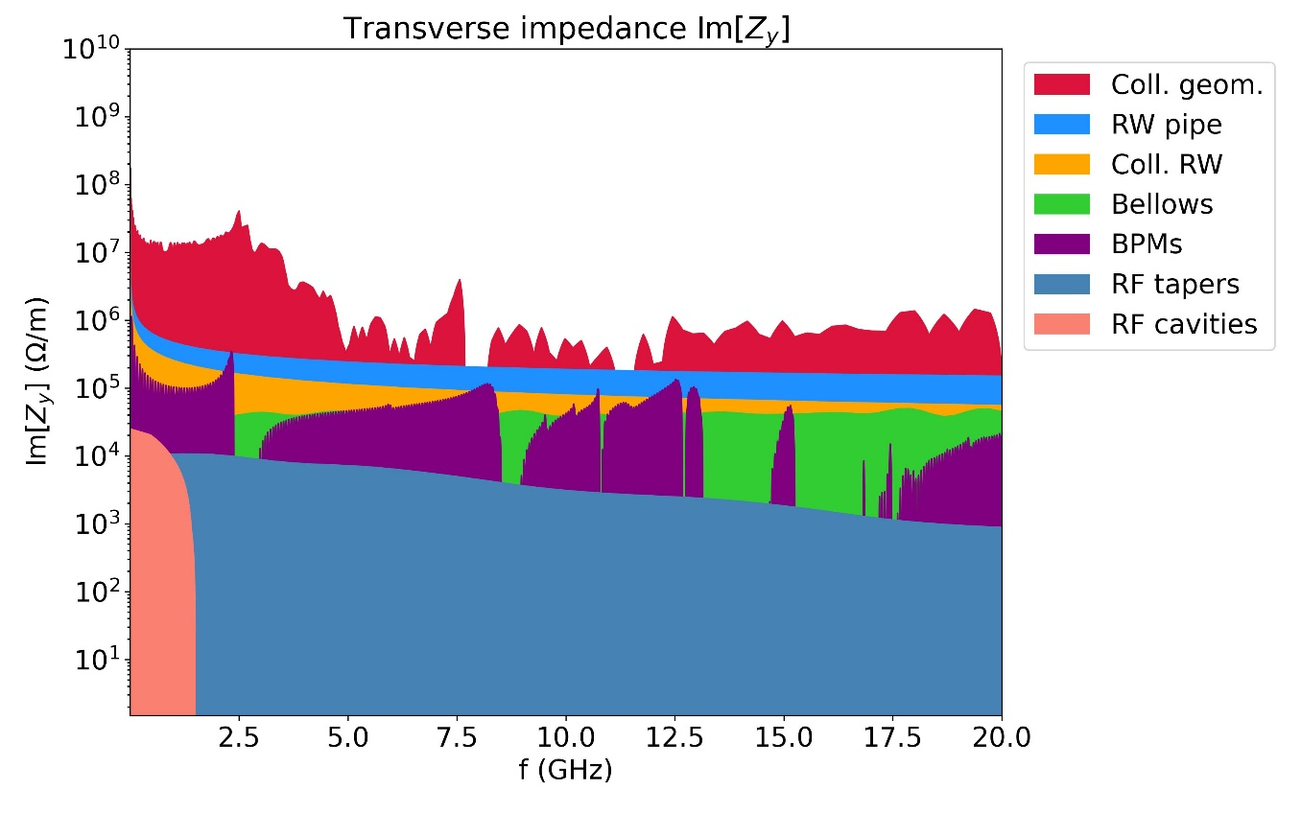
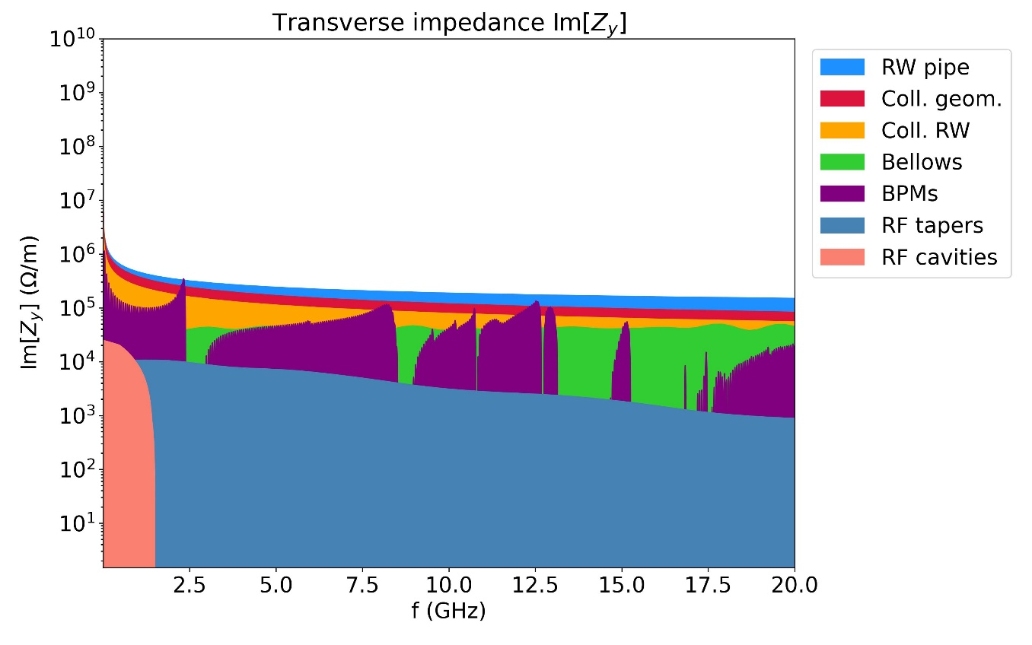
Impact of Collimator Geometric Impedance
Thanks to the optimization of the taper angle for all vertical collimators by reducing it from 15 degrees to 2.5 degrees, the y-transverse impedance drastically reduces.
Horizontal and vertical collimator taper angle of 15 degrees
Horizontal collimator taper angle of 15 degrees and vertical taper angle of 2.5 degrees
Courtesy of D. Gibellieri
FCCee_z_v23_coll_TCTs

Slide 16
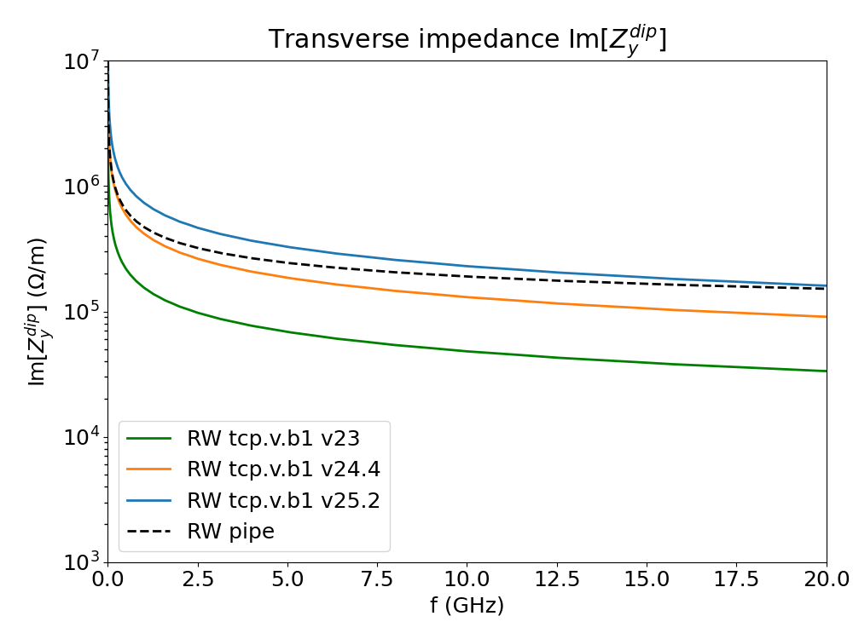


24
Comparison between different optics
Courtesy of D. Gibellieri
To highlight the impact of the new collimation optics, the RW impedance of the vertical collimator tcp.v.b1 under different optics is compared with that of the circular copper pipe, with 30 mm radius and 150 nm NEG coating. The plot presents the imaginary part of the vertical dipolar impedance.
  Decrease in half-gap
  for tcp.v.b1:
  2.5 mm ➔ 1.7 mm ➔ 1.4 mm
$$Z_{⟂}\left(f\right)∝{1/gap}^{3}$$
$$Z_{⟂}\left(f\right)∝\text{β}$$
20.05.2025 | FCC week 2025 | Dora Gibellieri
Notes:
Inermet 180: Tungsten alloy

Slide 17
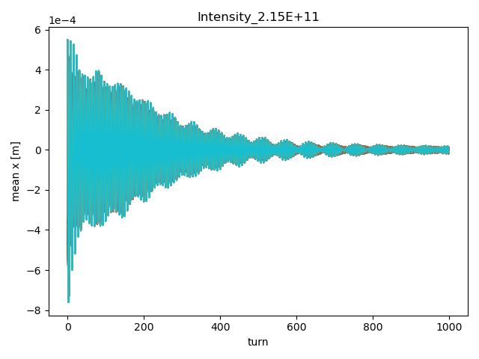
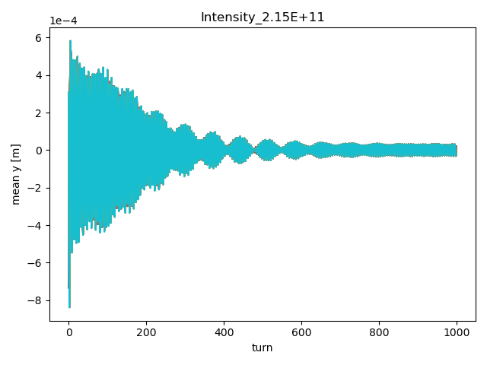
Bunch-by-bunch tune shift considerations
Multi-bunch simulations with resistive wall wake
Courtesy of I. Mases
Bunch-by-bunch tune shifts are obtained from the bunch monitoring of the centroid position

Slide 18
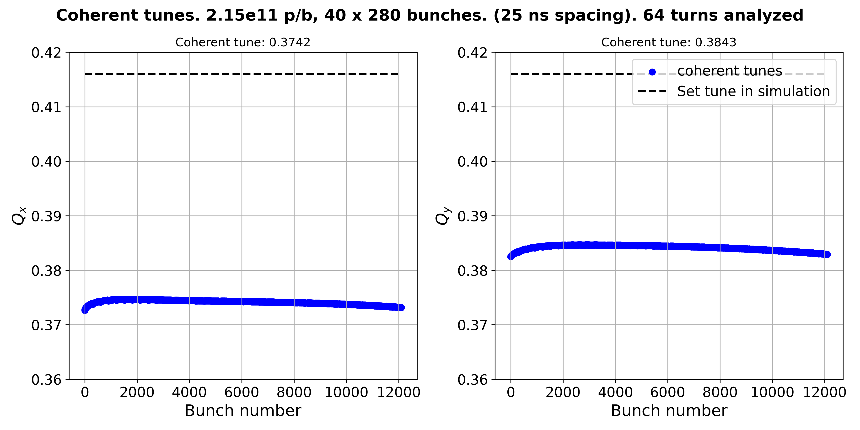
Bunch-by-bunch tune shift of the full machine Z configuration
Tune shift = -0.0418
Tune shift = -0.0317
Courtesy of I. Mases
Critical for X-Z instability
Overall bunch-by-bunch tune shift in the order of few ${10}^{−3}$ (in the same order of the horizontal beam beam parameter)

Slide 19
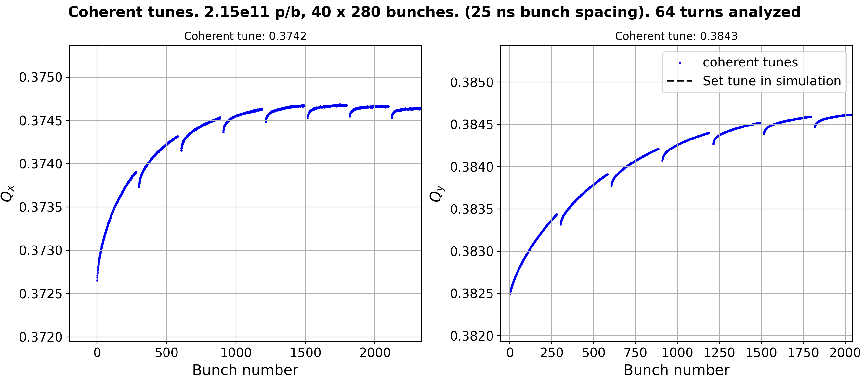
Bunch-by-bunch tune shift of the full machine Z configuration
Very preliminary studies
Courtesy of I. Mases
Overall bunch-by-bunch tune shift in the order of few ${10}^{−3}$ (in the same order of the horizontal beam beam parameter)
Bunch-by-bunch tune shift is a very critical subject for FCC-ee and must be taken into account to define the filling strategy and the overall impedance budget

Slide 20
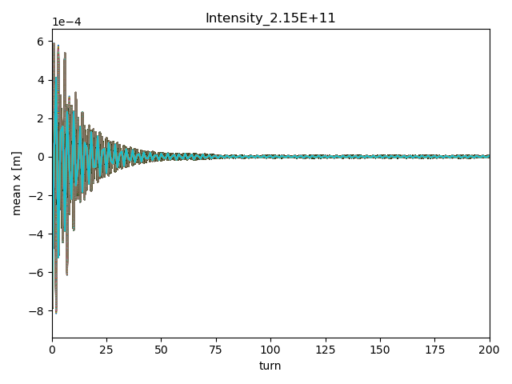
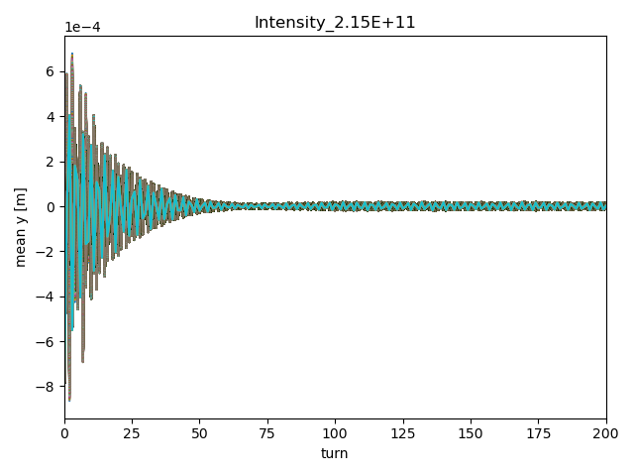
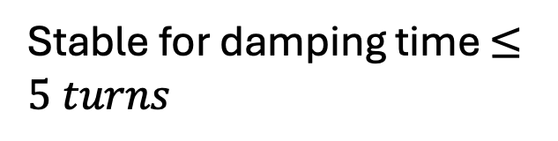
Beam stability with multi-bunch beam Z configuration
Set tunes:
Qx = 218.416
Qy = 222.416
Stable for damping time $≤5 turns$
Chromaticity = 5
Zoom in the first 200 turns
Zoom in the first 200 turns
Courtesy of I. Mases

Slide 21
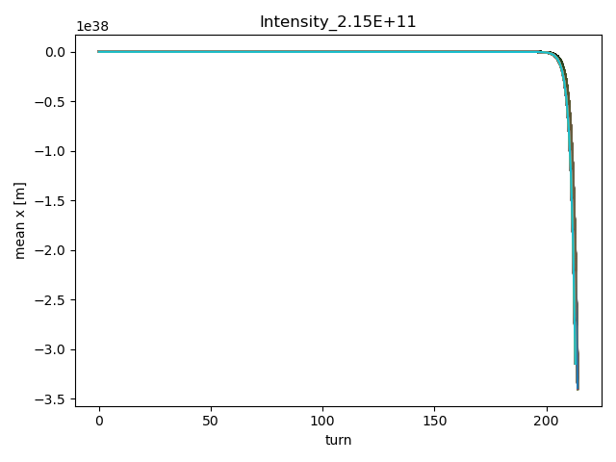
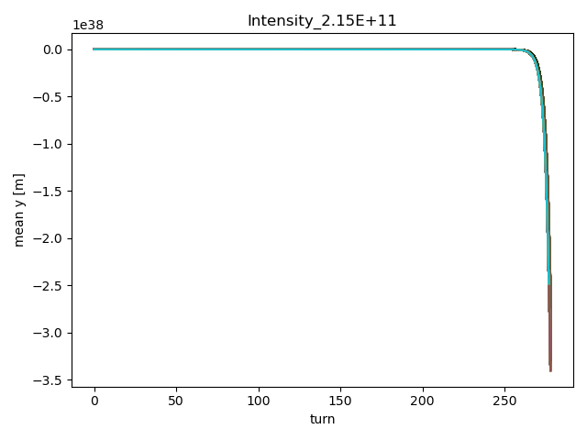
Beam stability with multi-bunch beam Z configuration
Set tunes:
Qx = 218.198
Qy = 222.232
Stability at nominal tune extremely challenging. Unstable with 4 turns damper
Very preliminary studies
Courtesy of I. Mases
Simulations including beam-beam and more realistic damper model to be performed. Stability with multiple bunches at the nominal working point looks challenging

Slide 22
FCC-ee challenging regime
  Combination of large beam pipe dimensions and short bunch lengths
  The beam pipe cut-off lies well within the relevant frequency spectrum
    Significant crosstalk between different accelerator elements
Follow-up design evolution ensuring impedance optimization
  Update FCC-ee model accordingly
Impedance beam induced power has a significant impact on the energy loss per turn from ~4% to ~20% depending on bunch length
Stability with single bunch is not obvious for the Z configuration
  Optimization of collimator impedance is needed
Impedance induced multi-bunch effects
  Bunch-by-bunch tune shifts must be taken into account to define the filling strategy and the overall impedance budget
  Stability at nominal working point looks critical due to very fast coupled bunch instability (~2 turns growth rate).
    Studies including beam-beam and realistic feedback system are needed

Slide 23
Beam coupling impedance studies: milestones, ongoing activities and next steps
Impedance/wake model development to guide critical design decision
  Criticality of collimators impedance: design optimization together with collimation team (to be considered for optics definition)
  Wall model: numerical form factor for both driving and detuning impedance considering realistic shape of the vacuum chamber
  Update of other models according to design evolution (BPMs and other beam instrumentation, bellows+fingers?, RF cavities, injection and extraction elements, …
  Combination of large beam pipe dimensions and short bunch lengths makes impedance/wake simulations extremely challenging
    Wakis development: crucial to face FCC simulation challenges (existing commercial softwares have important limitations)
  The beam pipe cut-off lies well within the relevant frequency spectrum
    Significant crosstalk between elements. Impact on impedance assessment? Do we need ad-hoc devices to absorb the propagating power?
  Impedance heating assessments: in collision global impedance beam induced power ~4% of SR power for the Z configuration.
Implementation of the impedance/wake model in PyWIT
  High flexibility of the model: easing model updates (optics, material choices, coating thicknesses, geometries, new elements)
Instability studies: full transition to Xsuite
  Single bunch TMCI threshold and impact of machine settings: figure of merit for impedance assessment
  Simulations with multi-bunch feedback system and impact of machine settings
    Bunch-by-bunch tune shift, working point and filling scheme considerations, stability with multiple bunches
  Effect of nonlinear impedance terms
Studies for the Booster
  Develop a complete impedance model (at the moment only wall model is included in the beam dynamics study)
  Simulations with multi-bunch feedback system

Slide 24
Beam coupling impedance studies: available and foreseen resources
Impedance/wake model development to guide critical design decision
  Optimization of collimator impedance (D. Gibellieri) + collaboration with collimation team
  Update of other models according to design evolution (BPMs and other beam instrumentation, bellows+fingers?, RF cavities, injection and extraction elements, ... (J. Li, E. Macchia, C. Zannini) + collaboration with equipment owner team (Vacuum (P. Krkotic), BI, RF, …)
  Combination of large beam pipe dimensions and short bunch lengths makes impedance/wake simulations extremely challenging (E. Macchia, New LD)
    Wakis development: crucial to face FCC simulation challenges (E. De la Fuente, 1 TECH)
  Significant crosstalk between elements. Impact on impedance assessment? Do we need ad-hoc devices to absorb the propagating power? (?)
  Impedance heating assessments (C. Zannini) + collaboration with equipment owner team (Vacuum (P. Krkotic), BI, RF, …)
Instability studies: full transition to Xsuite (A. Ghribi, D. Gibellieri, E. Macchia, M. Migliorati)
Single bunch TMCI threshold and impact of machine settings (D. Gibellieri, M. Migliorati, E. Macchia)
Simulations with multi-bunch feedback system and impact of machine settings (D. Gibellieri, I. Mases, New LD, C. Zannini)
    Bunch-by-bunch tune shift, working point and filling scheme considerations, beam stability, feedback requirements
  Impedance budget definition (M. Migliorati, C. Zannini, X. Buffat, New LD)
  Effect of nonlinear impedance terms (E. Macchia)
Studies for the Booster
  Develop a complete impedance model (at the moment only wall model is included in the beam dynamics study) (1 fellow at GANIL)
  Simulations with multi-bunch feedback system (A. Ghribi + GANIL fellow)

Slide 25
Beam coupling impedance studies: available, foreseen and desired resources
A. Ghribi – Leading booster impedance and instability activities
D. Gibellieri (PhD 100% on FCC started on April 2024)
J. Li (PhD from IHEP) – helping with impedance evaluations will leave on August 31st
E. Macchia (PhD 100% on FCC started on November 2024)
M. Migliorati – mainly coordination and particle tracking simulations
C. Zannini – mainly coordination and impedance evaluation
M. Zobov – mainly acting as impedance advisor
Collaboration with other teams (VSC, BI, RF, …)
E. De la Fuente (PhD started in July 2023) and 1 new TECH for Wakis development
I. Mases (PhD started in July 2023) bunch-by-bunch tune shifts evaluations
GANIL fellow to build the booster impedance model
New LD in ABP-CEI on FCC impedance and coherent effects
To ensure continuation and effectiveness of the ongoing studies additional resources are needed
1 Fellow for impedance evaluations
1 Fellow for multi-bunch studies

Slide 26
Thank you for your attention

