Slide 2











Some guidelines for follow-up of collaborations
Ezio Todesco
Thanks to G. Riddone
On HFM web site, under resources
- Procedure_on_HFM_Budget
- Procedure_on_HFM_PRE
- Procedure_on_HFM_Collaborations

Slide 3
Collaboration agreements
They are structured in three levels
  MOU/MOC, that is the general hat stating that institute X and CERN set a collaboration
    Addendum to MOU: this is what we call the collaboration agreement (KExxxx or KNxxxx) stating what is done, and for how much money (this is what is usually called collaboration agreeement)
    Note sometimes the relevant details are in the appendix
      Amandement to Addendum: these are modifications of the collaboration agreement, for instance to extend, or to change the scope, or modify the financial aspects
Please be fully aware of the original CA (addendum), and successive modifications (amandements)
  Read them carefully
  Official versions are in AIS – check that you have acess
  Link is given in https://hfm.web.cern.ch/hfm-programme-structure big table

Slide 4
Steering committees
The Steering Committee is the body that follows the collaboration agreement and approves variations of deliverables, schedule and budget
  The technical coordinators are not part of the steering committee but they are systematically invited and their contribution is very important
  Check carefully on the collaboration agreement who are the members of the SC (usually two/three from CERN, i.e. ASH, PL and DH, and two from the collaboration)
SC’s should take place once a year – however, for HFM this has not been the case (see next slide)
We plan to have one SC per year, in a quite short format (2 h) and by default on zoom
  Until now, in 2025 we had five SCs: PSI, UniGe, KIT, CIEMAT, INFN, plus CEA in June
  Exceptions are possible, i.e.
    SC in person
    More frequent SC if there are special decisions/ milestones to achieve

Slide 5
Steering committees
List of the steering committees of HFM
  All meeting properly stored in indico, and minutes uploaded in EDMS (action to be strictly followed)
  Check that you have access to all the historical
 |  | 2020 | 2021 | 2022 | 2023 | 2024 | 2025
INFN | https://indico.cern.ch/category/15431/ | Nov | May/Oct | Jan |  |  | Mar
CIEMAT | https://indico.cern.ch/category/15432/ |  | May |  |  |  | Mar
KIT | https://indico.cern.ch/category/15427/ |  |  | May |  |  | May
UniGe | https://indico.cern.ch/category/15433/ |  | Feb | Sep |  |  | Apr
CEA | https://indico.cern.ch/category/15430/ |  |  | Jan | Jun/Oct | Jun | Jun
PSI | https://indico.cern.ch/category/15433/ |  | Jun |  | Jun |  | Apr

Slide 6
Steering committees: agenda and TC contribution
Agenda of the steering committee:
  Technical advancement (from the collaboration WPL)
  Comments (from the CERN technical coordinator)
  Status of budget and invoicing (from program office)
Slides from technical coordinator
  Not more than 2-3 unless special cases – do not repeat the technical advancement given by the WPL
  Send before to PL/ discuss with PL before the steering committee to see together the main points
  Put in evidence the advancements, the delays, the critical issues (e.g. interfaces with CERN, etc)
  Report the list of the deliverables in the collaboration agreement, with the delivery dates for the past and updated for the future (see example of Table above)
  Report on the advancement of the CERN in-kind contribution
 | Dates given in CA | Dates last SC | Dates this SC | Invoiced
D1 | June 24 | September 24 | November 24 | YES
D2 | November 25 | January 26 | March 26
.. | .. | … | …

Slide 7
Steering committees
Minutes
  Minutes are prepared by program office (not more than 3 pages – should be a very synthetic summary of the advancements, and of the issues discussed, and of the decisions taken)
  Minutes are first reviewed by PL, TC and WPL
  Then they go in EDMS for comments from GL, and approval from the SC members
  We should make all efforts to have them approved rapidly (in one month)

Slide 8
Budget control
Structure of the budget codes for collaboration
  XXXXX: CERN monetary contribution (from CERN to collaboration)
    The total should be what CERN has to pay the collaboration
  XXXXY: CERN in kind contribution
    GOODS: This is the money spent via CERN orders for components that are delivered to the collaboration
    PERSONNEL: This also includes the CERN staff and MPA
    The total should also be in the collaboration agreement
  There is also a track of collaboration in-kind contribution, with BC’s having no real money
    You have nothing to do on these, they are done to track the contribution of the collaboration but this is not CERN funding and it is not part of the CtC
  Codes are 36xy3 (monetary of WP x.y) and 36xy3 (CERN material of WPx.y) for the existing collaborations
  For the new collaborations 57 and 58

Slide 9
Budget control
The technical coordinator should take responsability of these BC’s
  TC should be aware of the totals of CERN monetary, CERN in kind, and fraction that has been spent/invoiced
  Check in CET that
    You have access rights (if not, contact the PO)
    The money is there, in agreement with what written in the CA’s, and successive modifications in SC’s
    The profile is in line with the deliverables
  Systematically verify that the milestones are invoiced
    It seems strange, but collaborations tend not to invoice, and this creates issues with the budget

Slide 10
Budget control
Something more about CET: go to cet.cern.ch
  There is a large menu, go to transactions by cost centre
      Put your budget code
      Time period: all
      Retrieve – you can have an web page or a .xls
    Different columms:
      Payment budget : the money allocated
      Charged (what has been already paid)
      Annual open committent (e.g. for monetary you should have all the payments corresponding to future milestones)
      Pipeline
      Annual committent (total money)
  Note difference between EUR and CHF (all CA are with currency of the collaborating institute)
Please check periodically the expenses and report if there are anomalies
Verify with the WPL that the profile of monetary contribution is in line with the advancements of the work
Check what we have spent for the CERN in-kind part and compare to the expected profile
Note: the WPL have no access to CERN BCs, the TC are the responsible
The PO is available for a quick CET training

Slide 11
Budget control
Signature
  At the beginning of 2025, we made a large effort to have a coherent sequence in the signatures
    Everything should be fine now
  For the CERN in-kind contributions the sequence is
      Section leader
      Technical coordinator
      Group leader
      Program office
      Program leader (in some special cases I forward to DH)
  It would have been preferable to have the TC as first signature, but this is not possible
  There are some anomalies when the TC is SL or DPL
    When Amalia signs as TC or SL, Attilio is skipped since she is DGL
    So in these cases one has to forward by hand

Slide 12
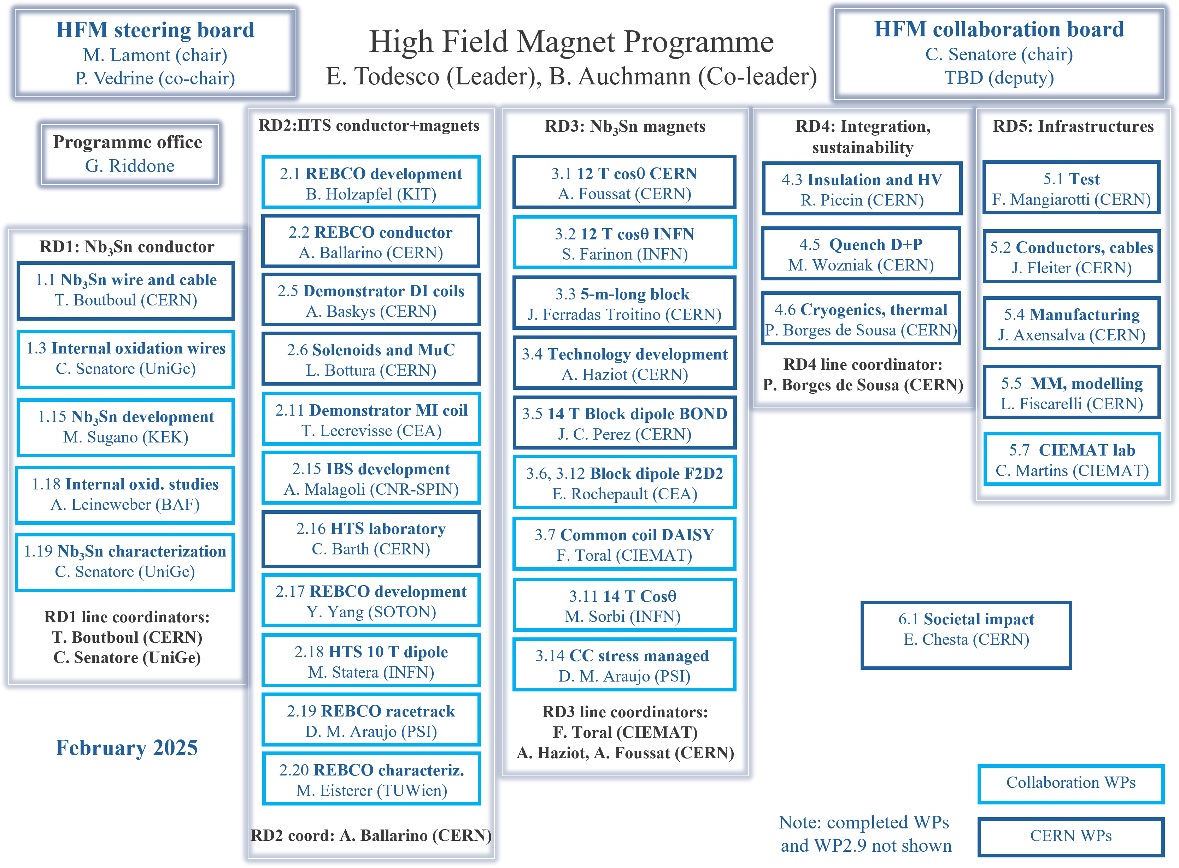
11 collaborating institutes
33 workpackages, half from CERN
HFM forum
HFM WG
www.cern.ch/hfm
Five RD lines
  Nb₃Sn conductor
  Nb₃Sn magnets
  HTS
  Integration & sust.
  Infrastructures

