Slide 1
Comparison LCC / GHC
BI needs
Robert Kieffer 5th june 2025

Slide 2
Questions to be adressed
What are the prerequisites you need to perform the comparison?
-> For example, do you require a complete lattice description including technical and experimental insertions, a specific set of information and data?
Do you require input from other teams and groups?
What are the criteria under your scope of study that you consider relevant for the comparison?
What output will your team or group provide as a result? How long do you estimate this will take you?
Does the choice of optics have a significant impact on your activities?

Slide 3
Systems for the collider ring
BPM
Beam Losses
BCM and Tune
Transverse profile (SR based)
Longitudinal profile
Lumi-monitors (BhaBha / Beamstrahlung)
Polarimeter for energy calibration

Slide 4
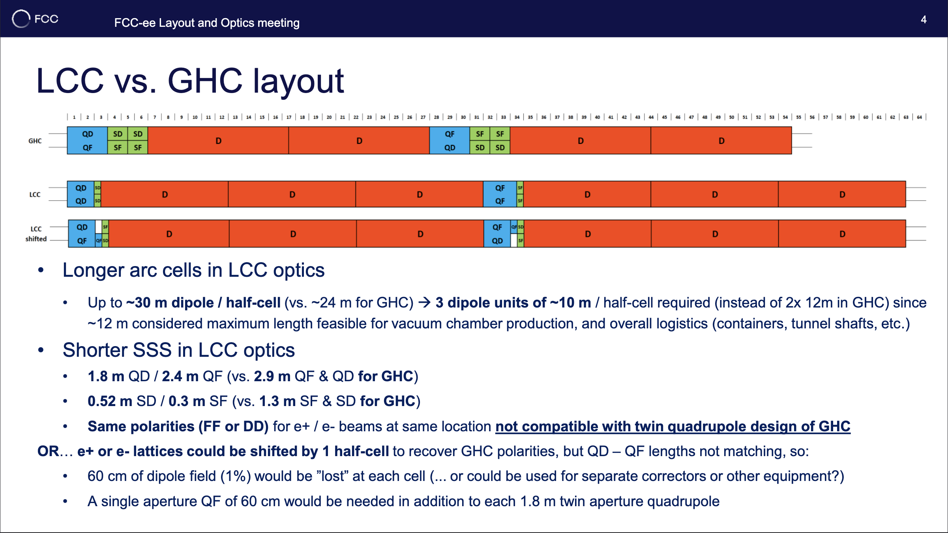
Magnets list

Slide 5
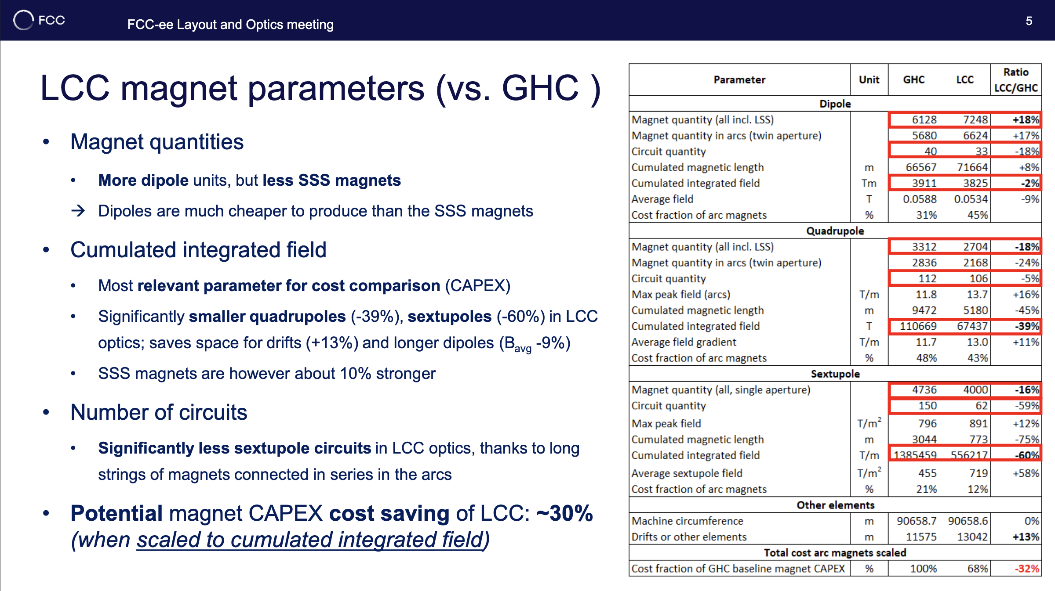
Magnets list

Slide 6
BPM
Since the number of arc quadrupoles in LCC reduce by 18% with respect to GHC, maybe the number of BPM scales accordingly?
Is a different BPM resolution required for different optics? Input needed from the optics team.

Slide 7
BLM (From Belen)
Regarding the BLM system we are not that sensitive to the optics choice. We would only need to know the locations with higher beta functions, in particular outside the ARC to define where the BLMs need to be located (similarly to electronics) but otherwise the impact on the design itself is minimal.

Slide 8
Polarimeters
The main difference for now between GHC and LCC is the fact that the polarimeter is not fitting in the LCC design.
What are the equilibrium polarisation level expected in both optics.
Changes needed from the LCC optics design team :
Confirm the choice of the spectro dipole.
Make space for the 2.5m long laser interaction chamber.
Make space for the 70m free field propagation without any magnet.

Slide 9
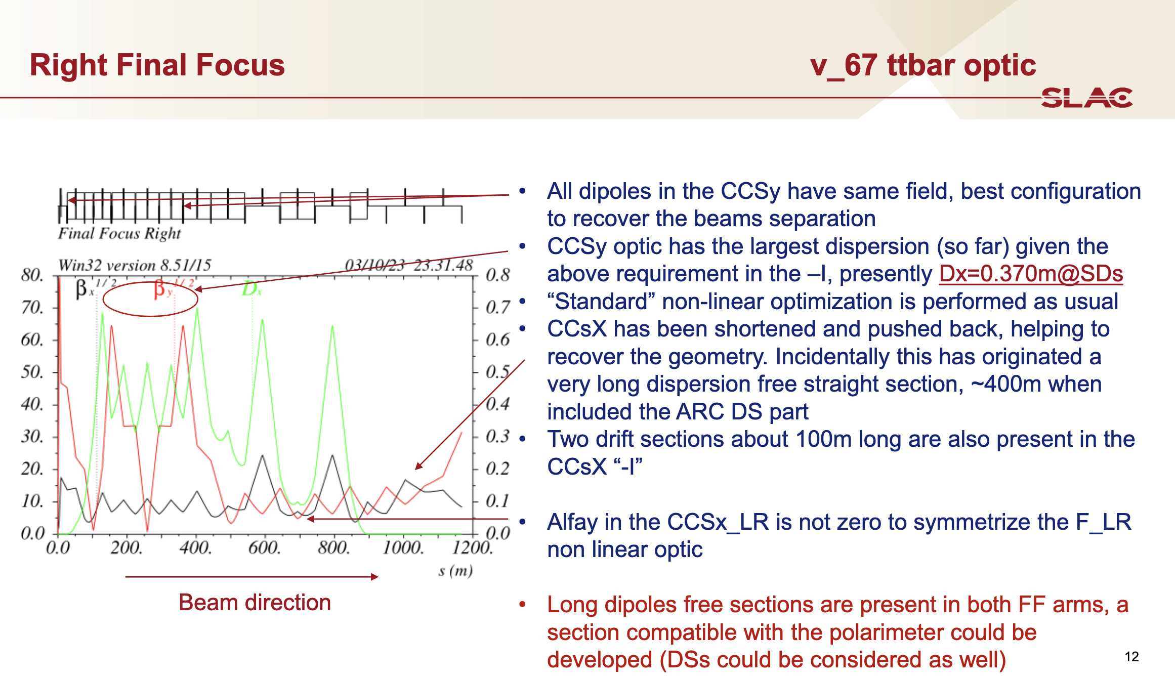
Pantaleo FCC week 2024
Quadrupoles
in the way
Spectro Dipole

Slide 10
Beamstrahlung (BS) monitoring and Lumi
Do we expect the same amount of BS radiation for both optics?
We would need the rate to be evaluated by the optics team (Jack ?) as he performed the simulations at the IP for GHC to evaluate the rate and spectrum of BS radiation.
Similarly for the expected rate of BhaBha events.
Do we expect large changes in filling scheme and bunch charge? (between GHC and LCC)

