Slide 1
Post-processing, Assembly, and interconnection at MPG HLL: Status and Plans
Who we are
Hetrogenous integration
Interposer PilotProject
Christopher Roth
for the team at the Semiconductor Laboratory of the Max Planck Society

Slide 2
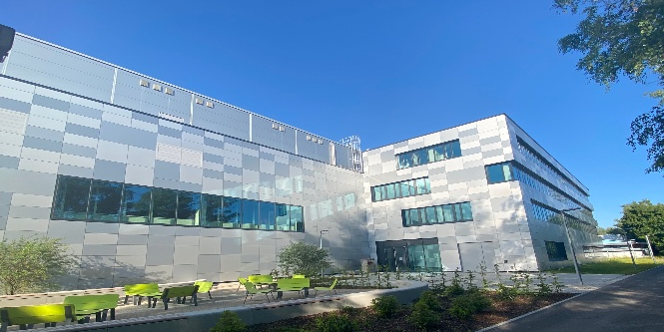
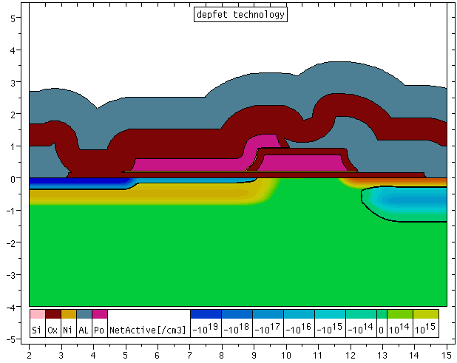
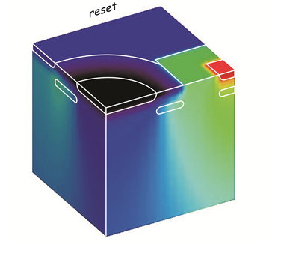
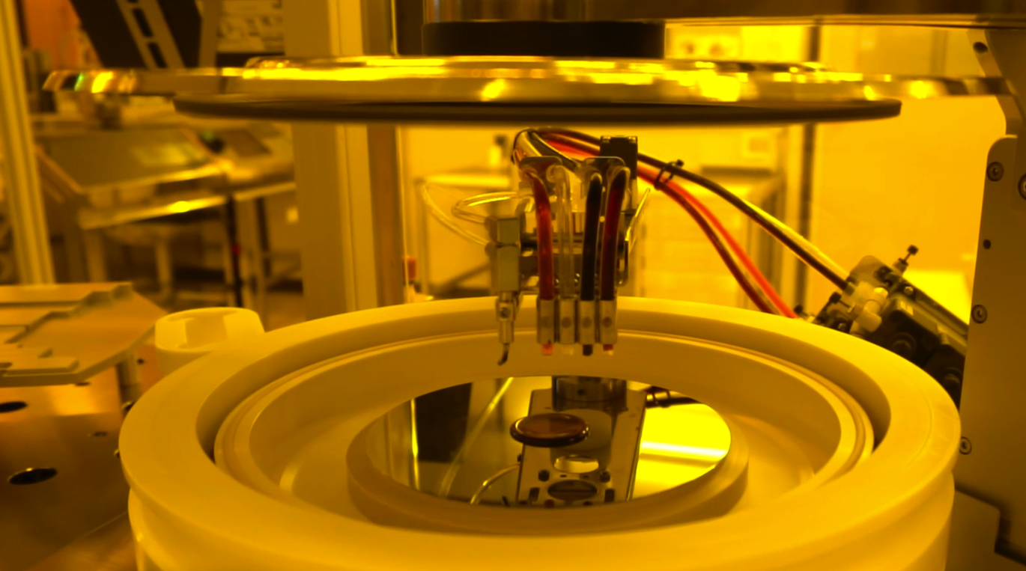
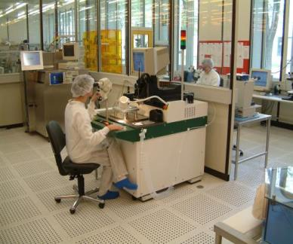
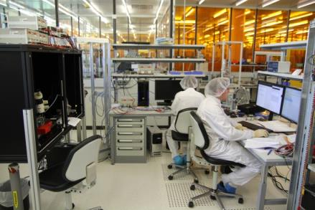
The Semiconductor Lab of the Max Planck Society – MPG HLL
2000 – 2023 @ Siemens Campus Neuperlach Munich
From 2024 @ Research Campus Garching
Central facility of the Max Planck Society
with ~40 employees
scientists, engineers, technicians, and students
1000 m² of clean room area
330 m² of ISO 3 area
Full 6 inch silicon process line
1500 m² of cleanroom area
600 m² of ISO 3 & ISO 4 area
8 inch silicon process line
Process and Device simulation, 2D and 3D
State-of-the-art layout tools
In-house fabrication
sensor design and fabrication
interconnection, assembly
system/camera design and test
System assembly
System test and evaluation

Slide 3
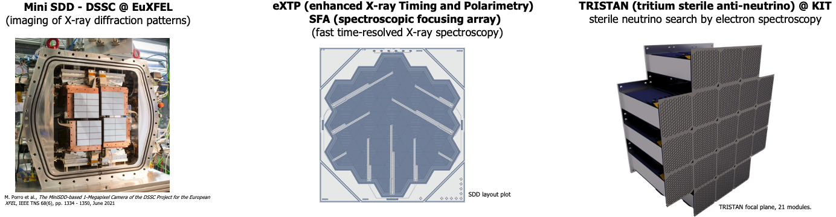
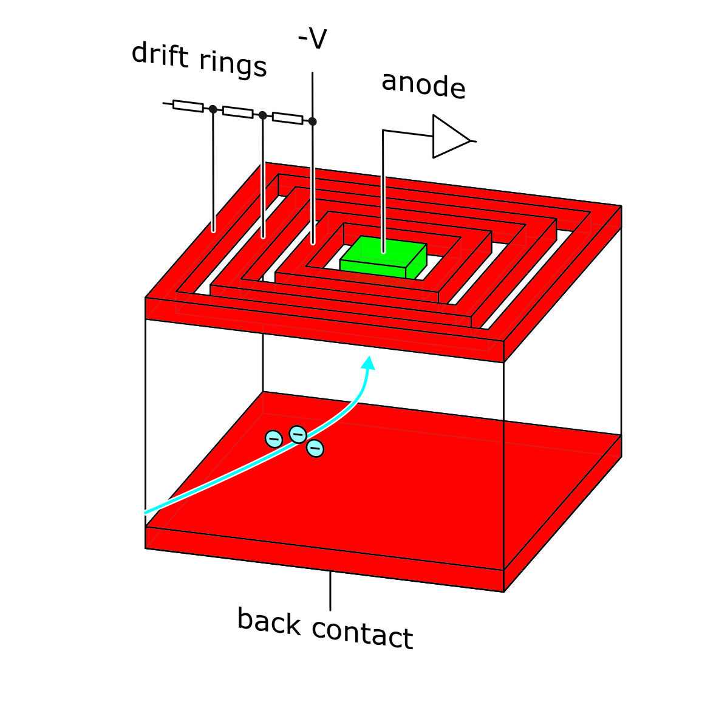
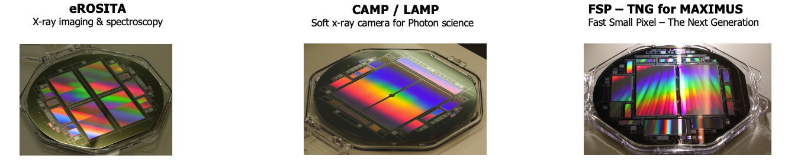
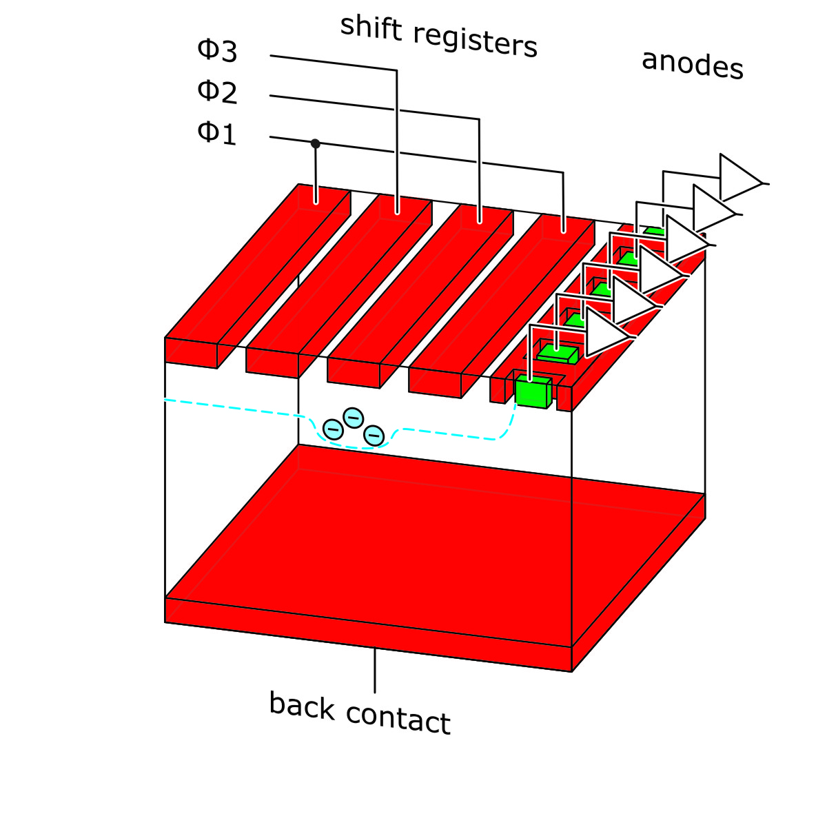
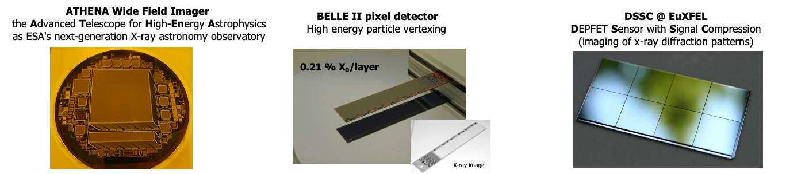
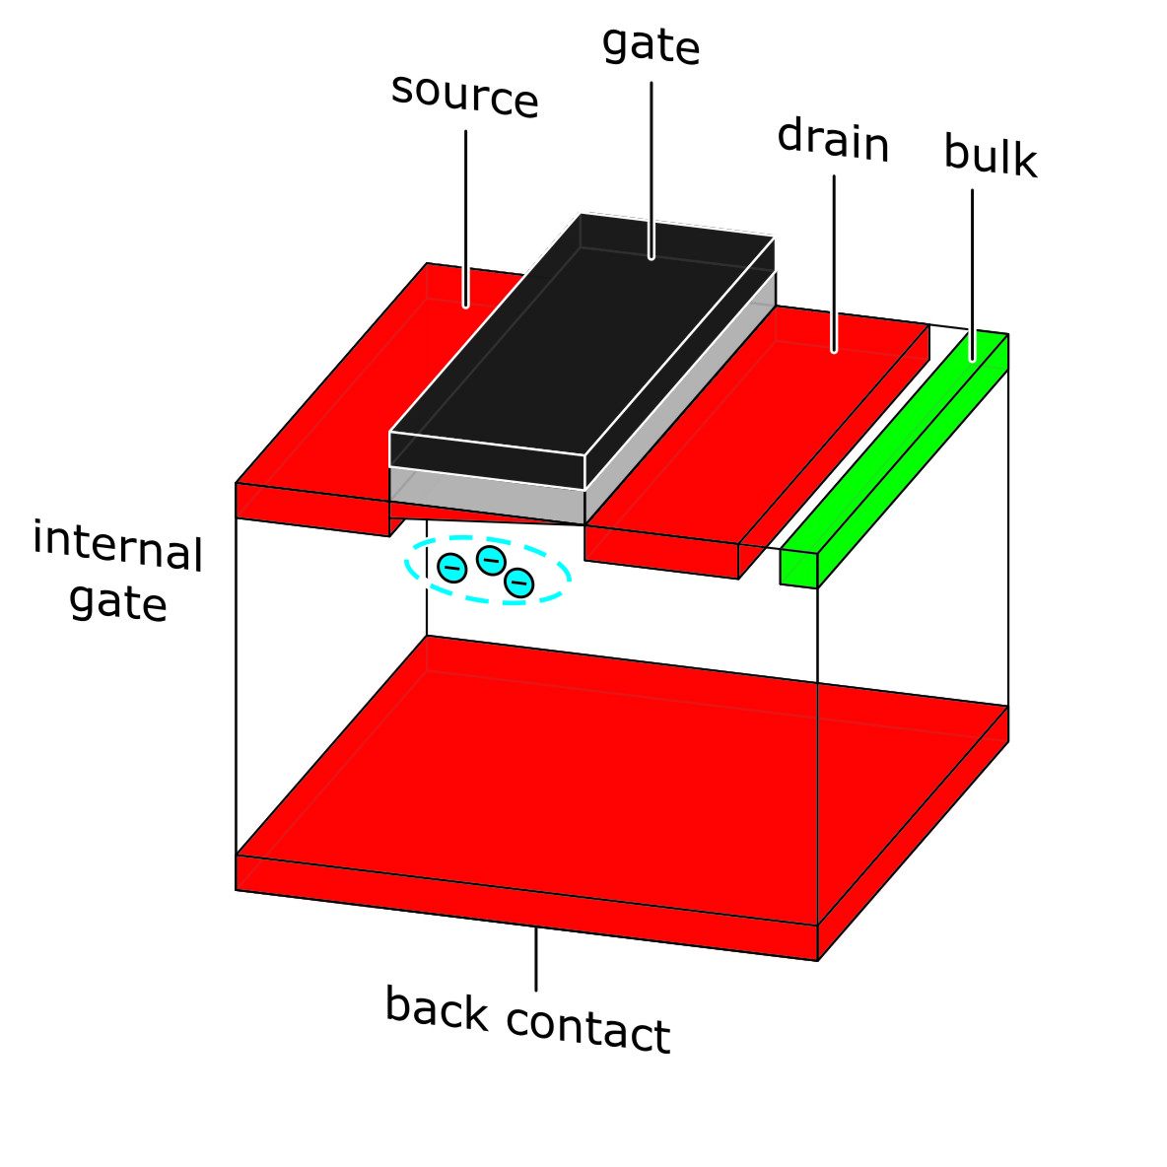
A selection of large detector projects - past and present
Silicon Drift Detector
pnCCD
DEPFET

Slide 4
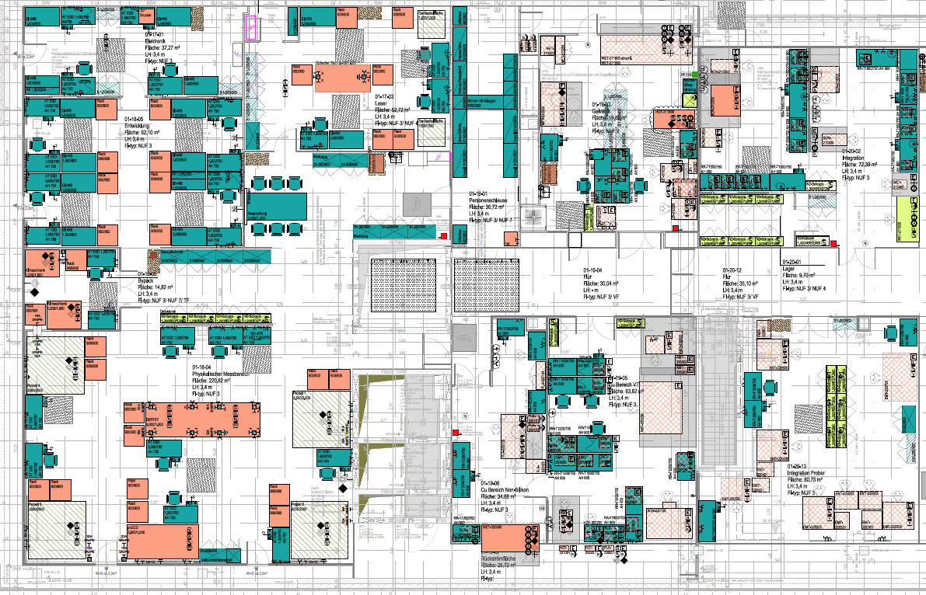
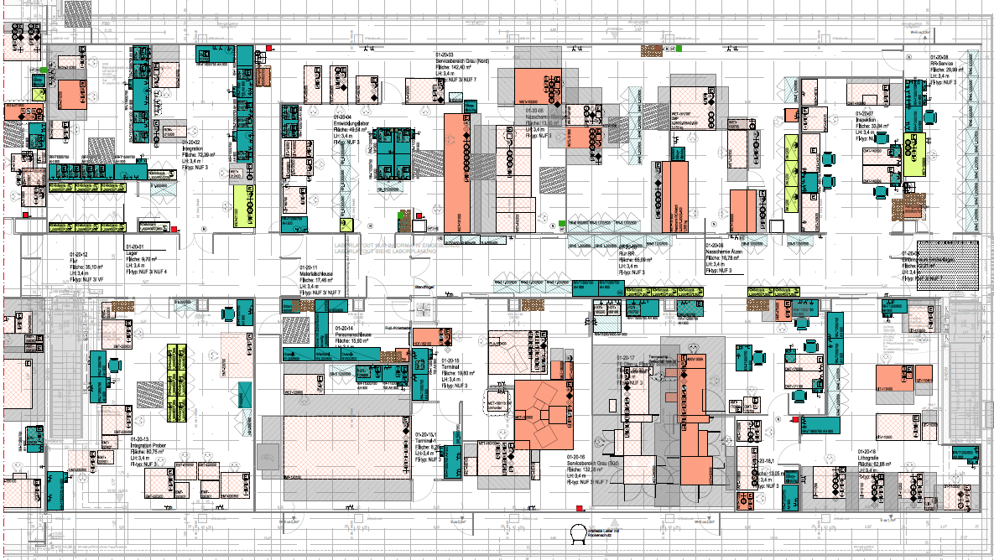
Inside HLL – 1500 m² lab space
Electronics and Laser Lab
3
2
1
6
5
4
ISO 8
System development and test
ISO 4 - 6
1: R&D Lab and post-processing of external wafers
2: Singulation, wire bonding and assembly
3: Cu Lab (UBM and RDL)
4: Wafer-level test and characterization
5: Vertical integration (flip-chip and wafer bonding)
6: Quantum Lab – MQV (shared with WMI/TUM)
ISO 3
“CMOS line” adapted to fully depleted double-side processed silicon radiation sensors
implantation, thermal, metallization, lithography, wet/dry etching, cleaning, inspection ....
Access only by qualified personnel
Strict control of material inside

Slide 5
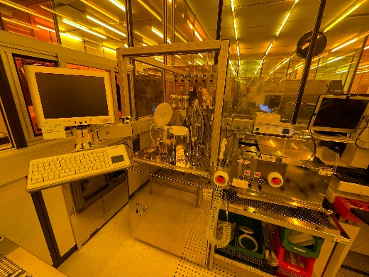
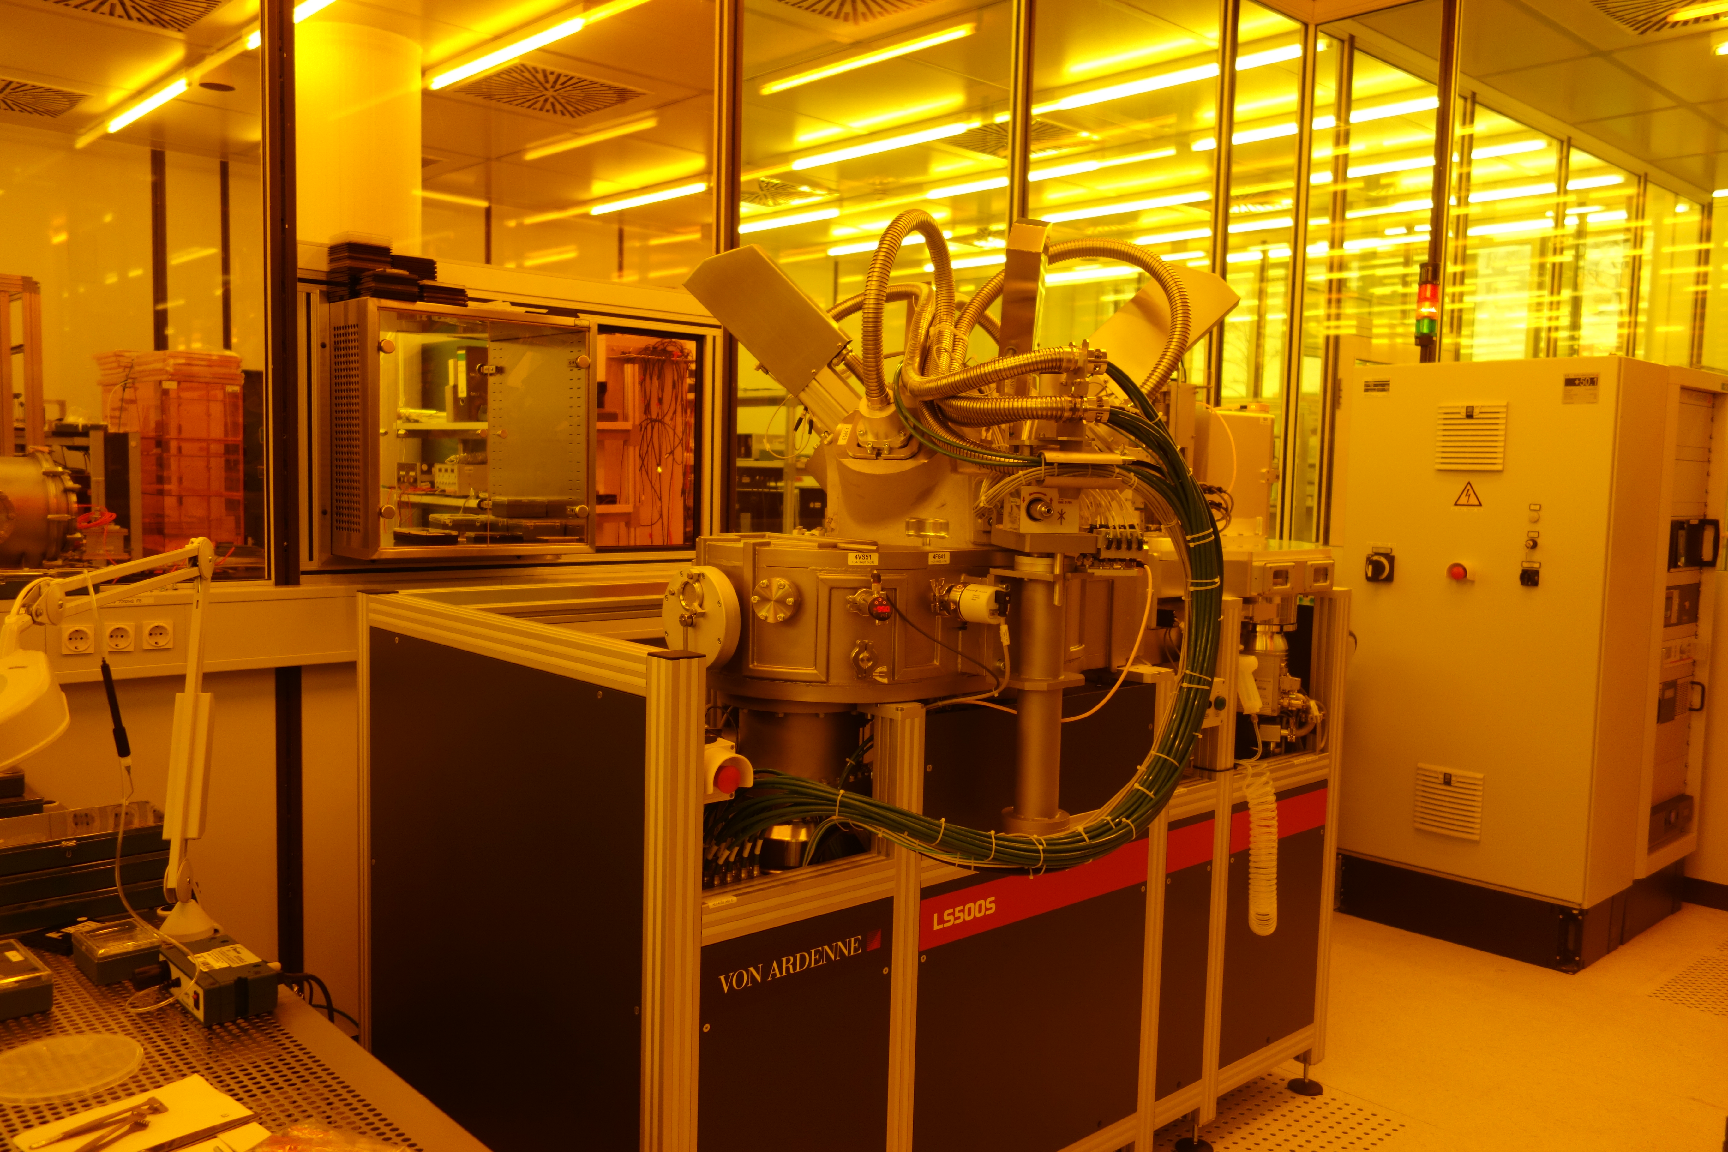
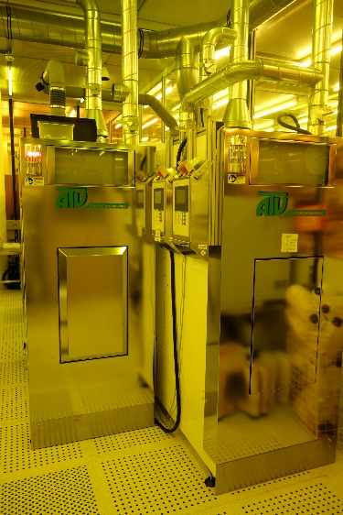
Post-processing and interconncet capabilities
R&D Lab
Complete process line for small and experimental (test) projects
Pilot development of ”non-standard” technologies with and on “non-standard” materials
Thermal processes, lithography, cleaning and wet etching, metrology
ICP-DRIE for TSVs and micro-channels being installed
Experimental sensors, test structures, micro-mechanics ...
Backend-of-line and interconnect Lab
Cu (and Al) redistribution layer (RDL), under bump metallization (UBM)
Wafer dicing, chip handling
Interconnect to read-out ASICs
Electrical: flip-chip, wire bonding, conductive adhesives
Mechancial: precision assembly of modules
Thermal: utilization of suitable materials (metals, ceramics, composite materials..)
Low temparature W2W, C2W, C2C bonding in preparation
Wafer format
All process tools set up for 6” wafers as baseline
4” wafer processing possible, smaller wafers and even single chip processing with customized adapter wafers
8” wafer processing after tool re-configuration, possible on most of the tools

Slide 6
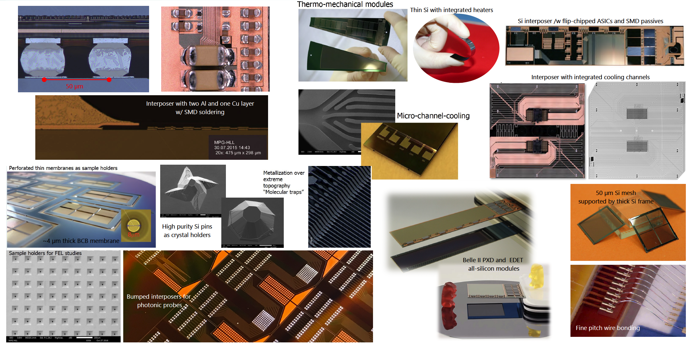
A few pictures from past projects

Slide 7
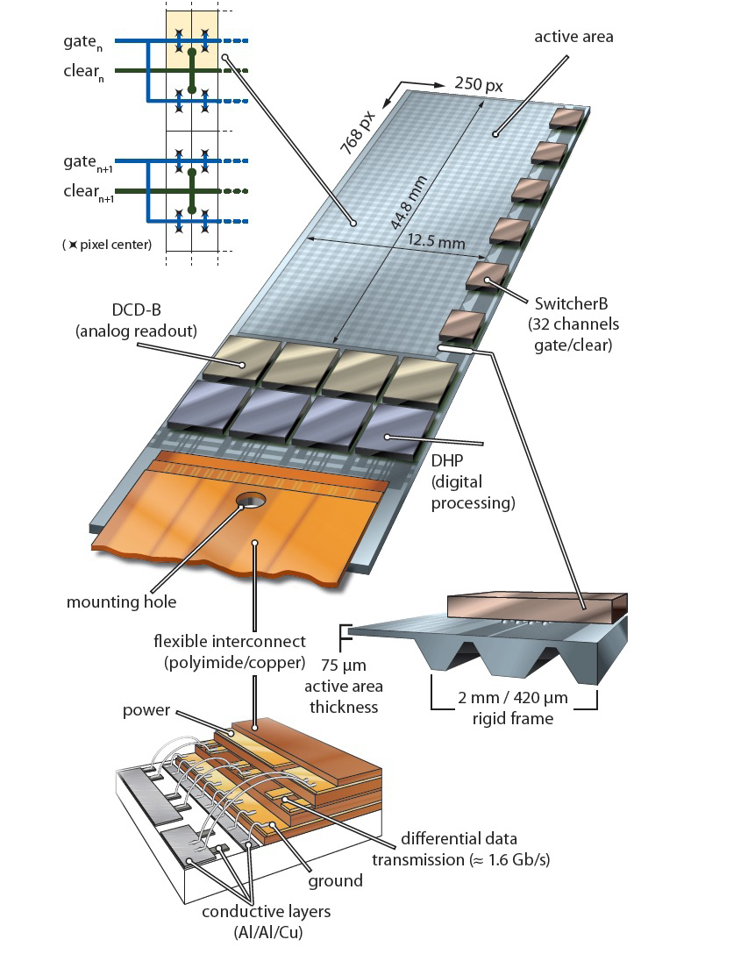
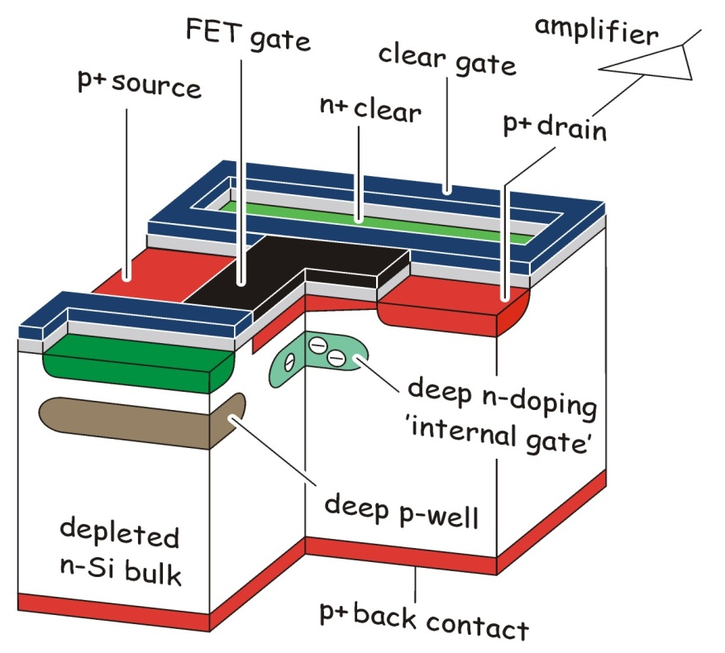
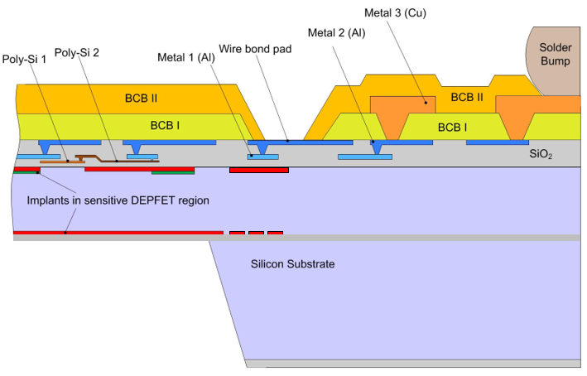
the DEPFET all-silicon module for Belle II PXD
module design starts on wafer level
module is one piece of silicon
Sensitive area (APS)
High density interconnect (HDI)
HDI as board for non-sensor parts
UMC 180, TSMC 65, IBM/AMS/TSI 180
Passive components
On-module solder interconnect
Off-module interconnect with flex
Solder and wire bonds
“MCM-D”, “2.5 D”, “SoC” ... We call it ASM
All-Silicon Module
Thin pixel array operated in „rolling shutter” mode, 20µs/f
Only 4/768 rows active a time → low power in active area

Slide 8
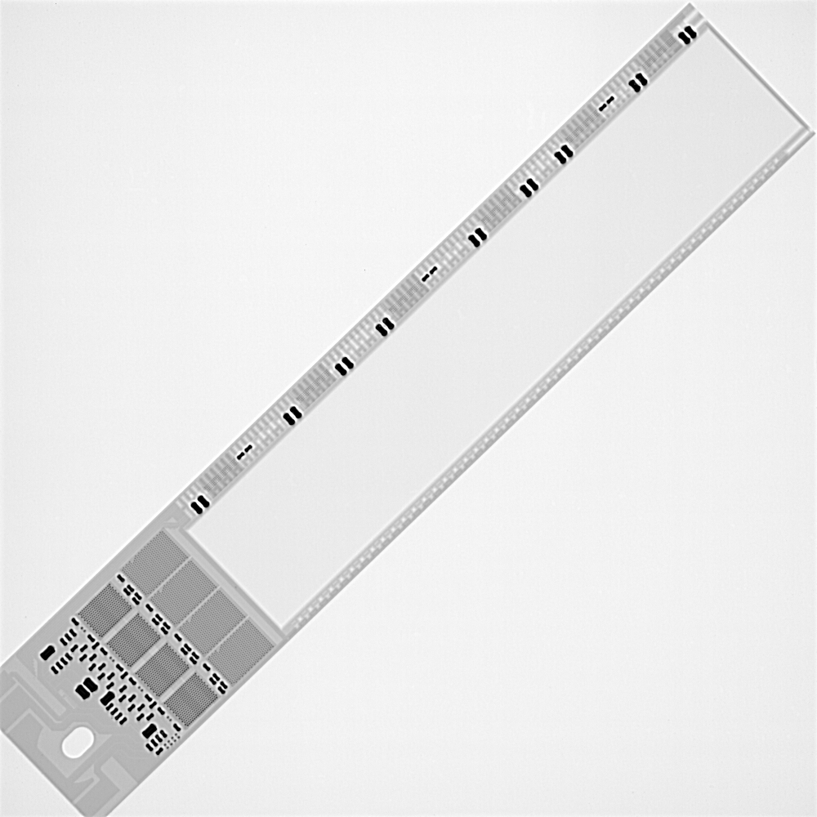
the DEPFET all-silicon module for Belle II PXD
module design starts on wafer level
module is one piece of silicon
Sensitive area (APS)
High density interconnect (HDI)
HDI as board for non-sensor parts
UMC 180, TSMC 65, IBM/AMS/TSI 180
Passive components
On-module solder interconnect
Off-module interconnect with flex
Solder and wire bonds
“MCM-D”, “2.5 D”, “SoC” ... We call it ASM
All-Silicon Module
x-ray picture of fully assembled module
0.21% of X₀

Slide 9
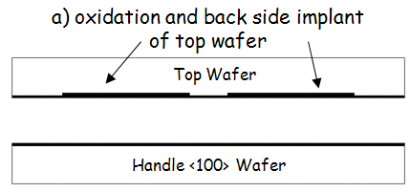
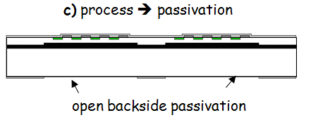
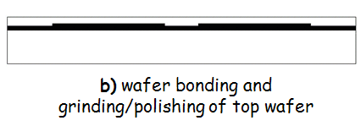
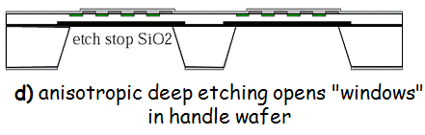
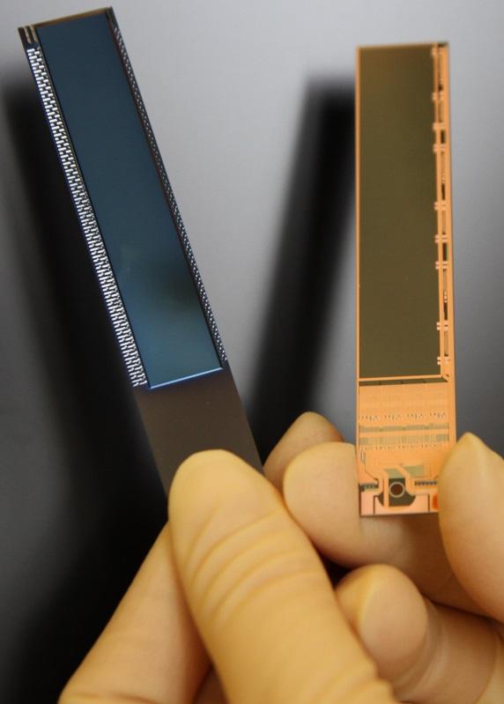
how to make thin DEPFETS
thickness of the sensitive area is an (almost) free parameter
thin area supported by a monolithically integrated silicon frame

Slide 10
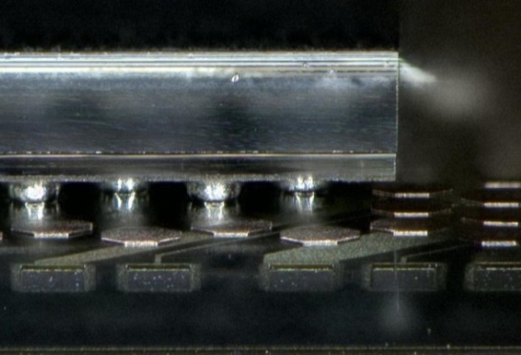
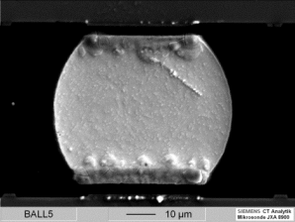


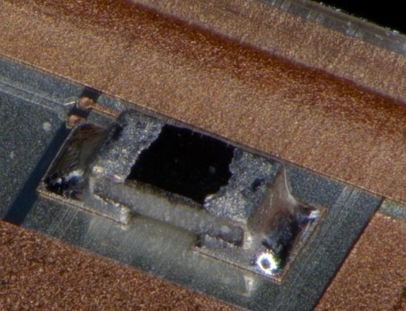
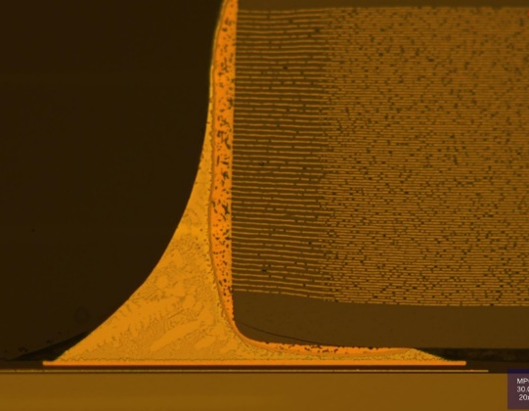
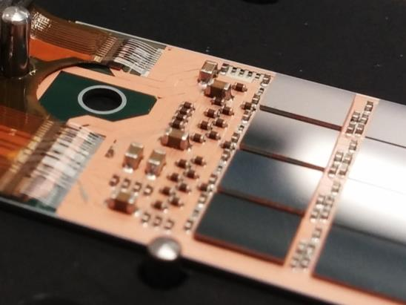
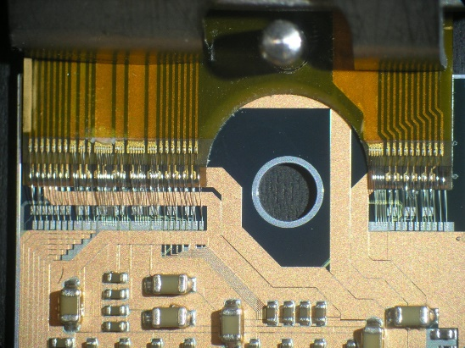

module assembly overview
Flip Chip of ASICs (~240°C):
Bumped ASICs have (almost) the same solder balls (SnAg)
DHP bumping at TSMC, DCD bumping via Europractice
SWB bumping on chip and wafer level as post-process
Bump bonding on customized support plates
Initially at IZM, then at HLL
SMD placement (~200°C):
Passive components (termination resistors, decoupling caps)
Dispense solder paste, pick, place and reflow
Kapton attachment (~170°C), wire bonding:
Solder paste printing on kapton, vapor phase soldering
Wire-bond, wedge-wedge, 32 µm Al bond wires

Slide 11
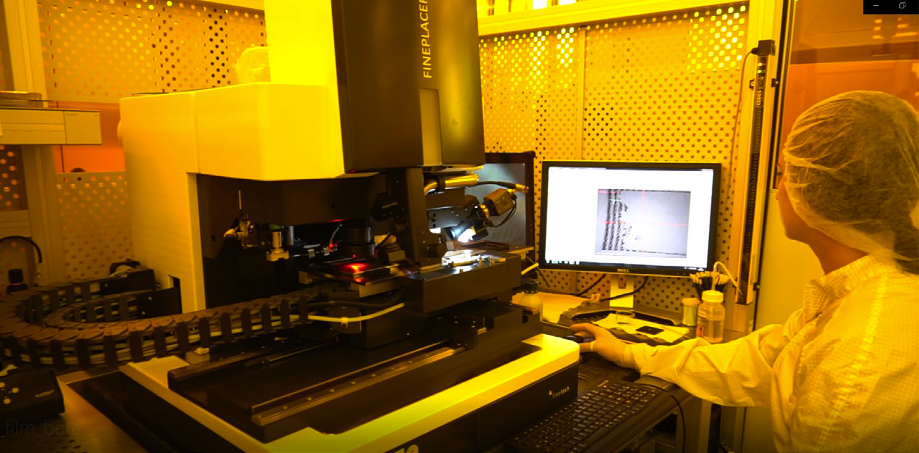
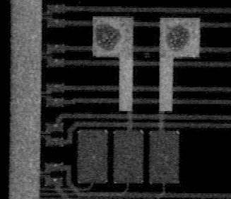
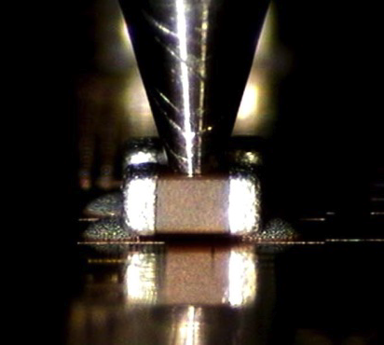
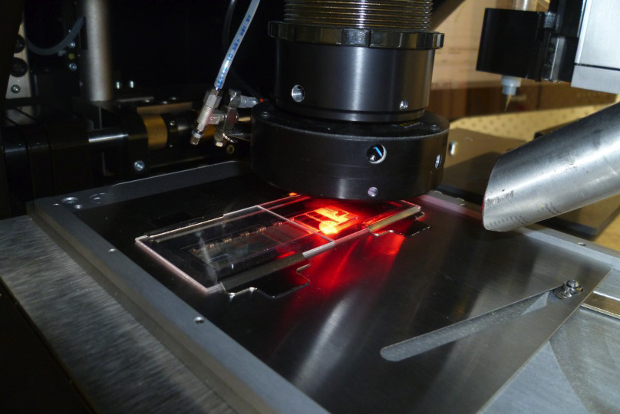
SMD assembly
Each module has about 100 capacitors and resistors of various formats (0402, 0201, 01005)
Very small footprint, no screen printing of solder possible, delicate handling of module ...
Adapted SMD technology installed at HLL
Automated micro assembly tool, the same as for flip-chip
Additional dispense system
Process flow
Condition module, dispense solder, place SMD parts, reflow in process chamber

Slide 12
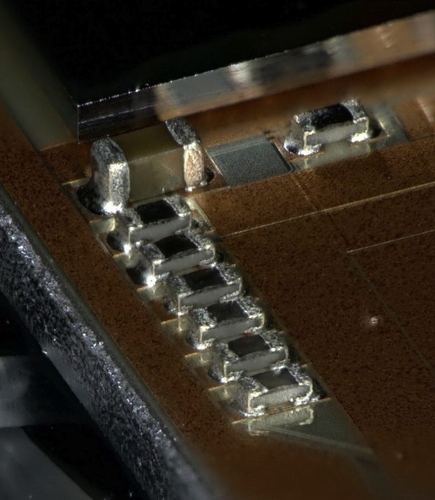
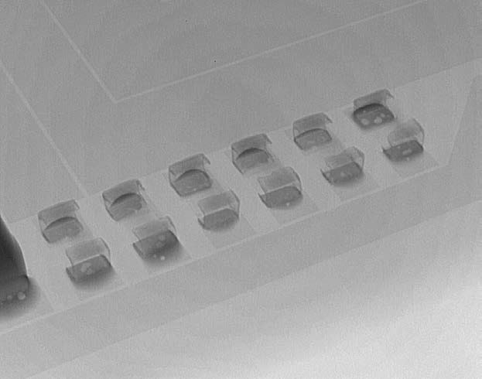
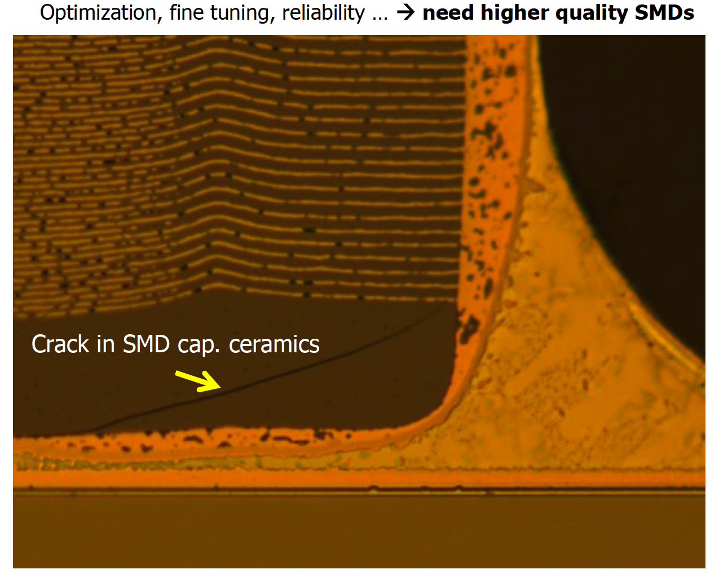
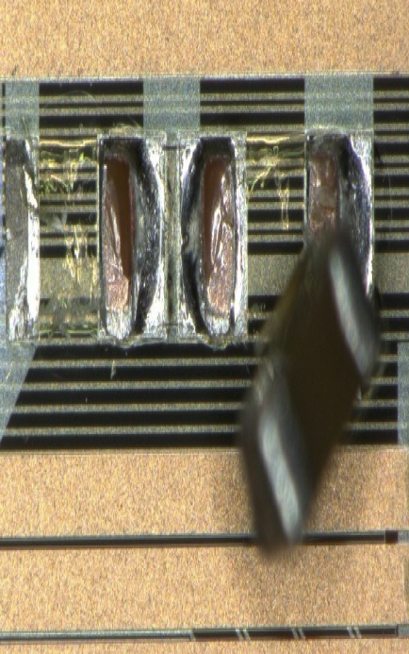
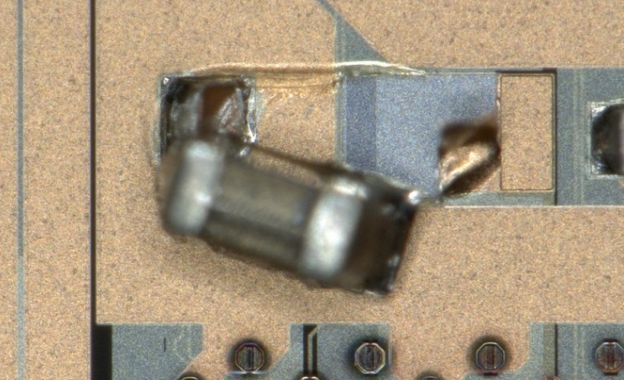
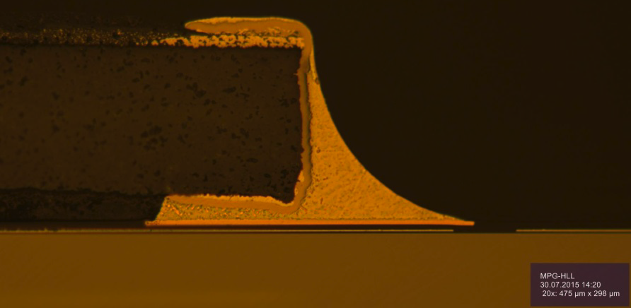
Process qualification
Extensive tests and QC/QA: shear tests, cross section, metallurgy, thermal stress tests ...

Slide 13
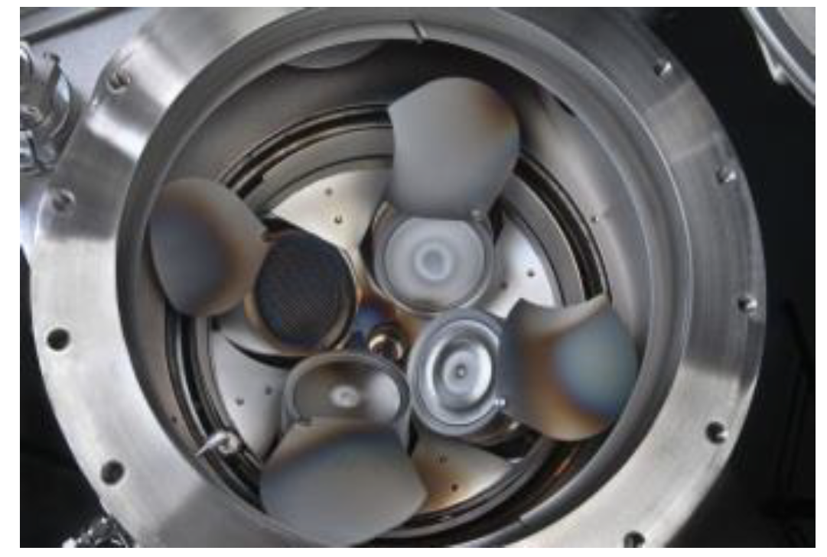
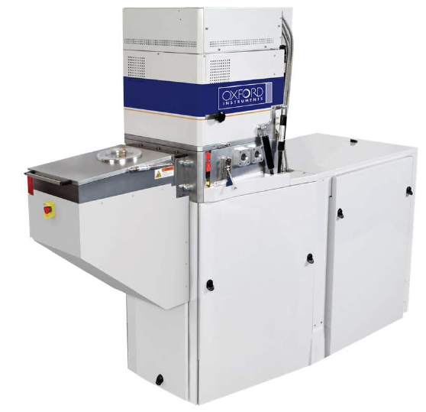
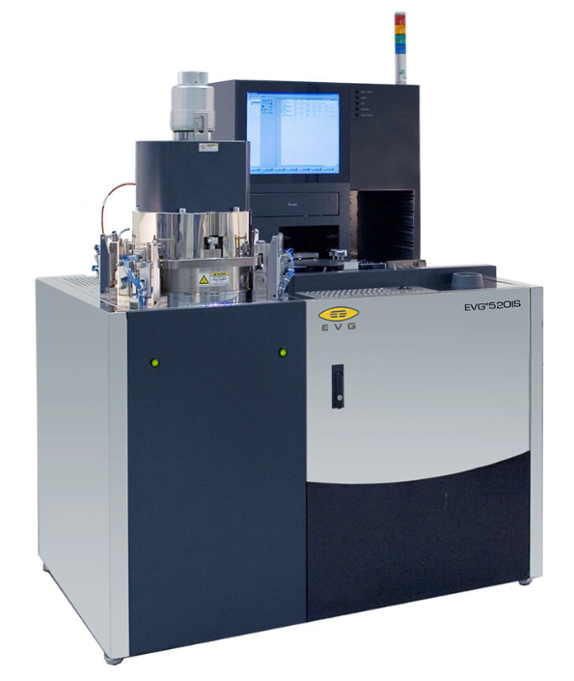
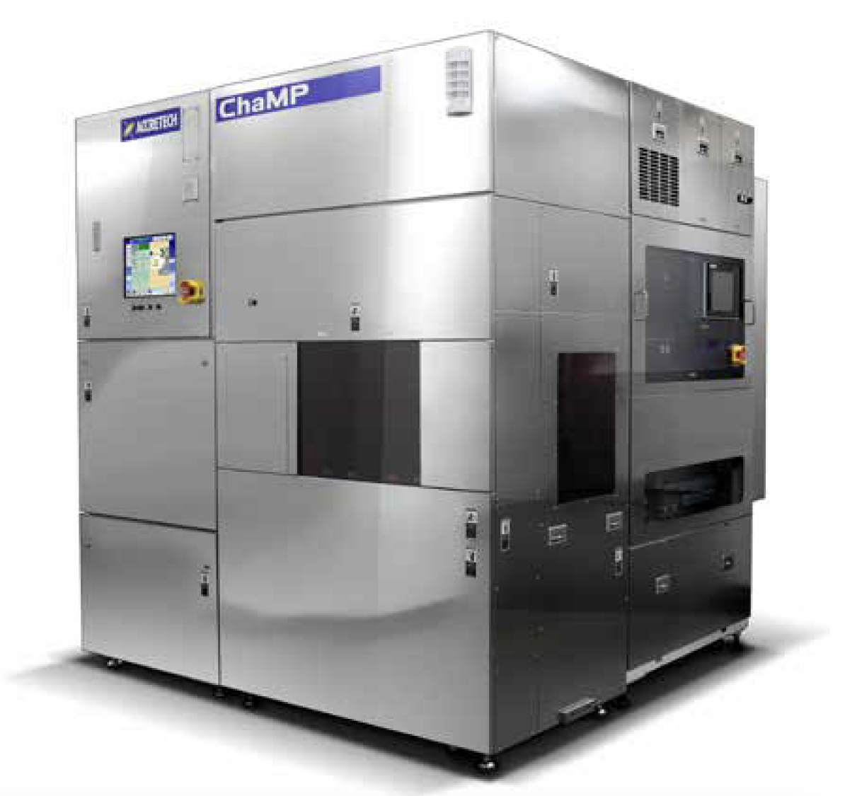
The way forward: overview
Extend sputtering capability on existing sputter system
targets are easy to exchange
→ new metals possible
replace 2/4 DC sputter guns with RF biased ones
→ sputtering of isolators (SiO2, Al2O3 .. )
software upgrade for co-sputtering and reactive sputtering
Improve lithography capability
Use of e-beam lithography system installed by MQV partner
HLL contribution: installation and qualification of required photo resist systems suitable for e-beam
Extend structuring capability
Installation of ICP-DRIE for silicon
TSV, Si wave guides
Extend interconnect capabilities and post-processing of ASICs and/or PICs
Install CMP of Cu and SiO2 as preparation for wafer bonding
Install and W2W and C2W direct and hybrid bonding
Low temperature bonding <350 °C mandatory

Slide 14
Main Objectives of the DRD7
project
facilitate a distributed lab for heterogeneous integration (HI) of radiation detectors
interconnections/assembly of chips of various technologies/types:
analogue + digital + memory + sensor + photonics + RF + MEMS ...
integration technology survey and development
align currently available technologies within DRD7.6b labs
identify required new process steps, install and qualify these steps (or find and qualify external suppliers)
define, practice, and qualify distributed process flow
provide HI ”service” to detector community

Slide 15
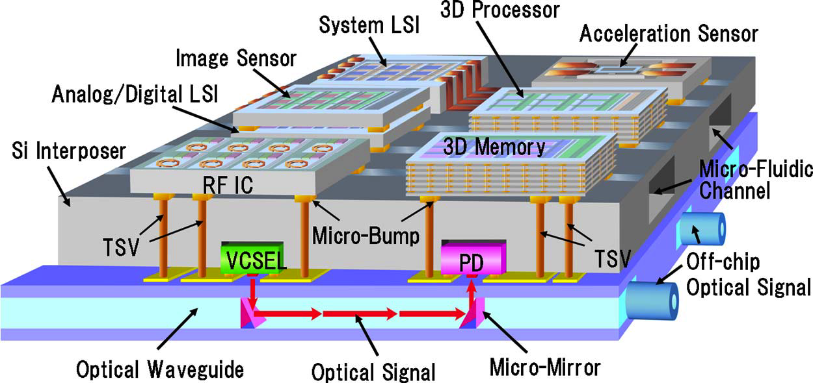
heterogenous integration
Very active field of R&D in industry
Players are foundries and OSATs (Outsourced Semiconductor Assembly and Test)
Intel/AMD/TSMC/Samsung.. and ASE/SPIL/Amcor...
See IEEE EPS Heterogenous Integration Roadmap
Large variety of technologies, solutions, techniques (and acronyms..)
Mostly proprietary, limited accessibility or expensive (for low volume production)
There are extreme examples, mostly experimental:
Technology building blocks overview
Interposer
single sided
double sided → TSV
interposer with micro-channels
optical interposer
Assembly preparations
Thinning of CMOS, Sensor, and/or interposer
Post-processing on Wafer level and chip level
std. solder bumps (“C4”)
µ-bumps w/ different metallurgy
Cu or Sn ep for SLID or hybrid bonding
Assembly
SMT passives
conventional bump bonding (flip-chip) – C2C
Bump-less interconnect
SLID - C2W, W2W
Hybrid bonding – C2W, W2W
Everything, all at once
Lee et al.: IEEE Transactions on Electron Devices (March 2011), DOI: 10.1109/TED.2010.209
Attempt to break it down in smaller pieces - easier to digest

Slide 16
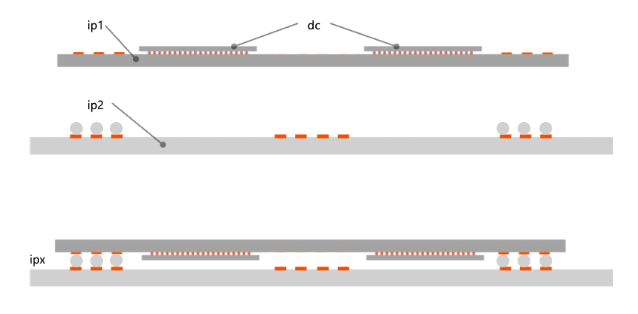

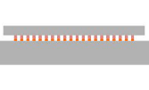

the next steps – more realistic
Joint project: complex silicon interposer
Interposer 1 – “ip1”
Single sided metal Al/Cu
Bumped dummy chips with Al/Cu - “dc”
small, high melting solder bumps, or Sn cap for SLID
thinned to ~100 µm
Bump bond or SLID dummy chips to ip1
Interposer 2 – “ip2”
Single sided metal Al/Cu
big, low melting solder bumps
Flip and assemble ip1 and ip2 - “ipx”
Evaluate daisy chains, process characterization ....
pretty ambitious!
need thin dummy chips, two different solder alloys ....
takes quite some time to get results!
intermediate step: heterogenous integration of existing chips on interposer
“only” tasks would be interposer production and bump bonding
add a few passives maybe

Slide 17
Interposer Process sequence I
Thermal Oxidation
~500nm wet or dry thermal oxide
Al sputter
1 µm Alu
sheet resistance ~30 mOhm/sq
Litho alu1
spin-on std. thin photo resist
expose mask 1, develop
Etch Al
std. acid
resist strip (solvent)

Slide 18
Interposer Process sequence II
Interlevel Dielectric ILD1
deposition temp < 350 °C
LTO or similar
BCB - photo sensitive polymer (preferred)
coat 3 µm, expose mask 2, develop
hard bake at ~200 °C
descum contact holes in CF4 plasma
eps_r (BCB) = 2.65 @1 MHz
Ti:W /Cu sputter seed layer
100 nm/200 nm
ep Litho
spin-on thick ep photo resist, ~7-9 µm
expose mask 3, develop

Slide 19
Interposer Process sequence III
Through mask electro-plating
Cu, about 5 µm
sheet resistance for 1µm Cu ~17 mOhm/sq.
resist strip
solvent
seed layer etching
Cu and Ti:W etch, selective to Al
Interposer design and layout started by Michele

Slide 20


Thank you for your attention!
SEMICONDUCTOR LABORATORY
OF THE MAX PLANCK SOCIETY

