Slide 1
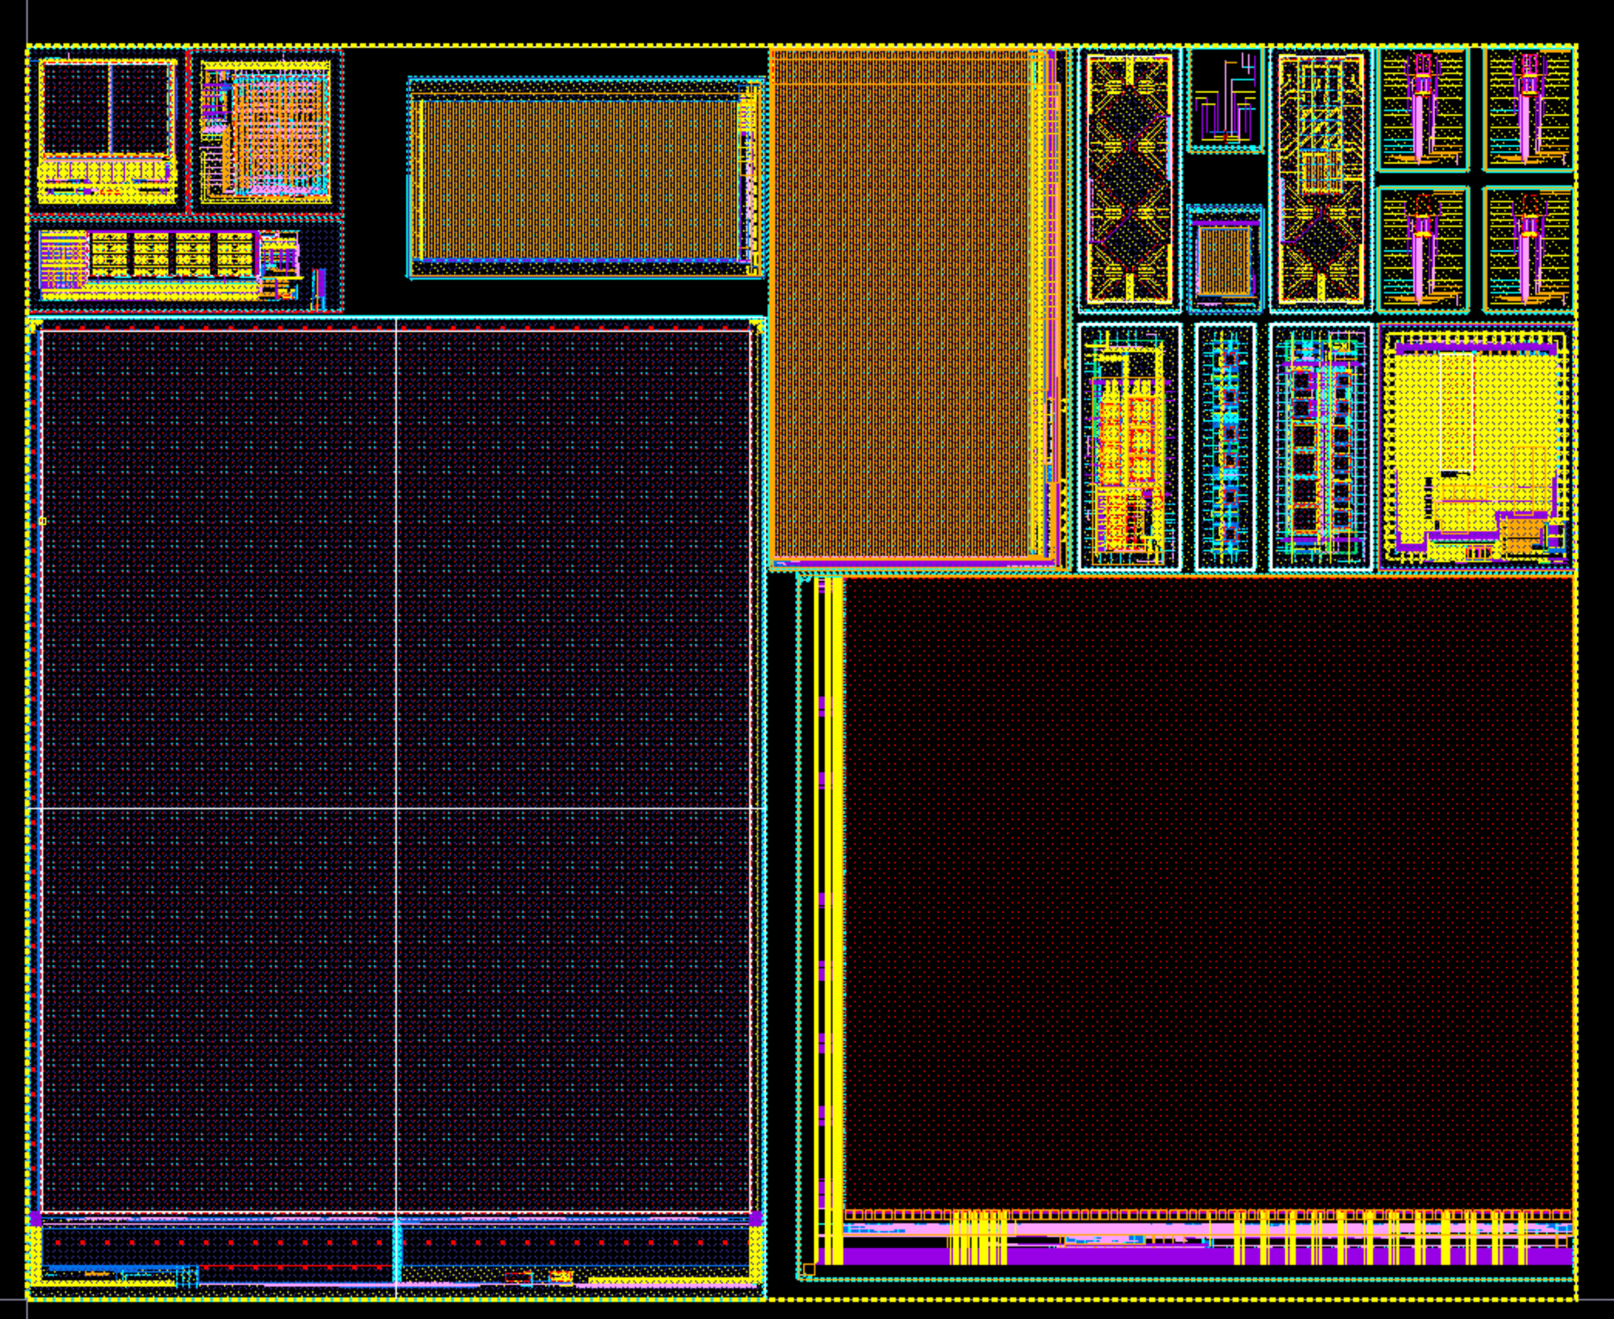
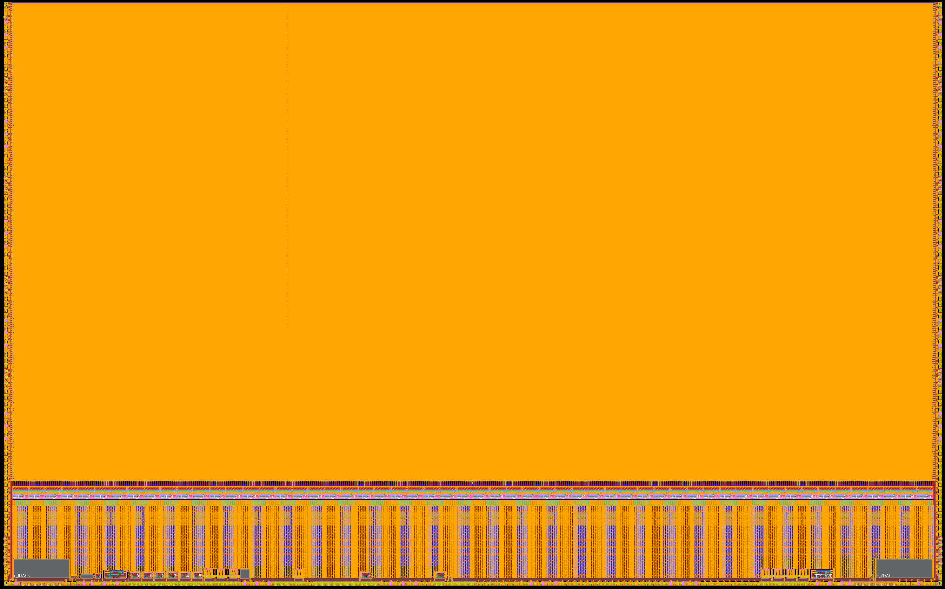
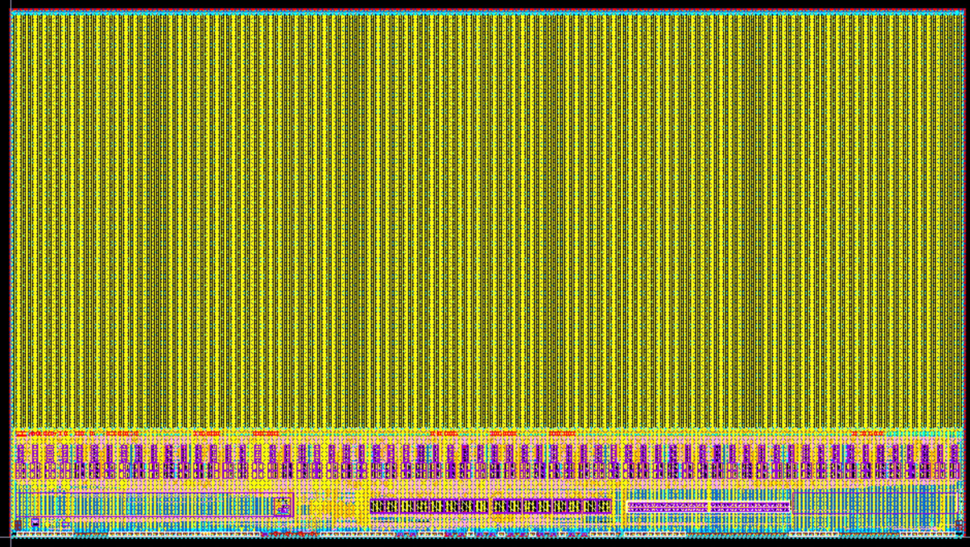
TJ 180 nm activities within WP 7.6a
Full report: https://indico.cern.ch/event/1582781/
Design support
  Digital on top flow available
  Many IPs already existing from past projects (STFC, IPHC/CPPM, CERN,) => documentation to be discussed
  IP under development : fast ADC-12bits (IN2P3 APC, LPSC, IPHC)
Legal matters
  Export license for chips established on individual basis (rules get stricter)
Wafer dicing
  Outsourced to MicroPacks platform in France
Foundry submissions
  ER Fall 2025: multi-project ER (QUARTIPIC-2) for various R&Ds, T/O in the coming weeks
  ER Dec. 2025: reticule-size sensor ER (OBELIX-1) for Belle II experiments
  ER Dec. 2005: reticule-size sensor ER (MIMOSIS-3) for CBM experiments
  Fall 2026: multi-project ER (QUARTIPIC-3) for various R&Ds <= area still available
CERN: specific TCAD simulation & process modifications
Circular ee
Impact
MonoImager
Chiplets
for R&D
CASSIA
MiniMALTA
QUARTPIC-2
Circular ee
PICMIC-1
IPHC
OBELIX-1
MIMOSIS-3

