Slide 1
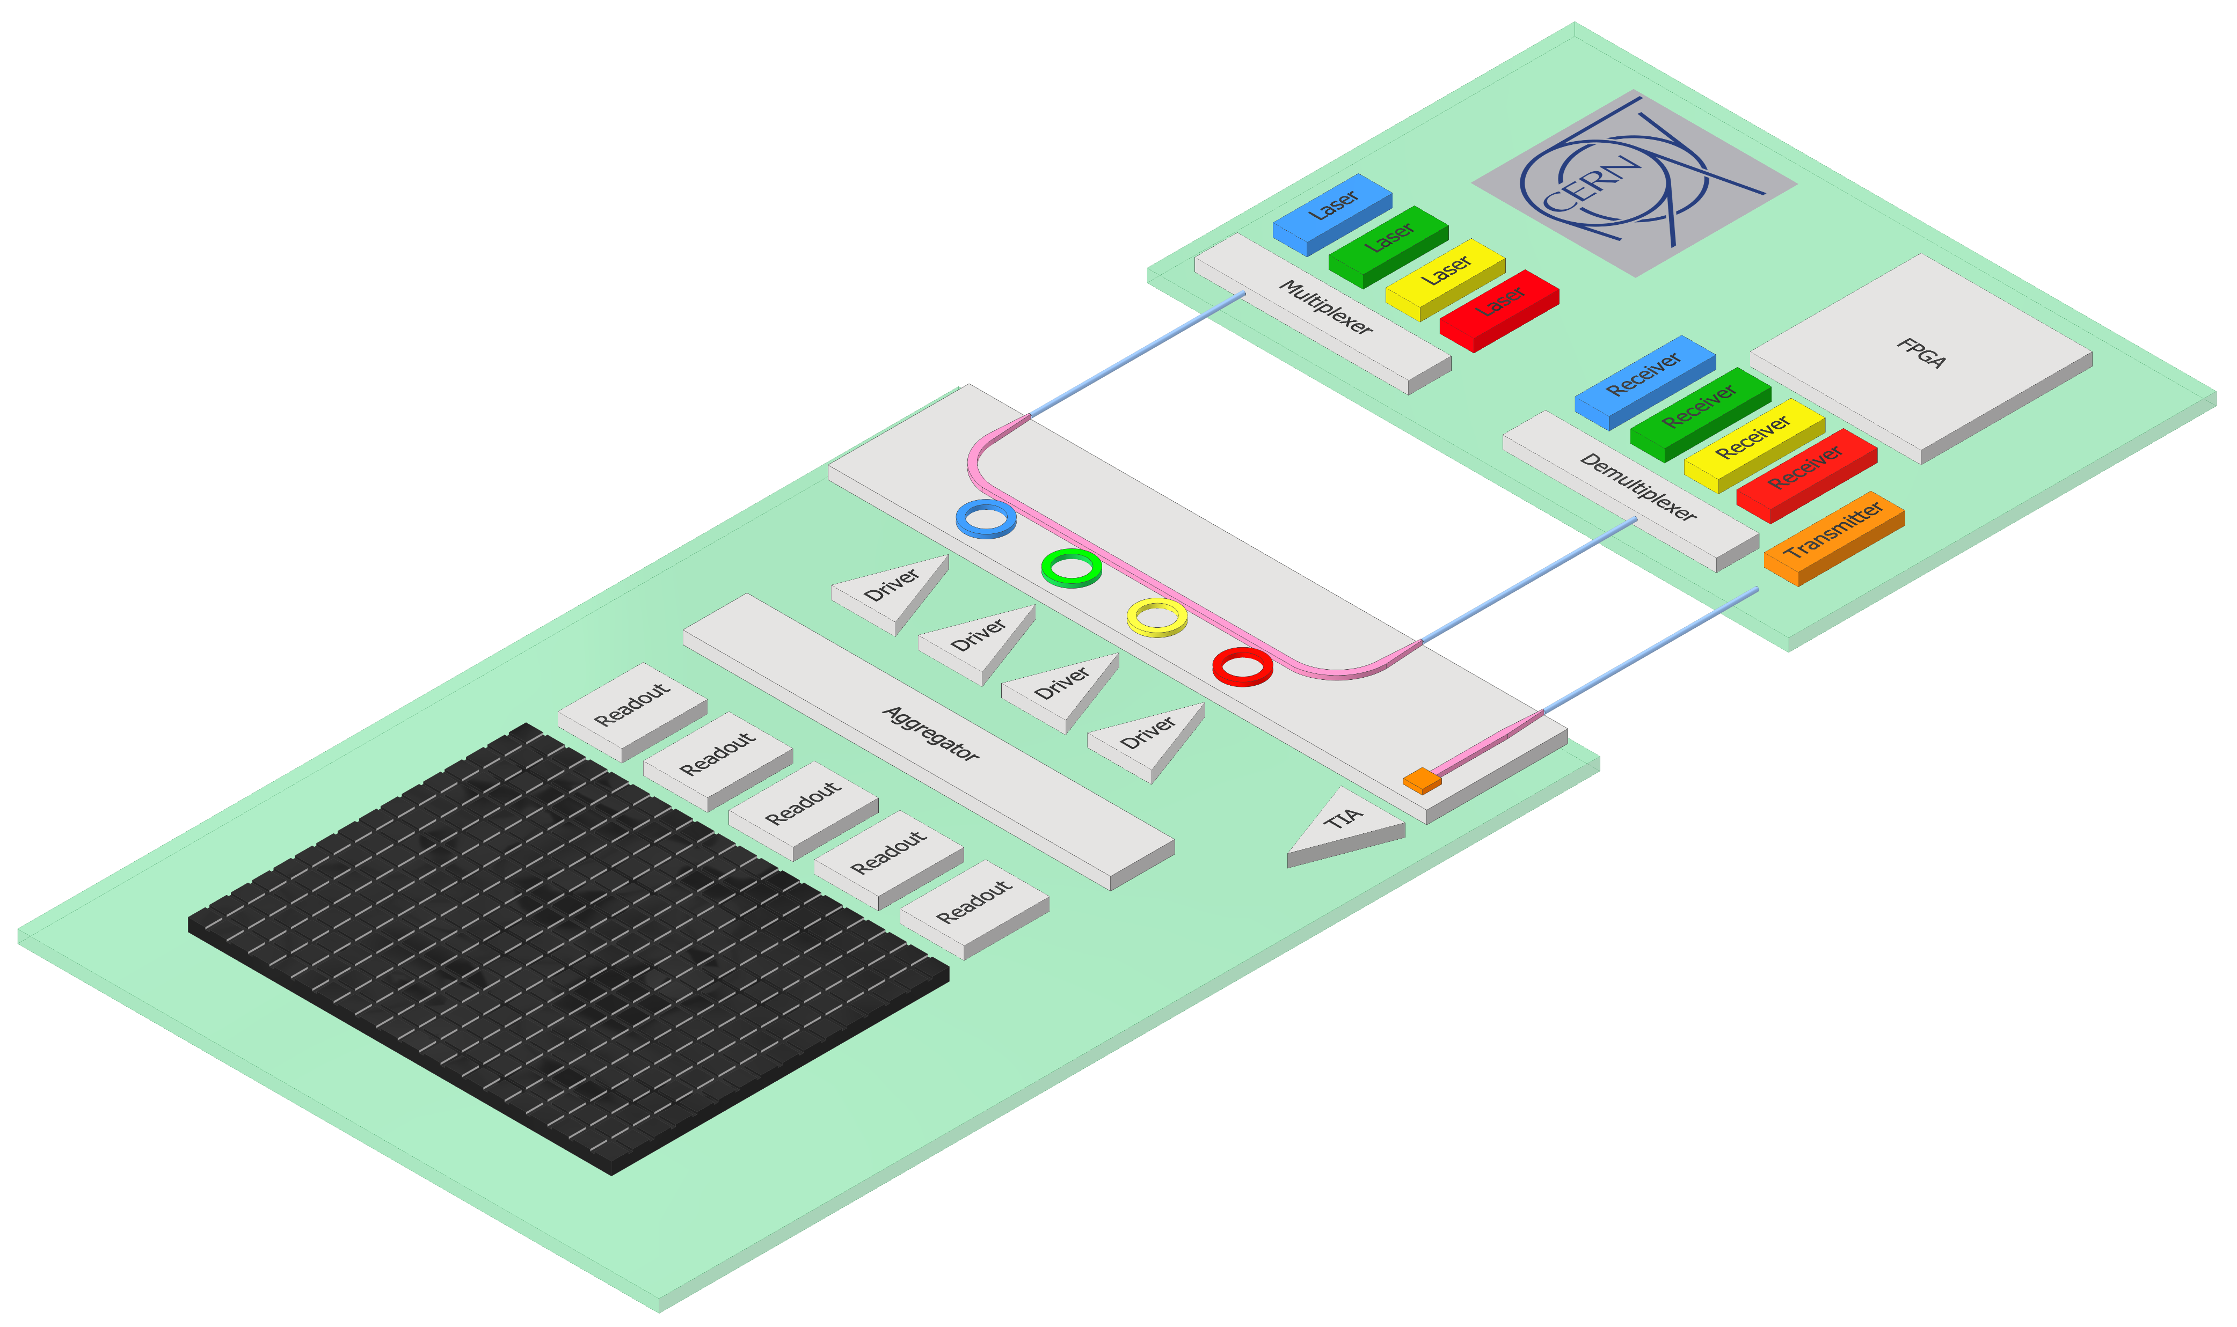


Silicon Photonics links for High Energy Physics
Photonic Integrated Circuits (PICs)
Chiplet fabricated using CMOS process
Fiber couplers, optical waveguides, modulators, photodiodes
Radiation tolerant
Wavelength division multiplexing:
Lane: 25 Gbps NRZ
Fibre: 100 Gbps
COTS 100G CWDM4 QSFP28 off-detector
Laser sits outside of radiation environment
Wavelength 1300 nm
Transparent window for Silicon
COTS External Laser Source
Low power / Low mass
>> 100 m Single-mode fibre
PIC
Fiber coupler
FPGA
Modulator
Photodiode
OPTO
Particle sensor
ASIC
More details in TWEPP 2024 contribution:
https://indico.cern.ch/event/1381495/contributions/5988694/
System concept under development in the
EP R&D WP6 project

Slide 2
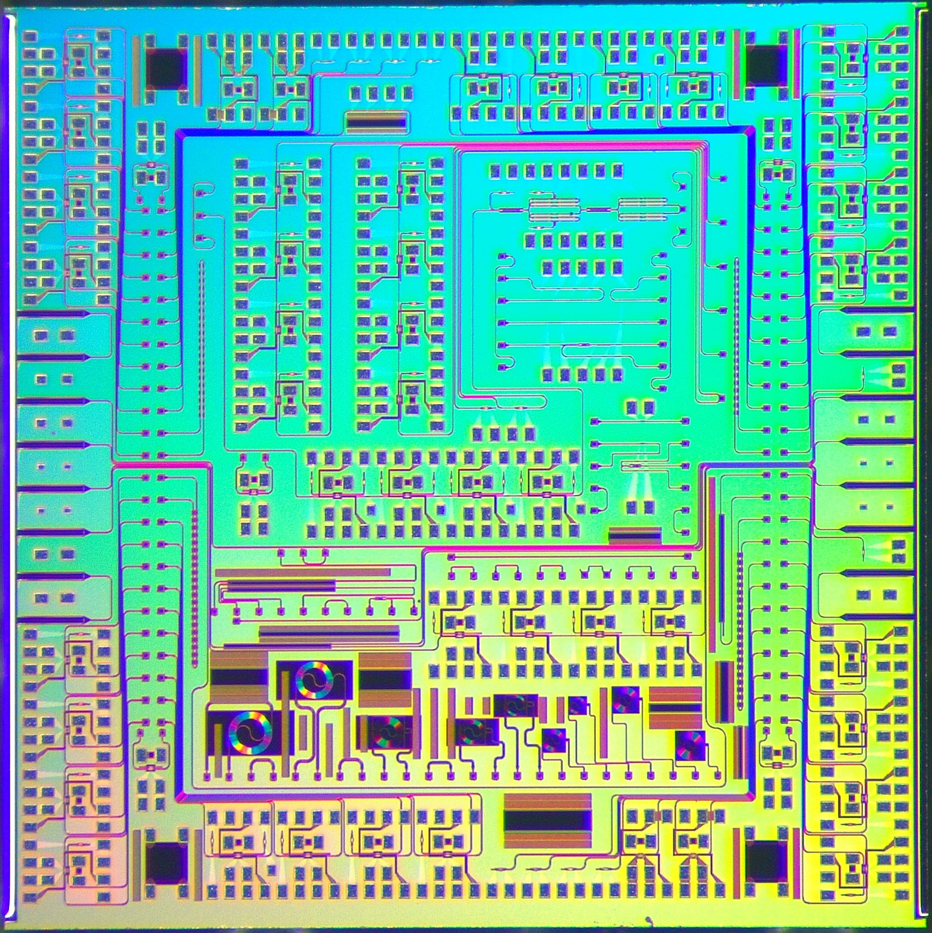
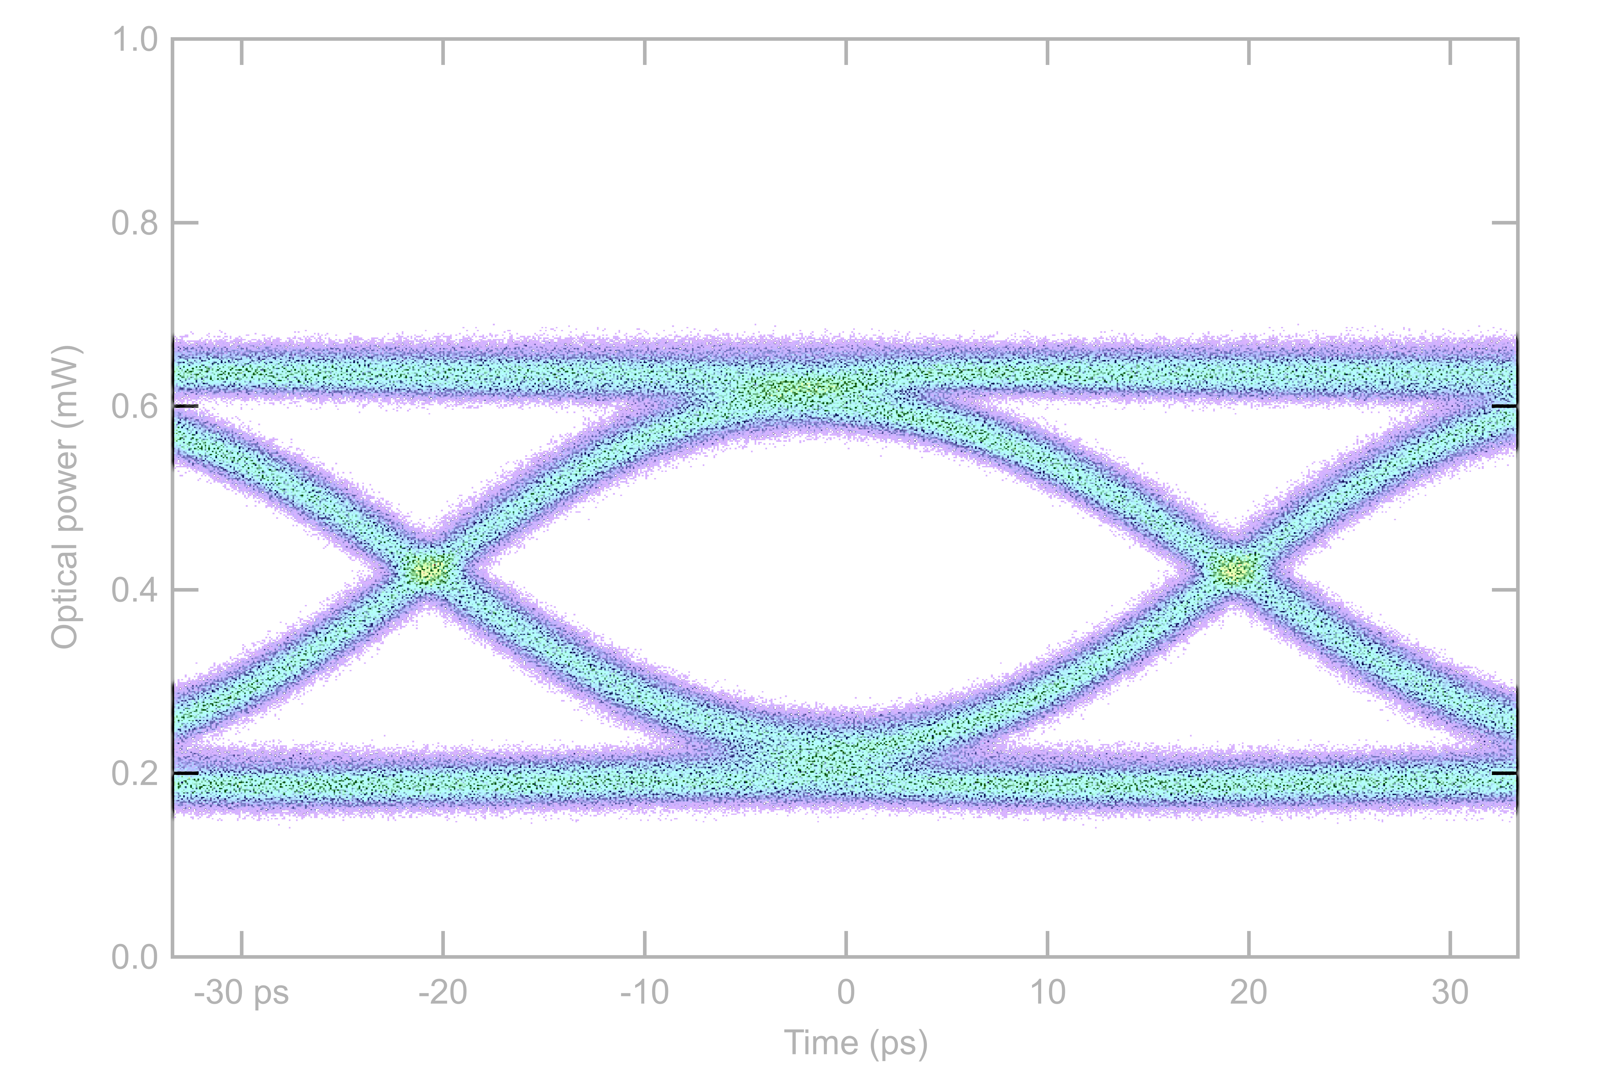
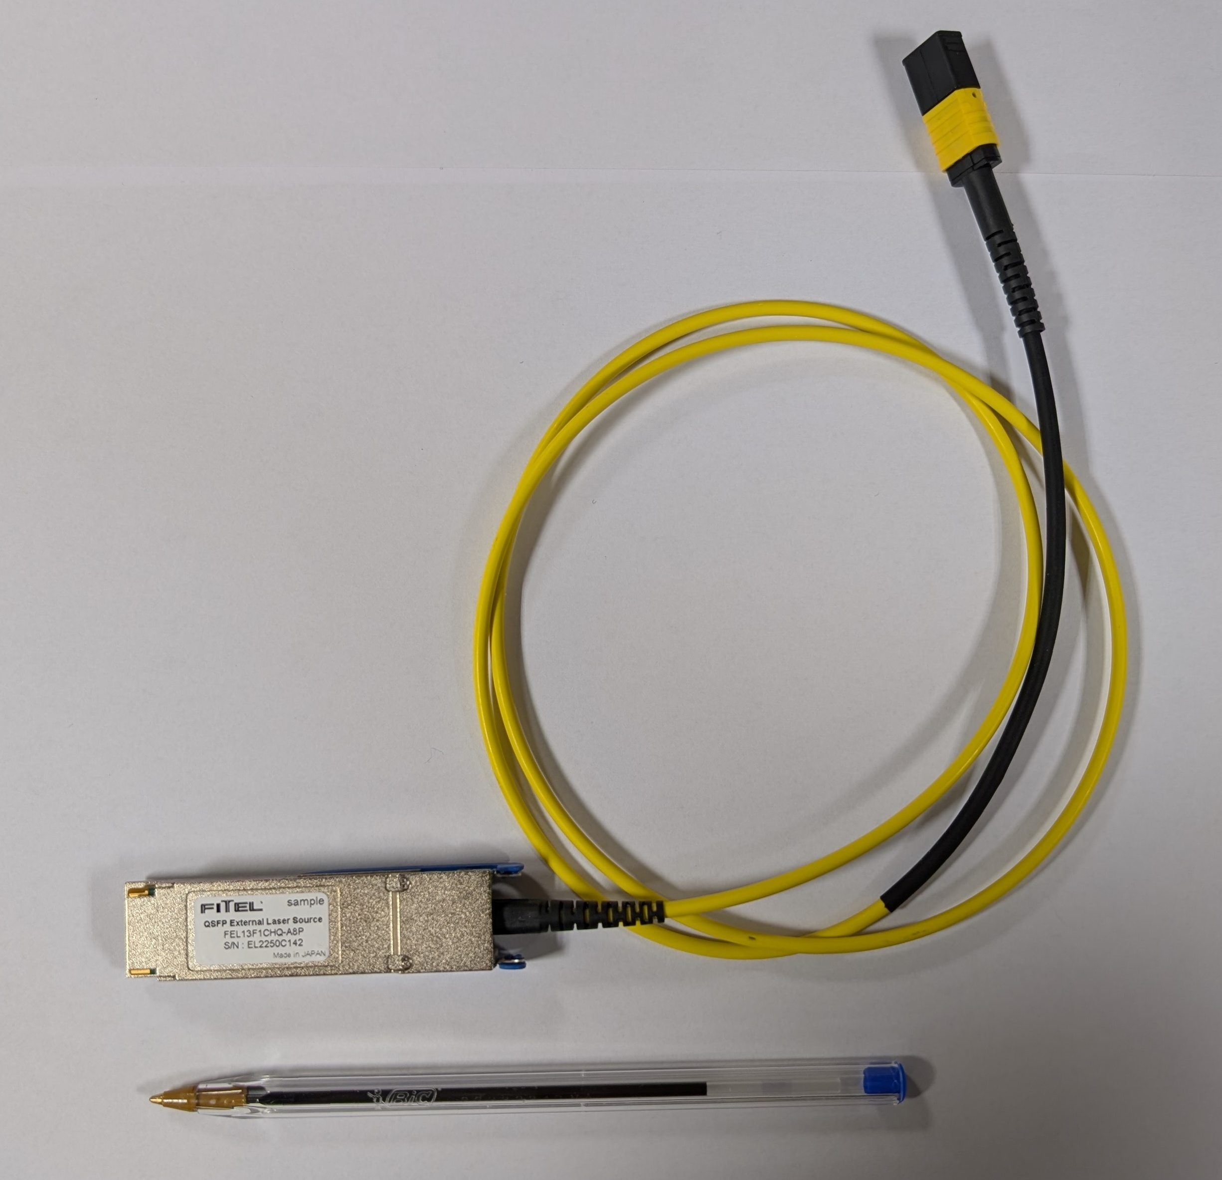
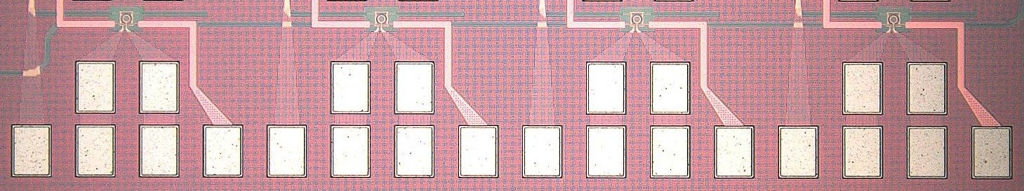
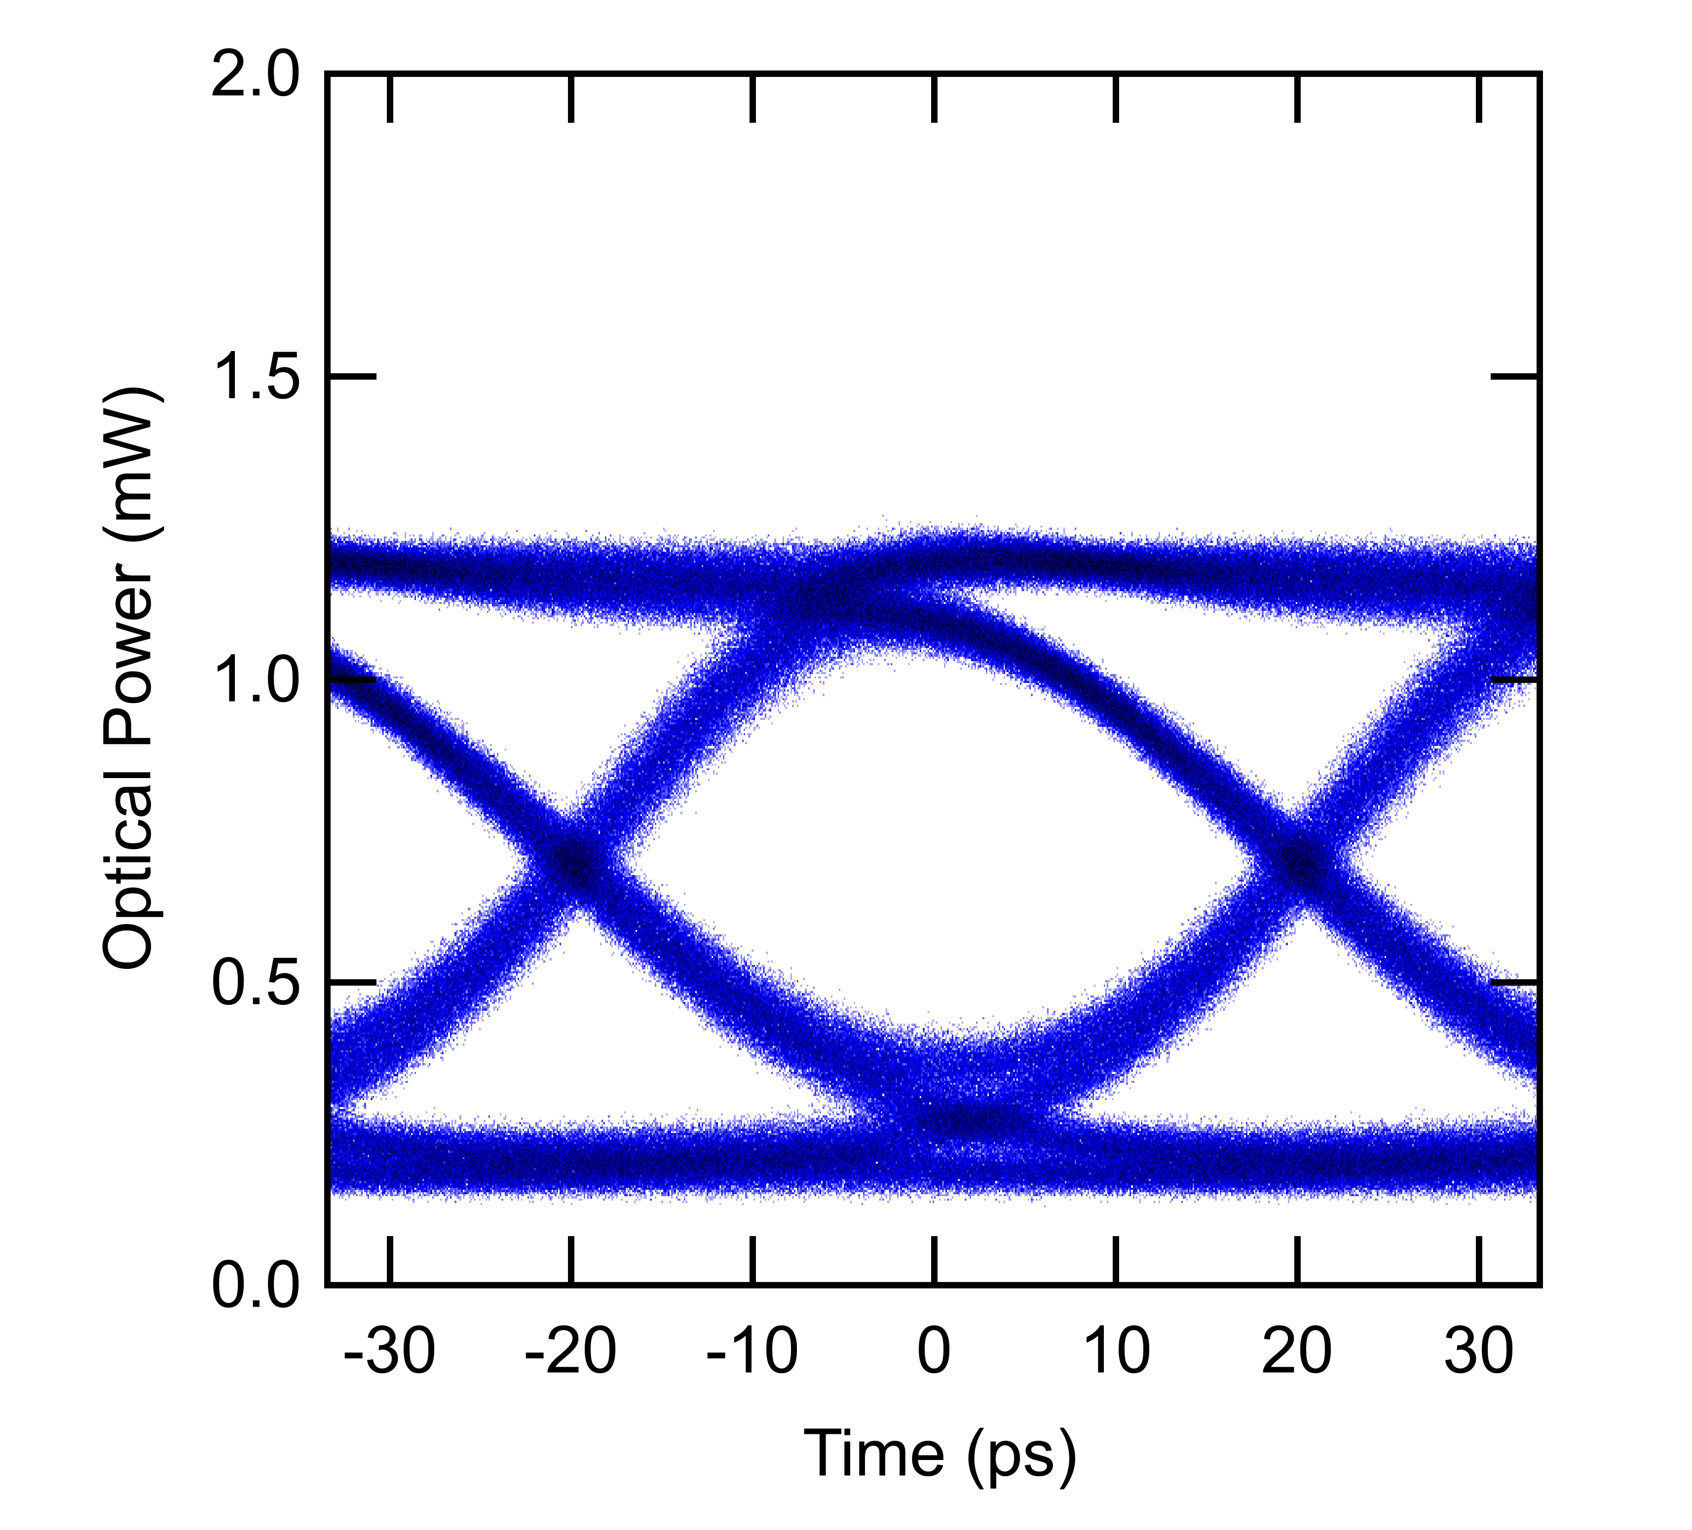
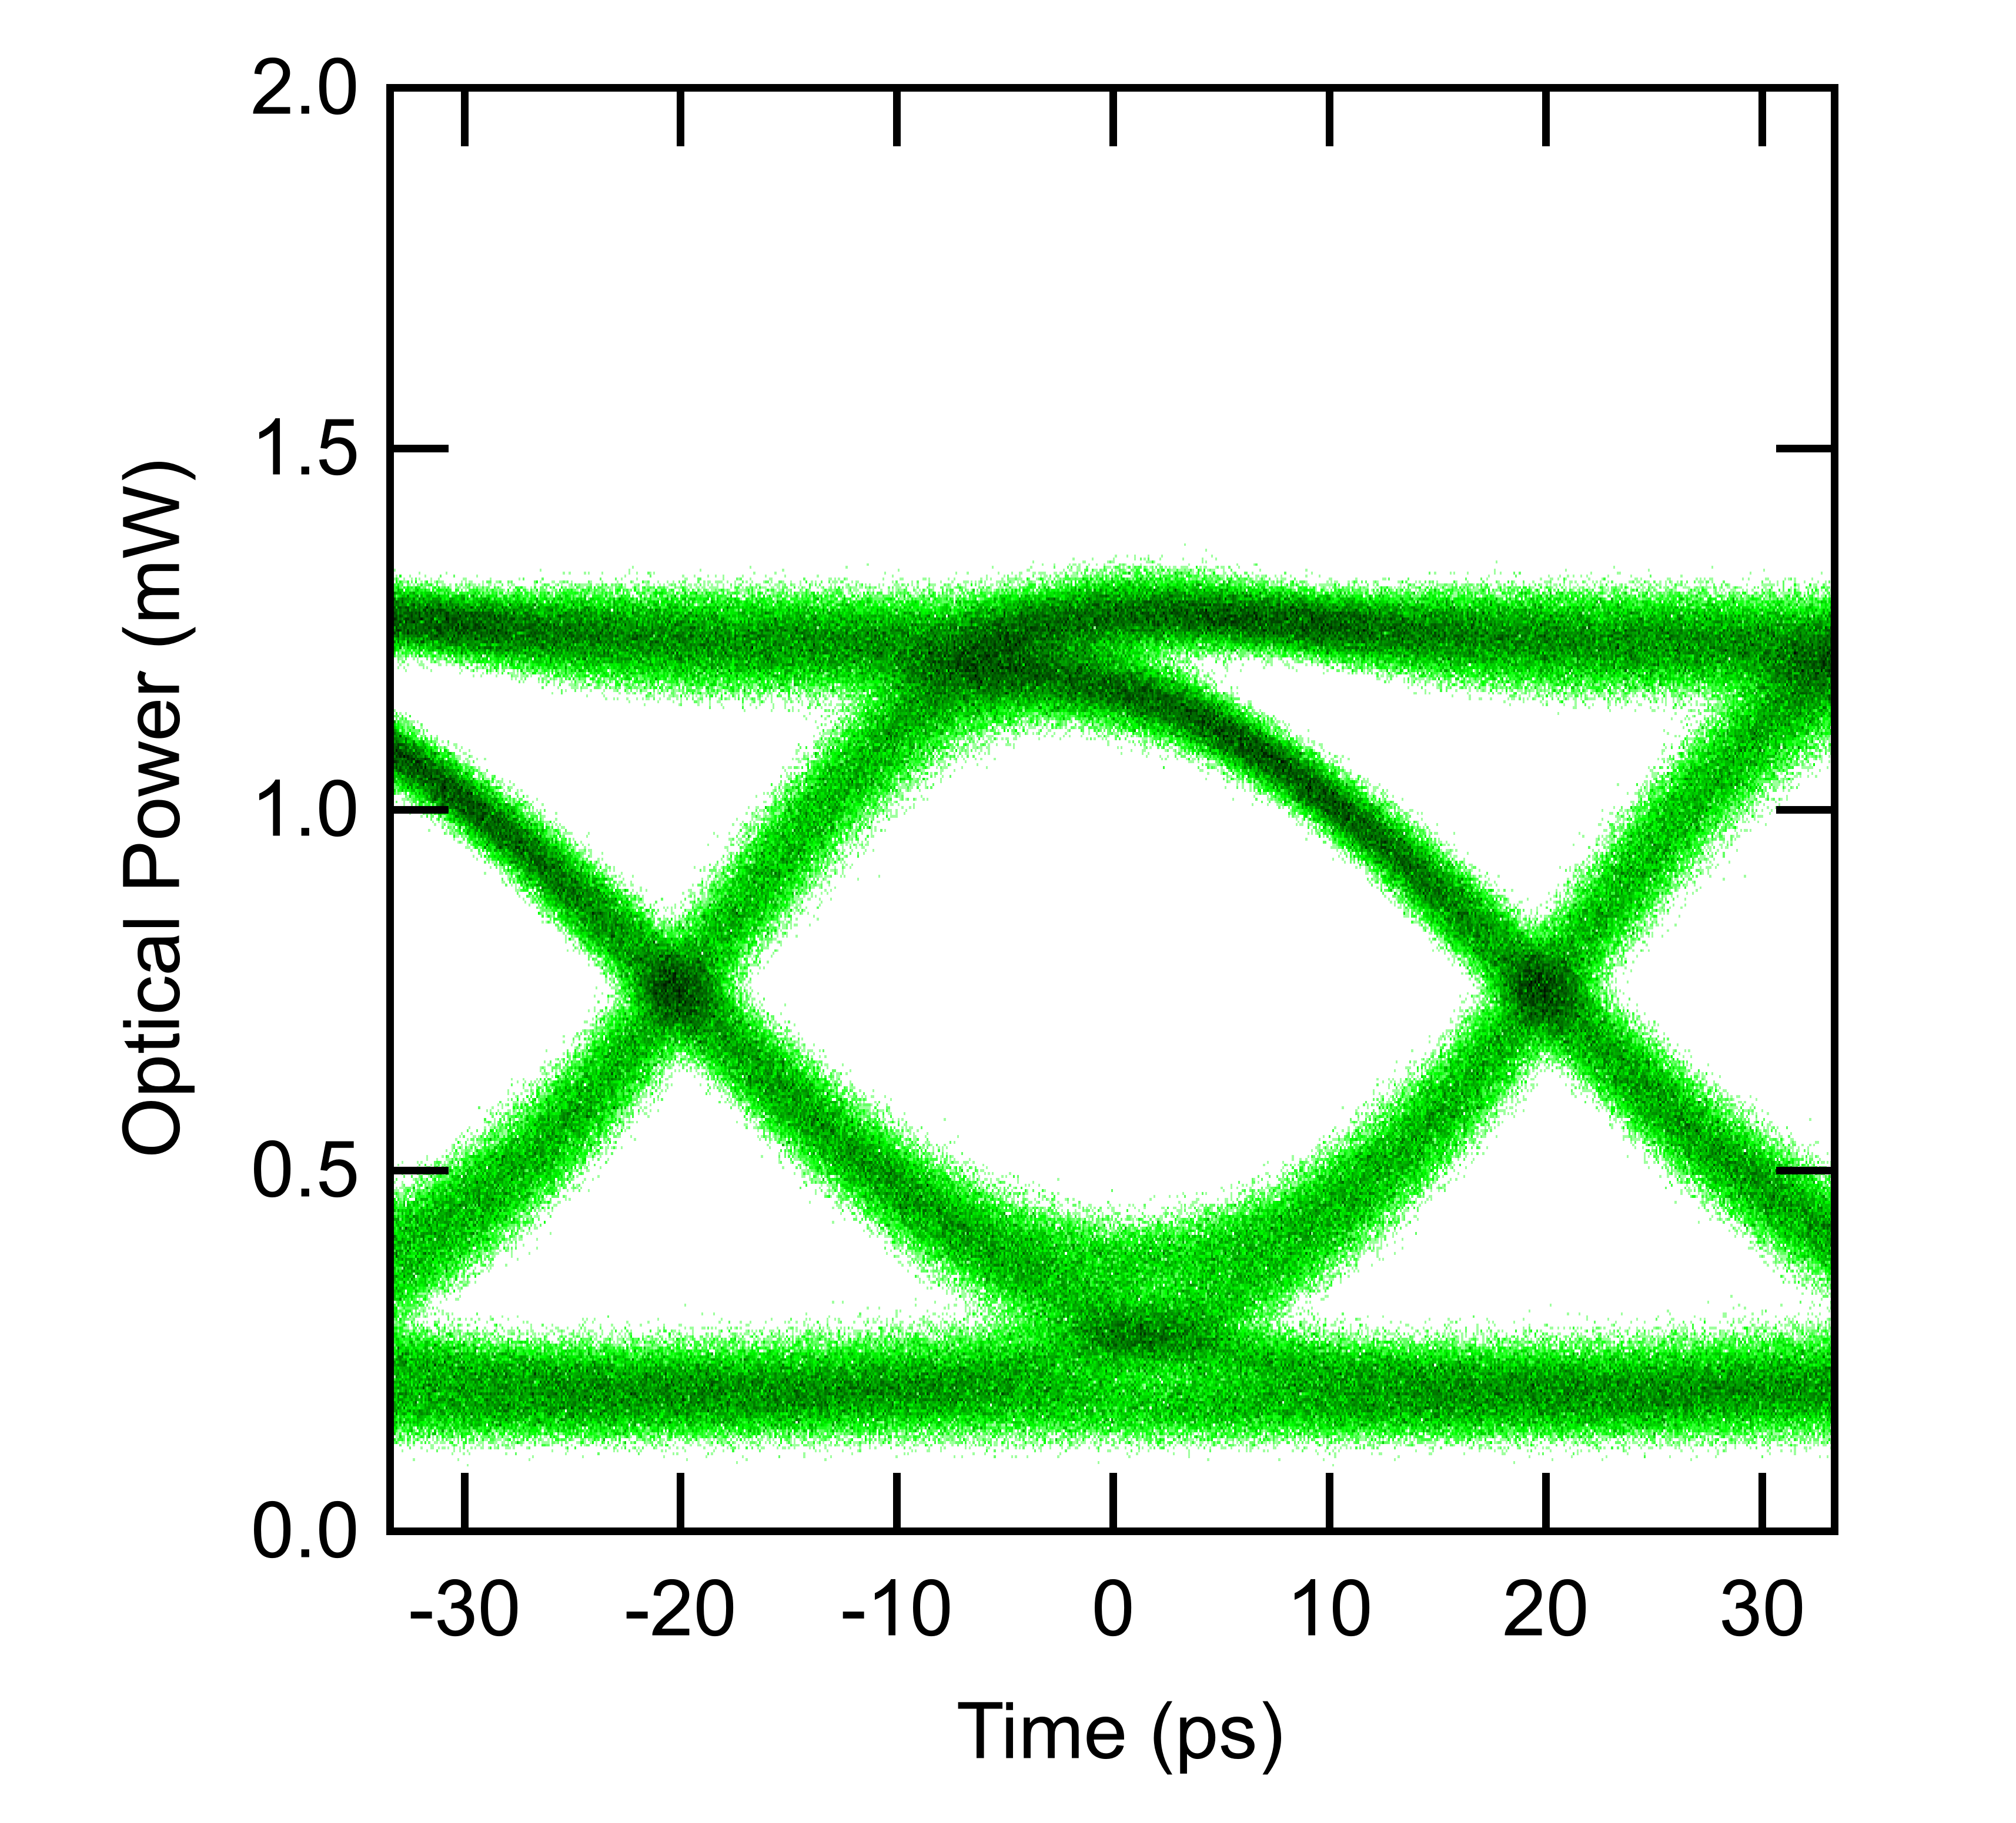
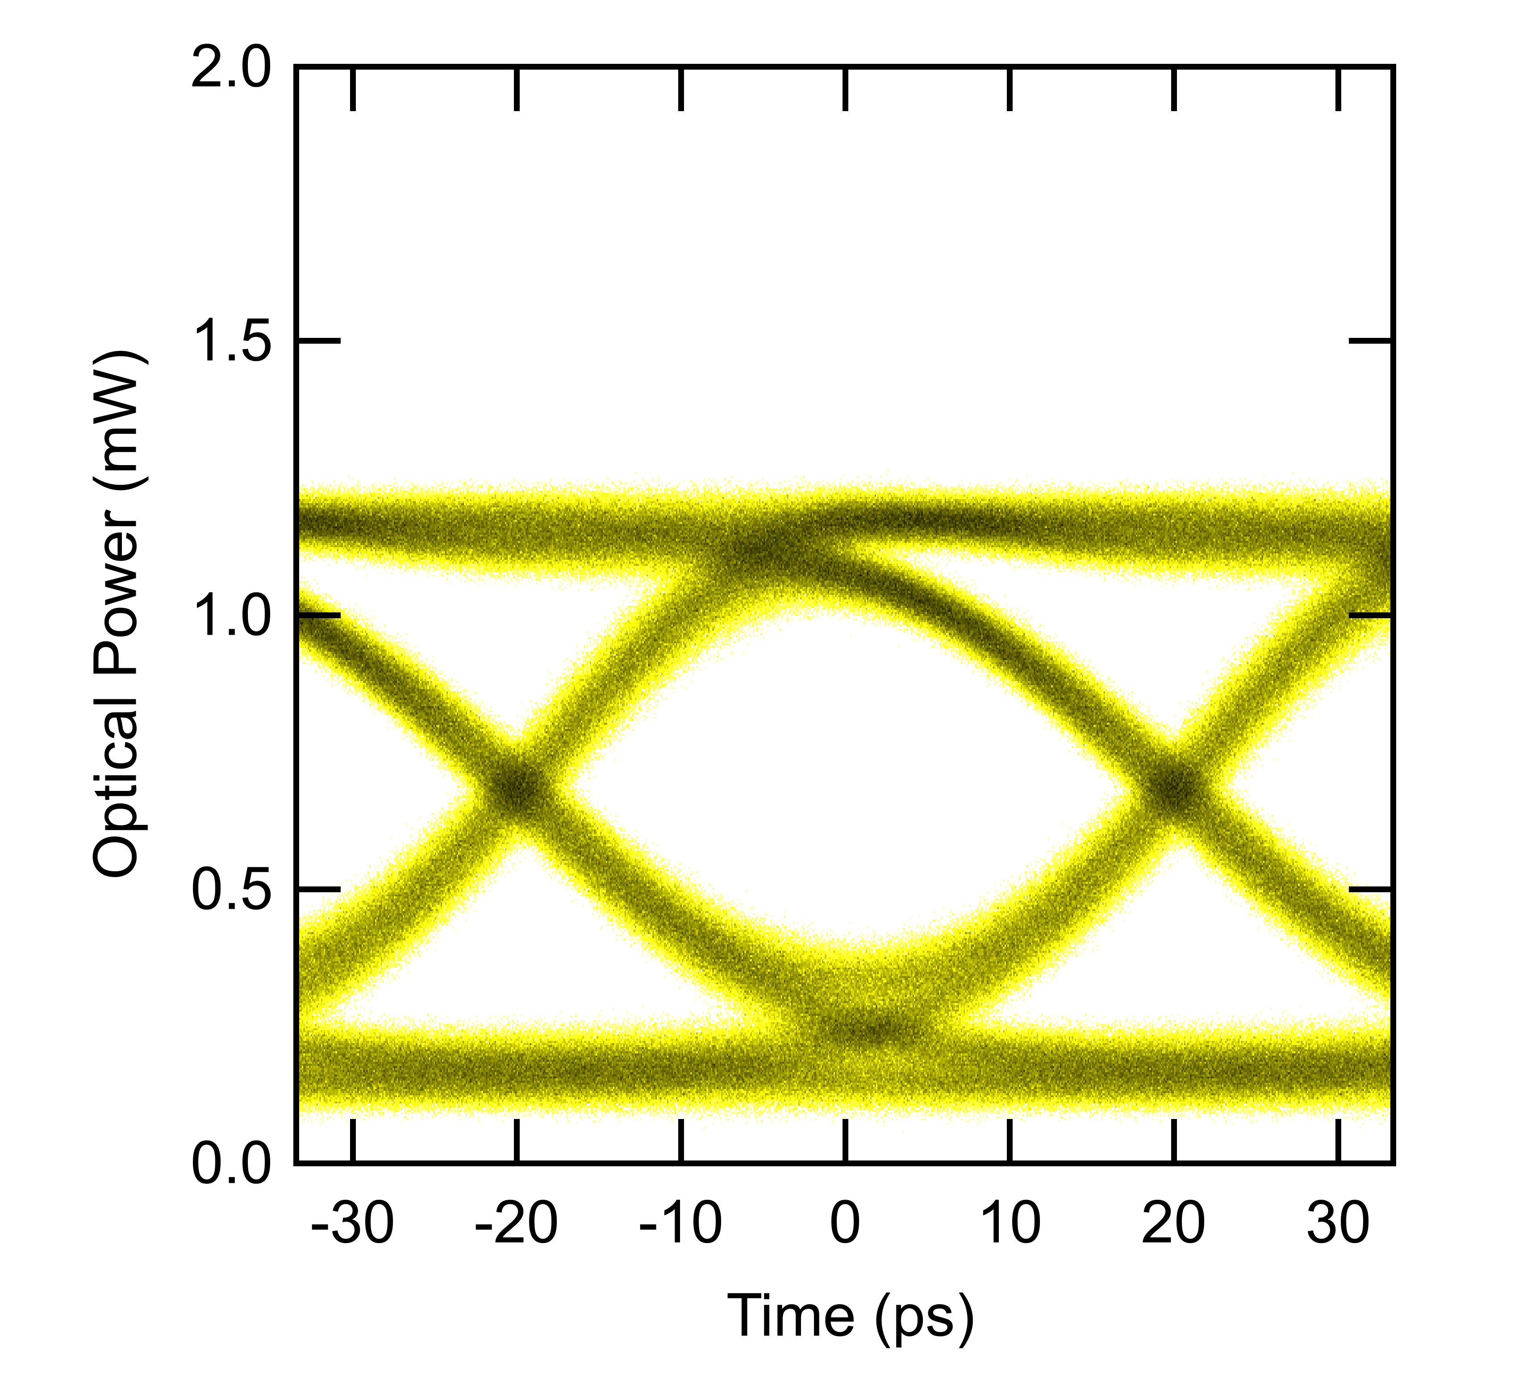
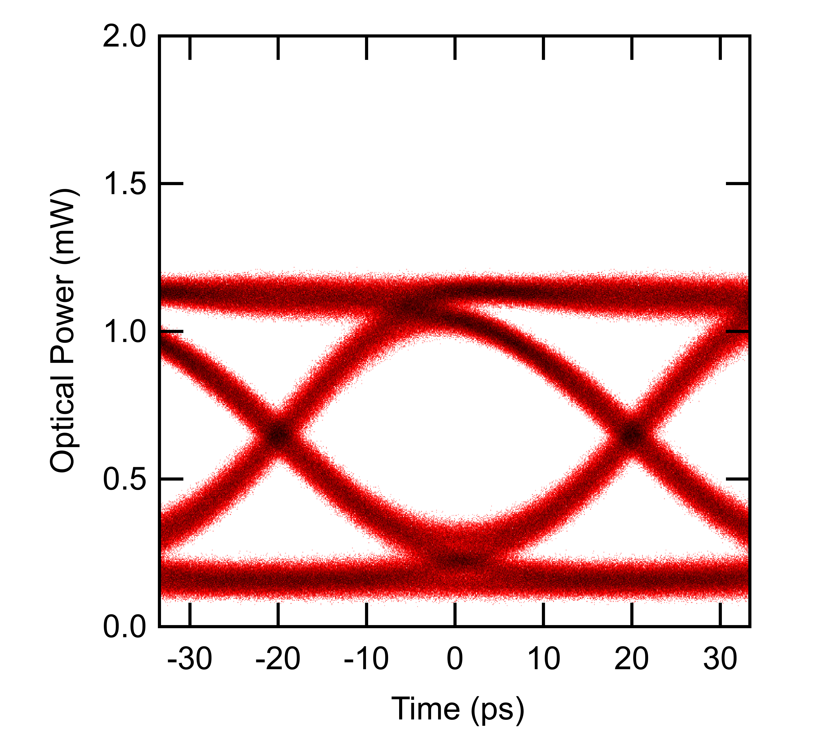
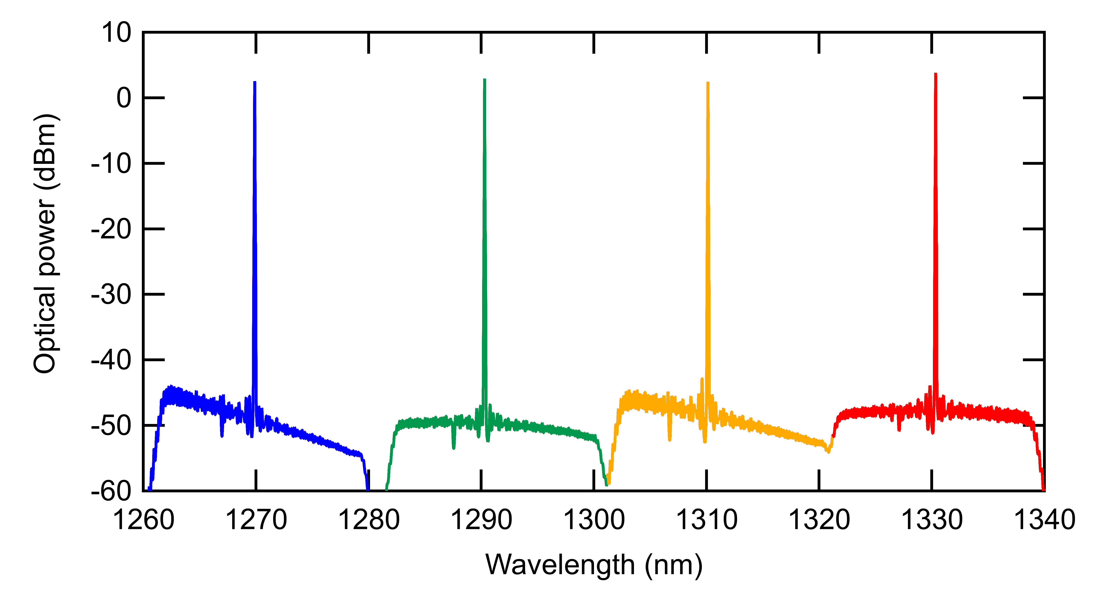
PIC System Testing
Demonstrated 4-channel wavelength division multiplexing WDM) operation using an optical circuit integrated into the SystemPIC
25 Gb/s per channel – 100 Gb/s into a single fibre
Optical power supply: External Laser Sources (ELS) standardised and available from multiple vendors
SystemPIC
Ring modulator
ELSFP
5 mm
200 µm
Electrical data in
Bond pad
25 Gb/s PRBS31
4-wavelengths ELS optical spectrum
Channel 1 – 1271 nm
Channel 2 – 1291 nm
Channel 3 – 1311 nm
Channel 4 – 1331 nm

Slide 3
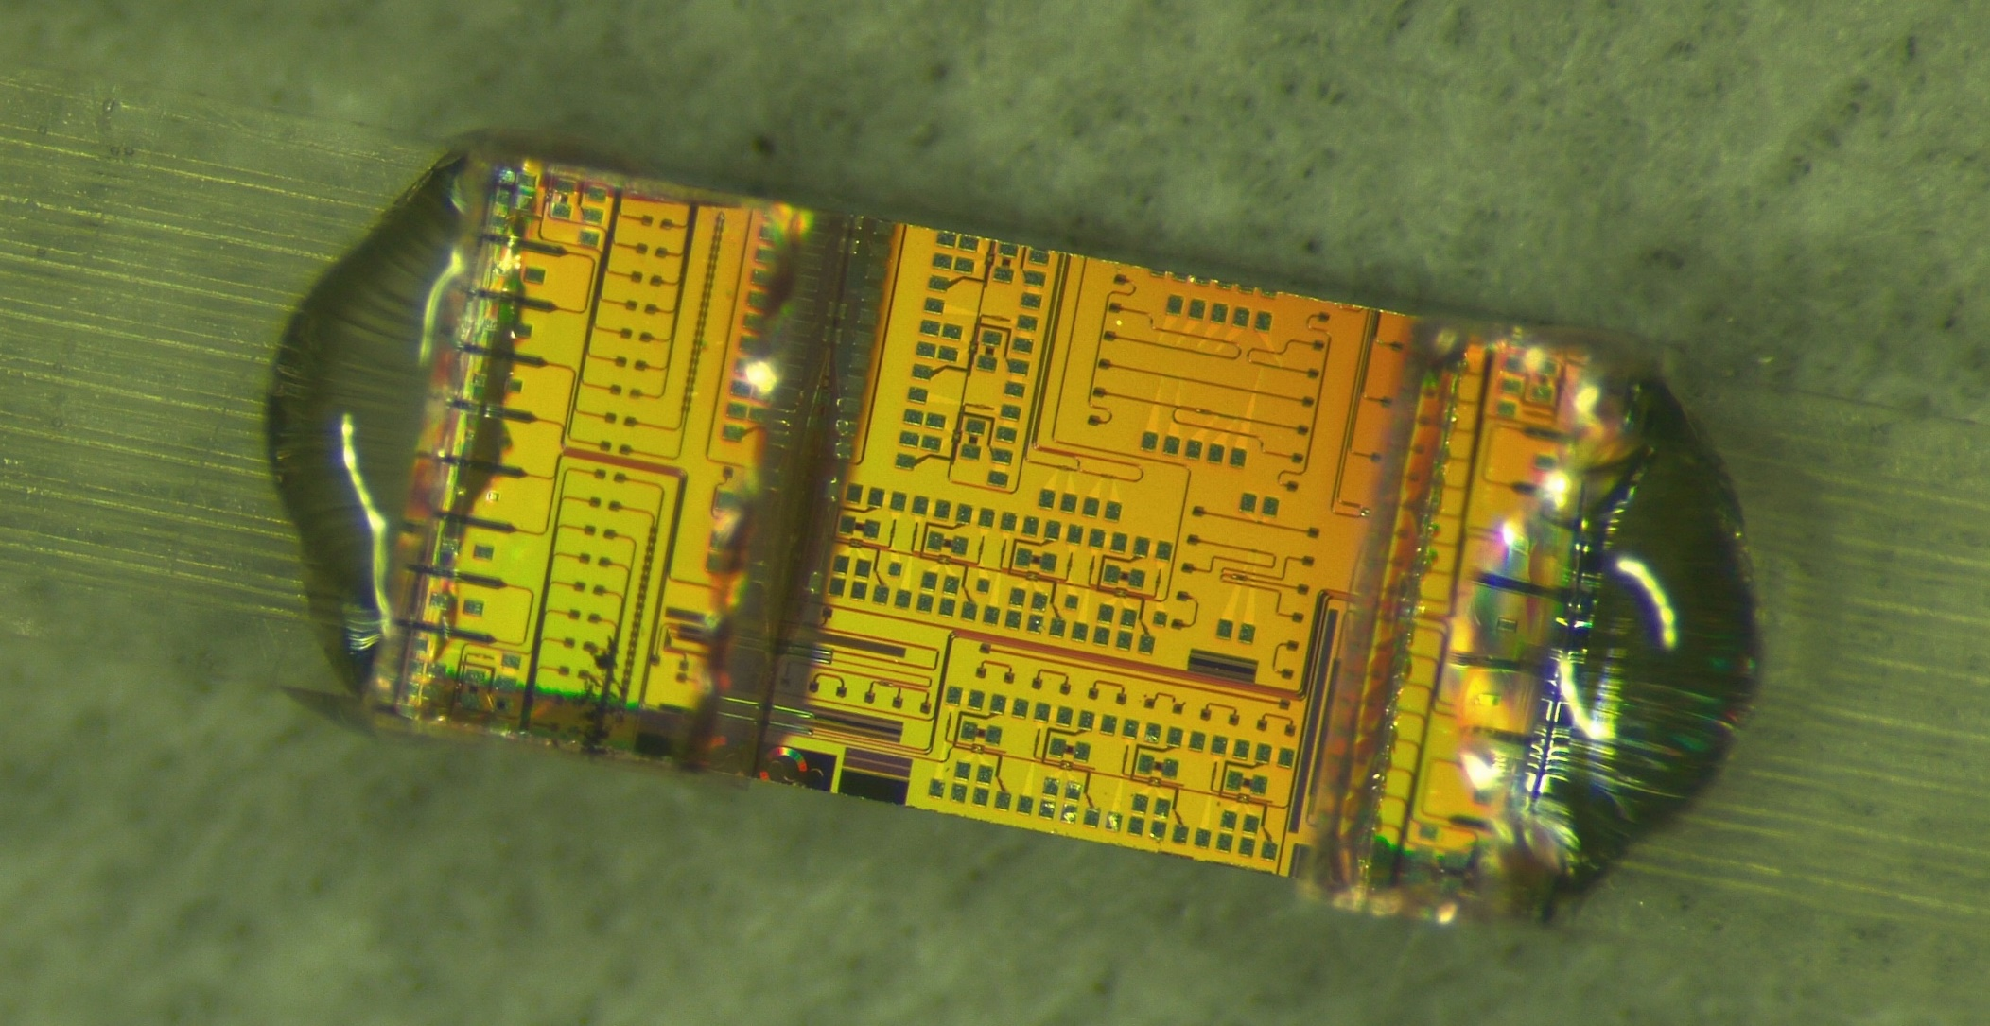
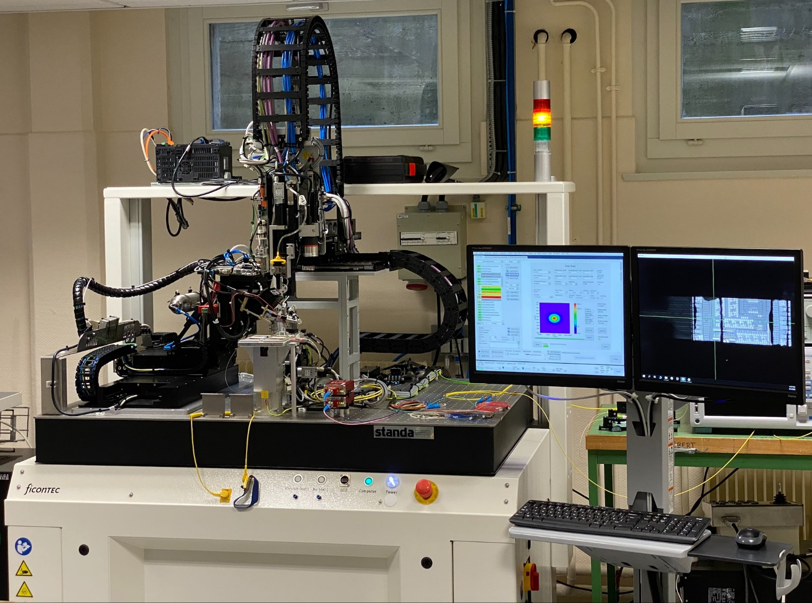
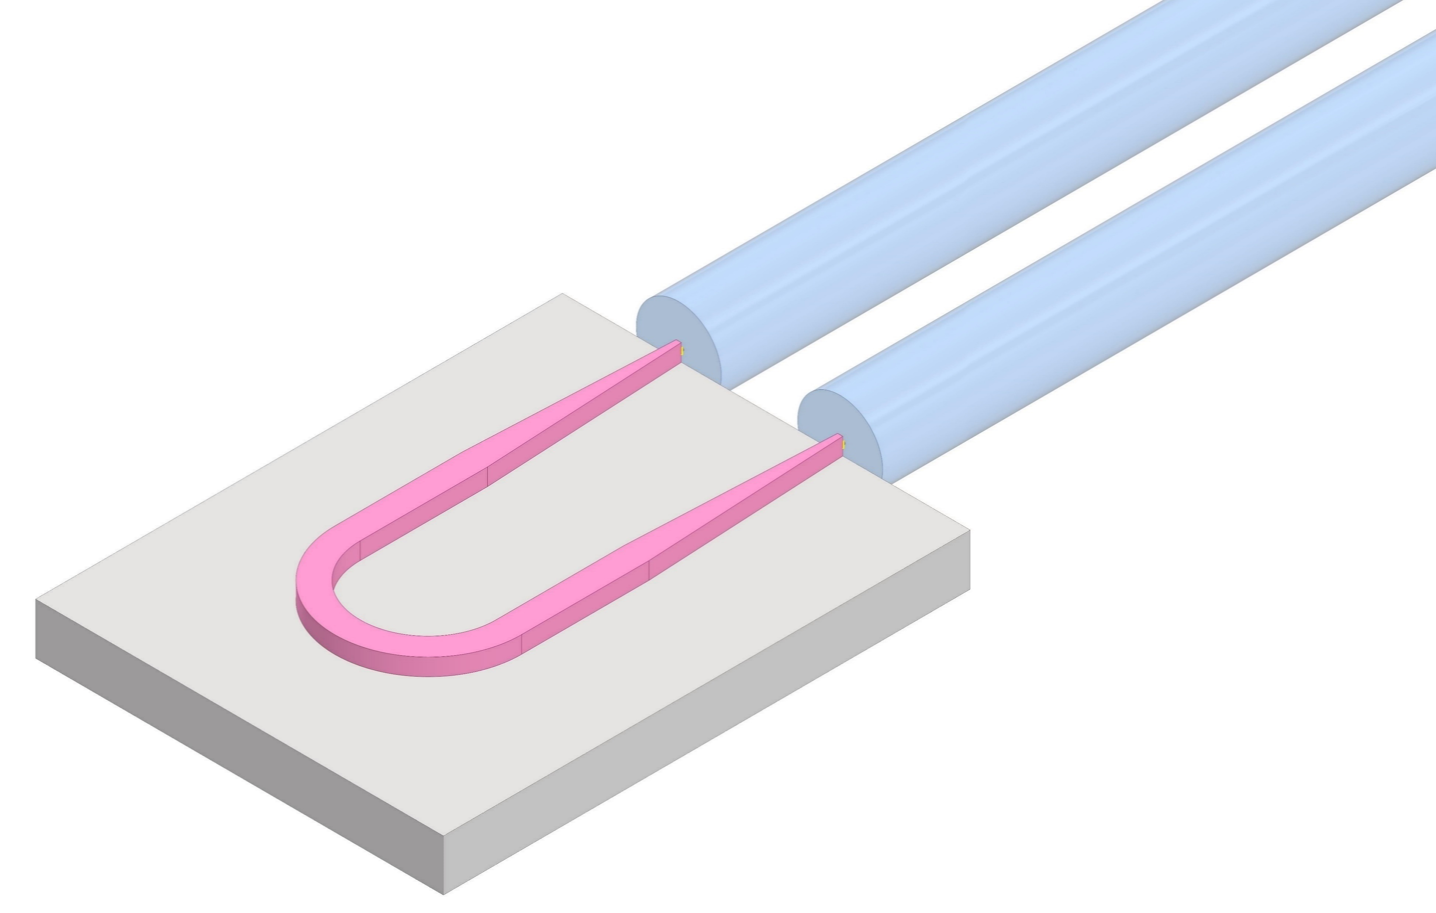
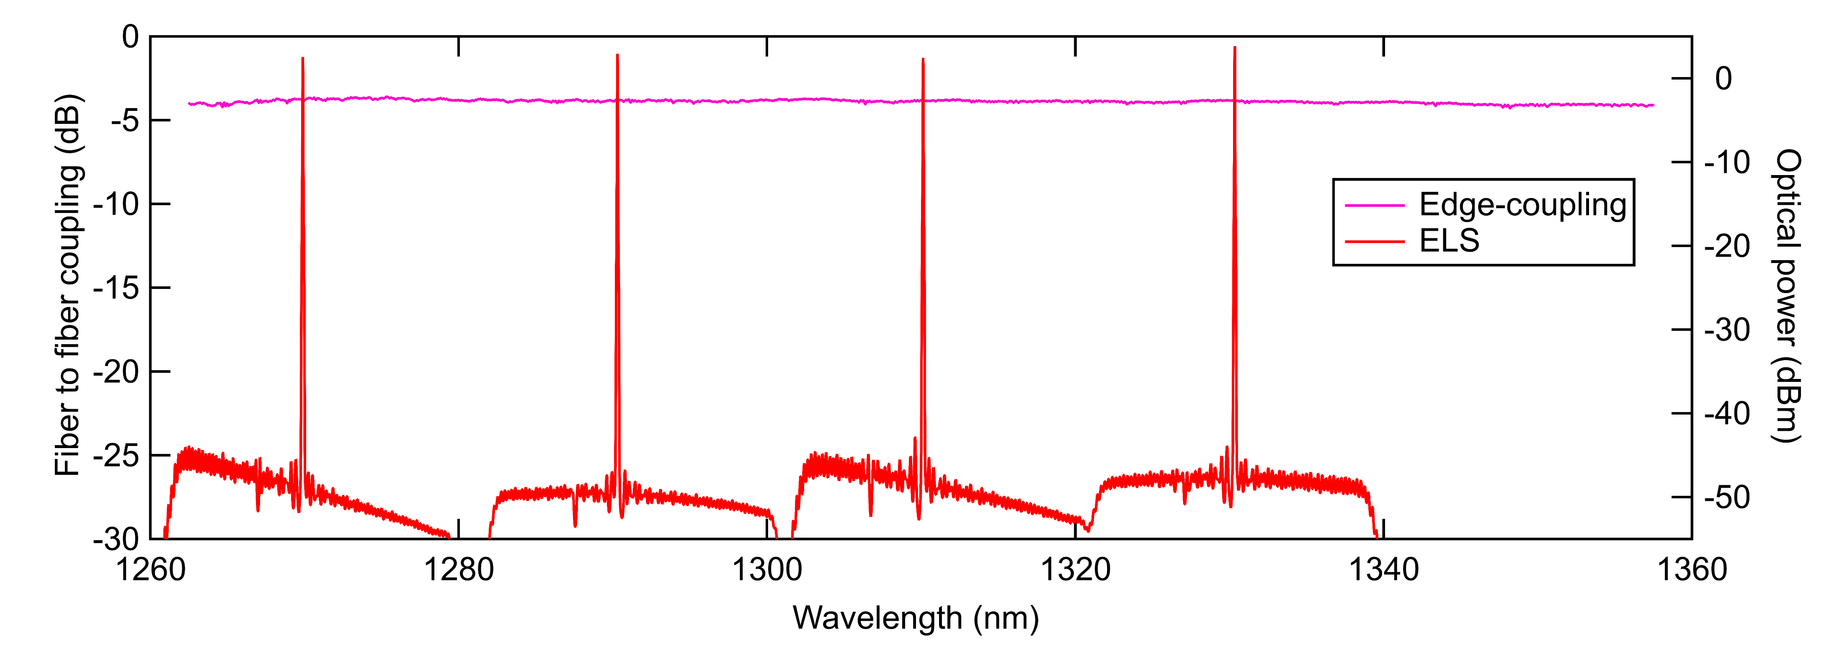
PIC Optical Packaging
R&D fiber attachment machine for PICs purchased by CERN
Supporting the R&D activity and build internal knowhow on photonic assembly
Active alignment and vision-based processes fully customisable by the user
8-channel fiber arrays attached to the SystemPIC using UV-cure epoxy
Test vehicle for 4-channel coarse wavelength division multiplexing (CWDM4) transmitter
High coupling efficiency ( ≈ 2 dB per fibre) and flat spectral response
8-channel
fiber arrays
5 mm
Optical fiber
Edge coupler
Check out the video at:
https://ep-news.web.cern.ch/content/silicon-photonics-circuits-integrated-optical-readout-future-high-energy-physics-detectors

Slide 4
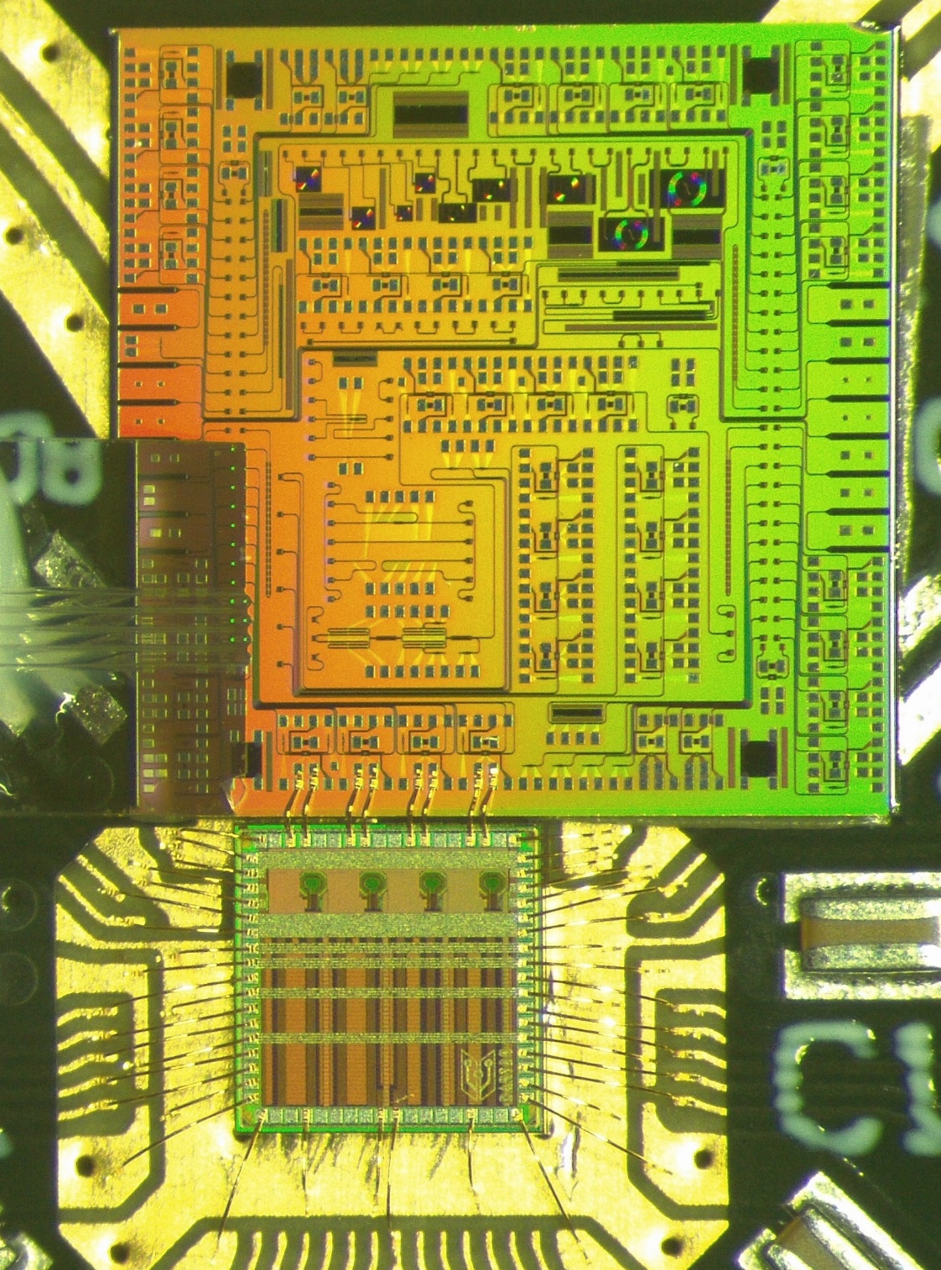

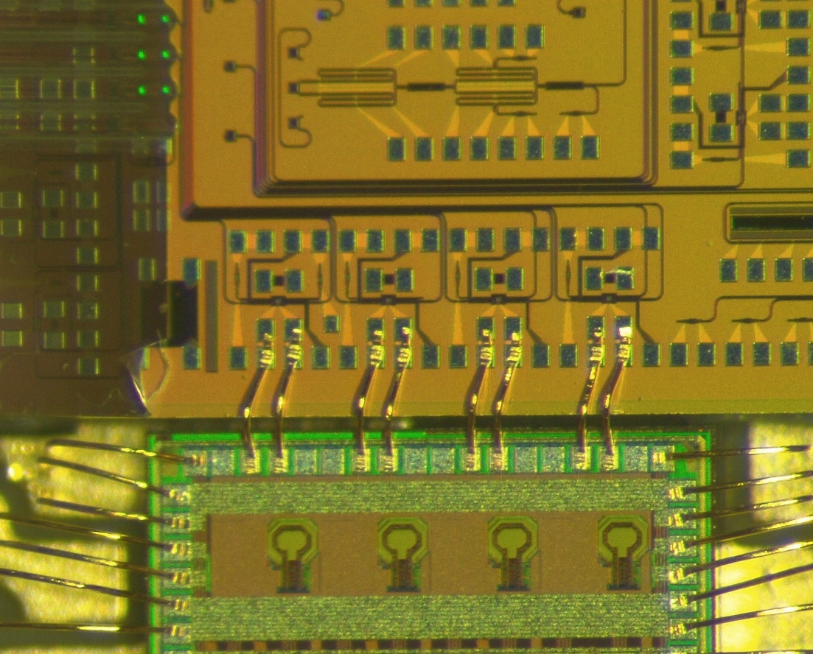
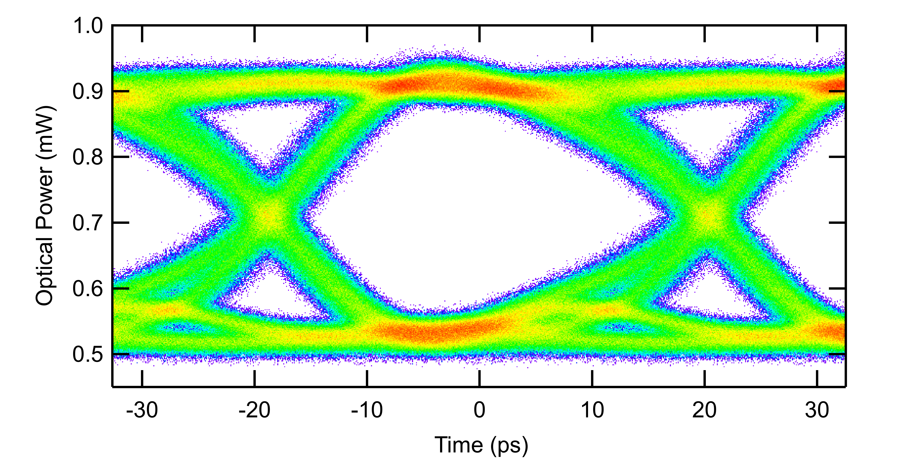
PIC Co-Packaging with DART28
Proof of concept for PIC and driver co-packaging
Stepping stone for the EP R&D WP6 project
Wire bond length is crucial for signal integrity at 25 Gb/s data rate
Wide open optical eye diagram at 25.6 Gb/s with fast edges
SystemPIC
Ring modulator
Fiber coupler
CW laser
Fibers
25.6 Gb/s PRBS7 data
~ 500 µm
DART

Slide 5
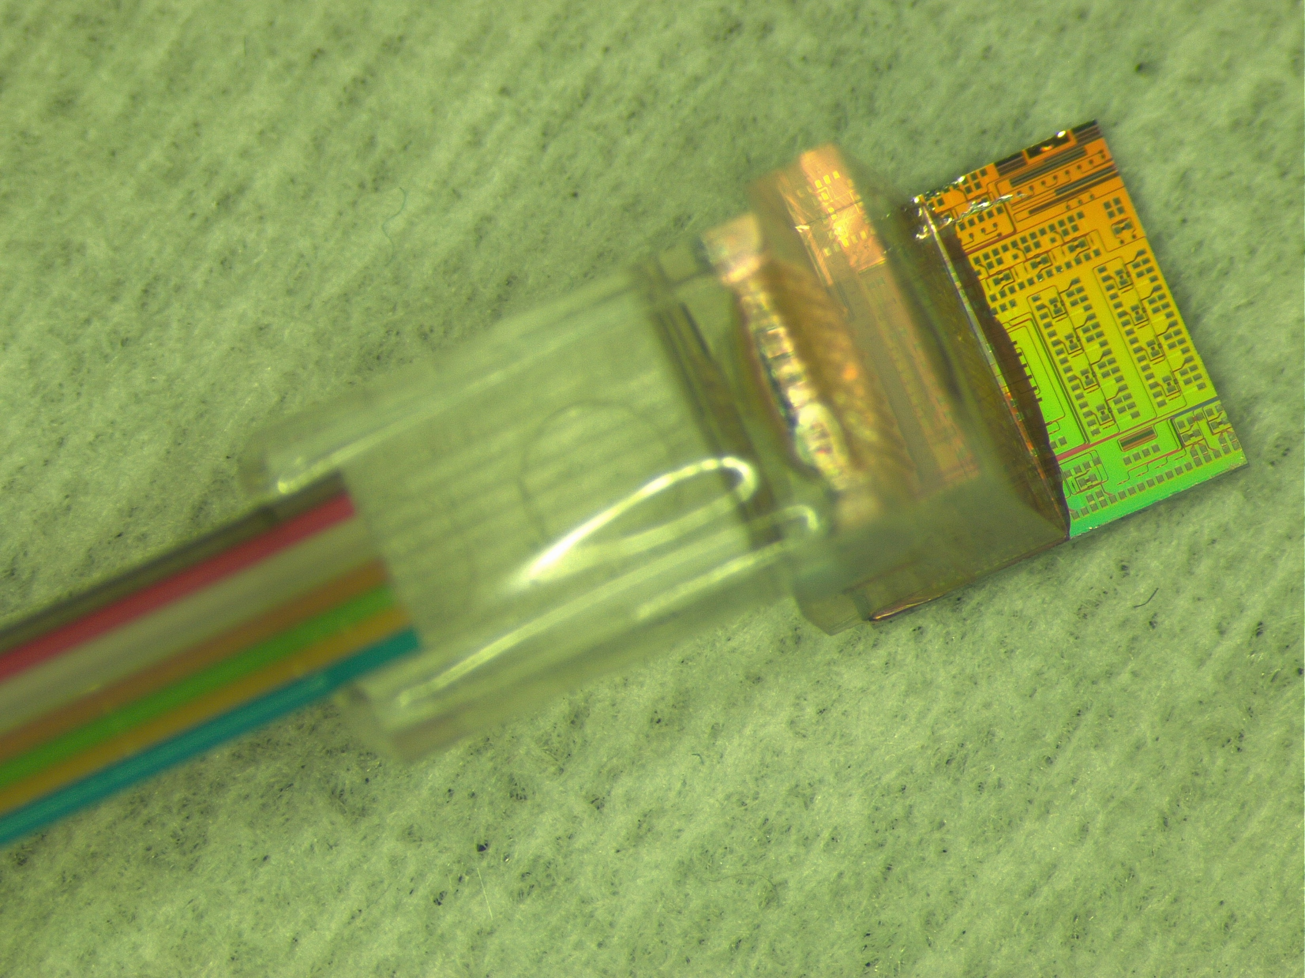
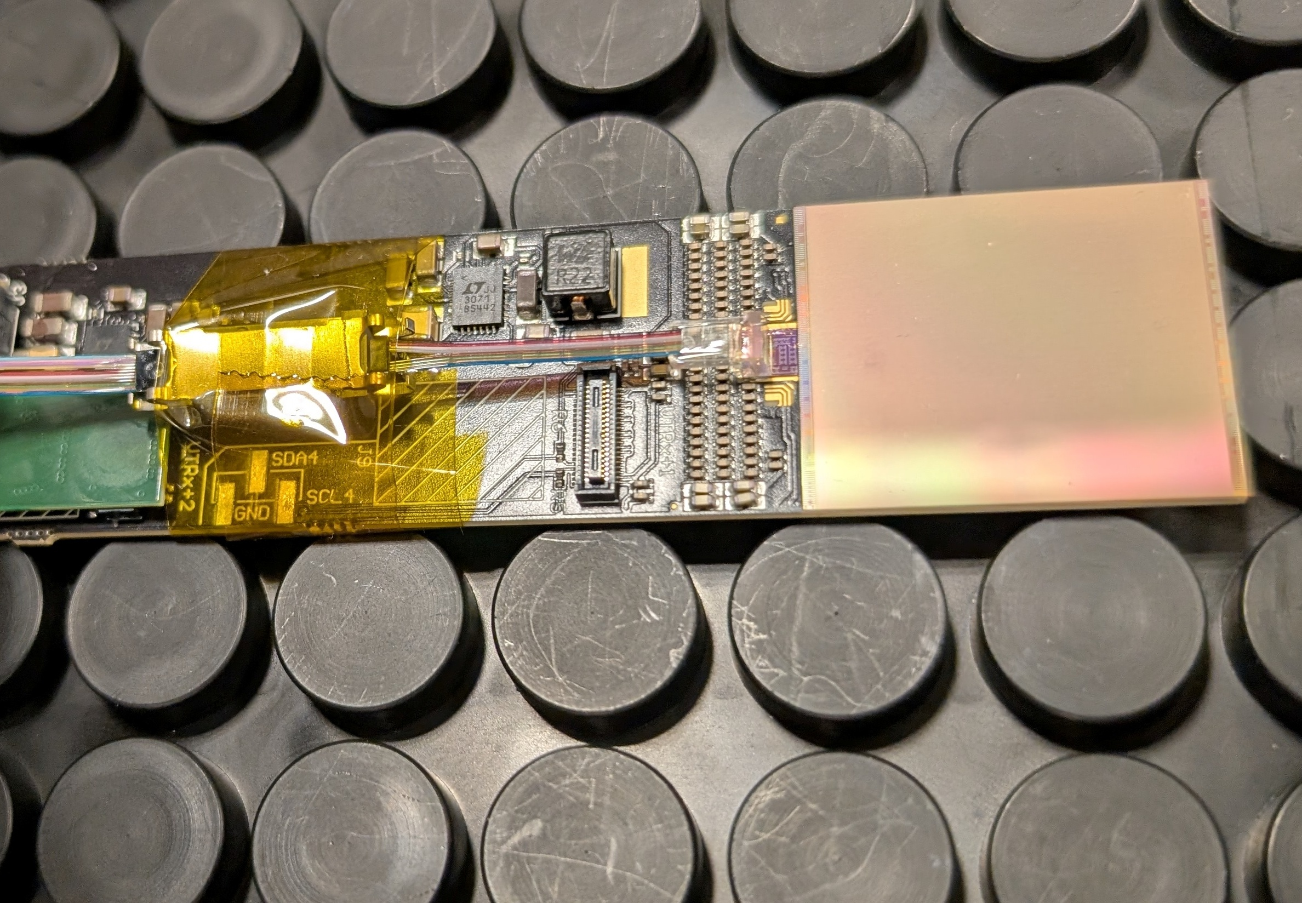
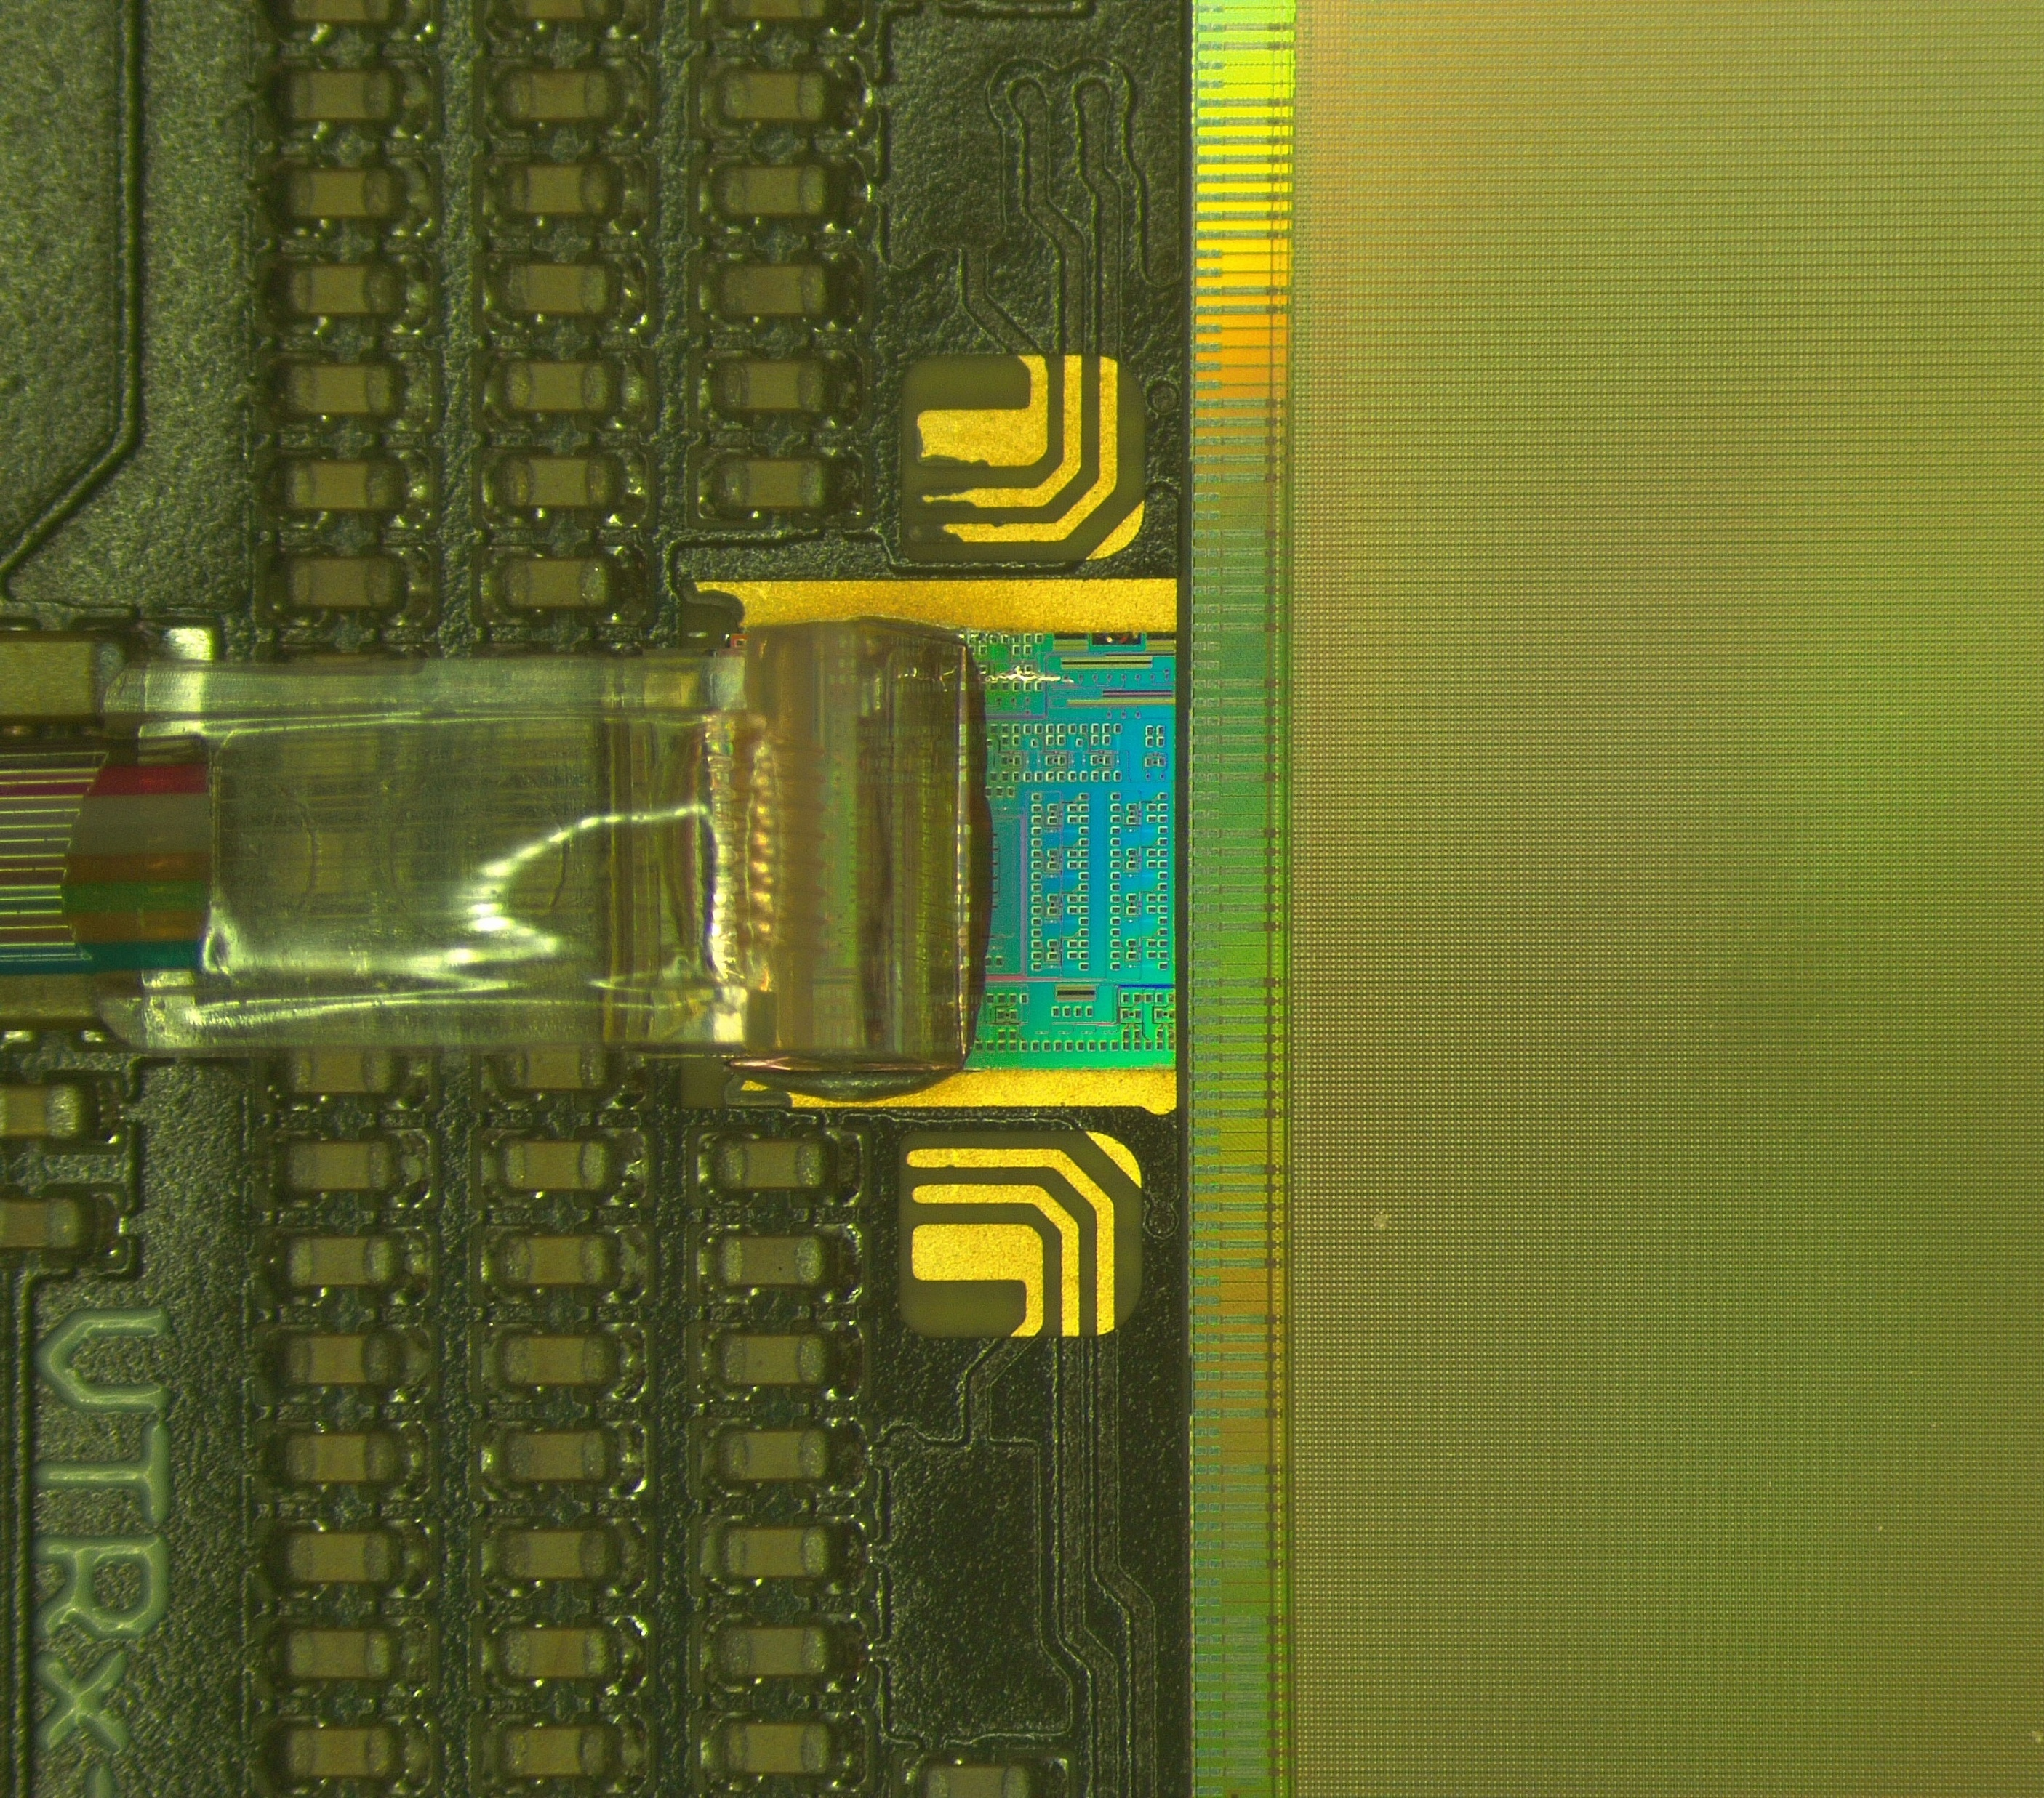
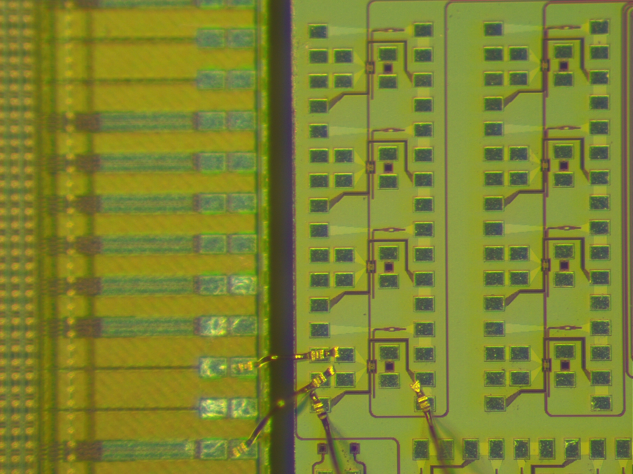
PIC Co-Packaging with Timepix4
Proof of concept of PIC co-packaging with particle sensor readout chips (ROCs), to achieving ultimately low-power and reduced mass
It is a paradigm shift respect to the traditional optical module approach, e.g., VTRx+
Saving power for sending and receiving high-speed data streams off-chip over copper traces
Timepix4 post-processed with Through Silicon Vias (TSVs) bonded onto a FR4 carrier board
The SystemPIC optical subassembly was mounted back-to-back with the Timepix4
Wedge wire bonds using 25 µm diameter gold wire
Fibre array
SystemPIC
Waveguide
Timepix4
Timepix4
Ring modulator
Channel 1
OUT
GND

Slide 6
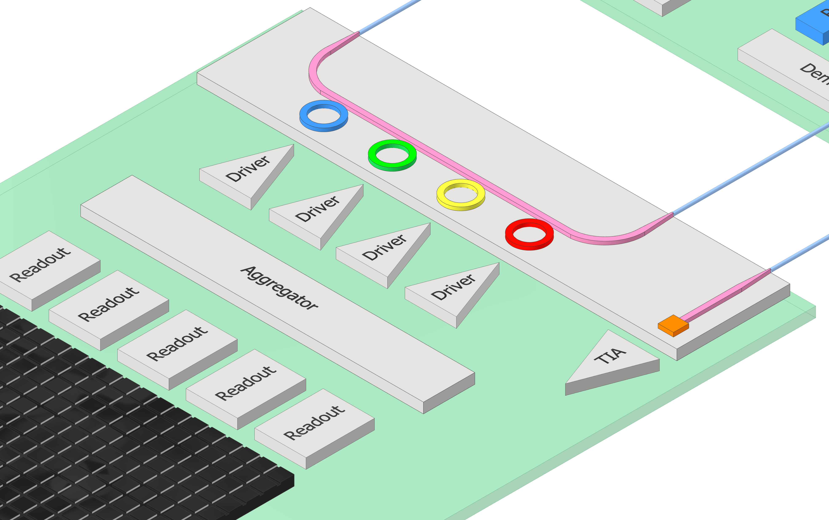
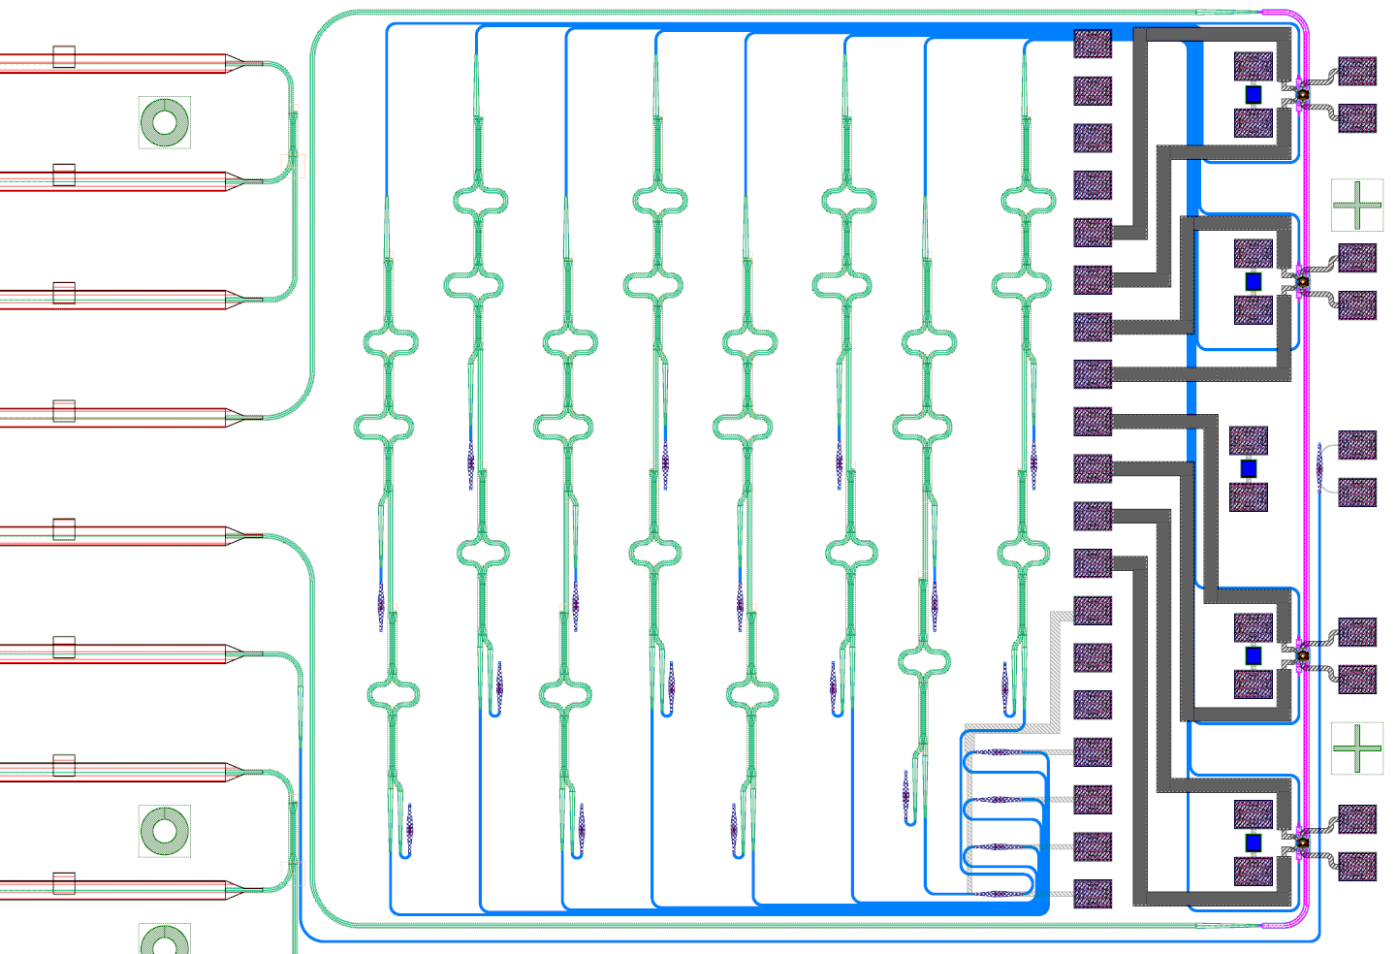

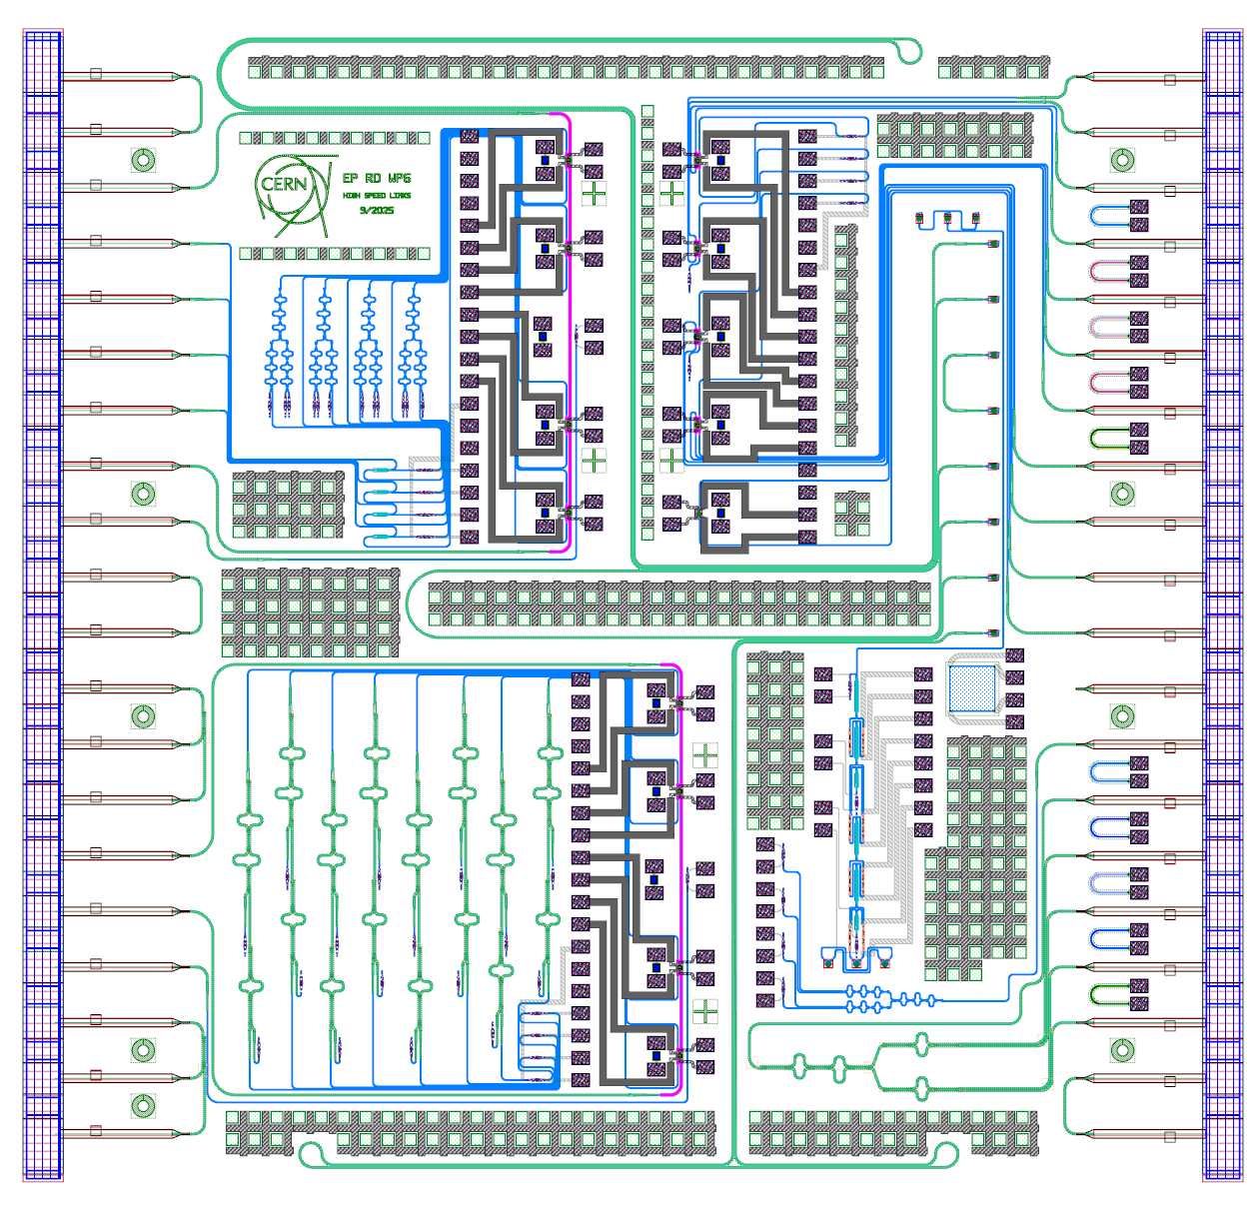
PIC Design: PIC4links
ELS
Design submitted for fabrication through an MPW run in Sept. 2025
To achieve tight integration the PIC must be co-designed with its driver circuit
Pad fame matching the SPRINT for chip-to-chip wire bonding connection
Transceiver chiplet footprint 2.2 mm x 3 mm
Fibre coupler
PIC
Tx channel
Modulator
Rx channel
PIC4links
SPRINT
2.2 mm
ELS
PIC floorplan ≈ 5 mm x 5 mm
Tx out
DC pads for RM
thermal tuning
4 µ-heater and
4 photodiodes
Rx in
3 mm
25.6 Gb/s
SPRINT output signals
SiN passband
optical filters

Slide 7
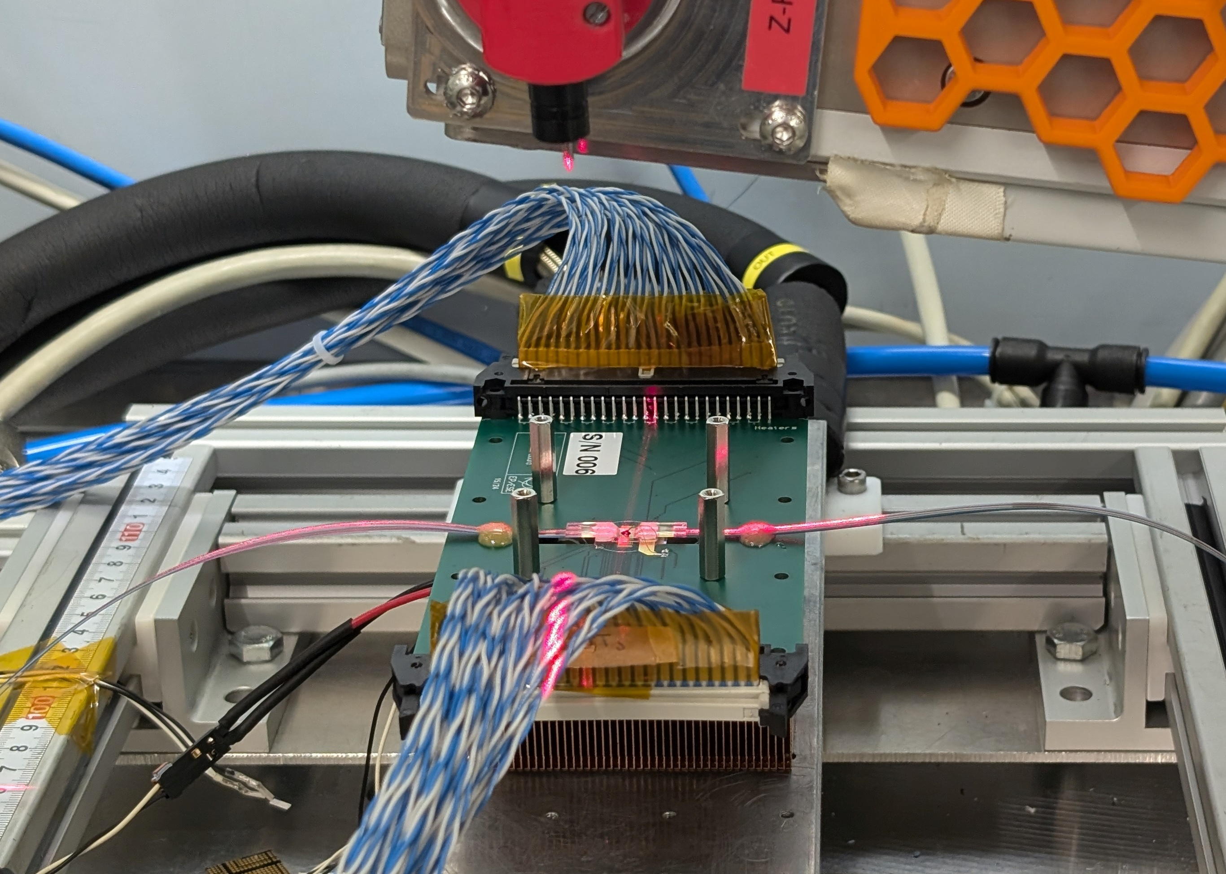
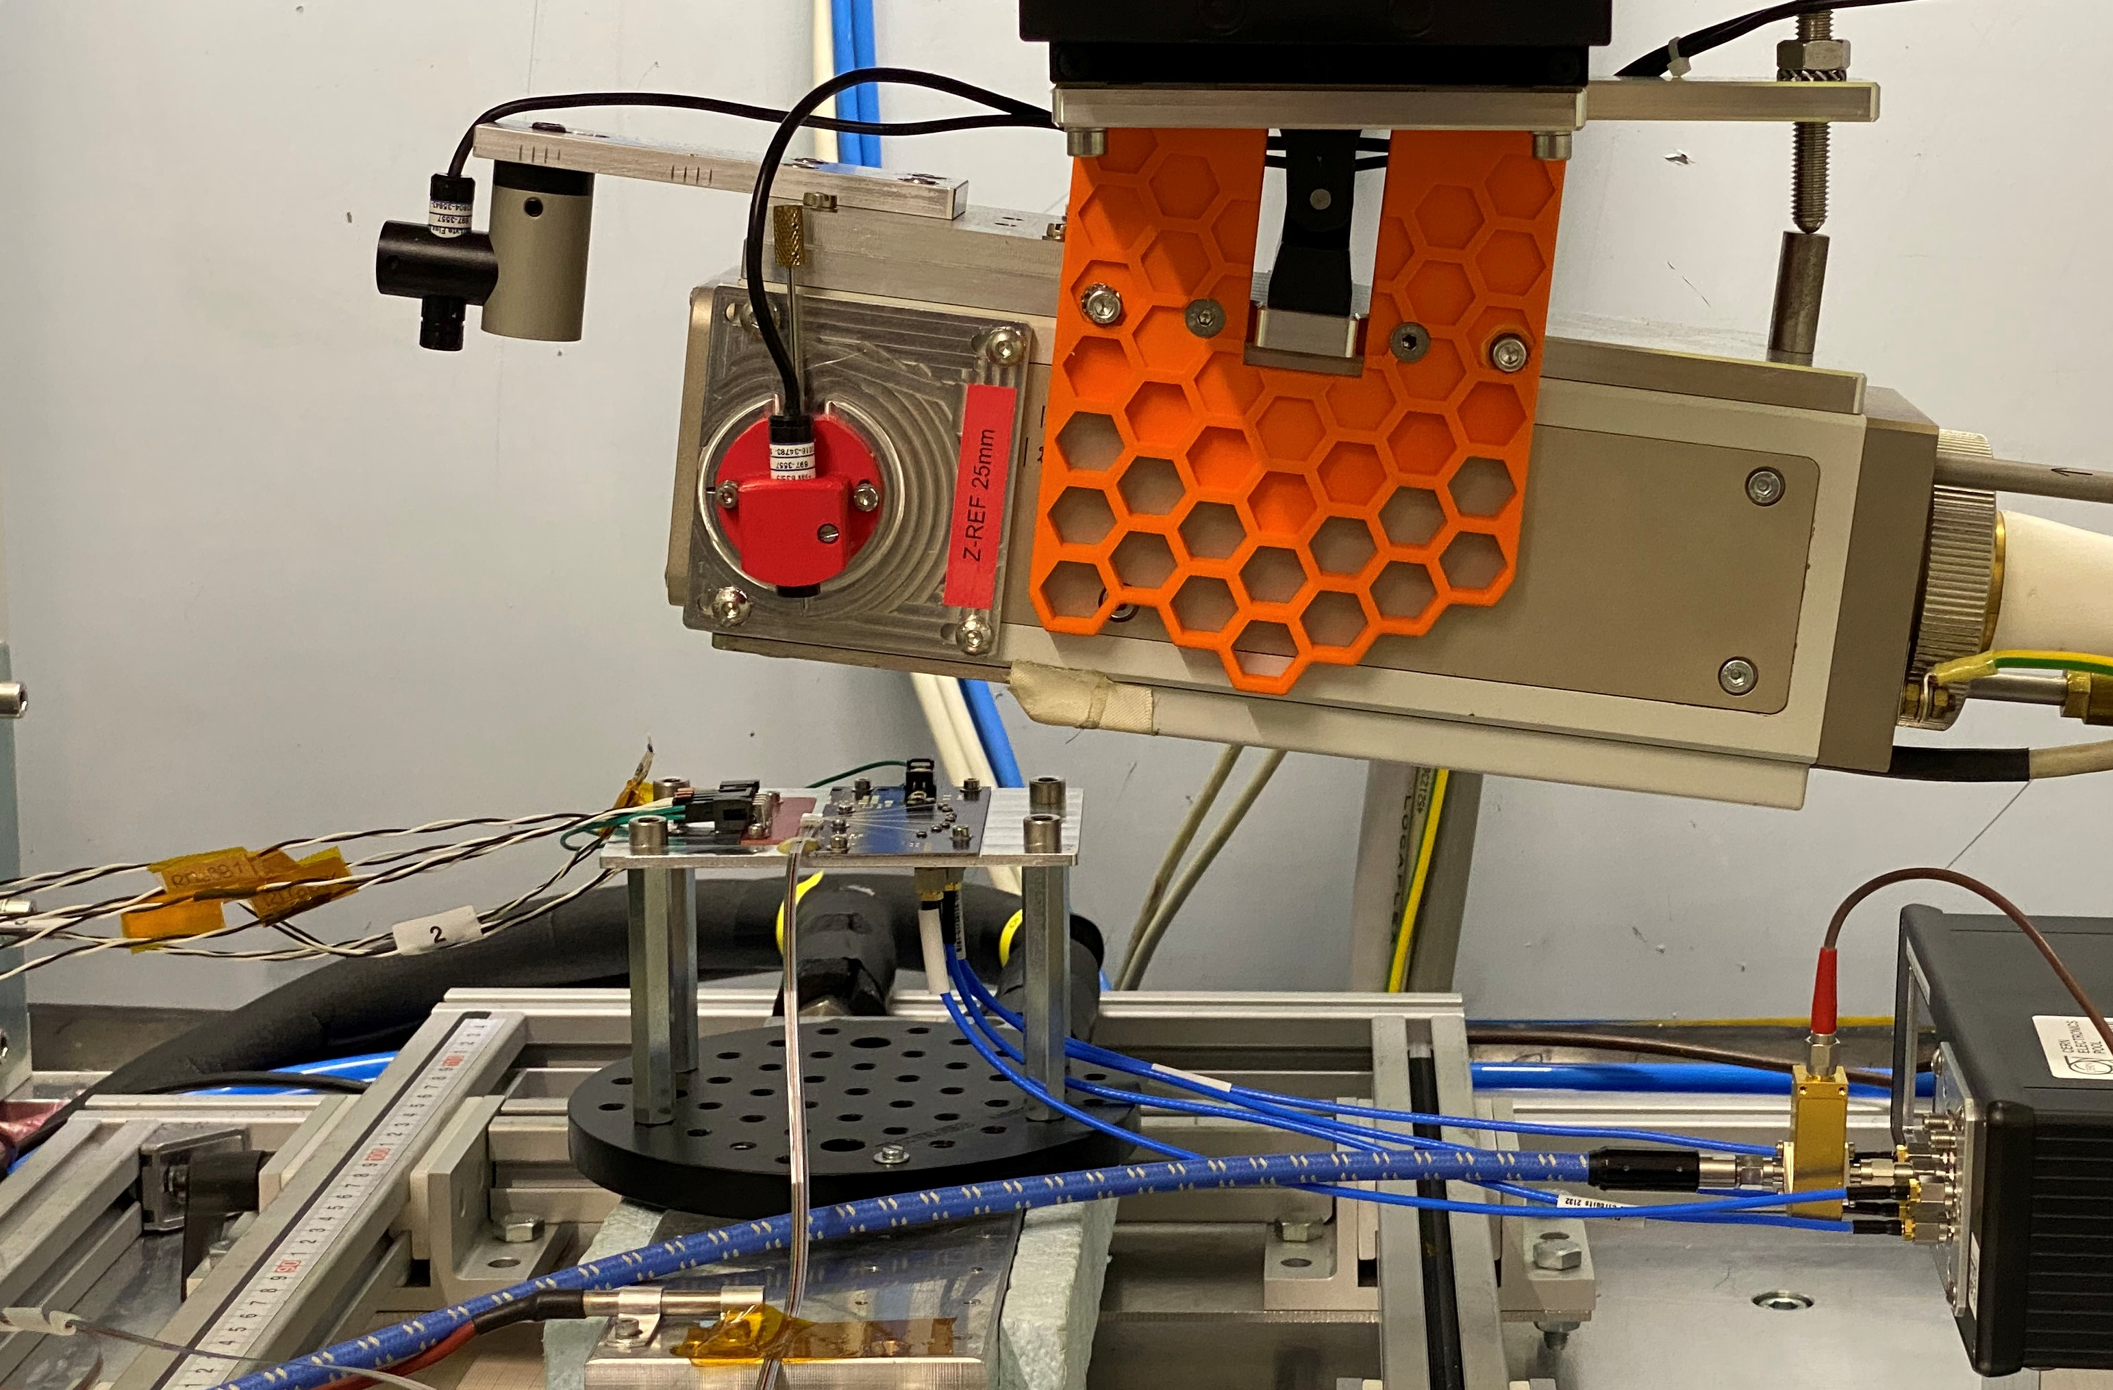
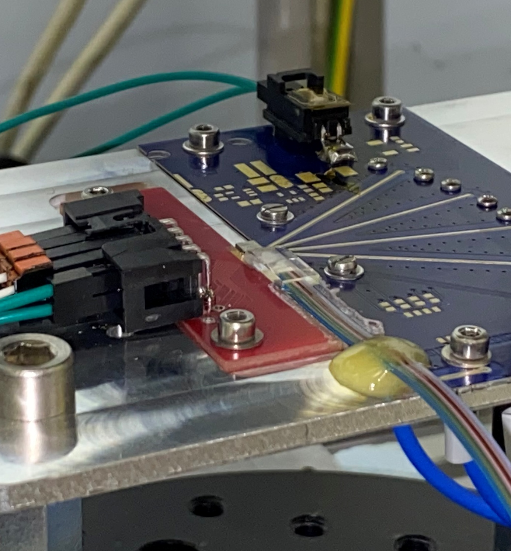
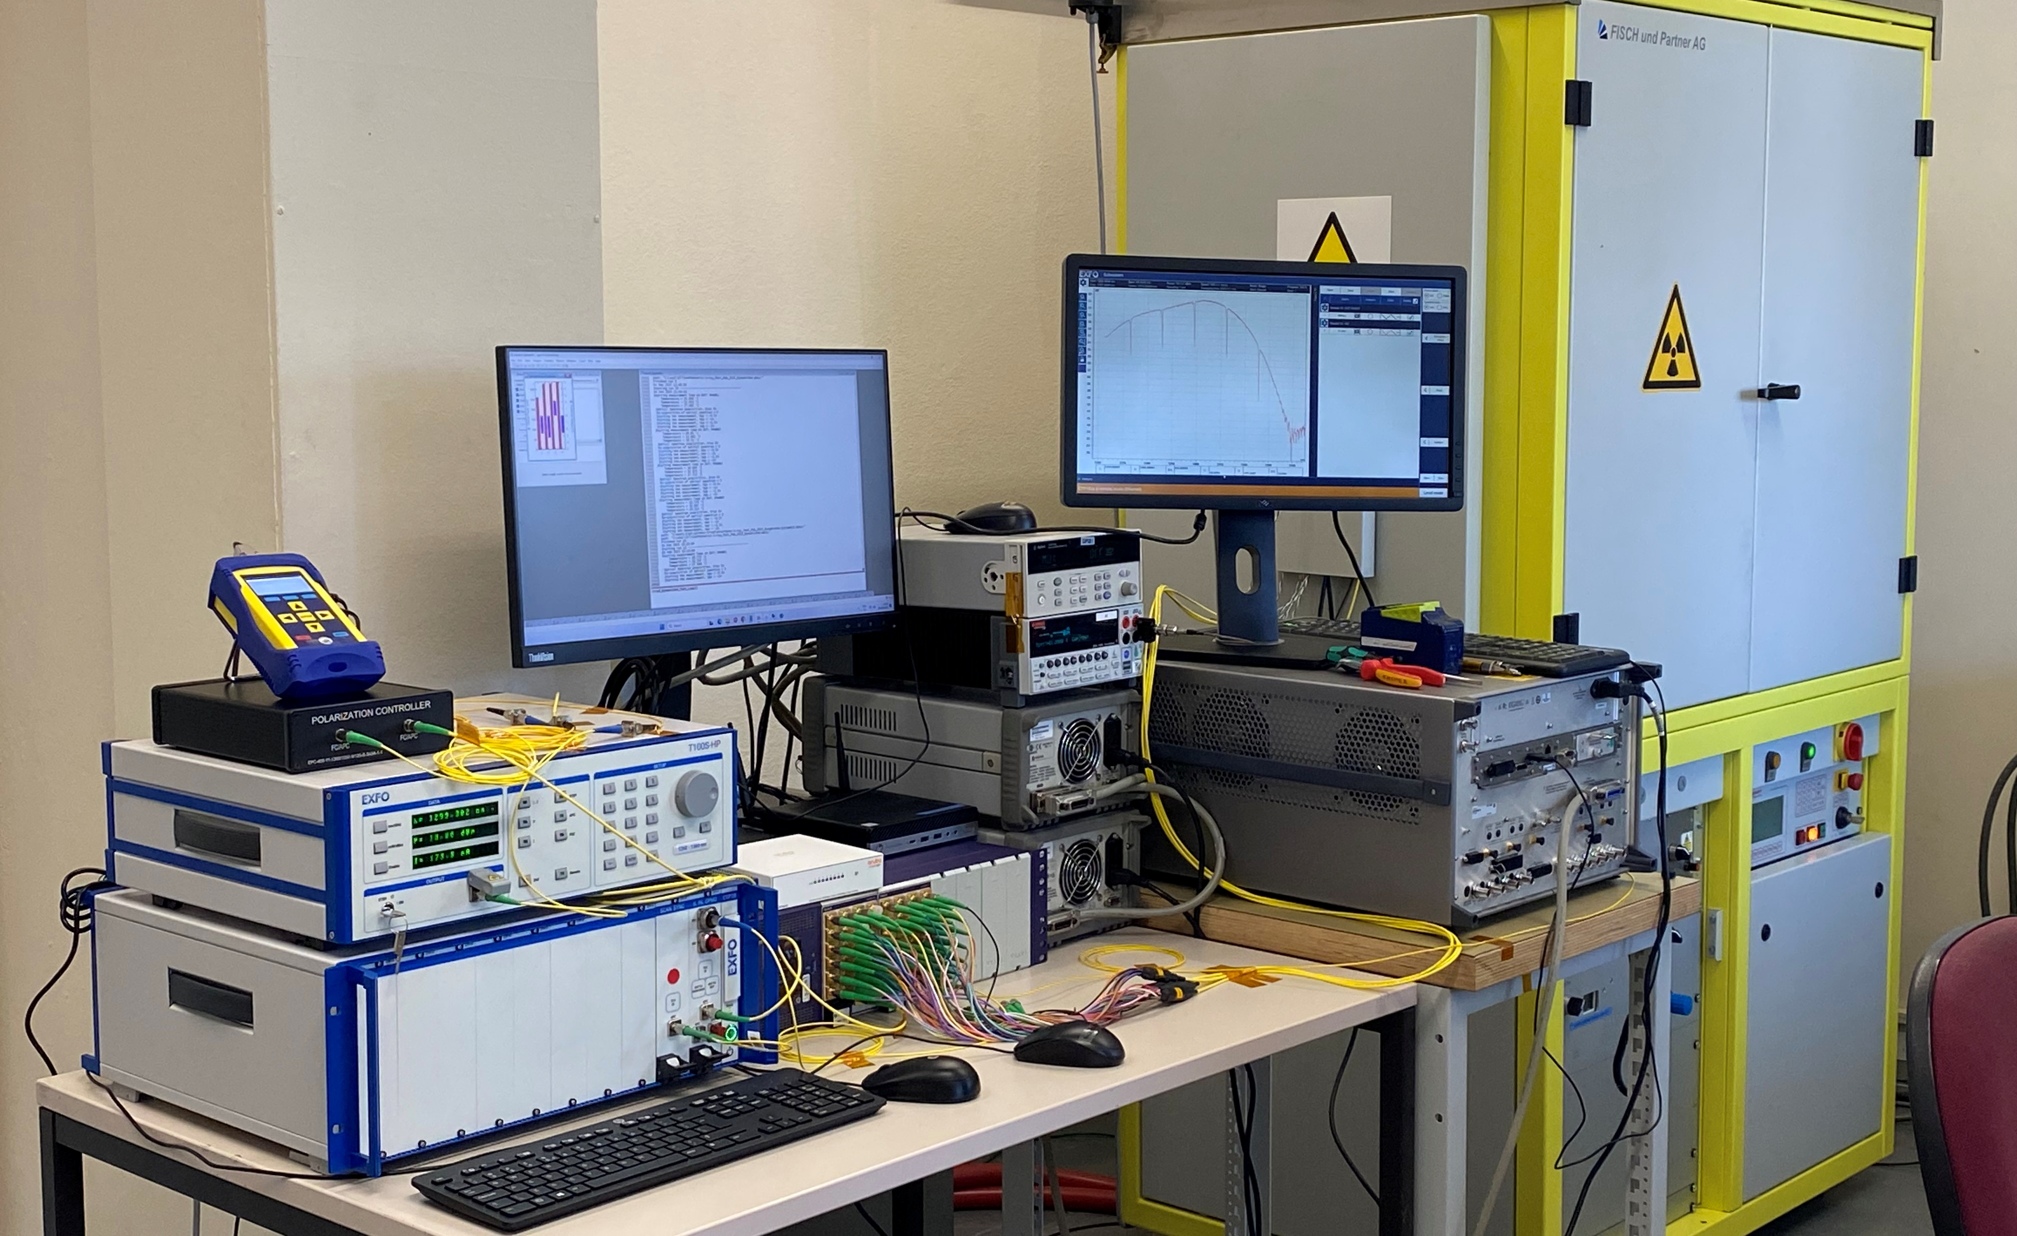
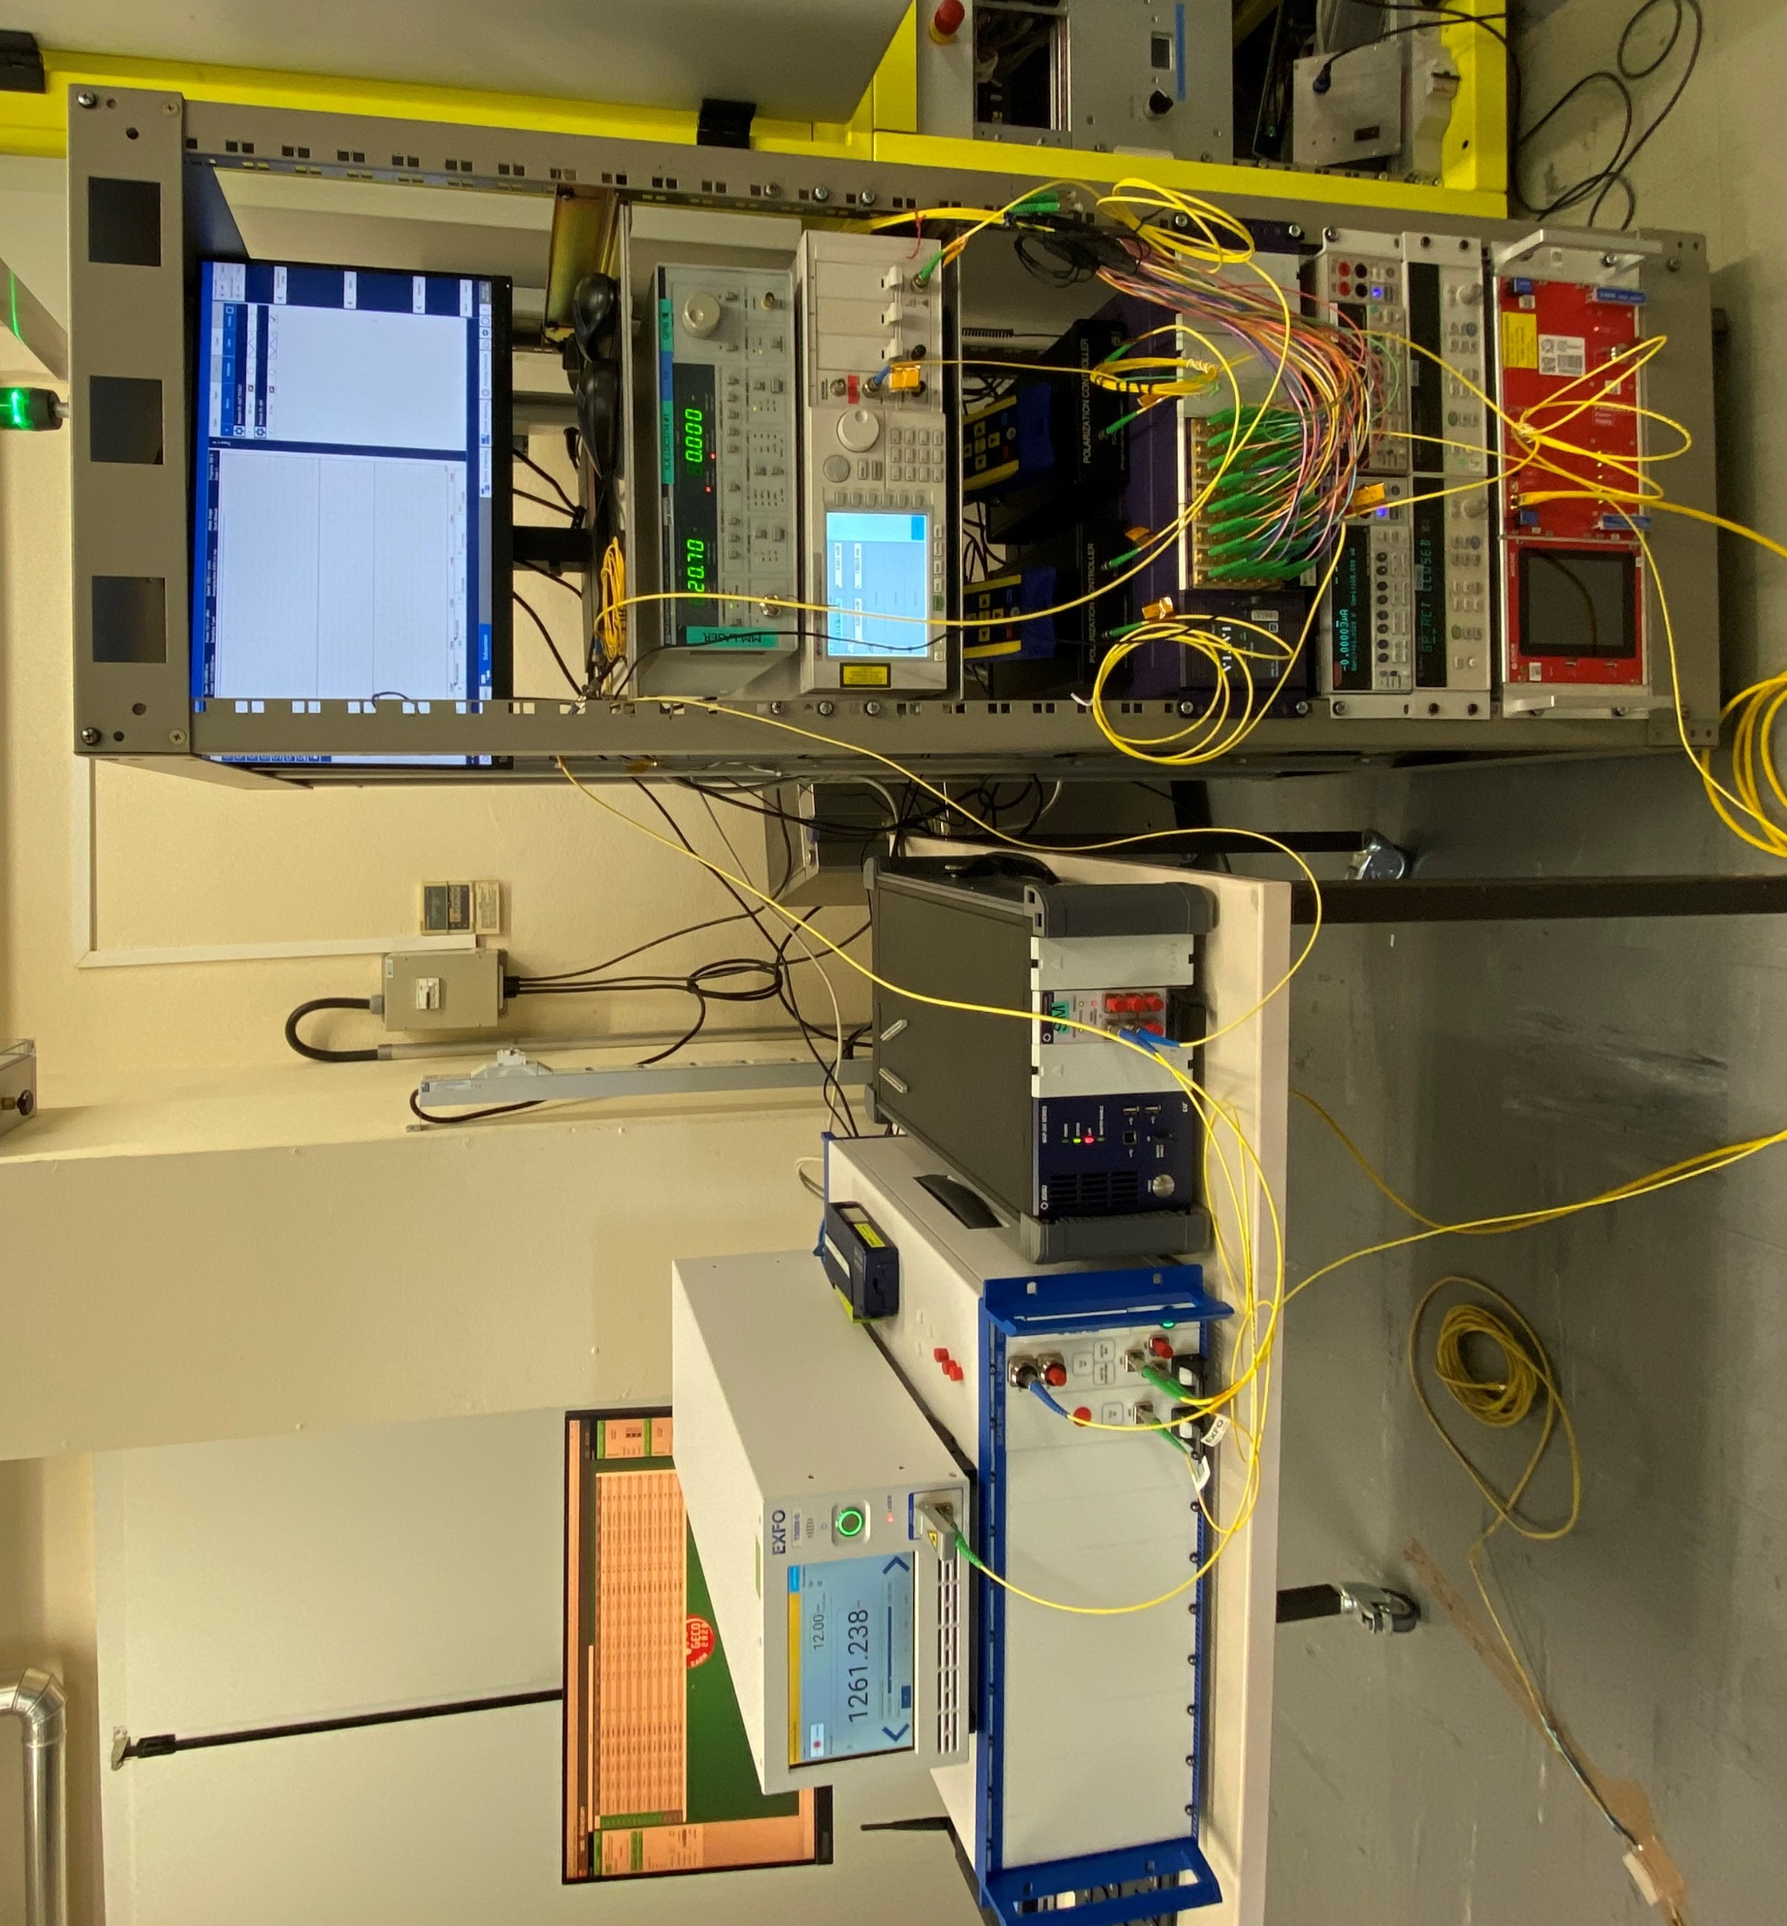
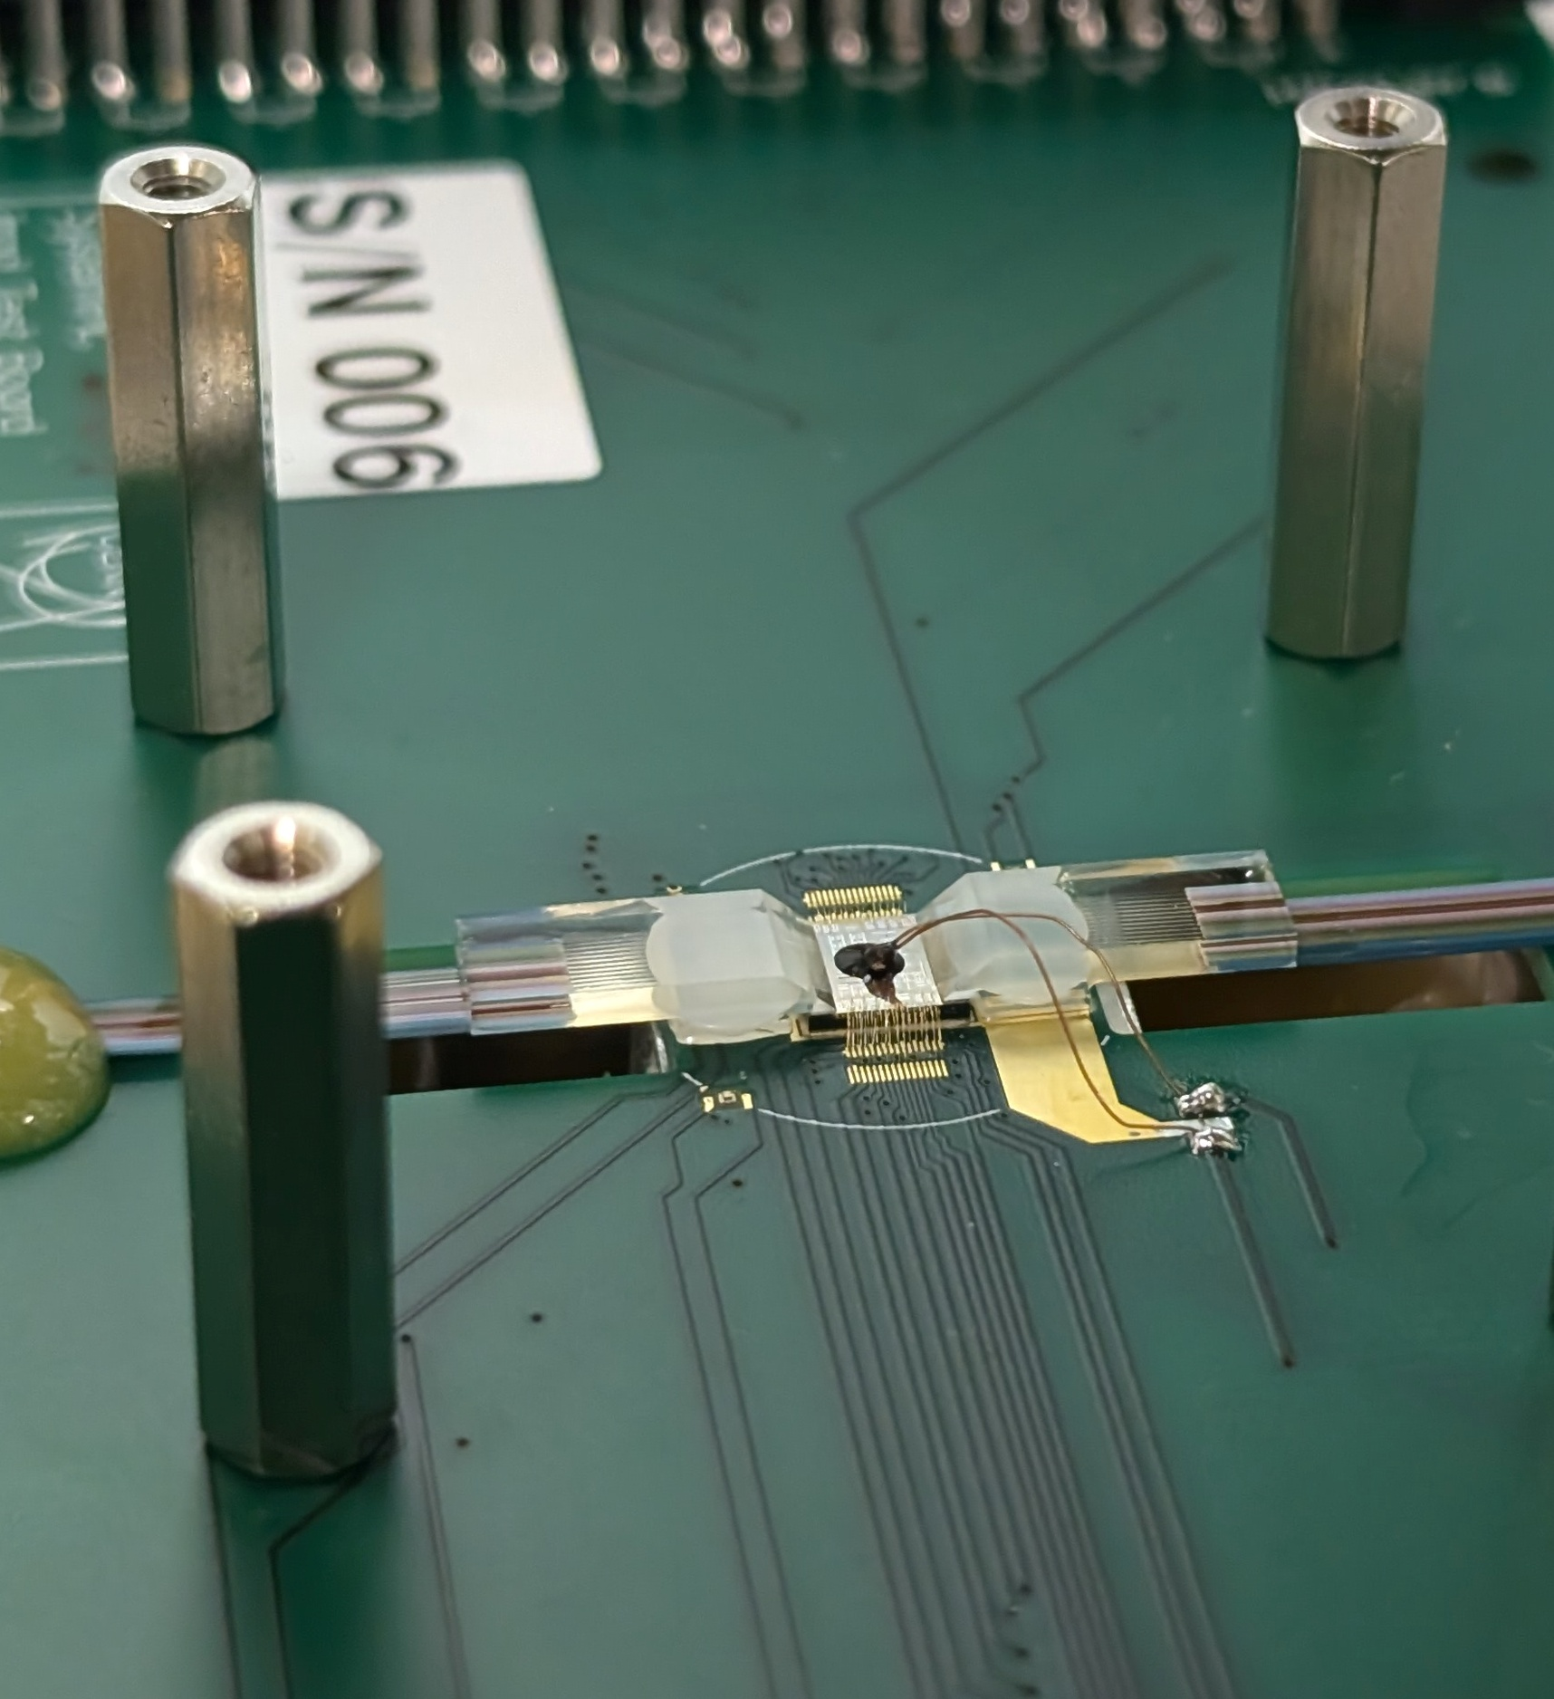
PIC Radiation tolerance - Total Ionizing Dose (TID)
X-ray irradiation facility at CERN
Online static test with tunable laser
12 ring modulators up to 12 MGy
I-V curves and spectra
Online dynamic test with VNA
Four ring modulators up to 12 MGy
Electro-optic frequency response up to 25 GHz

Slide 8
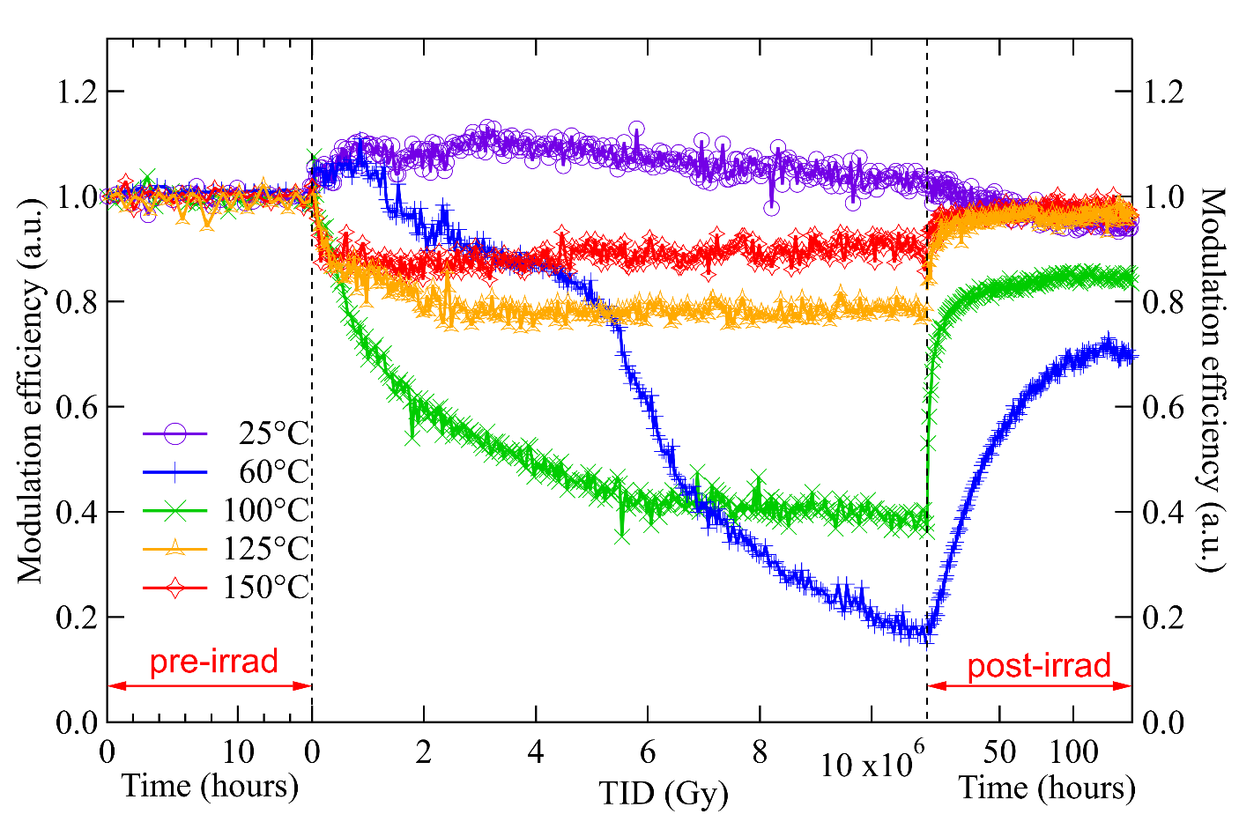
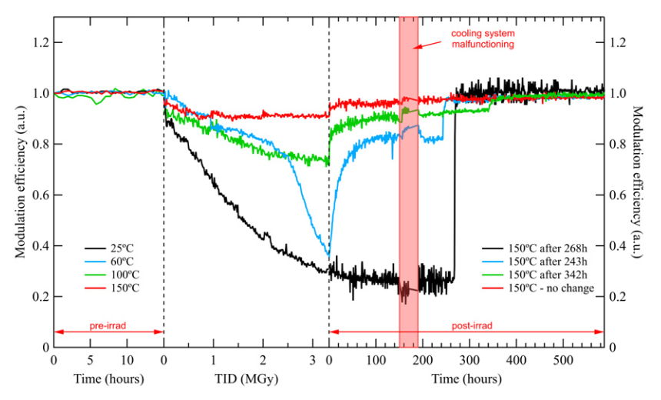
PIC Radiation tolerance - TID results for ring modulators
Modulation efficiency degradation due to trapped charge in the silicon dioxide
Both charge trapping and annealing are temperature dependent
The possibility of heating up locally the ring modulator allows fast recovery of TID the damage
This thermal annealing mechanism effectively recovers the electro-optic (EO) frequency response from DC to 25 GHz
These latest results will be presented at RADECS 2025 next week
High doping
Low doping
All high doping
M. Lalović et al., "Ionizing Radiation Effects in Silicon Photonics Modulators," in IEEE Transactions on Nuclear Science, vol. 69, no. 7, pp. 1521-1526, July 2022
M. Lalović et al., "Thermal annealing in silicon photonics ring modulators," in Journal of Instrumentation, vol. 18, no. 3, pp. C03028, Mar 2023

Slide 9
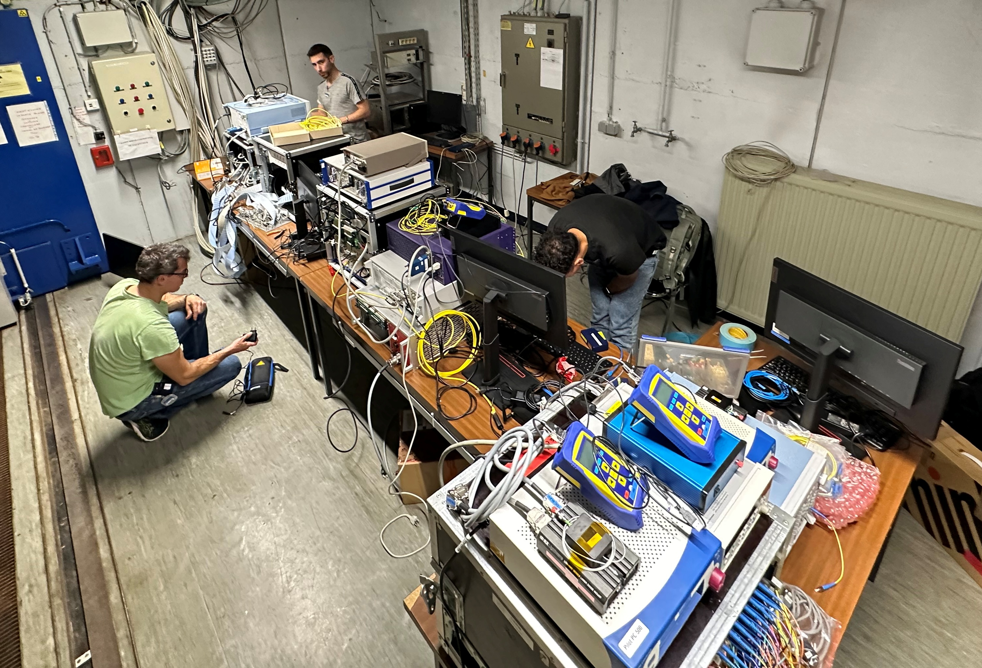
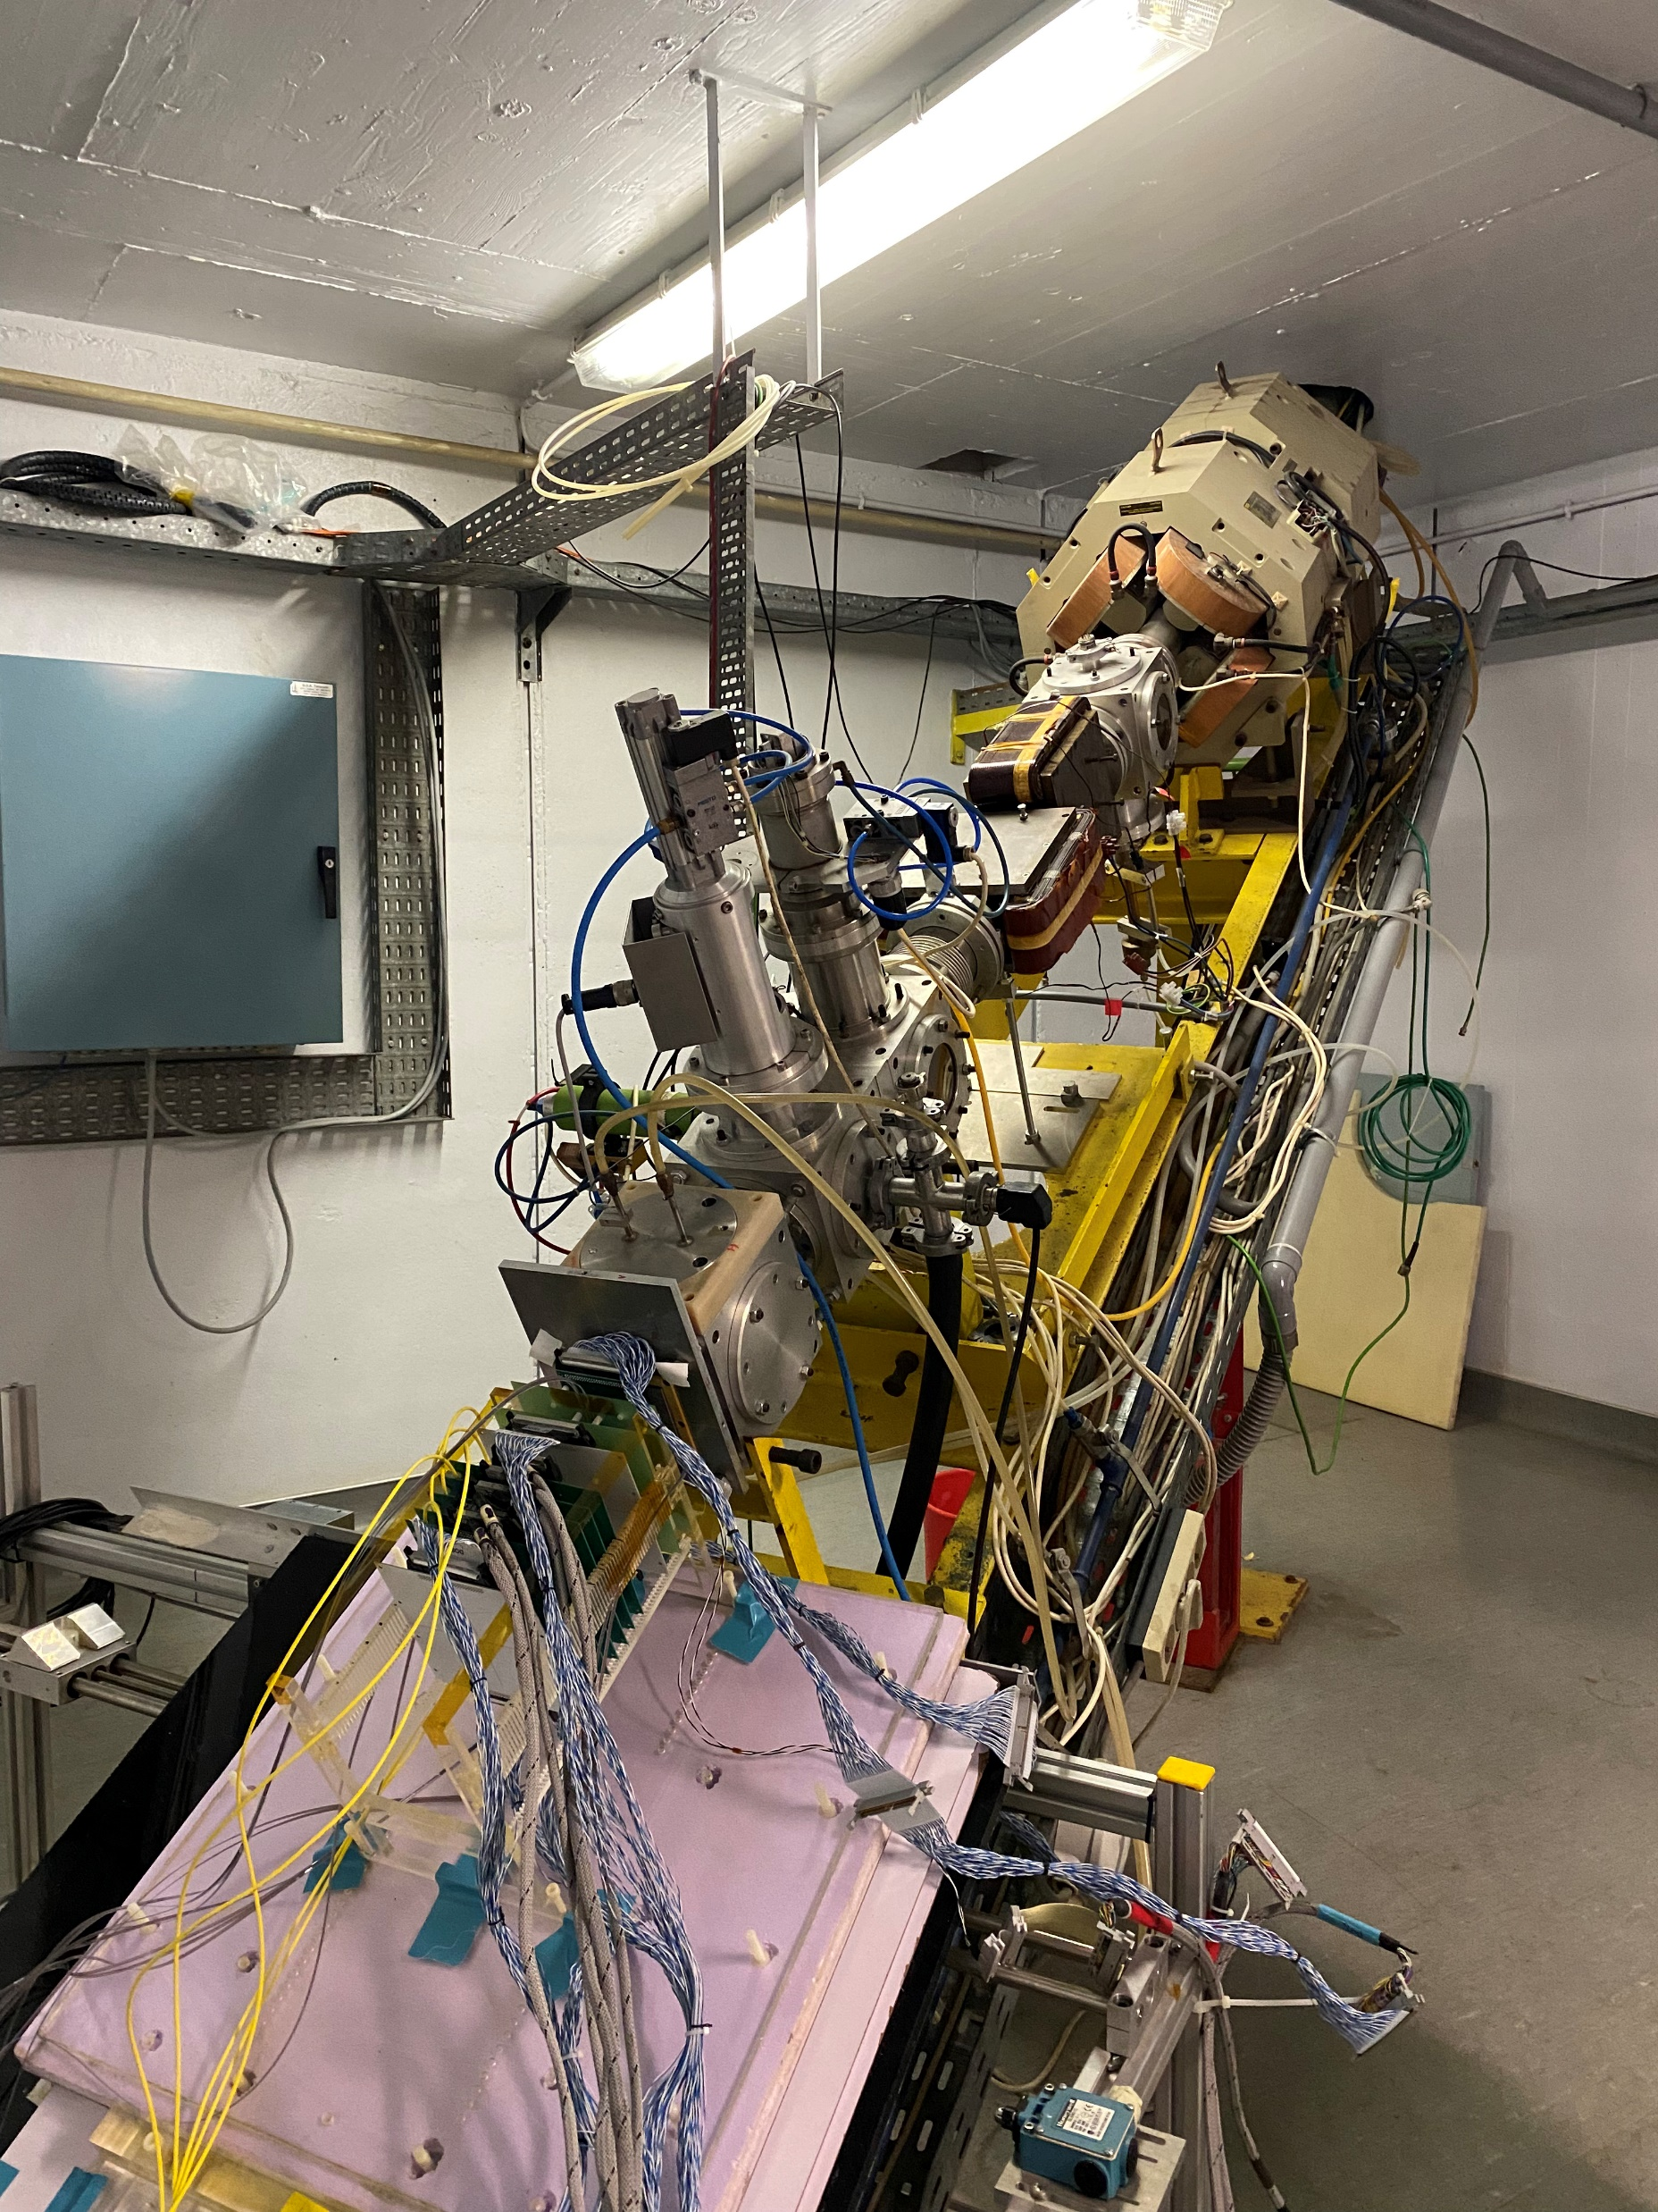
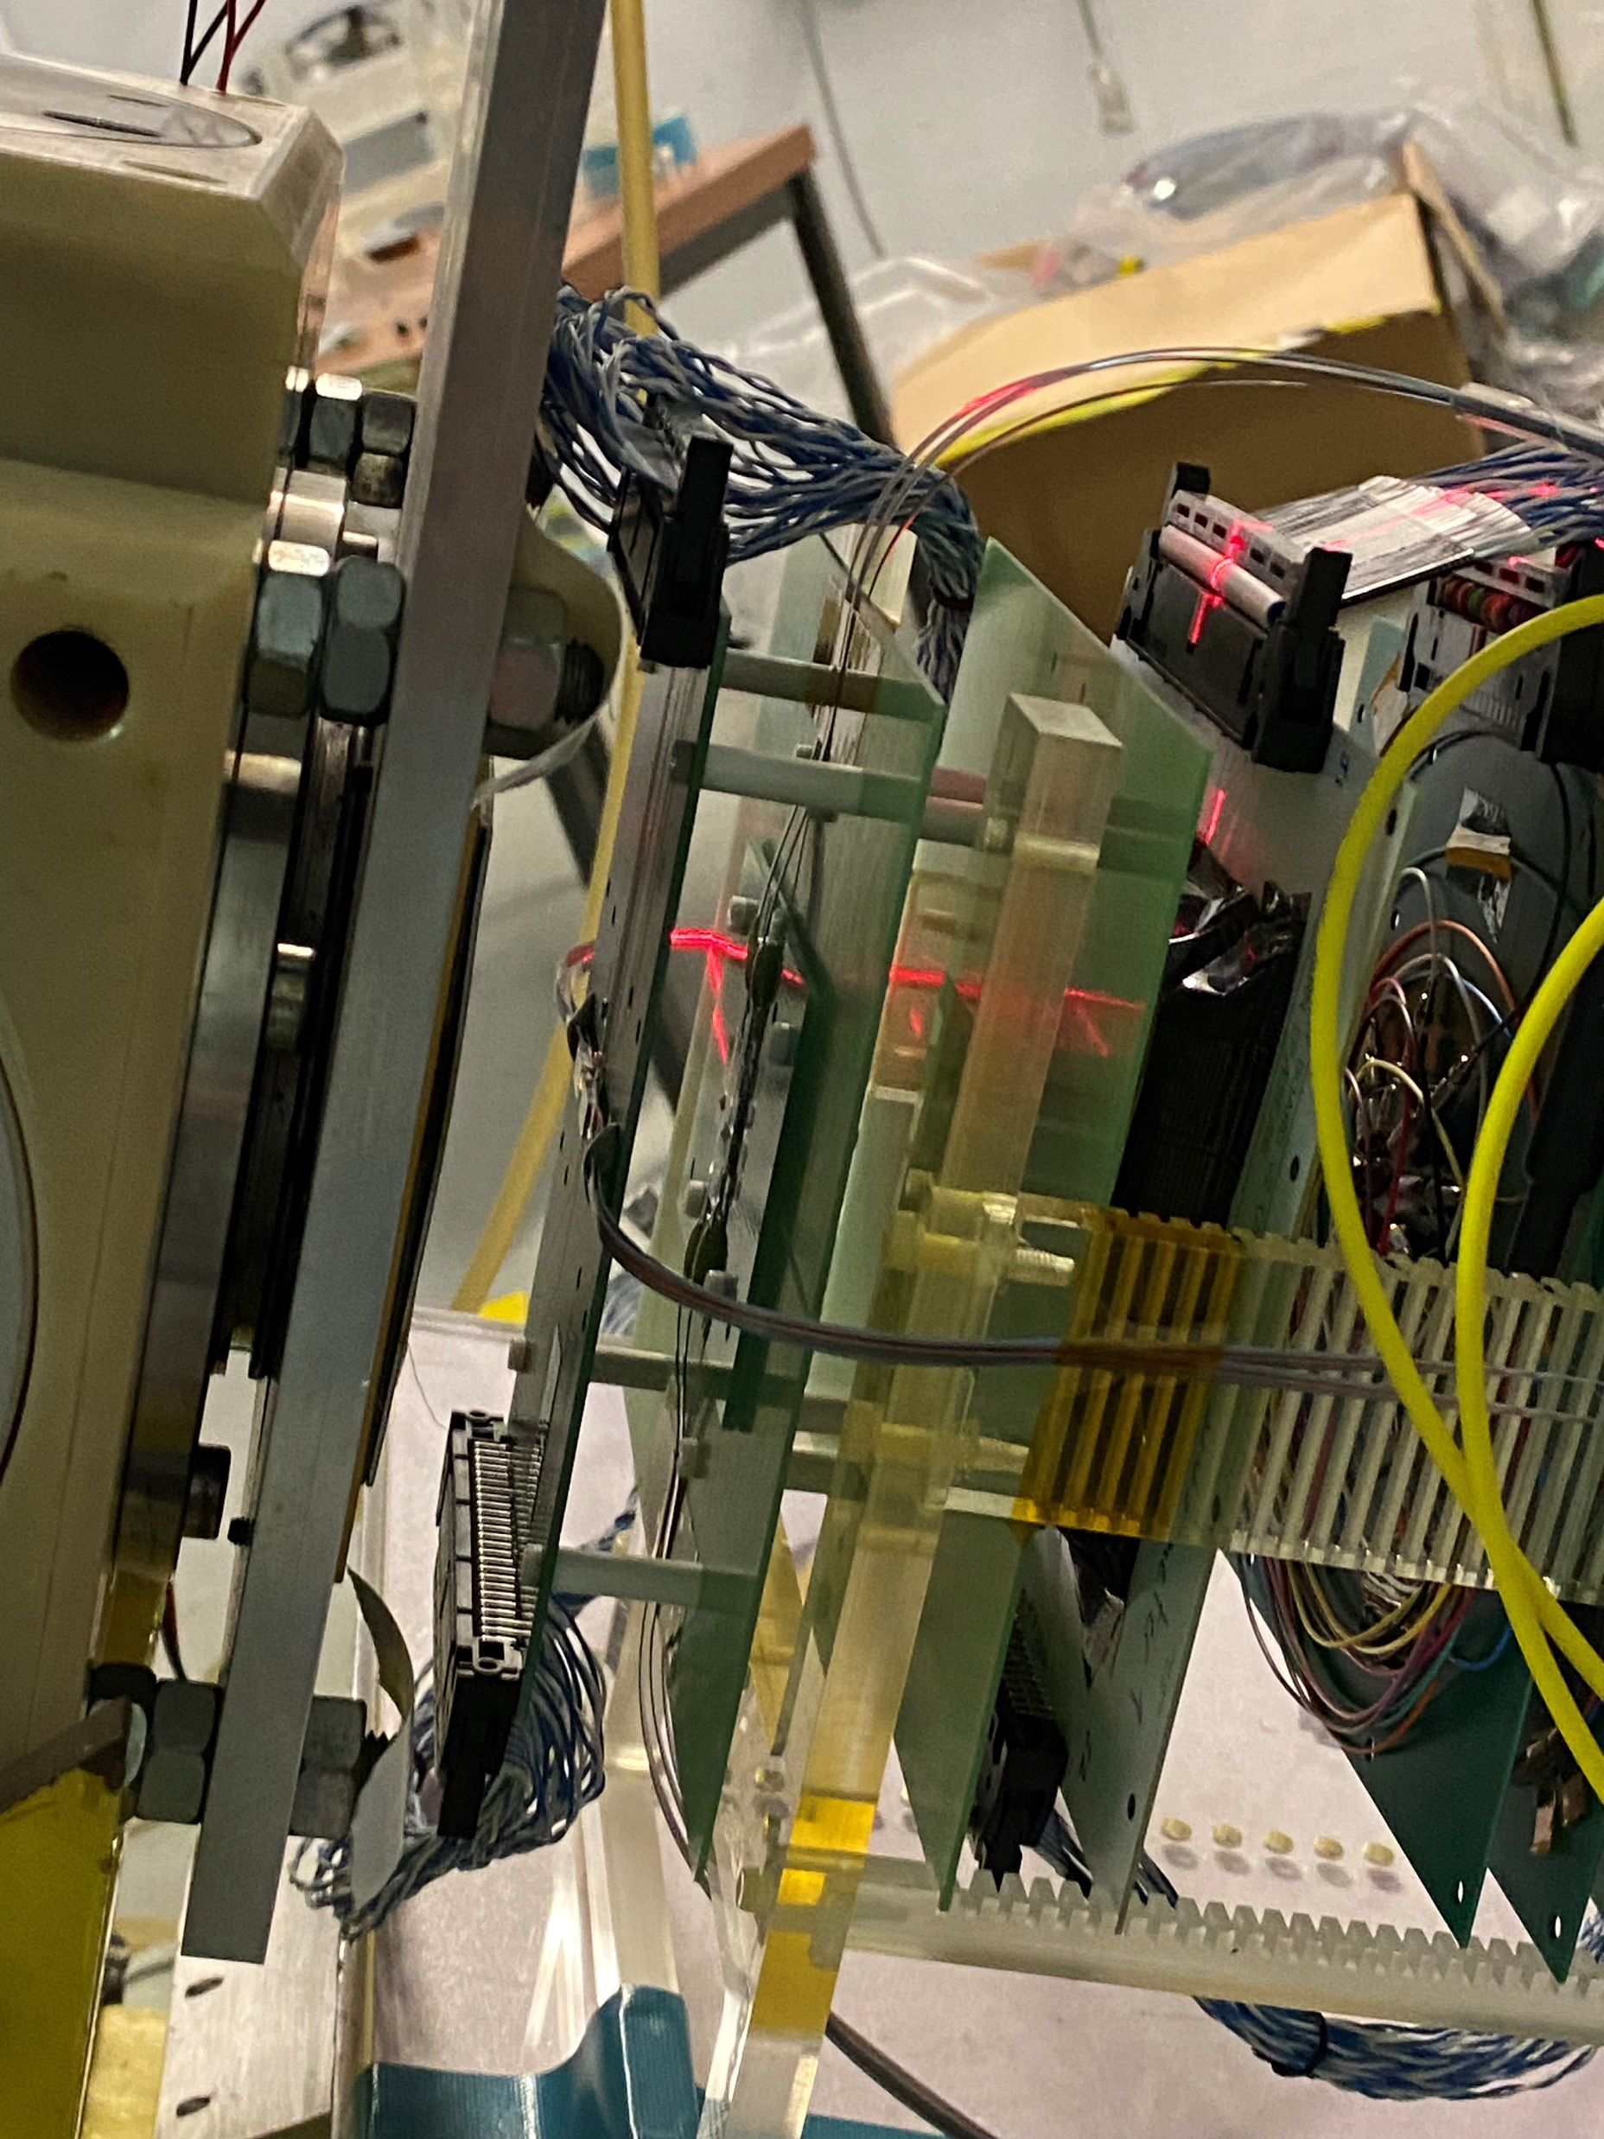
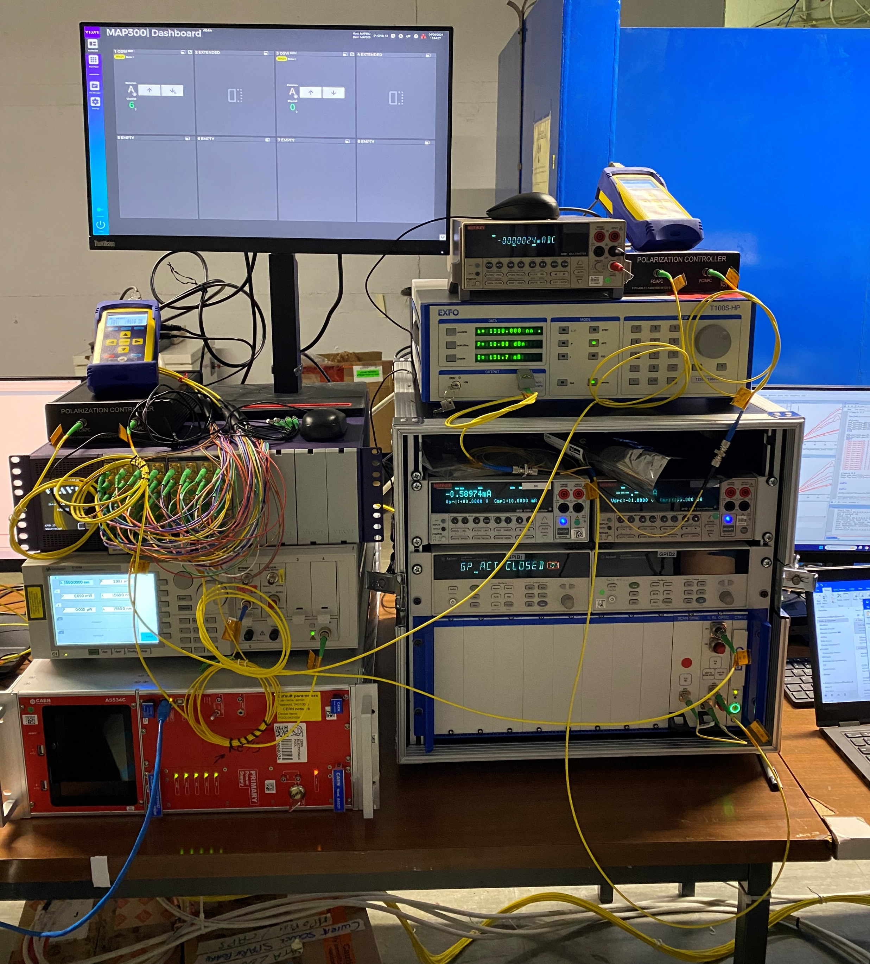
PIC Radiation tolerance - Displacement Damage
Neutrons beam at the UCL in Louvain la Neuve (BE)
Irradiation of PICs up to 10¹⁶ neutron/cm² fluence
Deuteron beam
Deuteron beam
Polarization controllers
O-band laser
neutrons
Optical switch
Be target
Sourcemeters
DAQ
C-band laser
O-band laser controller
Heater power supply
SystemPIC test setup for online data acquisition
PackagingPICs
SystemPIC

Slide 10
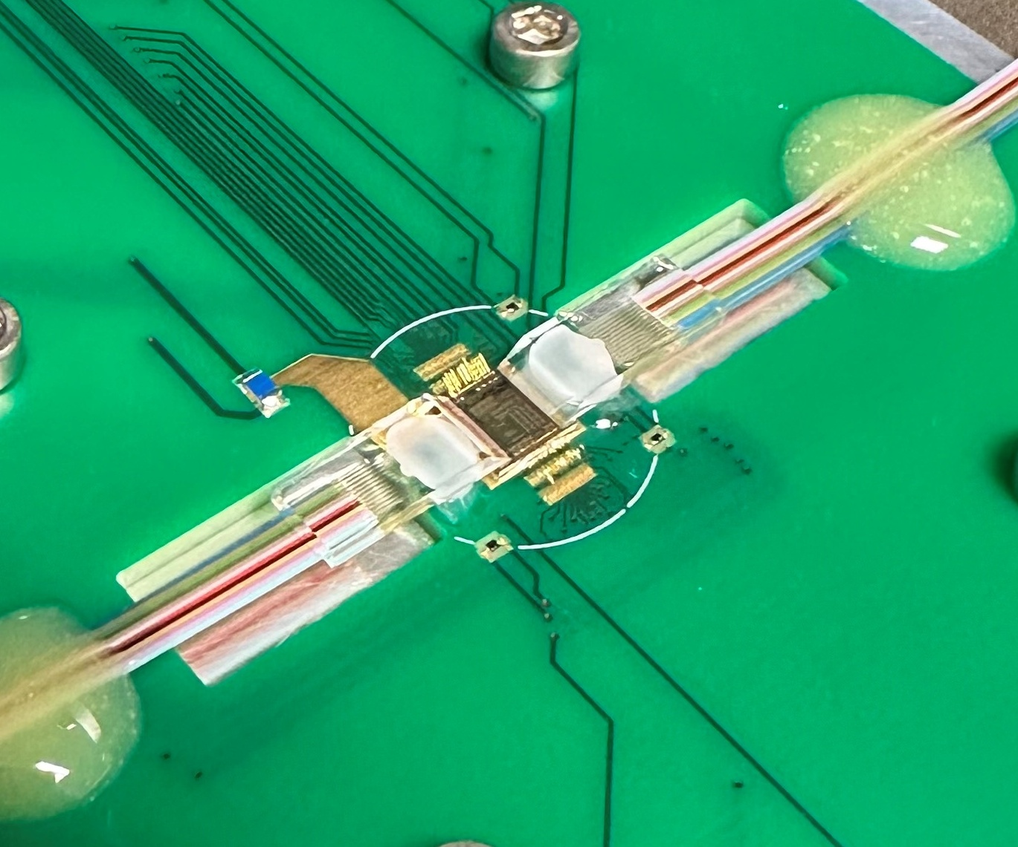
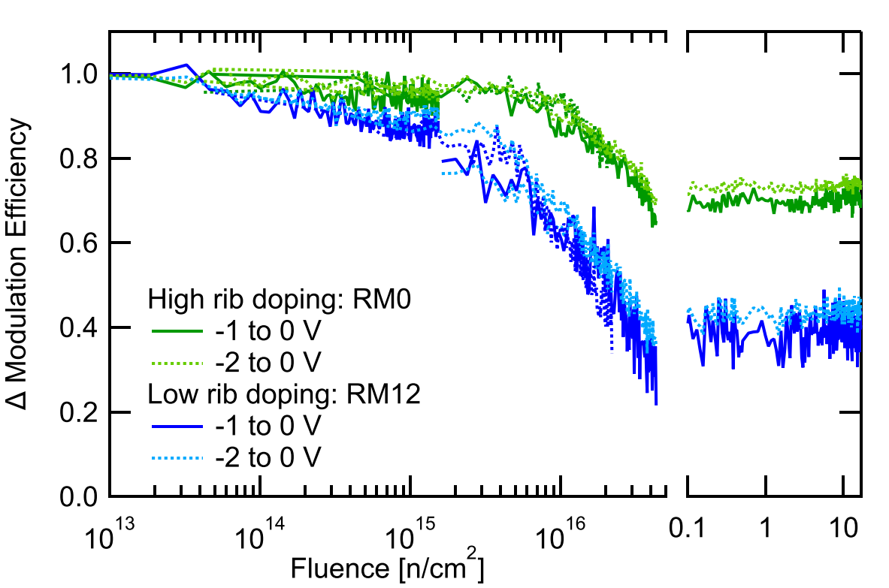
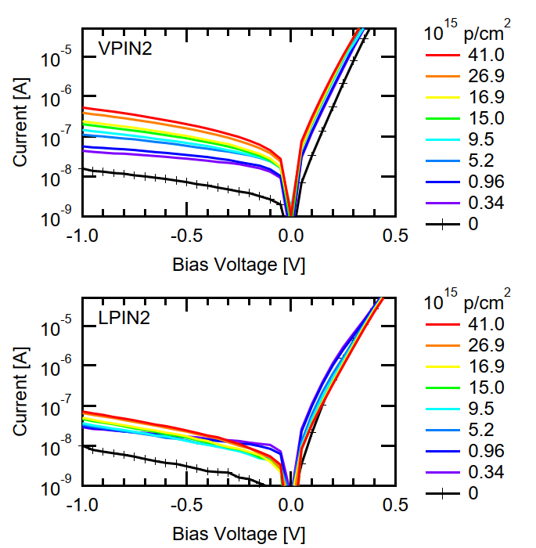
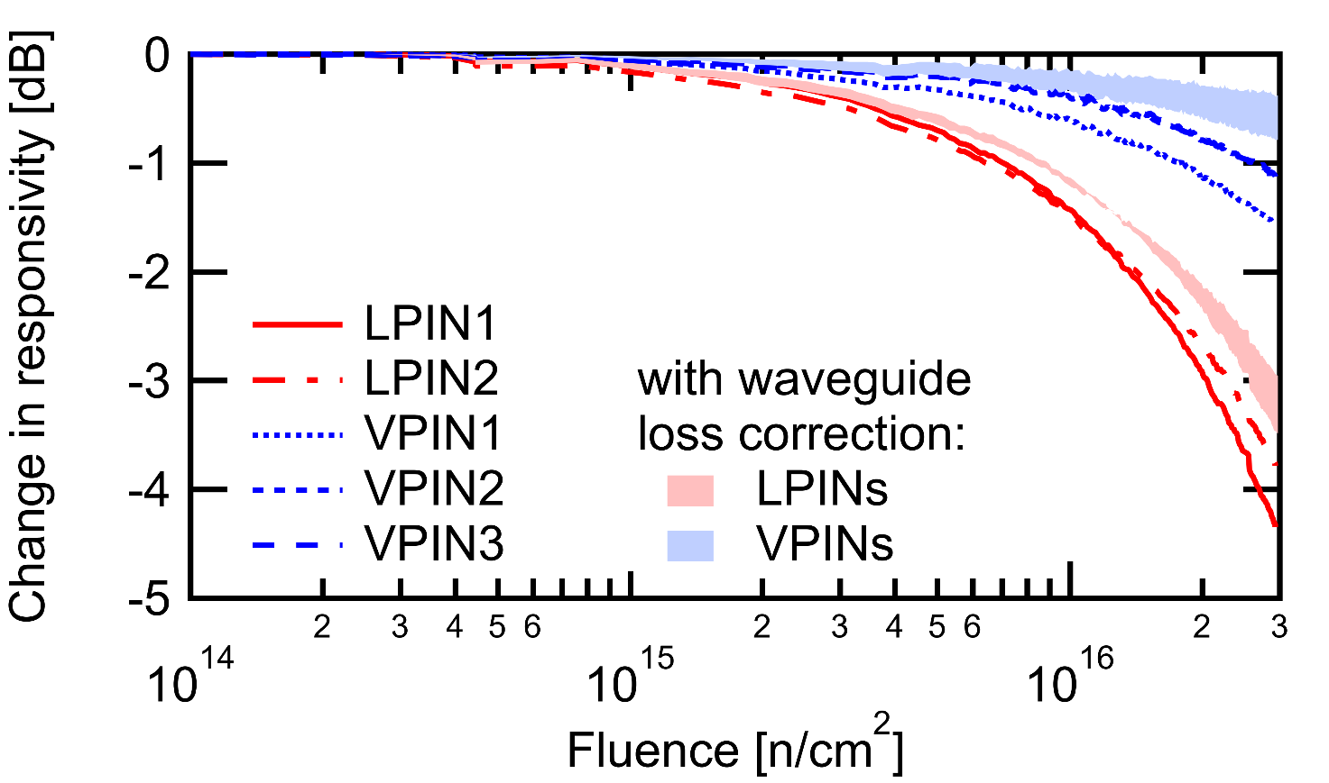
PIC Radiation tolerance - Neutron Irradiation Results
Moderate ring modulator modulation efficiency degradation up to a fluence of 10¹⁶ n/cm²
Negligible degradation of responsivity and I-V characteristic of Ge-photodiodes to fluences above 3·10¹⁶ n/cm²
L. Olanterä et al., "Effects of High Fluence Neutron Irradiation on
Silicon Photonics Ring Modulators," in RADECS 2024 proceedings, in review.
L. Olanterä et al., "Effects of High Fluence Particle Irradiation on Germanium-on-Silicon Photodiodes," in IEEE Transactions on Nuclear Science, vol. 71, no. 4, pp. 728-735, April 2024

Slide 11
Next Steps: Silicon Photonics
System demonstration and design
Evaluation of system-control devices/circuits (temperature, polarisation, wavelength)
Characterise and test PIC4links submitted in Sept. 2025
Photonic circuits co-designed with the SPRINT, the new modulator driver ASIC instantiated in the Picopix
Radiation Tolerance
Evaluation of radiation tolerance of waveguide structures
Continuing the evaluation and modelling of RM radiation eﬀects
Packaging/Integration
Exploitation of ﬁbre-attachment machine to evaluate prototypes based on ﬁbre edge-coupling
Evaluation of industry developments in PIC packaging
Co-packaging the SystemPIC and the next PIC generations with Picopix when it becomes available

Slide 12
Backup slides

Slide 13
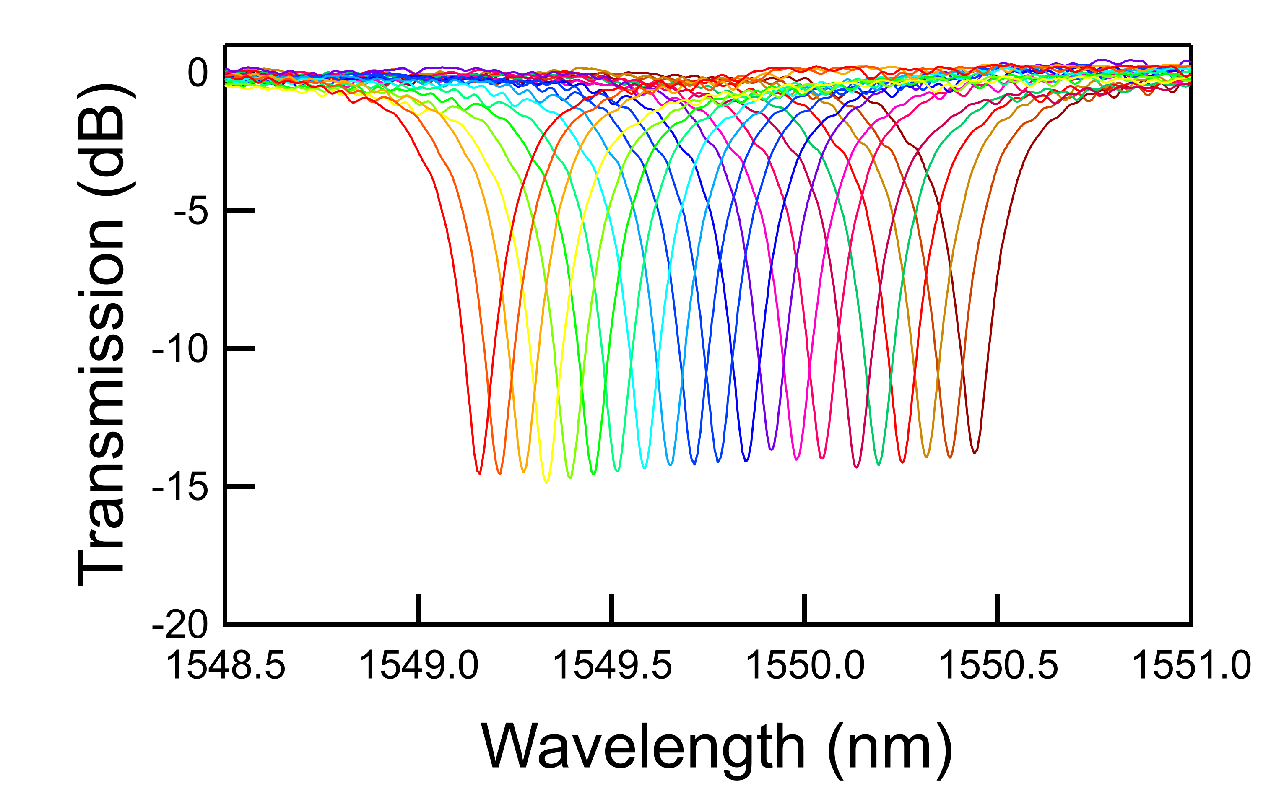
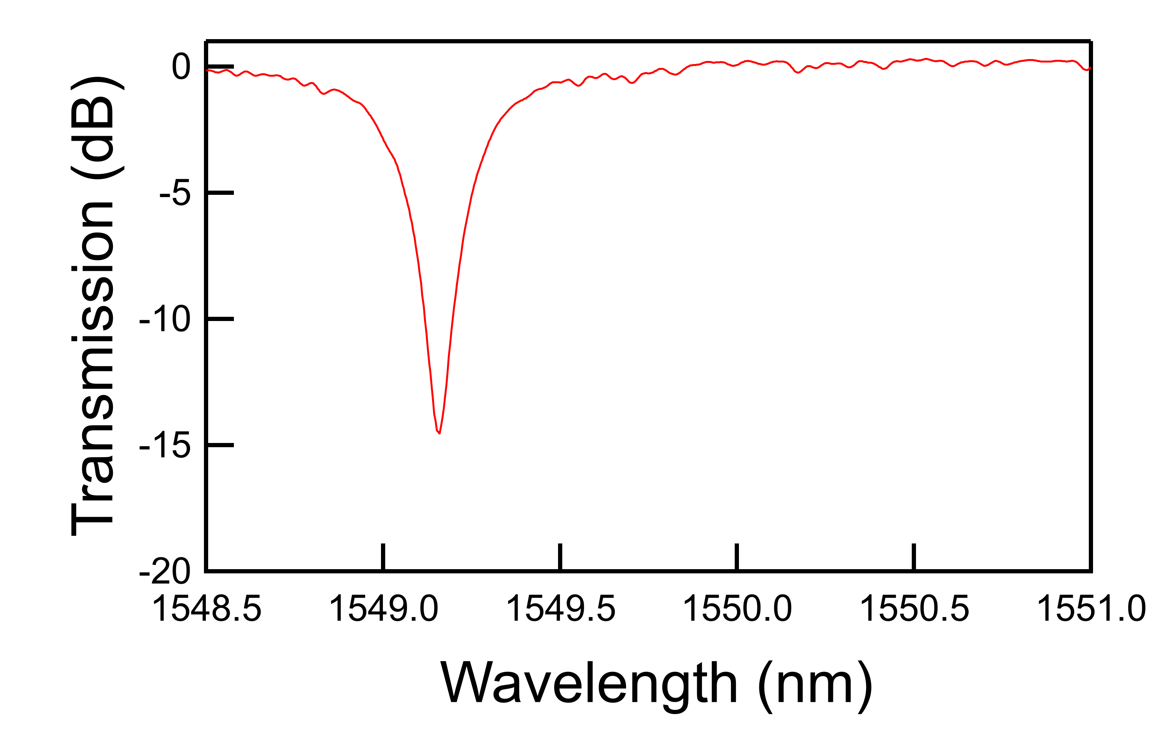
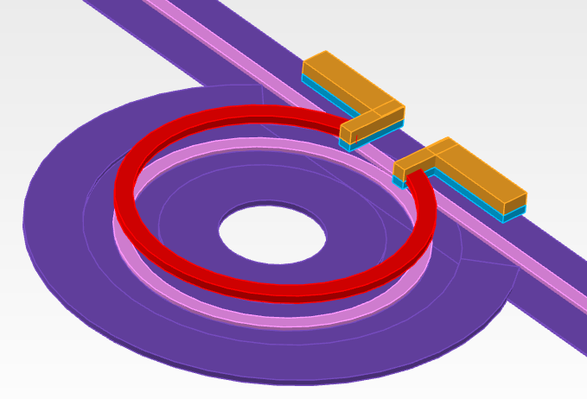
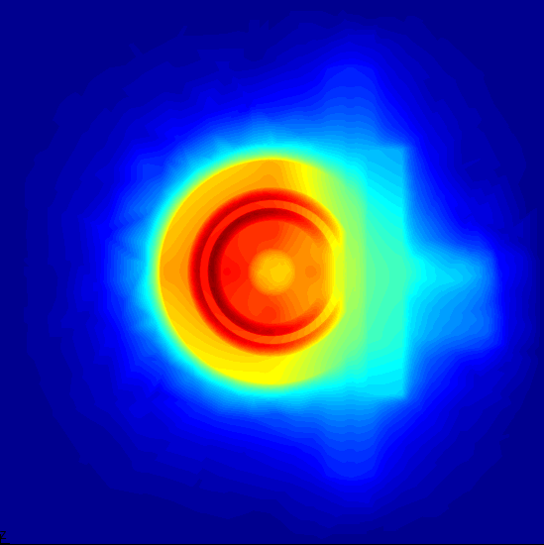
Resonance wavelength tuning
Input laser
Ring modulators are highly selective wavelength filters
Resonance wavelength (λ_{res}) influenced by temperature and fabrication
λ_{res} needs to be aligned to the input laser
Thermo-optic effect in Silicon to adjust λ_{res} (Δλ_{res} ~70 pm/°C)
Tungsten µ-heater on top of the ring waveguide for local and active tuning of λ_{res}
λ_{res}
From 17 °C to 34 °C
input laser
SiO₂
Temperature
400 K
10 µm
300 K
Si waveguide
µ-heater
20 µm

Slide 14
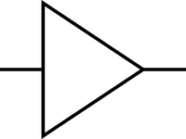

Control system for wavelength stabilisation
Goal is to build a system that automatically locks the ring to the input laser wavelength
This requires measurement of photodiode average current and steering of heater current
Optical data out
Input laser
Electrical
Data in
_{Δλ(V)}
µ-heater
_{Δλ(T)}
Photodiode
Drop port
setpoint
-
+
error
PID controller

Slide 15
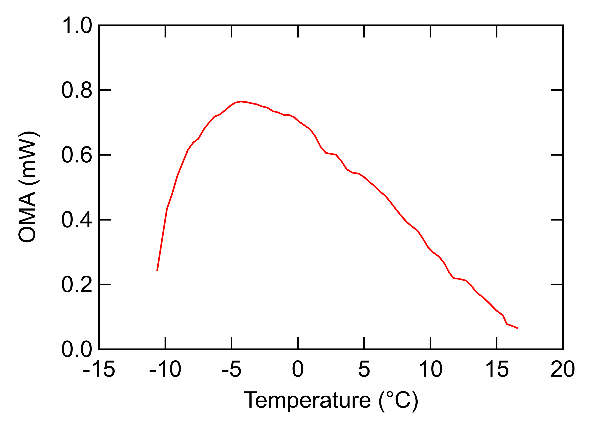
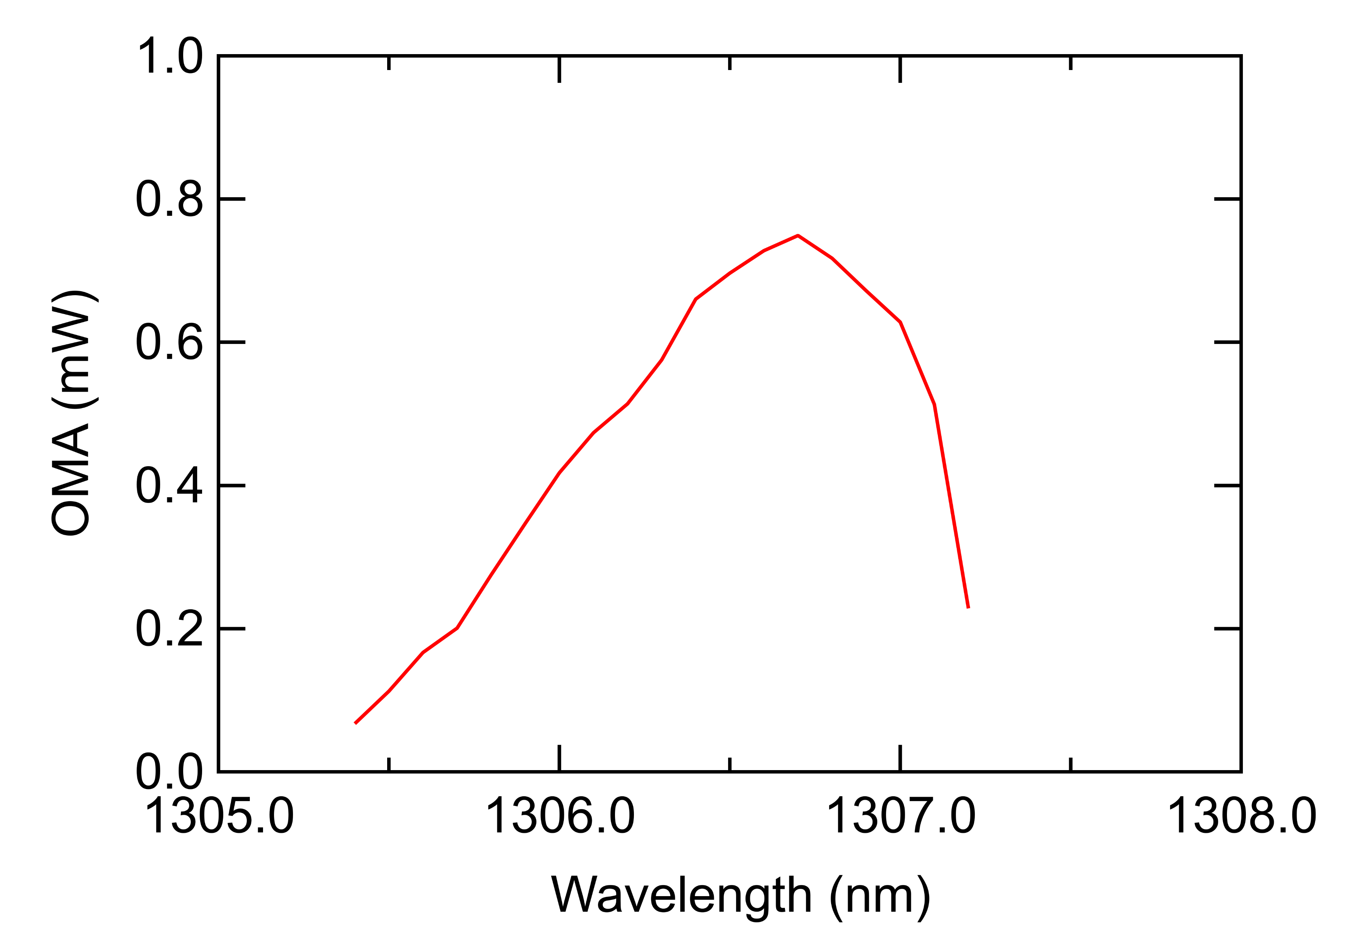
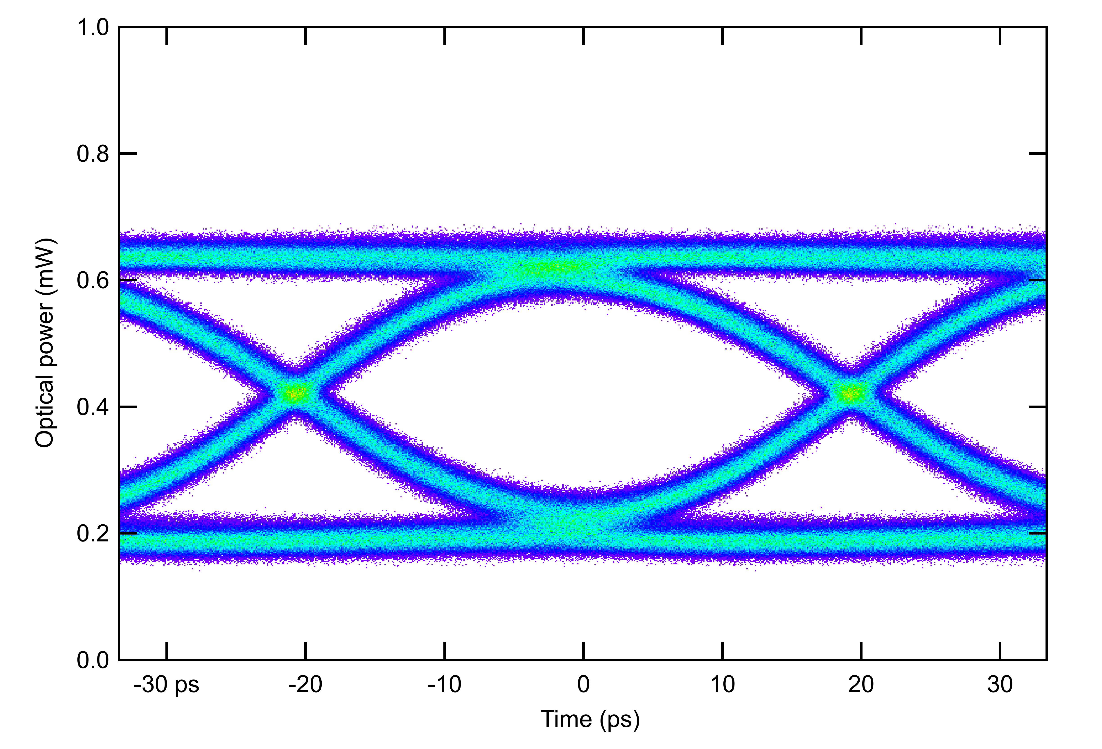
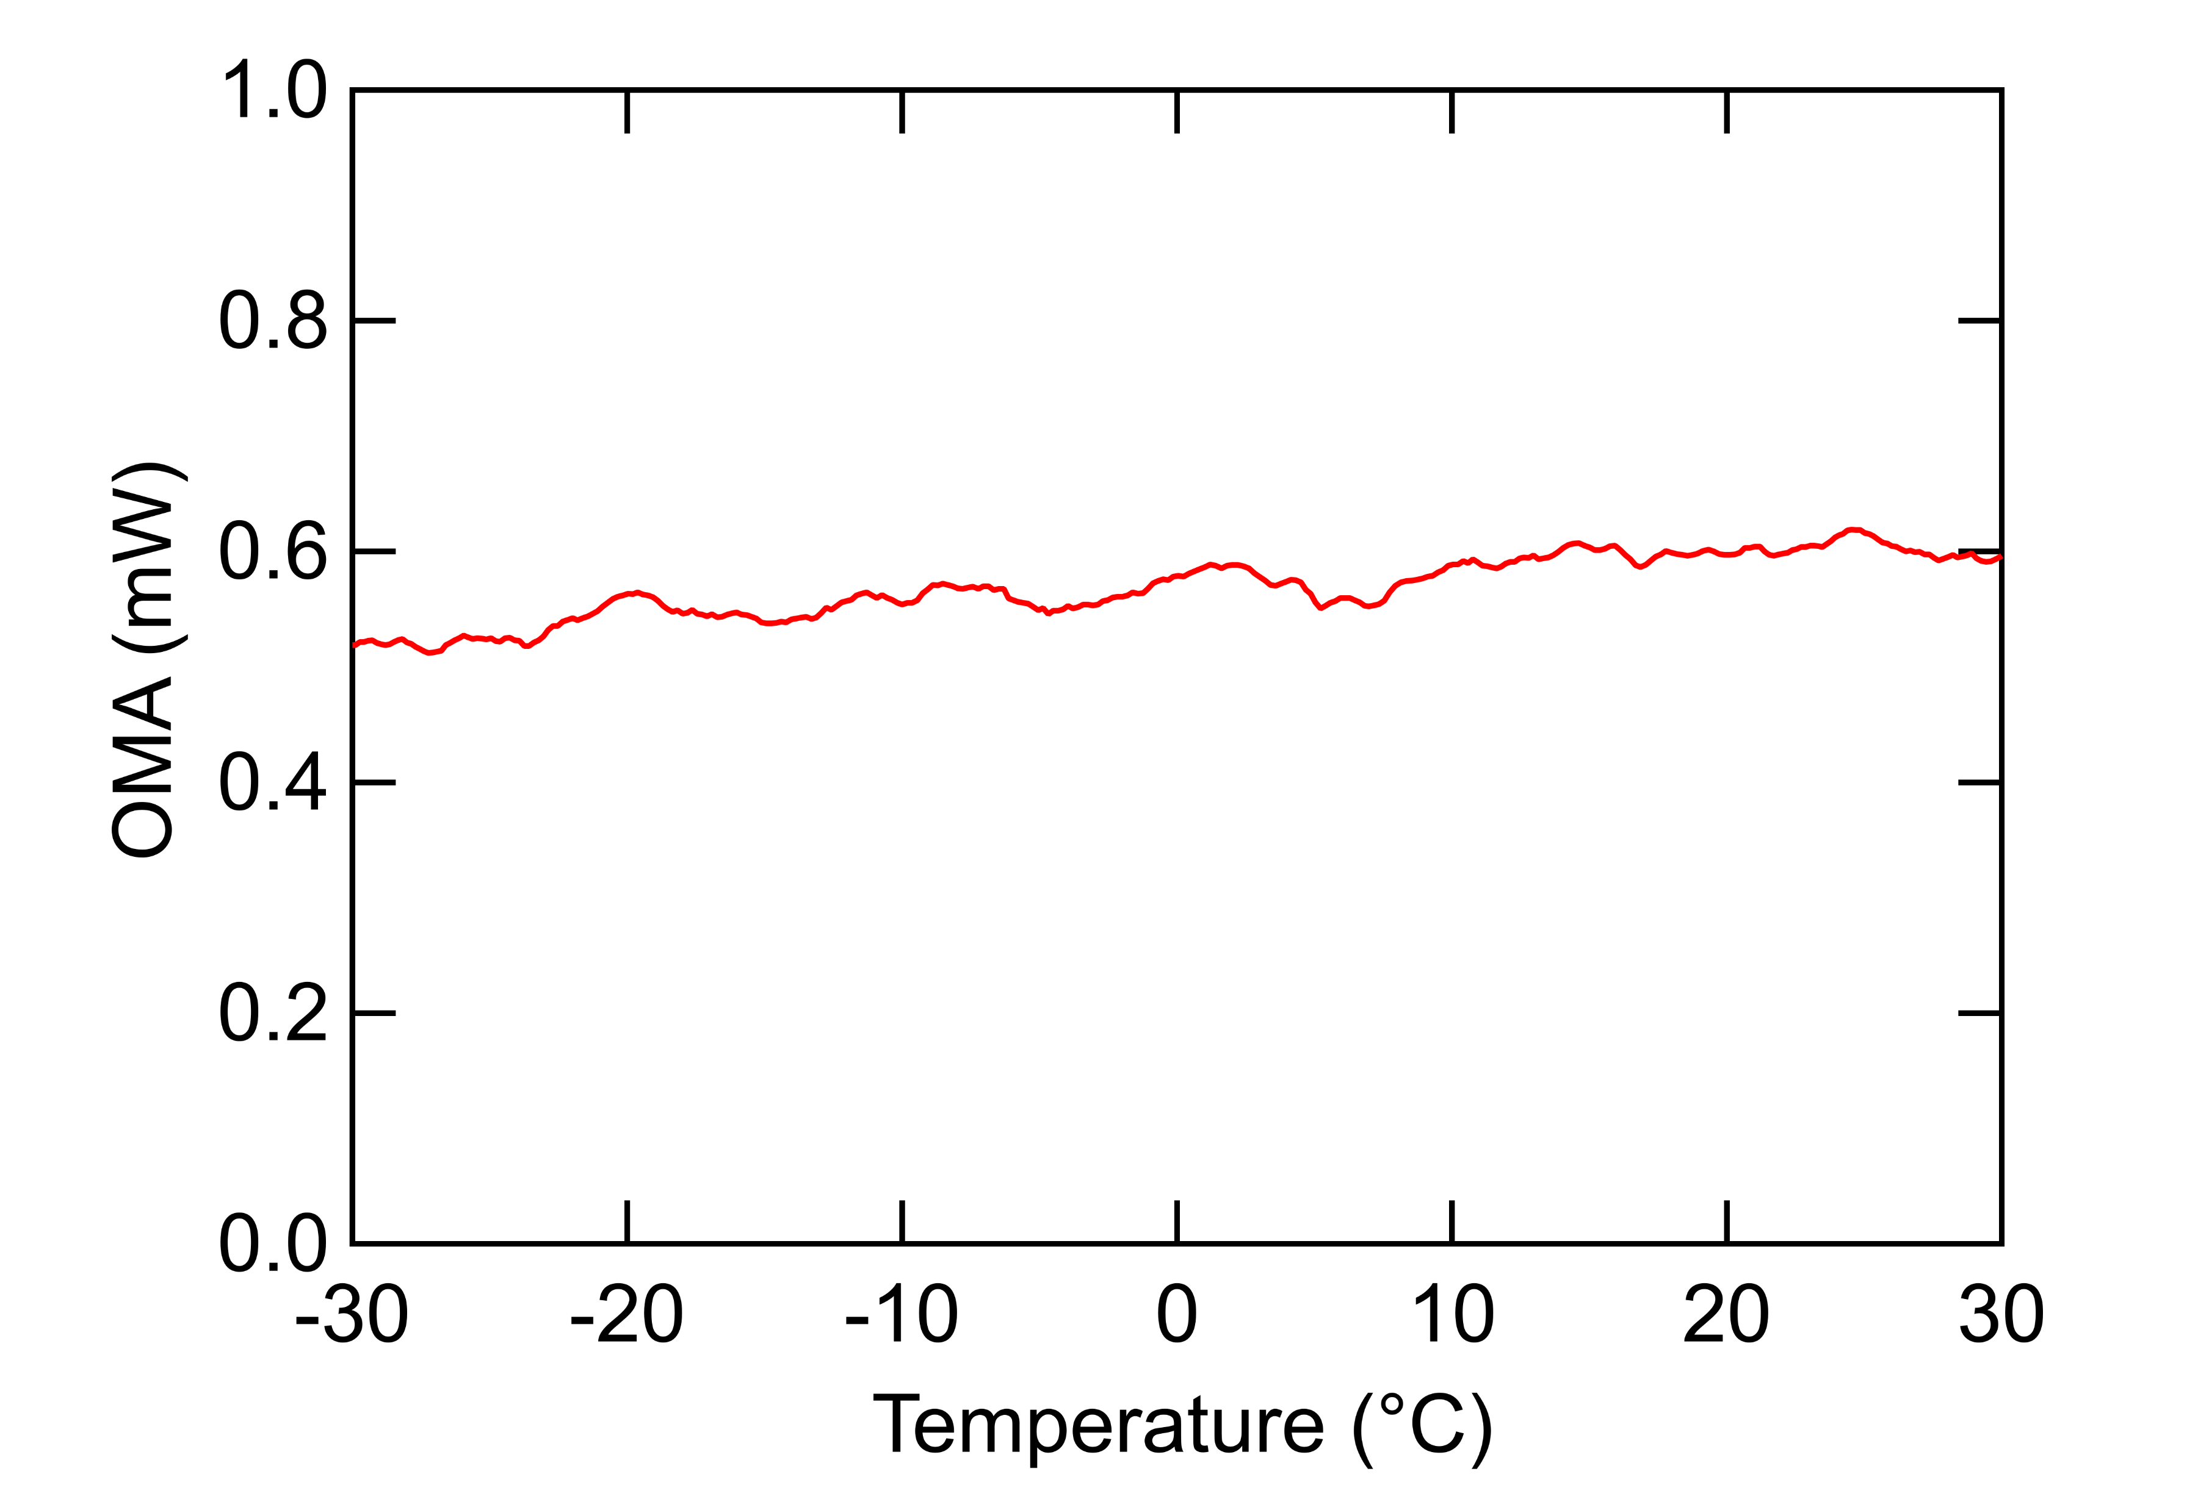
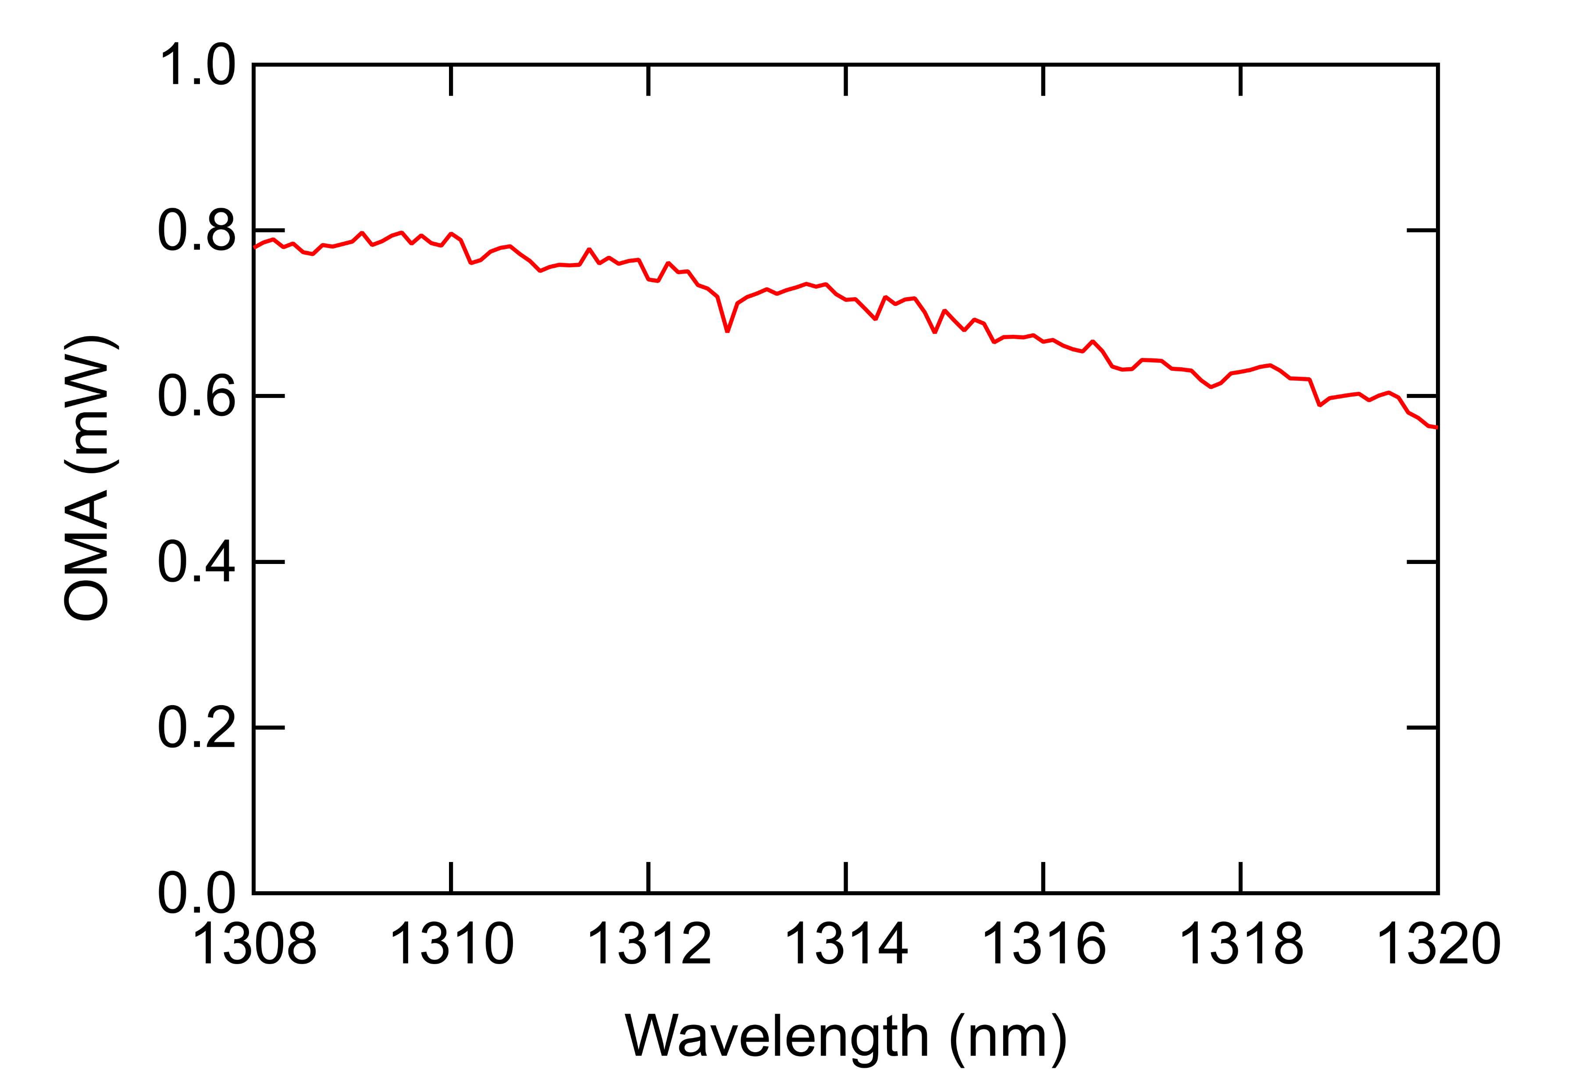
Proof of concept stabilisation test results
Temperature sweep
Ring modulator test board in a climatic chamber
Wavelength sweep
Tunable laser scan in a wide wavelength range
Control OFF
Control OFF
OMA
Control ON
Control ON
The controller keeps the modulator resonance locked to the laser wavelength to produce constant and maximum OMA
Controller concept demonstrated with discrete components

