Slide 1
Towards a detector concept
Sharing thoughts on how to get there…

Slide 2
Outline
One slide about my past experience and current activity
General considerations on detector design
Personal reflections on the detector concepts in the Feasibility Study plus some other sources
  Not discussed with any of the relevant experts – feel free to challenge!
Ideas on how to move forward – for discussion

Slide 3
One slide about my experience
Data analysis in ALEPH at LEP (first 10 years)
  Heavy flavour physics – from undergraduate student to WG convener
  Final version of most important analyses after (late) data reprocessing
    … then closed the shop!
Design and construction of the CMS Tracker
  Definition of the layout
  Design and construction of the Outer Barrel (TOB)
Project leader of the CMS Tracker Upgrade from 2009 until 2020
  From brainstorming and powerpoint sketches to validation of final prototypes
Currently
  Responsible for CERN deliverables in the CMS Tracker Upgrade (managerial)
  Leading the design of the HL upgrade of the SND detector, that will repurpose TOB modules
  Coordinating the R&D for an improved ladder for the CMS Inner Tracker TBPX L1 replacement
  CMX-ID Section leader (CMS Tracker + BRIL)

Slide 4
General considerations (in random order)
The detector design degrades going from early simulations to engineering designs
  More mass (in the tracker), more/larger gaps (everywhere), more space for services, smaller acceptance…
  Bold assumptions evolve towards more prudent choices when you actually have to build it, make sure it fits together, it works… and pay the bills!
    The degradation tends to be proportional to the complexity of the detector that you are building…
Results of simulations are only as good as the input
  The input cannot be very accurate for a detector that is not designed…!
    Particularly relevant when the performance is heavily affected by the mass of mechanical structures, power distribution, cooling system…
      Are there conductors in the tracker models???
  Some examples
    For the present CMS tracker, the mass increased by about a factor of 3 from early simulations to final detector
    For the HL tracker, I made myself the first detector model with *everything* in it (wires, fibers, pipes, connectors, patch panels…), trying to make reasonable/conservative assumptions… still, it got (a bit) heavier along the way

Slide 5
General considerations (in random order)
When doing simulations you easily conclude that the more the better
  Add an LGAD layer for timing information….
  Add a RICH for particle ID…
When you go to design and build the detector (and then operate it), the simpler the better
  Minimize the number of different subsystems
  Minimize the number of different detector technologies
  Minimize the number of different chips
  Add complexity when there is a compelling case for it
Consider how the different detector parts work together
    Examples:
  Is it really useful to have a super-expensive high-resolution electromagnetic calorimeter after a heavy tracker?
  Is it necessary to have high-precision muon detectors if the muon momentum is measured (much better) in the tracker?
Containing costs is not just virtuous – it also has important strategic value

Slide 6
General considerations (in random order)
Power consumption is the enemy
  Everywhere, and in the tracker much more than anywhere else
    Drives the mass in the conductors and in the cooling system
  Beware of your requirement on electronics
  Beware of timing detectors!
    An LGAD layer close to the IP is NOT a good idea…
Maintenance/repair scenario is a key ingredient of the detector concept
  May be linked to the service routing
  Defines the needed redundancy
For the Tracker, technologies for cooling, power distribution and readout links are as critical as sensors and chips

Slide 7
What is the goal?
Main goal: develop a detector design that will become a proposal for one of the four FCC-ee detectors
Side-goal: along the way form a proto-collaboration that stands behind the proposal and is willing to engage in the construction
  Develop a network of partnerships
At high level, the vision is that there should be > 4 proposals, out of which 4 will be selected
The four different detectors should be sufficiently different to support global risk mitigation
  While pursuing optimized technical choices, we can also keep an eye of what others are doing…

Slide 8
Tracker
Attractive concept with a vertex detector based on MAPS, a large gas detector, and a silicon “wrapper” at the outer edge of the tracking volume
Gas detector: is it worth the complication?
    Lighter
    Continuous tracking (better performance for long-lived V0s)
    Some particle ID capability
  Compelling advantages compared to silicon only
  Are we sure that it works?
Gas detector: what is it?
  Two nearly equivalent options being considered: wire chamber and straw tubes
  Should have very similar performance, with small advantages and disadvantages for each of them
    E.g. the wire chamber has less mass in the barrel region, but needs stronger flanges
      Perhaps a case where we can also consider what others are doing

Slide 9
Intermezzo: quick introduction to (some) silicon technologies
Strips, hybrid pixels (planar and 3D), MAPS, stitched MAPS

Slide 10
Strip detectors
Micro wirebonds connect the strips to the circuits carrying the readout chips

Slide 11
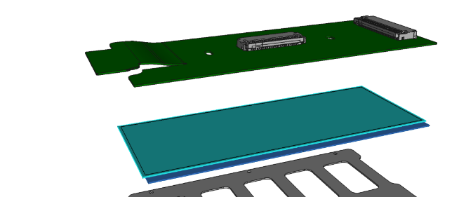
Hybrid pixels
Every cell on the sensor is connected to a pixel in the readout chip
Connection by “bump bonding”
Interconnection circuit
Sensor
Chips
An interconnection circuit connects to the periphery of all the chips, providing connectivity for powering and readout
11

Slide 12
The highest radiation regions: 3D sensors
Planar sensor 3D sensor
150 𝜇m
150 𝜇m
Drift path different from particle path (generating the signal)
Shorter drift path:
less prone to charge trapping – better charge collection efficiency after heavy irradiation
depletion at much lower bias voltage – mitigate power dissipation from leakage current
Some inefficiency for orthogonal particles
Complex fabrication, higher cost
Almost transparent for the system design (only differences: higher channel capacitance, lower V_{bias})

Slide 13
Lower radiation, lower rates, lowest mass: MAPS
Monolithic Active Pixel Sensor
MAPS: sensor and readout integrated in the same silicon wafer (CMOS process)
Lower mass
Easier fabrication and testing
Constraints in the electronics design ⟶ limited rate capability
Limited depletion region ⟶ limited radiation tolerance
Technology used in the ALICE Tracker
N.B. Still need an interconnection circuit to connect to the sensors

Slide 14
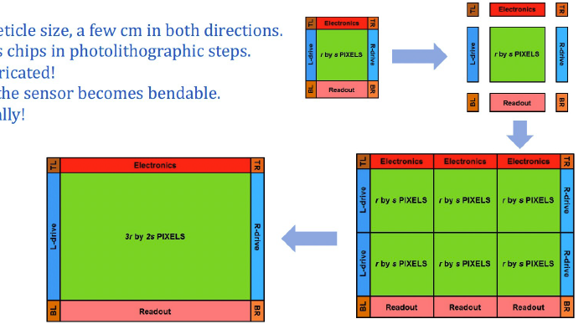
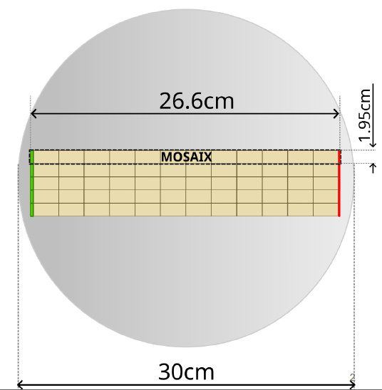
Ulrimate MAPS: stitched MAPS
Chip size is limited by reticle size in a given technology
  Typically 2-3 cm in both directions
Stitching enables connections between neighbouring chips
  Enables (ideally) the construction of wafer-size sensors, with auxiliary electronics on the periphery
Comes with significant design challenges
  Power distribution, yield
Wafer-size sensors can thinned and bent to form ultra-light (half) layers for vertex detectors

Slide 15
End of Intermezzo
Back to business…

Slide 16
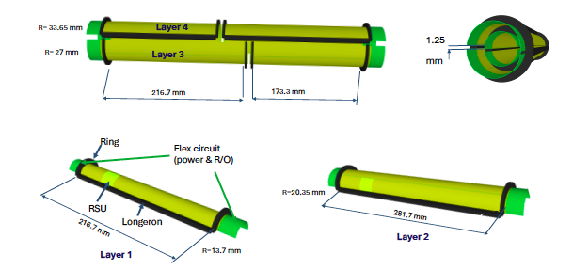
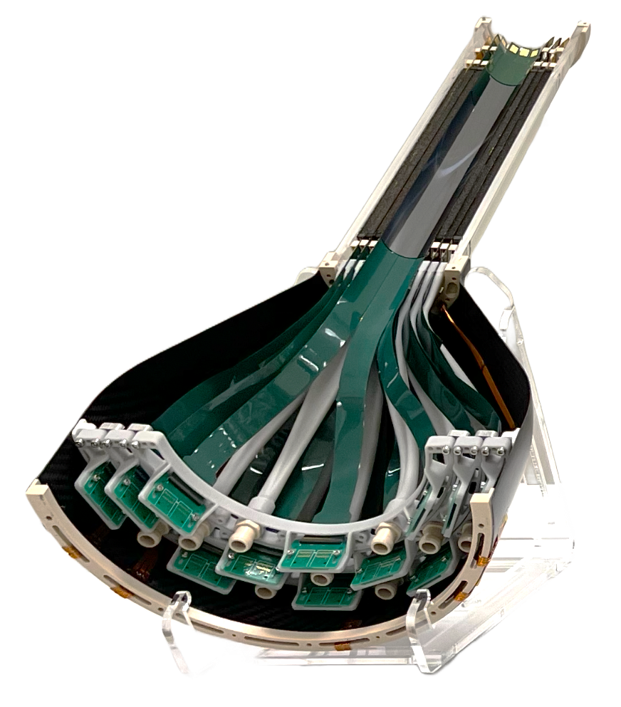
Tracker
Vertex detector
  For the innermost layers ultra-thin curved maps as in ALICE ITS3 are the compelling best option
    Stitching technique to realize large-area sensors
      Difficult to see how the four detectors could make different choices here…
    Layout to be optimized (within layer, as well as number of layers)
    Air cooling is a must
    Maintenance scenario is vital
      Beware of acceptance!
ITS3 engineering model 3

Slide 17
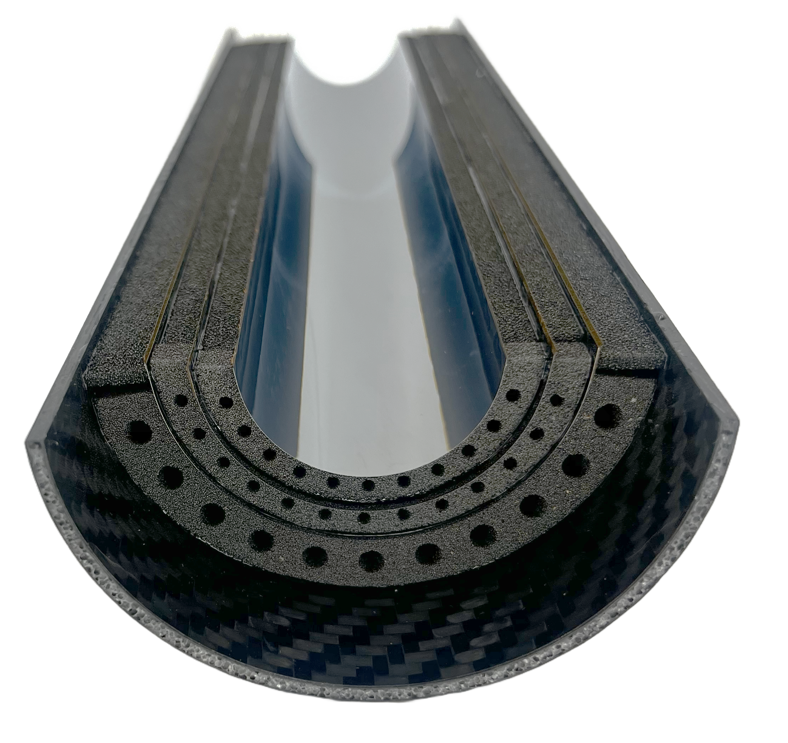
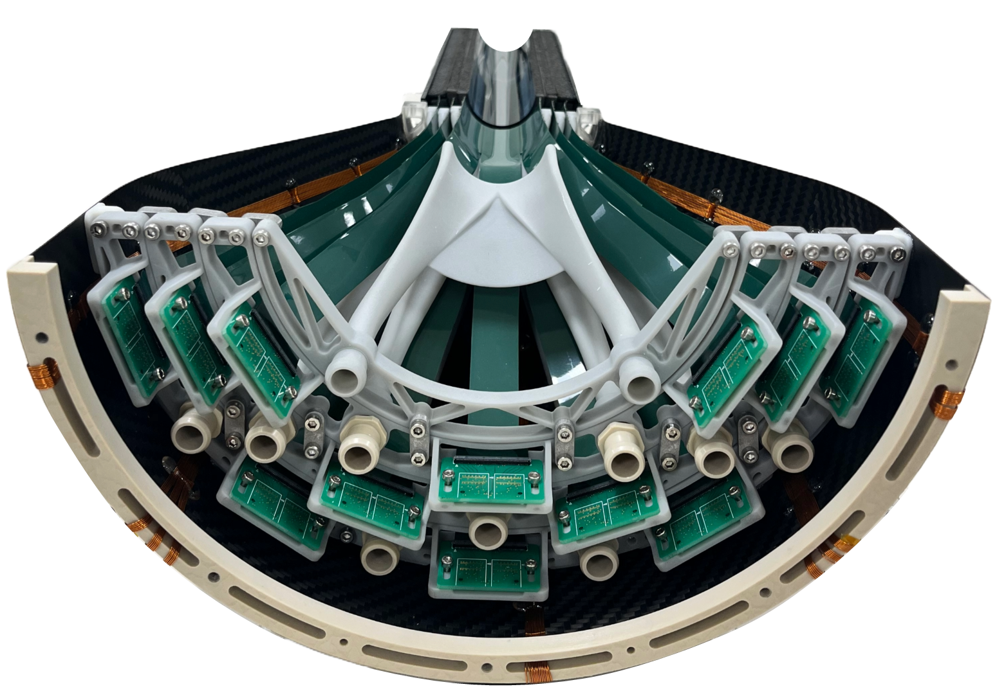
Half-detector prototypes
Support: Longeron
ERG (RVC) Duocel®
ρ = 0.07 kg/dm3
k = 0.033 W/m·K
3x half-layer sensor
65 nm TPSCo CMOS
imaging technology,
Radii = 19 | 25.2 | 31.5 mm
Length = 266 mm
Thickness ≤ 50 µm
Cooling radiator: Half-ring
Allcomp k9 foam
ρ = 0.2-0.26 kg/dm3
k = >17 W/m·K
Chip high-power dissipation region ~1 W/cm²
CYlindrical Structural Shell (CYSS)
Carbon sandwich
Power and data transmission
Flexible printed circuit
Air distributor
Polymer 3D printed
Cone Structural Shell (COSS)
Carbon laminate
Wall thickness = 0.8 mm, Length= 215 mm
Outer radius = 140 mm
Patch panel
Polymer 3D printed

Slide 18
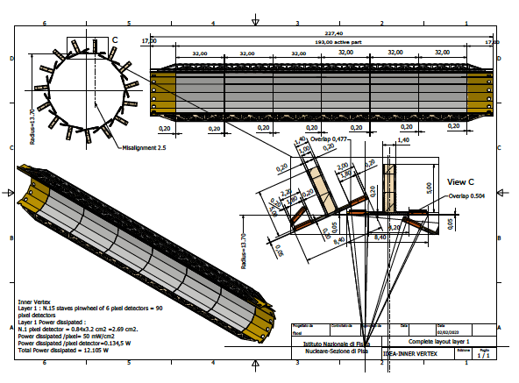
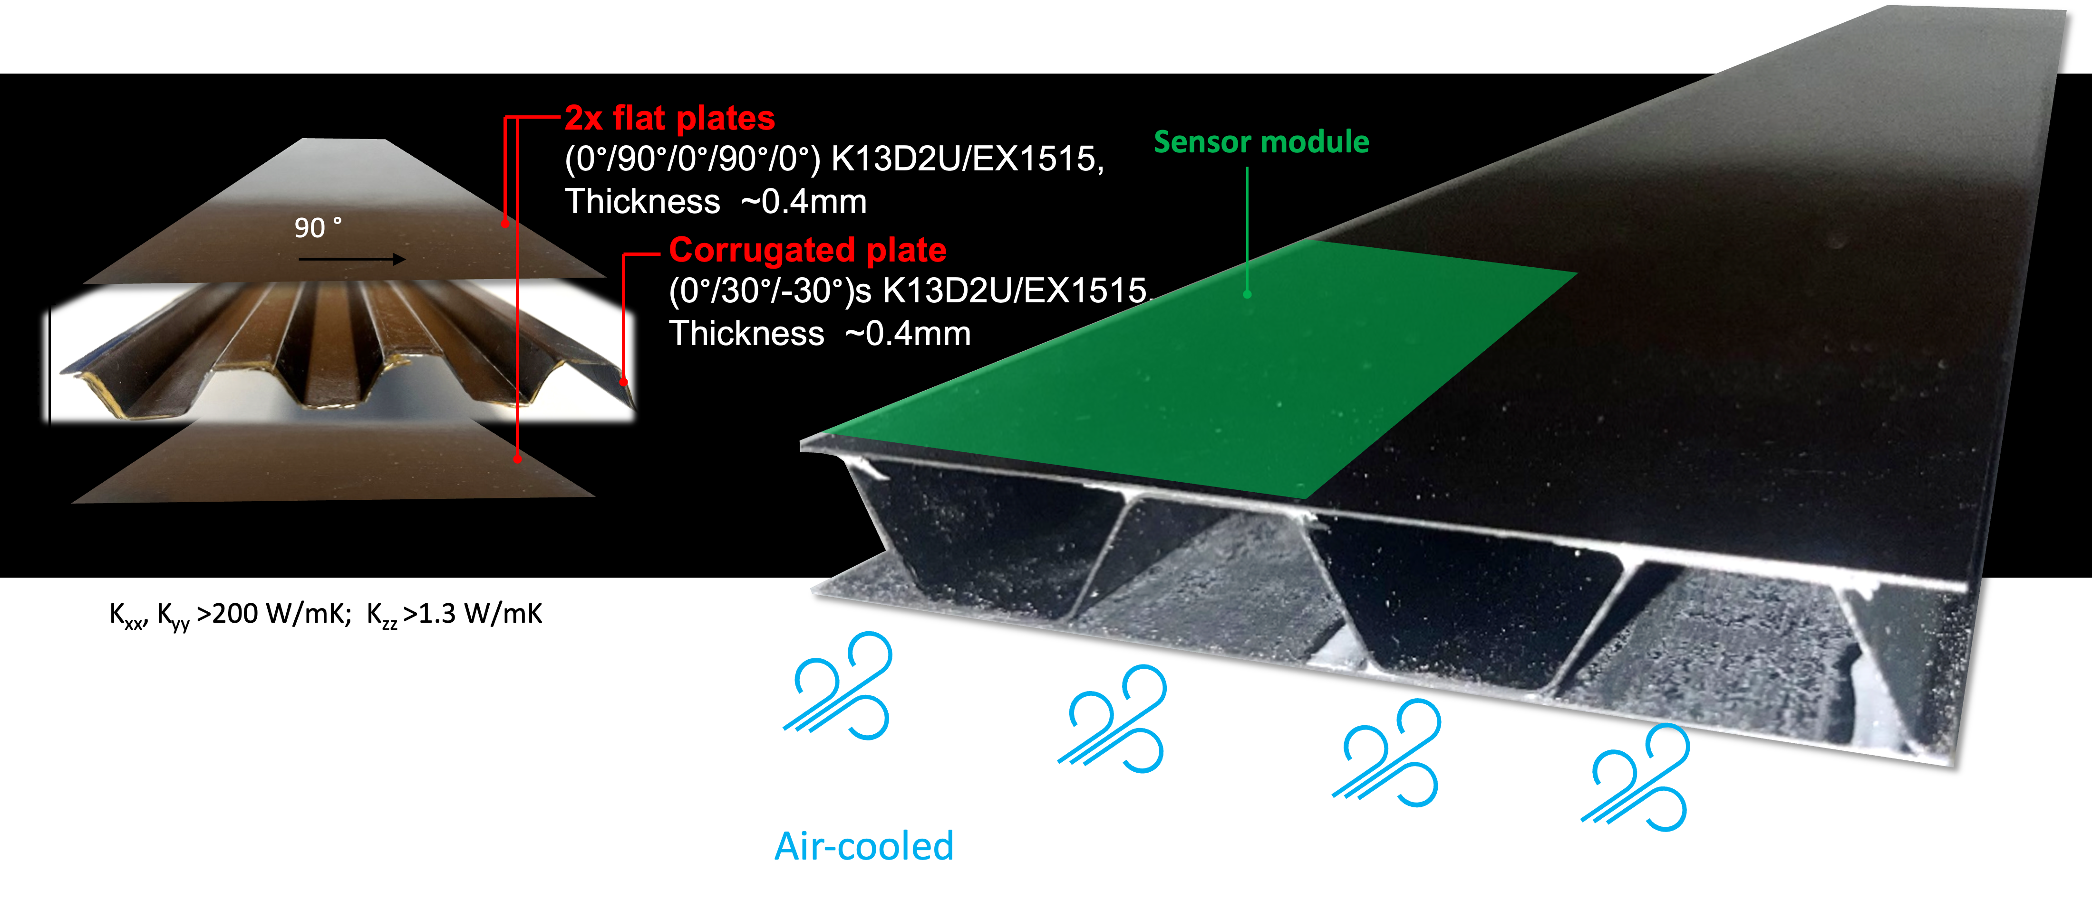
Tracker
Vertex detector
  For the outer layers hybrid pixels are maybe not the best option
    Could use the same MAPS in a more traditional module design?
      Lighter, less power and higher resolution (smaller pixels) compared to hybrid pixels
      Avoid introducing one additional system for no good reason!
      Could even use stitched sensors (not bent) if the yield is sufficiently good
  Concepts for air-cooled mechanical structures under development
    Also for outer layers in silicon wrapper!

Slide 19
Tracker
Silicon wrapper
  Maybe needs to be extended compared to what is in the document
    Two layers in the barrel, for redundancy?
    A few disks in the forward, also to compensate loss of performance of the gas detector?
  Which technology?
    Microstrips
    MAPS (as in the – outer – vertex detector)
    Resistive LGADs, if we want timing

Slide 20

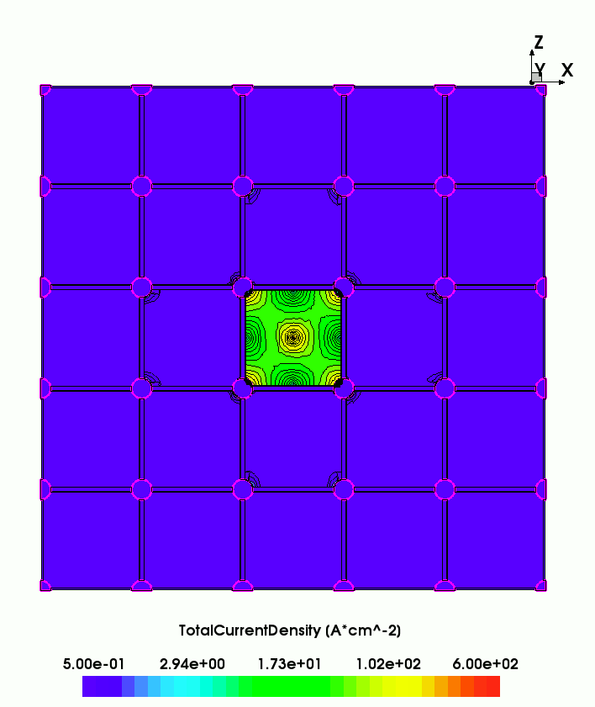
Resistive LGADs in few words
Signal spreading can be confined with isolating trenches
AC pad
n+ contact
oxide
---
--
++
+++
resistive n+
p bulk
gain implant
p++
RSD (AC-LGAD)

Slide 21
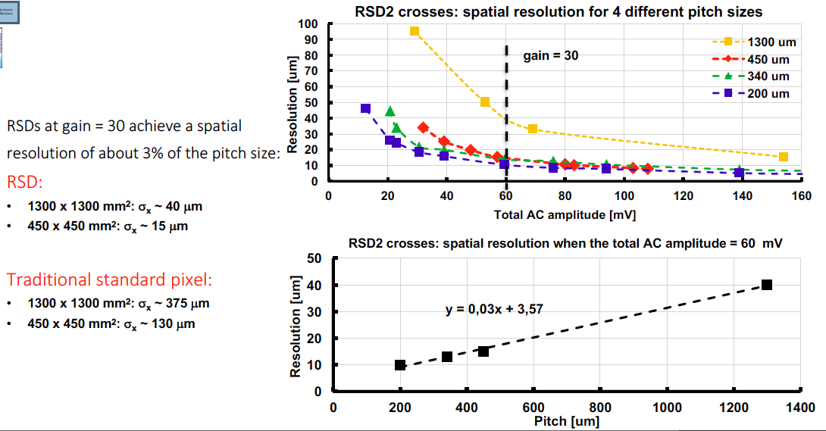
Resistive LGADs in few words
What are they good for?
Excellent spatial resolution with coarse granularity
Possibility to combine space and time resolution in a single detector, while mitigating power density

Slide 22
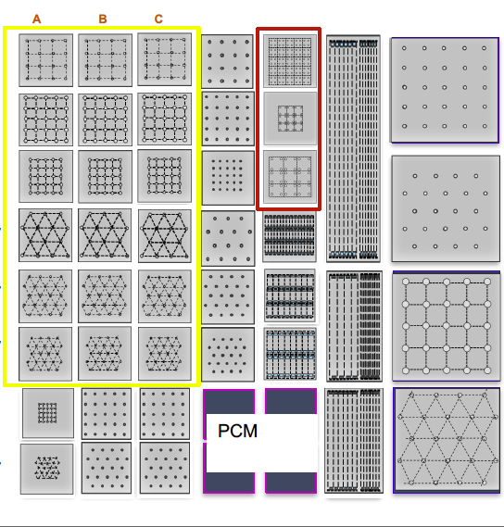
Resistive LGADs in few words
Many possibilities to configure geometry of readout electrodes and trenches
  Trade-off between resolution and two-hit separation, for a given granularity
Ongoing submission @ FBK with many different structures

Slide 23
Technologies for silicon wrapper
 | Microstrips | MAPS | RSDs
Power density | Lowest | Medium | Highest
Tracking performance | Modest | High | Good (trade off with power)
Maturity of the technology | Proven | Proven | R&D
Complication | Medium | Lowest | Highest
Timing | NO | NO | YES
Bottom line: how much do we care about timing?

Slide 24
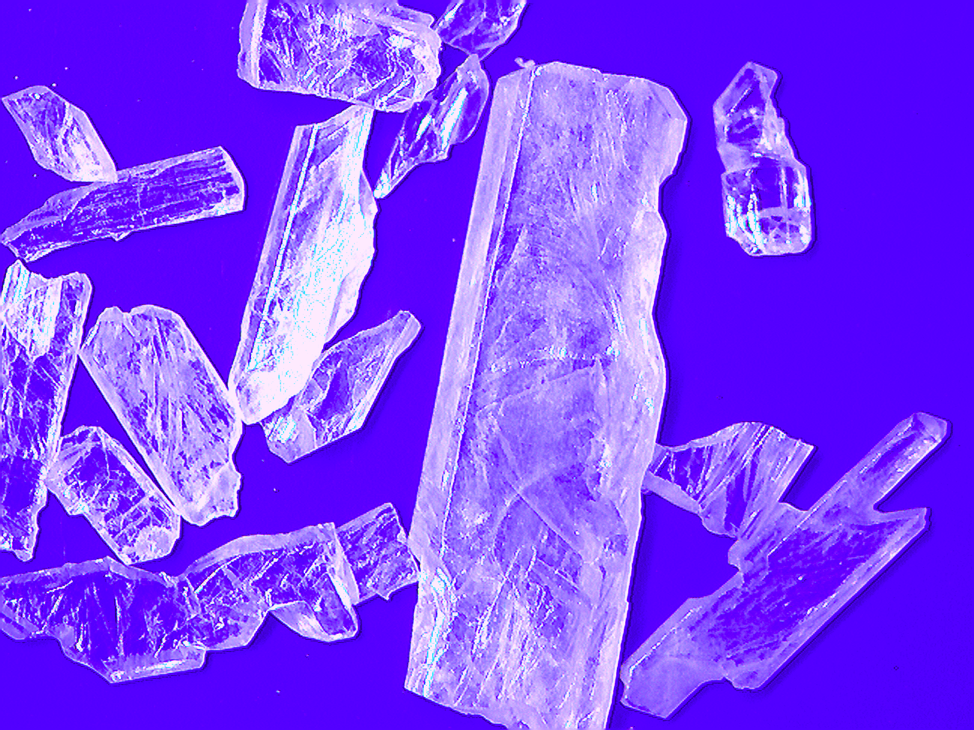
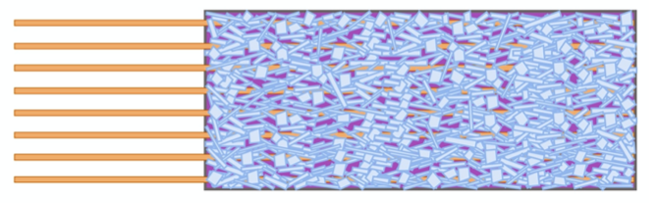
Moving away from the IP: electromagnetic calorimetry
  The GRAiNITA concept – try to achieve:
Excellent energy resolution – similar to a homogenous crystal calorimeter
Significantly higher transverse granularity
Significantly lower cost!

Slide 25
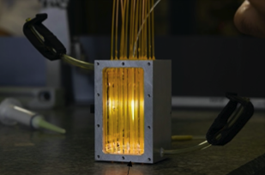
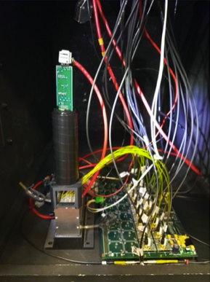
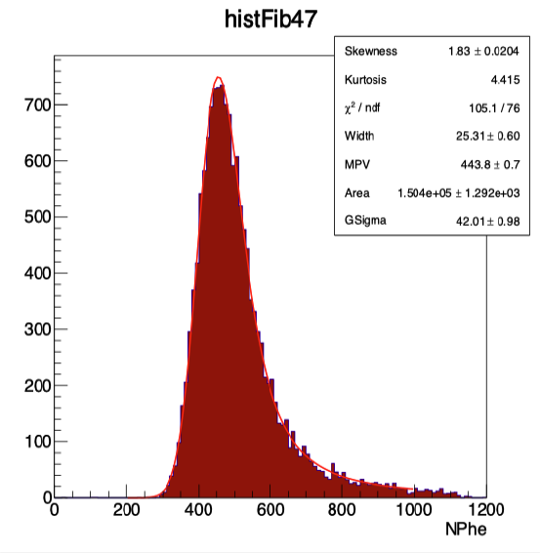
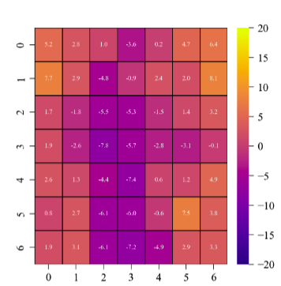
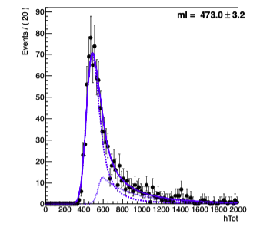
GRAiNITA
Small prototype built with ZnWO₄ grains
  Other materials can be studied
Volume between grains to be filled with heavy liquid
First results seem to indicate that 1% stochastic term and 1% constant term are plausible goals!
Energy deposited by muons O(40 MeV)
⟶ 10000 pe / GeV!
Scan of the surface with a pion beam
Fluctuations in the response less than 1% of the deposited energy

Slide 26
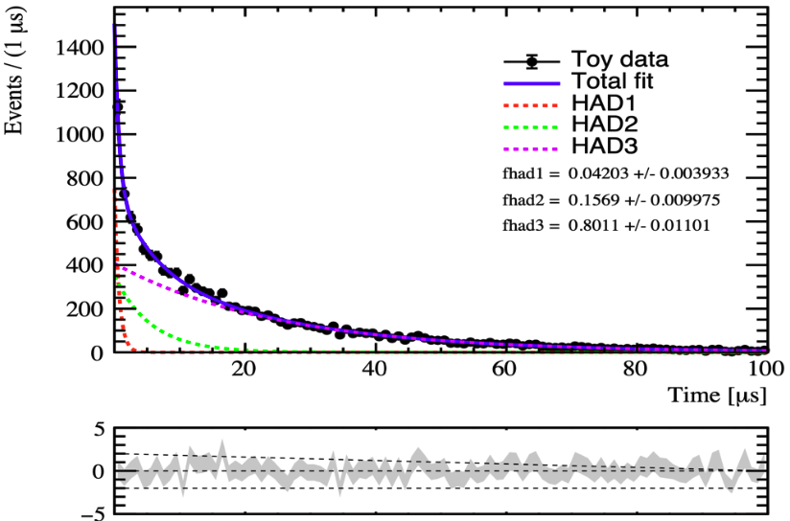
Complementary R&D: Apartè
Use pulse shape analysis to discriminate electromagnetic and hadronic components of the shower
  Electromagnetic and hadronic interactions produce different type of excitations in the material, resulting in different scintillation times
  Analysis of the pusle shape can give an indication of the em/had ratio, enabling an event-by-event correction to enhance jet energy resolution
Simulation framework developed, to be fed with experimental data

Slide 27
Coil and muon system
Lightweight relatively small coil for IDEA/ALLEGRO, with HCAL outside
  Looks reasonable
  Size of the coil should be optimized after having defined Tracker and ECAL
    If ECAL-GRAiNITA has high performance and is cost effective, maybe worth making it large, with only a hadron tail catcher outside
Simple instrumented iron yoke could serve both as hadron tail catcher and muon tagger?
  One single technology – which one?
    Muon momentum is measured in the tracker
  Should be simple, cost-effective and reliable

Slide 28
Important side topic: power distribution
With modern chip technologies, requiring large amount of current at very low voltage, direct powering with sensing from O(100 m) distance is not an option
  Would require conductors with huge cross section
  Sensing over large distance does not work anyway
Two main options
  DC-DC conversion: bring in power at higher voltage and convert/regulate locally
    Used in the CMS and ATLAS Outer Trackers for HL-LHC
  Serial powering: provide a current source going serially through several chips or modules
    Used in the CMS and ATLAS Inner Trackers for HL-LHC – first detector systems ever to use serial powering!

Slide 29
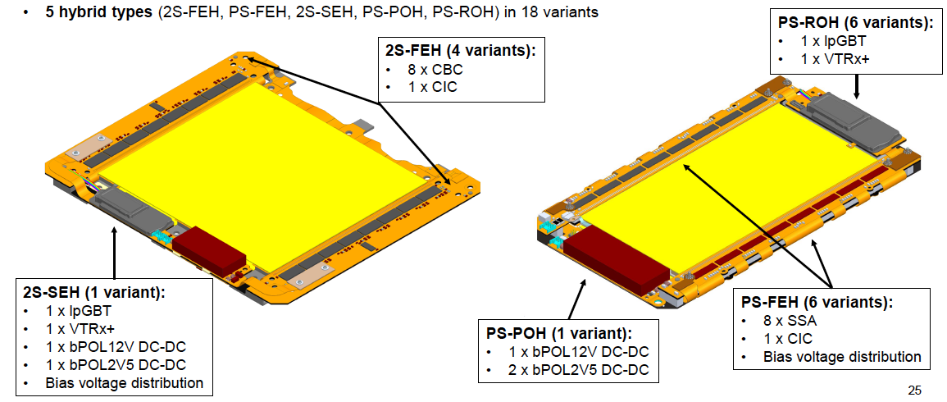
DC-DC conversion in CMS OT modules
Two-stage conversion: 10V ⟶ 2.5V, 2.5V ⟶ 1.2V
    VTRx+ is powered with 2.5V
  Non negligible size and mass
  Switching devices with inductors – require perfect shielding
  First stage actually works at around 6V input voltage
    Due to voltage drop from power supplies
  Beware of remaining voltage drop until the loads
  Overall efficiency < 70%
The module is a self-contained building block
    … to first order…

Slide 30
Serial powering basics
Serial powering is a current-based scheme
Modules are powered via a constant current flowing from module to module
I to V conversion is done on chip using a shunt regulator and linear drop-out regulator, combined into a shunt-LDO
  Compared to parallel powering:
The current flowing in a SP chain of N modules is just the current needed for one module: N×I_{mod} → I_{mod}
The voltage across the SP chain is N times the voltage needed by one module V_{mod} → N×V_{mod}
  Provided that every module represents the same constant load: this is the function of the shunt-LDO
  The shunt-LDO requires extra current and voltage drop: overhead in power consumption
The power consumption is constant (always max)
All the modules operate at a different potential: readout must be AC-coupled

Slide 31
Serial powering implementation
Bias voltage (a.k.a. “high voltage”) is distributed in parallel
  Modules have slightly different bias voltage
    Not a problem for planar sensors (typical V_{bias} ~ a few 100 volts)
    “Just works” for 3D sensors (typical V_{bias} ~ a few 10 volts), with two independent bias lines for long chains

Slide 32
Serial powering implementation
The shunt-LDO ensures the correct behaviour of the module as a serial power chain node
Overhead in power consumption, but no additional components
The system is (to first order) insensitive to voltage drops

Slide 33
Serial powering implementation
The shunt-LDO ensures the correct behaviour of the module as a serial power chain node
Overhead in power consumption, but no additional components
The system is (to first order) insensitive to voltage drops

Slide 34
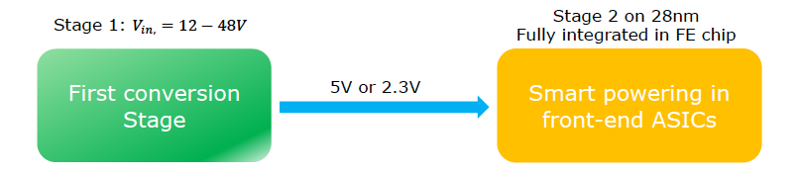
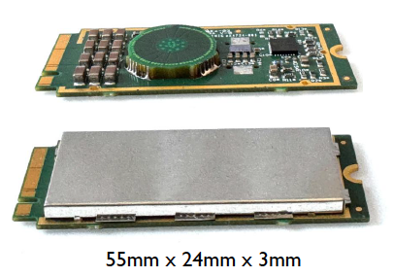
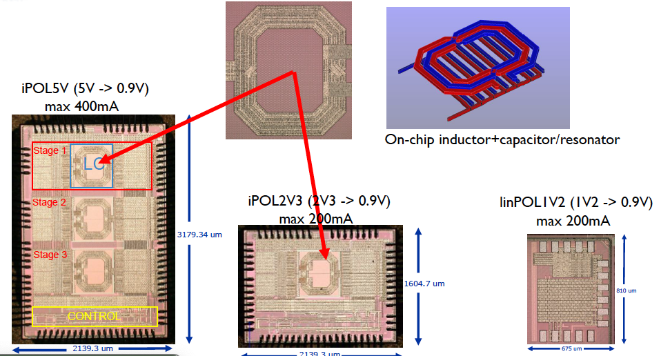
Next generation DC-DC converters
    ... being qualified to extreme TID
A first stage to be integrated in a patch panel is a step forward
Globally not really aligned with FCC-ee needs…

Slide 35
What about serial powering?
Sh-LDO in 65 nm technology already exists…
But unfortunately serial powering does not marry well with MAPS!
  Typical V_{bias} is a few Volts
  No obvious (to me) option for system implementation

Slide 36
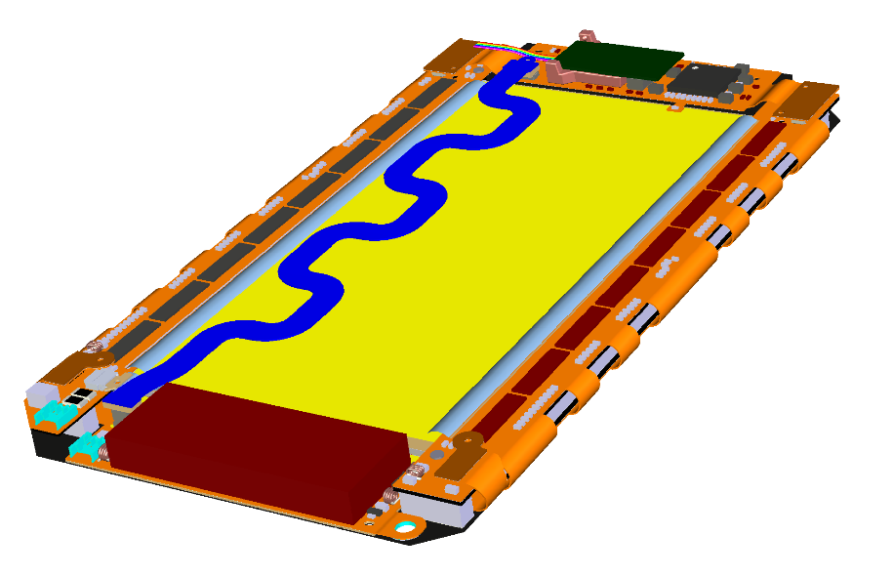
Current and future data links
VTRX+
Electro-optical transceiver (VTRX+) implemented “on-board” or relatively close to the modules
Additional components and powering infrastructure
E.g. CMS Tracker upgrade:
on-module optical conversion on the Outer Tracker
up to 2m electrical links in the Inner Tracker
Future: silicon photonics
Light source in the back end
Optical modulator integrated on module
Higher bandwidth capability and reduced material
First application will be the LHCb upgrade – integration at chip level
Efficient use for FCC-ee will require careful system integration
Test chip
Notes:
“on-board:”

Slide 37
Final (disruptive) consideration
There is the possibility to design a powerful and elegant FCC-ee detector based on a few key detector technologies
  Silicon MAPS
  One gas detector (e.g. wire chamber?)
  The GRAiN calorimeter?
  A (simple and cost-effective) system for HCAL and muon detection
    … and perhaps one or two more, if we conclude that there is a compelling need
With fewer technologies it is harder to attract many groups (at least initially)
It’s easier to make friends with a big “supermarket” of technologies
  … but then we end up with a messy detector to build and operate!
Unfortunately building a detector requires people and money – not only good ideas…

Slide 38
How to move forward? Proposal…
Organize topical brainstorming sessions with experts
Build a shared vision of what is possible and what is plausible
  Attention to system design, mechanics, and services
Aim to converge on a coherent detector concept and attract collaborators to commit to it

