Slide 1
BDSIM /ToyMC comparison
Robert Kieffer 11th June 2025

Slide 2
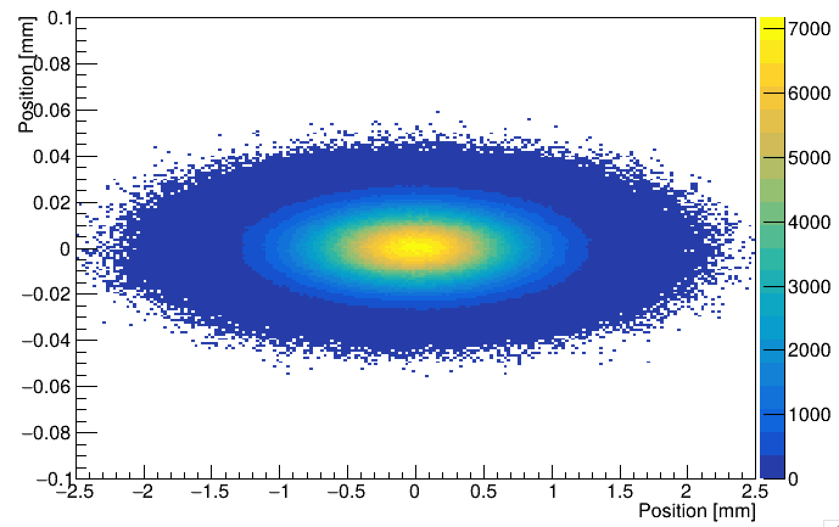
Laser /electron beam interaction (LIP)
Beam sizes
10um vertical
500um horizontal
Can we use cylindric lense to focus the laser beam ? Keeping the circular polarisation? To match the flat beam and maximise Compton collision yield.
For now W0=1mm circular
Beam profile at the laser IP location

Slide 3
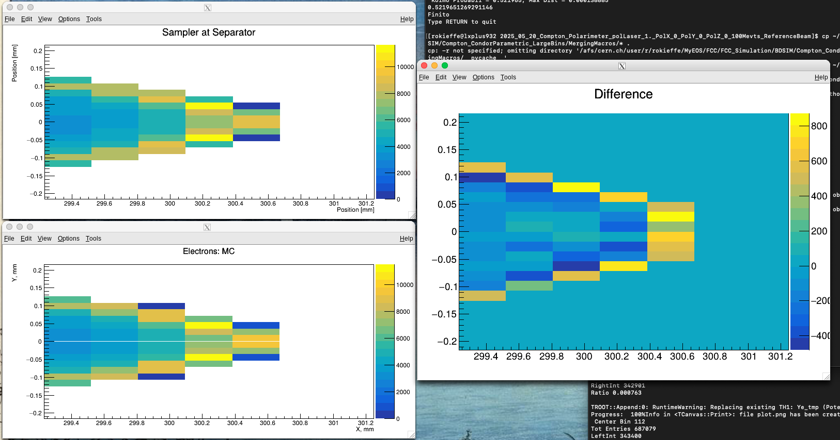
Kolmogorov test
Applying the test on ToyMC Vs BDSIM simulations
RESULT 0.52 with 100Mevts (zoom was to assert the binning and position)

Slide 4
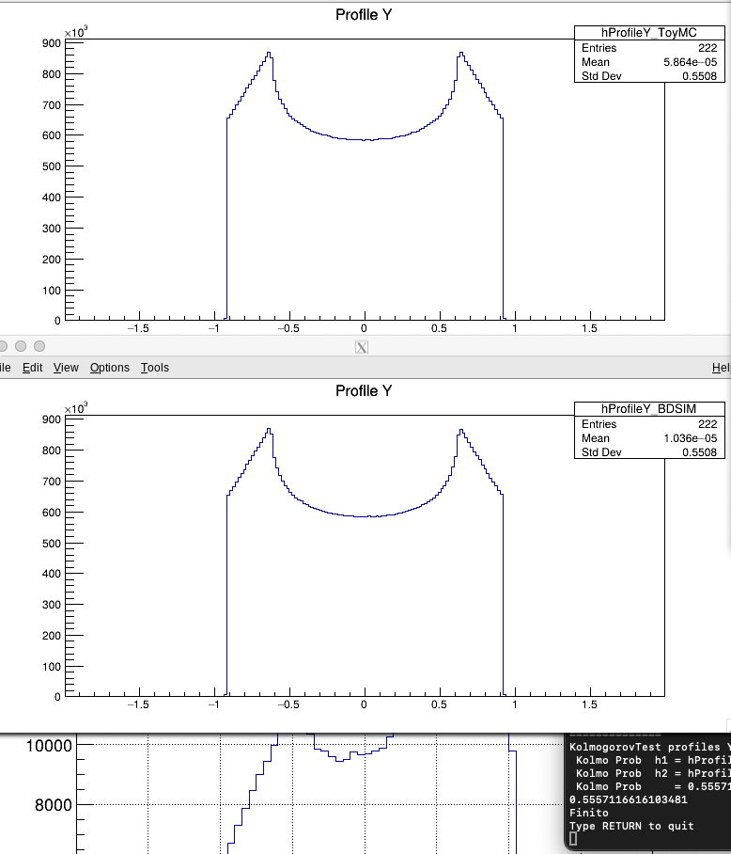
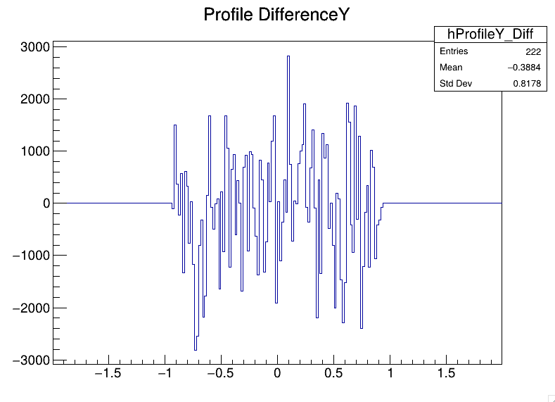
Kolmogorov test
Applying the test on ToyMC Vs BDSIM simulations on the profiles we reach 0.55 for vertical profile
0.63 for horizontal in 100Mevts

Slide 5
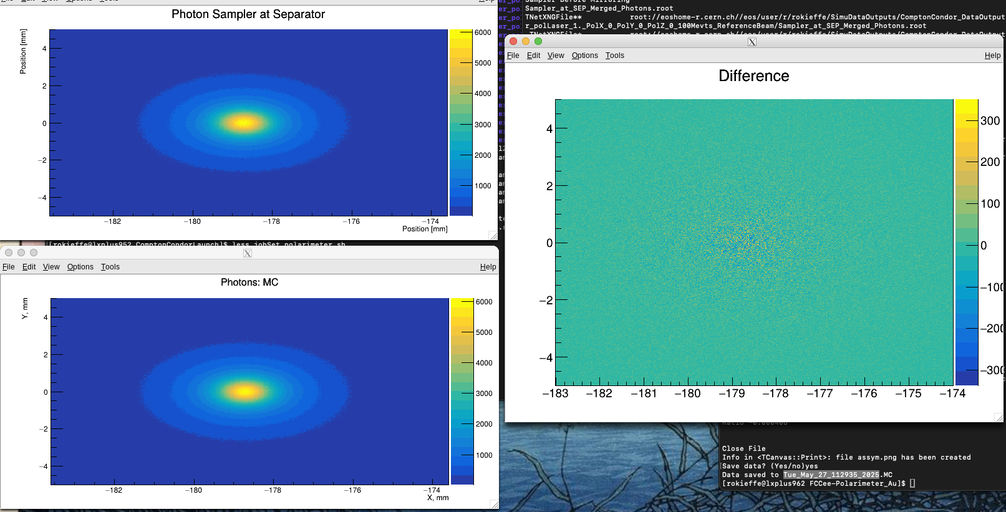
Difference plots
ToyMC Vs BDSIM simulations

Slide 6
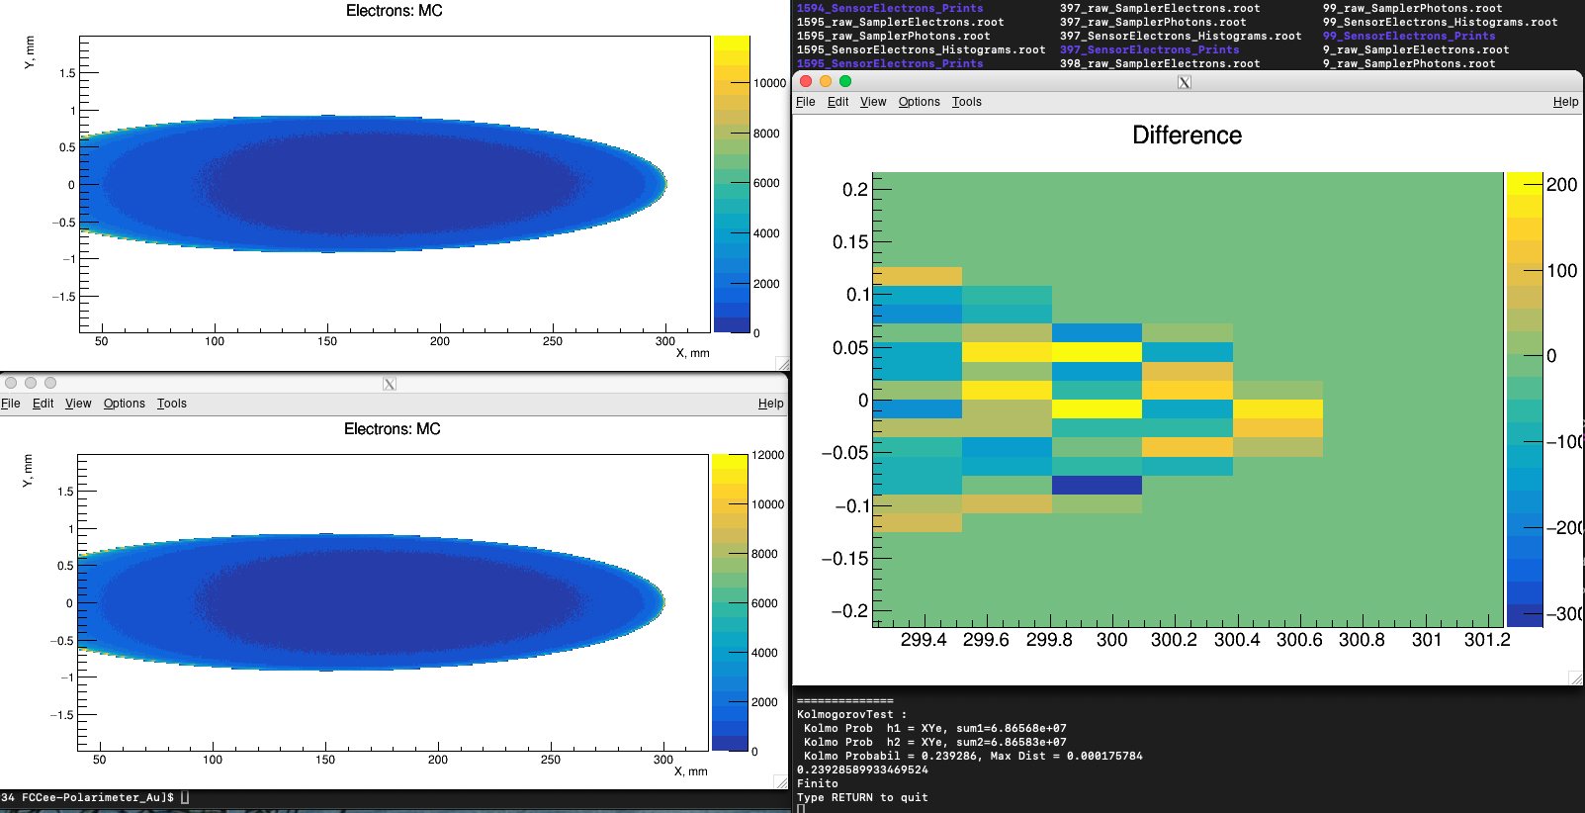
Kolmogorov self test
Applying the test on two successive ToyMC simulations only changing the seed. RESULT 0.23 is pretty bad with 100Mevts

Slide 7
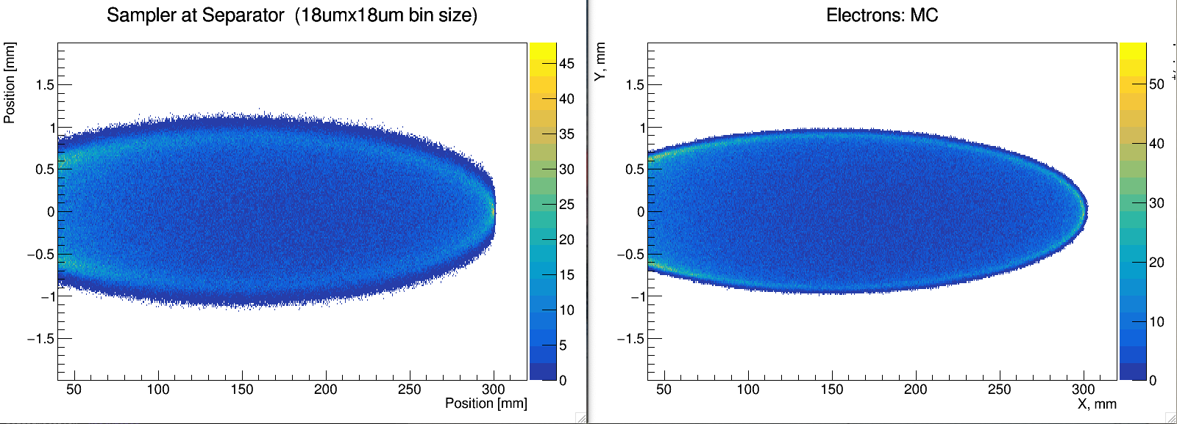
Using the full set of FCCee Z mode beam parameters at laser IP.

Slide 8
Using the full set of FCCee Z mode beam parameters at laser IP.

