Slide 1

Integration Review for Installation Readiness - Status
UL13/UL17/UL53/UL57
Stephane Maridor, Paolo Fessia, Miguel Navarro Baeza
HL-LHC WP15 Integration
06-06-2025
INDICO

Slide 2
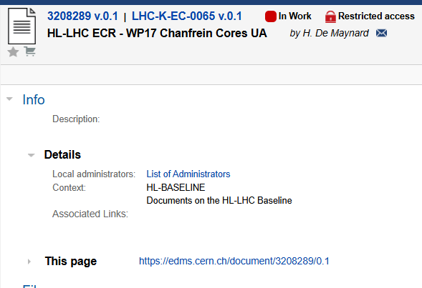
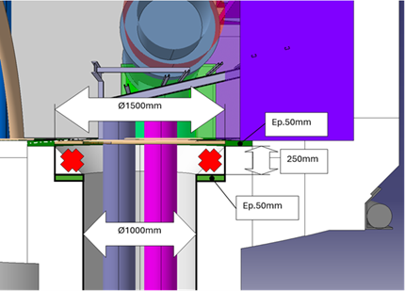
13 - Chamfer Replacement & Cable Routing
Topic: Replace chamfer with shoulder to aid cable integration flow.
Action: Approve chamfer proposal; ensure support rings and cable clearance.
Responsible: EN-EL

Slide 3
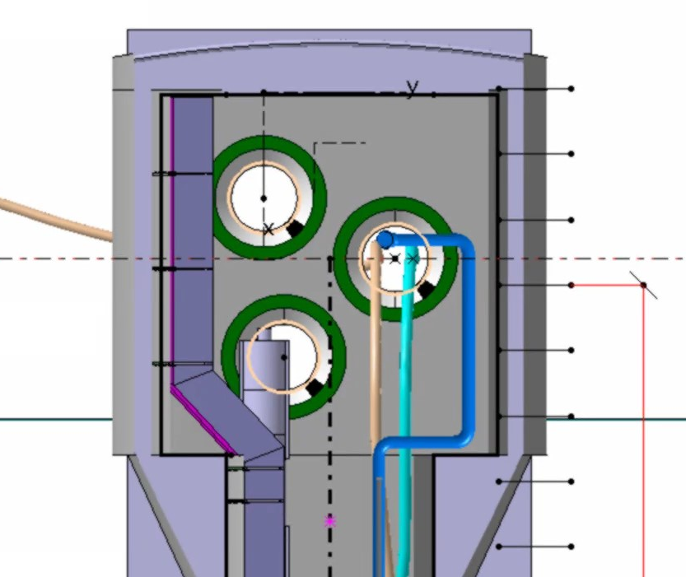
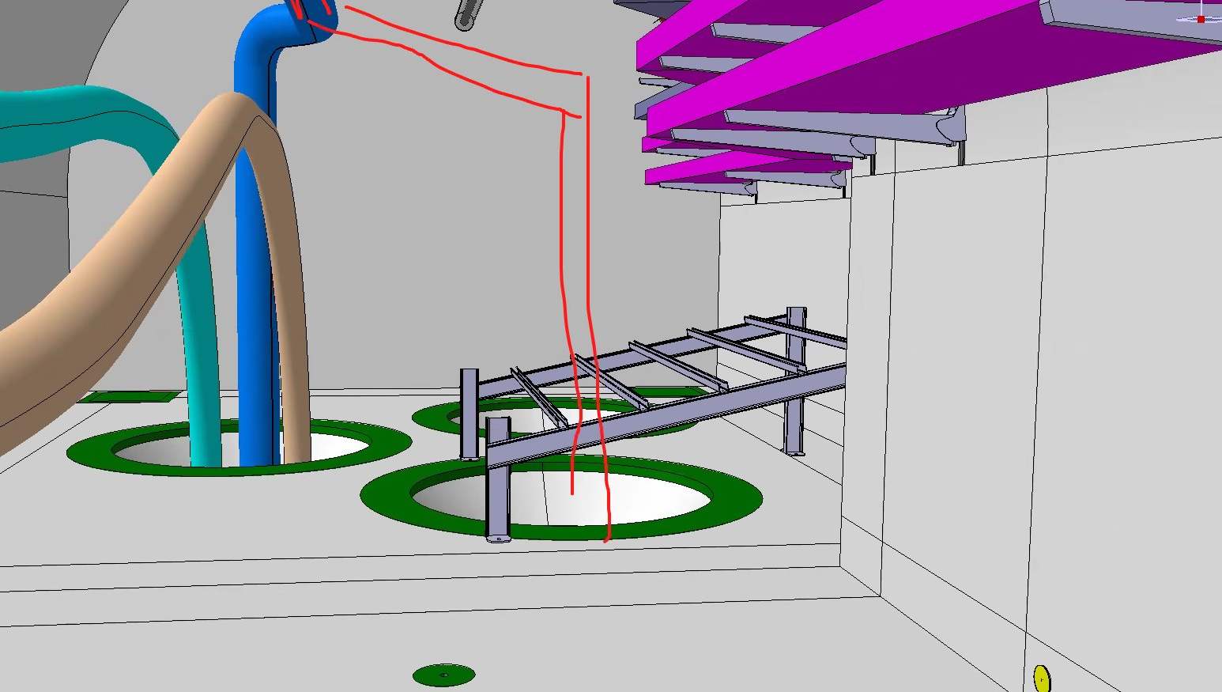
20 - Integration of Services in Cores
Topic: Integrate pipes, cable trays, access zones in UL cores.
Action: Reroute pipes, inspect access, integrate cable tray feasibility.
Responsible: EN-EL, EN-CV, SCE

Slide 4
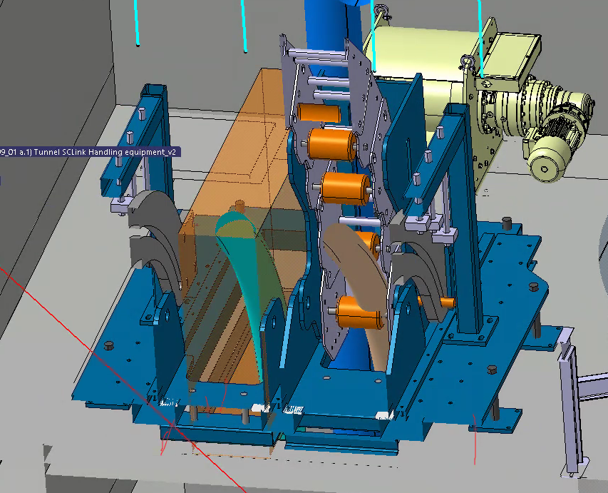
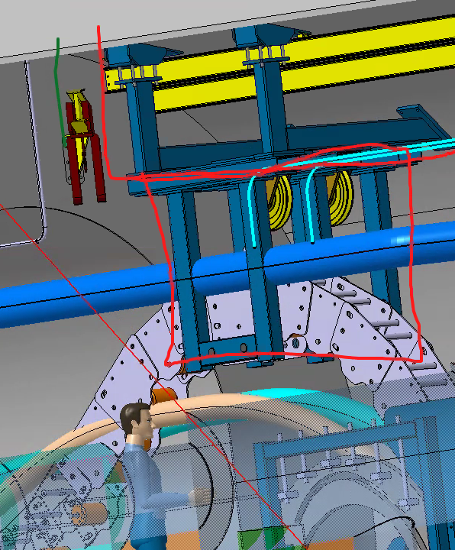
21 - SC Link Integration
Topic: Optimize SC Link structure and installation space for cabling.
Action: Adjust chassis width and define QXL installation sequence.
Responsible: WP6A, EN-HE

Slide 5
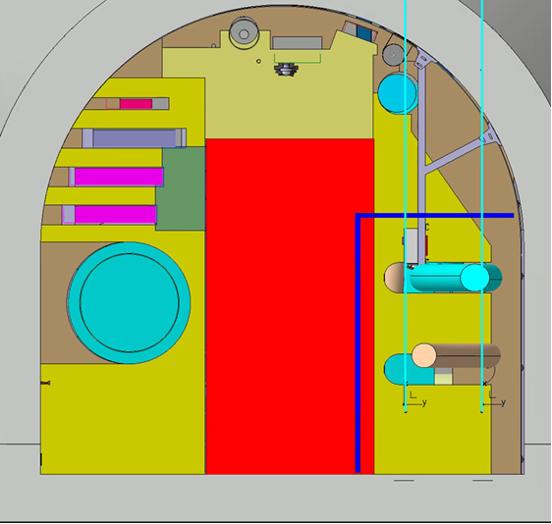
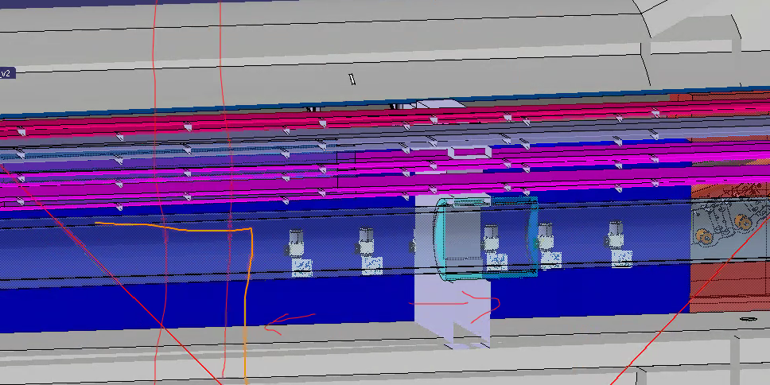
22 - RP Shielding Integration
Topic: Ensure shielding placement enables installation and radiation protection.
Action: Minimize shielding footprint; adapt volume for passage requirements.
Responsible: EN-HE, WP15, RP

Slide 6
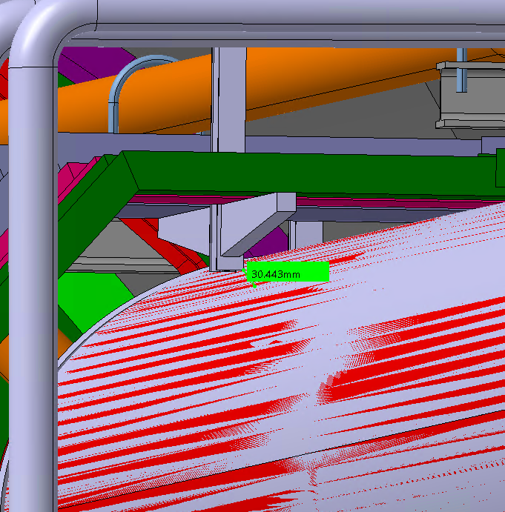
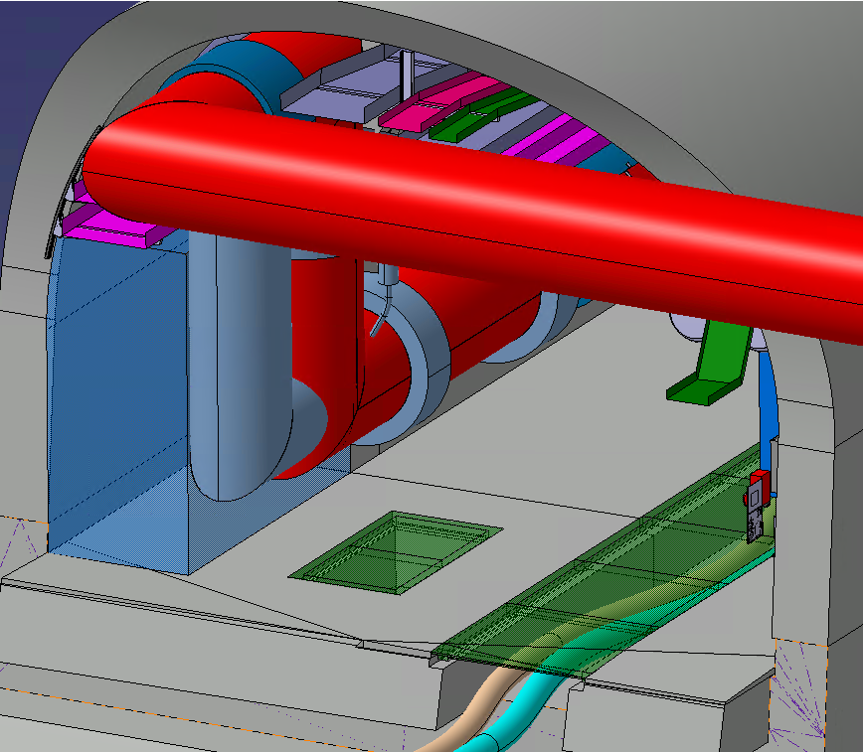
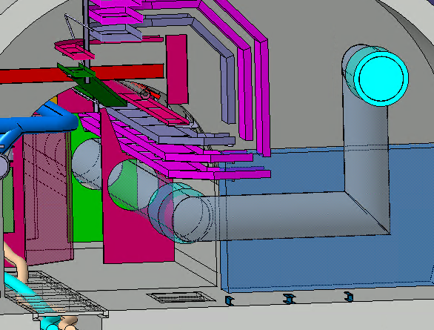
23 - QXL Integration Phase 1a2
Topic: Integrate QXL descent from door to cores in UL.
Action: Confirm installation volume unaffected by updated layout.
Responsible: TE-CRG

Slide 7
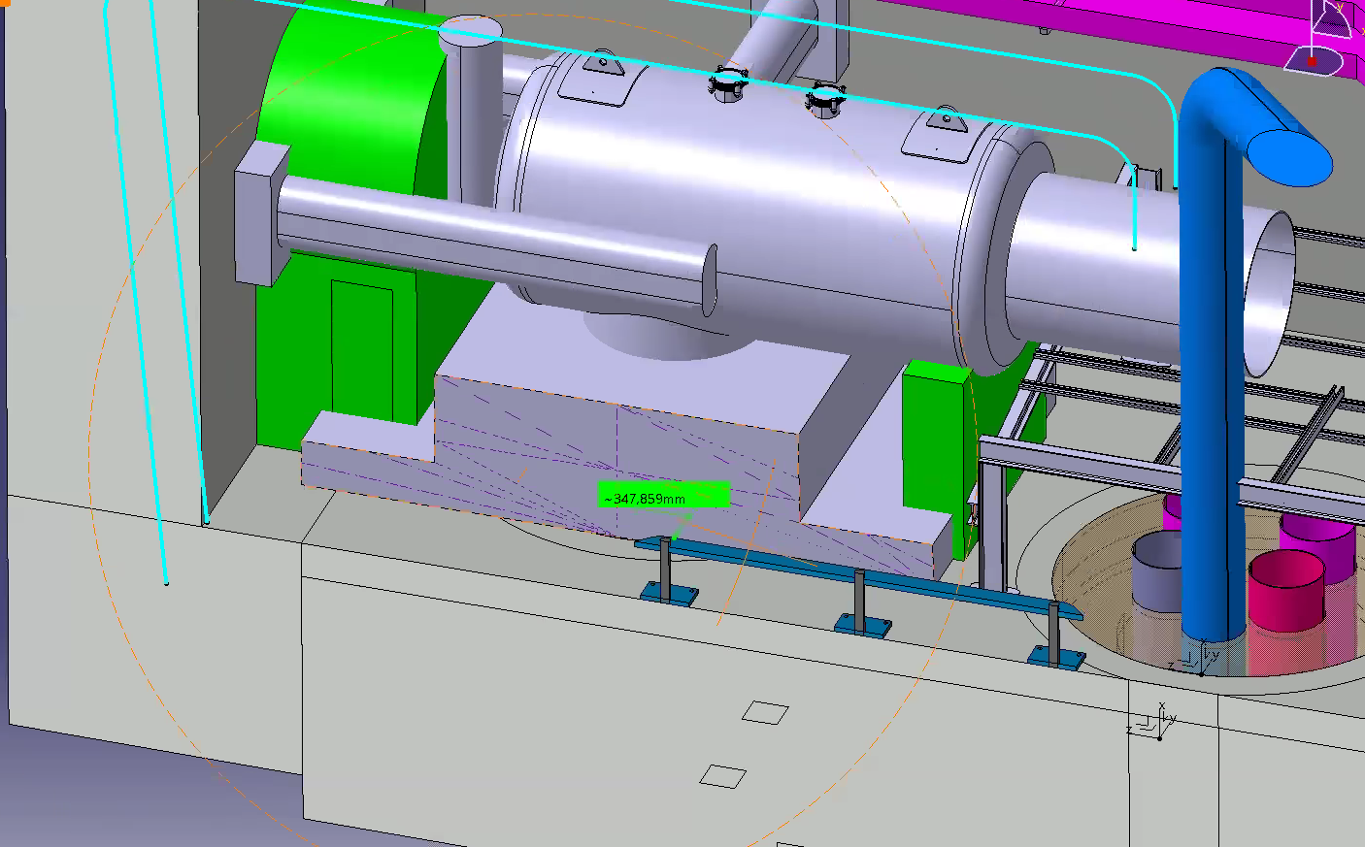
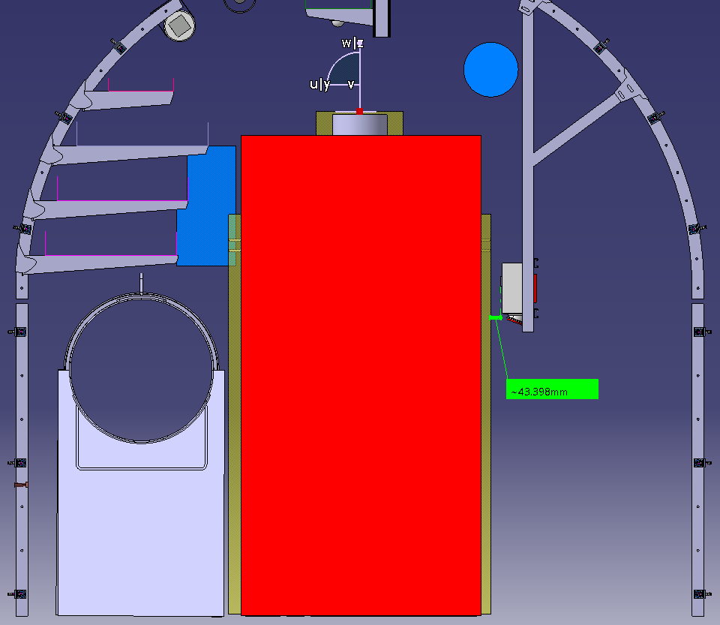
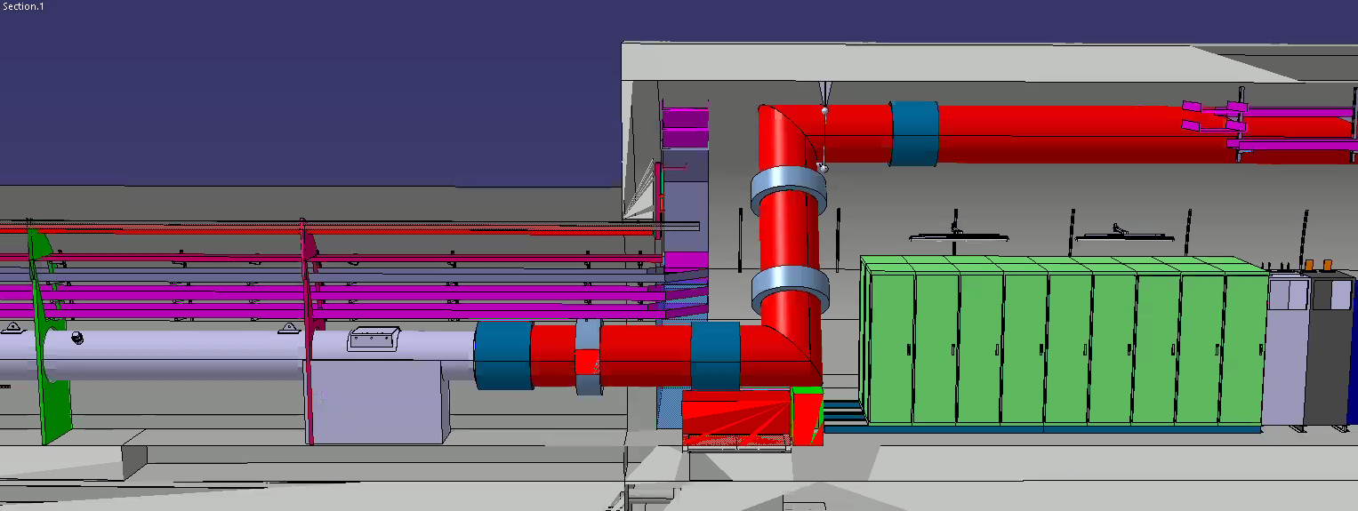
24 & 29 - QXL Integration Phase 1b
Topic: Integrate QXL descent from door to cores in UL.
Action: Confirm installation volume unaffected by updated layout.
Responsible: TE-CRG
QXL L-modules installation transport volume

Slide 8
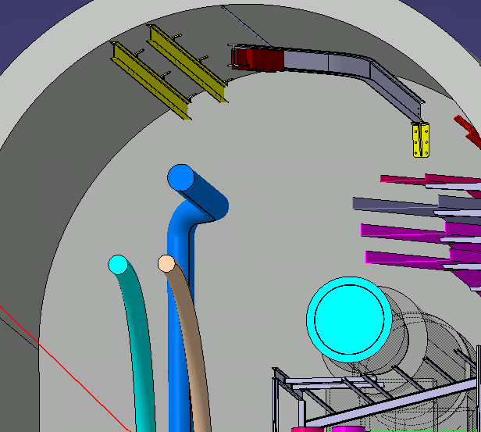
25 - Installation of Transport Rails
Topic: Install SC Link and QXL transport rails in ULs.
Action: Remove old rails; confirm hoist movement and anchors.
Responsible: WP6A, EN-HE, TE-CRG

Slide 9
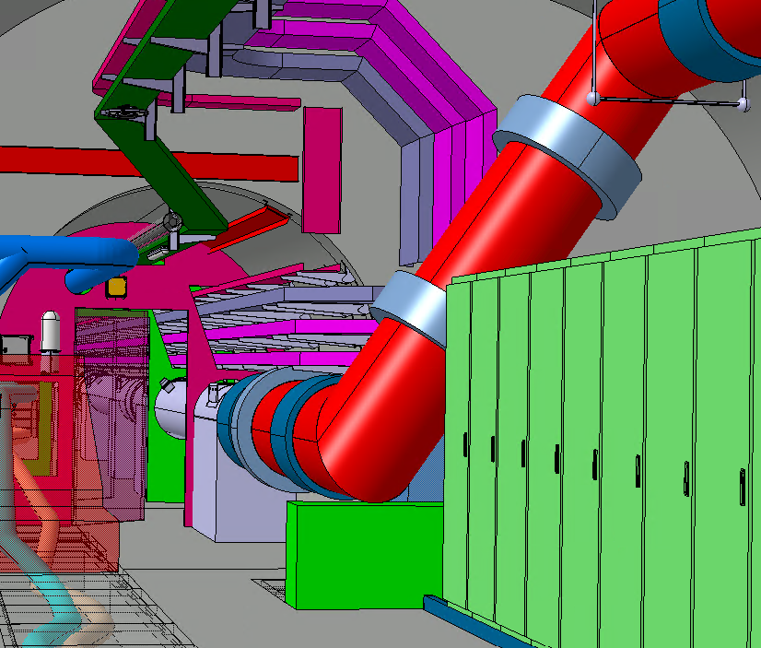
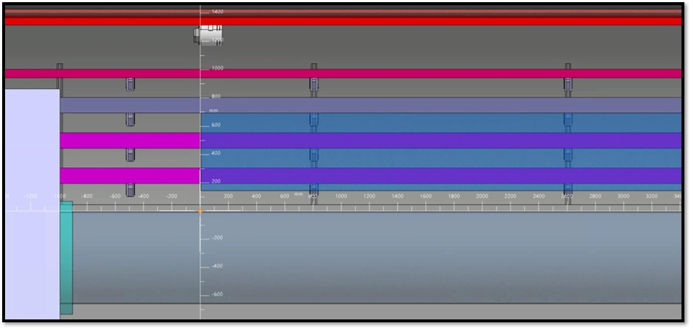
26 – Patch Panels
Topic: Design patch panel layout with sufficient welding clearance.
Action: Study tray positioning and space for later installations.
Responsible: EN-EL

Slide 10
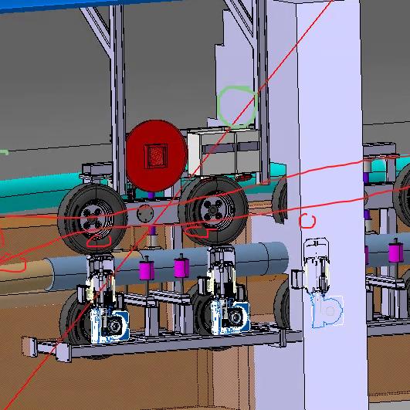
27 – Electrical powering and cabling needs
Topic: Provide power and cabling layout for SC Link operation.
Action: Propose electrical box and AUG placement near QXL.
Responsible: WP6A, EN-EL

Slide 11
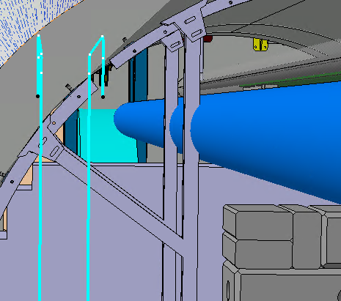
30 – CV Duct Collision
Topic: Resolve physical conflict between duct and electrical support.
Action: Reroute duct based on electrical power box resolution.
Responsible: EN-CV

Slide 12
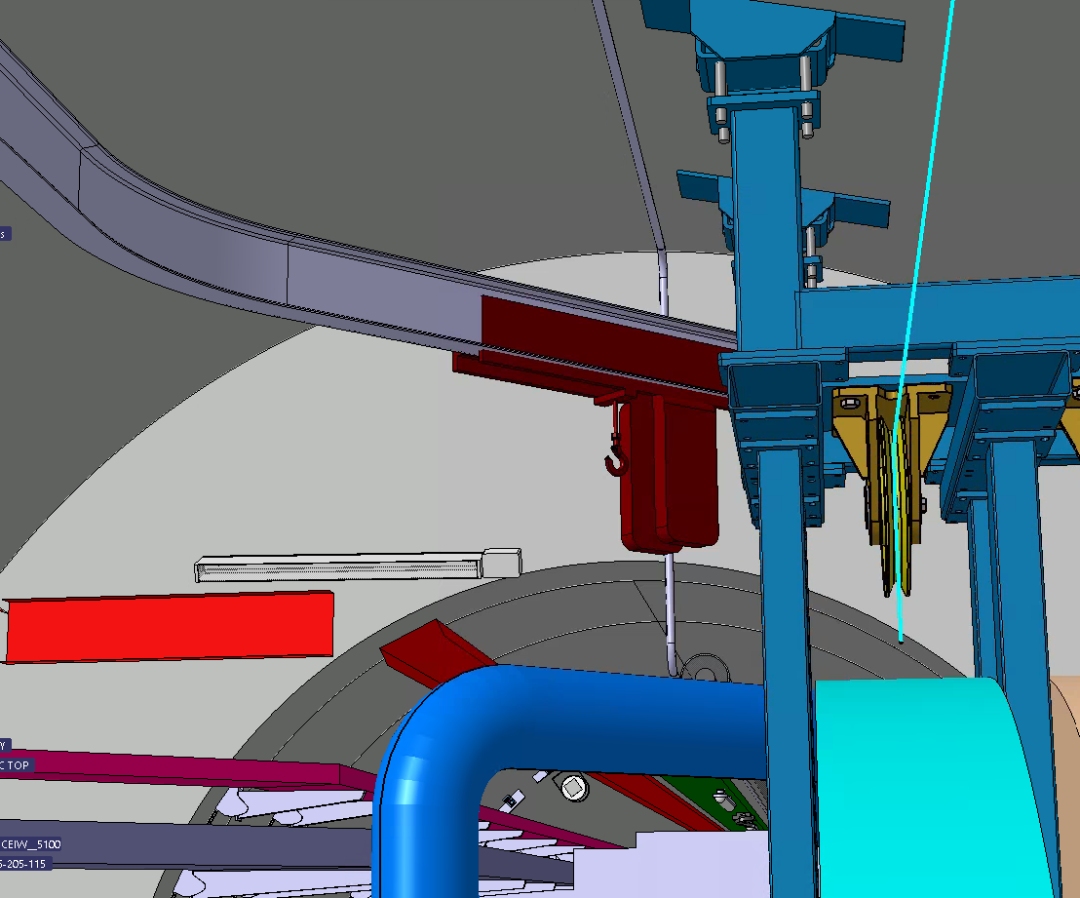
31 – ASD Sniffer Tubes
Topic: Confirm ASD tube needs and protect during installation.
Action: Clarify tube necessity, ensure dust protection and clearance.
Responsible: EN-AA

