Slide 1
Electron gun & collector for the new AD e-cooler
Numerical assessment
Teresa Guillen Hernandez
22/05/2025

Slide 2
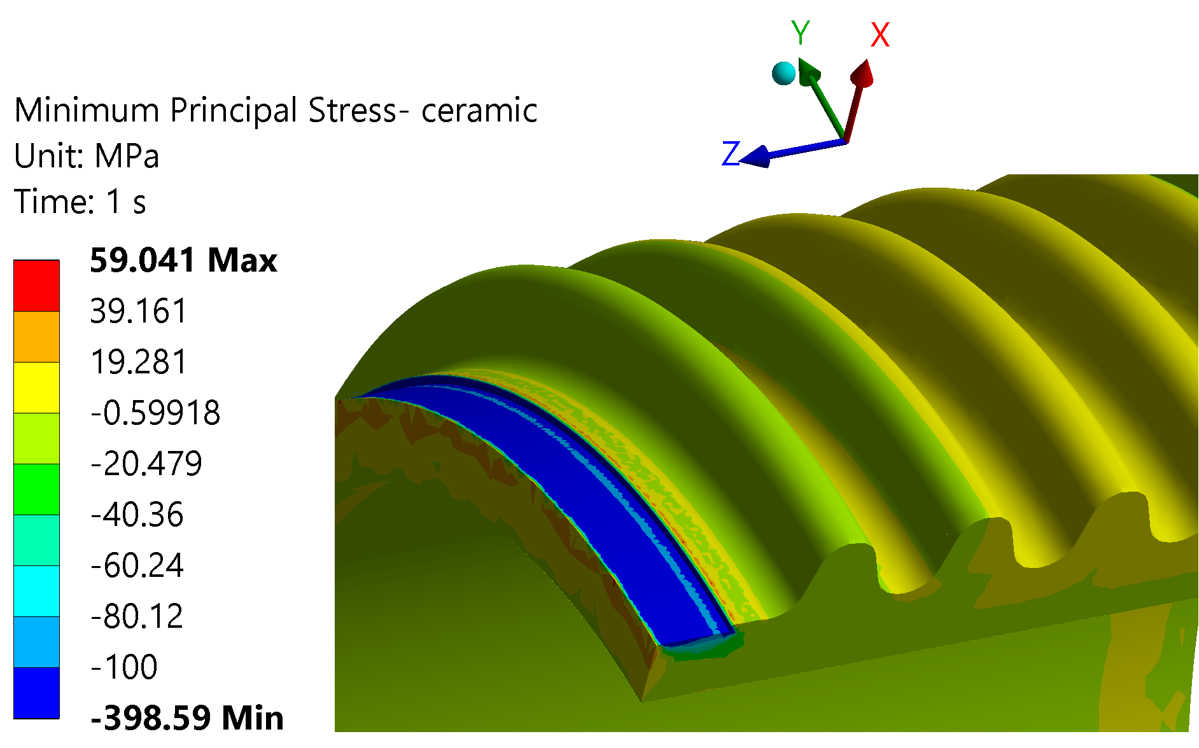
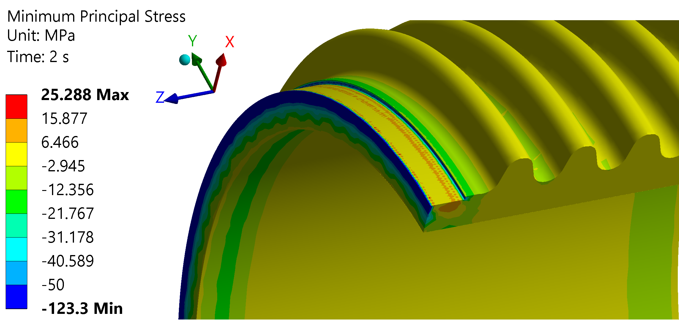
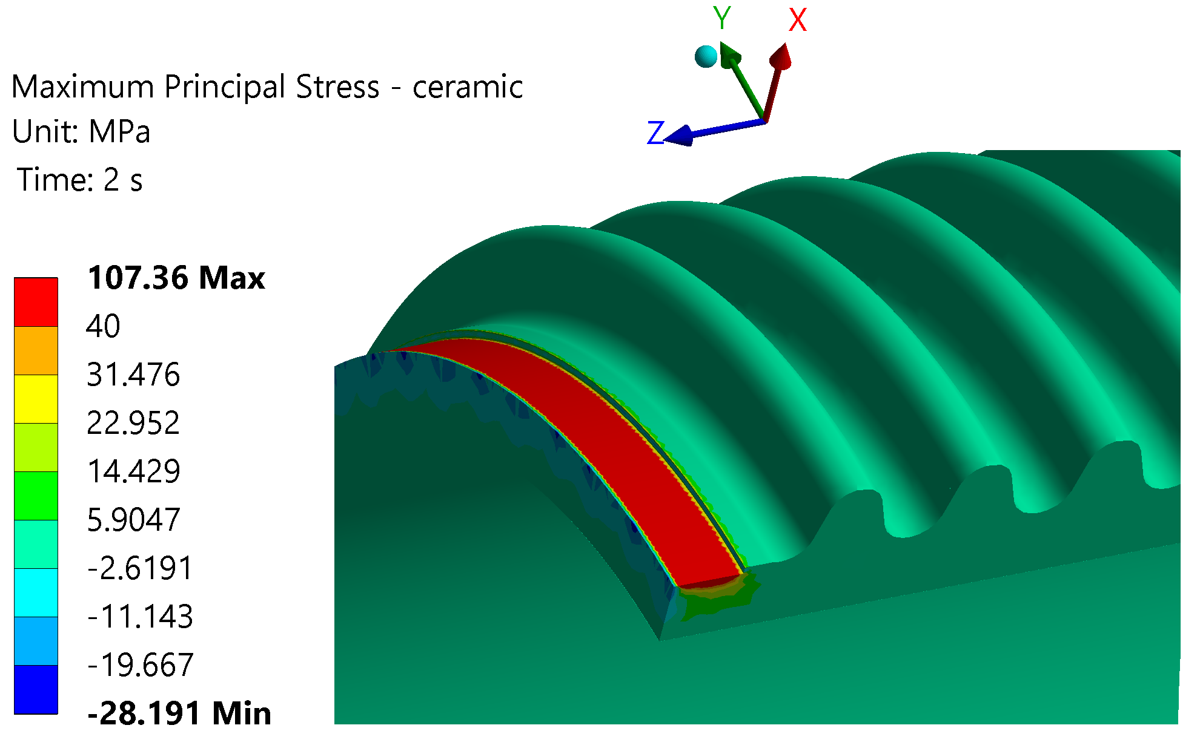
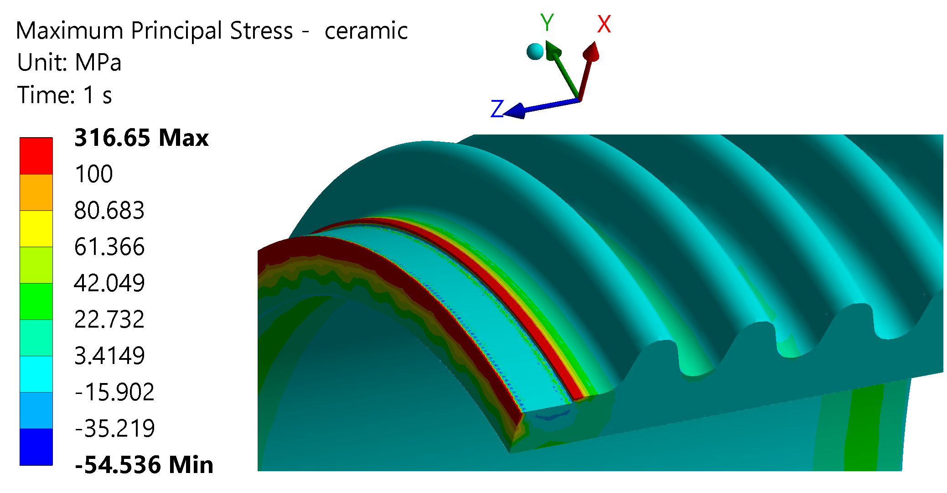
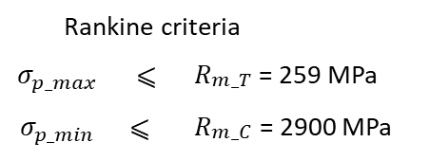
Ceramic assessment – bake out
Mesh sensitivity
Rankine criteria
$$σ_{p_max}$$ | ⩽ | $R_{\begin{aligned}m_T \\ \end{aligned}}$ = 259 MPa
$$σ_{p_min}$$ | ⩽ | $R_{\begin{aligned}m_C \\ \end{aligned}}$ = 2900 MPa
250 °C
T room

Slide 3
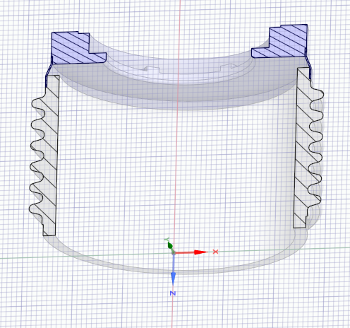
Ceramic assessment – bake out
Mesh sensitivity but superficial – filler should absorb this because is very soft
Include Filler in the simulation – 50 microns of very soft material (E=500MPa)
Do a test?
 |  | Step 1 - 250 degrees
 |  | Peak
 | mesh size [mm] | Max ppal stress [MPa] | Variation % Max ppal stress | Min ppal stress [MPa] | Variation % Min ppal stress [MPa]
Softer material | 3 | 55.86 | 68.89 | -46.07 | 72.52
 | 0.5 | 169.27 | 46.54 | -193.57 | 51.44
No filler | 3 | 179.55 | - | -167.67 | -
 | 0.5 | 316.65 | - | -398.59 | -
 |  | Step 2 - Troom
 |  | Peak
 | mesh size [mm] | Max ppal stress [MPa] | Variation % Max ppal stress | Min ppal stress [MPa] | Variation % Min ppal stress [MPa]
Softer material | 3.00 | 11.11 | 80.44 | -27.53 | 44.16
 | 0.50 | 11.88 | 88.94 | -27.53 | 77.68
No filler | 3.00 | 56.76 | - | -49.29 | -
 | 0.50 | 107.36 | - | -123.30 | -

