Slide 1
BGC regular meeting
06/06/2025
D. Butti

Slide 2
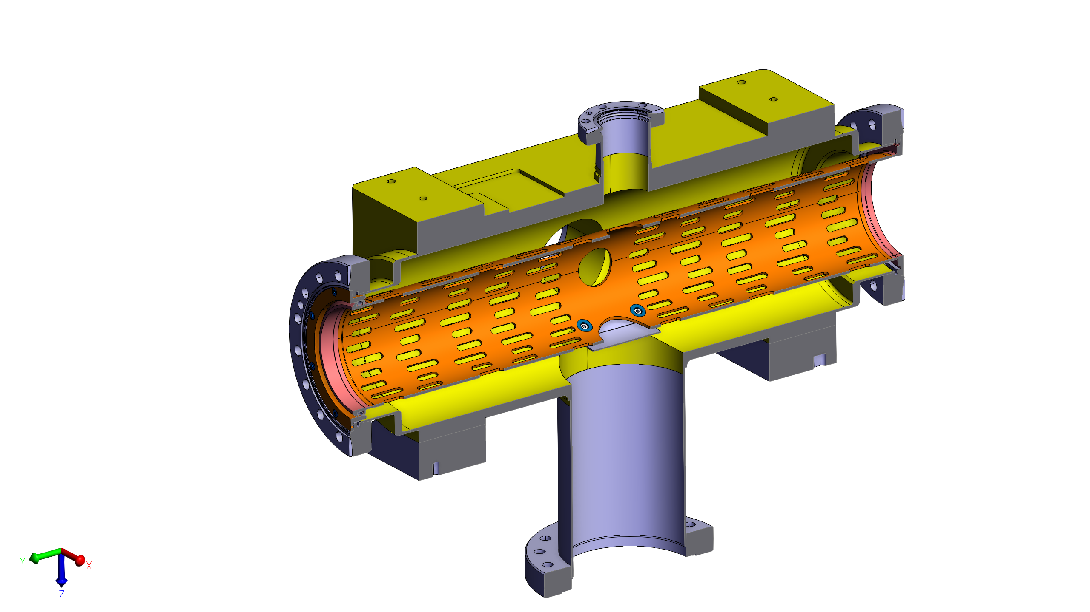
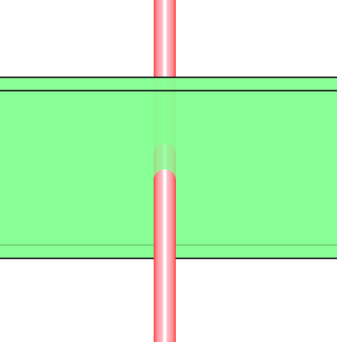

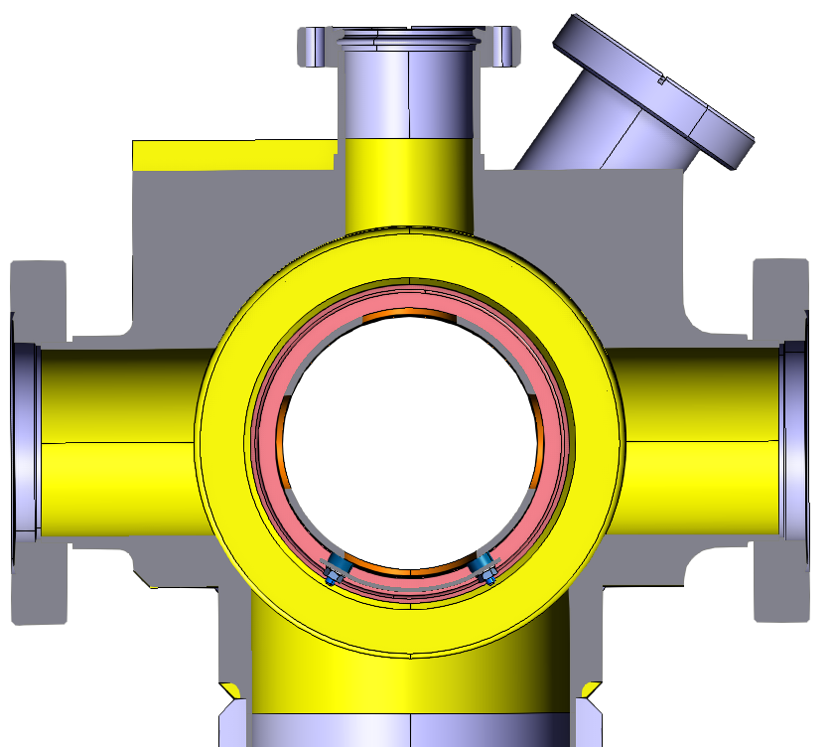
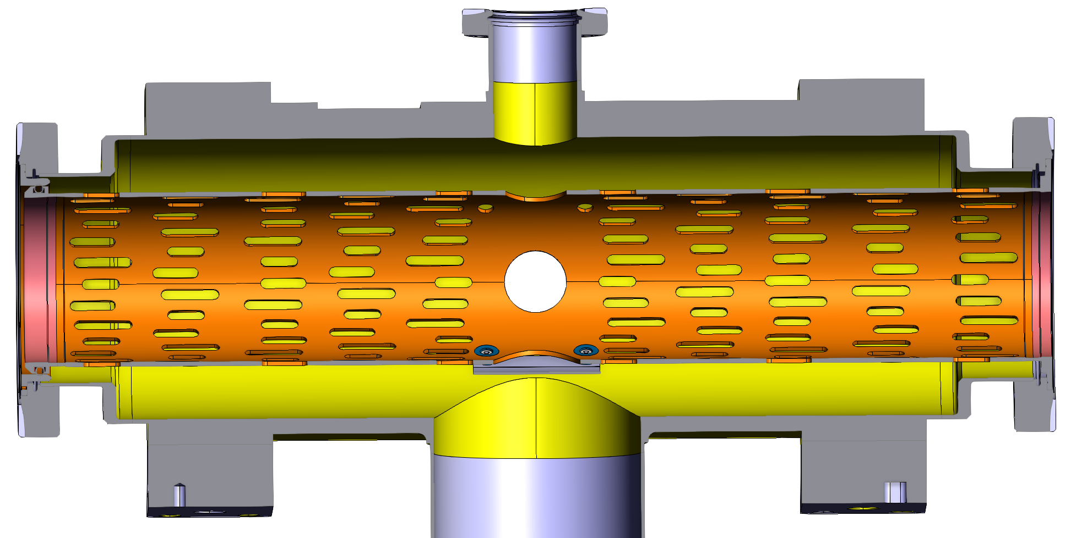
Present configuration of V3
Pro
both planes with one optical line
configuration OK for overlap monitor
relaxed margin for jet-beam alignment
Contra
one direction strongly affected by jet profile
thin jet limits size of emission volume (hence signal)
cannot be easily integrated in B2 due to QRL
camera only sees the active volume
(beam-jet intersection)
cam view
cam
beam_{V} ∗ jet
beam_{H}
front view
side view

Slide 3
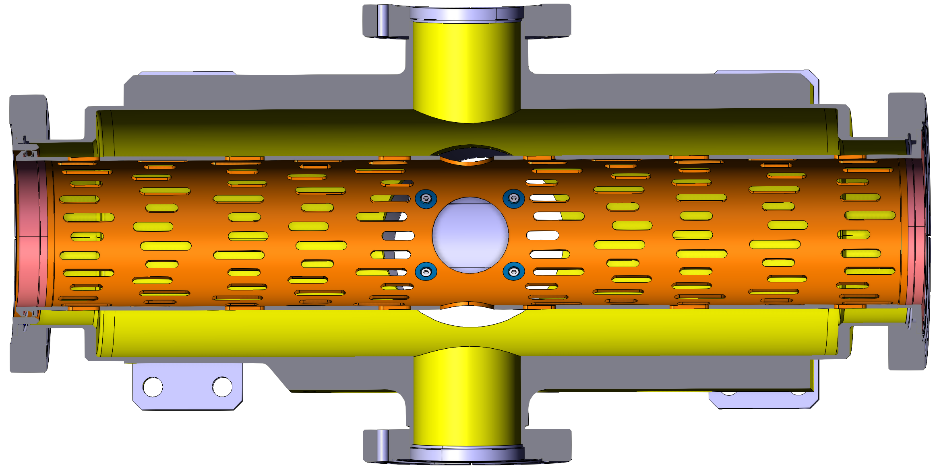
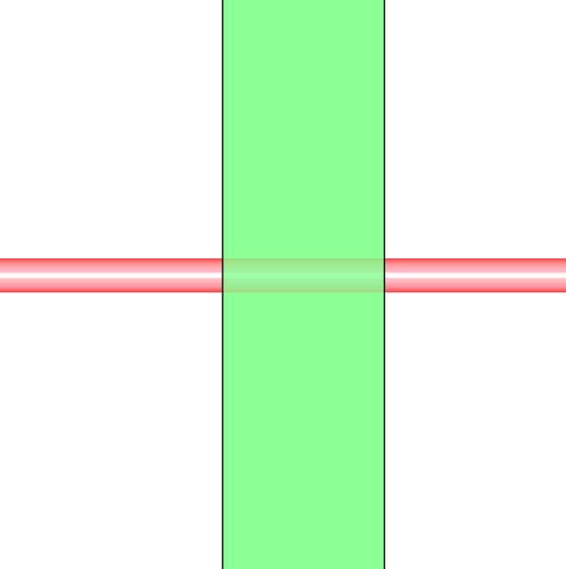
Configuration proposed for V4.?
Pro
no jet thickness effect
longer emissive region provides more signal
simpler integration in B2
Contra
extra optical line
tighter margin for beam-jet alignment
(jet cannot be too big for gas load)
more packed jet and optical lines (45 deg instead of 90)
cam H view
cam H
beam_{H}
top view
cam V view
cam V
beam_{V}
front view
side view

Slide 4
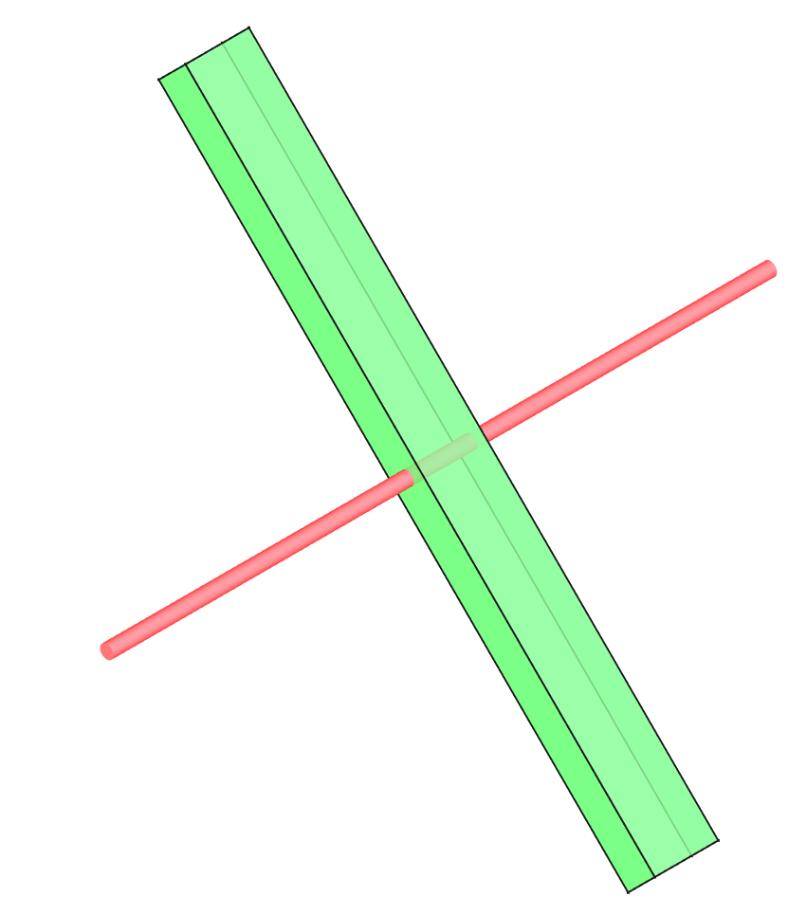








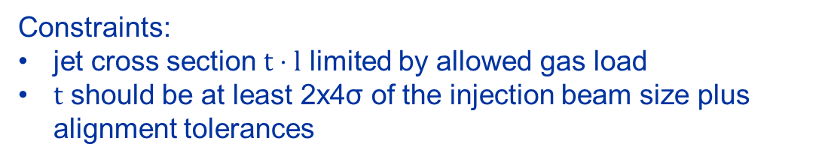


Jet rotation and aspect ratio
The baseline for V4 requires $θ=45°$, tilt ($φ$) and aspect ratio ($t,l$) are adjustable with skimmer size and orientation. Not an urgent decision!
$$l$$
$$t$$
cam H
Design criteria → maximize jet-beam intersection keeping enough margin for misalignments
$$θ=45°$$
H plane
Constraints:
jet cross section $t⋅l$ limited by allowed gas load
$t$ should be at least 2x4σ of the injection beam size plus alignment tolerances
In principle, multiple configuration possible playing with these three parameters…
$$t$$
$$t$$
$$φ≠0$$
cam V
V plane
$$φ=0$$
$$l$$
$$l$$
Necessary input: minimum misalignment tolerance we can achieve
(the larger the $t$ the lower signal we have!)
$$φ=?$$

