Slide 1
CI Update
O. Stringer & H. Zhang

Slide 2
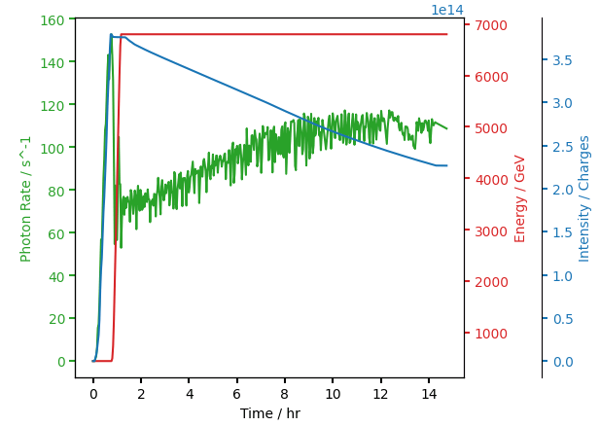
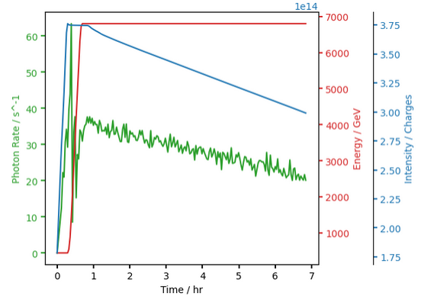
Photon Rate #9969 & #9978
Photon rate should be proportional to Intensity.
Identical operating conditions (BGC & beam)
Injectors broken in #9969, long beamtime.
#9969
#9978

Slide 3
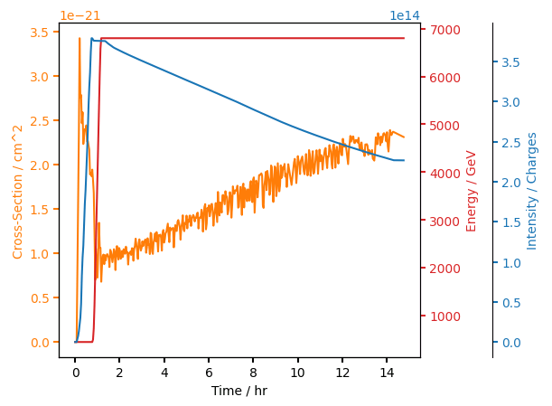
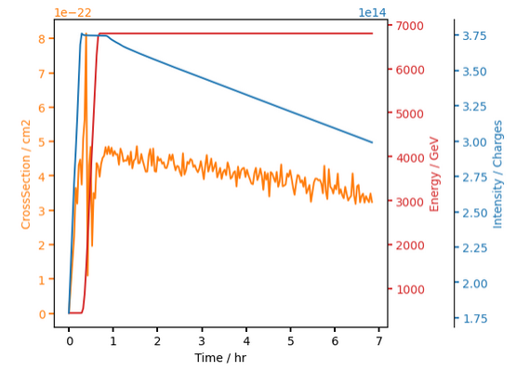

Cross Section #9969 & #9978
Expected Cross-Section, stable at ~ $4.7 × {10}^{−22}$
#9978 seems much more promising… Why is it not consistent?
#9969
#9978

Slide 4
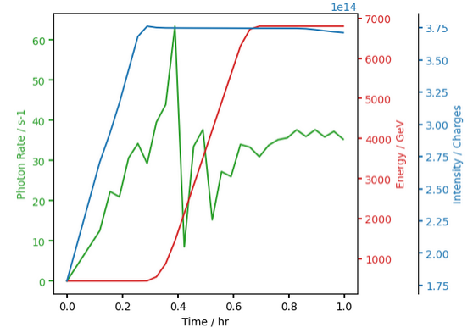
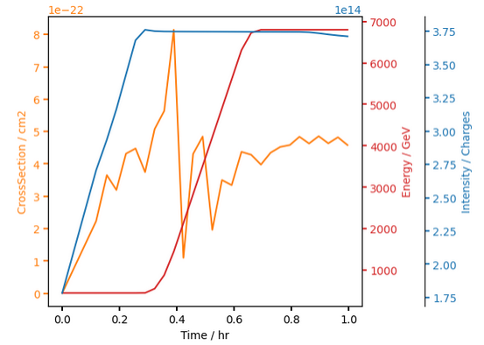
#9978 Injection & Ramp
Photon Rate proportional over injection, sudden decrease at start of ramp with high fluctuation.

Slide 5
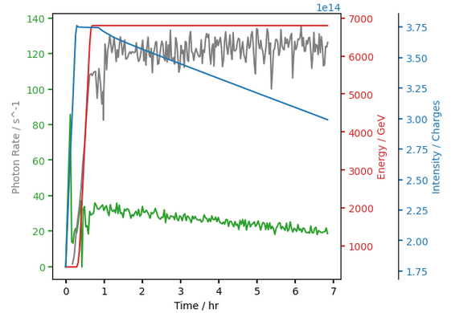
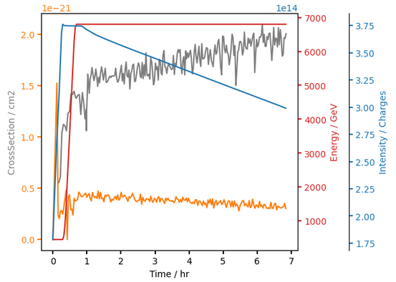
#9978 Timber vs Oliver’s
~4x photon counts and no decrease with intensity drop.
Difference is photon detection algorithm (future plans)

Slide 6
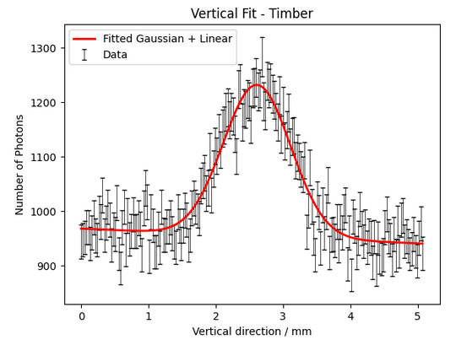
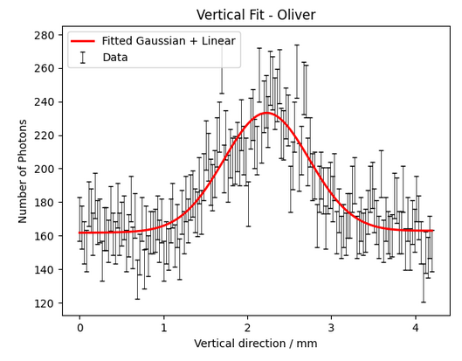
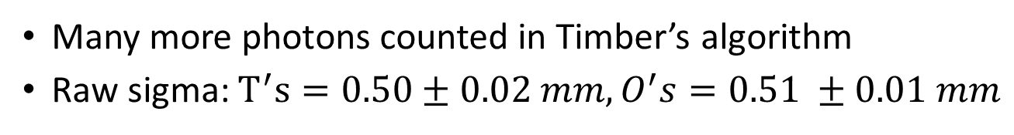
#9978 Timber vs Oliver’s
Many more photons counted in Timber’s algorithm
Raw sigma: $T^{′}s=0.50±0.02 mm, O^{′}s=0.51 ±0.01 mm$

Slide 7
2025 Year
Recommend taking more standard physics fills with each frame saved (large amounts of data, and impractical to do for every fill, but more data needed).
Potential unoptimised counting algorithm in CERN bgc_app? results inconclusive.
Investigations into fill-by-fill inconsistencies needed for halo work.

