Slide 1
CI update
BGC CI team

Slide 2
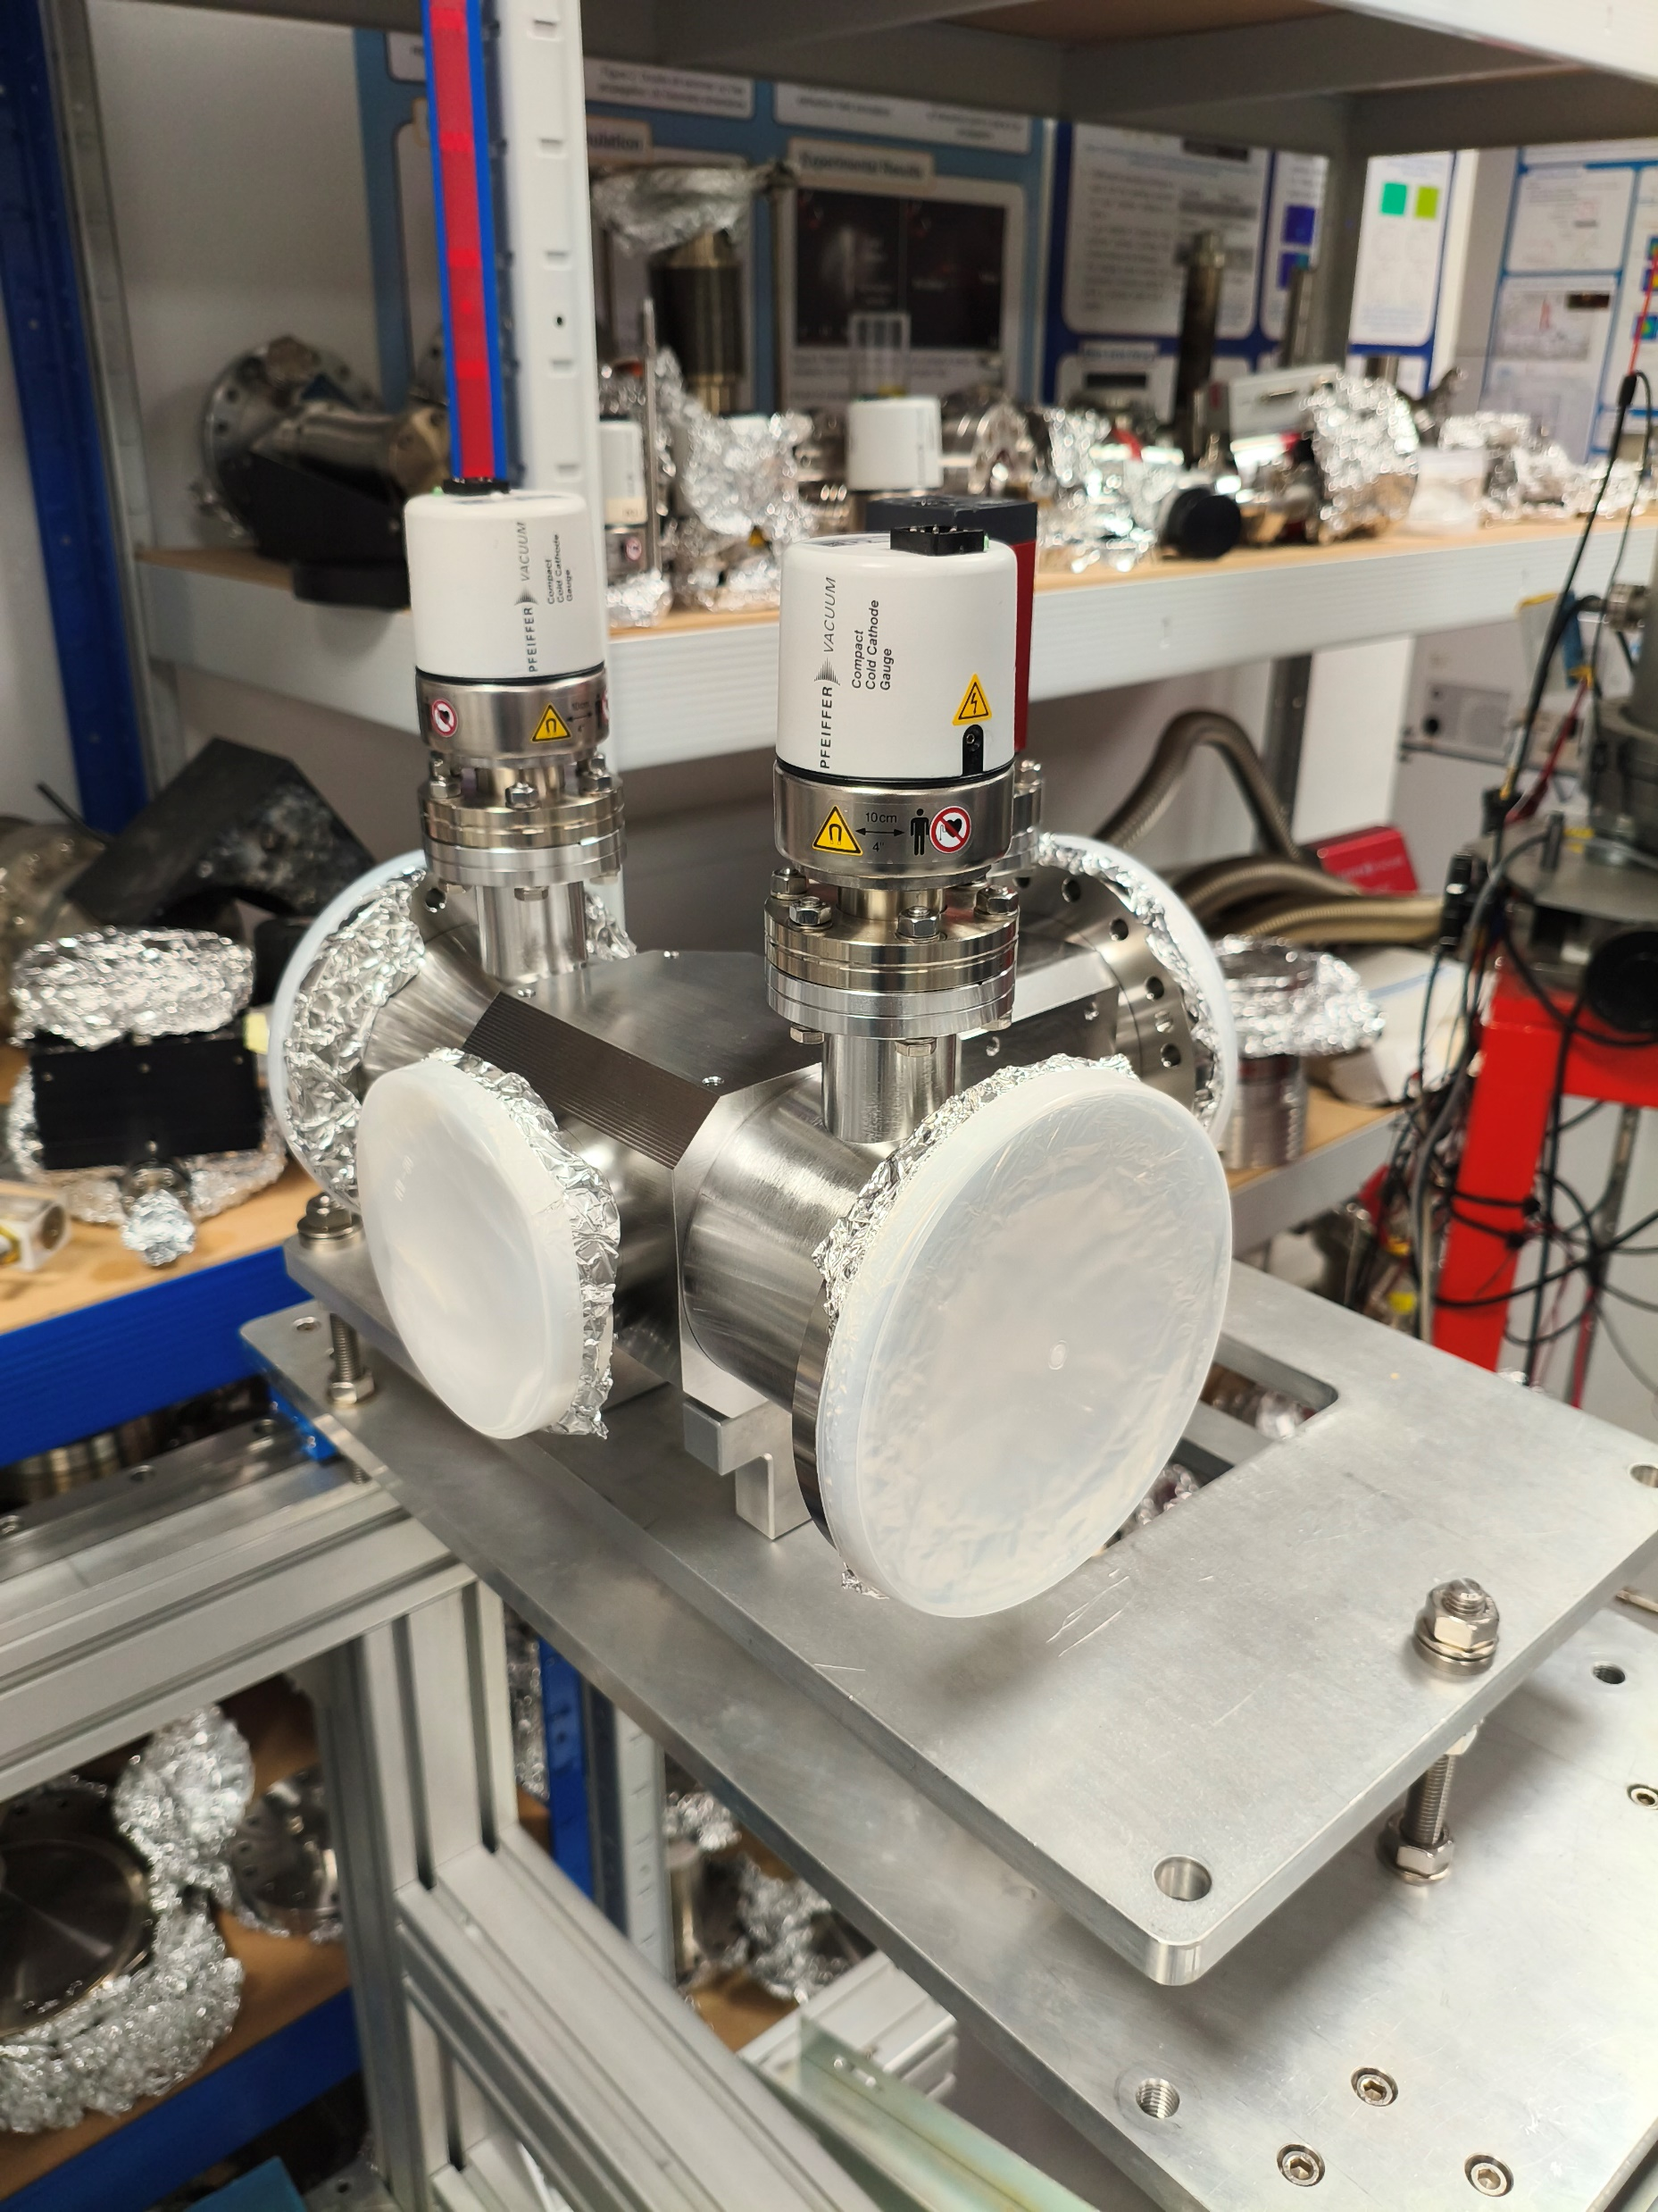
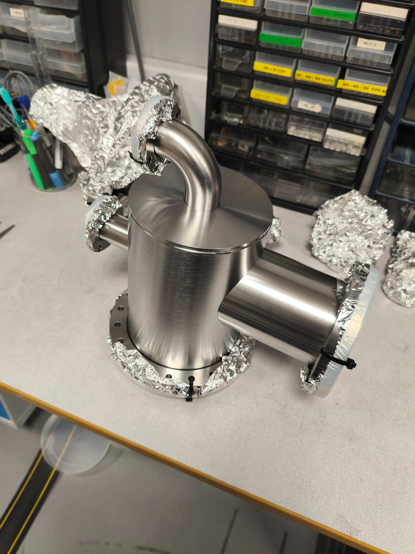
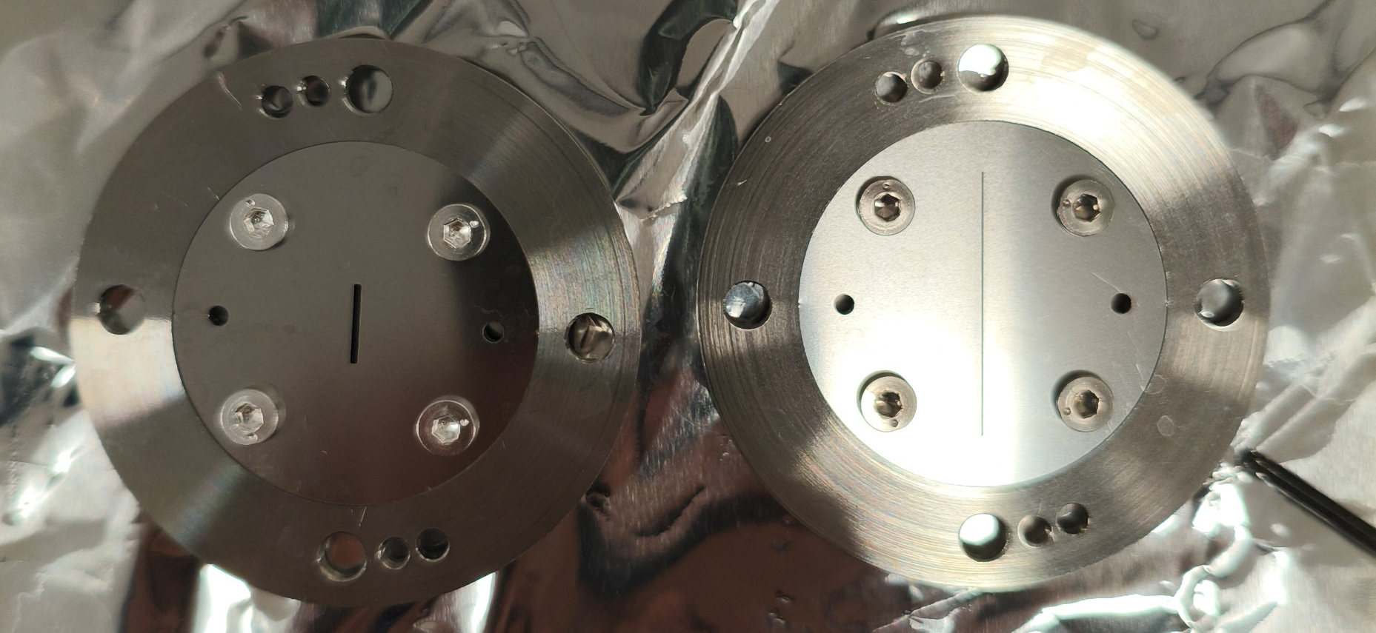
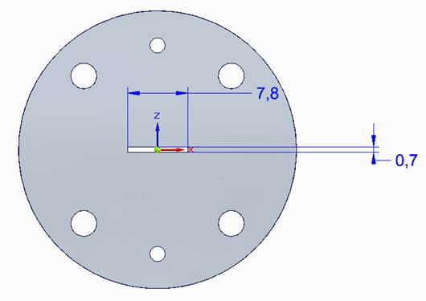
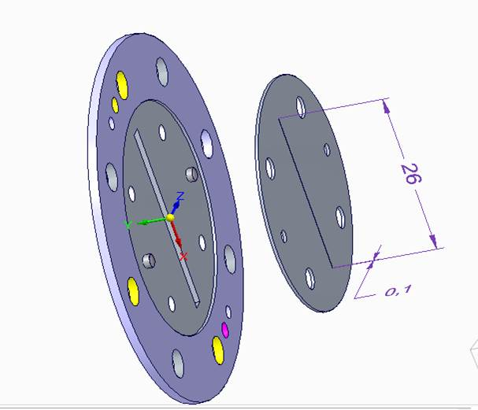
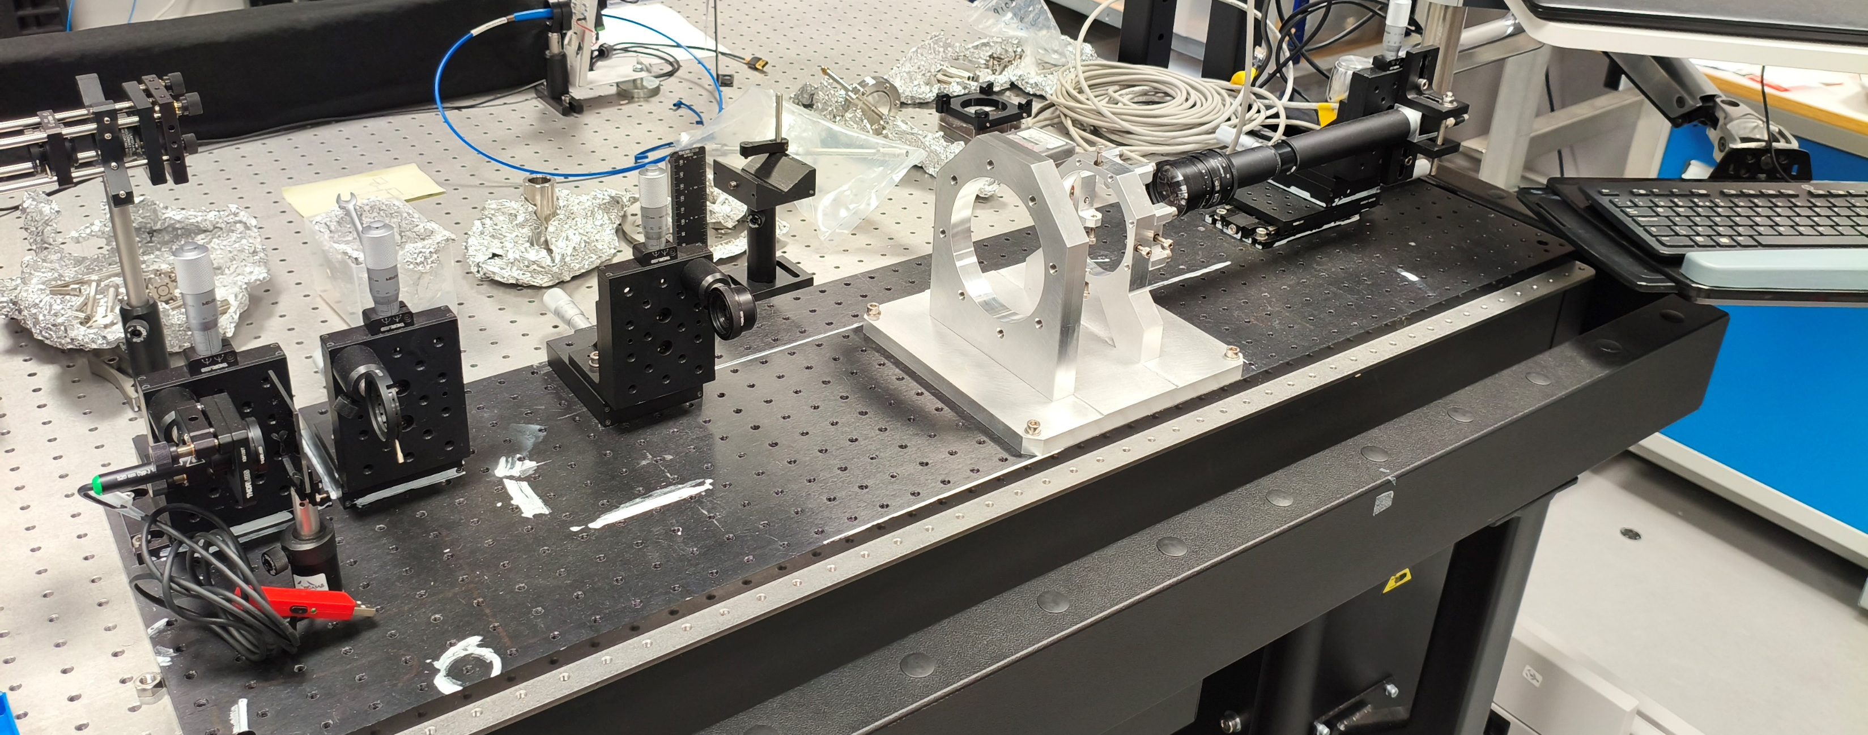
Version 4.1 update (all hardware are ready)
Gas injection chamber
Gas dump chamber
Halojet 3rd skimmer
V4.1 skimmer
Alignment

Slide 3
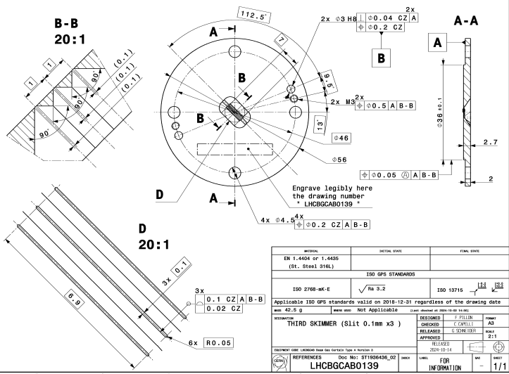
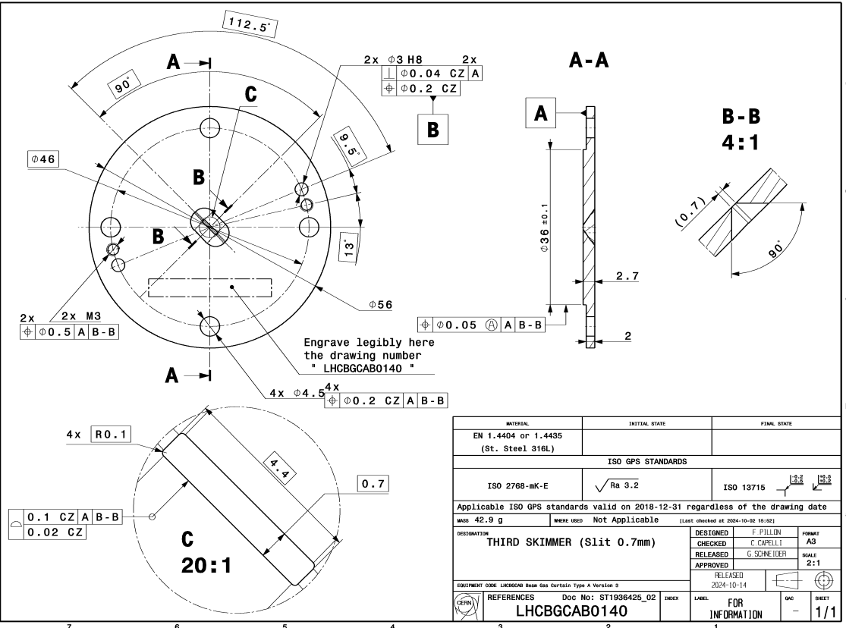
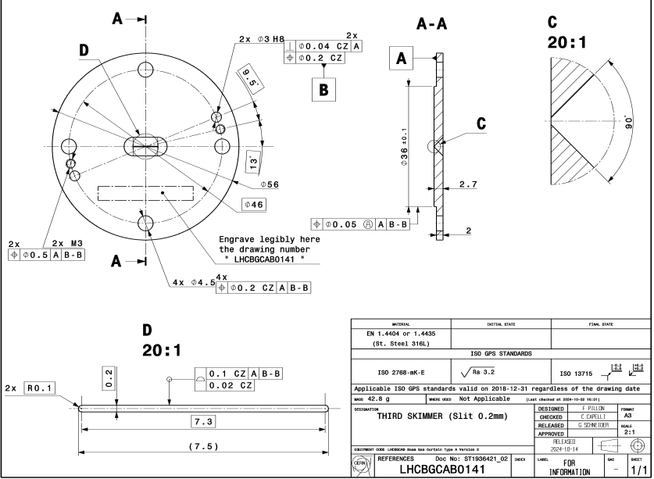
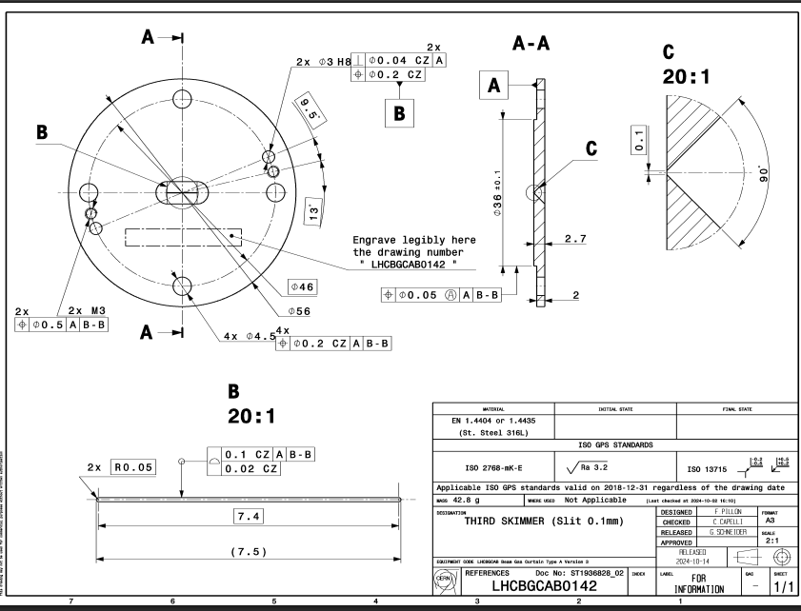
3rd skimmers & 4th skimmer from CERN
3rd skimmer
  0139 X 2 3 slits
  0140 X 2
  0141 X 1
  0142 X 2
4th skimmer
  0143 X 2
  0144 X 2
  Need v3 dump chamber to test 4th skimmer

Slide 4
Plan for the version 4.1 (Two months)
Assembly the system (2 weeks)
  Connecting parts
  Alignment
  Vacuum test
V4.1: 60 mm jet demonstration (1.5 week)
V3.1: 0.2 third skimmer measurement (1.5 week)
V3.2: halojet measurement (1.5 week)
Other 3rd skimmer test (1.5 week)
Any other tests?
Plan to ship to CERN in August.
  Do you want to see it during the IBIC (Delay transportation)

Slide 5
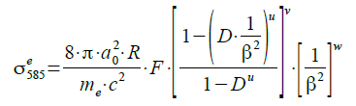
Update for the cross-section meetings
Meeting organised between Peter, Serban, Oliver and Hao.
Issues:
  Photon clustering (under-counting for proton data)
    Another beam test with Lower frame time test this year (25ms => 5 ms or even less)
  Get a value from ion data are significantly larger (5 orders) than the prediction from this formular.
    Action: do a check by Serban?
  Need guidance from nuclear physicist
    Action: Hao will reach out in the physics department in Liverpool
  Make sure the data analysis and error calculation are correct
    Action: Hao & Oliver

Slide 6
Planned journal articles
2025:
  “Measurements at 7 TeV with protons and lead ions”, Delayed
    Will get the second round reviewer feedback from editor soon
  “Simulation and experimental studies into a supersonic gas jet curtain for beam profile monitoring”,
    Draft ready. Hao lead, plan to send next week.
  ‘Measure the profile of a hollow electron beam at the electron beam test stand using beam gas curtain monitor’,
    Hao & Ondrej, in progress
  “MOGA simulation” in progress
    lead by Oliver, potentially Vacuum.
  “Cross section study” Data analysis in progress.
    lead by Hao/Shakti/Oliver, Phys Rev C?
  “V3 with full technical details” not started yet
    Mechanical design and gas flow test
    Optical system and resolution test
    LHC measurements in details (Visible and UV)
    Phys Rev AB, Lead? Danielle and Hao? ( Initially Ondrej, but full- time job now)

Slide 7
UK budget discussion with Gerhard
BGC monitor 2 for LHC | UK | Spend already | not considered | comments
Mechanical frames, supports, rails | £3,000
Turbo pumps | £24,000 | £24,000 |  | HIPACE300: 4911 chf *4; HIPAC700: 6967 chf *1, purchased from CERN by Liverpool account at CERN should have some leftover.
Backing pumps | £20,000 |  |  | Will use current Edward back pump for testing, Need to purchase for LHC integration, might be not enough for the pfeiffer one which used for LHC.
Vacuum chambers | £40,000 |  |  | If UK only pay for injection and dumping, there might be some leftover for extra intensified camera
Flanges, view ports, linear bellow drives | £0 |  | £3,000
Gate valves | £35,000 |  |  | This will not be enough for VAT gate valve
Special vaccum treatment (cleaning, blackening) | 0 |  | £14,000 | Might be overestimated or not needed from the UK side if the interaction chamber will be done at CERN.
Skimmers and nozzles | £5,000
Small vacuum parts (nozzle skimmer holder, etc) | £3,000
vacuum gauges | £7,000
Fluorescense imaging system(optics, intensified camera, cmos camera, filters) | £20,000 |  |  | One camera system in the original design. The other one might need to be purchased from CERN budget.
Workstation for data acquisition and control | 0 |  | £3,000
Small comsumables (gaskets, gloves, screw, washer, nuts, vacuum foil, PPEs, tools) | £3,000
Gas rack and injection | £15,000
Nozzle |  |  |  | Check the nozzle in CI.
Total 1 | £175,000 |  |  | Total should be less than £175000
Key Message:
The funding will end in March 2026.
Need to make decision what to buy first due to the design delay and manufacturing lead time.

Slide 8
Funding from UK after March 2026
Is there any risk to HL-LHC (as a whole) due to an incomplete handover of information, and lack of knowledge transfer to CERN due to HL-LHC-UK ending in phase 2?
  What specific skills or knowledge does CERN lack?
  How long would it take to get CERN up to speed?
  Is CERN able to maintain the UK equipment without us? If not why not?
Are there any key tests of UK hardware that will be compromised if the UK doesn’t participate post 2026?
  When are these tests? How long will they run for?
  Why can CERN not undertake these tests without the UK?
  What is the risk to HL-LHC commissioning if the UK doesn’t take part?
Please detail any risk to UK reputation caused by impact on HL-LHC due to the HL-LHC-UK project not continuing past phase 2.
  How specifically will UK reputation be damaged?
  What is the impact on HL-LHC commissioning or operations?
  Why would this be something the UK is responsible for?

