Slide 1
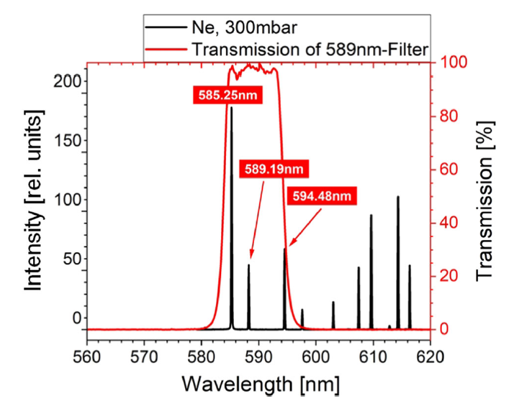
Cross Section Discussion
Potential for additional fluorescence lines to be detected.
Ignoring red transmission line (different filter).
585.25nm = ~185 (Arb.U.)
589.19nm = ~55 (Arb.U.)
594.48nm = ~70 (Arb.U.)
Ion beam induced fluorescence lines (R. Hampf, Eur. Phys. J. D 2023)
2s²2p⁵(²P°_{1/2})3s Transition

Slide 2
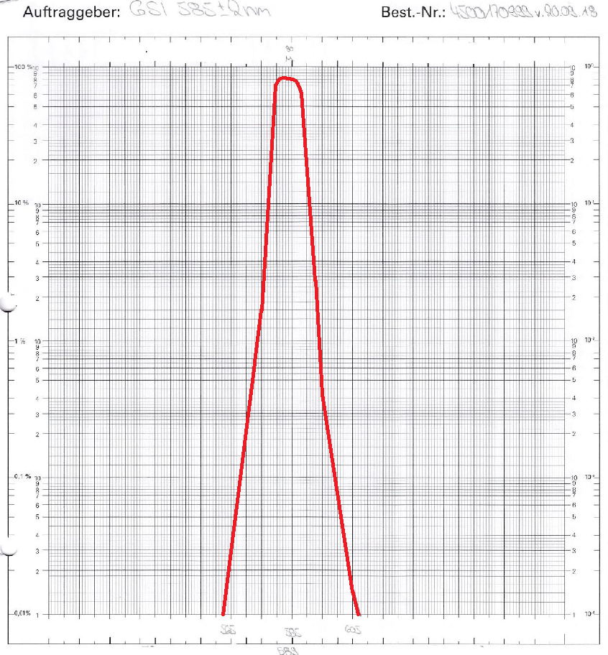
Cross Section Discussion
585nm GSI filter QE.
Peaks at 584nm, Transmission max = 82%
At 589nm = 30%
At 594nm = 0.8%
Expected 90.2% signal from 585nm and additional 9.8% from 589nm line.

Slide 3
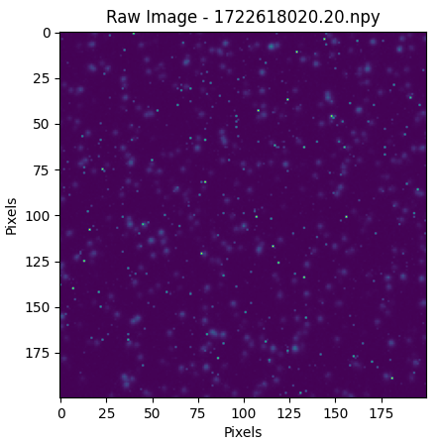
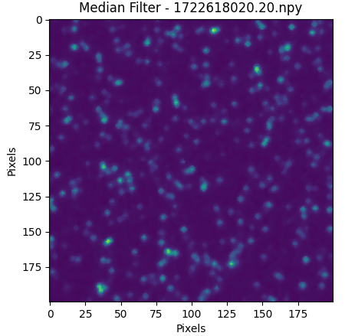
Frame Processing
Median filter (3x3)
Applied twice
Removes single pixel noise (dead pixels/camera dark counts)

Slide 4
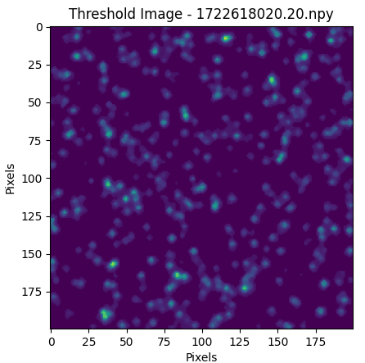
Frame Processing
Apply minimum threshold signal
Removes background static, anything remaining should be a photon

Slide 5
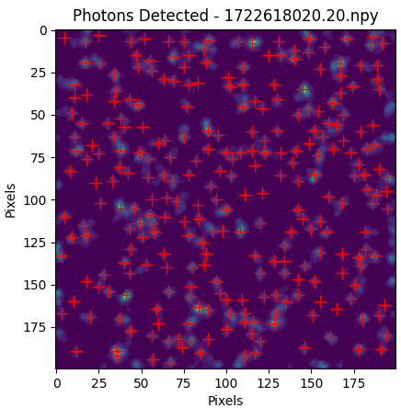
Single Photon Counting
Occasionally misses a double photon
Detect individual photons
Identify peak region, fit 2D gaussian within photon ROI and determine photon location
Misses photons on frame boundary (fitting issue)

Slide 6
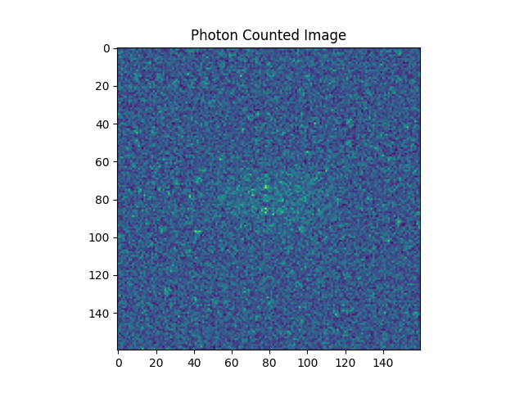
Single Photon Counting
Create a 2D histogram of all counted photons over the 120 second integration time.
Select RoI for vertical and horizontal fits & integrate over respective direction.

Slide 7
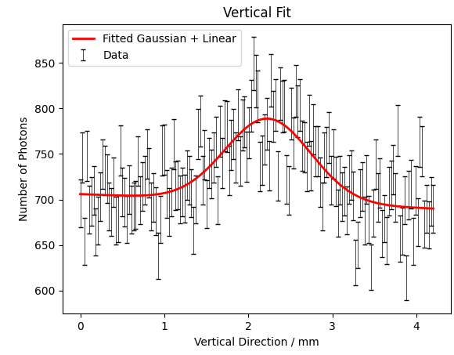
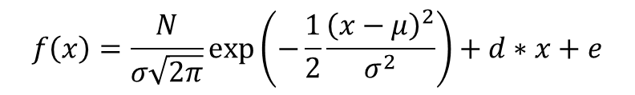
Vertical Distribution
Fit a gaussian + linear equation (beam + background)
Errors calculated using poissonian stats (error = sqrt(N))
Chi²/NDF = 1.6
Vertical distribution = beam + jet thickness
Total photon number from Gas curtain
$$f\left(x\right)=\frac{N}{σ\sqrt{2π}}\exp\left(−\frac{1}{2}\frac{{\left(x−μ\right)}^{2}}{σ^{2}}\right)+d∗x+e$$
Beam centroid
background
Beam size

Slide 8
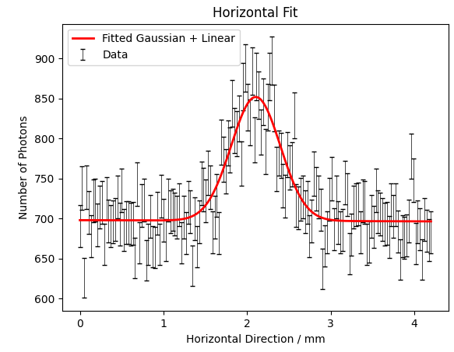
Horizontal Distribution
Chi²/NDF = 1.3
 | Fitted equation
Sigma | 0.293 ±0.015
Photon Number | 8942 (74.5 γ / s)
Photon Number Error | 577
Counting within 3 sigma
0.293 ±0.015
9224 (76.9 γ / s)
51.6

Slide 9

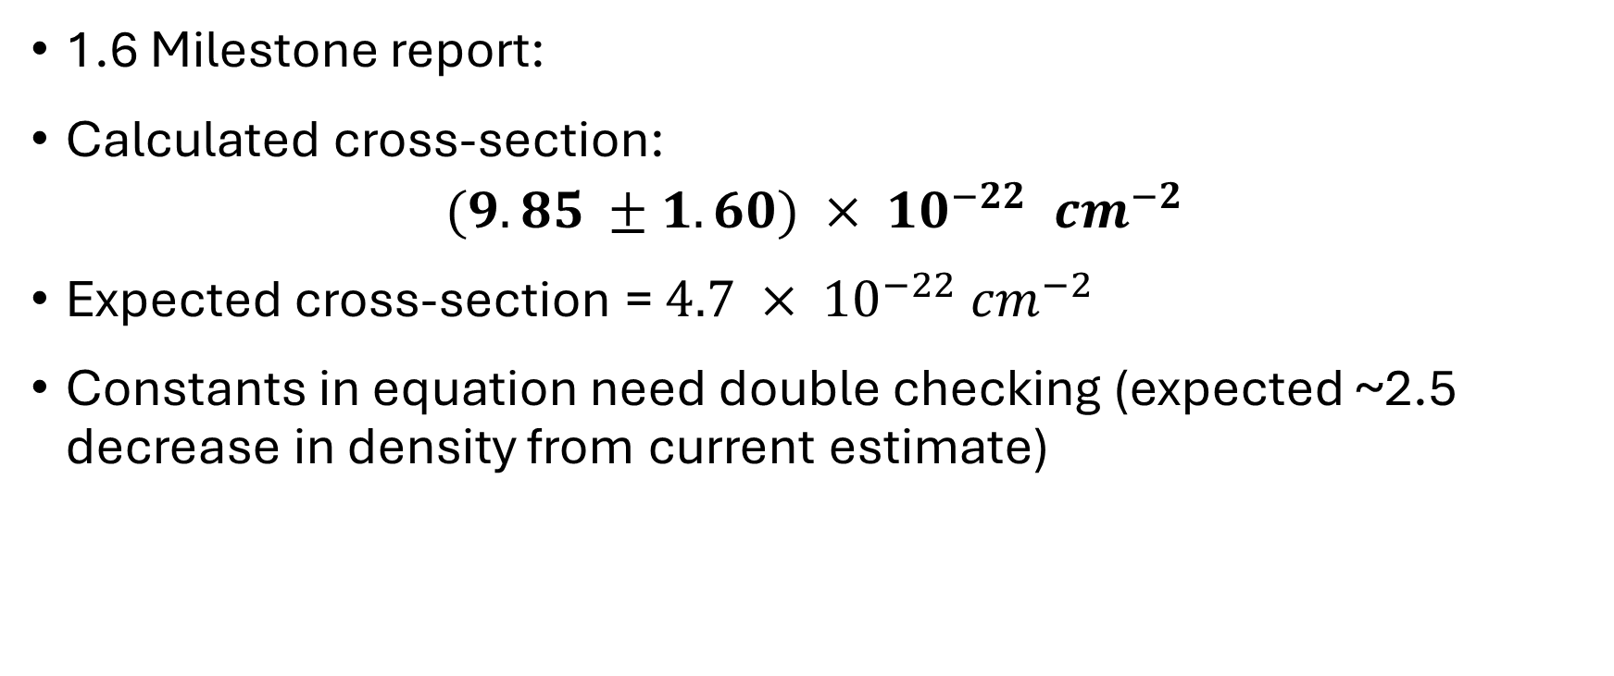
Cross-section
1.6 Milestone report:
Calculated cross-section:
$$(9.85 ±1.60) × {10}^{−22} {cm}^{−2}$$
Expected cross-section = $4.7 × {10}^{−22} {cm}^{−2}$
Constants in equation need double checking (expected ~2.5 decrease in density from current estimate)

Slide 10
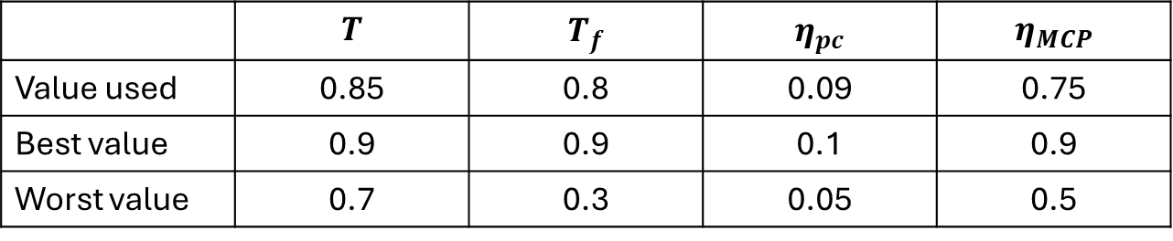
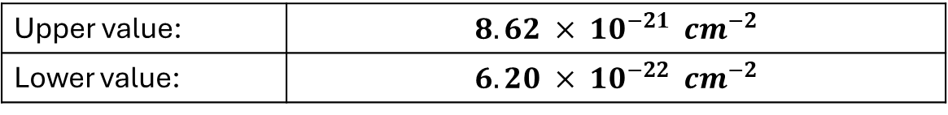
Cross-section
1.6 Milestone report gives upper & lower bounds for transmissions & efficiencies
Using these (instead of error on other terms):
 | $$T$$ | $$T_{f}$$ | $$η_{pc}$$ | $$η_{MCP}$$
Value used | 0.85 | 0.8 | 0.09 | 0.75
Best value | 0.9 | 0.9 | 0.1 | 0.9
Worst value | 0.7 | 0.3 | 0.05 | 0.5
Upper value: | $$8.62 × {10}^{−21} {cm}^{−2}$$
Lower value: | $$6.20 × {10}^{−22} {cm}^{−2}$$

Slide 11
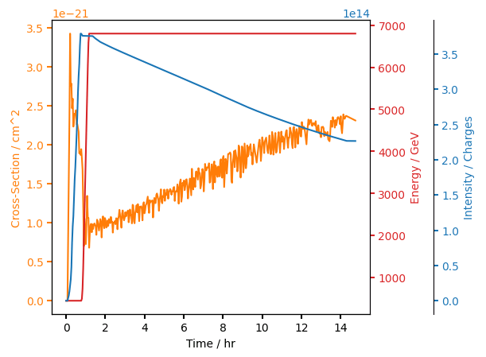
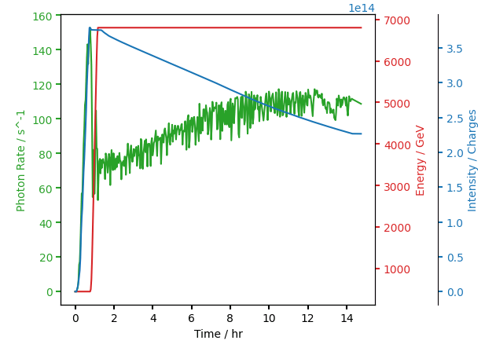
Cross Section & Photon Rate
Expecting a flat line for cross-section and a photon rate proportional to intensity
Suffer from clustering.
The cross-section supposed not to change when energy is the same. \
Photo-rate suppose to decrease when intensity decrease.

Slide 12
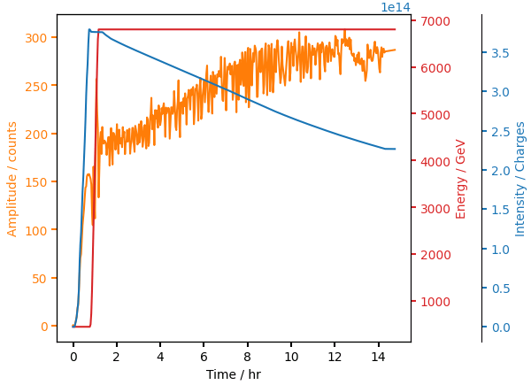
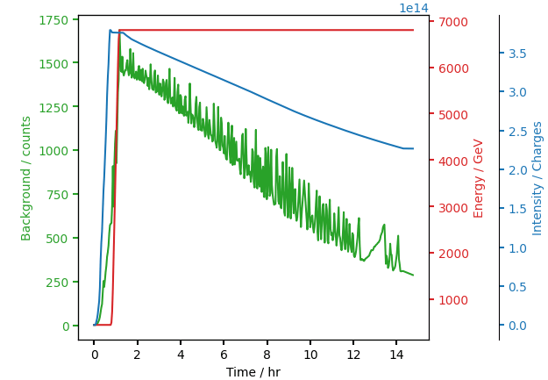
Signal & Noise
Heavily dominated by background.
Best S/N ~= 1, worst S/N ~= 0.1

Slide 13
1
2
4
5
6
7
8
3

Slide 14
1
2
4
5
6
7
8
3

Slide 15
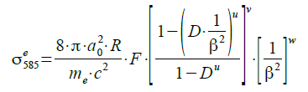
Cross-section estimation

Slide 16
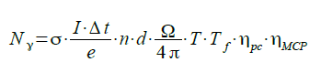
Parameter | Ion | Proton
Charge | 82 | 1
Intensity (max) [charges] | 2.54e13 | 3.79E+14
Energy [GeV] | 6800 | 6800
Current = Intensity*LHC_freq*e/82 [A] | 0.0045 | 0.683
Solid angle | 0.0045 | 0.0045
Optical attenuation | 1.64e-5 | 1.64e-5 Order of magnitude? PC = 0.09, MCP = 0.75, Lens = 0.85, Filter = 0.8.
Gas jet density [#/m³] | 1e16 | 2.5e+16 Need to check Building 8 density scan
Gas jet thickness [m] | 0.64e-3 | 0.64e-3
LHC frequency [Hz] | 11.245e3 | 11253 Calculated from beta
Photon Rate | ~500 | ~130
Cross-section [cm²] (prediction) | 1.4e-17 (4.7e-22) | 3.8e-21

