Slide 1


Optics and settings solutions to improve HL-LHC betatron collimation performance
B. Lindström, L. Bertolozzi, R. Bruce, X. Buffat, R. de Maria, A. Donadon Servelle, L. Giacomel, P. Hermes, D. Mirarchi, N. Mounet, S. Redaelli, F.F. Van der Veken, D. Veres, M. Zielinska
Many thanks to S. Fartoukh, M. Solfaroli, E. MacLean, OMC, OP, MD coordinators
4th July 2025 – BE seminar

Slide 2
Outline
Introduction
LHC collimation, beam losses
HL challenges and mitigations
New optics for protons
Simulations
Experiments
Other optics studies
IR3 impedance
Crystal collimation

Slide 3
Outline
Introduction
LHC collimation, beam losses
HL challenges and mitigations
New optics for protons
Simulations
Experiments
Other optics studies
IR3 impedance
Crystal collimation

Slide 4
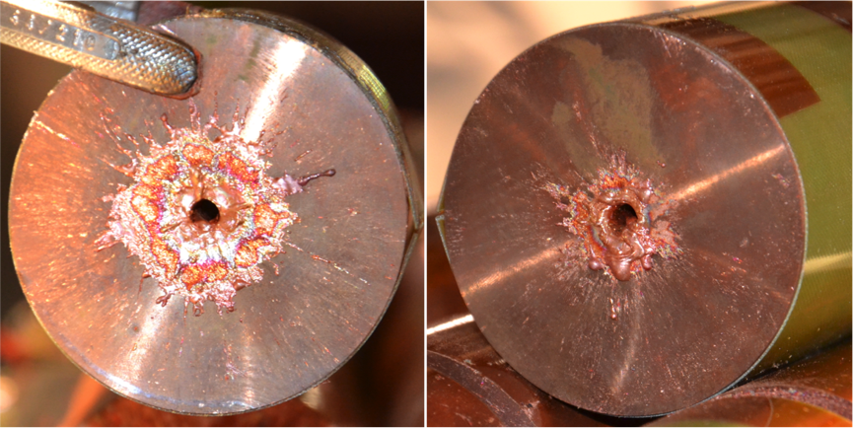
Collimation insertions in LHC
Design criteria: handle > 500 kW beam losses over min. 10 seconds
Beam losses heat Superconducting magnets: quench limits ~20 mW/cm^3
Avoid machine damage, magnet quenches and beam dumps, limit experiment background
 | 2025 | LHC design | HL-LHC design
Bunch intensity [p+] | 1.6 | 1.15 | 2.3
Energy [GeV] | 6800 | 7000 | 7000
Stored beam energy [MJ] | 450 | 362 | 678
Design beam loss limit [kW] | 650 | 500 | 1000
1.52 MJ deposited energy
(F. Burkart)
LHC needs a highly performant collimation system to protect the machine (~100 collimators installed)

Slide 5
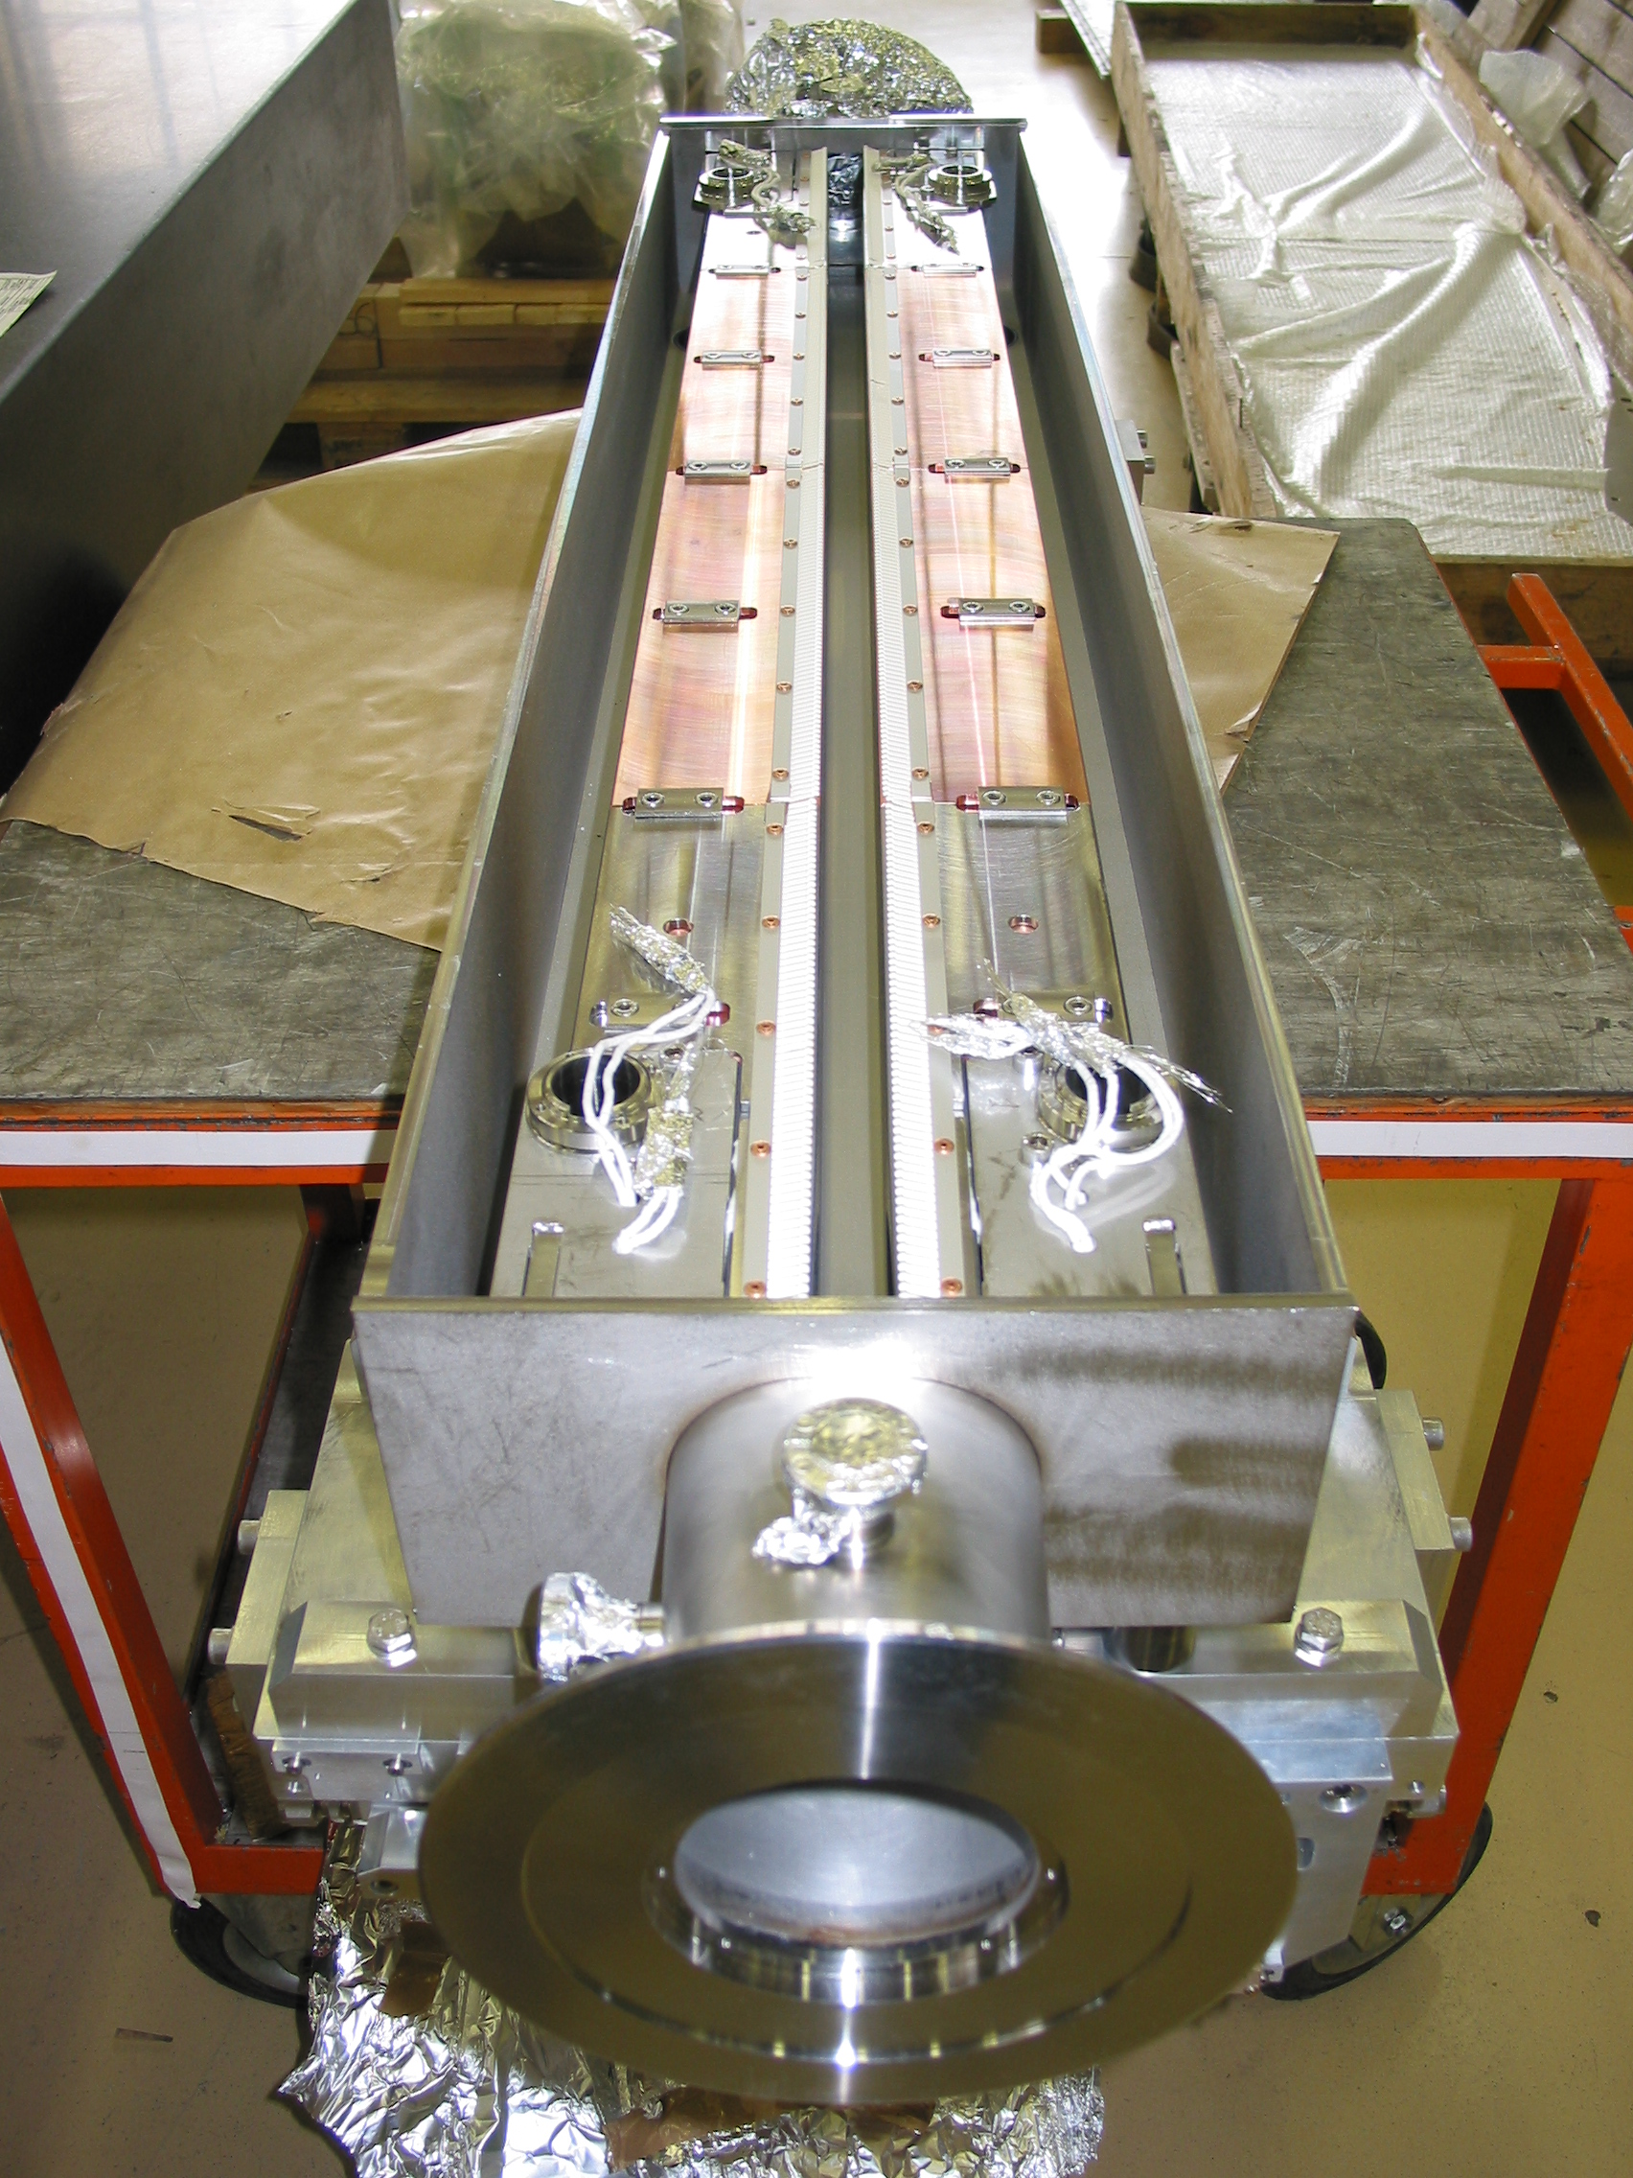
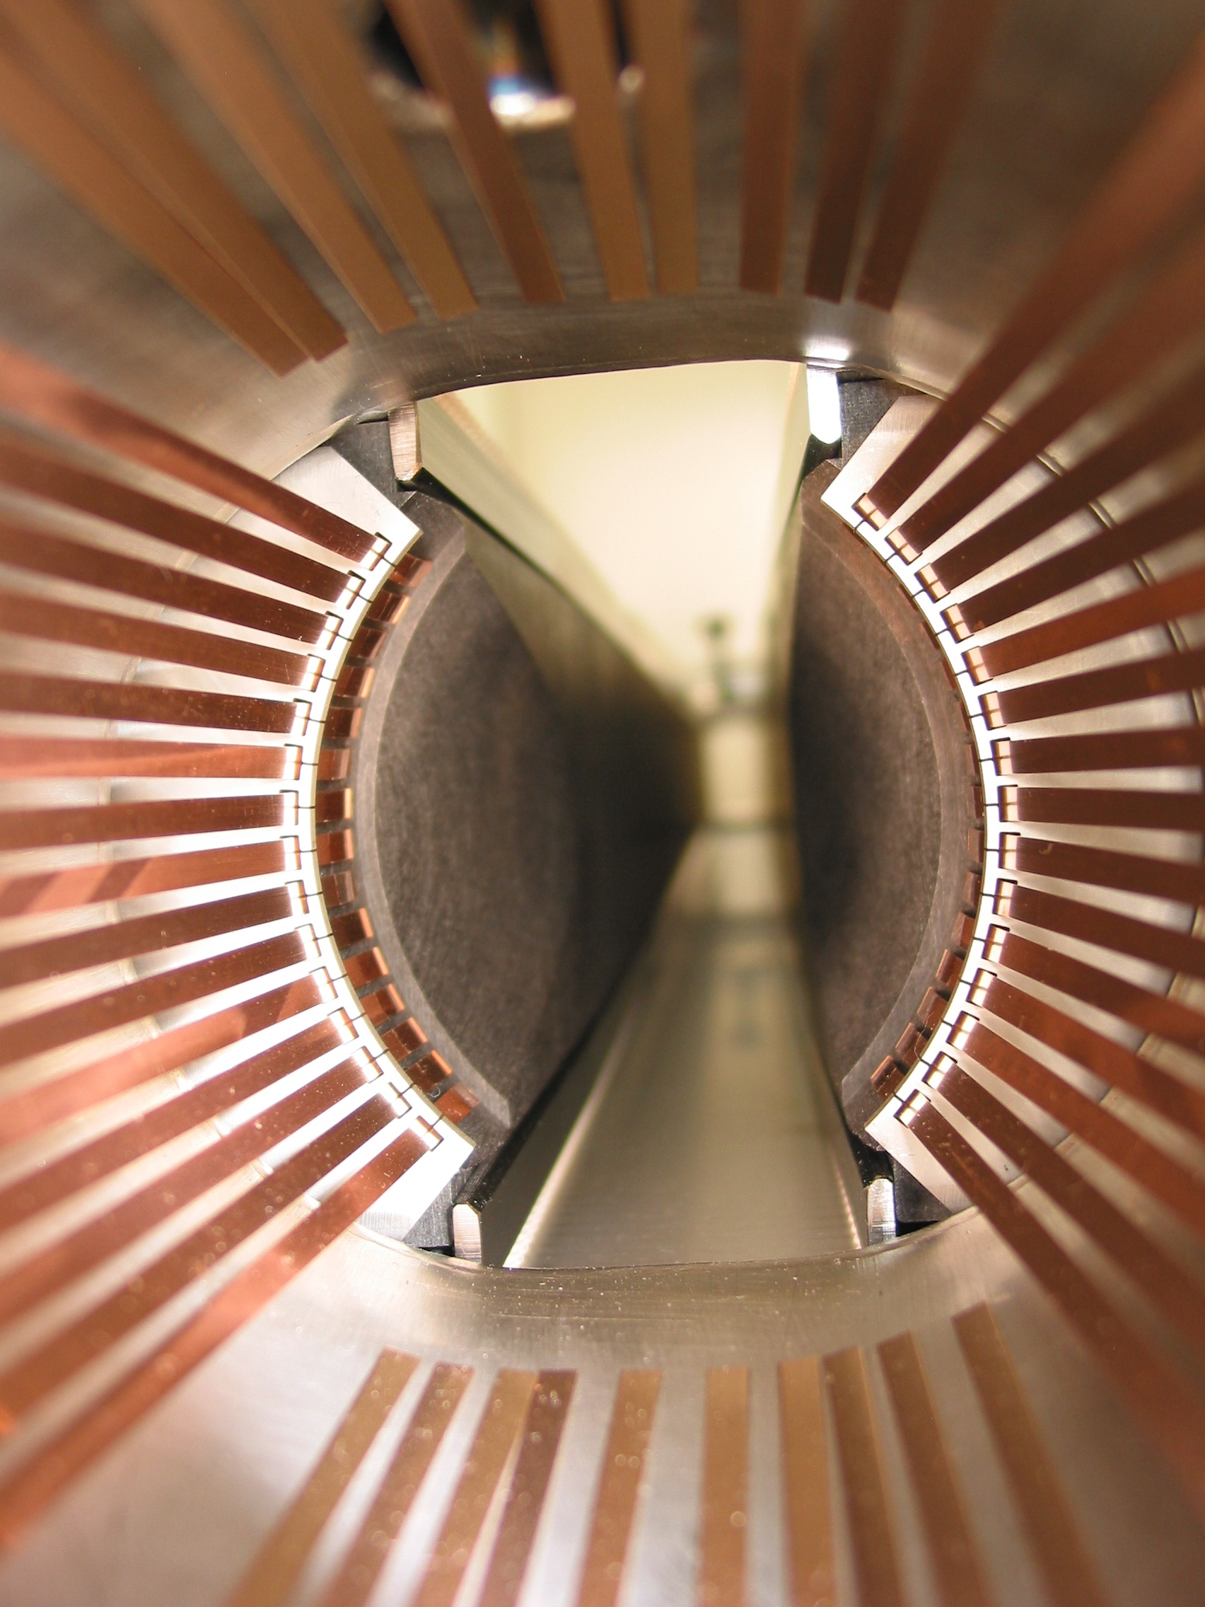
Collimator
Generally two parallel jaws to intercept beam particles and disperse their energy
Beam
Beam

Slide 6
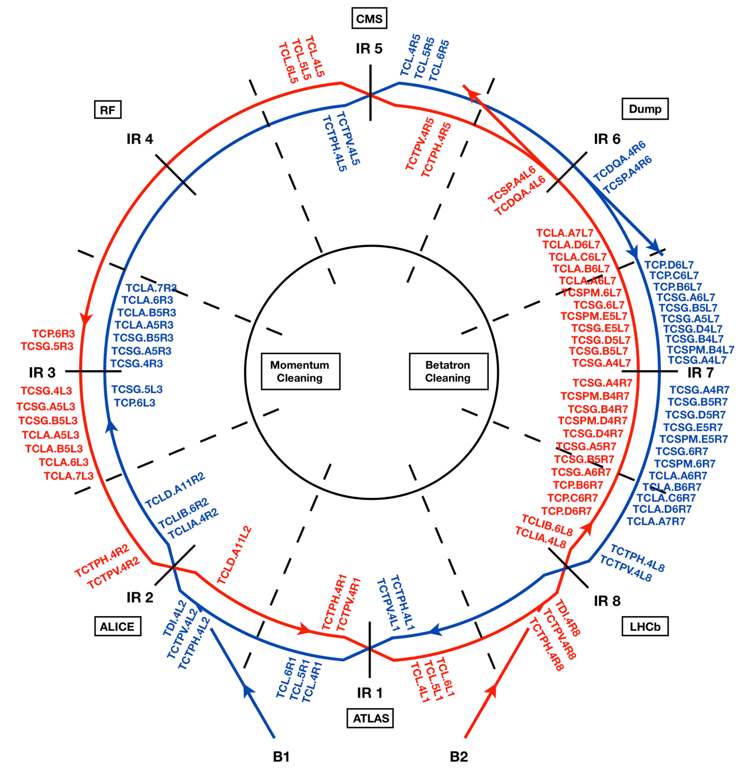
Collimation insertions in LHC
IR3
IR7
Momentum cleaning (IR3)
Particles with large momentum offsets
Betatron cleaning (IR7)
Particles with large betatron amplitudes

Slide 7
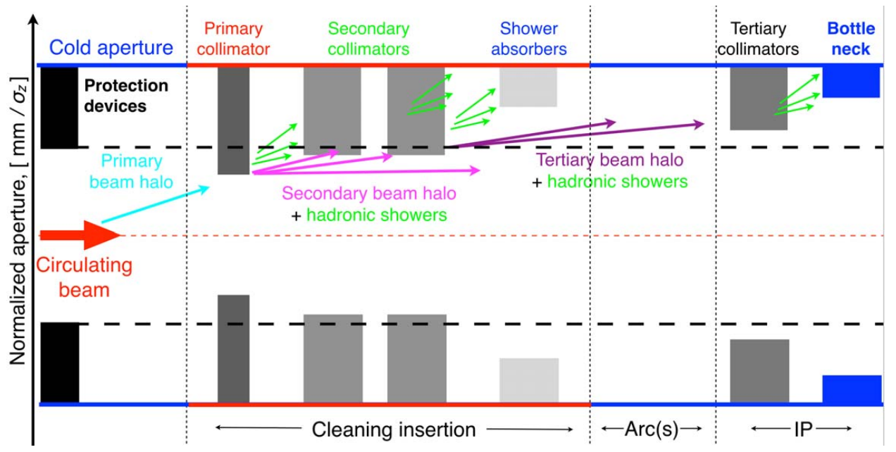
Multi-stage Collimation
Momentum cleaning (IR3)
Betatron cleaning (IR7)

Slide 8
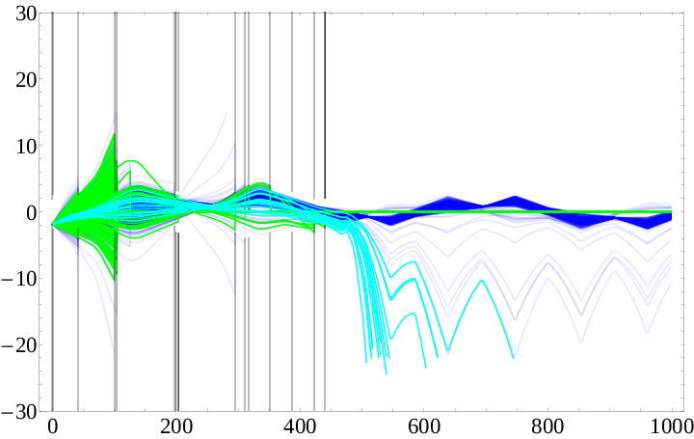
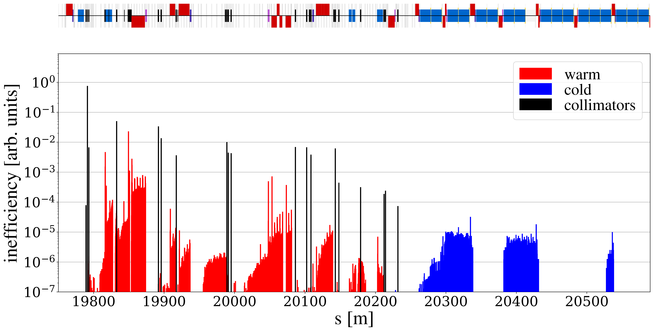
Leakage of collimator losses
on-momentum
Particles leak out of collimator insertion
Particles with large momentum offsets (>~0.2 %) lost in Dispersion Suppressor (DS)
10
0
x position [mm]
-10
off-momentum
-20
primary collimator
aperture

Slide 9
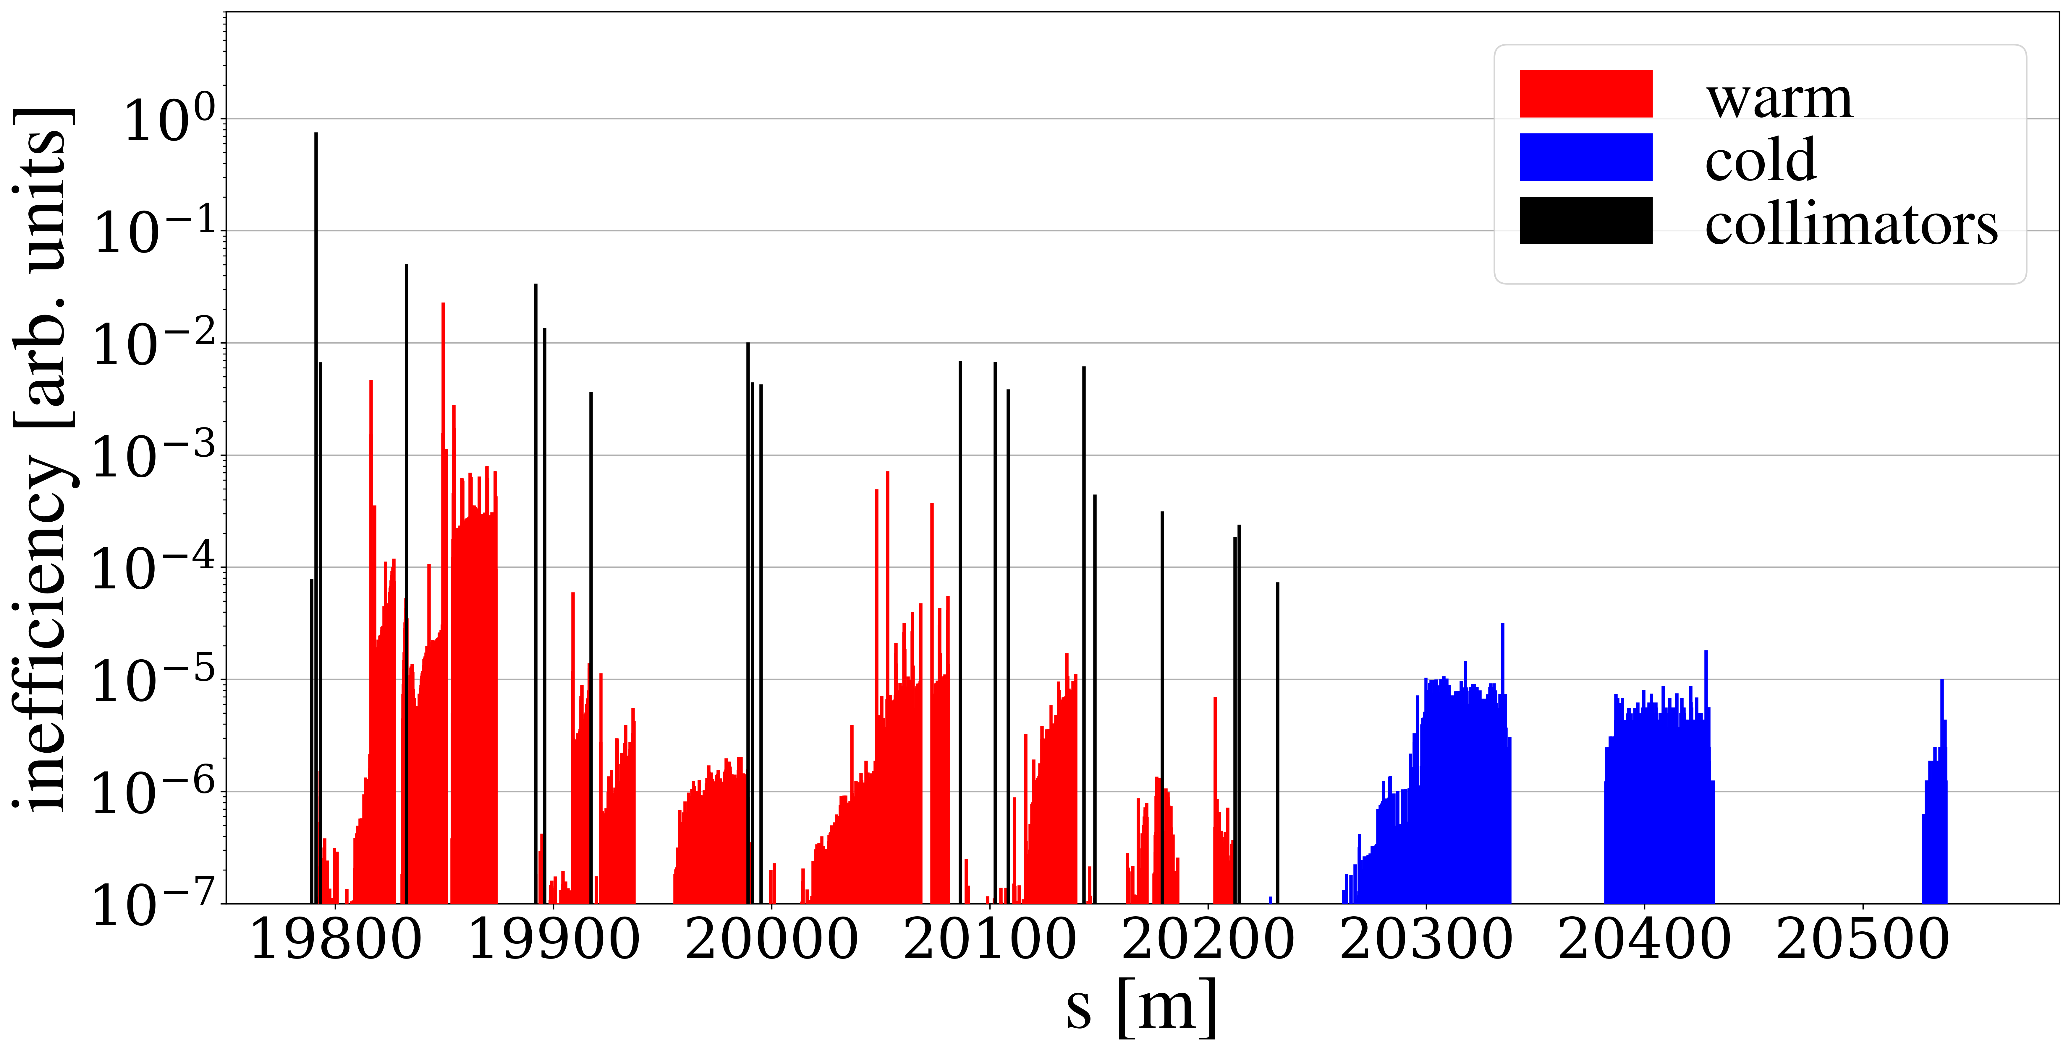
Leakage of collimator losses
on-momentum
Particles leak out of collimator insertion
Particles with large momentum offsets (>~0.2 %) lost in Dispersion Suppressor (DS)
Critical for cleaning performance due to quench risk
10
0
x position [mm]
-10
off-momentum
-20
primary collimator
aperture
DS clusters

Slide 10
HL-LHC challenges
Protons per bunch increase:
1.15e11 (design) → 1.6e11 (now) → 2.3e11 (HL)
Impedance scales with bunch charge
Image charges induced, act back on beam
→ beam lifetime decreases, instabilities
Collimators main source of impedance (low conductivity and tight gaps – scaling with third power of gap)
Collimator leakage (absolute) scales with beam intensity
→ increased quench risk
Limitations mainly from Betatron Collimation (IR7)

Slide 11
Collimator Settings
Defined in beam sigmas, well-defined hierarchy (primary, secondary, tertiary)
Balance to be taken between
Cleaning performance
Machine protection requirements
Impedance
Beta* reach
In HL-LHC:
Tight settings (TDR baseline) – better for cleaning
Relaxed settings – better for impedance

Slide 12
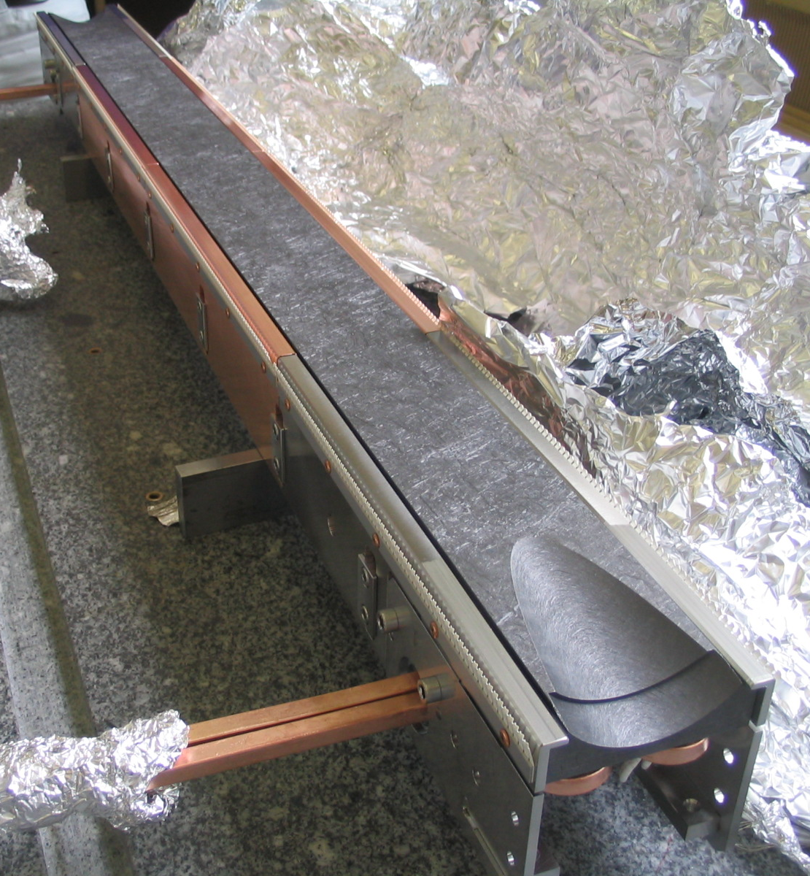
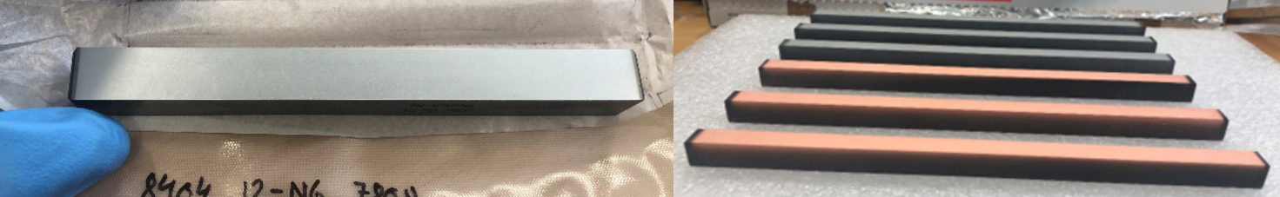
Impedance Mitigations
Replace collimators with low-impedance materials →Primary: Mo-graphite (instead of CFC) →Secondary: Mo-coated Mo-graphite / Cu-coated graphite
More open collimator settings
Carbon Fiber Composite
Mo-coated Mo-graphite
F. Carra
Cu-coated graphite

Slide 13
Impedance Mitigations
Replace collimators with low-impedance materials →Primary: Mo-graphite (instead of CFC) →Secondary: Mo-coated Mo-graphite / Cu-coated graphite
More open collimator settings
Concern that more margin needed (e.g. crab cavity impedance)
Carbon Fiber Composite
Mo-coated Mo-graphite
F. Carra
Cu-coated graphite

Slide 14
Beam Loss Mitigations
primary collimator

Slide 15
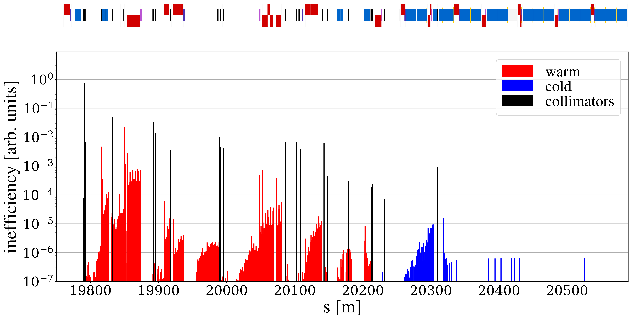
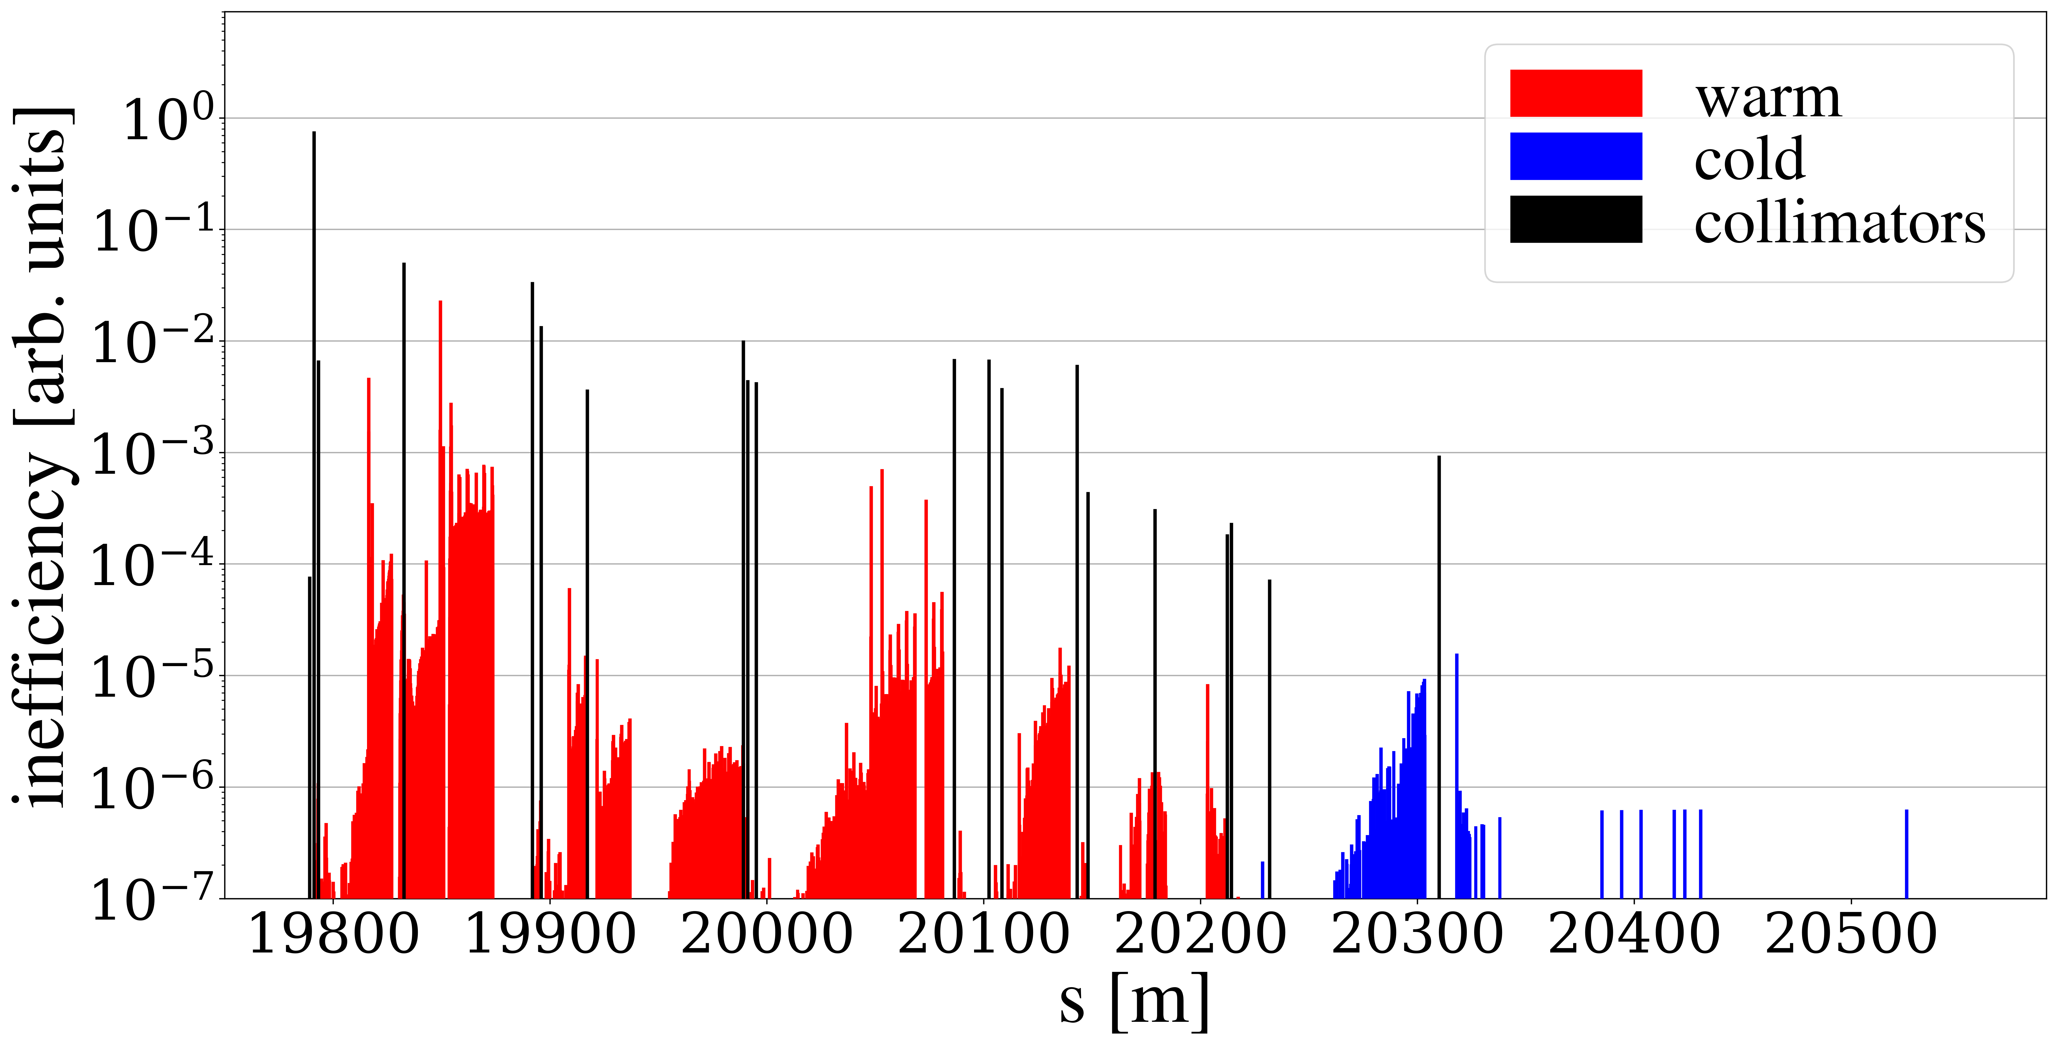
Beam Loss Mitigations
Replace one arc dipole (8.33 T) with two shorter dipoles (11T)
Install a collimator in the gap
Descoped from baseline due to 11T dipole production difficulties
Heavy Ions:
TCLD was strictly needed
Solved by crystal collimation
HL intensity used operationally in RunIII – no IR7 quench!
Protons:
Quench test indicate that we might reach HL beam loss scenario without quenching
Uncertainties remain (measurement precision, scaling to 7 TeV)
primary collimator
TCLD

Slide 16
Beam Loss Mitigations
Replace one arc dipole (8.33 T) with two shorter dipoles (11T)
Install a collimator in the gap
Descoped from baseline due to 11T dipole production difficulties
Heavy Ions:
TCLD was strictly needed
Solved by crystal collimation
HL intensity used operationally in RunIII – no IR7 quench!
Protons:
Quench test indicate that we might reach HL beam loss scenario without quenching
Uncertainties remain (measurement precision, scaling to 7 TeV)
primary collimator
TCLD

Slide 17
Beam Loss Mitigations
Replace one arc dipole (8.33 T) with two shorter dipoles (11T)
Install a collimator in the gap
Descoped from baseline due to 11T dipole production difficulties
Heavy Ions:
TCLD was strictly needed
Solved by crystal collimation
HL intensity used operationally in RunIII – no IR7 quench!
Protons:
Quench test indicate that we might reach HL beam loss scenario without quenching
Uncertainties remain (measurement precision, scaling to 7 TeV)
primary collimator
TCLD

Slide 18
Beam Loss Mitigations
Replace one arc dipole (8.33 T) with two shorter dipoles (11T)
Install a collimator in the gap
Descoped from baseline due to 11T dipole production difficulties
Heavy Ions:
TCLD was strictly needed
Solved by crystal collimation
HL intensity used operationally in RunIII – no IR7 quench!
Protons:
Quench test indicate that we might reach HL beam loss scenario without quenching
Uncertainties remain (measurement precision, scaling to 7 TeV)
primary collimator
TCLD

Slide 19
What else can we do?
Change the optics in IR7 to mitigate both
impedance and collimation leakage!
Focus on LHC here, but approach can be generalized to other multi-stage systems

Slide 20
Outline
Introduction
LHC collimation, beam losses
HL challenges and mitigations
New optics for protons
Simulations
Experiments
Other optics studies
IR3 impedance
Crystal collimation

Slide 21
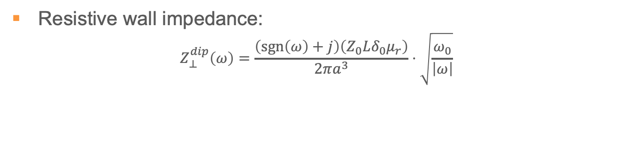
Impedance
Resistive wall impedance:
$$Z_{⊥}^{dip}\left(ω\right)=\frac{\left(\operatorname{sgn}\left(ω\right)+j\right)\left(Z_{0}Lδ_{0}μ_{r}\right)}{2πa^{3}}⋅\sqrt{\frac{ω_{0}}{\left|ω\right|}}$$
skin depth,
depends on material conductivity
gap between jaws,
depends on beta function
(collimator settings are defined in sigma)
More details: L. Giacomel et. al., THBP40, HB2023
N. Mounet et. al., THA1C1, HB2023

Slide 22
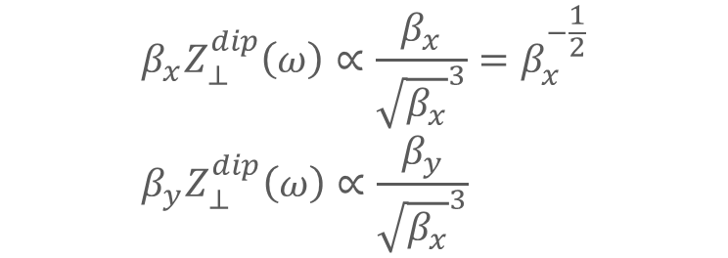
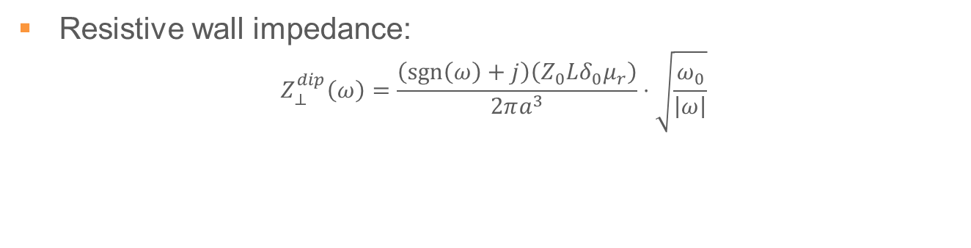
Impedance
Resistive wall impedance:
$$Z_{⊥}^{dip}\left(ω\right)=\frac{\left(\operatorname{sgn}\left(ω\right)+j\right)\left(Z_{0}Lδ_{0}μ_{r}\right)}{2πa^{3}}⋅\sqrt{\frac{ω_{0}}{\left|ω\right|}}$$
skin depth,
depends on material conductivity
gap between jaws,
depends on beta function
(collimator settings are defined in sigma)
$$β_{x}Z_{⊥}^{dip}\left(ω\right)∝\frac{β_{x}}{{\sqrt{β_{x}}}^{3}}=β_{x}^{−\frac{1}{2}} \\ β_{y}Z_{⊥}^{dip}\left(ω\right)∝\frac{β_{y}}{{\sqrt{β_{x}}}^{3}}$$
Effective impedance, e.g. horizontal collimator:
Increasing beta functions opens up collimator gaps
More details: L. Giacomel et. al., THBP40, HB2023
N. Mounet et. al., THA1C1, HB2023

Slide 23
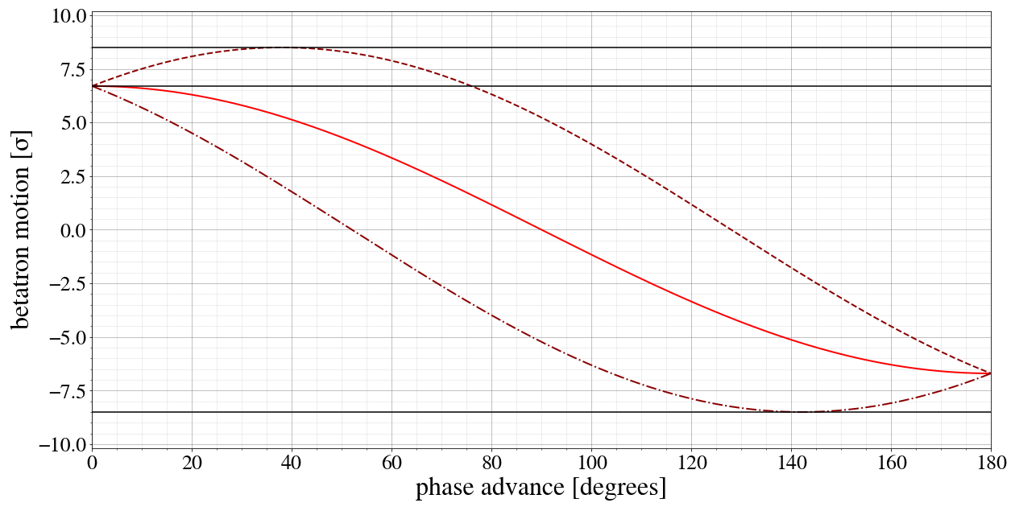
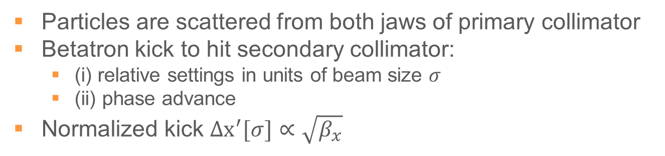
Collimator cuts (1/2)
Particles are scattered from both jaws of primary collimator
Betatron kick to hit secondary collimator:
(i) relative settings in units of beam size $σ$
(ii) phase advance
Normalized kick $Δx^{′}[σ]∝\sqrt{β_{x}}$
secondary collimator
primary collimator
Scattered by jaw
Unscattered particle

Slide 24
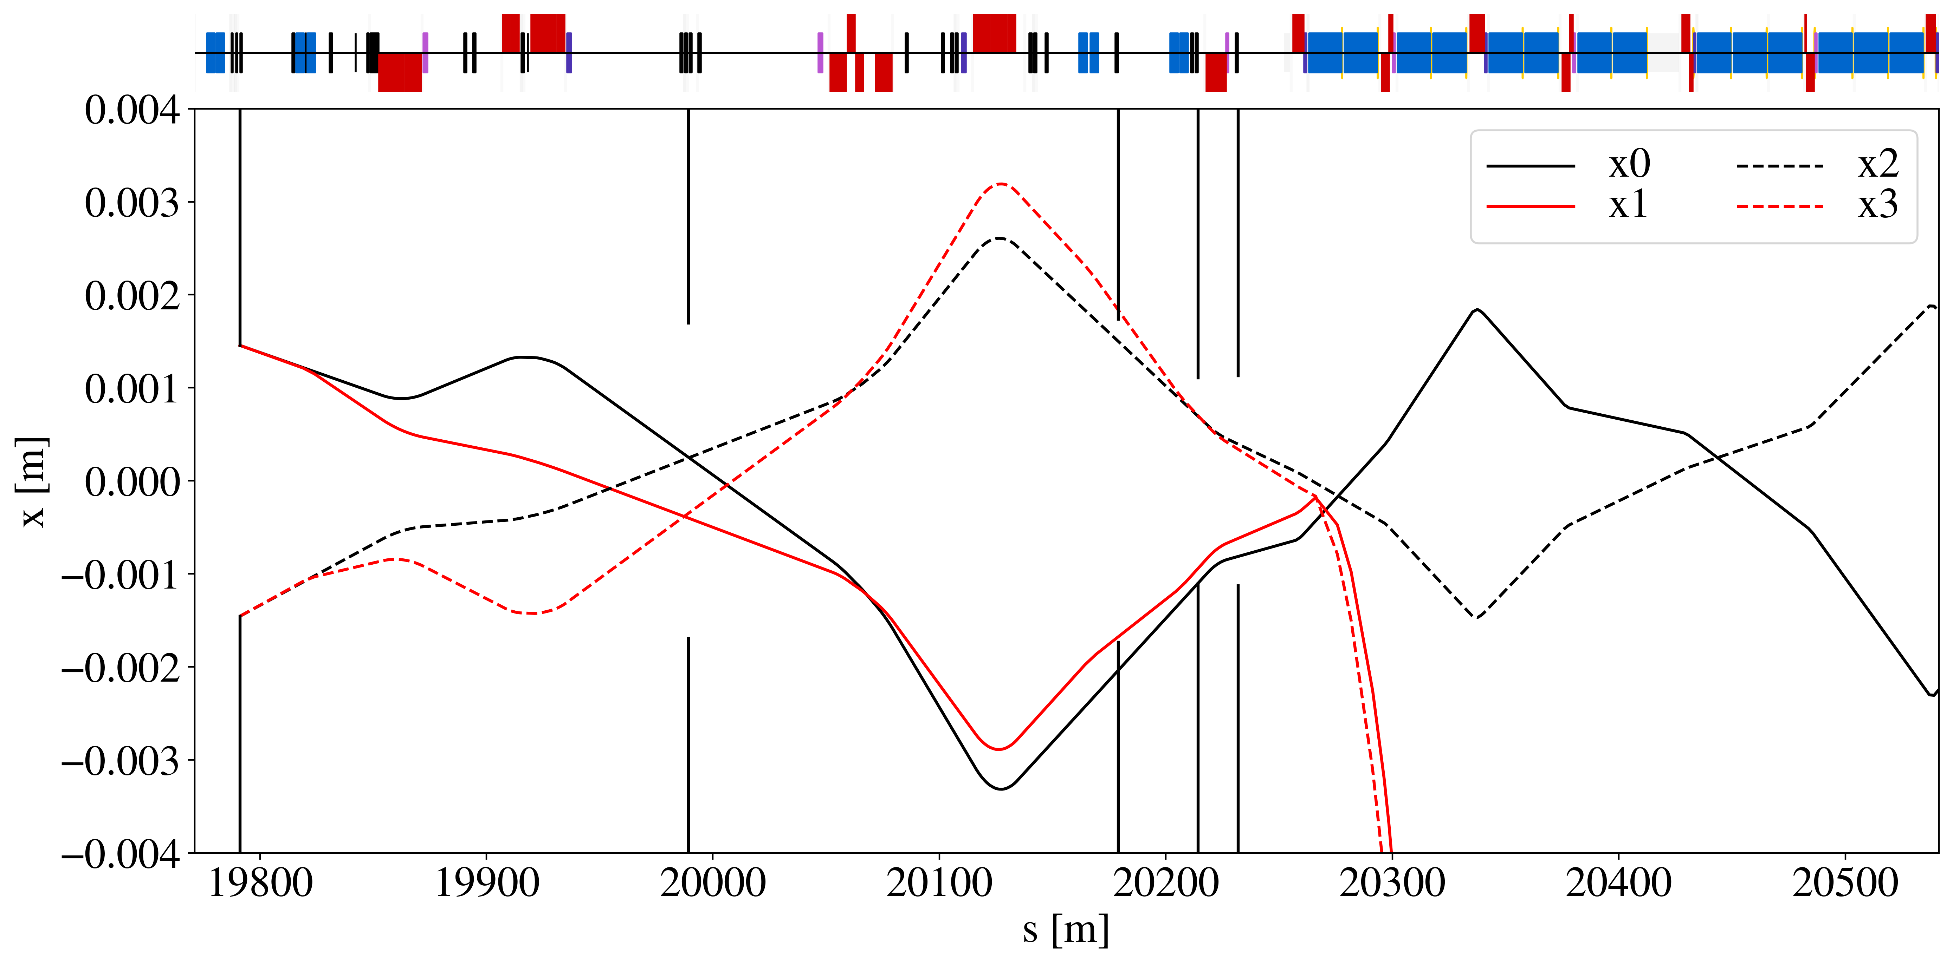
Collimator cuts (2/2)
Single-pass dispersion generated by dog-leg dipoles
Shifts collimator cuts (pos or neg) → causes off-momentum particle to leak or be intercepted
dog-leg
black: on-momentum
red: off-momentum

Slide 25
Collimator cuts (2/2)
Single-pass dispersion generated by dog-leg dipoles
Shifts collimator cuts (pos or neg) → causes off-momentum particle to leak or be intercepted
dog-leg
black: on-momentum
red: off-momentum
Increase beta functions at primary collimators and single pass dispersion at secondary collimators

Slide 26
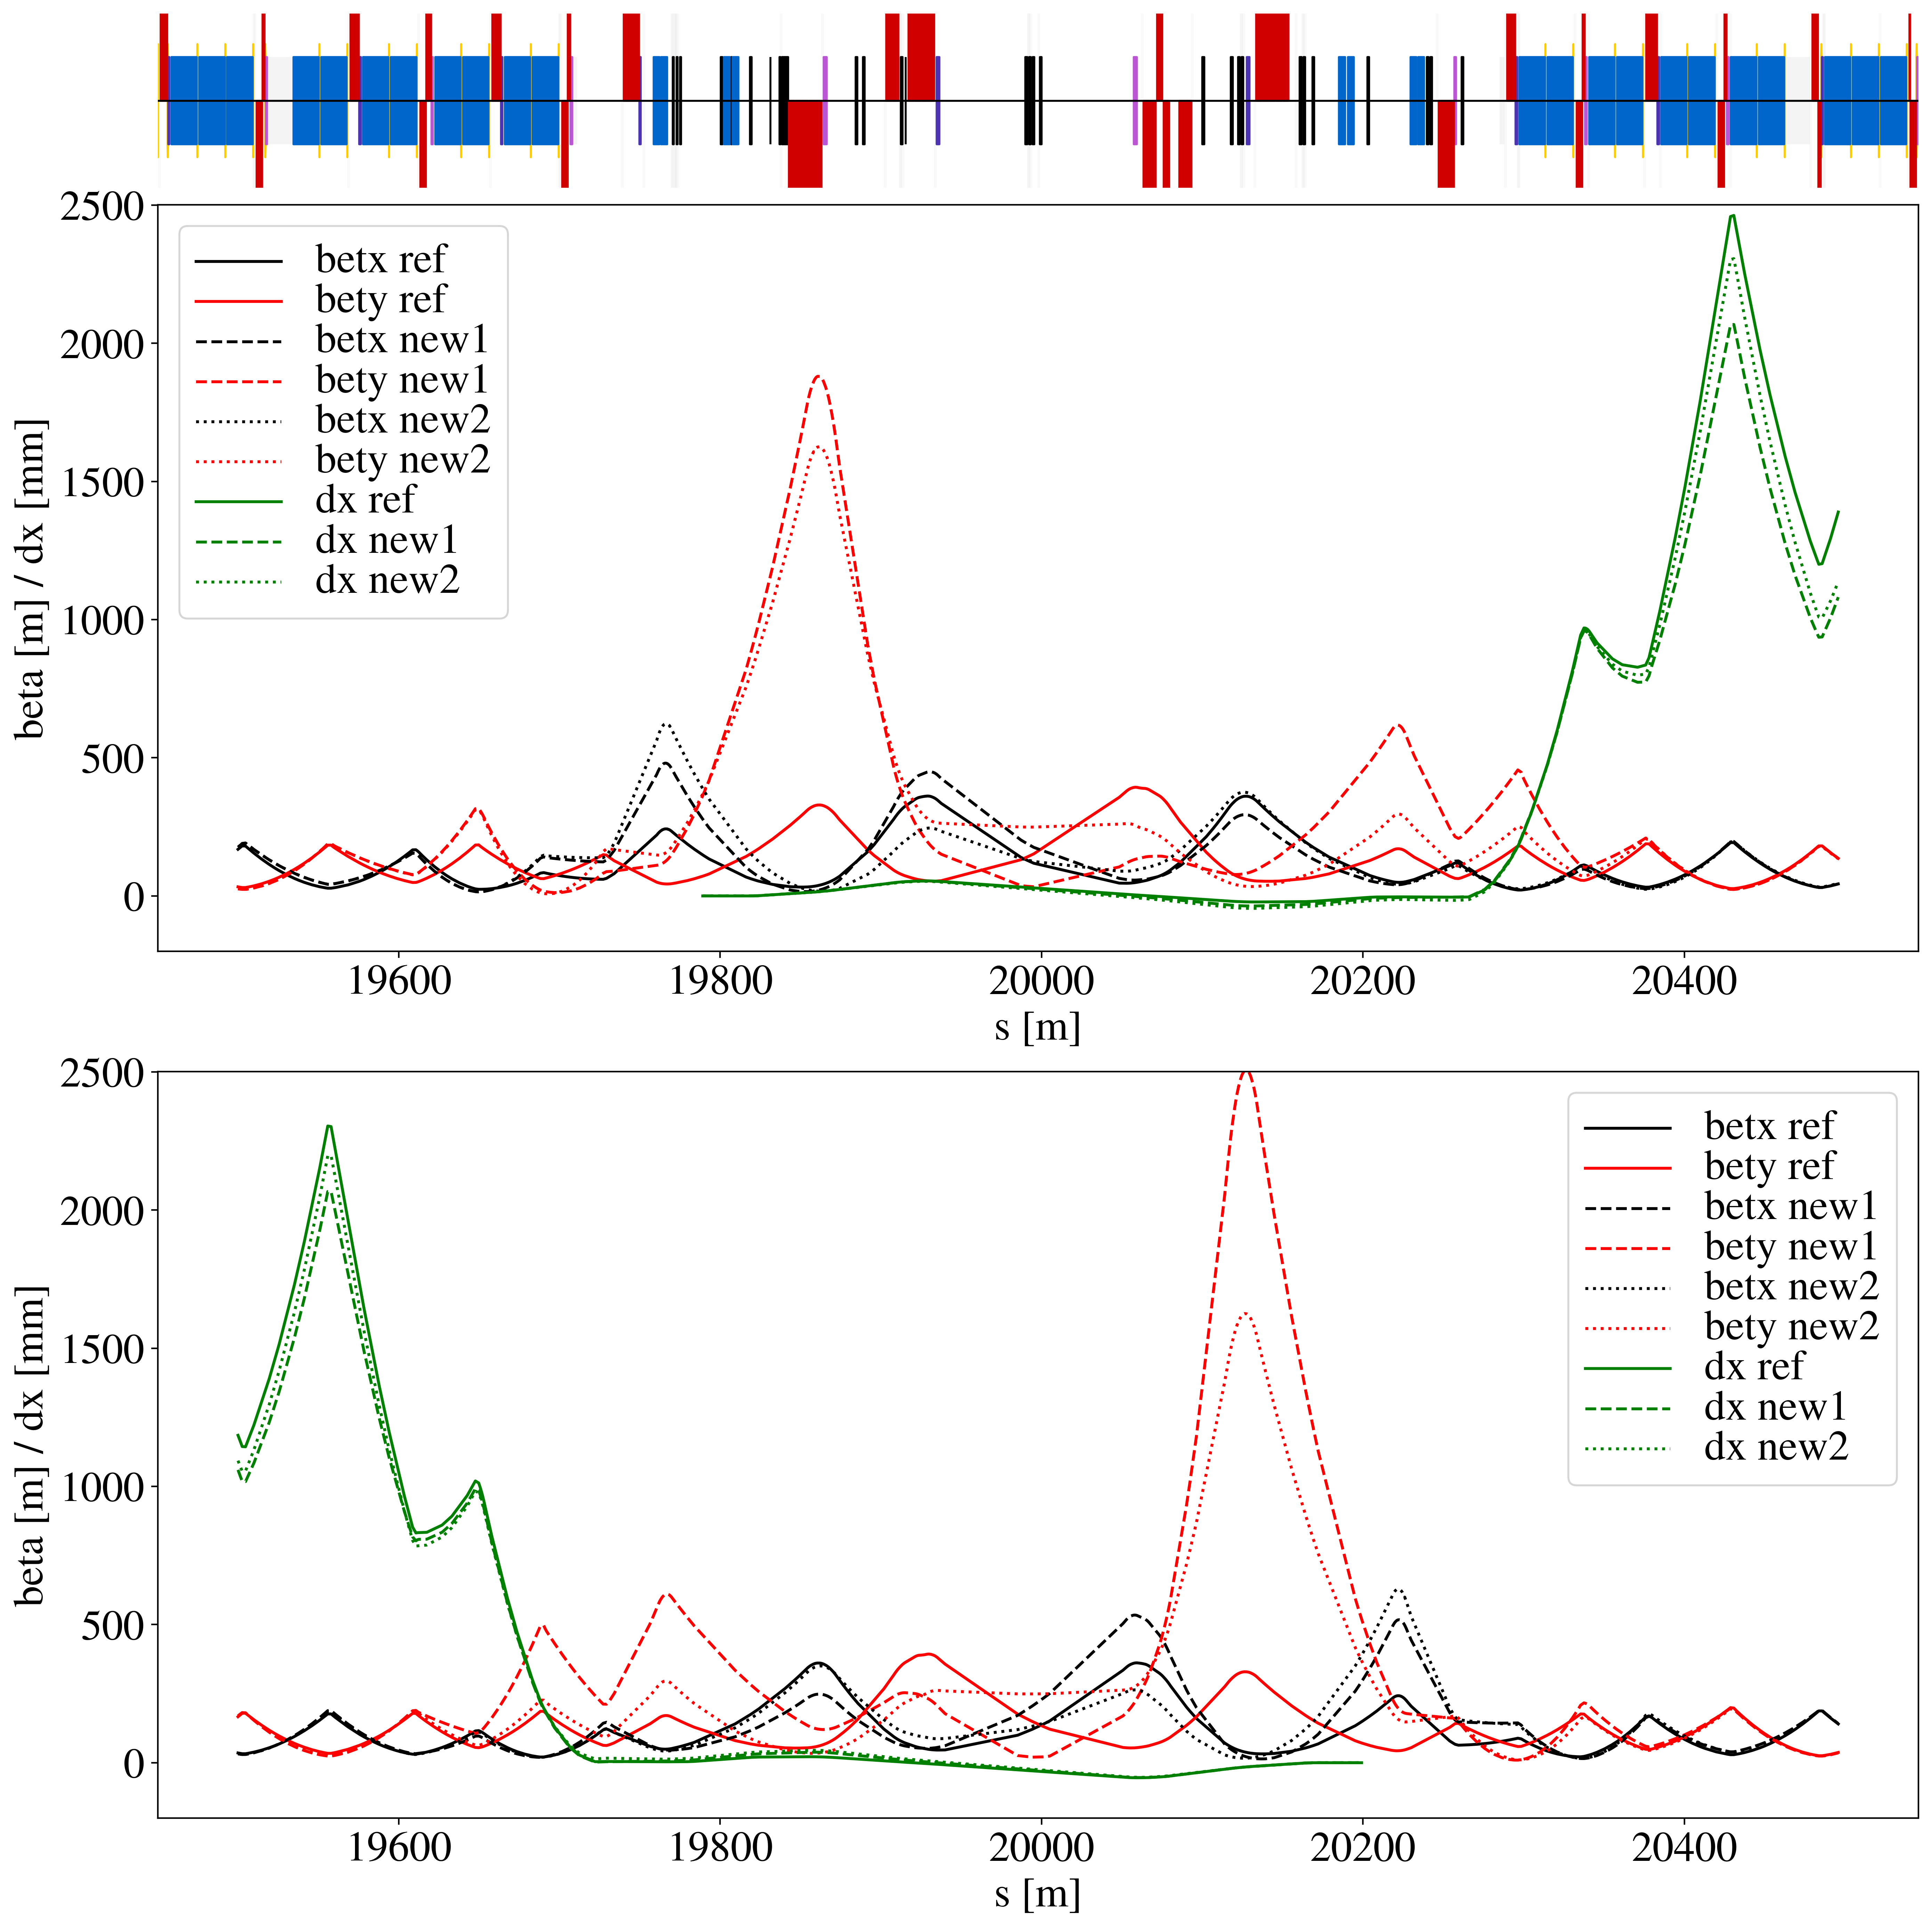
Optics rematch and constraints
Optics: specific magnet configuration to control beam parameters
Quadrupoles (individual and common for b1/b2) up to cells 13
Constraints:
Optics are matched to the arcs
Peak beta function kept reasonably small (aperture, field errors)
Goals:
(1) Large betx/bety at primary collimators – cleaning impedance
(2) Small betx at secondary collimators and absorbers – cleaning impedance
(3) Increase single-pass dispersion – cleaning impedance
(4) Small beta function in orthogonal plane of collimators – cleaning impedance

Slide 27
Optics rematch and constraints
Optics: specific magnet configuration to control beam parameters
Quadrupoles (individual and common for b1/b2) up to cells 13
Constraints:
Optics are matched to the arcs
Peak beta function kept reasonably small (aperture, field errors)
Goals:
(1) Large beam size (betx/bety) at primary collimators – cleaning impedance
(2) Small betx at secondary collimators and absorbers – cleaning impedance
(3) Increase single-pass dispersion – cleaning impedance
(4) Small beta function in orthogonal plane of collimators – cleaning impedance
(1)

Slide 28
Optics rematch and constraints
Optics: specific magnet configuration to control beam parameters
Quadrupoles (individual and common for b1/b2) up to cells 13
Constraints:
Optics are matched to the arcs
Peak beta function kept reasonably small (aperture, field errors)
Goals:
(1) Large beam size (betx/bety) at primary collimators – cleaning impedance
(2) Small betx at secondary collimators and absorbers – cleaning impedance
(3) Increase single-pass dispersion – cleaning impedance
(4) Small beta function in orthogonal plane of collimators – cleaning impedance
(1)
(2)

Slide 29
Optics rematch and constraints
Optics: specific magnet configuration to control beam parameters
Quadrupoles (individual and common for b1/b2) up to cells 13
Constraints:
Optics are matched to the arcs
Peak beta function kept reasonably small (aperture, field errors)
Goals:
(1) Large beam size (betx/bety) at primary collimators – cleaning impedance
(2) Small betx at secondary collimators and absorbers – cleaning impedance
(3) Increase single-pass dispersion – cleaning impedance
(4) Small beta function in orthogonal plane of collimators – cleaning impedance
(1)
(2)
(3)

Slide 30
Optics rematch and constraints
Optics: specific magnet configuration to control beam parameters
Quadrupoles (individual and common for b1/b2) up to cells 13
Constraints:
Optics are matched to the arcs
Peak beta function kept reasonably small (aperture, field errors)
Goals:
(1) Large beam size (betx/bety) at primary collimators – cleaning, impedance
(2) Small betx at secondary collimators and absorbers – cleaning, impedance
(3) Increase single-pass dispersion – cleaning, impedance
(4) Small beta function in orthogonal plane of collimators – cleaning, impedance
(1)
(4)
(2)
(3)

Slide 31
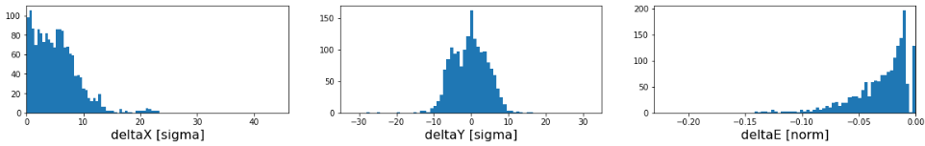
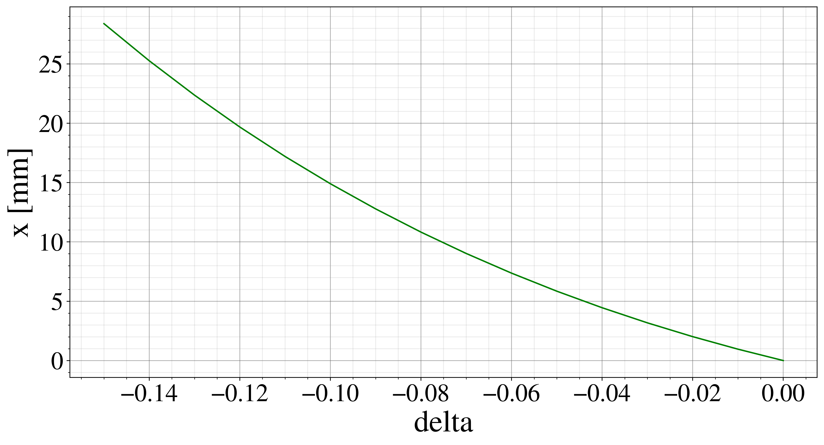
Distribution of leaked particles
Particles lost in DS following interaction with TCP, without impacting any other collimator
Particles with up to 15 % energy lost, must consider non-linear dispersion and chromaticity to optimize optics

Slide 32
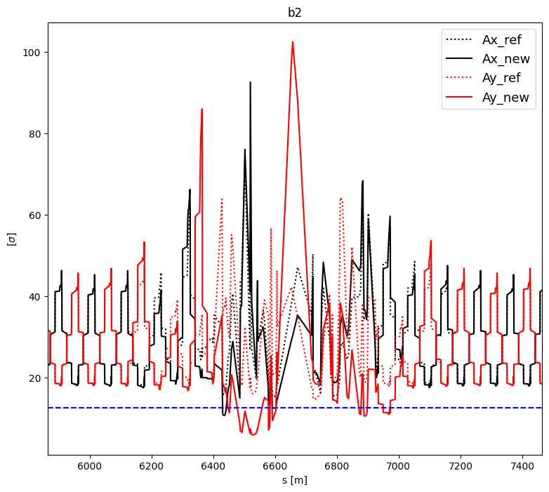
Aperture
Not enough aperture at injection to accomodate for the larger beta functions
L. Bertolozzi
Need combined ramp and desqueeze of IR7 – never before done in collimation insertions

Slide 33
Outline
Introduction
LHC collimation, beam losses
HL challenges and mitigations
New optics for protons
Simulations
Experiments
Other optics studies
IR3 impedance
Crystal collimation

Slide 34
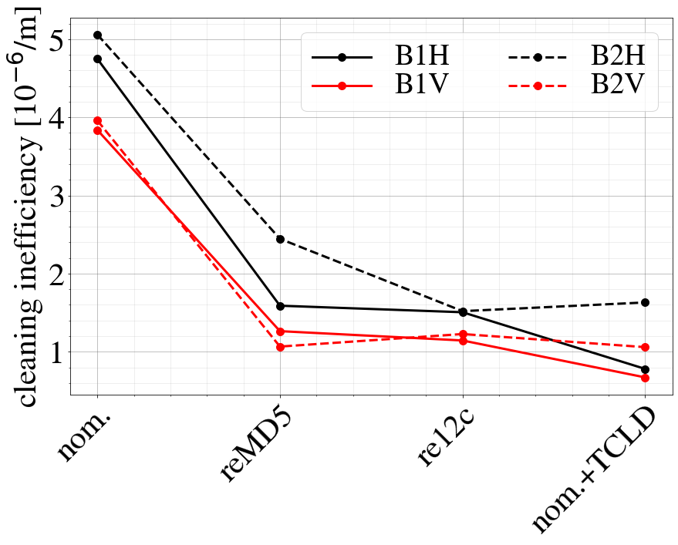
HL-LHC cleaning – simulated
Two optics version have been tested
Average losses in first cluster
Similar to nominal optics with TCLD
old baseline with HW upgrade
nominal
version 1
version 2
nom+TCLD

Slide 35
Experimental campaign
Several MDs launched:
MD7203 – cleaning performance and impedance at FT
MD11243 / MD12723 – first ramp and desqueeze of IR3 and IR7 (part of full HL optics cycle test)
MD11843 – test of different collimator settings for HL
MD15146 – ramp and desqueeze with high intensity beams
Critical parts to test:
Cleaning performance
Impedance
Experimental background
Operational feasibility of combined ramp and desqueeze of IR7 (loss spikes? cleaning performance during transition?)
done 2024
done 2024
done 2024
low intensity test done in MD1 high intensity test in MD2

Slide 36
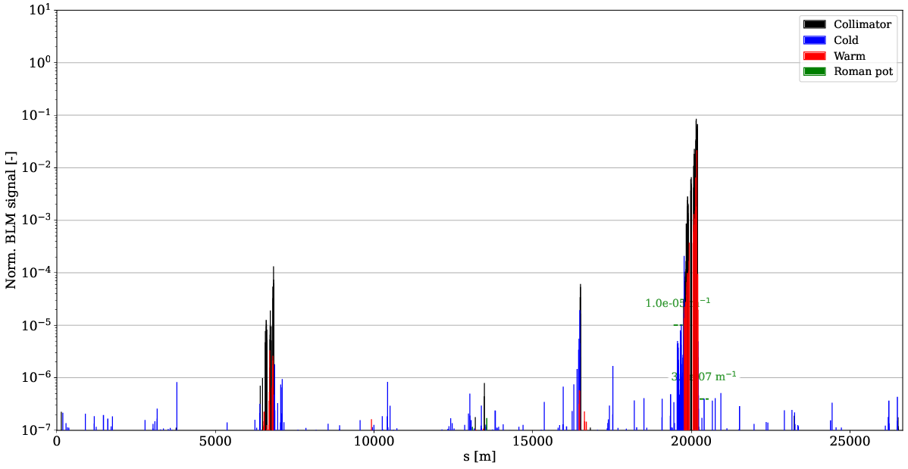
Measured Loss maps
Betatron:
Bunch is excited by transverse kicker to provoke beam losses
Evaluate cleaning performance

Slide 37
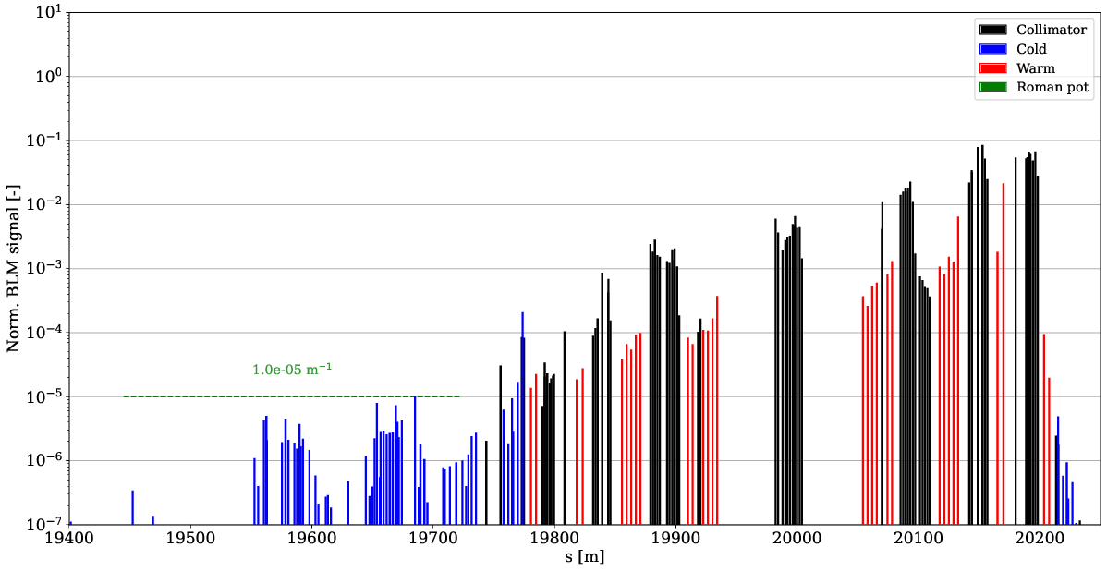
Measured Loss maps
Betatron:
Bunch is excited by transverse kicker to provoke beam losses
Evaluate cleaning performance
IR7 zoom
DS losses

Slide 38
Measured Loss maps
Betatron:
Bunch is excited by transverse kicker to provoke beam losses
Evaluate cleaning performance
Observables:
Collimator hierarchy
DS leakage
Tertiary collimator losses (around collision points)
No unexplained spikes (indicates aperture issues)
IR7 zoom
DS losses

Slide 39
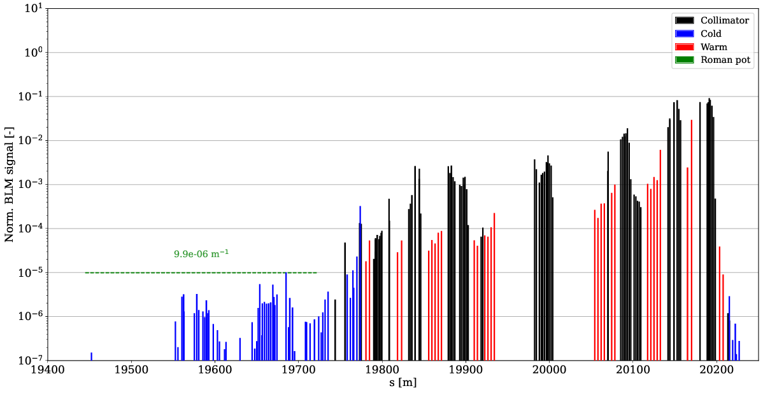
B2H losses (FT – HL MD)
nominal meas.

Slide 40
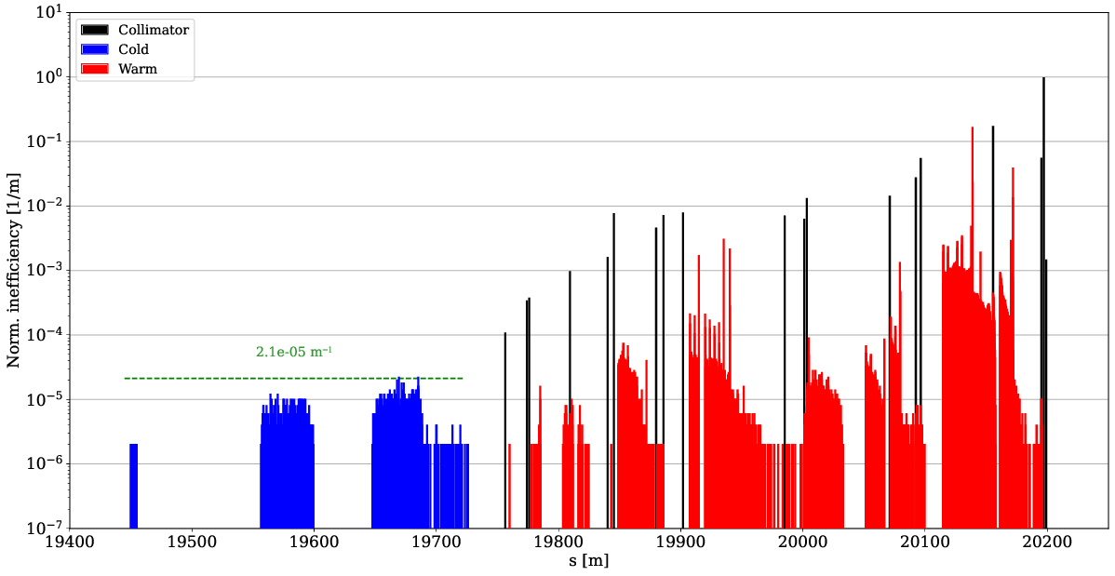
B2H losses (FT – HL MD)
nominal sim.
nominal meas.

Slide 41
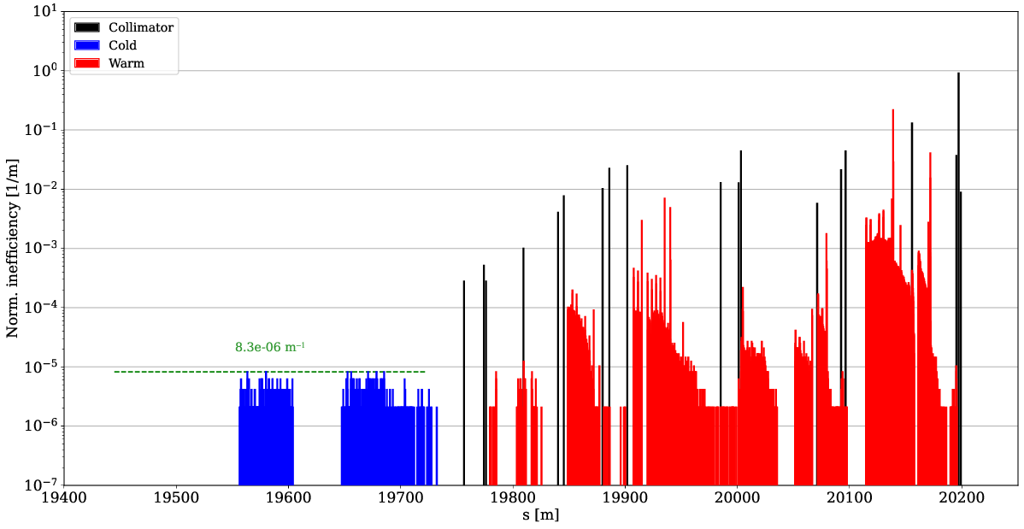
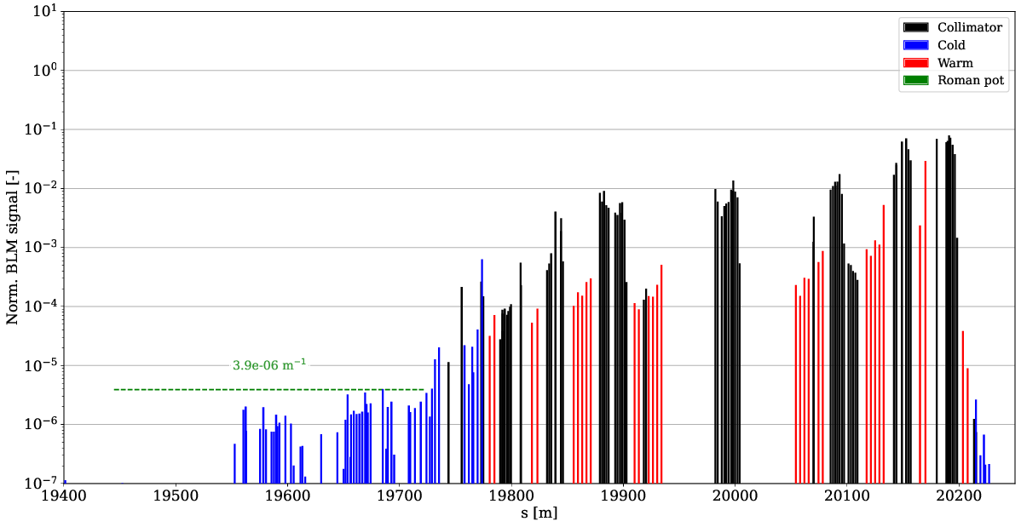
B2H losses (FT – HL MD)
Simulated 61 % improvement – measured 61 % (σ=7.4 %)
nominal sim.
HL MD sim.
nominal meas.
HL MD meas.

Slide 42
B2H losses (FT – HL MD)
Simulated 61 % improvement – measured 61 % (σ=7.4 %)
Secondary stages catch more losses – less leakage to DS
nominal sim.
HL MD sim.
nominal meas.
HL MD meas.

Slide 43
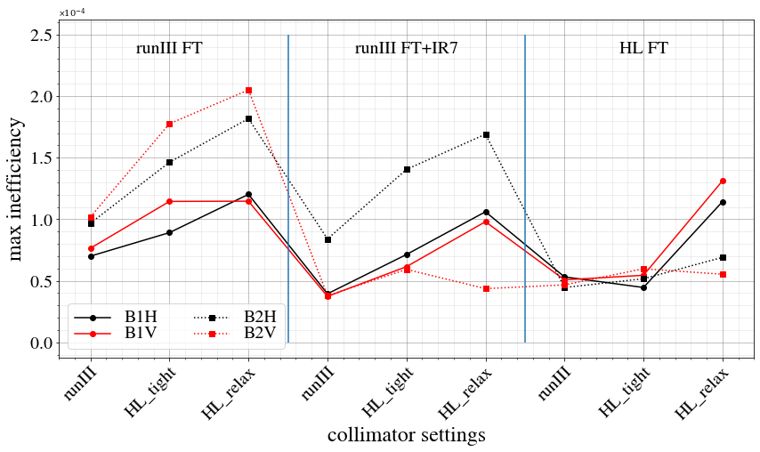
Summary of DS betatron cleaning
Significant worsening with relaxed settings (estimate only ~7 % worse than tight)
In general, significant improvement due to new optics!

Slide 44
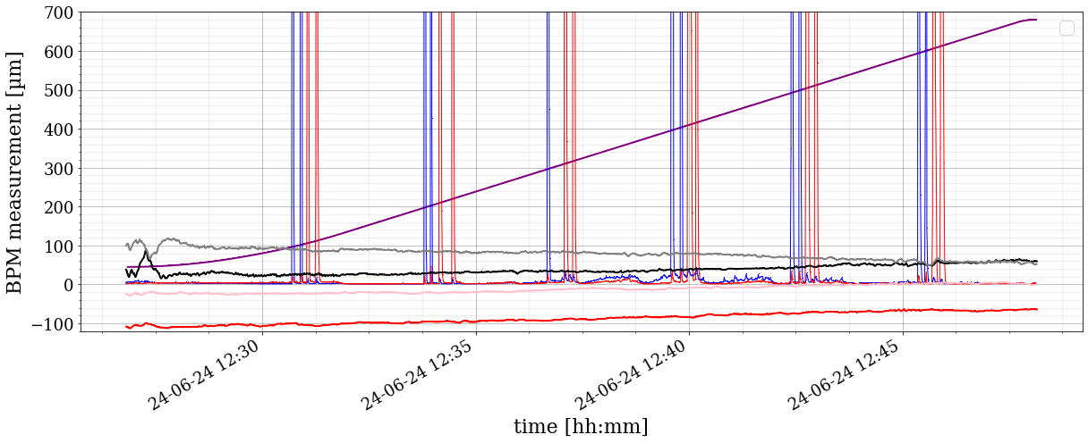
Losses during ramp
Ramp with tight settings and low intensity beam:
Orbit well controlled and optics corrected
Similar lifetime to normal ramps
No significant loss spikes noted
Follow-up with high intensity beam scheduled for MD2
loss maps

Slide 45
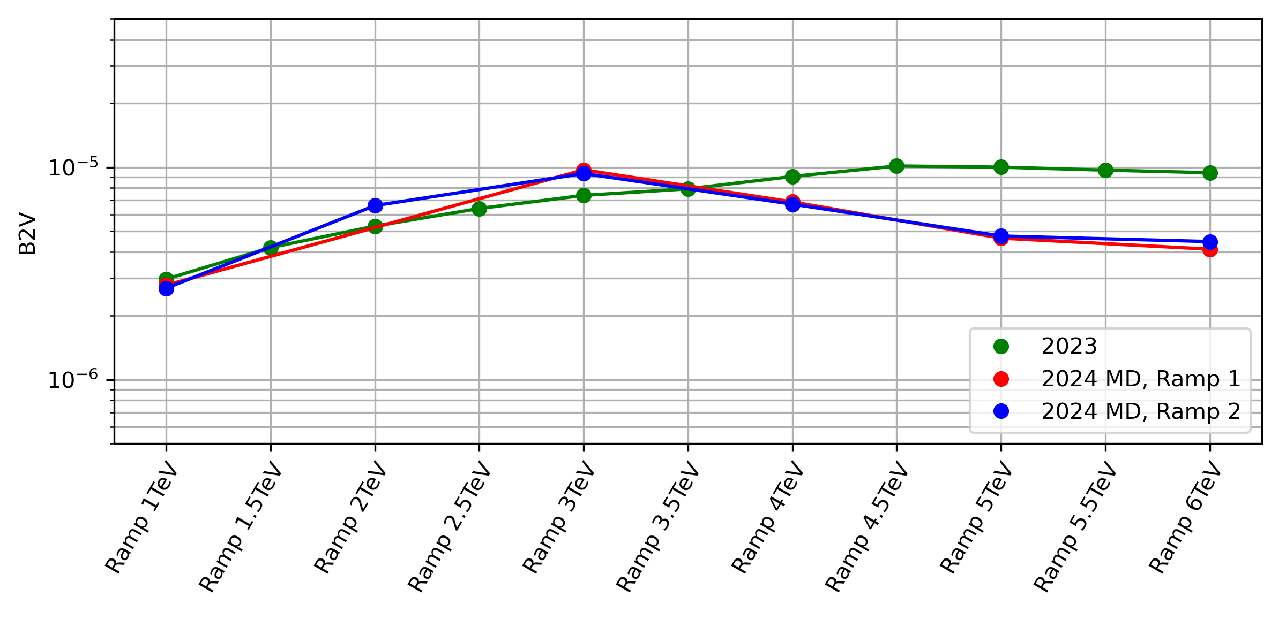
Cleaning during ramp
No issues observed in betatron loss maps
DS cleaning starts improving around 3 TeV as IR7 desqueeze kicks in
N. Triantafyllou

Slide 46
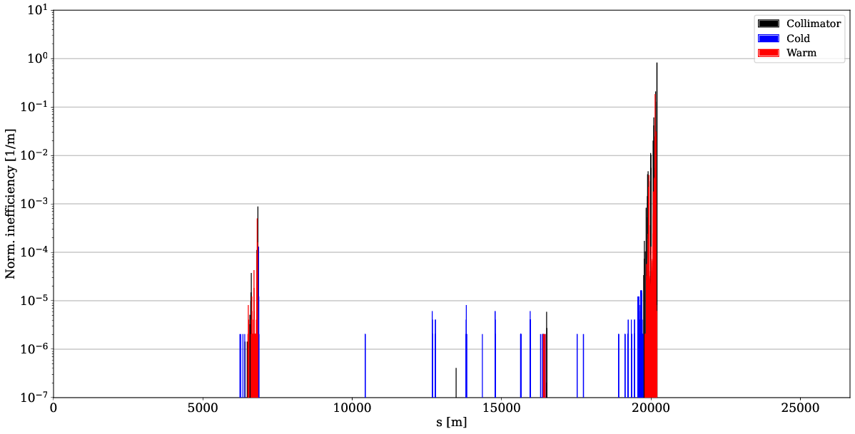
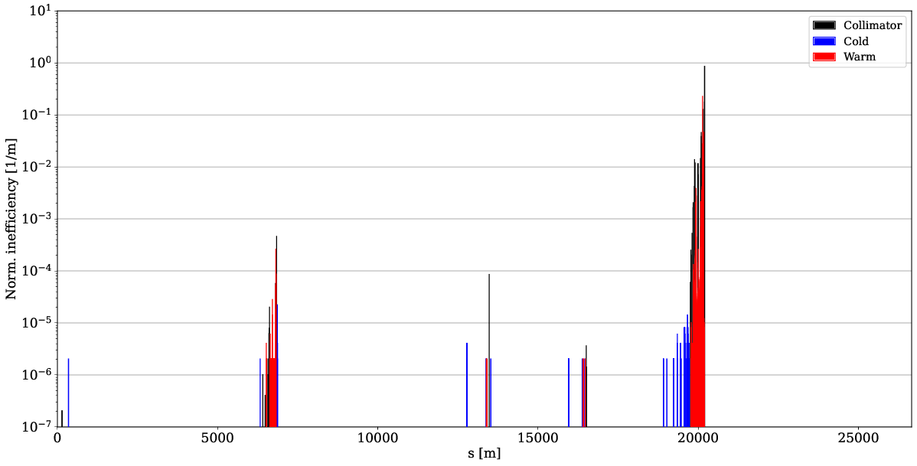
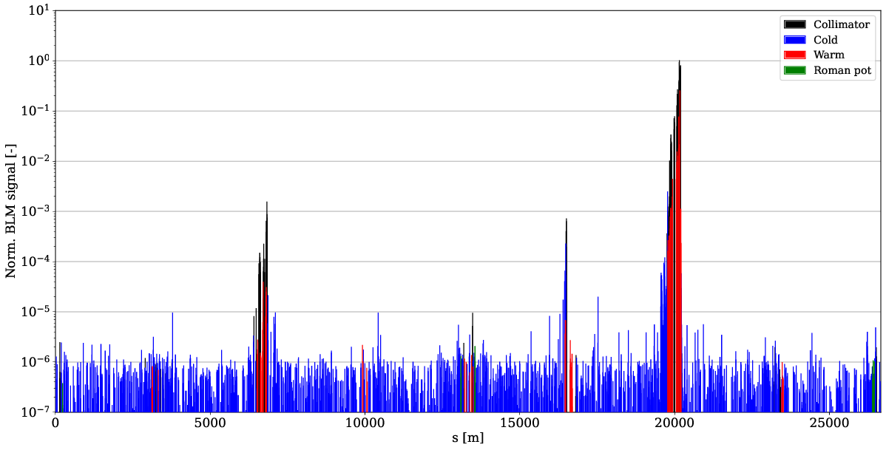
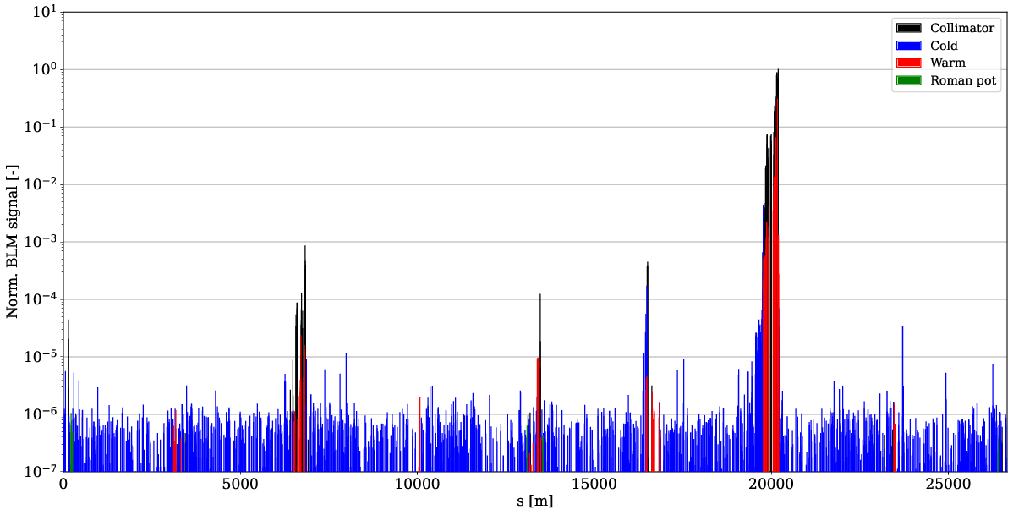
TCT losses – B2V
Increase of tertiary collimator (TCT) losses
TCT power load / detector background should be evaluated
Can be mitigated with phase advance from TCP to TCT
nominal sim.
IR7 MD sim.
nominal meas.
IR7 MD meas.

Slide 47
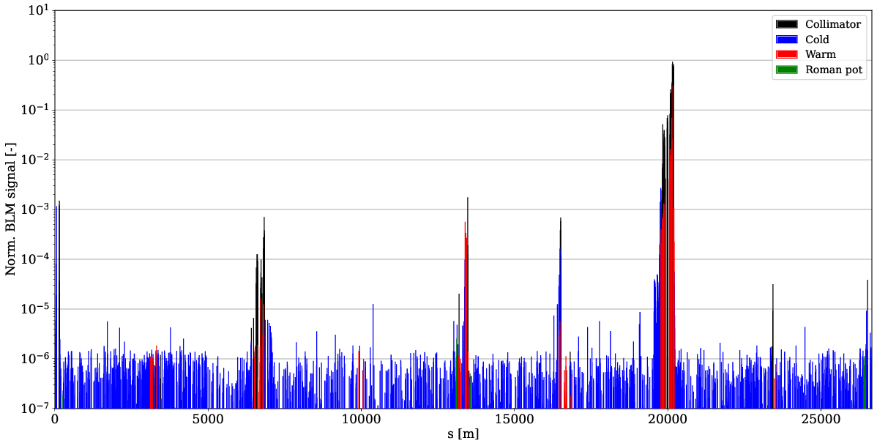
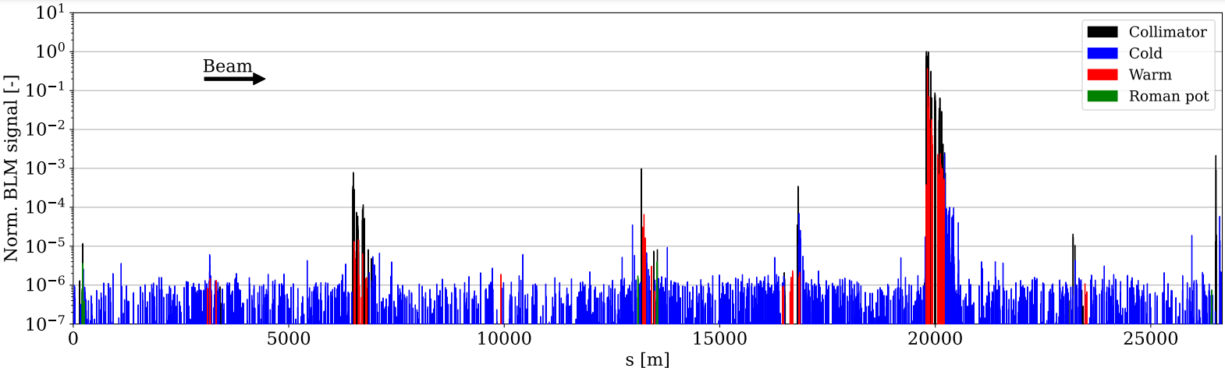
Tight TCT settings
Worst TCT losses in 2024 operation IR1 for B1H
Similar to HL MD optics
Only B2 measurements with tight TCT
Phase advance not yet optimized in the MD optics
In HL, TCTs in cell 6 as well
B2V: HL MD meas.
B1H: 2024 ref. meas.

Slide 48
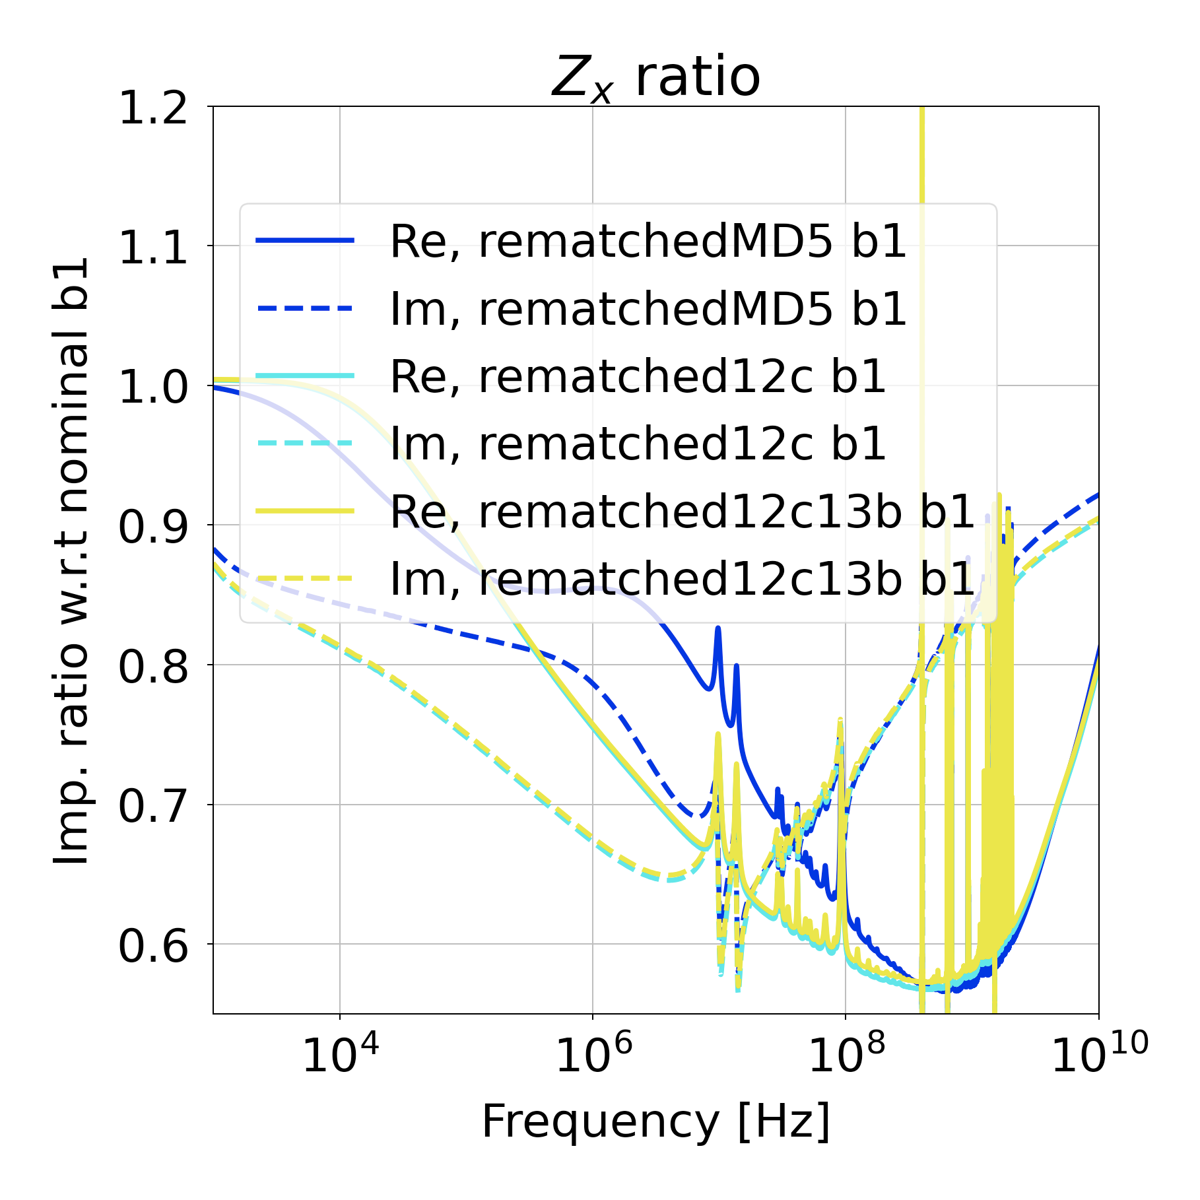
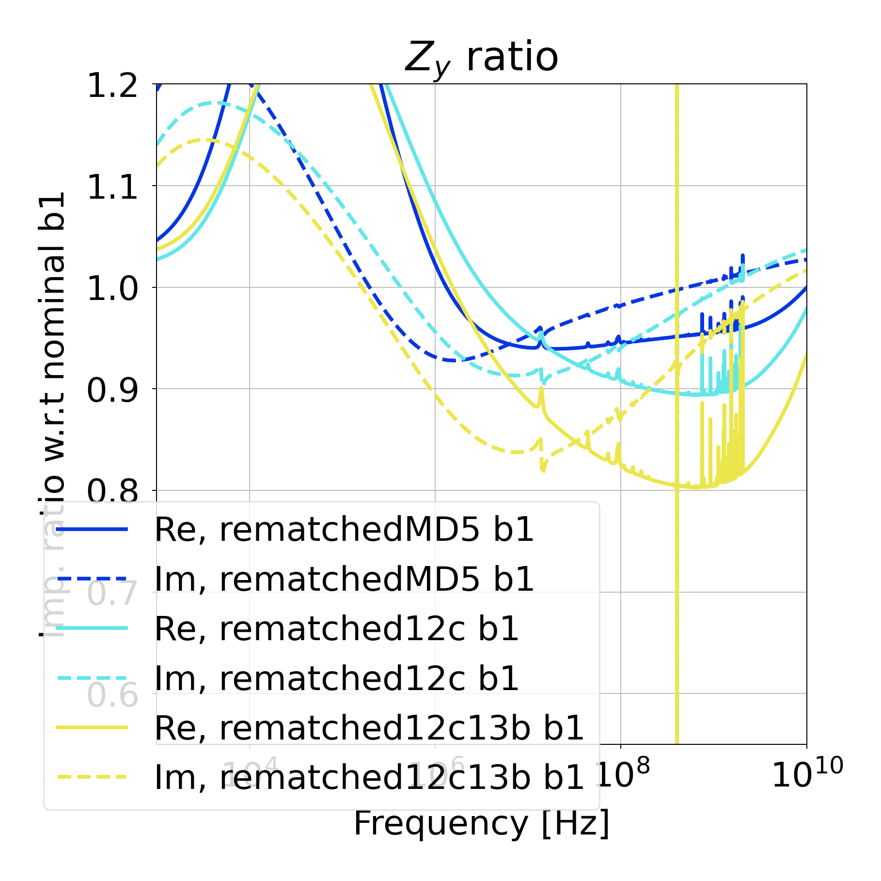
Impedance
Expecting > 40 % gain in H and 10-20 % in V in HL-LHC*
Measurement results:
B1H signal too noisy to measure due to unrelated HW issue
Impedance remeasured in 2025 – analysis pending
 | B1H | B1V | B2H | B2V
IR7 MD | 4 % | 26 % | 33 % | 19 %
* L. Giacomel https://indico.cern.ch/event/1421594/contributions/5979671/

Slide 49
Outline
Introduction
LHC collimation, beam losses
HL challenges and mitigations
New optics for protons
Simulations
Experiments
Other optics studies
Crystal collimation
IR3 impedance

Slide 50
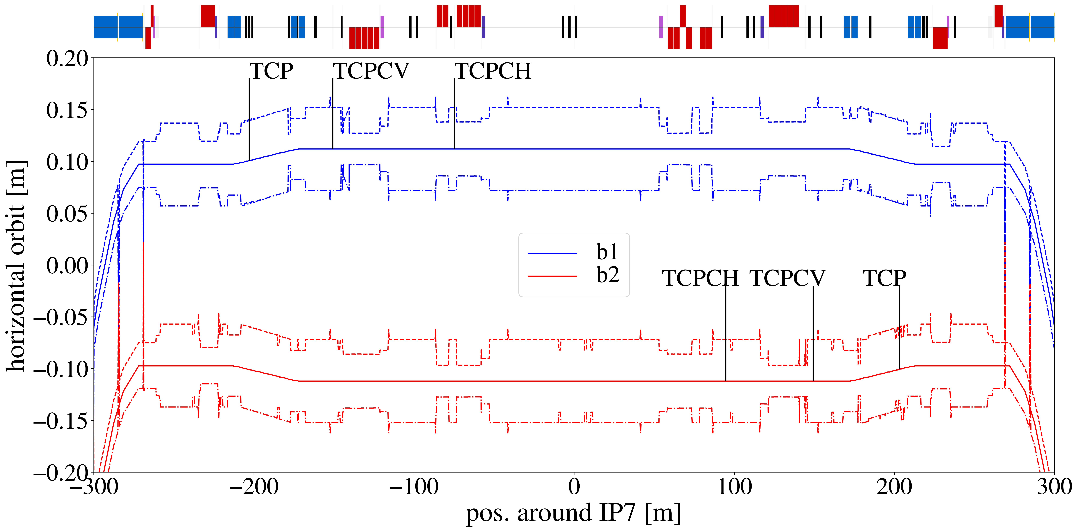
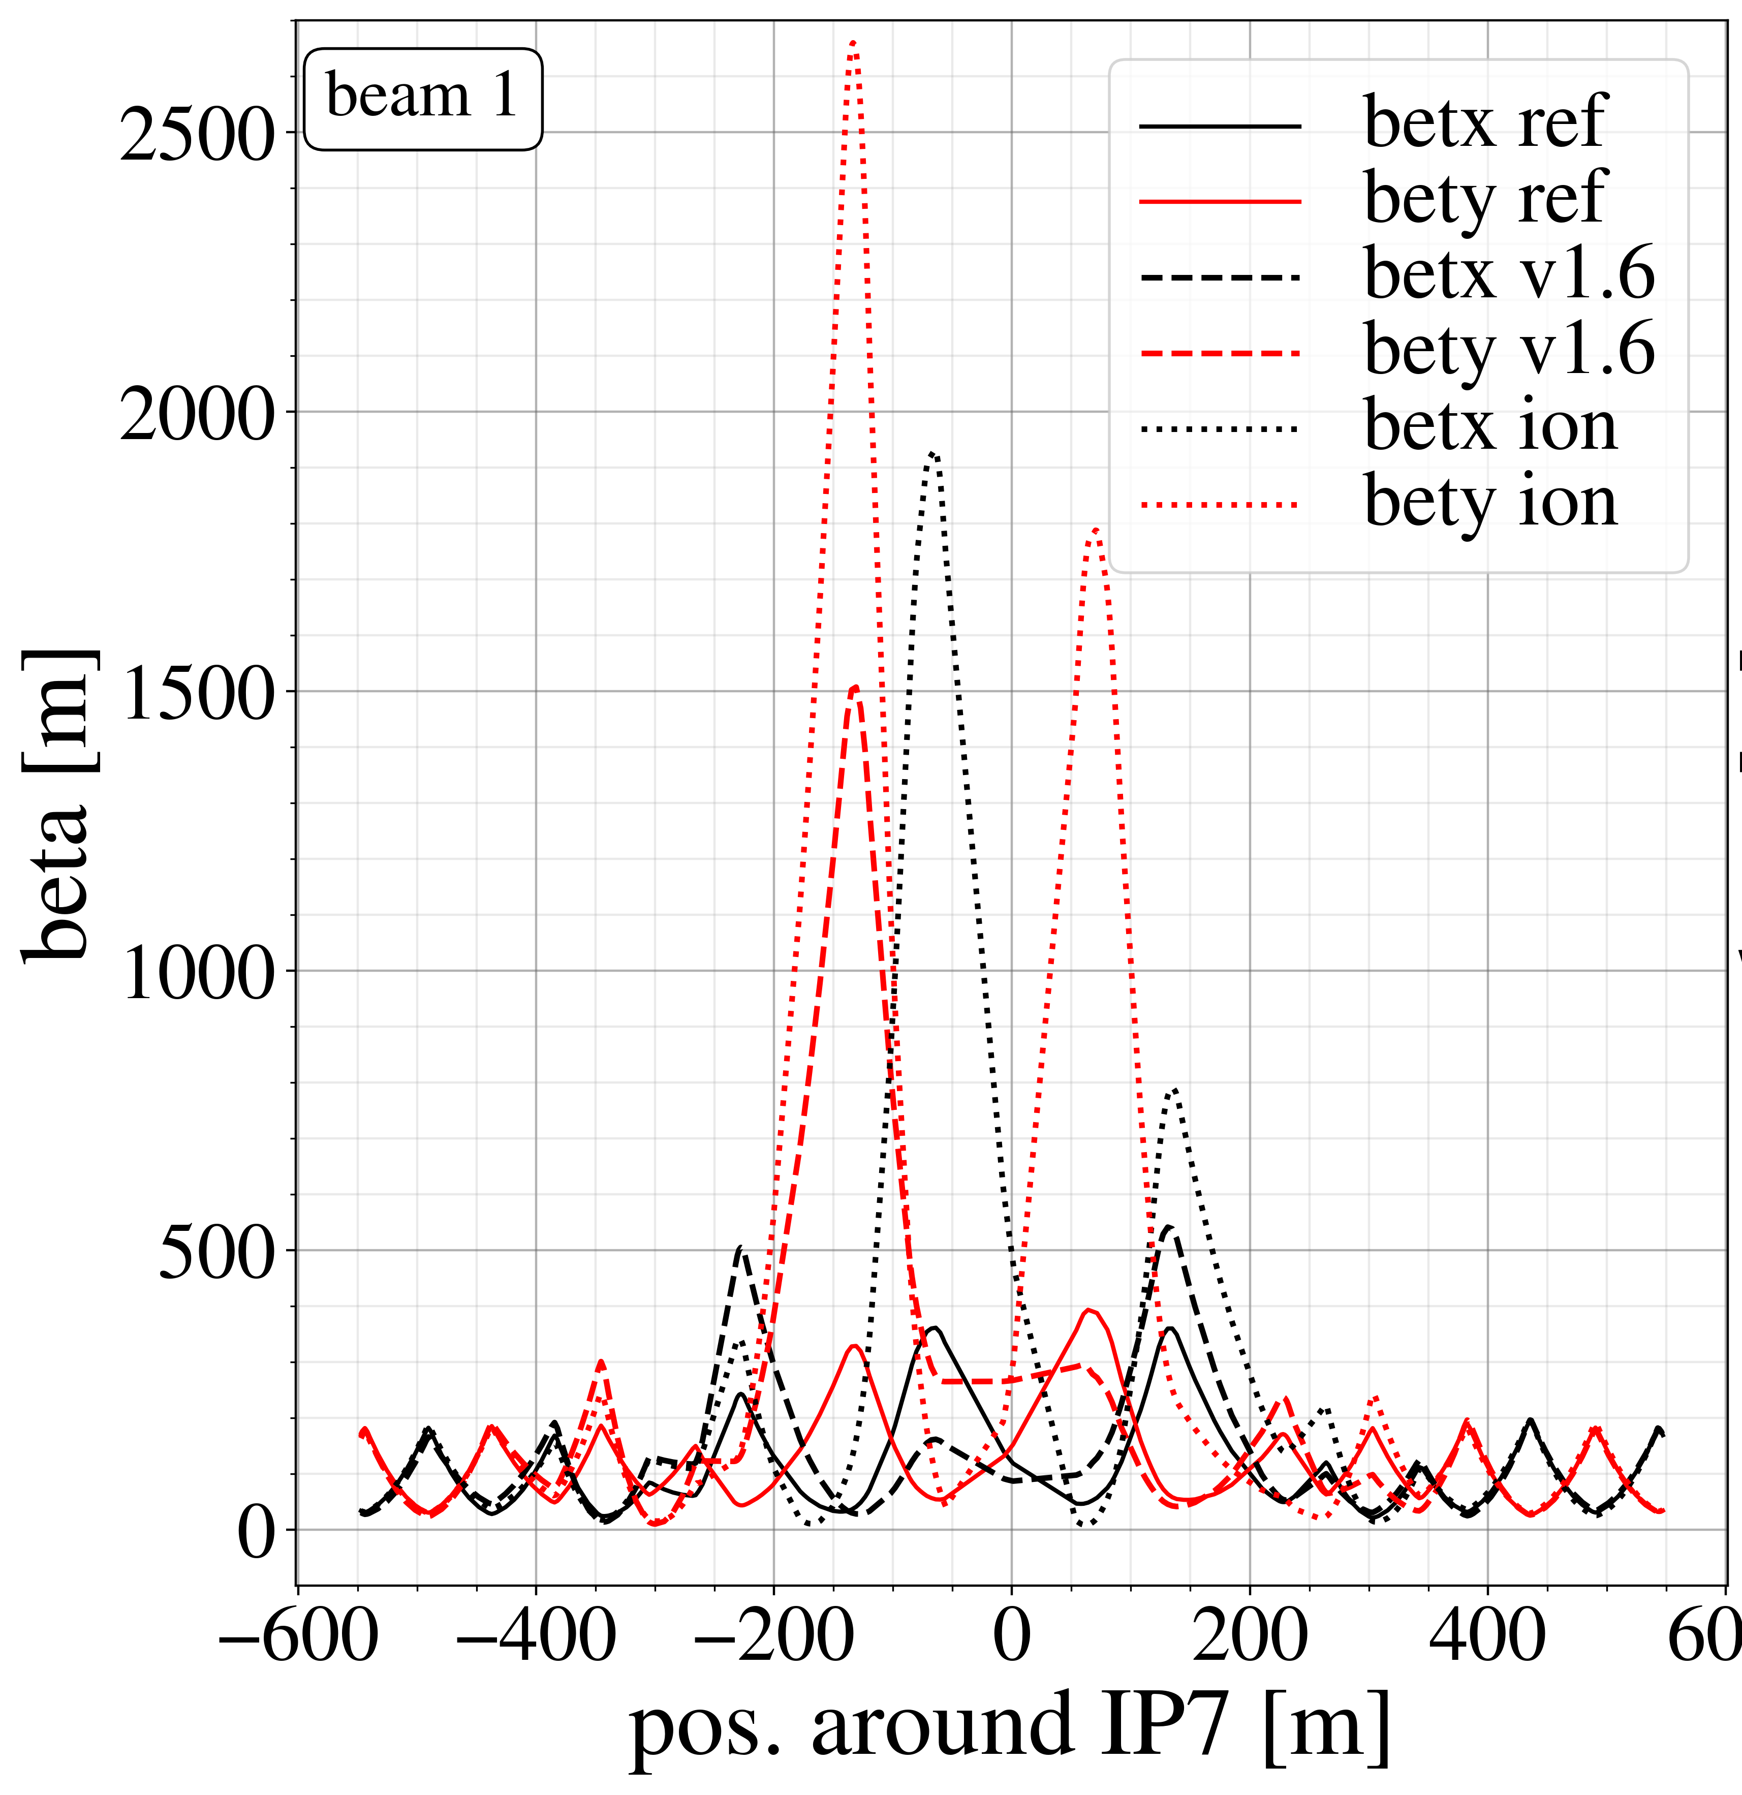
Crystal collimation
Crystal collimators used for heavy ions to mitigate lack of 11T dipole
Can it be improved further with dedicated optics?
Crystals placed downstream of D3 magnet → no single-pass dispersion to clean out off-momentum particles
Increase beta function and use orbit correctors for dispersion

Slide 51
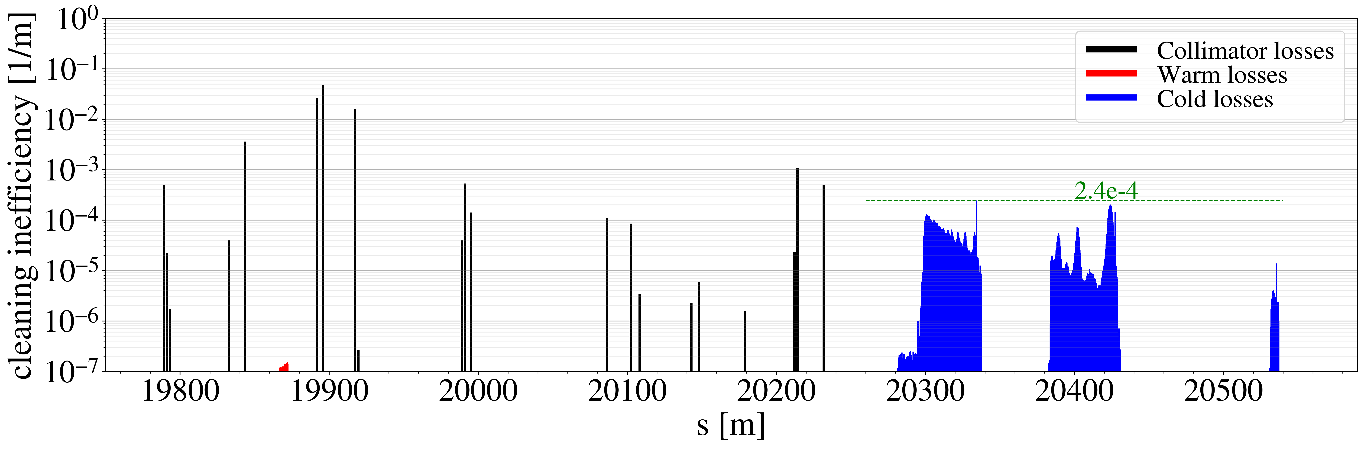
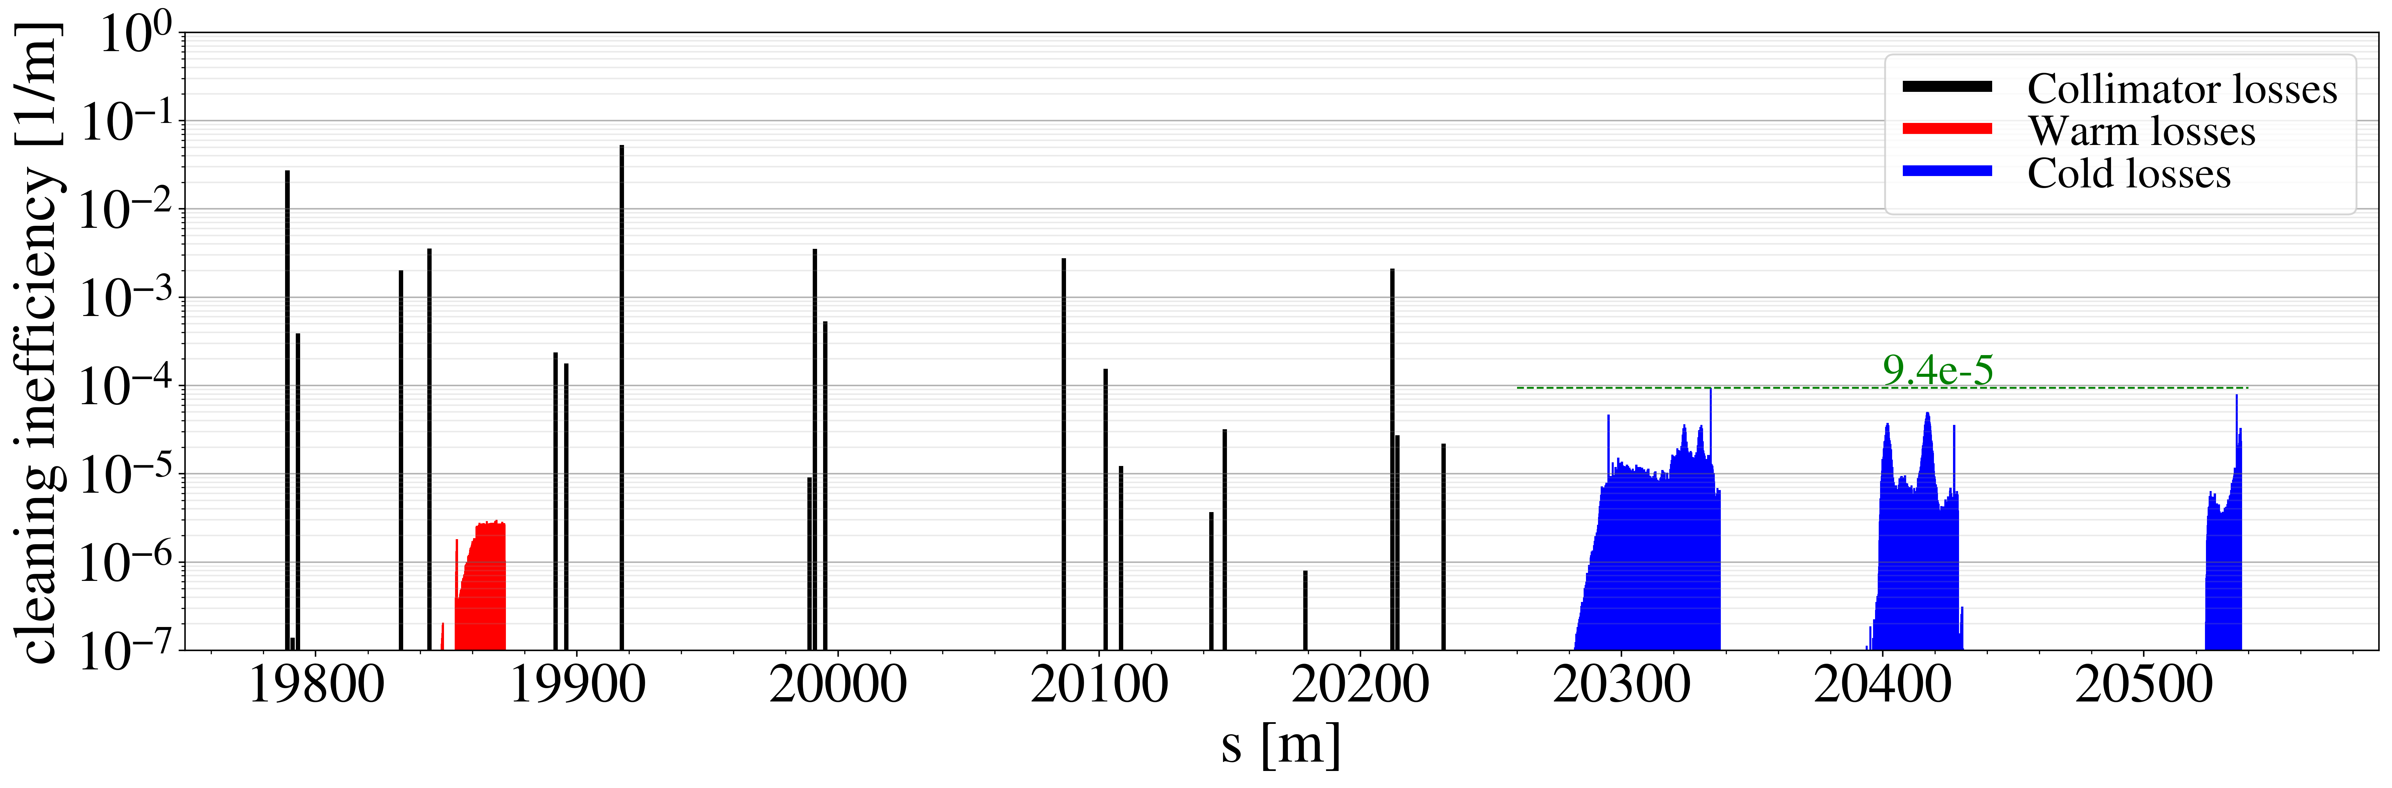
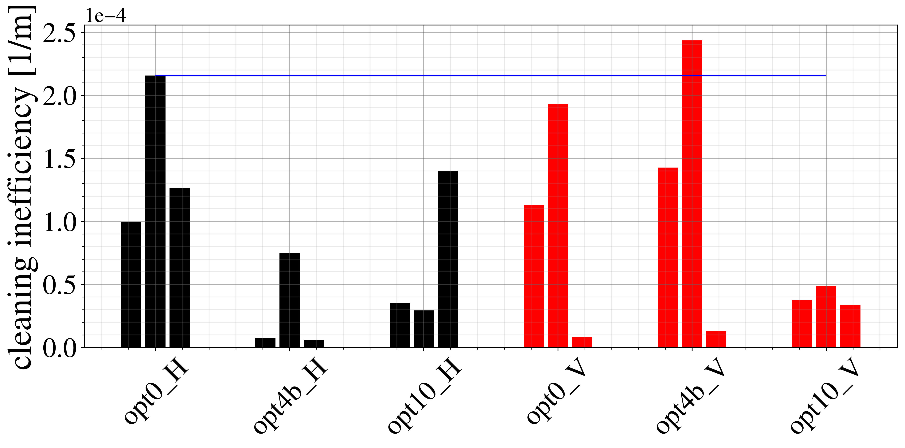
Simulated loss map (B1V)
Simulations indicate potential for significant improvements
MD requested for Pb ion run
n.b. optics are still under study

Slide 52
New IR3 optics
IR3
IR7
Momentum cleaning (IR3)
Particles with large momentum offsets
Betatron cleaning (IR7)
Particles with large betatron amplitudes

Slide 53
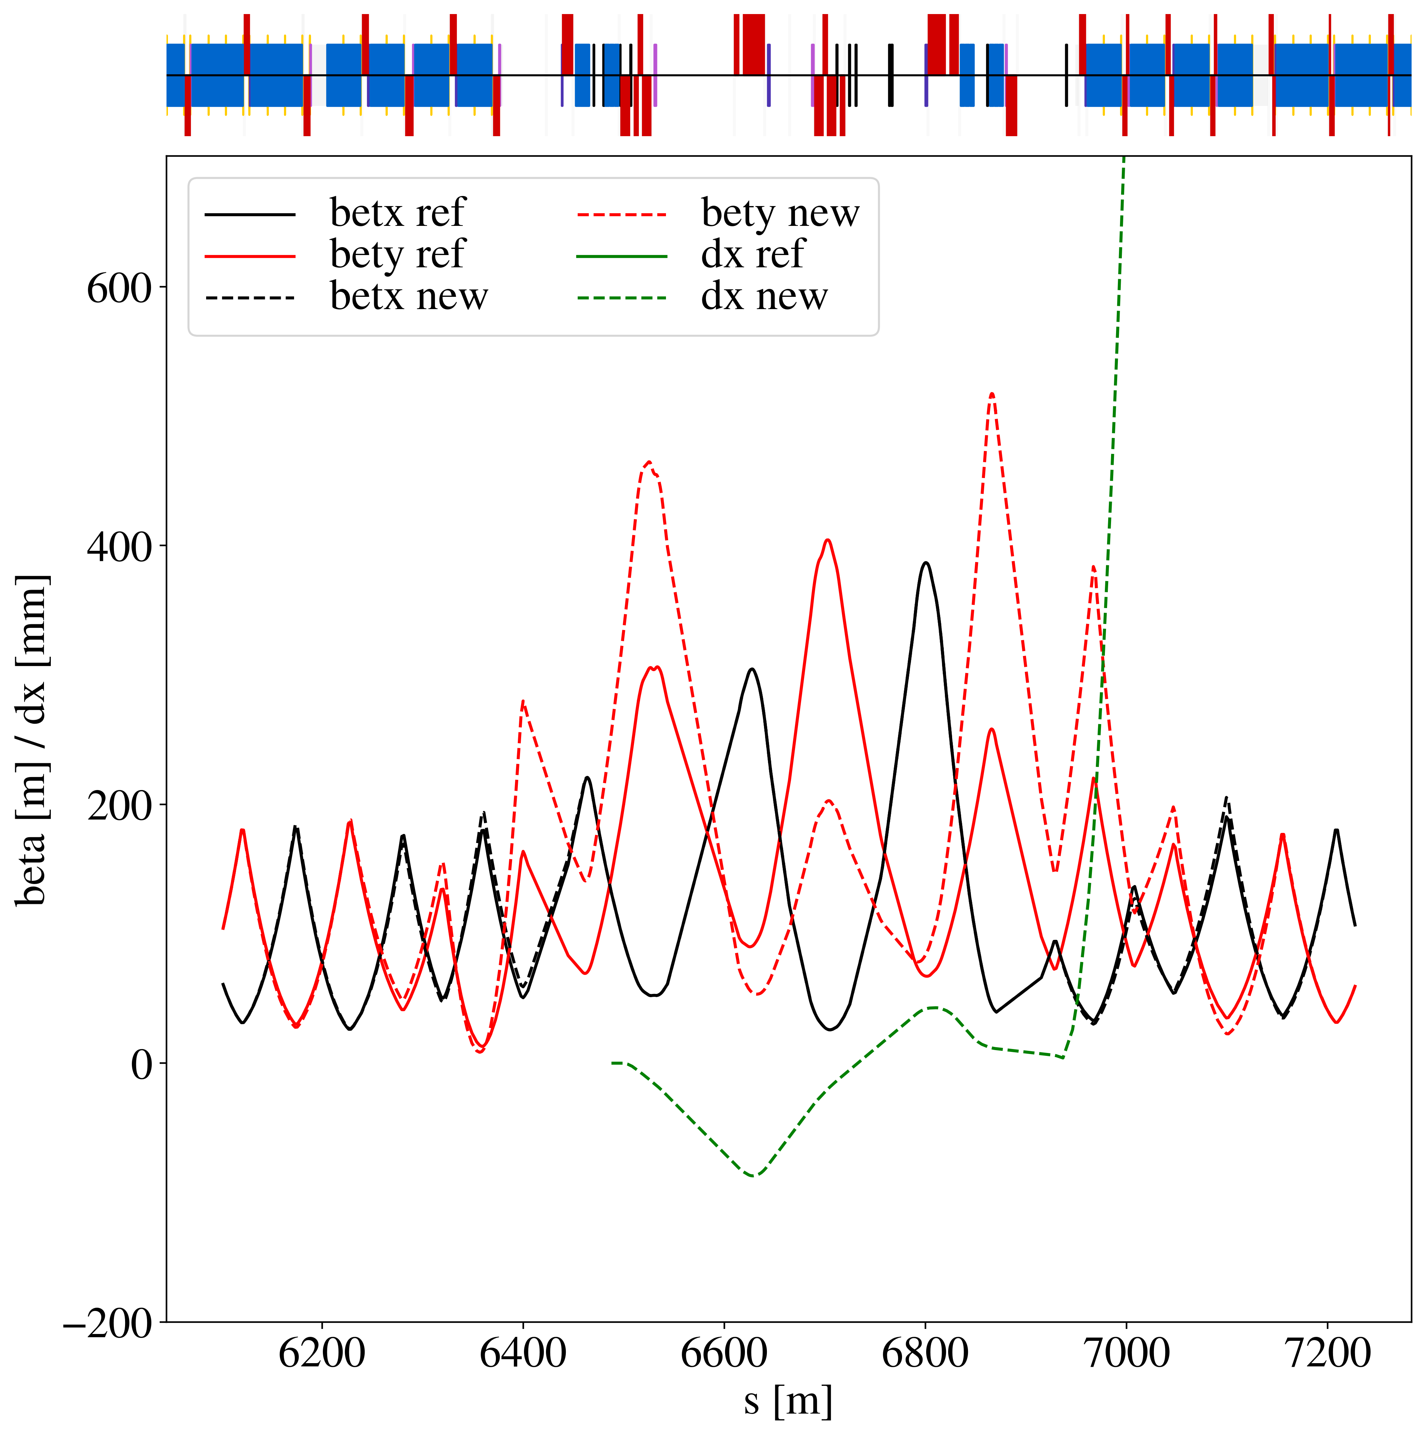
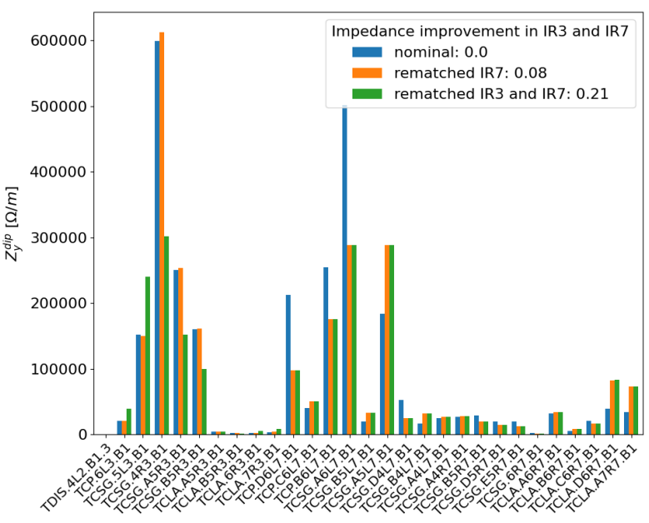
New IR3 optics
One single collimator creates majority of impedance due to small horizontal gap and large vertical beta function
B1
IR3 collimation is mostly horizontal
Idea: reduce problematic vertical beta peak, while keeping horizontal plane unchanged
L. Giacomel

Slide 54
Conclusions
New collimation optics developed for first time in LHC (since 2008)
Mitigates critical HL-LHC challenges: impedance and collimation cleaning
Included in HL-LHC baseline optics
Very promising measurements on cleaning performance
DS leakage cut by factor of ~2
Significant reduction of impedance by 19 – 33 %
B1H could not be measured
Remeasured in 2025 – analysis ongoing
Need combined ramp & desqueeze
No issue with low intensity beams
High intensity beam test scheduled for MD2
HL-LHC collimation settings tested
Unexpectedly large worsening with relaxed settings – analysis ongoing and further tests planned
Dedicated optics for crystal collimation shows significant potential

Slide 55
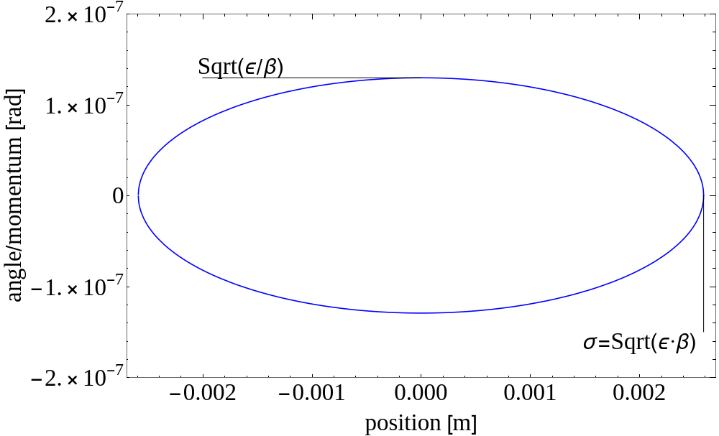


Beam sensitivity to perturbations
Constant area: $π⋅ε$

Slide 56
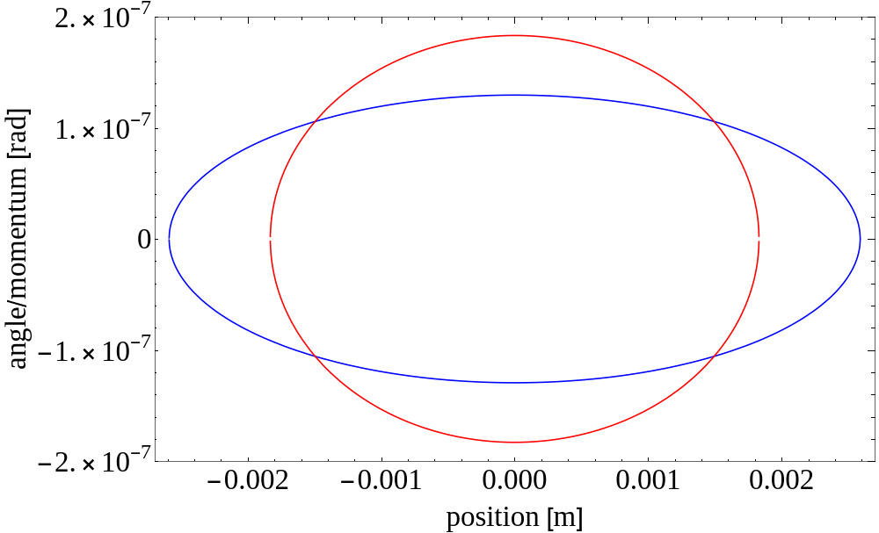
Beam sensitivity to perturbations
Ellipse at location with smaller beta function, area is the same

Slide 57
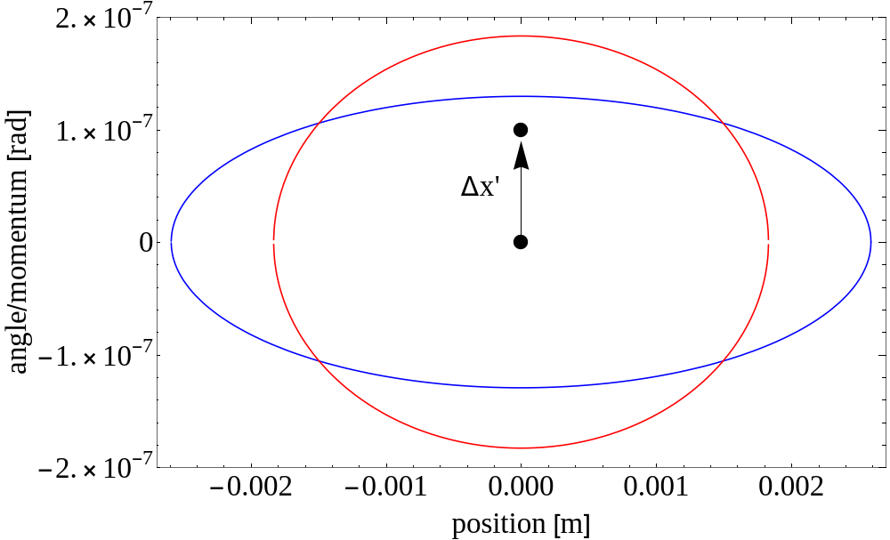
Beam sensitivity to perturbations
A particle receives a kick

Slide 58

Beam sensitivity to perturbations
Particle traces out ellipse in phase space

Slide 59

Beam sensitivity to perturbations
Particle at other location traces out different ellipse

Slide 60

Beam sensitivity to perturbations
Observe Red particle at Blue location, transforms the ellipse
Amplitude of particle kicked at Red location smaller than particle kicked at Blue location. This is because of the beta function

Slide 61

Beam sensitivity to perturbations
Observe Red particle at Blue location, transforms the ellipse
Amplitude of particle kicked at Red location smaller than particle kicked at Blue location. This is because of the beta function
$$\left(\begin{matrix}x_{n} \\ x_{n}^{′}\end{matrix}\right)=\frac{1}{\sqrt{ε}}\left(\begin{matrix}\frac{1}{\sqrt{β\left(s\right)}} & 0 \\ \frac{α\left(s\right)}{\sqrt{β\left(s\right)}} & \sqrt{β\left(s\right)}\end{matrix}\right)\left(\left(\begin{matrix}x \\ x′\end{matrix}\right)+\left(\begin{matrix}0 \\ Δx′\end{matrix}\right)\right)$$

