Slide 1
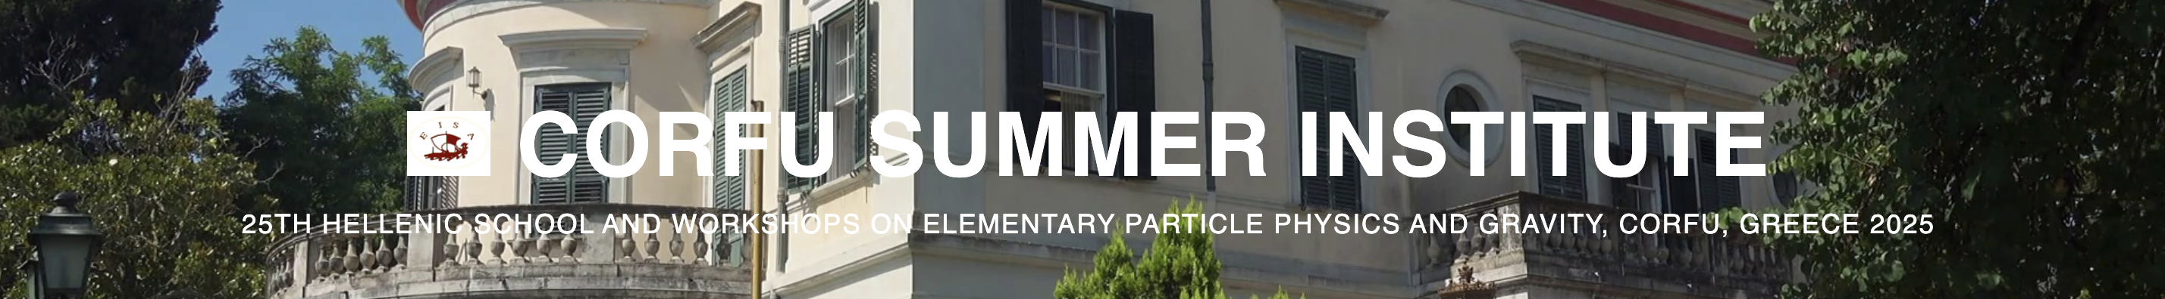

Gedenken Experiments of Entanglement in Particle Physics: Operators & Interactions?
Nausheen R. Shah
Workshop on the
Standard Model & Beyond 2025
EISA, Corfu Greece
Monday, August 25th

Slide 2
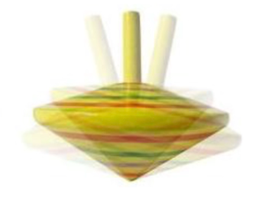

The Naturally UNNATURAL Standard Model of Particle Physics
Mystery of

Slide 3
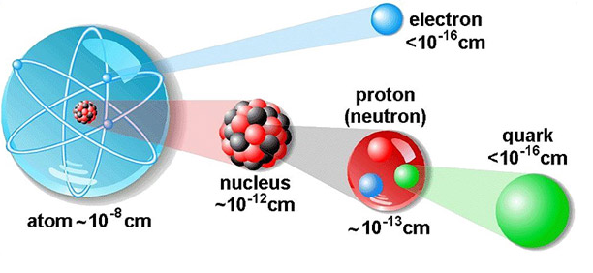
Particle physicists study the smallest pieces of matter…
… and their interactions.

Slide 4
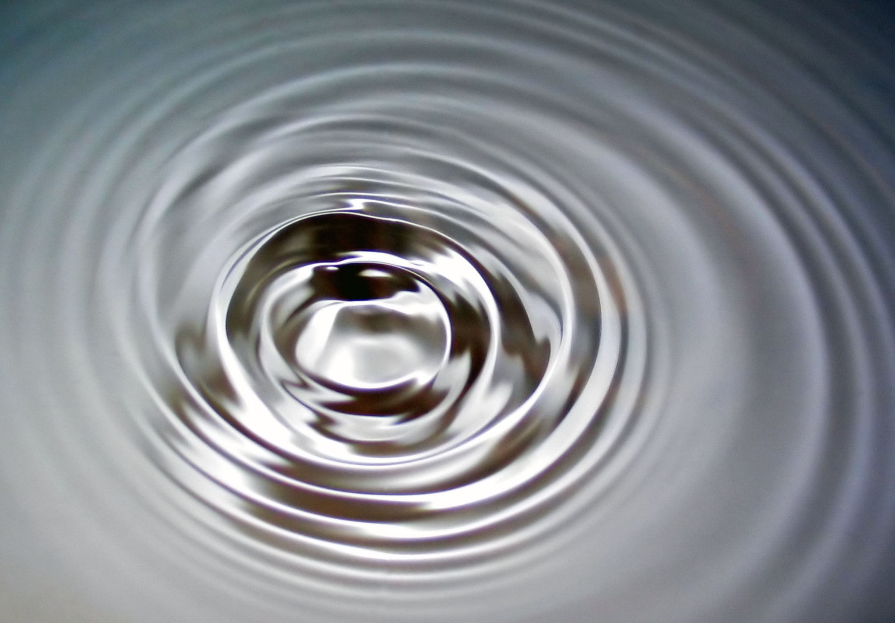
Big
Small
Classical Physics | Quantum Mechanics
Relativistic Physics | Quantum Field Theory
Slow
Fast
Natural Units:
m_{p} ~ 1 GeV ~ 2 x 10⁻²⁷ kg
Energy = 1 GeV ~ 2 x 10⁻¹⁰ J
Length = GeV⁻¹ ~ 0.2 x 10⁻¹⁵ m
Time = GeV⁻¹ ~ 10⁻²⁵ s
https://en.wikipedia.org/wiki/Capillary_wave#/media/File:2006-01-14_Surface_waves.jpg

Slide 5
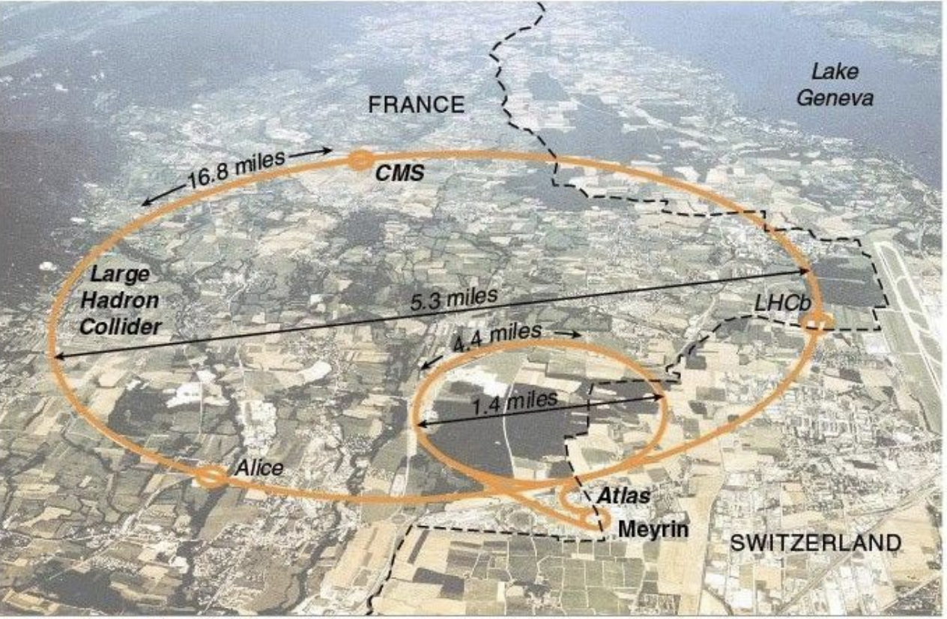
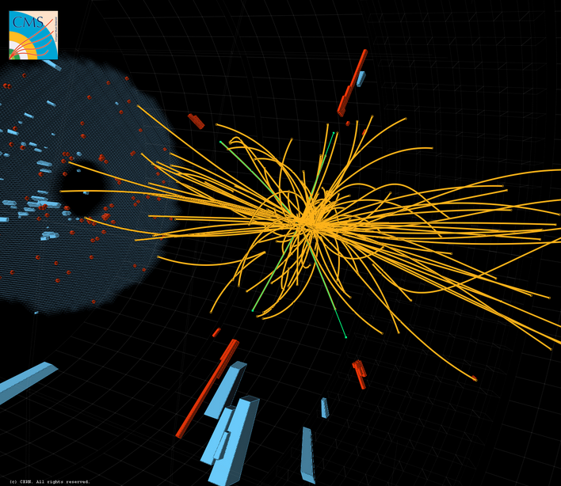
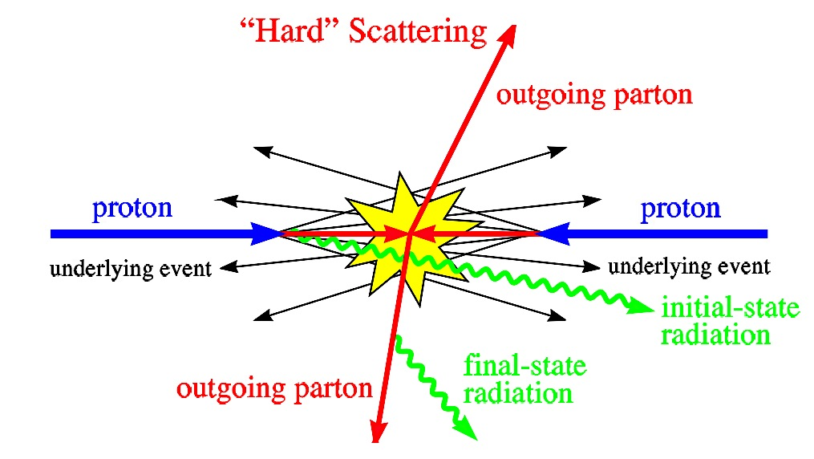
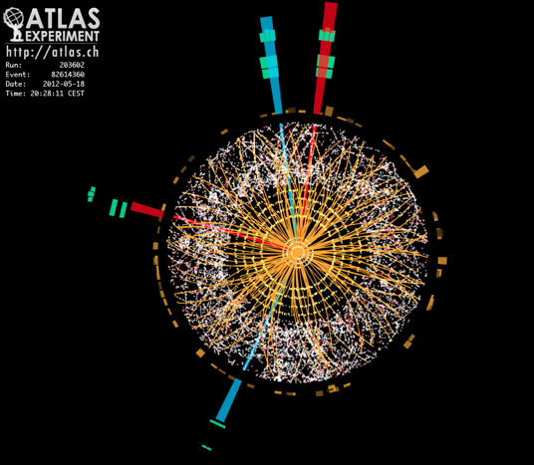
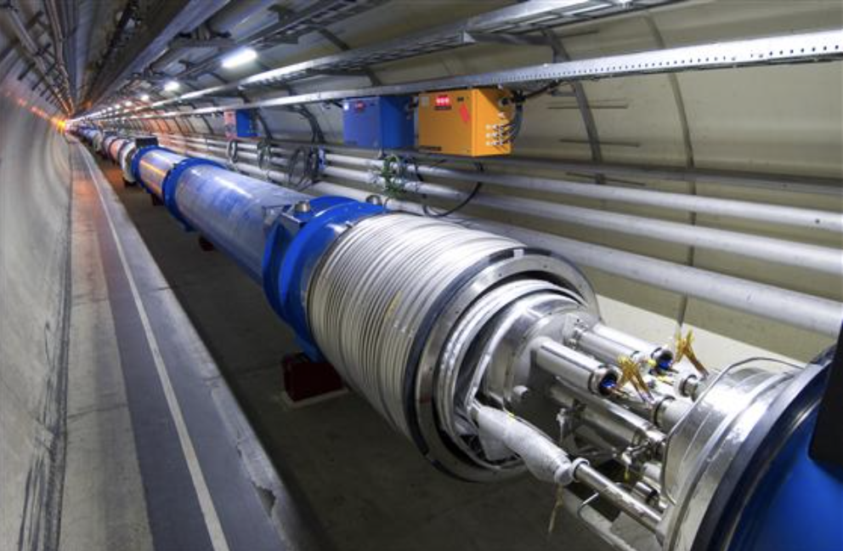
The Large Hadron Collider.
https://www.extremetech.com/extreme/210215-extremetech-explains-what-is-the-large-hadron-collider
https://home.cern/resources/faqs/facts-and-figures-about-lhc

Slide 6
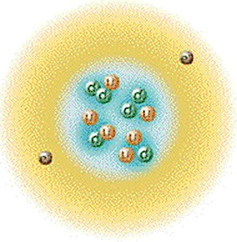
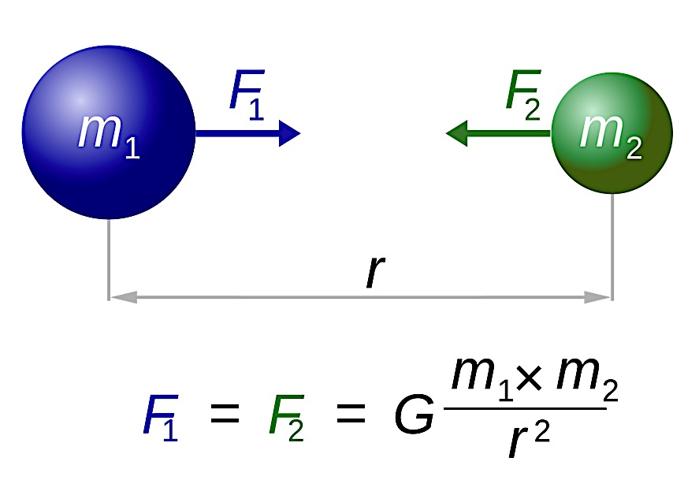
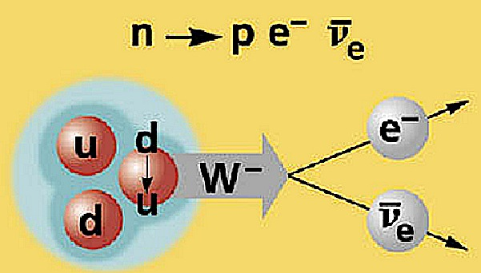
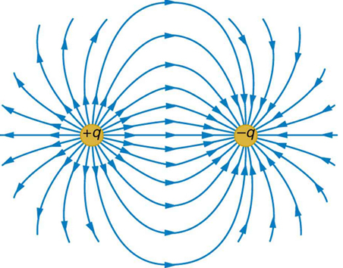
Forces in Nature.
Gravity
Electromagnetism
Strong Force
Weak Force
Attractive force between two massive objects.
Attracts particles of opposite charge, between and within atoms.
Is mediated by photons.
Binds protons and neutrons to form atomic nuclei.
proton: uud
neutron: udd
Formed by 3 quarks bound together by gluons of the strong interactions.
Mediates particle transformations
e.g., β-Decay
Is mediated by massive W/Z bosons.

Slide 7
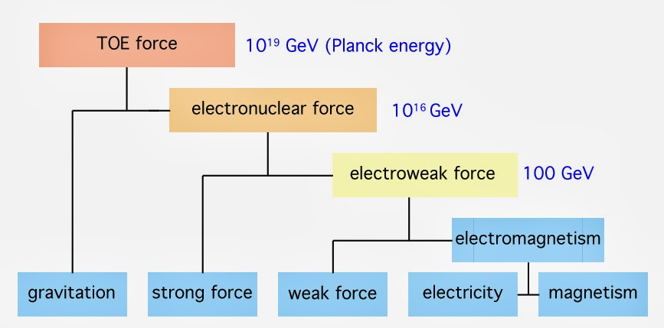
Big Picture
✓
why?
???
✓
What is Dark Matter?

Slide 8

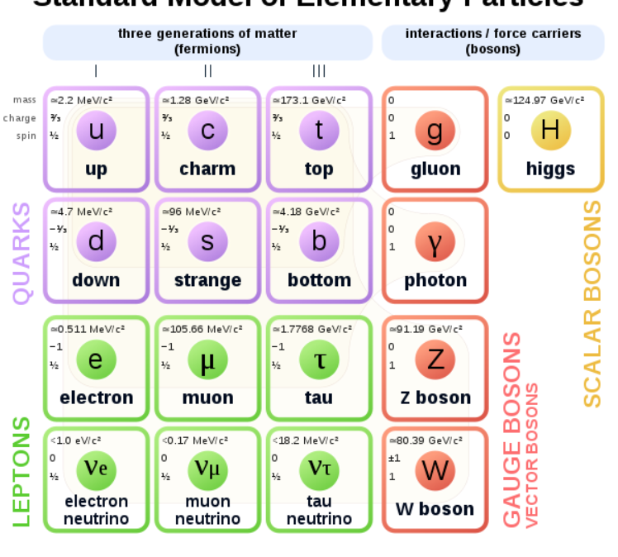
The Beloved Beautiful (& Unnatural) Standard Model
3 generations of matter
SU(3)_{C} x SU(2)_{L} x U(1)_{Y}
WHY????
https://en.wikipedia.org/wiki/Elementary_particle
Notes:
Emprical

Slide 9
The Beloved Beautiful (& Unnatural) Standard Model
Non-Minimal
Unnatural
Arbitrary Content
Arbitrary Masses
Arbitrary Mixings
Arbitrary Higgs Mechanism
https://en.wikipedia.org/wiki/Elementary_particle

Slide 10
The Beloved Beautiful (& Unnatural) Standard Model
e_{L}
e_{R}
X
m_{e}
Only Left handed fermions charged under the weak SM gauge group.
Fermion and gauge boson masses FORBIDDEN by symmetry.

Slide 11

The MOST RANDOM System
The MOST SYMMETRIC System
SYMMETRIES
ENTROPY??
CONSERVATION LAWS

Slide 12
Entanglement in Particle Physics?

Slide 13
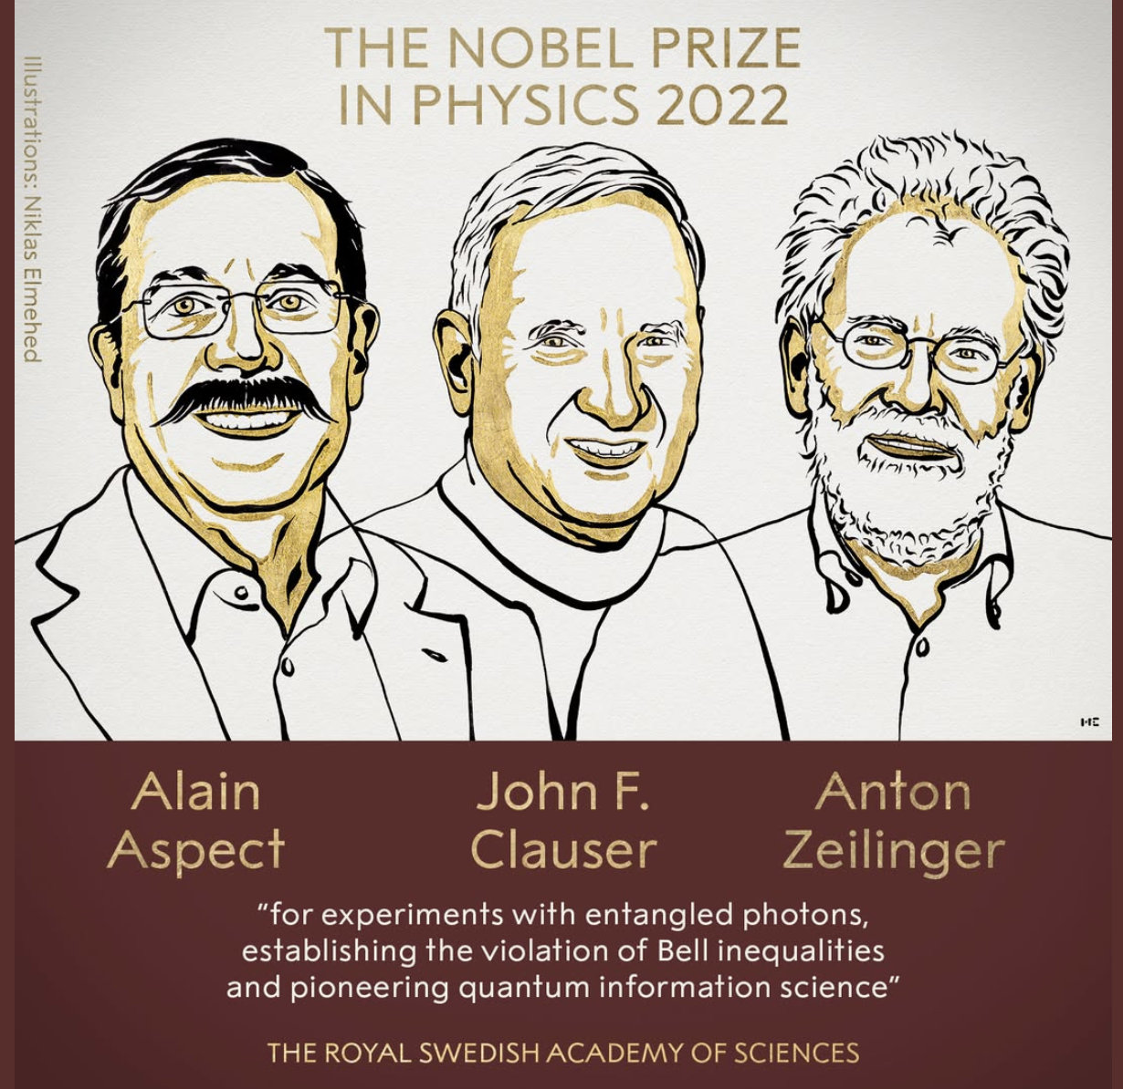
Bell’s Inequality & Entanglement
Increasingly important for
Quantum Computing etc.
NOTHING I will say will
have anything to do with that!

Slide 14

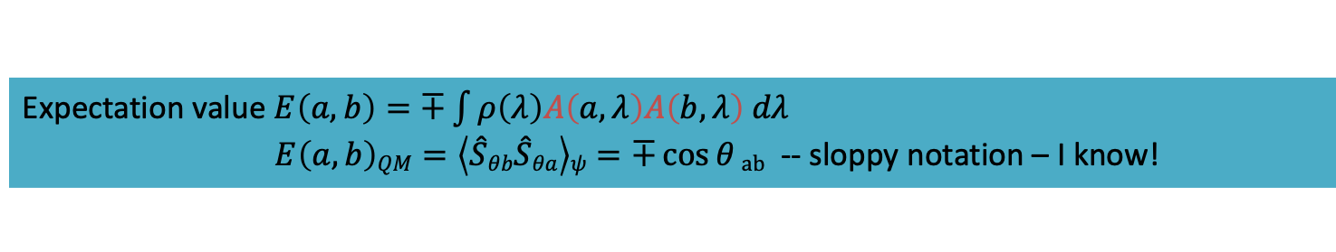

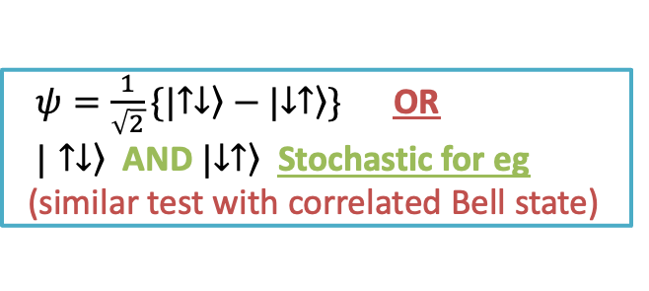



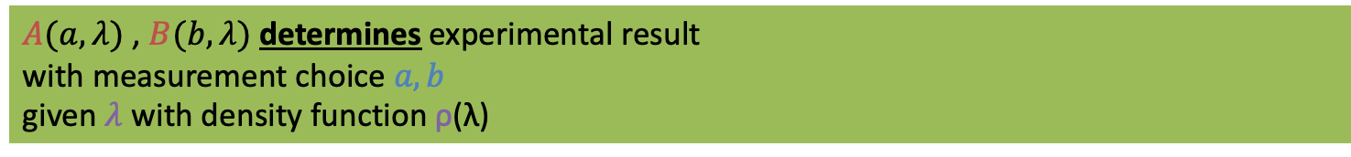
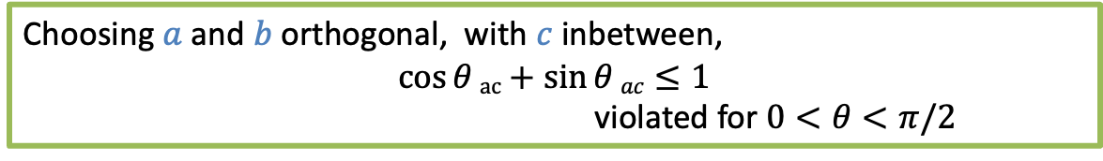
Bell’s Inequality
$ψ=\frac{1}{\sqrt{2}}\{|\left.↑↓\right\rangle −|\left.↓↑\right\rangle \}$ ΟR
$\left.|↑↓\right\rangle$ AND $|\left.↓↑\right\rangle$ Stochastic for eg
(similar test with correlated Bell state)
Assume LOCAL hidden variable theory (LHVT) with hidden variable $λ$
$A(a,λ)$ , $B(b,λ)$ determines experimental result
with measurement choice $a,b$
given $λ$ with density function ρ(λ)
$A\left(a,λ\right)=±1$ , $B\left(b,λ\right)=±1$
“Spooky Action at a distance”
Anti-correlated: $A\left(a,λ\right)=−B\left(a,λ\right)=1$
Correlated: $A\left(a,λ\right)=B\left(a,λ\right)=1$
Expectation value $E\left(a,b\right)=∓\int{ρ\left(λ\right)A\left(a,λ\right)A\left(b,λ\right) dλ}$
$E\left(a,b\right)QM=\left\langle \hat{S}θb\hat{S}θa\right\rangle ψ=∓\cos{θ}ab$ -- sloppy notation – I know!
Bell’s Inequality (BI) : $\left|E\left(a,b\right)−E\left(a,c\right) \right| ≤1±E\left(b,c\right)$
$$b$$
$$c$$
Choosing $a$ and $b$ orthogonal, with $c$ inbetween,
$$\cos{θ}ac+\sin{θ}ac≤1$$
violated for $0<θ<π/2$
$$θac$$
$$a$$

Slide 15
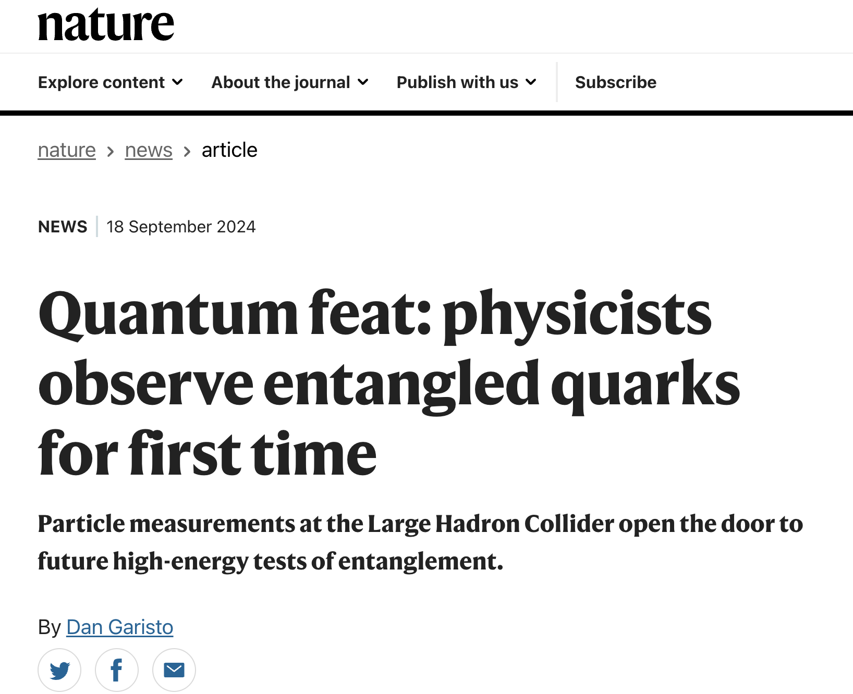
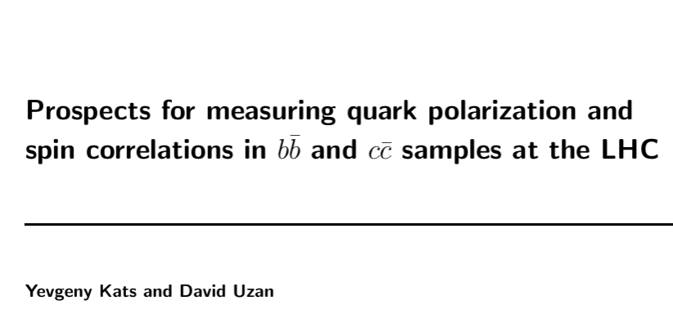
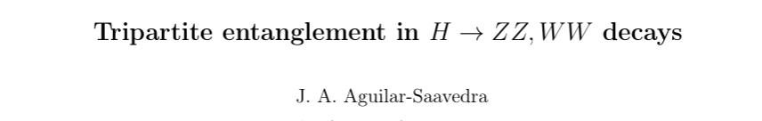
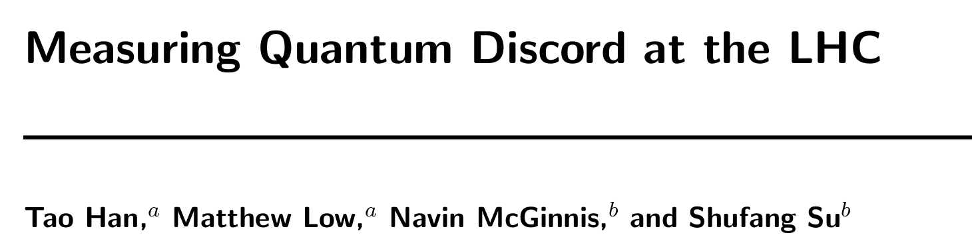
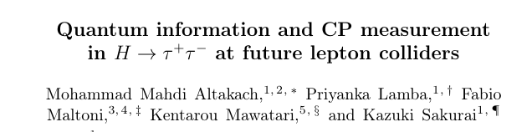
New Results @Colliders…
and many MANY MORE …

Slide 16
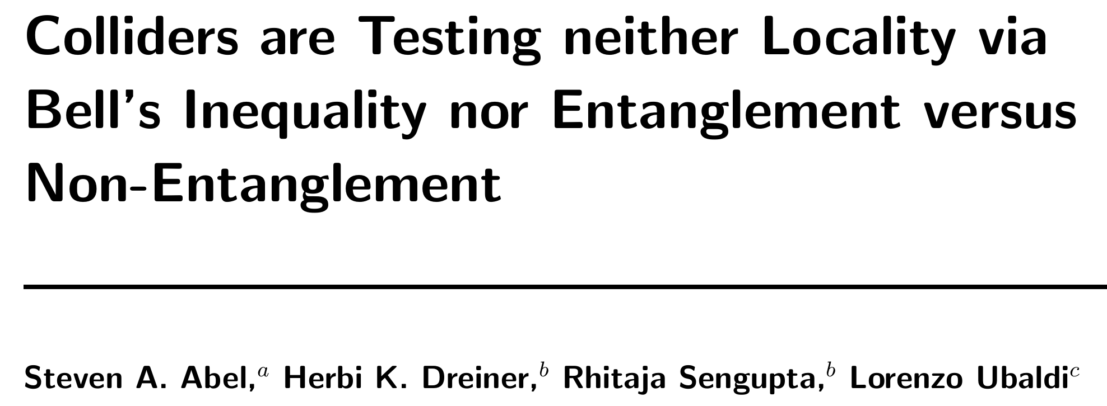
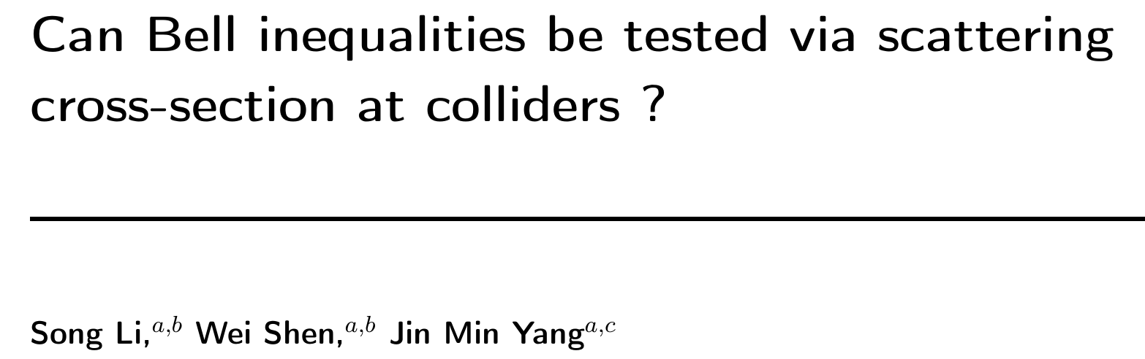
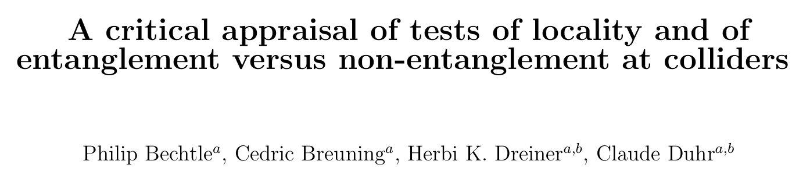
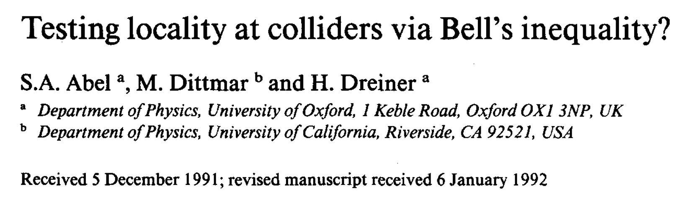
Really?

Slide 17
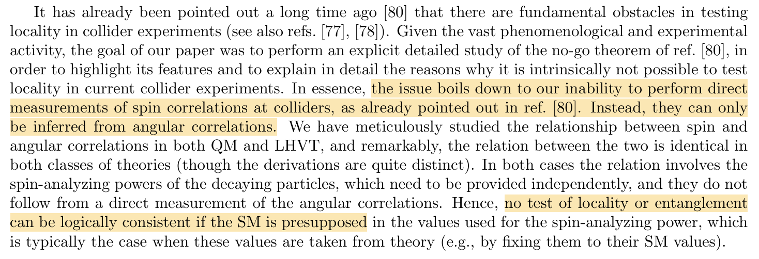
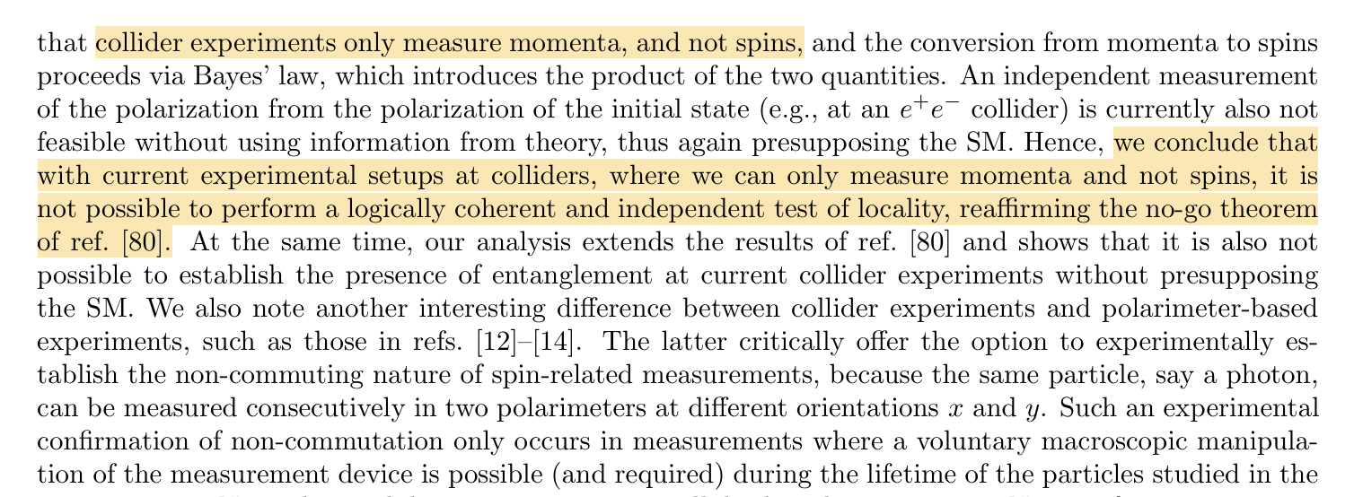
Basic Critique

Slide 18
But we only measure momentum…
We only “see” mass eigenstates…
Are there analogues of the spin operators in
the SM interactions?
MAYBE …
Gedenken Counting Experiments
ACTUAL value of observable doesn’t matter. Only that there are TWO distinguishable outcomes.
+1 -1

Slide 19
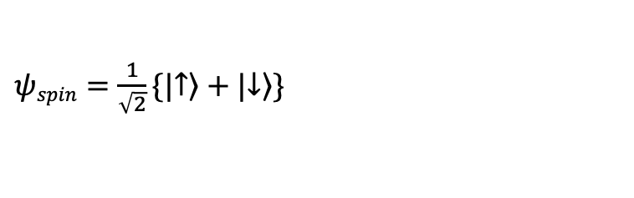
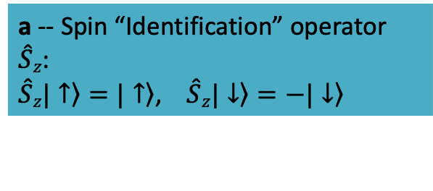
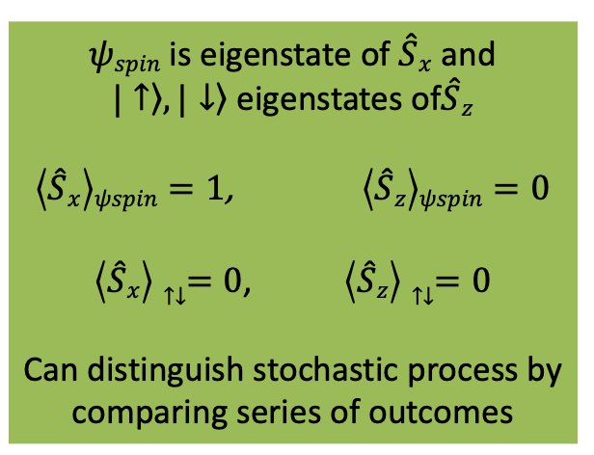
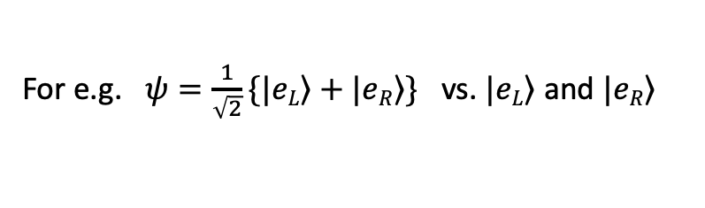
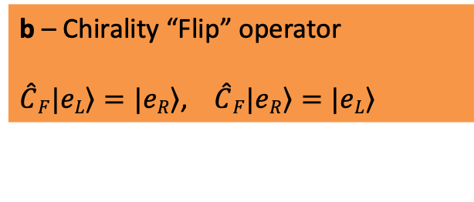
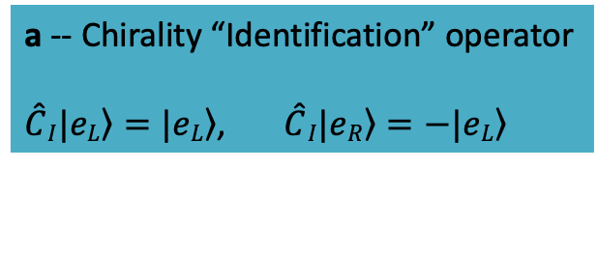
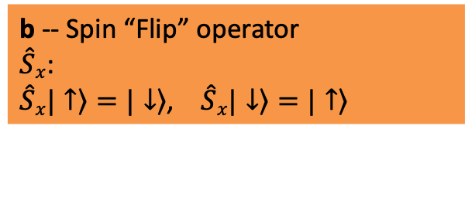
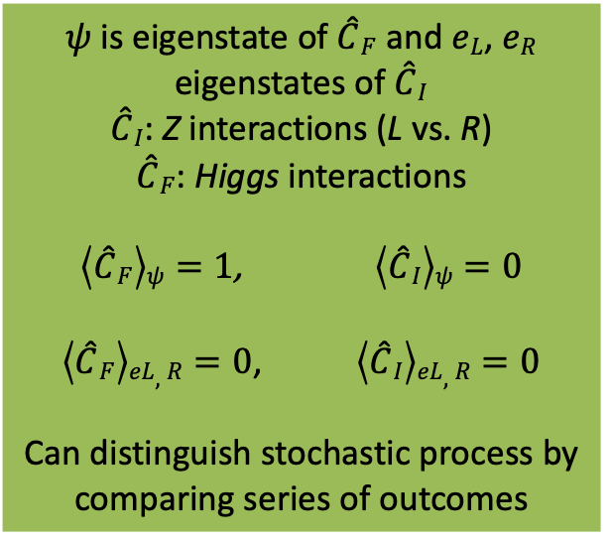
Single Particle Chirality Wave Functions
$ψspin=\frac{1}{\sqrt{2}}\{|\left.↑\right\rangle +|\left.↓\right\rangle \}$
For e.g. $ψ=\frac{1}{\sqrt{2}}\{|\left.eL\right\rangle +|\left.eR\right\rangle \}$ vs. $|\left.eL\right\rangle$ and $|\left.eR\right\rangle$
a -- Spin “Identification” operator
$\hat{S}z$:
$\hat{S}z\left.|↑\right\rangle =\left.|↑\right\rangle$, $\hat{S}z\left.|↓\right\rangle =−\left.|↓\right\rangle$
a -- Chirality “Identification” operator
$\hat{C}I\left.|eL\right\rangle =|\left.eL\right\rangle$, $\hat{C}I\left.|eR\right\rangle =−|\left.eL\right\rangle$
b -- Spin “Flip” operator
$\hat{S}x$:
$\hat{S}x\left.|↑\right\rangle =\left.|↓\right\rangle$, $\hat{S}x\left.|↓\right\rangle =\left.|↑\right\rangle$
b – Chirality “Flip” operator
$\hat{C}F\left.|eL\right\rangle =\left.|eR\right\rangle$, $\hat{C}F\left.|eR\right\rangle =\left.|eL\right\rangle$
$ψspin$ is eigenstate of $\hat{S}x$ and
$\left.|↑\right\rangle ,\left.|↓\right\rangle$ eigenstates of$\hat{S}z$
$\left\langle \hat{S}x\right\rangle ψspin=1$, $\left\langle \hat{S}z\right\rangle ψspin=0$
$\left\langle \hat{S}x\right\rangle ↑↓=0$, $\left\langle \hat{S}z\right\rangle ↑↓=0$
Can distinguish stochastic process by comparing series of outcomes
$ψ$ is eigenstate of $\hat{C}F$ and $eL$, $eR$ eigenstates of $\hat{C}I$
$\hat{C}I$: Z interactions (L vs. R)
$\hat{C}F$: Higgs interactions
$\left\langle \hat{C}F\right\rangle ψ=1$, $\left\langle \hat{C}I\right\rangle ψ=0$
$\left\langle \hat{C}F\right\rangle eL,R=0$, $\left\langle \hat{C}I\right\rangle eL,R=0$
Can distinguish stochastic process by comparing series of outcomes

Slide 20
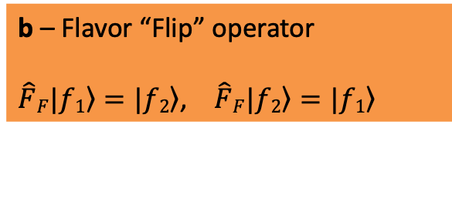
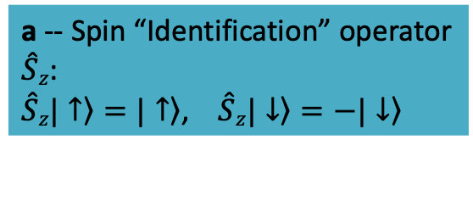
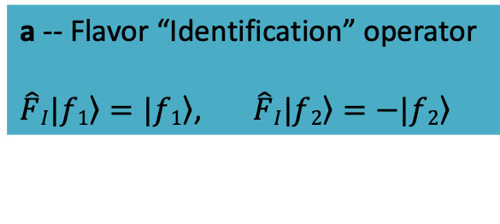
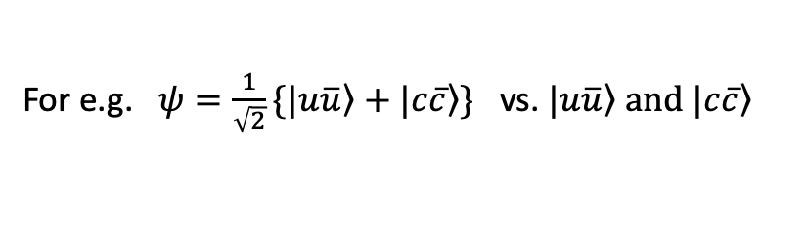
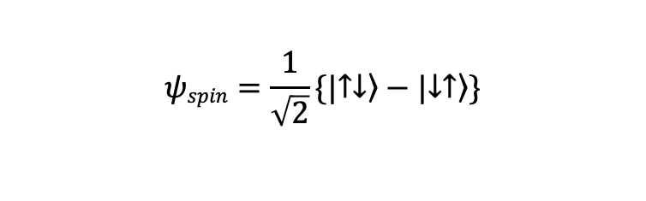
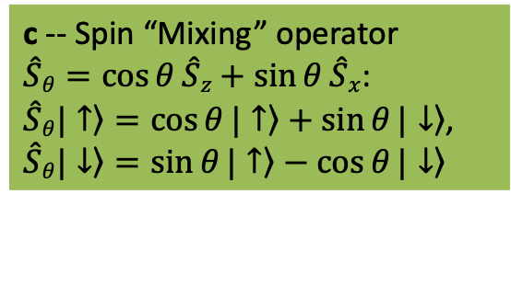
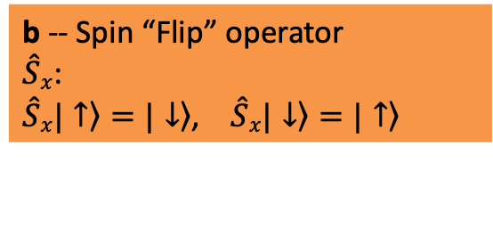
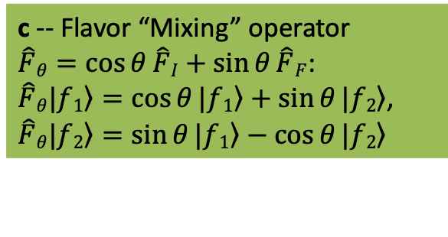
2-particle Flavor (generation) Wave Functions
$$ψspin=\frac{1}{\sqrt{2}}\{|\left.↑↓\right\rangle −|\left.↓↑\right\rangle \}$$
For e.g. $ψ=\frac{1}{\sqrt{2}}\{|\left.u\overline{u}\right\rangle +|\left.c\overline{c}\right\rangle \}$ vs. $|\left.u\overline{u}\right\rangle and |\left.c\overline{c}\right\rangle$
a -- Spin “Identification” operator
$\hat{S}z$:
$\hat{S}z\left.|↑\right\rangle =\left.|↑\right\rangle$, $\hat{S}z\left.|↓\right\rangle =−\left.|↓\right\rangle$
a -- Flavor “Identification” operator
$\hat{F}I\left.|f1\right\rangle =|\left.f1\right\rangle$, $\hat{F}I\left.|f2\right\rangle =−|\left.f2\right\rangle$
b -- Spin “Flip” operator
$\hat{S}x$:
$\hat{S}x\left.|↑\right\rangle =\left.|↓\right\rangle$, $\hat{S}x\left.|↓\right\rangle =\left.|↑\right\rangle$
b – Flavor “Flip” operator
$\hat{F}F\left.|f1\right\rangle =\left.|f2\right\rangle$, $\hat{F}F\left.|f2\right\rangle =\left.|f1\right\rangle$
c -- Spin “Mixing” operator
$\hat{S}θ=\cos{θ}\hat{S}z+\sin{θ}\hat{S}x$:
$\hat{S}θ\left.|↑\right\rangle =\cos{θ}\left.|↑\right\rangle +\sin{θ}\left.|↓\right\rangle$,
$\hat{S}θ\left.|↓\right\rangle =\sin{θ}\left.|↑\right\rangle −\cos{θ}\left.|↓\right\rangle$
c -- Flavor “Mixing” operator
$\hat{F}θ=\cos{θ}\hat{F}I+\sin{θ}\hat{F}F$:
$\hat{F}θ\left.|f1\right\rangle =\cos{θ}\left.|f1\right\rangle +\sin{θ}\left.|f2\right\rangle$,
$\hat{F}θ\left.|f2\right\rangle =\sin{θ}\left.|f1\right\rangle −\cos{θ}\left.|f2\right\rangle$
Ignoring more than two flavors/generations for now.

Slide 21
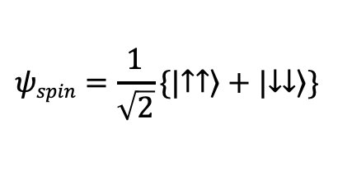
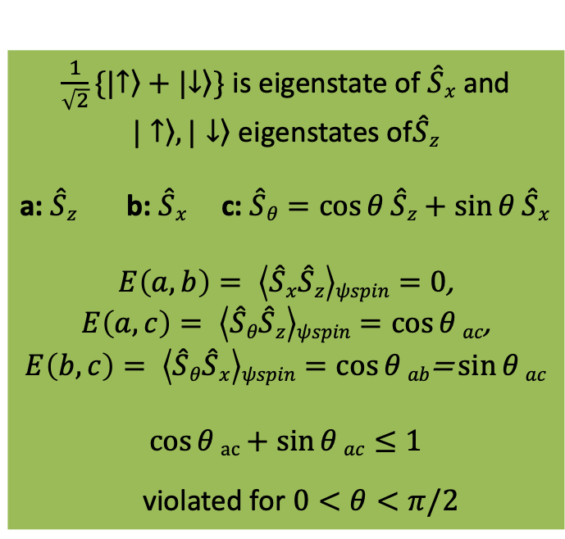

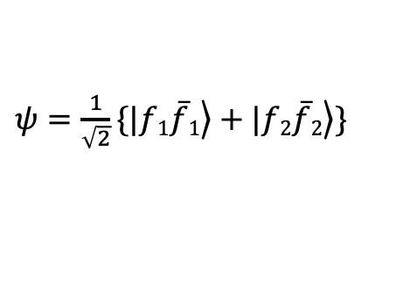

Flavor “Operators” in the SM
$$ψspin=\frac{1}{\sqrt{2}}\{|\left.↑↑\right\rangle +|\left.↓↓\right\rangle \}$$
$\frac{1}{\sqrt{2}}\{|\left.↑\right\rangle +|\left.↓\right\rangle \}$ is eigenstate of $\hat{S}x$ and
$\left.|↑\right\rangle ,\left.|↓\right\rangle$ eigenstates of$\hat{S}z$
a: $\hat{S}z$ b: $\hat{S}x$ c: $\hat{S}θ=\cos{θ}\hat{S}z+\sin{θ}\hat{S}x$
$E\left(a,b\right)= \left\langle \hat{S}x\hat{S}z\right\rangle ψspin=0$,
$E\left(a,c\right)= \left\langle \hat{S}θ\hat{S}z\right\rangle ψspin=\cos{θ}ac$,
$$E\left(b,c\right)= \left\langle \hat{S}θ\hat{S}x\right\rangle ψspin=\cos{θ}ab\text{=}\sin{θ}ac$$
$$\cos{θ}ac+\sin{θ}ac≤1$$
violated for $0<θ<π/2$
$ψ=\frac{1}{\sqrt{2}}\{|\left.f1\overline{f}1\right\rangle +|\left.f2\overline{f}2\right\rangle \}$
$\frac{1}{\sqrt{2}}\{|\left.f1\right\rangle +|\left.f2\right\rangle \}$ is eigenstate of $\hat{F}F$ and
$\left.|f1\right\rangle ,\left.|f2\right\rangle$ eigenstates of$\hat{F}I$
a: $\hat{F}I$ b: $\hat{F}F$ c: $\hat{F}θ=\cos{θ}\hat{F}I+\sin{θ}\hat{F}F$
$E\left(a,b\right)= \left\langle \hat{F}F\hat{F}I\right\rangle ψ=0$,
$E\left(a,c\right)= \left\langle \hat{F}θ\hat{F}I\right\rangle ψ=\cos{θ}$,
$$E\left(b,c\right)= \left\langle \hat{F}θ\hat{F}F\right\rangle ψ=\sin{θ}$$
$$\cos{θ}+\sin{θ}≤1$$
violated for $0<θ<π/2$
No Surprise $⟹$

Slide 22








Flavor “Operators” in the SM?
a – Flavor “ID” operator
$\hat{F}I\left.|f1\right\rangle =|\left.f1\right\rangle$, $\hat{F}I\left.|f2\right\rangle =−|\left.f2\right\rangle$
$\hat{F}I$ : Identify/differentiate mass eigenstates
Higgs !
$\hat{H}\left.|u\right\rangle =|\left.u\right\rangle$, $\hat{H}\left.|c\right\rangle =−|\left.c\right\rangle$
b – Flavor “Flip” operator
$\hat{F}F\left.|f1\right\rangle =\left.|f2\right\rangle$, $\hat{F}F\left.|f2\right\rangle =\left.|f1\right\rangle$
$\hat{F}F$ : “Flip” flavor
$\hat{Z}$ = $𝕀+ε \hat{F}F$
$\hat{Z}\left.|u\right\rangle =\frac{1}{\sqrt{1+ε^{2}}}\{\left.|u\right\rangle +ε\left.|c\right\rangle \}$, $\hat{Z}\left.|c\right\rangle =\frac{1}{\sqrt{1+ε^{2}}}\{\left.|c\right\rangle +ε\left.|u\right\rangle \}$
c – Flavor “Mixing” operator
$\hat{F}θ=\cos{θ}\hat{F}I+\sin{θ}\hat{F}F$:
$\hat{F}θ\left.|f1\right\rangle =\cos{θ}\left.|f1\right\rangle +\sin{θ}\left.|f2\right\rangle$,
$\hat{F}θ\left.|f2\right\rangle =\sin{θ}\left.|f1\right\rangle −\cos{θ}\left.|f2\right\rangle$
$\hat{F}θ$ : Mixes flavor
$W$ Interactions!
$\hat{W}\left.|u\right\rangle =\cos{θc}\left.|u\right\rangle +\sin{θc}\left.|c\right\rangle$,
$\hat{W}\left.|c\right\rangle =\sin{θc}\left.|u\right\rangle −\cos{θc}\left.|c\right\rangle$
a: $\hat{H}=\hat{F}I$ b: $\hat{Z}=𝕀+ε \hat{F}F$ c: $\hat{W}=\hat{F}θ$
$E\left(a,b\right)= \left\langle (𝕀+ε \hat{F}F)\hat{F}I\right\rangle ψ=0$,
$E\left(a,c\right)= \left\langle \hat{F}θ\hat{F}I\right\rangle ψ=\cos{θc}$,
$$E\left(b,c\right)= \left\langle \hat{F}θ(𝕀+ε \hat{F}F)\right\rangle ψ=\sin{θc}$$
$$θc\sim 13°$$
$$\cos{θc}+\sin{θc}=1.2≰1$$
Always observe:
Mass Eigenstates
Eg: $\left\langle \hat{W}\right\rangle u=\cos{θc}$
$Wu$ interaction$:$
See $d$ (+1) with a probability of $\cos^{2}{θc}$
and $s$ (-1) otherwise.

Slide 23


Many Avenues to Explore
More than 2 bit system?
$2 ⟶2$ Scattering?
Other Collider signatures?
Entanglement and Entropy?
Entanglement and Symmetries?
+ …

Slide 24

SM works beautifully…
But MANY puzzles remain.
Entanglement relatively unexplored in particle physics
What are the right questions?
???
How can we probe them?
Thank
You

