Slide 1

R2D2 Assembly Readiness Review
2. Assembly Sequence
J.Faucheux
17 June 2025

Slide 2
SUMMARY
Yoke-shell sub-assembly
Dummy coil-pack sub-assembly
Coil-pack insertion
Transverse preload
Longitudinal preload
Cooldown

Slide 3
Yoke-shell sub-assembly 1/9
Reference document: Gamme de montage yoke-shell V6 (GED R2D2)
Important yoke weight (500kg), necessity of a lifting crane with 2 winches to assure the rotation of the structure on X axis
RE side on top to facilitate bladders extraction → shells assembled upside down

Slide 4
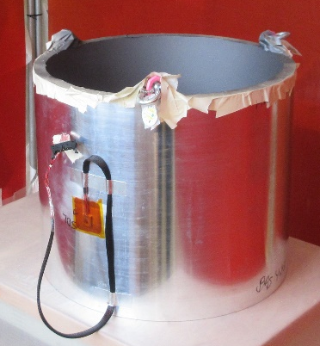
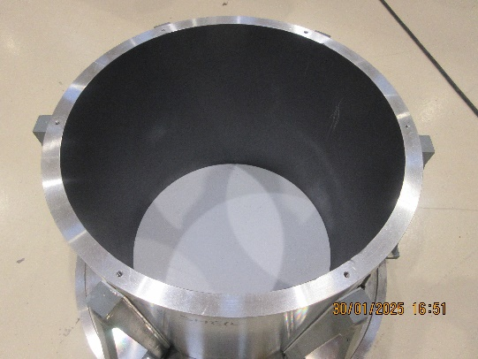
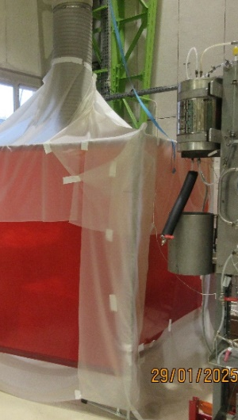
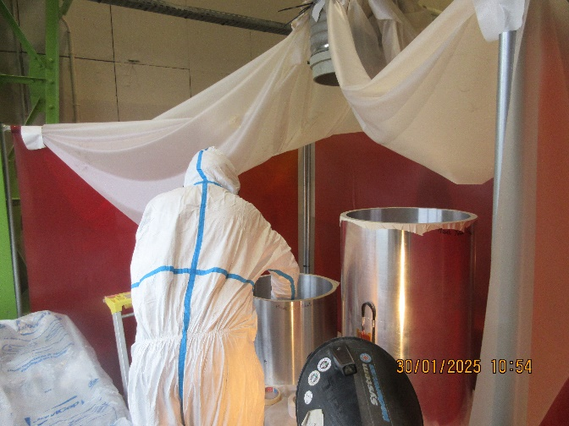
Yoke-shell sub-assembly 2/9
Molykote workshop → shells’ internal surface sprayed with antifriction solution to avoid undesired stress between yokes and shells
Operations realised with great carefulness
  Semi sealed structure with extractor
  Full suit
  Respiratory mask

Slide 5
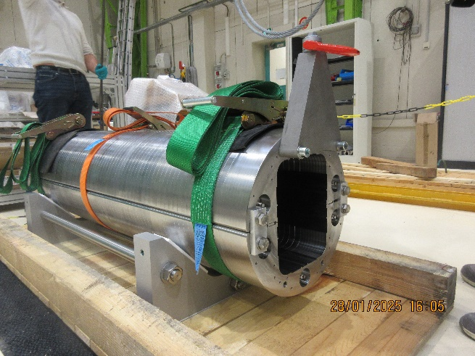
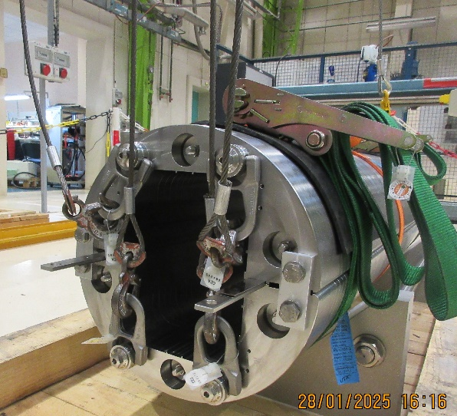
Yoke-shell sub-assembly 3/9
Yokes assembled on one another on the magnet crane
4 lifting hooks on RE side → overall weight firstly taken by lower hooks,then by all 4
Deported lifting ring
Tightening slings
Yokes clampers on RE and LE sides
12,2mm shim

Slide 6
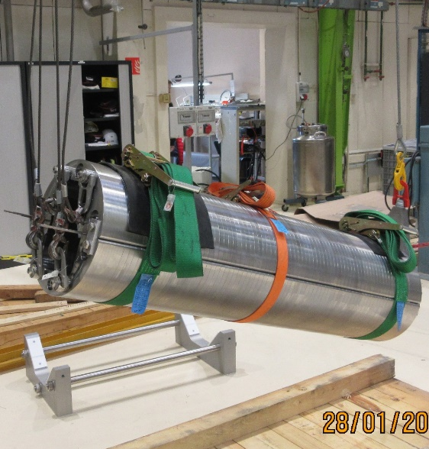
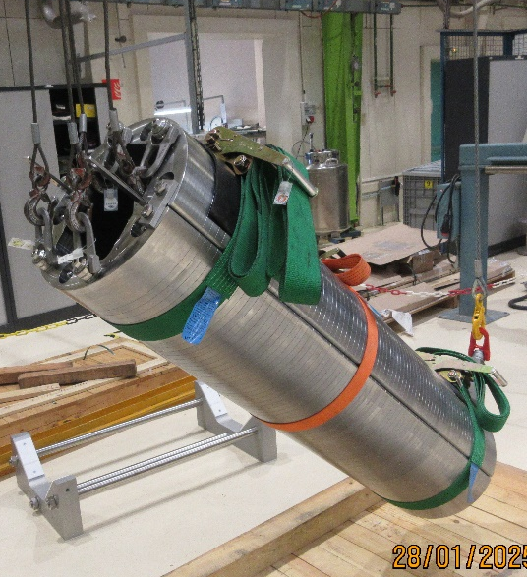
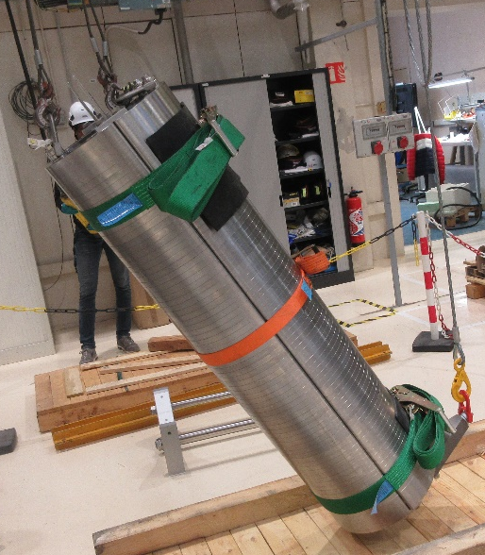
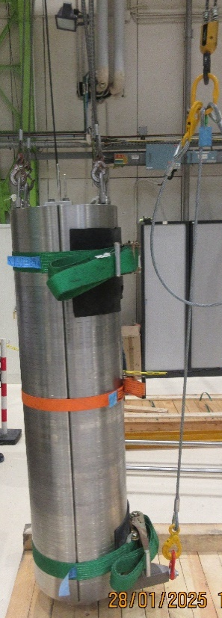
Yoke-shell sub-assembly 4/9
1T
2 mandatory winches to operate the rotation
Long sling between deported lifting ring and the hook
Operations realised with great carefulness
Winch
Hook
Sling
Deported lifting ring
  Progressive descent on LE side enables a progressive tension on RE side hooks
RE
LE

Slide 7
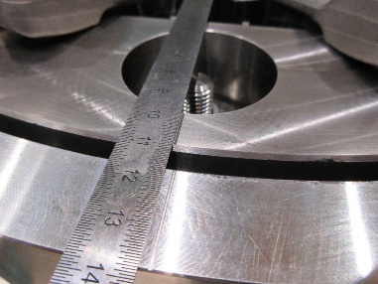
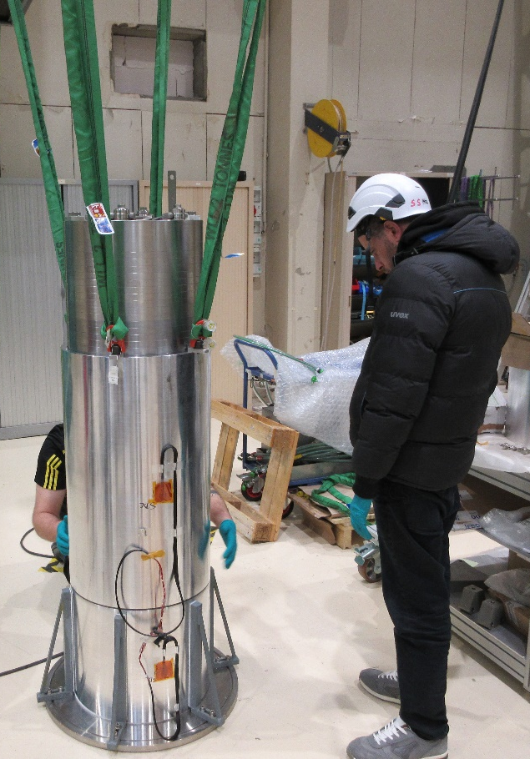
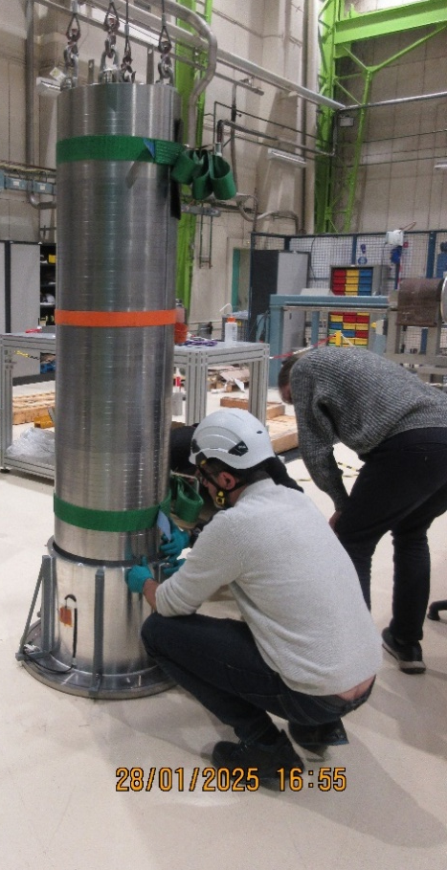
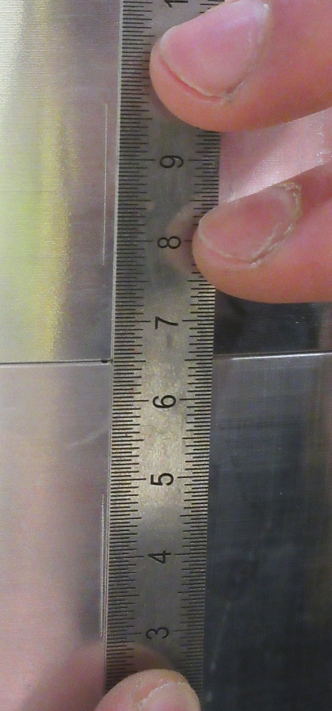
Yoke-shell sub-assembly 5/9
Coincidence assured between yokes and shells thanks to the machined streaks

Slide 8
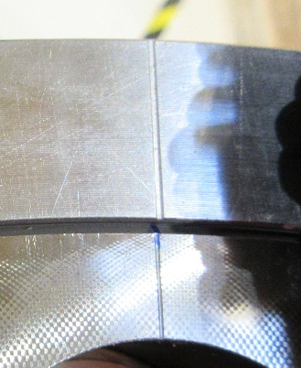
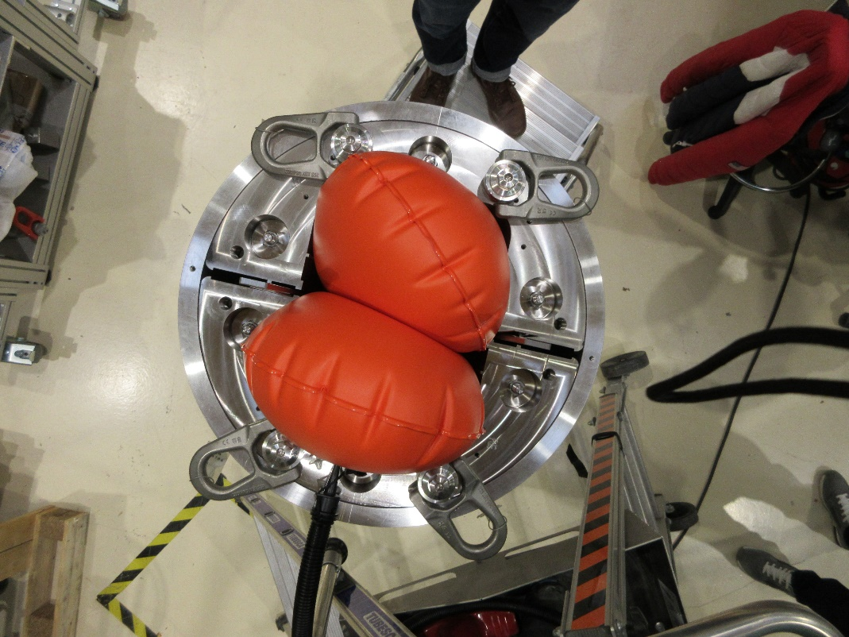
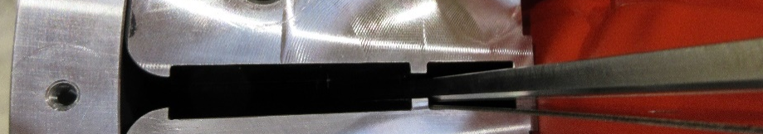
Yoke-shell sub-assembly 6/9
Inflatable haulage between yokes → contact between external yokes and inner shells, initial interference (13mm to insert bladders), strain gauges initialization before bladders stress

Slide 9
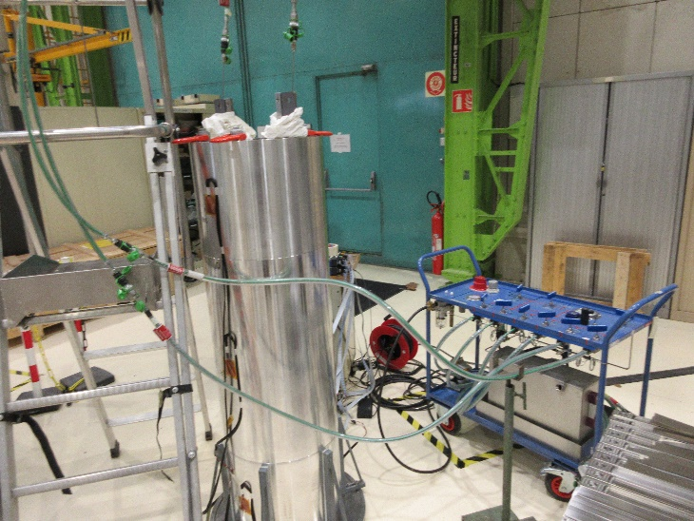
Yoke-shell sub-assembly 7/9
Shimming until 13,7mm (0,1mm step with bladders trolley)
  ≈200µm/m on strain gauges
  180bars maximum
RE and LE shells seem to see the same stress
Central shell stress is much higher than RE and LE shells (but more representative of the model)
Y results
Left
Right
RE
1,19µm/m
0,79µm/m
Central
81,97µm/m
150,34µm/m
LE
6,62µm/m
10,75µm/m

Slide 10
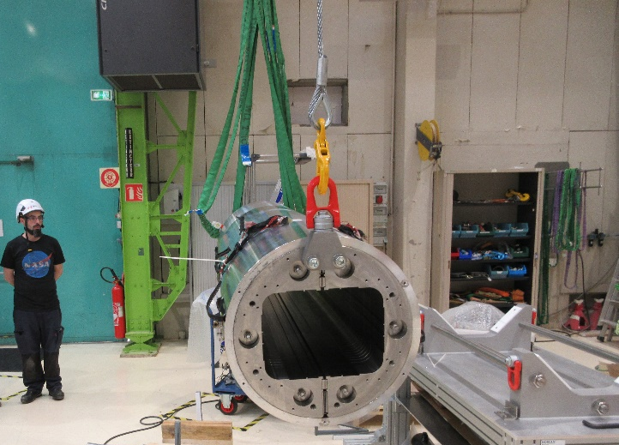
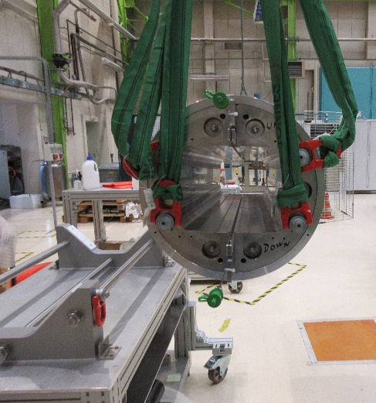
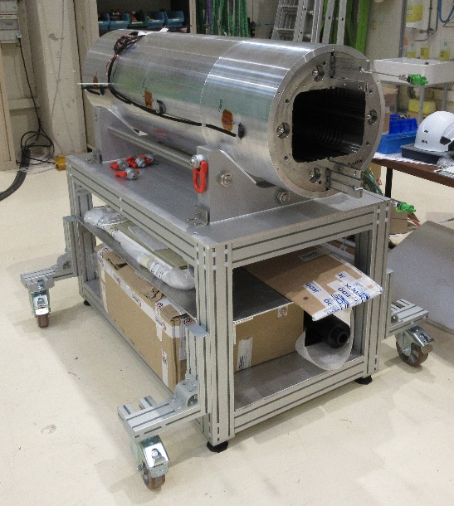
Yoke-shell sub-assembly 8/9
Rotation made backwards to lay the structure on its crane before coil pack insertion
RE
LE

Slide 11
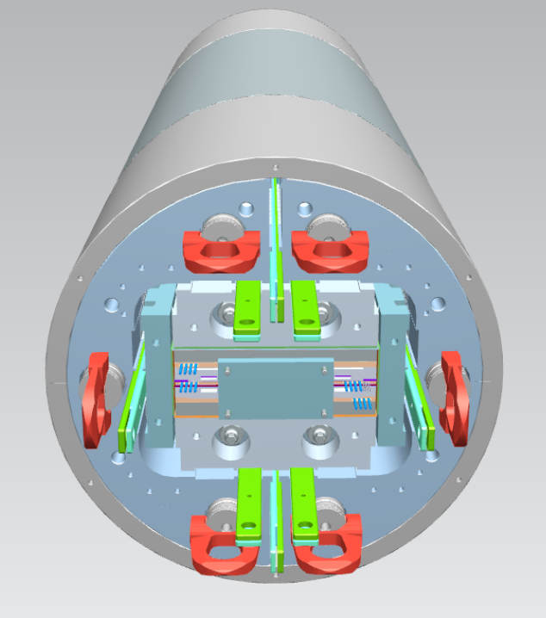
Yoke-shell sub-assembly 9/9
RE = Reference side
(« Assembly » side)
Up
Left
Right
Top coil
Bottom coil
Down

Slide 12
SUMMARY
Yoke-shell sub-assembly
Dummy coil-pack sub-assembly
Coil-pack insertion
Transverse preload
Longitudinal preload
Cooldown

Slide 13
Dummy coil-pack sub-assembly 1/5
Reference document : Gamme de montage coil pack V1 et Gamme de montage insertion coil pack V1 (GED R2D2)
Feedbacks matters regarding R2D2 Nb3Sn coil pack assembly, FD and F2D2 magnets

Slide 14
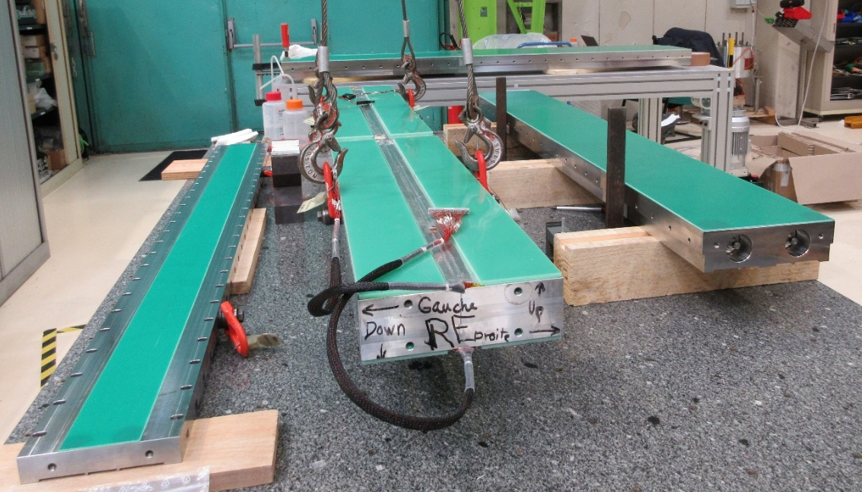
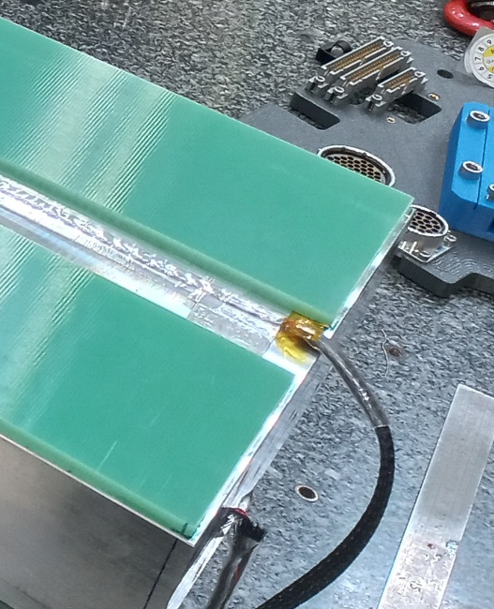
Dummy coil-pack sub-assembly 2/5
Coil pack preparation with an aluminium block 7075 to simulate the whole volume of the real coil pack
G11 glueing on the UP & DOWN sides, and on X & Y pads (Loctite 501)
Glueing with 1-2mm gaps between G11 and block → avoid X pads contact on the block

Slide 15
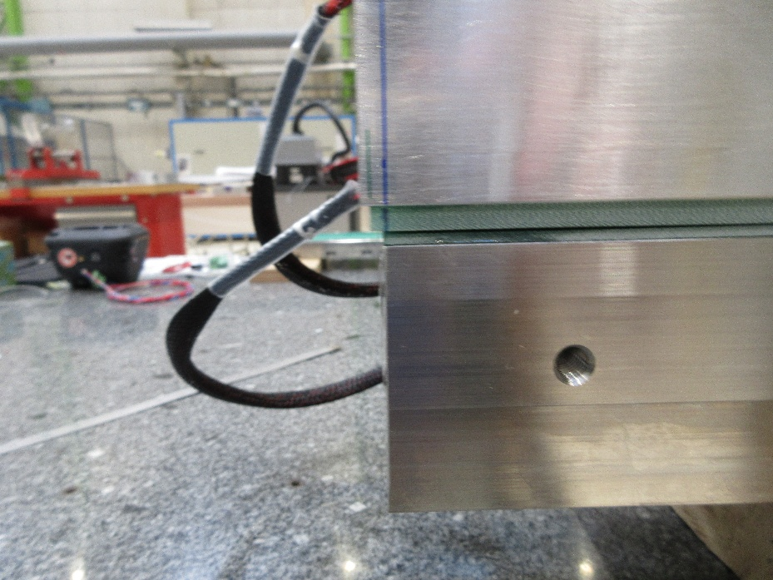
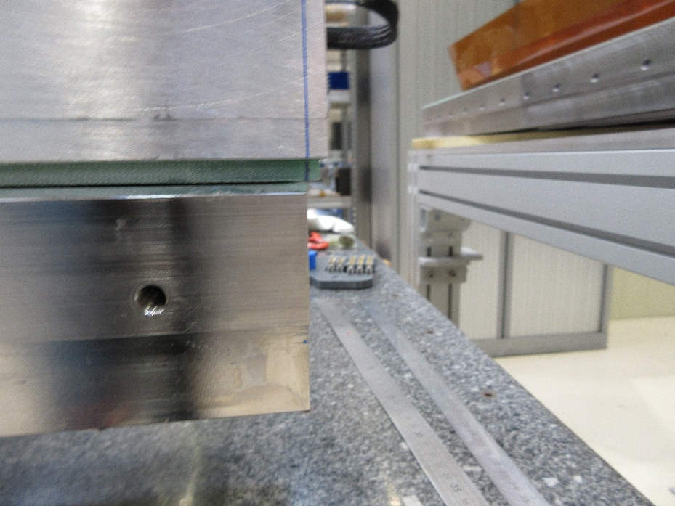
Dummy coil-pack sub-assembly 3/5
Block assembled on lower Y pad
Block marking regarding the Y pad, with 5mm leftover on each side (avoid G11 contact during Z-prestress)

Slide 16
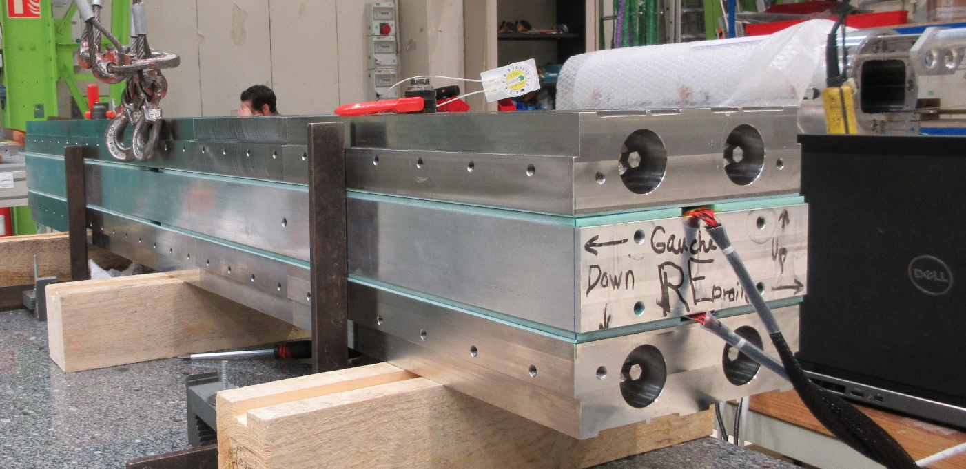
Dummy coil-pack sub-assembly 4/5
Upper Y pad assembled on the block
Positionning realised via :
  Block marking on Z
  Lower Y pad and squares on X

Slide 17
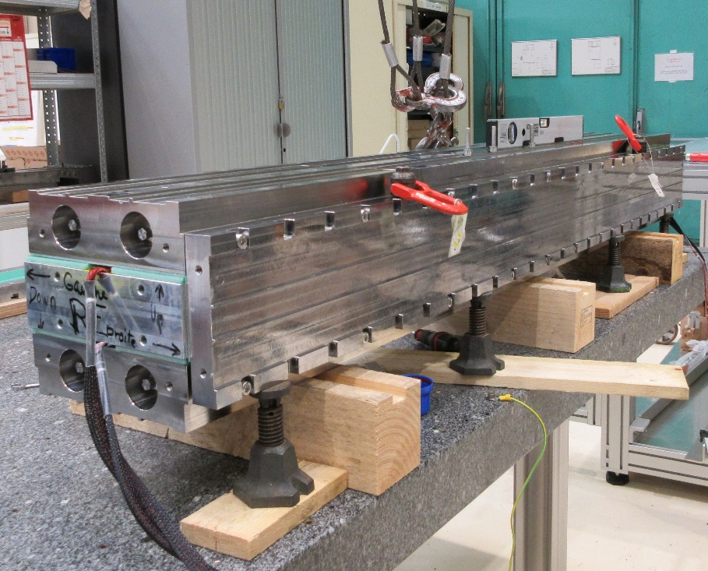
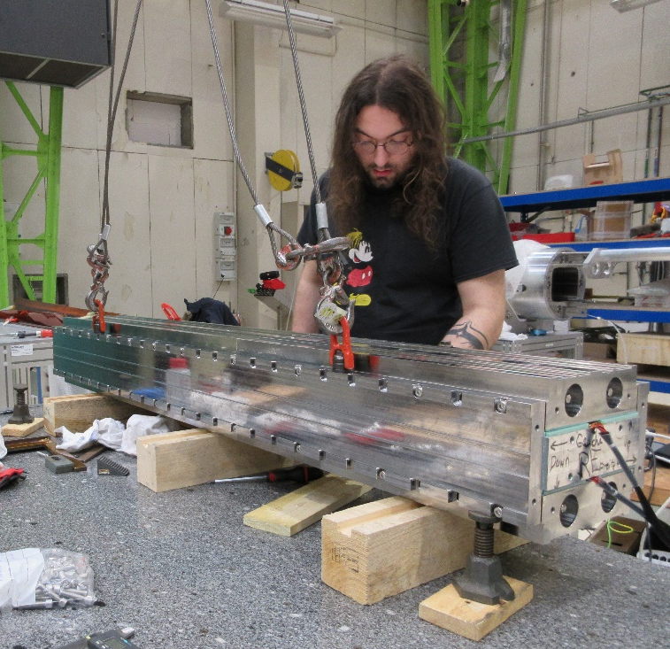
Dummy coil-pack sub-assembly 5/5
X pads assembly
  Pre positionning with lifting crane, few screws tightening to adjust on Z with adjustable jacks

Slide 18
SUMMARY
Yoke-shell sub-assembly
Dummy coil-pack sub-assembly
Coil-pack insertion
Transverse preload
Longitudinal preload
Cooldown

Slide 19
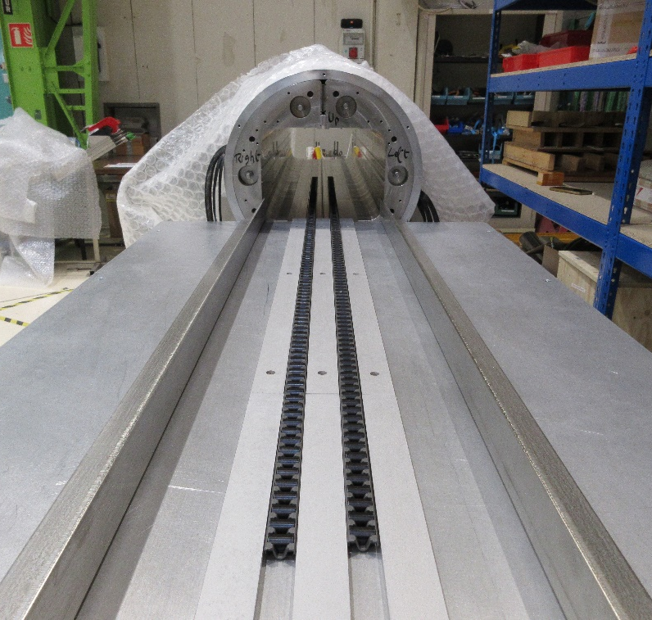
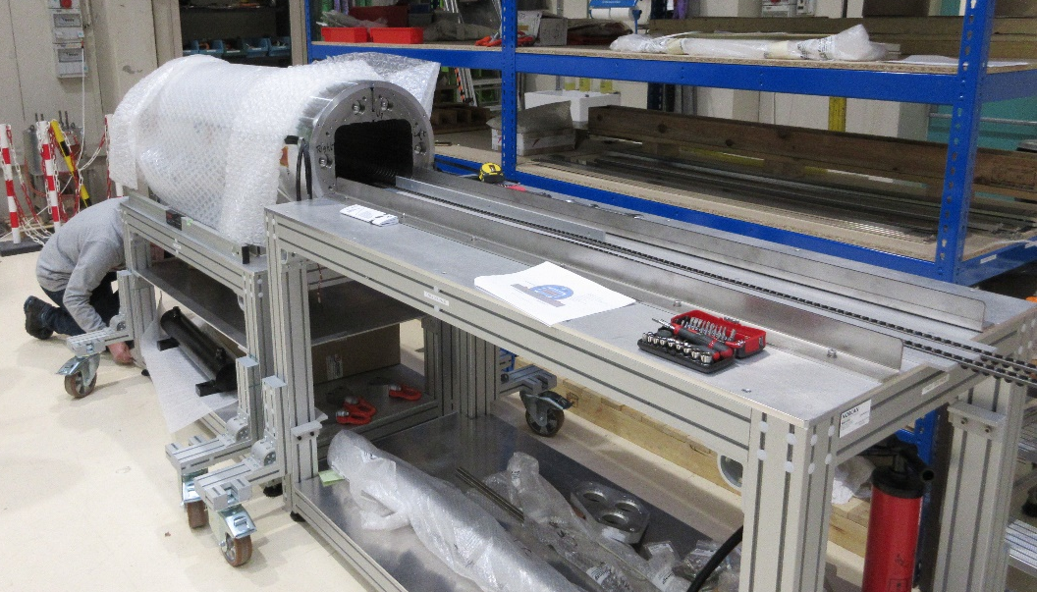
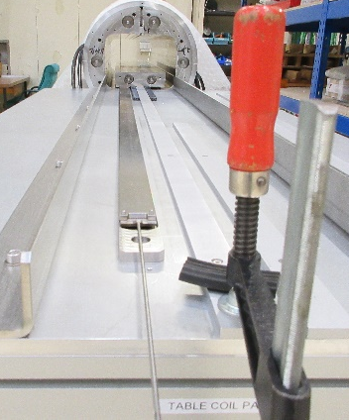
Coil-pack insertion 1/3
Insertion preparation
  Tables adjustements on Y
  Rollers and guides installed to transfer the coil pack on Z
  Squares positionning coincident with yokes for X guiding
Stopper to avoid coil pack sliding off the table
Rollers positionned on the first ¼ of the table length

Slide 20
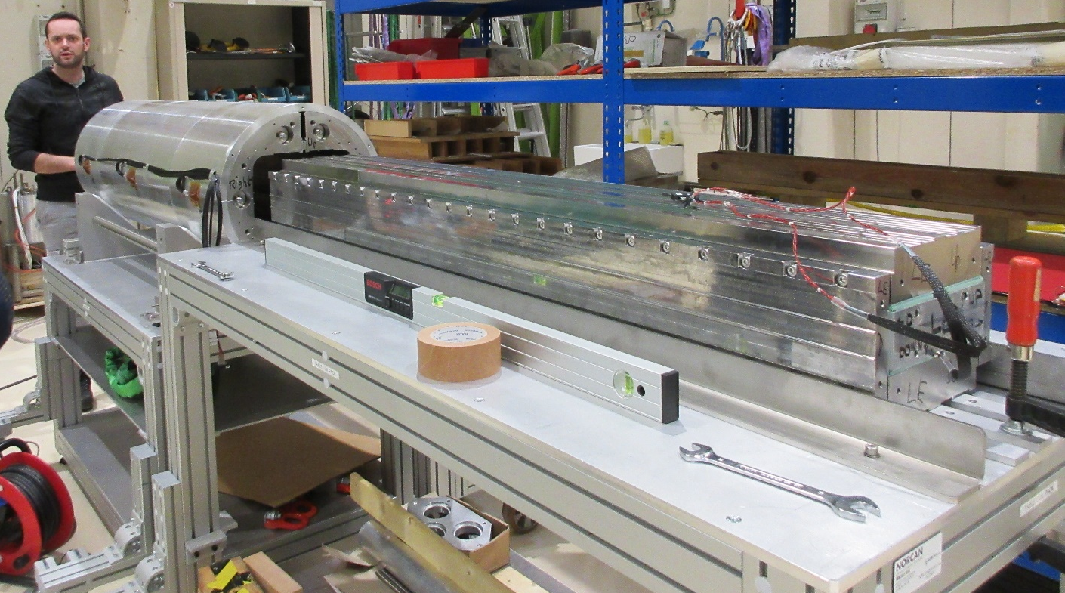
Coil-pack insertion 2/3
Coil pack positionned face to face with the structure
Squares in slight contact with X pads to guide the coil pack

Slide 21
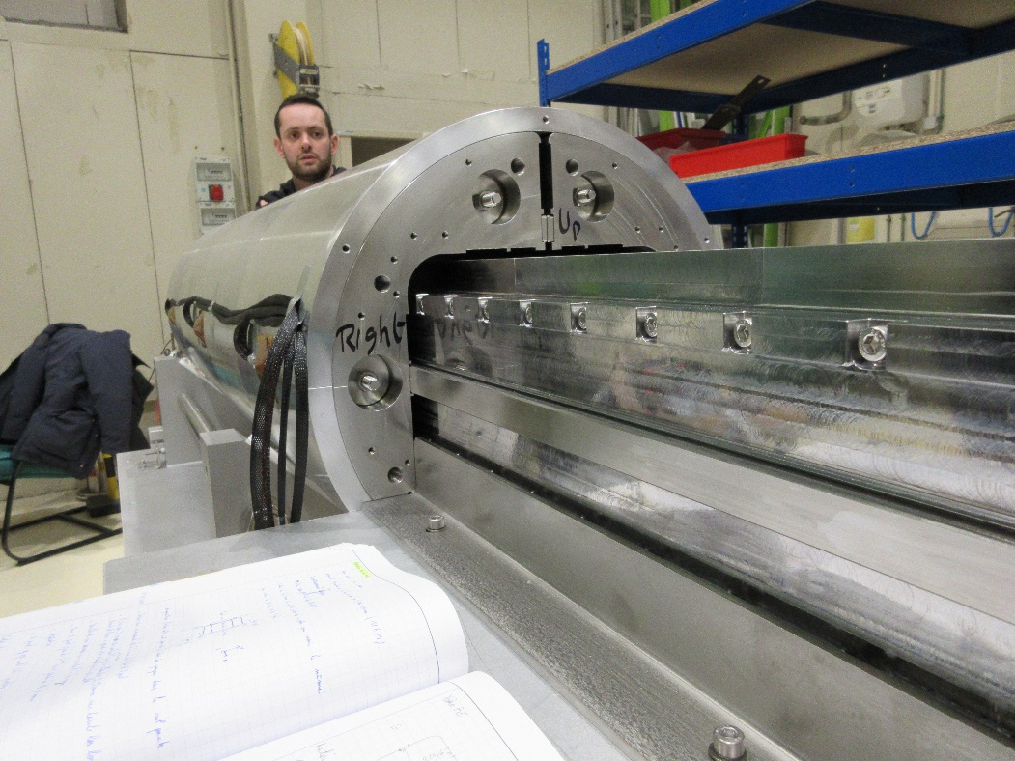
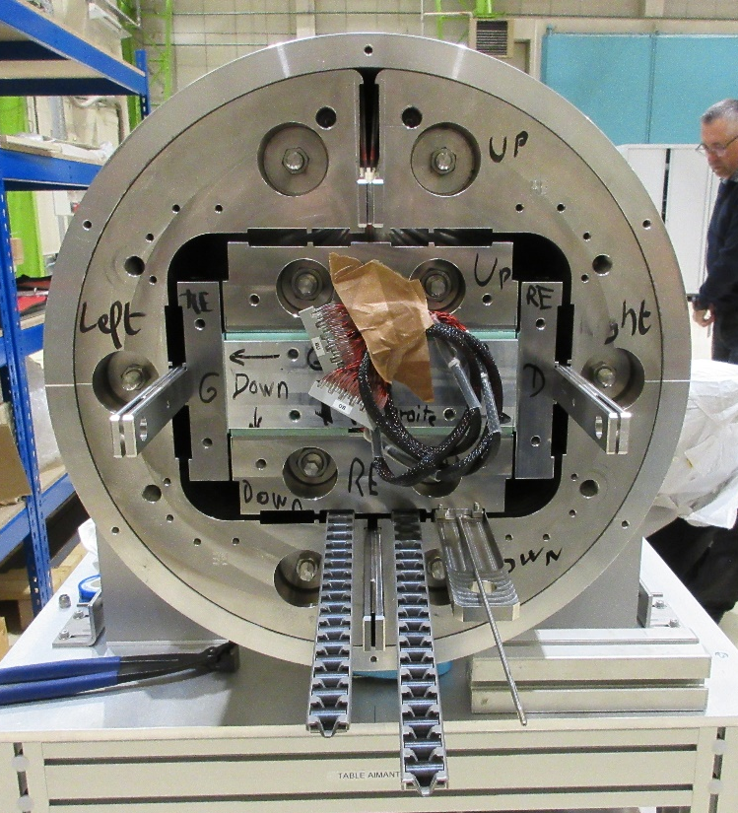
Coil-pack insertion 3/3
Shims with same thickness assembled (12,7mm) on each side of the coil pack on X → centre position in the structure
Coil pack inserted until the pads are edge to edge with yokes
Mechanical stoppers assembled on RE and LE sides

Slide 22
SUMMARY
Yoke-shell sub-assembly
Dummy coil-pack sub-assembly
Coil-pack insertion
Transverse preload
Longitudinal preload
Cooldown

Slide 23
Transverse preload 1/4
Reference document : Gamme de montage coil pack V1 and Gamme de montage insertion coil pack V1 (GED R2D2)
Feedbacks matters regarding R2D2 Nb3Sn coil pack assembly, FD and F2D2 magnets

Slide 24
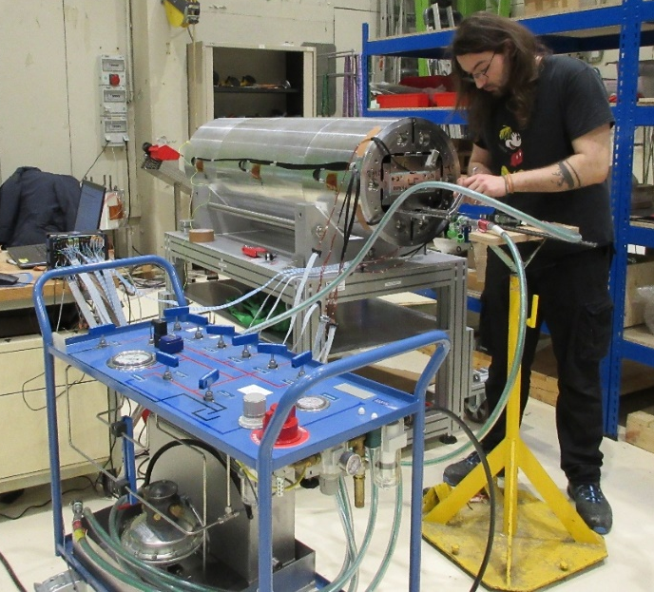
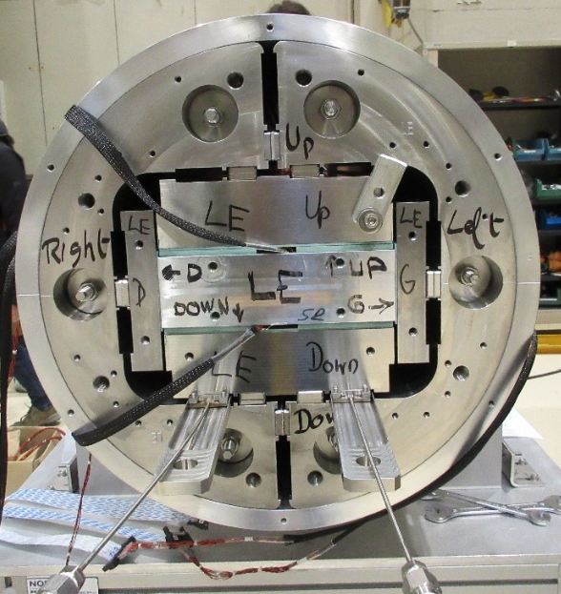
Transverse preload 2/4
Bladders inserted under coil pack to shim its position on Y and X
Position | Pressure (b) | Shimming (mm)
Right | None | 12,7
Left | None | 12,7
Up | None | 12,2
Down | 15-20 | 12,2
Up | Few bars | 12,3
Down | 10 | 12,3
Position | Pressure (b) | Shimming (mm)
Down | 10 | 12,35
Up | 70 | 12,35
Right | None | 12,8
Left | None | 12,8

Slide 25
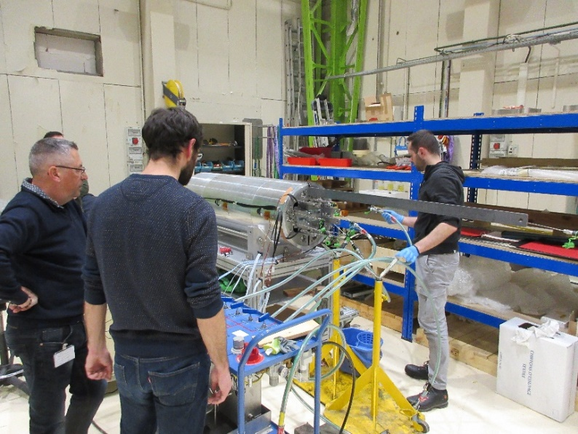
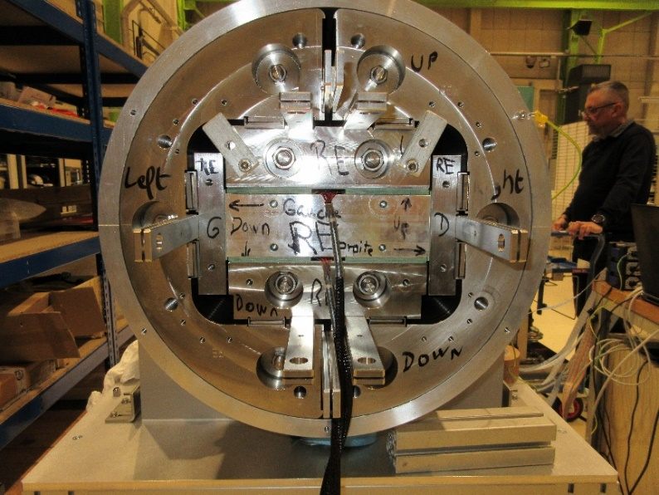
Transverse preload 3/4
Position | Pressure (b) | Shimming (mm)
Right | None | 12,9
Left | 2-3 | 13
Right | None | 13,1
- | - | -
Right | 203 | 13,7
Left | 220 | 13,7
Shims are outside the structure on RE side to avoid interference with connexion plate and instrumentation

Slide 26
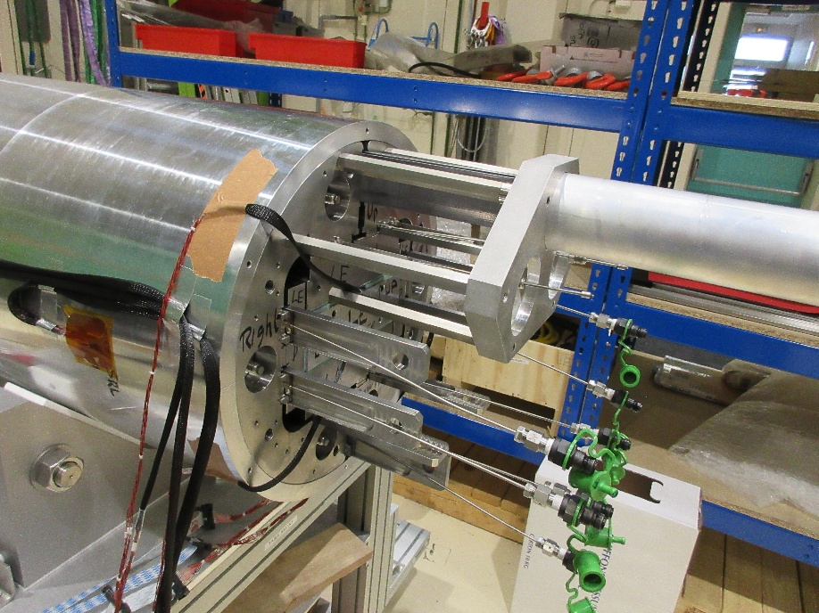
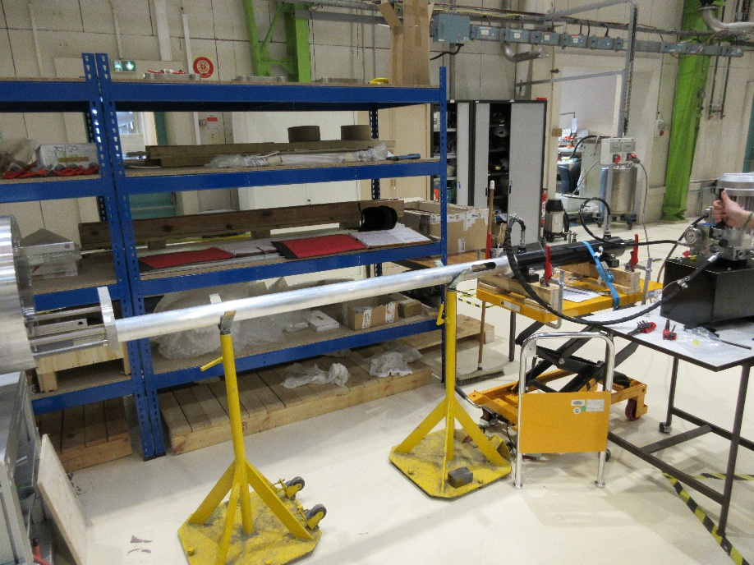
Transverse preload 4/4
Bladders are pulled out via extraction system on LE side
Shims are mounted on RE side

Slide 27
SUMMARY
Yoke-shell sub-assembly
Dummy coil-pack sub-assembly
Coil-pack insertion
Transverse preload
Longitudinal preload
Cooldown

Slide 28
Longitudinal preload 1/7
Reference document : Precontrainte_V0 (GED R2D2)
Feedbacks matters regarding future prestress, R2D2 Nb3Sn coil pack assembly, FD and F2D2 magnets

Slide 29
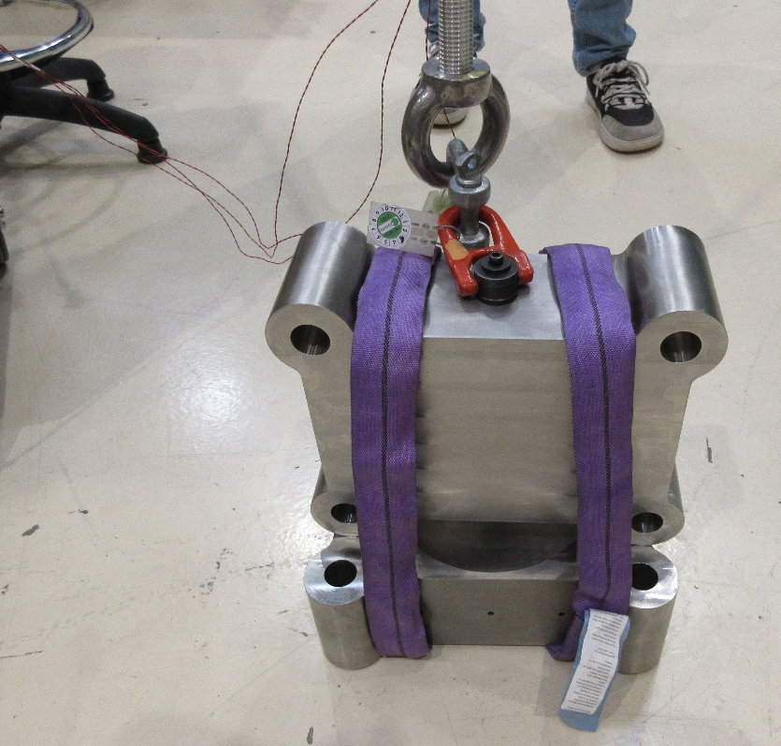
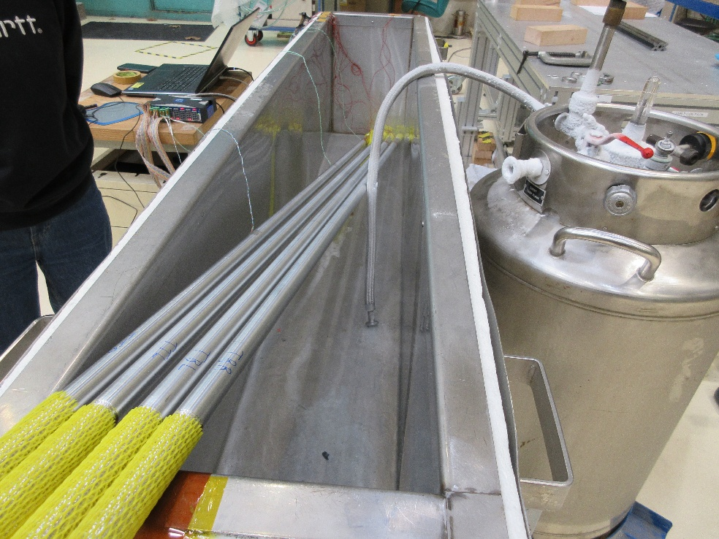
Longitudinal preload 2/7
Tie rods trials : traction and 77K cooldown to check the strain gauges assembly

Slide 30
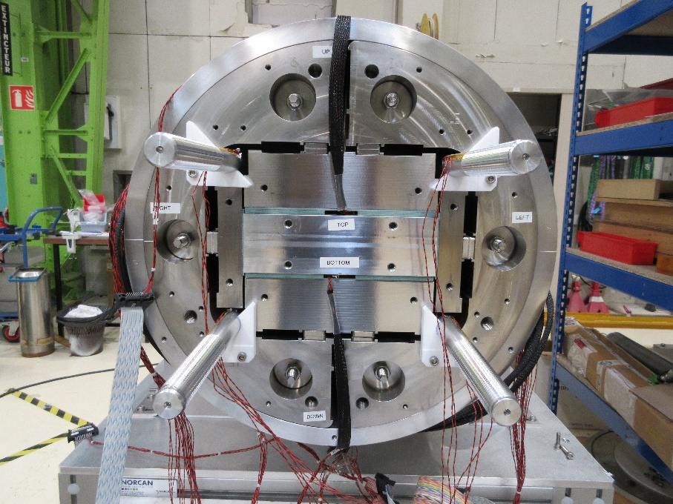
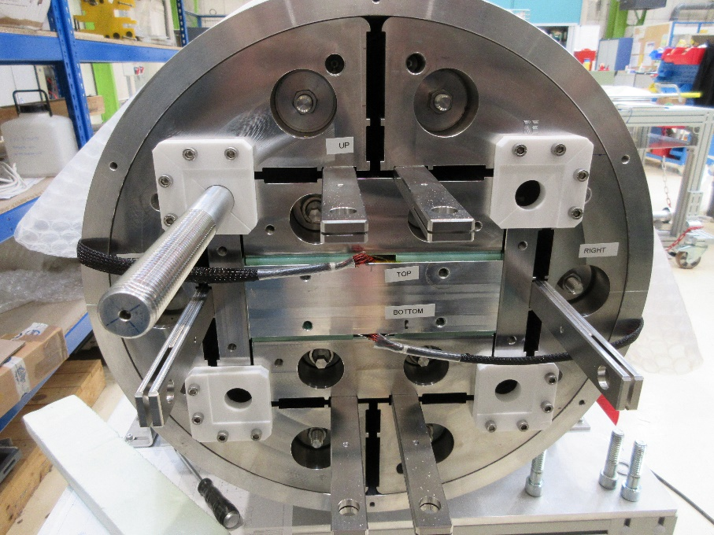
Longitudinal preload 3/7
Teflon guides assembled on yokes in order to help tie rods assembly
  Half LE side to avoid gauges wearing
  Full RE side for tie rod guiding
Tie rods inserted on their non-instrumented side

Slide 31
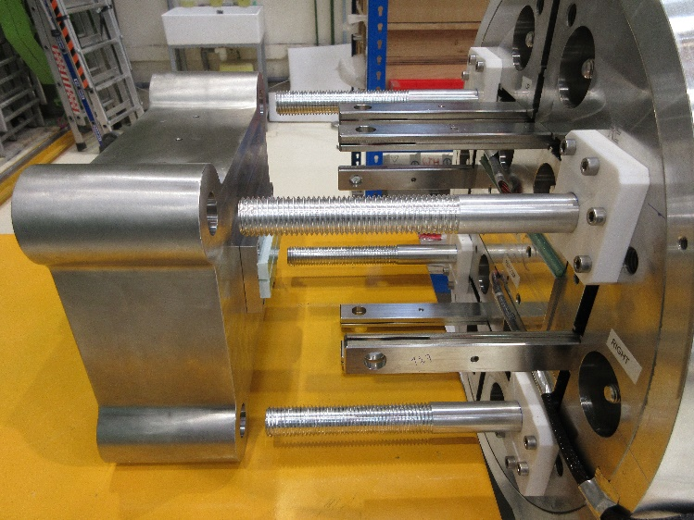
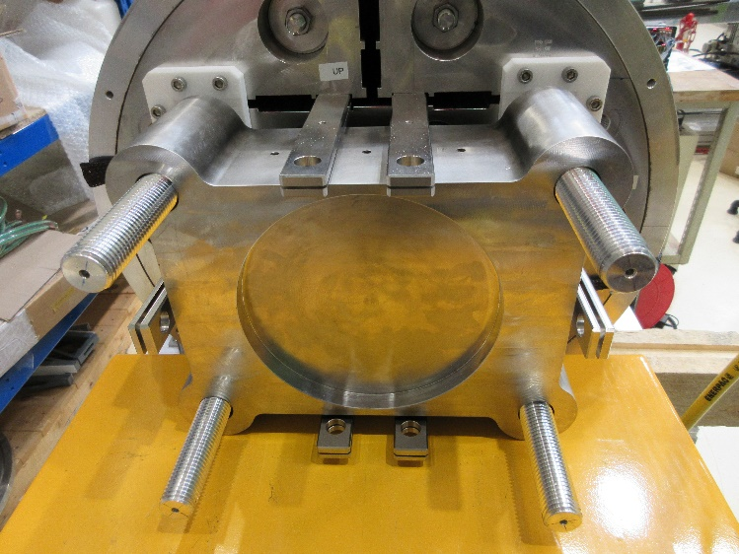
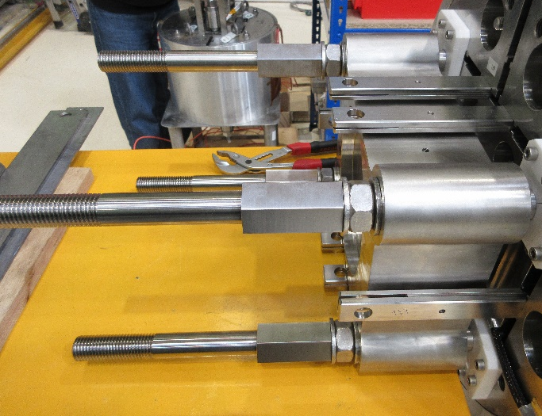
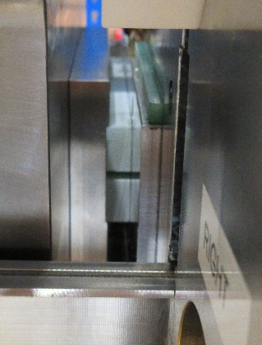
Longitudinal preload 4/7
RE end plate oncoming via lifting table to assure its position regarding the tie rods
Tie rods extensions assembled after end plate / aluminium block contact

Slide 32
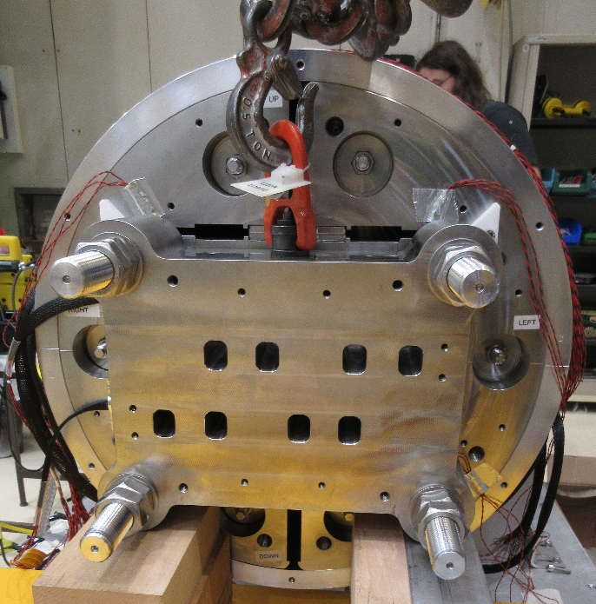

Longitudinal preload 5/7
LE end plate assembly
  Oncoming via lifting table
  Positionning via lifting crane
RE reaction end plate assembly with hydraulical cylinder
  Tie rods aiming value ~1000µm/m
  After P=140b (F~5,4t)
TTL
TTR
TBL
TBR

Slide 33

Longitudinal preload 6/7
Assembly transport to check prestress at 77K

Slide 34


Longitudinal preload 7/7
2nd prestress realised after 77K cooldown in order to get the same strain value (+/-100µm/m) in tie rods
  Cylinder concentricity: keep the reaction end plate parallel to the structure → shims assembled
  Nuts tightening quantification to better determine cylinder displacement → nuts and end plate (use as reference) marking

Slide 35
SUMMARY
Yoke-shell sub-assembly
Dummy coil-pack sub-assembly
Coil-pack insertion
Transverse preload
Longitudinal preload
Cooldown

Slide 36



Cooldown 1/4
Rotation and vertical transport of the structure from 122 building to 198 for cooldown
Insertion into cryostat with a flange assembled on R2D2

Slide 37
Cooldown 2/4
Criterias
  <100K thermal gradient between top and bottom structure
  Target values in tie rods : ~1500µm/m
  Instrumentation resilience during cooldown and warmup
Cool down results
  Max ΔT of 86K
  Every strain gauge was functional
Warm up results
  Max ΔT of 20K
  3 gauges lost close to 0°C (BDCMZ_comp, BUCRZ and BURMZ)

Slide 38

Cooldown 3/4
Temperature sensors on each shell segment and each end plate to manage the longitudinal thermal gradient
Method : LN2 injection from the bottom of the vessel below magnet and RT gaz nitrogen injection inside the liquid bath to cooldown the magnet homogenously with cold vapor created inside the vessel
Ability to keep the longitundinal gradient below 50 K after process optimisation
4 days to cooldown / 4 other days to warm up with care taken to not freeze the instrumentation around 0°C
LE
Centre
RE

Slide 39
Cooldown 4/4
Test bench optimisation
  Flange on top to isolate the structure from atmosphere conditions (possibility to vacuum to discard ice risk)
  Heat exchanger welded on the flange to better master thermal gradient

Slide 41
Annex
Yoke-shell sub-assembly shimming until 13,7mm (0,1mm step with bladders trolley)
Y results
Left
Right
RE
1,19µm/m
0,79µm/m
Position | Pressure (b) | Shimming (mm) | Shell strain (µm/m)
Up & Down | None | 13 | 3-60
U&D | 38 | 13,1 | 50-230
U&D | 39 | 13,2 | 47-225
U&D | 63 | 13,3 | 100-285
U&D | 83 | 13,4 | 100-335
U&D | 120 | 13,5 | 120-350
D | 120 | 13,6 | -
D | 160 | 13,7 | -
Central
81,97µm/m
150,34µm/m
LE
6,62µm/m
10,75µm/m
140b for Up side
180b for Up side

