Slide 1

R2D2 Assembly Readiness Review
1. Introduction
E. Rochepault
17 June 2025

Slide 2
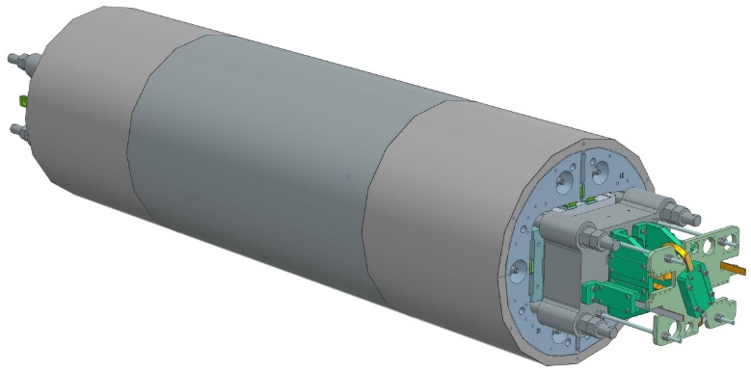
Overview of the R2D2 design
CEA design
Fabrication, assembly and pre-stress at Saclay
Tests at cold at CERN
Main goal: demonstrate feasibility of grading
  Winding two cables on top of each other
  Heat treating two different cables together
  Jonctions of the 2 cables → 1st option: external Nb₃Sn-NbTi joints
R2D2 = Research Racetrack Dipole Demonstrator
Aperture | None
Outer diameter | 480 mm
Structure length | 2.0 m
Nominal central field | 11.1 T
Ultimate central field | 12.0 T
Nominal peak field | 12.7 T
Ultimate peak field | 13.7 T

Slide 3

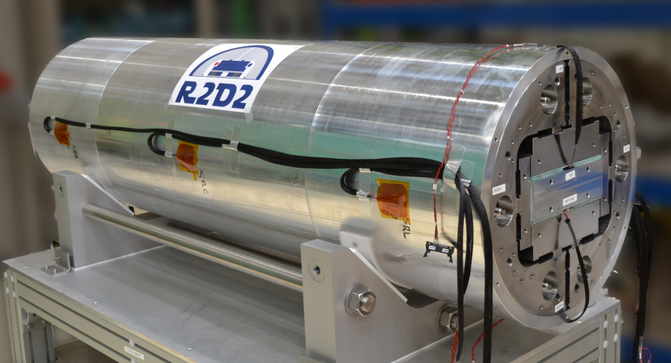
Assembly sequence
Yoke-shell sub-assembly
Dummy Coil-pack sub-assembly
Coil-pack insertion
Transverse Pre-load
Longitudinal pre-load
Cool-down
→ See 2. Assembly sequence (J. Faucheux)

Slide 4

Pre-load and cool-down : strain gauge analysis
Pre-loading
Cool-down
Un-loading
Geometric measurement of the shell
→ See 3. Pre-load and cool-down : strain gauge analysis (S. Perraud)

Slide 5

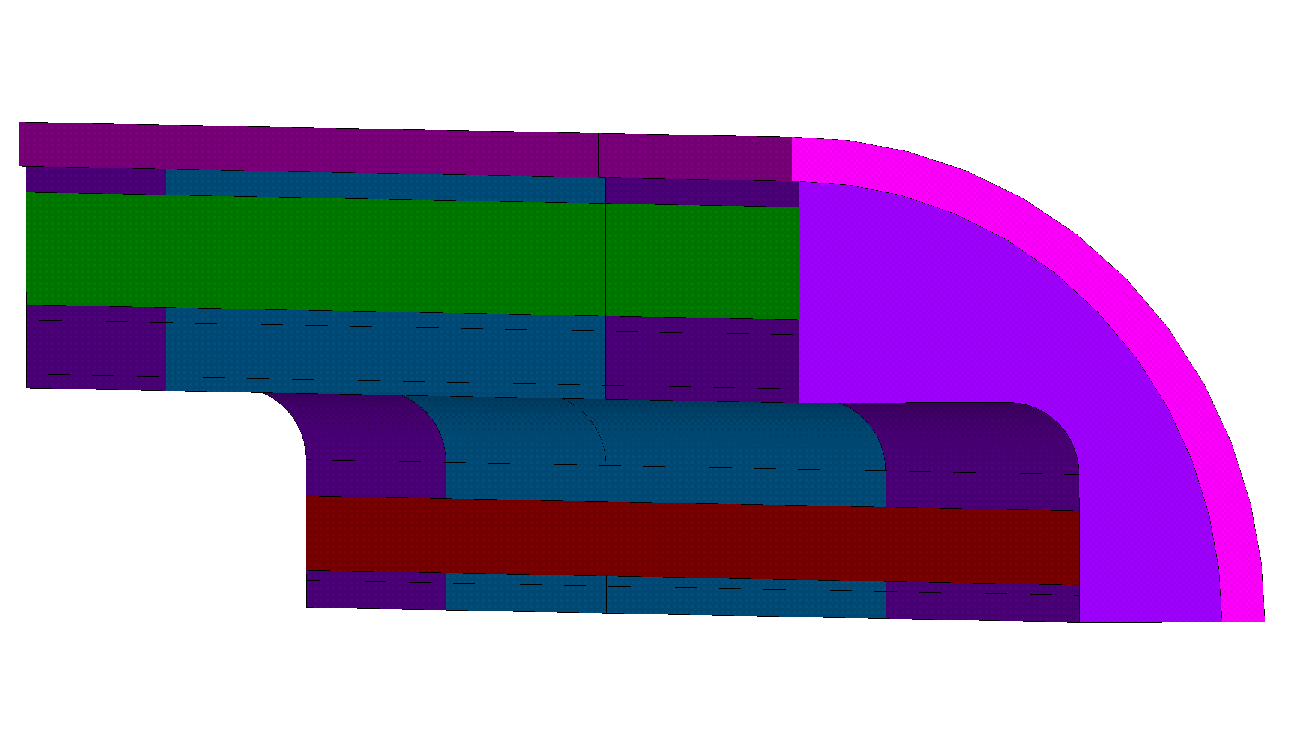
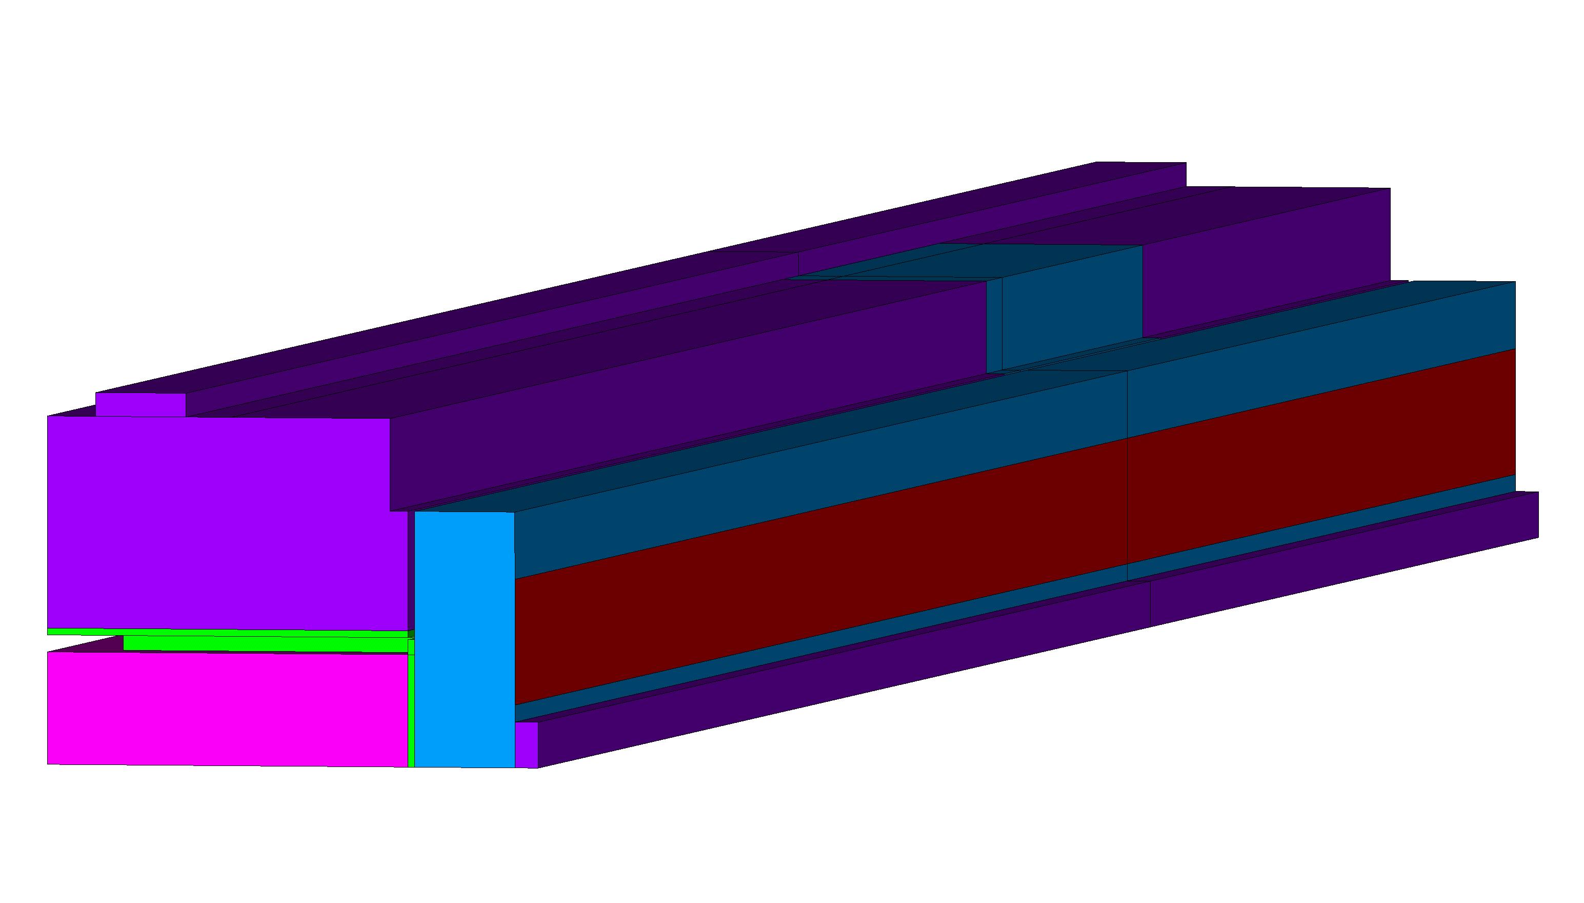
Modeling of the structure
Modeling hypotheses
Study of mismatches between the yoke and the shell
→ See 4. Modeling of the structure (Y. Perron)
2
1

Slide 6

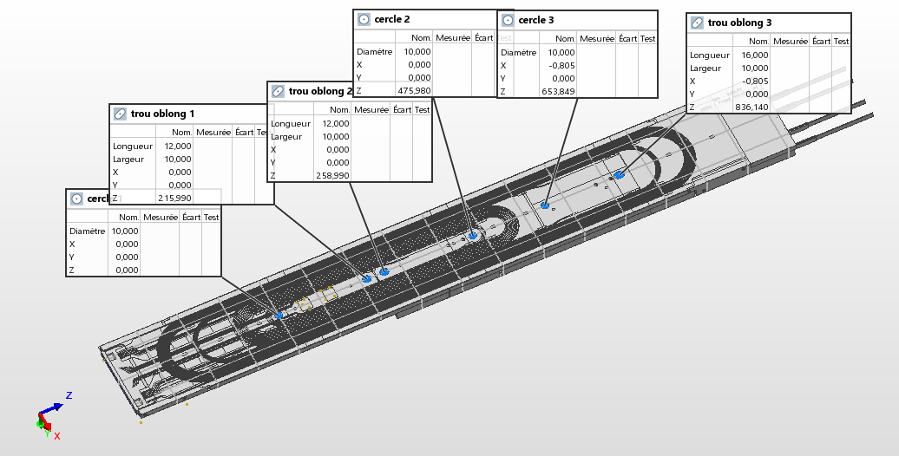
Geometric measurement of coils
Method
General characteristics
Particular characteristics
→ See 5. Geometric measurement of coils (M. Durante)

Slide 7
Timetable
Start | End | Duration | Title | Presenter
08:30 | 09:00 | 00:30 | Welcome and coffee
09:00 | 12:00 | 03:00 | Workshop visit and discussions
12:00 | 14:00 | 02:00 | Lunch and informal discussions
14:00 | 15:00 | 01:00 | Workshop visit and discussions
15:00 | 15:15 | 00:15 | Introduction | E. Rochepault
15:15 | 15:45 | 00:30 | Assembly sequence | J. Faucheux
15:45 | 16:15 | 00:30 | Preload and strain gauge analysis | S. Perraud
16:15 | 16:35 | 00:20 | Cool-down and strain gauge analysis | S. Perrraud
16:35 | 16:50 | 00:15 | Break
16:50 | 17:10 | 00:20 | Modeling the structure | Y. Perron
17:10 | 17:30 | 00:20 | Geometric measurement of coils | M. Durante
17:30 | 18:00 | 00:30 | Wrap-up and discussions

Slide 8
Charge
Do the several steps of the dummy structure assembly validate all the technological concepts and procedures?
Are the measurements and analysis sufficient to understand the behavior of the mechanical structure and validate the pre-load targets?
Is the numerical modeling sufficient to simulate the behavior of the mechanical structure and estimate the pre-load targets?
Do you recommend other tests to further assess the behavior of the mechanical structure?
Overall, is the Saclay team ready for final assembly with the Nb₃Sn coils?

Slide 10
Backup slides

Slide 11
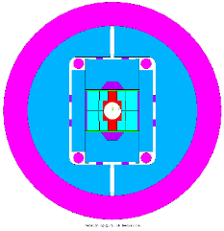
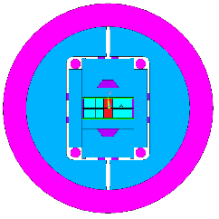
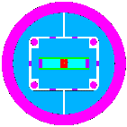
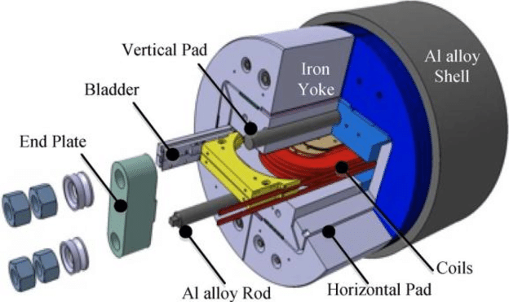
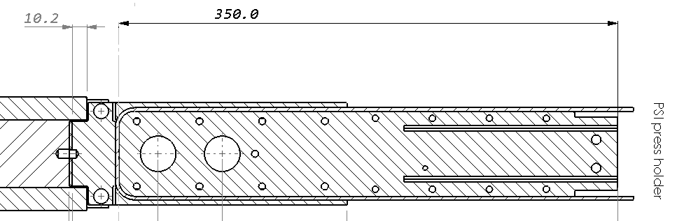
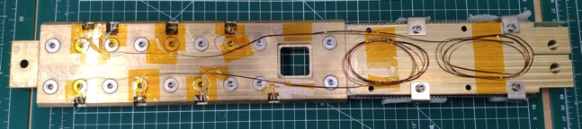
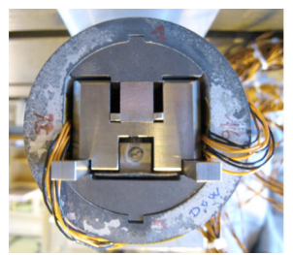
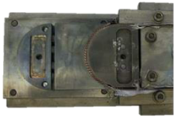
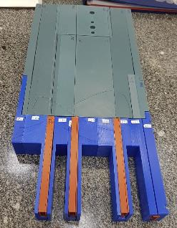
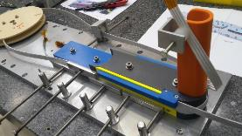
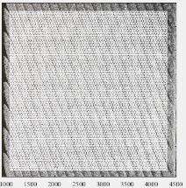
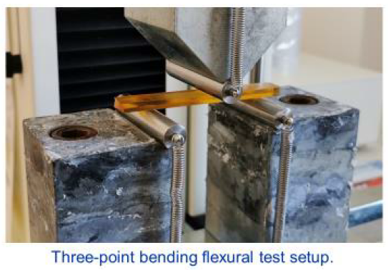
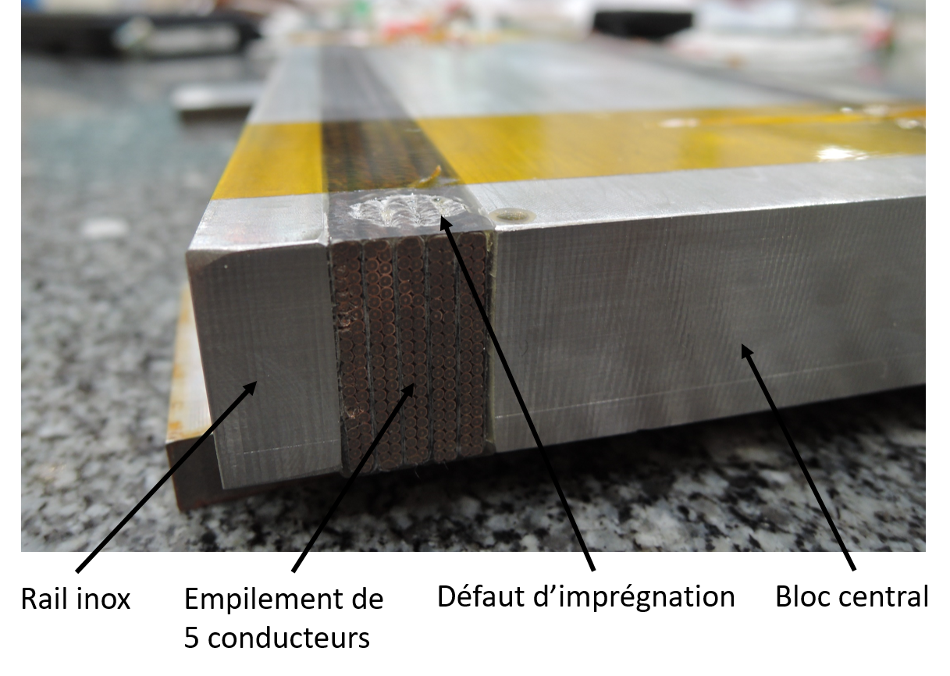
Development Plan towards 16 T Nb₃Sn Dipoles
16 T
demo
12-14 T demo
Subscales
Powered samples
Non-powered samples
F2D2
D5
FD
D5
SMC
D3
R2D2
D4

