Slide 1
P42 line
Beam skeleton
HI-ECN3 Integration
Beatriz Martínez Sutil (BE-EA-DC)
06/06/2025

Slide 2
INDEX
Introduction
  NA coordinate systems.
  Objectives of the meeting.
History of the exchanged data
P42 line integrated
Coordinate System Inputs
Tracking of the versions
Naming of the elements
Inputs
Next steps and outcome of the meeting

Slide 3
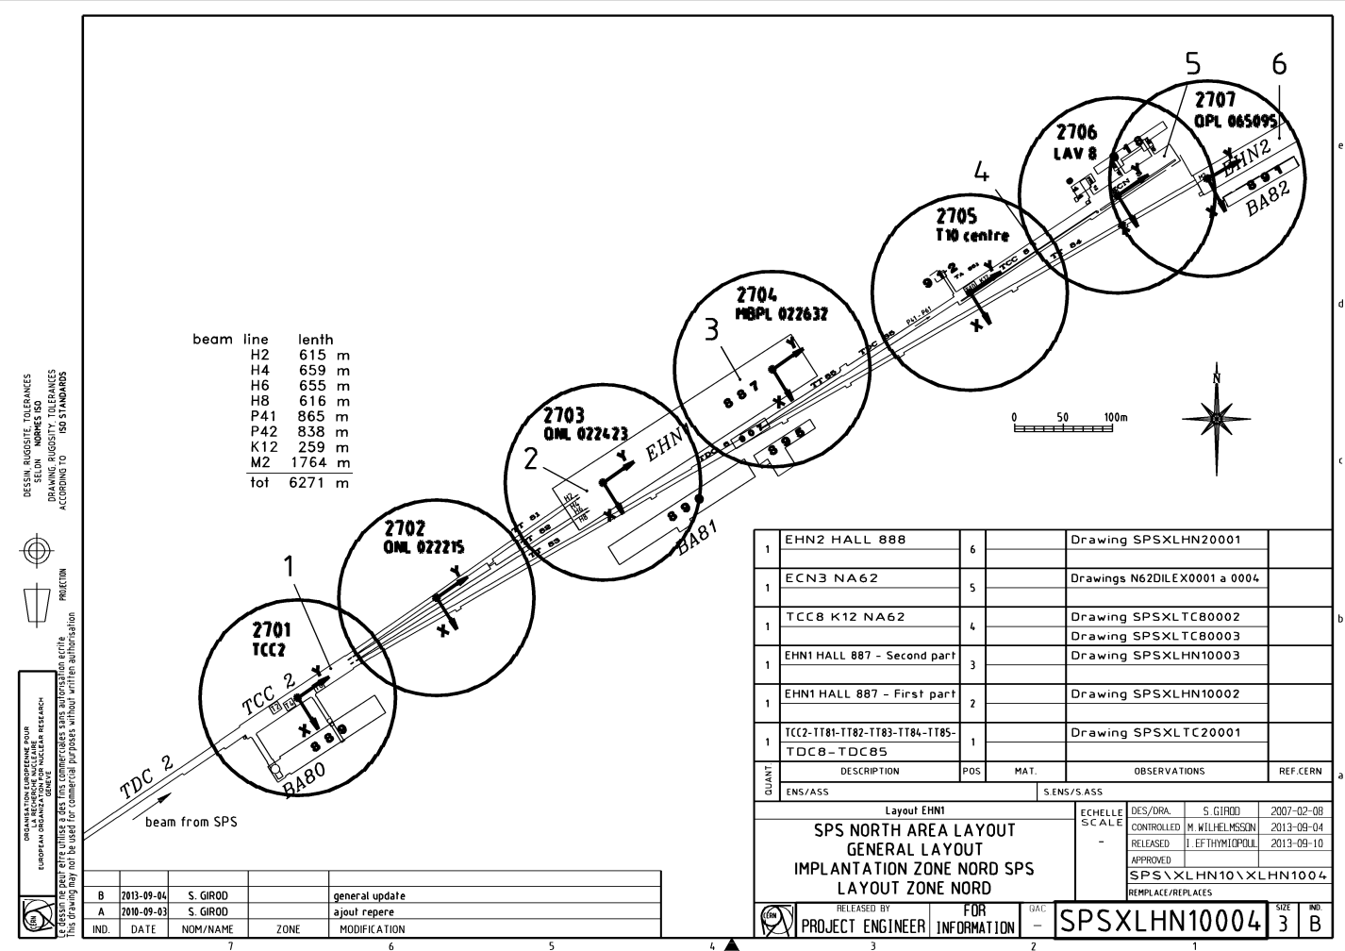
NA CATIA coordinate systems
TCC8-ECN3
TT85-TDC85
2705 C.S. will be replaced by the new C.S. defined in EDMS 3234956
S. Girod

Slide 4

Objectives of this meeting
Clarify the data provided
Stablish clear objectives of the inputs missing by integration
Stablish the Coordinate Systems (C.S.) of the inputs
Specify a clear communication method and the frequency of data exchange.

Slide 5
History of the exchanged data
17th September, Dipanwita: Current and post LS3 version of the P42 line
17th September to 5th November, Fabian+Bea – Conducted a study comparing the MADX files respect to the current beatch out files. Minor misalignments were corrected. Exchange the C.S. (survey ->2704)
5th November, Fabian: New version of the post LS3 files after corrections
7th November, Bea: Presentation of the layout in WP4. Decision of relocate MBNH.X0450792 and MBNH.X0450795.
6th December, Bea: Presentation of the layout in ICEA.
A new version was requested with the updated positions of magnets 792 and 795, the beam dilution system, and beam instrumentation, all in C.S. 2704.

Slide 6
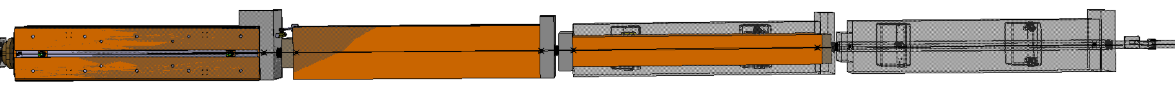
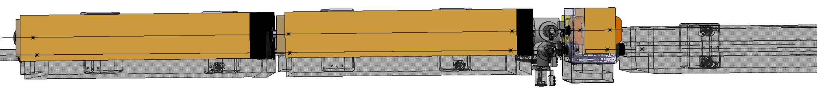
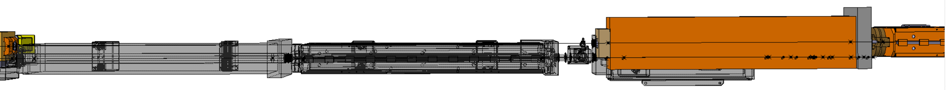
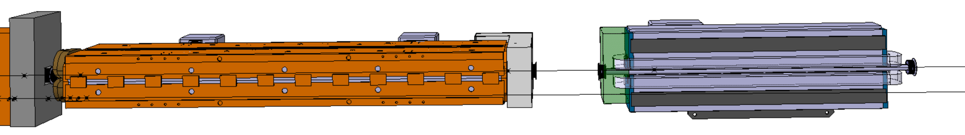
Presented in WP4 and ICEA
P42 line presented in the integration model
MBNH.X0430718
MBNH.X0430724
MBNV.X0430730
MBNH.X0430735 removed
BSP.X0430769
QNL.X0450770
MBNH.X0450792
MBNH.X0450795
MBNH.X0450814
MBNH.X0450817
BSM.X0450819
MCXCA.X0450820
Shifted ~12m from MBNV.X0450823
MBNH.X0450835 (MBNV.X0450823)
MBNH.X0450840
MBXGD.X0450846
Old layout
Integration: ST950060_01
Layout: ST194012_01

Slide 7
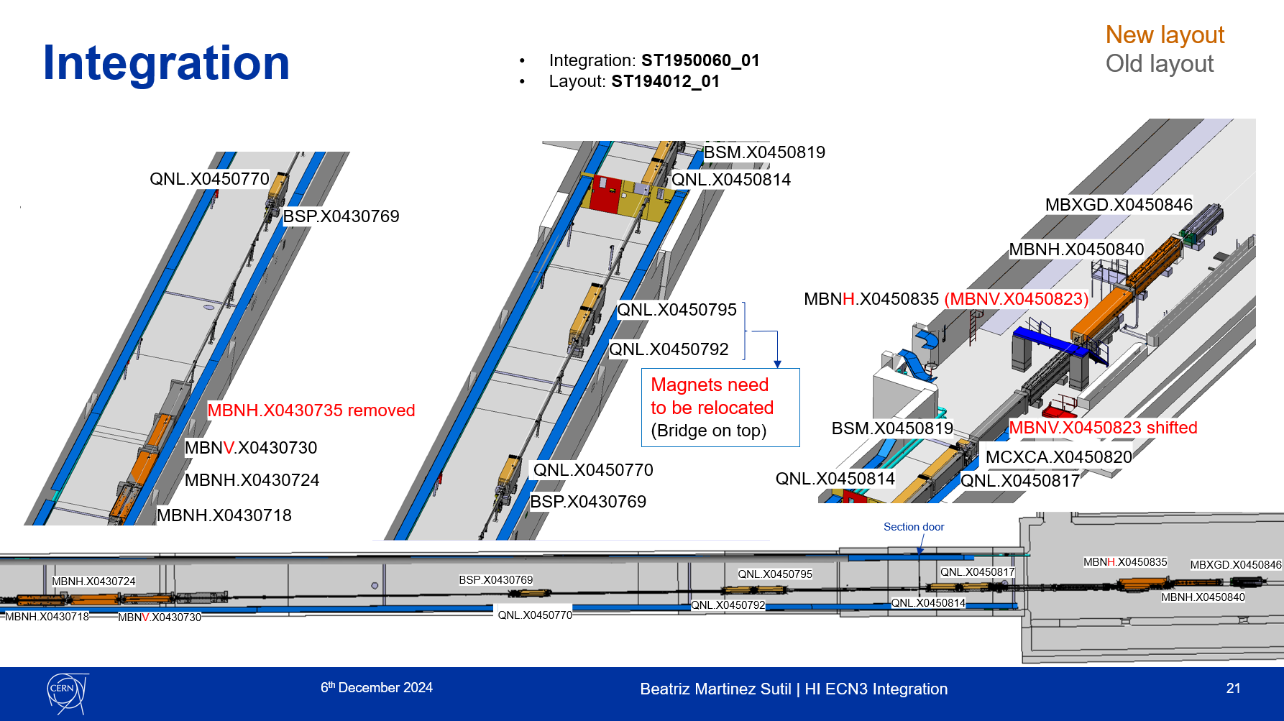
Presented in WP4 and ICEA
P42 line presented in the integration model

Slide 8
History of the exchanged data
17th September, Dipanwita: Current and post LS3 version of the P42 line
17th September to 5th November, Fabian+Bea – Conducted a study comparing the MADX files respect to the current beatch out files. Minor misalignments were corrected. Exchange the C.S. (survey ->2704)
5th November, Fabian: New version of the post LS3 files after corrections
7th November, Bea: Presentation of the layout in WP4. Decision of relocate MBNH.X0450792 and MBNH.X0450795.
6th December, Bea: Presentation of the layout in ICEA.
A new version was requested with the updated positions of magnets 792 and 795, the beam dilution system, and beam instrumentation, all in C.S. 2704.
24th March, Laurie: New version of the post LS3 files.
3rd April, Camille: Comments made by survey referred to phi and globaltilt.
17th April, Laurie: New version of the post LS3 files, after comments made by Camille.
23rd May, Laurie: New version of the post LS3 files. Changes?
Note: the version of 23rd May was referred as the same version as the one if 17th April, but it has changes.

Slide 9
Coordinate System of the inputs
The beam line will be divided in two. It will be implemented by integration as follow:
TT85-TDC85: 2704 C.S.
TCC8-ECN3: New C.S. (It will be implemented in 2705 meanwhile)
MADX files should be implemented in CATIA already in the respective C.S.
Using the CAD macro, we can have accuracy errors in long distances.

Slide 10

Tracking of the versions
Currently, MAD-X files have been shared via email or Mattermost.
Suggestion made by J.Louis -> Would it be possible to upload the new files to EDMS?
Upload the new version
Get the files in released
Send an email to all involved parties explaining the main changes compared to the previous version and the EDMS link.
The EDMS link would be placed in the CATIA skeleton
Please, do NOT name two versions with the same name🙏
The objective is to improve the clarity, transparency, and frequency of the data exchange.

Slide 11
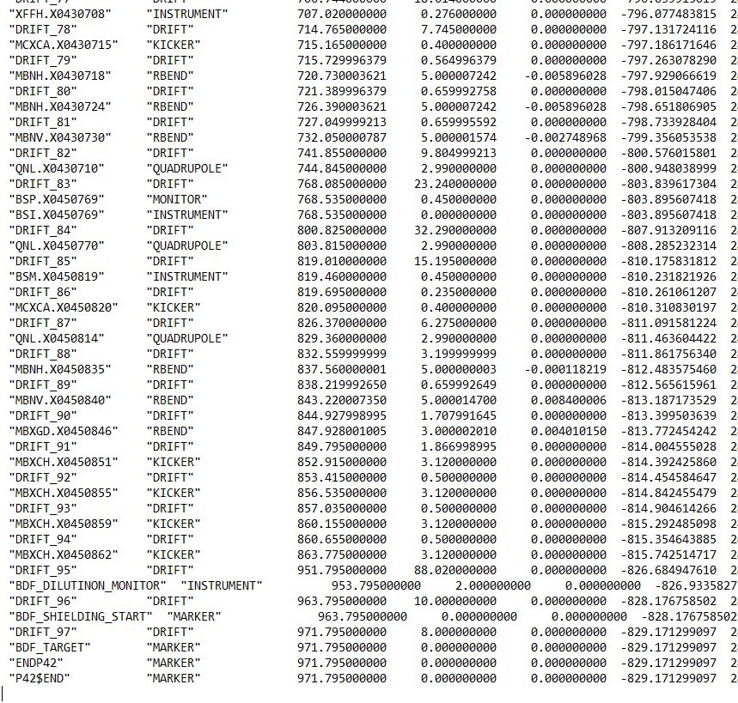
Naming of the elements
Naming of some of the elements not corresponding with the distance to the target
Last version (23/05/25, Laurie)

Slide 12




Inputs
Beam dilution system
Last bend adjusted
Is it this OK?
Beam instrumentation
Position TIDVG4 adjusted
Correct C.S.
Last version (23/05/25, Laurie)

Slide 13
Inputs
Gemma and I are currently writing a document to define the layout.
A drawing will be included.
Feedback will most likely be asked soon.
Could you give us a small description of where is starting the beam dilution system and what is exactly the beam instrumentation?
Last version (23/05/25, Laurie)

Slide 14
Next steps
Insert the new MADX files, and update the layout.
Create a drawing of reference of the layout.
Study the possible interferences of the systems and the routing if the services.
Outcome of the meeting
C.S. of the inputs?
Is the list of inputs OK?
EDMS for the exchange of data?
Small description of the modifications?

