Slide 1
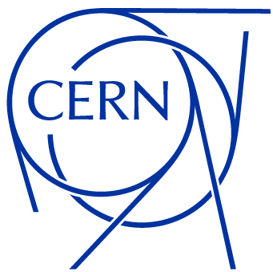
Status update
June 2025
Antonio Cristiano
EP-ESE-BE
BRATOL Meeting

Slide 2
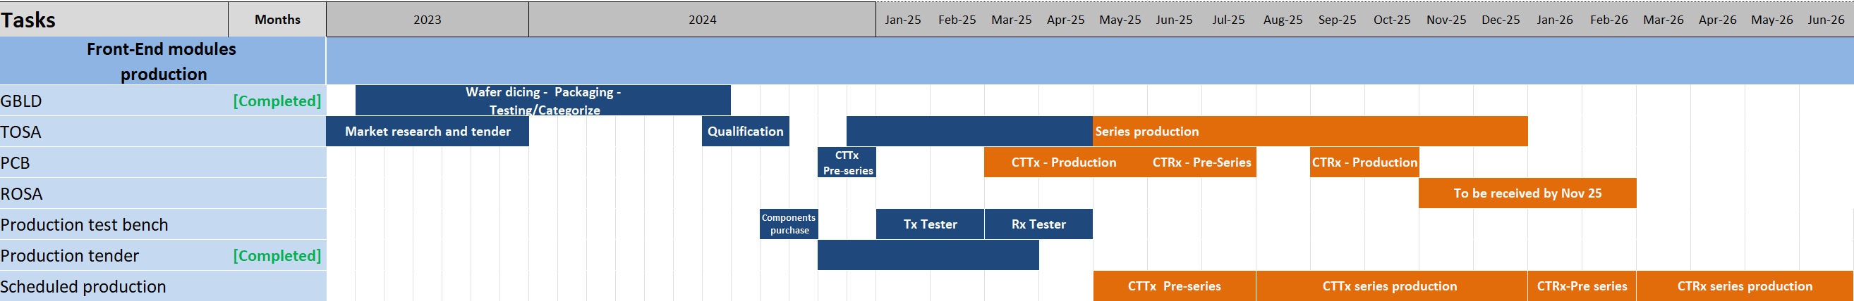

Front-end Modules Production Timeline
PCB
  CTTx PCB series production arrived on the 5th of June.
  A design problem was found:

Slide 3
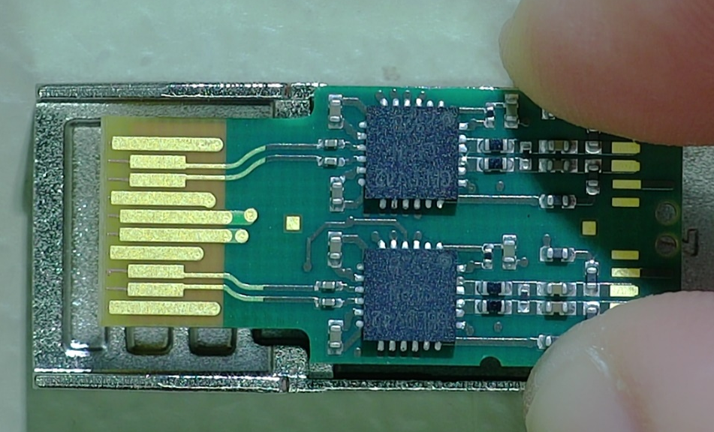
CTTx PCB – Design problem
CTTx PCB - Front side

Slide 4
CTTx PCB – Design problem
CTTx PCB - Front side
1.5 V Power supply decoupling capacitors

Slide 5
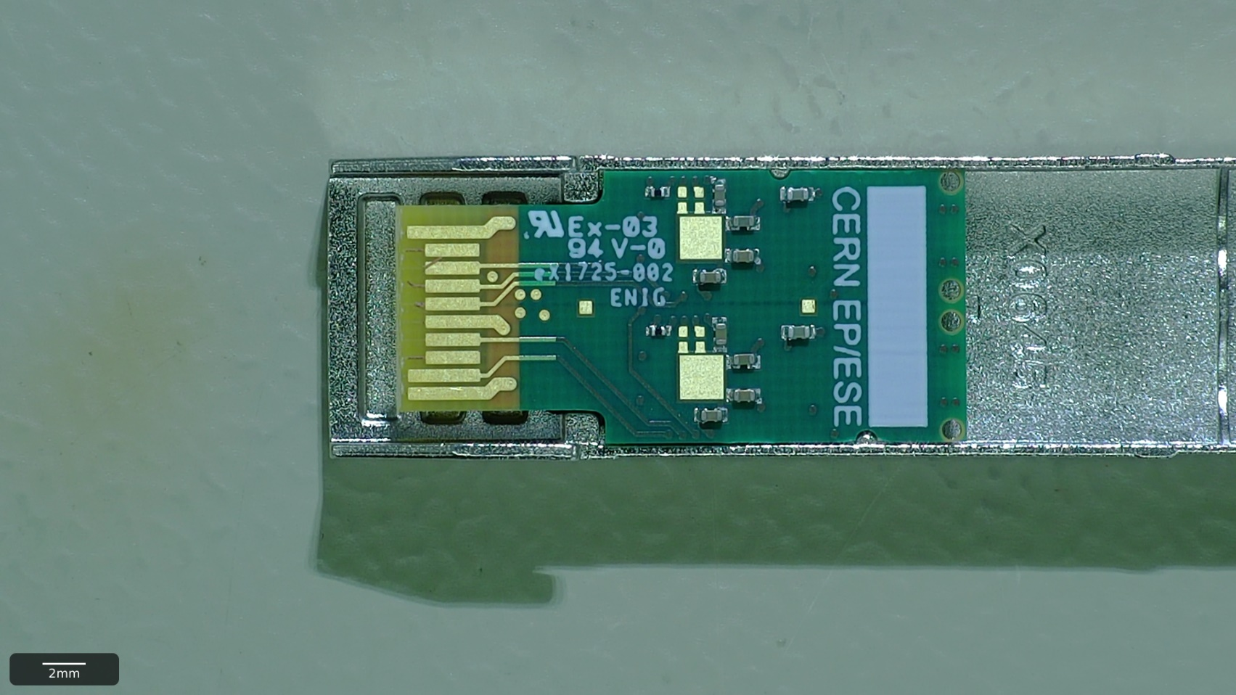
CTTx PCB – Design problem
CTTx PCB - Front side
1.5 V Power supply decoupling capacitors
CTTx PCB - Back side

Slide 6
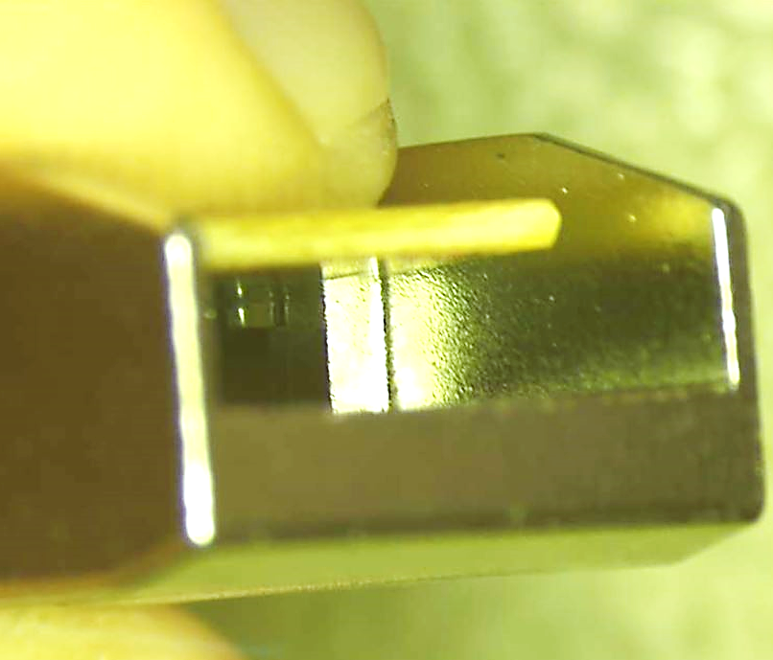
CTTx PCB – Design problem
CTTx PCB - Front side
1.5 V Power supply decoupling capacitors
CTTx PCB - Back side
CTTx Module
Edge connector view

Slide 7
CTTx PCB – Design problem
CTTx PCB - Front side
1.5 V Power supply decoupling capacitors
70% of 30 CTTx tested show a contact between the metal enclosure and the power supply pad.
When metal case is grounded, as in real application, the laser driver stops working.
The modules passed the qualification procedure with the metal case being floating on the automated test system.
Second round of production for PCB required.
CTTx PCB - Back side
CTTx Module
Edge connector view

Slide 8
CTTx PCB production timeline.
360 PCBs
60 PCBs
Today
PCB Redesign and validation
Design submission
Pre-Series
Delivery
Assembly and
qualification
1 w
1 w
4-6 w
1 w
Timeline:
The PCB is redesigned and the drawings are validated for mechanical compatibility and design re-submitted.
The Pre-Series, delivered in 4 to 6 weeks, will consist of 360 PCBs.
60 PCBs will be used for PCB qualification.

Slide 9
CTTx PCB production timeline.
360 PCBs
60 PCBs
Today
PCB Redesign and validation
Design submission
Pre-Series
Delivery
Assembly and
qualification
1 w
1 w
4-6 w
1 w
300 PCBs
Delivery to ROMPAL
CTTx
Pre-Series
CTTx Delivery and qualification
1 w
4 w
4 w
Timeline:
The PCB is redesigned and the drawings are validated for mechanical compatibility and design re-submitted.
The Pre-Series, delivered in 4 to 6 weeks, will consist of 300 PCBs.
60 PCBs will be used for PCB qualification.
Upon qualification, the remaining 300 will be delivered to ROMPAL to start Pre-Series production of CTTx.

Slide 10
CTTx PCB production timeline.
360 PCBs
60 PCBs
Today
PCB Redesign and validation
Design submission
Pre-Series
Delivery
Assembly and
qualification
Series production and delivery
Assembly and
qualification
Delivery to ROMPAL
1 w
1 w
4-6 w
1 w
4-6 w
1 w
1 w
300 PCBs
Delivery to ROMPAL
CTTx
Pre-Series
CTTx Delivery and qualification
1 w
4 w
4 w
Timeline:
The PCB is redesigned and the drawings are validated for mechanical compatibility and design re-submitted.
The Pre-Series, delivered in 4 to 6 weeks, will consist of 360 PCBs.
60 PCBs will be used for PCB qualification.
Upon qualification, the remaining 300 will be delivered to ROMPAL to start Pre-Series production of CTTx.
While the Pre-Series of CTTx is manufactured, delivered at CERN and qualified, the remaining PCBs intended for series production are manufactured, qualified and delivered to ROMPAL.

Slide 11
CTTx PCB production timeline.
360 PCBs
60 PCBs
Today
PCB Redesign and validation
Design submission
Pre-Series
Delivery
Assembly and
qualification
Series production and delivery
Assembly and
qualification
Delivery to ROMPAL
1 w
1 w
4-6 w
1 w
4-6 w
1 w
1 w
CTTx Series production
300 PCBs
Delivery to ROMPAL
CTTx
Pre-Series
CTTx Delivery and qualification
1 w
4 w
4 w
Timeline:
The PCB is redesigned and the drawings are validated for mechanical compatibility and design re-submitted.
The Pre-Series, delivered in 4 to 6 weeks, will consist of 360 PCBs.
60 PCBs will be used for PCB qualification.
Upon qualification, the remaining 300 will be delivered to ROMPAL to start Pre-Series production of CTTx.
While the Pre-Series of CTTx is manufactured, delivered at CERN and qualified, the remaining PCBs intended for series production are manufactured, qualified and delivered to ROMPAL.
CTTx Series Production is started.

Slide 12
CTTx PCB production timeline.
7-9 w
6-8 w
360 PCBs
60 PCBs
Today
PCB Redesign and validation
Design submission
Pre-Series
Delivery
Assembly and
qualification
Series production and delivery
Assembly and
qualification
Delivery to ROMPAL
1 w
1 w
4-6 w
1 w
4-6 w
1 w
1 w
CTTx Series production
300 PCBs
Delivery to ROMPAL
CTTx
Pre-Series
CTTx Delivery and qualification
1 w
4 w
4 w
9 w
Timeline:
The PCB is redesigned and the drawings are validated for mechanical compatibility and design re-submitted.
The Pre-Series, delivered in 4 to 6 weeks, will consist of 360 PCBs.
60 PCBs will be used for PCB qualification.
Upon qualification, the remaining 300 will be delivered to ROMPAL to start Pre-Series production of CTTx.
While the Pre-Series of CTTx is manufactured, delivered at CERN and qualified, the remaining PCBs intended for series production are manufactured, qualified and delivered to ROMPAL.
CTTx Series Production is started.
Total delay on CTTx start of production ~ 8-10 w.
Additional cost foreseen ~ 10-11 kCHF.

Slide 13
CTTx PCB production timeline.
Previous production schedule
Current production schedule
Production schedule to be proposed
ROMPAL previously mentioned the possibility of increasing volume production up to the values of VTRx production (~2000 modules/month).
The production schedule shown above will be discussed shortly.

Slide 14
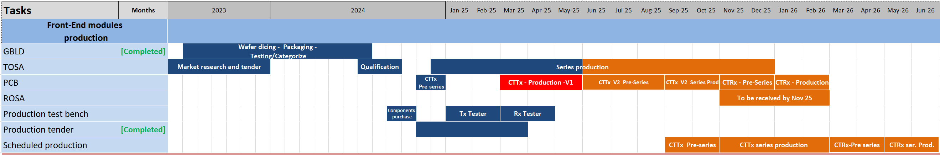
Front-end Modules Production Timeline

Slide 15
Front-end Modules Production Timeline
PCB
  CTTx PCB series production arrived on the 5th of June.
  A design problem was found.
  The problem called for a new PCB design. 8-10 weeks of delay foreseen to start the production.
TOSA
  LOTs 4 and 5 Qualified and accepted.

Slide 16
TOSA Lot 4-5 acceptance
Static tests results
Dynamic tests results

Slide 17
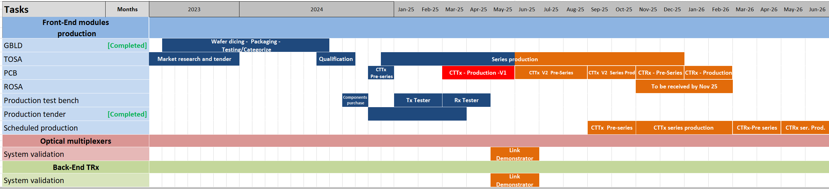
Optical Multiplexers and Back-End components
Link demonstrator:
  Test system for the optical link implemented.

Slide 18
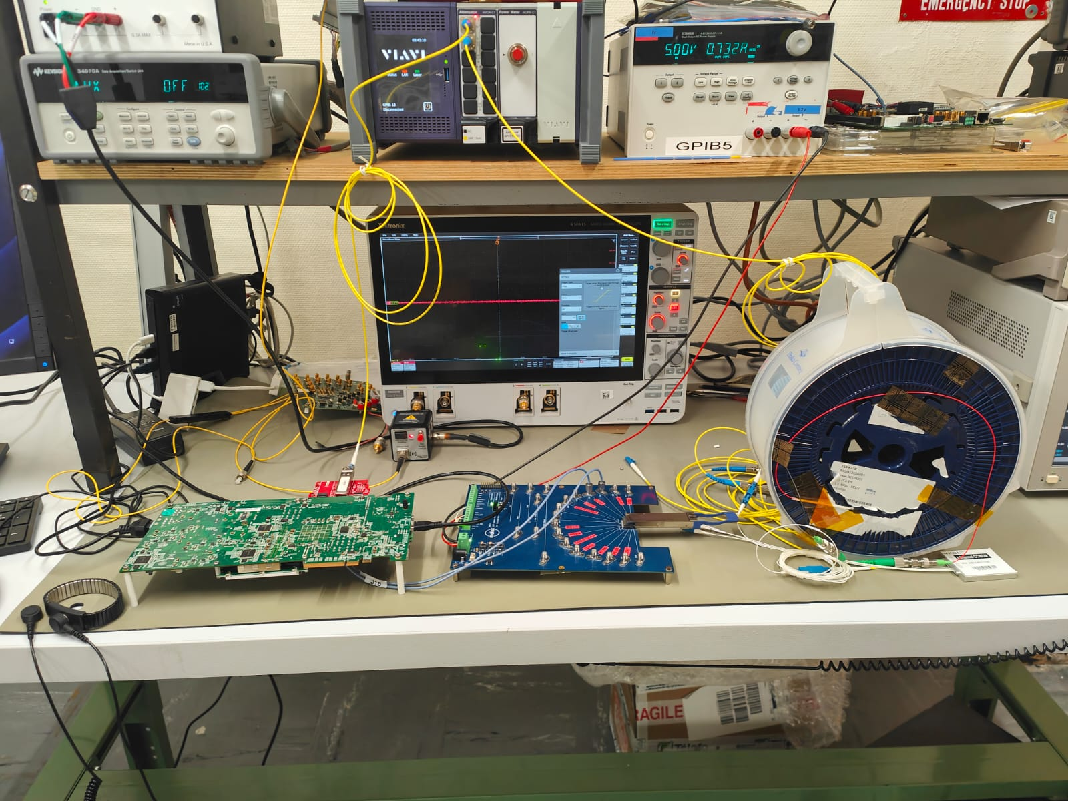
Link demonstrator

Slide 19
Link demonstrator
Optical Variable Attenuator (OVA)
3 km SM Fibre + Optical MUX
FPGA KC705 +
FMC & CTTx
QSFP board +
QSFP Module

Slide 20
Optical Multiplexers and Back-End components
Link demonstrator:
  Test system for the optical link implemented.
  Preliminary results obtained with only two optical signals transmitted simultaneously.

Slide 21
Link demonstrator – Preliminary results
CTTx V1
Preliminary results obtained with two CTTx of different variant (1271/1291 nm and 1311/1331 nm)
Insertion losses of each channel of the multiplexer were measured before the link test.
λ= 1271 nm
Tx OMA = 2.5 dB
λ= 1291 nm
Tx OMA = 2.41 dB
CTTx V2
λ= 1311 nm
Tx OMA = 2.44 dB
λ= 1331 nm
Tx OMA = 2.31 dB
Optical multiplexer : ACALbfi 4x1 MUX
Insertion losses = 1±0.2 dB
QSFP : Skylane QFPQL010400D
Rx Sensitivity <-11.5 dBm

Slide 22
Link demonstrator – Preliminary results
All the measurements were carried on with only two optical signals transmitted.
CTTx
OVA
QSFP
CTTx V1 – CH1
CTTx V2 – CH1
CTTx V1 – CH2
CTTx V2 – CH2

Slide 23
Link demonstrator – Preliminary results
All the measurements were carried on with only two optical signals transmitted.
CTTx
OVA
MUX
QSFP
CTTx V1 – CH1
CTTx V2 – CH1
CTTx V1 – CH2
CTTx V2 – CH2

Slide 24
Link demonstrator – Preliminary results
3 km fibre
All the measurements were carried on with only two optical signals transmitted.
In the setup with the 3 km optical fibre included in the chain, for the CTTx V2 link was unstable also at 0 db attenuation.
CTTx
OVA
MUX
QSFP
CTTx V1 – CH1
CTTx V2 – CH1
CTTx V1 – CH2
CTTx V2 – CH2

Slide 25
Link demonstrator – Preliminary results
3 km fibre
All the measurements were carried on with only two optical signals transmitted.
In the setup with the 3 km optical fibre included in the chain, for the CTTx V2 link was unstable also at 0 db attenuation.
The CTTx V1 link show a remaining power budget greater than 8 dB, enough to accommodate the:
  Tx penalties: 2.7 dB
  RIA : 1 dB
A better analysis on the CTTx V2 unstable link will follow.
CTTx
OVA
MUX
QSFP
CTTx V1 – CH1
CTTx V2 – CH1
Power budget > 8 dB
CTTx V1 – CH2
CTTx V2 – CH2
Power budget > 9 dB

Slide 26
Summary and next steps
Front-End modules production:
  Design mistake of CTTx PCB discovered.
  ~2 months of delay from now to start the production.
  New volumes of production will be discussed with ROMPAL to recover from the delay.
  TOSA LOT4 and LOT5 qualified and accepted.
  QA samples will be “patched up” and distributed.
MUX and Back-End components validation:
  Link demonstrator hardware and software ready.
  Preliminary measurements have been performed transmitting only two of the four channels.
  The full link using the CTTx V2 selected for the test was unstable, the analysis of the problem will follow.
  An additional FPGA board was procured to transmit in parallel the four channels.

