Slide 1
TCC8 dismantling
QUINQUIS Nicolas
18/06/25

Slide 2
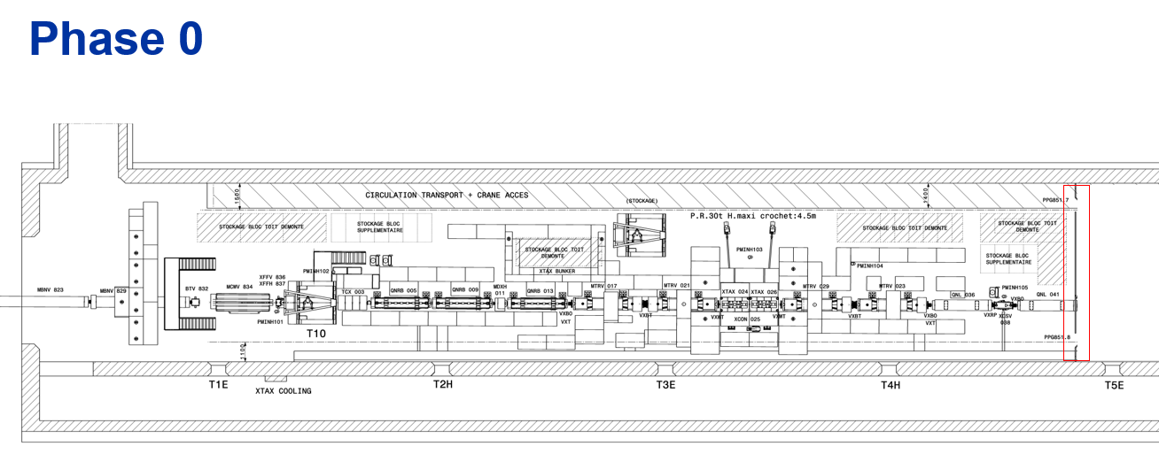
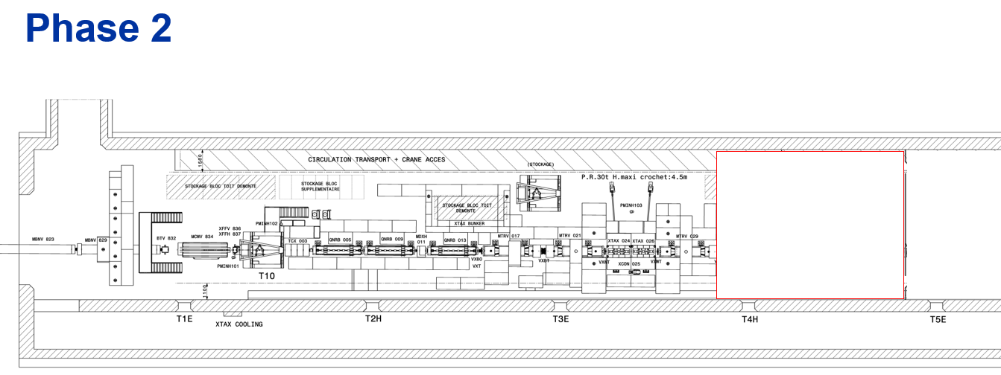
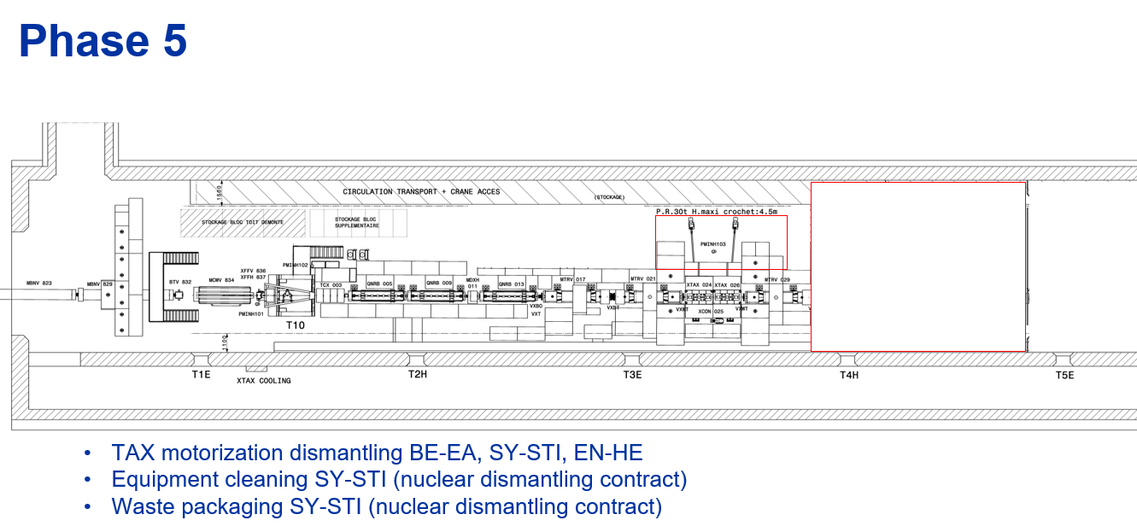
Dismantling stages scenario

Slide 3
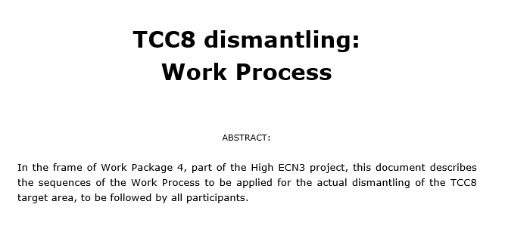
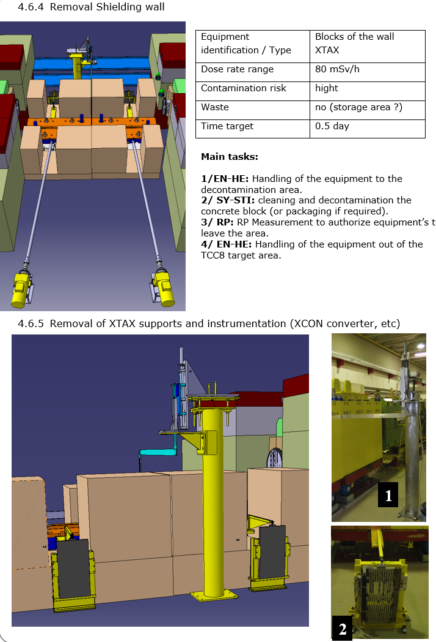
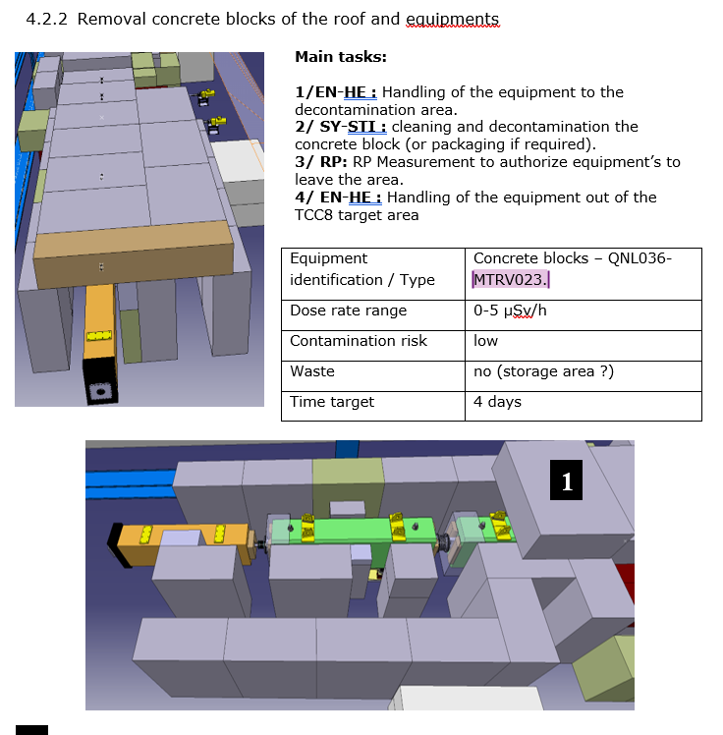
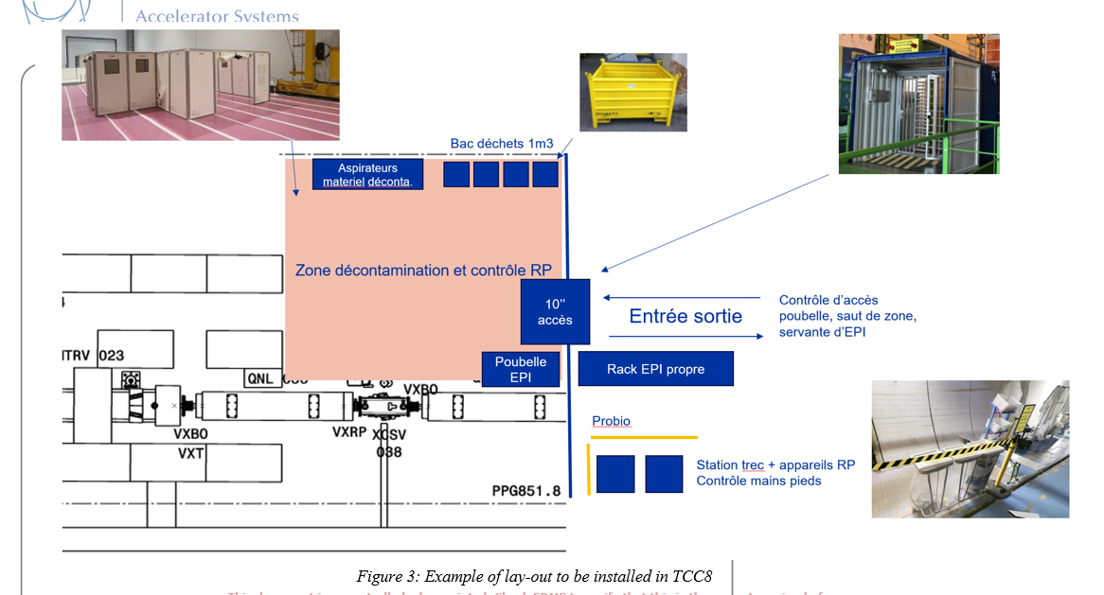
Dismantling stages scenario

Slide 4
Dismantling stages scenario
Goal of this document :
Define and order each step, define the resources needed and groups invovled
Tools and process preparation (eg : bunker for XTAX dismantling or loading, container for transport, etc)
Overview of this operation to prepare the work and dose planning, planning, ALARA comittee, etc.
Next steps :
Review and comments on the document from the involved groups
Choose and assess solution for specific tasks (XTAX dismantling, target)
Transport and RWM requirements => Handling process and containers needed => dismantling process.
EN HE | Cristina G., Roberto R.
HSE RP | Yann P., Claudia A.
EN | Sylvain G.
TE-MSC | Philip Schwarz
BE-EA | Philippe Boisseaux

Slide 5
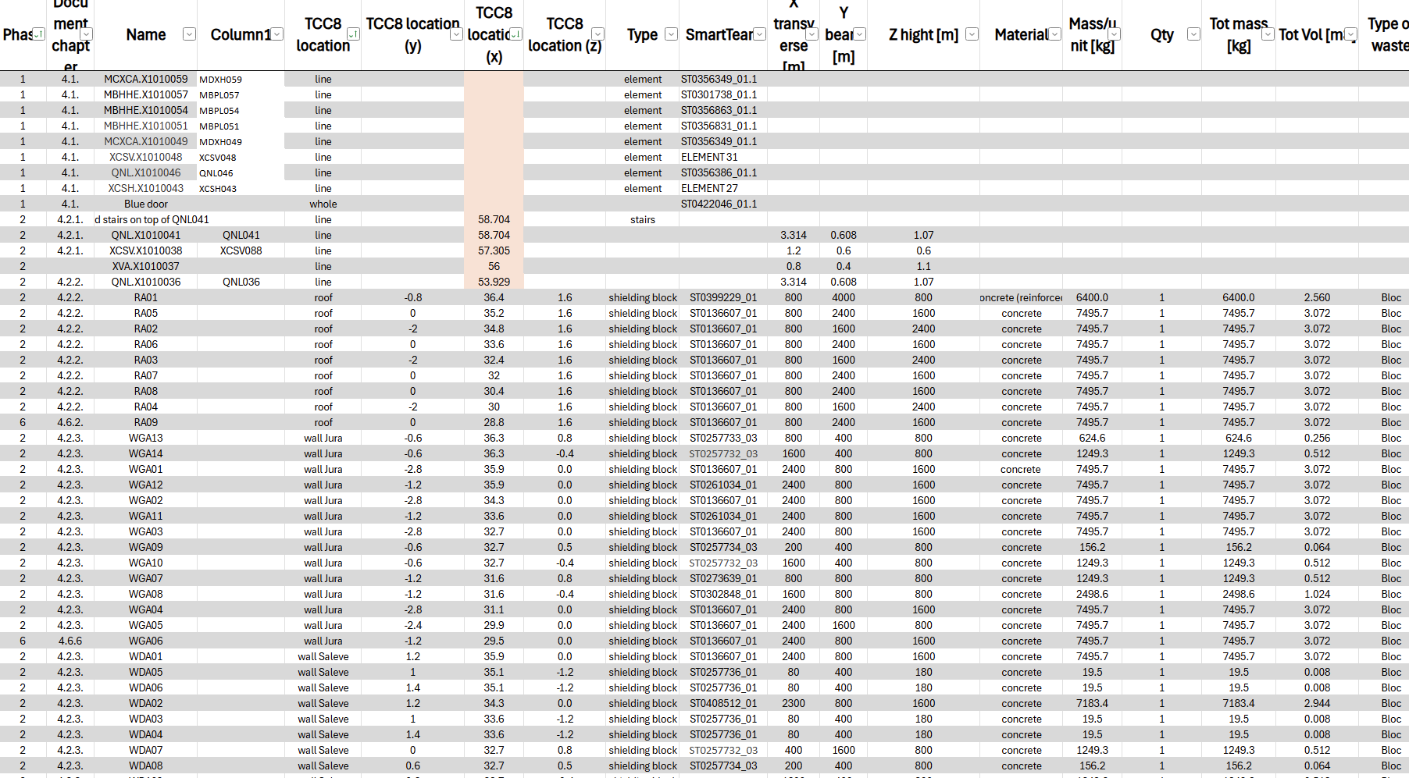
Inventory of material

Slide 6
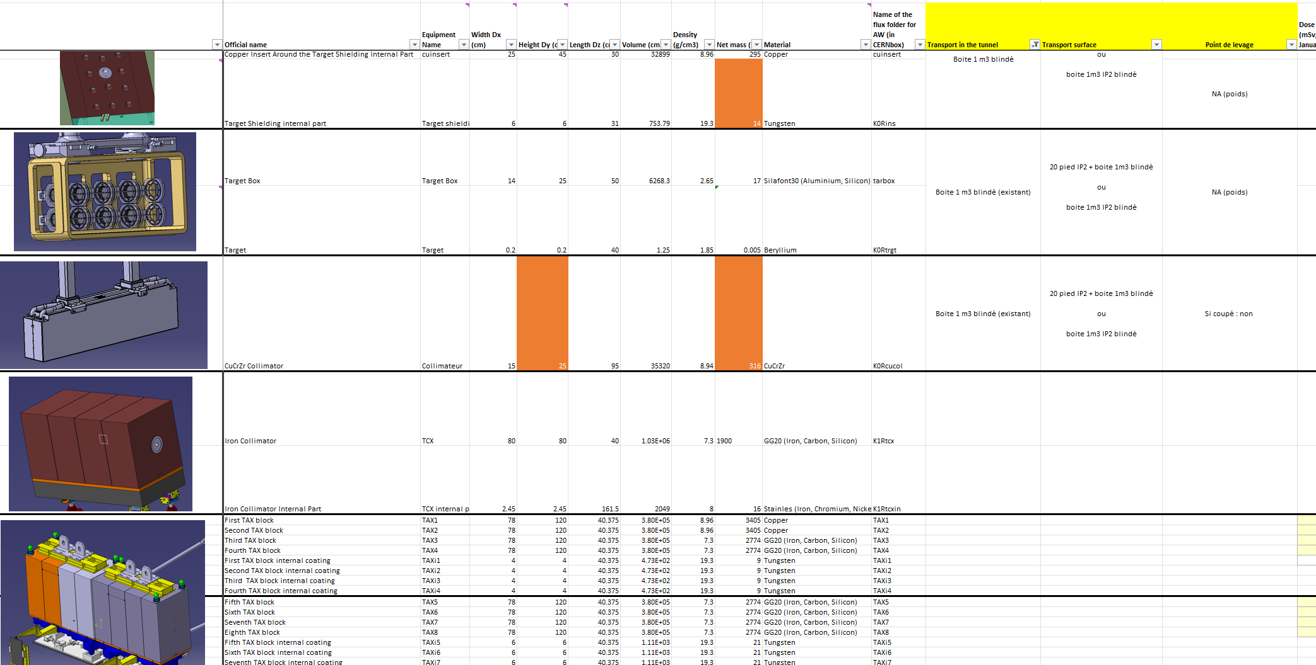
Hot items and tranport

Slide 7
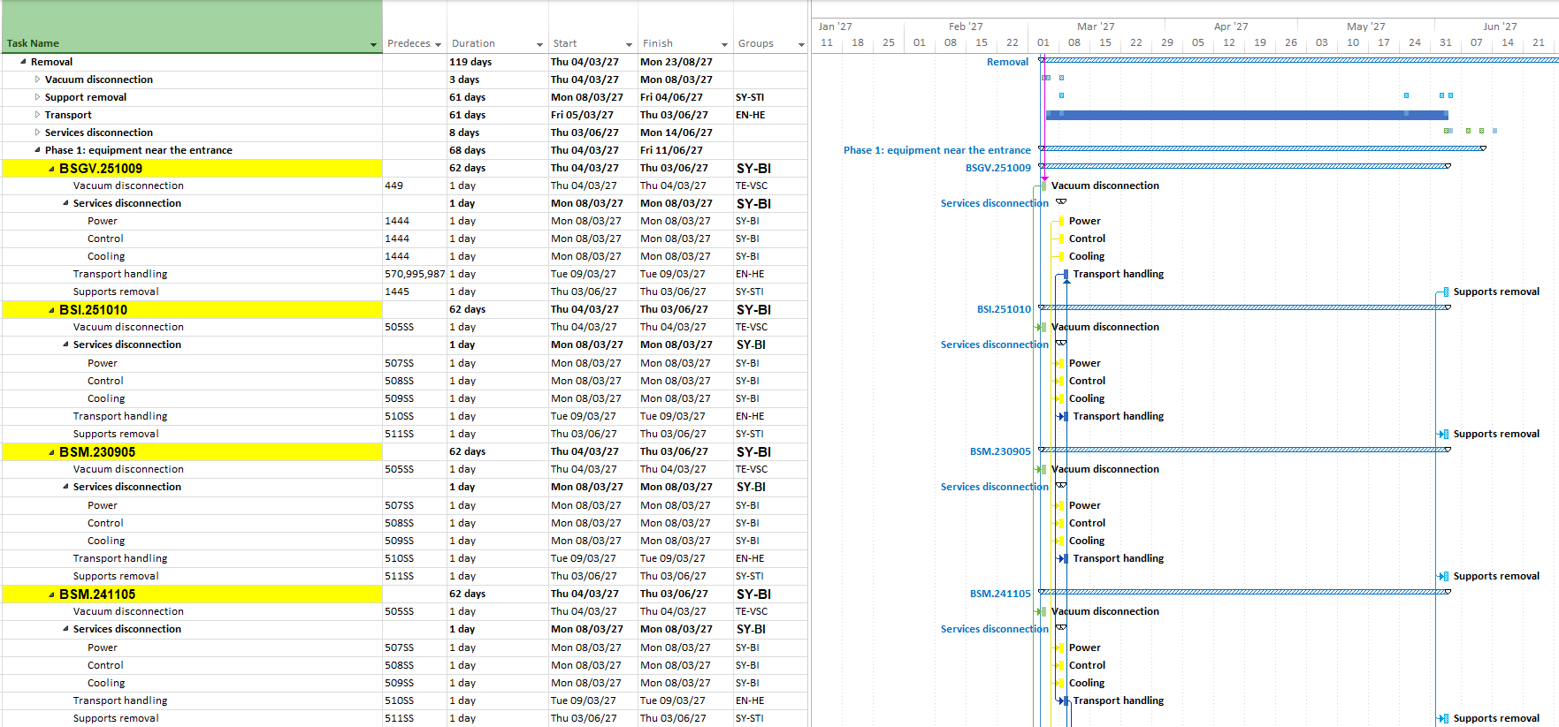
Dismantling schedule example:
Activities duration
Activities per magnet
* The connection between different elements it is done with the constrains of the activities e.g.: only 4 magnets can be transported per day or for the radioactive supports only 6 can be removed per day

