Slide 1
Target station configuration & Vacuum vessel design study
Gemma Humphreys
18/06/2025

Slide 2
Introduction
Feedthroughs
FLUKA Differences
Sample Testing
Specification

Slide 3
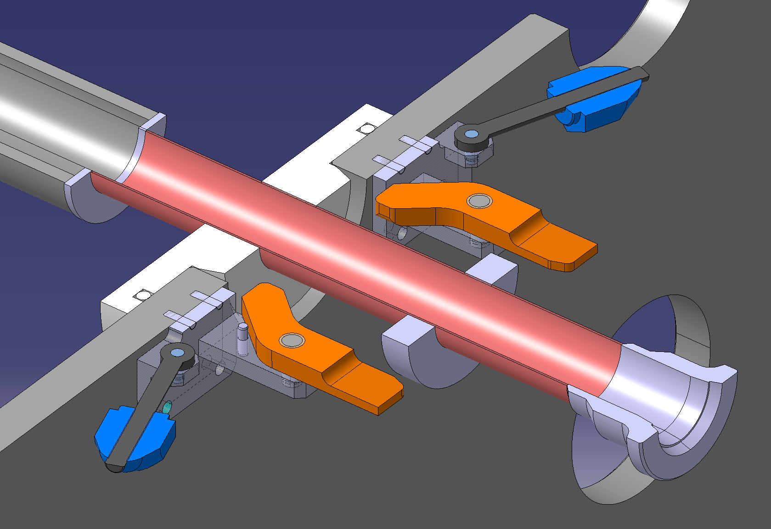
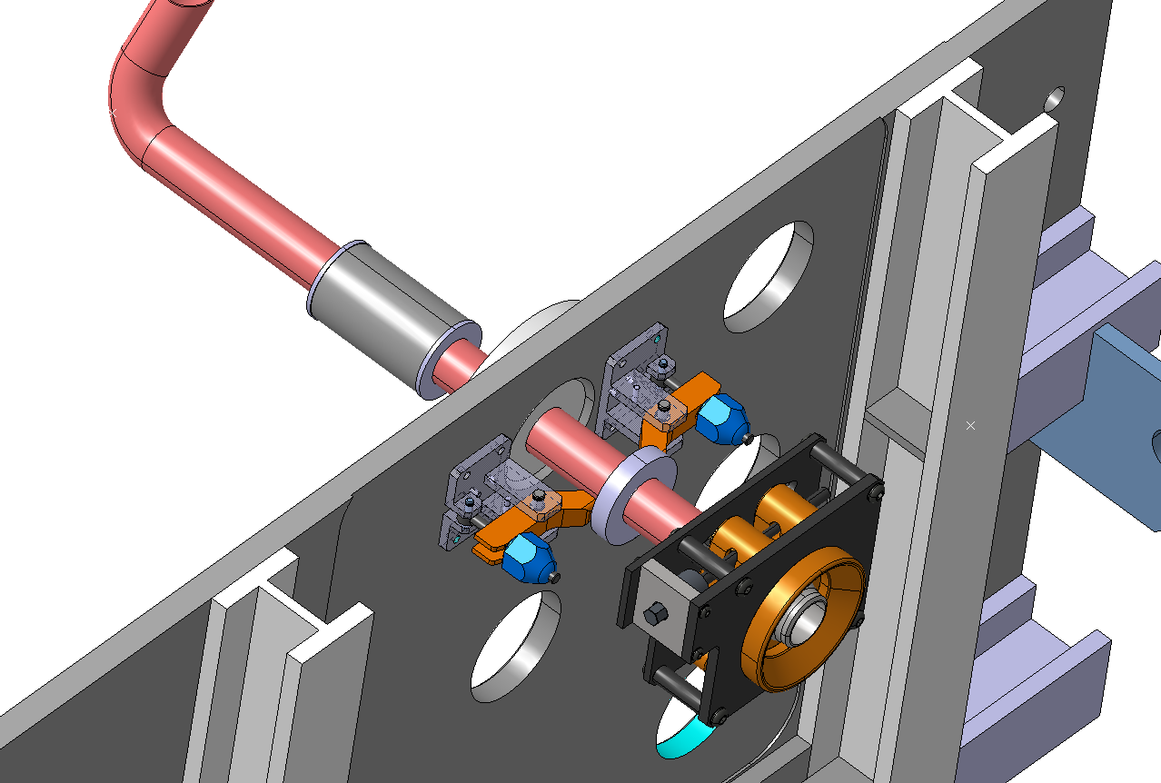
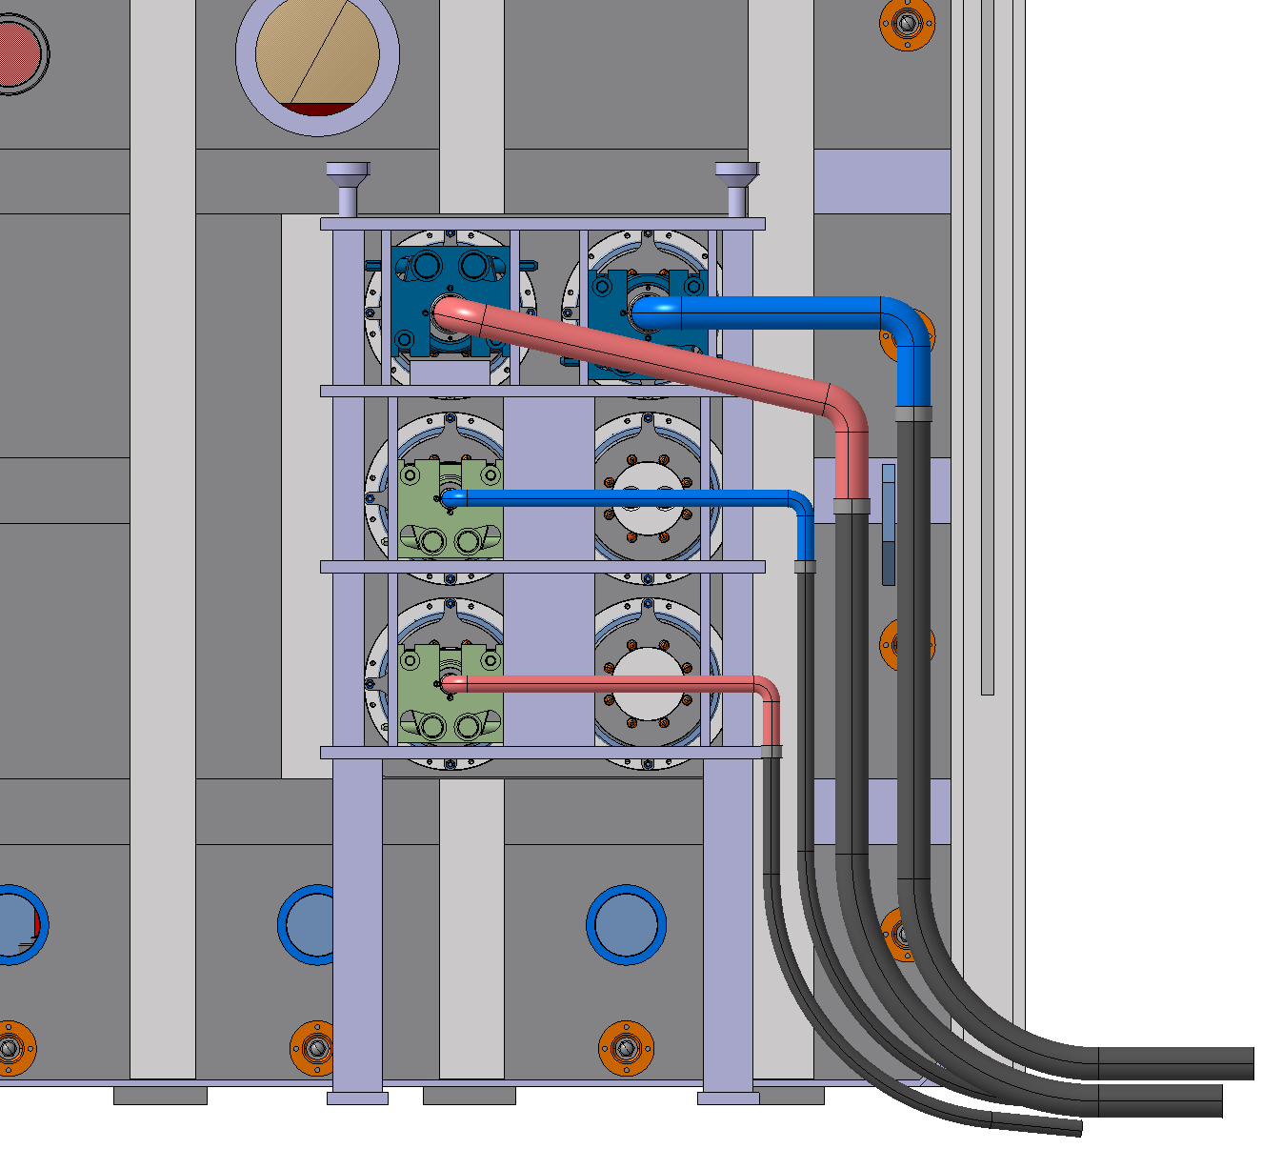
Feedthroughs
Feedthroughs brainstorming discussion held in May
Support structure and clamping mechanism proposed
Possibility to launch a design study covering the connector design, integration with surroundings and leak testing the connection. The full extent of the study is to be clarified.
Flexible pipe section
Clamp
Remote Connector Attachment
Support Structure
Flexible Pipe

Slide 4
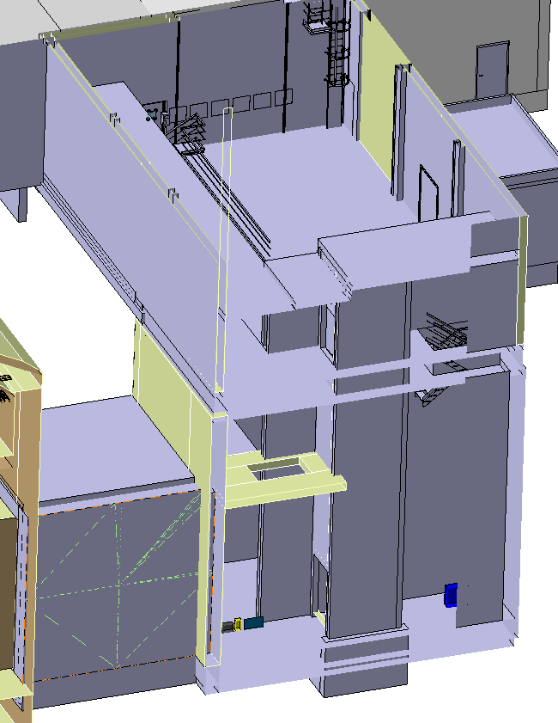
FLUKA Differences
Comparison between FLUKA and CATIA being checked
Major differences so far:
Shielding gap next to MHS
Room missing in the CATIA model
Differences in thickness of the proximity shielding and slight positional differences
Floor height differences
More Differences to be identified

Slide 5
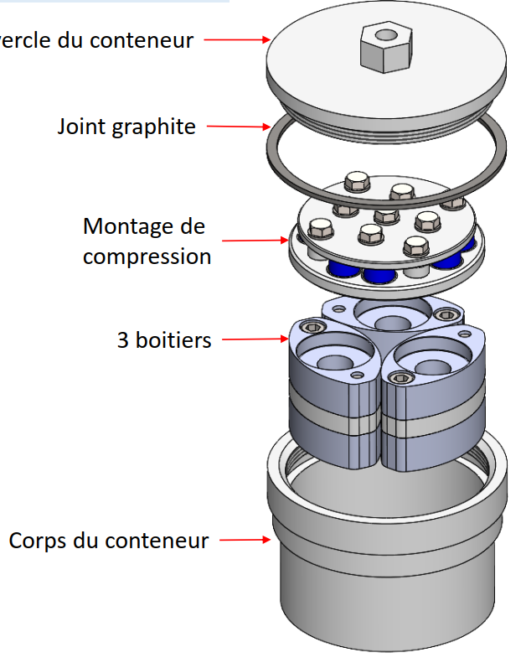

Vacuum Vessel Door Seal Sample Testing
Samples to be irradiated at n_TOF under compression (10% compression rate)
3 irradiation containers, 3 dose rates (1,2,3 months)
  6 O rings
  12 Round samples
Round Samples 13mmø 6mm thickness
3 materials
  1 EPDM
  2 silicon rubber
4 samples per material
O Rings 20mmø 3mm thickness
3 materials
  1 EPDM
  2 silicon rubber
2 samples per material
Tests to be conducted:
Leak Test (O-rings)
Compression
Tensile Strength
Weight loss
Elongation at break
83.5mm

Slide 6
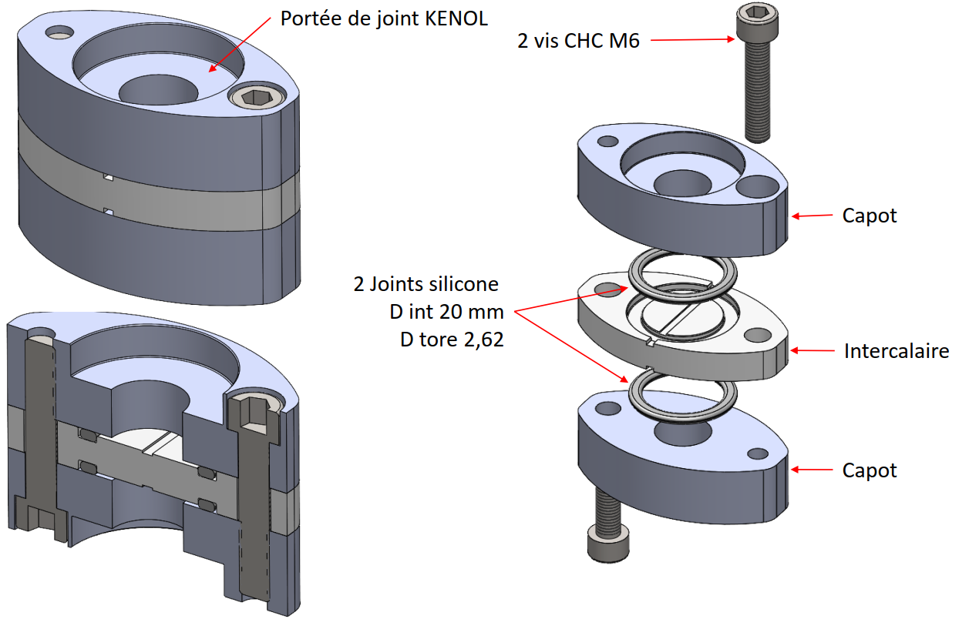
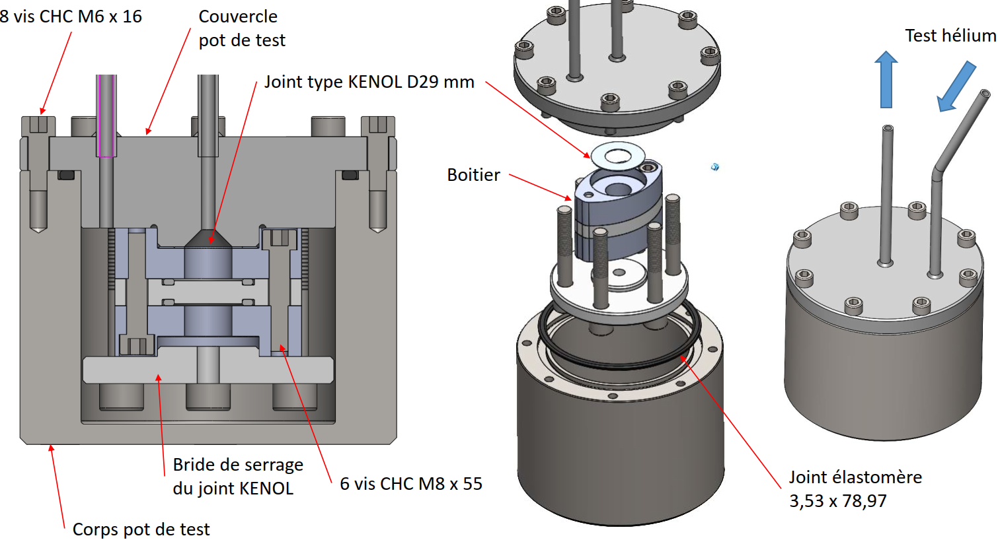
Leak Testing
Technetics to develop a leak test rig for the O ring seals
Vacuum pump to direct helium to 1 seal and use mass spectrometer to measure any leaks

Slide 7
Vacuum Vessel Specification
Specification almost complete
Aim to be finished by end of June
Finalising and checking being completed currently

Slide 9
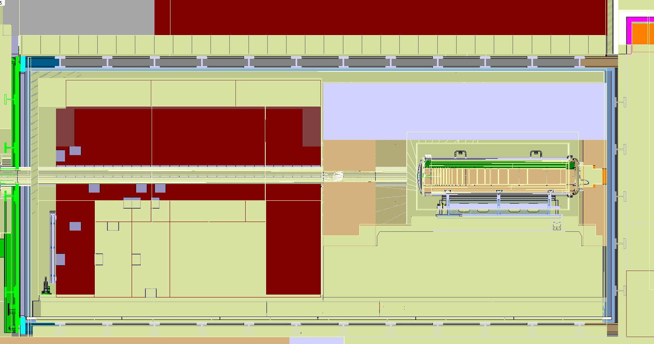
Shielding 530mm thick?, should be 600mm
Vacuum vessel finishes 93mm before
Shielding 190mm longer
Rear shielding 49.5mm further forward
MHS shielding 87mm closer to target than should be
Proximity shielding 900mm thick instead of 550mm
Shielding 855mm thick instead of 695mm

Slide 10
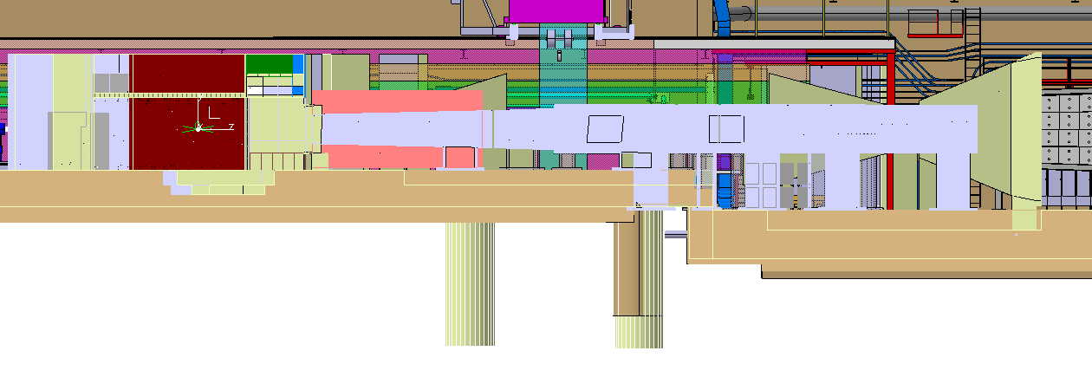

2.6m experiment finishing difference?
374mm offset of shielding pit
610mm Floor height offset
810mm Floor height offset

