Slide 1

HI-ECN3 WP4 coordination meeting #13
Jean-Louis GRENARD
18-6-2025

Slide 2
Agenda
Target complex updates
Target station and vacuum vessel updates → Gemma
Magnetized Hadron Stopper design → Melvin
Target cooling station and target complex ventilation → Nikola & Francesco
Handling studies update → Cristina
TCC8 dismantling → Ixone & Nicola
AOB

Slide 3
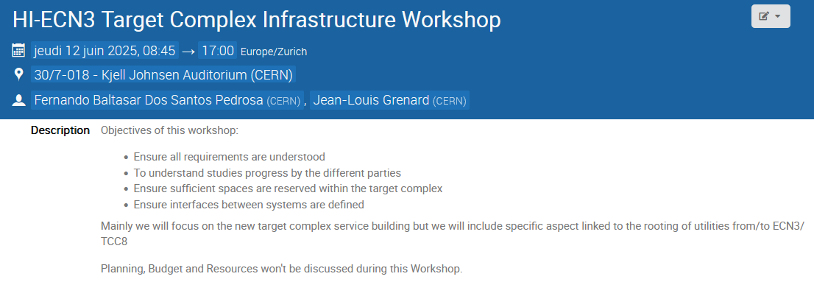
HI-ECN3 Target Complex Infrastructure Workshop
Thanks all for your contributions and the major progress!
https://indico.cern.ch/event/1546119/
Already some discussions triggered following this WS
More general outcomes in the forthcoming weeks

Slide 4
Service cell – design study
Technical specification for design study out
https://edms.cern.ch/document/3264680/1.0
Offers under evaluation

Slide 5
Integration
We need continue our progress with service building integration
Please fill the shared table: Service building design parameters.xlsx
Pending one major concern cooling room size:
Need space for a second compressor to be adressed:
How long will take to replace the compressor in case of failure?
RP constrains, time to prepare the area, replacement, recomissioning, area ‘’cleaning’’
→ What downtime shall we expect out this procedure

Slide 6
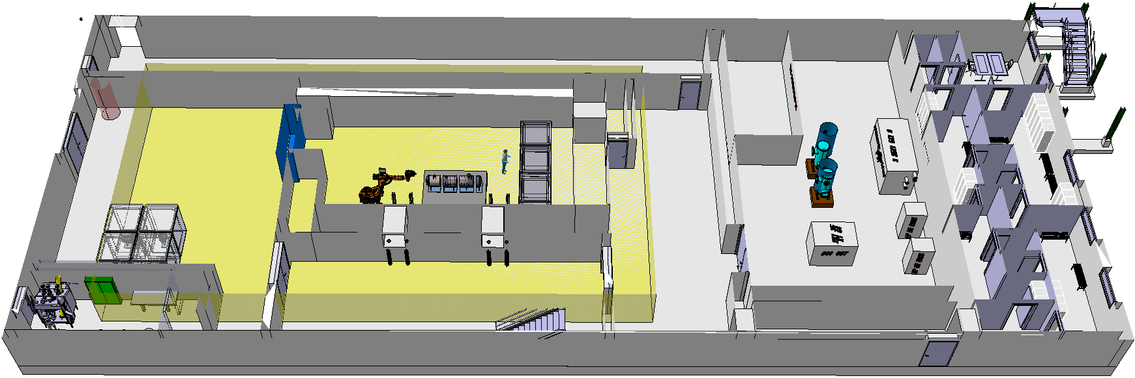
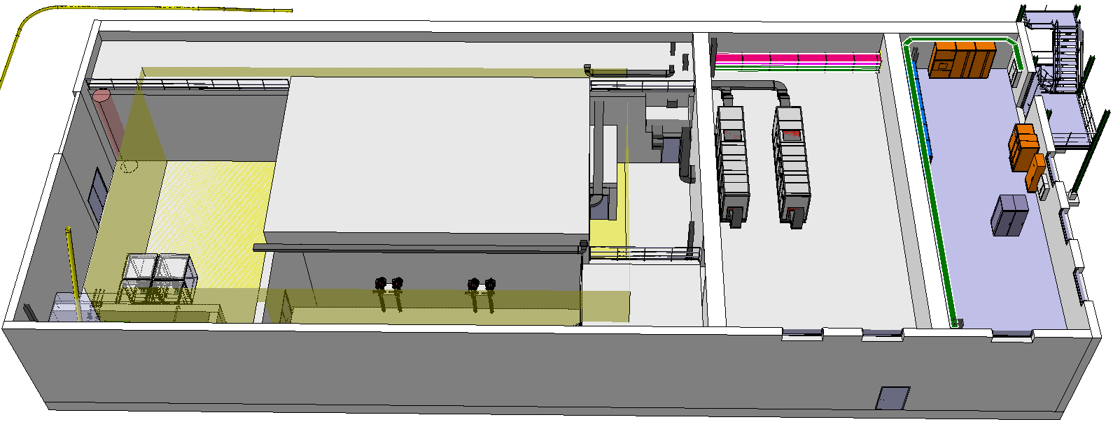
Integration - Service building
1rst floor
Ground floor

Slide 7
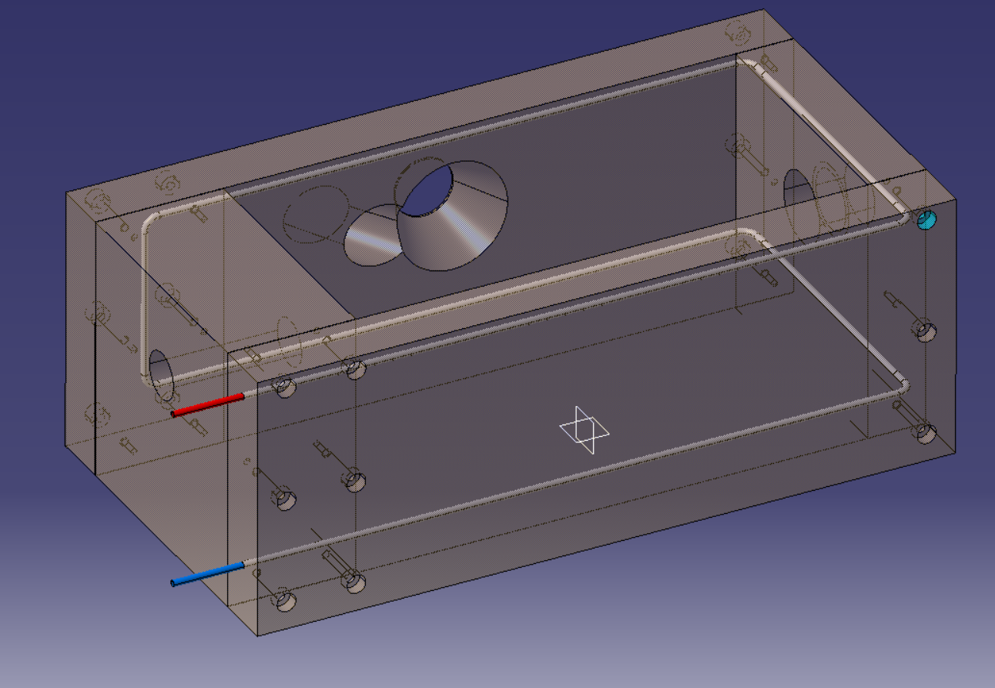
Proximity shielding
Working on a more mechanical design
Bolted casted Cu alloy blocks
Development of cooling channels and associated connections
  Can we cast stainless steel pipes in Cu?
  Shall we embed pipes by diffusion bonding?
  Shall we do deep drilling?
Need to add lifting features → 2 lifting mushrooms
Will discuss this preliminary design with CERN material science team (EN-MME), Cu casting supplier

Slide 8
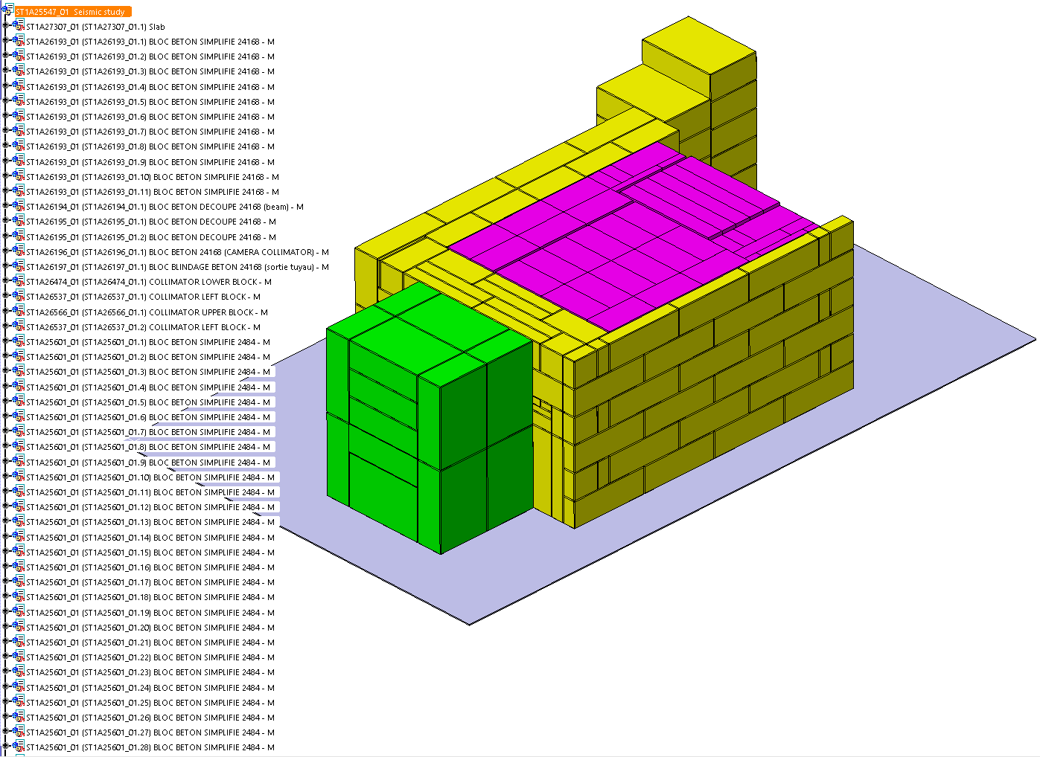
Seismic assesment of target station
Simplified 3d model for seismic assessment feedback from HSE foreseen next week

