Slide 1
EN-HE Updates
HI-ECN3 WP4 - Coordination meeting #13 – C. Duran Gutierrez, R. Rinaldesi – EN-HE
18-06-2025

Slide 2
Content
Building 911 Works
Service Building
  3D Model Update
TCC8
  3D Model Update
    CV Mezzanine
  Transport study: from EHN2 to TCC8
  Retention of 2 cranes in TCC8
Ongoing and future assessments
  ECR
  15T crane in Cooling room (B754)

Slide 3
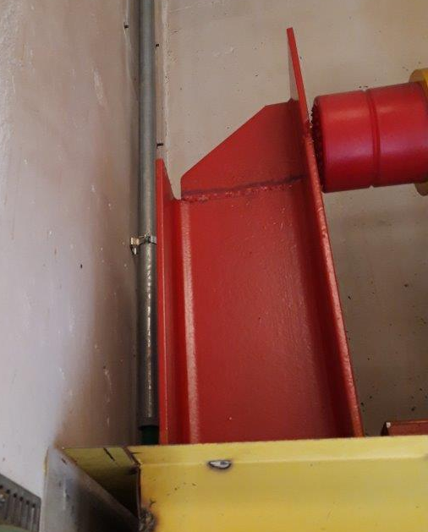
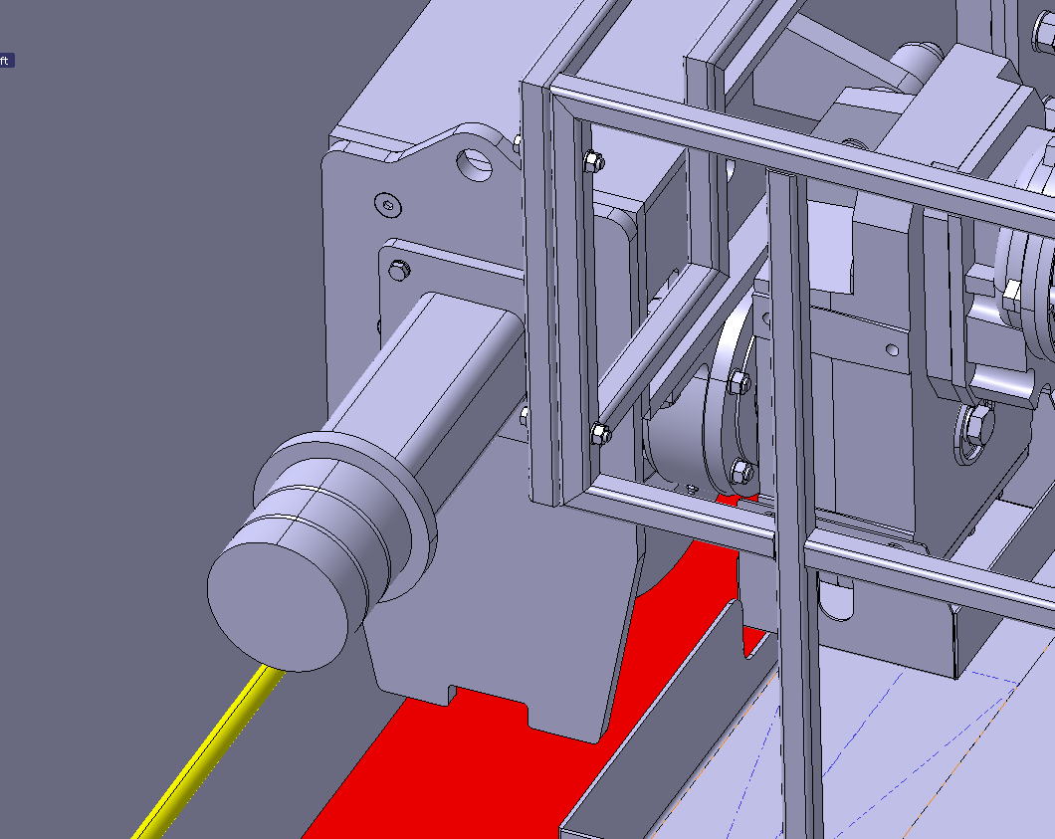
Building 911 works
Initial plan to increase crane coverage
Alternative
Cut the existing end stops and replace them with a steel plate anchored to the concrete wall. → Not possible
Extra coverage ≈ 300 mm
Crane modification – Removal of end bumper extension
Extra coverage ≈ to be verified on site (around 300mm as well)

Slide 4
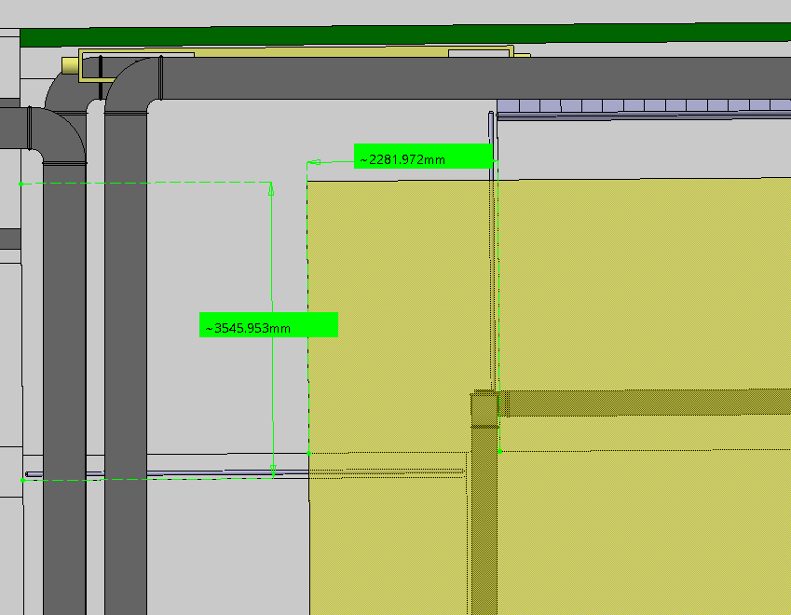
Service Building
1300 mm interference
3D Model Update
Crane coverage (30T)*
Area covered in the mezzanine
2280 x 3545 mm (provisional)
Pending assessment:
Conflicts with the duct layout

Slide 5
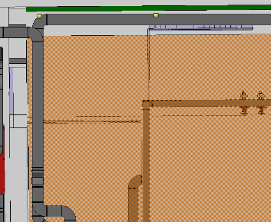
Service Building
3D Model Update
Auxiliary hoist (2.5T)*
To minimize the loss of coverage, the location of the auxiliary hoist will be determined based on the duct layout and the elevation of the first floor.
The auxiliary hoist could potentially be installed:
On an additional structure on the same side as the maintenance walkway (initial proposal)
On the main trolley (with the 30t hoist)
Other custom solutions
We can also assess the possibility of rotating the crane (the maintenance walkway facing b.911)
Pros – More coverage in the mezzanine
Cons – Less coverage in the handling hall
Auxiliary hoist coverage proposal (1)
Extra coverage (compared to the 30T hook)
Height + 500mm*
Lateral approach + 500mm*
Pending assessment:
Conflicts with the duct layout

Slide 6
Service Building
3D Model Update
To minimize the loss of coverage, the location of the auxiliary hoist will be determined based on the duct layout and the elevation of the first floor.
The auxiliary hoist could potentially be installed:
On an additional structure on the same side as the maintenance walkway (initial proposal)
On the main trolley (with the 30t hoist)
Other custom solutions
We can also assess the possibility of rotating the crane (the maintenance walkway facing b.911)
Pros – More coverage in the mezzanine
Cons – Less coverage in the handling hall
2
1
1
2

Slide 7
TCC8
3D Model Update
3D Models
Crane Coverage | ST1988294_01 | Provisional (Lateral approach to be confirmed)
Transport volumes - Target | ST1988115_01 | Provisional (target volume clashes with shielding – 42mm)
TCC8 Mezzanine Access | ST1A23812_01 | 3000 x 2000
TCC8 Mezzanine monorail | ST1A45062_01 | Coverage: Length – 4800 mm Height – 3120 mm

Slide 8
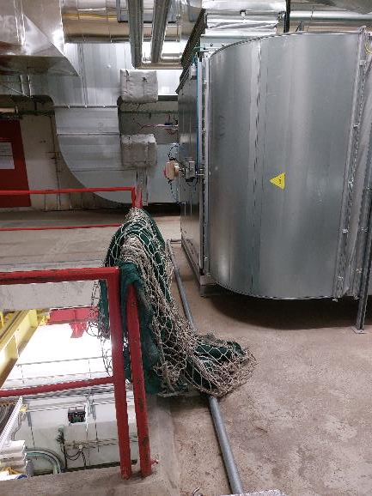
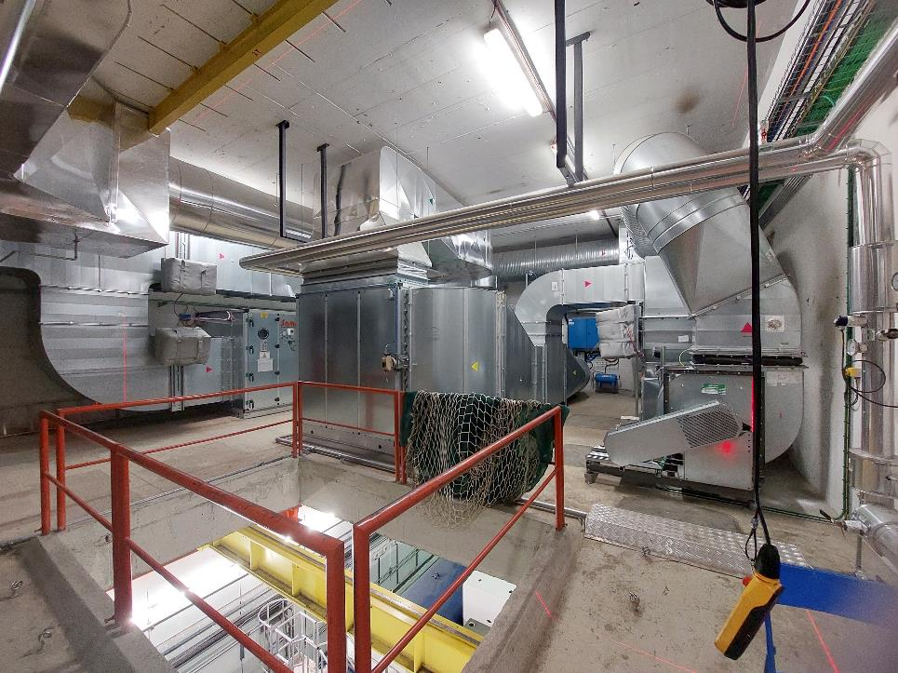
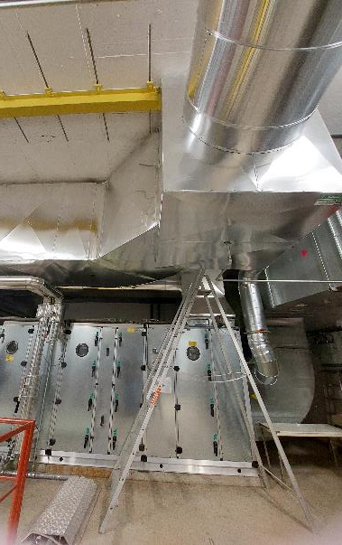
TCC8
CV Mezzanine
900
200 mm step around the opening

Slide 9
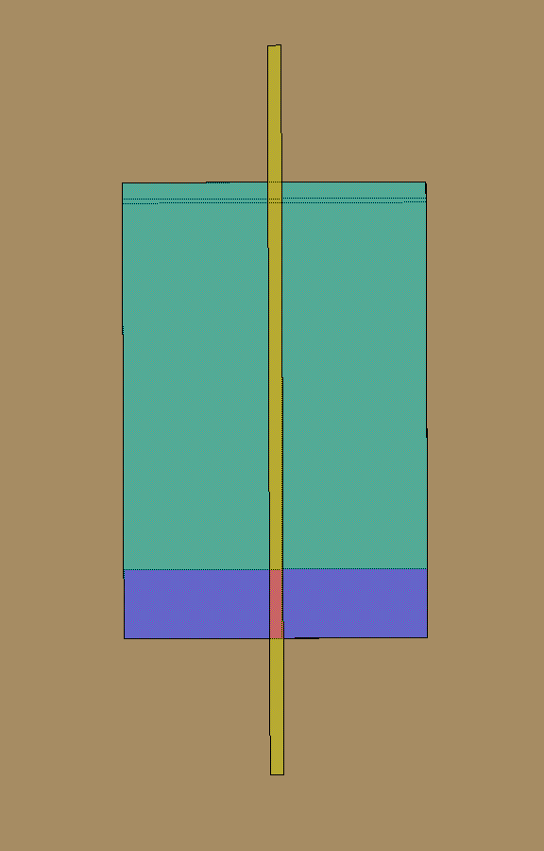
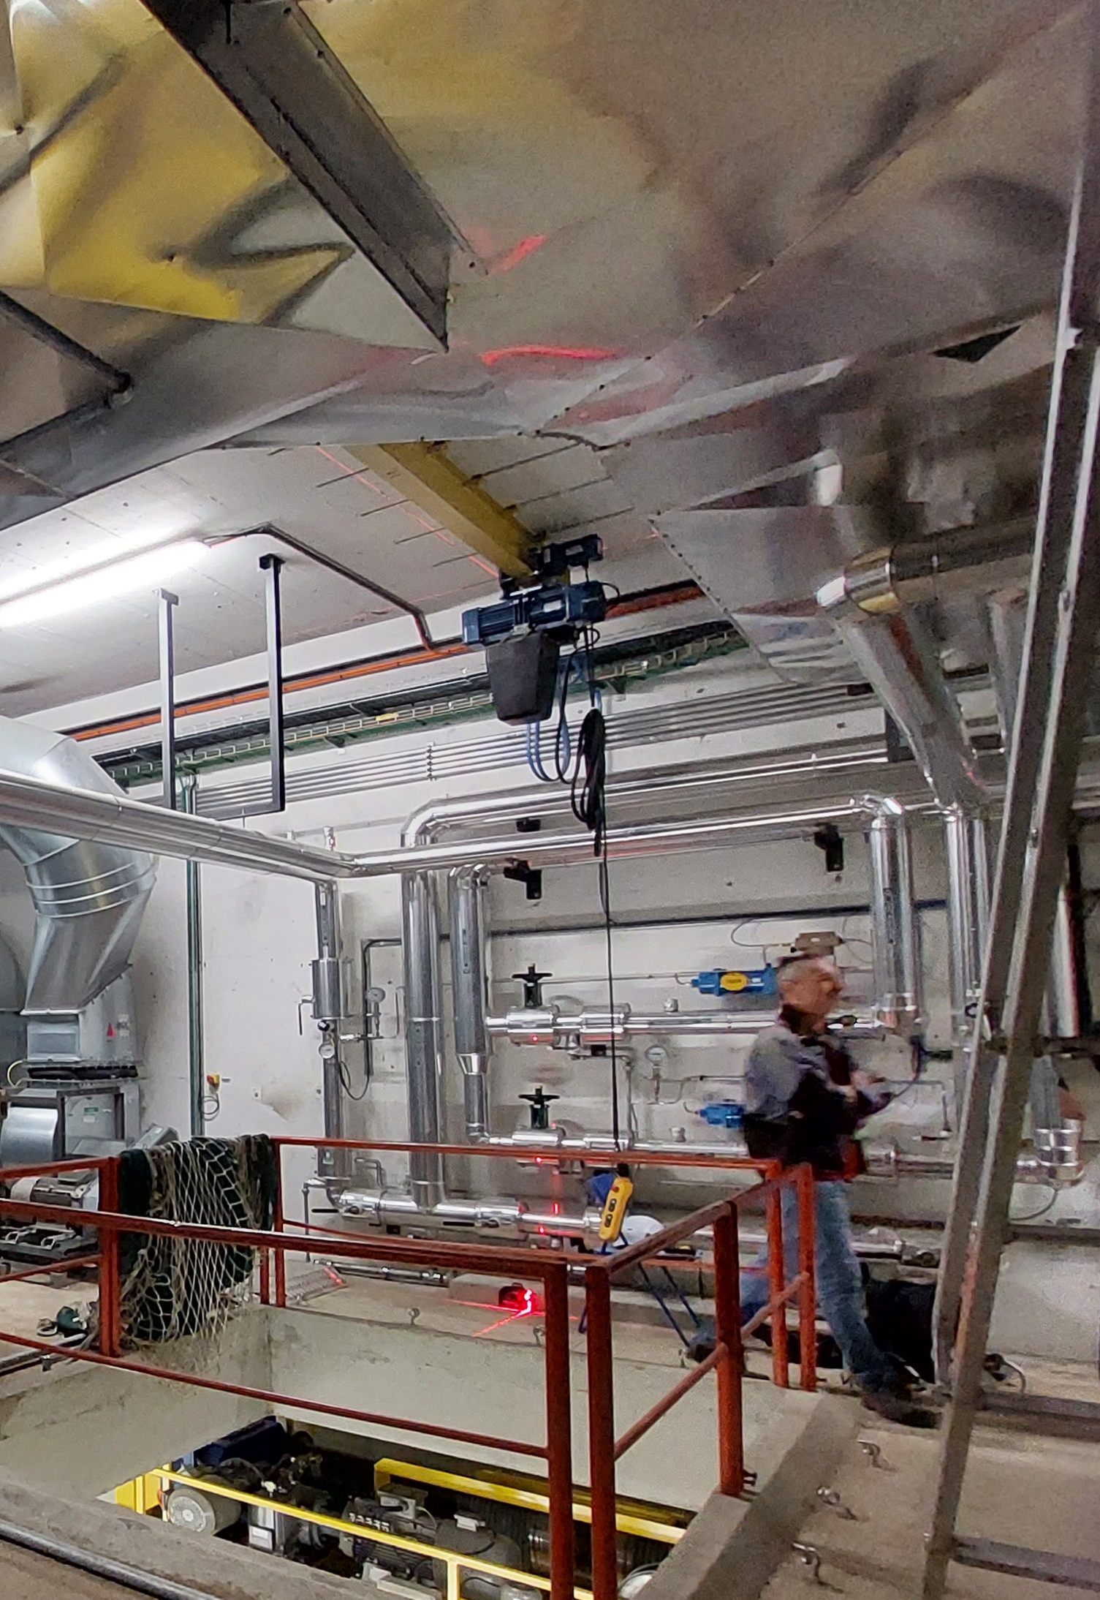
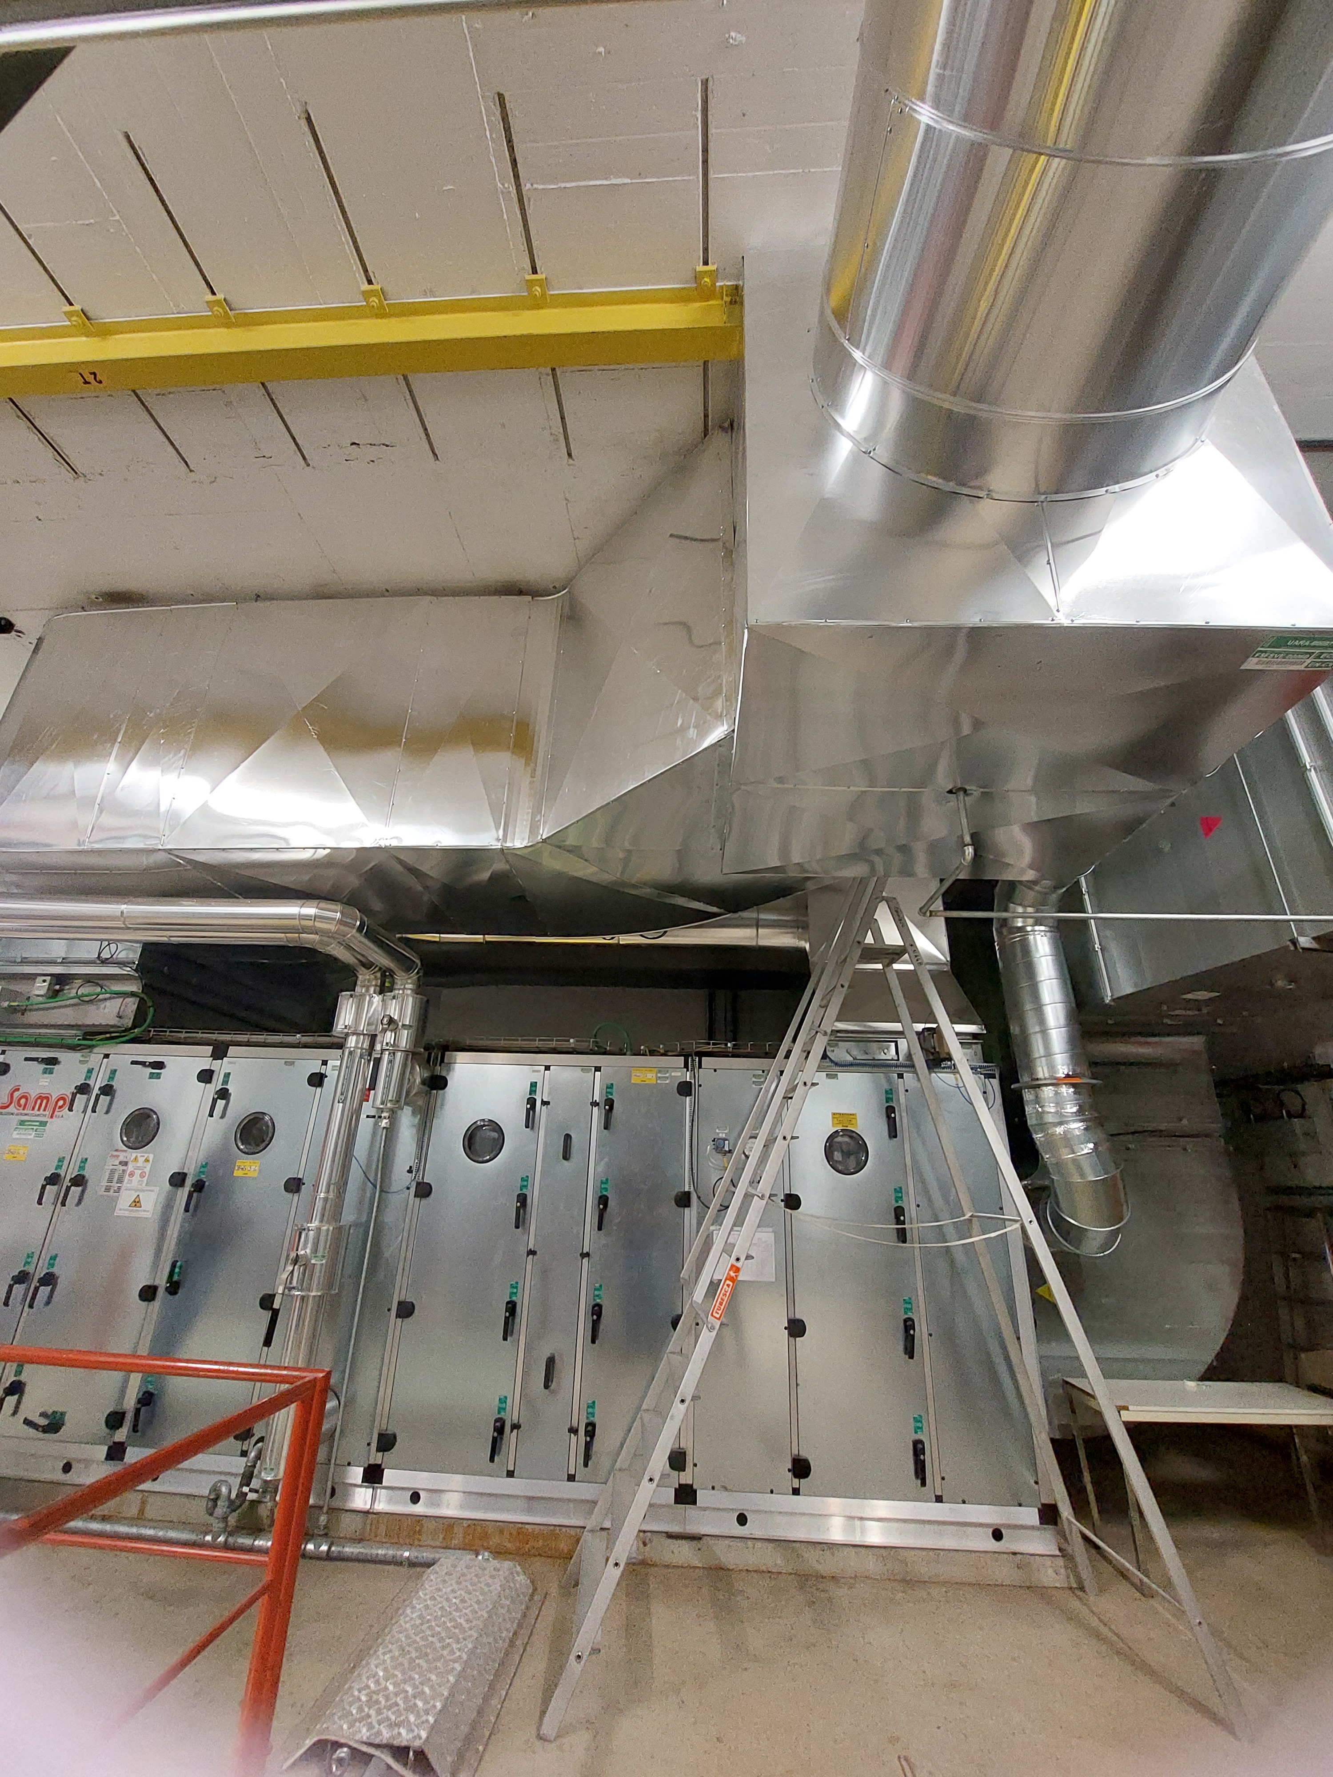
TCC8
Jura side
CV Mezzanine
The potential extension of the opening toward the Jura side wall must be carefully evaluated
900
200
900
Jura side
900

Slide 10
TCC8
3D Model Update
Spectrometer Magnet (SHiP)
The existing transfer tables may not provide sufficient transport support area for the required length (7250mm)
  Some alternatives under study
  Max height ≤ 620 mm
Space reservation for CV pipes through the shaft
  Could it be less than 400 mm?

Slide 11
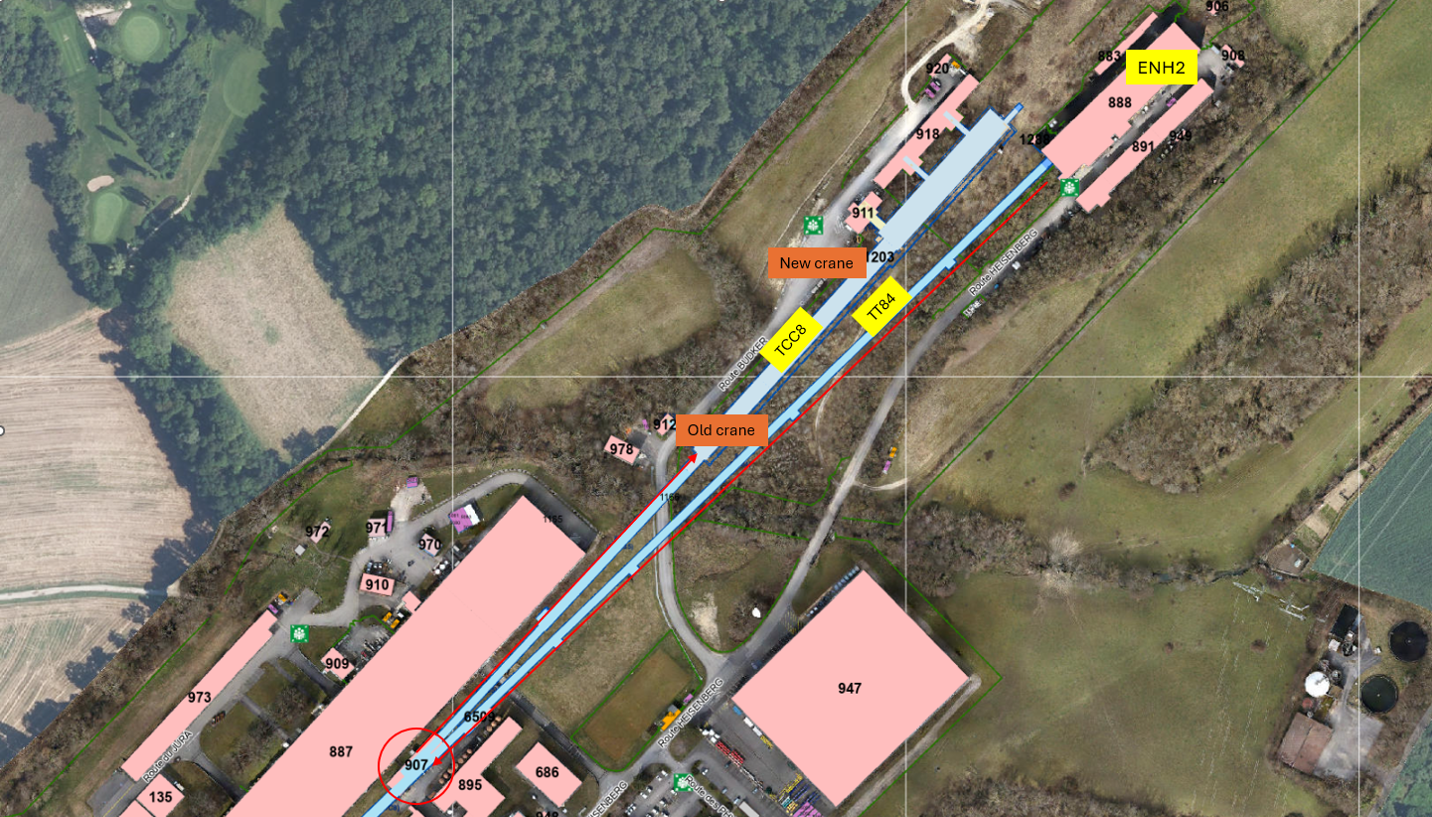
TCC8
Transport study: from EHN2 to TCC8

Slide 12
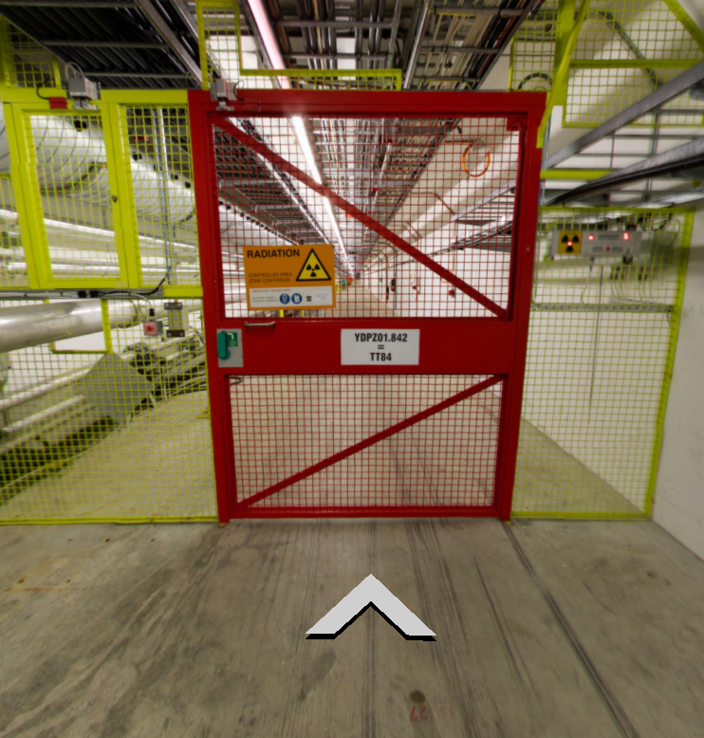
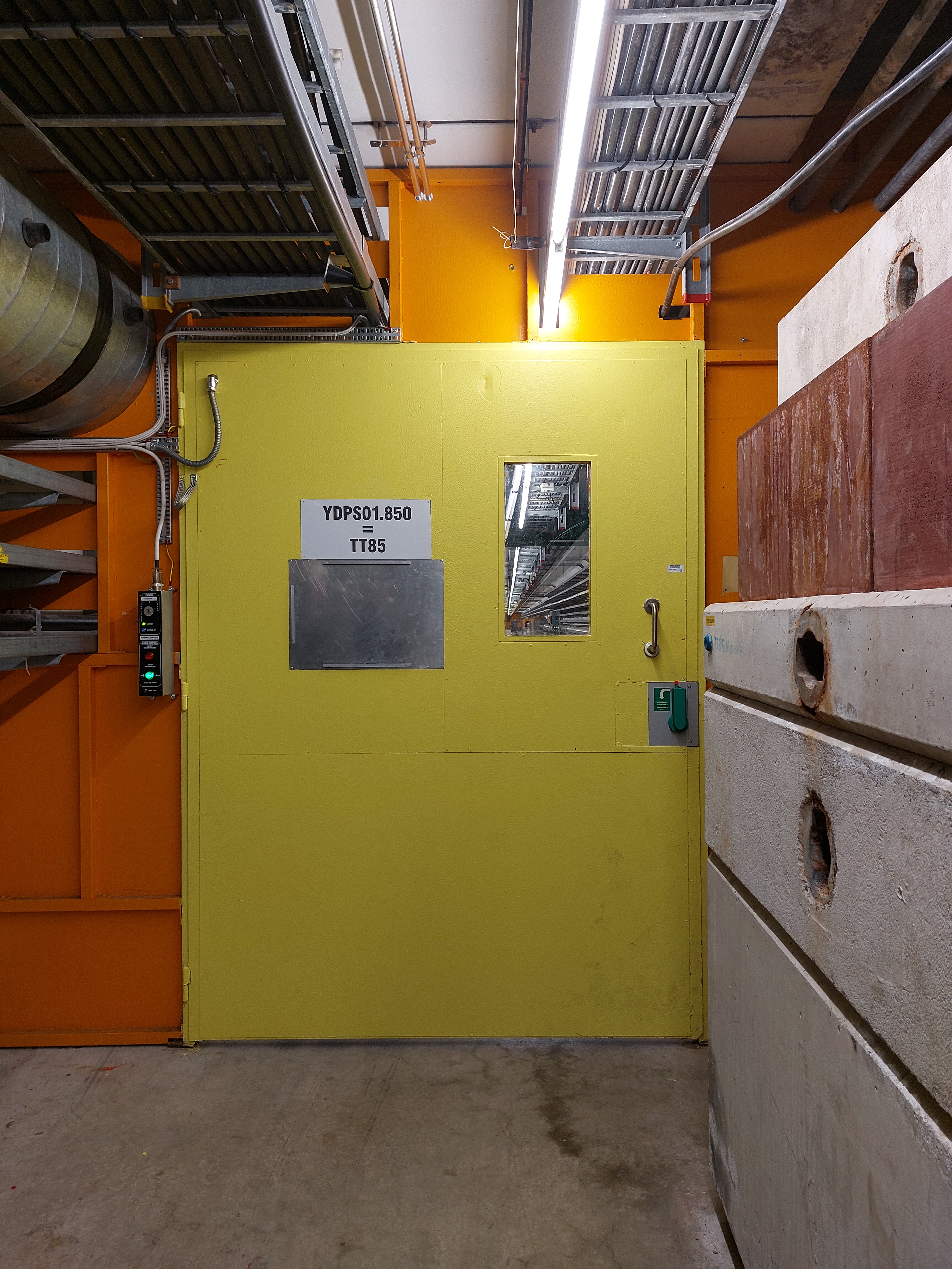
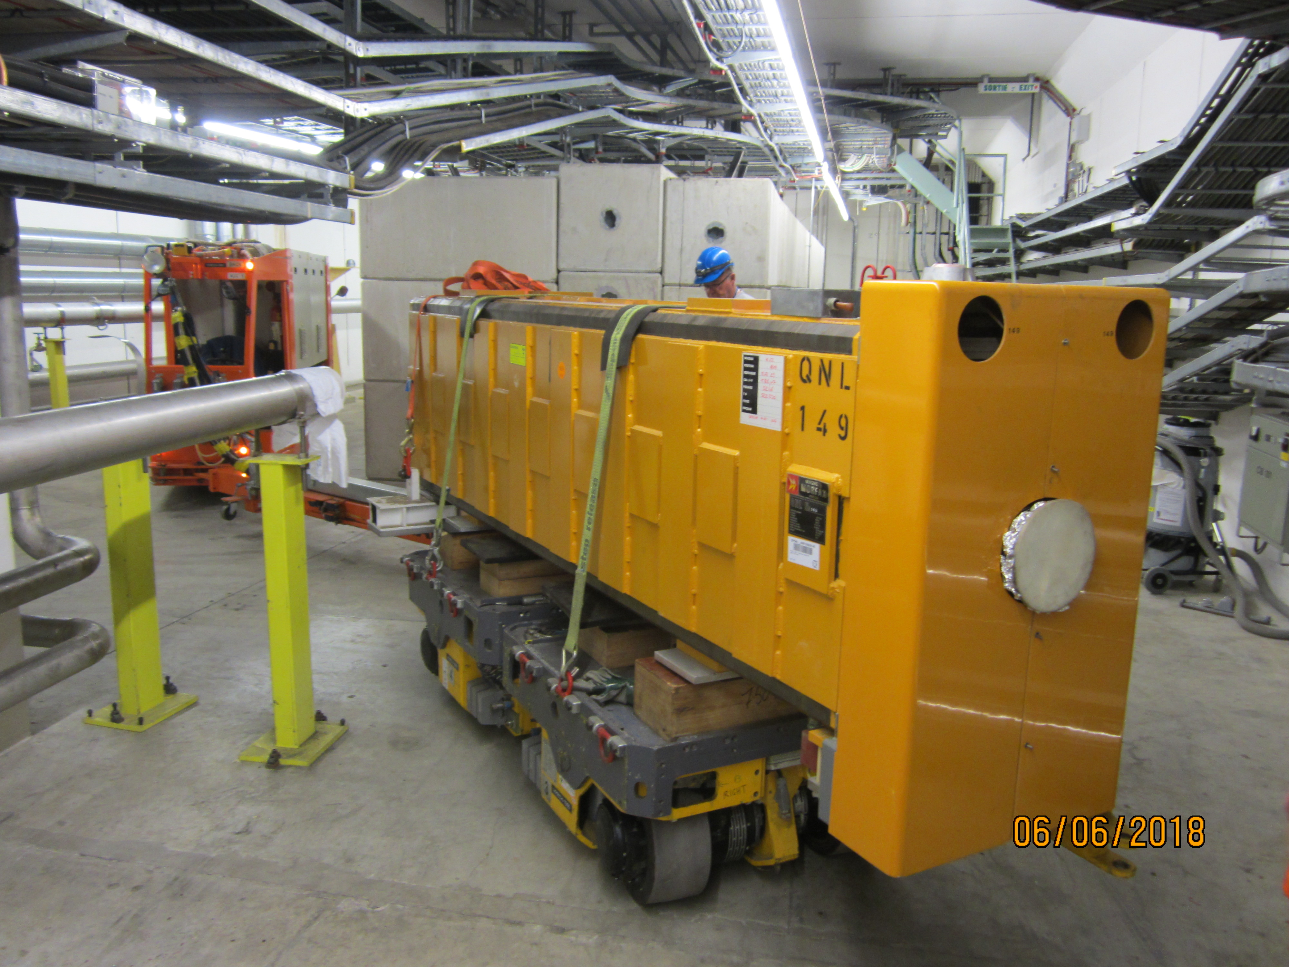
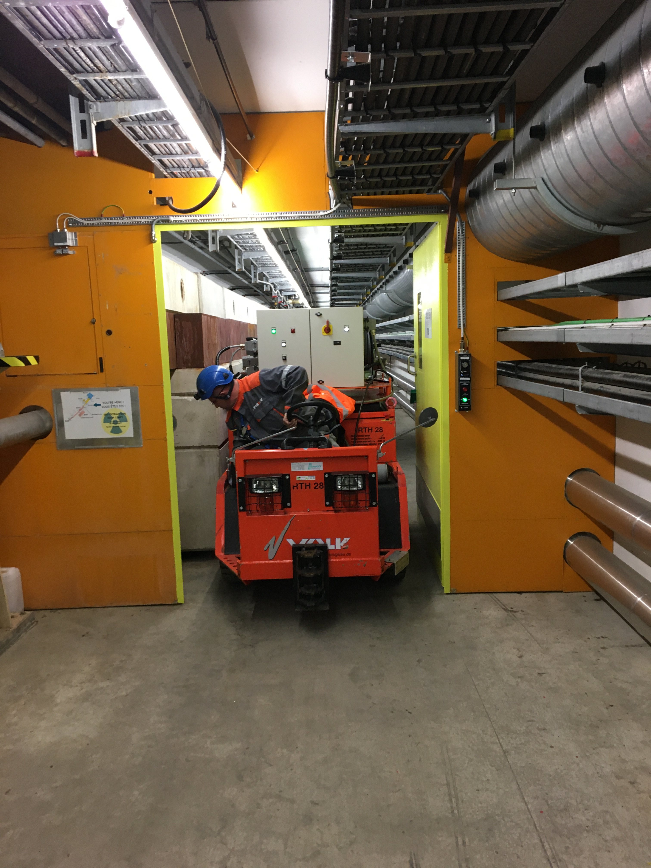
TCC8
Transport study: from EHN2 to TCC8
TT84
TT85 (YDPS01.850) – door 1
It is not advisable to dismantle these doors unless it is very justified and there are no alternative transport routes.
The maximum transport volume is limited by the red door opening and the sector door in TT85:
Max Width = 1500 mm
Max Height = 2032 mm
(verified on site)
Tunnel slope (TT84) → 30T maximum.
2032
1500
1500
2018 – QNL with MAFI KOUBA

Slide 13
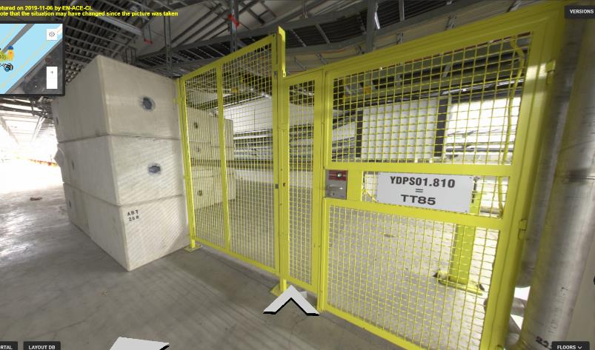
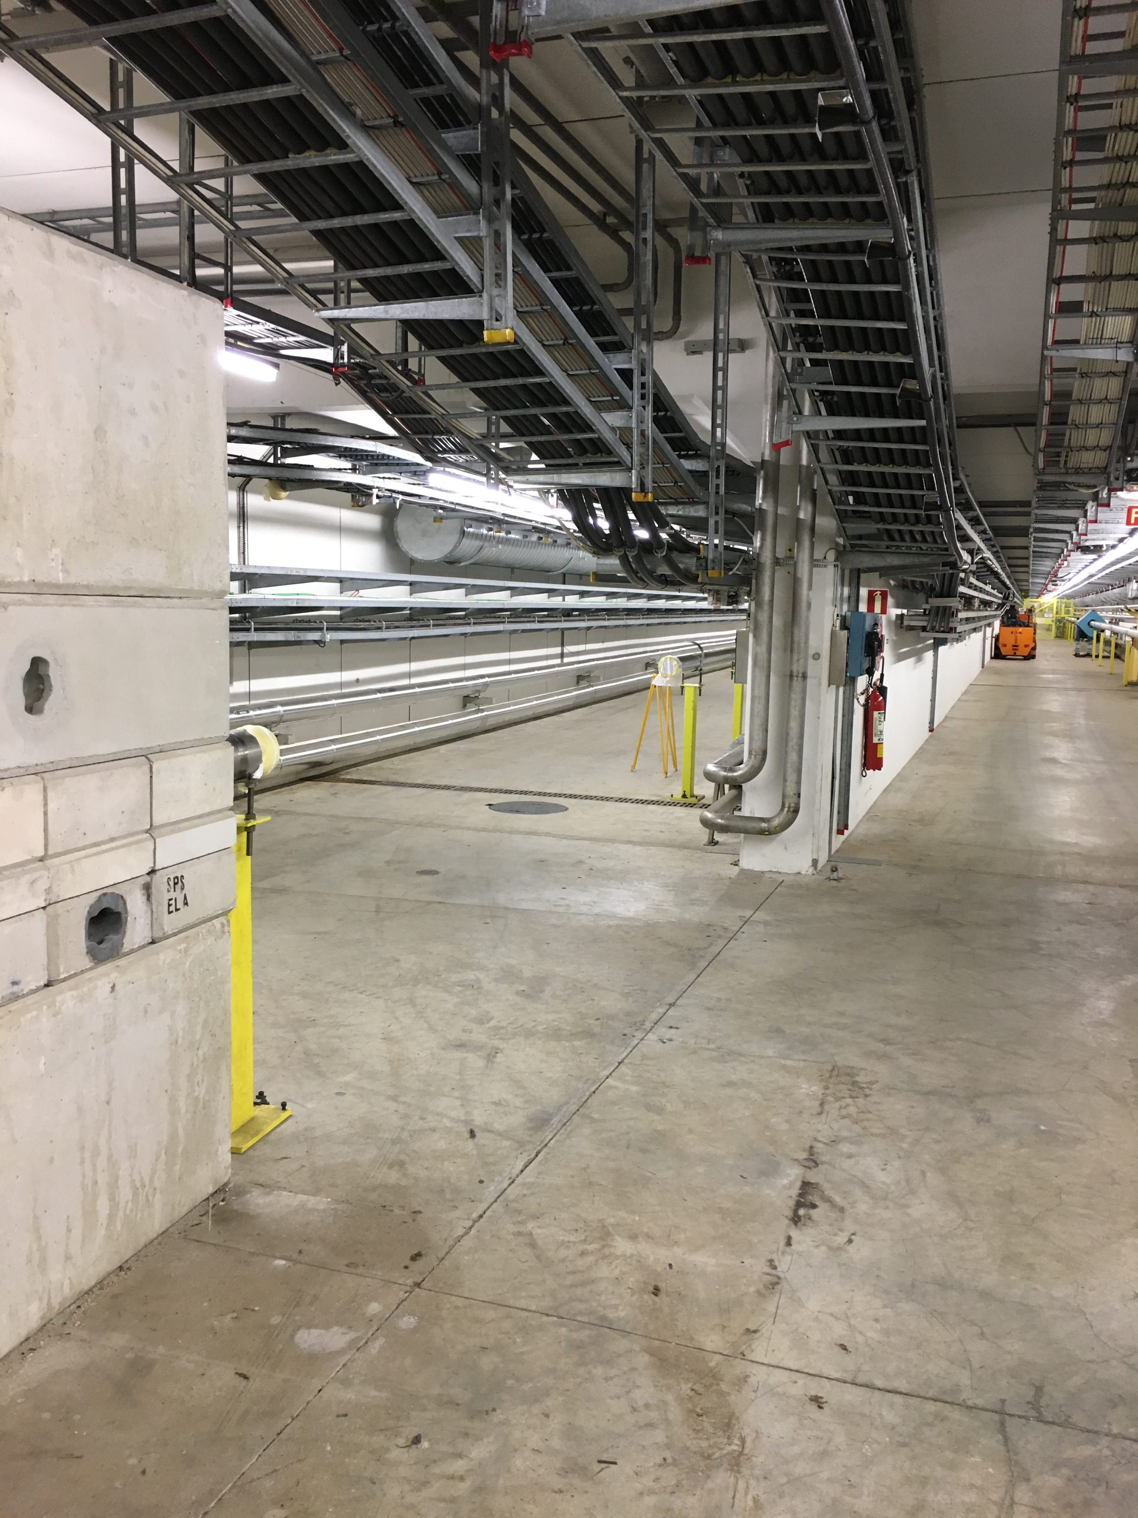
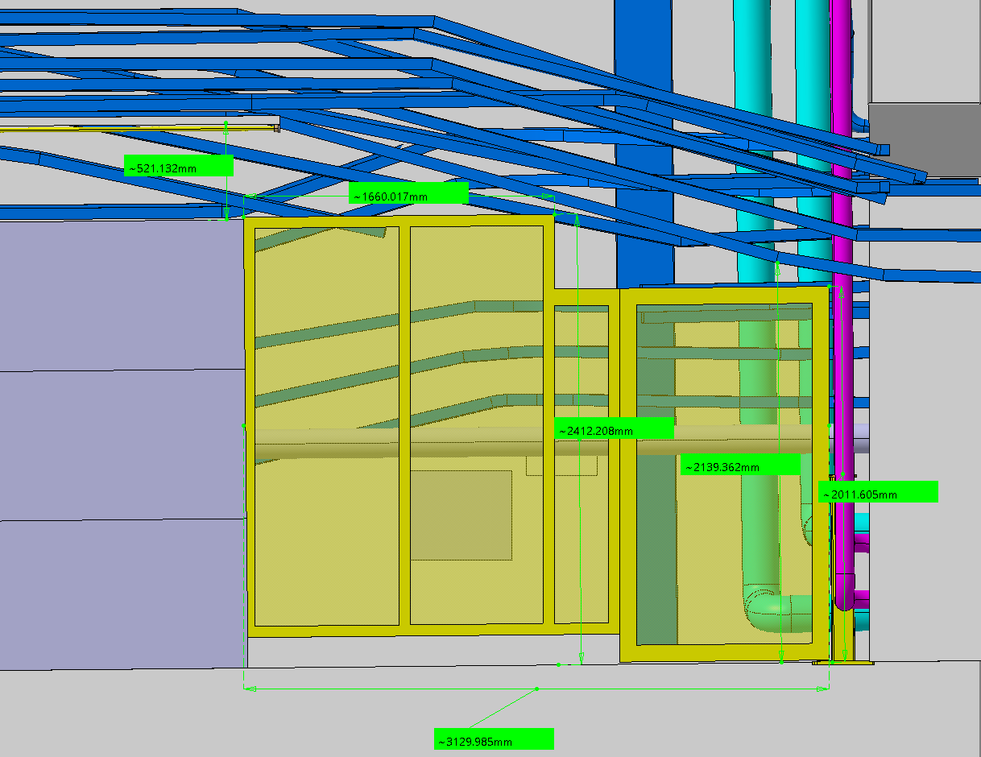
TCC8
Transport study: from EHN2 to TCC8
TT83 – TT84 – TT85
3130
TT84 Inputs
The yellow door can be dismantled
The concrete blocks can be dismantled
Turning radius will depend on the dimensions and configuration of the equipment to be transported.
Blindage dismountable with chariot à potence
Total Height = 2400 mm
Concrete Blocks 1688 (9B1BE 60)
  1600x800x800
  2500kg
2410
TT83 - ST1542986_01
TT85
TT84
TT83

Slide 14
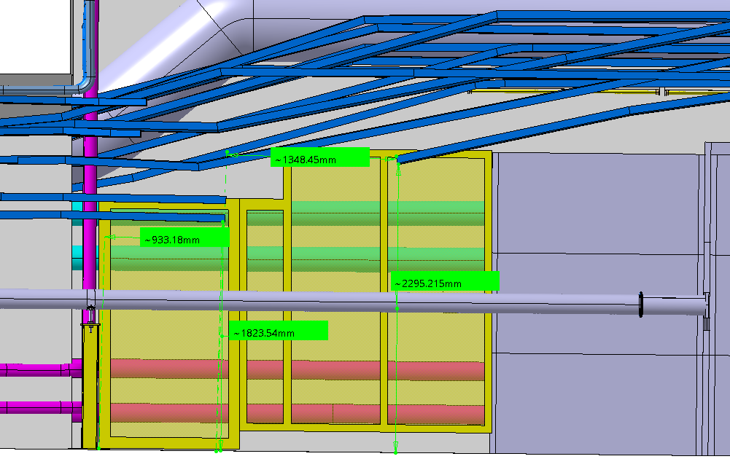
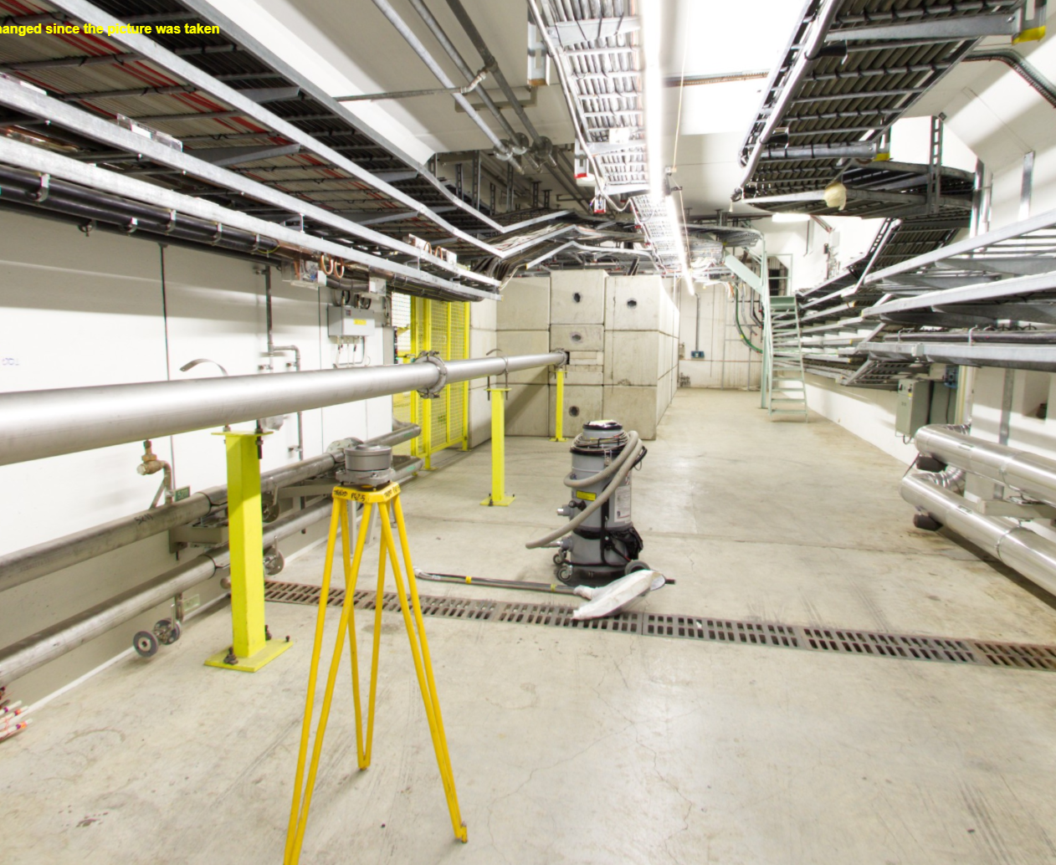
TCC8
TT84 – TT85
Transport study: from EHN2 to TCC8
TT85 Inputs
The cable trays limit a bit the clearance of the passage in the door area BUT:
  It is not a constraint if enough shielding is dismantled.
A section of the beamline must be dismantled
Turning radius will depend on the dimensions and configuration of the equipment to be transported.
TT85
1800

Slide 15
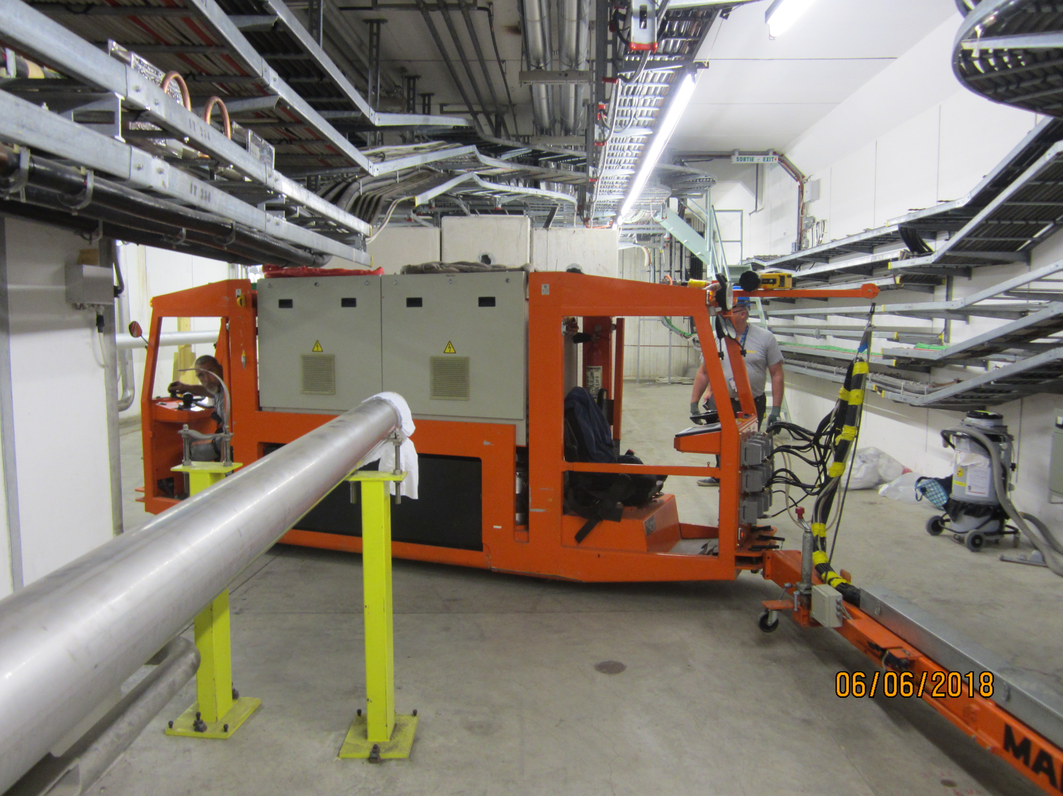
TCC8
Transport study: from EHN2 to TCC8
2023 – Chariot Loer + magnet
2018 – QNL with MAFI KOUBA
For heavy or long equipment, a specific transport study shall be carried out to assess the manoeuvring requirements and the feasibility of performing a 180-degree turn.
Concrete blocks will be dismantled as necessary and where feasible.

Slide 16
TCC8
Transport study: from EHN2 to TCC8
TCC8 Inputs
All transport and handling activities will depend on the new layout planned for TCC8.
If the existing overhead crane is retained in that tunnel area, its hook coverage can be used to assist with transport.
TCC8
TCC8 crane
TT85 (YDPZ01.851)
Determine the available space in this area that can be designated for handling operations

Slide 17
TCC8: Retention of the two overhead cranes
MAIN MOTIVATION
To avoid dismantling the new TCC8 confinement wall each time access to the upstream part of the tunnel is required. Material can be introduced through EHN2
IMPACTS
The new festoon cables will be shorter
The festoon storage area will be moved close to the confinement wall
Loss of crane coverage between cranes in the longitudinal direction (new festoon storage area)
The hook coverage of the existing crane in the transversal direction may be reduced to avoid conflict with the cables in fixed installation
It may be necessary to modify the maintenance walkway of the existing crane (handrails)
New end stops for each crane before reaching the confinement wall
Some modification to the cabling required
Access to the existing crane for maintenance will still be possible via a removable ladder - A corridor shall be kept clear to allow the possibility to attach a removable ladder (position can be modified)
The existing crane has electronic components on-board - Resistance to radiation to be checked
DRAFT
New festoon storage area with junction box
Upstream TCC8
Target Area
≈ 10000
Loss of crane coverage
Existing festoon storage area
Control panel
Confinement wall

Slide 18
TCC8: Retention of the two overhead cranes
Layouts
New festoon storage area with junction box
New festoon storage area with junction box
Upstream TCC8
Target Area
Upstream TCC8
Target Area
A
≈ 10000
B
≈ 10000
Control panel
Control panel
New festoon storage area with junction box
Upstream TCC8
Target Area
C
≈ 10000
Control panel

Slide 19
Retention of the two overhead cranes in TCC8
Comments and remarks | Pros | Cons
New confinement wall in TCC8 | Dismantling of the confinement wall between the target area and the upstream section may not be required to transfer material. | No access to the upstream section with the new crane.
Access to the upstream part of TCC8 via EHN2 (if the volume fits the passage ) - 1500(w)x2030(h) in area, and 30t weight (max) | Material transfer from the upstream part of TCC8 to the target area, accessing through EHN2 could be possible. The confinement wall might not be dismantled if the volume fits the door/opening made in the wall. | The volume shall fit in the opening. Loss of crane coverage in the longitudinal direction near the confinement wall due to the space required for the new festoon cable storage area - 10 m estimated, several options to be considered
Festoon cabling for the new crane | Shorter festoons | A dedicated storage area must be designed and built close to the confinement wall and that will imply a considerable loss of crane coverage. Hook coverage of the existing crane in the transverse direction (upstream part) may need to be reduced to prevent interference with fixed cable installations.
Modifications on the cabling of the current crane | Minor works shall be carried out Move the feeding line towards the centre of the tunnel | Minor site works shall be carried out and accounted for prior to the installation of the new crane. – The economical impact must be addressed and responsibilities assigned.
Unlikely event = Major intervention in the crane located in the upstream part of TCC8 (like trolley replacement) | - | Replacing the trolley (for example) of the old crane would require dismantling the new crane and possibly partial dismantling of the SHiP experiment.
Structure (SCE) Pending – feasibility study to determine if both cranes cane operate on the same rails and min. distance between them. |  | It will be more efficient to have two independent rails and corbel support systems, one on each side of the separation wall. This will ensure better load distribution and minimizes the risk of structural interference between the two cranes.
Electrical requirements (EN/EL) |  | Extra power cables Minor works and modifications (re-routing)
IMPORTANT PENDING INPUT – Equipment to be installed nearby the confinement wall and the upstream part of TCC8

Slide 20
Ongoing and future assessments
ECR - ECN3 Transfer Tables
Document shared with some of you. Any feedbak would be greatly appreciated. (27th June) - https://cernbox.cern.ch/s/OI2EjwA2K7Me4DA
It will be presented at one of the upcoming ICEA meetings (18th July)
B.754
Transport and handling studies. Space reservation
15T Manual overhead crane for the cooling room (R-005)
  A height space reservation of approximately 1000 mm is foreseen for the crane.

