Slide 1
Magnetized Hardon Stopper (MHS) Design
Melvin Liebsch, Vittorio Ferrentino
16/06/2025

Slide 2
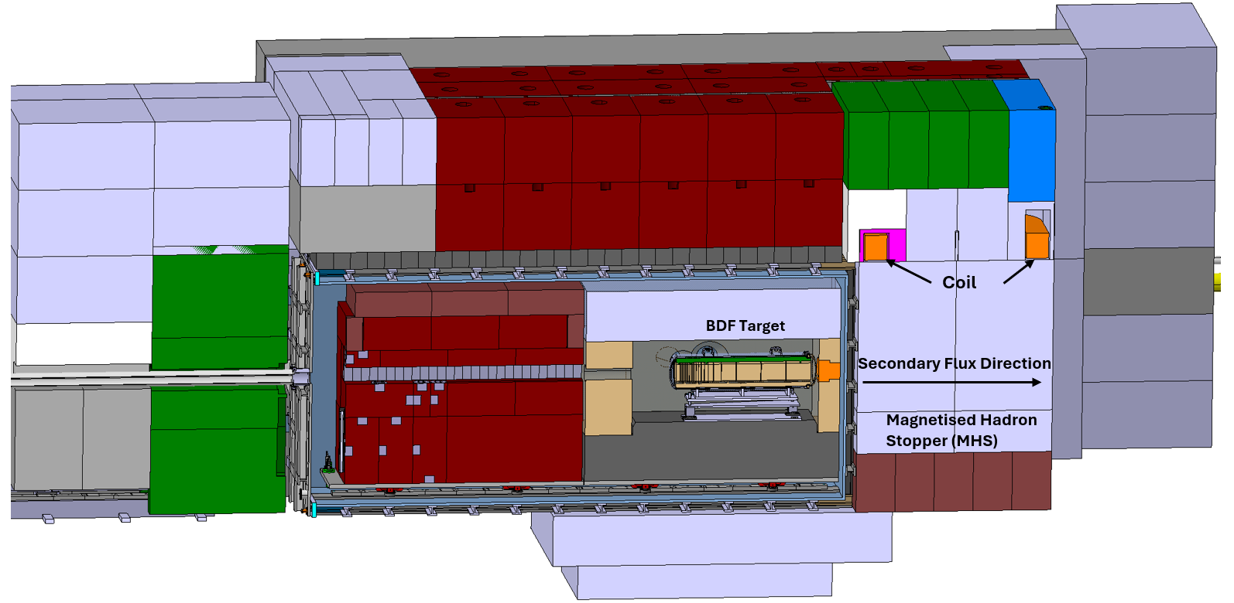
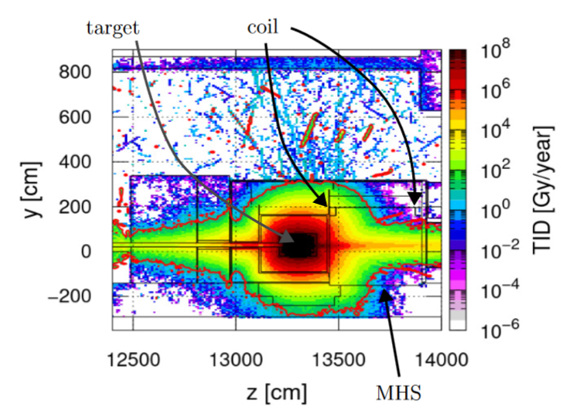
The MHS in the target complex
Requirements for the Epoxy-Impregnated Coil
  Coil position at 1.7 m with respect to the beam axis to limit the TID below 1 MGy
  Coil must be accessible for maintenance and repair
  Operation in all 4 quadrants is required for degaussing
Requirements from the Muon Shield
  Core field of 1.9 T in “good field region” (GFR)
  Magnet length 2.3 m
The target complex TTC8 and the MHS
Heat map of the total ionizing dose per year

Slide 3
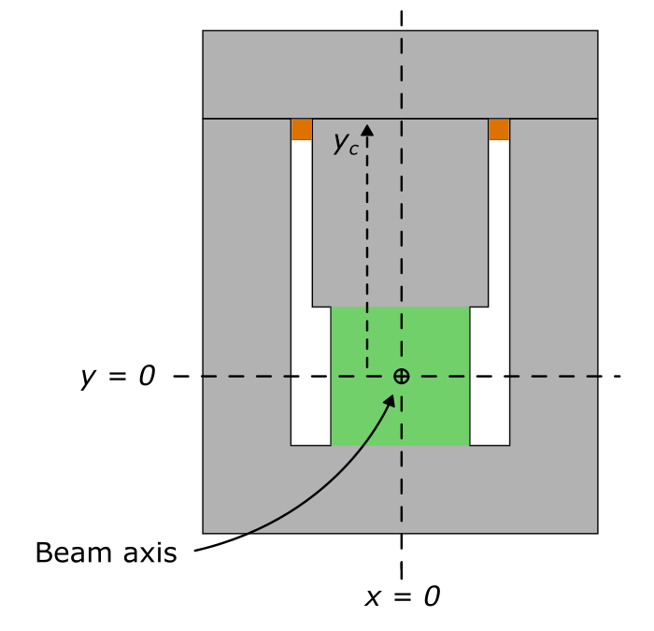
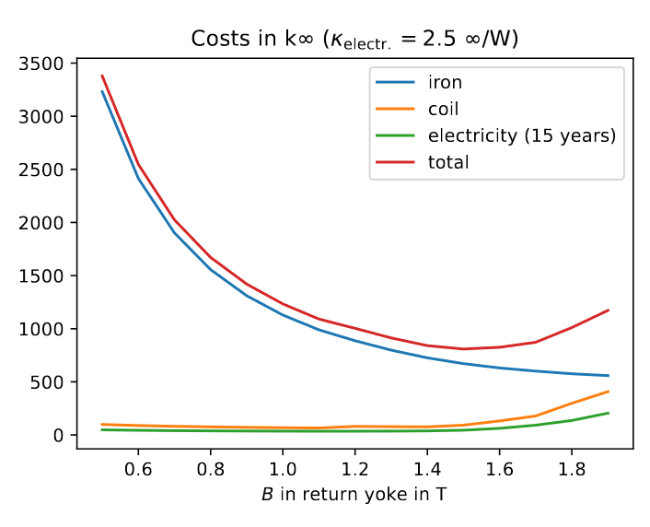
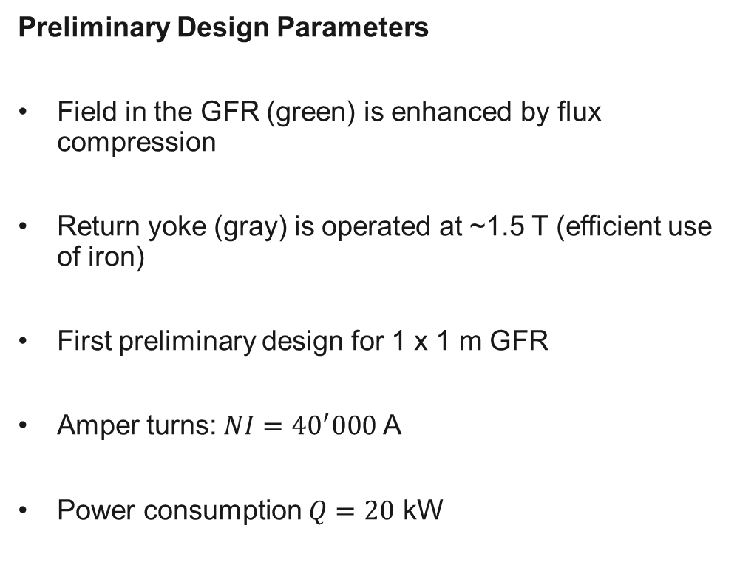
The Flux Compressor
  Preliminary Design Parameters
  Field in the GFR (green) is enhanced by flux compression
  Return yoke (gray) is operated at ~1.5 T (efficient use of iron)
  First preliminary design for 1 x 1 m GFR
  Amper turns: $NI={40}^{′}000$ A
  Power consumption $Q=20$ kW
Sketch of the flux compressor cross section and the GFR
Costs of the MHS versus the field in the return yoke

Slide 4
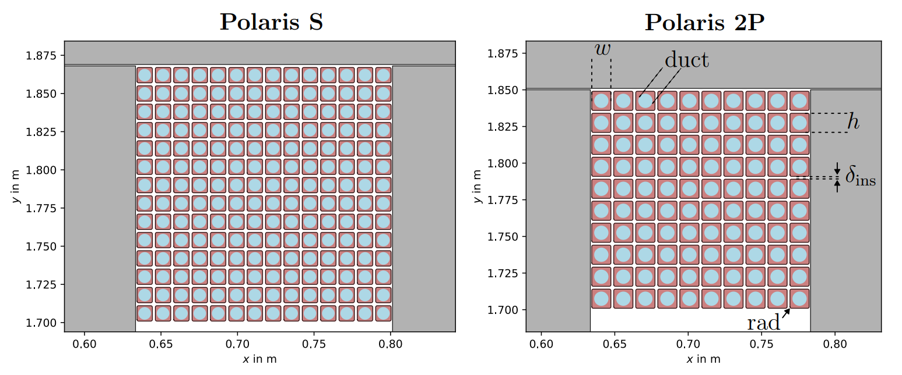
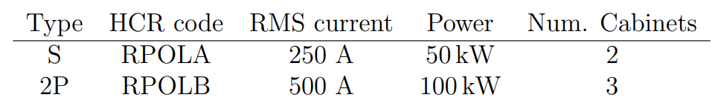
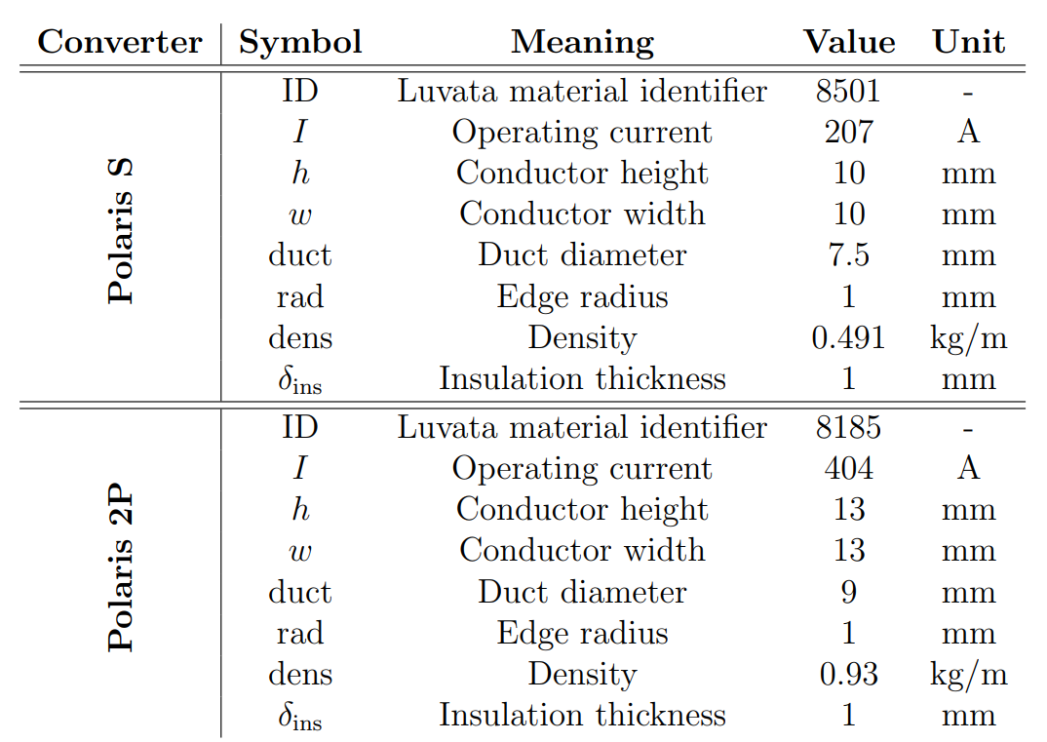
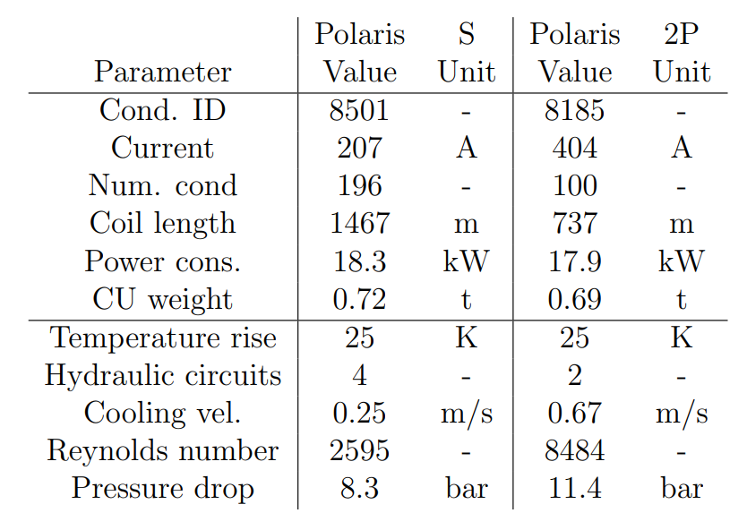
Preliminary Coil Design
  Two coil designs for the Polaris S and Polaris 2P
Key parameters for the Polaris S and Polaris 2P
Left: Coil design with 200 turns for the Polaris S. Right: Coil design with 100 turns for the Polaris 2P
Key parameters for the coil designs for the Polaris S and Polaris 2P
Key parameters for the water cooling circuits for the operation using the Polaris S and Polaris 2P

Slide 5
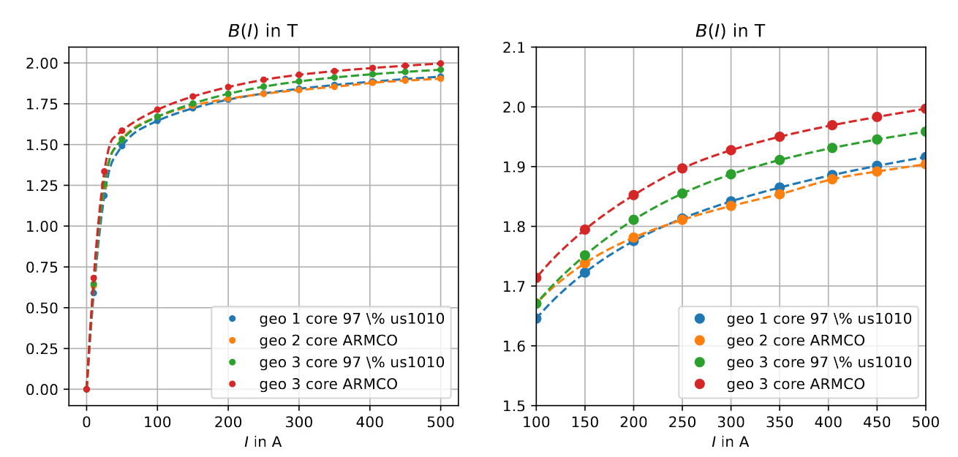
Operational Margin
  Sources for discrepancy between design and magnet “as built”
  Material curve B(H)
  Geometric tolerances
  Contact imperfections
  Magnet hysteresis
  Operational (current control)
  Environment (ferromagnetic material in the vicinity)
  The measured discrepancy must be compensated by the magnet current
  This requires some operational margin
Transfer functions for different designs of the MHS.

Slide 6
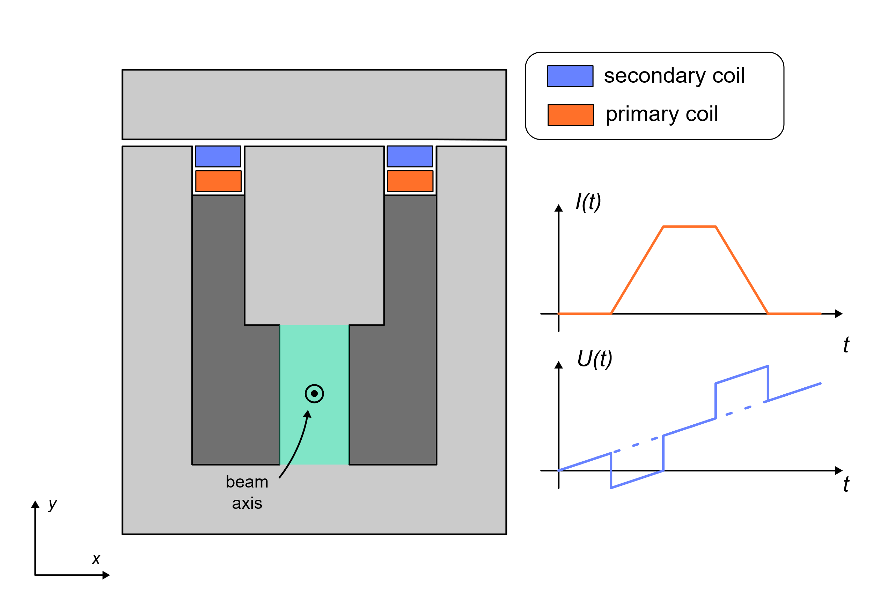
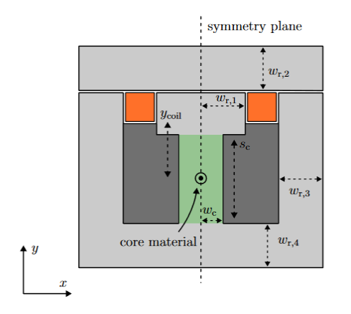
Tuning the magnet current
  The currents in the muon shield (MS) magnets and MHS will be tuned to minimize the muon background
  MS model can only be benchmarked with feedback on the magnetic fields
  Magnetic measurement possibilities
  Voltage pick-up in secondary winding
    + Little or no additional hardware (sensors) needed
    Magnet will need to be pulsed
    Only flux is measurable
Hall sensor plates
    + Independent on magnet operation (DC measurement)
    + Local variations are measurable
    Sensors need to be installed in magnet gaps (potentially on stainless steel plates)
Hall sensors
Stainless steel plate

Slide 7
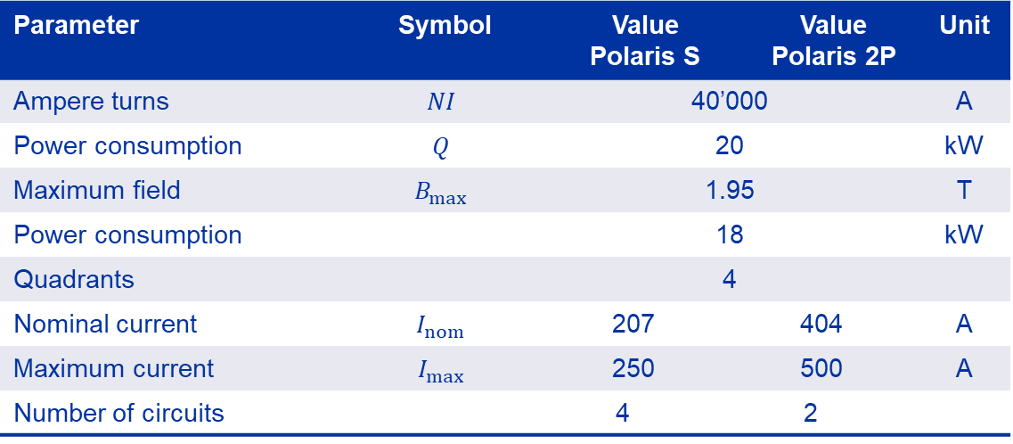
Conclusion
  Key parameters for the preliminary* coil design
Parameter | Symbol | Value Polaris S |  | Value Polaris 2P | Value Polaris 2P | Unit
Ampere turns | $$NI$$ | 40’000 |  |  |  | A
Power consumption | $$Q$$ | 20 |  |  |  | kW
Maximum field | $$B_{max}$$ | 1.95 |  |  |  | T
Power consumption |  | 18 |  |  |  | kW
Quadrants |  | 4
Nominal current | $$I_{nom}$$ | 207 |  | 404 |  | A
Maximum current | $$I_{max}$$ | 250 |  | 500 |  | A
Number of circuits |  | 4 | 2
  *Cross section optimization (ongoing) will have implications on this design

Slide 8
Discussion
  Robust cross section design
    → Yoke will need to be split in blocks
    → Design for robustness towards contact imperfections between blocks
  Detailed coil design
    Lower operational current is preferred to limit losses in powerline
    Higher operational current is preferred to limit number of turns and cooling circuits
    If space is available, add a secondary coil for redundancy
  How much flexibility is there on the PC parameters (20 kW, 500 A?)
  How can the core field be validated?
    In-situ magnet testing with pick-up voltage in secondary winding?
    What is the allowed discrepancy?

