Slide 1
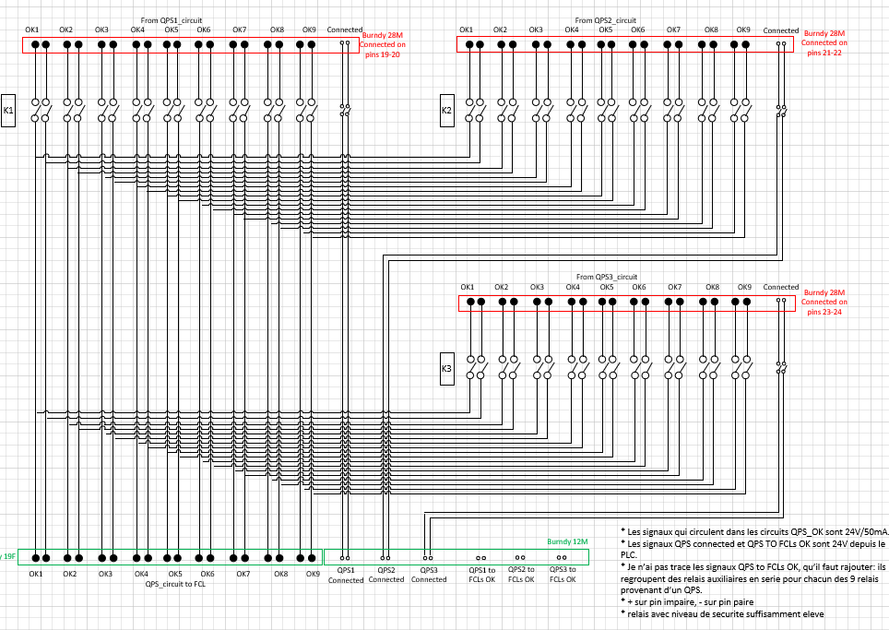
FAIR – Parallel powering
FCLs design
1 - Actual design of FCLs vs. QPS commutator :
9 Power converters FCLs -> 9 QPS channel per bench
3 PLC Digital Oututs -> Bench selection
3 PLC Digital Inputs -> Selection feedback

Slide 2
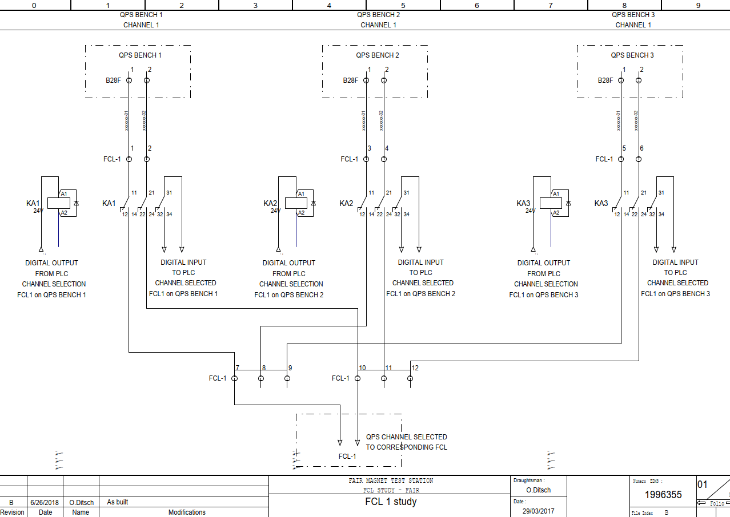
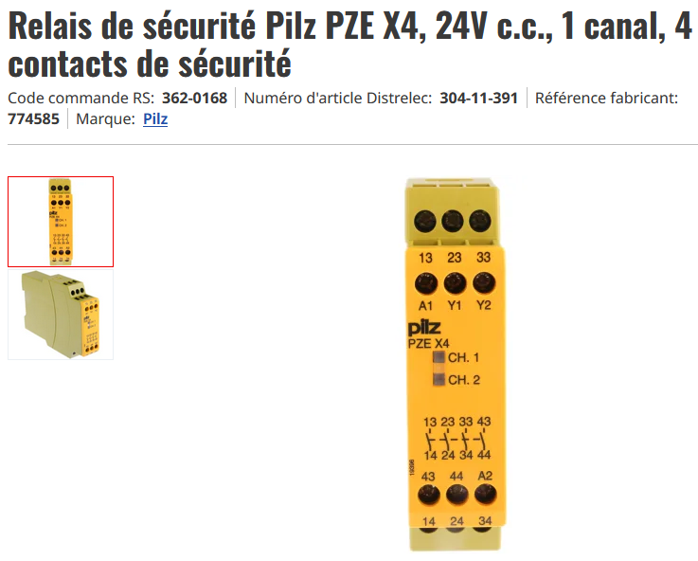
FAIR – Parallel powering
FCLs design
2 – QPS commutation done by the PLC :
For 1 Power converters FCL -> Commutation between the 3 QPS
3 safety relays SIL3 level with 3 NO contacts
3 PLC Digital Oututs -> QPS channel selection
3 PLC Digital Inputs -> Selection feedback
Safety level with discrepancy check
For 9 Power converters :
27 Safety relays SIL 3 level
27 DOs
27 DIs

