Slide 1
Transients in temperature and pressure before flattop quenches in CP and Q3 tested on bench A2.
G. Willering TE-MSC-MQA
19-05-2025
https://indico.cern.ch/event/1549648/

Slide 2
Summary
New info shows that there are possible pre-cursors in temperature and vacuum pressure around 5 to 8 seconds before the flattop quenches start in the magnet.
If confirmed this would be very good news for the magnet project, since this allows for qualification of the CP and the Q3.
Content
Events in CP during MCBXF flattop quenches
Events in the Q3 during MQXF flattop quenches
Heat transfer bore tube to coil
Further investigation
What triggers the transients?
How can enough heat go from the vacuum space in the bore tube into the magnet?
Could the rather high vacuum pressure due to leak (5.10⁻⁵ mbar) have an impact?
Is there any chance that similar transients can be produced when the beam screen is installed?
…

Slide 3
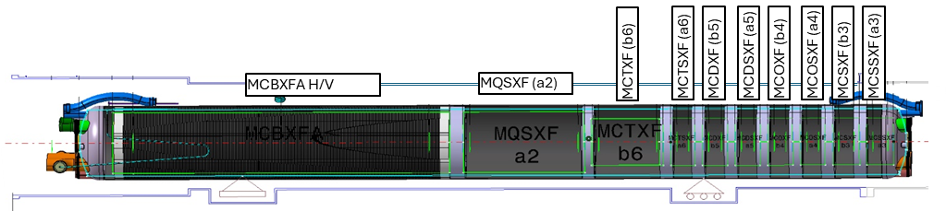
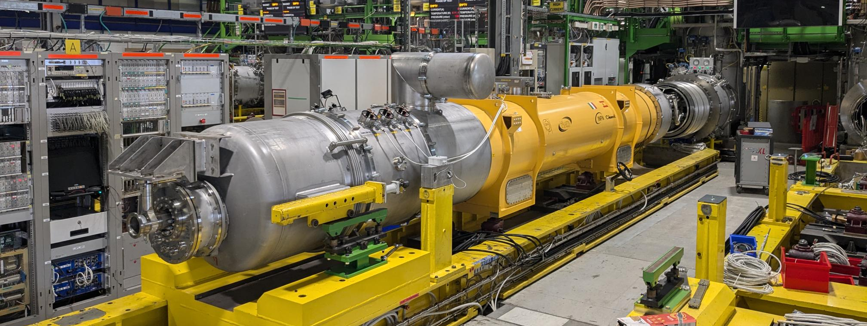
CP-assembly on the SM18 test bench
CFB
MRB
TT151. On the outside of the cold mass in the vacuum.
TT821 – Temperature on the yoke, in the liquid helium bath, around 2 meter from end of cold mass.

Slide 4
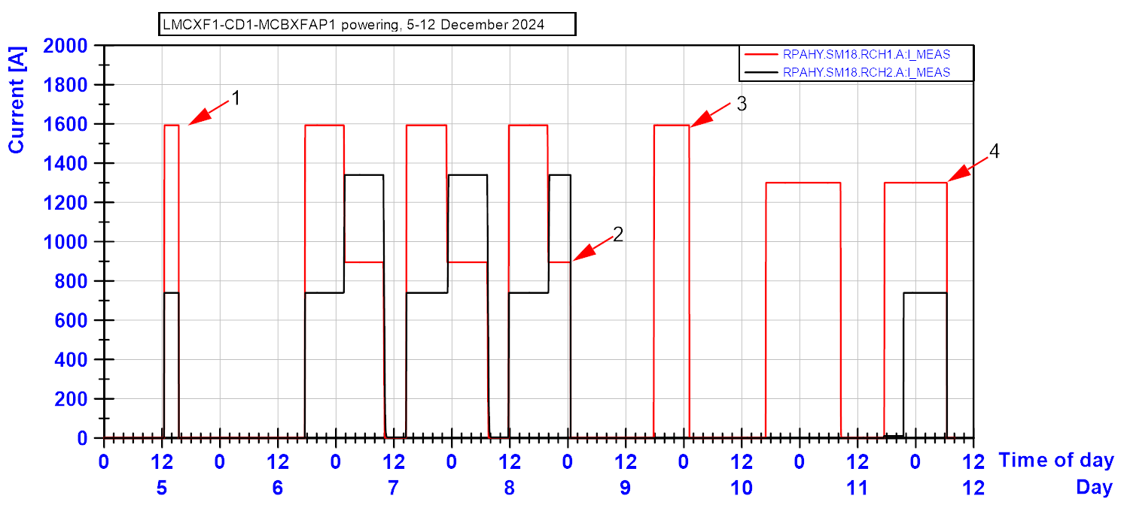
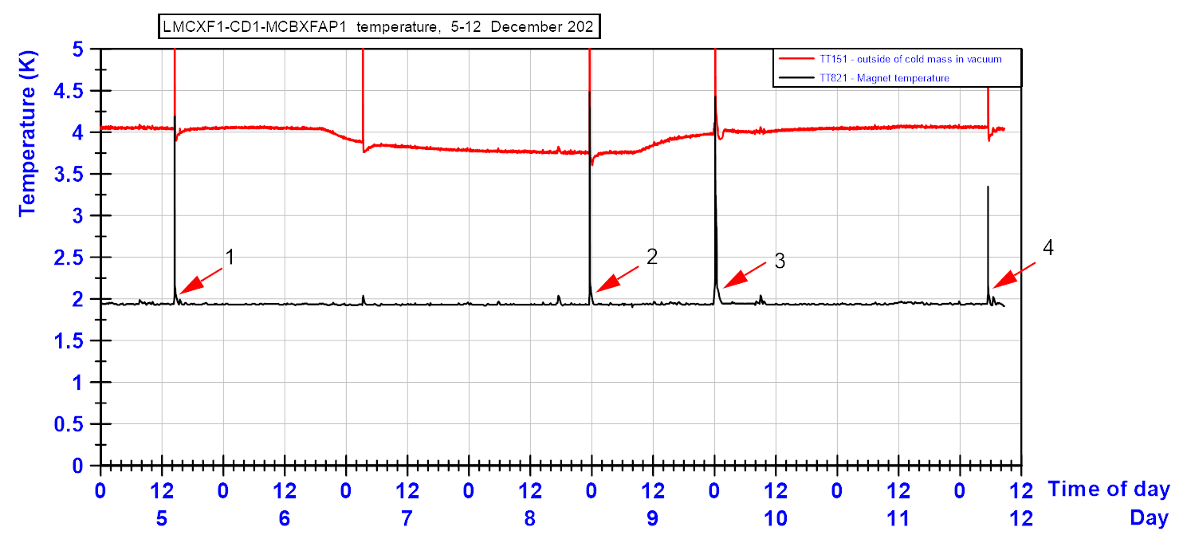
Recall MCBXFAP1: 4 flattop quenches
TT821 shows no temperature changes in the superfluid helium temperature before the quench starts. (except quench 3 where the temperature had slow rise to 2.05 K.)
At the time, TT151 temperatures were placed in the plot since it showed some variations due to thermal screen temperature control variations.
One spike in TT151 was recorded without giving a quench. This triggered additional questions.
Spike with current, but no quench

Slide 5
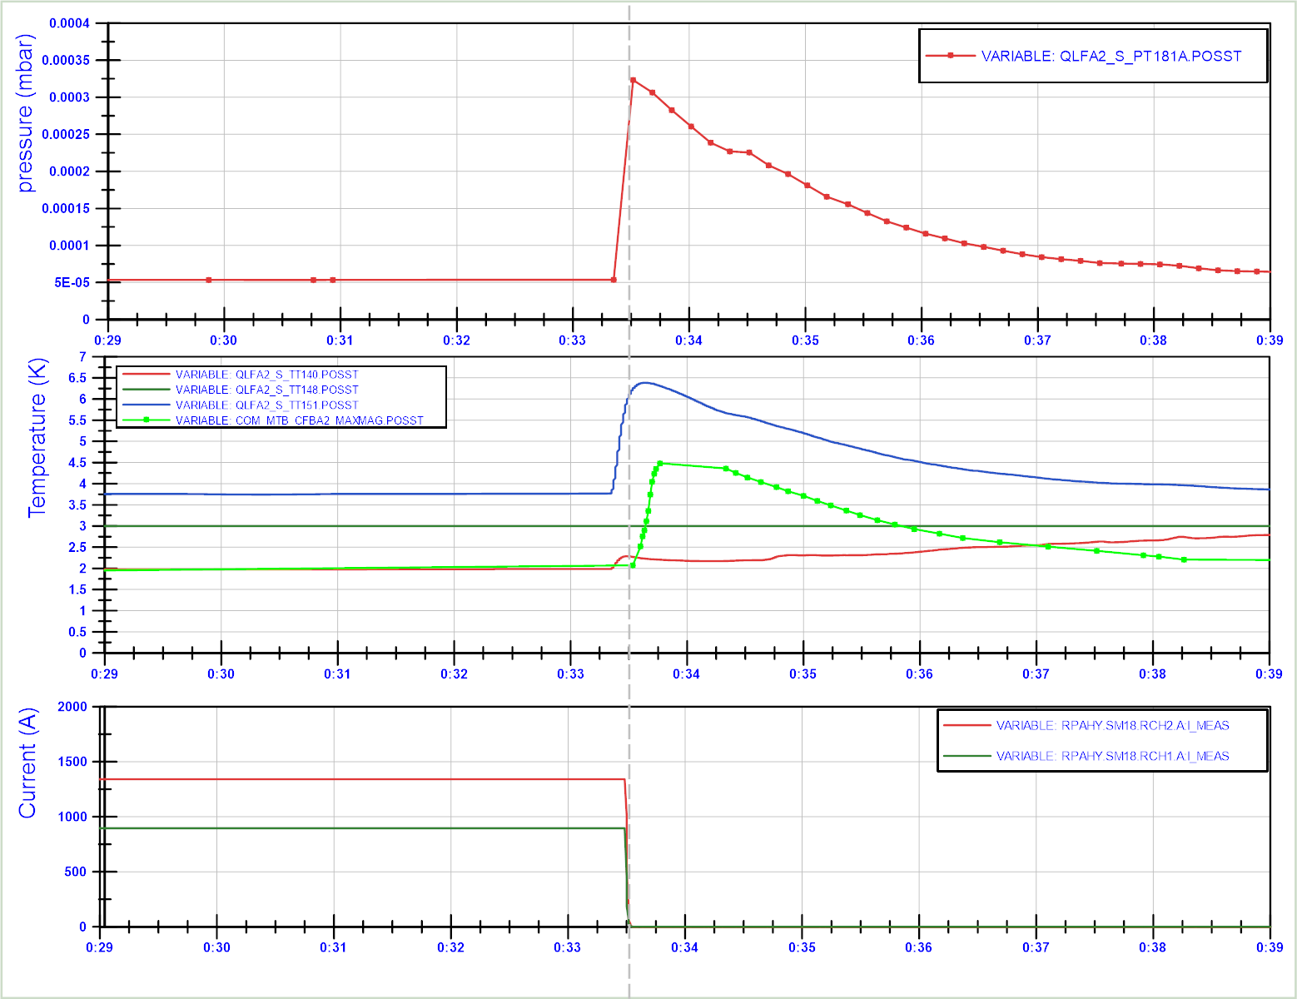
MCBXFAP1: Flattop quench event at 900 A (10 minute plot window)
Recent additional investigation shows that the TT151 and the TT140 (inlet tube with superfluid helium liquid) show a temperature increase before the quench.
Also the pressure in PT181 (vacuum pressure) seems to have a large spike before the quench moment. (Note that the data refreshrate for samples in NXCALS is low. )
For all 4 quenches, the data looks similar.
TT151
TT821
TT140
Time (hh:mm)

Slide 6
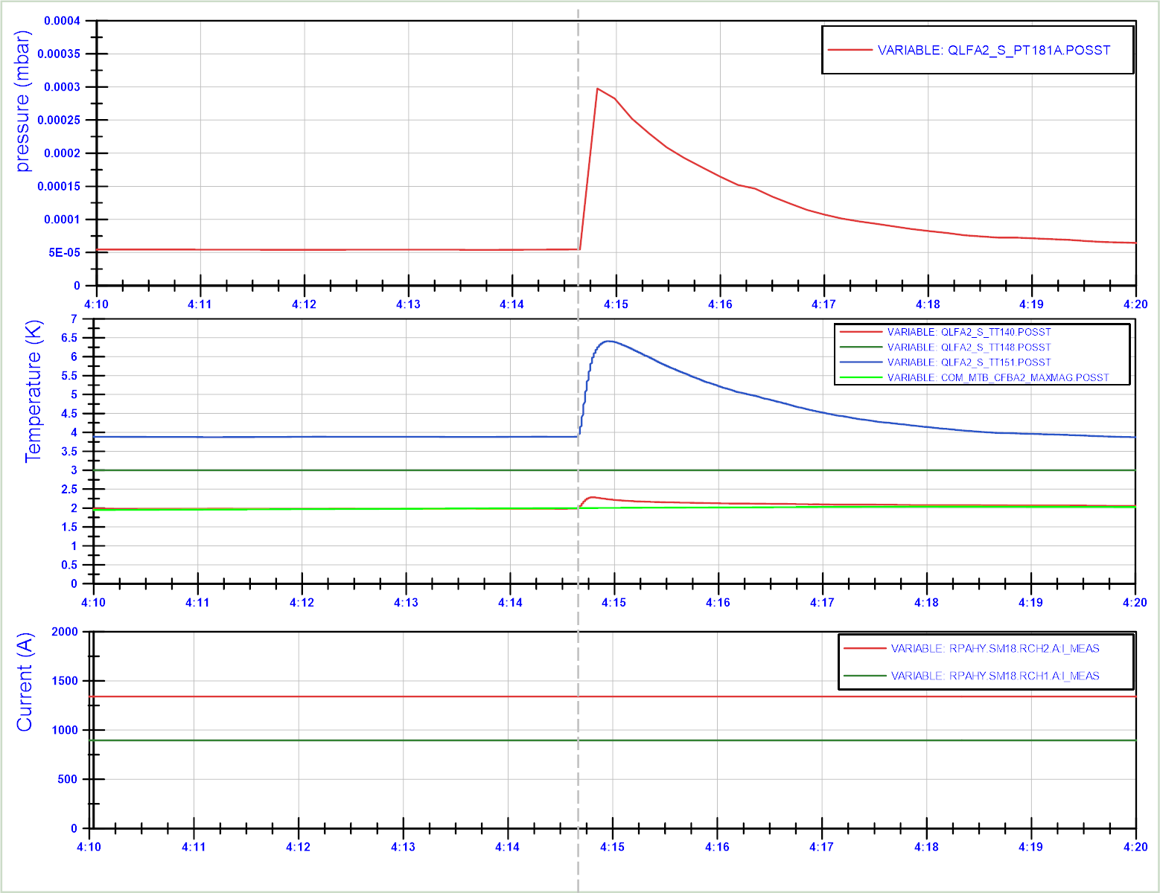
MCBXFAP1: Flattop No-quench event (10 minute plot window)
Signature of the spike in vacuum pressure and TT151 and TT140 are identical to the quench in the previous slide.
Only here, the TT821 measuring the liquid helium temperature is not changing significantly. It shows that the vacuum temperature and pressure are impacted much stronger by the transient than the liquid temperature.
It also shows that this event is not caused by a quench, or heat from the magnet, since the current is stable.
Vacuum pressure
TT151
TT148
TT140
TT821
Time (hh:mm)

Slide 7
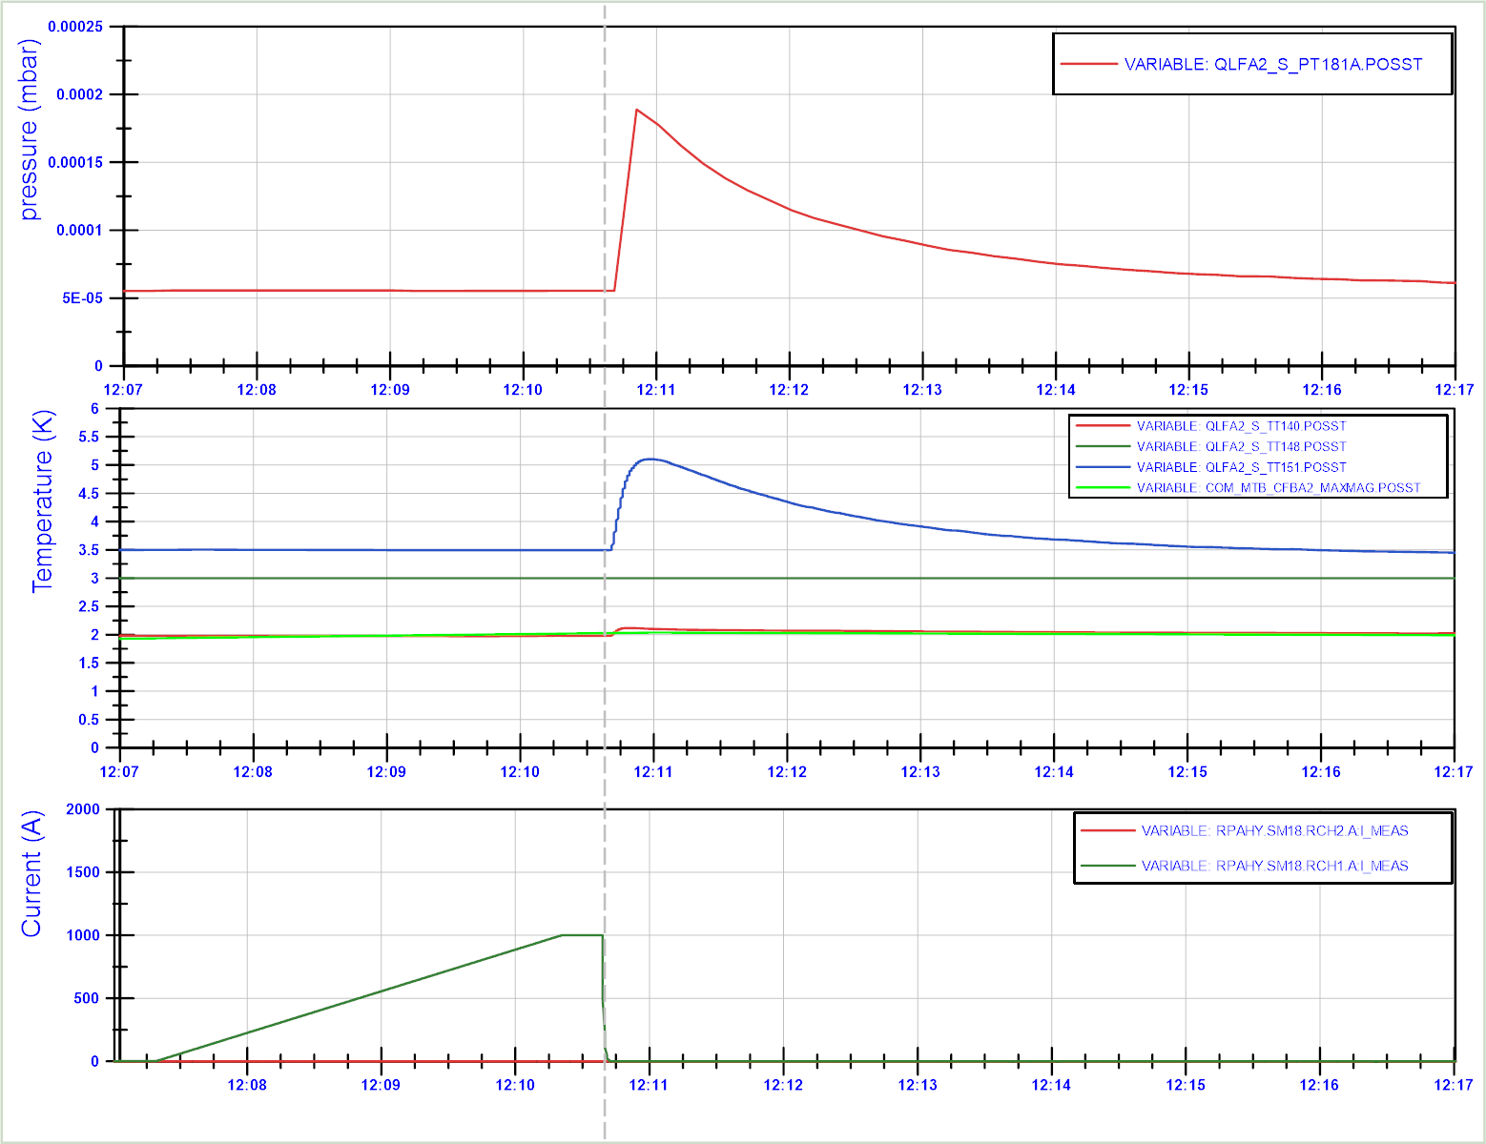
MCBXFAP1: Provoked energy extraction trigger event (10 minute plot window)
When triggering the energy extraction, a similar transient in TT151, TT140 and PT181A is triggered, but now only starting after the quench.
To be investigated why.
TT151
TT140
TT821

Slide 8
Detailed analysis of a quench event in CP MCBXFAP1

Slide 9
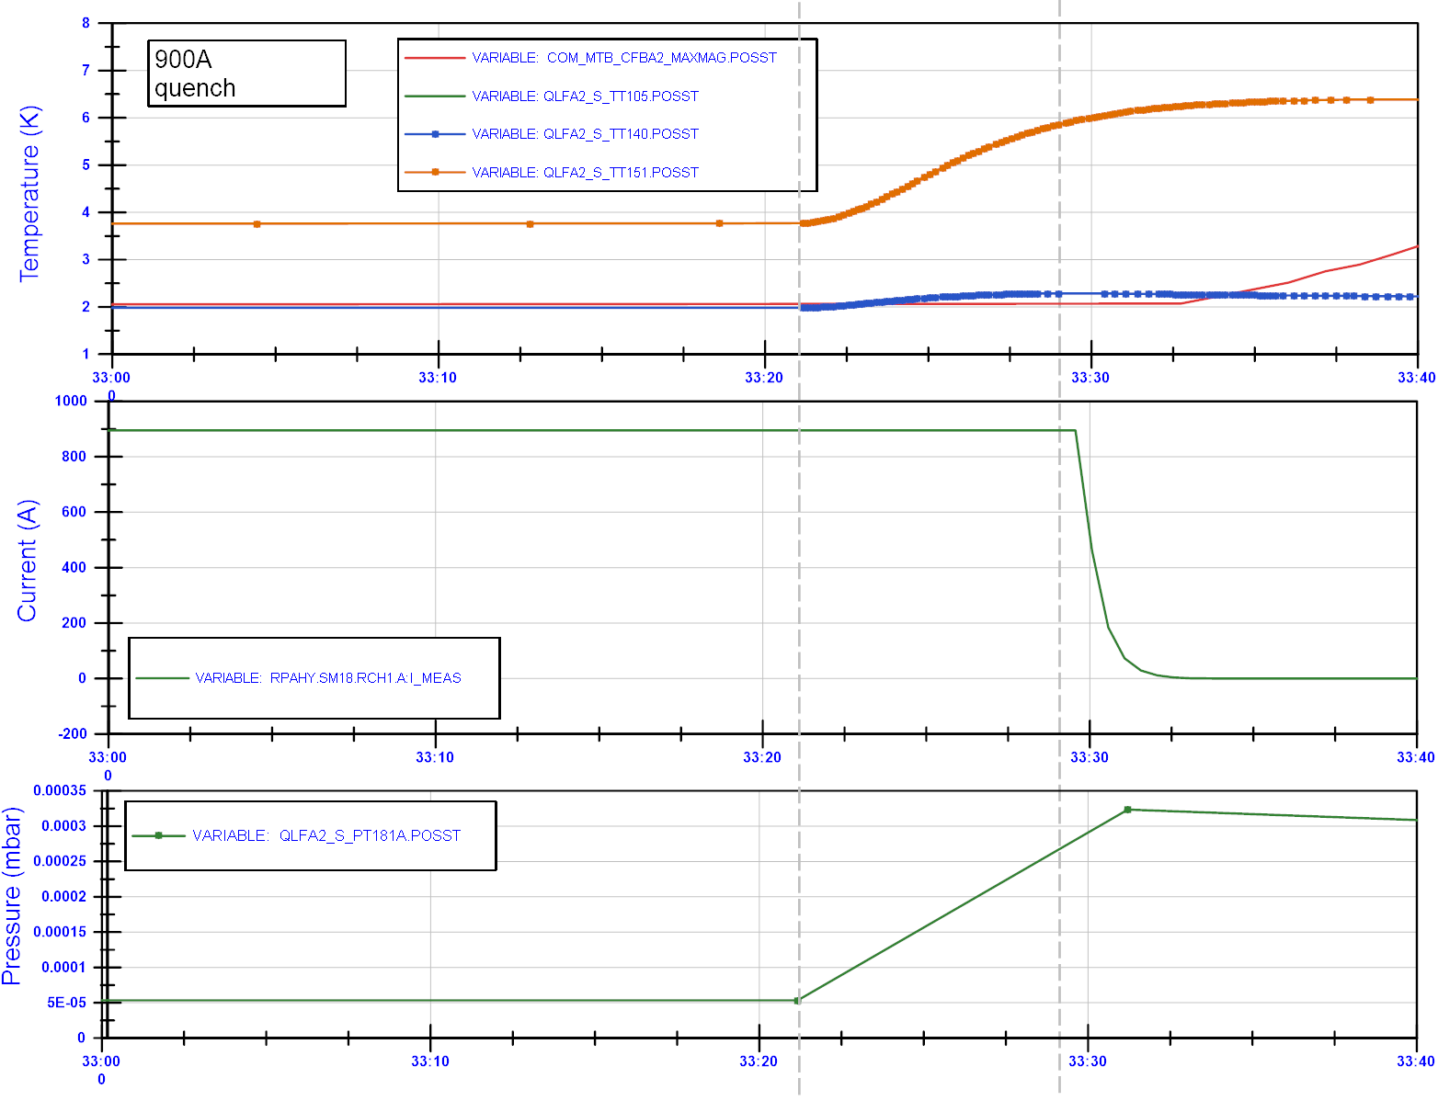
MCBXFAP1: Flattop quench event at 900 A (40 second plot window)
Quench at 900 A event:
~8 seconds before the quench:
  the temperature in TT151 starts to increase (2 K in 8 seconds).
  The temperature in TT140 increases from 1.9 K to about 2.2 K.
  The temperature in the magnet (MaxMag) does not vary before the quench starts.
TT151
TT140
TT821
Time (mm:ss)
Time (mm:ss)
Time (mm:ss)

Slide 10
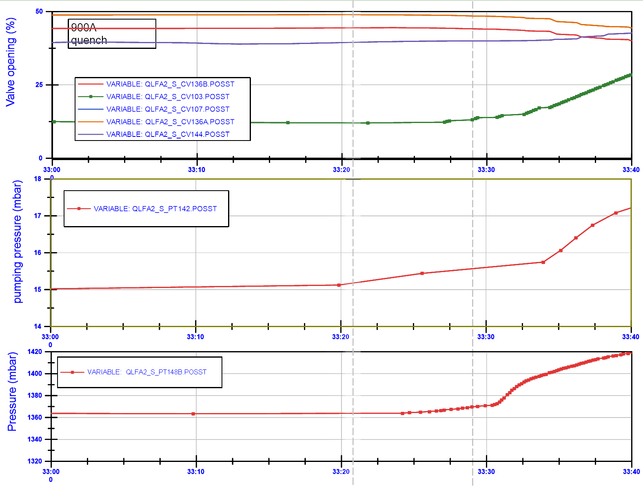
MCBXFAP1: Flattop quench event at 900 A (40 second plot window)
Quench at 900 A event:
~8 seconds before the quench:
  The pressure in PT142 (pumping pressure) increases a bit, but possibly not out of range of the normal variation.
  Pressure in PT148B (shuffling module) increases before the quench.
Time (mm:ss)
Pressure in pumping line
Time (mm:ss)
PT148B
Time (mm:ss)

Slide 11
Quench events in MQXFA (Q3)

Slide 12
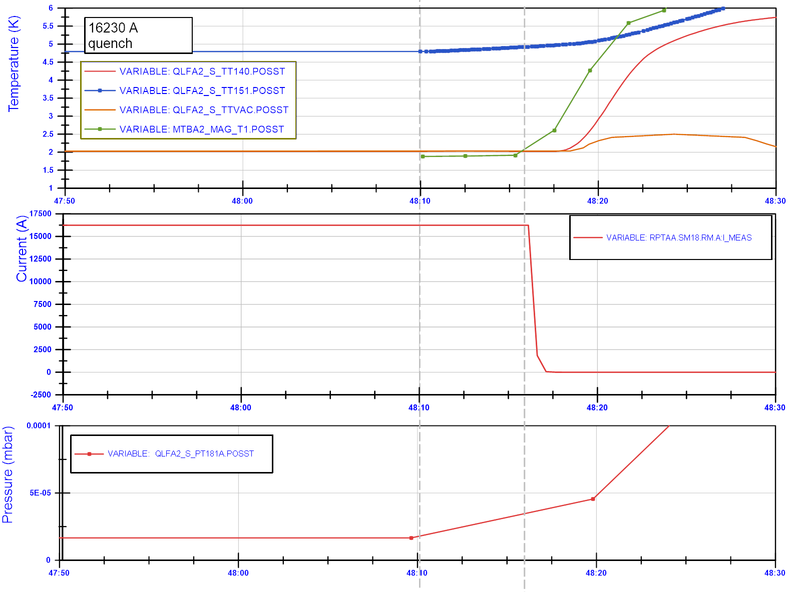
MQXFA in Q3: Flattop quench event at 16.23 kA (40 second plot window)
One flattop quench in Q3:
Temperature rise in TT151 precedes quench by about 5 seconds.
No effect on helium bath temperature in magnet (TT821, named here Mag_T1)
Pressure rise in PT181 is only recorded every 10 seconds, so not usefull.
TT151
TT148
Time (mm:ss)
Time (mm:ss)
Time (mm:ss)

Slide 13
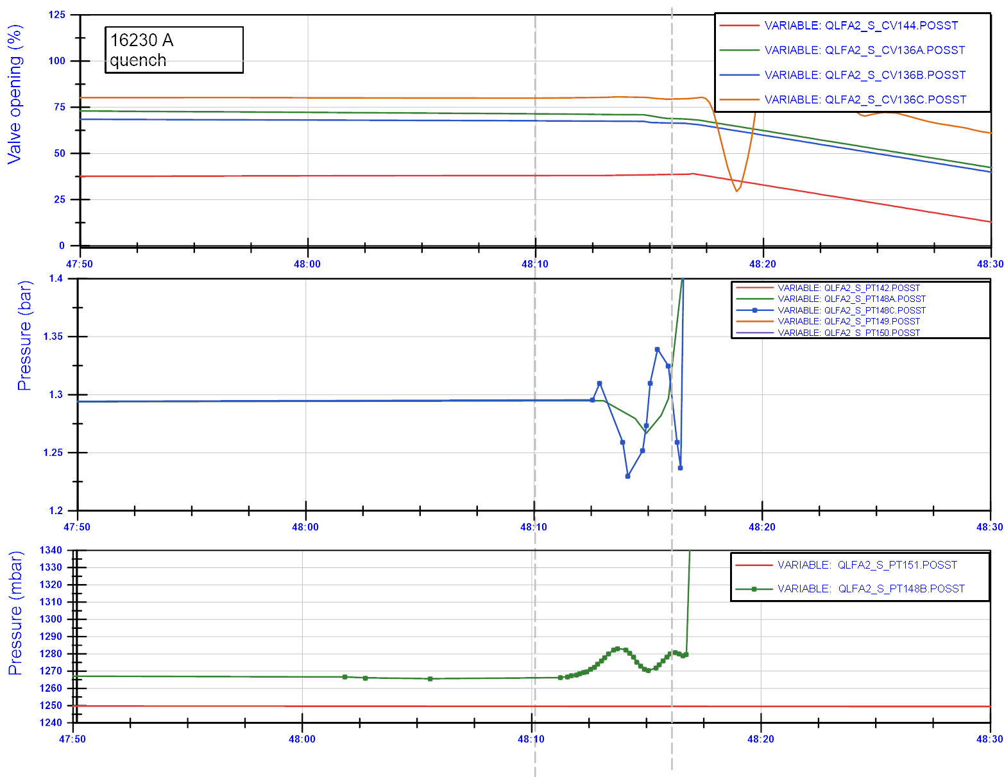
Flattop quench in Q3:
Pressure waves in PT148B before the quench.
Valves are more complex, since the values always vary due to regulation.
The pressure variation in PT148B and temperature rise in TT151 before the quench are systematically seen for all 6 flattop quenches, not for other quenches.
Time (mm:ss)
Time (mm:ss)
Time (mm:ss)

Slide 14
Heat from bore tube to magnet

Slide 15
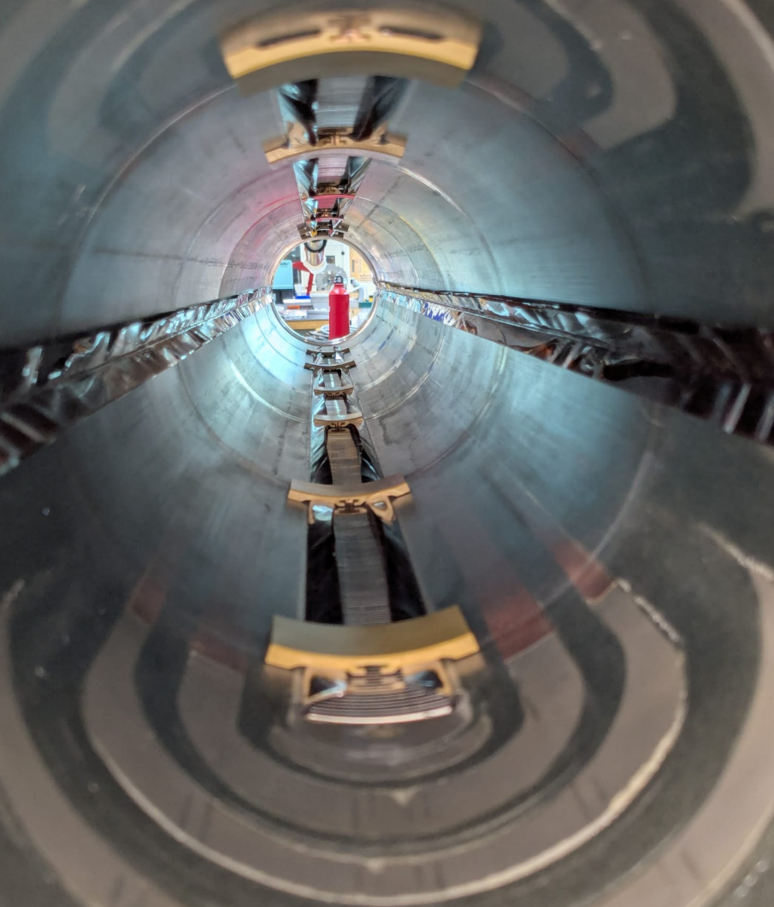
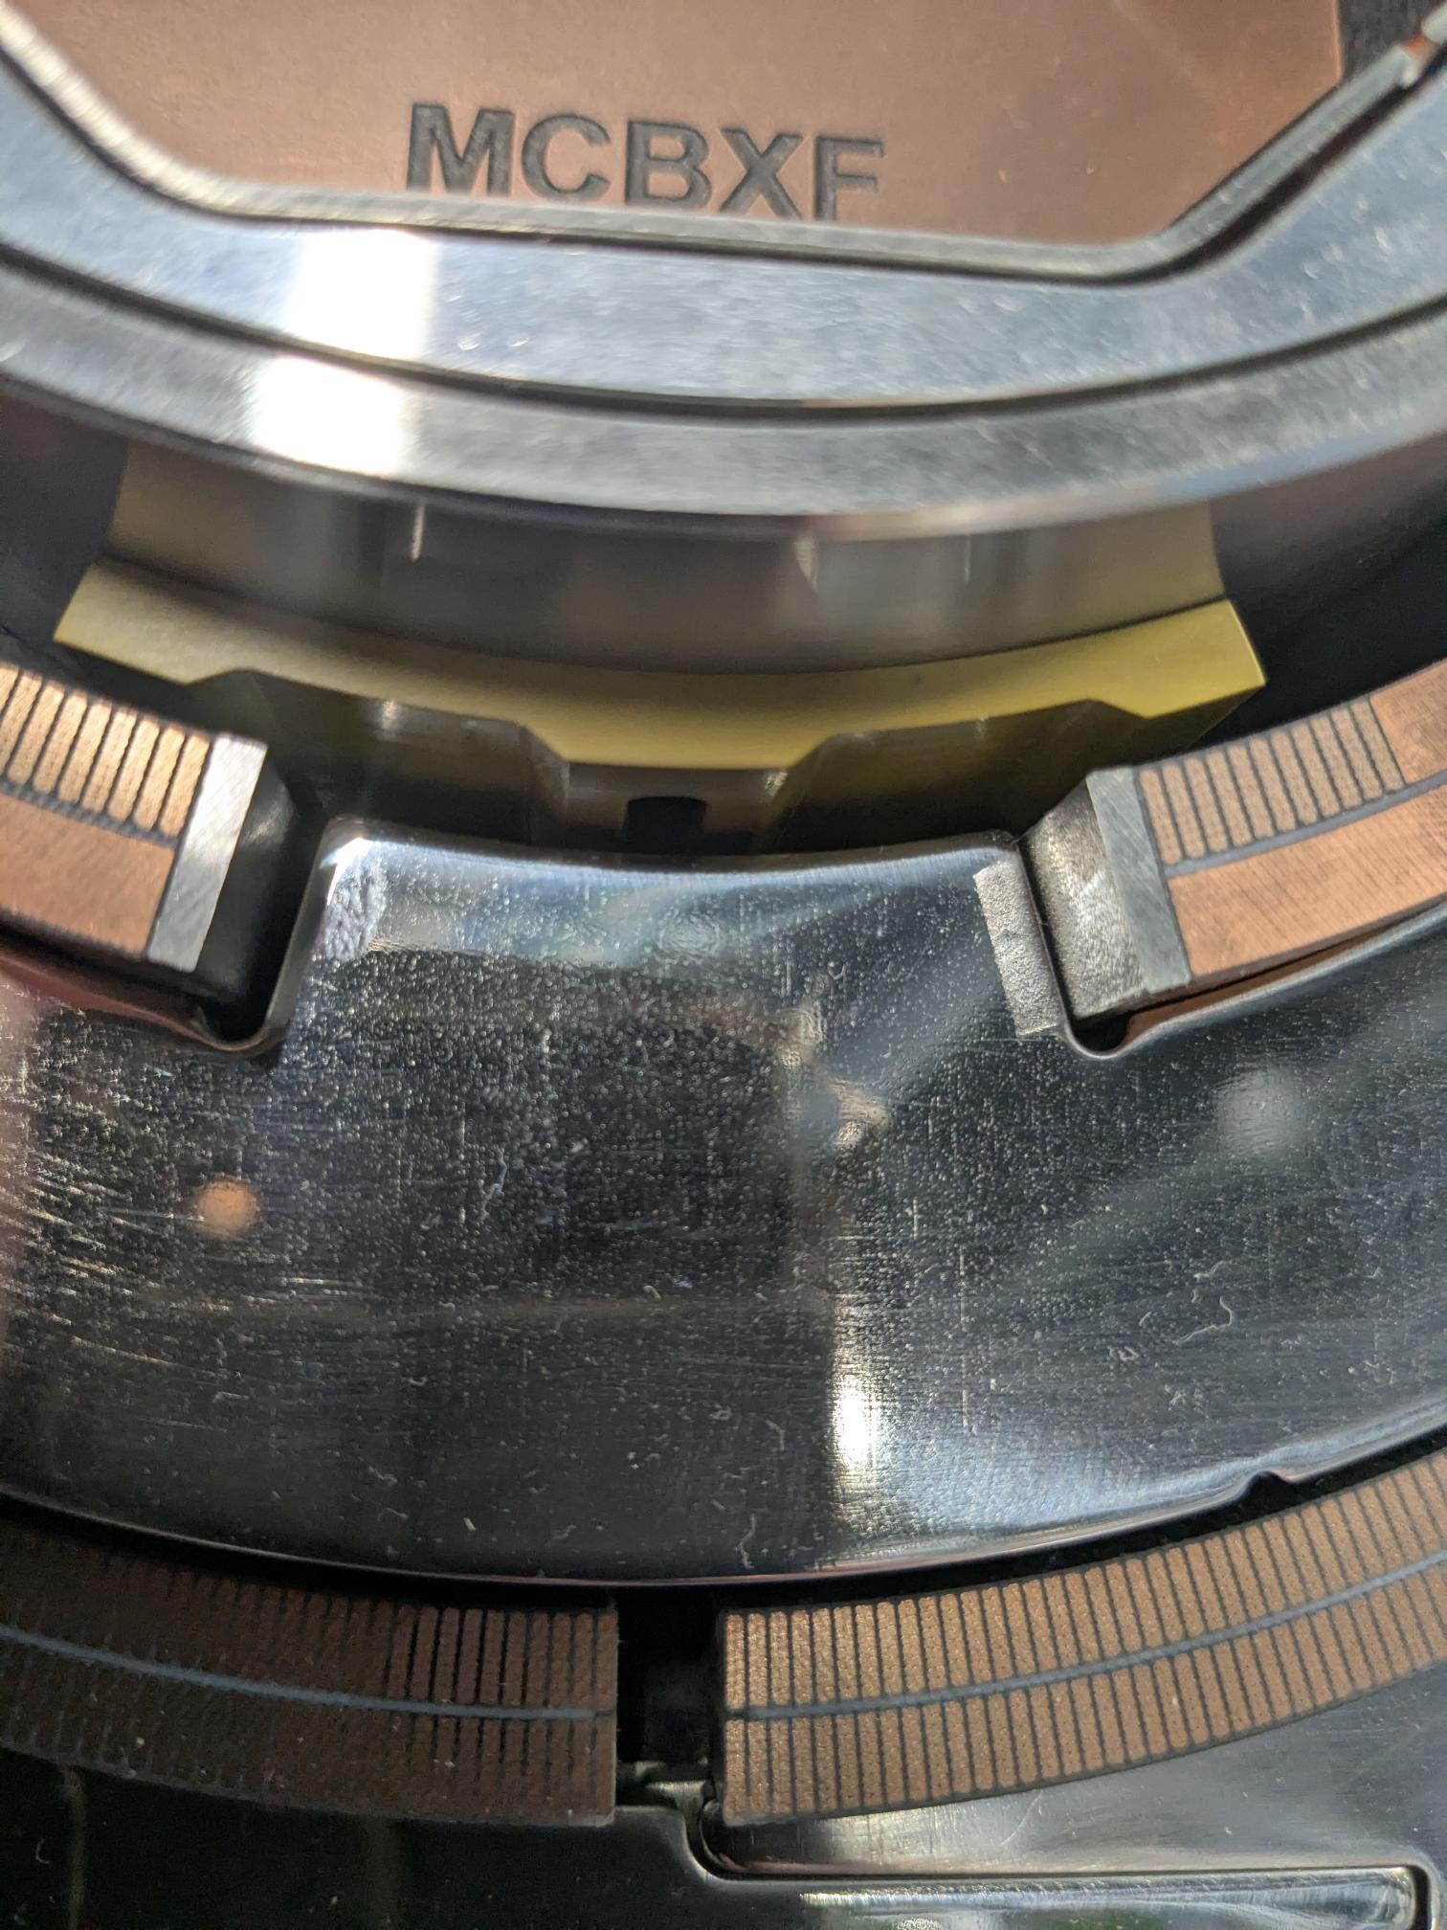
MCBXFA in CP
Quenches:
Always in inner layer, in the bottom half.
Exact longitudinal location not measured.
To investigate:
How does heat transfer from bore tube to coil? Can it go through the superfluid helium or only through spacers? How much heat you need to transfer to increase the coil temperature to 6.5-7 K?
Beam tube, not present in SM18. In SM18 an anti-cryostat is placed.
Not touching the coil
Bore tube
The quenches occur in the lower layer of the inner dipole. With the bore tube pressing more on the bottom supports, this seems to be compatible.
The spacers touch multiple tapes (about 5-6), which could support a fast voltage buildup since multiple turns can quench simultaneously.
Spacer
coil
MCBXFA
Spacer touches coil
Pole
MCBXFA in B180 ready for cold mass assembly
Cross-section Mockup of MCBXF in SM18

Slide 16
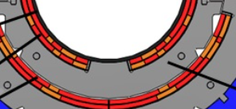
MCBXFA in CP, schematic.
Warm air at 300 K
(only stretched wire in the CP, no rotating shaft).
Anti-cryostat (warm bore 300 K, heaters, superinsulation, and thermal screen).
The anticryostat and space between anti-cryostat and bore tube share vacuum with the CFB and cryostat.
G10 spacers anticryostat (2.5 mm thick)
G10 spacer bore tube (surrounded by superfluid helium)
Coil

Slide 17
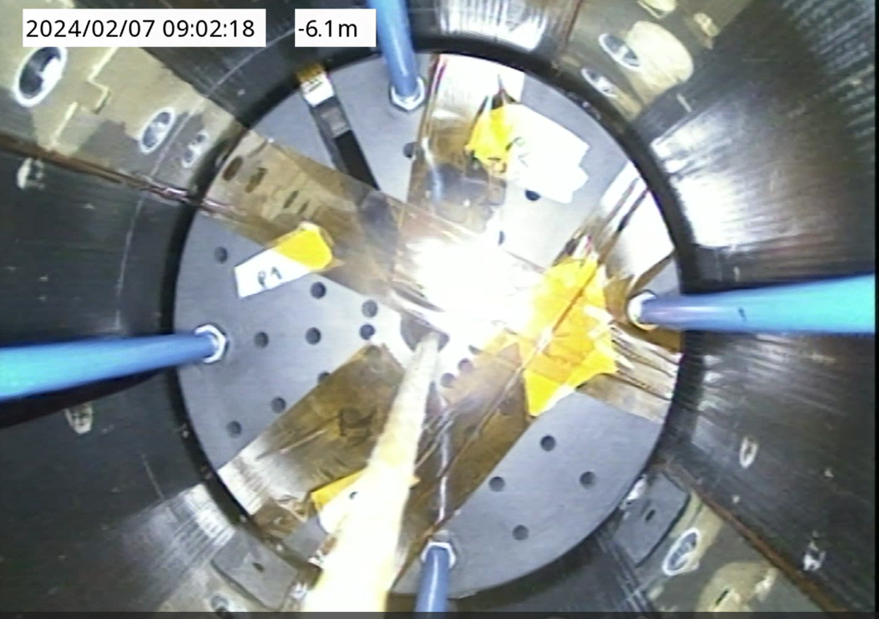
What about the Q3 – flattop quenches.
The MQXFB spacers are only in contact with the pole, not with the coil.
The flattop quenches were in a coil in the lower position (pole 3).
Questions remain:
Spacers are not in contact with coil
No quenches seen at 4.5 K…
MQXFB
Spacers only in contact with pole

Slide 18
Summary
New info shows that there are possible pre-cursors in temperature and vacuum pressure around 5 to 8 seconds before the flattop quenches start in the magnet.
If confirmed this would be very good news for the magnet project, since this allows for qualification of the CP and the Q3.
The data points to transients in the vacuum compartment, more than in the liquid helium compartment.
Further investigation
What triggers the transients?
How can enough heat go from the vacuum space in the bore tube into the magnet?
Could the rather bad vacuum pressure due to a leak (5.10⁻⁵ mbar) have an impact?
Is there any chance that similar transients can be produced when the beam screen is installed?
…

Slide 19
Thank you.

Slide 20
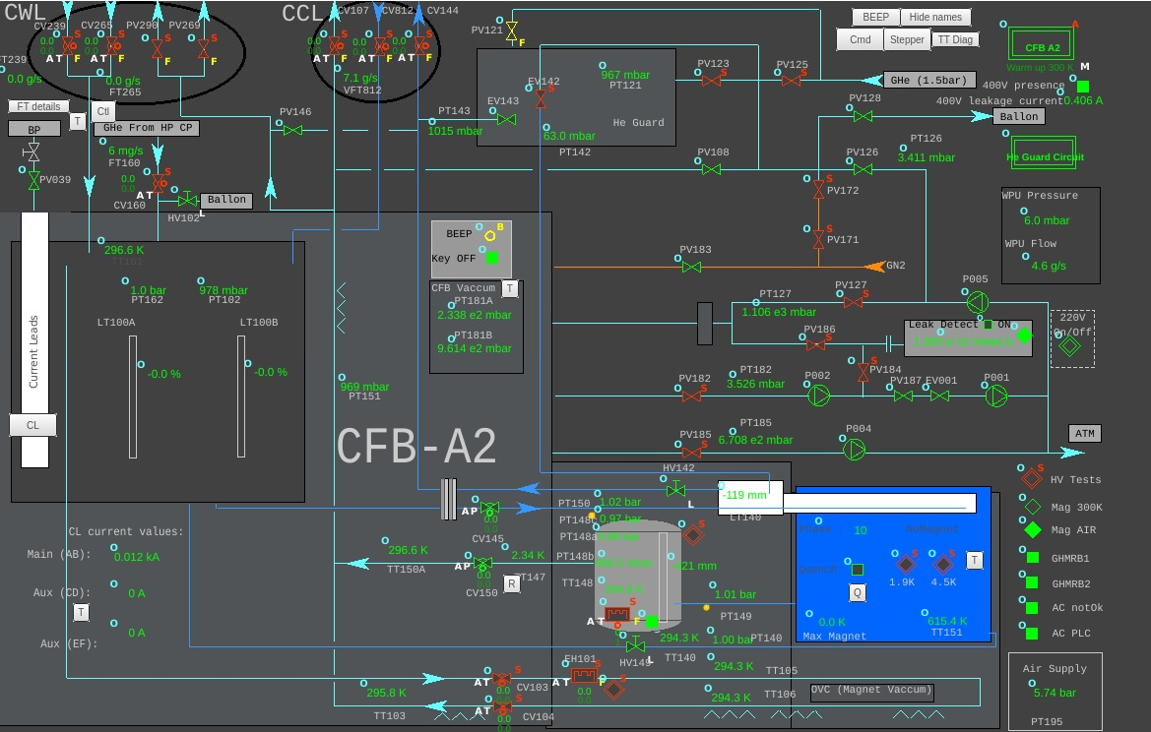
PT181 vacuum pressure
PT181 vacuum pressure

Slide 21
