Slide 1

Developing a High Voltage Switch for Increased Penning-Malmberg Trapping Efficiency
Caroline Crann
UMich REU Talk 1
13 June 2025
Notes:
Add Cern logo
give ashwin credit
description of project
What experiment will you be working on?
Who is your mentor(s)?
What will your specific project be?
What do you hope to learn?
Any questions or issues you might have.
Photos from your great mountain expedition (and anything else you want to show off)

Slide 2
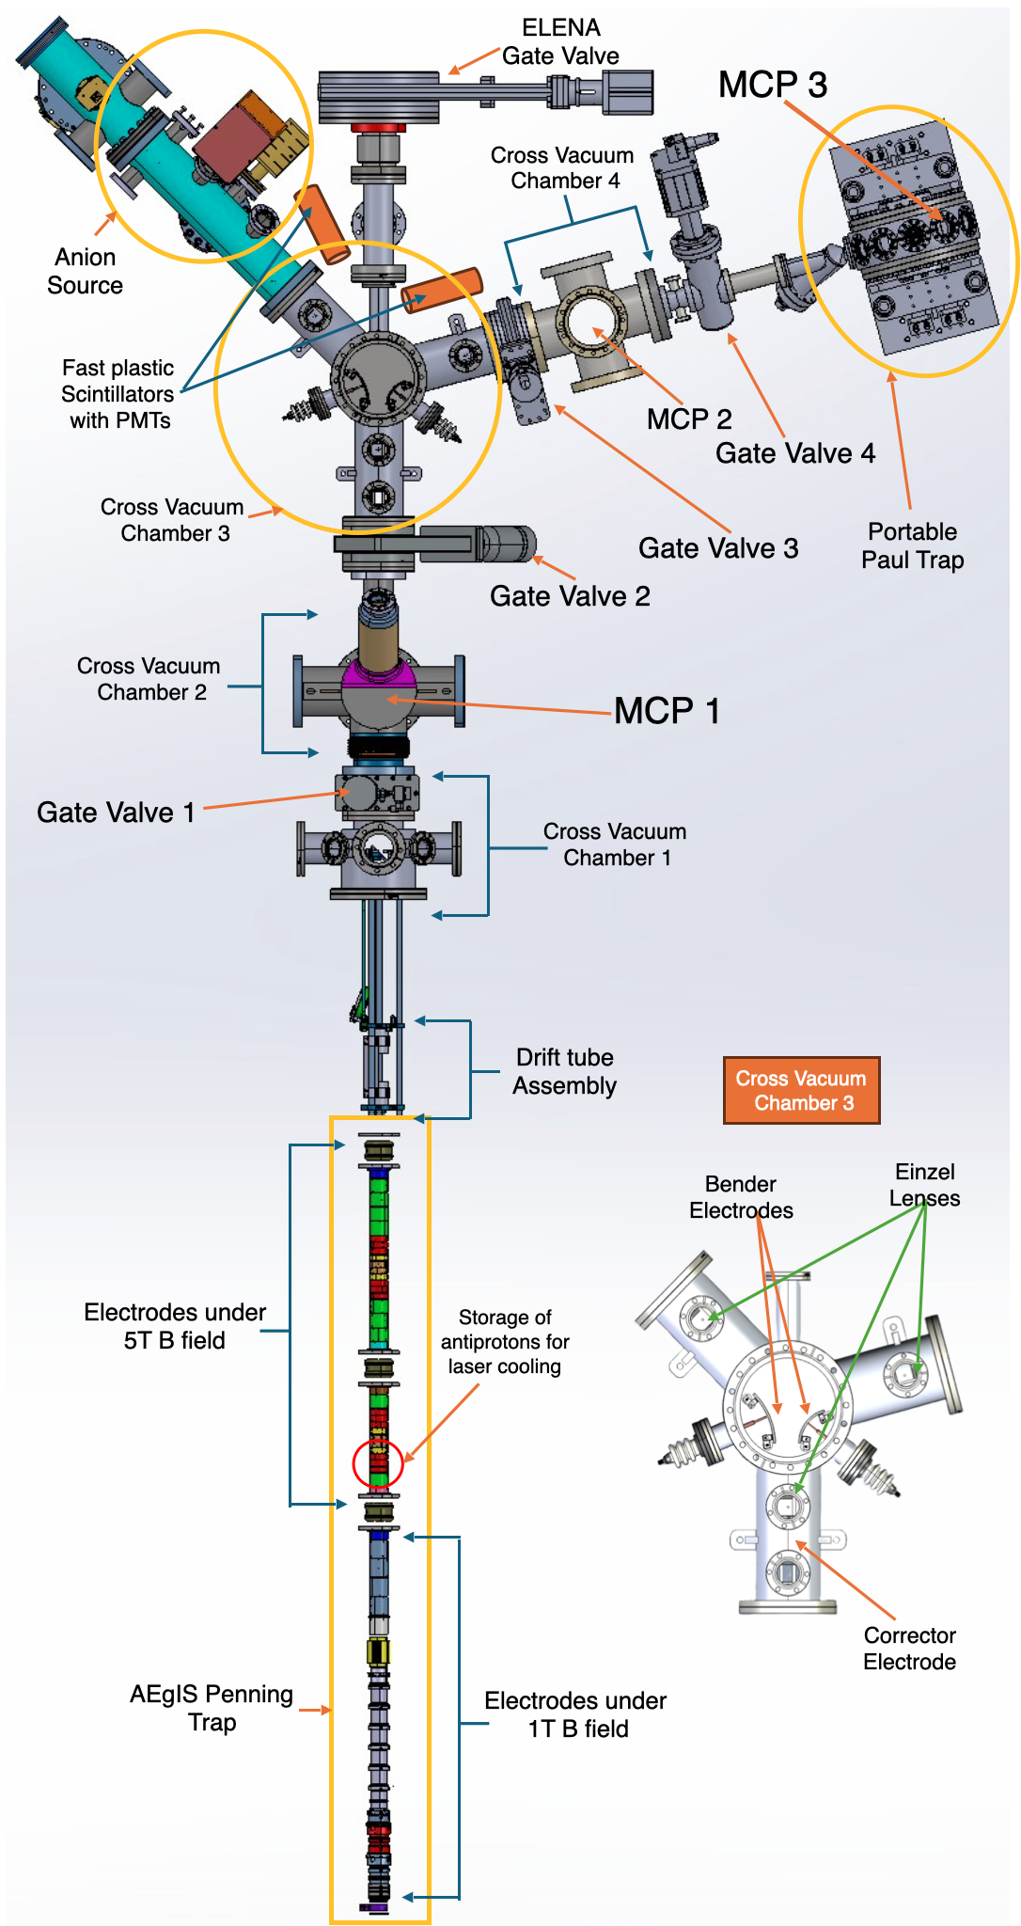
AEgIS - Antimatter Experiment:
Gravity, Interferometry, Spectroscopy
Consists of a Penning-Malmberg trap used to trap and cool antiprotons from ELENA.
  Produce antihydrogen and positronium for gravity measurements,etc.
Expanding the experiment to study antimatter bound species.
  Nuclear fragments from antiproton annihilation.
Mentor: Dr. Gustafsson
C. Crann
A. Bhartia. 2024.
Notes:
Axial Magnetic Field confines particles raidally and radial electric field confines particles axially
General description: consists of a penning ion trap (which uses magnetic fields to confine radially and electric fields to confine axially) (with large magnets and a cryostat) used to trap and cool antiprotons from elena. this apparatus has many different uses
Based on the name one of the biggest initiatives is to produce antihydrogen and then perform gravity measurements
to produce antihydrogen you need to first produce positronium (which is an election and a positron orbiting around a center point) additional experiments on positronium are also being performed
Additionally there are experiments being conducted surrounding HCIs and antipotonic bound systems
as well as a push to cotrap anti protons and anions and understand their interactions
my mentors are Dr fredrik Gustafsson and… and their main focus is on the last two parts
insert ashwin’s figure

Slide 3
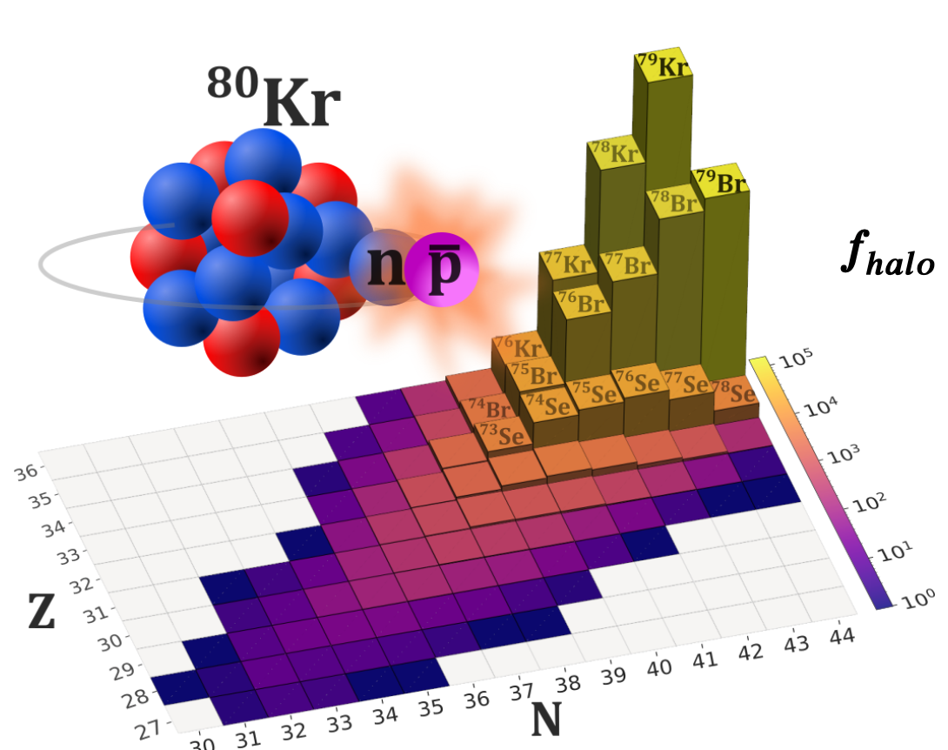
Studying Nuclear Fragments
Antiprotons captured by anions in the trap leading to Auger ejection.
Forms Highly Charged Ions (HCIs).
Antiproton annihilation leads to nuclear fragments.
Provides information on the structure of atomic nuclei and can act as probes in QED/QCD experiments.
F. Gustafsson. 2025.
C. Crann

Slide 4
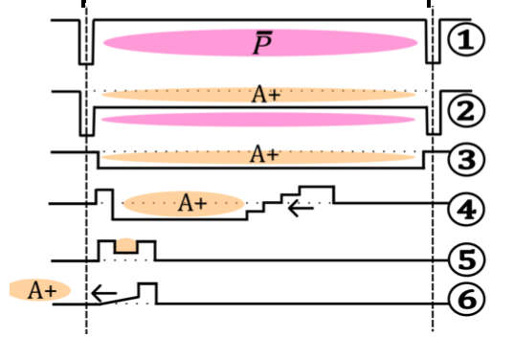
Improving the Trapping Efficiency
Trapping potential for negative particles: -14 kV
Current trapping potential for positive particles: 200 V
My project: Develop a high voltage automated switch to increase the trapping efficiency of positive particles.
C. Crann
F. Gustafsson. 2025.
Notes:
lowing the floor potential creates a nested trap so both positive and negative ions can be confined
atoms capture antiprotons to replace electrons

Slide 5


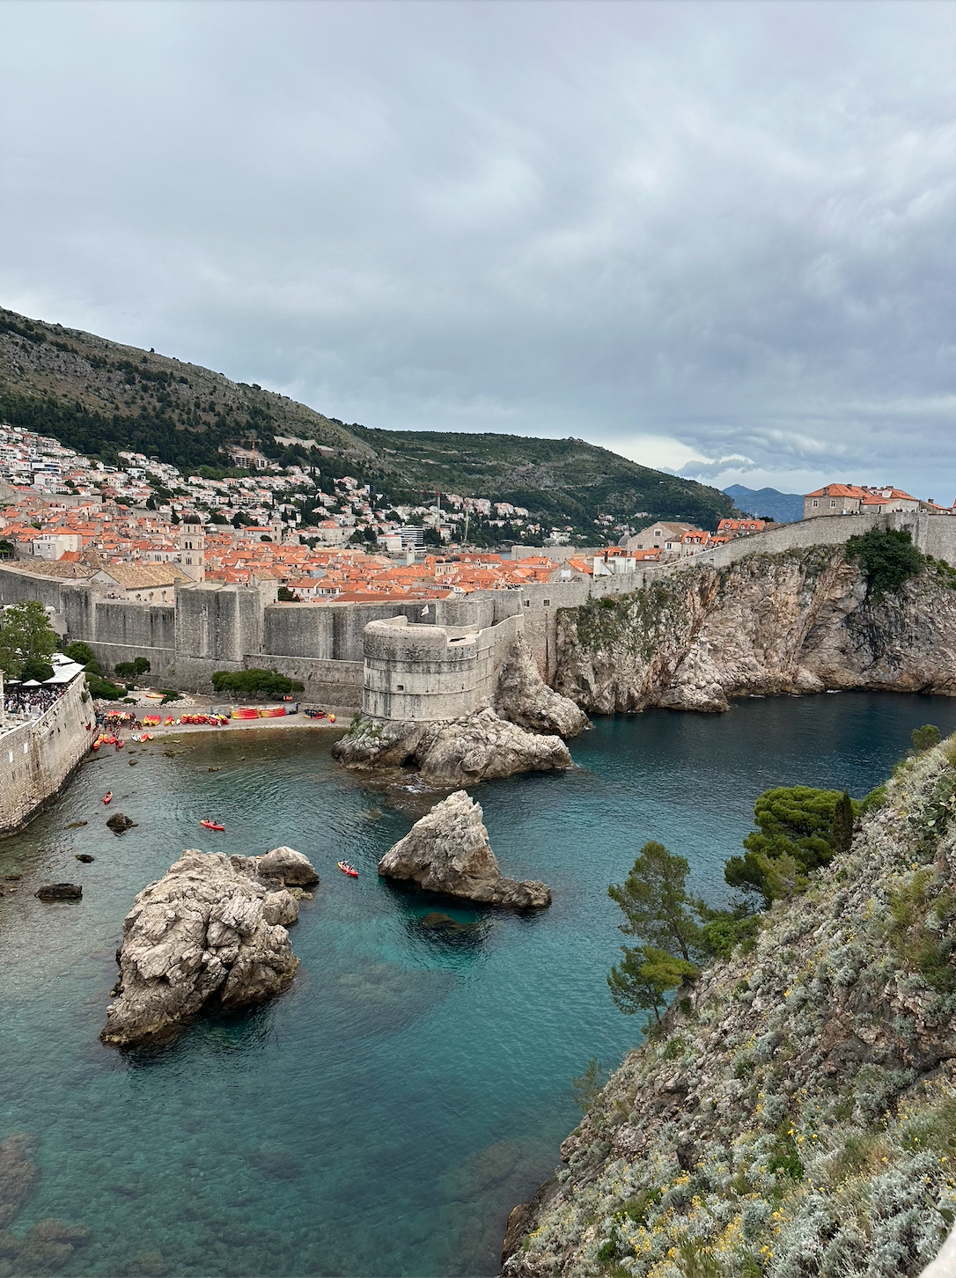
Exploring - Croatia!
Notes:
rydberg positronium
gravity measurement - need to produce antihydrogen
highly charged ions - tof spectroscopy
future plan - gas jet clean injection of neutral gas
negative ion injection anions - =

Slide 6



Exploring - Geneva!
Notes:
injection of anions and cotrapping and interaction

