Slide 1




Developing A Transmission Line For The VITO Beamline
Carolyn A. Chinatti
Advisor: Dr. Nikolay Azaryan

Slide 2
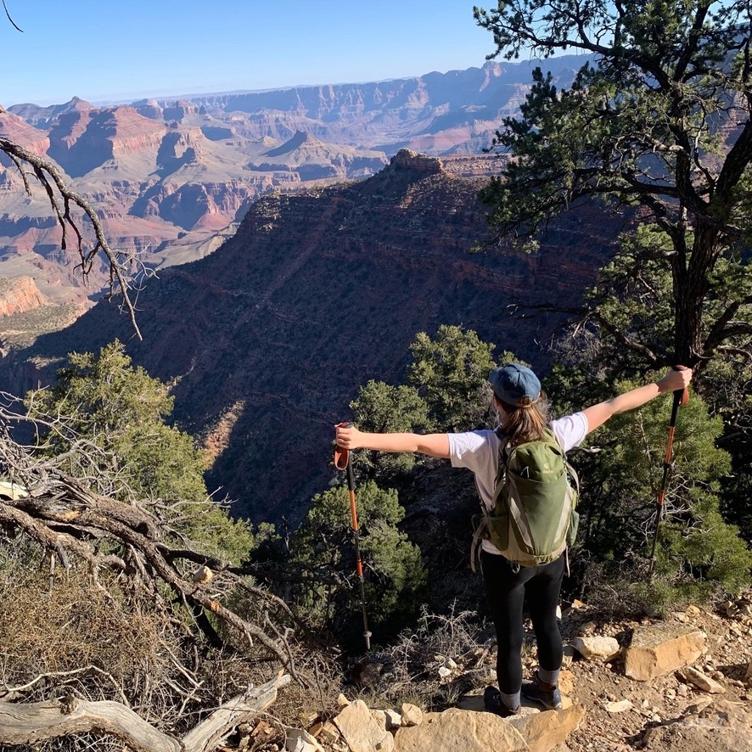
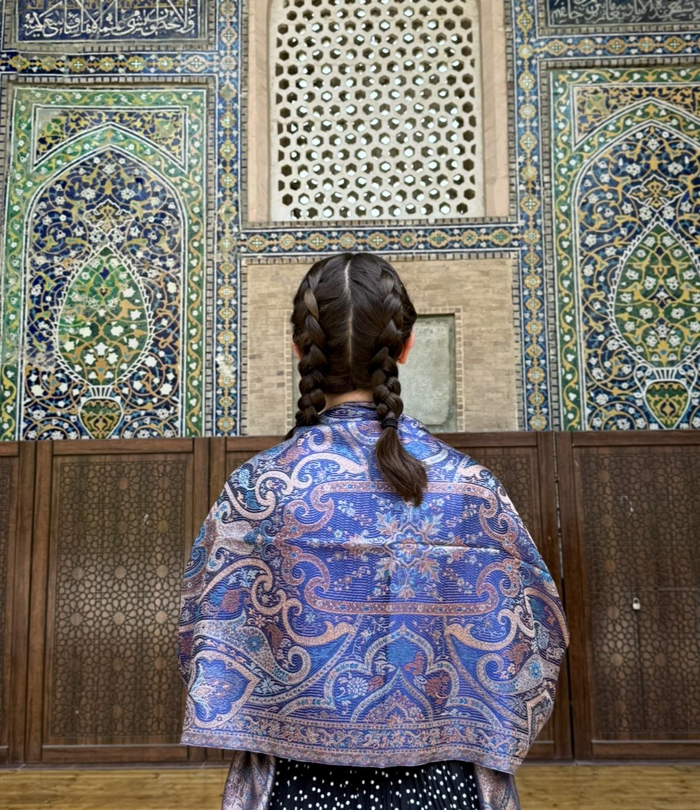
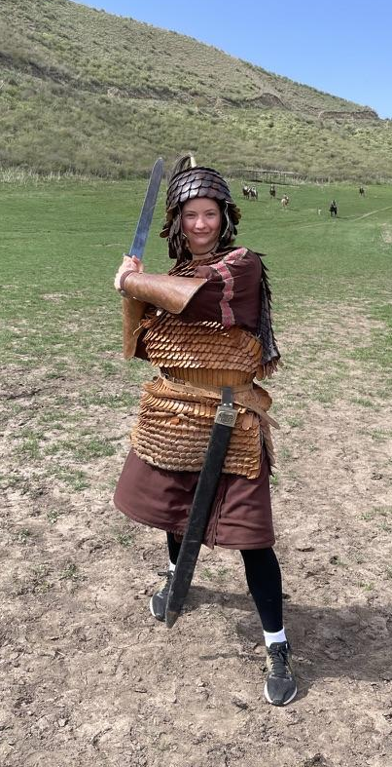
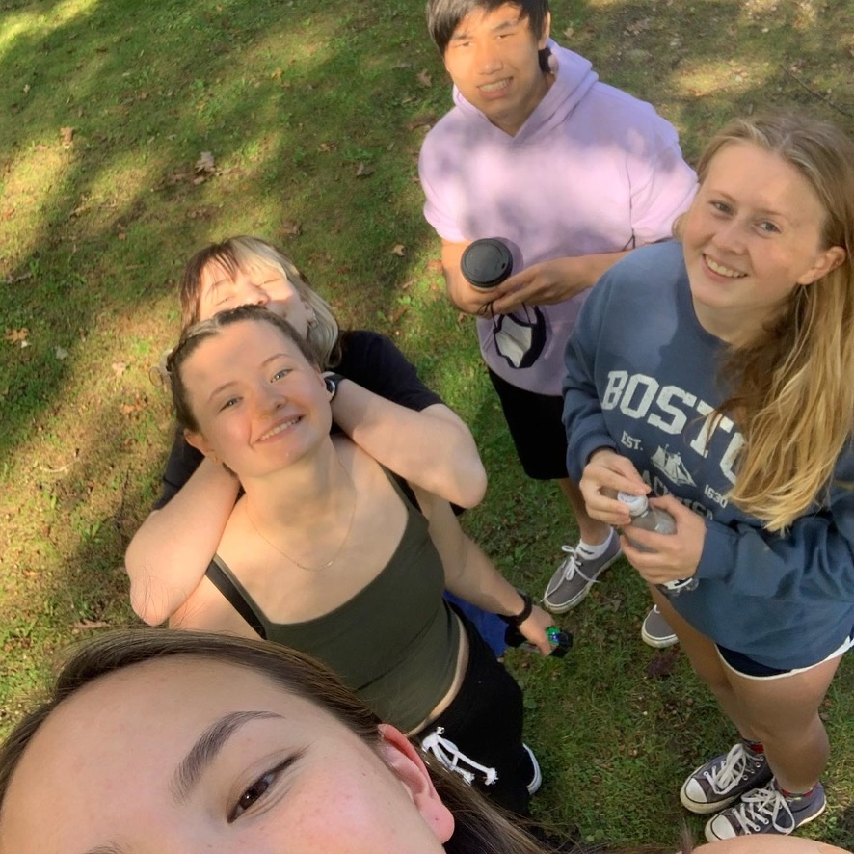
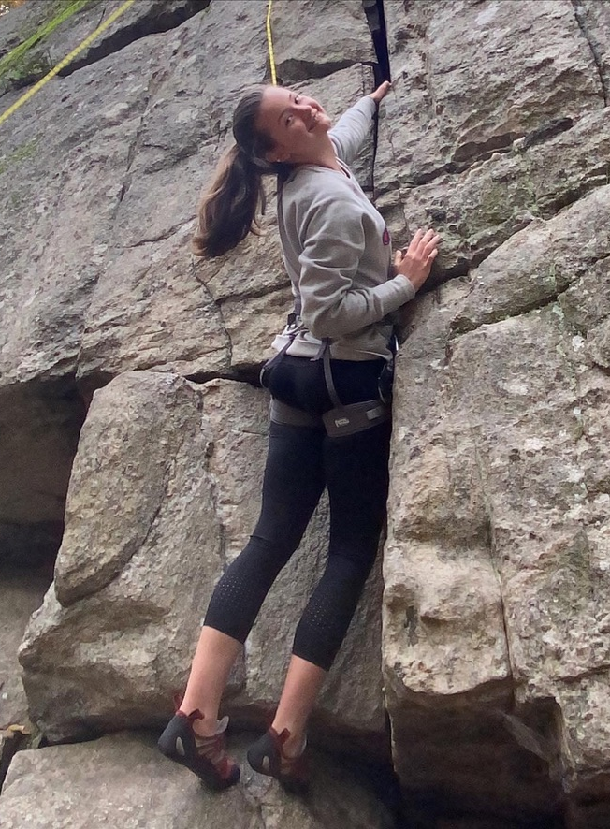
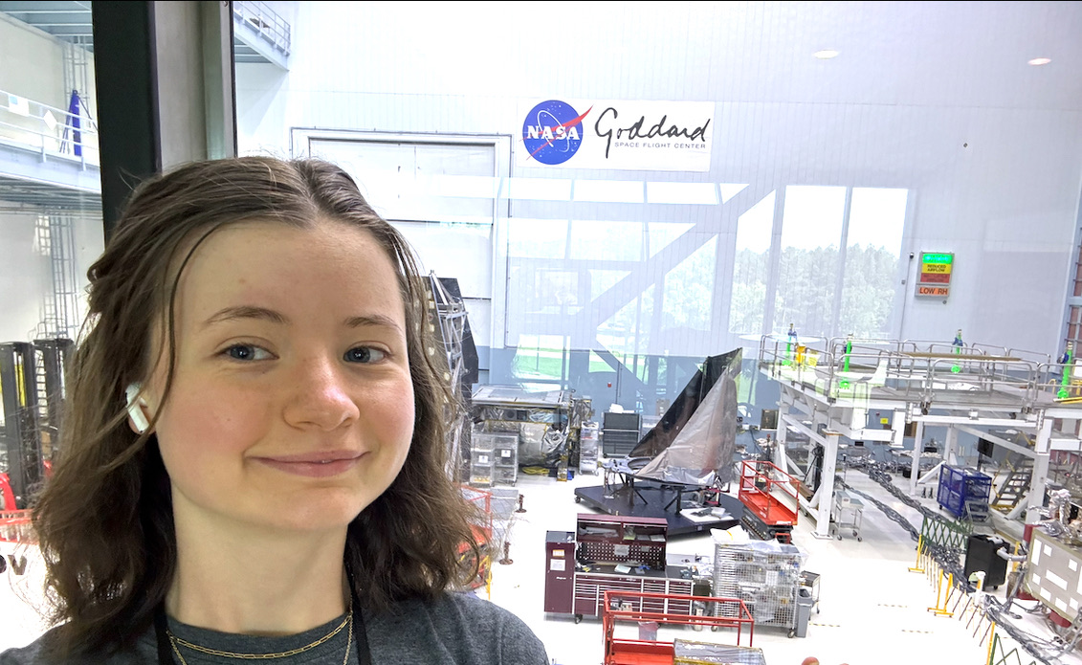
About Me!
From Boston, MA
Rising senior physics major at Carleton College
Previous work at NASA Goddard, Carleton College, and with the Galileo Project
Spent last Spring studying abroad in Almaty, KZ
C. A. Chinatti - UMich CERN REU 2025

Slide 3

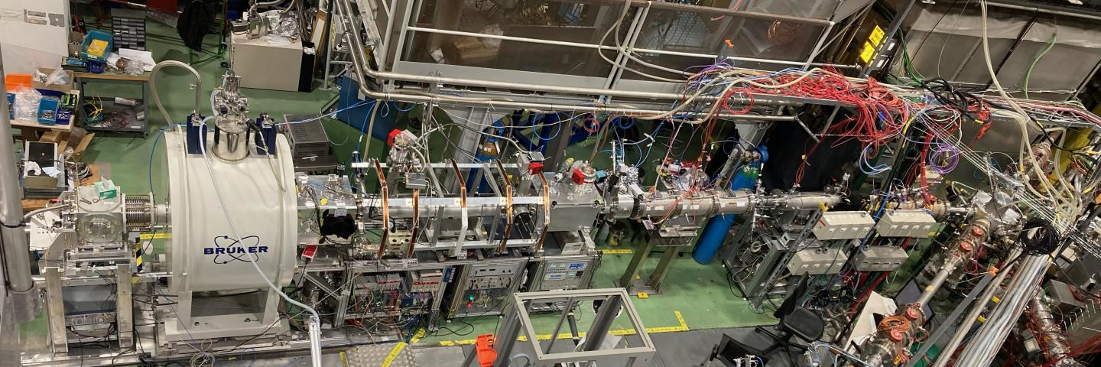
ISOLDE and The VITO Beamline
Isotope Mass Separator Online Device (ISOLDE) is a set of beamlines that uses radioactive nuclei from the PSB
Versatile Ion polarization Technique Online (VITO) is a beamline that polarizes the radioactive nuclei for β-NMR and hyperfine structure studies
A future upgrade to VITO will add RF excitation capabilities, enabling more precise studies of hyperfine anomalies
C.A. Chinatti - UMich CERN REU 2025

Slide 4
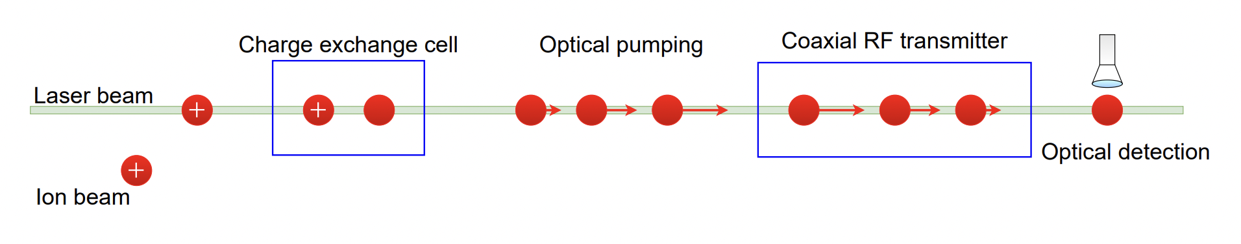
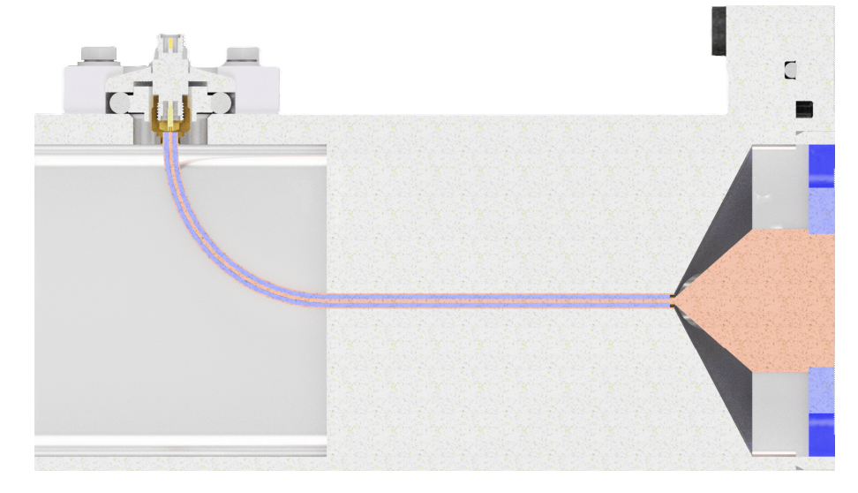
What Am I Doing Here?
My goal is to develop the transmission line for this upgrade
Transmission Line
C.A. Chinatti - UMich CERN REU 2025

Slide 5
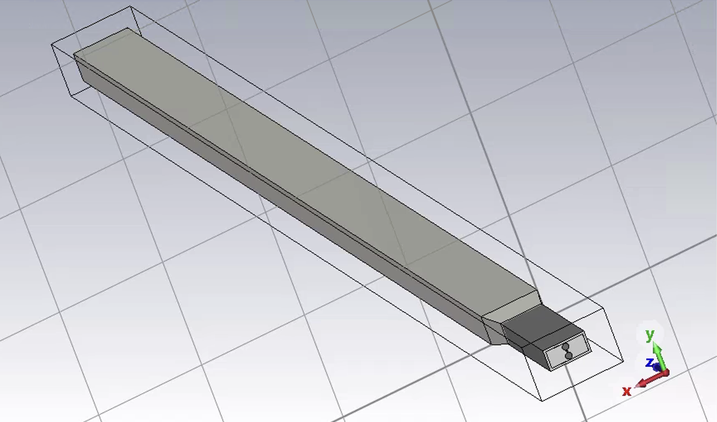
How Will I Do That?
I will first simulate the transmission line using CST
The simulations will give us parameters that will inform design choices for the physical transmission line
C.A. Chinatti - UMich CERN REU 2025

Slide 6
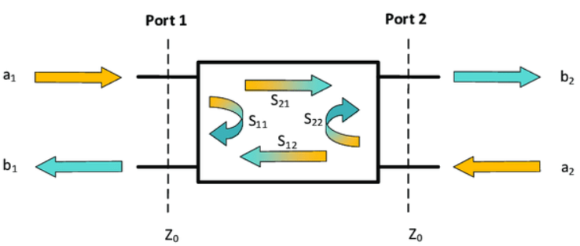
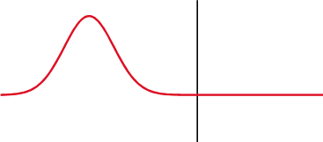
How Will I Optimize The Design?
Imperfections
Scattering Parameters Time Domain Reflectometry
Frequency domain
Send in continuous sine waves at many frequencies
Learn how effective the transmission line is at each frequency
Like playing piano keys and checking how accurate each note sounds
Time Domain
Send in short electrical pulses
Learn about imperfections/faults in the transmission line
Like using echolocation to find objects in your path
C.A. Chinatti - UMich CERN REU 2025

Slide 7
What Else Am I Doing Here?
Developing magnetic shielding for the beam
C.A. Chinatti - UMich CERN REU 2025

Slide 8
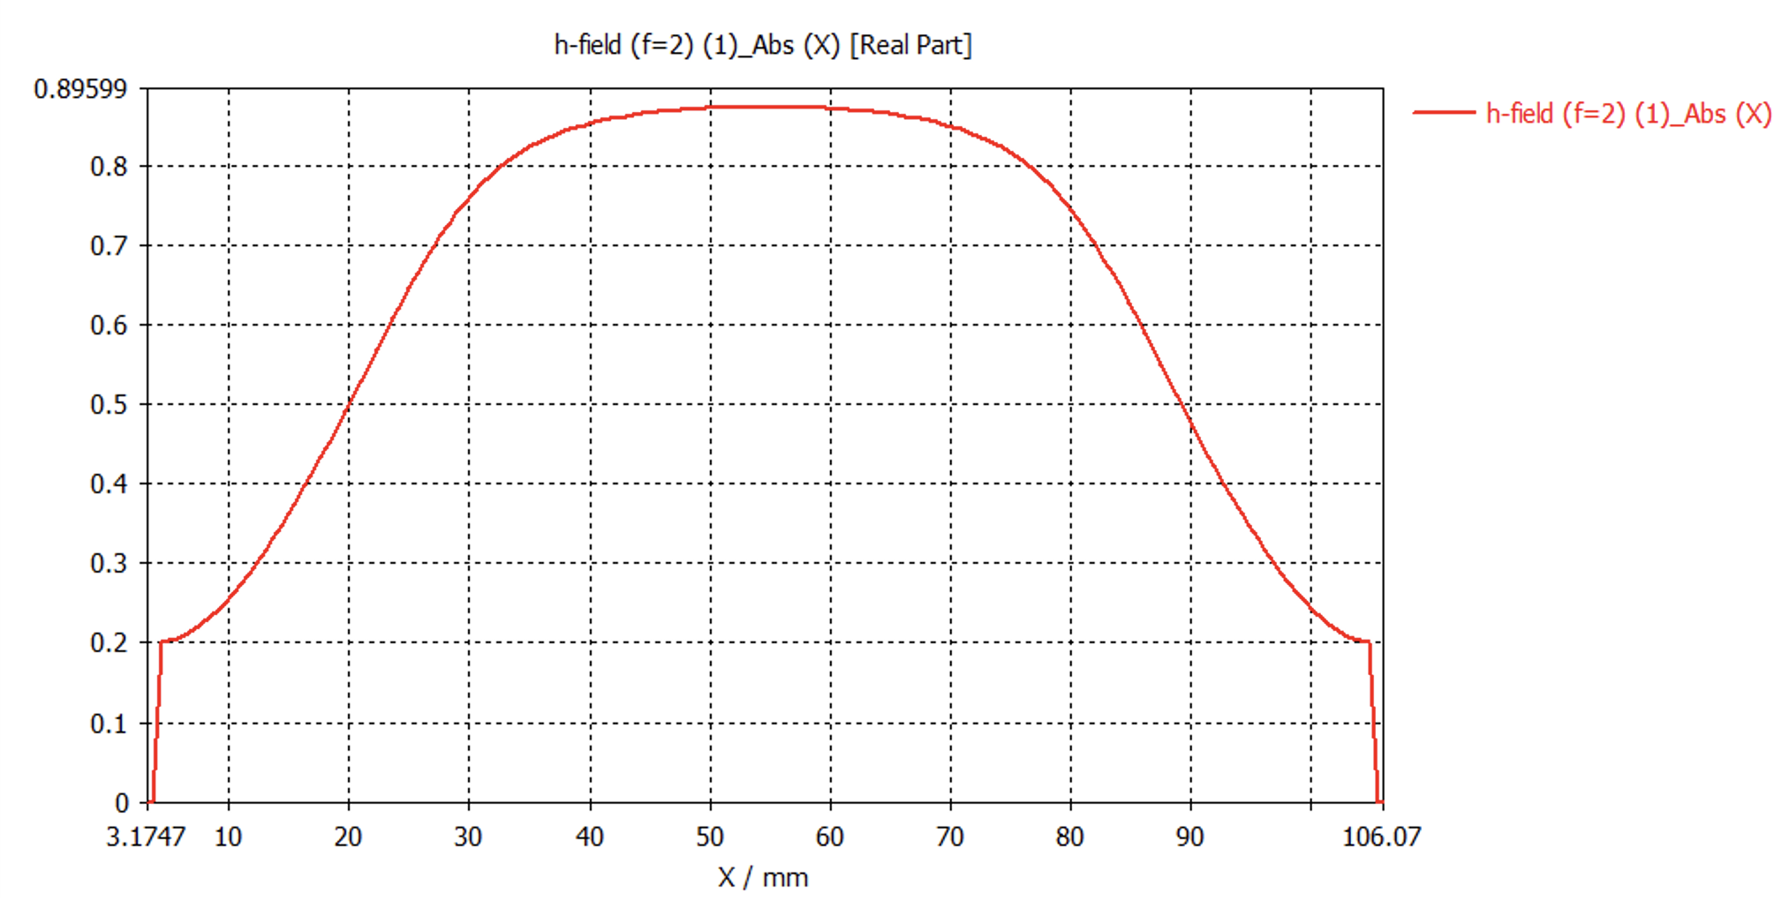
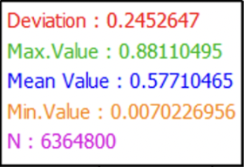
What I’ve Done
Learned how to use CST
Designed three potential transmission lines based on equipment available in the CERN store
  Optimized each design for a 50 Ohm impedance
  Determined magnetic field strength and uniformity in each design
C.A. Chinatti - UMich CERN REU 2025

Slide 9
What I Will Learn
More about RF and magnetic instruments
How to effectively design instrumentation under time/budget constraints
How to make and defend my own design choices
More about different instrumentation and physics opportunities and projects
C.A. Chinatti - UMich CERN REU 2025

Slide 10
References
Thank You!
https://isolde.cern/vito
https://theses.cz/id/evzpic/Havranek_DP.pdf
https://i0.wp.com/liquidinstruments.com/wp-content/uploads/2022/05/Figure-1-1.png?resize=738%2C314&ssl=1
https://en.wikipedia.org/wiki/Time-domain_reflectometer
C.A. Chinatti - UMich CERN REU 2025

