Slide 1
Testing Radiation-Hard Fibers for the LUCID-3 Prototype
Cole Morrison
University of Central Arkansas
June 13, 2025

Slide 2
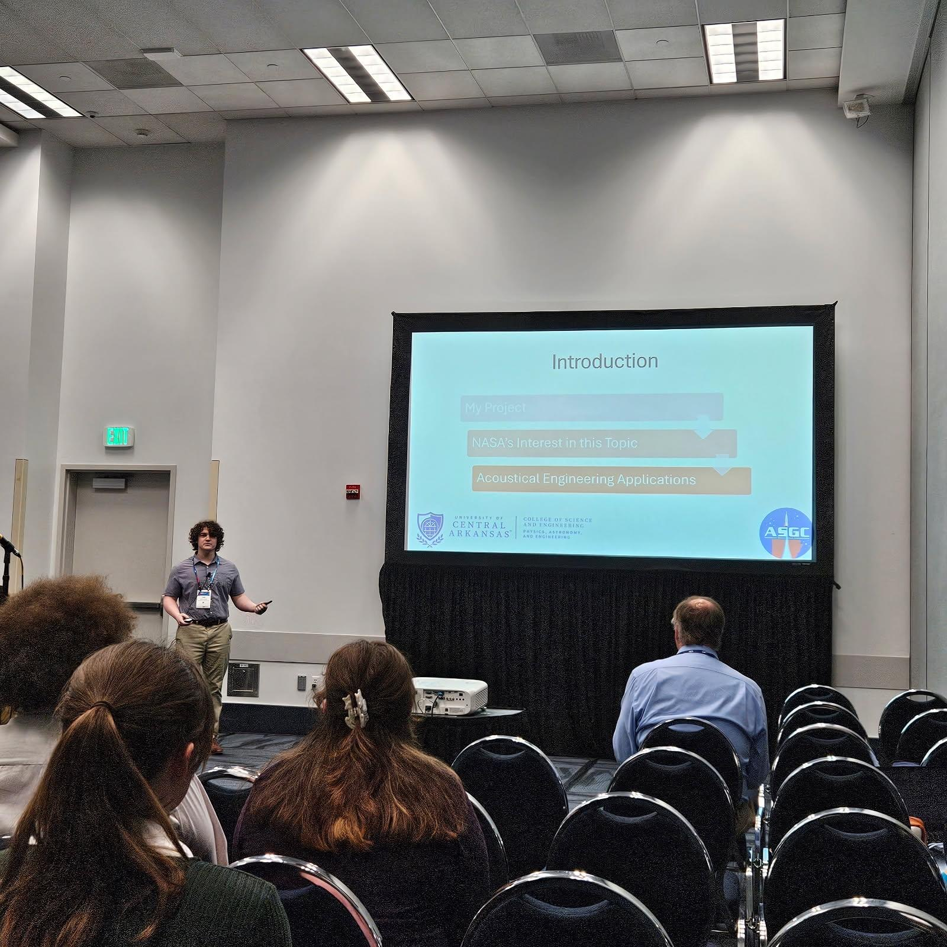
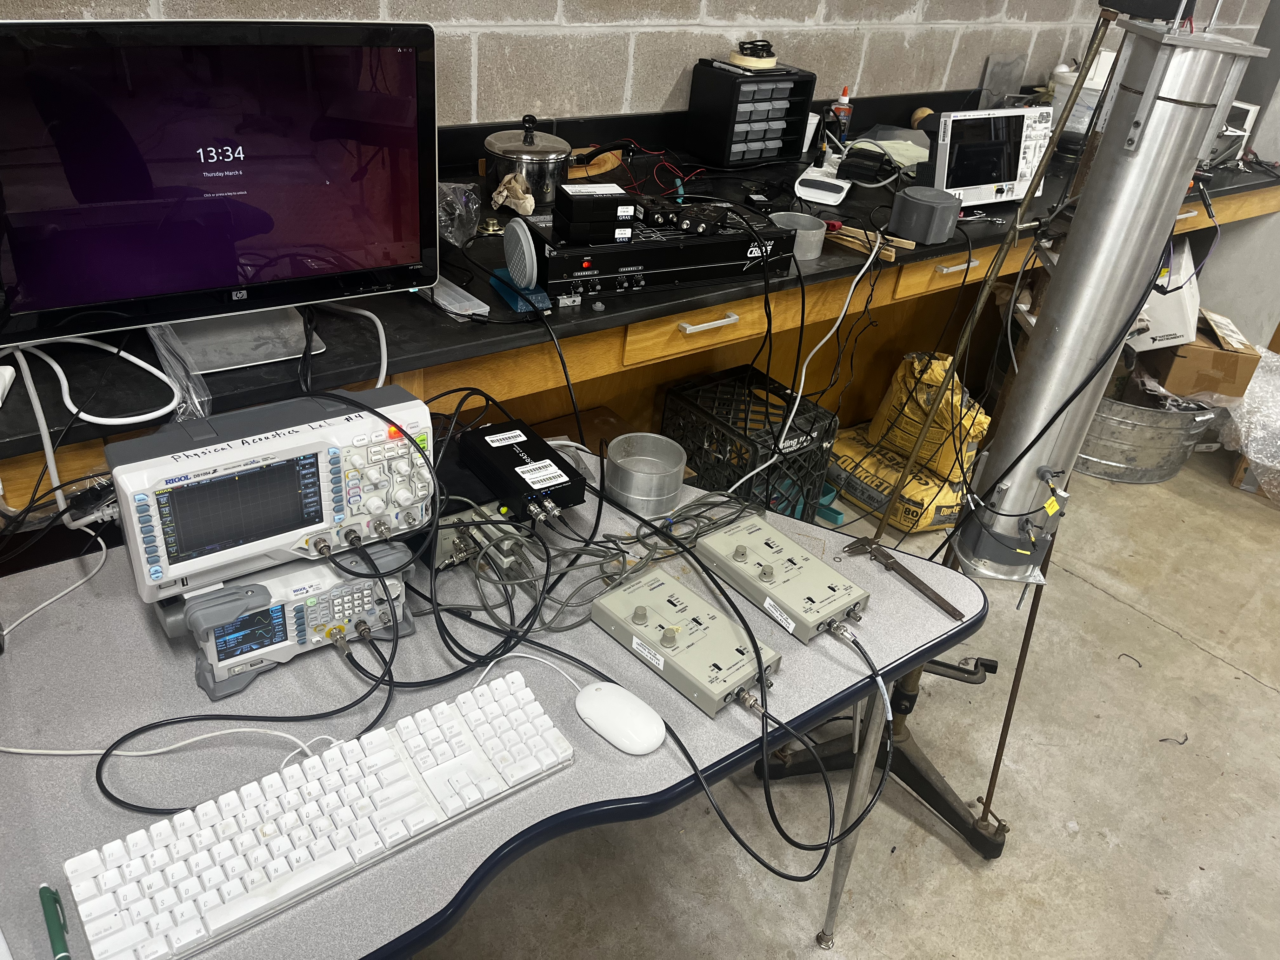
Who I Am

Slide 3
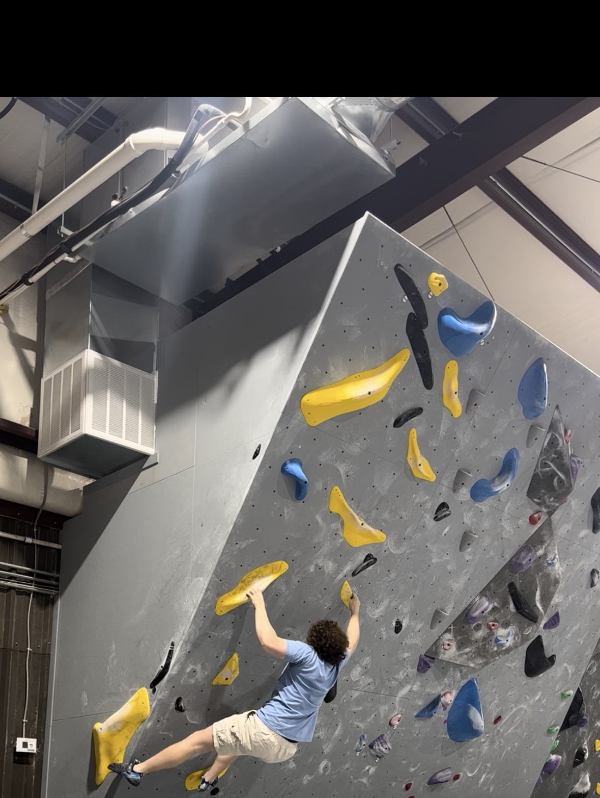
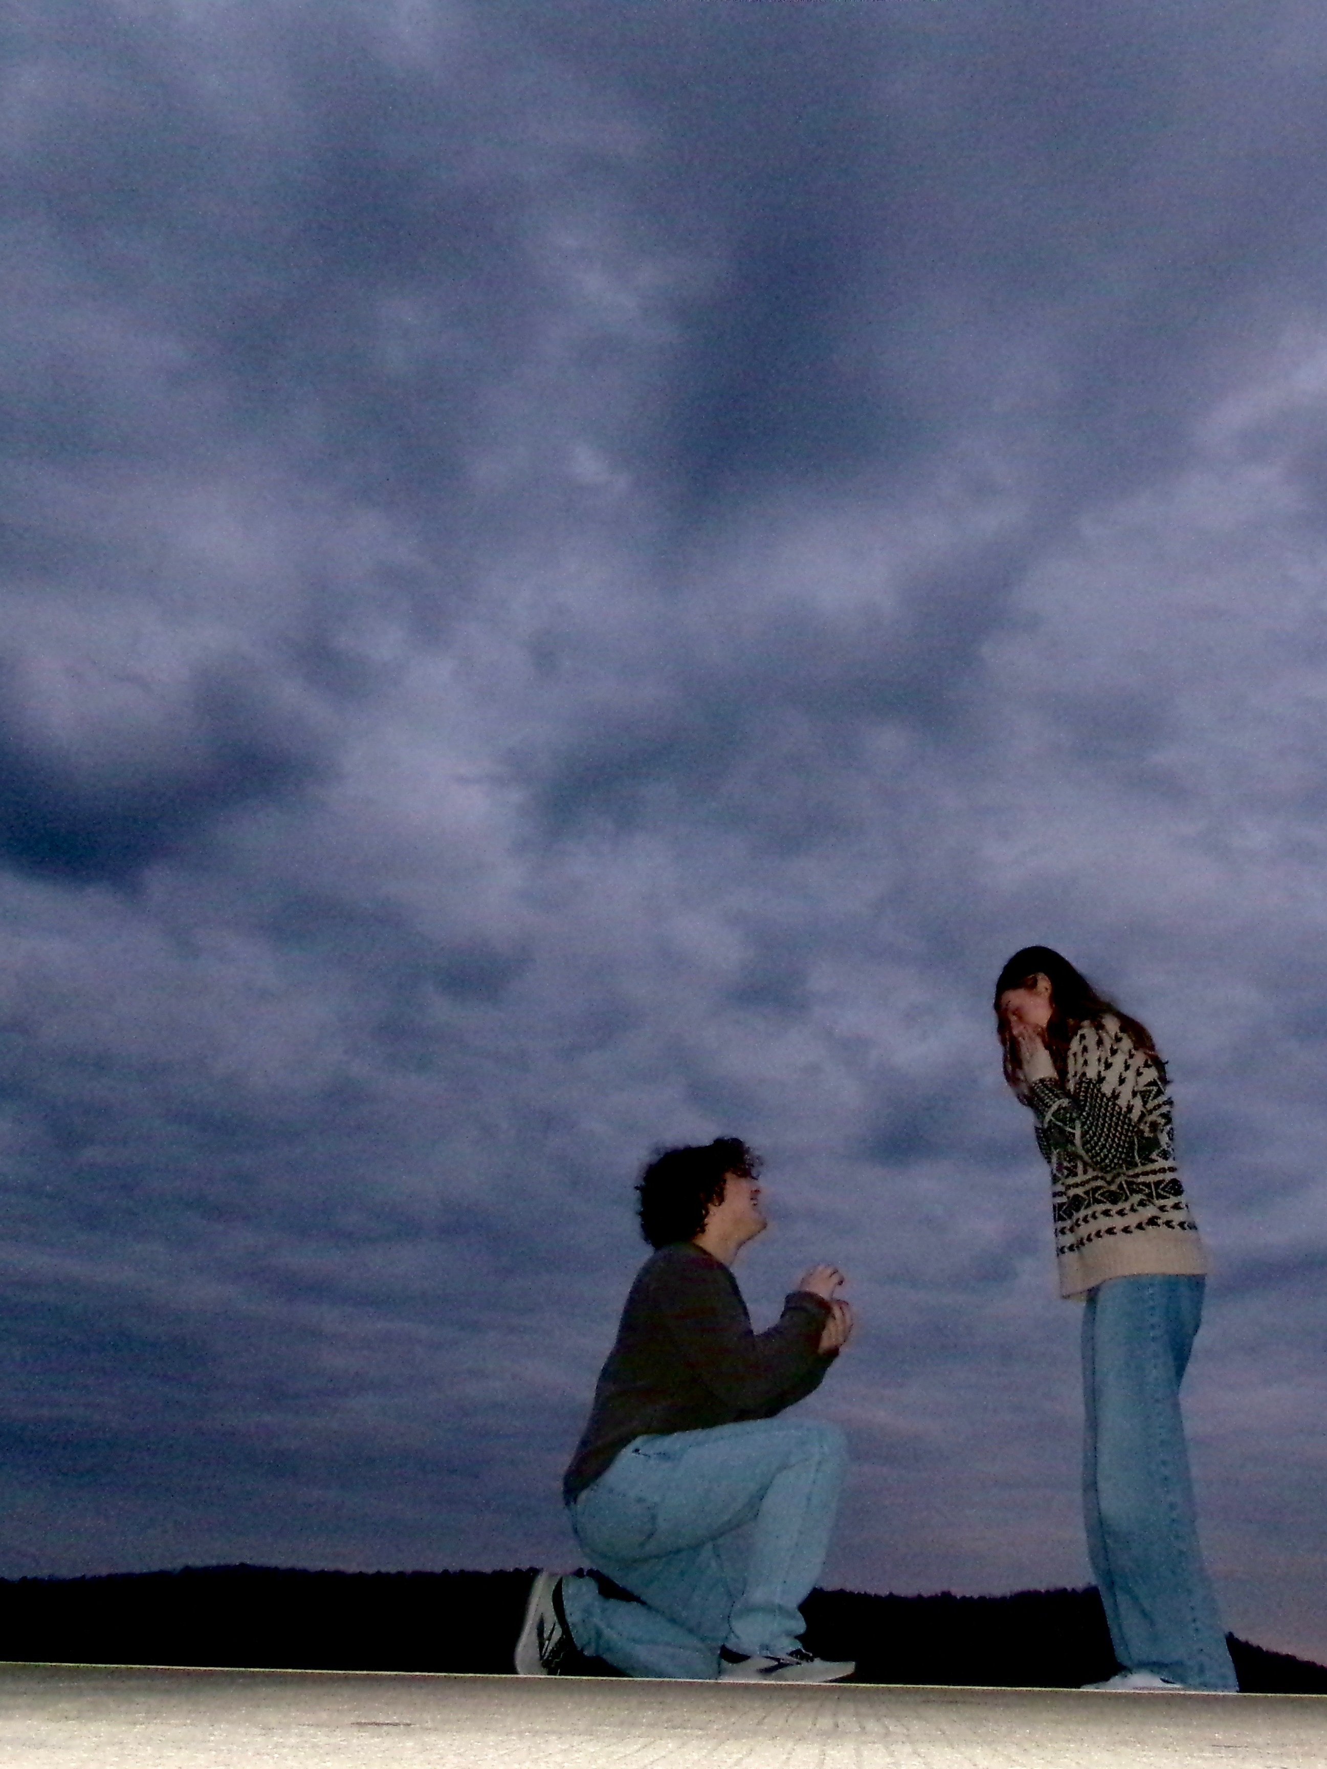
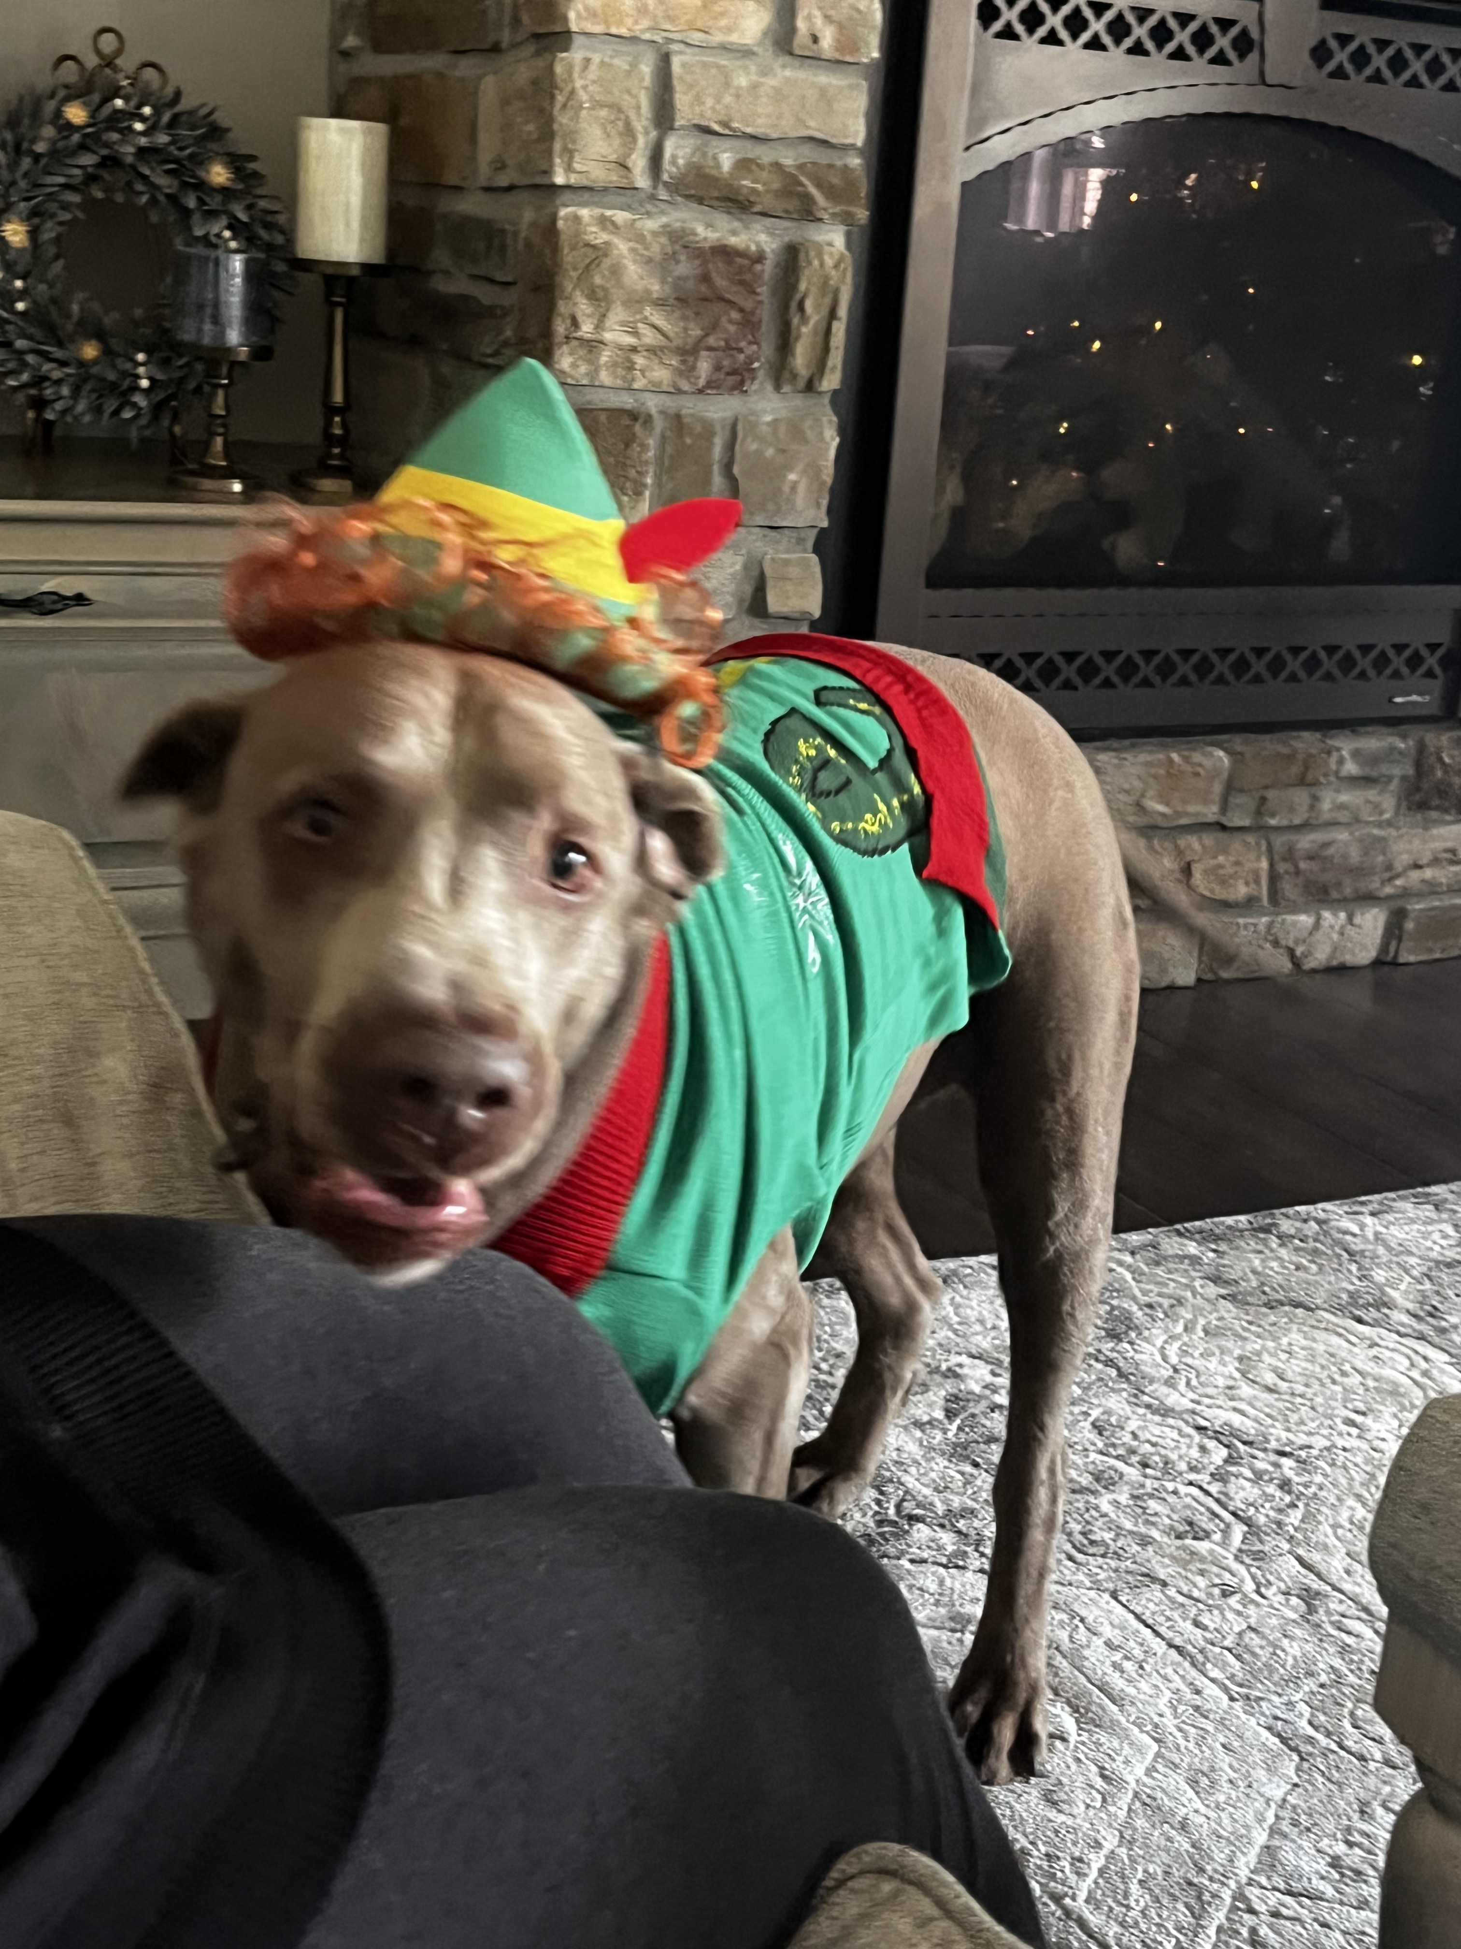
Who I Am

Slide 4
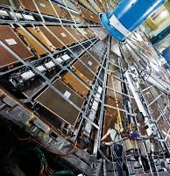
My Supervisors and the Experiment
My Supervisors
  Dr. Lasagni
  Dr. Sbrizzi
They are a part of the ATLAS team working on the LUCID detector
The LUCID detector supplies ATLAS with continuous luminosity measurements
This detector provides information in real-time about the accelerator's performance

Slide 5
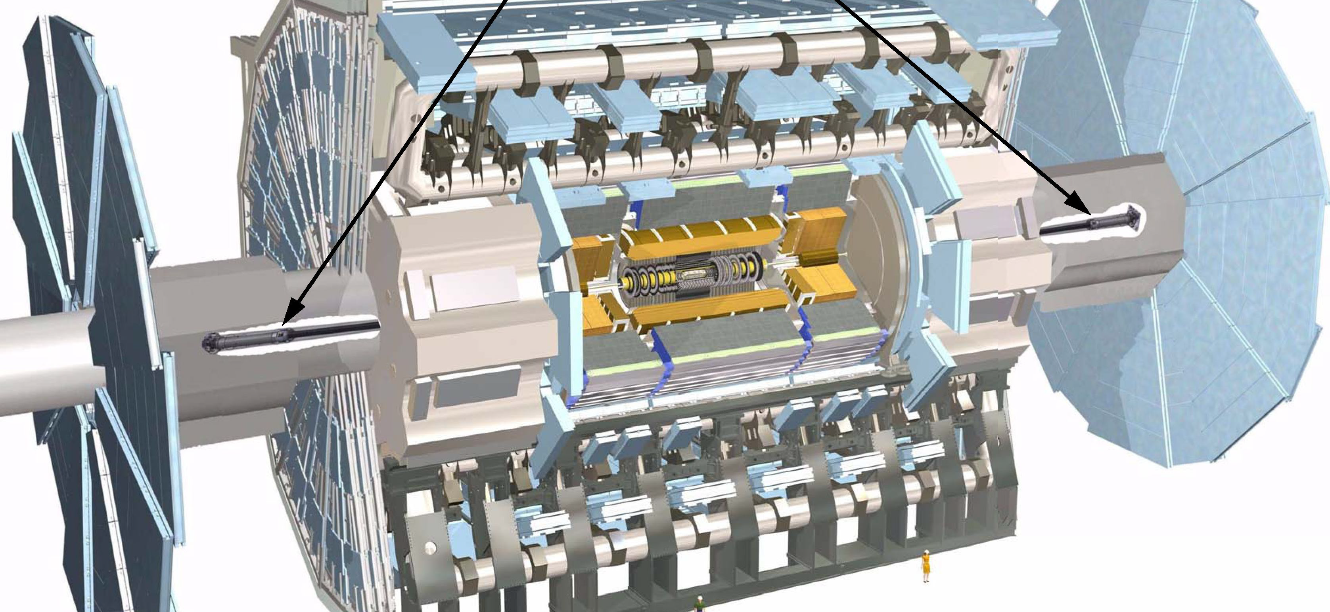
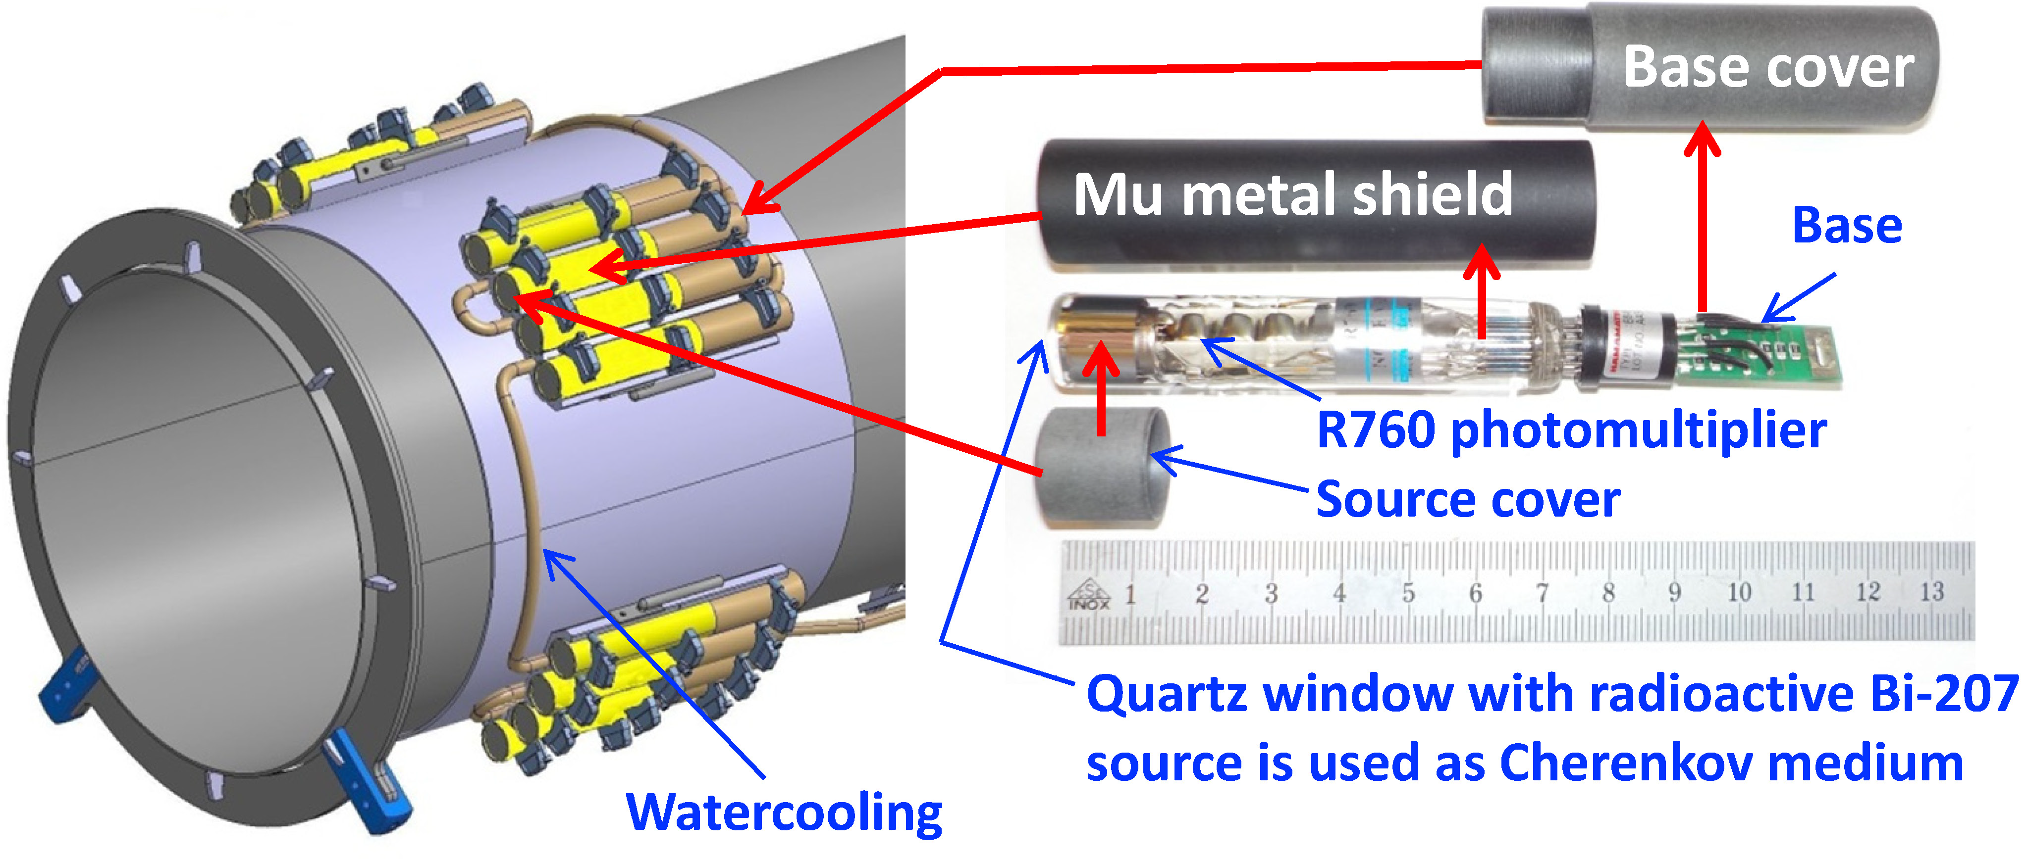
Lucid Detector
Two modules
Each module contains photomultiplier tubes
The photomultiplier tubes creates and amplifies electrical
Issues with the PMT’s

Slide 6
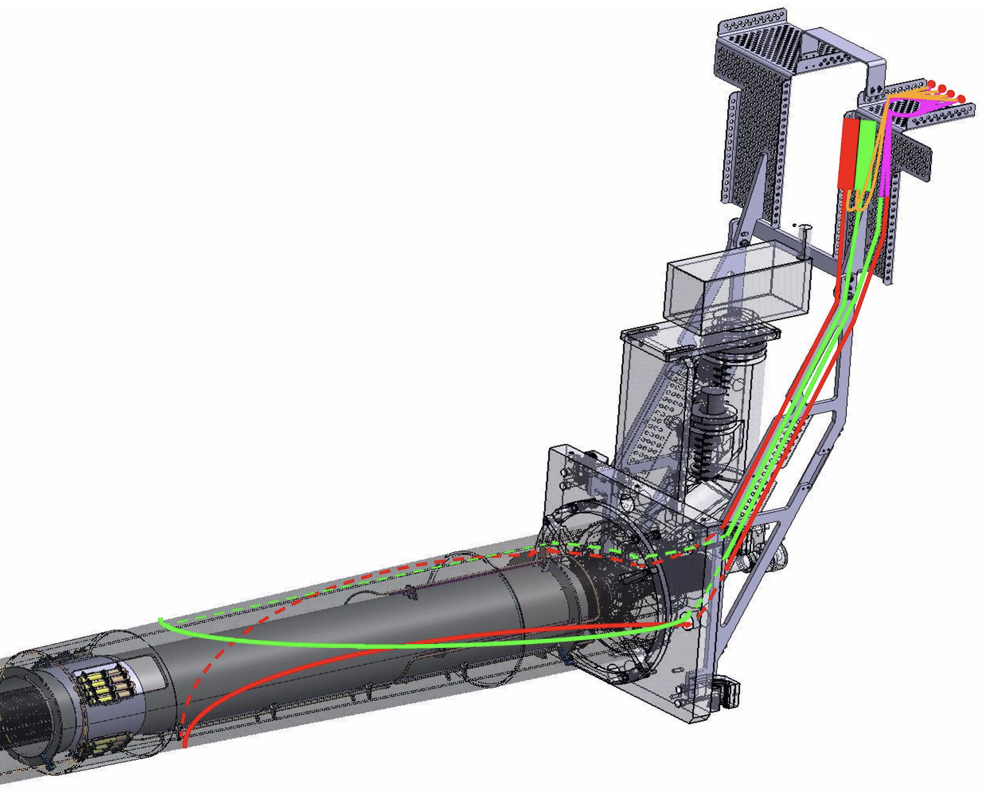
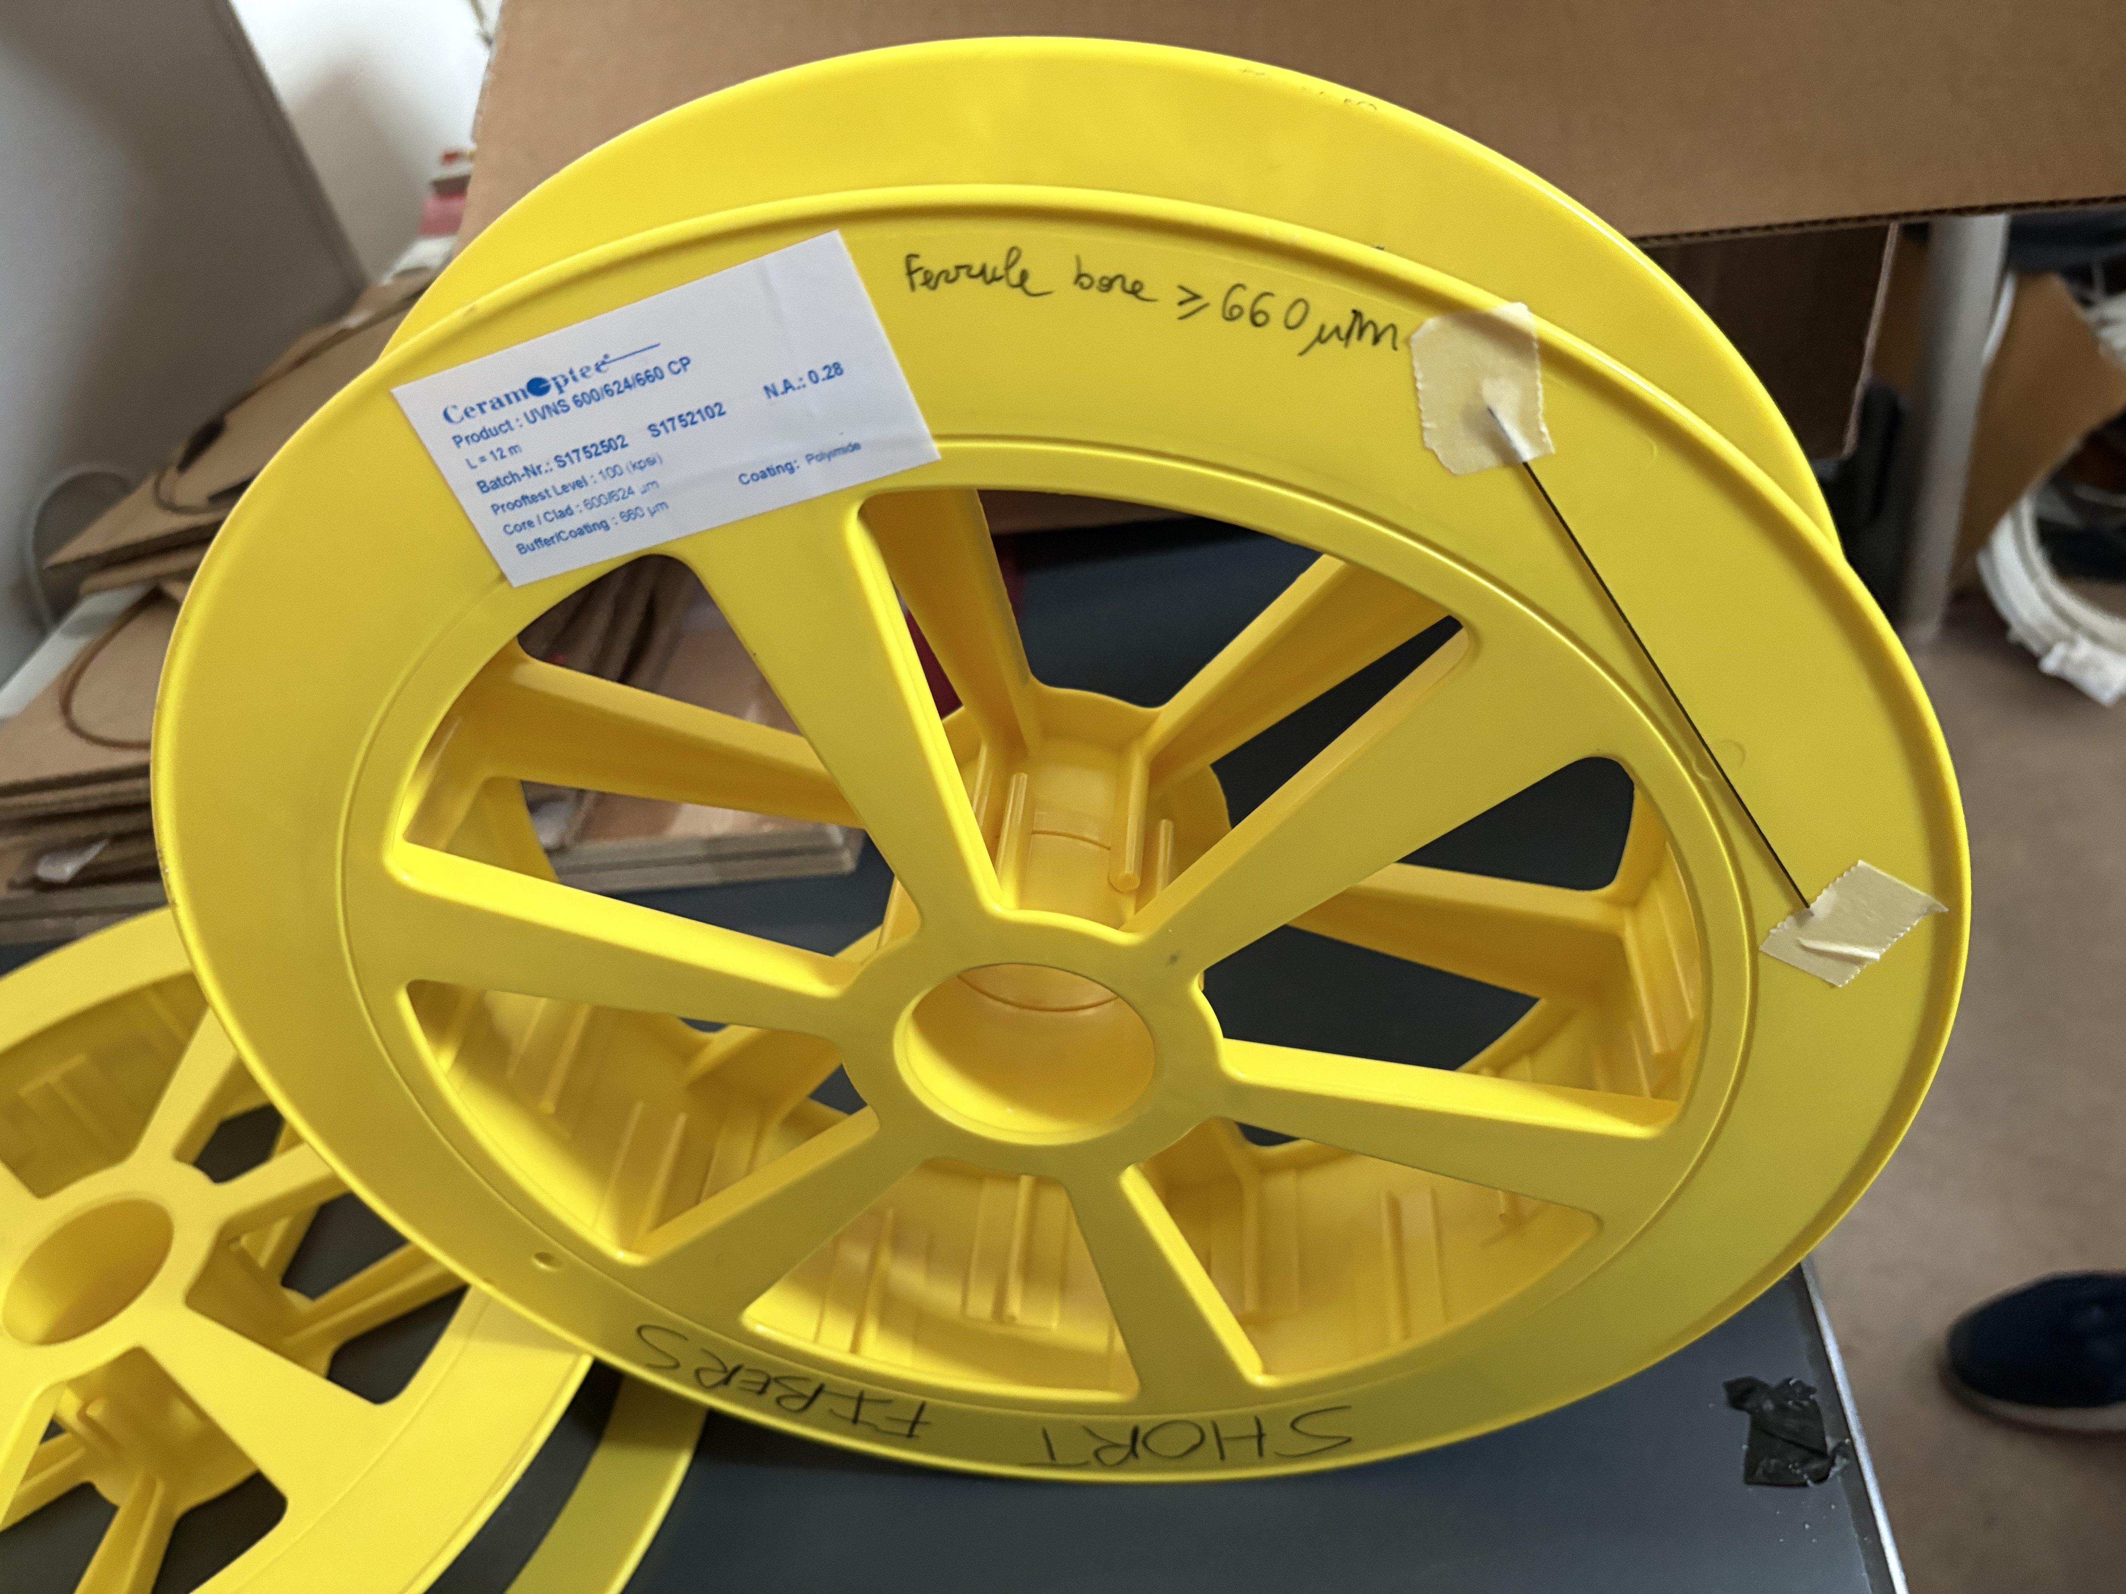
My Project
Performing laboratory measurement on the capabilities of different radiation-hard fibers to transmit light at different wavelengths
Help create a model for understanding the difference between these fibers
This prototype of the LUCID detector has the benefit of allowing the PMT’s to be far away from the IP
I hope to learn more skills for instrumentation and circuitry within a lab setting

Slide 7
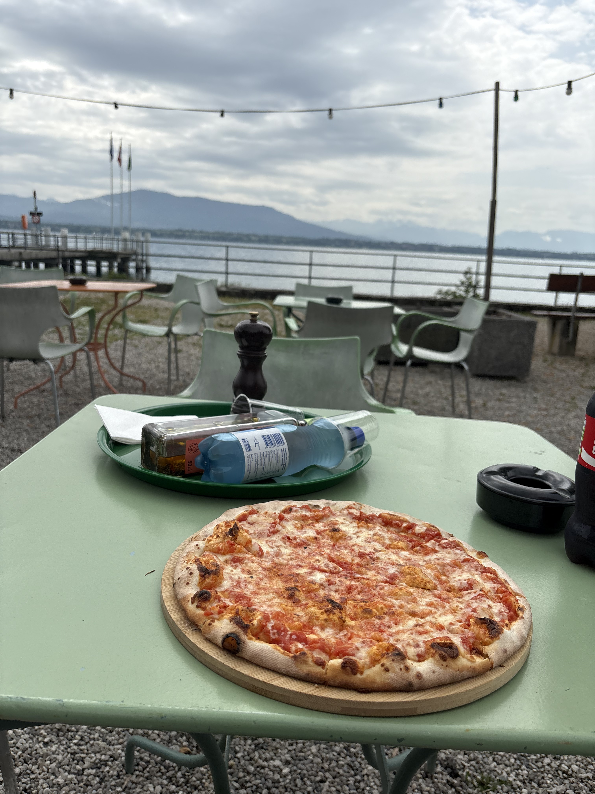
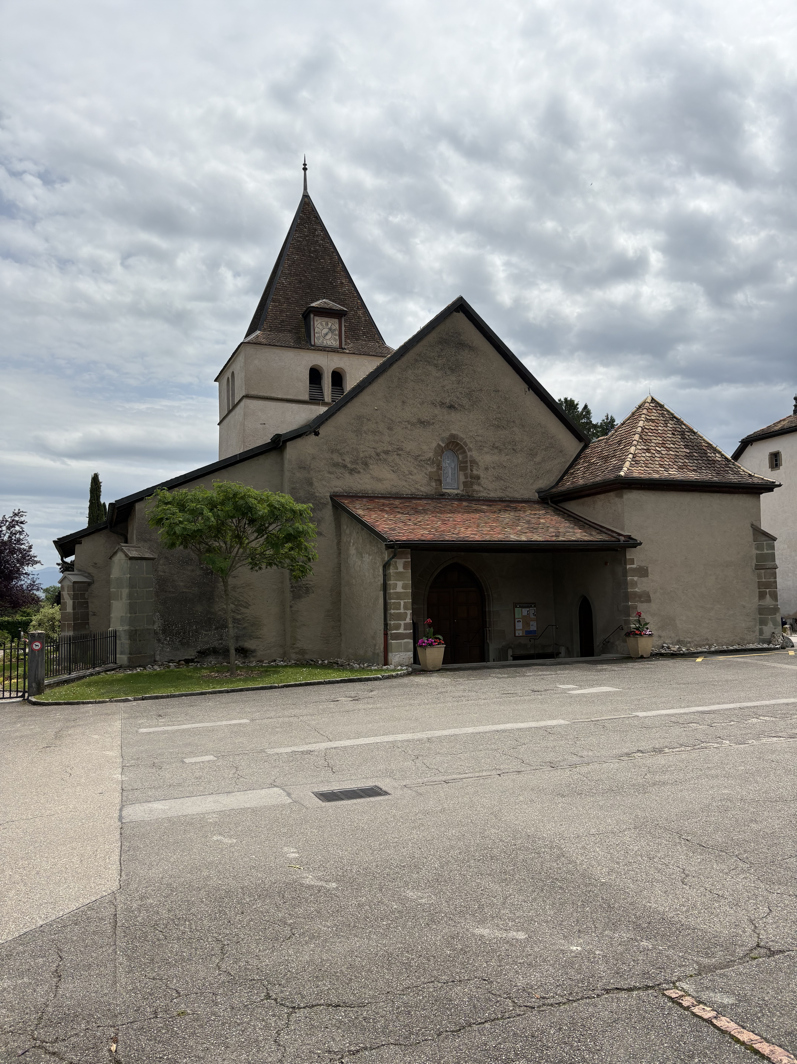
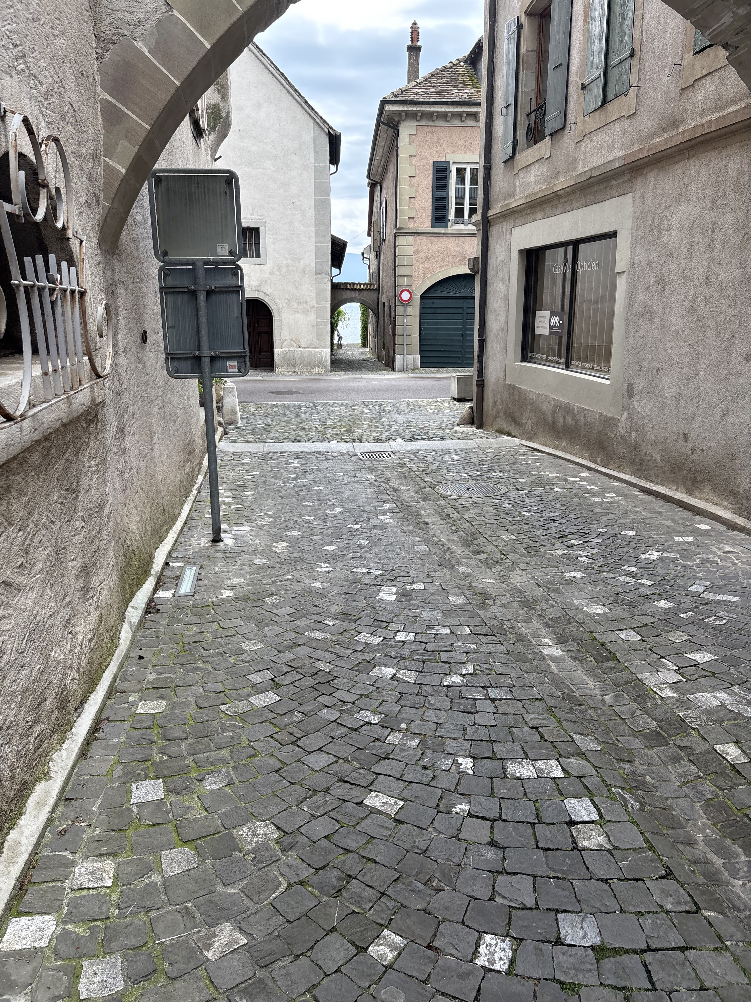
Places I’ve Visited

Slide 8
